Slide 1

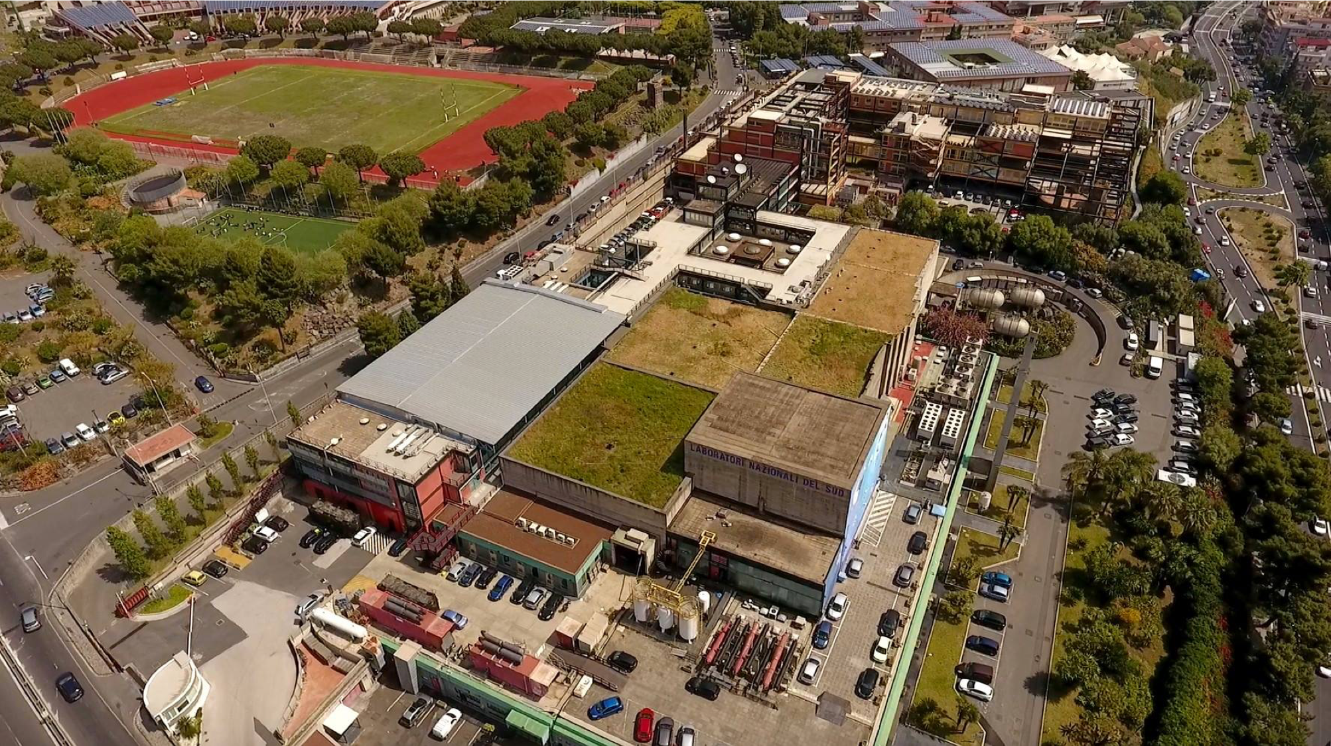
Contributo LNS
Gruppo di Lavoro per la preparazione della "European Strategy for Particle Physics 2025-2026"

Slide 2
European strategy for particle physics
LNS Contribution
1. Determination of neutrino mass and nature
2. Gravitational waves
3. Multimessenger physics
4. Dark Matter and Dark Sectors

Slide 3
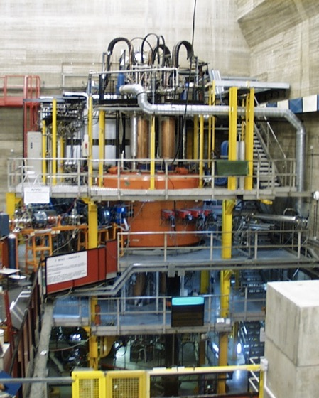
Neutrino Physics: Determination of neutrino mass and nature
Neutrinoless double-beta decay (0νββ) can exist only if neutrinos are Majorana particles
Its observation would prove that total lepton number is not conserved in physical phenomena and that could be linked to the cosmic asymmetry between matter and antimatter.
CS e MAGNEX crucial for the experimental challanges
Heavy-ion DCE as surrogate processes of 0νββ : same initial and final state
NME: transition probability of a nuclear process
Model-independent comparative information on the sensitivity of half-life experiments

Slide 4

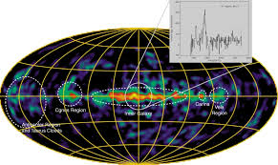
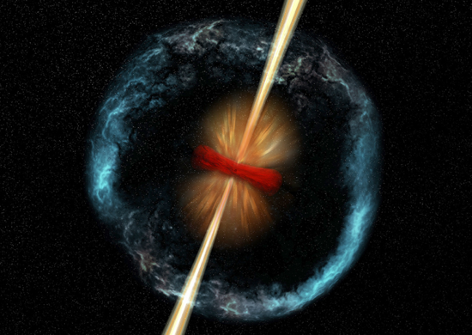
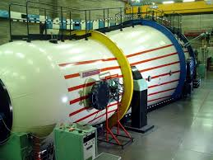
Cosmic Messengers: constraining the progenitors of the sources
ASFIN Collaboration
Study of progenitors of SN event which lead to compact objects (for instance, the chemical composition before explosion) → role of crucial reaction C-C burning, C-O burning, O-O burning
Nucleosynthesis of ²⁶Al: connected to the number of Galactic SN expected → estimate of black holes and neutron stars numbers
X-ray burst nucleosynthesis → constraining the physical and orbital properties of neutron stars, in particular the outer layers
Use of the LNS tandem accelerator
→ Role of long lifetime radioactive ion beams

Slide 5
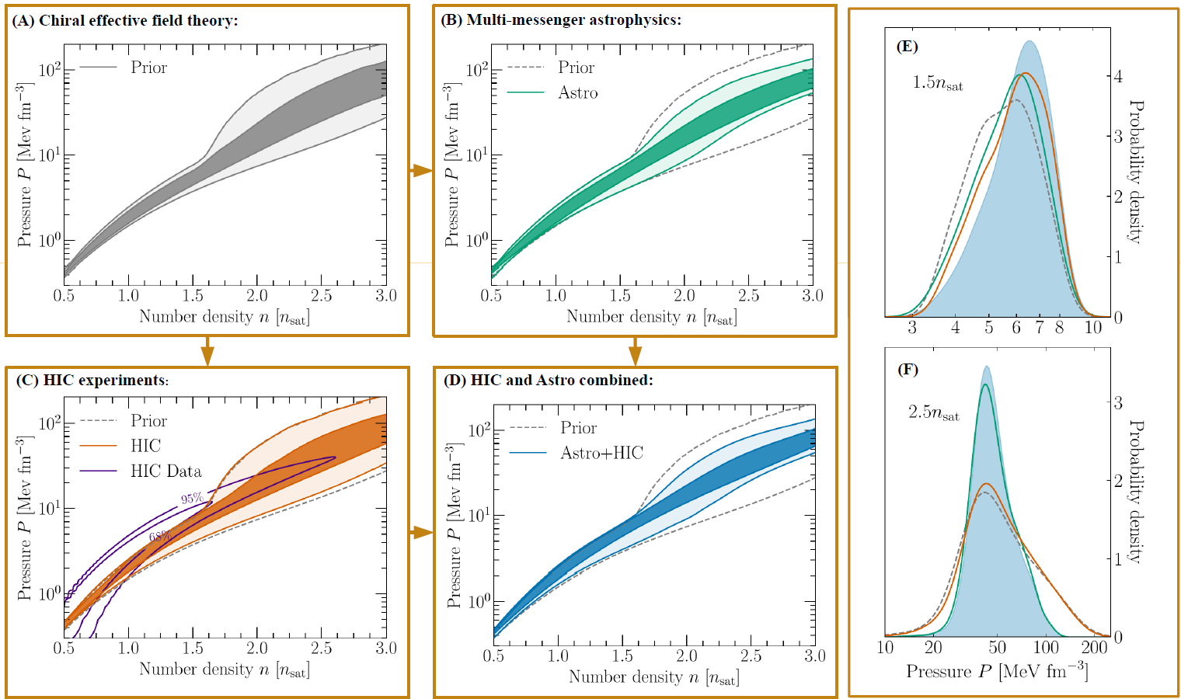
Cosmic Messengers: constraining the merger dynamics
CHIRONE
Combining Heavy-Ion Collisions (HIC) and astrophysical results to constrain neutron matter EOS
« HIC » = FOPI+ASY-EOS+AGS - « Astro » = GW, NICER (pulsar X-ray hot spots)
HIC data favors larger pressures at 1-1.5 ρ₀ with a clear impact on total posteriors at those densities;
but HIC(ASY-EOS) sensitivity is quite reduced above 1.5 ρ₀
Conclusion:
advancing HIC experiments to higher densities
Joint effort of EU and extra EU laboratories
GSI, LNS, GANIL, FRIB…
ASY-EOS I
P. Russotto et al.,
PRC 94, 034608 (2016)

Slide 6
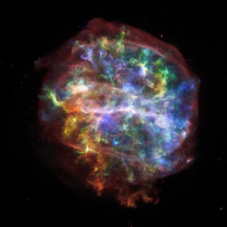
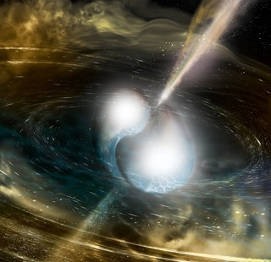
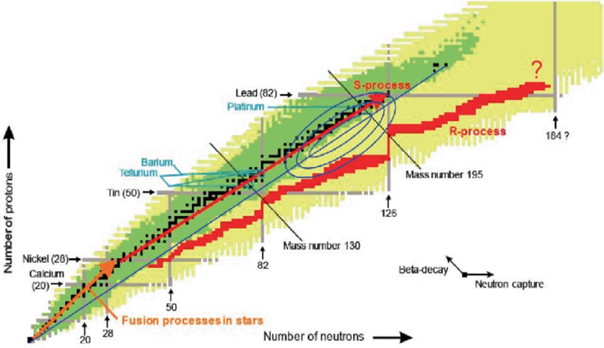
Cosmic Messengers: constraining the transient
Core collapse supernoave
Neutron star mergers
The rapid neutron capture process
(r-process)
Under those extreme neutron-rich conditions, atomic nuclei capture neutrons becoming increasingly heavy, with the reaction path running close to the neutron dripline
τ_{n} << τ_{b}
N_TOF @ CERN
Fission Recycling Cycles
Neutron-induced fission reactions play a fundamental role
New experimental data on actinides are required to produce more reliable r-process models
.
National Science Foundation/LIGO/Sonoma State University/A. Simonnet

Slide 7
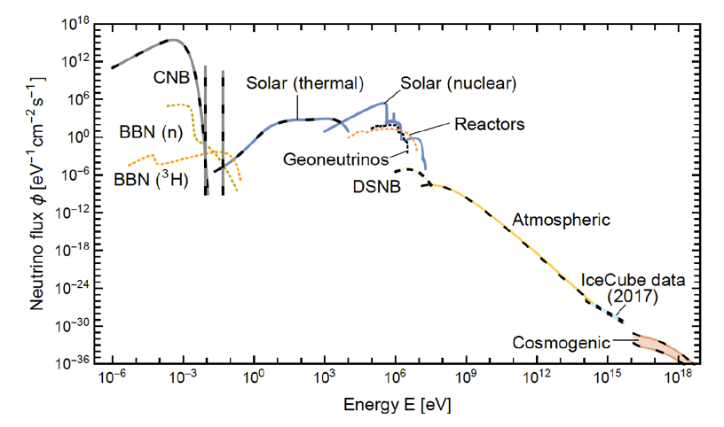
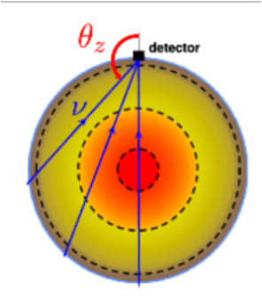
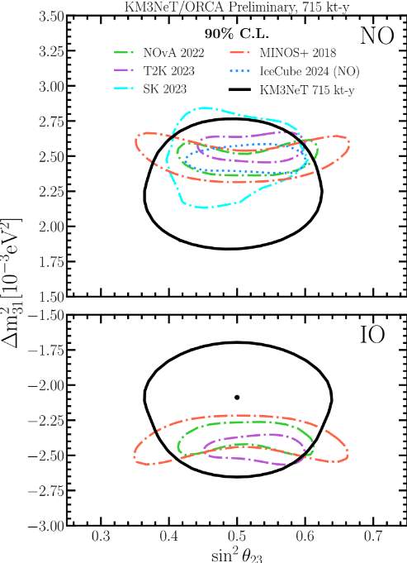
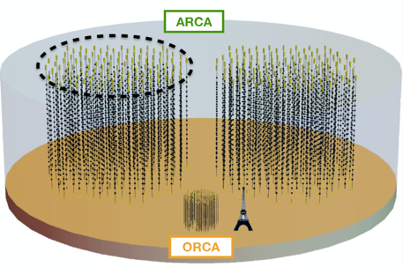
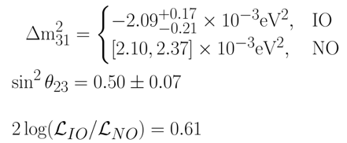
Determination of neutrino mass and nature
KM3NeT-ORCA
Neutrino Mass Ordering measuring atmospheric neutrinos crossing the Earth

Slide 8
Determination of neutrino mass and nature
DUNE
DUNE is a long baseline neutrino infrastructure and experiment
LNS is heavily committed in R&D and construction of several compnents of the near and far detector

Slide 9
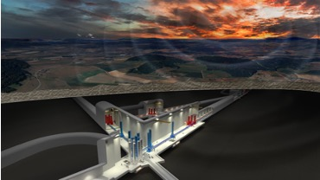
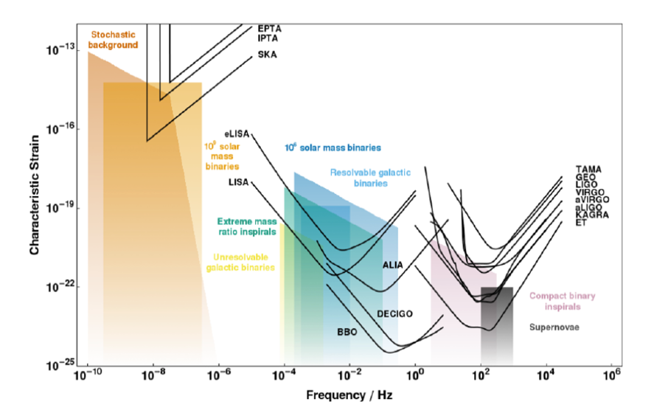
2. Gravitational waves
ET
LNS plays a crucial role in design and preparation of the infrastructure
Virgo: 20-2000 Hz
compact binary inspirals (BBH, BNS and BH-NS), supernovae and bursts.
O4 started!
Einstein telescope: 1-10000 Hz
Precision measurements AND new discoveries

Slide 10

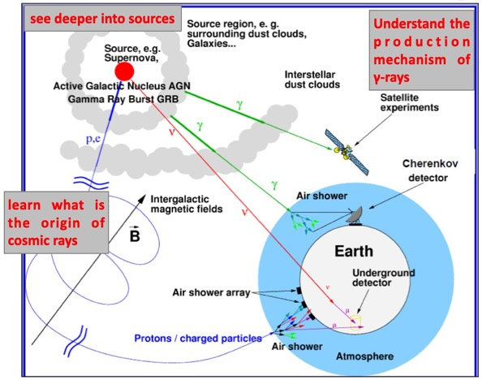
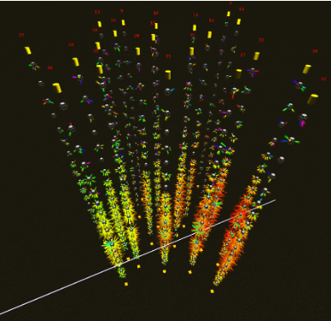
3. Multimessenger Physics
ET & KM3NeT-ARCA
KM3NeT ARCA is a high-energy (TeV-PeV) km3-scale neutrino telescope installed in deep Ionian sea. It is also a MeV SN anti neutrino detector
LNS manages the ARCA infrastructucte and it plays a leading role in detector construction, calibration and anlysis
KM3NeT actively monitors and analyses a variety of external triggers in real-time, including alerts due to IceCube neutrinos, Fermi/Swift GRB, HAWC gamma-ray transients, LIGO-Virgo-KAGRA gravitational waves, SNEWS neutrino alerts, and others
The >10 PeV neutrino Event

Slide 11
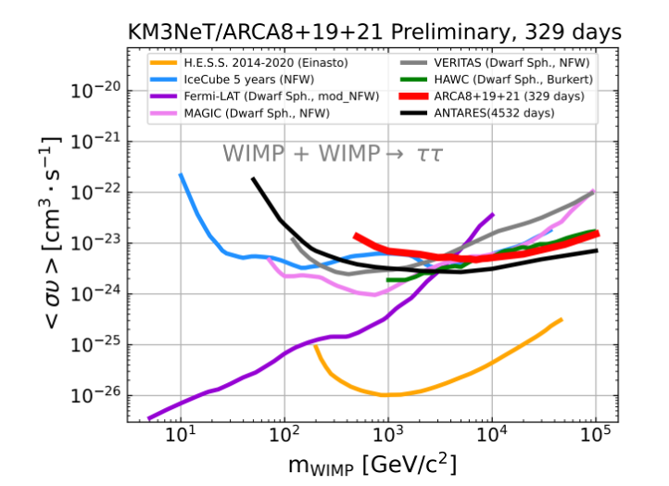
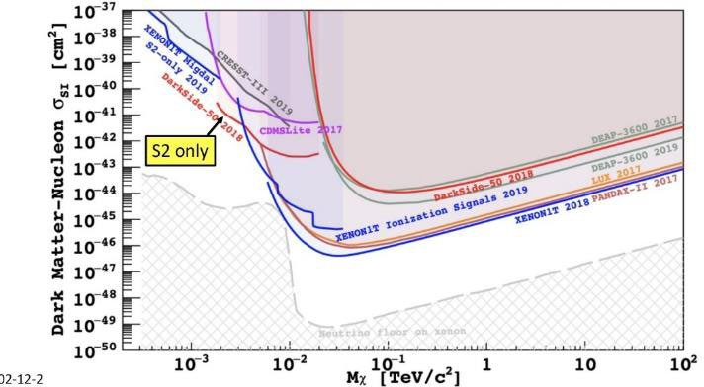
3. Dark Matter and Dark Sectors
KM3NeT and Darkside
LNS participates to the DarkSide-20k experiment (@LNGS). A liquid argon detector to detect low energy (< 100 keV) nuclear recoils produced by WIMP elastic scattering
LNS leads the ReD Activities, aiming to characterize the (poorly-known) response of the Ar detectors to very low energy recoils <1 keV → critical input for the search of low-mass WIMPs (< 10 GeV) by DarkSide
KM3NeT performs indirect search of Dark Matter from the Galctic centre, Sun and Earth

Slide 12


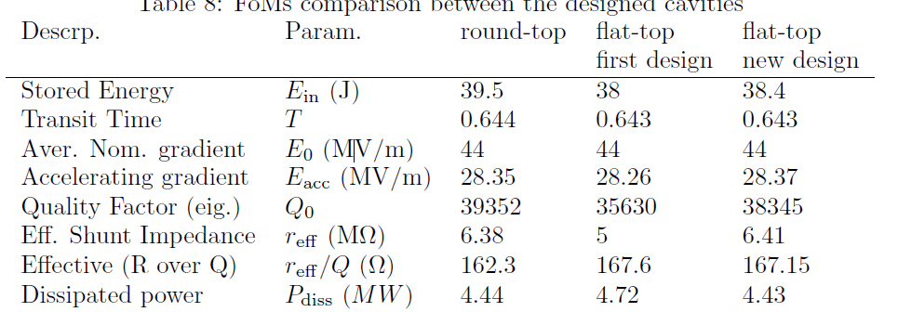
LNS contribution to MUON collider
Several cavity designs have been analyzed and results cross-checked with the other members of collaboration.

Slide 13
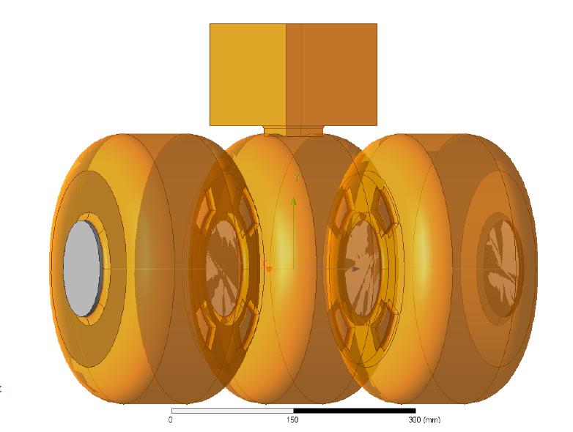
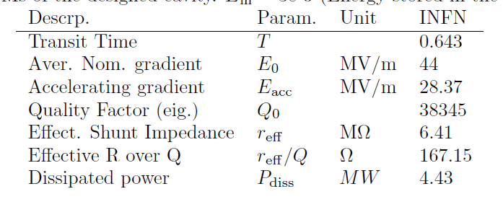
LNS contribution to MUON collider

