Slide 1
1
Maria Giovanna Dainotti
SNe Ia, BAO and GRB cosmology to tackle the Hubble constant tension
National Astronomical Observatory of Japan
Sokendai Advanced Studies
University of Nevada Las Vegas
23/05/2025, CosmoVerse, Naples

Slide 2
2
The Hubble constant and its tension
$${v=H}_{0}∙D$$
$H_{0}$ TENSION due to the evolution of its parameters or new physics?
HUBBLE’S LAW
Dainotti et al. 2023, Galaxies, vol. 10, issue 1, 24.
M. G. Dainotti, et al., 2021, ApJ, 912, 150.
~ 500 citations listed in top 1% papers in web of Science
Montani, Carlevaro, Dainotti, PDU, 44, 2024, 101486
Montani, Carlevaro, Dainotti, PDU, 480, 1847M
[[2501.11772] A New Master Supernovae Ia sample and the investigation of the $H_0$ tension] A New Master Supernovae Ia sample and the investigation of the $H_0$ tension (Dainotti, et al. JHEAP submitted)

Slide 3
Di Valentino, Said et al. 2025, PDU

Slide 4
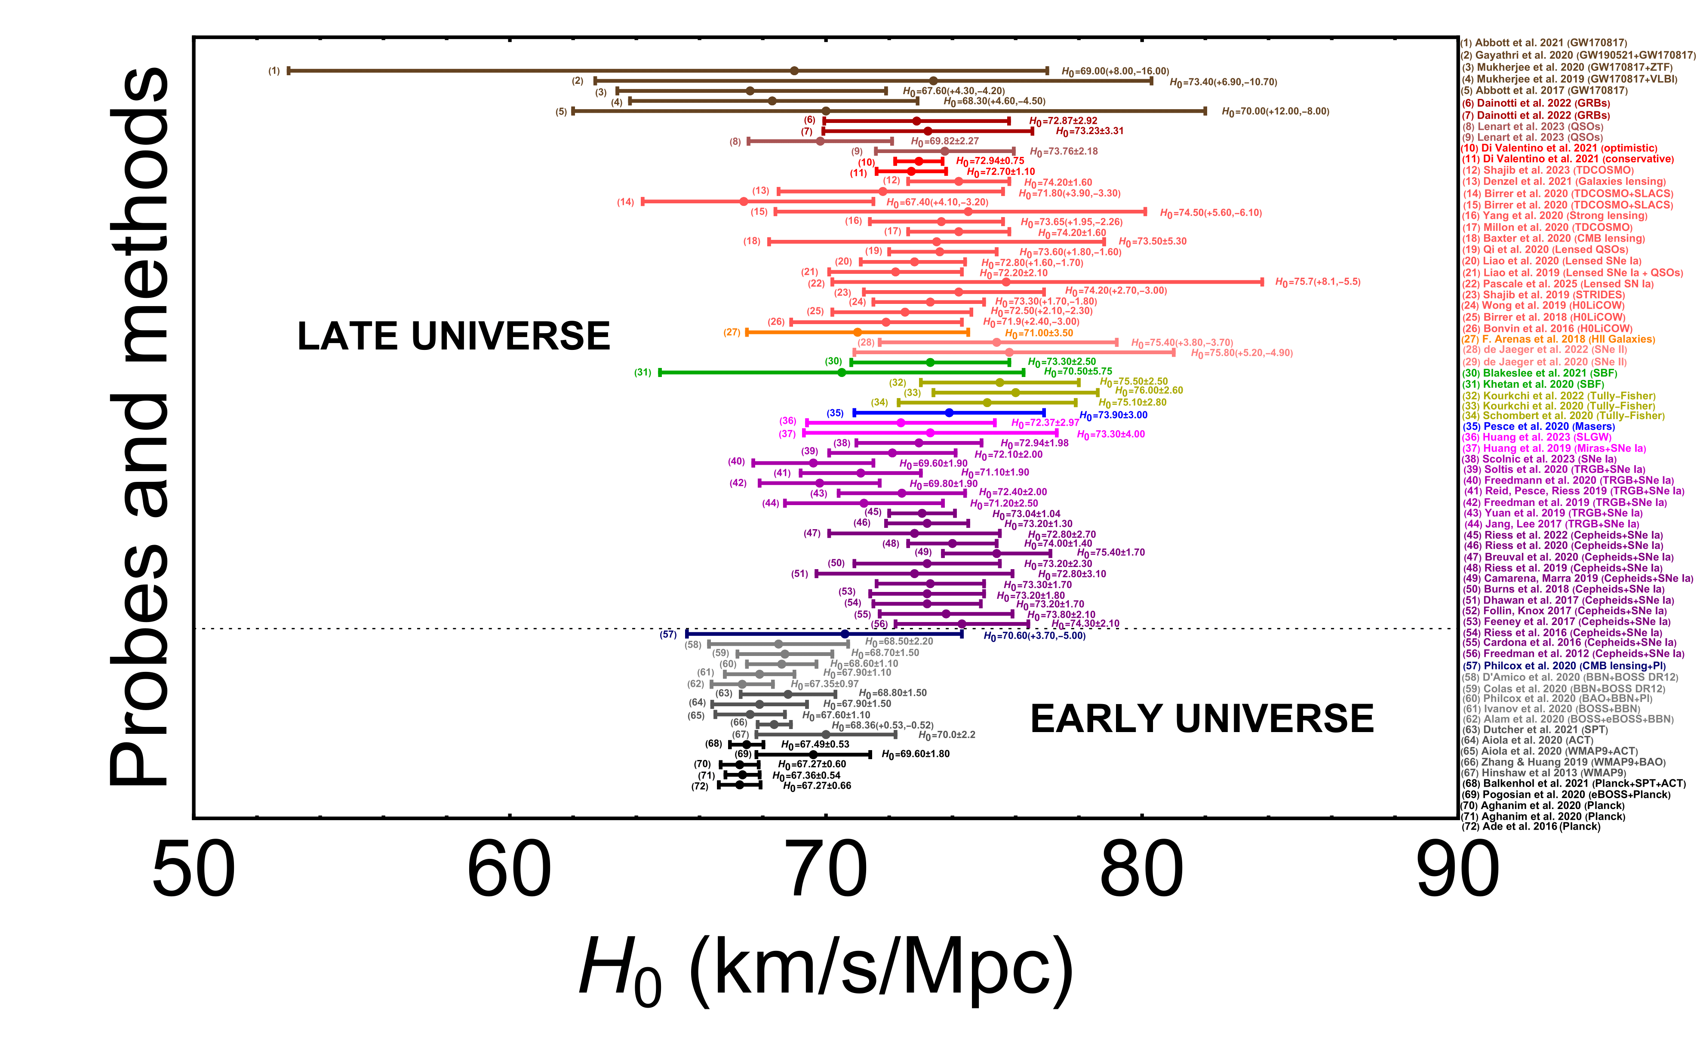
From M. G. Dainotti et al. 2025 (JHEAP submitted)
M. G. Dainotti, et al., 2021, ApJ, 912, 150

Slide 5
From the Philipp’s relation to the 3-parameter relation
4
The observed distance moduli of SNe Ia can be expressed through the modified Tripp formula (Scolnic et al. 2018):
Peak magnitude (B-band)
Absolute magnitude (B-band)
Stretch
Host galaxy mass correction
Color
Bias correction
M is the absolute magnitude of a reference SN (in B band) with stretch = 0 and color = 0
Because the devil is in the detail
M is degenerate with H0

Slide 6
9
Results for ΛCDM and wowaCDM model (3, 4 bins)
The $w_{0}w_{a}$CDM model results are compatible with the ΛCDM ones
The evolution of the Ho is similar to the evolution of the MB parameter
(L. Kazantzidis and L. Perivolaropoulos
Phys. Rev. D 102, 023520)
M. G. Dainotti, et al., 2021, ApJ, 912, 150

Slide 7
11
Extrapolation at z=1100
Results for ΛCDM model (3, 4 20, 40 bins)
Dainotti, et al., 2021, ApJ, 912, 150
Extrapolating $H_{0}$ at $z=1100$ $H_{0}$ is compatible in 1 $σ$ with the $H_{0}$ CMB measurement.
By accounting for this evolution, we have 1.88 sigma tension < 2 sigma

Slide 8
12
w0waCDM model results (3, 4 20, 40 bins)
Calibrating the $M$ value of $μ_{obs}$ such that locally (namely, in the first bin) $H_{0}=73.5 km/s/Mpc$
Values compatible in 1 σ with the Planck CMB value
M. G. Dainotti, et al., 2021, ApJ, 912, 150
On the Hubble constant tension in the SNe Ia Pantheon sample

Slide 9
14
$Continuing with$BAOs
$H_{0}\left(z\right)$ fitting (3 bins $Λ$𝐶𝐷𝑀) + BAOs
M.G. Dainotti, et al., 2022, Galaxies, 10, 1, 24
M.G. Dainotti, et al., 2022, Galaxies, 10, 1, 24
Varying $H_{0}$ and $Ω_{0m}$

Slide 10
15
$H_{0}\left(z\right)$ fitting (3 bins $w_{0}w_{a}$𝐶𝐷𝑀) + BAOs
Varying $H_{0}$ and $w_{a}$
M.G. Dainotti, et al., 2022, Galaxies, 10, 1, 24
M.G. Dainotti, et al., 2022, Galaxies, 10, 1, 24

Slide 11
16
Results due to:
DIFFERENT THEORETICAL FRAMEWORKS
ASTROPHYSICAL BIASES OR SELECTION EFFECTS
MODIFIED GRAVITY SCENARIO, $G=G\left(z\right)$ -> IN MODIFIED THEORIES THERE IS A VARIATION OF THE G CONSTANT (ex. $f(R)$ THEORIES, HU-SAWICKI MODEL)
THE HU-SAWICKI MODEL WITH VARYING $Ω_{0m}$ is not an a successful model.
New Theories are needed: slow rolling?

Slide 12
New Analysis with a combination of sample: The Master sample
17
Pantheon, PantheonPlus, JLA, and DES: 3789 SNe Ia.
Duplicate entries removed by assigning priority to catalogs in the following order: DES, PantheonPlus, ,Pantheon and JLA.
The order priority chosen for comparison with the DES sample
Two binning techniques: equi-populated, equi-spacing and moving window
Paper is now arxive: [2501.11772] A New Master Supernovae Ia sample and the investigation of the $H_0$ tension
Do you have a sample of SNe Ia that you have and you wish to add?

Slide 13
18
Results
Fitting $ℋ_{0}(z)$
Checking the $\frac{α}{σ_{α}}$
Is $\frac{α}{σ_{α}}>1$?
NO
Skip
YES
Is $ℋ_{0}(z=1100)$ compatible in $1σ$ with $H_{0,CMB}$?
Diamond
YES
NO
Gold
M. G. Dainotti, et al., 2021, ApJ, 912, 150

Slide 14
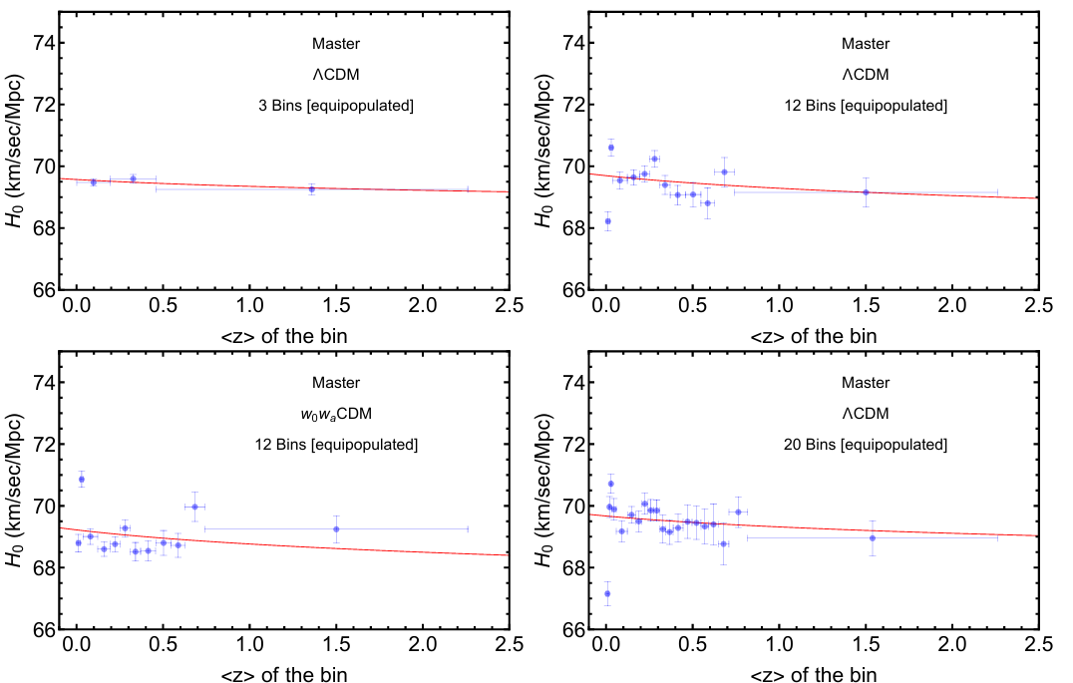
21
Results: Master Sample
M. G. Dainotti, et al., 2021, ApJ, 912, 150

Slide 15
22
SNe Ia ANALYSIS: POSSIBLE ASTROPHYSICAL EFFECTS
EVOLUTIONARY EFFECTS ON THE OBSERVABLES LIKE COLOR, STRETCH AND MASS CORRECTION OR STATISTICAL FLUCTUATIONS OR EVEN HIDDEN BIASES ?
NICOLAS ET AL. 2021 → STRETCH EVOLVES WITH REDSHIFT AND THIS MAY EXPLAIN OUR OBSERVED TREND.
NEW DATA confirms this trend
Wojtak et al. 2023, MNRAS, 525, 4 → 2 populations regarding the stretch and a clear trend of Hubble residuals increasing with the colour parameter.
Asymmetric distribution
N. Nicolas, et al., 2021, A&A, 649, A74
SN Ia redshift distribution → a long (≳1 h⁻¹ Gyr) mean delay time between the formation of a stellar population and the explosion of some of its members as SNe Ia (Avishay & Maoz 2004).

Slide 16
Are you ready to look at the tension from another perspective?
23

Slide 17
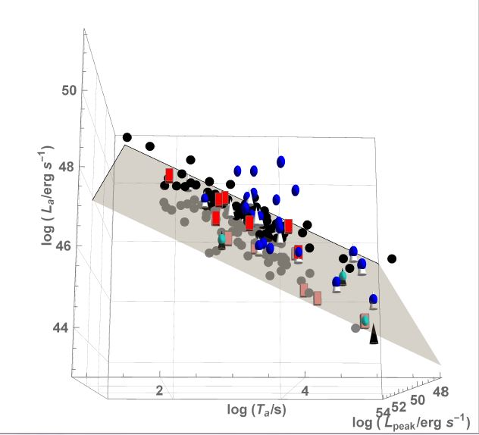
24
THE extension of the LX-Ta and LX-Lpeak correlations Given theIR intrinsic nature
Press release by NASA and press conference at the AAS June 2016:
https://swift.gsfc.nasa.gov/news/2016/grbs_std_candles.html
Mention in Scientific American, Stanford highlight of 2016, INAF Blogs, UNAM gaceta, and many online newspapers took the news.
M. G. Dainotti, S. Postnikov, X. Hernandez, M. Ostrowski, 2016, ApJL, 825L, 20
the 3D Lpeak-Lx-Ta correlation is intrinsic and it has a reduced scatter, σint of 24 %.
Short
X-ray Flashes
Long
GRB-SNe

Slide 18
Similarly to SNe Ia the GRB fundamental plane relation
Dainotti et al. 2020, ApJ, 904, issue 2, 97, 13
$$μ_{th}^{(GRB)}\left(z,H_{0},…\right)=5∗\log_{10}\left( \frac{d_{L}\left(z.H_{0},…\right)}{10pc} \right)+25$$
Kx, Kpeak= the k-correction for the plateau and peak prompt luminosity

Slide 19
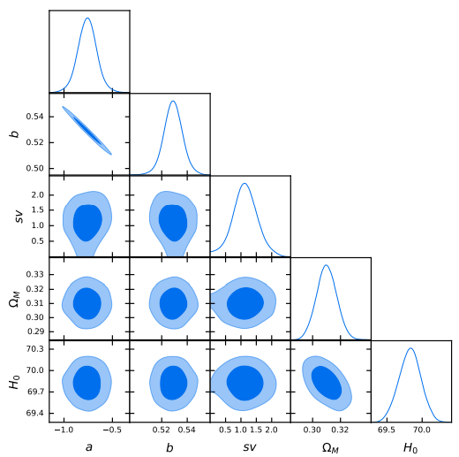
Combining GRBs + SNe Ia + BAO
Are you ready to look at the tension with high-z probes?
28
“The Gamma-ray Bursts fundamental plane correlation as a cosmological tool”,Dainotti M.G. et al. 2023, MNRAS, 518, 2.
compatibility with standard
cosmological model
Simultaneous fitting
But let’s take one step back

Slide 20
We strive to reach precision cosmology
24
BUT
What about the assumptions of the likelihood?
Common assumption: Gaussian likelihood of the SNe Ia, BAO, Quasars and GRBs.
Are all this valid?

Slide 21
NO! SNe Ia, BAO and QSOs do not fulfill. Only GRBs fulfil the Gaussianity assumptions the Gaussian likelihoods. Starting with SNe Ia
25
Dainotti, M.G., Bargiacchi, G., Bogdan M., Capozziello, S. and Nagataki S, ”Reduced uncertainties up to 43% on the Hubble constant and the matter density with the SNe Ia with a new statistical analysis”, JHEAP, 41, 30-41.

Slide 22
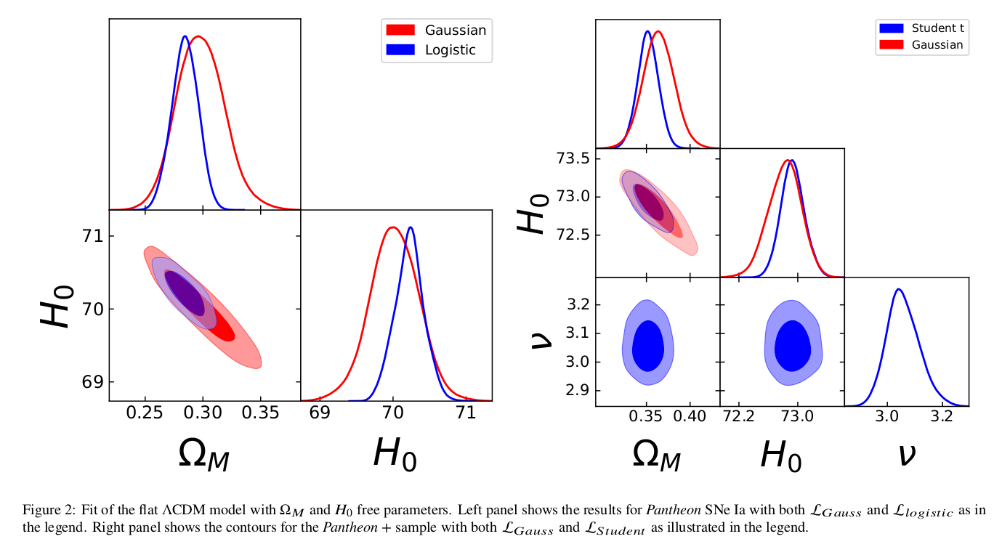
The two different Cosmological analysis
26

Slide 23
Results on Ω𝑀 and 𝐻0 within a flat ΛCDM model
27
Both Ω𝑀 and 𝐻0 are free parameters,
The L𝑙𝑜𝑔𝑖𝑠𝑡𝑖𝑐 for the Pantheon
L𝑆𝑡𝑢𝑑𝑒𝑛𝑡 for the Pantheon +
significantly reduce the uncertainties on both parameters.
L𝑙𝑜𝑔𝑖𝑠𝑡𝑖𝑐 on Ω𝑀 by 43% (from 0.021 to 0.012) and 41% (from 0.34 to 0.20) for H0, respectively,
L𝑆𝑡𝑢𝑑𝑒𝑛𝑡 by 42% (from 0.019 to 0.011) for Ω𝑀 and 33% (from 0.24 to 0.16) for H0.

Slide 24
New statistics: Non-Gaussianity likelihoods for SNe Ia and QSOs -> reduced uncertainties
30
In All configurations we have reduction of the scatter on all parameters
Dainotti et al. 2023 2303.06974.pdf (arxiv.org)
Bargiacchi, Dainotti,..Nagataki.. et al. 2023, MNRAS, 521, 3909
Dainotti et al. 2023, .. B. Zhang, N. Fraija, ApJS, 2023arXiv230510030D, 951, 63, press release from NAOJ
Lenart et al. 2023,
H0 central values are higher when probes are combined together → 73!

Slide 25
How many GRBs with optical plateaus are needed to achieve the SNe Ia precision?
25
When?
How?
67
With Machine learning (ML), errors on the parameters halved (n=2), and Lightcurve reconstruction (LCR)
Conley et al. 2011 precision σΩM =0.10
Now
134
Betoule et al. 2014 precision σΩM =0.042
2026
390
Scolnic et al. 2018 precision σΩM =0.022
2042
M. G. Dainotti, Nielson, V.; Sarracino, G.; Rinaldi, E.; Nagataki, S.; Capozziello, S.; Gnedin, O. Y.; Bargiacchi, G.
2022, MNRAS, 514, 2, 1828-1856

Slide 26
36
What else do we need for GRB cosmology?
Increase the sample size, having a cosmology independent approach via low-z probes
New or tighter Reliable correlations
Physical interpretation, connection with theory
In the quest for the standard set
How?

Slide 27
With machine learning
37
For redshift inference, regression:
1) Dainotti, Narendra, al. 2021, ApJ,920, 2, 118.
2) Narendra, Gibson, Dainotti, et al. 2022, ApJS, 259, 2, 55.
3) Gibson, Narendra, Dainotti, et al. 2022, Frontiers, 9, 836215
4) Dainotti, ApJS, 267, 2, id 42, Lightcurve Reconstruction,
5) Dainotti et al. 2024, Inferring the Redshift of More than 150 GRBs with a Machine-learning Ensemble Model, ApJS, 271, 1, id.22, 15.
6) Dainotti, Narendra et al. 2024, ApJL, 967L,30D, press from UNLV and Facebook post from Swift, Cosmic Leap: NASA Swift Satellite and AI Unravel the Distance of the Farthest Gamma-Ray Bursts | University of Nevada, Las Vegas (unlv.edu); (20+) Facebook
7) Dainotti, et al. 2022, MNRAS, 514, 2, 1828-1856 (forecasts for GRB cosmology) (details will be given at CosmoVerse in Instanbul!)

Slide 28
What else can we do?
32

Slide 29
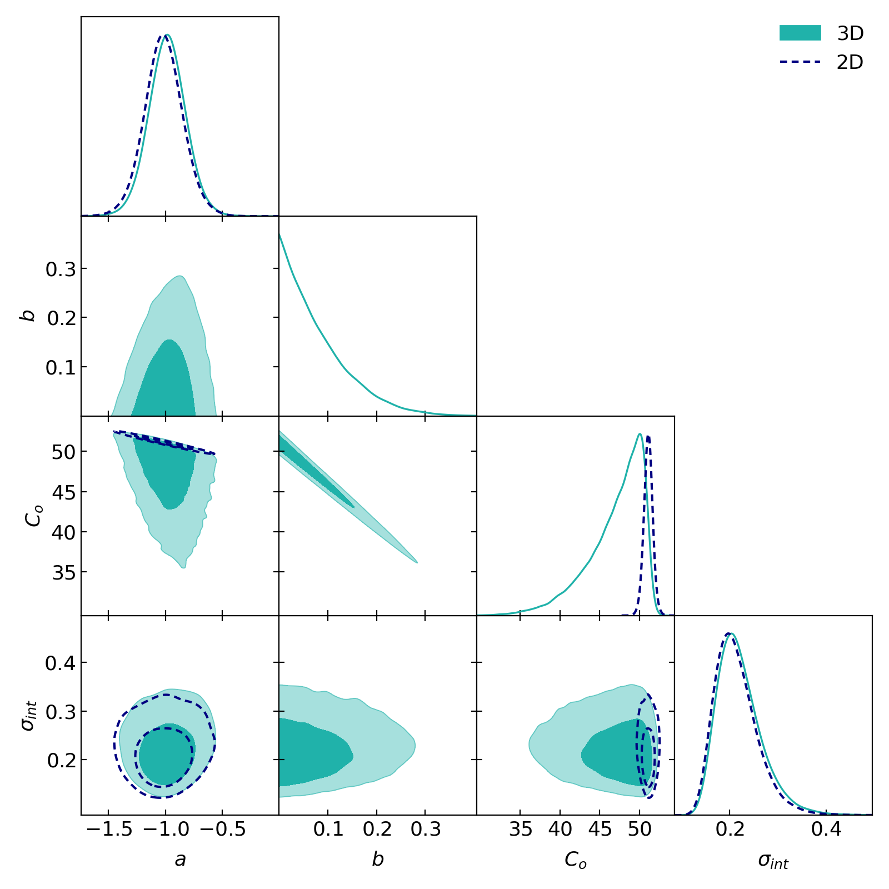
Besides the simultaneous fitting, we use the CCH as calibrators for the fundamental plane correlations
35
Favale, Dainotti, Gomez, Migliaccio , JHEAP
With evolutionary effects we have
This is comparable with the fundamental plane relation
σ=0.18 +/0.09
Currently the Epeak-Eiso correlation has a scatter of 0.20 (Amati et al. 2022), but depending on the sample size reaches 0.55 (Liu et al. 2022, Liang et al. 2022, Li et al. 2023)
Thus, we have consistently reached the smallest scatter for the GRB relations in the literature with this sample

Slide 30
How many GRBs with optical plateaus are needed to achieve the SNe Ia precision?
38
When?
How?
67
With Machine learning (ML), errors on the parameters halved (n=2), and Lightcurve reconstruction (LCR)
Conley et al. 2011 precision σΩM =0.10
2022
134
Betoule et al. 2014 precision σΩM =0.042
2026
390
Scolnic et al. 2018 precision σΩM =0.022
2042
Forecast including Swift, SVOM and Theseus (Einstein Probe data yet to be added)
So, we should not wait 18 years!
M. G. Dainotti, et al. 2022, MNRAS, 514, 2, 1828-1856

Slide 31
The story of GRB cosmology does not end here, it is just the beginning…
46
Analyzing the impact of the BAO from DESI Collaboration
Leveraging the constraints from the SH0ES SNe Ia (Riess et al. 2022)
For the GRB sample increase we built the largest optical catalog to date (Dainotti et al., MNRAS, 533, 4023, 53 coauthors)
Improve the GRB redshift prediction and LC reconstruction with Machine learning to reduce the number of years (ask me if you need data from reconstructed lightcurves)
We continue the theoretical discussion: a given subset of GRBs fulfilling the magnetars or BH can be standardizable candle (Lenart et al. 2025, JHEAP, 4700384L and interview in National Geographic Polska).

Slide 32
What are the next step?
39
And the party still continues…
Use data from Einstein Probe
Extend the distance ladder with CCH which entails a model independent approach at high-z possibly with the use of GRBs for which the redshift is inferred
Continue Combine GRBs with other probes which are treated similarly as GRBs and look for a standard set of QSOs to tighten the existing relations
We already did in..
“Quasars: Standard Candles up to z= 7.5 with the Precision of Supernovae Ia” by Dainotti et al. ApJ, 950(1), id.45, 8 pp. (2023), ArXiv:2305.19668
The scavenger hunt for Quasar samples to be used as cosmological tools
Dainotti, M.G., et al. Galaxies, 12, (1), id.4 (2024), ArXiv:2401.11998
“A new binning method to choose a standard set of Quasars”,
Dainotti, et al. Physics of the Dark Universe, Vol. 44, 101428, doi.org/10.1016/j.dark.2024.101428,https://arxiv.org/abs/2401.12847.
Some tension in ΩM also in QSOs? Yes…

Slide 33
Thank you very much for your attention

