Slide 1
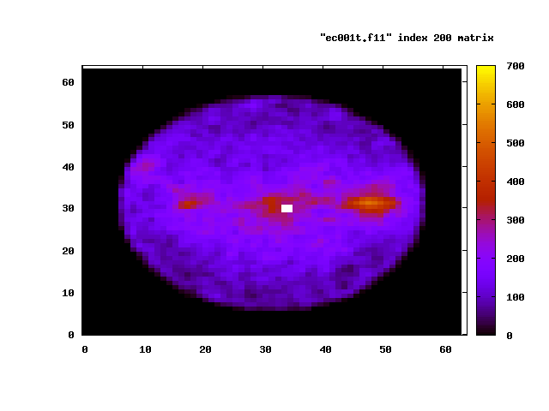
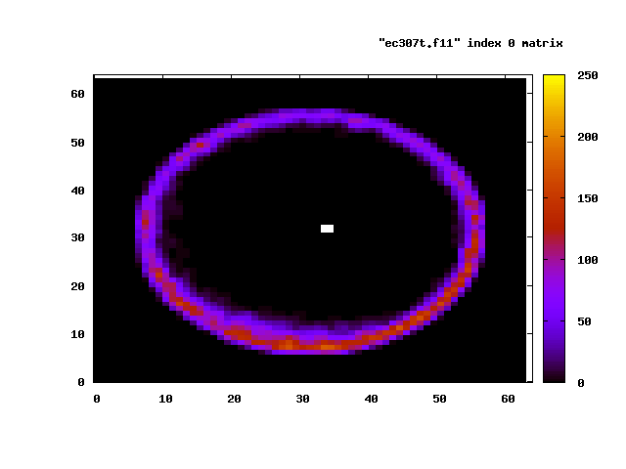
Drift Solenoid
Electron distribution and Coupled bunch motion
White point: beam position passing through the chamber cross-section

