Slide 1
Simulation of electron-cloud heat load for the cold arcs of the LHC
ECLOUD’12 Workshop
5 – 8 June 2012 – La Biodola, Isola d’Elba, Italy
Thanks to F. Zimmermann and G. Iadarola
Humberto Maury Cuna
CINVESTAV/CERN
June 6th, 2012

Slide 2
Outline
Introduction:
What an electron cloud is?
Electron cloud effects
Electron Cloud Simulations
Methodology
Results
What information can we obtain from the simulations?
What is the utility of such information?

Slide 3
Introduction
The electron cloud (EC) is a set of electrons produced inside the beam pipe due to residual gas ionization or photoemission when the beam-induced synchrotron radiation hits the surface of the beam pipe.
Electron cloud effects:
Beam instabilities
Pressure increase
Heat load
How is produced the EC build-up?

Slide 4
Electron Cloud Simulations
The EC simulation includes the electric field of the beam, arbitrary magnetic fields, the electron space charge field, and image charges.
As input numbers, the code requires various beam parameters, surface properties, the vacuum chamber geometry and the type of magnetic field
Low-energy electron reflectivity (R):
it designates the probability for an elastic reflection of an electron hitting the wall in the limit of zero primary energy.
SEY = $\frac{Number of secondary electrons}{incident electron}$

Slide 5
Simulations Methodology
Parameter | 450 GeV | 4 TeV | 7 TeV
Bunch intensity | 1.15x10¹¹ p/b | 1.15x10¹¹ p/b | 1.15x 10¹¹ p/b
RMS bunch length | 11.8 cm | 9 cm | 7.55 cm
Bunch spacing | 50 ns | 50 ns | 25 ns
Transverse normalized emittance | 2 µm rad | 2.5 µm rad | 3.75 µm rad
Pressure | 32 nTorr | --- | ---
All the simulations were performed for a bending section using the recently developed electron-cloud simulation code: PyECLOUD (see G. Iadarola´s talk).
We assumed a Gaussian bunch profile.

Slide 6
Electron Cloud Simulations
Filling pattern:
for 50-ns bunch spacing we considered the actual filling pattern used in operation, with 1380 bunches per beam. The details of this filling pattern are described in LHC filling schemes website: http://lpc.web.cern.ch/lpc/documents/FillPatterns/50ns_1380b_1331_0_1320_144bpi12inj.txt
For the case of 25 ns, we took the nominal LHC filling pattern with 2808 bunches per beam LHC Project Note No. LHC-Project Note 323_Revised (2003).
SEY scan from 1.1 to 2.0
R scan from 0.3 to 1.0

Slide 7
Results
Simulated heat load values for a dipole section at 450 GeV and 50-ns bunch spacing.

Slide 8
Results
Simulated heat load values for a dipole section at 4 TeV and 50-ns bunch spacing.

Slide 9
Results
Simulated heat load values for a dipole section at 7 TeV and 25-ns bunch spacing.

Slide 10
Results

Slide 11
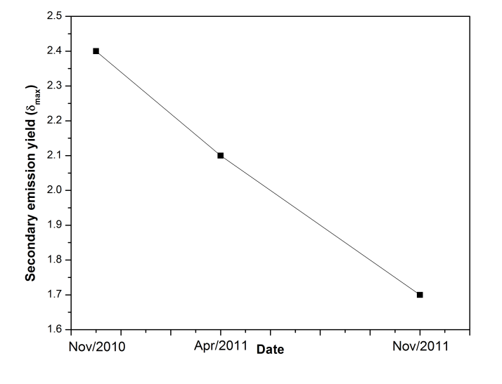
Results
Evolution of δmax for the LHC arc chamber during the 2011 LHC run as inferred from benchmarking heat-load simulations (ECLOUD) and measurements at 25-ns and 50-ns bunch spacing, assuming a low-energy electron reflectivity R = 0.5.

Slide 12
Conclusions
For the nominal LHC operation scheme with 25-ns bunch spacing at top energy, the maximum secondary-emission yield should be below 1.4 in order to reach the nominal bunch intensity with acceptable heat load.
For the current operational mode of the LHC the calculations at 50-ns bunch spacing show acceptable heat load values for all combinations of δ_{max} and R.
The simulated heat-load values can be compared with measured heat-load data for 50-ns and 25-ns bunch spacing in order to estimate the actual surface parameters (especially δ_{max}) for the LHC and their evolution in time.
0.5 < R < 0.7?

Slide 13
Acknowledgements
Frank Zimmermann
Giovanni Iadarola
Giovanni Rumolo
Octavio Dominguez
Chandra Bhat
Silvano Roubatel

Slide 14
Thank you for your attention
Questions???

