Slide 1
Benchmarking Headtail with e-cloud observations with LHC 25ns beam
H. Bartosik, W. Höfle, G. Iadarola, Y. Papaphilippou, G. Rumolo

Slide 2
Outline
Part I
Observations with 25ns beams in LHC and estimation of δ_{max} in the LHC arcs
Reproducing machine observations with HEADTAIL simulations
Part II
Dependence on distribution of electron cloud
Dependence of instability onset on build-up parameters
Part III
Comparison of simulations with beam observations with large chromaticity

Slide 3
Scrubbing history of the LHC arcs
26/08: 48 bunches with Q’≈2
G. Iadarola and G. Rumolo (Chamonix 2012)
24 bunches
Up to 288 bunches
Injected (with Q’>15)
δ_{max}≈2.1

Slide 4
Observations with 25ns beam in the LHC
June 29th: 24 bunches: strong emittance growth, but no instability
August 26th: 48 bunches on beam 2 with 1e11p/b and standard chromaticity (Q’_{x}≈Q’_{y}≈2)
Injection with transverse damper → dumped after ~1000 turns (beam excursion)
Injection without transverse damper → dumped after ~500 turns (fast beam loss)
Further MDs in October: up to 288 bunches injected
high chromaticity (Q’_{x}≈Q’_{y}≈15) needed for stabilizing the beam
Clear signature of electron cloud effects: pressure rise, heat load, emittance growth along the bunch train, losses …
Suitable to benchmark simulation
codes
Losses vs. time
~ 150 turns

Slide 5
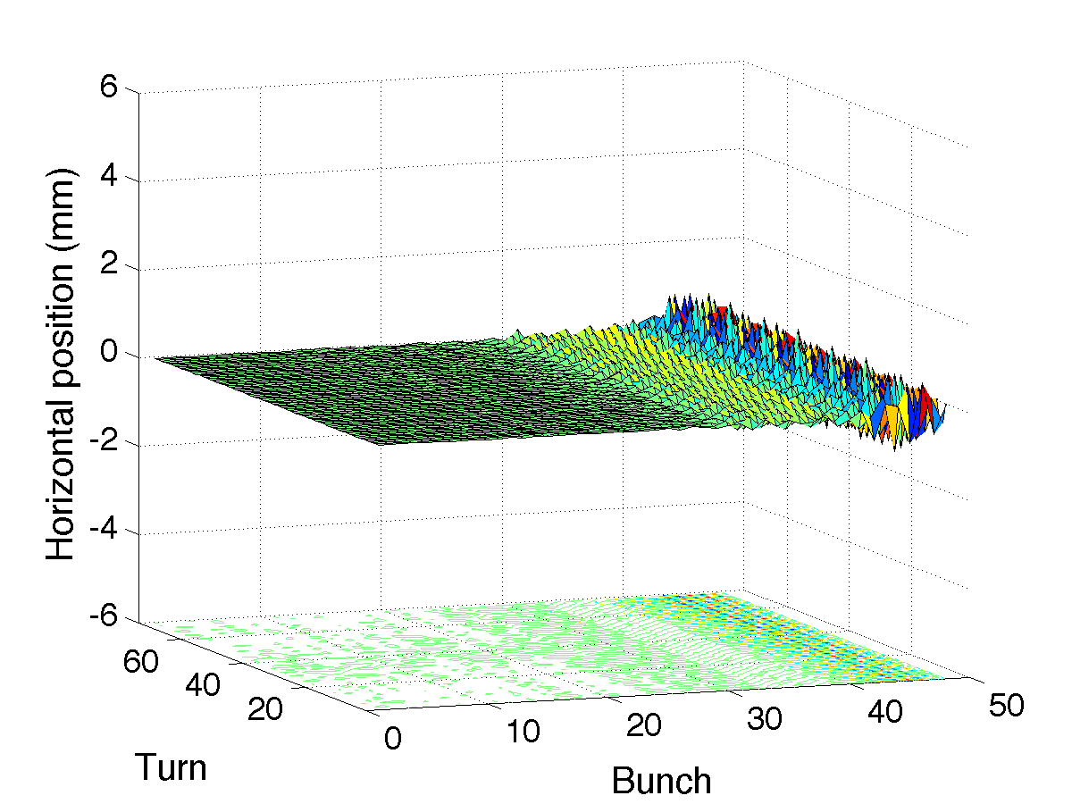
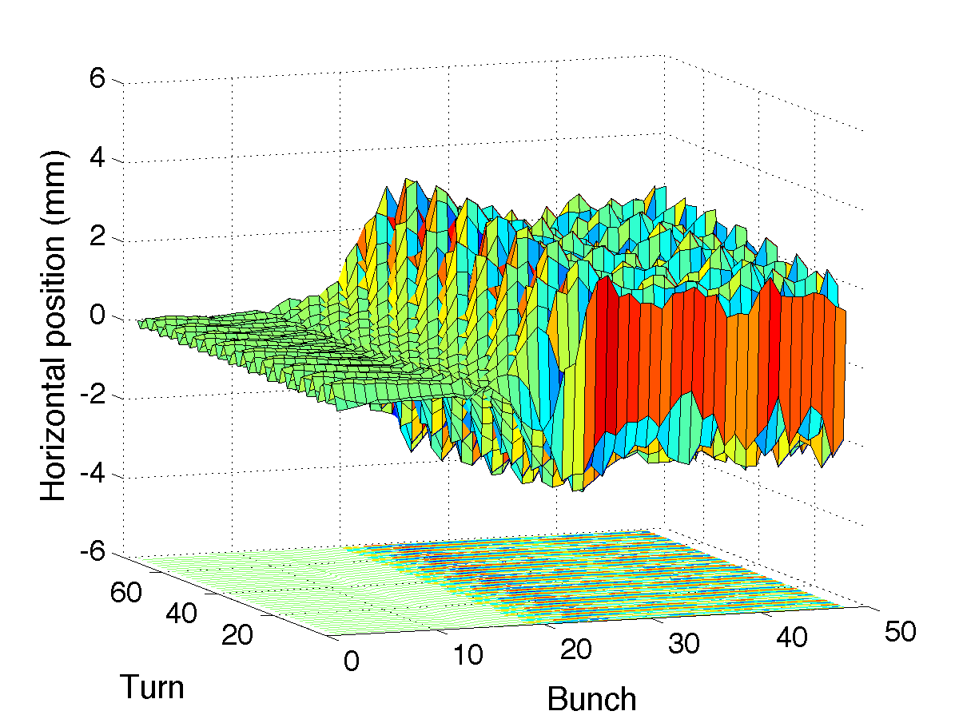
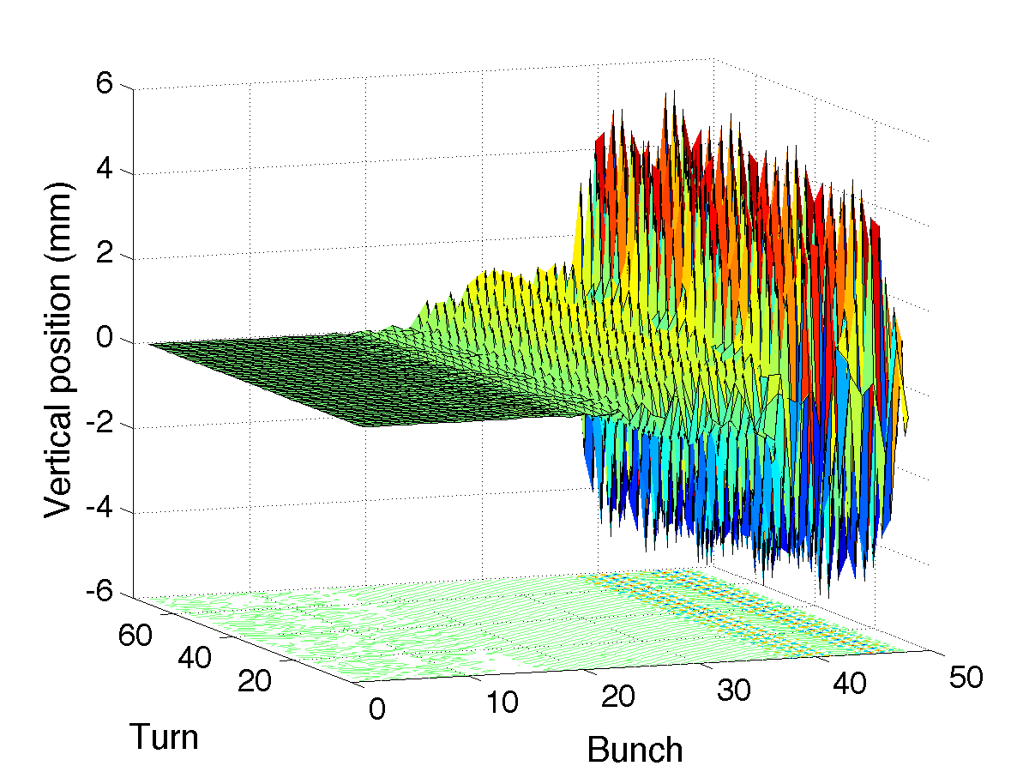
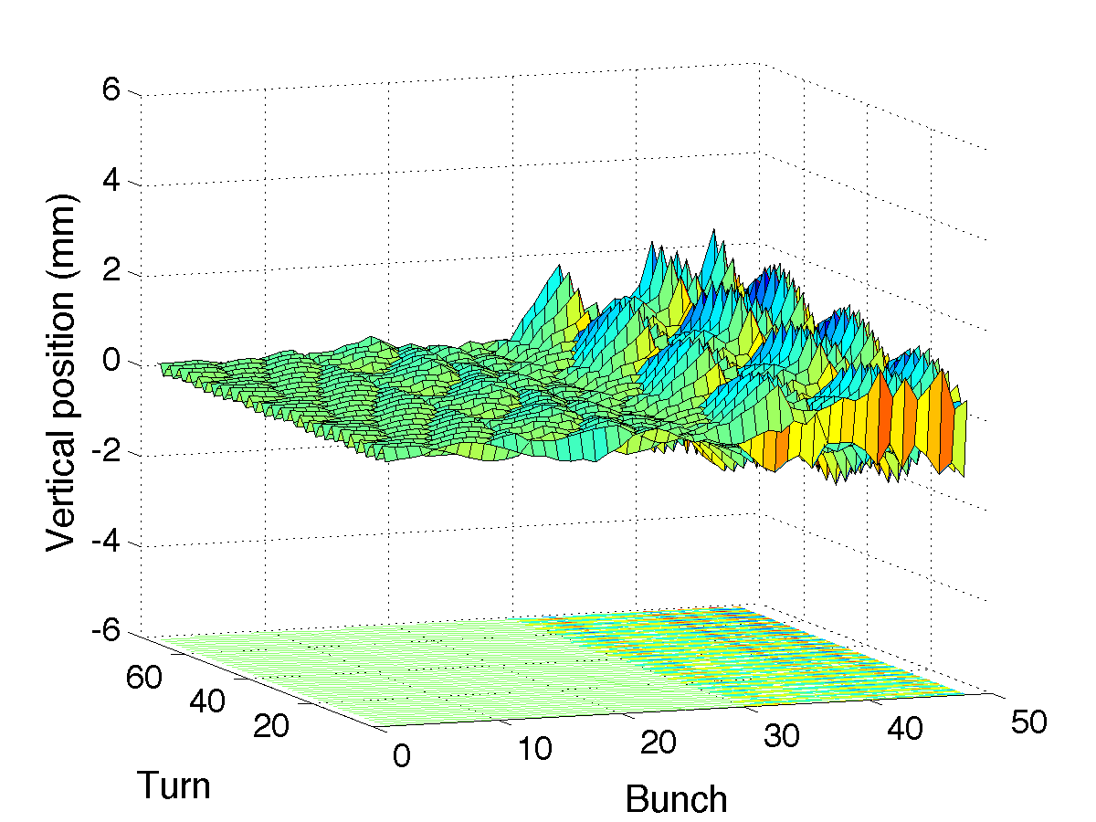
Post mortem of the 2 beam dumps on August 26th
The ~last 73 turns before the beam dump are stored in the post mortem …
with transverse damper
without transverse damper
notable oscillations only
for last bunches …
mainly coupled bunch oscillations
~ bunch 25 is the first unstable
single + coupled bunch oscillations
up to ±5mm
→ explains why 24 bunches could be injected and stored …

Slide 6
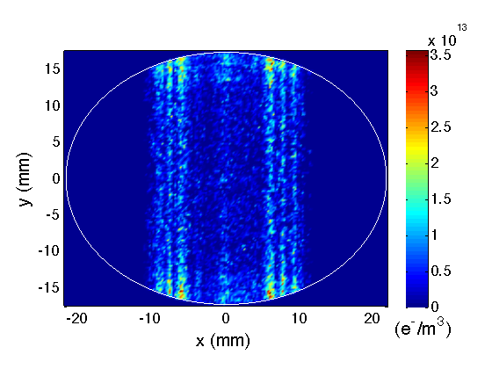
Simulation procedure
1x
PyECLOUD
Single passage of 48 bunches
Equal bunch intensities (1.0e11p/b)
Transverse emittance of ε_{x}=ε_{y}=3.5μm
Electrons move in dipole field
Beam screen approximated as ellipse
Headtail simulation 1
Headtail
48x
Headtail simulation 1
48x
Headtail
e⁻ distribution at bunch entrance
HEADTAIL
bunch 48
e⁻ distribution from PyECLOUD
e-cloud reset after bunch passage
Electrons move in dipole field
Each bunch simulated individually
Simulation of 500 turns

Slide 7
Simulation results – onset of instability
No instability in horizontal plane (e-cloud distributed in dipoles only)
→ Consistent with coupled bunch motion observed in LHC
Onset of vertical instability at bunch 26 with
δ_{max}=2.1 (as determined from heat load data), R₀=0.7
20000 primary electrons with a uniform spatial distribution
LHC beam and machine parameters (1e11p/b, ε_{x}=ε_{y}=3.5μm, Q’=2, …)
Losses are taken into account (collimators placed at 5.7σ, as in the real machine)

Slide 8
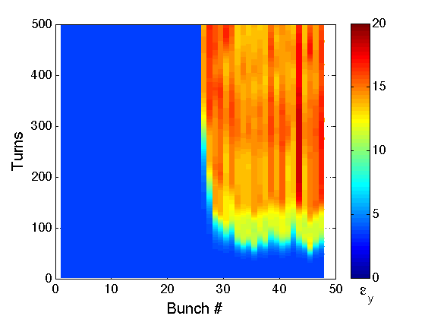
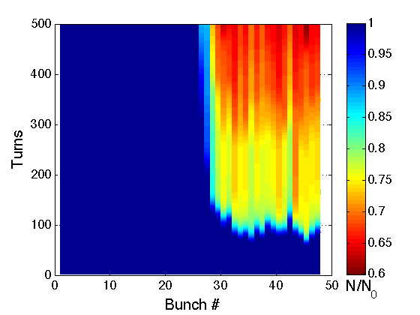
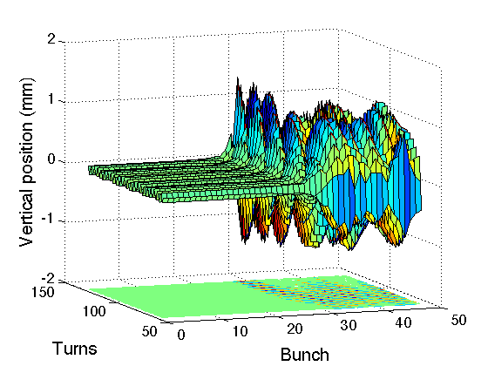
Simulation results – all 48 bunches
Rise time of vertical instability on the order of few tens of turns
Maximal oscillation amplitude of about 1mm
Up to 5mm observed in LHC with dampers on
Up to 2mm observed in LHC without dampers
Coherent oscillations until emittance growth and significant losses stabilize the beam

Slide 9
Outline
Part I
Observations with 25ns beams in LHC and estimation of δ_{max} in the LHC arcs
Reproducing machine observations with HEADTAIL simulations
Part II
Dependence on distribution of electron cloud
Dependence of instability onset on build-up parameters
Part III
Comparison of simulations with beam observations with large chromaticity

Slide 10
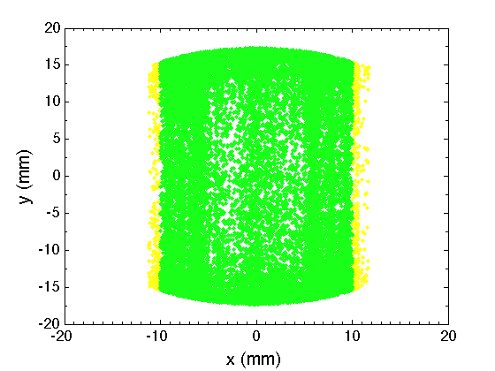
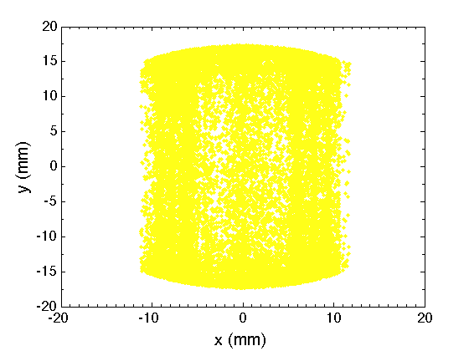
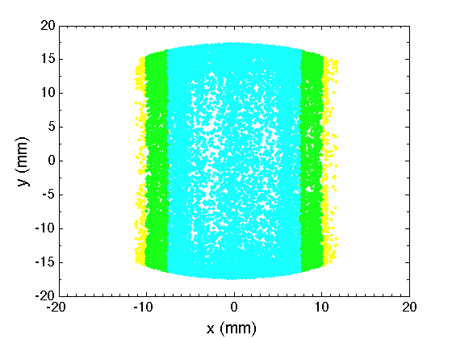
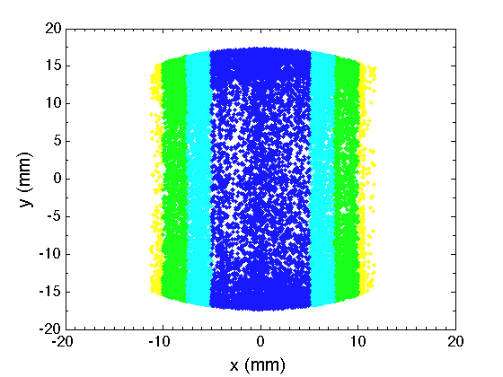
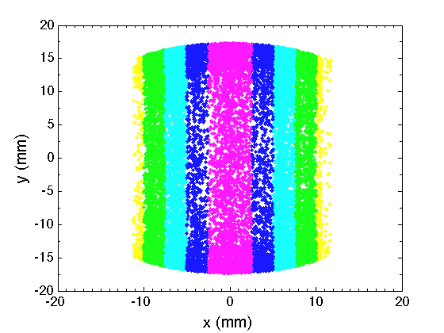
Dependence on “stripes”
99% of beam
… it’s mainly the central electron density that determines the instability threshold

Slide 11
Dependence on number of primary electrons
Onset of instability can be inferred approximately from the central electron density
Instability threshold in LHC at injection energy is around ρ_{c}≈1e12e⁻/m³
Consistent with simulations assuming uniform electron cloud
Onset of the instability depends on the number of primary electrons
Unlike the estimation of δ_{max} from the heat load data where the saturation level counts

Slide 12
Dependence on distribution of seed electrons
Uniform distribution of primary electrons
Gaussian distribution + 10% uniform background
s
→ Similar instability onset but very different central density in the saturated part of the train

Slide 13
Scanning build-up parameters
Scanning δ_{max} and number of primary electrons
Combinations where instability onset is between bunch 23-27 considered compatible
Investigated range of number of primary electrons/bunch corresponds to ~10-200nT
→ More seed electrons needed for uniform distribution due to smaller central density

Slide 14
Outline
Part I
Observations with 25ns beams in LHC and estimation of δ_{max} in the LHC arcs
Reproducing machine observations with HEADTAIL simulations
Part II
Dependence on distribution of electron cloud
Dependence of instability onset on build-up parameters
Part III
Comparison of simulations with beam observations with large chromaticity

Slide 15
Large chromaticity – beam observations …
Further MDs for scrubbing the LHC with large chromaticity
Q’_{x}≈Q’_{y}≈15 needed in addition to transverse feedback for stabilizing the beam
Injection of up to 288 bunches, but with (fast) emittance blow-up and slow losses
Norm. Vertical emittance [mm mrad] – Beam2 14/10/2011
Reminder: estimated here δ_{max}≈1.8

Slide 16
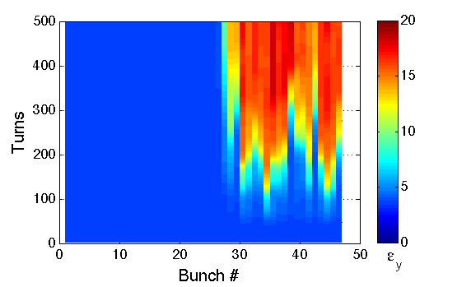
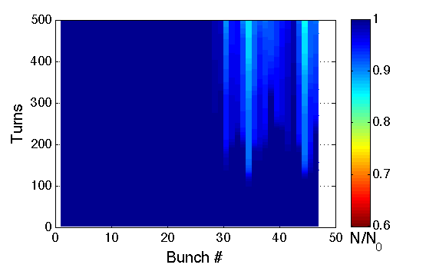
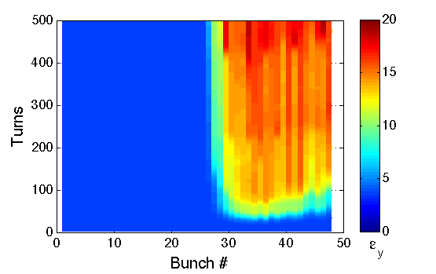
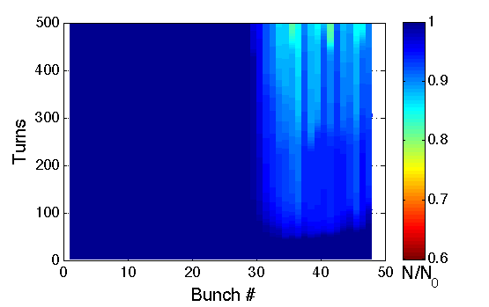
Large chromaticity – simulation …
δ_{max}=2.1 with 32000 primary e⁻/bunch (uniform) - Q’_{x}≈Q’_{y}≈15
δ_{max}=2.0 with 19200 primary e⁻/bunch (Gaussian + 10% uniform) - Q’_{x}≈Q’_{y}≈15

Slide 17
Summary and conclusions
Onset of vertical single bunch e⁻-cloud instability can be reproduced in good agreement
using δ_{max} estimated from heat load data analysis
combining PyECLOUD for build-up and HEADTAIL for beam dynamics simulations
Simulations show fast emittance growth and strong losses, similar to observations in LHC
Instability onset depends strongly on central electron density seen by the bunch
Central density before saturation depends strongly on the distribution of primary electrons
Uncertainty on pressure and initial distribution of primary electrons plays important role for the onset of instability but is of minor concern for the analysis of heat load data
Large chromaticity helps stabilizing the beam but still emittance blow-up and losses
Observed both in simulations and in the LHC
Could be interesting to include the effect of the damper in the single bunch simulation
Coupling between bunches should also be taken into account
Self consistent model of electron cloud effects for studying horizontal coupled bunch instability
→ Combine HEADTAIL with PyECLOUD …

Slide 18
Thank you for your attention!

Slide 19
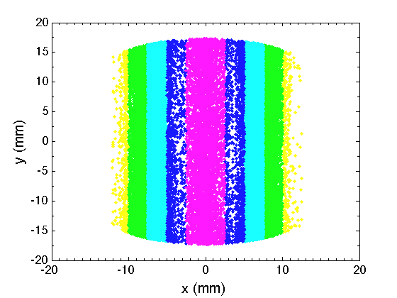
Backup slides – horizontal cuts

Slide 20
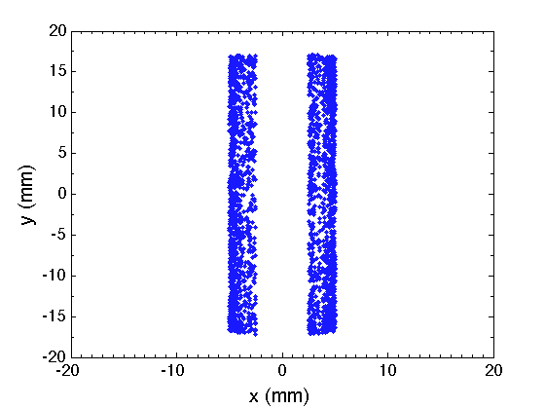
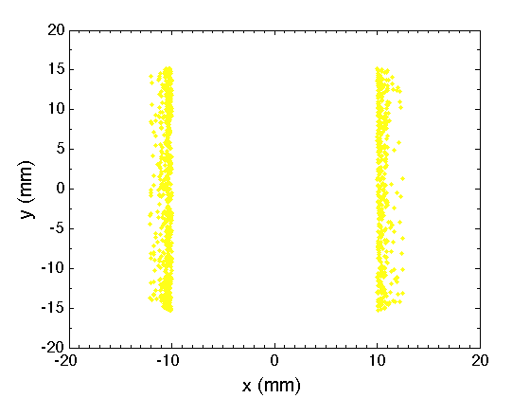
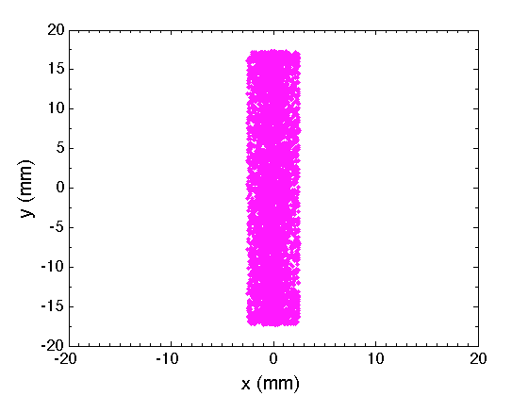
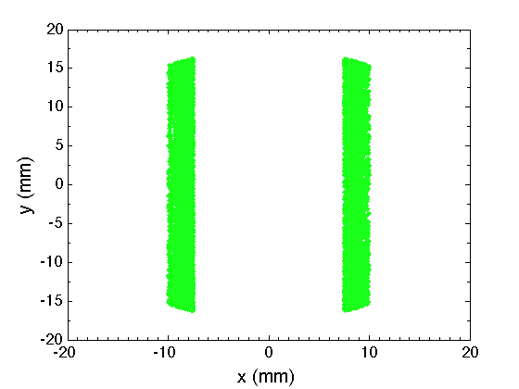
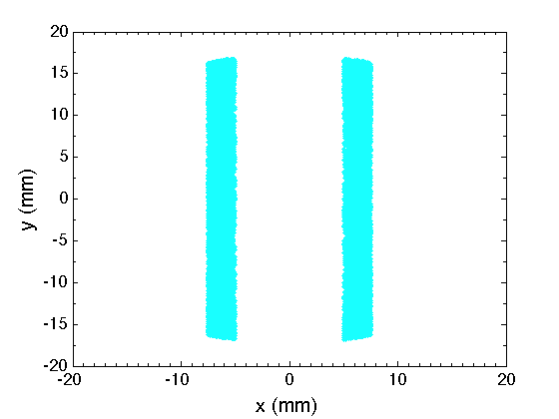
Backup slides – stripes only

