Slide 1
SPS: Mitigation Strategy at CERN
José Miguel JIMENEZ
On behalf of the LIU-SPS WG
special thanks to M. Taborelli & P. Costa-Pinto

Slide 2
Main Topics
Introduction
Status Report
Pending Issues
Review of objectives
Conclusions

Slide 3
LIU-SPS Electron Cloud issues
Introduction
SPS has to be prepared to digest:
  High bunch intensity: up to 2.5 10¹¹ ppb @ 25 ns ; 3.5 10¹¹ ppb @ 50 ns
  and
  Small emittances (LHC requirements)
cannot be guaranteed since electron cloud limitations have been identified:
  Beam instabilities: transverse emittance blow-up and single bunch vertical instability
  Pressure rise: beam gas scattering, dose rates to tunnel and components
Improvements considered against Electron Cloud:
  Suppression of the build-up: Clearing electrodes and very low SEY (<1.1) coatings
  Mitigation of the build-up: Scrubbing Runs
  Cure of the induced effects (single bunch vertical instability): High bandwidth feedback systems

Slide 4
Criteria for decision
Introduction
Safety
  The solution shall be safe for the operation of ALL SPS beams
  The implementation shall not induce major personnel safety issues e.g. radiation, handling...
Performance
  The solution shall allow a routine operation with the bunch populations required by HL-LHC
Reliability
  The solution shall not degrade with time and behaviour shall be predictable and reproducible
Operation margin
  The solution shall provide contingency in case real situation is worst than our expectations
Other important criteria
  “Best value for money”
  Implementation duration compatible with a long shutdown
  Infrastructures required must be compatible with CERN existing options

Slide 5
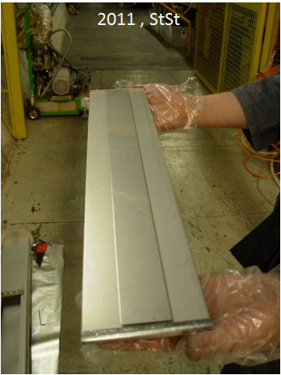
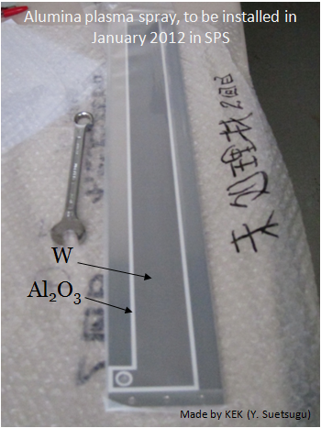
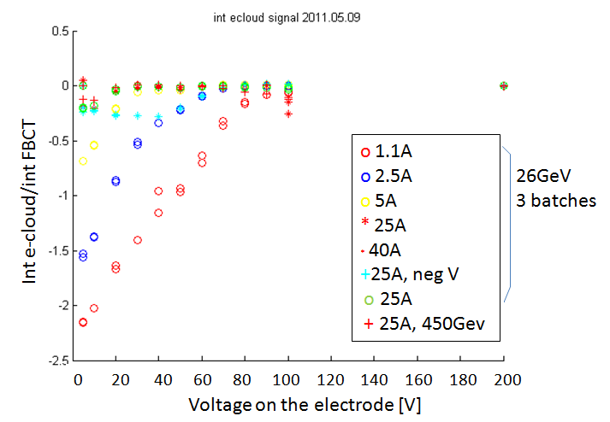
Feasibility study is completed…
Status Report
EC Suppression – Clearing Electrodes
Effective suppression at all tested B fields with low (<100 V) bias voltage
Clearing electrodes can ONLY be applied on few places of the machine: aperture restriction
No solution found to apply clearing electrodes inside existing main magnet chambers
Feasibility studies are now stopped
  KEK clearing electrode tested successfully with beams in the SPS in field free and dipole field conditions
  Without dipole field, Ecloud dominated by alumina surface, rough sprayed tungsten had a SEY=1.3

Slide 6
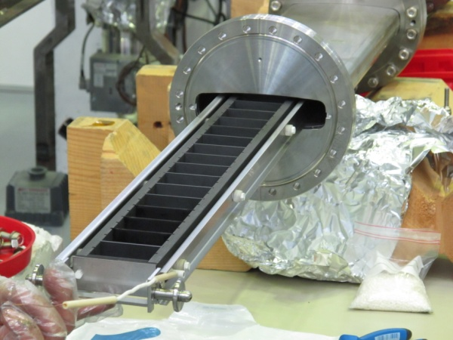


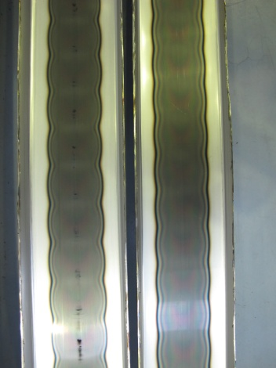
Validation being completed…
Status Report
EC Suppression – Very low SEY a-C Coatings
Very low SEY achieved by purifying the discharge during the coating process
  SEY below 1 obtained systematically
Lifetime
  Very small effect (drift up to 1.1) visible after 3 years in the SPS
Effect of venting
  Small increase up to 1.1, still bellow the EC threshold
Industrialisation of coating solutions
  Coating ex-situ (new beampipes)
    Magnetron sputtering has been validated for both MBB and
    MBA beampipes
  Coating in-situ (existing beampipes)
    Hollow cathode as baseline
      Successfully industrialised for MBB profiles
      Delays with MBA due to inhomogeneity other the 7 m length
      will need about a year to validate the coating since the tooling is being
      optimised
Hollow cathode

Slide 7
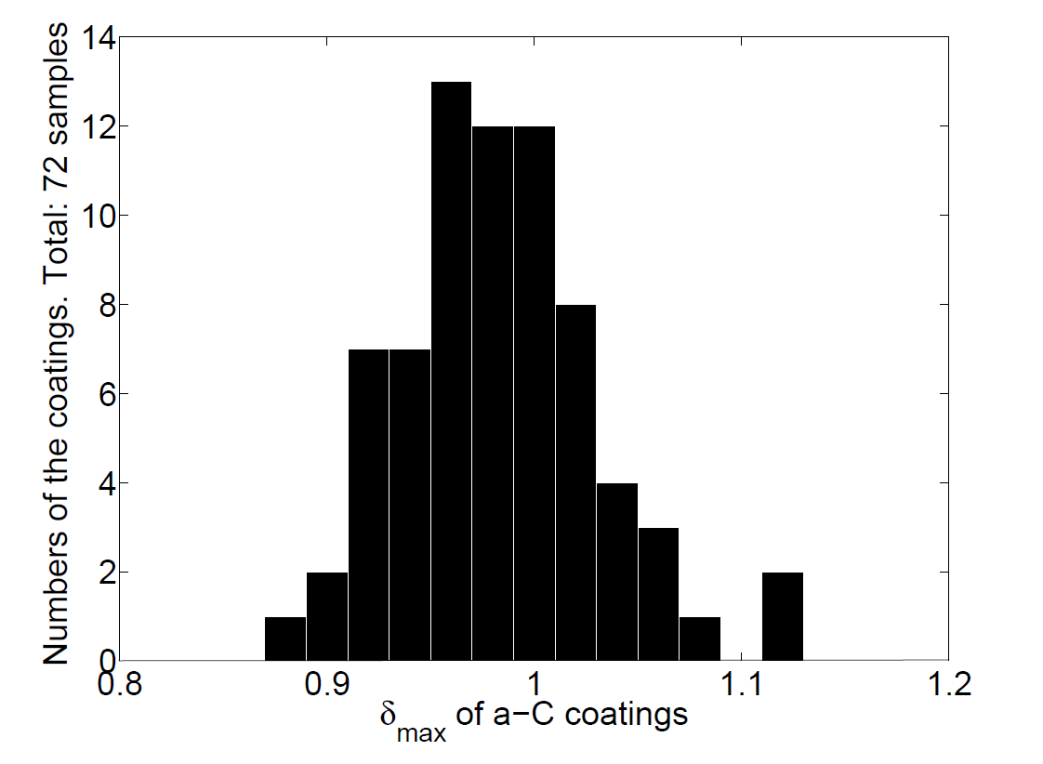
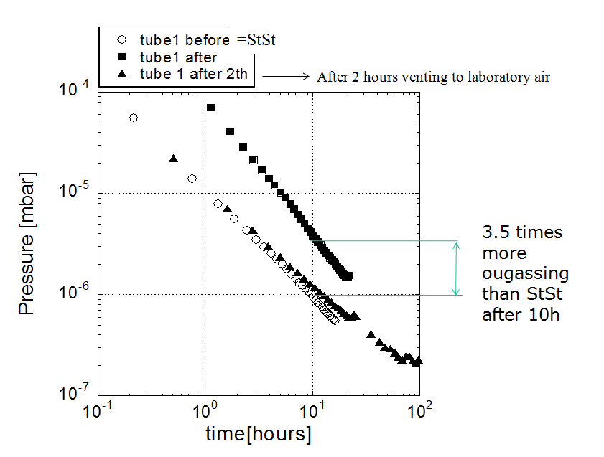
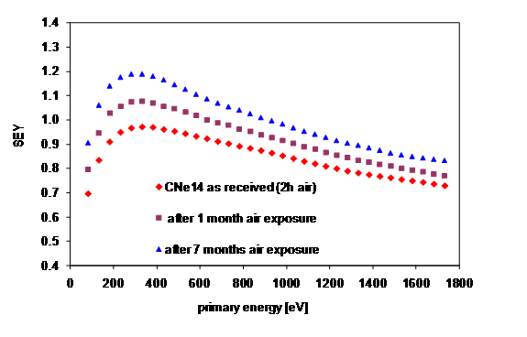
Reliability and Performances…
Status Report
EC Suppression – Very low SEY a-C Coatings
Static outgassing of a-C coating
  As expected, static outgassing is higher but no difference can be seen after 2nd pump down
  Dynamic vacuum is expected to be lower because of the intrinsic good properties of a-C coating

Slide 8
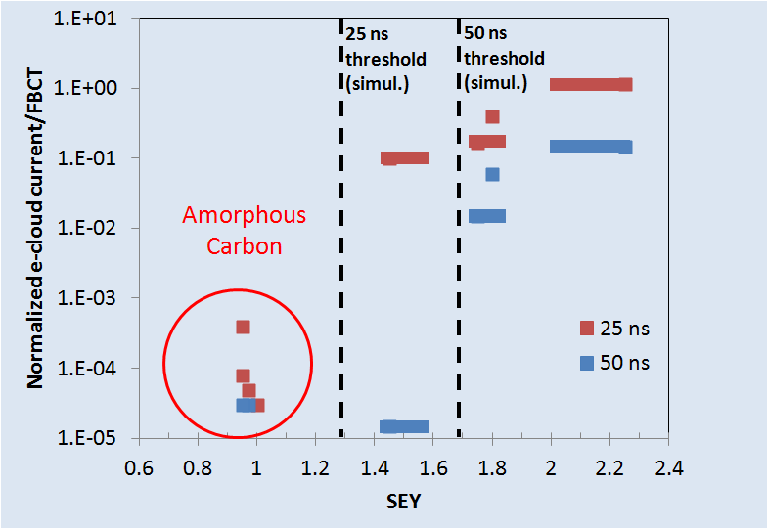
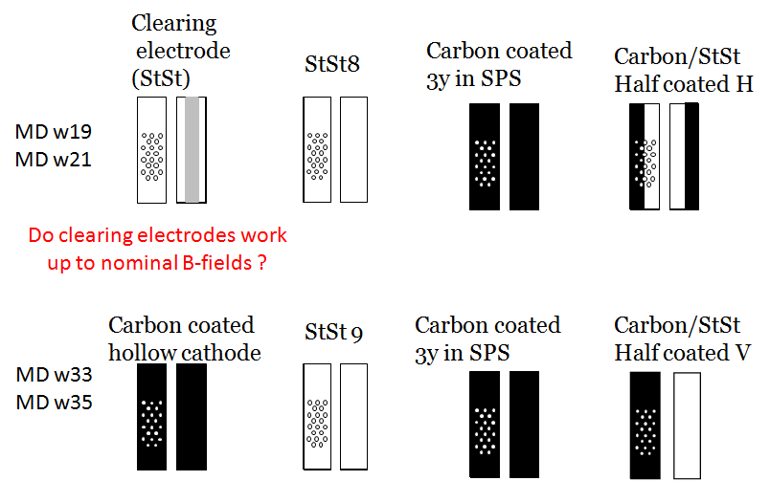
Is it required to coat the entire beampipe?
Status Report
EC Suppression – Very low SEY a-C Coatings
In dipole magnets, coating the top and bottom surfaces is required
In field free regions, coating the entire inner surface is required

Slide 9
What’s required?
Status Report
EC Mitigation – Scrubbing Runs
Beam scrubbing is successfully used since 1999 to reduce the EC activity, BUT:
  No scaling rule exists: EC builds-up can be non-monotonic and depends on:
    Parameters which totally change the picture: Chamber’s shape and size, Bunch spacing, Presence of an externally applied magnetic field
    Minor changes are also observed passing from the 26GeV to the 450GeV scenario due to change in: Bunch length, Geometrical emittance
  SPS is more demanding than LHC
  Full suppression was never achieved except in field free regions
  Corresponds to a mitigation solution and NOT to a suppressing method
Beampipe profile | SEY threshold @ 1.1 10¹¹ p/bunch | SEY threshold @ 2.5 10¹¹ p/bunch
ID 156 (LSS) | 1.4 | 1.1
ID 130 (LSS) | 1.45 | 1.05
MBA (Dipole) | 1.4 | 1.45
MBB (Dipole) | 1.15 | 1.25

Slide 10
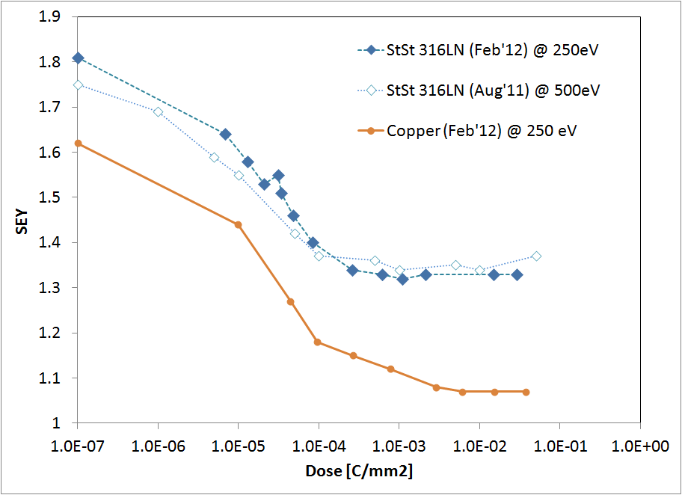
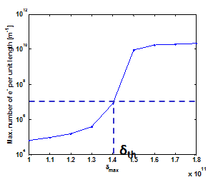
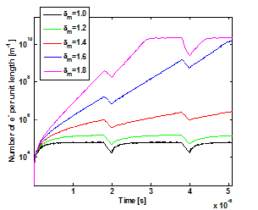
Some issues to be followed…
Status Report
EC Mitigation – Scrubbing Runs
Beam scrubbing has intrinsic limitations:
  Reaching smaller SEY (δ) need larger electron bombardment doses: log behaviour
    Lower bombardment dose when going closer to threshold for a given bunch population: ~3 orders of magnitude decrease!
      Some materials like Stainless Steel show saturation of the dose effect in the Lab
  Induces collateral effects: heating of kickers, internal dump heavily loaded
Saturation...
10 times more
integrated dose!
10 times less
dose rate!
x 100 more beam time!
SPS = StSt / LHC = Copper

Slide 11
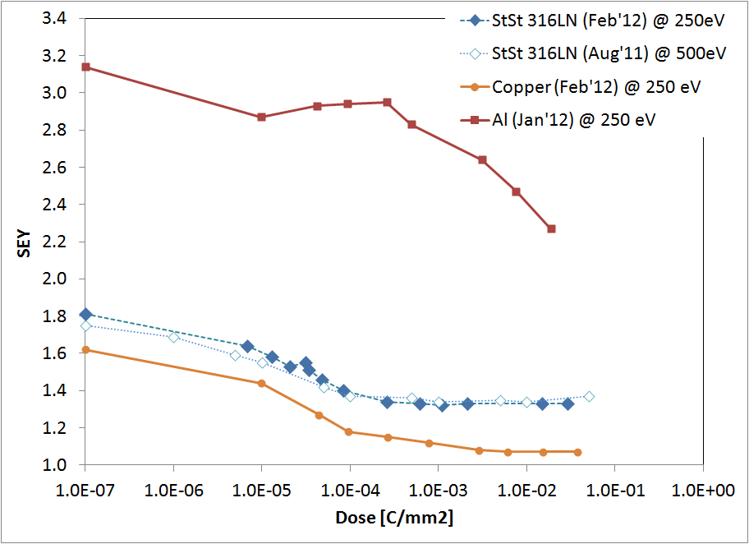
Scrubbing and limitations linked to material
REMINDER !
Aluminium MUST be avoided!!
Except if coated...

Slide 12
How to enhance the EC close to threshold?
Status Report
EC Mitigation – Scrubbing Runs
Strategies of e-cloud enhancement (input for SPS scrubbing run tests):
  5ns bunch spacing
  Slip stacking
  5-10% uncaptured beam
    (alternative to) Filling SPS with 8 x 72 b @ 25 ns and 26 GeV
  PS bunch splitting deregulation (Bunch intensity modulation)
Beam configuration | Scrub. dose enhancement factor | Entirely scrubs the required region | Additional remarks
5 ns beam | 4 | NO | At least two batches required
Slip stacking | 5 | YES | (10+15)ns much better than (5+20)ns
5-10% uncaptured beam | 1.3 Much more if sat. not reached in 4 batches | YES | In worst case, it can be employed to scrub with 3 batches (factor 2000) instead of 4 (less heating, less outgassing)
PS splitting deregulation | <1 | YES
At SPSU-BD meeting (12 October) it was pointed out that the first two options are not feasible with the installed RF system.

Slide 13
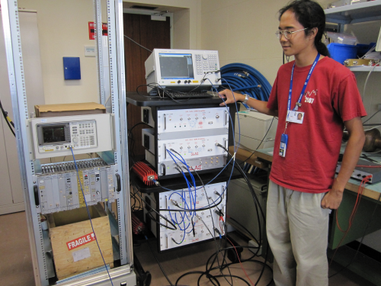
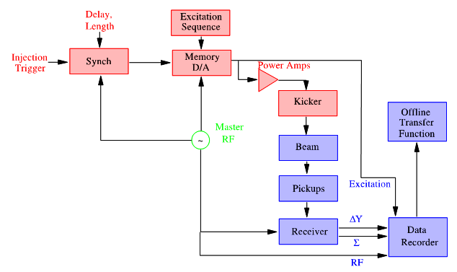
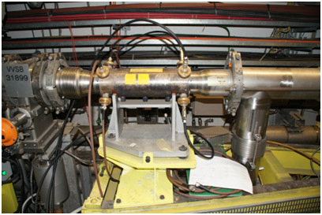
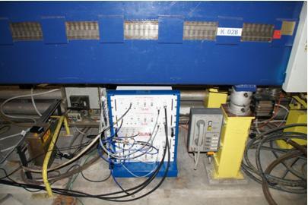
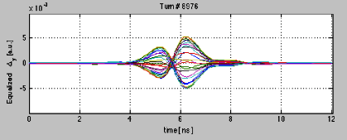
R&D for SPS high bandwidth transverse feedback system
Status Report
EC Cure - High bandwidth feedback systems
*supported by US-LARP and LIU project, joint effort of CERN, SLAC, LBNL
Status reviewed in November 2011 by the LIU project:
  https://indico.cern.ch/conferenceDisplay.py?confId=162989
Aimed at:
  Demonstrating transverse damping of intra bunch headtail motion caused by impedance and e-cloud, GHz bandwidth
  Full system implementation could be ready for 2018 if proof of principle shown before LS1, i.e. 2012
  Test-set-up operational in SPS

Slide 14
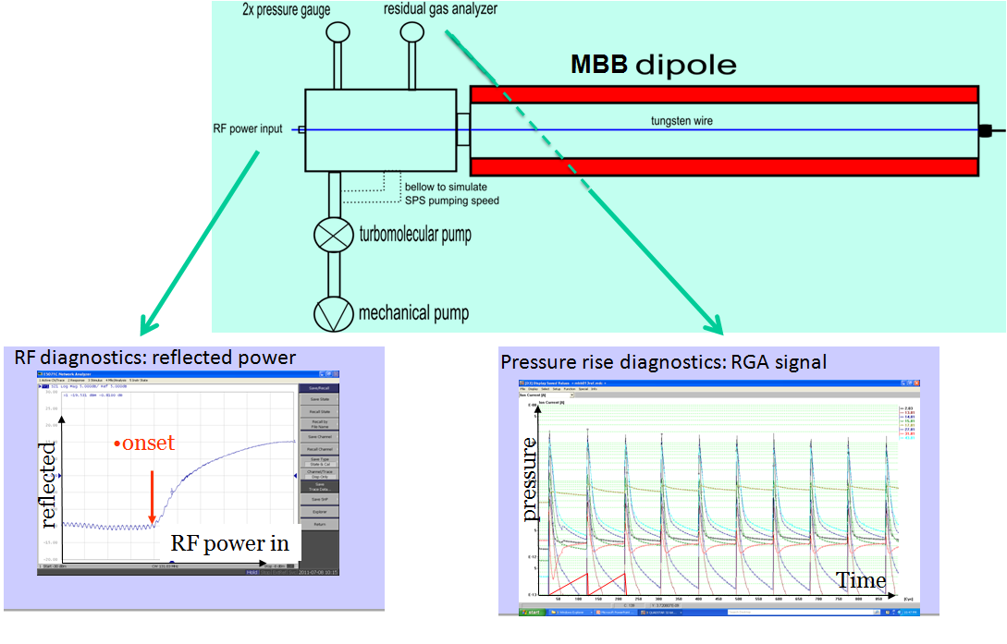
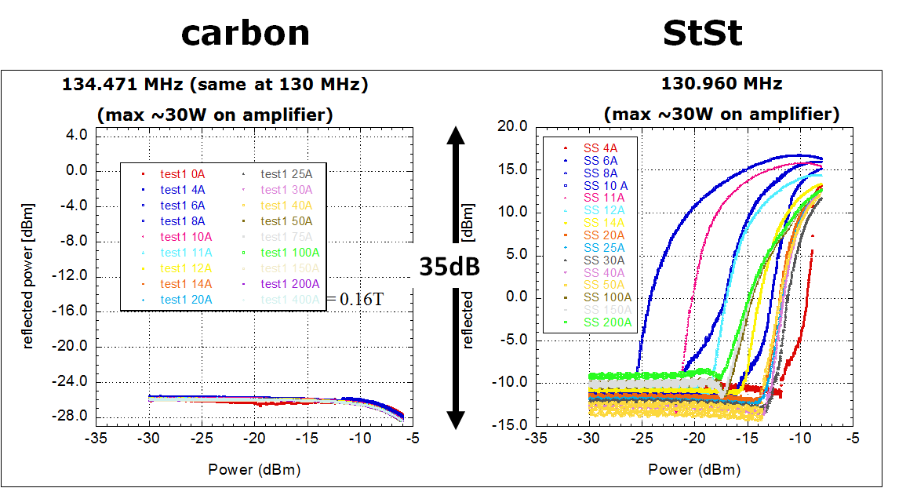
Scrubbing or Coating?
Pending Issues
Measurements in the Lab
Secondary electron yields
  SEY measurements and dose effects,
  venting to atmosphere
Multipactor test bench
  Testing the multipacting performances
  of the coatings
  combined with:
  Pressure gauges which provide
  also indication of multipacting in the
  beampipe
Coating features
  Dynamic behavior (electron
  stimulated desorptions), static
  outgassing
  Ageing, peel-off
MBA not tested yet

Slide 15
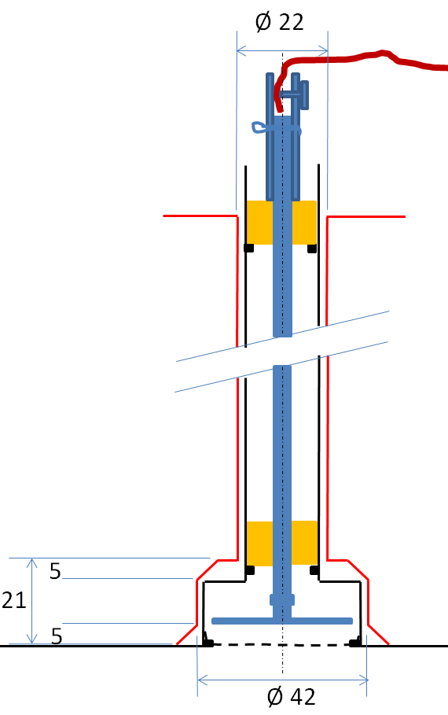
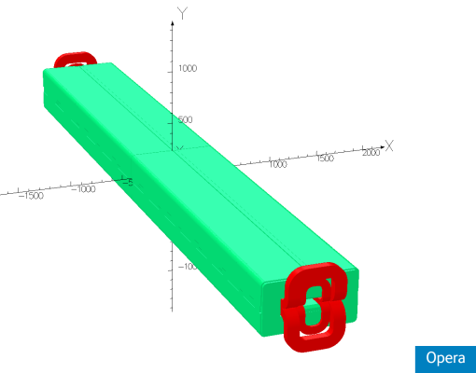
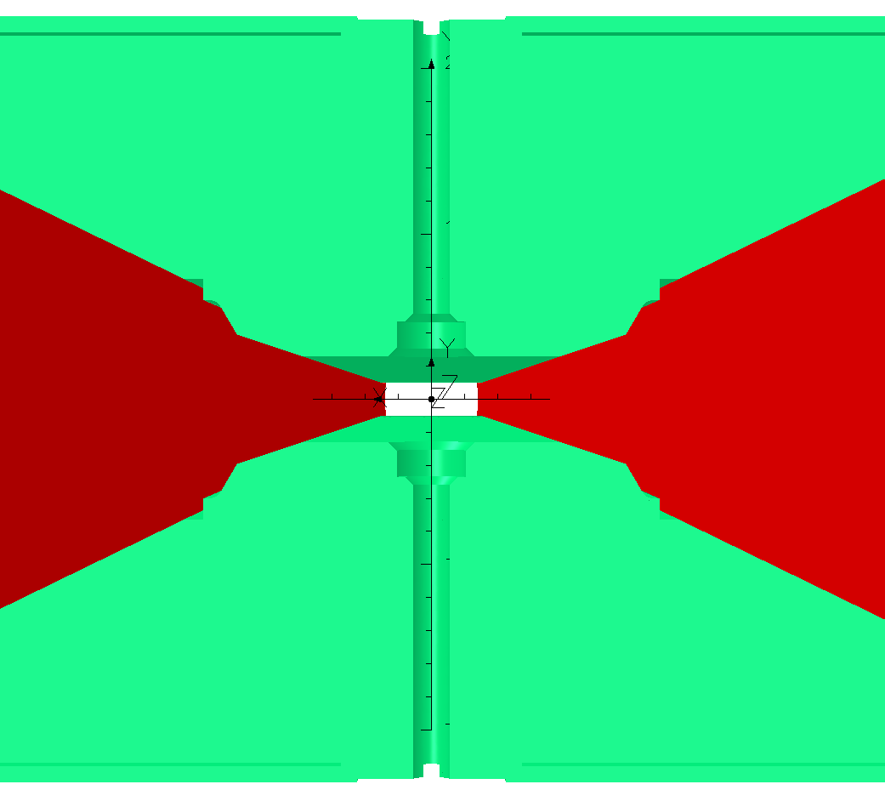
Scrubbing or Coating?
Pending Issues
Measurements with Beams
Strip detectors, pick-ups, sample extractor, Pressure rise...
  Nothing yet inside real long magnet: MBB or
  MBA
  Installing an electron probe at the centre of a
  dipole magnet was abandoned
    Simulations and observations made with the
    strip detectors with dipole fields confirmed
    that the EC build-up will not take place or
    will be strongly perturbed
    Magnetic field combined with collector
    will “kill” locally the multipacting
Symmetric holes
on top and
bottom half
yokes to avoid
longitudinal
effects

Slide 16
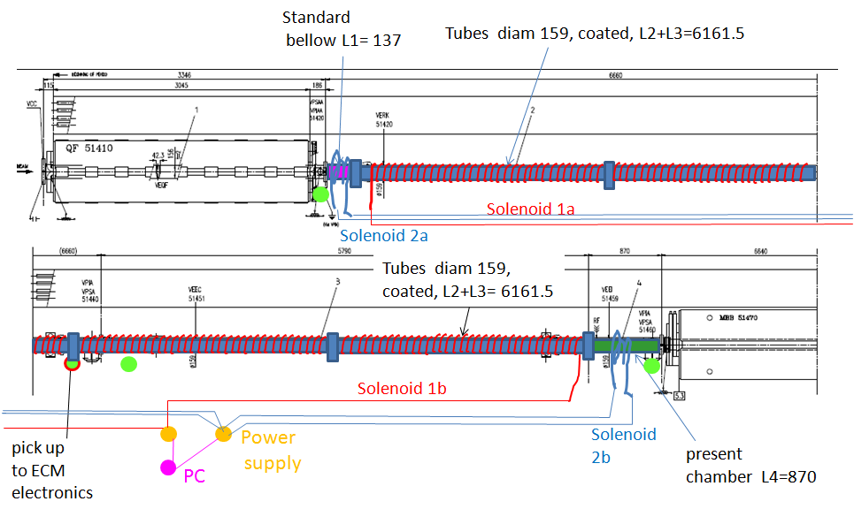
SPS HC514: a-C coated beampipes instead of magnets…
Pending Issues
Measurements with Beams

Slide 17
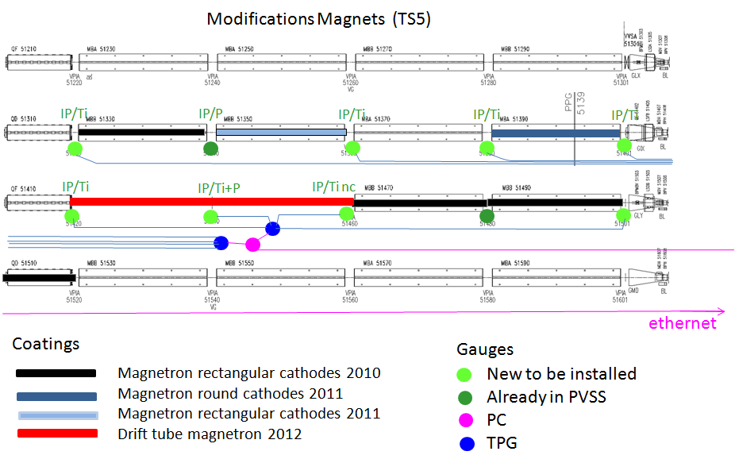
SPS HC513: a-C coating magnets as from June’12…
Pending Issues
Measurements with Beams

Slide 18
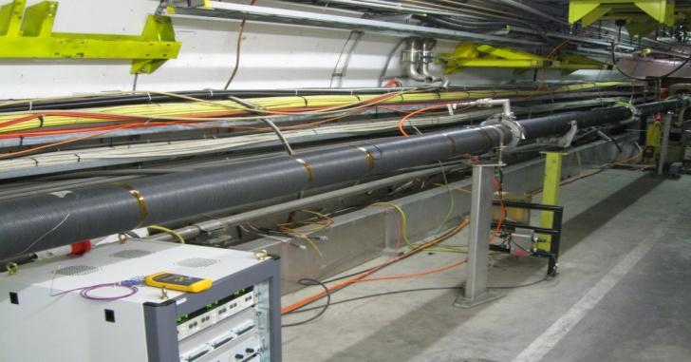
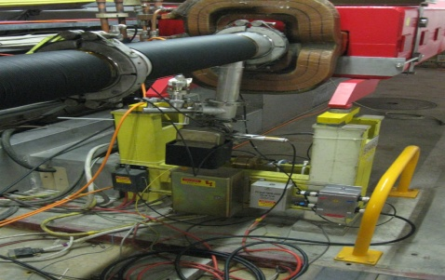
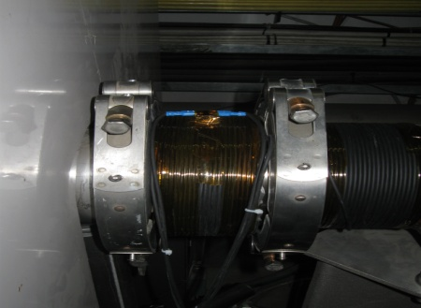
Pending Issues
Measurements with Beams
Solenoids in drift space in sextant 5 (51420-51460)
External solenoid
on StSt bellow
(L=128 mm)
Central solenoid
on carbon coated chamber
(L=12324 mm)
External solenoid on
StSt chamber
(L=850 mm)

Slide 19
Pending Issues
Measurements with Beams
W13, Dynamic pressure with solenoids on/off, 3 batches 25 ns
The dynamic pressure rise is influenced only by the external solenoids:
in the coated drift section there is
no p rise due to
e-cloud
Q
Q
MBA
MBA
GIX
MBB
MBB

Slide 20
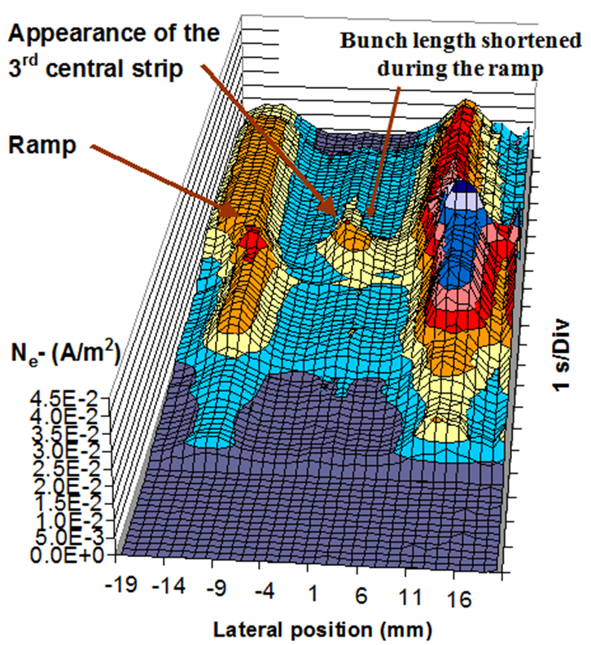
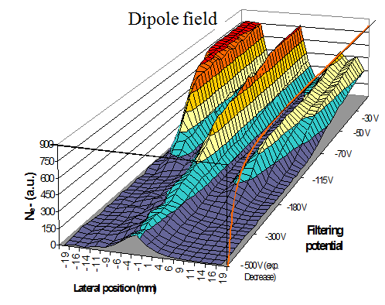
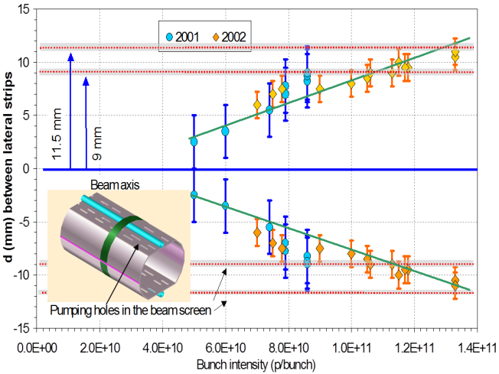
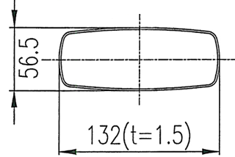

Pending Issues
Simulations
An amazing work done…
⇨ presented at the Electron Cloud LIU-SPS meeting (Jan’12)
Simulations are required to assess the EC induced instability threshold in dipoles
  Electrons in dipole field are, after some scrubbing, far away from beams
    Faster scrubbing at the centre where high energetic electrons are concentrated
    Lateral strips move away from beam while increasing bunch population
2004 data

Slide 21
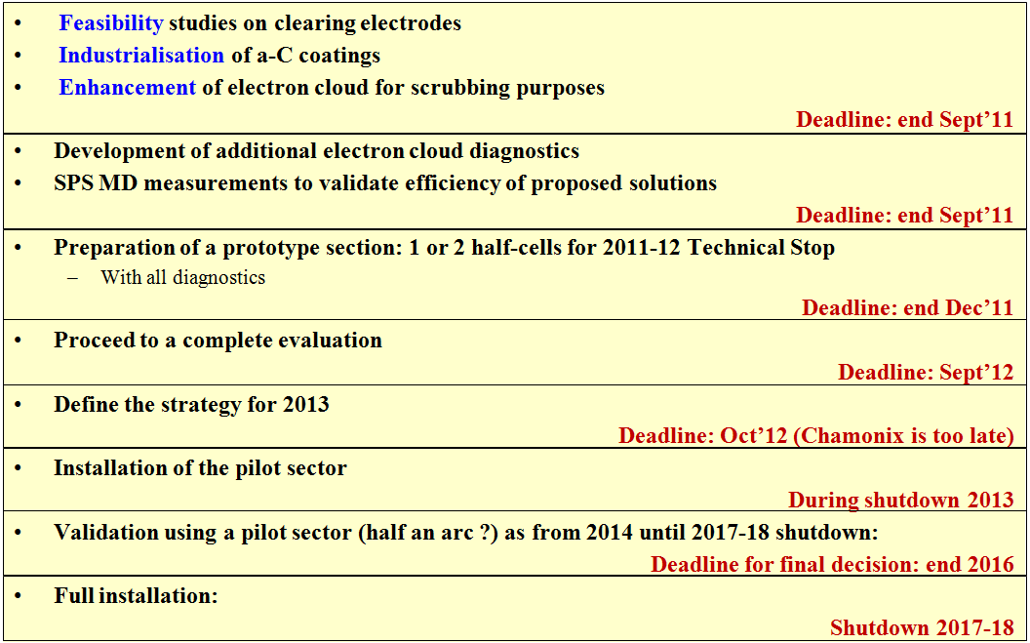
Review of objectives
As re-evaluated for Chamonix’12
2012
2012
2012
2012
⇨ 4 coated half-cells coated installed
⇨ 4 new coated half-cells to be installed if 2012 measurements are
not conclusive
(4 coated half-cells)
Slide N°11 / Electron Clouds in the SPS: progress in the analysis of cures/mitigations…
Session 09, J.M. Jimenez – Chamonix’11

Slide 22
The guaranty of suppression…
Conclusions
Amorphous Carbon Coatings
a-C coating technology is at the same level of validation than NEG when approved for LHC…
  Very low SEY is compatible with ultimate bunch populations for all beampipe shapes
  Solution of coating in-situ magnets is the only solution considered for the future
  Industrialization process is getting validated, only MBA is pending
  Long straight section beampipes will be coated as well (easy)
  Reversibility is not an issue since coating can be remove using and oxygen glow discharge
  Large scale quality is not a showstopper since already done for LHC NEG coated beampipes
  Static vacuum behavior, slightly higher outgassing of the coating, will be worked out
Remaining concerns essentially logistical:
  Cost, Resources, Infrastructures, Duration, Radiation dose to personnel
aC coating is project baseline and presently working towards assumption that this will be needed

Slide 23
The low-cost alternative…
Conclusions
Scrubbing Runs
The ongoing simulations and Scrubbing MDs are prerequisite to decision…
  Solutions exists on paper to enhance the multipacting close to EC threshold and thus speed up the Dose effect on SEY
  Only MBB dipoles (1/3 of SPS) shows a very low EC multipacting threshold
  Benefit expected on the instability threshold resulting from the non-homogeneous distribution of electrons in dipoles required to compensate for the saturation of the SEY dose effect on StSt
  Simulations ongoing to determine required scrubbing time/feasibility - profiting from excellent LHC data and simulations
Remaining concerns:
  Saturation of the Dose effect on SEY of Stainless Steel beampipes is a major issue
  Beam type required to enhance EC close to threshold
  Unexpected limitation on beam equipments like RF, kickers due to heating

Slide 24
Acknowledgements
Many thanks to all contributors: Jeremie Bauche; Mauro Taborelli; Giovanni Iadarola; Gianluigi Arduini; Elias Metral; Pedro Costa Pinto; Paolo Chiggiato; Fritz Caspers; Yannis Papaphilippou; Holger Neupert; Brennan Goddard; Roland Garoby; Elena Chapochnikova; Malika Meddahi; Hannes Bartosik; Karel Cornelis; Wolfgang Hofle; Giovanni Rumolo. (My excuses if the list is not complete)
It was a great pleasure to lead the LIU-SPS Electron Cloud Study team and I am very happy to pass this role (as from Feb’12) to:
  Mauro TABORELLI [TE-VSC-SCC Surface, Chemistry and Coating Section Leader]

