Slide 1

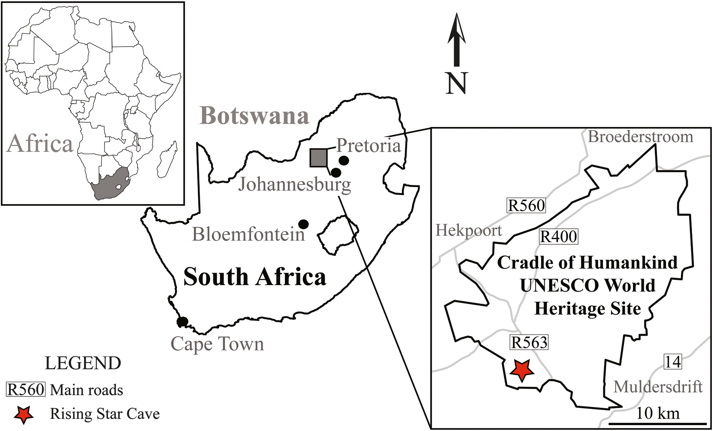
Muography in COHWHS
The MUSTAR Project
M. Bruschi - INFN Bologna (ITALY)

Slide 2
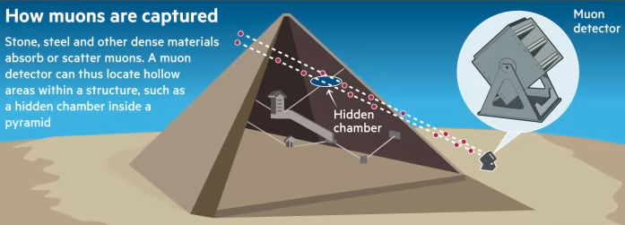
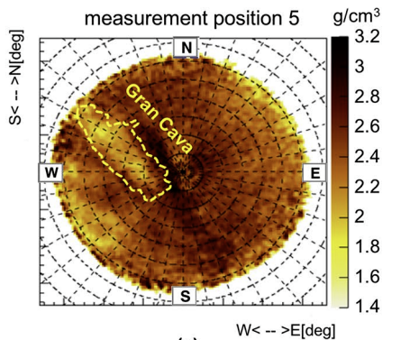
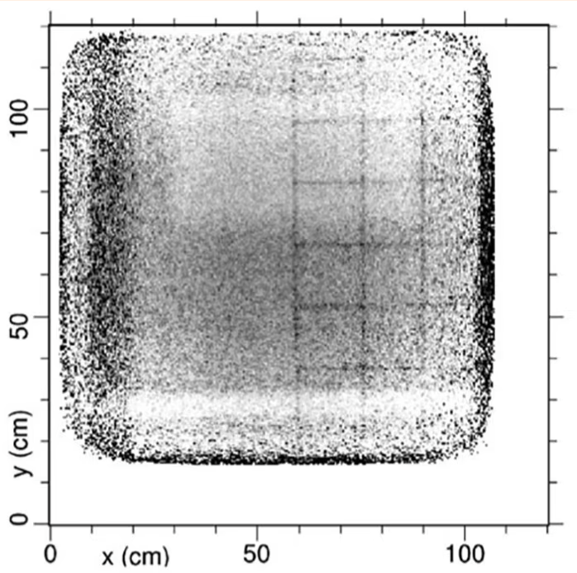
The principle of muography
Natural Imaging Agents
  Unlike X-rays that require a source, muons are naturally and abundantly available.
  Muons lose energy and get absorbed or deflected when passing through matter.
Capturing Shadows
  Detectors placed on opposite sides of an object capture muons after they pass through.
  Areas with denser material (like metals or rock) absorb more muons, casting a 'shadow' on the detector.
Creating an Image
  By measuring the number of muons passing through different parts of the object, a 2D (or 3D using more detectors) image can be constructed.
  Helps in revealing the internal structure without physically opening the object.
  Needs comparison with MonteCarlo simulations
Example of muography inside the Temperino mine (Tuscany) by the Florence group(INFN and Uni.)
Areas of lower (hidden caves) or higher densities materials are visible
More about this in the following

Slide 3
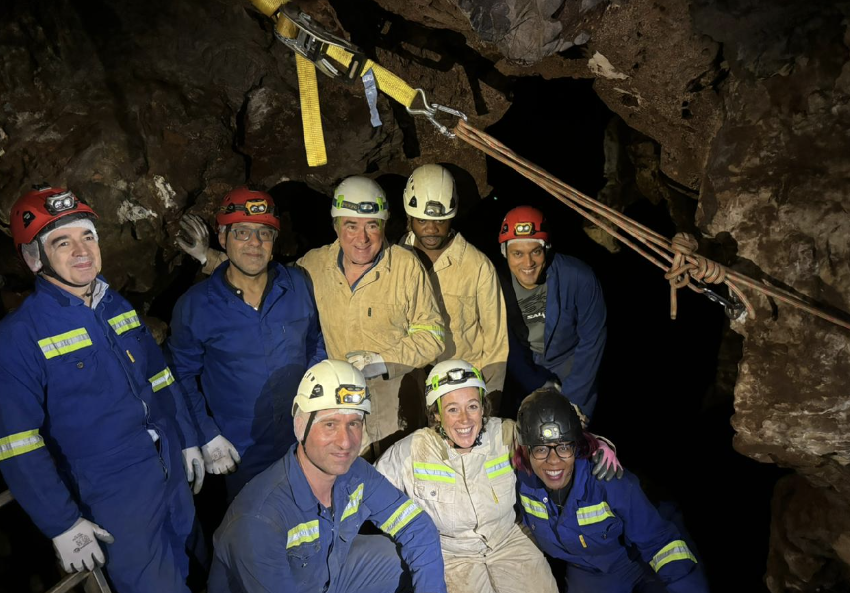

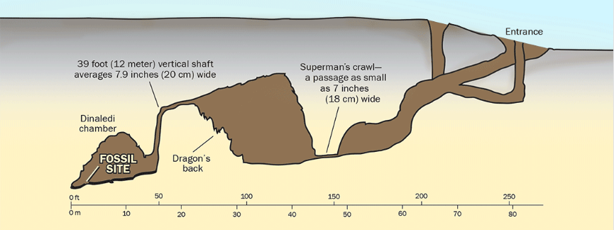
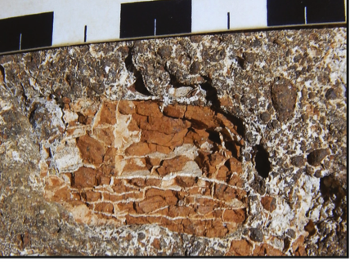
Proposed experiments with Muon Imaging in COHWHS
POC: Muography of the RS site 105
  appropriate position
  ideal for an initial muographic experiment
    These first results will have already a big scientific impact
Exploring for alternative access points to the Rising Star subsystem
  hypothesis based on the discovery of numerous remains of Naledi man in the cave system
  Presently hardly accessible
  The Rising Star subsystem floor sits at 30-35m depth good for MI
  Positioning the detectors in different areas in the cave could be used to discover any spaces or passages that are now sealed off from the main chambers
Muon tomography to inspect blocks of fossil bearing breccias
  Present imaging used conventional computed tomography or higher energy synchrotron imaging, both of which are expensive modalities and expose fossils to higher doses of radiation which may affect some studies

Slide 4
Decision and actions - 1
1. MIMONE vs. MIMA:
o Decision: MIMONE is the baseline choice due to its significant advantages in measurement time and manageable transportation challenges.
o Reference:
§ Dimensions of the BOX for MIMONE: LxWxH = 150x120x105 cm
§ Weight BOX + Detector: 260 kg
§ Weight Detector (including mount): 160 kg
§ Weight Mount: 40 kg
o Action: Transport for FRAGILE material should be adopted.
2. Free Sky Measurement:
o At the Rising Star base camp using a canvas tent. Attention should be paid to the metallic infrastructure of the tent.
o Action: Dirk to send tent details to Lorenzo. Luna also has a solution and will provide details to Lorenzo. Last update needed (Lorenzo, Dirk, Luna)
3. Local Transportation:
o From Johannesburg airport directly to Rising Star base camp using ITHEMBA LABS van. Consider switching to an LRBF van if necessary.
4. Transport/Customs Paperwork:
o Action: Luna and Lorenzo to organize paperwork for temporary export from Italy to ZA. Consider a 6-month duration and use of the ATA Carnet: ATA Carnet. Update: it is confirmed that in terms of shipping and VAT, the best way to act is using the ATA Carnet. Luna will write a short report about this.

Slide 5
Decision and actions - 2
5. Access to #105:
o Entry point is a sinkhole with 1 m height and smooth slope, adjustable by terrain removal.
o Action: Dirk to follow up on shipment details.
6. Platform at #105:
o Provide a platform to place the detector. Provide with UPS and internet connections.
o Action: Dirk to pass proposed UPS characteristics to Lorenzo for confirmation and purchase with LRBF support. Done
o Action: Lorenzo to confirm that LRBF can proceed with the purchase of the proposed UPS. Also comment if the proposed tent to place the detector is suitable.
7. LIDAR DSM:
o Obtain precise mapping of the #105 site.
o Action: Dirk to coordinate with Catalin and Diletta to provide necessary information in correct data format to INFN Florence for MC studies. Some data have been sent to Catalin to start with. More additional georeferenced survey points will be sent soon. Dirk should also check with Lee if and when LiDar data will be available.
8. Training Organization:
o When the detector is in ZA.
o Action: Coordinated by Lorenzo, Luna, Dirk, and Tebogo.
9. Audiovisual Material for Dissemination Events:
Working on this using material from RAI TV and available public shorts from the “cave of bones”

Slide 6
Decision and actions - 3
10. Accommodation and Meals:
o Action: Dirk to circulate details about guest houses near COH to facilitate reservations and cost estimates. Dirk sent the following of an accommodation which is normally used https://www.rabbitholehotel.com/ .
11. Data Management:
o Action: Lorenzo and Luna to propose:
§ Data collection methods and storage
§ Data access protocols and permissions
§ Backup and security measures
12. Risk Management:
o Action: Dirk to propose:
§ Potential risks and mitigation strategies
§ Emergency contact numbers and procedures
13. Timeline and Milestones:
o Action: Marco to propose a detailed timeline after consulting all parties, including key milestones and deliverables.
14. Budget and Funding:
o Action: Marco to propose an overview of budget allocation, funding sources, and financial tracking after consulting all parties.
15. Memorandum of Understanding (MoU):
o Action:
§ Lee R. Berger Foundation and National Geographic: Draft existing and submitted to LRBF
§ ITHEMBA LABS: Assess if the existing MoU needs updating. Likely not.
§ WITS (Physics): Luna to investigate if an MoU is necessary for the PoC. Likely not. Update: under offline discussion with Luna
Next Meeting:
• Date: Wednesday September 18th at 15:00

Slide 7
Backup

Slide 8
Organization of the PoC in the MUSTAR project
Coordinate activities among:
  INFN Bologna and Firenze
    Will provide the detector, install and commission it in the initial phase. Will transmit knowledge to run it.
  LRBF and National Geographic
    Will provide access to the area and contribute to building up infrastructures (cabling, UPS, internet, etc.) and to run the detector with local personnel.
  ITHEMBA LABS
    Will contribute to the detector shipment to the WITS site. Will provide a place to store and possibly refurbish the detector. Will support detector running and data analysis.
To Be Decided Today
  Appoint contact people for the operations:
    INFN: Dr. Lorenzo Bonechi
    LRBF: Dr. Dirk van Royeen, Dr. Tebogo Makhubela
    ITHEMBA: Dr. Luna Pellegri (TBC)
  Regular Meetings:
    Frequency (bi-weekly)
    Next scheduled meeting date: On Thursdays at 14:00 CET
  Communication Plan:
    Establish primary communication channels (email –group email list needed-)
    Define response times and protocols for urgent matters
To Be Decided in the next weeks
  Logistics for the people participating in the PoC (accommodation and meal arrangements)
  Data Management:
    Data collection methods and storage
    Data access protocols and permissions
    Backup and security measures
  Risk Management:
    Identify potential risks and mitigation strategies
    Emergency contact numbers and procedures
  Timeline and Milestones:
    Detailed timeline of the PoC phases
    Key milestones and deliverables
  Budget and Funding:
    Overview of the budget allocation
    Funding sources and financial tracking
  MoU
    Lee R. Berger Foundation and National Geographic
      Draft existing and submitted to INFN administration
    ITHEMBA LABS
      Understand whether the existing one should be updated
    WITS (Physics)
      Understand if necessary for the PoC
  ERC
    Synergy grant
      Will be published on July 2024
      Deadline November 2024

Slide 9
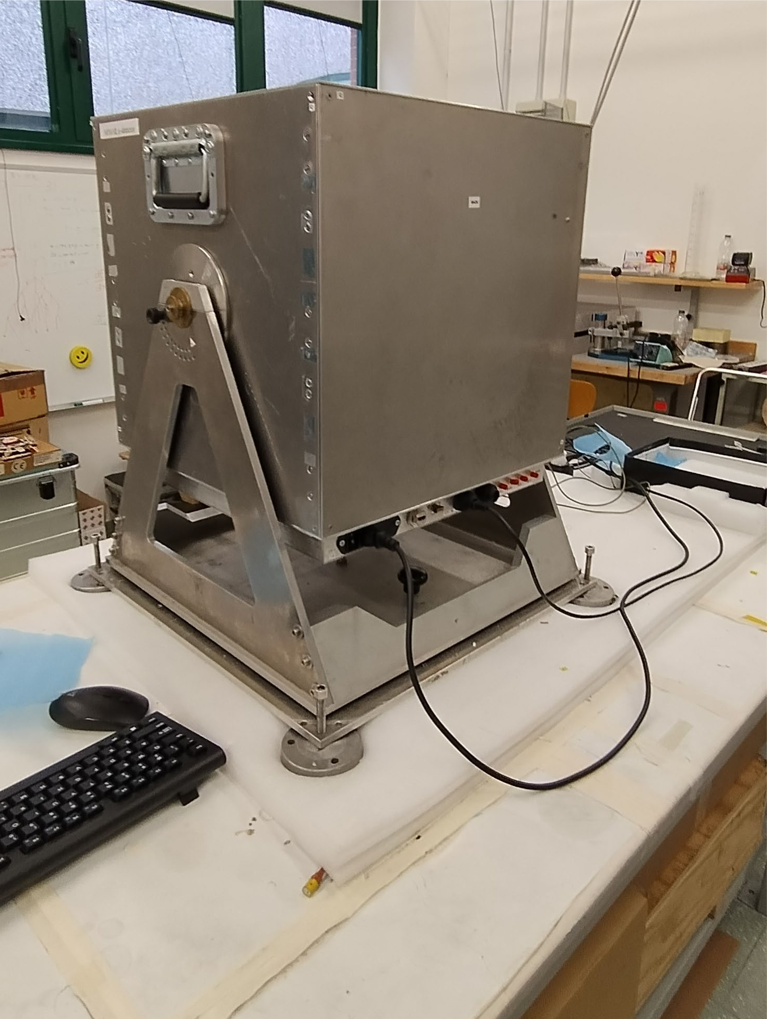
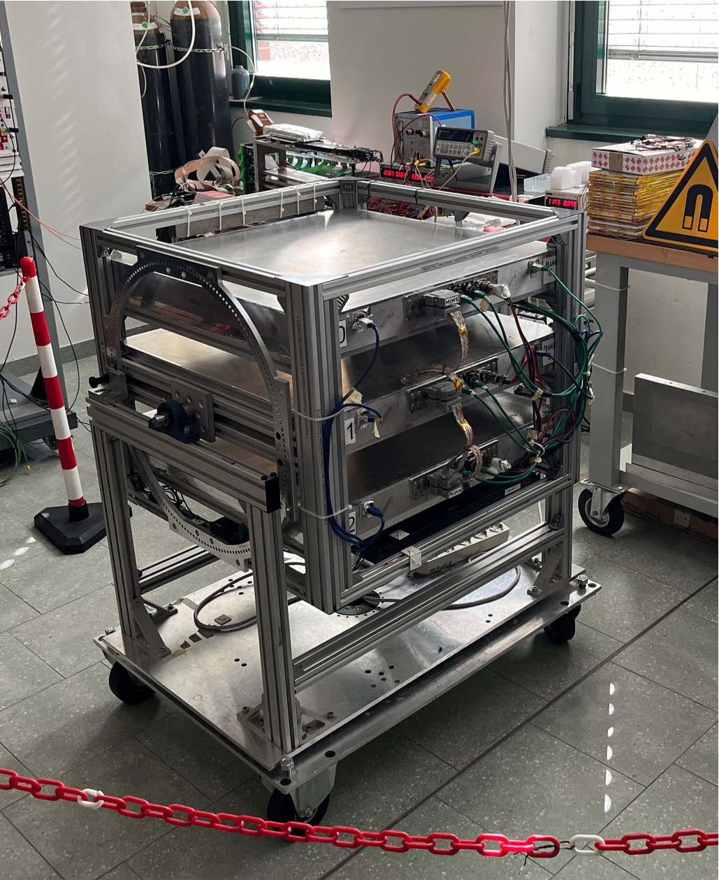
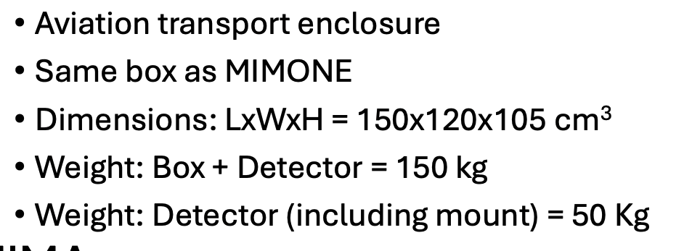
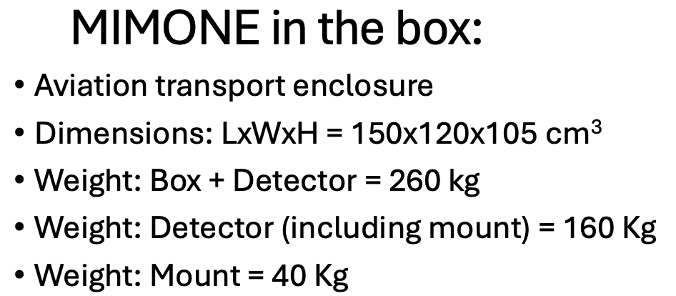
List of points to be addressed today
64x64 cm2
MIMA or MIMONE?: List of PRO/CONTRA. (Lorenzo)
Mechanical Stress Requirements: For the shipped detector. (Lorenzo)
Local Transportation: Inside the Cradle of Humankind (COH) to #105. (Dirk/Tebogo)
Transport/Customs Paperwork: From Johannesburg to ITHEMBA/WITS and then to COH #105. (Luna, Lorenzo)
Access to #105: Determine entry points and method. (Dirk/Tebogo)
Platform at #105: Provide with UPS and internet connections. (Dirk/Tebogo)
LIDAR DSM: Obtain precise mapping of the #105 site. (Dirk/Tebogo)
Training Organization: When the detector is in ZA. (Lorenzo, Luna, Dirk/Tebogo)
Accommodation and Meals: Arrangements when working at ITHEMBA/WITS or COH. (Luna, Dirk/Tebogo)
Discussion on Next Steps.
Next Meeting: July 25th at 14:00
40x40 cm2
  MIMONE type (64x64cm2) reduces a factor of 2.5 the measurement time

Slide 10

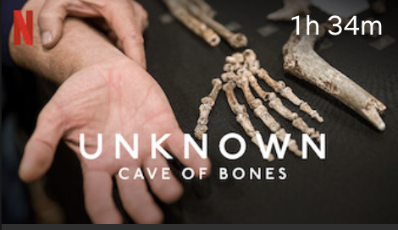
Researchers' Night
Researchers' Night is an initiative promoted by the European Commission since 2005 that involves thousands of researchers and research institutions in all European countries every year
In this type of events the most prominent projects in physics reasearch are explained to the non expert public with posters, audiovisuals etc
The MUSTAR project has been invited to have a stand in Bologna at the end of September
We are collaborating with outreach experts at INFN of Bologna to prepare a poster and a video to show to the public
It would be very nice if we could take parts of the Netflix series «The cave of Bones» to build the audiovisual
  This material is not completely available due to existing copyrights preventing not authorized use
  Question: is there any possibility to have the allowance to use this video (or other similar videos) by mentioning properly the entity which has the property?

Slide 11
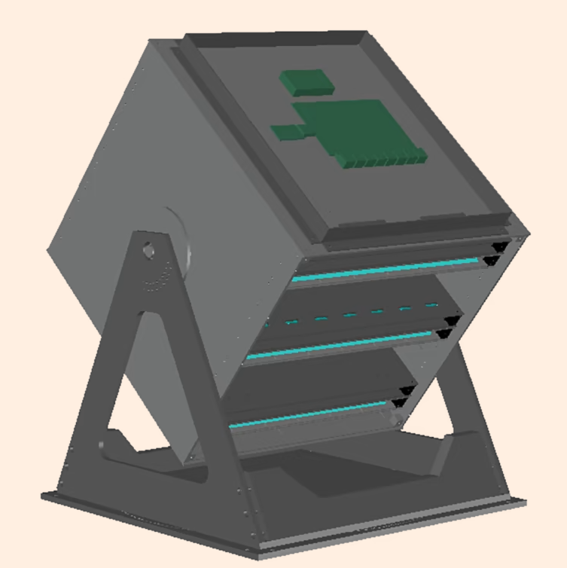
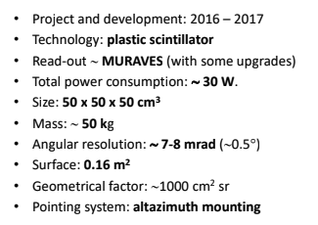
PoC funded by INFN-ENERGY
INFN in-kind
  detector
Infrastructures (15k)
  Detector adapting (5k)
  In-situ (10k) Protective case, UPS, Cabling, Internet ....
Travel expenses (~20 k)
  2 people for 2 weeks to start the activity ~ 10 k
  2 people for 2 weeks to close the activity ~ 10 k
Detector transportation + Insurance (~10 k)
Dissemination (INFN): 5k
Total ~ 50 k
custom
From April 2024: Detector available

Slide 12
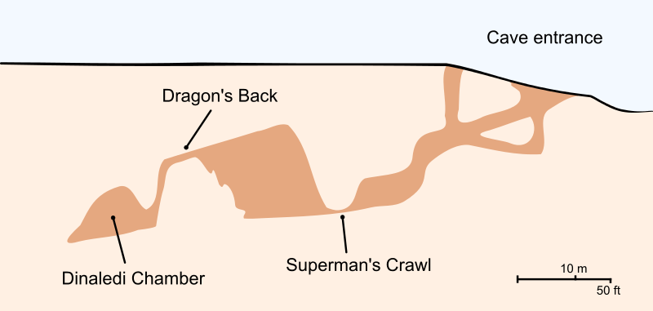
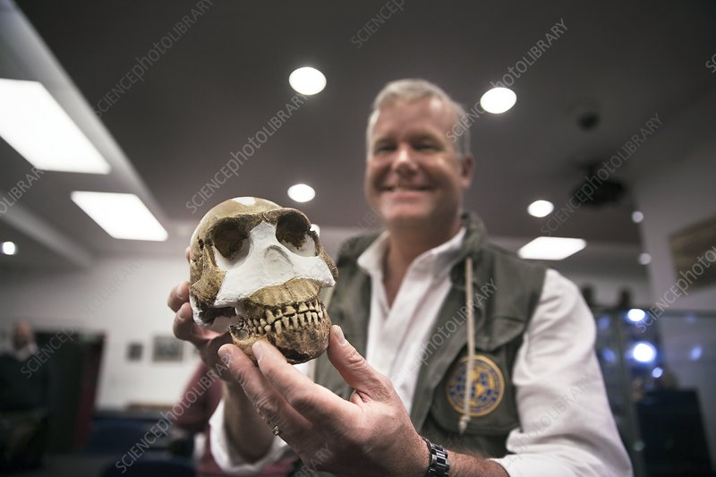
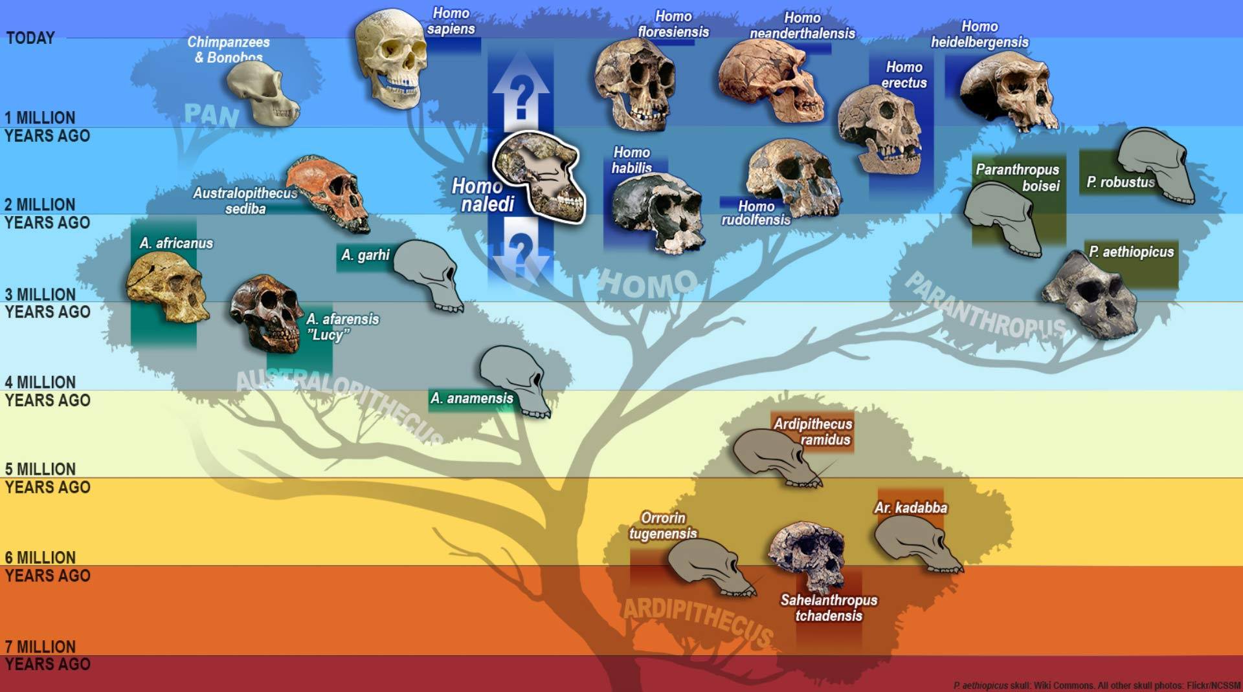

Muon Imaging in the Cradle of Humankind
Introduction:
  The Cradle of Humankind UNESCO World Heritage site (COHWHS) is a region rich in karstic dolomite, featuring caves, sinkholes, and subterranean structures.
  These formations preserve crucial fossil records, offering insights into human origins and paleoenvironments.
Challenges in Exploration:
  Traditional methods have limitations in uncovering the full extent of these karstic systems.
  Recent surveys have revealed hundreds of cave systems and fossil-bearing deposits, indicating a need for more advanced exploration methods.
Potential of Muon Imaging:
  Muon Imaging presents a promising solution for discovering and exploring these subterranean spaces.
  The technique uses naturally occurring muons to create detailed images of the interior of structures, capable of revealing hidden chambers and passages.

Slide 13
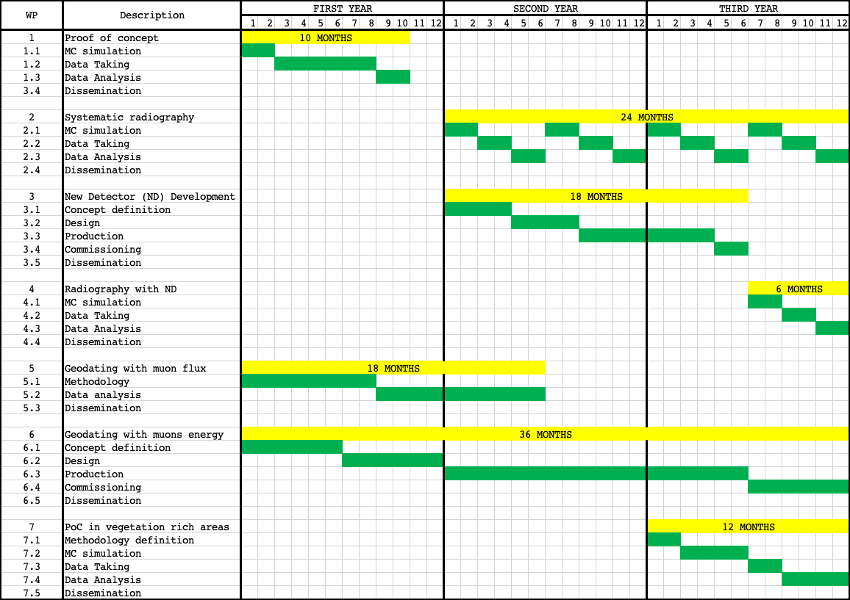
WP structure (3Y, Preliminary)

Slide 14
Today’s discussion
Organization of the PoC
  Talk by Prof. D’ Alessandro
  Coordinate activities among:
    INFN Bologna and Firenze
      Will provide the detector, install and commission it in the initial phase. Will transmit knowledge to run it
    LRBF and National Geographic
      Will provide access to the area and contribute to build up infrastructures (cabling, UPS, internet, etc.) and to run the detector with local personnel
    ITHEMBA LABS
      Will contribute to the detector shipment to the WITS site. Will provide a place to store and possibly refurbish the detector. Will support detector running and data analysis
To Be Discussed
  Appoint contact people for the operations
    INFN:
    LRBF: Tebogo (TBC)
    ITHEMBA: Luna (TBC)
  Logistics for the people participating to the PoC (accommodation and meal arrangements)
  Regular Meetings
  MoU
    Lee R. Berger Foundation and National Geographic
      Draft existing and submitted to INFN administration
    ITHEMBA LABS
      Understand whether the existing one should be updated
  ERC
    Synergy grant
      Will be published on July 2024
      Deadline November 2024

Slide 15
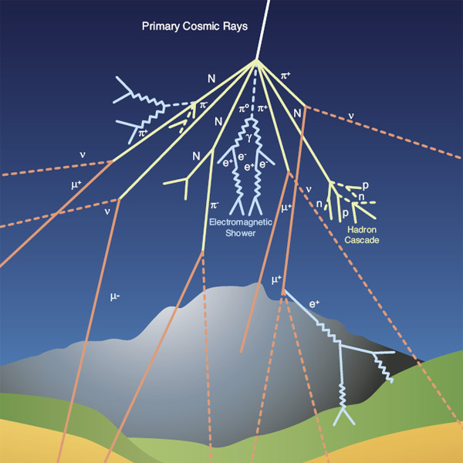
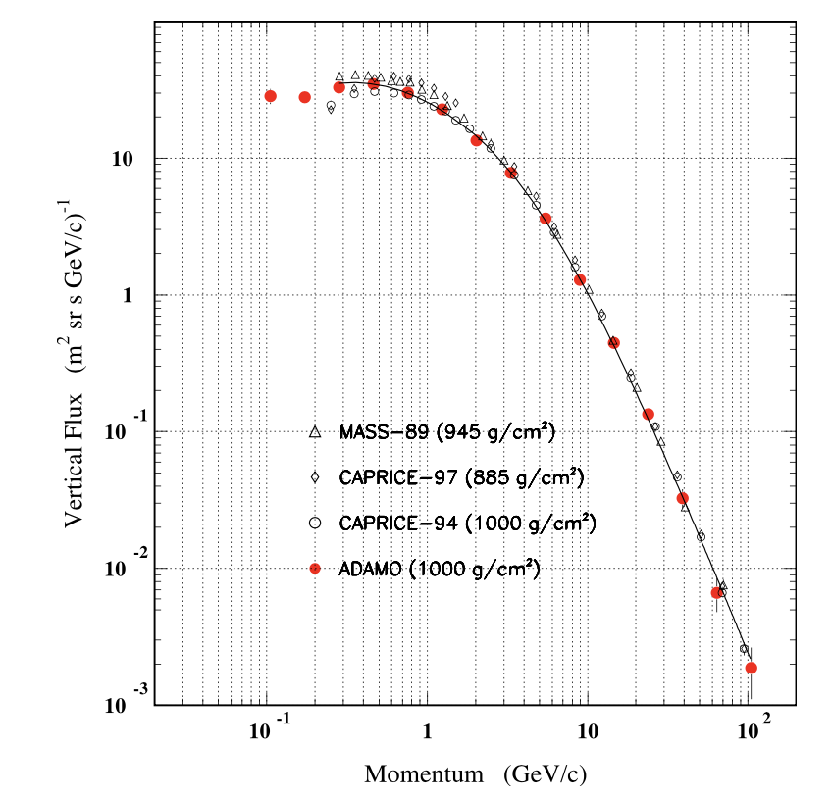
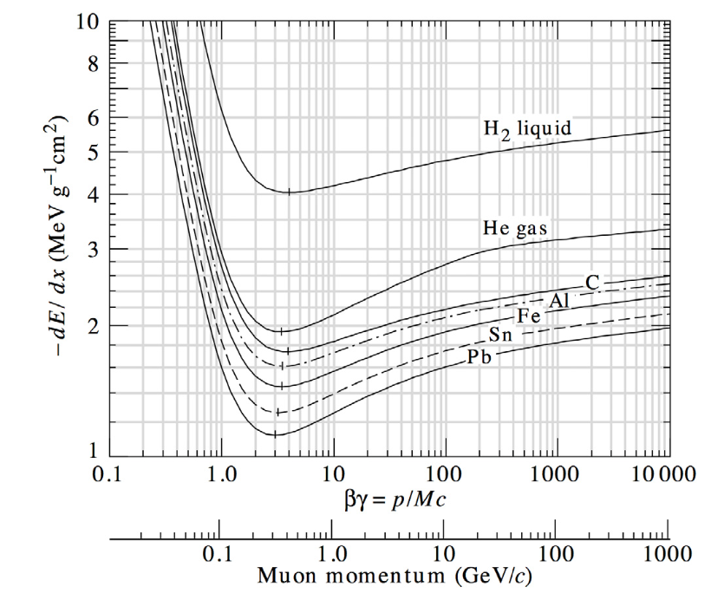
Cosmic rays cascades
Primary cosmic rays
  85% protons
  12% α particles
  3% heavier particles
At altitudes between 15-20 km they interact in the atmosphere with nuclei initiating electromagnetic or hadronic showers
Secondary cosmic rays can survive enough to reach Earth’s surface
At the sea level, 80% of all the charged particles hitting the ground are MUONS
Typical flux of vertical muons: 1/cm²/min
The flux depends on the momentum and the zenith angle θ: I(θ)~I(θ=0) cos² θ at the sea level for muons momenta ~ 3 GeV

Slide 16
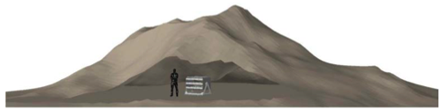
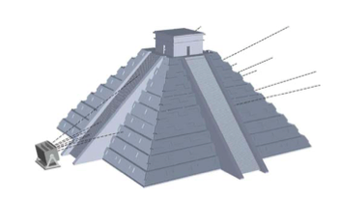
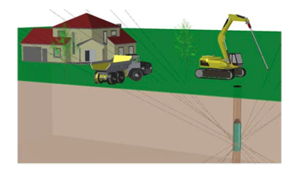
Types of Muography
Depending on the specific situation, three types of radiographic setup can be used
  to map the overburden of natural or artificial cavities such as caverns or tunnels
  search for hidden chambers in pyramids in Egypt and Mexico
    longer data taking
  A borehole can be used to host a small sized muon detector with cylindrical shape

Slide 17
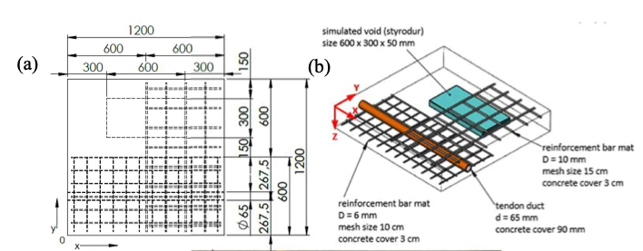
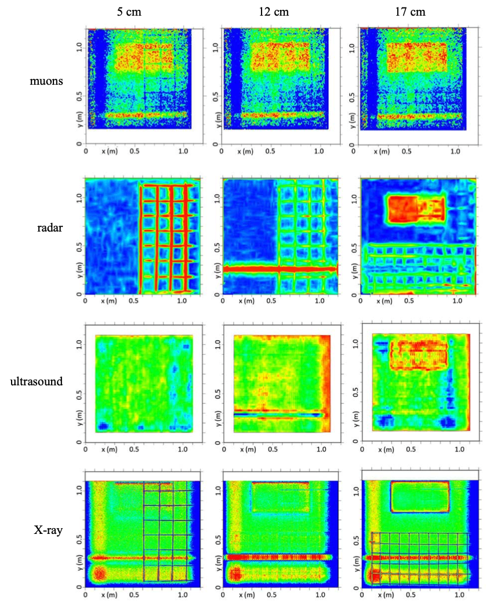
Advantages of muography wrt other techniques
Conventional Techniques & Their Boundaries:
  Radar: Effective but limited to a penetration depth of about two meters. Inadequate for imaging thick walls, deep pipelines, or structures buried beyond this depth.
  Ultrasound: Offers detailed insights but can be noisy and prone to echoes and self-interference, especially in dense materials, leading to unclear images.
  X-rays: Provide crisp, detailed images quickly but pose significant health risks due to radiation exposure. Needs extensive paperwork for safety permits.
    Not suitable for penetrating dense and extended materials
FROM: IAEA REPORT IAEA-TECDOC-2012

Slide 18
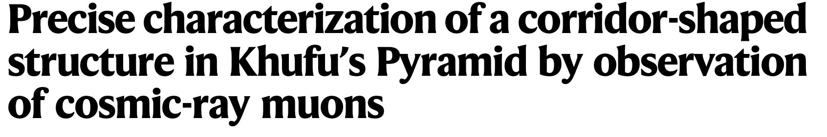
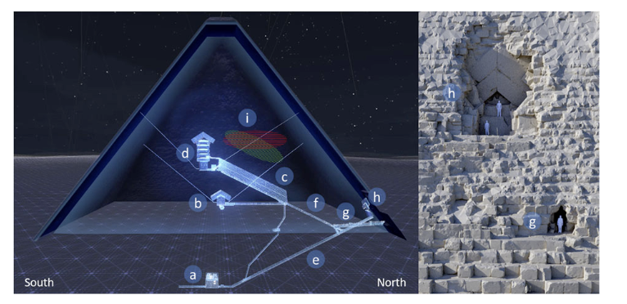

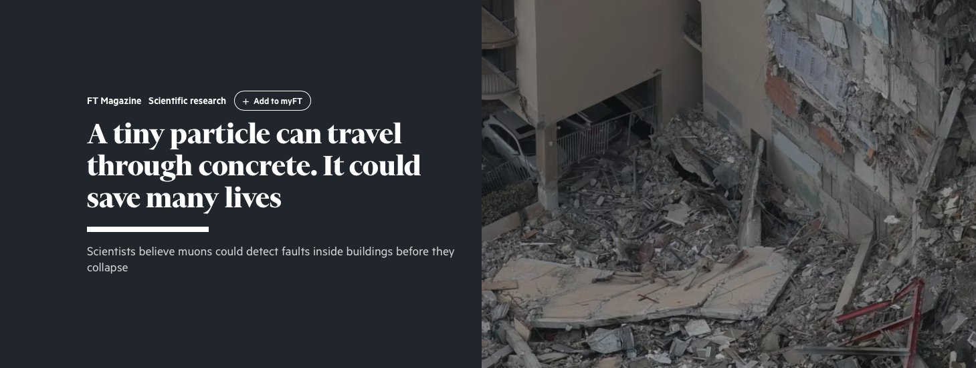
Muography applications
1955: Proposed by E. P. George to determine the thickness of snow layers on a mountain
Archaeology
  from 1971: Search of unknown burial cavities in the Chephren pyramid (L. Alvarez and coll.)
Volcanology (lateral)
  from 2003: Study of the internal structure of volcanoes (Tanaka and coll.)
Civil engineering and underground
  imaging of concrete structures, bridges, monitoring of historical buildings, tunnel boring machines
Industrial
  Process monitoring, Preventive maintenance, production optimization

Slide 19
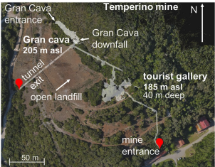
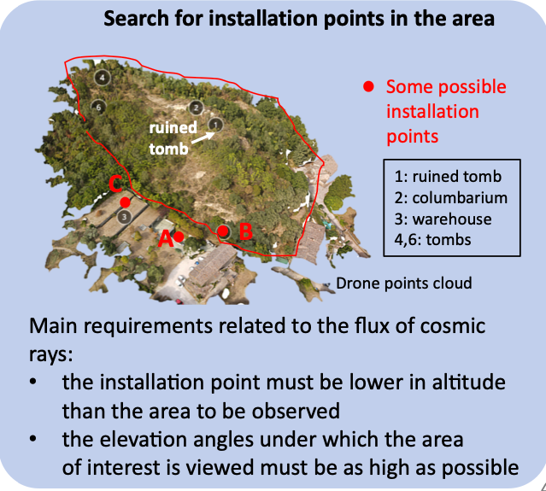
Typical measurement time
https://www.nature.com/articles/s41598-022-26393-7
Numbers received by R. d’Alessandro (thanks!)
Temperino mine (Tuscany, Italy)
  In cave, 30-50 m rocky overburden, difficult access, MIMA-like detector (40x40 cm2), 4 weeks for each measurement point.
Palazzone necropolis site (Perugia, Italy)
  Side protected towards the hill
  used MIMA, measurement time 6-8 weeks (more inclined and greater thickness of rock to cross).
Using other types of detector
  MIMONE type (64x64cm2) reduces a factor of 2.5 the measurement time
  BLEMAB type (80x80cm2) reduces a factor of 4 the measurement time

Slide 20
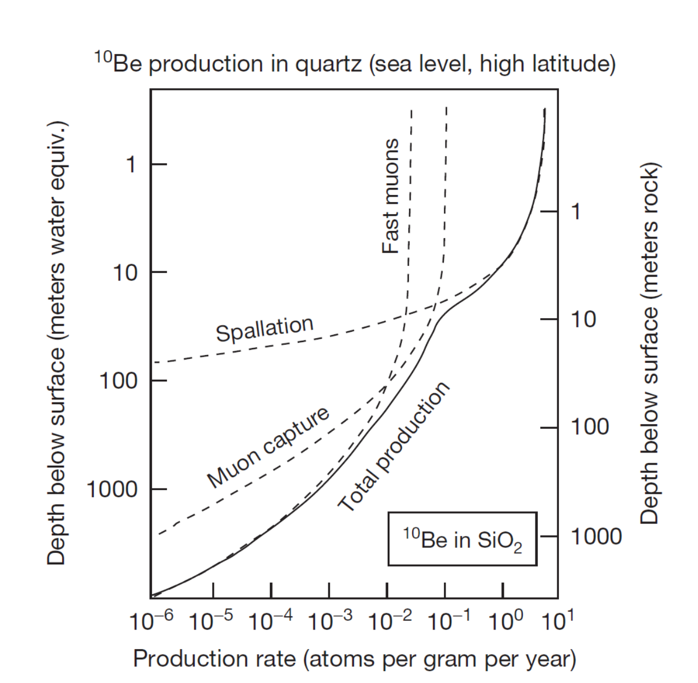
Muography and geodating
Cosmic rays products reaching the soil can produce nuclides
  Spallation of high energy neutrons
    ¹⁶O(n,4p3n)¹⁰Be
    ²⁸Si(n,p2n)²⁶Al
  Slow neutron capture
  Slow μ⁻ capture
  Fast muon interaction → BS – photons → photoneutrons (depth > 20m)
Measuring the relative abundance and the ratio of long-lived nuclides as ¹⁰Be (1.4 Myears) or ²⁶Al (0.71 Myears) is a commonly used technique for geodating
  Experimental measurement of the muon fluxes (and spectra) at the surface and in cave are needed (together to MC modeling) to extract the dating
Measure initially proposed by Dr. T. Makhubela, Geology dpt. of Uni. of Johannesburg
Feasibility using only muon flux measurements on surface and in cave must be studied
Other groups interested
  Univ of Johannesburg
  INFN Bologna
  Ithemba/Wits
Precision needed for dating must be assessed and then feasibility studies must be performed

Slide 21
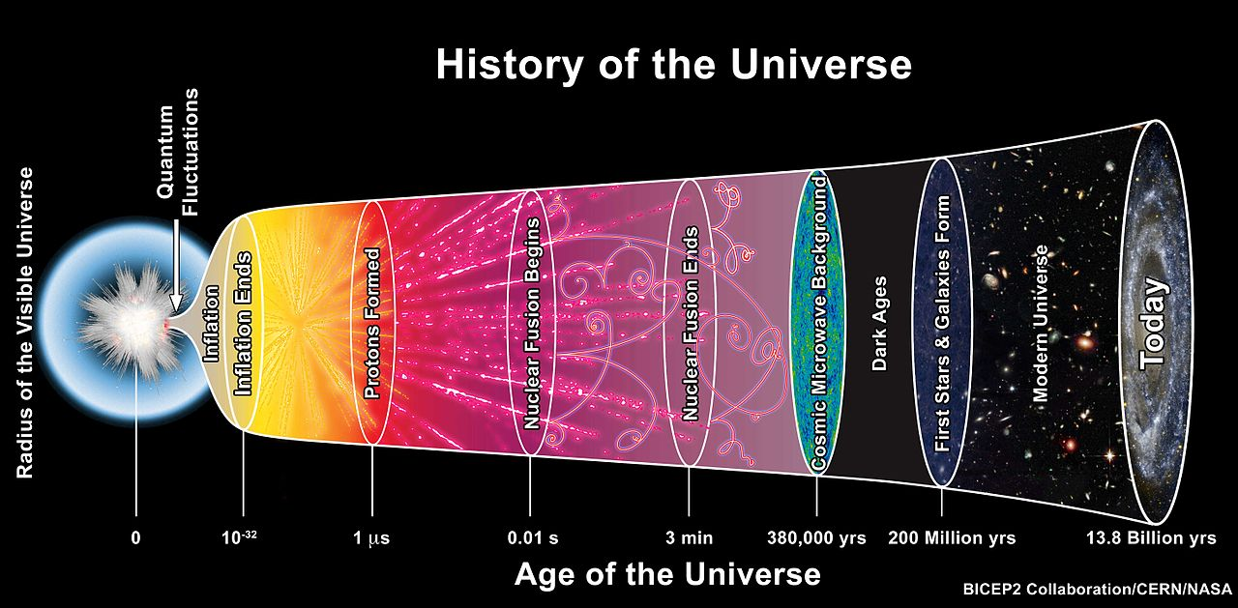
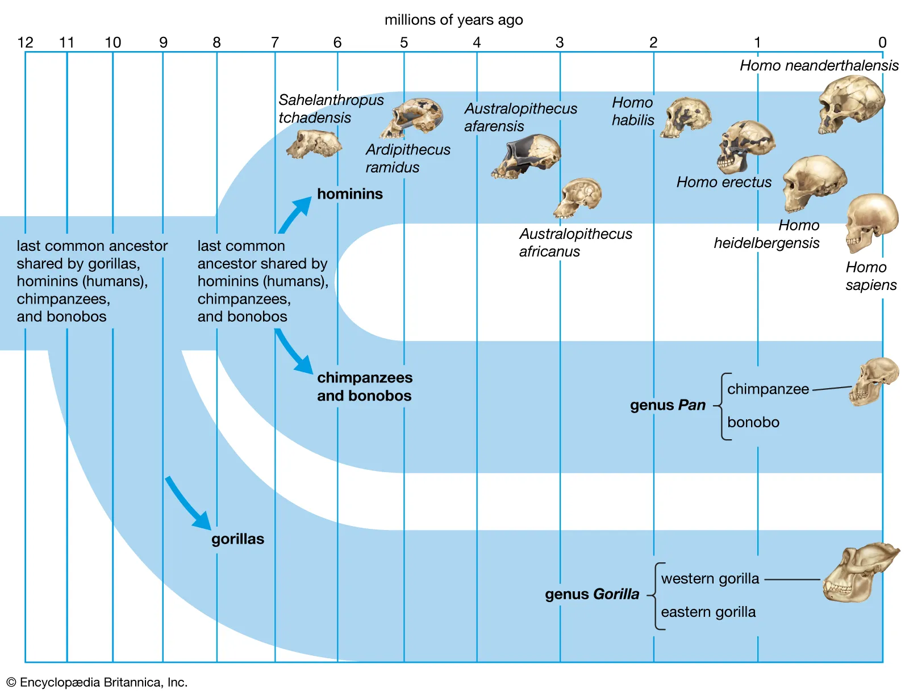
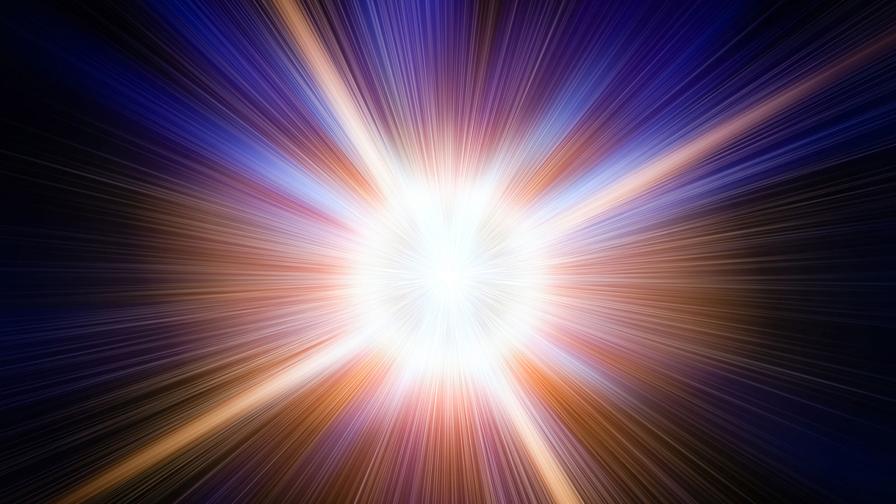
Scientific Impact of this project
The Big Bang: The Universe's Origin
  Understanding the Big Bang helps scientists explore fundamental questions about the universe's origin, composition, and eventual fate.
Emergence of Humanoids: The Human Big Bang
  Studying the 'human Big Bang' sheds light on human nature, social structures, and the development of civilizations.
Common points
  Both events represent critical thresholds that led to vast expansions in complexity and diversity — in the universe at large and within the realm of human ancestry.
Scientific impact
  Studying these pivotal moments not only enhances our understanding of the cosmos and ourselves but also underscores the interconnectedness of all things in the mosaic of existence.
  Muon imaging, in its capacity to unveil hidden chambers within the Rising Star cave system, is as revolutionary to paleontology as the LHC it has been for the discovery of the Higgs Boson in particle physics!
Muon Imaging in the Rising Star cave systems gives a unique opportunity to all of this!

Slide 22
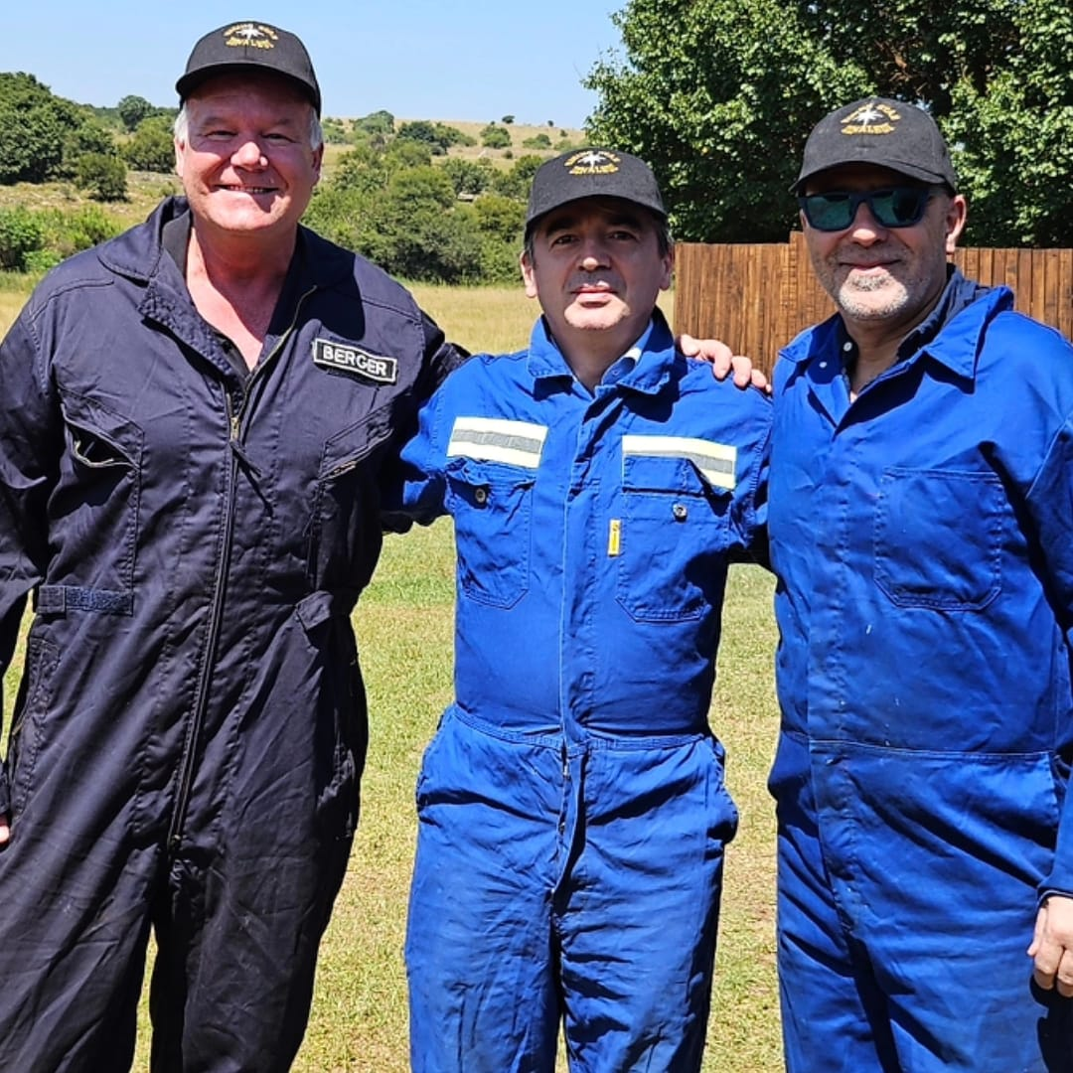
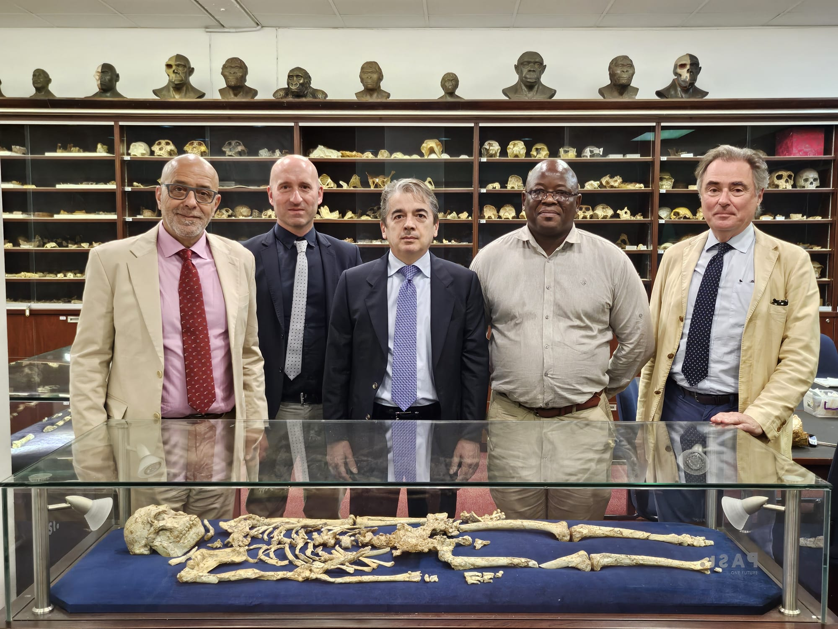
Present interested groups composition
INFN
  Supported by the directors of Bologna, Firenze and LNL: E. Scapparone, G. Passaleva, F. Azaiez
  Bologna
    MB, B. Giacobbe, M. Sioli
  Firenze
    R. D’Alessandro, L. Bonechi
Big world experts in palaeontology, archaeology and anthropology express a strong interest to participate
  Prof. Lee Berger (NG), Prof. John Hawks (Wisconsin Uni.), Prof. Tracy Kivell (MPI)
  Regular meetings started since October 2023

Slide 23

Collaboration INFN-ITHEMBA LABS
Since September 2022 there is an updated (after the 2013 one) and agreed MoU between INFN and ITHEMBA LABS
Joint research on new topics may be included in this collaboration program after mutual discussion and approval by both Parties, in line with the period of this MoU
The existence of this MoU will make easier the possibility collaboration between the two groups
    possibility to have a space where to store and test the detector before the measurement starts
This project gives a great opportunity to start a fruitful collaboration between the two parts
The part concerning the geodating using muons is most likely the most promising

Slide 24
Useful links
A Google Doc Folder has been setup which contains the proposal plus other relevant documents
  Regularly updated
  https://drive.google.com/drive/folders/1aMP_zXJXw1S0-AaBuSJuKtYfldtC3-HQ

Slide 25
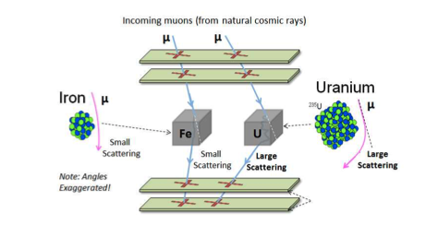
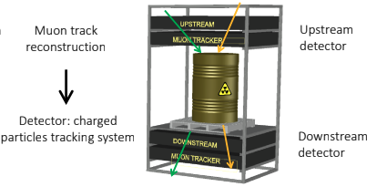
Muon Scattering Tomography
Introduction to MST:
  Developed in 2003, Muon Scattering Tomography (MST) is a relatively recent technique compared to muography, offering high-precision imaging by exploiting Coulomb scattering of muons.
  Utilized in fields requiring the distinction between high-Z (atomic number) and low-Z materials, such as cargo scanning for nuclear material prevention and interrogation of nuclear waste casks.
Working Principle:
  MST is based on the interaction of muons with nuclei. As muons pass close to a nucleus, they experience significant electromagnetic interaction, a concept known for over a century since the experiments of Geiger, Marsden, and Rutherford.
  The strength of this interaction varies with the electric charge of the nucleus, making it possible to distinguish between different materials based on the root-mean-square deflection of muons.
Applications and Advantages:
  MST's intrinsic ability to discriminate materials by atomic number makes it invaluable for nuclear waste characterization, security, and material control.
  Used in the development of 'muon portals' for cargo scanning and nuclear waste interrogation, enhancing safety and security in crucial sectors.

Slide 26
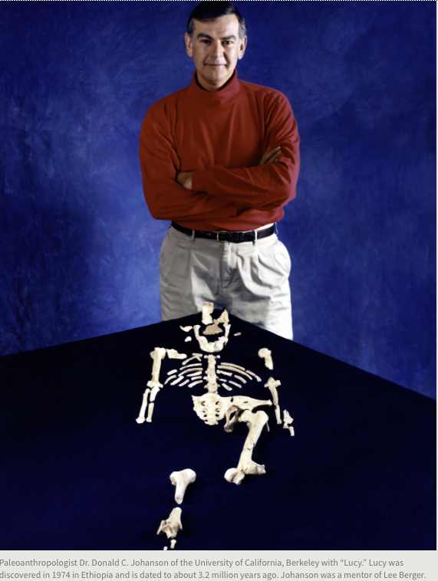
Something about our Palaeontology counterpart
Lee ”Rod” Berger is a world-famous and prizes-winner palaeontologist
His CV and carrier scientific achievements can be found here
In 2008 he discovered some rests of hominid later classified as Australopithecus sediba
  transitional stage between Australopithecus Africanus and Homo erectus
In Autumn 2013, Lee Berger led an excavation at the Rising Star cave complex in the Cradle of Humankind, and recovered more than 1500 hominid fossils, representing 15 or more individuals
  They belong to an unknown hominid species named Homo Naledi (200-300 kY old) , whose characteristics do not fit in the present scheme of the human evolution
In March 2023, Berger was appointed National Geographic Society Explorer in Residence and staff member.

Slide 27
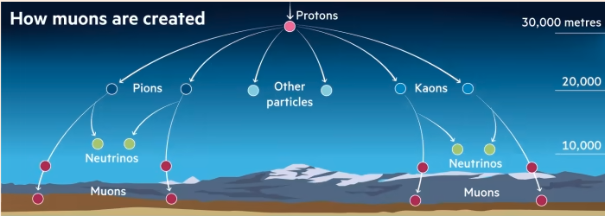
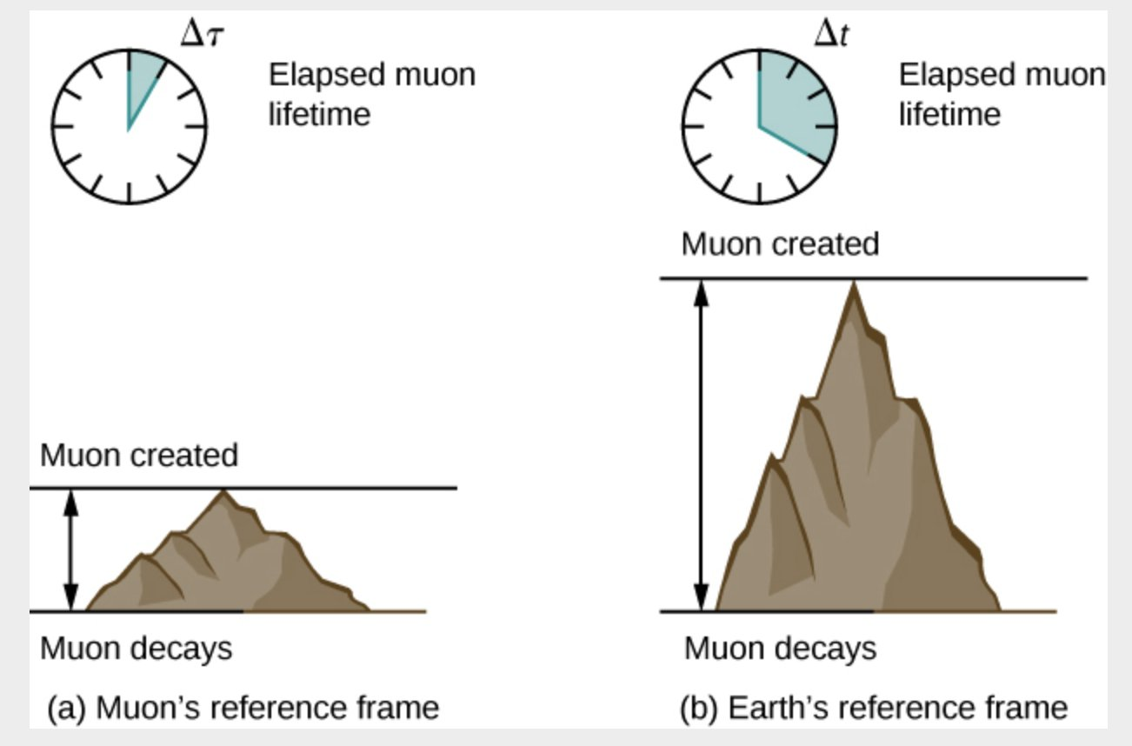
What are muons?
Muons: The Cosmic Messengers
  Muons are subatomic particles similar to electrons but heavier.
  Originating from cosmic rays that constantly bombard Earth from space.
Penetrating Power
  Muons can penetrate through materials like rock, metal, and other dense substances.
  Their ability to pass through objects makes them useful for imaging.
Remarkable Lifetime
  Despite being unstable, muons have a relatively long lifetime (2.2 microseconds) at rest, allowing them to reach the Earth's surface from the upper atmosphere.
  Their longevity at high speed enable them to travel significant distances (even kilometers!) before decaying, making them excellent probes for imaging.

Slide 28
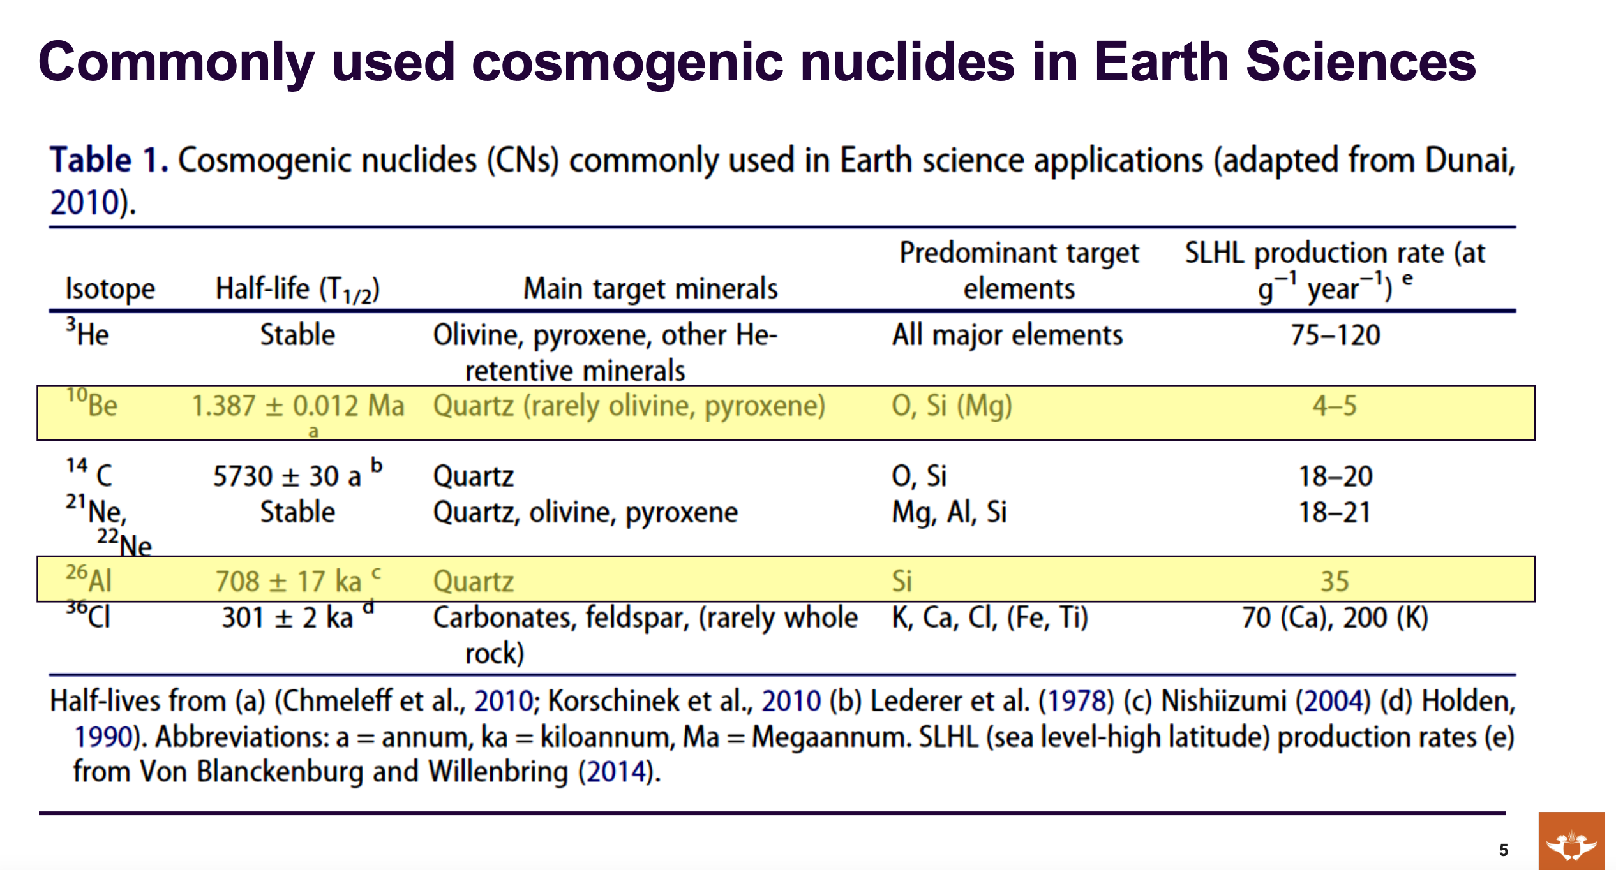

Slide 29
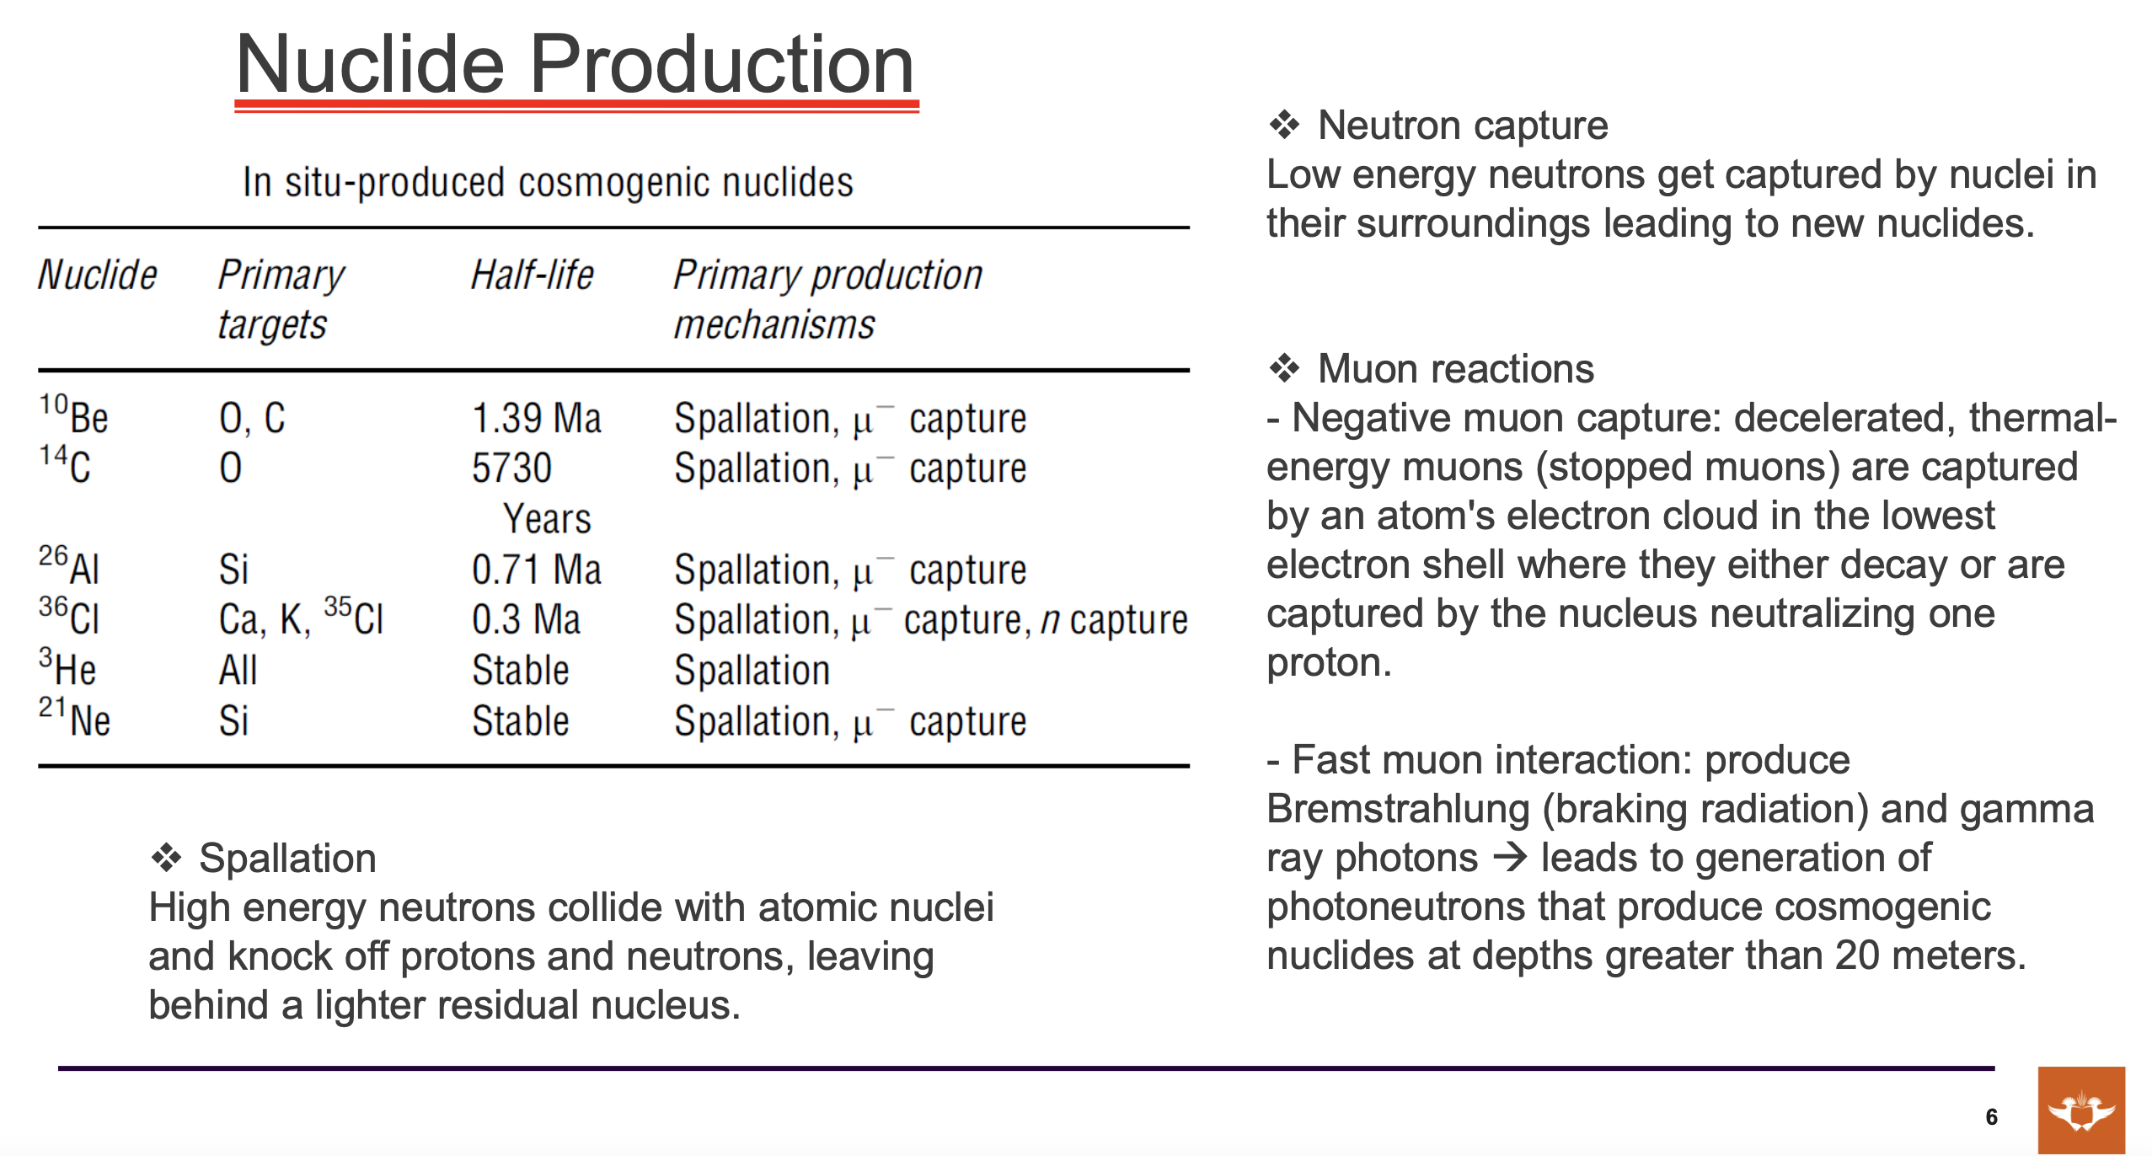

Slide 30
