Slide 1
Analysis of astrophysical phenomena using efficient and parallelized models on HPC computing systems.
Saim Ali Supervisor: Fabio Vitello University of Padova Co-supervisor: Eva Sciacca
INAF Catania
PhD course of National Interest in Technologies for Fundamental Research in Physics and Astrophysics

Slide 2
Outlines
Introduction
Data Used
Tools
Current Work
Future Plan
Challenges faced
Courses attended
School/Workshop
Conclusion

Slide 3
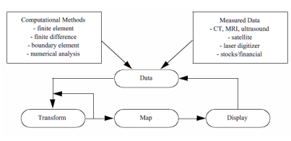
Introduction
The aim is to design and develop efficient and parallelized models for big data analysis, leveraging advanced visualization techniques and algorithmic solutions on modern HPC computing systems.
This endeavor focuses on discovering astrophysical patterns from cosmological simulations.
Focused on creating innovative solutions using different algorithms for processing large datasets and accelerating computation and AI libraries.

Slide 4
Some Images generated with VisIVO server
Spot on a stellar surface, data from
catalogue and from a cosmological simulations.

Slide 5
Data for this project
The data for this research is provided in Gadget format from DEMNUni simulations.
These simulations use the Tree Particle Mesh-Smoothed Particle Hydrodynamics (TreePM-SPH) code GADGET-3.
The DEMNUni suite consists of large-scale cosmological N-body simulations, referred to as the "Dark Energy and Massive Neutrino Universe" (DEMNUni).

Slide 6
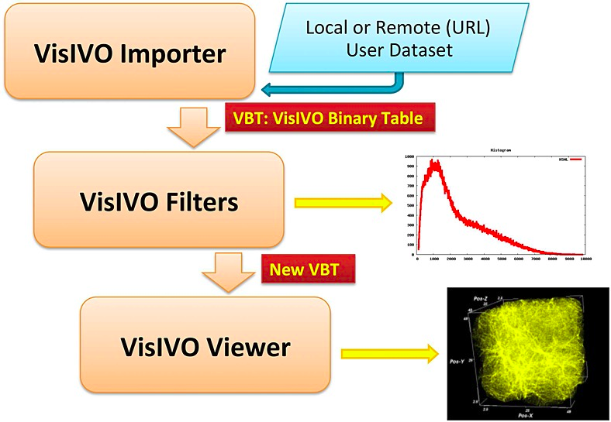
Tool:
VisIVO Server: An open-source platform for data analysis and scientific visualization, designed for the fast rendering of 3D views of astrophysical datasets.
VisIVO Importer, Converts user
datasets into a simple data format
used by VisIVO Filter
VisIVO Filter, a collection of data
processing modules that construct
data tables from the tables produced by VisIVO Importer
VisIVO Viewer, which generates
3D visualizations of astrophysical datasets.
Notes:
i

Slide 7
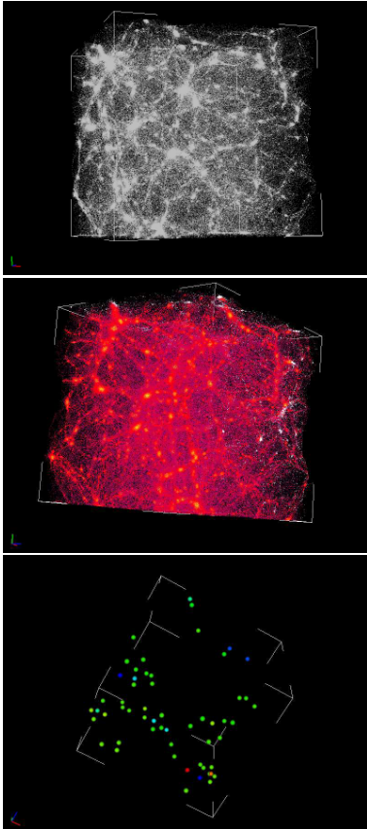
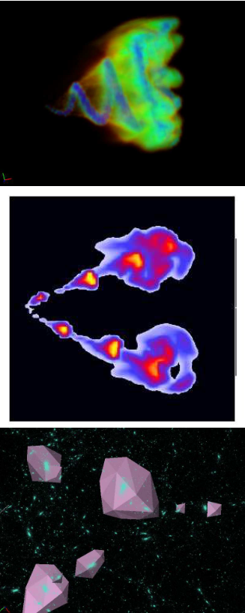
VisIVO Viewer Data Points Views/ Volume Views
A cosmological N-body
simulation containing 4
million elements
Volume rendering of
relativistic electron-positron
plasma flow emitted by an
active galactic nucleus
containing a black hole.

Slide 8
Point Distribute Filter
The VisIVO Server provides a variety of filters, with my research focusing on the Point Distribute Filter.
This filter generates a table representing a volume derived from selected fields of the input table,
distributed using the NGP (Nearest Grid Point), CIC (Cloud-In-Cell, default), or TSC (Triangular Shaped Cloud) algorithms.

Slide 9
CIC (clouds-in-cells method) algorithm
A popular technique in computational astrophysics and particle physics for assigning values from discrete particles to a grid, and vice versa.
It is commonly used in N-body simulations to interpolate properties like mass, density, and forces between particles and grid points.
The method balances computational efficiency and accuracy, making it suitable for large-scale simulations.
Overview of the CIC Algorithm
Grid Initialization:
Particle Assignment:
Weight Calculation:
1D Interpolation:
Mass Distribution:

Slide 10
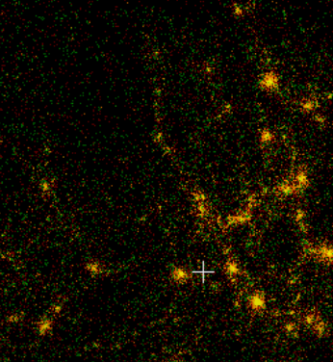
GADGET
Cosmological N body simulation code.
To simulate formation and evolution of the structure of the universe Such as galaxies, clusters, large scale cos structure.
This code will output some
snapshots of simulations in
HDF5 format.
Algorithm:
TreePM:
Tree: short range gravitational interactions with high accuracy by organizing particles into hierarchical structure.
Particle Mesh: For long range interactions with high accuracy.

Slide 11
VBT (VisIVO Binary Table)
VBT : Format used to store tabular data efficiency.
It is suited for handling large data sets. Which are common in astrophysical research.
Key features.
Efficient storage:
Support for complex data:
Compatibility with VisIVO TOOLS:
Binary tables are fully supported by VisIVO tools ensuring integration for visualization and analysis tasks.

Slide 12
Current Work:
To enhance the efficiency of the Point Distribute Filter, a strategy for parallelization using MPI (Message Passing Interface) and OpenMP (Open Multi-Processing) will be developed.
Data Distribution with MPI
The data will be divided into smaller subgroups using MPI. This involves breaking the set of points into manageable chunks.
MPI_Scatter will be used to distribute these subgroups of points to different MPI processes.
Each process will handle a portion of the dataset and perform the filtering operations.

Slide 13
Parallel Processing with OpenMP
Within each MPI process, OpenMP will be employed to parallelize the filtering tasks.
The #pragma omp parallel directive will create multiple threads to manage the workload efficiently.
The loop that processes the points will be parallelized using OpenMP to ensure that each thread handles a segment of the points.

Slide 14
Data Collection and Communication
After filtering, the results from each MPI process need to be gathered.
MPI_Gather can be used to collect the processed points back to a single process, if necessary, or to distribute them to all processes as required.
Effective load balancing, minimizing communication overhead, and managing data dependencies are crucial for optimizing performance.

Slide 15
Future work:
The implementation of the openMP and MPI parallelization is the most important task I have to do in my 2nd year of PhD.
I also need to write a strategy for the Openacc, and see the solutions for it.
OpenACC (Open Accelerators) is a directive-based parallel programming model that allows us to easily offload code to accelerators like GPUs.
Designed to help optimize performance on heterogeneous systems
At last but not the least i have to Compare the two solutions and write a paper on this.

Slide 16
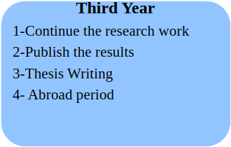
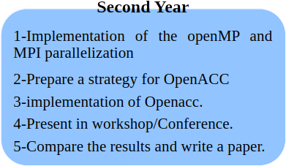
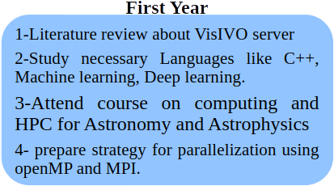
Overall Planning for the PhD

Slide 17
Challenges faced
My Background is not from Computer Science as I did my Bachelor and Master Degrees in Physics.
In My Master i worked on different analysis and simulations in High energy Physics.
But still I faced a lot of challenges while working on my Phd research project because it is focused on advanced Visualization techniques which i never used before.
My Phd research work is focused on using parallelization models on HPC computing systems,which i never used before.
Most importantly i arrived late in may 2024 due the Visa Issues in Pakistan.
So i attended my two courses from pakistan, and also study the research materials in parallel.
Everything is possible under the Sky

Slide 18
Courses/School
Courses Attended
Machine learning for Physics, preparation for Exam
High energy physics detectors in space, Exam passed
Deep network and structure learning, Exam passed
To be attended
Machine learning programming for physics, starting in oct
Statistical learning Not yet

Slide 19
School/Workshop
Attended
Bologna/Course on computing and HPC for Astronomy and Astrophysics.
To be attended.
Towards exascale-ready astrophysics" — virtual workshop on computational astrophysics and cosmology
INAF OACT/ Workshop on Astrostatistics
CERN/Scientific computing workshop for High energy physics
Stockholm/Physics of machine learning and machine learning for physics.
ICTP/A hands on workshop on machine learning with R/Python.

Slide 20
Conclusion
VisIVO Server is a suite of software tools for creating customized views of 3D renderings from astrophysical data tables.
Point Distribute Filter generates a table representing a volume derived from selected fields of the input table.
CIC used in N-body simulations to interpolate properties between particles and grid.
To enhance the efficiency of the Point Distribute Filter, a strategy for parallelization using MPI and OpenMP is developed.
A strategy will be develop for the Openacc.
I faced a lot of challenges while starting my Phd Project, i worked on analysis but not on parallel computing before.

