Slide 1
First Year Presentation
Presented By: Saba Imtiaz
Research Group Head: Dr Paolo Soffitta
Supervisor: Dr Fabio Muleri

Slide 2
9 DEC, 2021
IXPE Launch

Slide 3
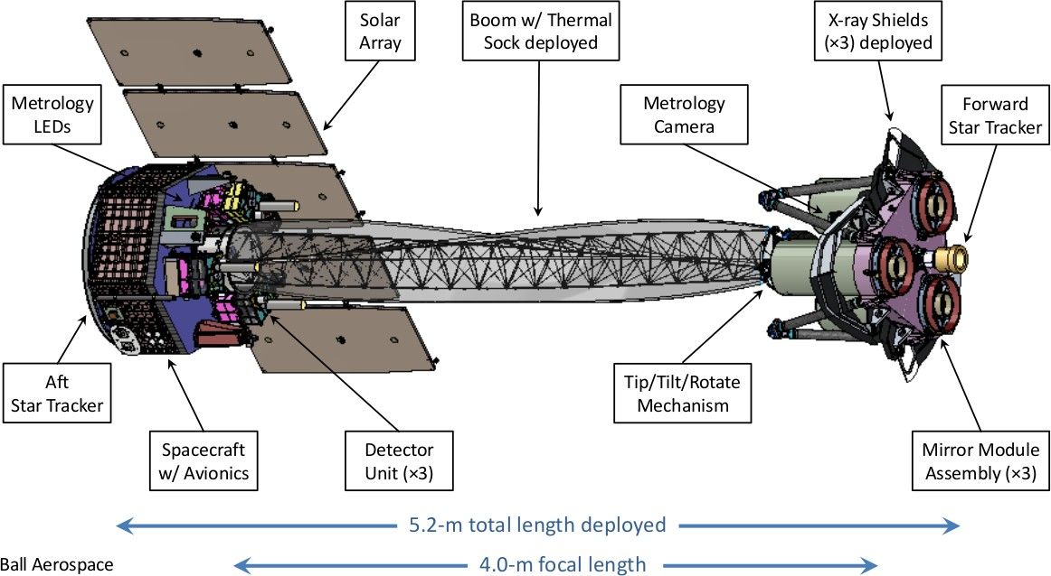
What is IXPE?
Introduction:
IXPE is a pioneering mission designed to measure X ray polarization in the 2-8KeV range revealing critical insights into the nature of black holes, neutron stars, supernova remnants, and other cosmic phenomena.
Current Limitations of IXPE in X-ray Polarization:
(i) Limited to 2-8 keV, missing key polarization data at other X-ray energies.
(ii) Challenges in detecting faint X-ray sources and managing background noise.
(iii) Cannot achieve high-resolution polarization imaging, affecting detailed study of extended X-ray sources like supernova remnants.
Overview of the Observatory
IXPE
My Project is my Passion
NASA+ASI

Slide 4
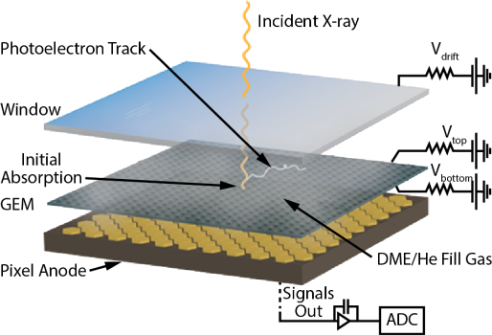
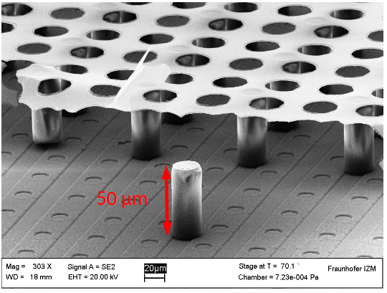
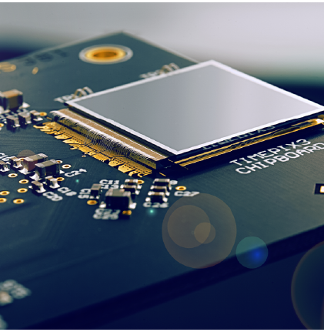
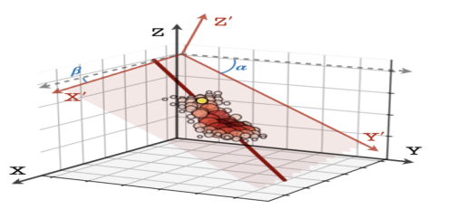
Expanding X-ray Polarimetry Capabilities beyond IXPE
Enhancements with TimePix3
(i) Negligible dead time.
(ii) Simultaneous time and energy per pixel.
Advancing with GridPix Technology
(i) Unlike GPDs,GridPix offers, precise 3D reconstruction of electron tracks, enhancing polarization measurement accuracy.
(ii) Achieve larger modulation, improving sensitivity across a wider energy range (2-8 & 6-35 keV).
(ii) Improve energy resolution
(iv) Increase effective area
GPD
3D track of Photo- electron
Gridpix Detector
TimePix3
IXPE
My Project is my Passion
NASA-ASI

Slide 5
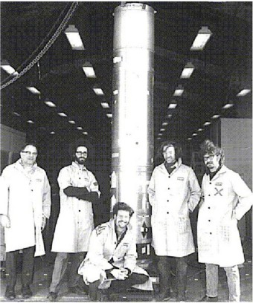
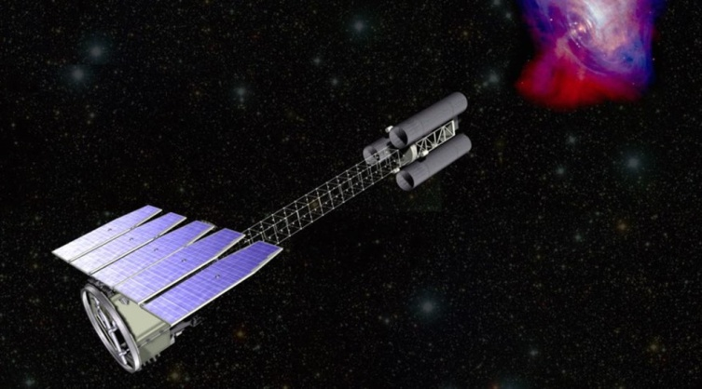
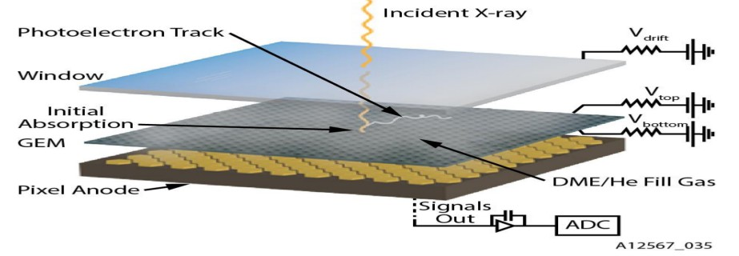
Whats been Done? and Whats Next?
First X-ray polarimeters flown on sounding rockets.
Angel et al. 1969 Wolff et al. 1970
Dark age: many X-ray polarimeters developed, none flown…
e.g. Kaaret et al. 1989
IXPE
Enhancement with TimePix3
Novick 1970
Tindo et al. 1970
Novick et al. 1972
1969 – 1972 1976
...
2000-2017
My Work now ,after IXPE
OSO-8: First significative detection of X- ray polarization from the Crab Nebula.
Weisskopf et al. 1976 Weisskopf et al. 1978
GPD
Offer Gridpix , unlike of GPD
IXPE
My Project is my Passion
NASA-ASI

Slide 6
Courses and Exams Passed
Course Title | Credit Hours | Status
Front End Electronics and DAQ System for Radiation Dectection HE5 | 1.5 | Passed
Advanced Electronics Sensing Devices | 2 | Passed
Gaseous Dectector for Experimental Particle Physics | 2.5 | Continue
Machine Learning Programming in Physics | 2.5 | Start from 1st Oct
Additional Courses
Design of Readout Integrated Circuits for Particle Detector | 2.5 | Start from 4th Nov
Italain Language Course | ---- | Continue
more than 10
I will Complete
11 Credit Hours till 2nd NOV 2024
More than 10

Slide 7
Publication,Period Abroad, School…..
Soffitta, P., Costa, E., De Angelis, N., Del Monte, E., Desch, Muleri,F., Imtiaz, S.,Di Marco, .......& Weisskopf, M. C. (2024). Considerations on Possible Directions for a Wide Band Polarimetry X-ray Mission. Galaxies, 12(4), 47.
University of Bonn Period abroad for research work.
Possibile School on x ray polarimetery(detectors and astrophysics)
Student: Saba Imtiaz
INAF-IAPS-ROMA
NASA+ASI

Slide 8
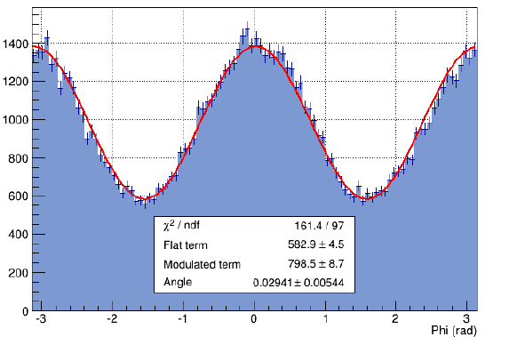
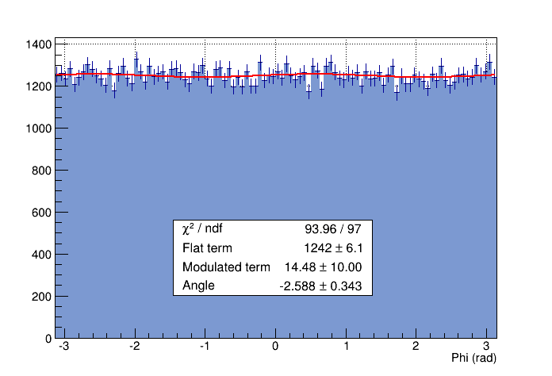
Objectives & Aims for my 2nd year of PHD
Aim:
study of the architecture and the performance of TimePIX3 ASIC
Specific objectives:
Data analysis of the GridPix with TimePIX3 data.
(i) Response to Polarized Radiation
(ii) Response to charge accumulation and gain variation.
(iii) Response to high count-rate
(iv) Response to unpolarized Radiation
Monte Carlo Simulation of GridPix response to Polarized Radiation by
GEANT4 at
(i) Different gas mixture.
(ii) Different Pressure.
(iii) Different Drift thickness
Polarized photons:
Modulation curve
φ
P
Unpolarized photons:
Flat response
Student:Saba Imtiaz
University of Padua
2nd Year

Slide 9
Conferences and Seminar
INAF-OAPD Seminar
Bologna Joint Astrophsical Colloquium
IFPU Colloquium
Osservatorio Astronamico di Roma
INAF-IAPS seminars
Plan for the final Year of PHD
.
Refinements and Conclusion of second year Actvities
Performance evaluation of various mission concepts using an enhanced detector
Thesis Writing and finalize
Preparation of Manuscripts for Publication
Student: Saba Imtiaz
University of Padua
38th Cycle

Slide 10
Difficulties Encountered During Year
I experienced a long delay in obtaining my visa due to extremely inefficient process of embassy.
Research Work in Parallel of studying the courses and preparation of exams.
Due to first time experience of living abroad, faced fewer issues regarding settlement in new place, new environment, process of documentation in Italy (even you are legal person),language barrier, Medication, etc.…….
Student: Saba Imtiaz
My Project is my Passion
Grazie

