Slide 1
Annual Presentation
Presenter:
Ammad Ul Islam
PhD in Technologies for Fundamental Research in Physics and Astrophysics(Electronics)
Supervisor: Prof. Dr. Andrea Fabbri
Notes:
https://pixabay.com/en/achievement-agreement-business-3481967/

Slide 2
Agenda
01
Personal Information
02
Research Topic
03
Research Objectives/Goals
04
Courses and Activities Planning Year Wise
05
3 Year Planning Gantt Chart
Notes:
https://pixabay.com/en/open-book-library-education-read-1428428/

Slide 3
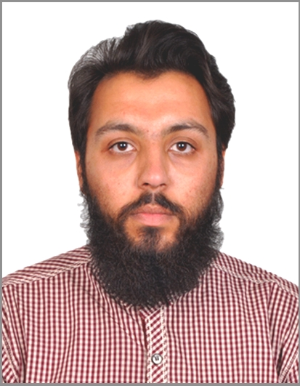
Personal Information
MS Electrical Engineering
Ammad Ul Islam
ammadulislam92@gmail.com
+39 331 281 8761
Swabi, Pakistan
Funded By:
University of Padua
PhD Scholar at
INFN Roma Tre

Slide 4
Research Topic
Research Topic
Pattern Recognition Development on FPGA through AI in Harsh Environment
Project Aim
The project aims to implement pattern recognition algorithms based on artificial intelligence on latest generation FPGA devices. The proposed algorithms will be deployed, A dedicated analysis about TID and SEU will be explored to find which kind of damage can happens and developing methodologies to mitigate such damages.
Research Topic
About the Site
Taishan Antineutrino Observatory (TAO): A satellite experiment of Jiangmen Underground Neutrino Observatory (JUNO)
A ton-level, state-of-the-art liquid scintillator detector with high energy resolution.
Measure reactor neutrino spectrum w/ sub-percent E resolution.
Current Task
Acquisition system of JUNO/TAO Experiment Full chain prototype is present in INFN-Roma3 lab
Investigate optimal filtering solution to improve energy resolution and signal to noise ratio.
Preliminary study regarding trigger algorithms and noise rejection.
Notes:
https://unsplash.com/photos/man-in-blue-scrub-suit-standing-near-white-and-black-office-rolling-chair-UNkNx6Hn9Fs

Slide 5
Research Objectives/Goals
Preprocessing
AI Implementation
Pre processing of Data collected from JUNO/TAO Experimental Setup
Introducing AI for the detection of Photon event.
01
04
Detection of Event
FPGA Implementation
Denoising of the Data and proposing optimum method for the detection of event peaks in the collected signal. (TAO Detector Single Channel)
Research Objectives
Implementation of the Proposed Method on FPGA.
02
05
Expanding to Matrix
Integrating
03
06
Integrating the whole proposed method and finalizing the project.
Proposed trigger algorithms will be Expanded to the whole matrix of 8100 Channels of TAO Detector and testing on the TAO model.

Slide 6
Research Activities During 1st Year
01
Step 01
Experimental setup is visited and site is studied.
Understanding the basic structure and configuration of the JUNO/TAO experiment.
02
Step 02
Data is acquired from experimental setup.
Data Acquisition from the JUNO/TAO Experimental setup.
03
Step 03
Data is loaded, and algorithms will be applied
Pre-processing the acquired data for the purpose to apply trigger algorithm and to test noise rejection techniques.

Slide 7
Courses and Activities Planning of PhD Year Wise
1st Year
2nd Year
3rd Year
Machine Learning For Physics
High Energy Particle Physics Detectors in Space
Advance Scientific Programming in Matlab
Programmable System on Chip(SoC) for data acquisition and Processing
Research Work and Finalization of Thesis
PhD Educational Week
PhD Kick Off Meeting
Abroad Period
Conferences and Workshops
Talks/Presentations
Conferences and Workshops
Talks/Presentations
Final Presentation

Slide 8
3 Years Planning Gantt Chart
2024
2025
2026
Activity
Progress
1
2
3
4
1
2
3
4
1
2
3
4
Main Tasks
Courses
60%
Pre-Processing
25%
Photon Event Detection
15%
Expanding to Matrix
0%
Thesis Writeup
0%
AI and FPGA Implementation
AI Implementation
0%
FPGA Implementation
0%
Integration
0%
Final Thesis & Presentation
0%
Course Work
Research Objective-1
Research Objective-2
Research Objective-3
Thesis
Research Objective-4
Research Objective-5
Research Objective-6

Slide 9
Questions & Feedback
Ammad Ul Islam
University of Padua

