Slide 1
Stock Market &
Finance News
Design and Characterization of a Data Acquisition Board for High Energy Physics Experiment with a 1G/10G Copper/Optical Ethernet Connection
Presented by: Fatima Bzeih
fbzeih@ge.infn.it

Slide 2
Table of Contents
Introduction
Main Objective and Motivation
System Block Diagram
FPGA Architecture
First Year Activities
Second Year Activities
Overall Planning

Slide 3
Introduction
High Energy Physics (HEP)
Study of fundamental particles (quarks, leptons, bosons) and forces (electromagnetism, weak force, strong force, gravity) that govern them.
Goal: Understanding matter, validating theories, discovering new physics, advancing technology.
Importance of DAQ Systems in HEP
Detect, amplify, digitize, and transmit data from particle detectors.
Ensure accurate and efficient data collection for analyzing particle interactions and validating theoretical models.

Slide 4
Introduction
Detection with GEM Detectors
Ionization: A charged particle passing through the detector ionizes the argon gas, creating electron-ion pairs.
Multiplication: The electrons are accelerated by the electric field in the GEM foils, causing further ionizations and producing a cascade of electrons.
Collection: The multiplied electrons are collected, generating a detectable signal.
The gas mixture is 70% Argon (Ar) and 30% Carbon dioxide (CO₂).
Compared with other gases, this gas offers a balanced combination of high ionization efficiency, stable proportional gain… etc.
Amplification with APV Chips
Signal Amplification: Weak signals from the GEM detectors are amplified to detectable levels.
Signal Shaping: The signals are shaped and filtered to improve their quality and reduce noise.

Slide 5
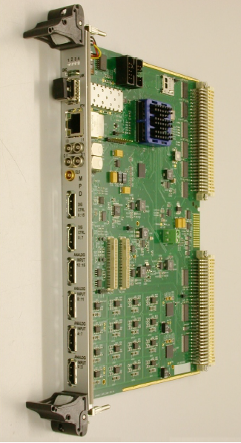
Introduction
Digitization with Multi-Purpose Digitizer (MPD)
Convert the analog signals from APV into digital data, preparing it for further processing and transmission.
Analog-to-Digital Conversion
Data Aggregation: The digital data from multiple channels is formatted for transmission.
Buffering: The digitized data are buffered to manage data flow and prevent loss during transmission.
There is an Existing MPD board that operates with VME.

Slide 6
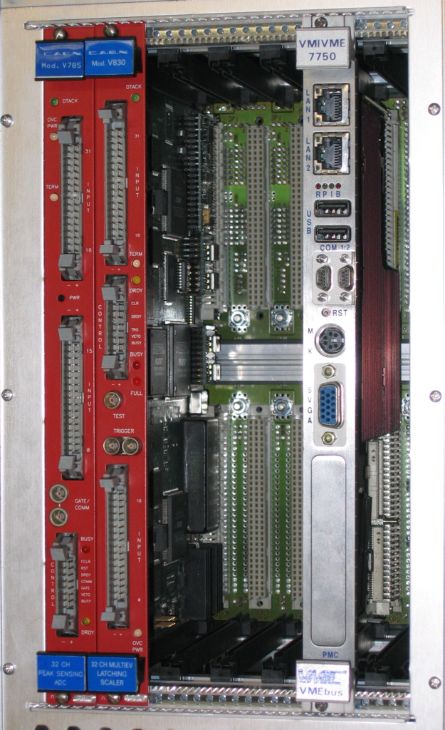
Introduction
Data Transmission with VME
VME Bus: A parallel bus system that allows for high-speed data
transfer between modules.
VME Crate: Houses the MPD modules and other components,
providing power and communication pathways.
Data Controller: Manages data flow and ensures accurate data
transmission.
The buffered digital data from the MPD modules are transferred onto
the VME bus.

Slide 7
Introduction
VME Limitations
The data transfer rate was 40MB/s for the original VMEbus while now it’s up to 320MB/s for advanced VME which is VME320.
This evolution of VME standards, from the original VMEbus to advanced versions of VME320, reflects the growing need for higher data transfer rates.
VME tends to be expensive and traditional.

Slide 8
Introduction
Data Transmission with Ethernet
Ethernet evolution: Fast Ethernet (100Mbps) to 100 Gigabit Ethernet (100Gbps, 12.5GB/s).
Ethernet scales from 1Gbps to 100Gbps, accommodating the high data volumes generated by modern HEP experiments.
Long-Distance Communication: Optical fiber allows for long-distance (several kilometers) data transmission with minimal signal loss, essential for distributed HEP facilities.
Cost-Effectiveness: Drive down costs for Ethernet hardware.

Slide 9
Introduction
Data Acquisition and Control Using FPGA
Real-Time Data Processing: Handle the high-speed streams from detectors.
Parallel Processing: Allow multiple data channels to be processed simultaneously.
Integration with other components: Interface with ADCs…
Trigger System: Implement complex trigger logic to identify and respond to specific events in real time, ensuring that only relevant data is captured and processed.
Data Aggregation and Transmission: Aggregate data from multiple detectors and transmit it over high-speed links Ethernet to PC for further analysis and visualization.

Slide 10
Main Objective and Motivation
Main Objective
Motivation
Transitioning from Traditional Industrial Bus Architecture VME to Network-Based DAQ System Ethernet.
VME Limitations
The maximum speed of the Advanced VME320 is around 320-500+ MB/s.
Expensive
Ethernet
Higher data transfer rate.
Lower cost

Slide 11
System Block Diagram
Power Supply
Clock Generator
Kintex-7 FPGA
GEM Detector
ADC ADS5281
SFP Transceiver
Net
APV
Trigger and System Interface
DAQ
&
CTRL

Slide 12
FPGA Architecture
Data Flow Block Diagram
Histogrammer
ADC Configurator
ADC Serial Data
DESERIALIZER
ADCLK
LCLK
ADCLK (40MHZ)
Channel Processor
0
I²C
Interface
LCLK (240MHZ)
7
ADCLK
0
Channel 0 to 7
7
Trigger Generator
Channel 8 to 15
Event Builder
GbE Fiber Optic
SFP
Ethernet Interface

Slide 13
First Year Activities
Histogrammer
ADC Configurator
ADC Serial Data
DESERIALIZER
ADCLK
LCLK
ADCLK (40MHZ)
Channel Processor
0
I²C
Interface
LCLK (240MHZ)
7
☑
ADCLK
0
Channel 0 to 7
7
Trigger Generator
Channel 8 to 15
Event Builder
GbE Fiber Optic
SFP
Ethernet Interface
☑

Slide 14
First Year Activities
Conference 1: 16th Pisa Meeting on Advanced Detectors.
Type: Participate.
Conference 2: SIE Meeting
Type: Poster Presentation.
Paper Title: Low Power Design of Approximate Adders based on Inexact Full Adder
Objective: Present a poster summarizing part of the master thesis work.
Course Title | Credits | Status
Electronics and Data Acquisition | 2.5 | Preparing for the final exam
Machine Learning programming in physics | 2.5 | Preparing for the final exam

Slide 15
Second Year Activities
Current Work
Study how to utilize Ethernet instead of VME for MPD.
Set up the simulation test bench for it.
Paper Publication: Soon will start to write a paper about the work done which is “Development of a high-performance network-based data acquisition board dedicated to high energy physics experiment”.
The second paper will be about the Performances of a newly developed network-based data acquisition board….
Future Work
Set up the design and start to test it.
Course Title | Credits | Status
Gaseous detector for experimental particle physics | 2.5 | Started from 10th September
Design of readout integrated circuits for particle detector | 2.5 | Start from 4th November
Italian Language Course | - | Start Next week

Slide 16
Overall Planning
First Year
1-Literature review
2-Study necessary knowledge like C Language
3-Start with FPGA Programming
4-Implement ADC Deserializer
5-Implement 1G Ethernet Interface
Second Year
1-Utilize Ethernet instead of VME.
2-Set up simulation test bench for it.
3-Start testing when the MPD board will done, then go to Jlab to test it.
5-Attend a summer school
6-Publish the work done in journals and conferences
Third Year
1-Continue testing to get better performance connected to a real installation.
2-Publish the results
3-Thesis Writing
4- Stay abroad

Slide 17
Thank You
For Your Attention!
Any Questions?

