Slide 1
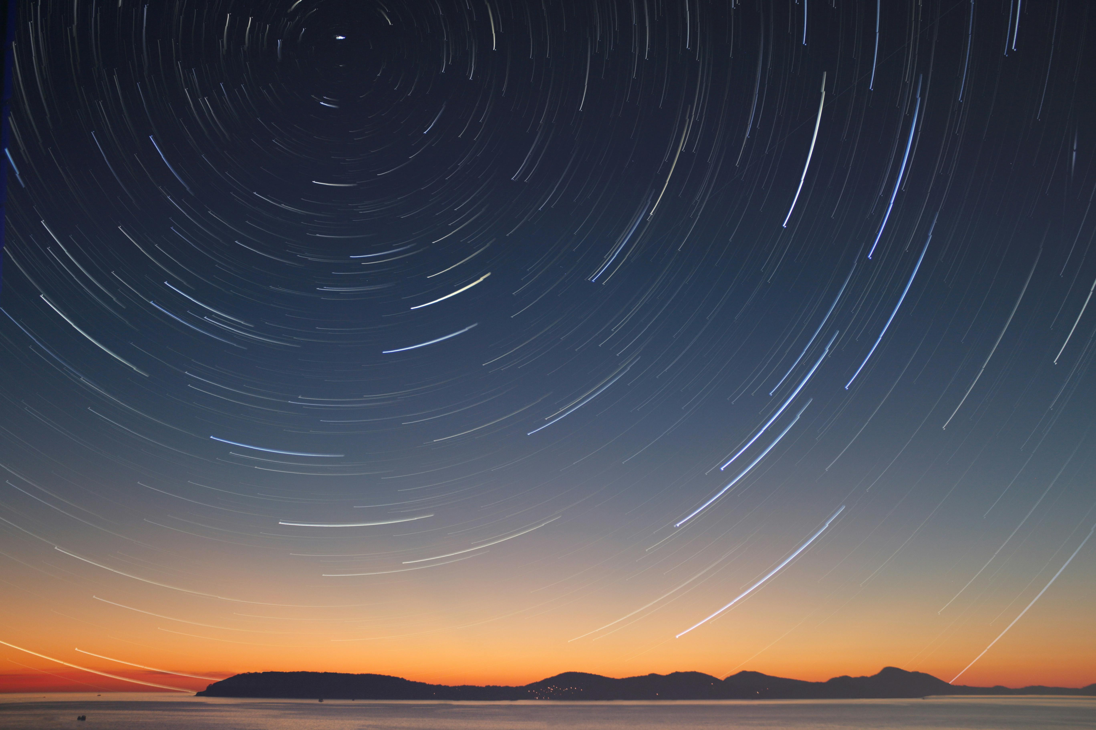
PHD First Year Progress report: Innovative holographic optical elements for modern optical instrumentation: CURRICULUM: Rivelatori, laser e ottica Research Activity location: Observatory di Brera, Merate,milan Student name: Dhiraj Gupta Supervisor: Andrea Bianco 06/09/2024

Slide 2
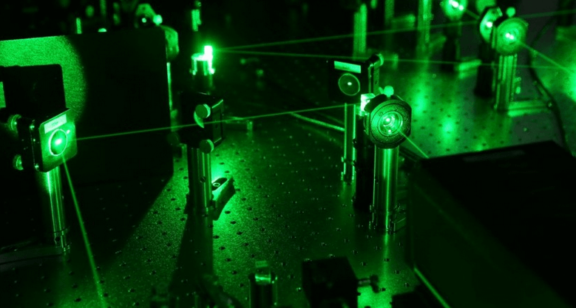
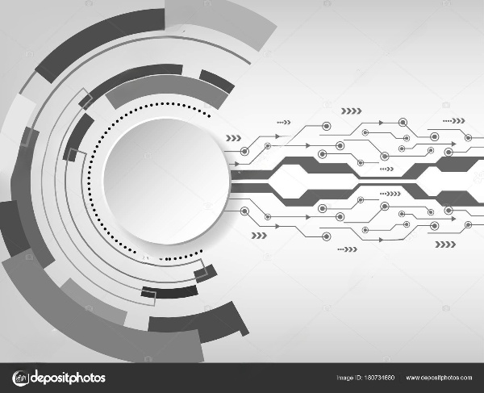
1. Introduction
2. Challenges & Solution
3. Lab work
4. Work at Telescopes
5.Coursework
6. Planning

Slide 3
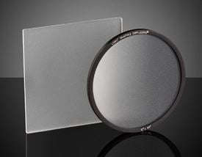
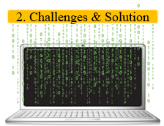
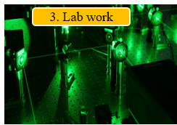
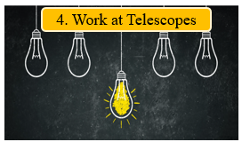
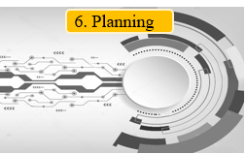
Innovative Holographic Optical Elements for Modern Optical Instrumentation
The PhD thesis focuses on developing Volume Holographic Optical Elements (VHOEs).
The research aims to:
Enhance the Optical Systems: Developing Volume Holographic Optical Elements (VHOEs) with higher efficiency and broader functionality.
Simplify Optical Systems: Create compact, lightweight, and versatile optical systems using VHOEs.
Exploration of Applications: Apply VHOEs in spectroscopy, astronomical instrumentation, adaptive optics, and precise photometry.
VHOE Developments: (Volume Phase Holographic Gratings and Diffuser)
Efficient dispersive Gratings elements for spectroscopy, enhancing resolution and sensitivity in astronomical instrumentation.
Diffuser to be used in Adaptive optics for pyramid wavefront sensors to improve wavefront correction.
Applied for Accurate Photometry of Exoplanets, increasing precision in light measurement.
Holographic Grating
Holographic Diffuser

Slide 4
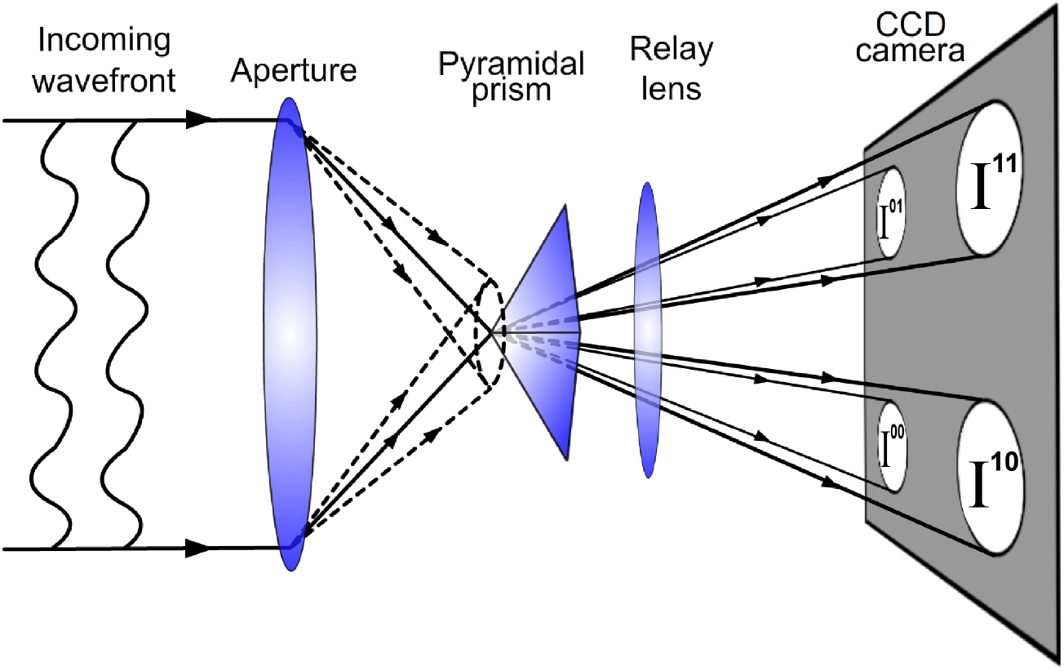
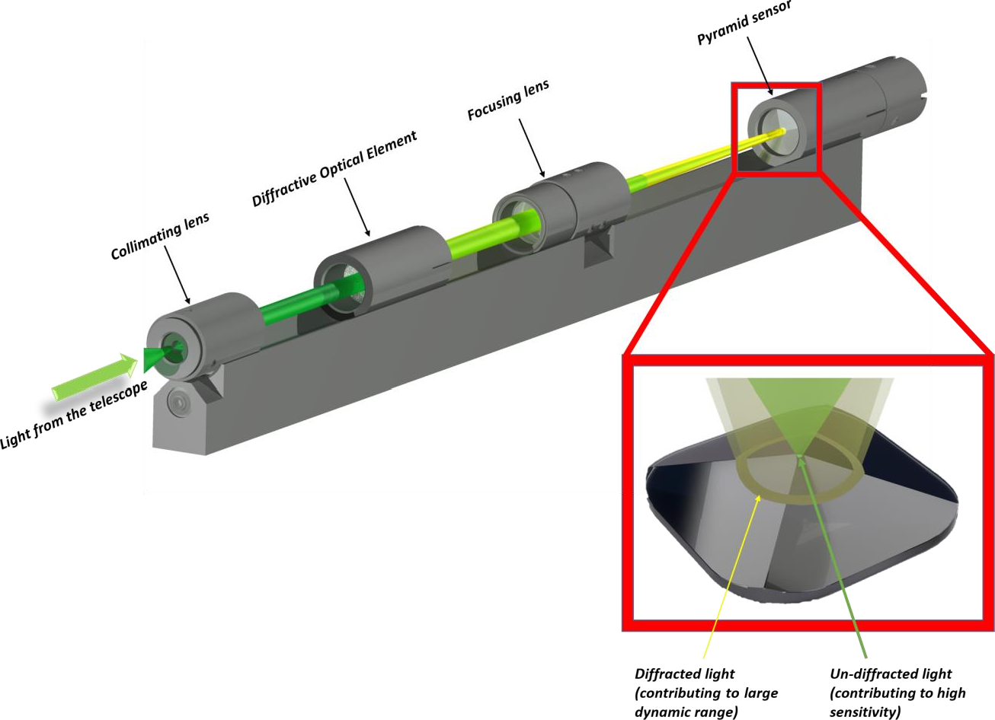
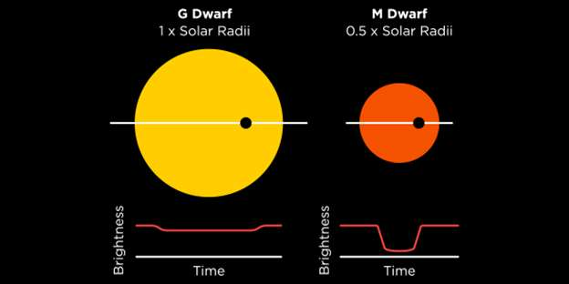
Scientific Challenges and Innovative Solution
Adaptive optics (AO) is a technique that involves deforming a mirror to compensate for light distortion by measuring and correcting distortions in an Incoming wavefront using a wavefront sensor and a deformable mirror.
The Pyramid Wavefront sensor in Adaptive Optics (AO) measures and corrects light distortion using dynamic modulation or by directing the wavefront onto the pyramid tip.
Dynamic modulation involves moving the incoming wavefront around the tip of the pyramid to improve sensitivity, but it requires precise alignment and can be challenging.
Static modulation with a holographic diffuser can stabilize the wavefront, reducing sensitivity to alignment errors and maintaining high sensitivity without dynamic movement.
Holographic diffusers improve accuracy and efficiency in finding and studying exoplanets by controlling light scattering, customizing scattering profiles and being compatible with bright targets.
Photometry is crucial in discovering and characterizing exoplanets.
It helps astronomers find planets, determine their sizes and orbits, and study their atmospheres when used with other methods.
The transit method, which measures the brightness of a star over time, is the most widely used photometric method for detecting exoplanets.
Enhancing photometric accuracy can be challenging when finding stable reference stars near bright targets due to the limited field of view(FOV).

Slide 5
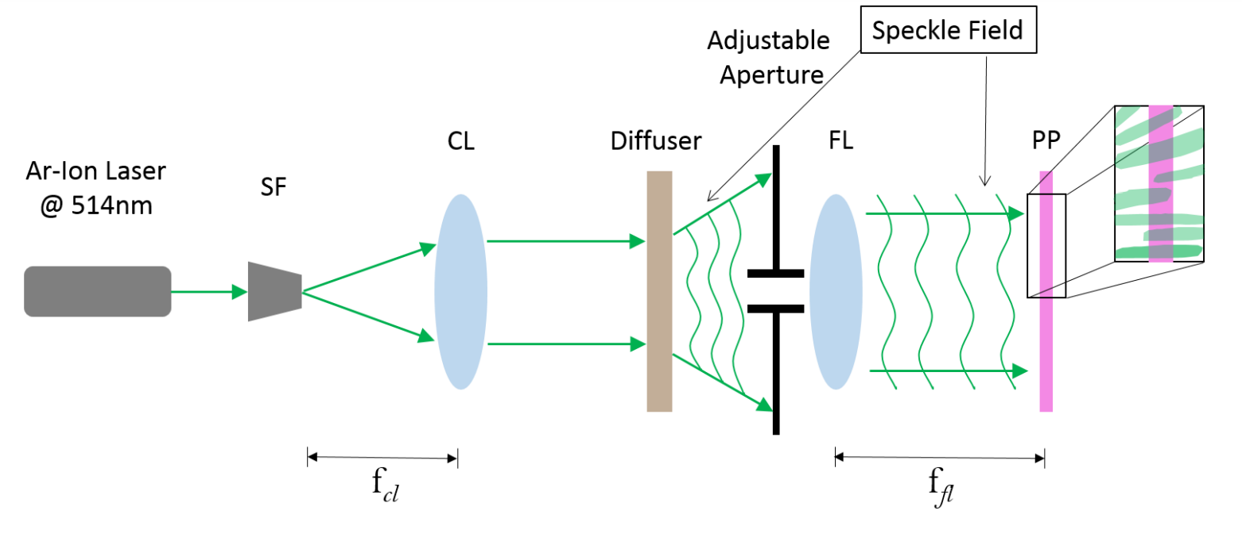
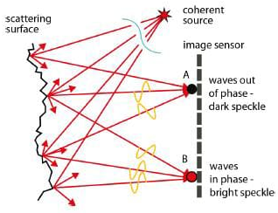
Why a holographic diffuser and how can it be produced?
Diffuser:
An optical component that scatters light for a softer, more even distribution.
Common diffusers include milky light bulbs, frosted glass panels, and screens for projectors.
Limitations
Inefficient light use
Lack of control over light spread
Inconsistent performance
Not ideal for high-precision applications
Holographic diffusers
Enhanced light control and efficiency
Wavelength-Selective Diffraction,
Customized Angular Distribution,
High Diffraction Efficiency
Spectral Control
Speckle :
When laser light illuminates on a diffuse object, it produces a random interference effect known as a speckle pattern.
By controlling the speckle Size, Holographic diffuser can be prepared

Slide 6
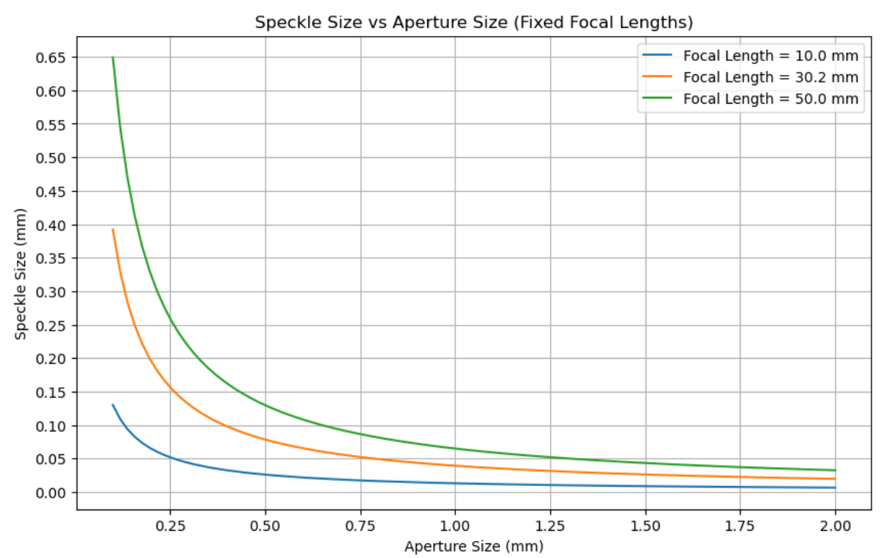
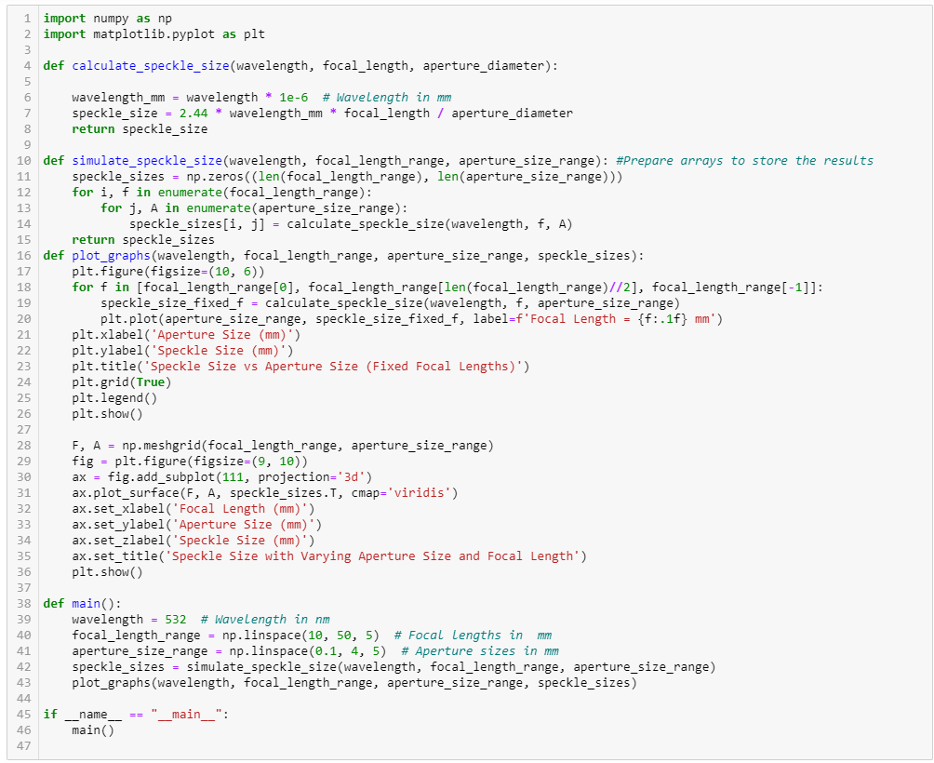
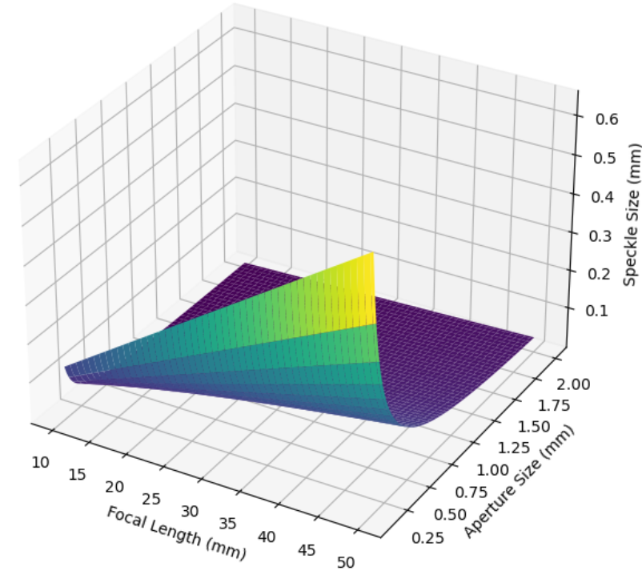
Model for Holographic Diffuser
Theoretical models can help us understand diffusers based on speckle size, which depends on the aperture size and focal length of the optical setup.
Smaller speckles (produced by larger apertures) result in a higher diffraction efficiency, while larger speckles (produced by smaller apertures) scatter light over a wider range of angles, reducing the peak efficiency but increasing the diffusion angle.
Aperture

Slide 7
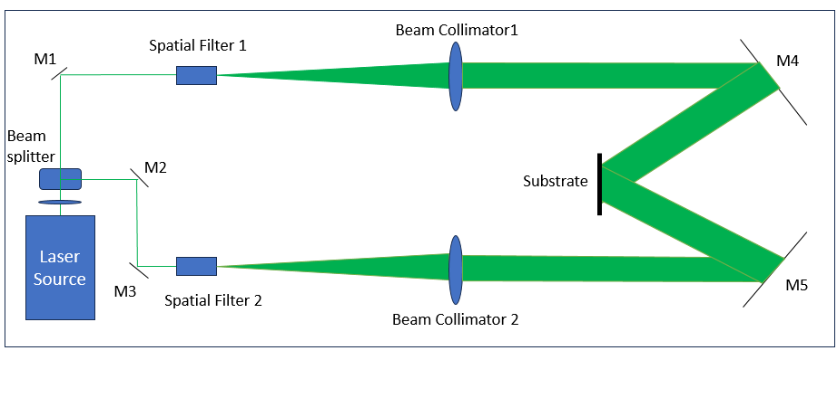
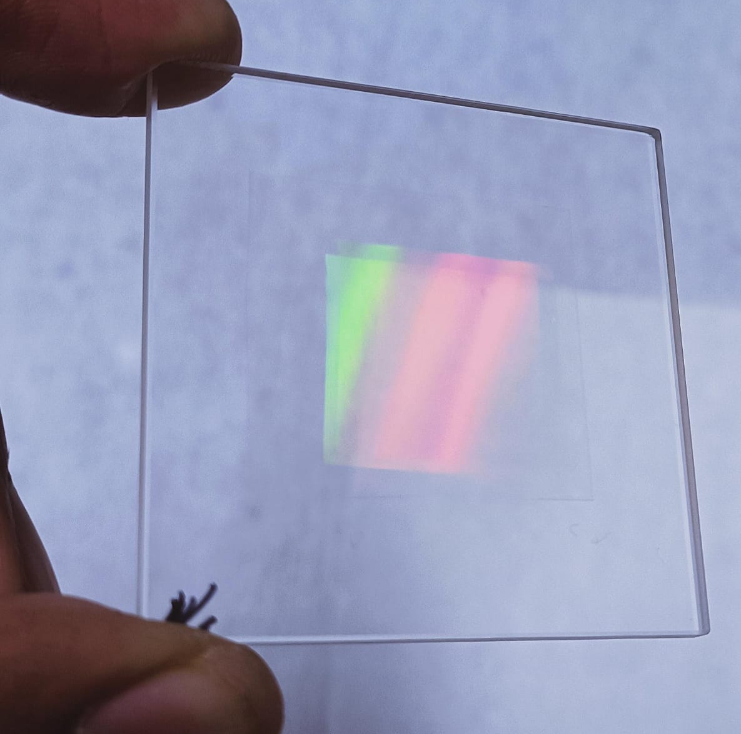
Labwork
Green Laser Setup For VHOEs Fabrication:
Laser source
Mirrors
Beam Collimators
Spatial Filter
Other optical Component

Slide 8
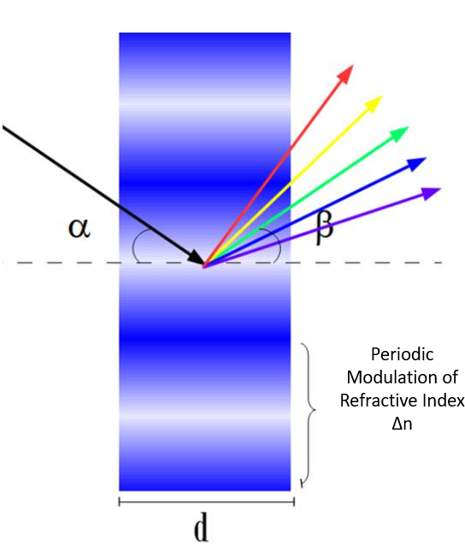
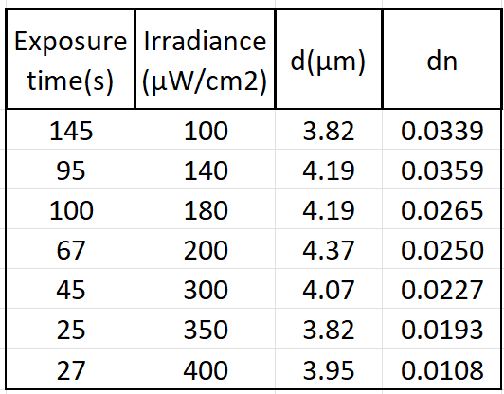
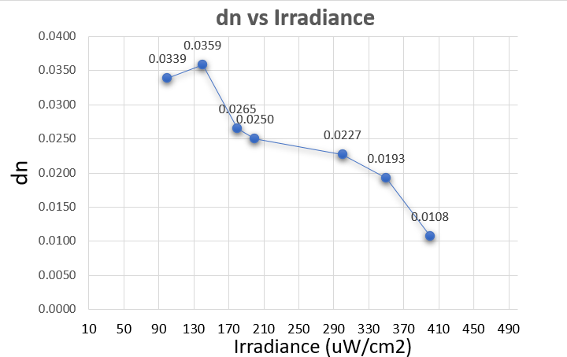
Labwork Results
VPHGs function effectively due to a periodic modulation of the refractive index (Δn) stored in a holographic material with a defined thickness (d).
As irradiance increases, the refractive index modulation decreases. This relationship is crucial for understanding the behavior of different photopolymers. This information will be useful while Fabricating the Diffuser.

Slide 9
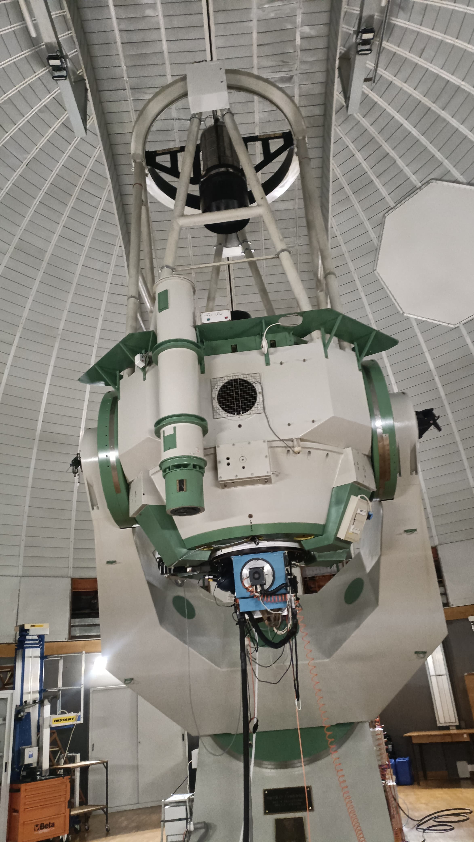
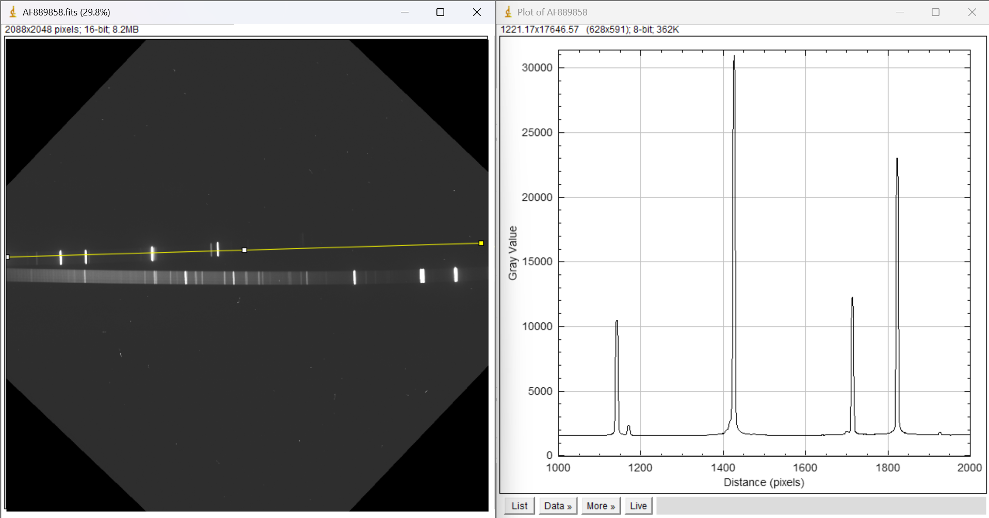
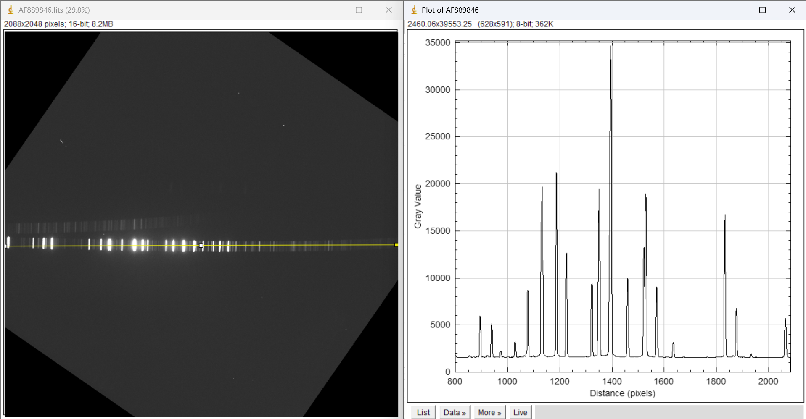
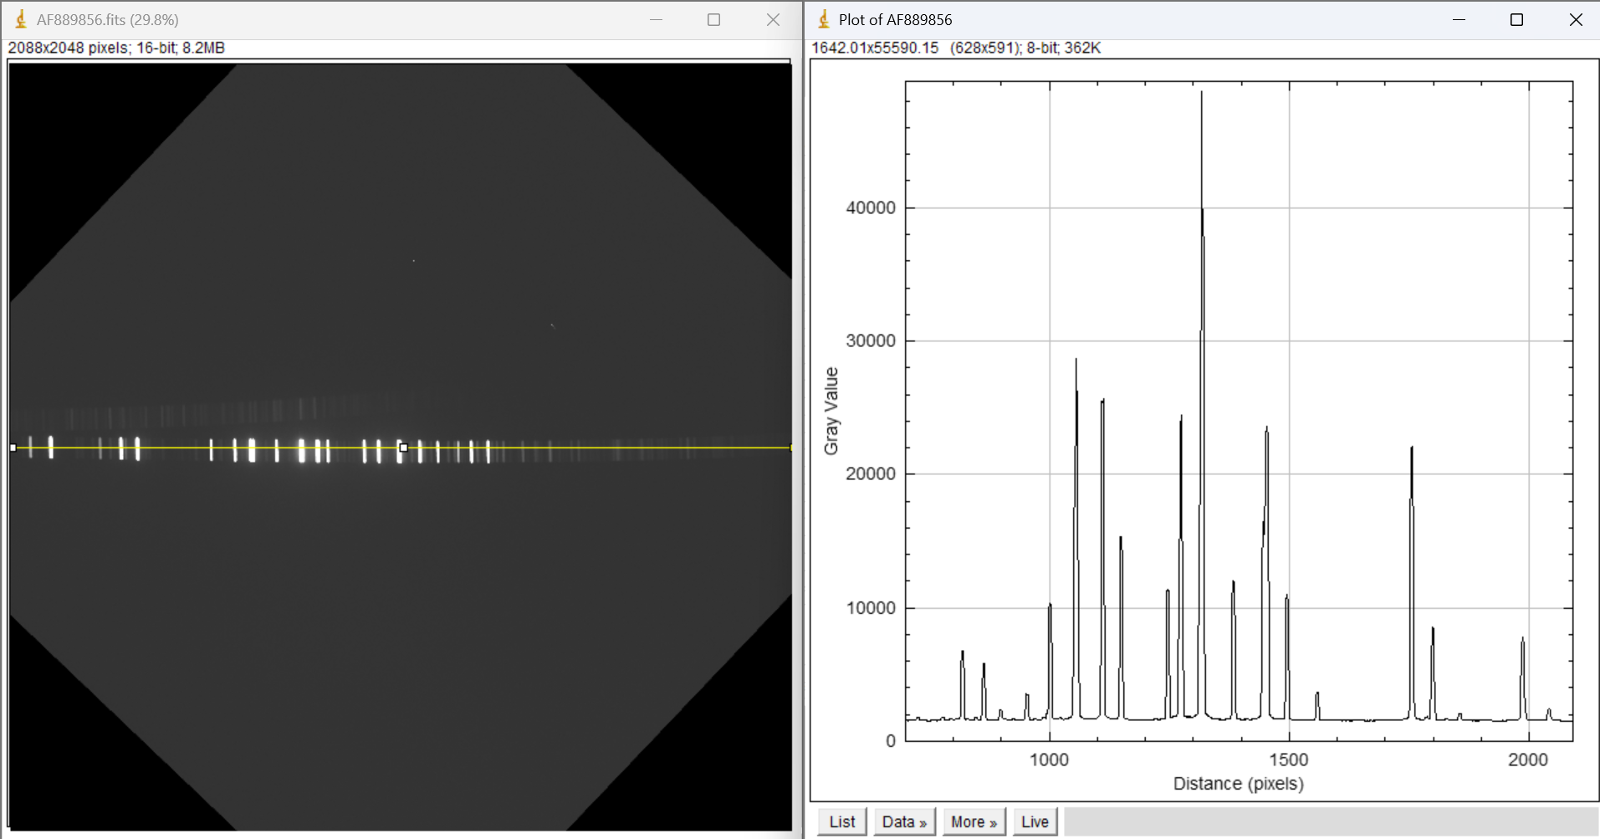
Work at Telescopes
Helped to install VPHGs at the ASIAGO telescope
11-04-24 to 13-04-2024
Dual Order Test

Slide 10
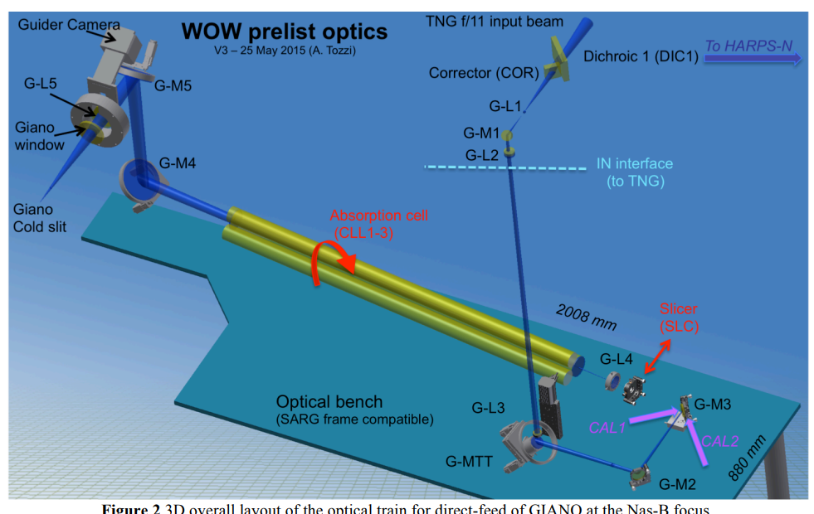
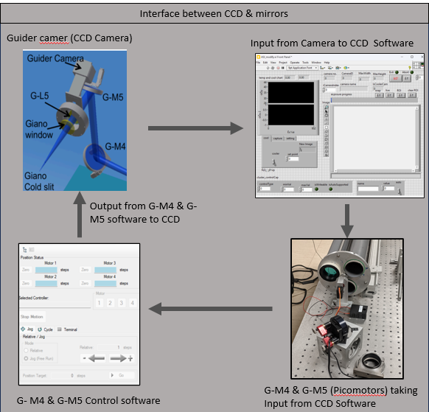
GIANO
GIANO PRE-SLIT SENSITIVITY IMPROVEMENT at TNG TELESCOPE:
12-08-24 to 23-08-2024
It is important to keep the pre-slit of the Giano spectrograph exactly centered on the target star to achieve the best possible data quality.
GIANO is an infrared (0.9-2.5 μm) cross-dispersed echelle spectrometer designed to achieve high resolution, high throughput, wide band coverage, and very high stability for accurate radial velocity measurements.
To address these issues and keep the observation slit centered, we were working on a guiding interface that continuously monitors and adjusts the star's position in real-time.
Centered image of Star

Slide 11
Coursework:
Courses Completed
Adaptive Optics for Astronomy: Lecture time: 12hr (1.5 credits) Lecturer: Carmelo Arcidiacono (INAF Padova) | Atmospheric Effects: Physics of the Earth's atmosphere and its impact on observations. AO Principles: Core concepts of adaptive optics and types of AO systems. Implementation: Design, implementation, and usage of AO systems in astronomy. Applications: Use of AO in observing planets, stars, and galactic phenomena.
Radio and Optical Interferometry: Lecture time: 12hr (1.5 credits) Lecturer: Fabrizio Massi & Lorenzo Busoni (INAF Arcetri) (8/10/2024) | Basics of Interferometry: Introduction to radio and optical/infrared interferometry. Technical Overview: How interferometers work and the key challenges in instrumentation and observation. Key Results: Significant discoveries using interferometry.
Laser Physics and Applications : Lecture time:16hr (2 credits) Lecturer: Annalisa Volpe (Uniba) (27/09/2024) | Fundamentals: Optical cavities, spontaneous and stimulated emission. Laser Types: Continuous wave and pulsed beam lasers. Applications: Overview of laser applications.
Courses to be Completed by end of the second year
Advanced scientific programming in Matlab : Lecture time:30hr (4 credits) Lecturer: Paolo Bardella | MATLAB improvements, source control with Git, MATLAB internals, OOP in MATLAB, code optimization, MEX files, parallel computing, GPUs, I/O optimization, and alternatives to MATLAB.
Machine Learning Programming in Physics: Lecture time: 20hr (2.5 credits) Lecturer: Gioacchino Vino (INFN-Bari) | Python Fundamentals, Data Handling, Machine Learning Basics, Frameworks and Optimization

Slide 12
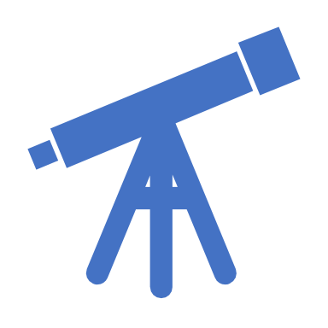
Planning:
Focus on Holographic Diffuser Development (2024-2025)
Experimental Understanding (10/24) : understanding of holographic diffuser functionality through detailed experimental studies.
2.Simulation (12/24) : Perform theoretical simulations to model diffuser behavior and optimize design parameters.
3.Production (2/25) : Fabricate holographic diffusers based on optimized designs.
4. Comprehensive Testing (2/25) : Test holographic diffusers across all relevant parameters (e.g., efficiency, angular response, stability).
5.Real-World Testing (5/25) : Validate performance in pyramid Sensor At INAF BOLOGNA
6. Application on Telescopes :
Assembling and testing the performance of Diffuser with Telescopes
Analysis, Writing, and Dissemination (2025-2026)
7.Final Research Activities (12/25) : Complete data analysis, finalize experiments, and integrate results.
8.Thesis Writing(1/26): Draft, revise, and finalize the PhD thesis; prepare for submission.
9.Academic Contributions: Submit research papers, present findings at conferences.
10.Milestone: Submit final thesis by September 2026.

Slide 13
Thank you For your Time

