Slide 1
VERY PRELIMINAR ANALYSIS OF HADRONS INTERACTIONS AT «SPS TB2023»
7x7
21 layers
….
Charge
Tagger
first , second , third …..CUBE are Lyso cube along the BEAM and belonging to first , second , third LAYER

Slide 2
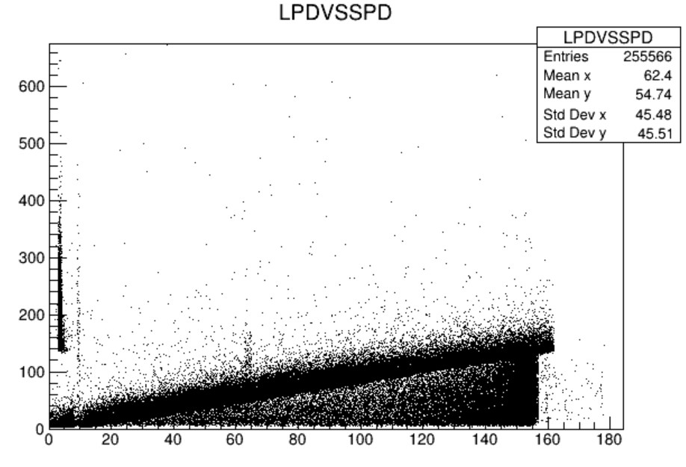
This analysis consider event only from RUN 484 (with good casis time)
LPD : Pietro Calibration + ‘average calibration’ for cube not included in Pietro Calibration (ONLY 3X5 CALO CORE)
SPD : an «average» calibration factor is applied for every SPD (LPD saturation flag does not work ?)
In the present analysis ( Z=2,5,6 ) NO LPD SATURATES
SPD (GeV)
LPD (GeV)

Slide 3
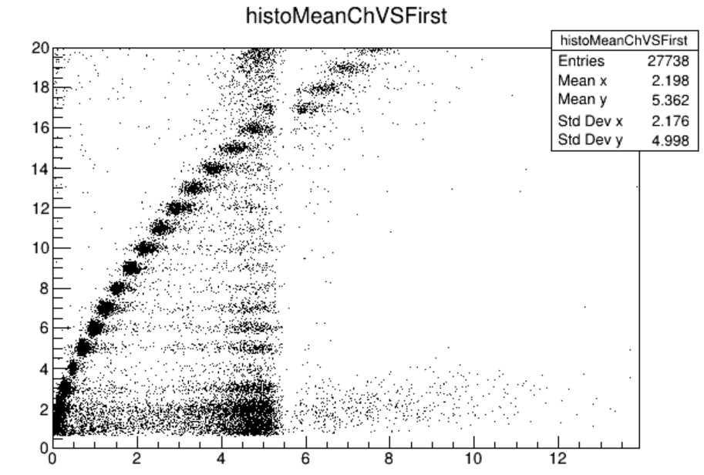
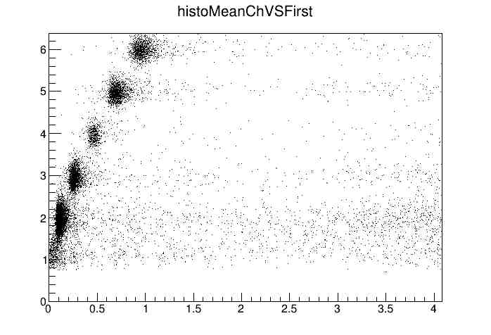
WITH : ChargeTagger coincidence (6 layer) and quiet first layer around first cube
CHARGE (Z)
CHARGE (Z)
First cube DE(GeV)
First cube DE(GeV)
first , second , third …..CUBE are Lyso cube along the BEAM and belonging to first , second , third LAYER

Slide 4
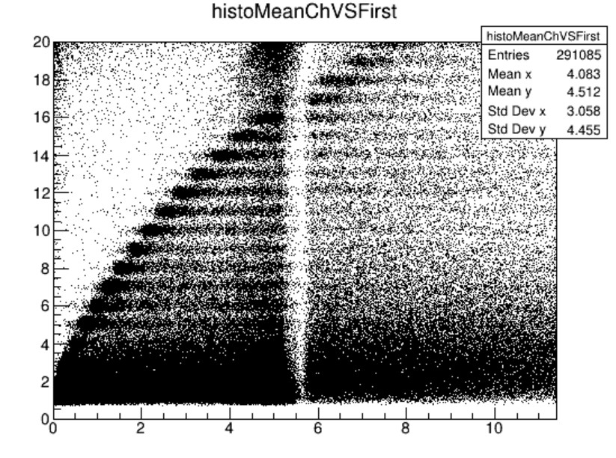
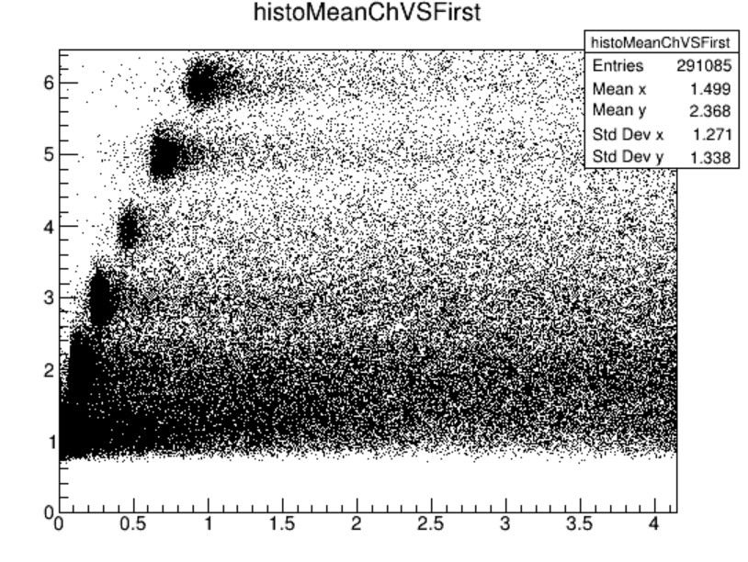
WITH : total ChargeTagger coincidence (6 layer)
CHARGE (Z)
CHARGE (Z)
First cube DE(GeV)
First cube DE(GeV)
For each nucleus we selected events with coincidence in CHARGE TAGGER and First Cube
Then we analyzed the CALO signals looking for first nuclear interaction starting from second layer

Slide 5
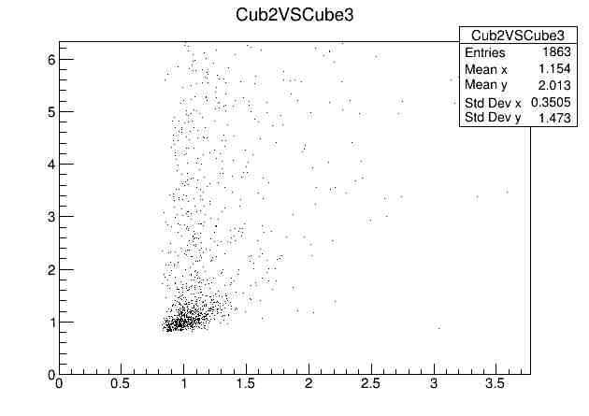
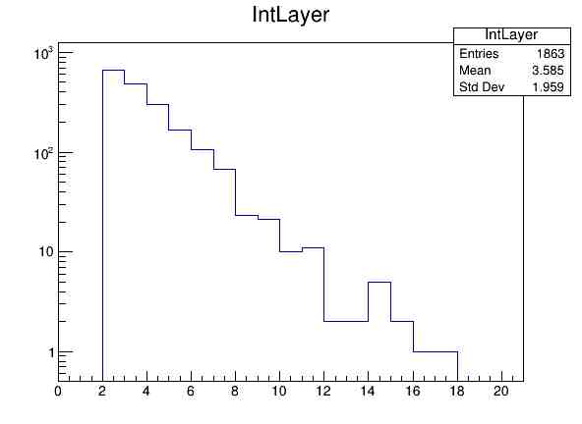
RESEARCH OF THE FIRTS NUCLEAR INTERACTION POINT (cube)
The «Interacting» cube is identified looking at the first cube along beam with signal above
threshold , asking also to exhibit a stronger signal in the successive layer (starting from the second layer)
the asimmetry ( cube2 cube3) is due to interactions
Cube3 dE(GeV)
Z=6
Z=6
threshold
Cube2 dE(GeV)
Interacting layer
ionization
The threshold value for each nucleus is determined looking at the signals itself, being above the «ionization blob» and
being the one that produce the best compliance to the expected exponential HISTOGRAM of «Interacting layer» frequency

Slide 6
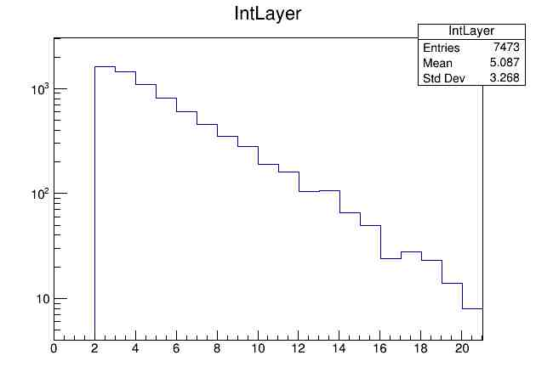
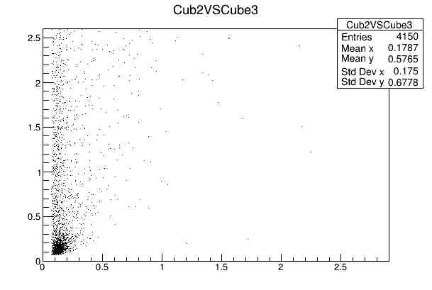
The «Interacting» cube is identified looking at the first cube along beam with signal above
threshold , asking also to exhibit a stronger signal in the successive layer (starting from the second layer)
Cube3 dE(GeV)
threshold
Z=2
Z=2
Cube2 dE(GeV)
Interacting layer

Slide 7
The «EFFECTIVE LENGTH»
The number of Lyso cube along the beam from the «interacting cube» to the end
21 layers
Charge
Tagger
The cube identified as
«interacting layer»

Slide 8
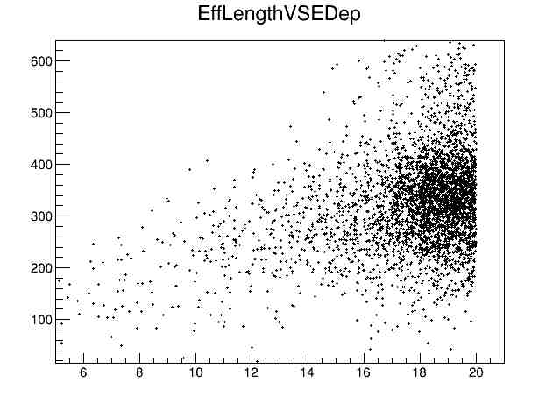
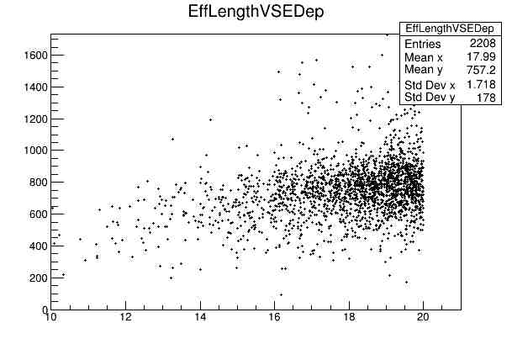
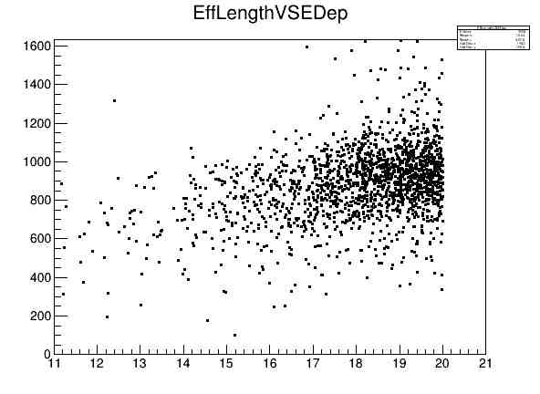
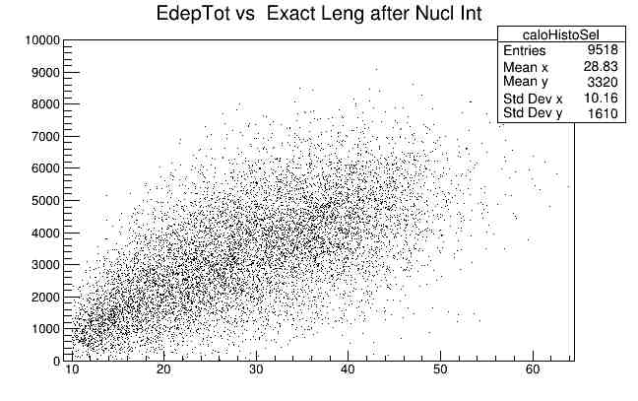
Z=2
E=600GeV
Z=5
E=1500GeV
EnergyDeposited(GeV)
EnergyDeposited(GeV)
EffectiveLength (LysoCube)
EffectiveLength (LysoCube)
Z=6
E=1800GeV
Protons in
HERD
very different «effective length» distribution
due to geometry
EnergyDeposited(GeV)
EnergyDeposited(GeV)
EffectiveLength (LysoCube)
EffectiveLength (cm)

Slide 9
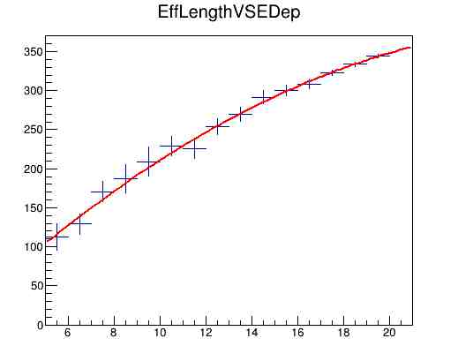
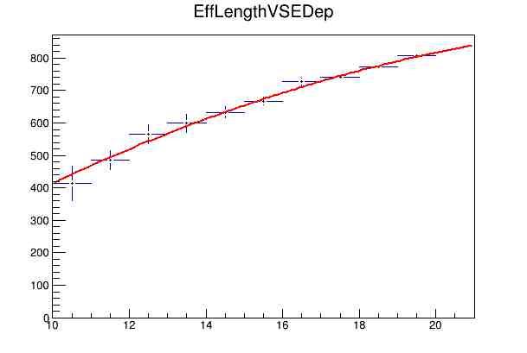
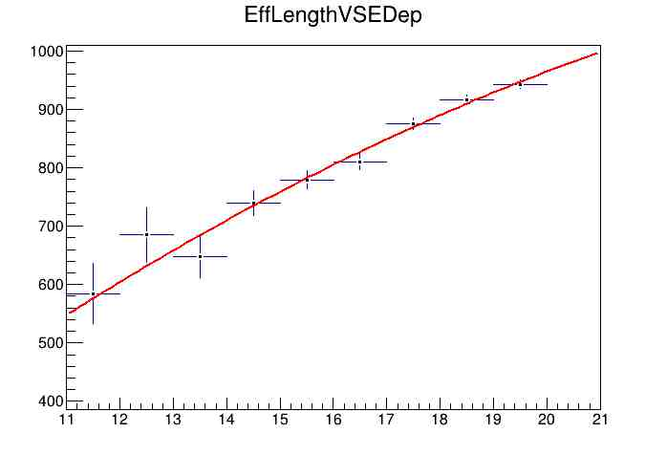
<EnergyDeposited(GeV)>
Z=2
E=600GeV
<EnergyDeposited(GeV)>
Z=5
E=1500GeV
EffectiveLength (LysoCube)
EffectiveLength (LysoCube)
<EnergyDeposited(GeV)>
«CALIBRATION CURVES»
Z=6
E=1800GeV
EffectiveLength (LysoCube)

Slide 10
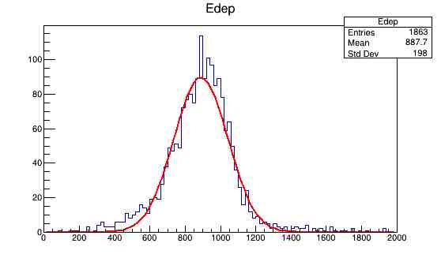
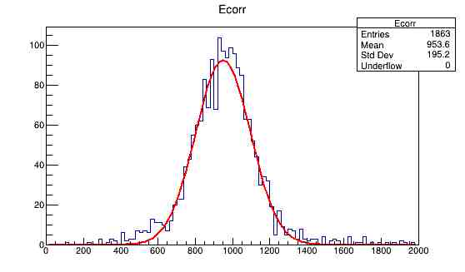
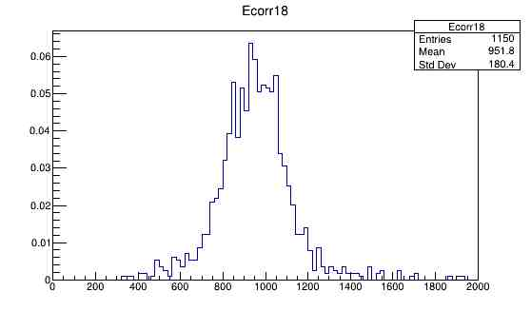


σ/E=17%
σ/E=15%
Z=6
Z=6
Not corrected with
the calibration curve
all events
Corrected with
the calibration curve
All events
Edep (GeV)
Edep (GeV)
σ/E=15%
Corrected with
the calibration curve
Effective Length > 18

Slide 11
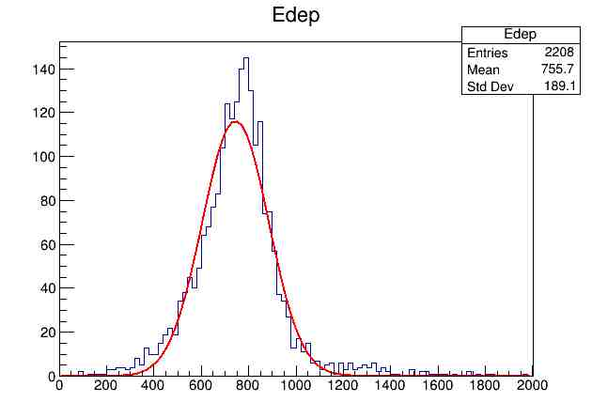
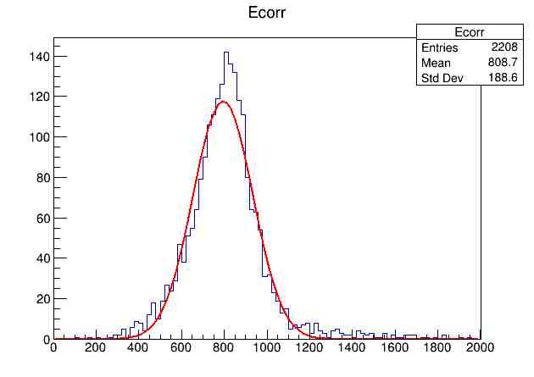
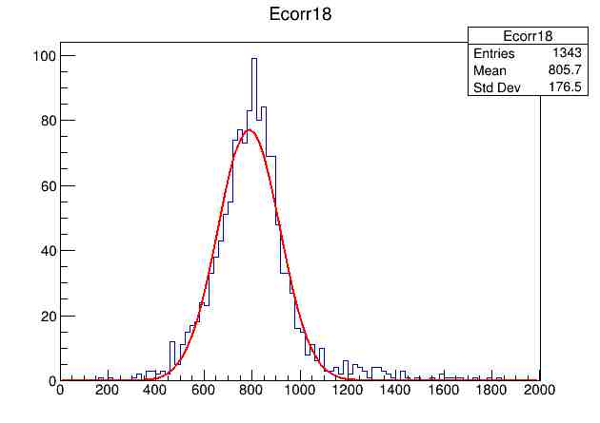
σ/E=19%
σ/E=17%
Z=5
Z=5
Not corrected with
the calibration curve
all events
Corrected with
the calibration curve
All events
Edep (GeV)
Edep (GeV)
σ/E=16%
Z=5
Corrected with
the calibration curve
Effective Length > 18
Edep (GeV)

Slide 12
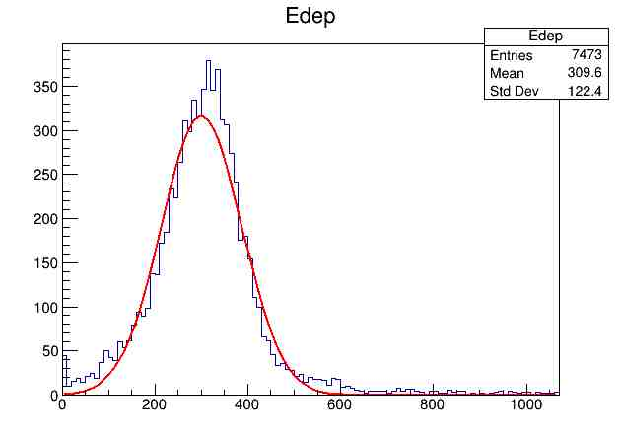
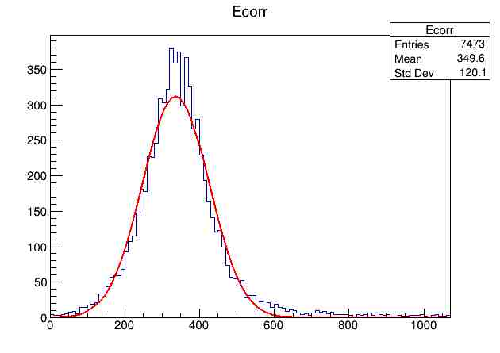
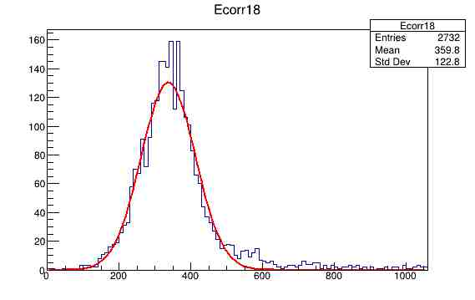
σ/E=29%
σ/E=26%
Z=2
Z=2
Not corrected with
the calibration curve
All events
Corrected with
the calibration curve
All events
Edep (GeV)
Edep (GeV)
σ/E=23%
Z=2
Corrected with
the calibration curve
Effective Length > 18
Edep (GeV)

