Slide 1
(very) short news

Slide 2
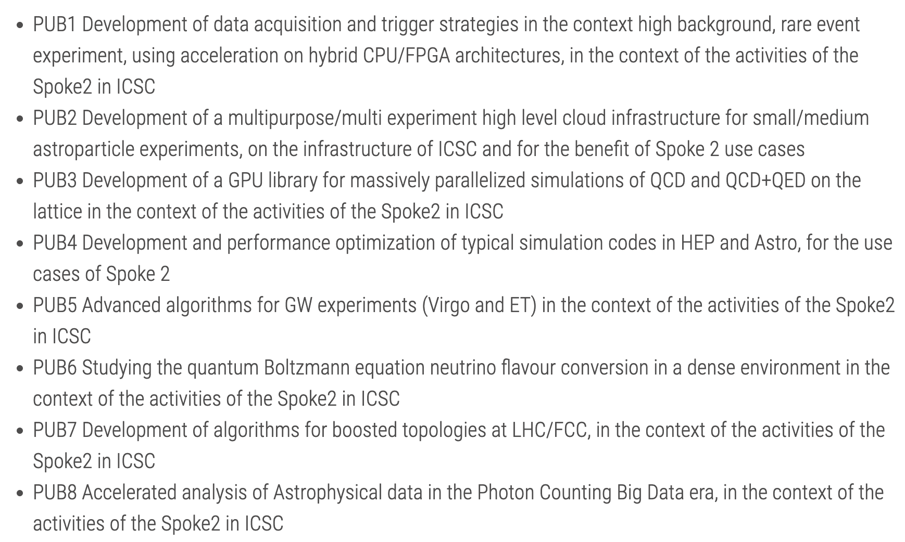
Honestly, not many since July …
Better definition of the Rome End-of-Second-Year-Conference (next week)
Start of the OpenCalls
Contracts signed
Official start Sept 1st
3.12MEur budget assigned, but there are some “features/problems”

Slide 3
Accounting and reporting
MS8 (end of June): 98% of targets “DONE” (the rest “delayed to MS9” mostly for external reasons)
We are getting closer to MS9 (end of October), but: there is a ~ 100% probability the project will be extended to December 2025, so the MSs will be dedesigned
Important:
We will be asked by the end of the year on the real utilization of ICSC resources (Cloud, CINECA, …)
Did whoever asked got the resources? Are you able to use them?

