Slide 1
Update on analog design for L4-L5
SVT FE confcall – 04/11/11
B.Nasri, P.Trigilio, L.Bombelli, C.Fiorini
Activity:
study and optimization of input MOSFET
ENC estimations
preliminary layout evaluations
Notes:
A

Slide 2
Electronics noise evaluation with Cadence (IBM 130nm)
Charge preamplifier
(ideal)
Shaping amplifier
(CR-(RC)² ideal)
Detector
(Cd, Rs)
(NMOS, PMOS)
Considered parameters for the detectors:
Layer 4: Rs=234Ω, Cd=52.6pF
Layer 5: Rs=300Ω, Cd=67.5pF
Rs/3 considered for noise
(and compared with distributed parameters model)

Slide 3
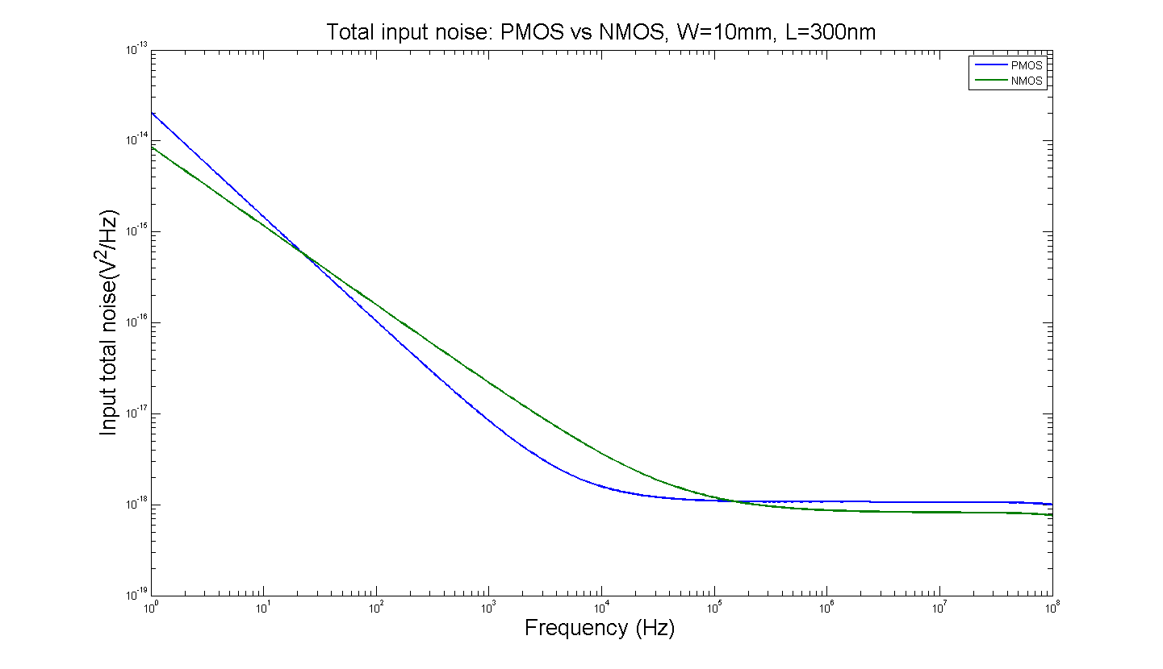
Usefulness of direct Cadence simulations of ENC
Comparison of FETs contributions to ENC not fully evident from noise spectra only

Slide 4
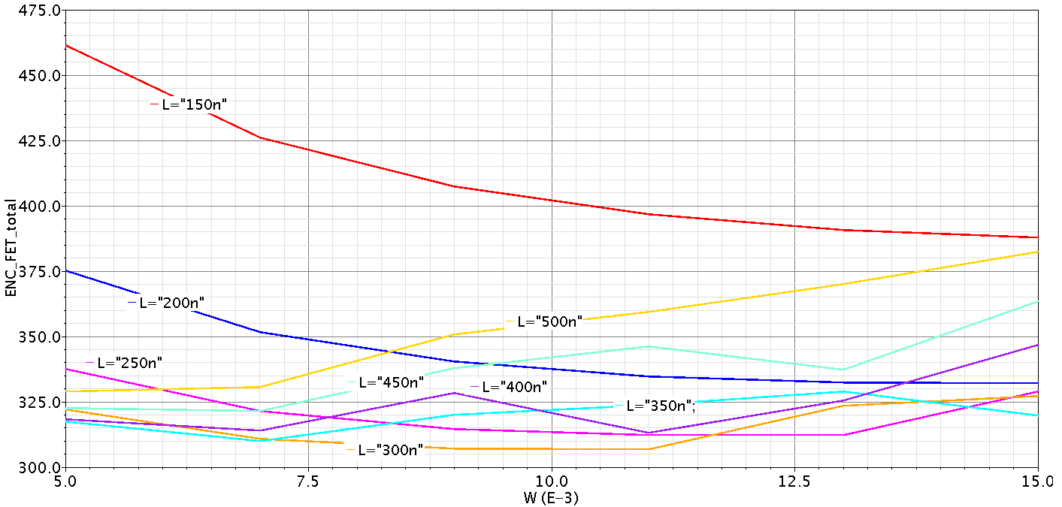
NMOS, Layer 4
Ibias=500µA and Tp=1µs
L= 150nm ~ 500nm ; W=5mm ~ 15mm
Minimum ENC of FET relates to L=300nm; ENC_FET_total= 307.2 e rms @ W=9mm

Slide 5
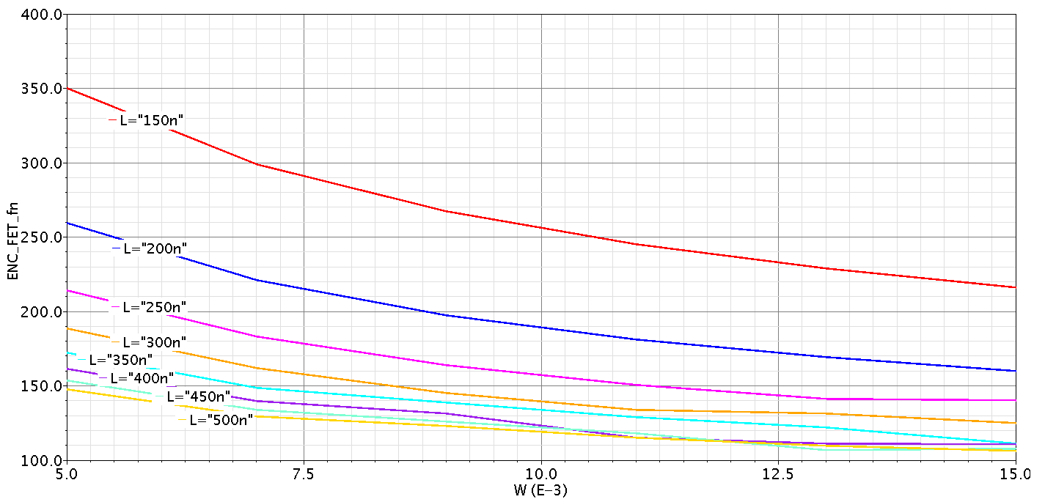
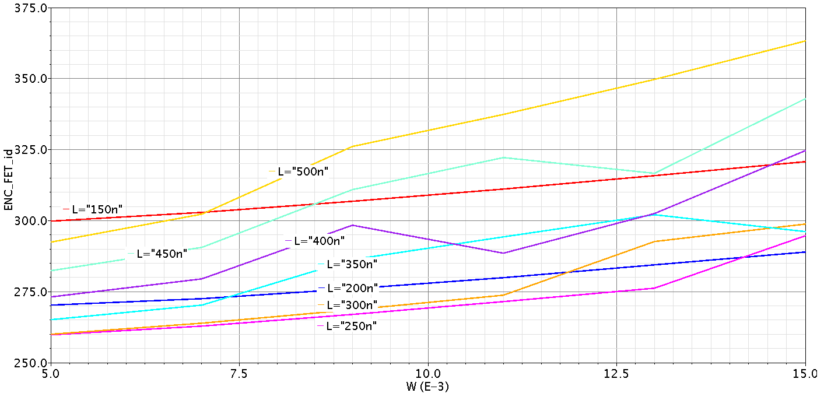
Flicker
Thermal
L (nm) | 150 | 200 | 250 | 300 | 350 | 400 | 450 | 500
ENC_FET_fn (e rms) | 267.2 | 197.4 | 163.9 | 145.3 | 138.7 | 131.6 | 126.1 | 123
ENC_FET_thermal (e rms) | 306.9 | 276 | 267 | 268.7 | 286.2 | 298.5 | 310.8 | 326.1
Table 1. ENC generated by thermal and Flicker noise of NMOS FET at Layer 4 and W=9mm

Slide 6
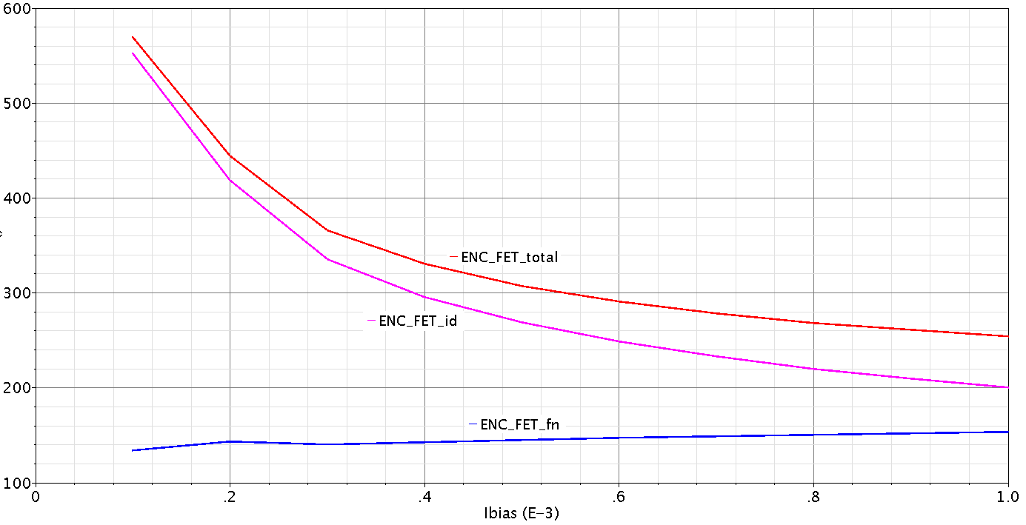
Sweeping the bias current @ optimum L and W (L=300nm, W=9mm) and Tp=1µs

Slide 7
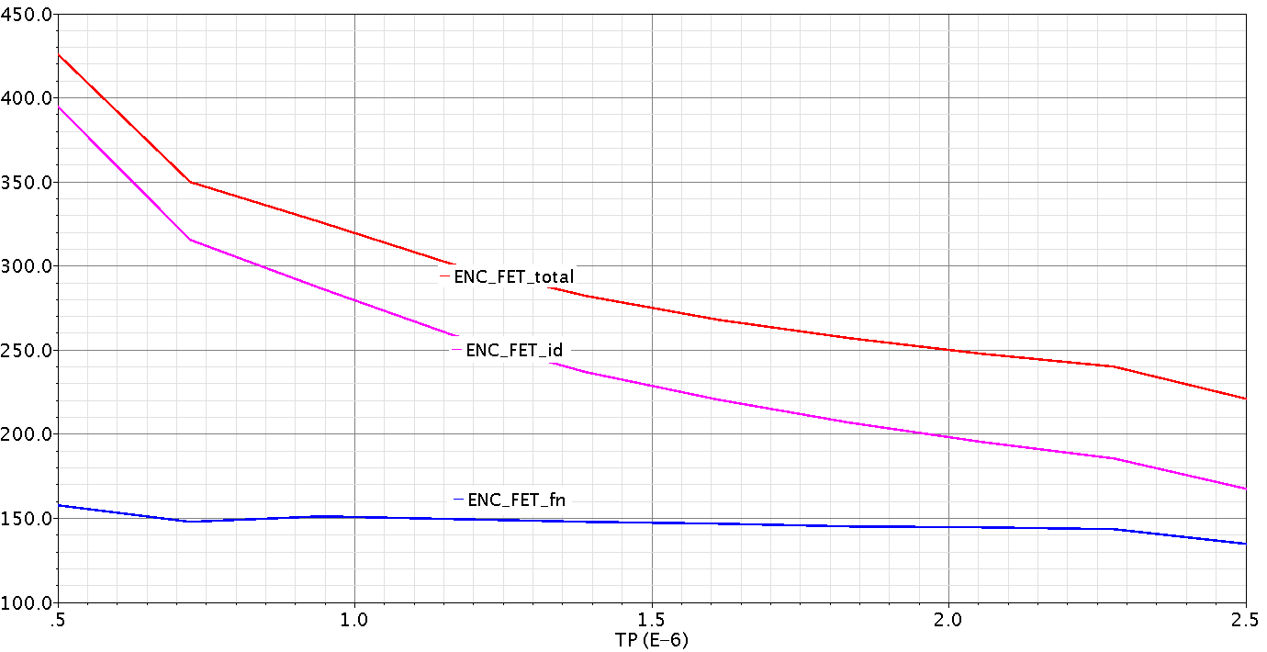
Sweeping the peaking time @ optimum L and W (L=300nm, W=9mm) and Ibias=500µA

Slide 8
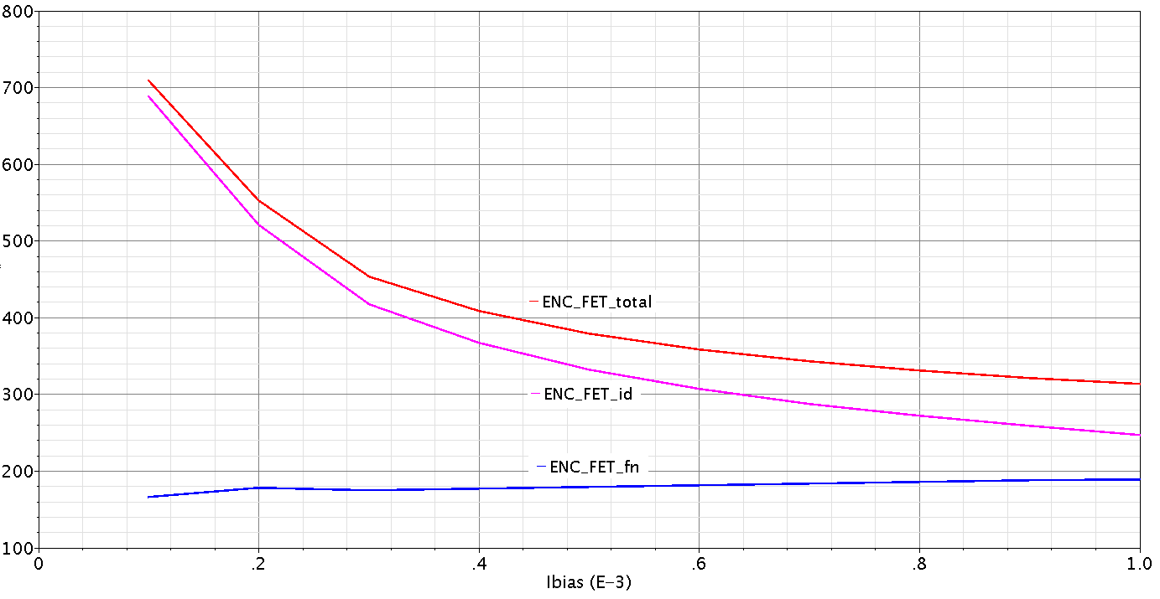
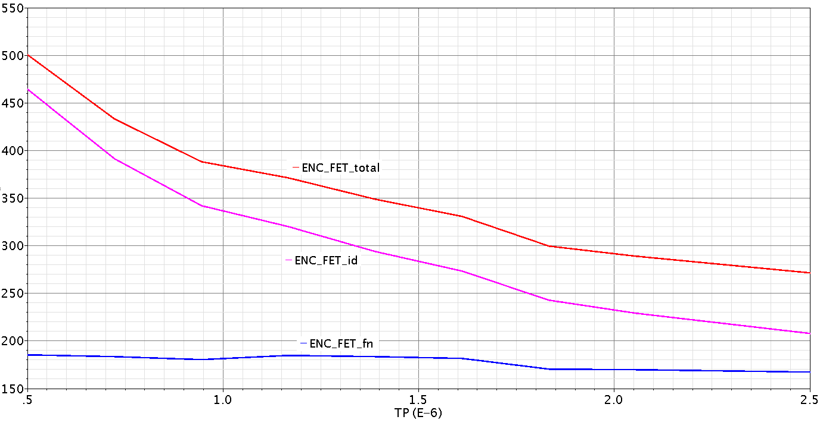
NMOS, Layer 5
Ibias=500µA and Tp=1µs
L= 150nm ~ 500nm; W=5mm ~ 15mm
Minimum ENC of FET relates to L=300nm; ENC_FET_total= 379.6 e rms @ W=9mm
L (nm) | 150 | 200 | 250 | 300 | 350 | 400 | 450 | 500
ENC_FET_fn (e rms) | 334.2 | 246.3 | 203.8 | 179.8 | 164.9 | 160.8 | 148 | 142.8
ENC_FET_thermal (e rms) | 383.8 | 344.4 | 333 | 332.6 | 364.7 | 364.7 | 365 | 378.5
Table 2. ENC generated by thermal and Flicker noise of NMOS FET at Layer 5 and W=9mm

Slide 9
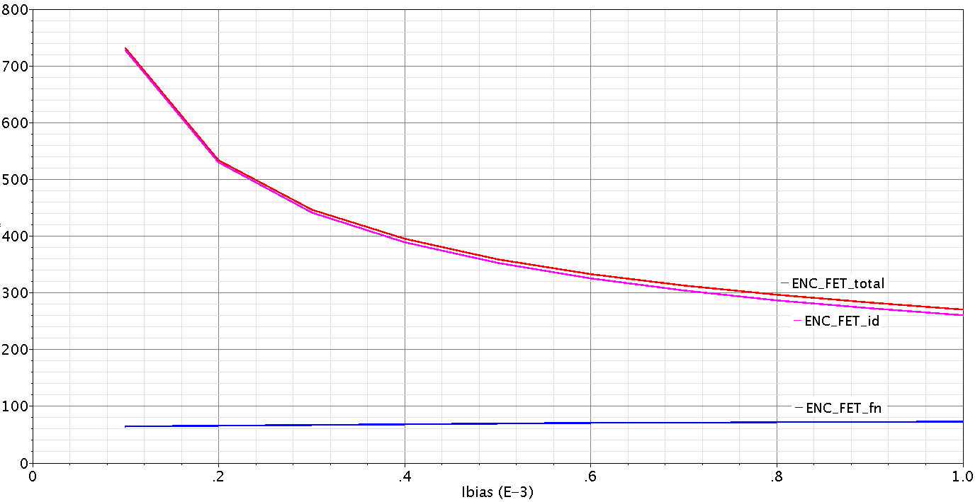
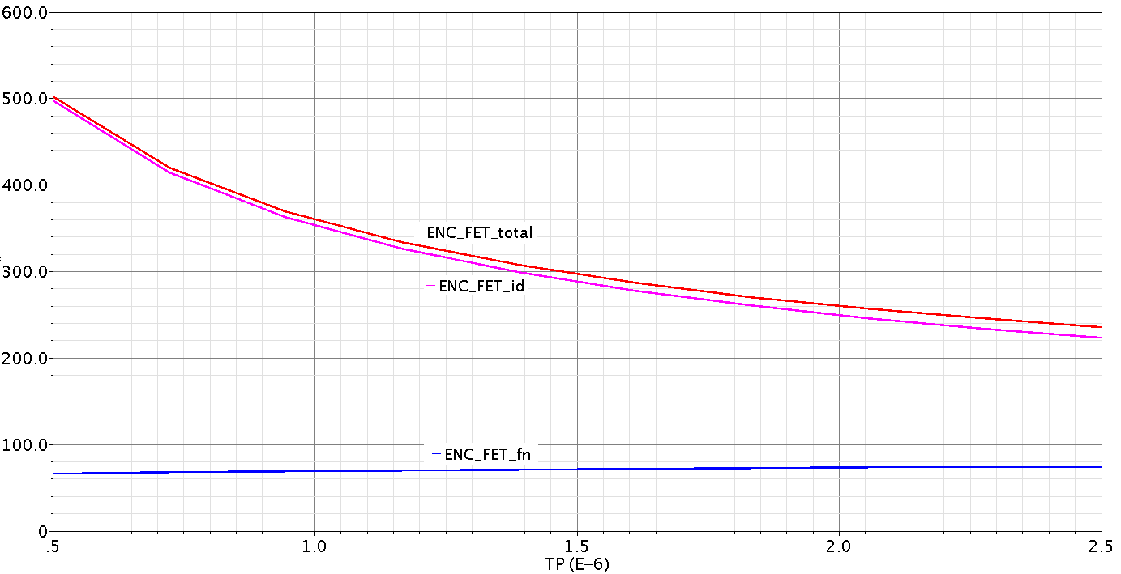
PMOS, Layer 4
Ibias=500µA and Tp=1µs
Minimum ENC of FET relates to L=150nm; ENC_FET_total= 359 e rms @ W=7mm
L (nm) | 150 | 200 | 250 | 300 | 350 | 400 | 450 | 500
ENC_FET_fn (e rms) | 69.46 | 59.18 | 52.79 | 48.49 | 45.45 | 43.22 | 41.52 | 40.22
ENC_FET_thermal (e rms) | 352.3 | 366 | 385.6 | 404.3 | 421.5 | 437.8 | 453.6 | 469.2
Table 3. ENC generated by thermal and Flicker noise of PMOS FET at Layer 4 and W=7mm

Slide 10
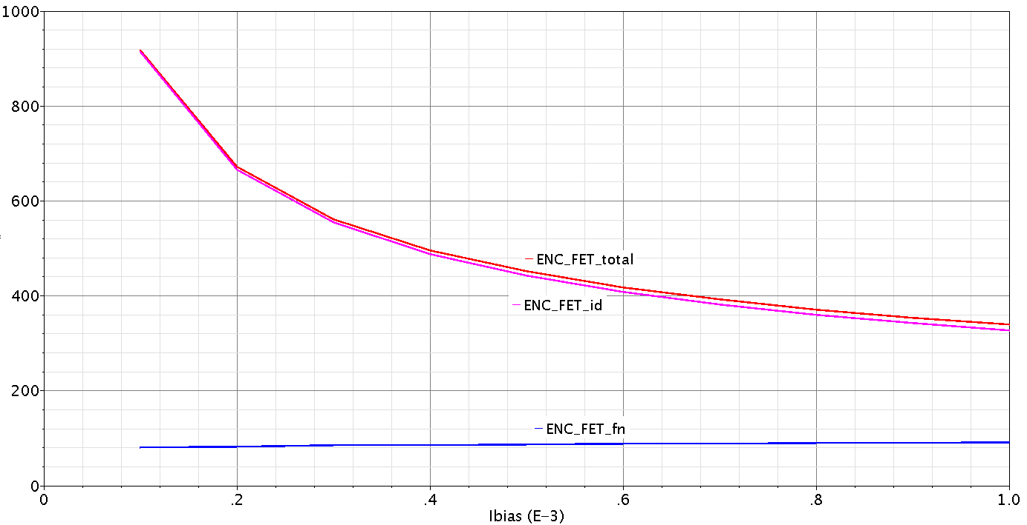
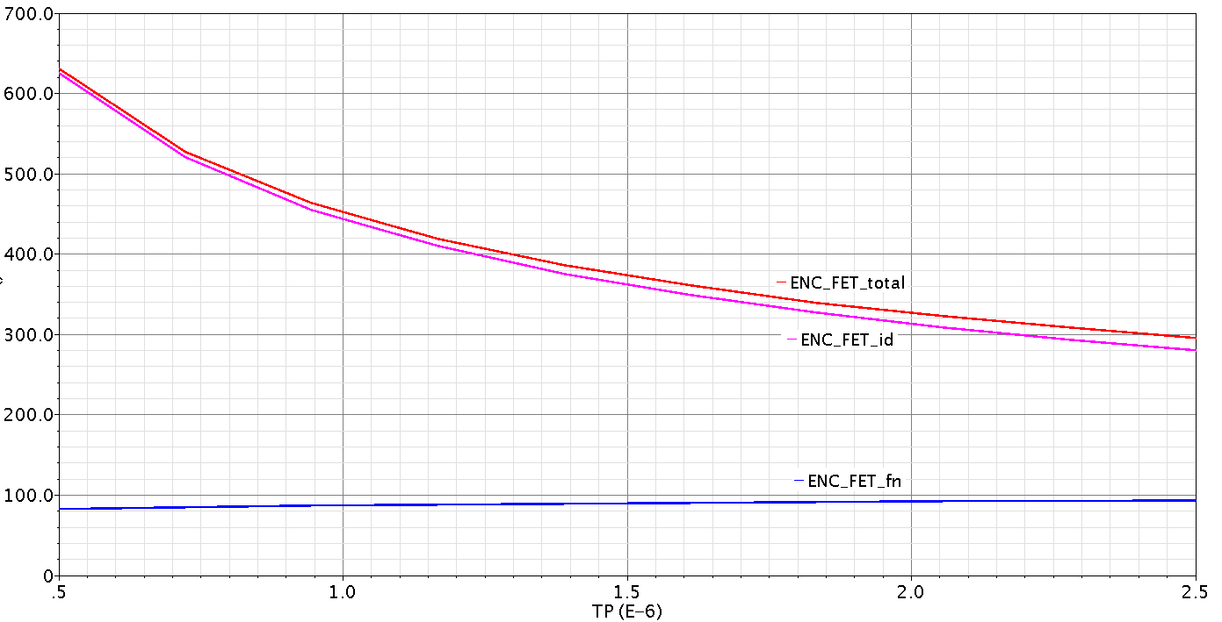
PMOS, Layer 5
Ibias=500µA and Tp=1µs
Minimum ENC of FET relates to L=150nm; ENC_FET_total= 451 e rms @ W=7mm
L (nm) | 150 | 200 | 250 | 300 | 350 | 400 | 450 | 500
ENC_FET_fn (e rms) | 87.27 | 74 | 65.8 | 60.2 | 56.15 | 53.12 | 50.78 | 48.93
ENC_FET_thermal (e rms) | 442.6 | 458 | 480.7 | 501.8 | 520.7 | 538 | 554.7 | 570.9
Table 4. ENC generated by thermal and Flicker noise of PMOS FET at Layer 5 and W=7mm

Slide 11
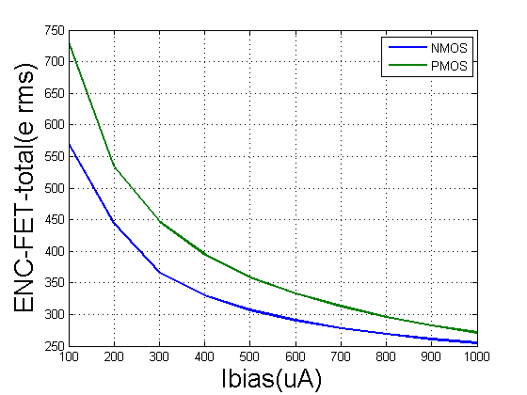
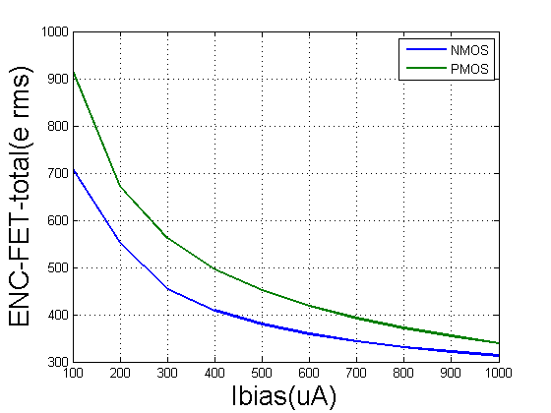
Comparison of NMOS and PMOS (without Rs)
Layer 4
Layer 5

Slide 12
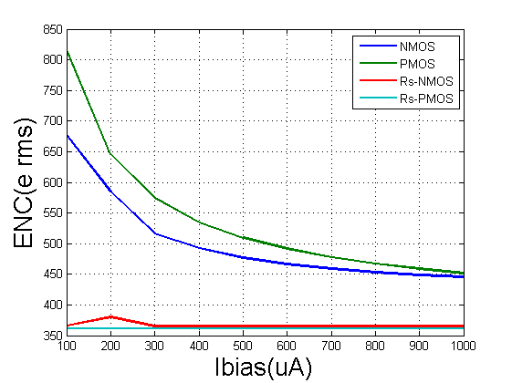
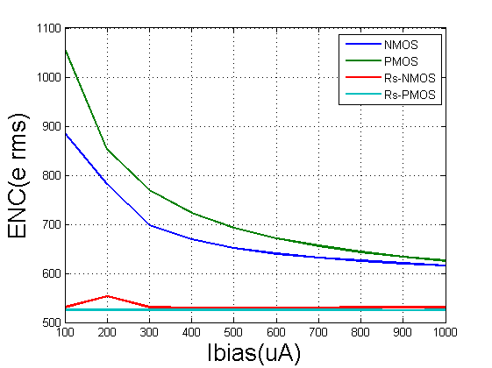
Overall noise (including Rs)
Layer 4
Layer 5
blue/green are total noise,
others lines are Rs only,
for reference
Tp= 1us

Slide 13
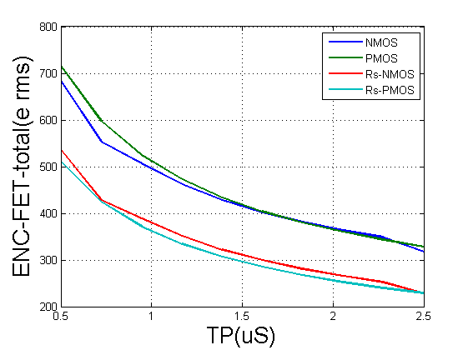
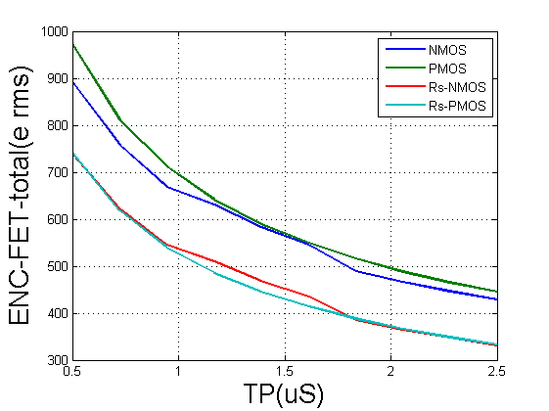
Layer 4
Layer 5
blue/green are total noise,
others lines are Rs only,
for reference
Ibias= 500uA

Slide 14
Summary of noise evaluations
Contribution of Rs on the overall noise quite significant
Noise from NMOS slightly better than in PMOS
‘Optimum size’ PMOS smaller than NMOS (W: 7 vs. 9mm, smaller L)
Compromise L however could be chosen (e.g. 200nm)
NMOS vs. PMOS choice also depending on cleaner power line
(more clean GND for NMOS or VDD for PMOS?)
Choose input MOS and start of preamplifier design
Further noise evaluations with respect to shaping amplifier design

Slide 15
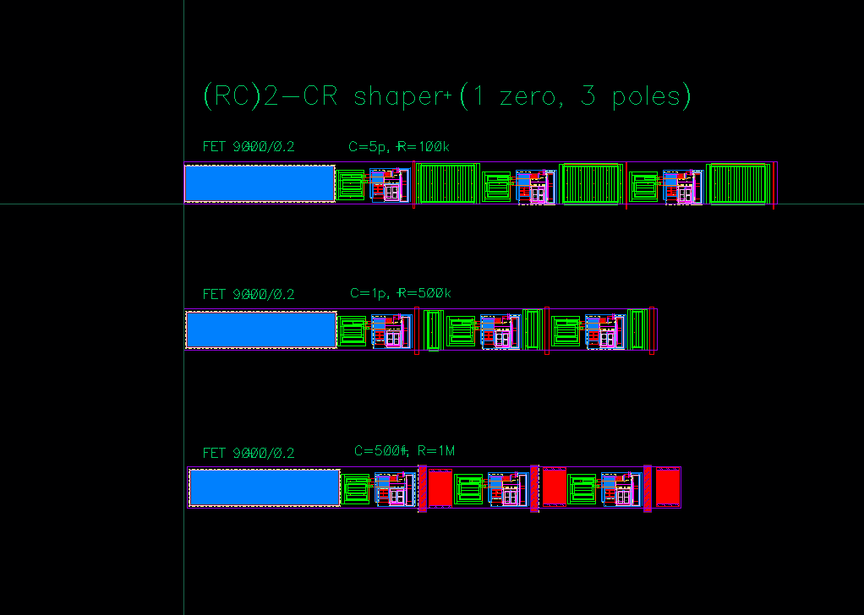
Preliminary area estimations
46um
480um
MIMs cap
46um
350um
std cap
46um
370um
170um
Peaking time = 1us
Very simple implementation with physical R,C

