Slide 1
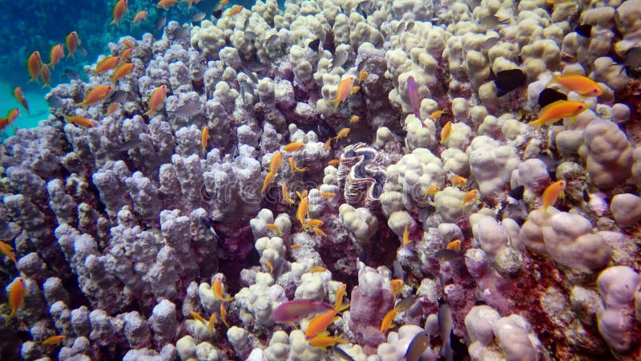
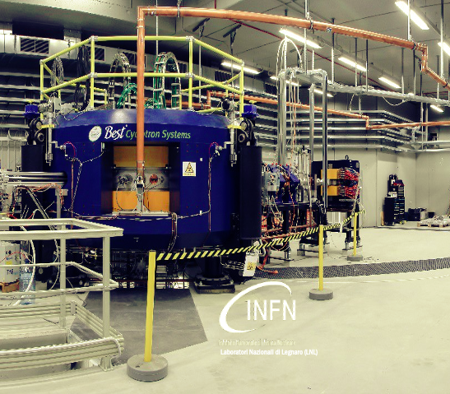




Radioisotopes for monitoring the effects of Climate Change on marine Ecosystems
The REMO/ClimOcean project at SPES/LNL RIB facility
F. F. Zeng, G. De Angelis, M.D. Marin, E. Nácher, B. Rubio, J. Balibrea-Correa, S. Rocca, et al.

Slide 2
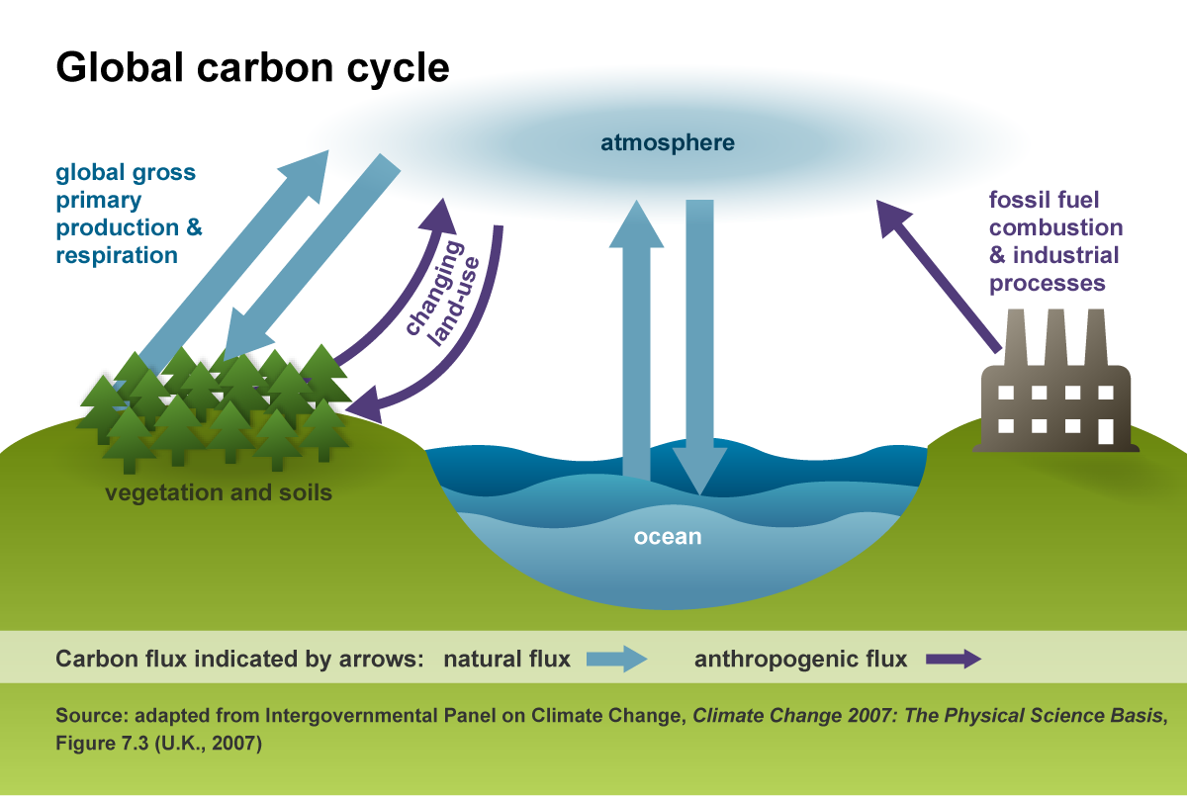
CO₂
CO₂+H₂O→H₂CO₃
_{Production of Carbonic Acid}
CO₂+2H₂O→CH₂O + O₂+H₂O
(production of carbohidrates)
H₂O
Notes:
Since the Industrial Revolution, rapid technological advancements have led to massive carbon dioxide (CO₂) emissions due to human activities, e.g. fossil fuel combustion, industrial processes, deforestation, and agricultural development. The surge in CO₂ has intensified the global warming. The oceans have absorbed approximately one-third of the human-caused CO₂ emissions, and results in ocean acidification. Compared to pre-industrial levels, the average pH of seawater has decreased by 0.1.
CO2 from fossil fuel burning and cement production, newly released from hundreds of millions of years of geological storage and (ii) CO2 from deforestation and agricultural development, which has been stored for decades to centuries
Since the industrial revolution, the oceans have absorbed approximately 1/3 of human emissions of CO2 into the atmosphere, and the pH of seawater has dropped by 0.1.

Slide 3
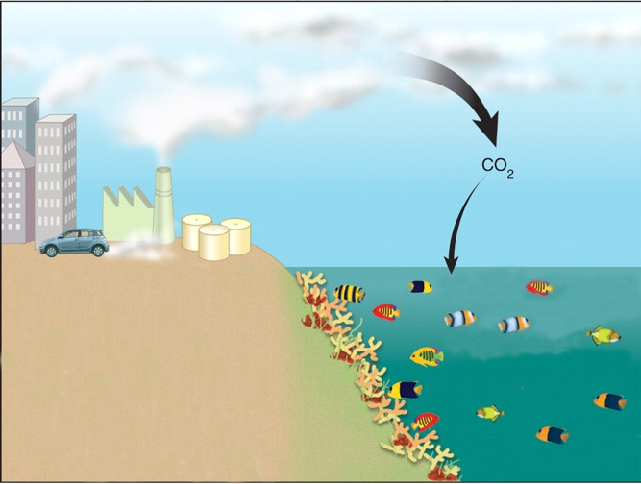
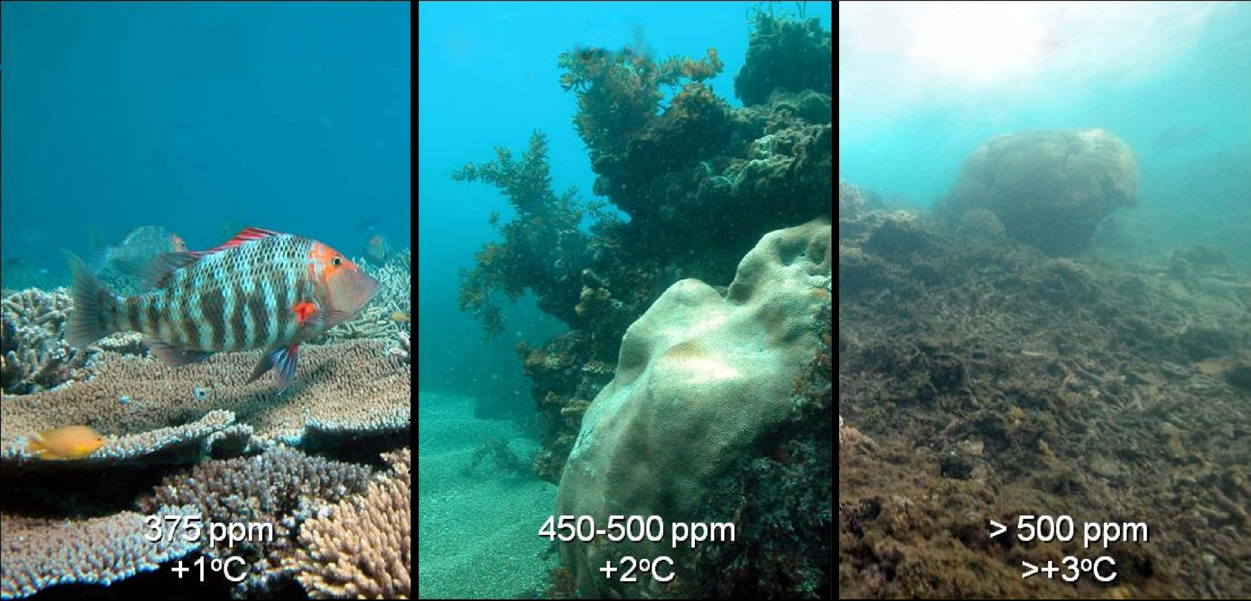
Ocean Acidification
Carbon dioxide dissolves in the ocean, where it causes a potentially more serious problem → ocean acidification.
Notes:
The absorption of carbon dioxide (CO₂) by the oceans leads to seawater acidification, a process known as ocean acidification. As CO₂ levels rise, the resulting decrease in pH severely impacts marine ecosystems. it affects fish physiology, impairing sensory functions and reproductive success. The cumulative effect threatens biodiversity, fisheries, and coral reef systems, with cascading consequences for marine food webs. If CO₂ emissions continue unchecked, ocean acidification could become irreversible, causing long-term ecological collapse.

Slide 4

Mechanisms of Ocean Acidification
CO₂ + H₂O
Carbonic acid reduces ocean pH.
H₂CO₃
carbonic acid
CO₂ + CO₃²⁻ + H₂O
carbonate ions
2HCO₃ –
bicarbonate ions
The concentration of carbonate ions decreases.
Notes:
Two effects: one make the ocean acidification. The other one make it hard to form the shell.
Ocean acidification occurs mainly through changes in the seawater inorganic carbon cycle system.
The inorganic carbon cycle is an important aspect of controlling the pH of seawater and maintaining the chemical balance of the ocean. When CO2 dissolves in seawater, HCO3- is formed and most of it decomposes into H+ and HCO3-. The net effect of adding CO2 to seawater is that as the concentration of CO2 increases in the surface layer of the ocean, the original chemical balance of the ocean is altered and the concentration of HCO3-, H+ and HCO3- increases rapidly, thus affecting the chemical state of seawater.

Slide 5
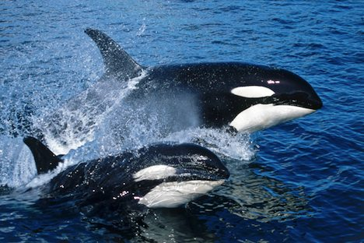
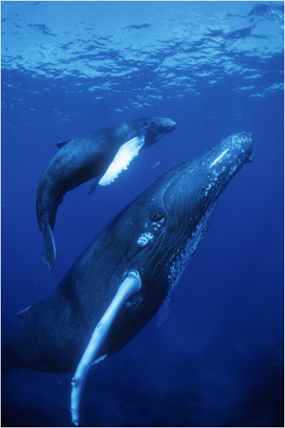
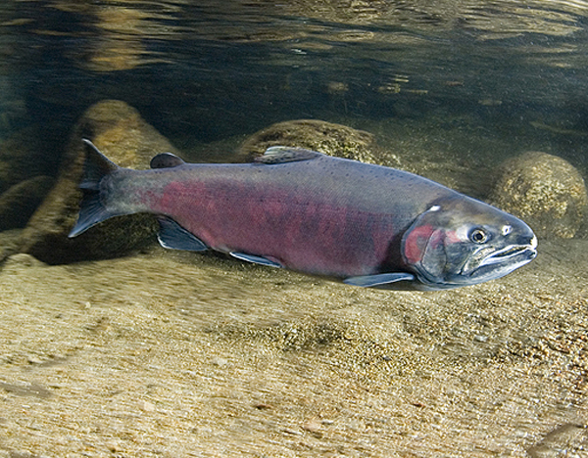
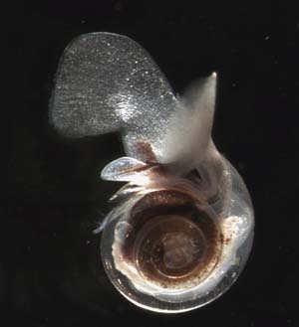
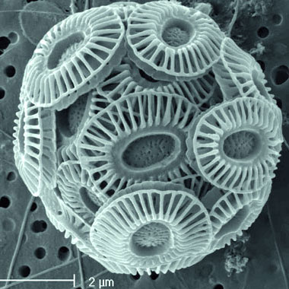
www.travel-vancouver-island.com
www.nceas.ucsb.edu
www.bigmoviezone.com
www.noaanews.noaa.gov
http://elrid.cult.bg
Notes:
For example, the Zooplankton, such as pteropods, feast on the tiny coccolithophores (click). In turn, the pteropods are critical food sources for larger marine animals like fish (click) and whales (click). If coccolithophores and pteropods become less abundant due to ocean acidification, there will be less food for animals higher up the food chain (click).

Slide 6
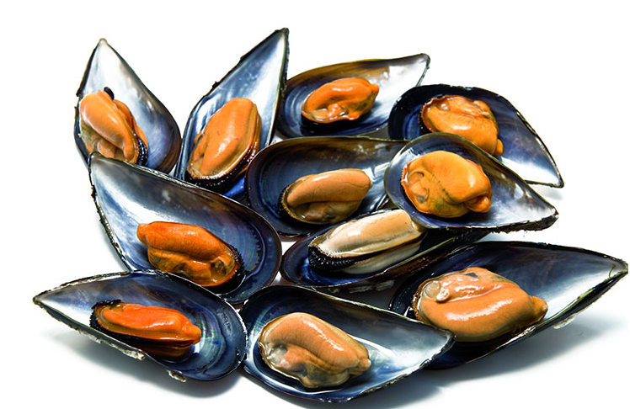
Important and “Accessible” Species
Coral reefs support more species per unit
area than any other marine environment,
including about 4,000 species of fish.
Bivalve mollusc are very important for the
Economy of Mediterranean and Atlantic
Countries like Spain: we eat them, export them.
Notes:
Bivalve mollusc are important for it’s a resource of food and it can be export. Coral is important for the marine species.

Slide 7
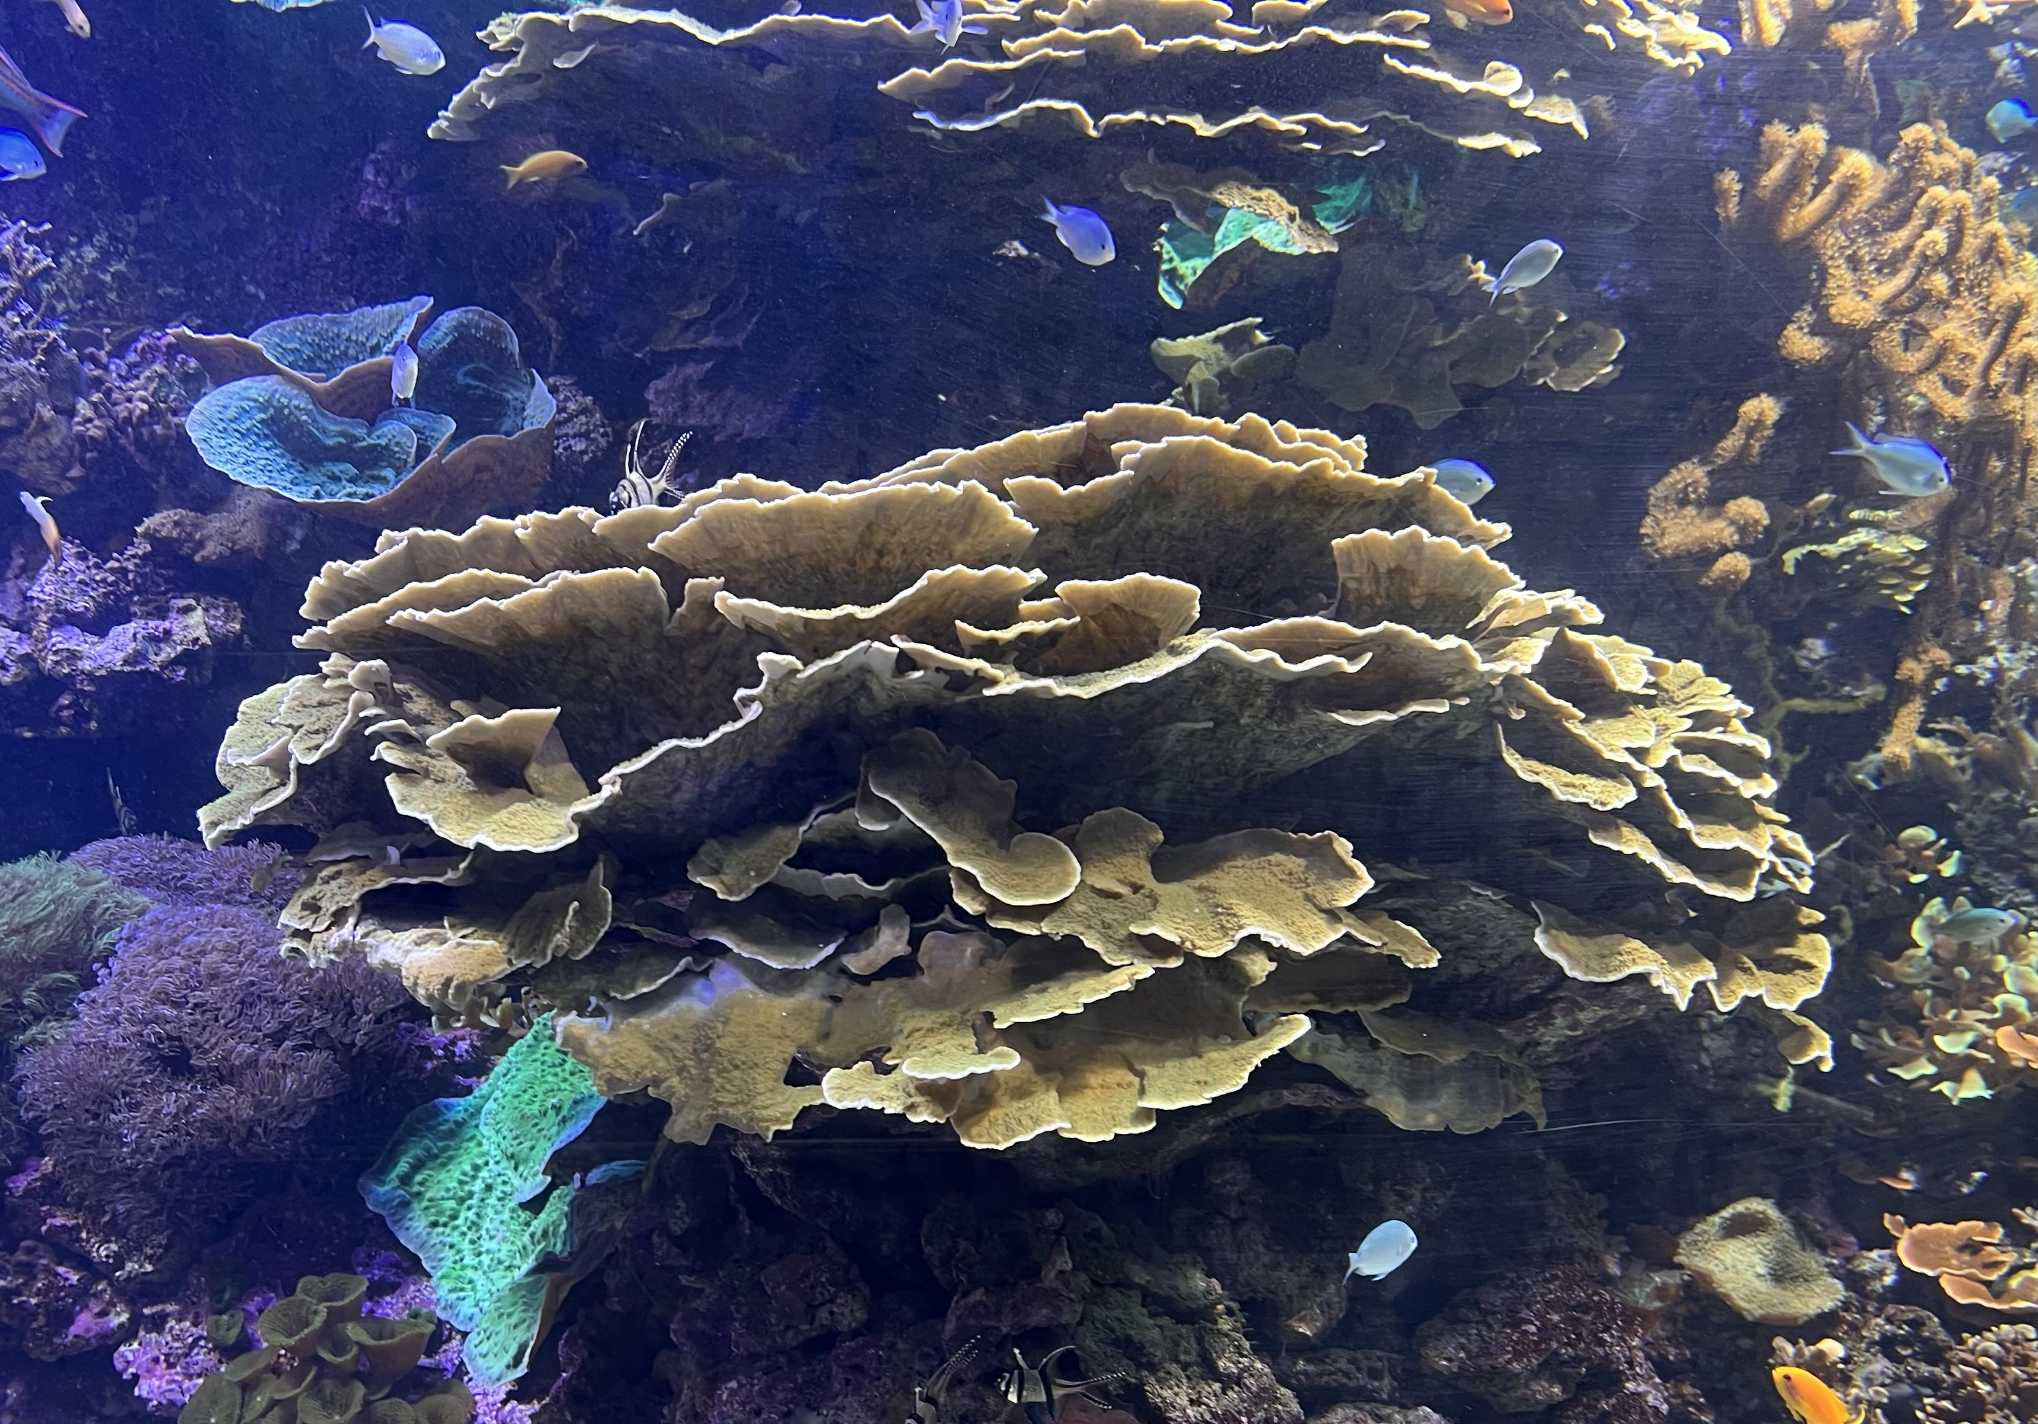
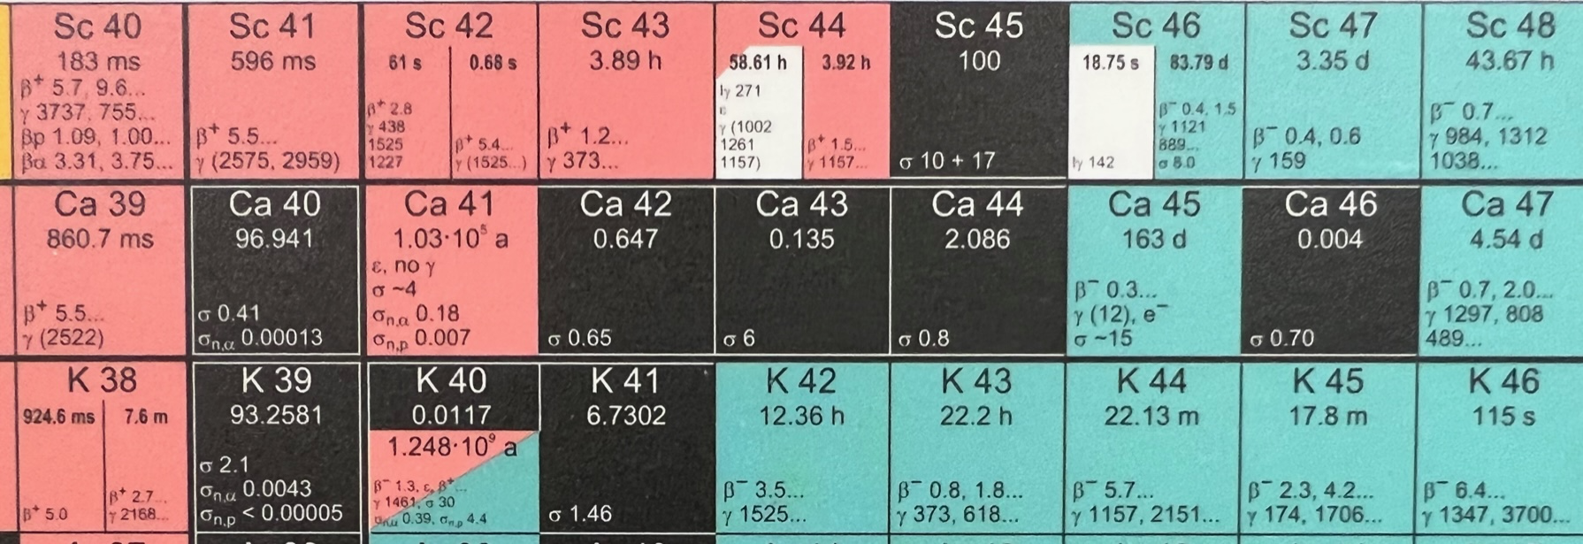
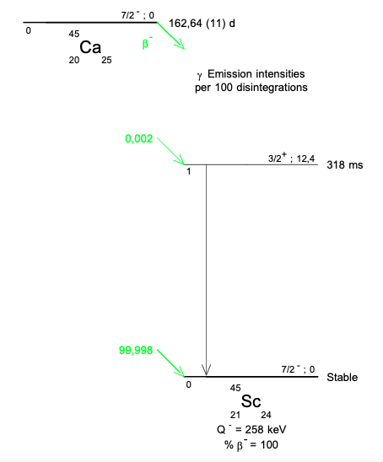
Climate change effects studied using unstable tracers:
1.03 10⁵ y
⁴¹⁻⁴⁵Ca radioactive
163 d
Monitoring the adaptation of species to climate change
through ⁴¹⁻⁴⁵Ca uptake
Notes:
To monitoring the effect. The unstable tracer are essencial. We chose the Ca-45 to monitor the growth of coral. The lifetime of Ca-45 is 163 days and decay by emiting the electron. For the mussels, we use the Ca-41.

Slide 8
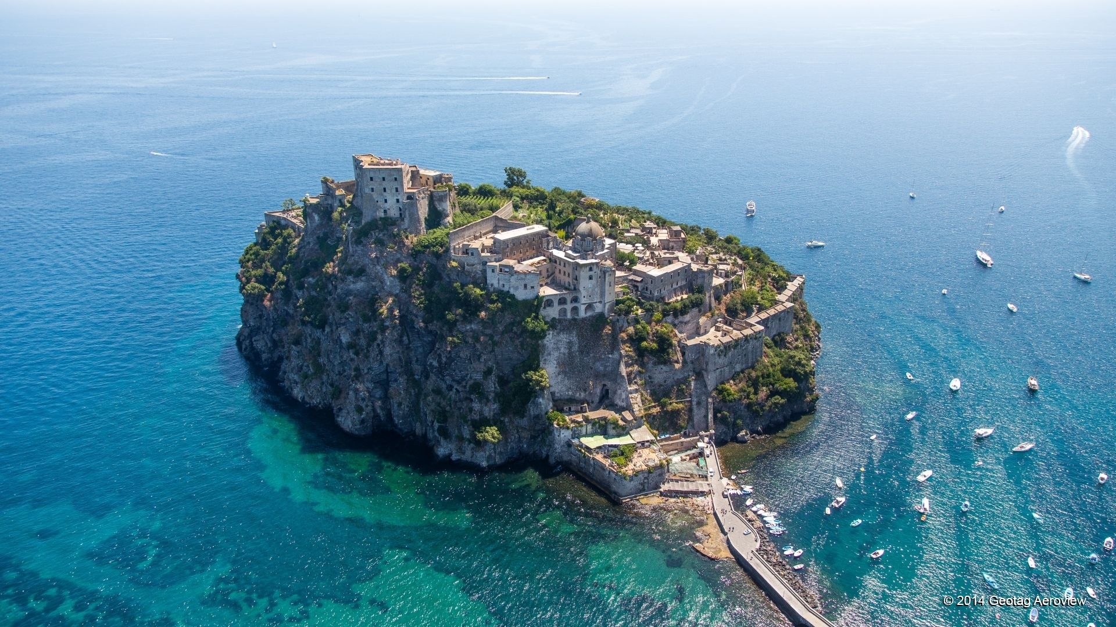

Collabrating
Institutes
INFN - LNL, Legnaro (PD), Italy.
Department of Marine Biology of the University of Padova and Hydro-Biological Station of the University of Padova, Chioggia, Italy.
IFIC-CSIC, University of Valencia, Spain.
Oceanografic, Valencia, Spain.
Valencia, Spain
Chioggia (PD), Italy
Ischia (NP), Italy

Slide 9
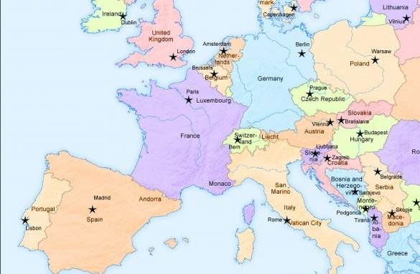
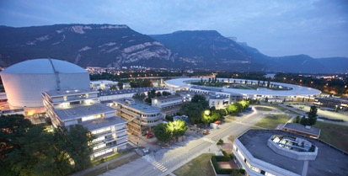
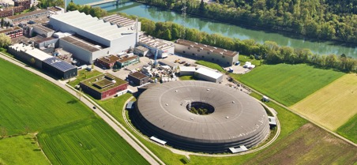





Radiotracer ⁴⁵Ca: a global problem due to the war, to the
inflaction and to the handling of radiactive materials
Through good international contacts (E. Nácher) and after several months
of negotiations…
⁴⁵Ca and other isotopes
are analised and calibrated
at PSI (CH). A primary
separation is performed
9,5 k€
⁴⁴Ca (stable), neutron irradiation
at the high flux reactor in Grenoble
CIEMAT (Madrid) does a
purification process with
dissolution in water at low
concentration (allowing use
in uncontrolled areas)
(costs in nature: 45Ca)
⁴⁵Ca arrives at IFIC Valencia (E) the 13th of May 2024
Notes:
For the Ca-45, we have met some problem due to the war, inflaction and … Fouturnately, by good international contacts, the radioisotope 45Ca (lifetime 163 days) is produced at reactors with Ca target enriched in 44Ca at Grenoble. Samples have sent to PSI, Ca45 were separated.
高通量中子辐照Ca44产生Ca45。在PSI进行初步分离和纯化。随后至马德里进一步纯化，并制成低浓度溶液。

Slide 10

How?
Water enriched
in 45Ca
The aquarium
Ecosystems will be intalled
at Oceanographic
In Valencia
PH 8,1(present)
PH 8,1(present)
Mediterranean
Tropical
PH 7,5 (year 2100, if we do nothing!!)
PH 7,5 (year 2100, if we do nothing!!)
Notes:
为什么要逐渐降低ph值
The ecosystems have been installed at Valencia. The water enriched the radiotracer Ca-45. Simulate the ph value nowdays and year 2100 while the other conditions is same.

Slide 11
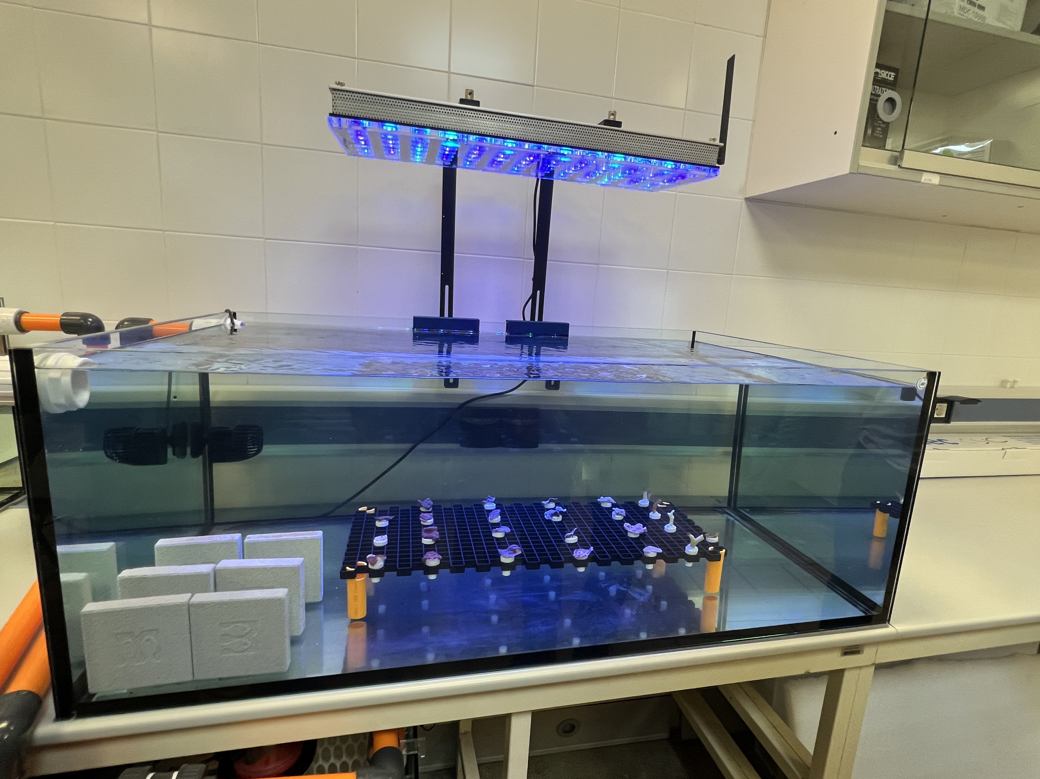
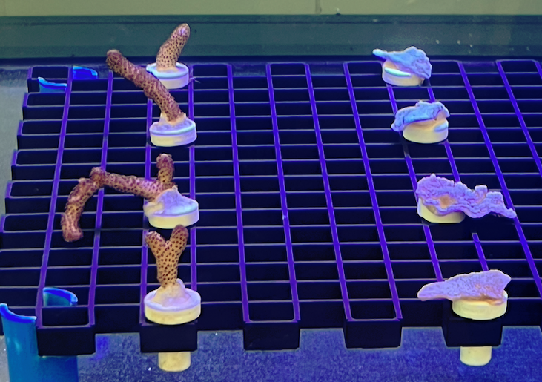
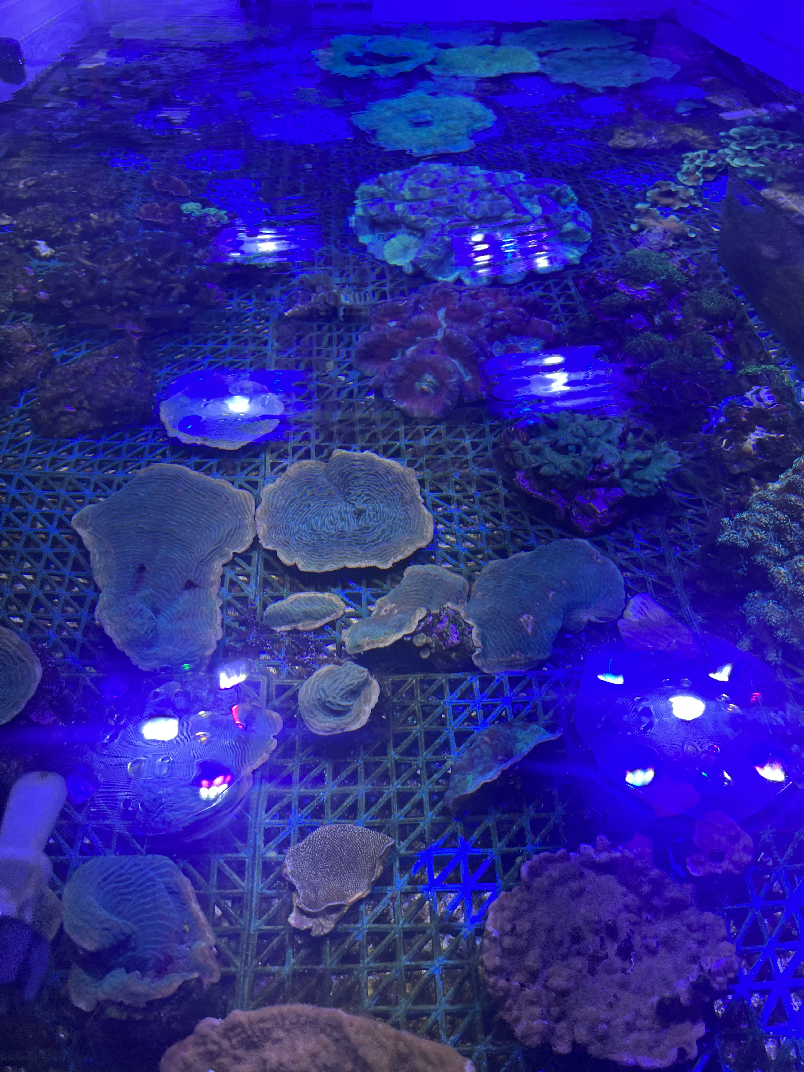
REMO-ClimOcean Installations at the Oceanografic
Nursery
Installations
Notes:
实验在Spain开展 Blue light for？
Select 20 animals in total, accounting for two coral species and tanks,

Slide 12
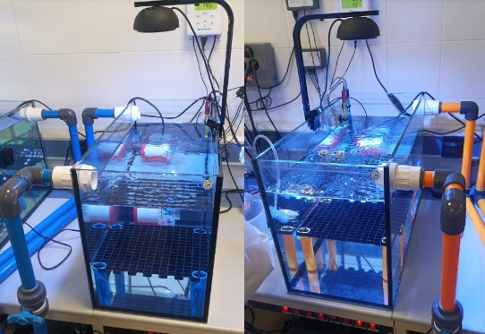
Valencia Experiment
First measurement at the Oceanografic Valencia 16 July 2024
PH=8.1
PH=7.8
Notes:
The 20 animals were exposed to a 45Ca radiotracer in the auxiliary water tanks for a total duration of 5 hours. During the exposure period, the concentration of 45Ca was maintained at around 20 kBq/L in both tank systems.
To replicate solar conditions, a special light lamp was placed above both auxiliary tanks
A good agreement between different systems was found for the two coral species under study. However, the obtained calcification is smaller compared with previous measurements. This fact is not completely understood yet and it is under investigation.
Experiments with different pH have already taken place at Valencia’s Oceanogr` afic and their analysis is underway. It is expected that in the forthcoming months new experiments involving mollusks will be carried out.

Slide 13
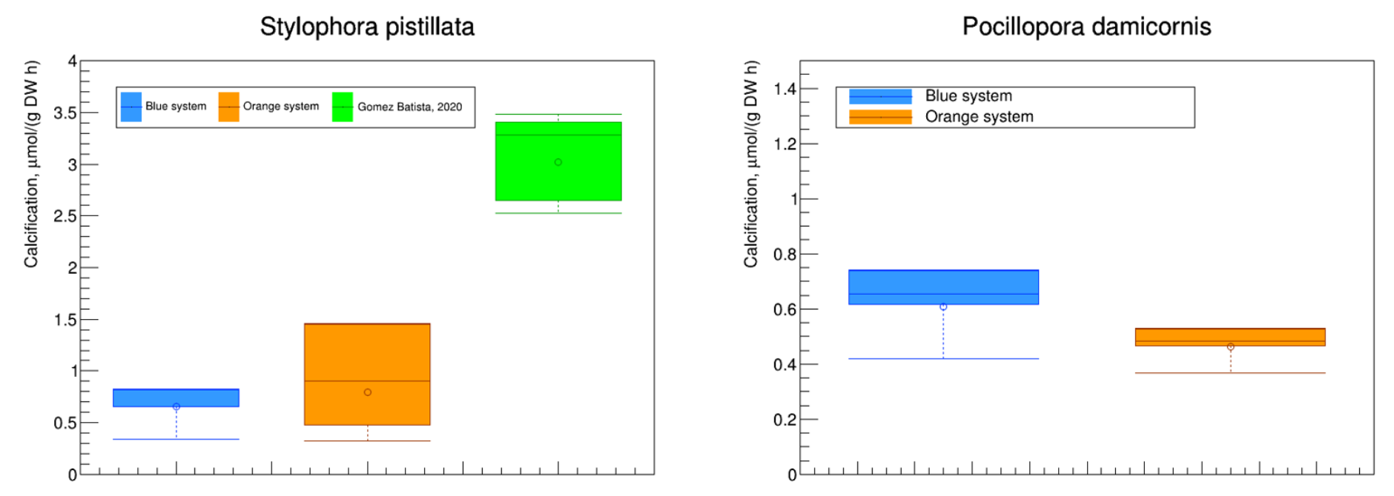
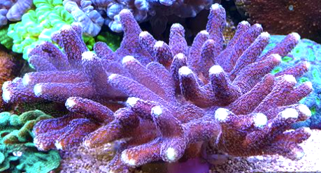
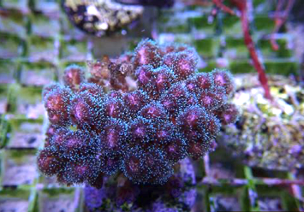
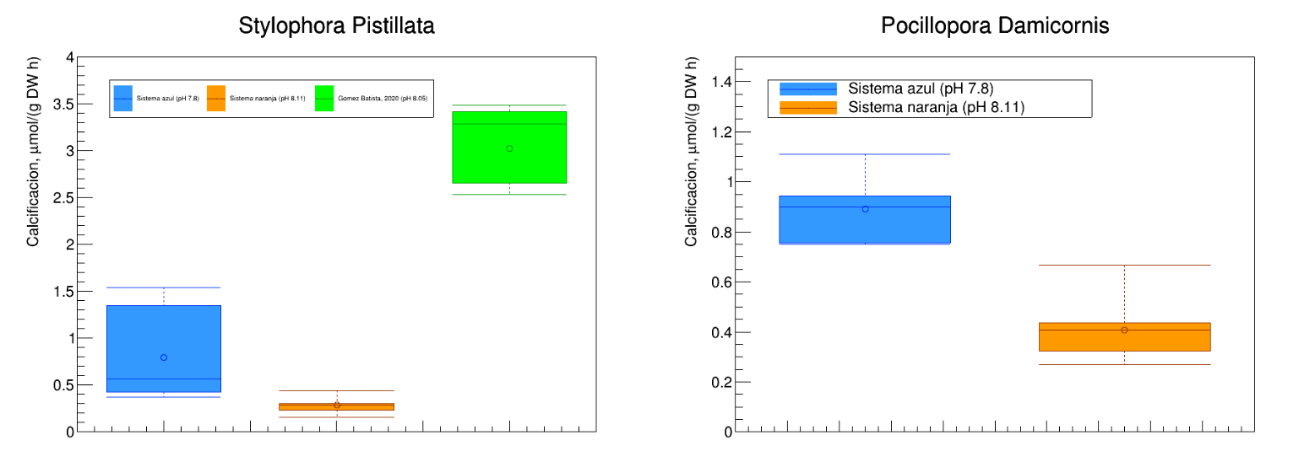
Results of the first measurement
Light problems affecting the growth of the symbiotic algoe
Notes:
The results for both water tank systems are presented in orange and blue colors, respectively. Blue for the low ph value. Y axis is the calcification rate.
As shown by the panels, the results for both water tanks are compatible and different for each coral species as expected from a null change in pH. Therefore, validating that for both water tank systems, the corals grow in an equivalent way. However, it is important to remark that the results for Stylophora pistillata are smaller when compared with previous measurements as indicated in the left panel.
It worth note that maybe because of the Light problem, the result of orange is lower than previous.
affecting the growth of the symbiotic.

Slide 14
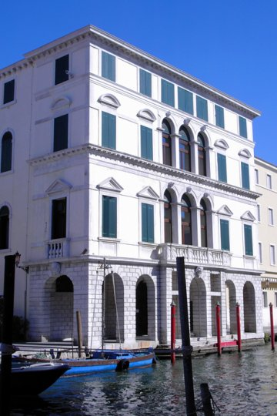
PRIN 2022 - LNL-INFN-PD-Univ-Padova
Use of stable & unstable isotopes ( ¹³C ⁴¹Ca) for
Monitoring the growth in Mollusks and Echinoderms
Institute of marin biology of the University of Padova
Dep.
of Biology
Chioggia experiment
Notes:
用Ca41 研究贝类生物的生长
Another experiment is collibrate with IMB of UniPD located at Chioggia. By using Ca-41, we can moniter the growth in mullusks and Echinoderm.

Slide 15
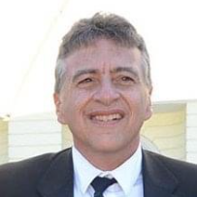






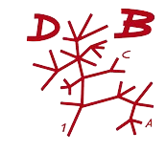

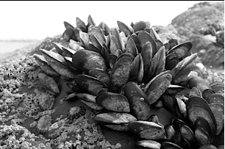
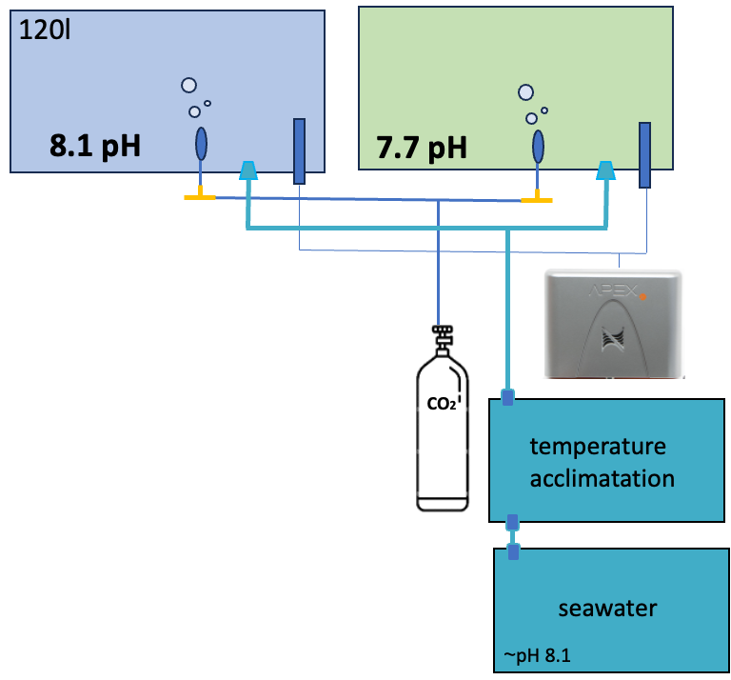
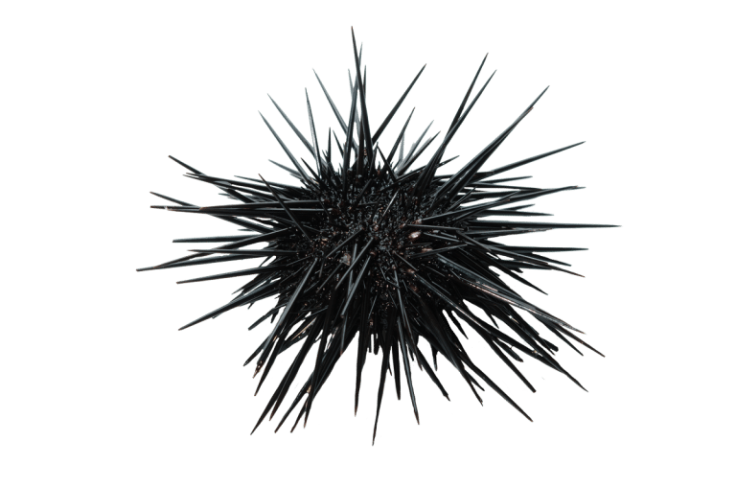
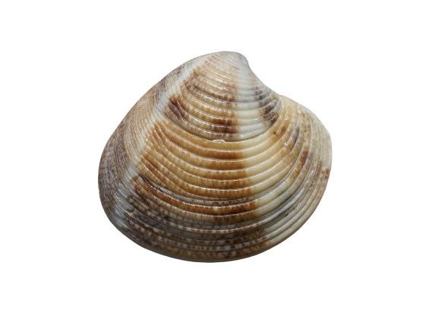
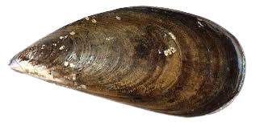
Isotopes for assessing the impacts of climate change and ocean acidification in marine calcifying organisms (ClimOcean)
Giacomo
De Angelis
Maria Gabriella
Marin
Annalisa
Capasso
Marco
Munari
Istituto Nazionale
di Fisica Nucleare
Dep.
of Biology
Dep.
of Geoscience
Predicting Climate Change Impacts
Laboratory experiments
Mytilus galloprovincialis
(12 mm)
Chamelea
Gallina
(8 mm)
Sea Urchin
Notes:
We are starting a 6 months exposure to reduced pH of juveniles of mussels and clams at the end of which the levels of stable carbon isotope （or Ca？？）will be measure to assess the impact of ocean acidification on somatic growth and shell formation

Slide 16
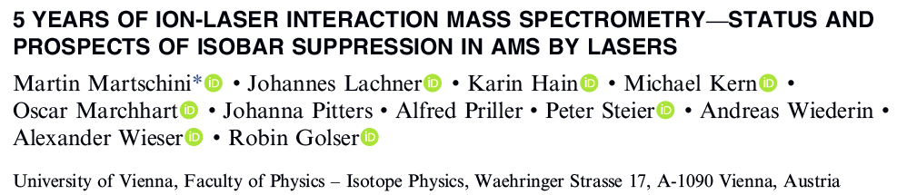
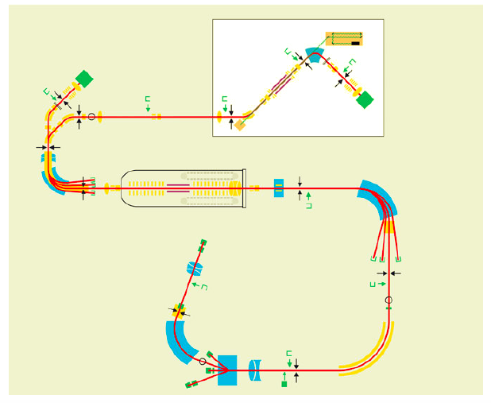
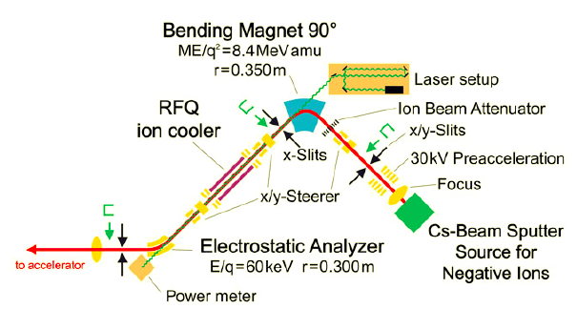
⁴¹Ca/⁴⁰Ca Isotopic ratio by
ILAMS @ Vienna
Notes:
We have collected the sample of mussels and sent to Vienna to perform the AMS measurement to access the level of Ca-41 and Ca-40.
样品运送至AMS in Vienna，开展研究

Slide 17

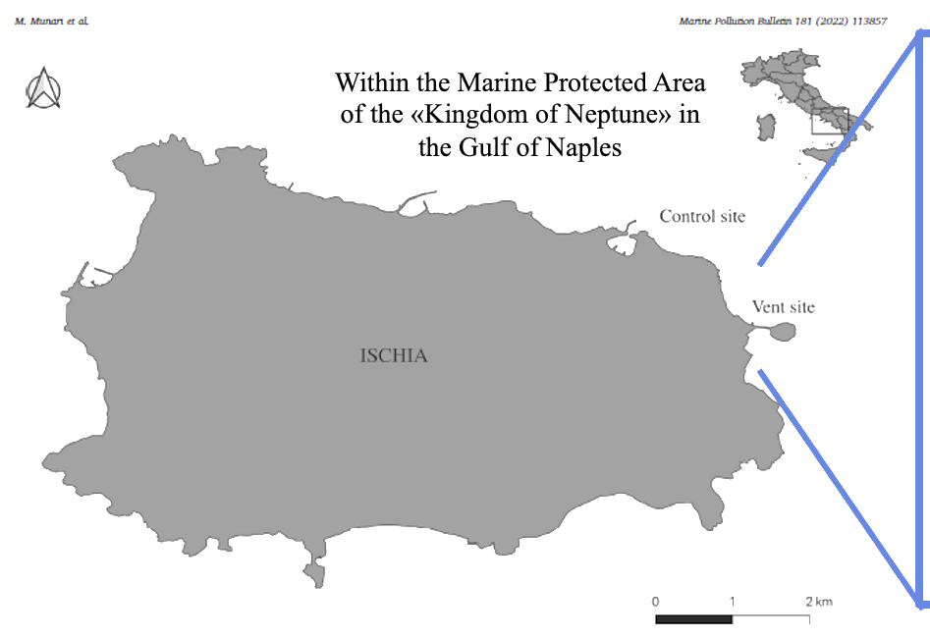
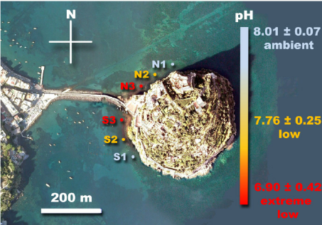
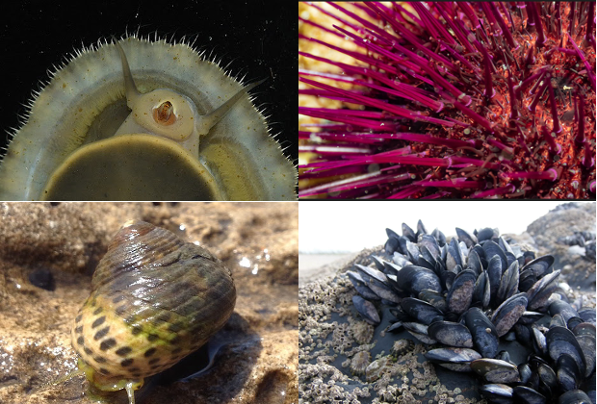
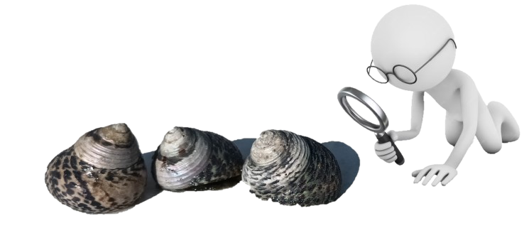
Istituto Nazionale
di Fisica Nucleare
Dep.
of Biology
Dep.
of Geoscience
Munari et al., 2022
Gambi et al., 2020
Predicting Climate Change Impacts
From the lab to the field
Castello Aragonese vent systems
(Ischia Island, Italy)
Notes:
Furthermore, collection of calcifying organisms directly from the CO2 vents system of Ischia Island in the Tyrrhenian Sea, where the water column is naturally acidified, will take place. In this systems it is possible to find different species of marine invertebrates with calcareous structures. However, collection will focus on the gasterops Phorcus turbinatus which is the most abundant along the whole pH gradient of the CO2 vents system

Slide 18
Production of ⁴⁵Ca
⁴⁴Ca enriched in ⁴⁴Ca (stable)
⁴⁵Ca, ⁴¹Ca and other isotopes
⁴⁵Ca
centrifugal separation,
mass spectrometers
…
Neutron irradiation
It’s difficult and expensive to separate from the unstable isotope ⁴¹Ca
Notes:
The radioisotope 45Ca (lifetime 163 days) is produced by neutron irradiation at reactors with Ca target enriched in 44Ca. However this technique has the disadvantage that the 45Ca produced in this way needs to be separated from the unstable isotope 41Ca (lifetime 105 y) via centrifugal separation or mass spectrometers or other difficult techniques.

Slide 19
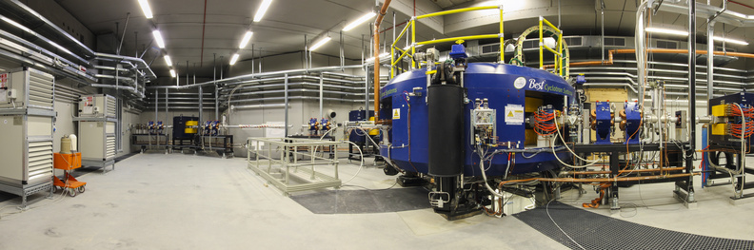
⁴⁵Sc(n,p)⁴⁵Ca reaction: A new concept to produce the radiotracer
Sc target placed inside or near the target area at Radioactive Ion Beam Facilities, leveraging the (n,p) nuclear reaction for isotopic production
Only stable Ca isotope created except ⁴⁵Ca
chemically separate isotopes with different Z
Notes:
It is therefore very interesting to investigate a new concept based on inserting a 45Sc target inside or close to the target at the Radioactive Ion Beam Facilities exploiting the (n,p) nuclear reaction for the isotopic reaction. In fact, in this case, in addition to 45Ca, only Ca stable isotopes are created (so no need to separate them). The remaining isotopes produced have a different atomic number and can be chemically separated from the 45Ca.

Slide 20
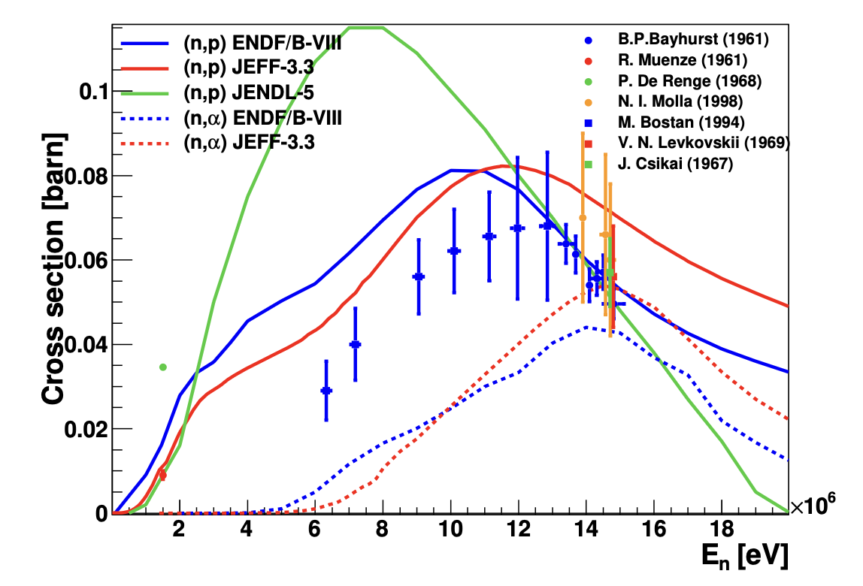
Cross section of ⁴⁵Sc(n,p)⁴⁵Ca
Notes:
Currently, the precision of the 45Sc(n,p) cross section is very limited, as only activation measurements are available in the literature, covering the neutron energy range from 1 to 16 MeV. This limitation is evident in the inconsistencies among evaluated libraries.
It is therefore of interest to measure 45Sc(n,p) in a wide neutron energy range from thermal neutron energies up to 20 MeV in order to unveil the discrepancies between different evaluations.

Slide 21
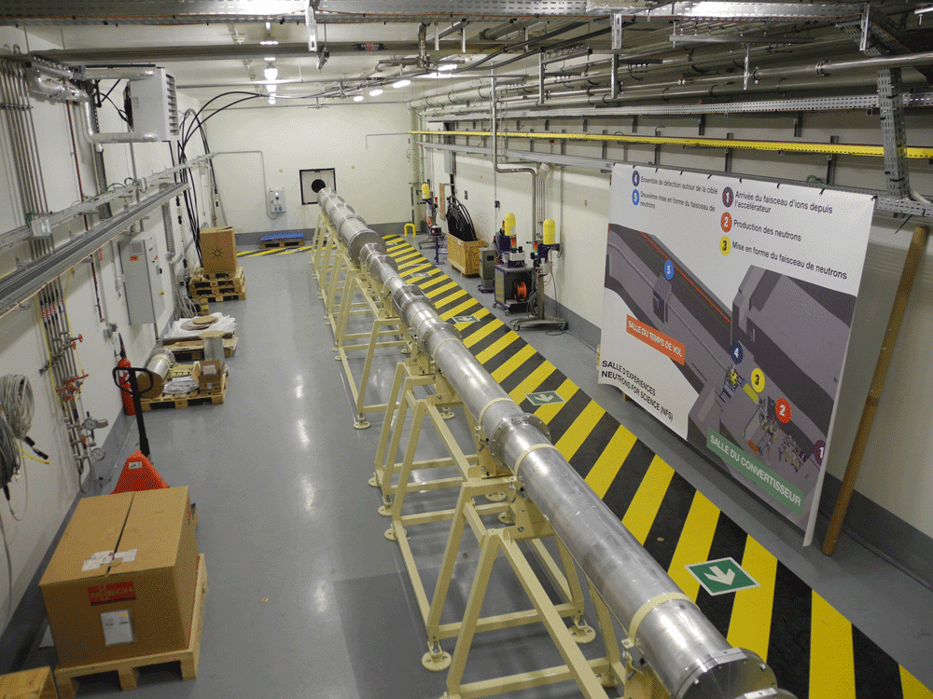
Measurement of the ⁴⁵Sc (n,p)⁴⁵Ca cross section
NFS at GANIL
TOF hall
In Preparing

Slide 22
Thanks for Attention
Notes:
The ecosystems of the red sea are estimated to harbor greater than 150 species of corals and more than 1000 species of fish of which over 85% are likely to occur within the gulf of Aqaba. Over 5% of fish species are endemic. Over the past 40 years a large majority of the world’s reefs have suffered serious effects of climate change, with an estimated 50% loss of coral reefs globally bleaching. It is predicted that, even if global warming remains below the 1.5 C target stipulated by the Paris agreement, up to 90% of the worls’s coral reefs may be destroyed by mid 21° century. The termal tolerance of the Gulf of Aqaba’s corals is likely to provide these coral reef ecosystems the best chances of surviving relatively intact untill the end of this century.

