Slide 1
Emulating hadronic matter in extreme conditions
Massimo Mannarelli
INFN-LNGS
massimo@lngs.infn.it
Phys.Rev.Lett. 131 (2023) 22, 223401
Few Body Syst. 65 (2024) 81
Sterne und Weltraum, Oktober 2024
Sterne und Weltraum
Oktober 2024
14th SPRING
Ischia, May 2025
E. Poli, T. Bland, S. J.M. White, M. Mark, F. Ferlaino, S. Trabucco

Slide 2
Outline
Hadronic matter in compact stars
Dipolar supersolids (in brief)
Supersolids vs compact stars
Emulating glitches
Conclusions

Slide 3
Phases of hadronic matter
Heavy-Ion
Collisions
quark-gluon
plasma
hadrons
gas
color
superconductors
Compact Stars
pion condensed
phase

Slide 4
A neutron star is forever
Repulsion
Gravity
Repulsion due to exchange forces and nuclear repulsion… it does not burn any fuel

Slide 5
Compact stars
Mass
Radius
Average density $ρ≃{10}^{17}kg/m^{3}$
Our Aim
To extract information relevant for the nuclear scale

Slide 6
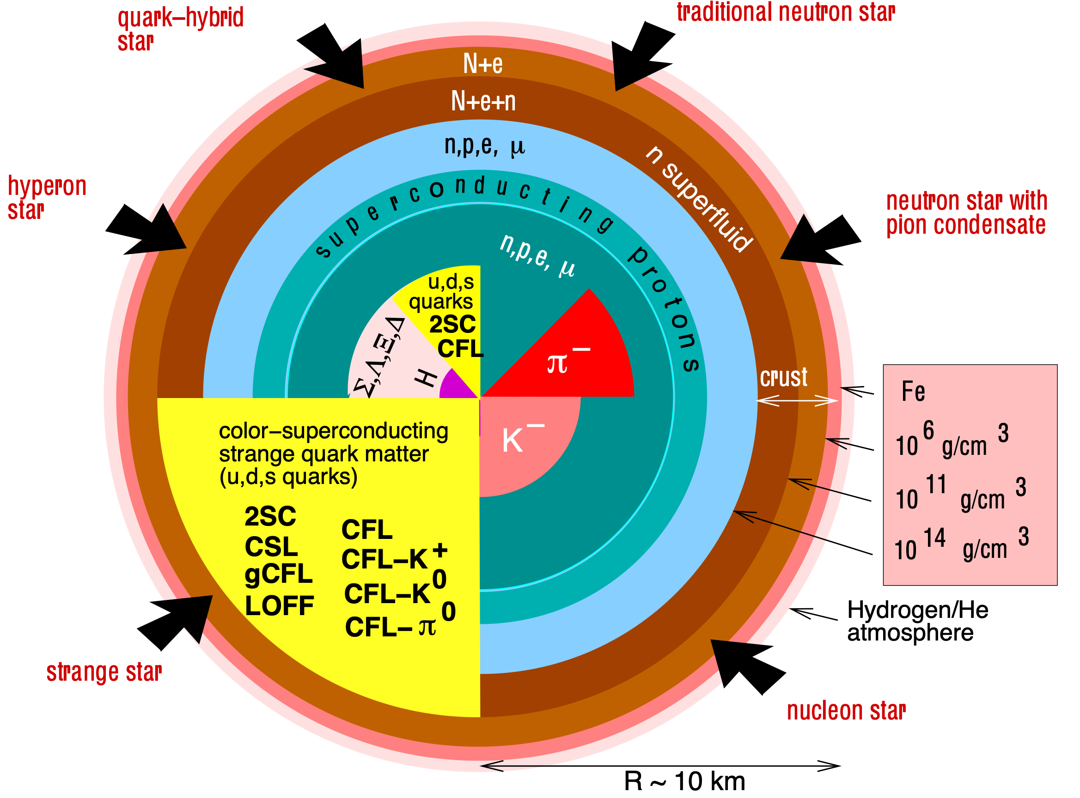
Compact stars
F. Weber, Prog.Part.Nucl.Phys. 54 (2005) 193

Slide 7
How we see them

Slide 8
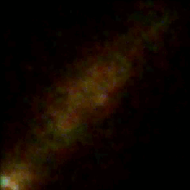
Pulsars
Vela
PSR B0329
P~0.7s
Vela
P~89ms
Crab
P~33ms
PSR J1748 –2446ad
P~1.4ms
Goddard Space Flight Center
Washing machine about 30 rounds/s thus P~33 ms
Ferrari engine: P~3.16 ms

Slide 9
Spin down
Neutron stars lose angular momentum by photon emission
The process is extremely slow
$\overset{·}{P}∼{10}^{-22}-{10}^{-9}ss^{-1}$
Notes:
Glitches as probes of the neutron star interior structure
paricles wind: emission of high energy particles

Slide 10
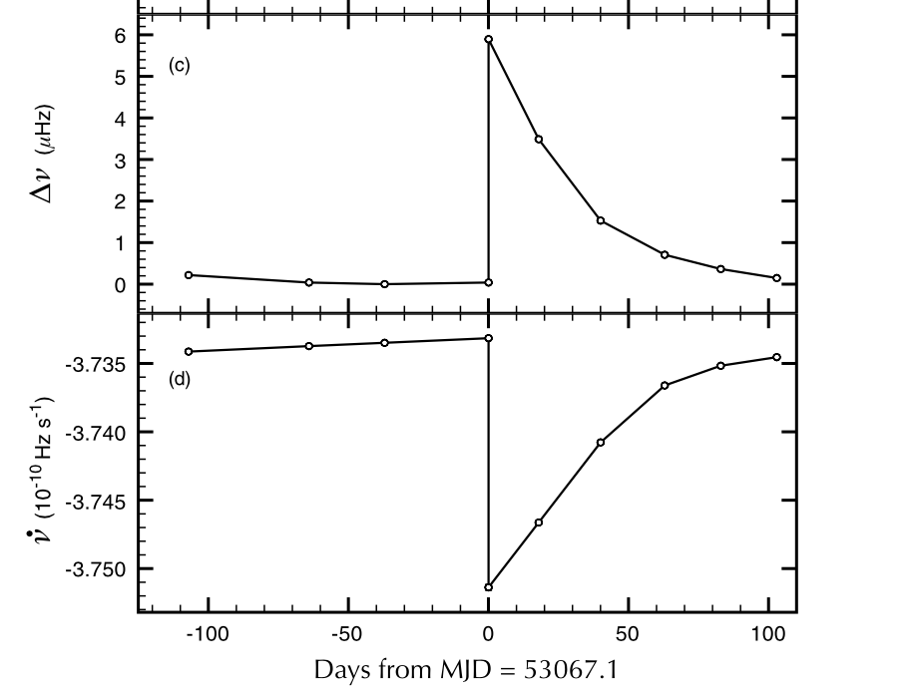
Glitches
1. They occur without warning
2. Large variety of time scales
Sudden speed-up in the rotational frequency
PSRB0531+21
relaxation
steady state
spin-up
$$ΔΩ/Ω∼{10}^{-12}-{10}^{-3}$$
Espinoza et al., Mon. Not. R. Astron. Soc. 414, 1679–1704 (2011)
Notes:
Glitches as probes of the neutron star interior structure
paricles wind: emission of high energy particles

Slide 11
Possible glitch mechanism
z
1) Superfluid vortices are initially pinned
2) Superfluid vortices unpin and transfer
angular momentum to the crust
vortices move if
magnus force > pinning force
pinned vortices
magnus force

Slide 12
Can we understand this process?
Aut inveniam viam aut faciam
Hannĭbăl

Slide 13
Dipolar supersolids
Superfluid
Rigid
Review: M. Boninsegni and N. V. Prokof’ev, Rev. Mod. Phys. 84, 759 (2012)
Can be realized with ultracold atoms in optical traps
Tool to emulate inhomogeneous hadronic matter in extreme conditions

Slide 14
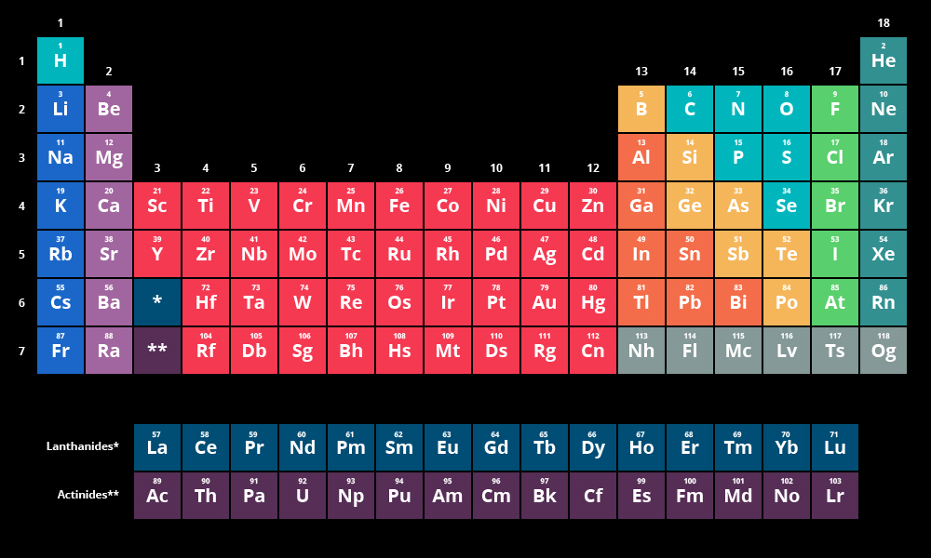
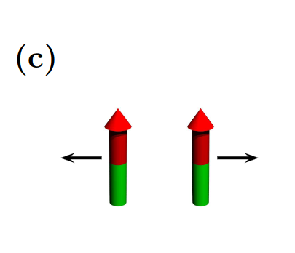
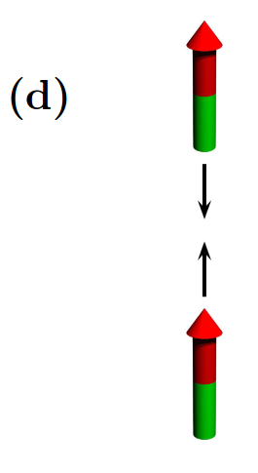
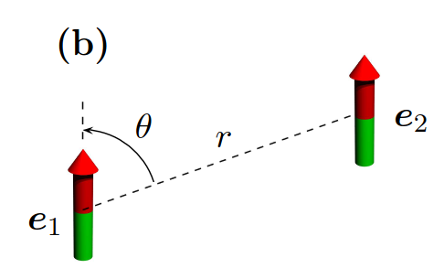
Ultracold dipolar atoms
repulsive
attractive
polarized
$$a_{dd}=\frac{μ_{0}μ_{m}^{2}m}{12πℏ^{2}}$$
“Long-range” dipolar interaction
${}^{165}\text{Dy},a_{dd}≃131a_{0}$
Short-range repulsion
(Feshbach resonance)
$$U_{c}(r)=\frac{4πℏ^{2}a_{s}}{m}δ(r)$$
$$a_{s}\text{tunable}$$

Slide 15
Relevant parameters
fixed
Relative interaction strength
$$ϵ_{dd}=\frac{a_{dd}}{a_{s}}$$
tunable
$$n=\frac{N}{V}$$
Number density
tunable
Ultracold dipolar atoms:
Number density and interaction strengths can be separately tuned
Nuclear matter:
The interaction strengths are given functions of density

Slide 16
Tuning the relative interaction strength
The Fano-Feshbach resonance allows to change $a_{s}$ and thus $ϵ_{dd}$
Crystal or glass
BEC
Supersolid
or
Superglass
Contact interaction dominates
Homogeneous Superfluid
Dipolar interaction dominates
Solid
Competition between interactions
Inhomogeneous Superfluid
$$ϵ_{dd}≪1$$
$$ϵ_{dd}≫1$$
$$ϵ_{dd}∼1$$

Slide 17
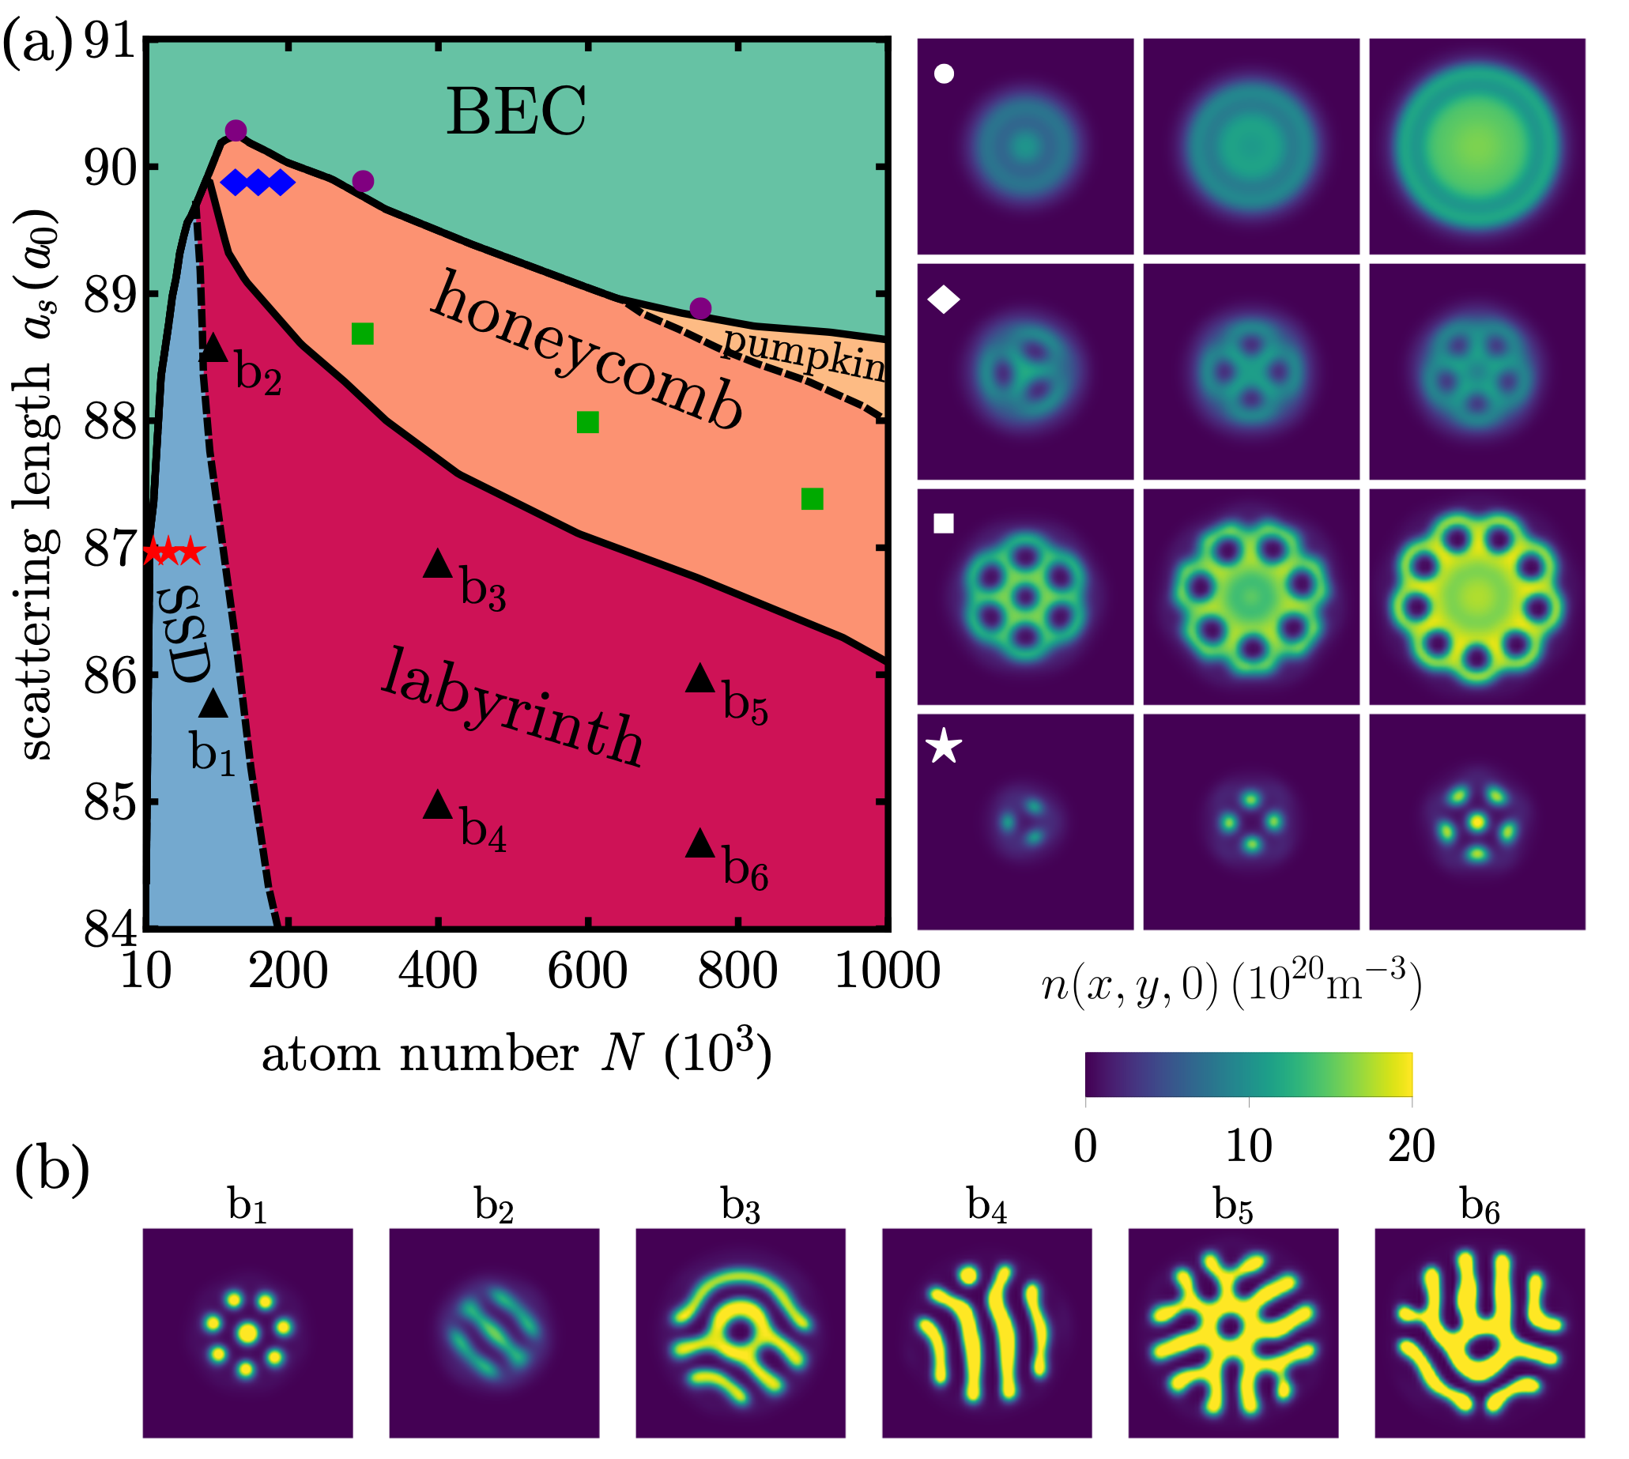
Phase diagram
Fluid
Supergalsses
Supersolid
droplets
J. Hertkorn et al.,
Phys. Rev. Research 3, 033125 (2021)

Slide 18
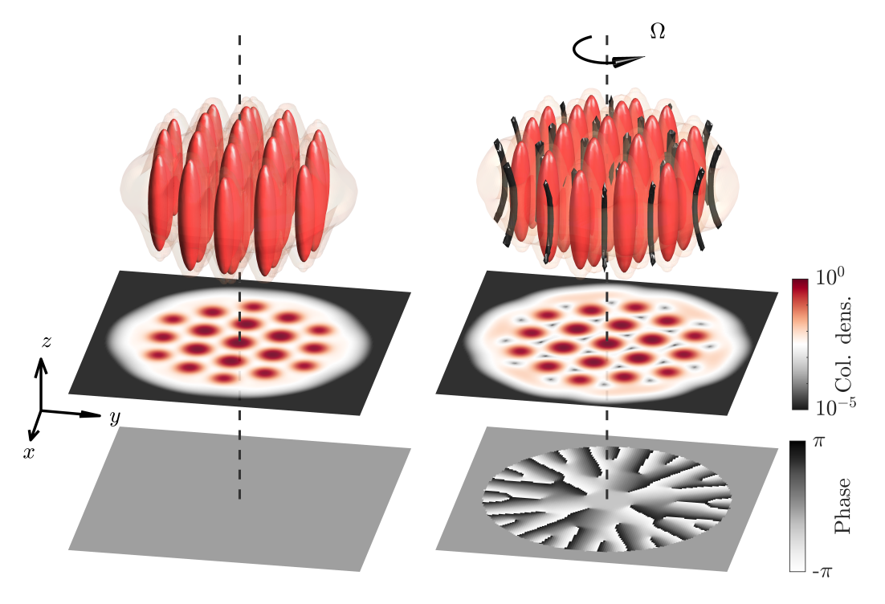
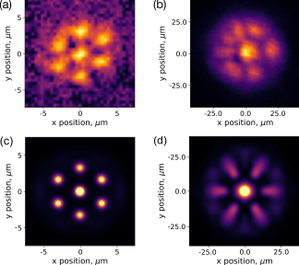
Supersolid droplets
Observations of supersolids@ MIT, Pisa/LENS, Stuttgart, Innsbruck
$$N=3×{10}^{5}$$
$$n∼{10}^{3}μm^{-3}$$
Droplets
$$n∼10μm^{-3}$$
Dy experiment
Numerical
Bland et al PRL 128, 195302 (2022)

Slide 19
Compact stars vs Supersolids

Slide 20
Nuclear matter
Supersolids
Fermions
Bosons
(fermions can in principle be used)
Long range attraction
Short range repulsion
Long range attraction
Short range repulsion
Scalar, vector and tensor forces
Dipole-dipole + s-wave scattering
High density $ρ∼{10}^{14}{\text{g/cm}}^{3}$
Diluted
$$ρ∼{10}^{-5}{\text{g/cm}}^{3}$$
Density and interactions
given by nature
Density and interactions
tunable

Slide 21
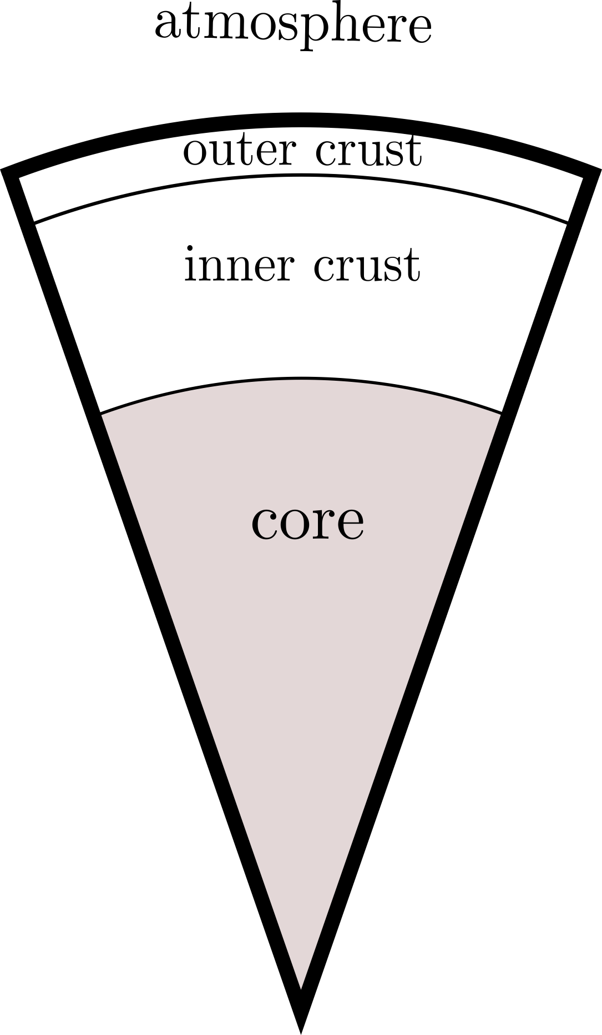
Neutron star vs dipolar superfluids
$$ϵ_{dd}=\frac{a_{dd}}{a_{s}}$$
dipolar superfluids
$$ϵ_{dd}$$
lattice of ions
$$ϵ_{dd}≫1$$
coexisting ions
and superfluid
$$ϵ_{dd}∼1$$
In principle
all layers could be emulated !
homogeneous
superfluid matter
$$ϵ_{dd}≪1$$

Slide 22
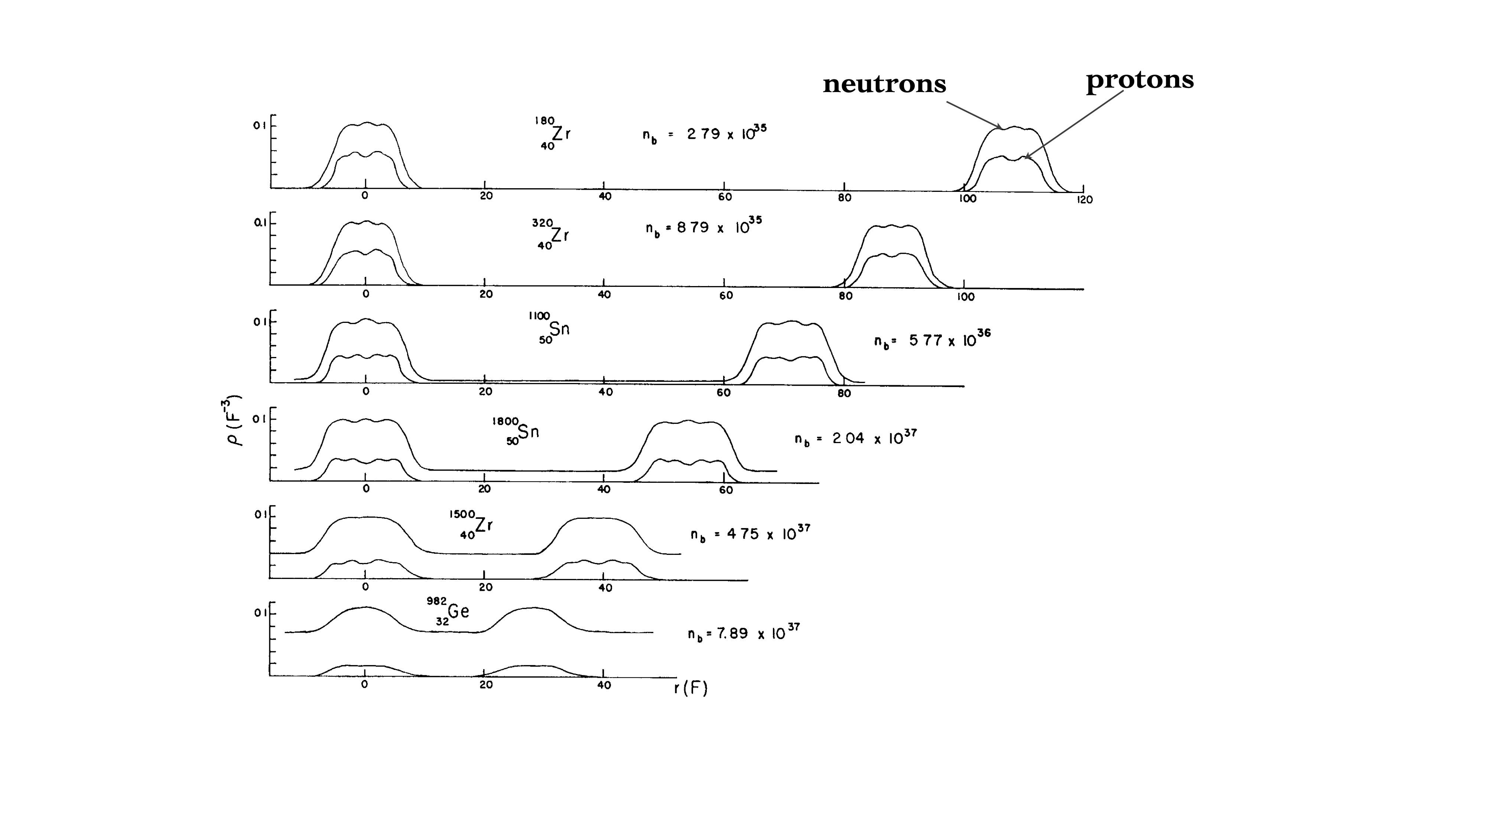
Inner crust
Particularly relevant for glitches: inner crust provides the pinning of superfluid vortices
$$ϵ_{dd}$$
$$ϵ_{dd}≫1$$
$$ϵ_{dd}∼1$$
J. W. Negele and D. Vautherin, Nucl. Phys. A207, 298 (1973)

Slide 23
Neutron Star inner crust
Dipolar Supersolid
$$ϵ_{dd}∼1$$
Poli, Bland, White, Mark, Ferlaino, Trabucco, MM
Phys.Rev.Lett. 131 (2023) 22, 223401

Slide 24
Emulating neutron star glitches

Slide 25
Glitches
relaxation
steady state
spin-up
Possible mechanism
Superfluid vortices are pinned to the lattice of ions
Superfluid vortices unpin and transfer angular momentum to the crust
One needs:
Superfluid vortices
A structure where vortices are pinned
Notes:
Glitches as probes of the neutron star interior structure
paricles wind: emission of high energy particles

Slide 26
Supersolids
AT REST
ROTATING
Vortices

Slide 27
Vortex pinning and evolution

Slide 28
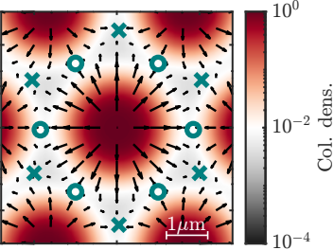
Vortex pinning
X = stable
O= metastable

Slide 29
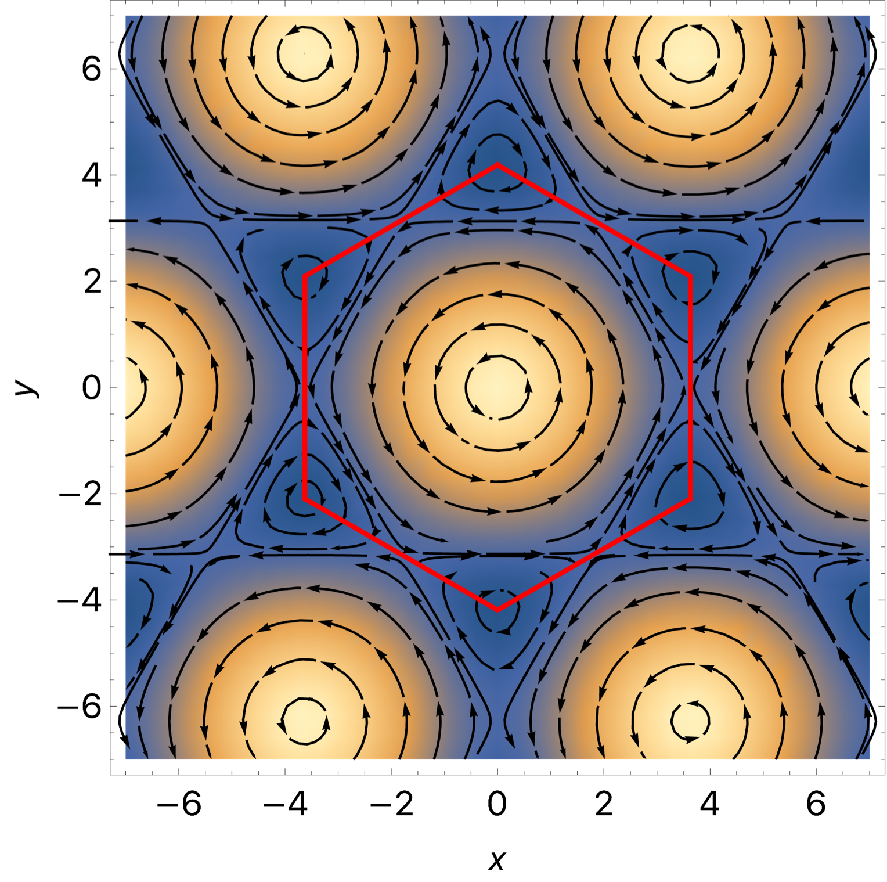
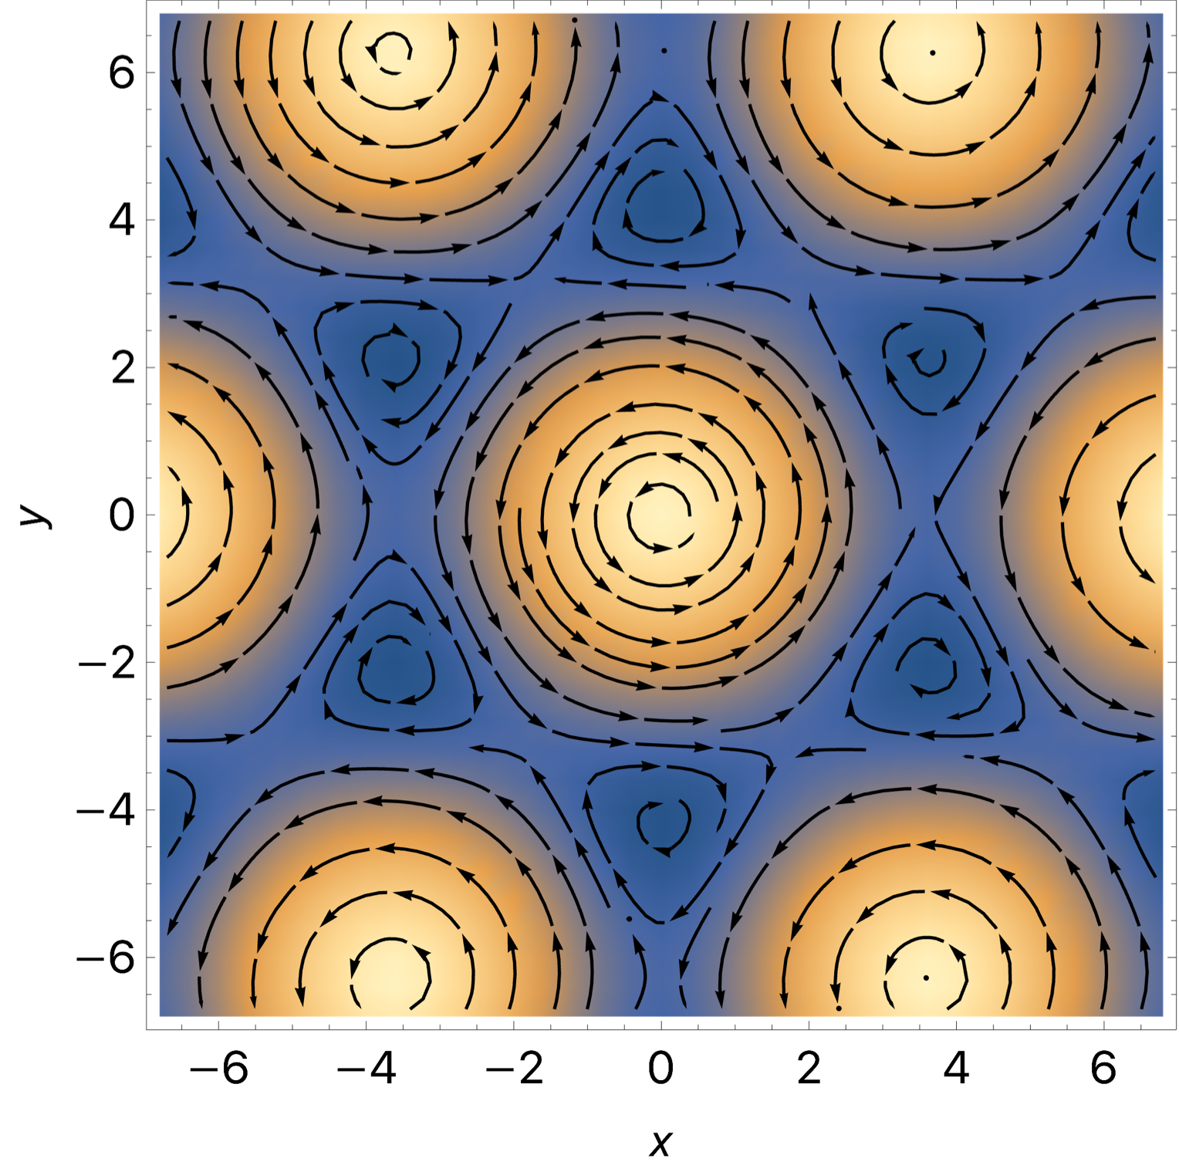
Vortex streamlines
Without dissipation
With dissipation
$$v_{v}≃-\frac{ℏ}{m}\left\{γ∇log\sqrt{ρ}+\overset{̂}{z}×∇log\sqrt{ρ}\right\}=v_{⊥}+v_{∥}$$
MM et al. Few Body Syst. 65 (2024) 81

Slide 30
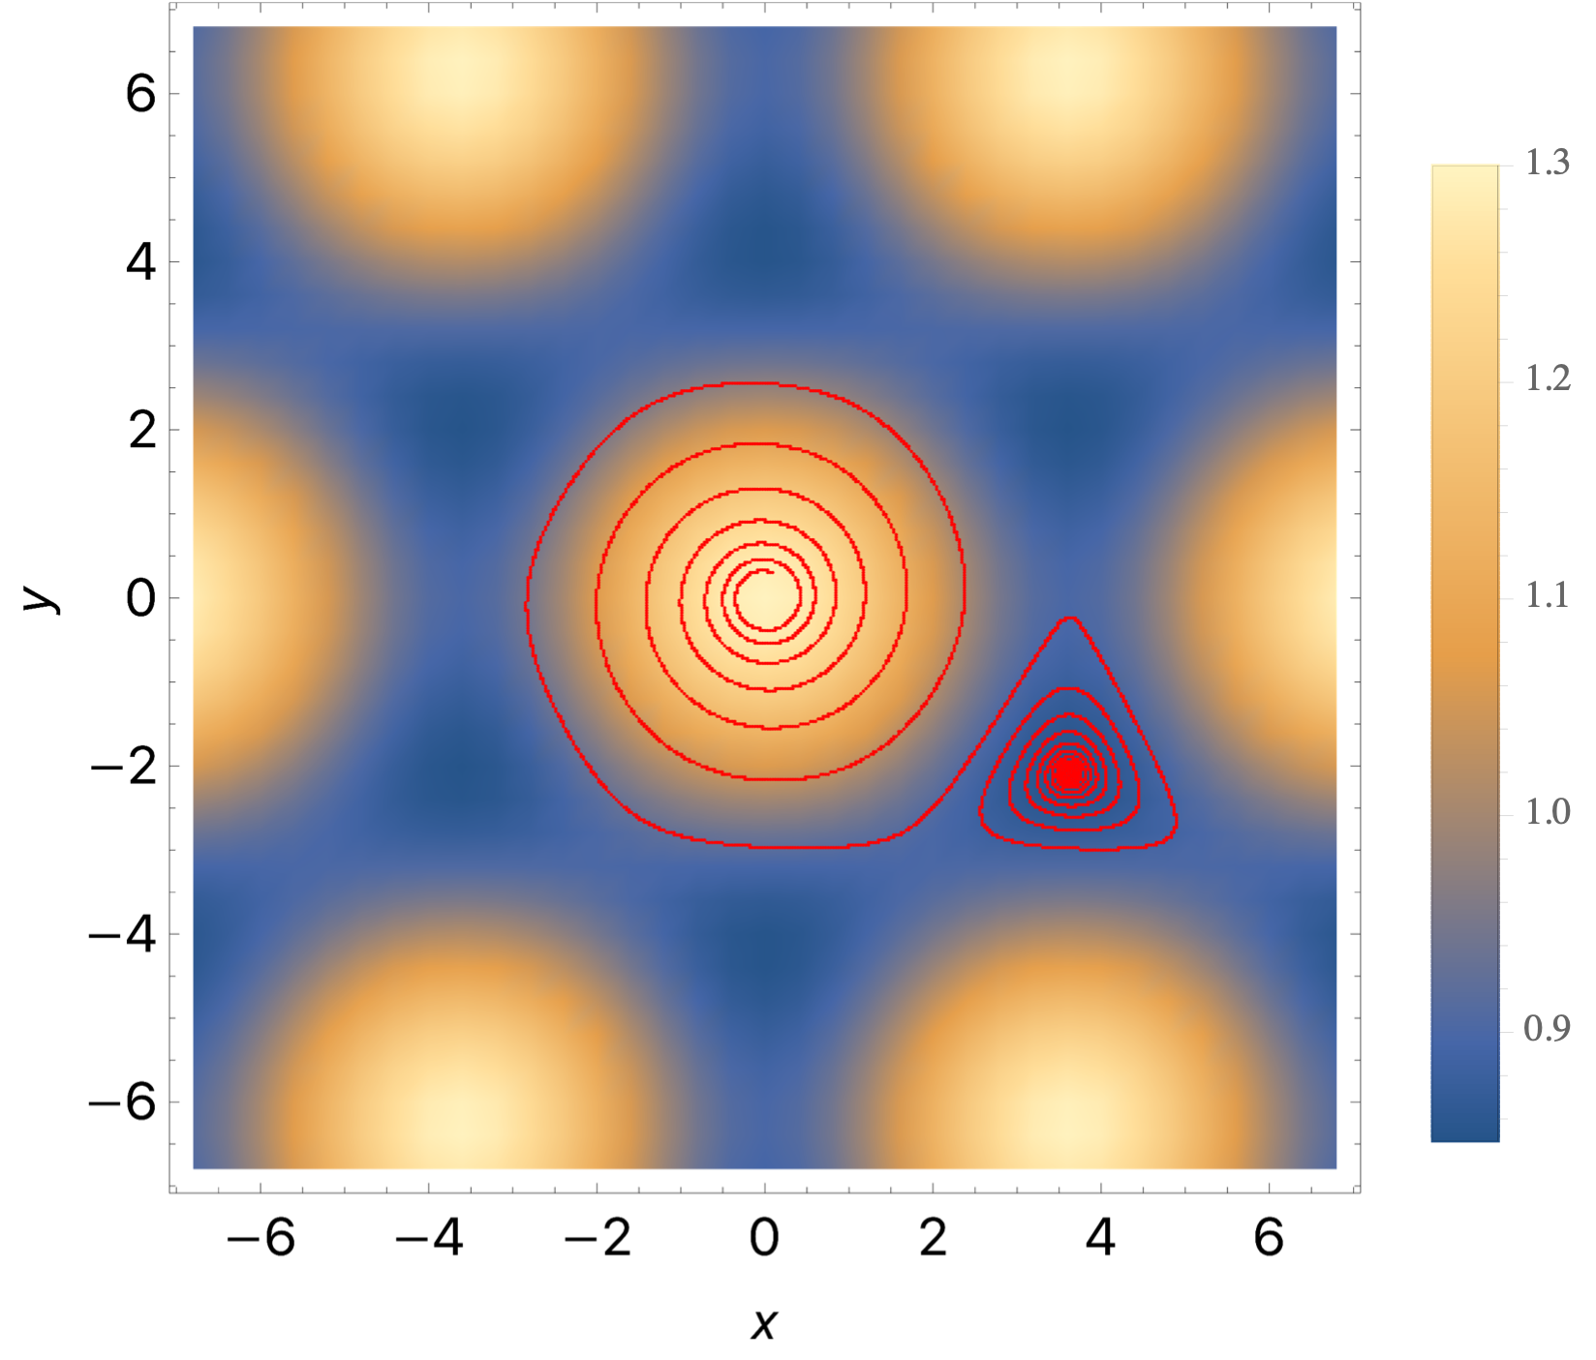
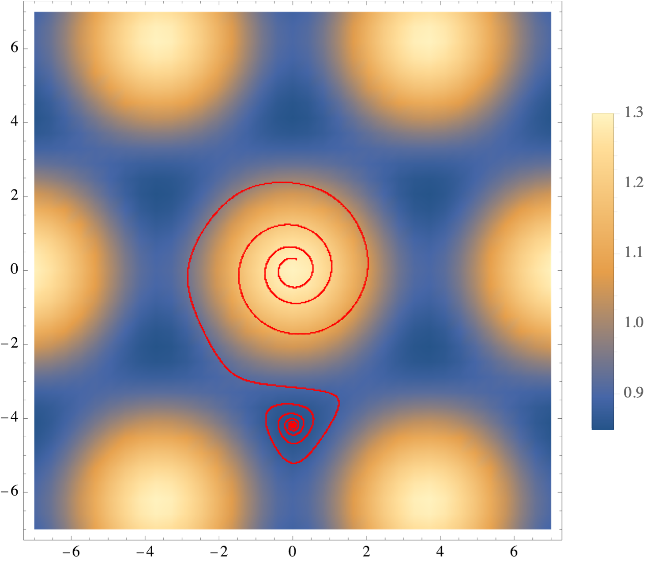
Vortex evolution with dissipation
$$v_{v}≃-\frac{ℏ}{m}\left\{γ∇log\sqrt{ρ}+\overset{̂}{z}×∇log\sqrt{ρ}\right\}=v_{⊥}+v_{∥}$$
MM et al. Few Body Syst. 65 (2024) 81

Slide 31
Inertia

Slide 32
Inertia of supersolids
Momenta of inertia can be defined in two ways:
From the mass distribution
From the response to rotation
$$I_{mass}=<x^{2}+y^{2}>_{ψ}$$
$$L_{solid}=I_{solid}Ω$$
related to the superfluid fraction
$$0≤α≤1$$
$$I_{solid}=αI_{mass}$$
$α=1$ completely solid
Legget PRL, 25, 1543 (1970)
$α=0$ completely superfluid
Total angular momentum
$$L_{total}=<{\overset{̂}{L}}_{z}>_{ψ}≠L_{solid}$$
$$L_{total}=L_{solid}+L_{vortices}$$

Slide 33
Evolution
Optical trap
Outer crust
Dipolar atoms
Inner crust
To emulate the NS spin down, we put a “break” on the optical trap
$${\overset{·}{L}}_{total}=-N_{em}$$

Slide 34
Supersolid glitches

Slide 35
More hadronic matter phases
Crystalline color superconductors
Supersolids are versatile.
Possible applications
Pion crystals
Other inhomogeneous superfluid phases

Slide 36
Conclusion
Hadronic matter in extreme conditions is realized in compact stars
Dipolar atoms offer a portal
Emulating the glitch mechanism can teach us how this phenomenon happens
Outlook
Layered superfluids to have layered structure
Angular momentum evolution (diffusion ?)
Scaling

Slide 37
Thank you!

Slide 38
Backup

Slide 39
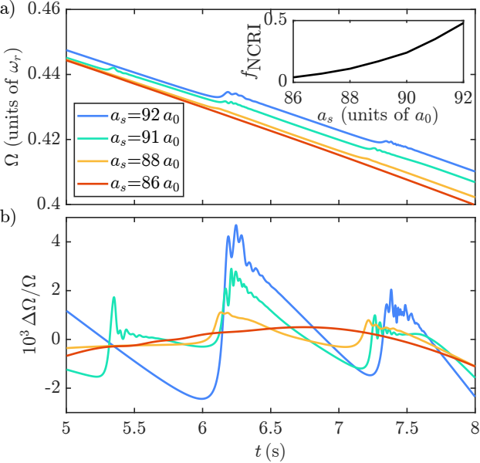
Parameters

Slide 40
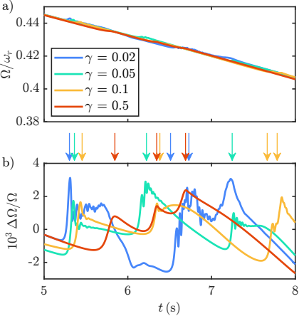
Different values of mimic different coupling with the outer crust
Parameters

Slide 41
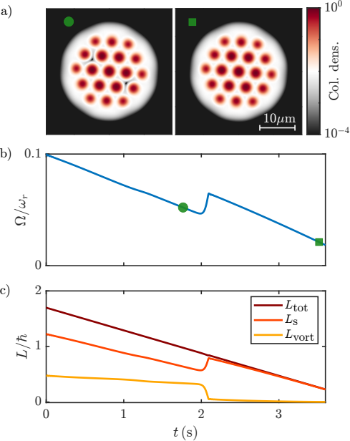
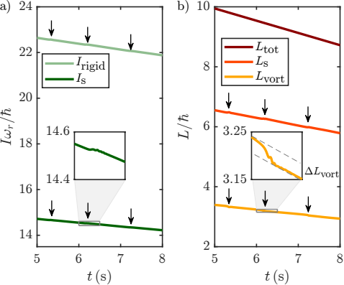
Testing the angular momentum decomposition

Slide 42
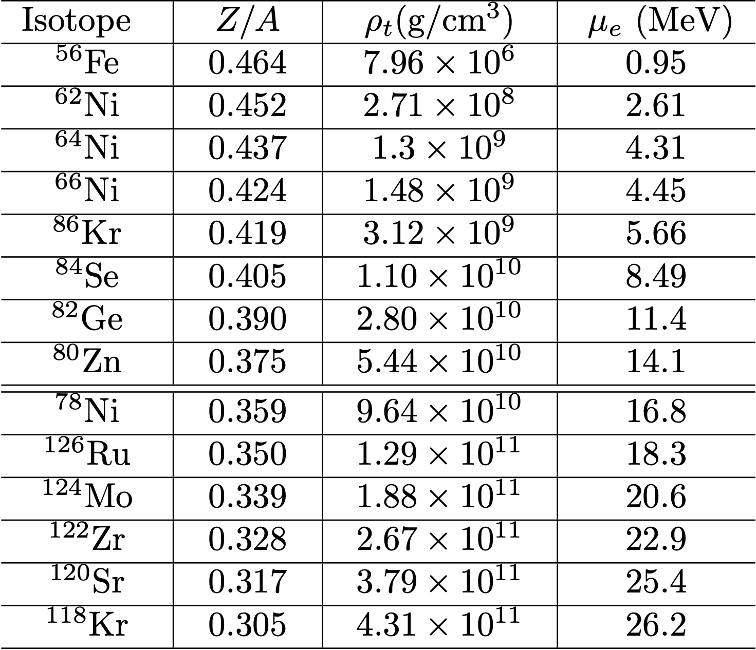
Outer crust
$$ρ≲4.3×{10}^{11}{\text{g cm}}^{-3}$$
Weak equilibrium works to produce the most stable isotope
Neutron rich
matter
many electrons
neutron drip
Haensel and Pichon Astron.Astrophys. 283 (1994) 313

Slide 43
Numerical simulation
Angular rotation of the trap
Dissipation
Evolution of the
macroscopic wavefunction
$$iℏ\frac{∂Ψ}{∂t}=(1-iγ)\left[H[Ψ;a_{s},a_{dd},ω]-Ω(t){\overset{̂}{L}}_{z}\right]Ψ$$
Hamiltonian
$$H[Ψ;a_{s},a_{dd},ω]=-\frac{ℏ^{2}∇^{2}}{2m}+\frac{1}{2}m\left[ω_{r}^{2}(x^{2}+y^{2})+ω_{z}^{2}z^{2}\right]+∫d^{3}r^{′}U\left(r-r^{′}\right){\left|Ψ\left(r^{′},t\right)\right|}^{2}+γ_{QF}|Ψ(r,t)|^{3}-μ$$
Trapping potential
(pancake-like)
Self-interaction
LHY correction

Slide 44
Density matters!
Energy density scaling
kinetic
(single particle)
Interaction
(mean field)
Quantum fluctuations
$$E_{contact}∝n^{2}$$
$$E_{dipolar}∝U_{dd}n^{2}$$
$$E_{LHY}∝n^{5/2}$$
$$E_{sp}∝n$$
Repulsive
Long-range inhomogeneous
“Interaction channels” change with density

Slide 45
Evolution
Optical trap
Outer crust
Dipolar atoms
Inner crust
To emulate the NS spin down, we put a “break” on the optical trap
$${\overset{·}{L}}_{total}=-N_{em}$$
System of equations solved recursively
$$I_{solid}\overset{·}{Ω}=-N_{em}-{\overset{·}{L}}_{vortices}-{\overset{·}{I}}_{solid}Ω$$
$$iℏ\frac{∂Ψ}{∂t}=(1-iγ)\left[H[Ψ;a_{s},a_{dd},ω]-Ω(t){\overset{̂}{L}}_{z}\right]Ψ$$

Slide 46
Dawn of neutron stars
Iron core
H and He
During the stellar contraction ions capture electrons forming neutrons
Matter falling towards the stellar center bounces back, because neutrons cannot be easily squeezed.
A shockwave is produced: a supernova!

