Slide 1

ab initio effective operator with continuum
Zhicheng Xu (Z. C. Xu)
Fudan University
14th International Spring Seminar on Nuclear Physics, Ischia

Slide 2
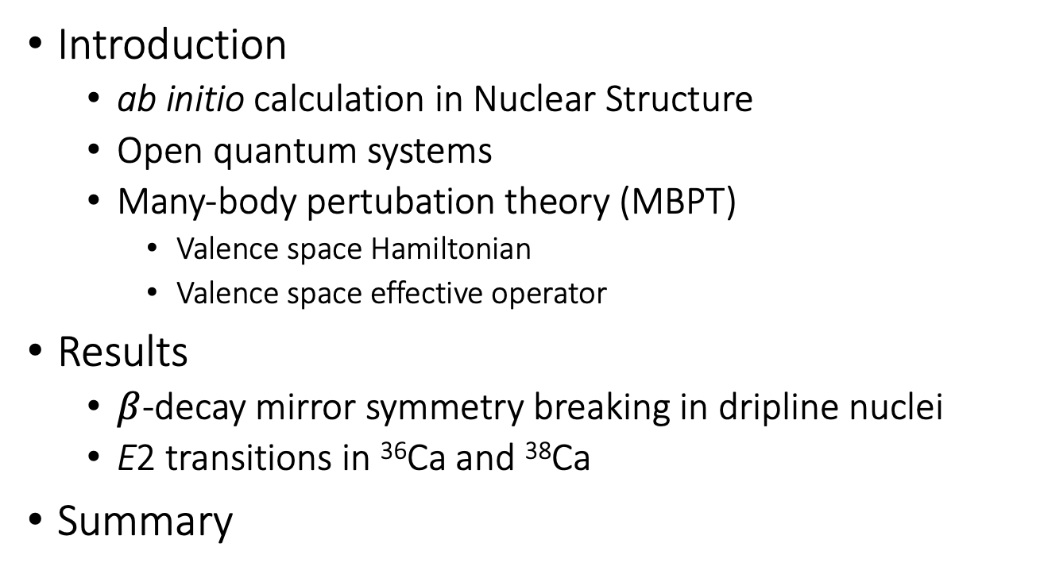
Outline
Introduction
  ab initio calculation in Nuclear Structure
  Open quantum systems
  Many-body pertubation theory (MBPT)
    Valence space Hamiltonian
    Valence space effective operator
Results
  $β$-decay mirror symmetry breaking in dripline nuclei
  E2 transitions in ³⁶Ca and ³⁸Ca
Summary
Notes:
ab initio calculation in nuclear physics,
The continuum are important
The shell model we use with Berggren basis
The system we studied.

Slide 3
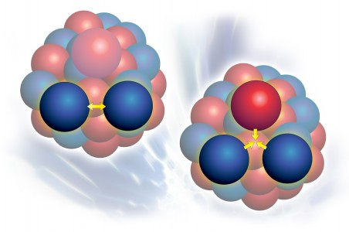
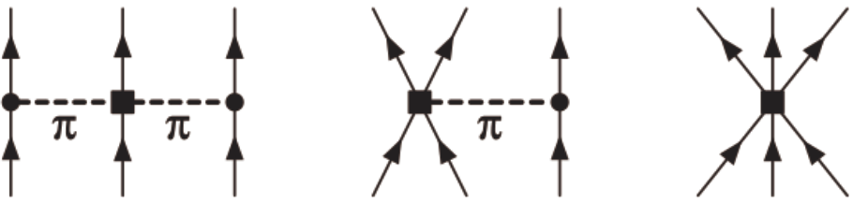
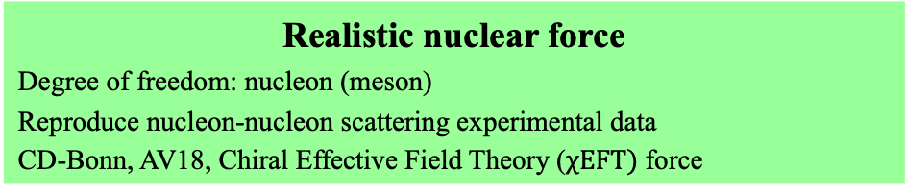
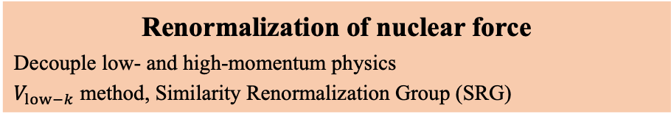
ab initio calculation in Nuclear Structure
Realistic nuclear force
Degree of freedom: nucleon (meson)
Reproduce nucleon-nucleon scattering experimental data
CD-Bonn, AV18, Chiral Effective Field Theory ($χEFT)$ force
3NF
Renormalization of nuclear force
Decouple low- and high-momentum physics
$V_{low−k}$ method, Similarity Renormalization Group (SRG)
Many-body methods
No-core shell model (NCSM), Many-body perturbation theory (MBPT), Coupled-Cluster (CC), In-Medium Similarity Renormalization Group (IMSRG), Nuclear Lattice effective field theory (NLEFT), Self-Consistent Green’s Functions (SCGF), Quantum Monte Carlo (QMC), …
Takayuki Miyagi‘s talk, Christian Forssén’s talk.

Slide 4
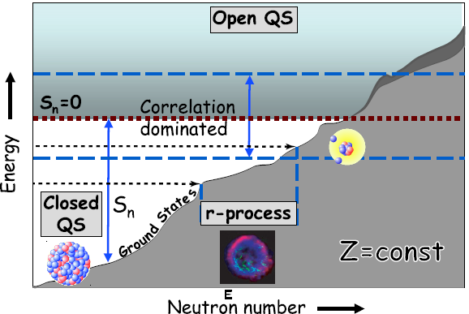
Open Quantum Systems
N. Michel et al., JPG: NPP 36, 013101 (2009)
Halo & clustering
Exotic decay
Deformation
New magic number
…
Resonance & continuum near threshold
S. M. Wang‘s talk, Marek Ploszajczak’s talk.
Notes:
How can we treat the Resonance & continuum?

Slide 5
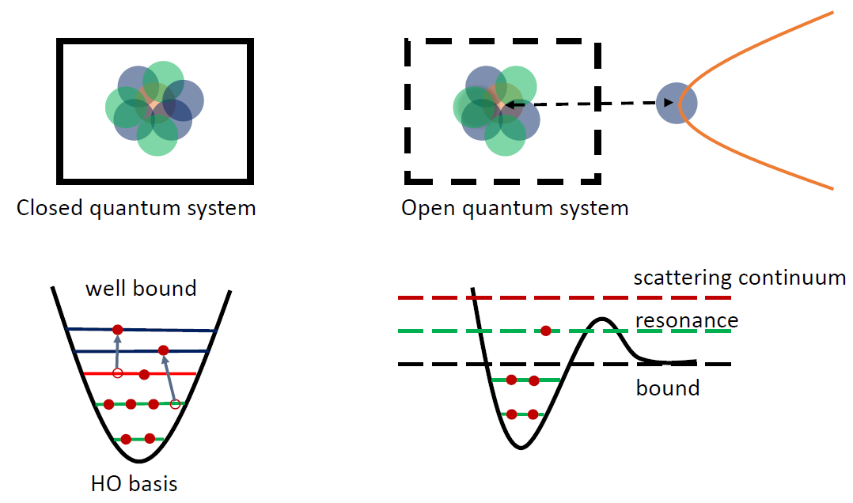
Berggren basis & Gamow Shell Model
closed quantum system
open quantum system
Hilbert Space
Rigged Hilbert space
Gamow Shell Model
N. Michel et al, Phys. Rev. Lett. 89, 042502 (2002)
bound
bound, resonant, continuum
HO basis
Berggren basis
T. Berggren, Nucl. Phys. A 109, 265 (1968)
Gamow Hartree-Fock method: chiral 2N+3N Forces
S. Zhang et al., Phys. Rev. C 108, 064316 (2023)

Slide 6

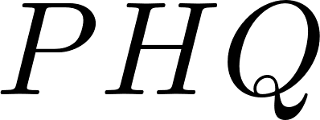

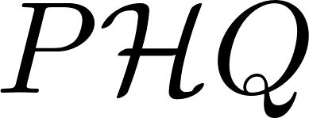




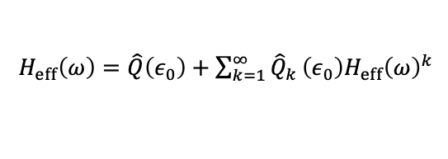
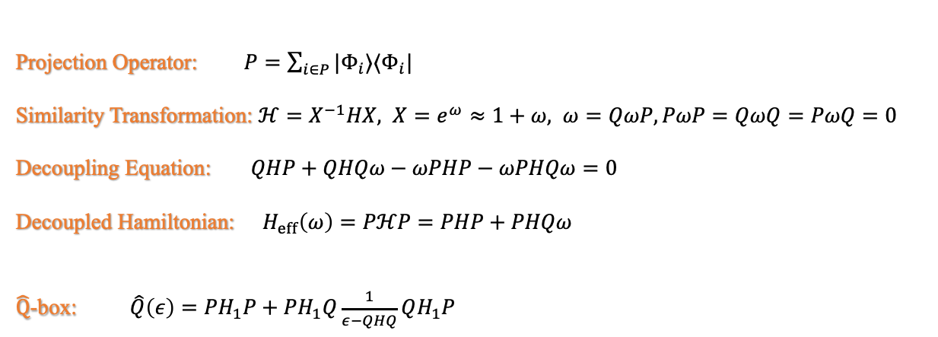

Many-Body Pertubation Theory
Similarity Transformation
Decoupling Equation
$$QℋP=0$$
Projection Operator: $P=\sum_{i∈P}{|Φ_{i}⟩⟨Φ_{i}|}$
Similarity Transformation: $ℋ=X^{−1}HX, X=e^{ω}≈1+ω, ω=QωP,PωP=QωQ=PωQ=0$
Decoupling Equation: $QHP+QHQω−ωPHP−ωPHQω=0$
Decoupled Hamiltonian: $H_{eff}\left(ω\right)=PℋP=PHP+PHQω$
$\hat{Q}$-box: $\hat{Q}\left(ε\right)=PH_{1}P+PH_{1}Q\frac{1}{ε−QHQ}QH_{1}P$
$H_{eff}\left(ω\right)=\hat{Q}\left(ε_{0}\right)+\sum_{k=1}^{∞}{{\hat{Q}}_{k}}\left(ε_{0}\right)H_{eff}{\left(ω\right)}^{k}$
L. Coraggio and N. Itaco, Front. Phys. 8, 345 (2020)
With EKK method, the $H_{eff}$ with non-degenerate model space can be derived.
K. Takayanagi et al. Nucl. Phys. A 852, 61 (2005)
K. Takayanagi et al. Nucl. Phys. A 864, 91 (2011)

Slide 7

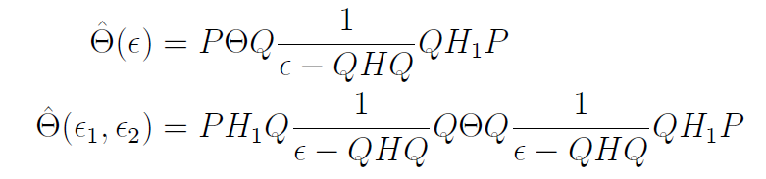
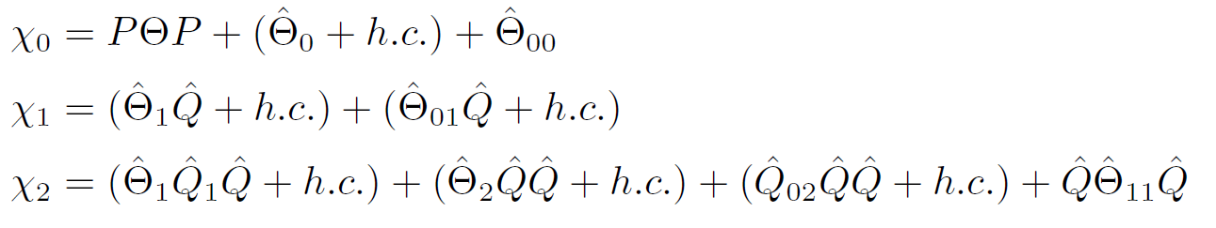


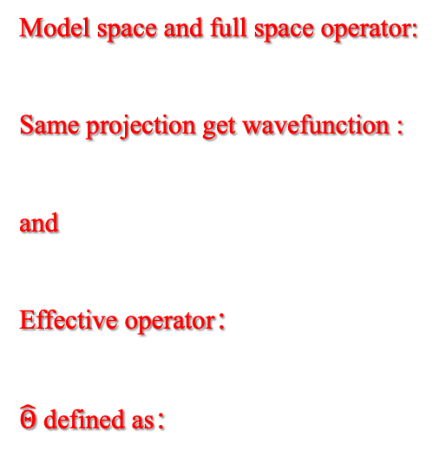
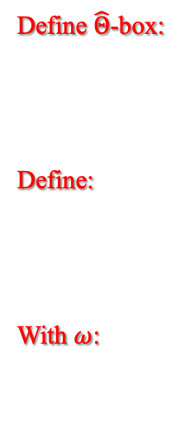
MBPT effective operator
Model space and full space operator:
Same projection get wavefunction :
and
Effective operator：
$\hat{Θ}$ defined as：
Define $\hat{Θ}$-box:
Define:
With $ω$:
K. Suzuki, R. Okamoto. Prog. Theor. Phys. 93,905 (1995)
L. Coraggio and N. Itaco, Front. Phys. 8, 345 (2020)
Songlin Lyu‘s talk
We extend the model space effective operator to Berggren basis.
Notes:
The work have done by Prof. Luigi Coraggio. They did a lots of good work with this method. We extend this system to Berggren basis to study the continnum effect.

Slide 8
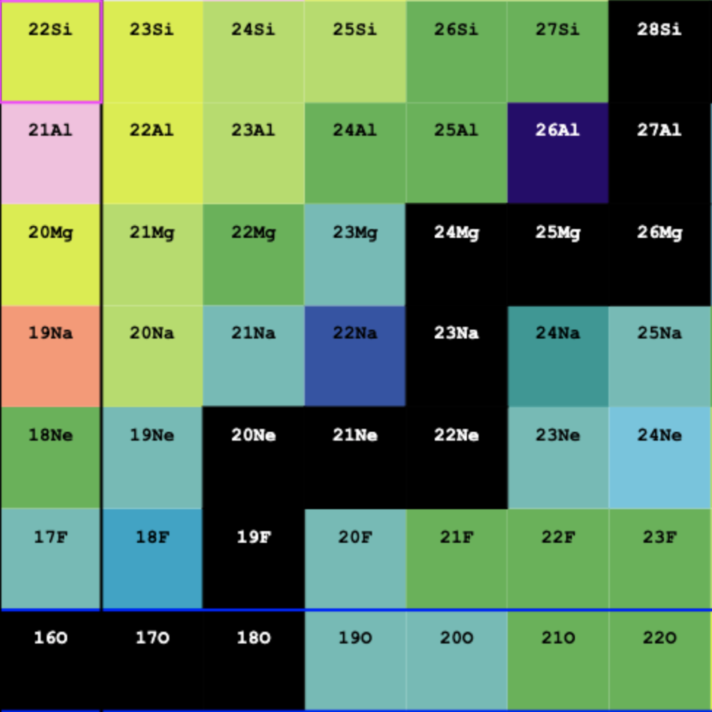
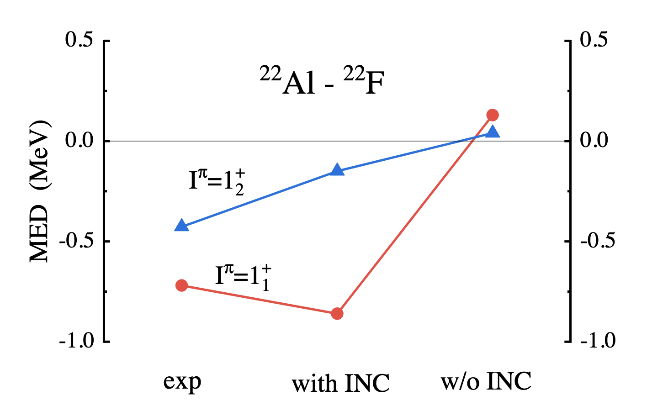
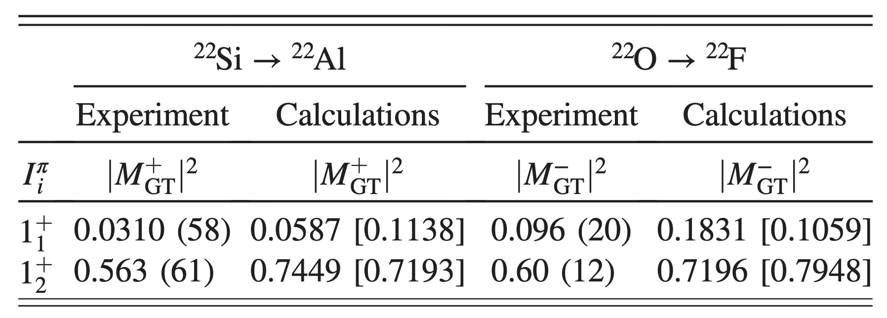



Mirror symmetry breaking near dripline
$$β^{+}$$
$$mirror energy differences:$$
$$MED=E_{x}\left(I,T,T_{z}=−T\right)−E_{x}\left(I,T,T_{z}=T\right)$$
$$β^{−}$$
Z=8
N=8
MSB in energy: larger MED of two 1⁺ states.
MSB in Gamow-Teller transition
USDA with isospin-nonconserving (INC) forces related to the s_{1/2} orbit.
The MSB are attributed to the significant proton occupation of s_{1/2} orbit.
J. Lee, et al. Phys. Rev. Lett. 125,192503 (2020)
Notes:
Try to understand the effect from realistic force and the continuum respecttively.

Slide 9
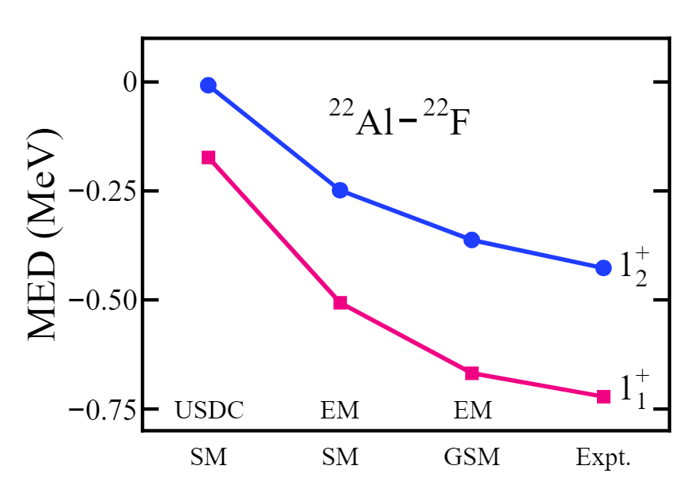
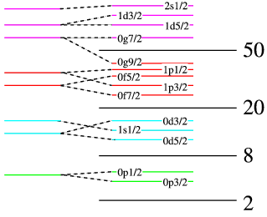
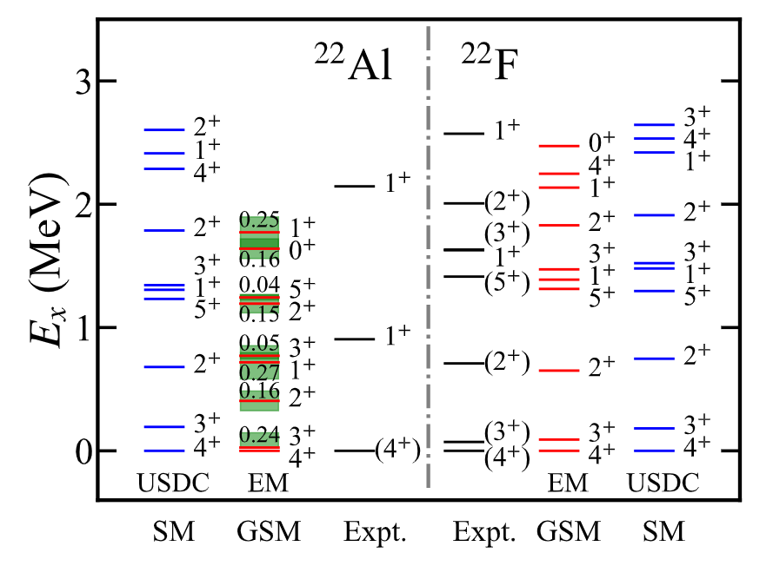
Mirror symmetry breaking near dripline
sd-shell model space
d_{3/2}, s_{1/2} wave with continuum
USDC interaction calculation
EM1.8/2.0 interaction with (GSM) and without (SM) continuum
The continuum increase the MSB because of proton s_{1/2} wave
Z. C. Xu, et al., Phys. Rev. C. 108, L031301(2023)
Notes:
We compare our results with USDC interaction
The spectrum of the mirror nuclei can be properly discribed.

Slide 10
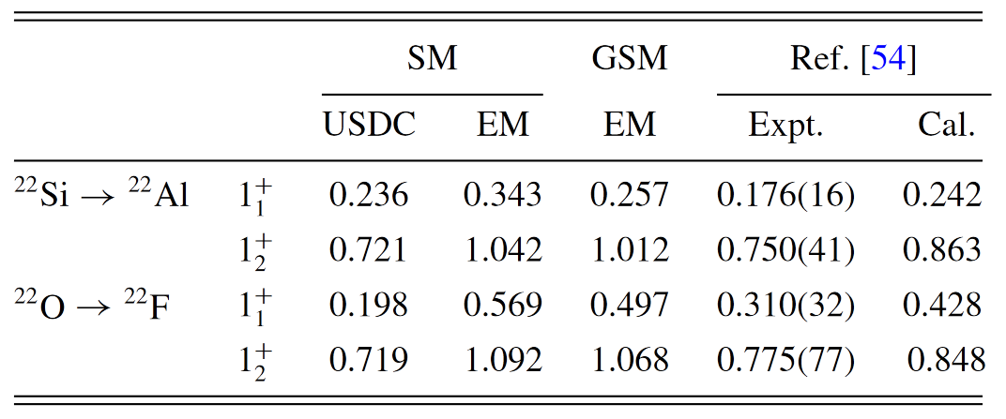
Mirror symmetry breaking near dripline
|M_{GT}| values
|M_{GT}| of ²²Si & ²²O mirror pair
  The USDA with INC (Cal.) consider the effect from continuum
  The proton s_{1/2} occupation increased in GSM calculation, which reduce the E(1⁺) and |M_{GT}|
  The realistic force & continuum are vital for MSB near dripline
Z. C. Xu, et al., Phys. Rev. C. 108, L031301(2023)
Notes:
Than we went to study the
The same reason is due to the larger
The SPE of s-wave lower by continuum, the

Slide 11
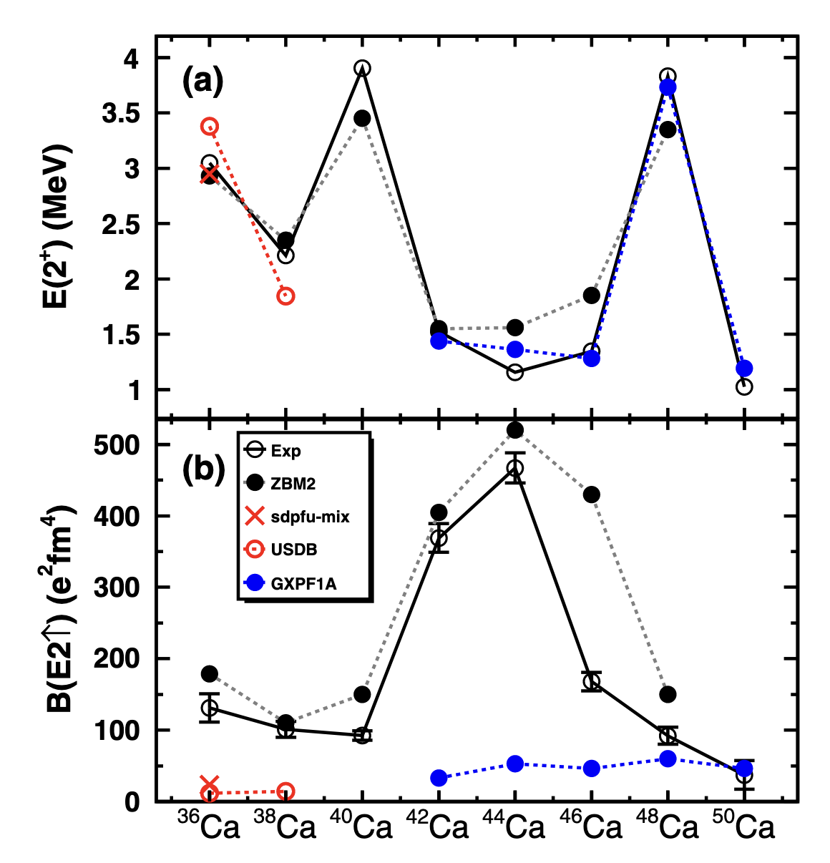
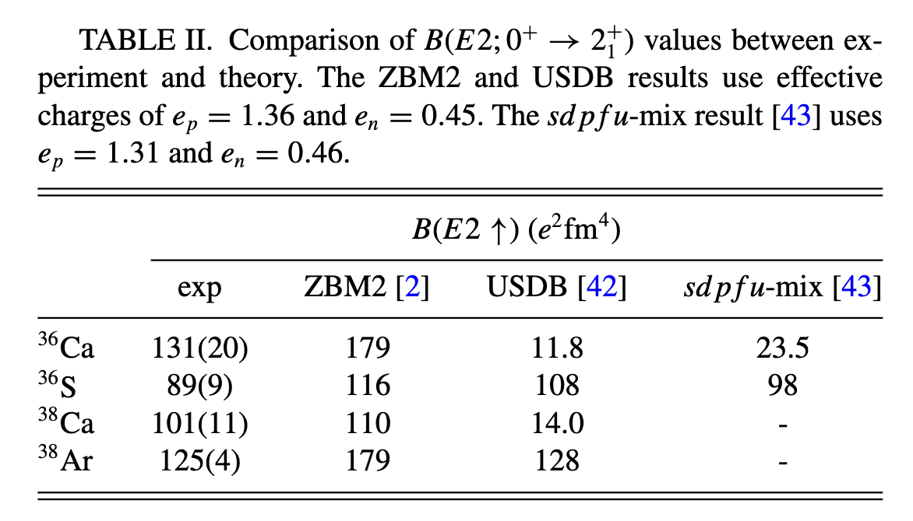
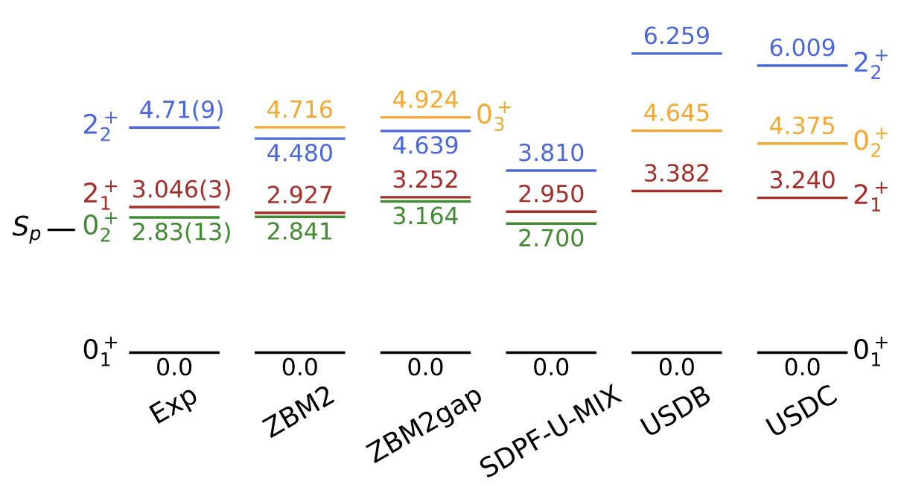
E2 transition in ³⁶Ca and ³⁸Ca
Abnormal E(2⁺) and B(E2) trend
Proton excitation cross shell
ZBM2 interaction
2⁺ state in ³⁶Ca is near threshold
N. Dronchi, et al., Phys. Rev. C. 107, 034306 (2023)
T. Beck et al., Phys. Rev. C. 108, L061301 (2023)
E. Caurier et al., Phys. Lett. B 522, 240 (2001)
Notes:
Asymbtotic behavir of WF.

Slide 12
E2 transition in ³⁶Ca and ³⁸Ca
Spectrum and B(E2) values
ZBM2 valence space
f_{7/2}, p_{3/2} wave with continuum
A. P. Zuker, et al. Phys. Rev. C 92, 024320 (2015)
The 2⁺ state in ³⁶Ca above threshold
B(E2) & E(2⁺) trend can be reproduced
The B(E2) values are smell
Z. C. Xu, et al., arXiv:2502.14126 (2025)
Notes:
中子从s到d使得Ca36能量增大，但对BE2贡献不大。
Ca36和Ca38的跨壳增大。

Slide 13
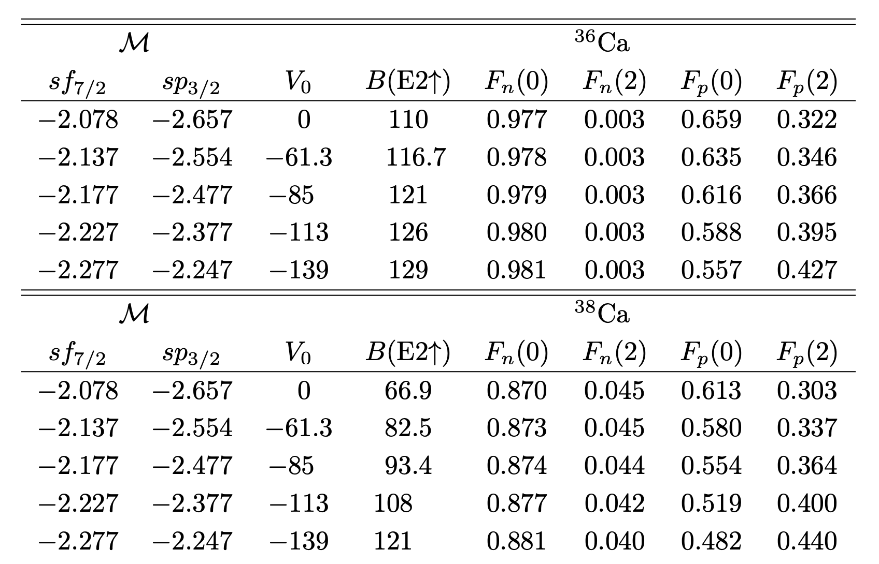
E2 transition in ³⁶Ca and ³⁸Ca
shell model embedded in the continuum
V₀ is continuum coupling strength
F_{p}(n): n protons cross excitation to pf shell excitations
T = 1 cross-shell monopoles are adjusted to reproduce the threshold
E(2⁺) trend can be reproduced with the large cross-shell excitations
J. Okolowicz and M. Ploszajczak. Acta Phys. Pol. B Proc. Suppl. 18, 2–A6 (2025)
Notes:
Shell model e in the continuum

Slide 14
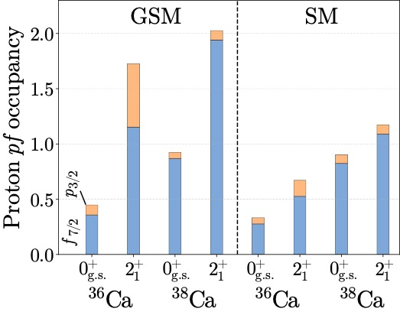
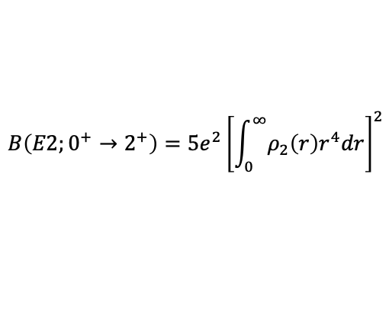
E2 transition in ³⁶Ca and ³⁸Ca
E2 transition density
Proton sd→pf cross shell excitations enhanced by continuum
The E2 transition density near surface
The p-wave component are vital for transition density
Continuum are vital for this abnormal E2 transition
$$B\left(E2;0^{+}→2^{+}\right)=5e^{2}{\left[\int_{0}^{∞}{ρ_{2}\left(r\right)r^{4}dr}\right]}^{2}$$
Z. C. Xu, et al. arXiv2502.14126

Slide 15
Summary
The framework of ab initio complex valence space effective operator.
The mirror symmetry breaking and abnormal E2 transition near dripline nuclei are studied by this framework.
The continuum effect are vital for the observables of nuclei near the dripline.

Slide 16




Acknowledgements
  F. R. Xu
  S. M. Wang
  S. Zhang
  S. L. Jin
  J. G. Li
  W. Nazarewicz
  N. Michel
  A. Gade
  …

