Slide 1
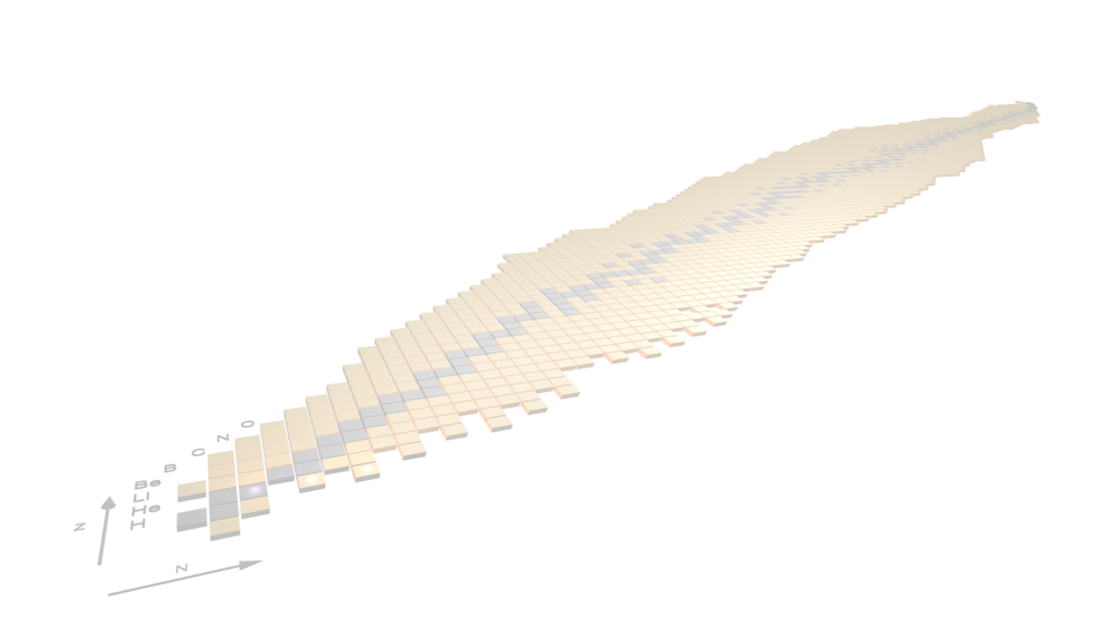



The AGATA campaign at LNL: nuclear structure from high-resolution γ-ray spectroscopy
Andrea Gottardo, AGATA collaboration

Slide 2


Outline
AGATA installation at LNL
Physics campaign: selected examples
- lifetimes near N=20
- lifetimes near N=28
- lifetimes in heavy nuclei via reverse plunger
- search for a double octupole phonon in ⁹⁶Zr
- fusion fission
Plans for 25-26
AGATA zero-degree configurations

Slide 3
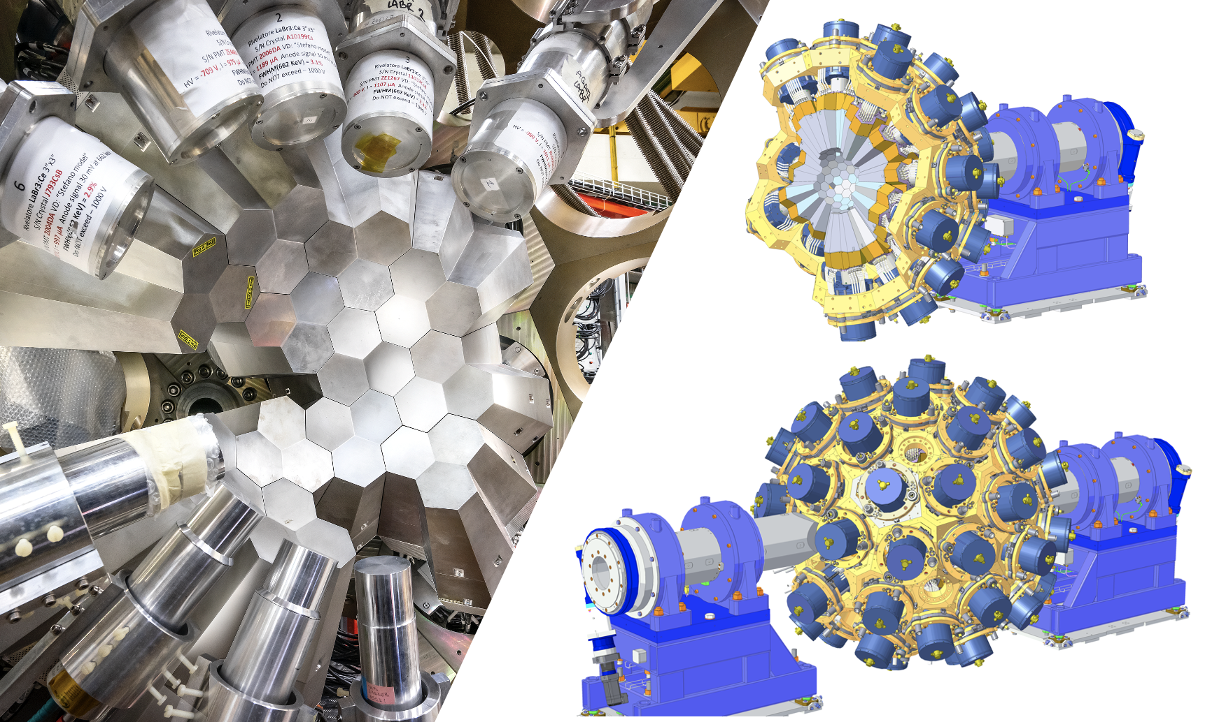
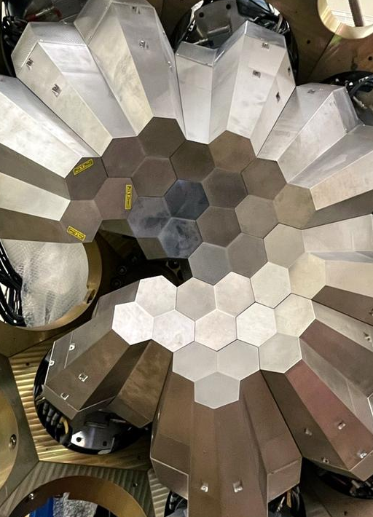
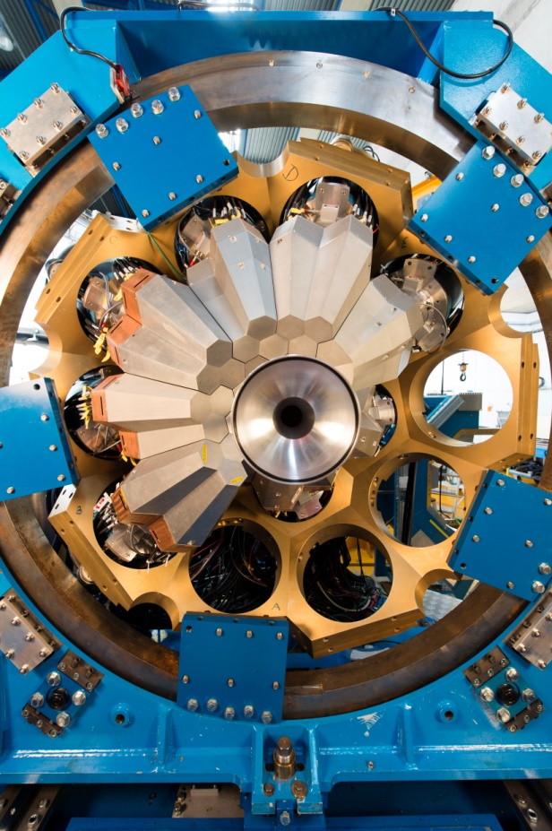
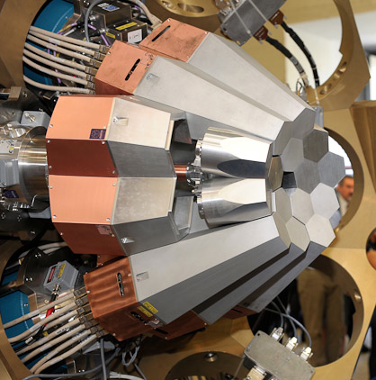
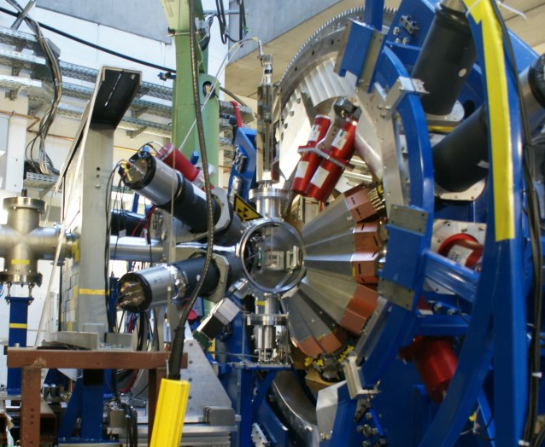
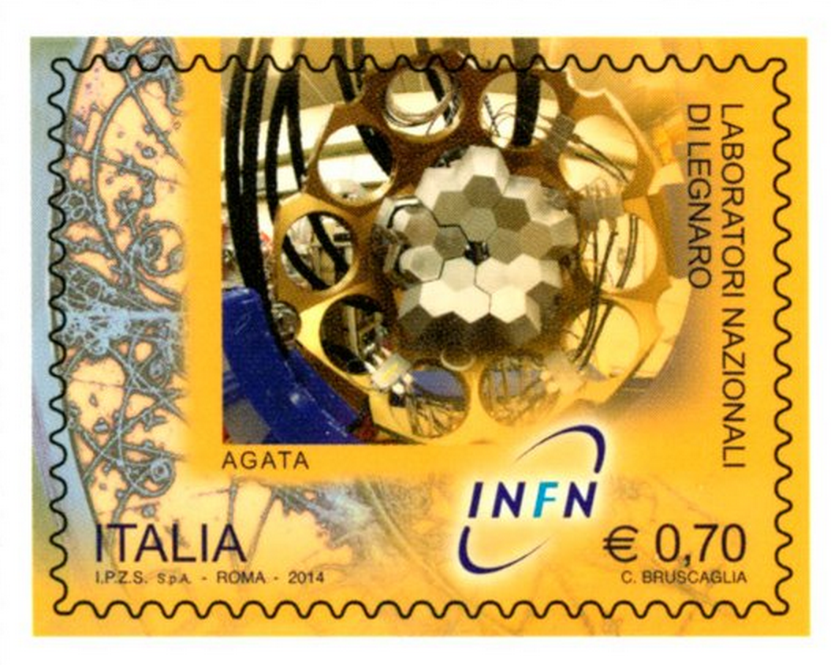
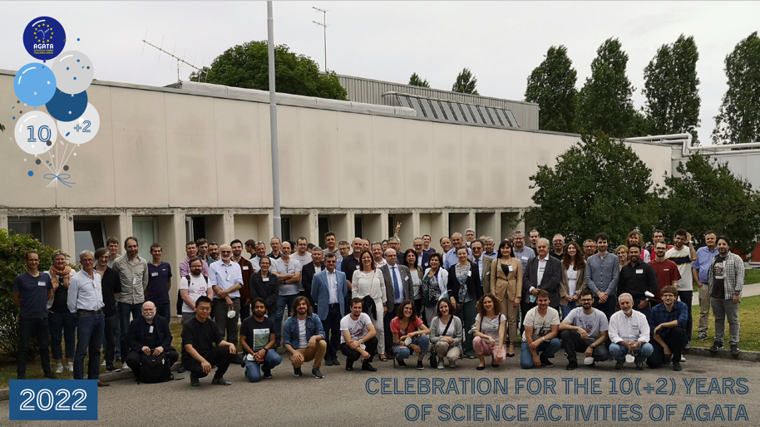
The AGATA 𝛾-ray tracking array
European collaboration towards a 4𝜋 array
Travelling detector array
AGATA@LNL
AGATA@LNL
AGATA@GSI
AGATA@GANIL
Celebration 10(+2) years
M. Zielinska physics coordinator
2009
2011
2014
2021-mid 2028
Phase 1
Phase 2

Slide 4
Legnaro National Laboratories
Stable beams from ¹H to ²³⁸U
Energies up to 7-20 MeV/u
Tandem accelerator
PIAVE superconducting RFQ
ALPI superconducting LINAC
ADIGE normoconducting RFQ
SPES ISOL beams: 70 MeV proton cyclotron (40 MeV, ~300 𝜇A on UCx), UCx ISOL source, ADIGE post acceleration

Slide 5
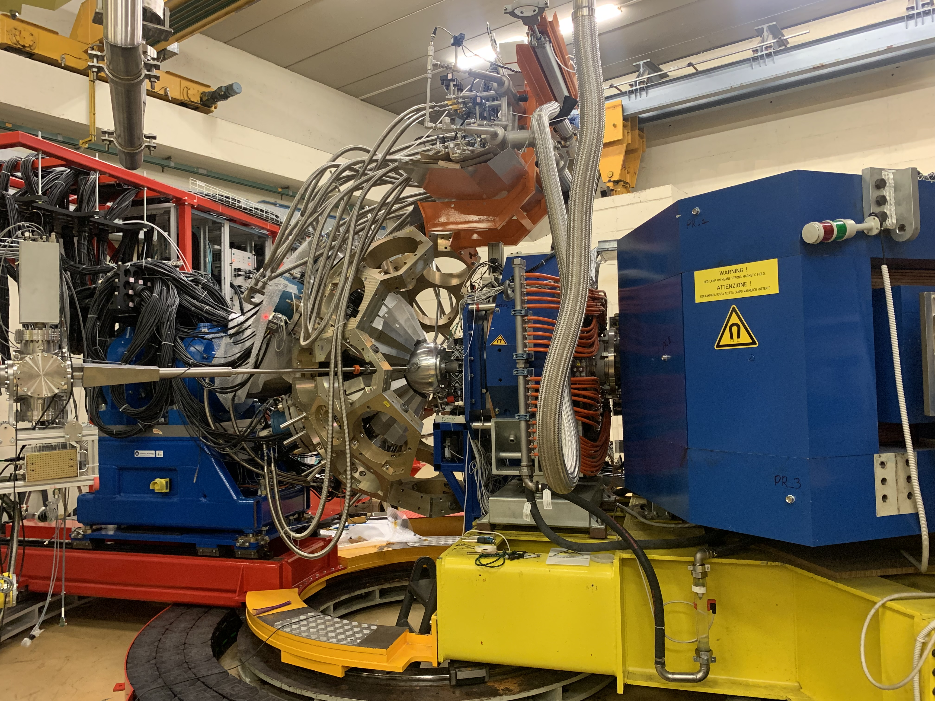
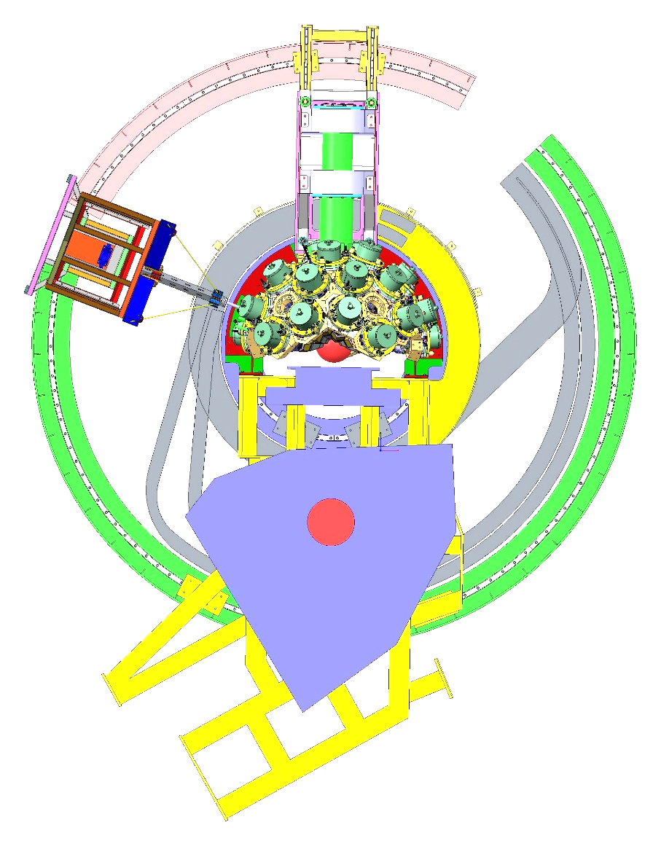
Installation at LNL
AGATA coupled with PRISMA
PRISMA
Current configuration

Slide 6
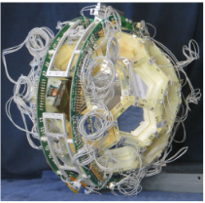
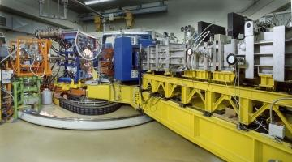
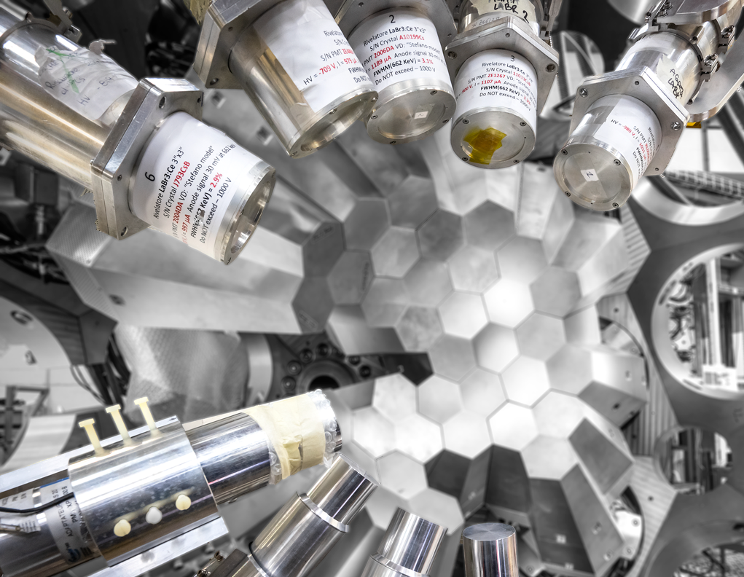
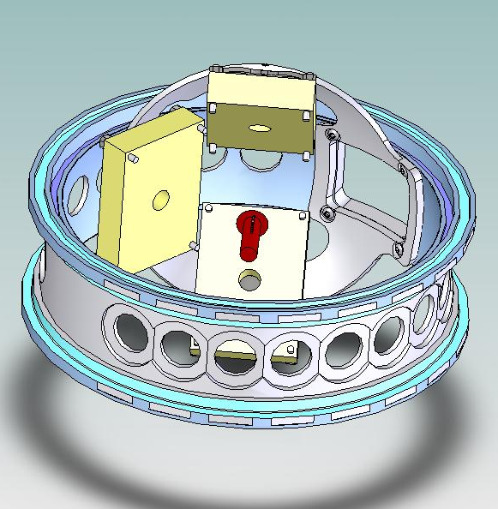
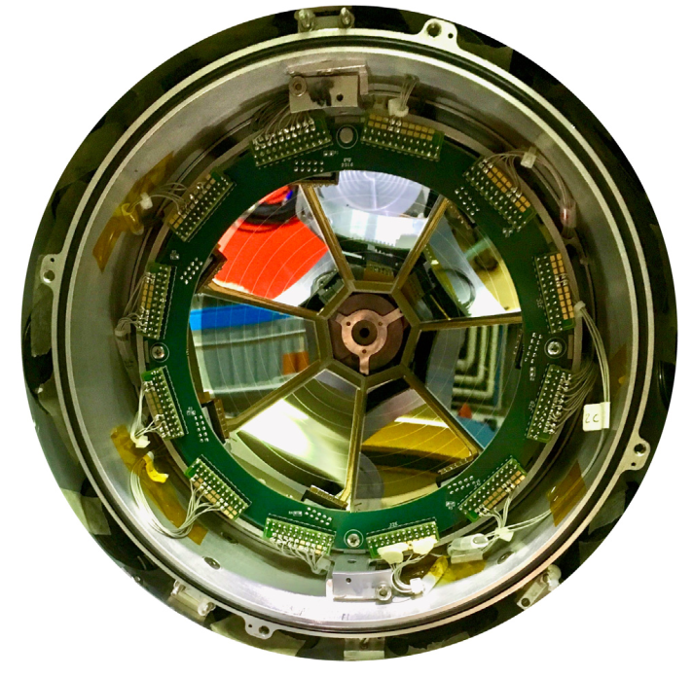
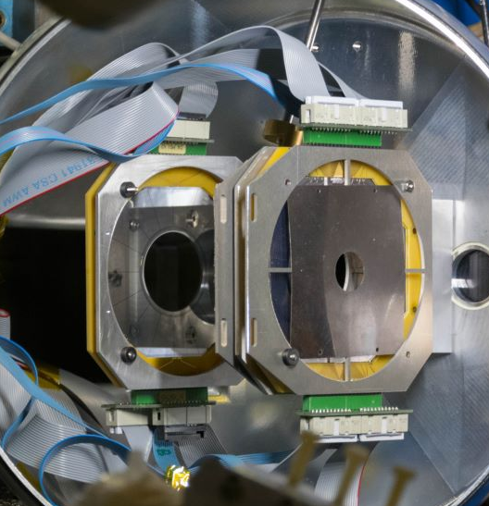
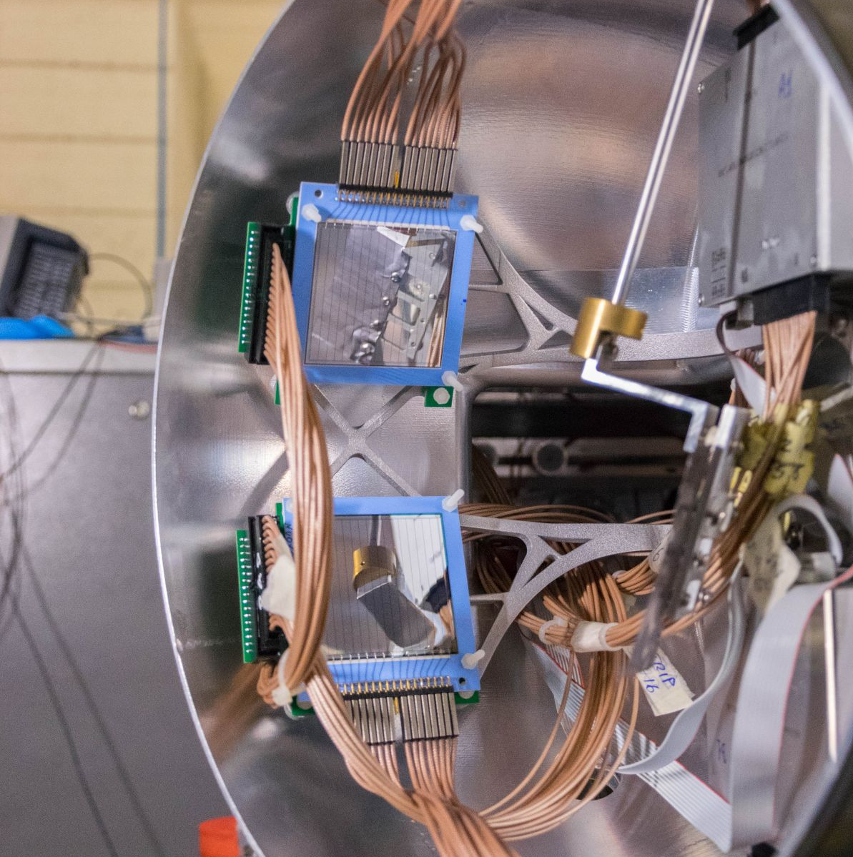
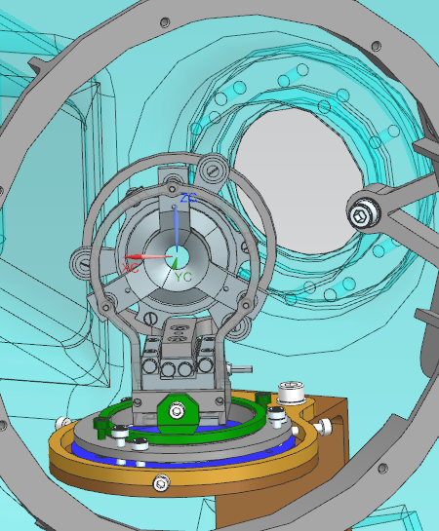
Complementary detectors for AGATA in coupling with PRISMA configuration
PRISMA
heavy ions
LaBr
γ-rays, fast timing
EUCLIDES
light charged particles
DANTE
heavy ions
OSCAR
light charged particles
PLUNGER
Lifetime measurements
SPIDER
light and heavy ions
SAURON
light charged particles

Slide 7
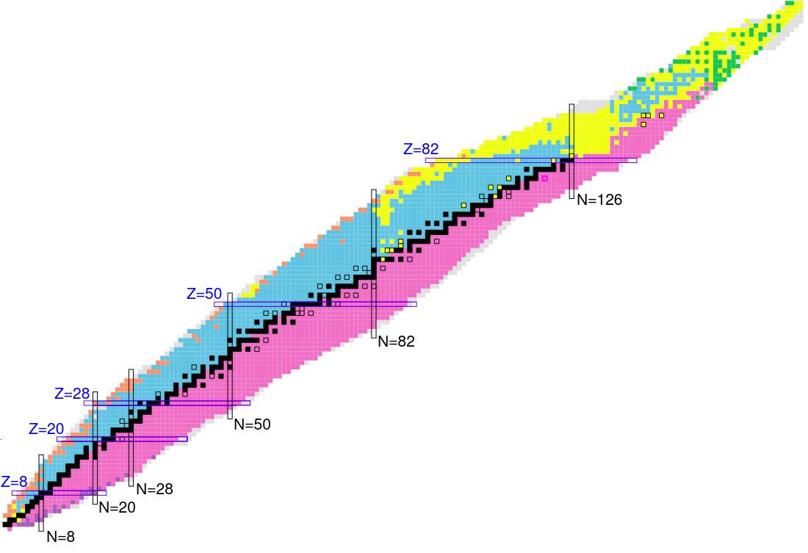
The 2nd LNL AGATA campaign until now
46 experiments performed
2022-2024: ~7000 hours of beam on target !
2025: already 750 hours of beam on target
Wide user community:
EU, UK, USA, Canada,
South Korea, China
Search for octupole structures in the light U Th and Pa isotopes via Multinucleon transfer reactions
(A. Goasduff G. De Angelis)
Octupole correlations in the neutron deficient plutonium isotopes (J.F.Smith,D.Mengoni )
Accessing neutron-rich nuclei close to ²⁰⁸Pb via multi-nucleon transfer reactions (F. Galtarossa, T. Mijatovic)
Decay-out of the oblate, triaxial and highly-deformed bands in ^{136,137}Nd (C. Petrache/O. Stezowski )
Understanding the nature of 0⁺ states in ¹¹⁰Sn and ¹¹²Sn and ¹⁰⁸Cd
( N. Marginean, M.Ciemala, F.Crespi)
Lifetimes in the ¹⁹⁶Os region populated with multinucleon transfer reactions
(D. Brugnara, M. Sedlak, J. Pellumaj)
Probing Multiple Shape Coexistence in ¹¹⁰Cd with Coulomb Excitation (M.Zielinska, K.Wrzosek Lipska, A.Nannini, P.Garrett)
Pathway to nuclear structure in heavy neutron rich nuclei in the vicinity of N=126 and nuclei northwest of ¹³²Sn via multinucleon transfer reactions (P.Reiter)
Search for a Josephson like effect in the ¹¹⁶Sn+⁶⁰Ni system
(L. Corradi, S. Szilner)
Probing nucleon nucleon correlations in the ⁴⁸Ca+²⁰⁸Pb system below the Coulomb barrier
(T. Mijatovic L. Corradi)
Combined lifetime and transition-probability measurements in ⁹⁶Zr via unsafe Coulomb excitation (M. Zielinska, F. Ercolano, N. Marchini, J.J. Valiente Dobon)
Two-Phonon Octupole excitation in ⁹⁶Zr
(D. Stramaccioni, J.J. Valiente-Dobon, A. Gadea)
Shape Coexistence Coulex of ⁷⁴Se
(W.Korten, K.Wrzosek Lipska, E.Clement)
Coexisting Shapes in ⁹⁶Zr
(D. Doherty, N. Marchini, M. Zielinska)
The emergence of enhanced collectivity near magic nuclei: Coulomb excitation of ⁶⁰Ni (K. HadinskaKleck, N. Marchini, M. Rocchini,)
Fusion fission for gamma ray spectroscopy of neutron rich nuclei around N=50 (A. Gottardo, M. Caamano, D. Ramos, JJVD)
Nuclear structure in the vicinity of the Z=28 neutron rich isotopes with AGATA and PRISMA
(R.M.Pérez Vidal, S.Bottoni, E.Sahin,A.Illana, J. Benito, J. Ljungvall, M. Doncel, A.Gadea, L.M. Fraile)
Study of shape coexistence in ⁶⁰Fe via lifetime measurement of excited 0⁺ states (G.Pasqualato/J.Ljungvall)
The low energy fusion in the system ¹²C + ²⁶Mg (G. Montagnoli)
Precise measurement of the B(E2; 2⁺₁ → 0⁺₁) in ⁵⁶Ni (F. Galtarossa, A. Gottardo)
Test of the CKM unitarity and the existence of Fierz interference through the measurement of superallowed beta decay of light nuclei
(J.Ha/F.Recchia )
Lifetime measurements around ⁴⁸Ca
(C. Fransen, A. Gottardo, D. Menogni)
Evolution of the mixing between single particle and intruder configurations at N=20 (F. Galtarossa, A. Gottardo)
Shell and shapes above ⁵⁶Ni: lifetime measurements in ground-state and side band of ⁶⁰Zn (E. Pilotto, G. Pasqualato)
Spectroscopy and lifetime measurements toward the Island of Inversion (K.Wimmer, S.Bottoni, G.Benzoni, F.Recchia, P.Aguilera)
Lifetime of the 6793 keV state in ¹⁵O (J.Skowronski, E. Pilotto)
Lifetime measurements intruder states towards the island of inversion along the N=20 shell closure (Z. Irene, D. Brugnara)

Slide 8
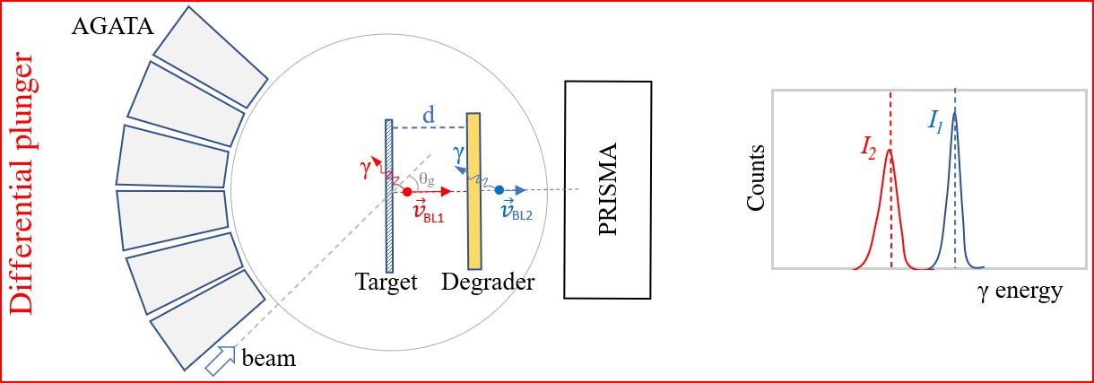
The campaign: main physics subjects
Nuclear Structure: - Excited level lifetimes measurement in key regions: N=20 (³⁶S, ²⁶Mg) , N=28
(⁴⁸Ca,⁵⁶Ni…), towards N=126 (¹⁹⁸Pt) using direct and MNT reactions
- Spectroscopy of N=50 nuclei towards ⁷⁸Ni with fusion-fission reactions
Safe and unsafe Coulex measurements in the ⁶⁰Ni, ⁷⁴Se, ⁸²Se, ¹¹⁰⁻¹¹²Cd, ¹²²Te, ⁹⁶Zr, ¹⁶²Dy, ²³²Th for quadrupole/octupole deformation
Inelastic scattering on ⁹⁶Zr and MNT on actinides for octupole structures
Nuclear Reactions: - Nuclear Josephson effect in near-barrier neutron pair transfer reactions
between heavy ions
- Increasing the cross-section sensitivity of sub-barrier reactions to the nbarn using 𝛾-ray tagging
Nuclear Astrophysics/fundamental physics

Slide 9
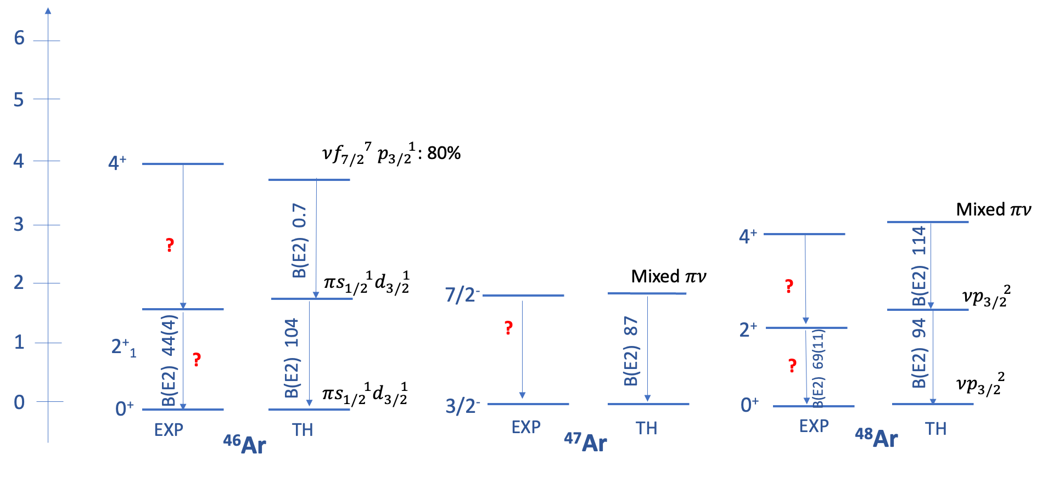
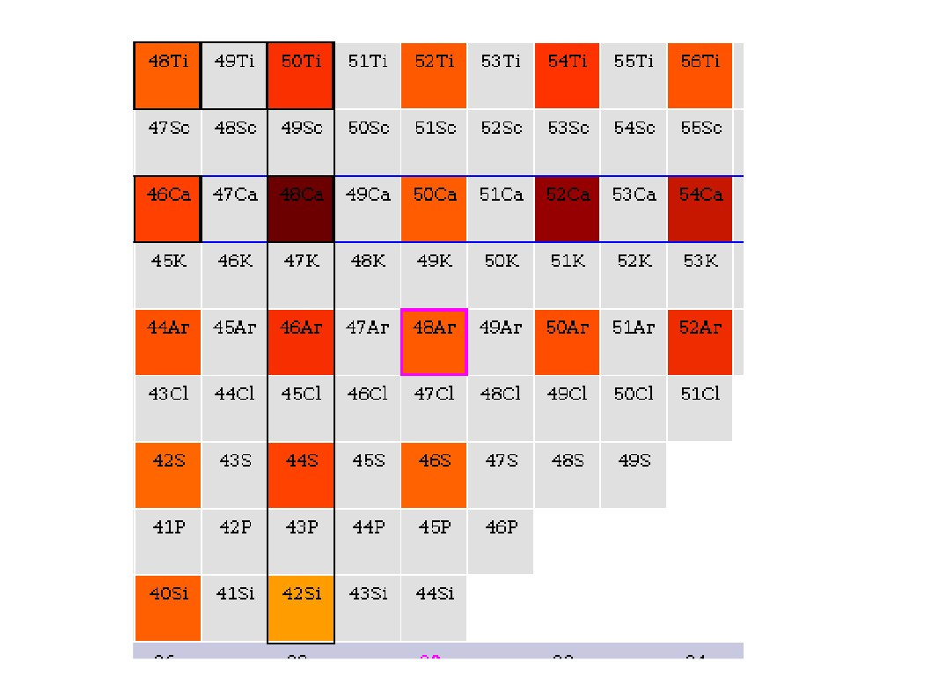
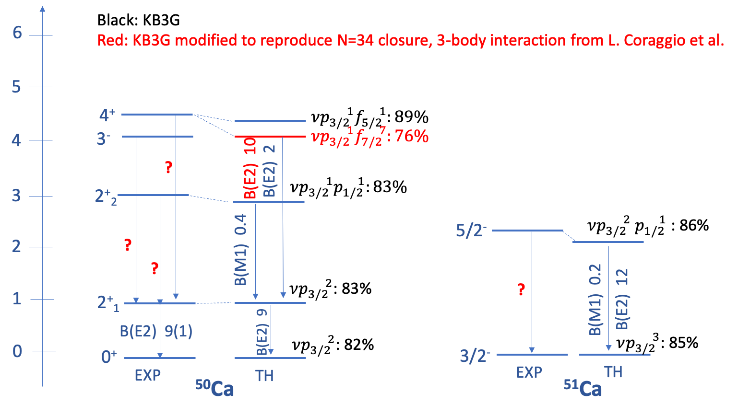
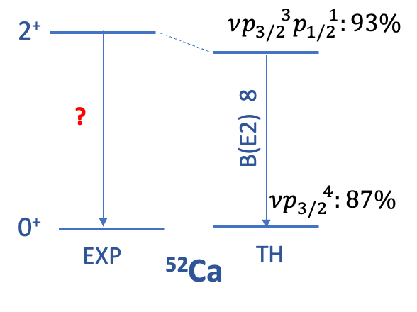
1. Multi-nucleon transfer around ⁴⁸Ca: motivation
⁴⁸Ca @ 305 MeV onto ²³⁸U, Nb degrader
AGATA-PRISMA
RDDS and DSAM
Investigation of ⁵⁰⁻⁵²Ca
→ large charge and matter radii observed
→ also hints for subshell closures
N=32 (νp_{3/2}), N=34 (νp_{1/2}); mass
measurements
50Ca
52Ca
Z=28
Investigation of ⁴⁶⁻⁴⁸Ar
→ Weakening of N=28 shell closure in ⁴⁶Ar
→ explanation from shell structure:
depletion of πs_{1/2}?
46Ar
48Ar
Spokepersons: C. Fransen, A. Gottardo, D. Mengoni,
N=28
E(2⁺) = 700 – 800 keV
E(2⁺) = 1000 – 1500 keV
E(2⁺) > 2500 keV

Slide 10
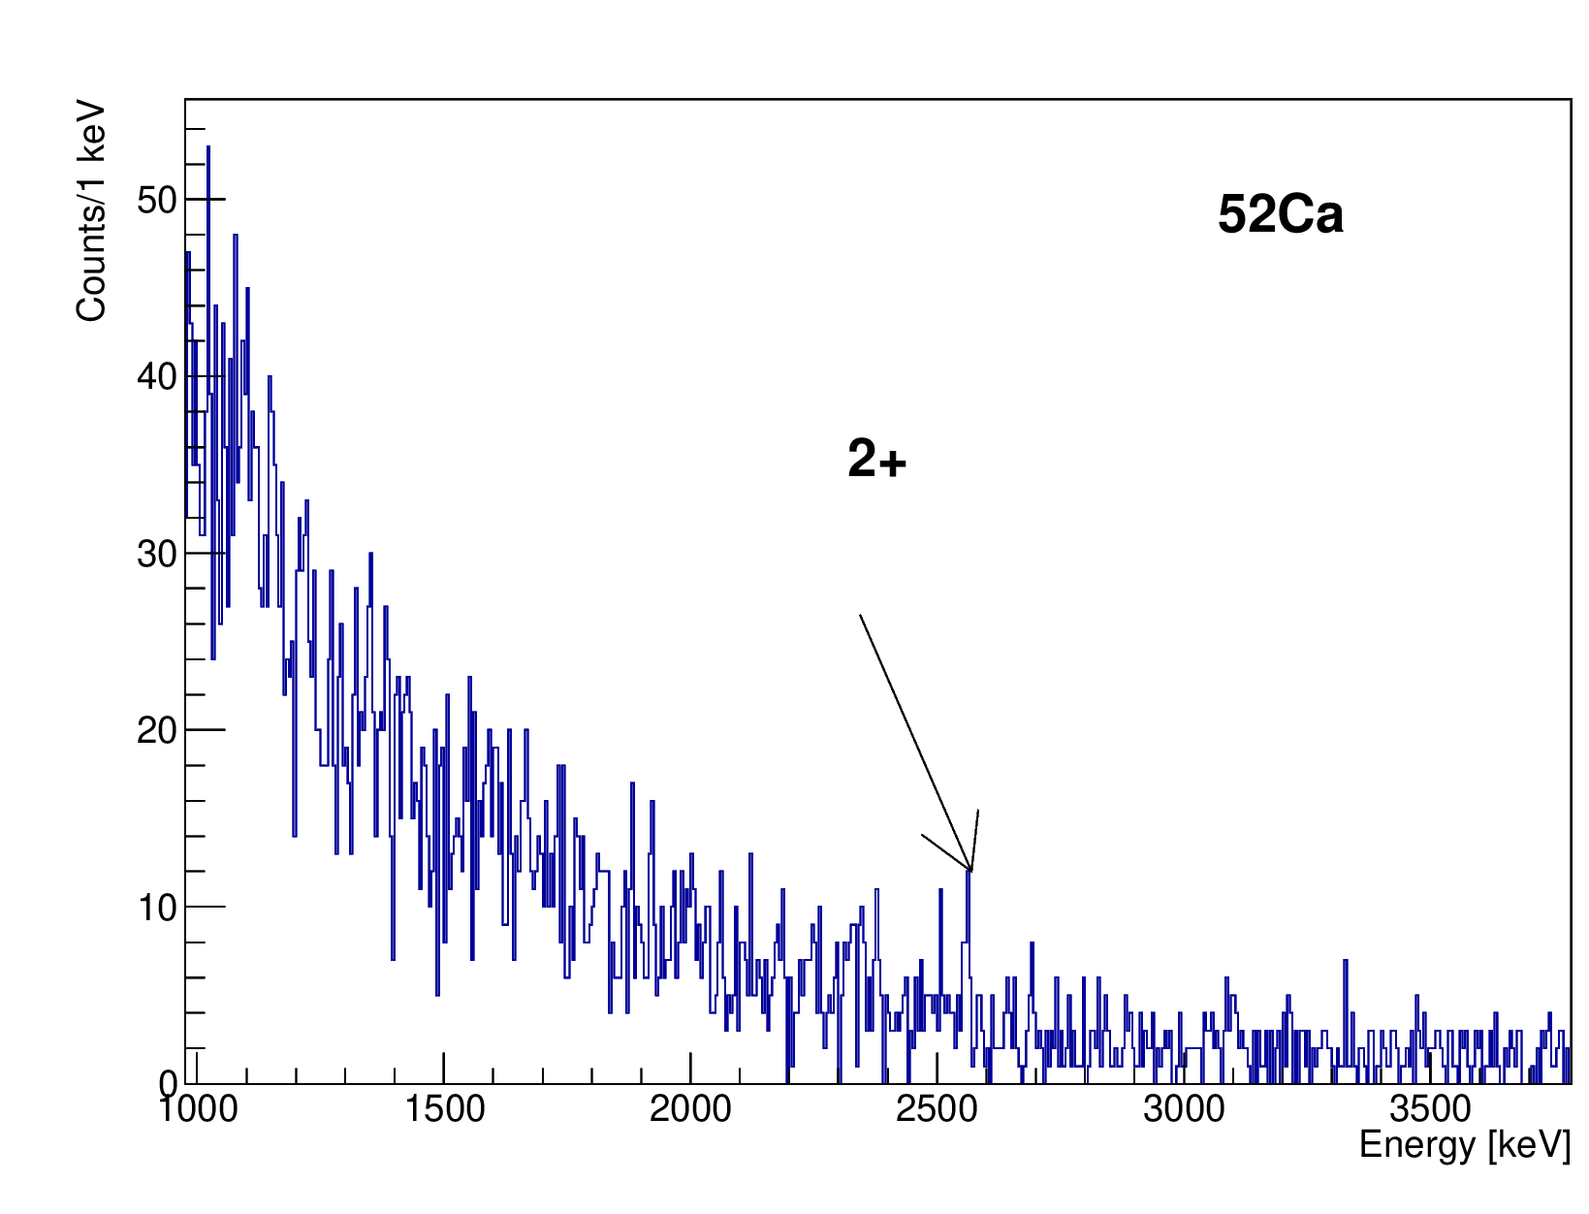
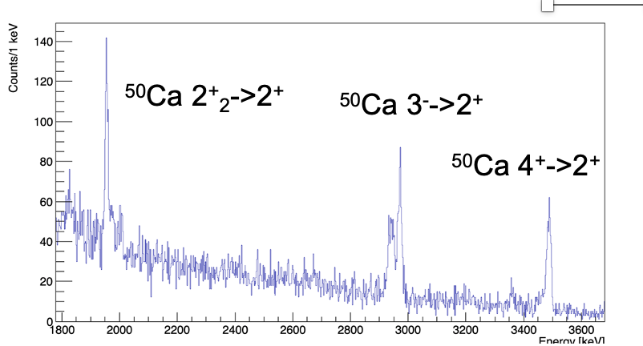
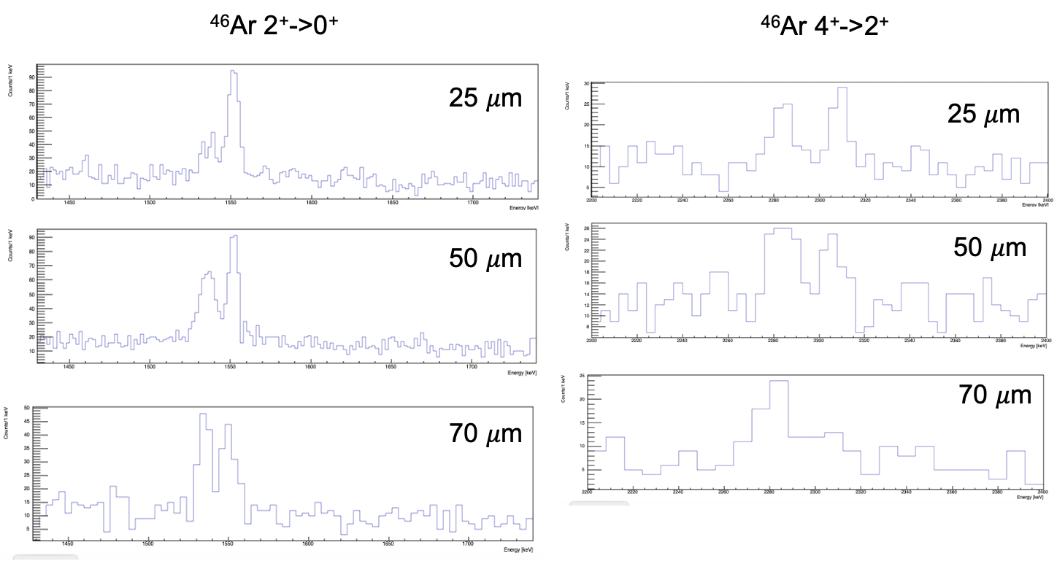
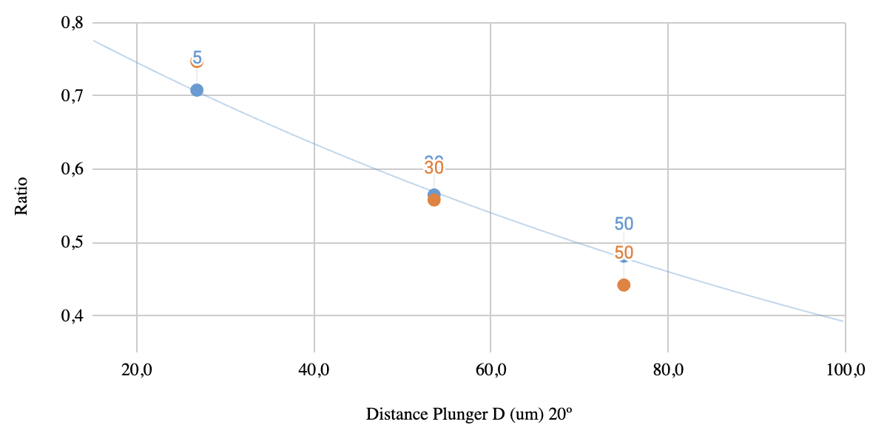
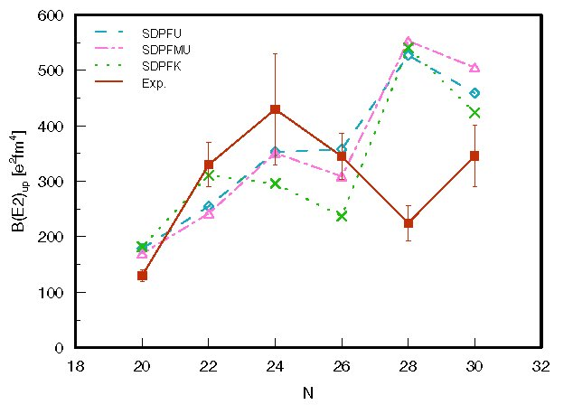
1. Multi-nucleon transfer around ⁴⁸Ca: rersults
DSAM
DSAM
A. Gade et al., PRC 68, 014302 (2003)​
S. Calinescu et al., PRC 93, 044333 (2016)​
t_{1/2}~2 ps,
B(E2) in line with i.e. Coulex
RDDS

Slide 11
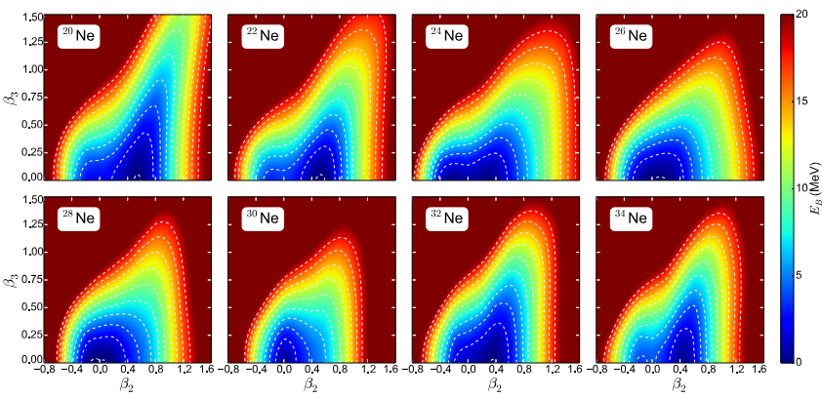
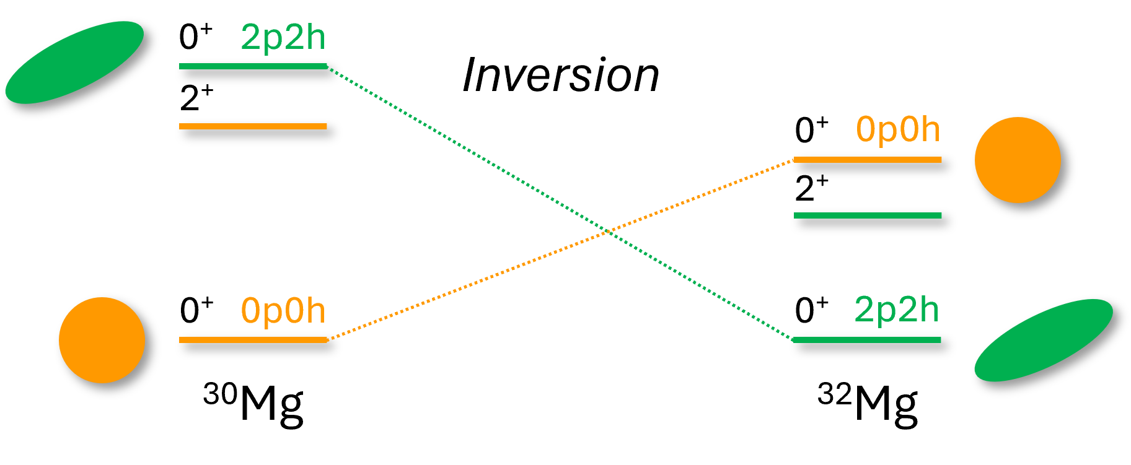
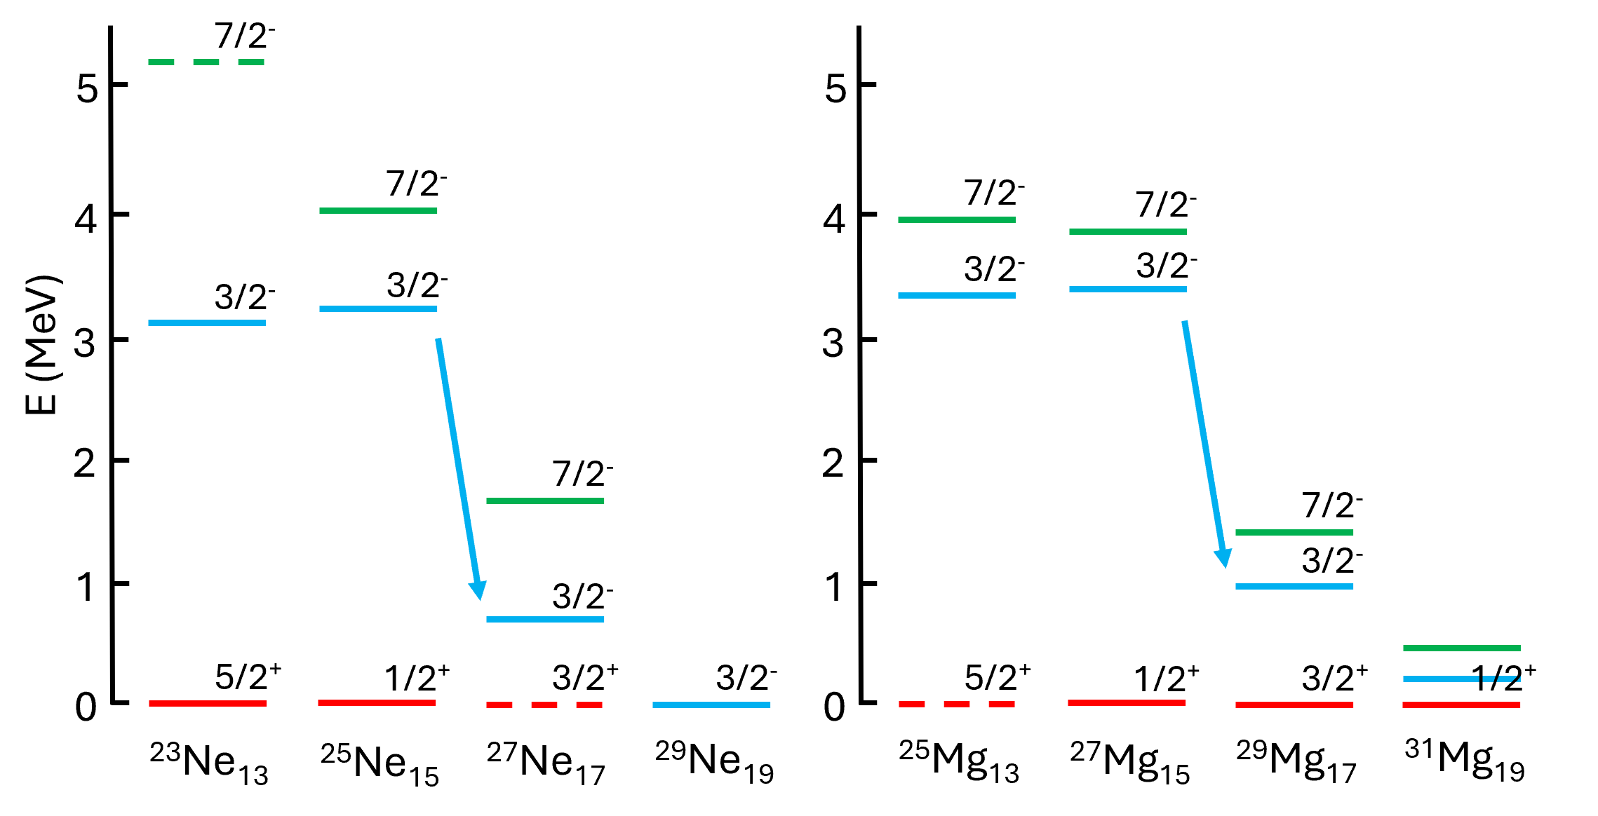
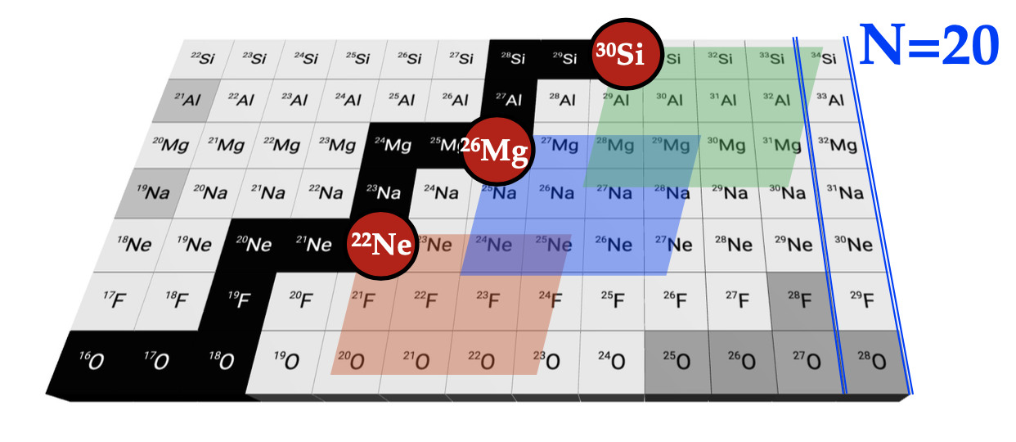
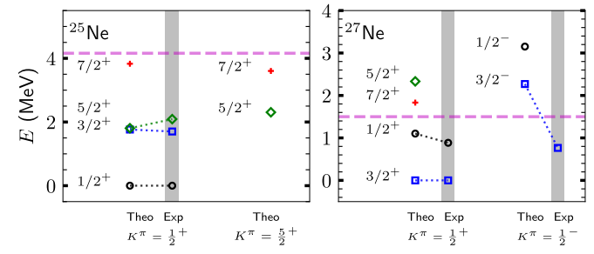
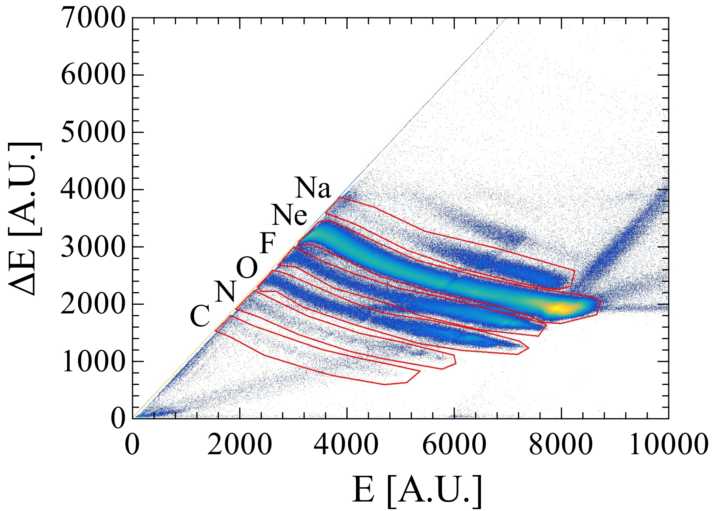
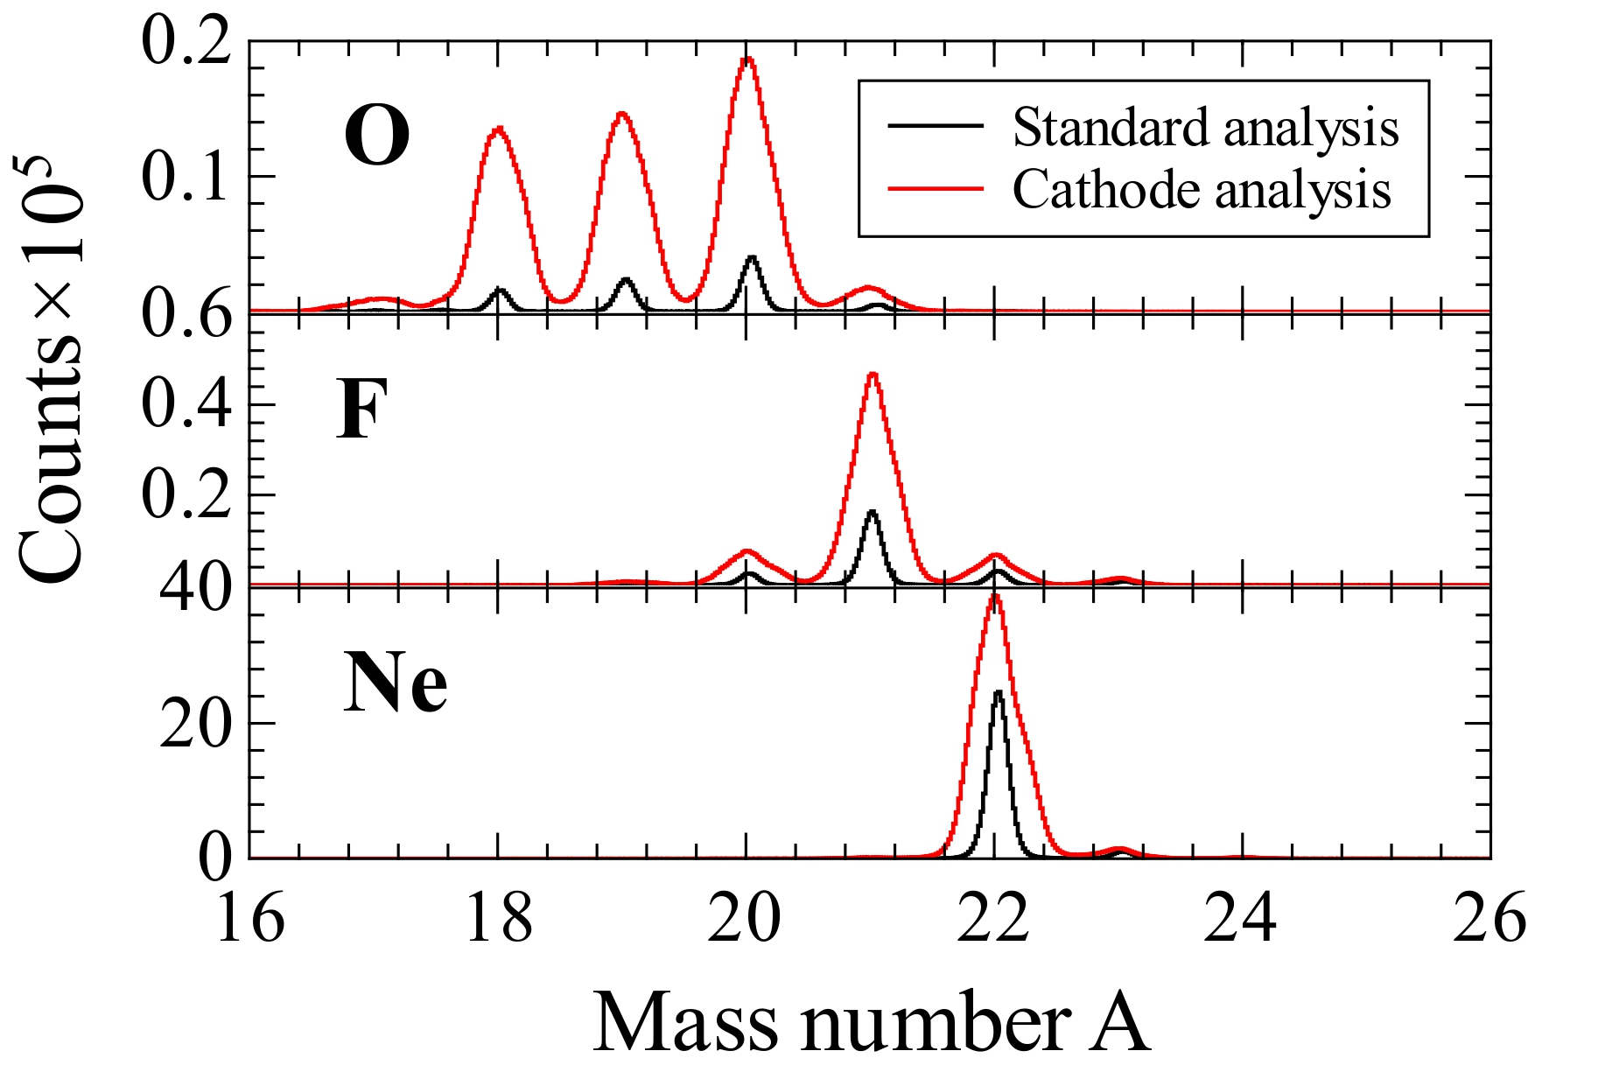
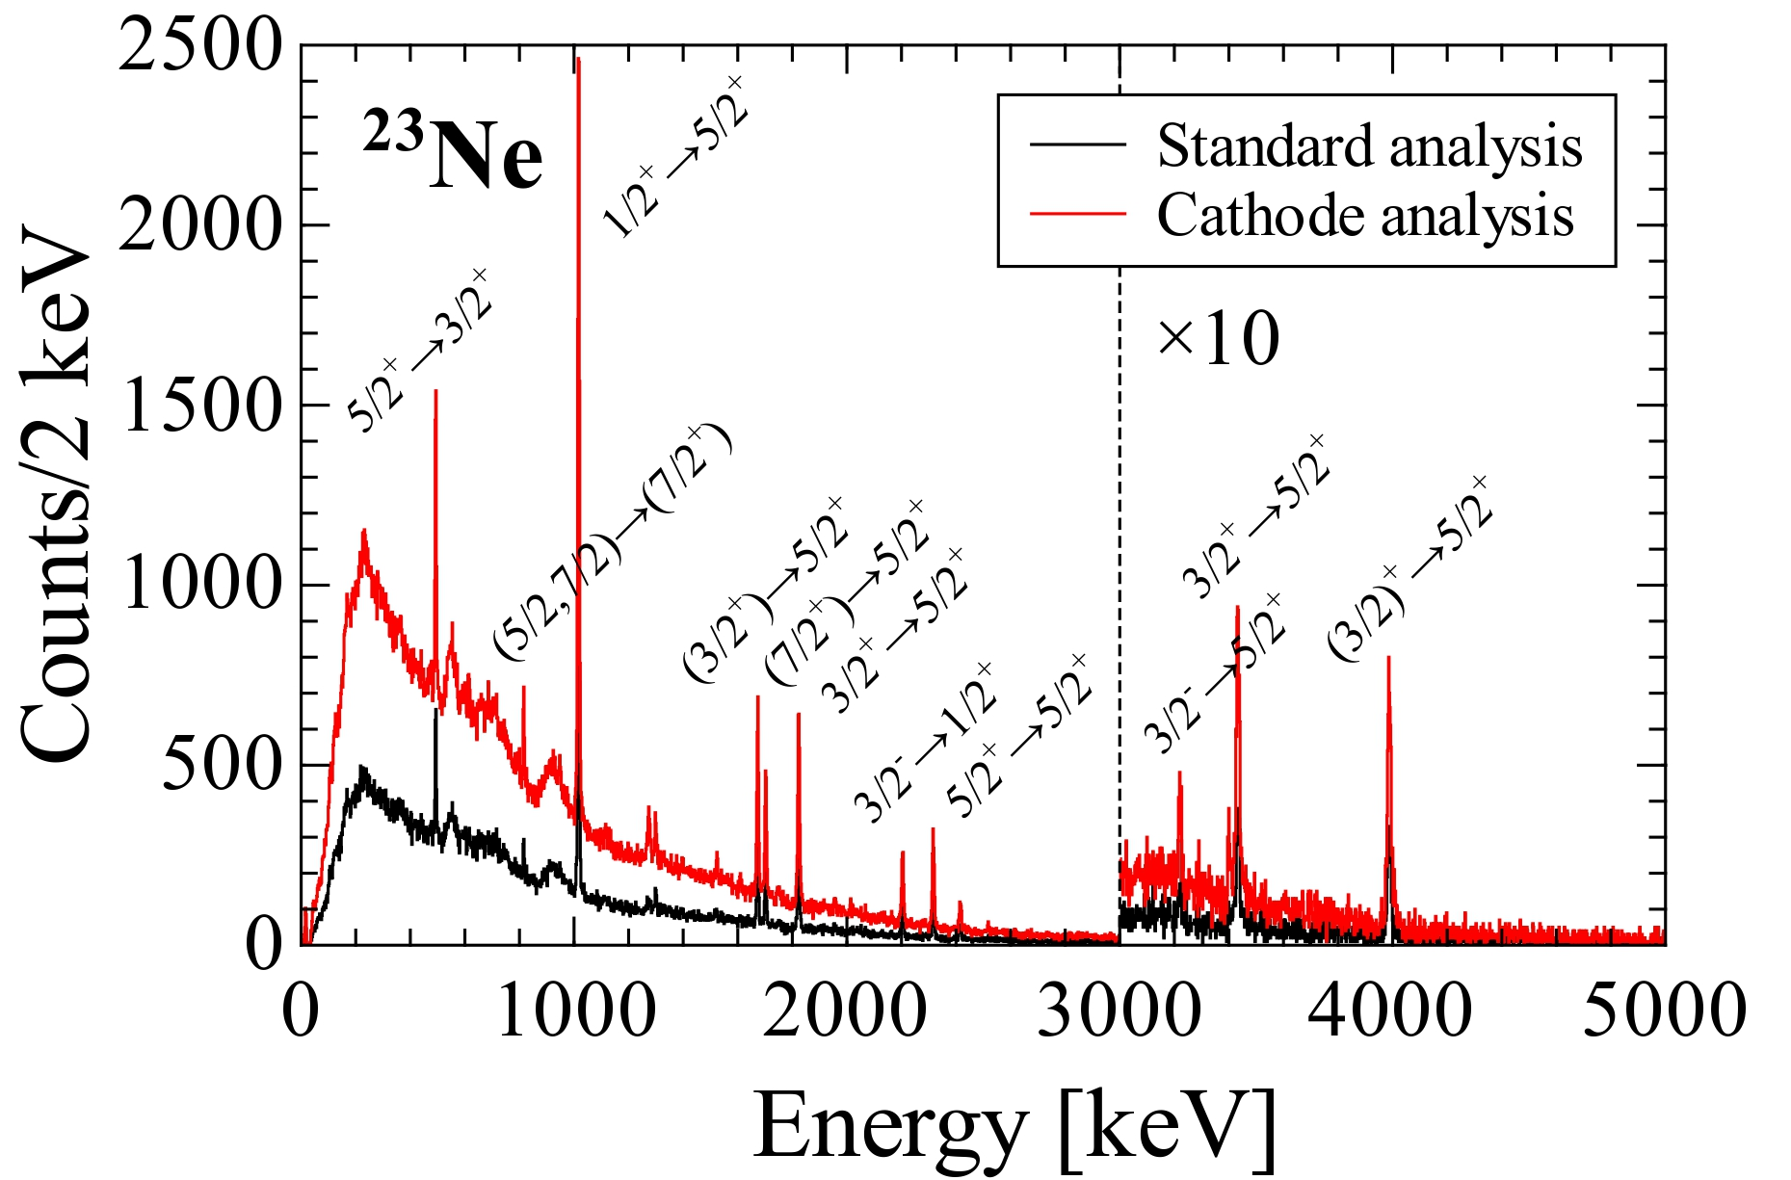
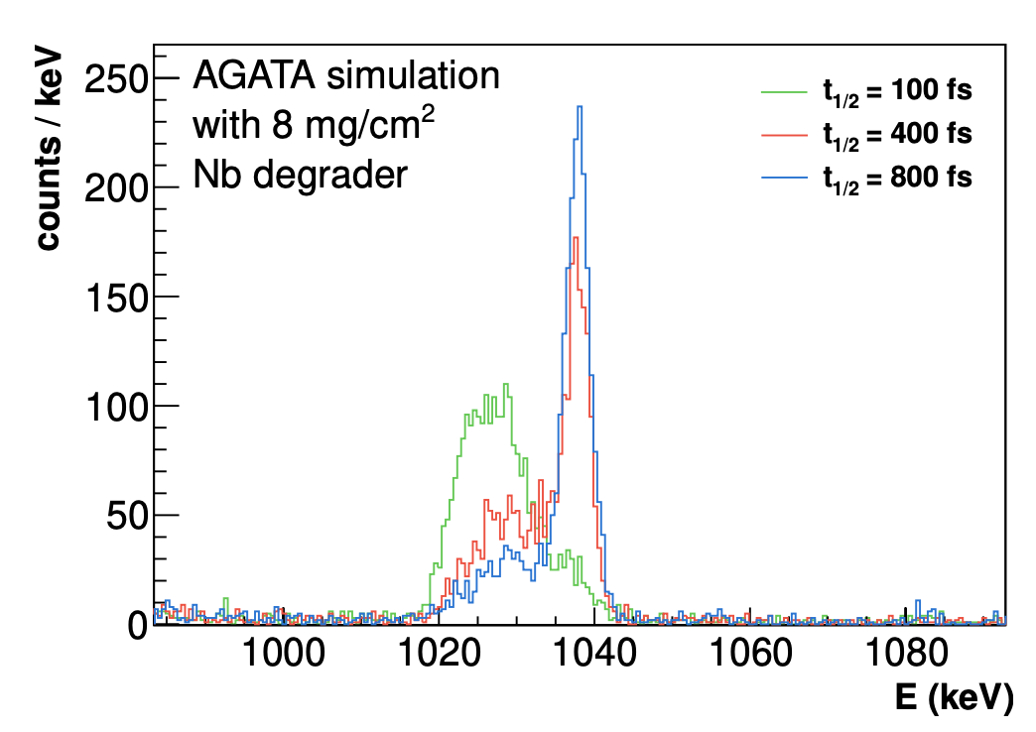
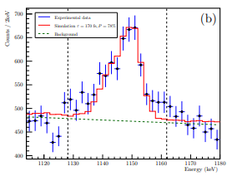
2. Towards the N=20 IoI
Intruder configurations towards N=20
evolution of negative-parity states
Multi-nucleon transfer reactions
AGATA+PRISMA and ²³⁸U target
P. Marević et al., Phys. Rev. C 97 (2018) 024334
PHASE A
Z. H. Sun et al., Phys. Rev. C 111, 044304 – 2025
²²Ne + ²³⁸U @160 MeV
PRISMA optimization and lifetime measurements
assessing fs lifetimes of excited states
²⁶Mg + ²³⁸U @200 MeV
²⁸Mg 3⁻ ->4⁺
DSAM
D. Genna(Milano), S. Bottoni(Milano), G. Benzoni(Milano), K. Wimmer(GSI), P. Aguilera(Padova), F. Drent(GSI), F. Recchia(Padova).

Slide 12
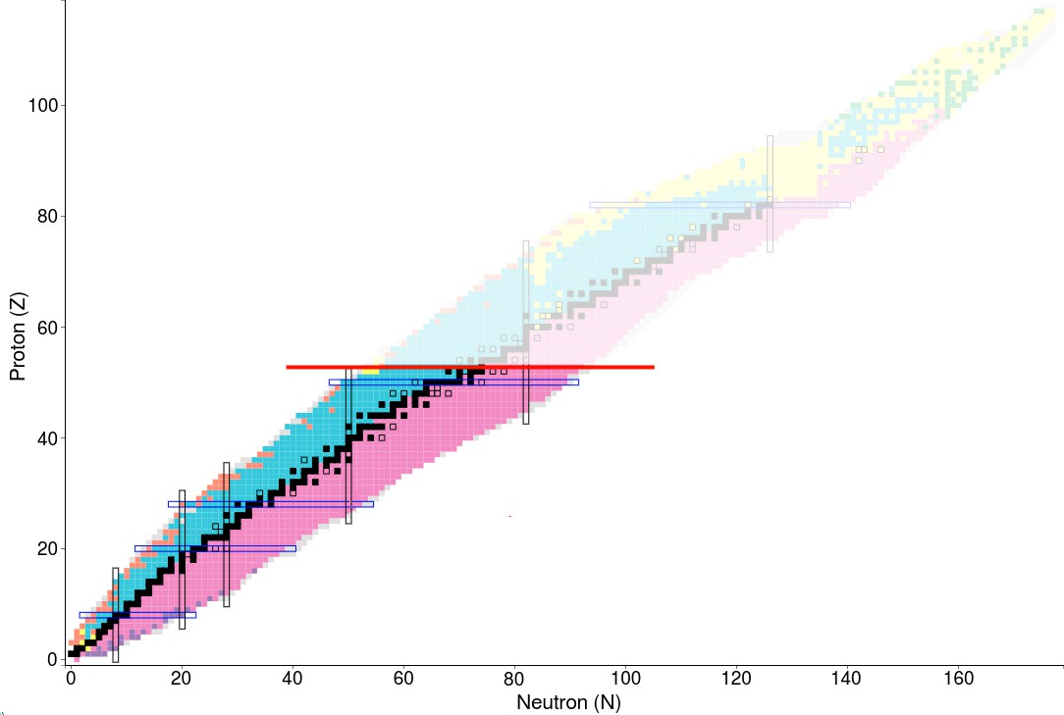

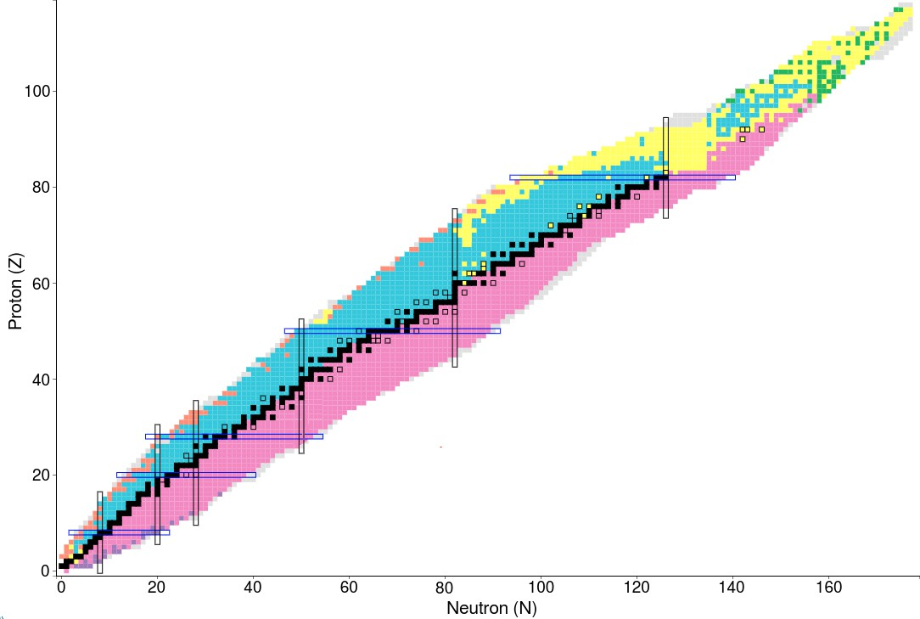
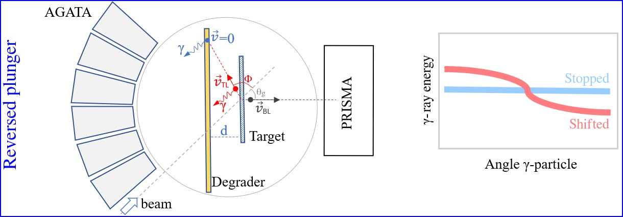
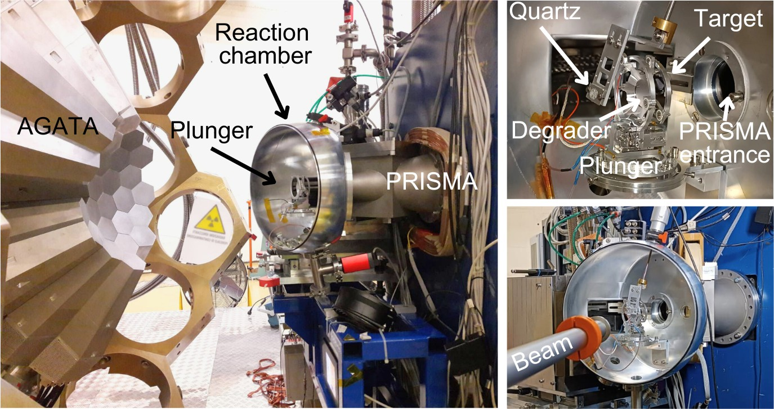
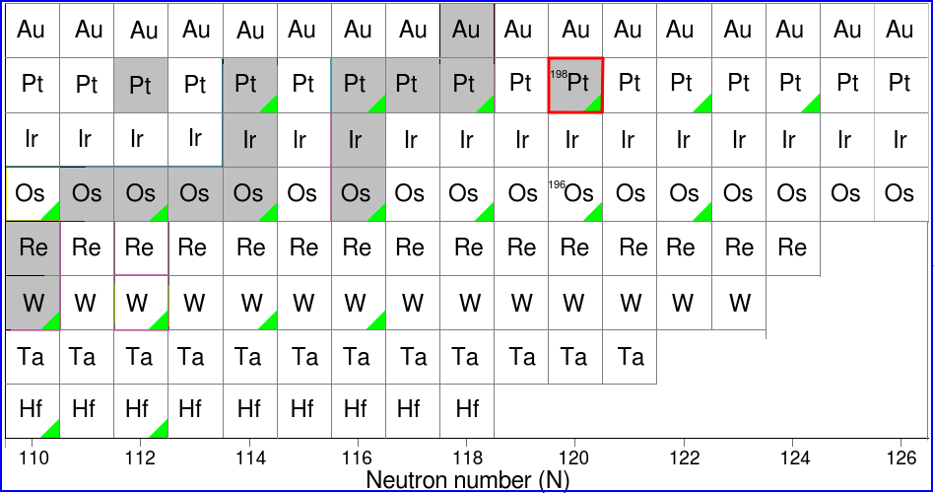
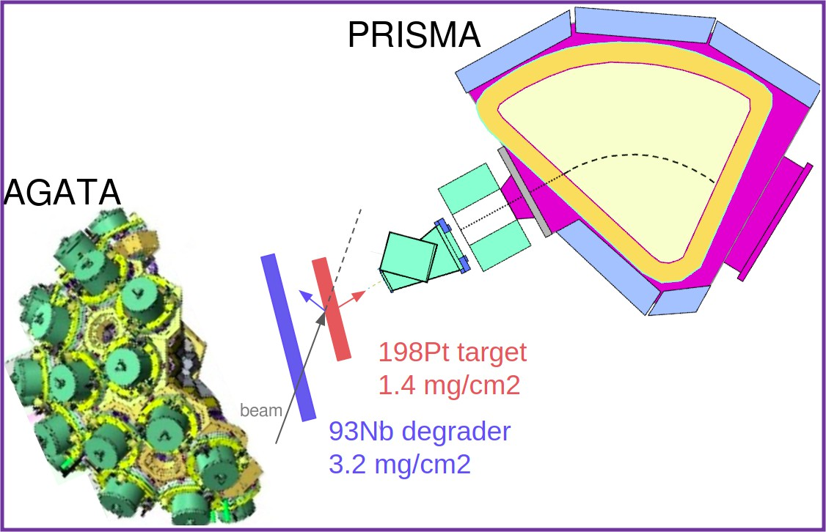
3. Reverse plunger technique: motivation
At 7-10 MeV/u, no Z discrimination for Z>54 in PRISMA
Kinematics reconstruction of heavy partner in typical binary reaction with AGATA-PRISMA
No lifetime measurement for heavy reaction residues
Shape transitions from prolate to oblate and spherical at N=126
Spokepersons: D. Brugnara, J. Pellumaj
Collaboration with Univ. Cologne

Slide 13
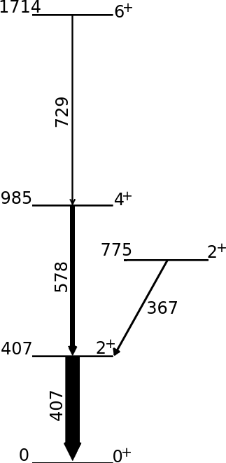
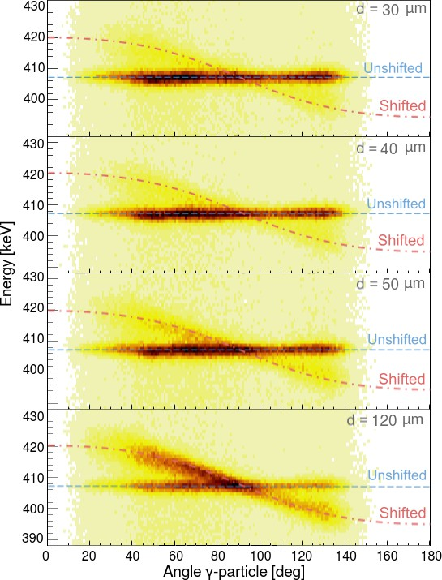
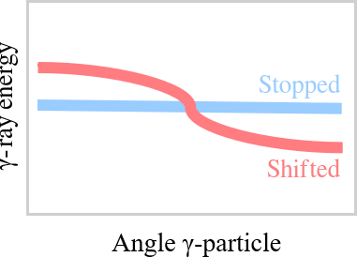
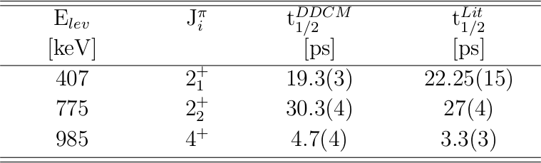
3. Reverse plunger technique: results
Beam: ¹³⁶Xe@1134 MeV Target: ¹⁹⁸Pt
Degrader: ⁹³Nb PRISMA set at 39◦
Plunger (in collaboration with Koln) distances:
30, 40, 50 and 120 µm
198_{Pt}
J. Pellumaj PhD thesis
The technique works and is being applied to measure lifetimes in neutron-rich Pt, Os isotopes !

Slide 14
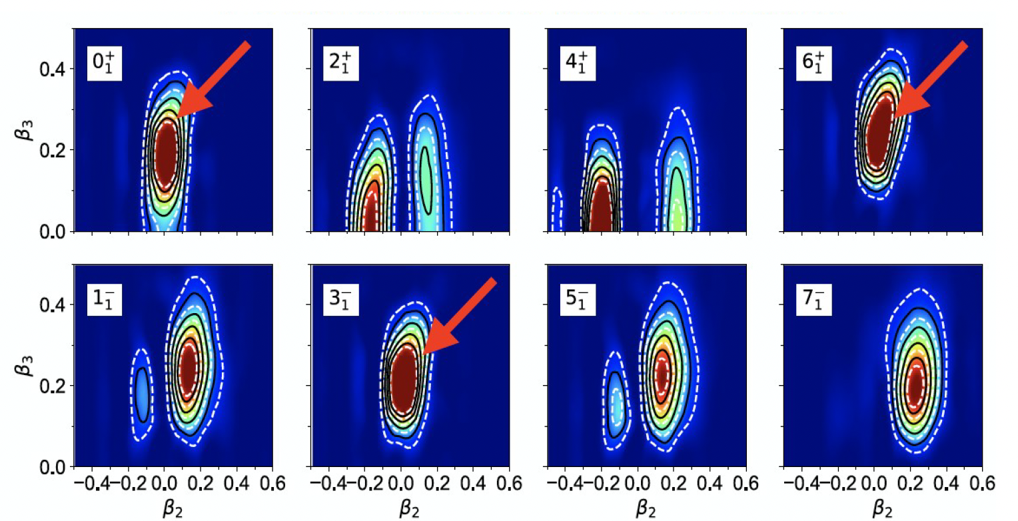



4. Octupole phonons in ⁹⁶Zr: motivation
Gogny EDF calculations show strong octupole deformation for 0⁺, 3⁻ and 6⁺ collective wf, which indeed present very similar features
T. Rodriguez (private communication)
84 Wu ?
42 Wu
Measurement by safe Coulex of the B(E3)
D. Doherty, N. Marchini, M. Zielinska
Unsafe ⁹⁶Zr Coulex
F. Ercolano Master thesis
Spokepersons: D. Stramaccioni/J.J. Valiente-Dobon
D.Stramaccioni PhD thesis

Slide 15



4. Octupole phonons in ⁹⁶Zr: results
Spokepersons: D. Stramaccioni/J.J. Valiente-Dobon
D.Stramaccioni PhD thesis
The reconstructed ⁹⁶Zr excitation energy spectrum shows that the 6⁺ state, along with a few candidates for the other two-phonon multiplet members, was strongly populated
Tentative evidence of an E3 branch connecting 6+ and 3- states. Searching for other members (0⁺, 2⁺, 4⁺) of the double octupole phonon.
3⁻ x 3⁻
3⁻

Slide 16









5. Fusion-fission ²⁰⁸Pb+⁹Be
Spokepersons: M. Caamano, A. Gottardo, J.J. Valiente-Dobon
²⁰⁸Pb beam, 6 MeV/u
Filippo Angelini PhD thesis (2nd year) UNIPD
PRISMA second arm
First half 2026: AGATA –PRISMA campaign with ²³⁸U beams at 7 MeV/u from PIAVE-ALPI for fusion-fission and MNT reactions
- spectroscopy of medium-spin states
- lifetimes of excited states
D. Verney

Slide 17
Plans for 2025-26
²³⁸U beams at 7 MeV/u from PIAVE-ALPI for fusion-fission and MNT reactions
In-flight light exotic beams from EXOTIC facility
¹⁷F E = 3–5 MeV/u Purity: 93-96 % Intensity: 10⁵ pps
⁸B E = 3–5 MeV/u Purity: 30-43 % Intensity: ~ 10³ pps
⁷Be E = 2.5–6 MeV/u Purity: 99 % Intensity: 10⁶ pps
¹⁵O E = 1.3 MeV/u Purity: 97-98 % Intensity: 4*10⁴ pps
⁸Li E = 2–2.5 MeV/u Purity: 99 % Intensity: 10⁵ pps
¹⁰C E = 4 MeV/u Purity: 99 % Intensity: 5*10³ pps
¹¹C E = 5 MeV/u Purity: 99 % Intensity: 2*10⁵ pps
¹⁸Ne E = 1.3 MeV/u Purity: 95 % Intensity: 6*10³ pps (under dev.)
Soon to be commissioned on AGATA target point
1.5*10⁵ pps on AGATA target point (150 enA ¹¹B primary beam) !

Slide 18





Agata @ zero degree (~ mid ‘26)
To be implemented in 2026 after the Uranium campaign
PARIS
γ-rays
NEDA
neutrons
NEDA
neutrons
CTADIR
cryogenic target

Slide 19
































The young strength of AGATA@LNL: PhD, Postdocs
9 nationalities !

Slide 20
Thanks for the attention !

Slide 21
Backup

Slide 23



1. Physics of the 𝛎g_{9/2} shell beyond N=40
⁷⁰Zn @ 470 MeV onto ²³⁸U, Nb degrader, AGATA- PRISMA, RDDS
Joint proposal aiming to study the physics of the νg_{9/2} beyond N=40:
Collectivity and seniority conservation in νg_{9/2} orbital
Shape coexistence and octupole vibrations in ⁶⁸Ni
Island of inversion and the role of intruders at N~40
AGATA measurement conditions:
- 50-60 kHz/core
- 100 validations/core
Preliminary (near online)
C. Lifetime measurements in neutron-rich ⁶⁷⁻⁷³Cu and ⁷⁰⁻⁷⁴Zn nuclei above N=40
A. Investigation of the Seniority Conservation in the 𝝂g_{9/2} shell towards ⁷⁸Ni
D. Spectroscopy and lifetime measurements neutron-rich Co and Fe isotopes
B. Effects of multiple shape coexistence on low-lying octupole vibrations and couplings
Preliminary (near online)
Spokepersons: R.M.Pérez Vidal, S.Bottoni, E.Sahin, A.Illana, J. Benito, J. Ljungvall, M. Doncel, A.Gadea, L.M. Fraile

Slide 24








A playground for nuclear models
"An almost perfect
γ-unstable/triaxial rotor yrast band is predicted for ¹⁹⁶Os"
The Os-Pt region shows a unique set of prolate, oblate, axially asymmetric, and co-existing shapes.
PES calculated by beyond-mean-field with the Gogny D1S interactions + PN-VAP
T. R. Rodríguez
P. R. John et al., Phys. Rev. C 90, 021301 (2014)

Slide 25






Digression. ⁴⁶Ar: proton closure, bubble nucleus ?
Spokepersosns: A. Gottardo, M. Assié, D. Mengoni
⁴⁶Ar(³He,d)⁴⁷K experiment performed during the AGATA GANIL campaign with SPIRAL1 beams
AGATA-MUGAST-VAMOS setup, HeCTOR cryogenic ³He target
Suppressed proton transfer to the 3/2⁺ state in ⁴⁷K, contrary to shell-model predictions (SDPF versions)
D. Brugnara PhD thesis
0.08
ν
Amplitude
0.06
0.04
-> Ab-initio NNLO_{sat} calculations predict a closed 𝜋d_{3/2} shell , and an empty 𝜋s_{1/2} shell, leading to a proton density bubble in ⁴⁶Ar
46_{Ar}
π
0.02
0.00
0
4 6
Radius (fm)
8
10

Slide 26







PRISMA second arm
MWPPAC
2nd arm
Bragg IC
Sn-like
beam
¹²⁴Sn
²³⁸U
ULTIMATE GOAL
direct identification in PRISMA of ions in the mass range
200 < A < 250
by tagging target-like products selected in Z by NOSE
U-like
PRISMA

Slide 27




Prisma second arm tests (06/02/2025)
PPAC XY impact matrix
PPAC wires, separated by 1 mm, are visible
Energy in the Bragg chamber with 3-peaks α source

Slide 28
1. Reversed plunger techinique: setup
Spokepersons: D. Brugnara, J. Pellumaj
Beam: ¹³⁶Xe@1134 MeV Target: ¹⁹⁸Pt
Degrader: ⁹³Nb PRISMA set at 39◦
Plunger (in collaboration with Koln) distances: 30, 40, 50 and 120 µm

Slide 29




Ab-initio model NNLO_{sat}: shell structure
Ab-initio calculations
Ab-initio calculations with the NNLOsat in ADC2 and ADC3
(C. Barbieri, S. Brolli, V. Somà)
NNLO_{SAT} chosen because of its capability of reproducing radii (cross check with the NNLO_{lnl} in ADC2)
14 harmonic oscillator shells and ℏΩ=22 MeV to optimize the
convergence of binding energies
BE and charge radii well in agreement with ⁴⁸Ca and ⁴⁶Ar data
SF in ⁴⁶Ar in agreement with data
0.08
ν
Amplitude
0.06
0.04
48_{Ca}
π
0.02
0.00
0
2
4 6
Radius (fm)
8
10
0.08
ν
Amplitude
0.06
0.04
0.02
46_{Ar}
π
NNLO_{SAT}: a 𝜋d_{3/2} subshell closure and
an empty 𝜋s_{1/2}
0.00
0
2
4 6
Radius (fm)
8
10

Slide 30



5. Search for a nuclear Josephson effect
Search for evidence that two colliding nuclei behave like a Josephson junction, a device in which Cooper pairs tunnel through a barrier between two superfluids
¹¹⁶Sn beam PIAVE+ALPI, E_{lab} = 452.5 MeV, I = 2 pnA
target thickness 200 μg/cm2, Prisma θ_{lab} = 20°
gamma ray strength function predicted by Broglia et al.
¹¹⁶Sn+⁶⁰Ni reaction at energies below the Coulomb barrier.
𝛄-ray radiation emitted via a dipole oscillation D generated by the two neutron transfer process
gamma spectrum obtained with Agata in coincidence with Z=28, A=62 events in Prisma
?
data analysis in progress
Preliminary data
Spokespersons L.Corradi, S.Szilner

Slide 31




Research focus: shell structure around N=20
How to identify single-particle states ? Observable: particle transfer cross section vs B(E2)
Co-spokesperson of the first experiment of the LNL AGATA campaign: ³⁶S(d,p)³⁷S
T_{1/2}³⁴⁹³ = 30⁺⁶⁰₋₂₀ fs
Results:
- lifetimes of normal and intruder states
- simultaneous test of the shell-model predictions for spectroscopic factors (single-particle dof)
AND E2 collectivity (collective dof)
Luca Zago PhD thesis (t.b.d. 2024-25) UNIPD

