Slide 1
Energy Density Functionals for nuclei and astrophysical applications
Gianluca Colò
14th International Spring Seminar on Nuclear Physics (Ischia, 19th-23rd May 2025)

Slide 2
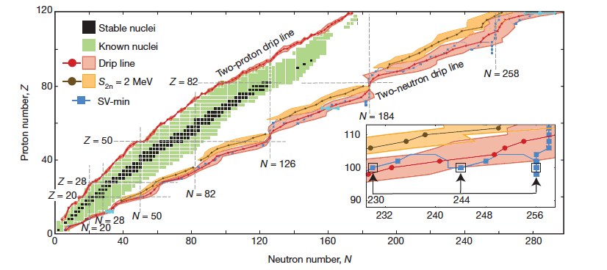
(Nuclear) Density Functional Theory
E is a functional called EDF
Existence is guaranteed by the Hohenberg-Kohn theorem.
It gives access, in principle, to all properties of the system.
The theorem does not tell what the EDF looks like.
Starting from current EDFs, the road for improvement is not fully clear.
n
⁹Li
n

Slide 3
Possible improvements
Changing the form of the functional (more parameters, more terms, different form...)
Advanced statistical methods (Bayesian inference, ML...)
Adding specific many-body correlations
Building the EDFs from ab initio
Skyrme, Gogny, covariant EDFs exist

Slide 4
Bayesian inference of a Skyrme EDF
Outcome: posterior distribution of the parameters
Prior distribution of the parameters
Likelihood
Parameters: all those associated with a standard functional.
Prior distributions (“priors”): rather ”agnostic” choice of flat priors.
Likelihood: assumed as a product of Gaussian:
f is the model result, and the error includes theoretical error:

Slide 5
Skyrme EDFs (even-even nuclei)
They are local functionals depending on various densities.
In a first work, we use the EoS and HF-RPA for standard GRs

Slide 6
¹ L.W. Chen et al., PRC 80, 014322 (2009)

Slide 7
Observables used
These are the data

Slide 9
Results: marginalized posterior distributions
P. Klausner et al., PRC 111, 014311 (2025)

Slide 10
Inferred values of the parameters / predictions
All observables are within experimental errors. The BE of ⁵⁶Ni and so splitting of ²⁰⁸Pb are within 1 and 2𝜎 while only the A_{PV} of ²⁰⁸Pb lies at more than 2𝜎.

Slide 11
Binding energies of nuclei with different N, Z
Using either N = Z nuclei, or nuclei with N ≠ Z, have a quite strong bias on the results for the IV EoS parameters J and L.
Is this a signature of the Wigner term?

Slide 12
What about the odd part of the EDF?

Slide 13
The Gamow-Teller Resonance (GTR)
“Vibration” in spin-isospin space
Z
N
Several precise experimental data exist
The p-h structure of the GTR is sensitive to spin-orbit splitting (cf. the operator )
The GTR energy location and collectivity are governed by strong repulsive spin-isospin p-h interaction.
M. Yasuda et al., Phys. Rev. Lett. 121, 132501 (2018)
So far, this parameter has been estimated based on empirical models without uncertainty quantification

Slide 14
Bayesian inference focused on GTR and G₀’
Coll.: Zidu Lin (UTK) and A.W. Steiner (UTK+Oak Ridge)
Input data:
masses and charge radii of magic nuclei;
measured spin-orbit splittings [M. Zalewski et al., Phys. Rev. C77, 024316 (2008)];
GT energies and fractions of Ikeda sum rule for ⁴⁸Ca, ⁹⁰Zr, ¹³²Sn and ²⁰⁸Pb.

Slide 15
Inference for the Landau parameter G₀’
In line with some previous findings and yet with quantified uncertainty.
Comparison with π-exchange models:
Lower effective mass may play a role.
SAMi: Skyrme Aizu-Milano

Slide 16
Astrophysical applications
Further motivation:
use the Skyrme EDF to calculate weak interaction processes in dense matter, like neutrino interactions in core-collapse supernova; discuss pion condensation (?)
Other properties can be looked at...
N/A means < 2

Slide 17
Conclusion (I)
All Skyrme EDFs are wrong
Maybe...
Perhaps all models are wrong
The analysis of the PDFs, and of the correlation matrix, may allow us to go deeper and point better to pros and cons

Slide 18
Conclusion (II)
One can use EDFs as a basis for many-body calculations like those based on the particle-vibration coupling idea.
Using inference when parameters are input these calculations is so far too demanding

Slide 19
Collaborators
P. Klausner, E. Vigezzi (Milano)
M. Antonelli, F. Gulminelli (LPC Caen)
X. Roca-Maza (Milano, now at U. Barcelona)
A. Steiner, Z. Lin (UTK)

Slide 20
Thank you for listening

Slide 21
Backup slides

Slide 22
Parity-violating asymmetry (and weak FF)
Parity-violating asymmetry measured in electron scattering is a probe of the neutron distribution (in principle, a model-independent probe).
Neutron skin
D. Adhikari et al., Phys. Rev. Lett. 129, 042501 (2022)

