Slide 1


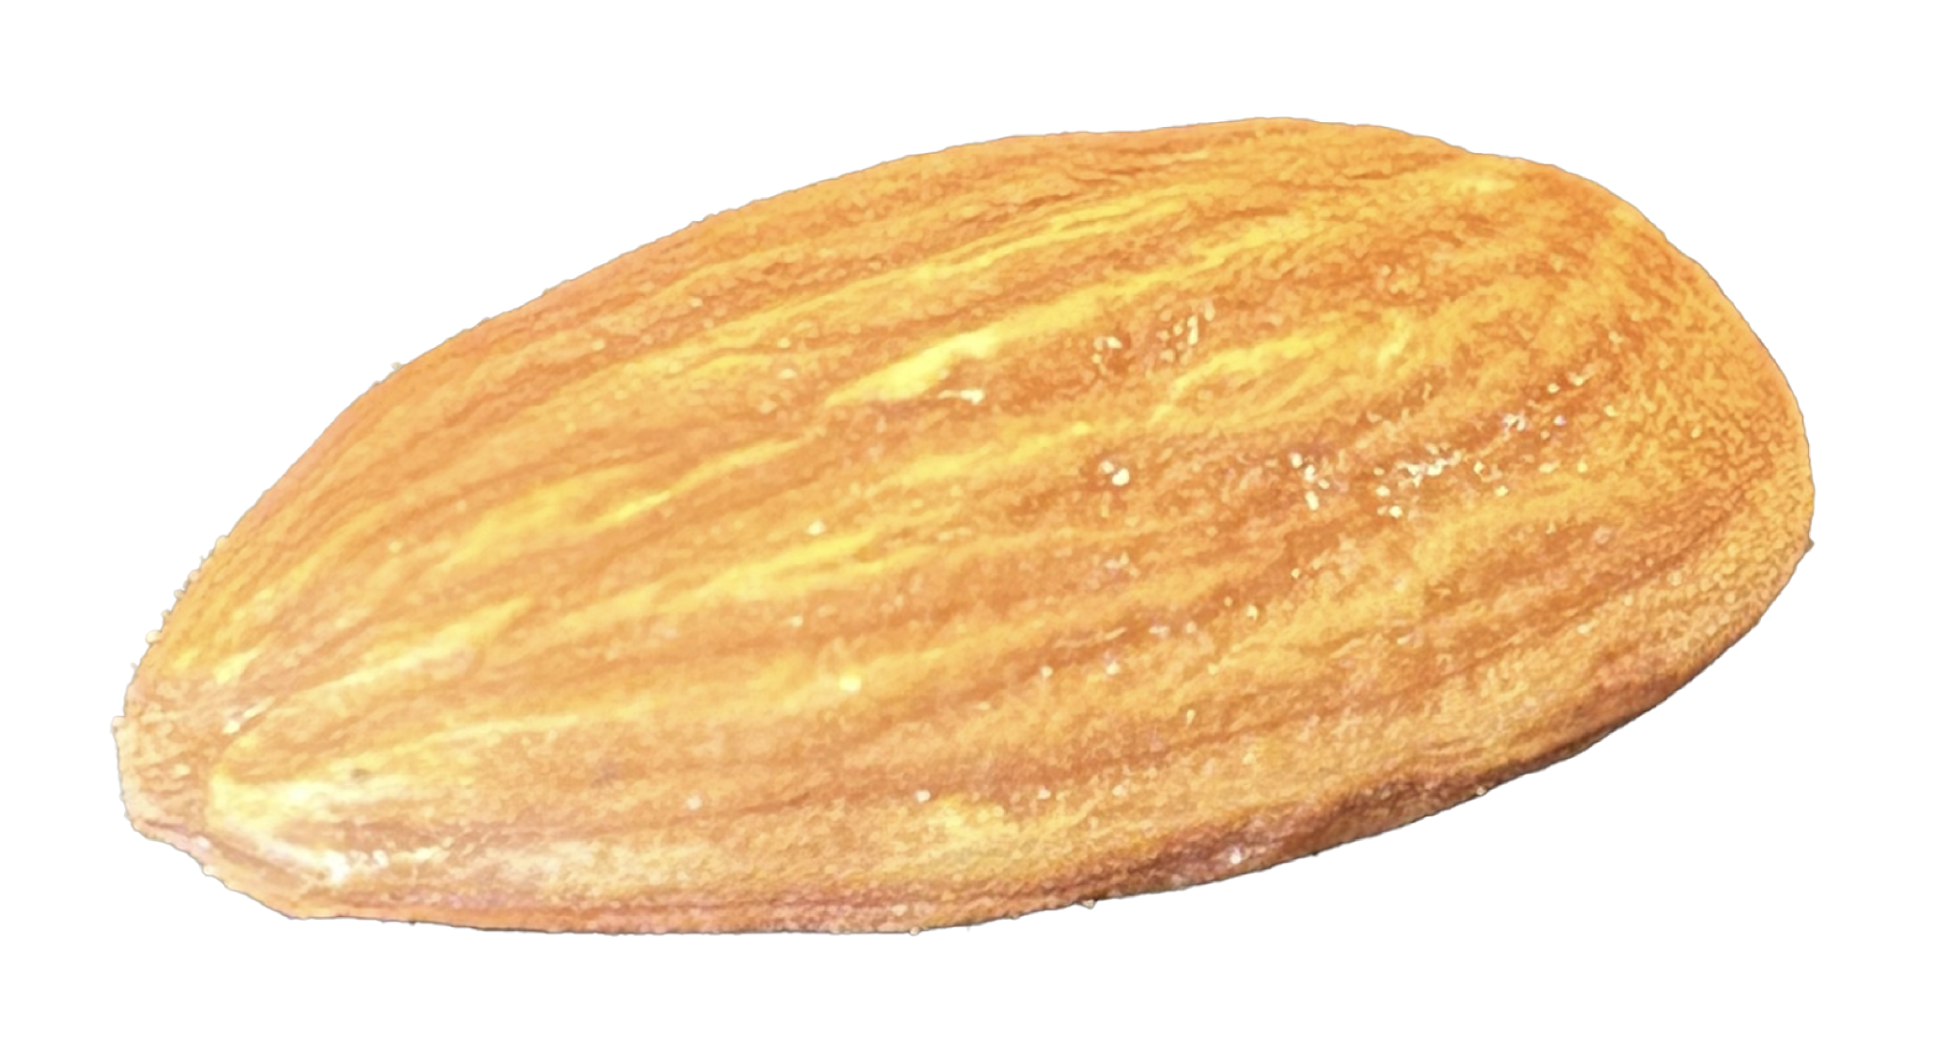

A comprehensive view of nuclear shapes, rotations and vibrations from fully quantum mechanical perspectives
14th Int. Spring Seminar on Nuclear Physics
Ischia
May 20 (May 18-23), 2025
Takaharu Otsuka
Are atomic nuclei like
rugby ball or almond ?
Supported by “Program for promoting research on the supercomputer Fugaku”, MEXT, Japan (JPMXP1020230411)

Slide 2
Outline
1. Quantum many-body formulation of “rotational energy”
2. Triaxiality and rotational states
3. Vibrational excitations – deformed case -
4. Vibrational excitations – spherical case -
Sections 1 & 2 have been made in collaboration with Y. Tsunoda (CNS, Tokyo), N. Shimizu (Tsukuba), Y. Utsuno (JAEA), T. Abe (Keio U.), H. Ueno (Riken), while
T. Duguet (Saclay) joined for Sections 3 & 4.

Slide 3




Origin of the J(J+1) rule of rotational excitation energy
conventional description
Ring & Schuck,
The Nuclear Many-Body Problem
classical mechanics
time t, angle Ω(t)
rotation of rigid body
Bohr Hamiltonian
time t₀, angle Ω₀
quantization of free rotation of this rigid body
→ eigenstate with angular momentum h J
- superposition of states
at varying angles
- for axially symmetric shape,
J(J+1) rule is suggested
Thus, for axially symmetric shapes, the rotational kinetic energy is given by
T _{rot}
J ( J+1 )
- just kinetic energy of free
rotation, no interaction

Slide 4

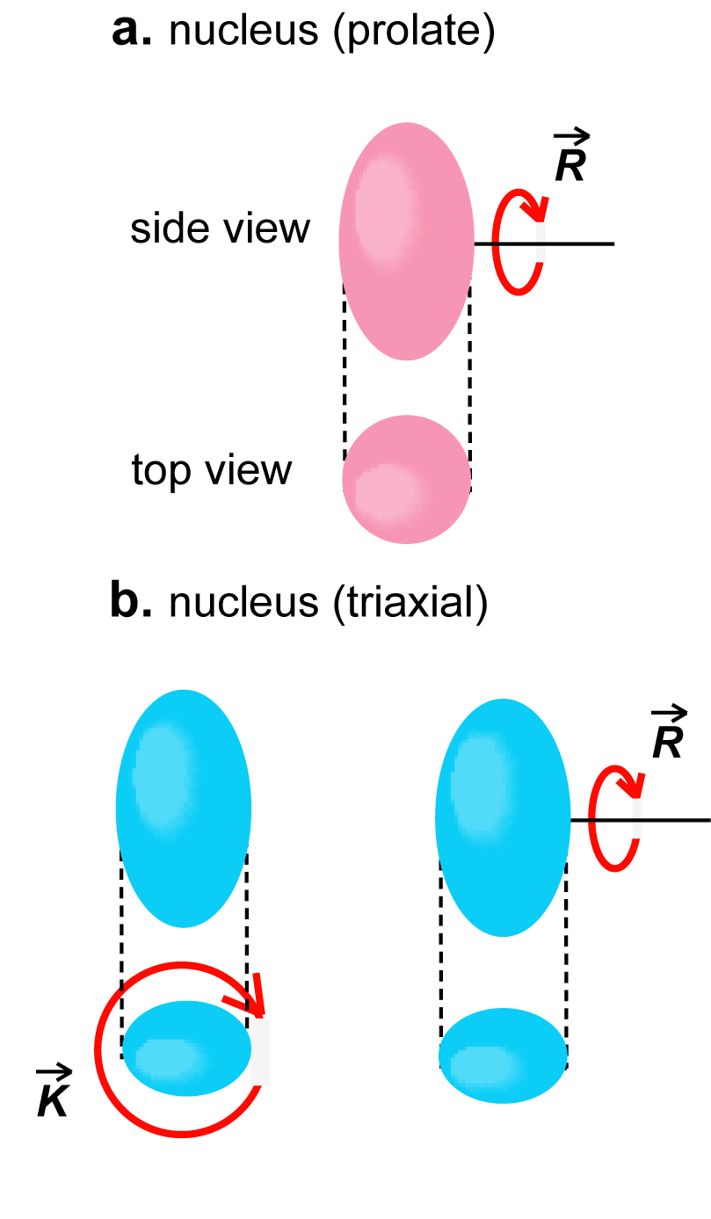


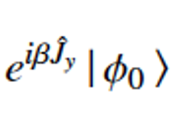
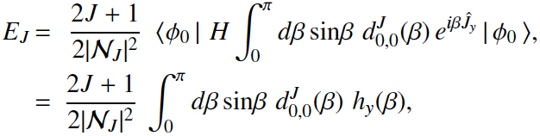


Quantum many-body description (derivation) of rotational excitation energy
: intrinsic state (i.e., state in the body-fixed frame) with K=0
symmetry restoration with angular momentum J
y axis
state projected onto J
rotation about y axis
→ energy of the state projected onto J
H
y axis
β
energy kernel
y axis
polynomial expansion:
+ …
(see next page)

Slide 5

A general formura at LO (leading order) + NLO (next-to-the-
leading order) is derived for a K value with a triaxial ellipsoid,
by utilizing mathematical stuff like the hypergeometric function
(skipped because of time):
The coefficients are calculated with intrinsic states of
assigned K values

Slide 6
Origin of the famous J(J+1)-K² rule of rotational excitation energy
conventional description
alternative view
classical mechanics
quantum mechanics for many-body system
time t, angle Ω(t)
rotation of rigid body
eigenstate with angular momentum h J
- superposition of states at varying angles
time t₀, angle Ω₀
H
- Hamiltonian H, including
interactions, couples
states created by
orienting the same
intrinsic state at
different angles
quantization of free rotation of this rigid body
→ eigenstate with angular momentum h J
- superposition of states
at varying angles
- resultant excitation energy
depicts the J(J+1) – K² rule
for strong deformation
- for axially symmetric shape,
J(J+1) rule is suggested
- this rule arises from
specific angle dependence
of superposition amplitudes,
which are governed by J
- lower K and J provide more binding energies
- just kinetic energy, no
interaction
- this feature is general and robust

Slide 7
The present results are obtained within the quantum many-body framework,
without resorting to the quantization of the free rotation of classical object.
The Hamiltonian H stands for a nucleon Hamiltonian which
comprises SPEs, NN interactions, 3N interactions, etc.
binding
energy
J=4
The rotational excitation energy represents a loss of the
binding energy as a function of J.
excitation
energy
J(J+1)
J=0
J=2
The equations are general and independent of Hamiltonian. They are valid
for ab initio calculations (such as ¹²C (R=2.99)) as well as for DFT approaches.
What we need is just a strong deformation, including cluster states.
Despite rather substantial differences, the underlaying picture can be partly shared with earlier works, Peierles & Yoccoz (1957), Verhaar (1963), Kamlah (1968), Siemens & Jensen (book, 1987), although they may not have well been perceived by the community.

Slide 8
Outline
1. Quantum many-body formulation of “rotational energy”
2. Triaxiality and rotational states
3. Vibrational excitations – deformed case -
4. Vibrational excitations – spherical case -

Slide 9
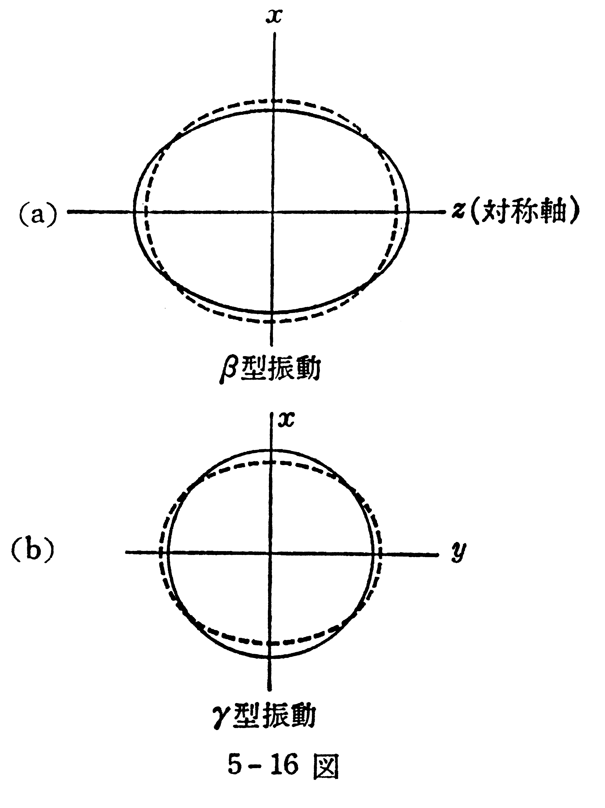
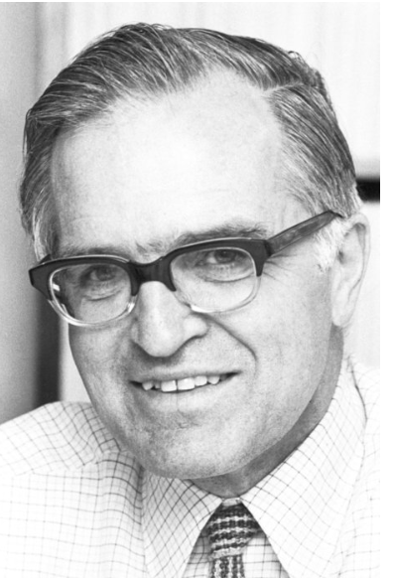
A case of the textbook example:
原子核 by M. Nogami
Aage Bohr
Novel Prize Lecture
(1975)
¹⁶⁶Er
γ – vibration
phonon
excitation
Aage N. Bohr, 1922-2009
Nobel Foundation archive
Axially symmetric
prolate ellipsoid
(equilibrium)
also emphasized in
A. Bohr and B. R. Mottelson,
Nuclear Structure II
(1975, Benjamin, New York)

Slide 10
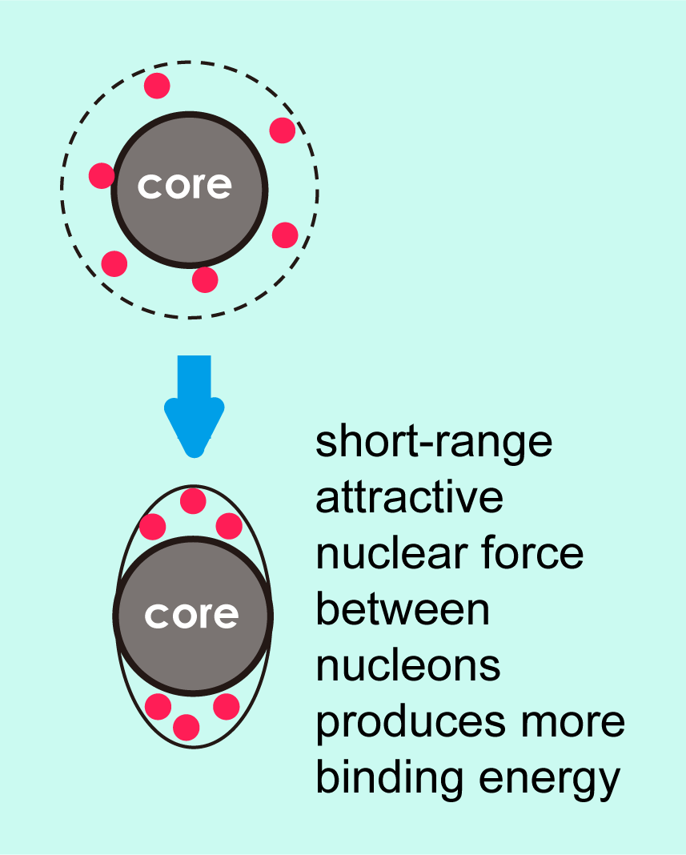
Revisit with Monte Carlo Shell Model (CI calculation)
3s_{1/2}
Effective interaction: G-matrix* + V_{MU}
* Brown, PRL 85, 5300 (2000)
2d_{5/2}
1g_{9/2}
2p_{1/2}
Nucleons are excited fully within this model space (no truncation)
1f_{5/2}
0i_{13/2}
0h_{9/2}
We performed Monte Carlo Shell Model (MCSM) calculations, where the largest case corresponds to the diagonalization of 3.9 x 10 ³¹ dimension matrix.
Its recent extension, Quasiparticle Vacua Shell Model (QVSM)* is used, in order to incorporate
pairing and deformation effects on an equal footing.
*Shimizu et al, PRC 103, 014312 (2021)
2p_{3/2}
2p_{3/2}
1f_{7/2}
1f_{7/2}
0h_{11/2}
0h_{11/2}
1d_{3/2}
0g_{7/2}
70
2s_{1/2}
1d_{5/2}
0g_{9/2}
¹¹⁰Zr
40
proton
neutron
+ HFB (number VAP, J VBP) + GCM for γ
V_{MU} : same interaction for the description of shell evolution in exotic nuclei

Slide 11
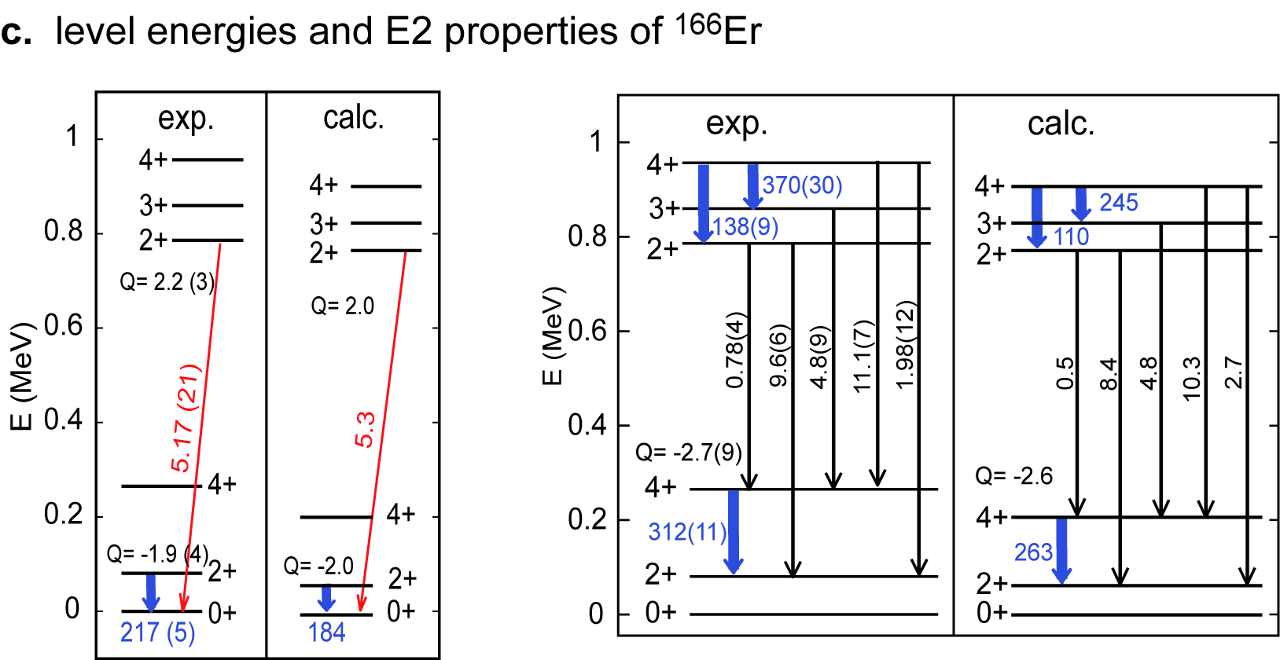
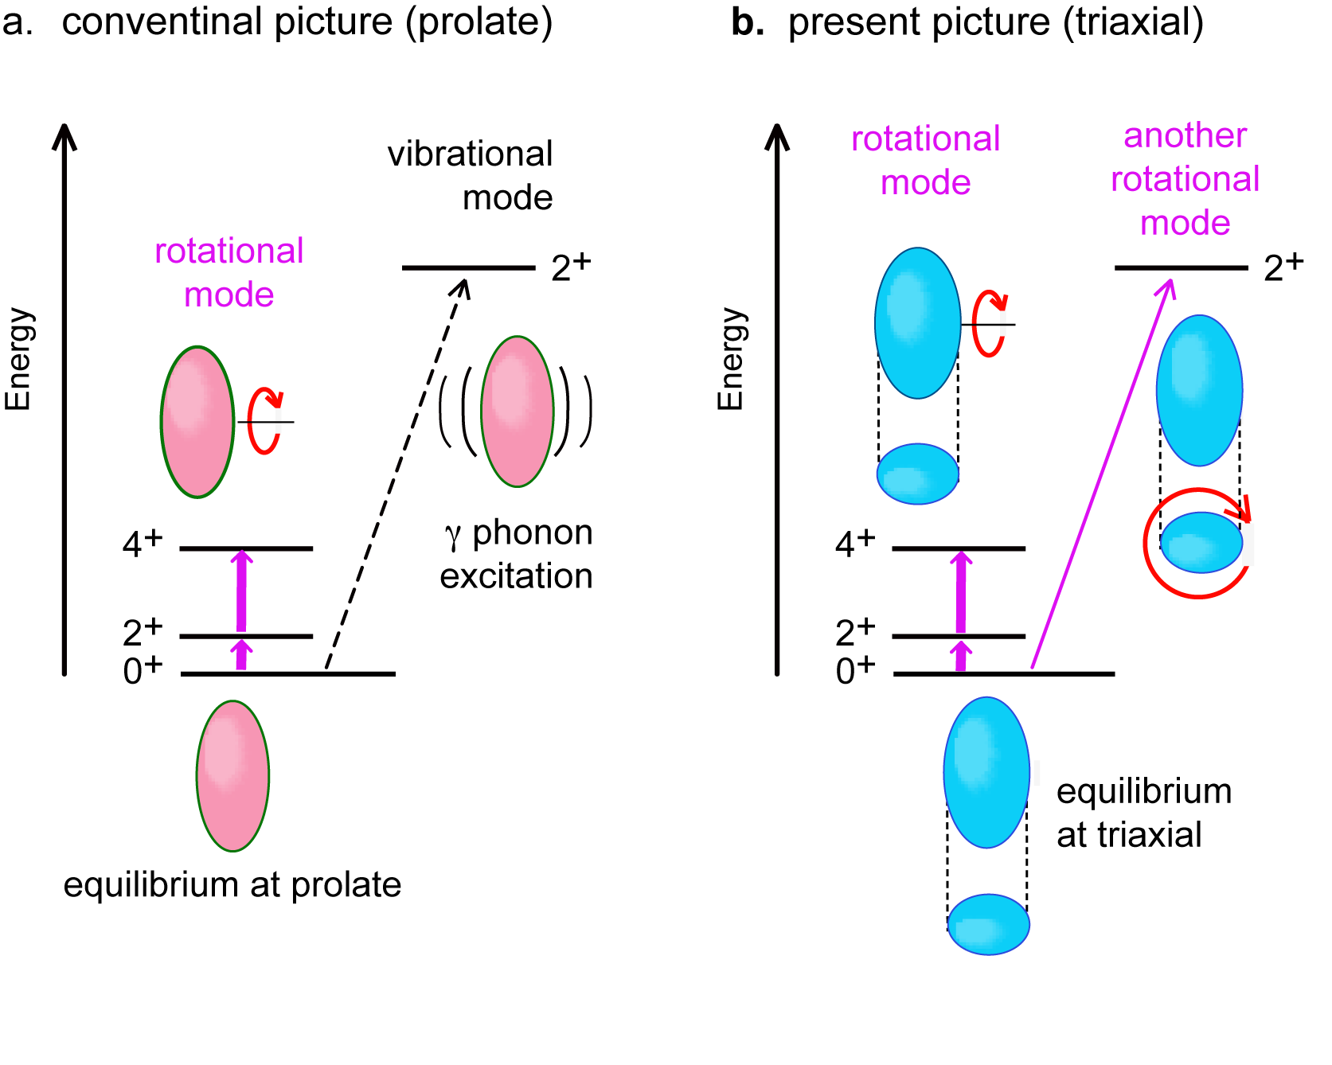
Aage Bohr’s
picture
Our picture
Result of MCSM calculation (QVSM)
E2 quantities in W.u.
K =2
R
K = 2
K
K = 0
K =0
ellipse
In the present case, the mixing between K=0
and K=2 states is small, and can be neglected.
circle
J = R + K
(cannot rotate)
The MCSM result points to a triaxial shape with axis ratio, 1.00 : 1.06 : 1.35, through its T-plot analysis (see next pages).
No hint of vibrational excitation.

Slide 12

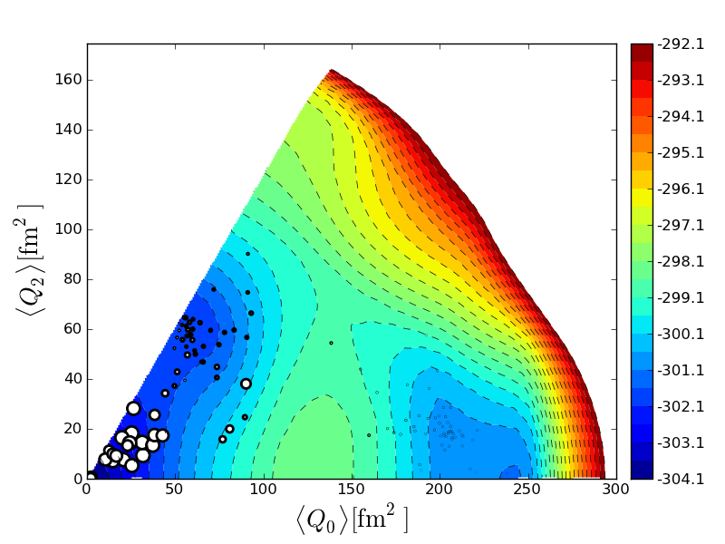
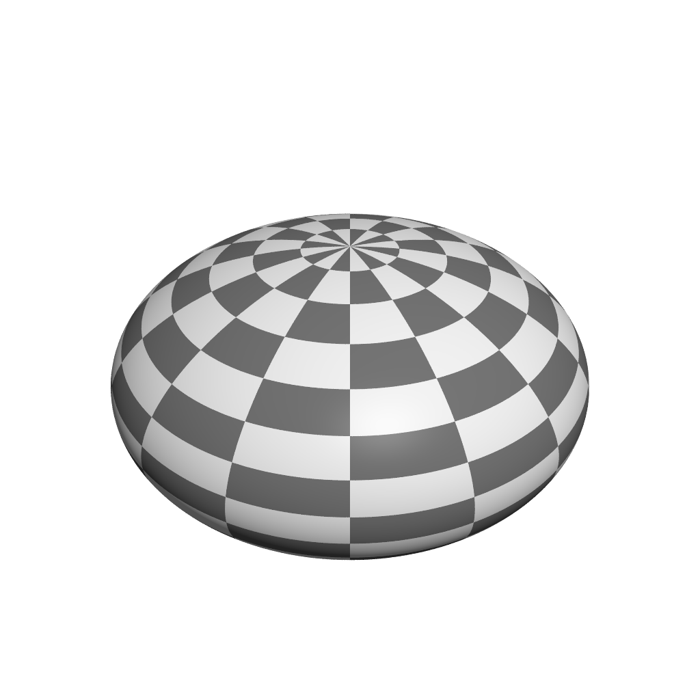
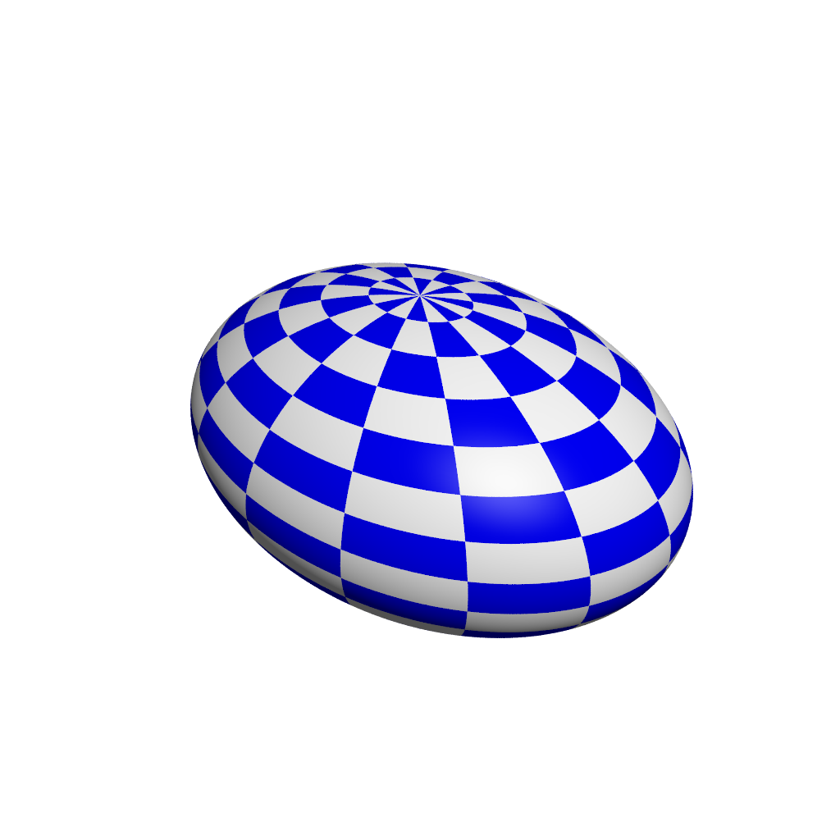
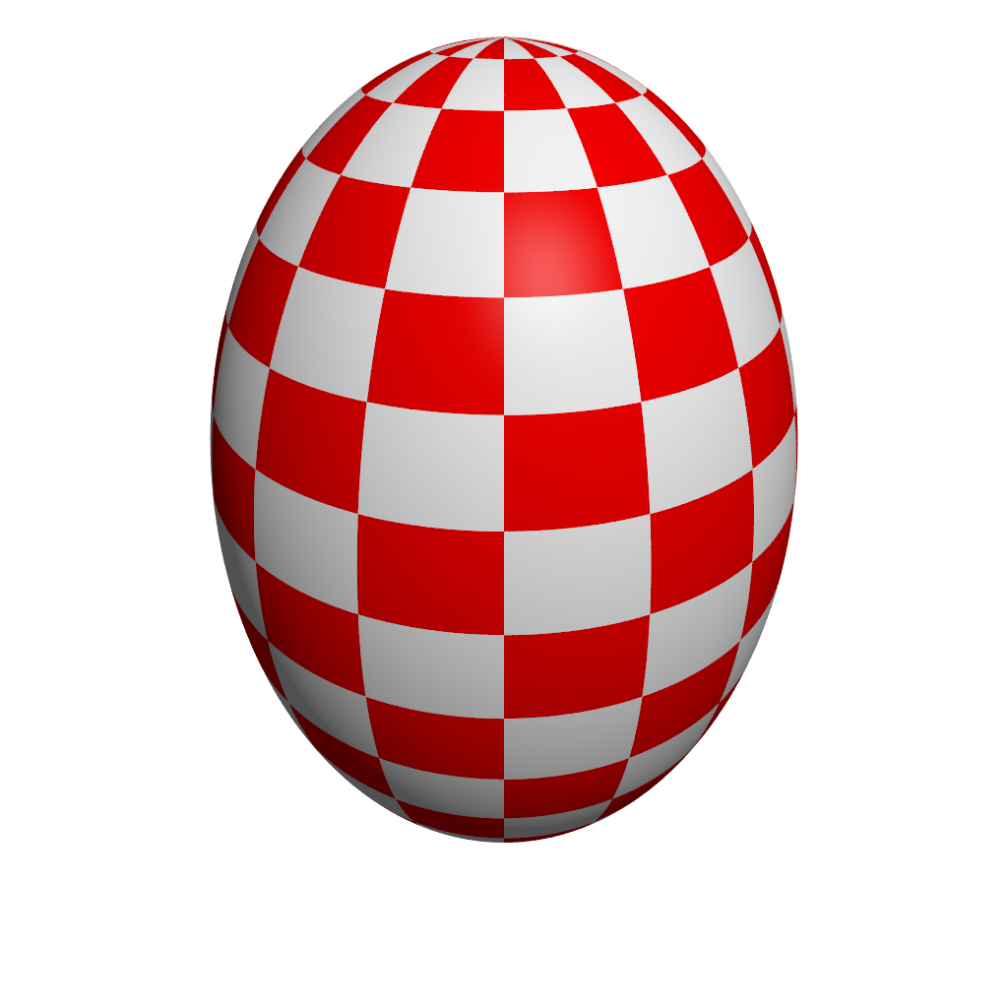

T-plot : visualization of MCSM eigenvector on Potential Energy Surface
eigenstate
stochastically deformed Slater determinant
→ intrinsic shape
Our answer to
Wigner’s worry*
mentioned by
Andrew
Stuchbery
amplitude
projection onto J^{π}
PES is calculated
by CHF for the shell-model Hamiltonian
Location of circle : quadrupole deformation of unprojected MCSM basis vectors
Area of circle :
overlap probability
between each
projected basis and
eigen wave function
0⁺₁ state of ⁶⁸Ni
Rx = Rz
γ
β ₂ and γ are
used as partial
coordinates of
basis vectors
oblate
triaxial
spherical
β ₂
prolate
Rx = Ry
Y. Tsunoda, et al. PRC 89, 031301 (R) (2014)

Slide 13
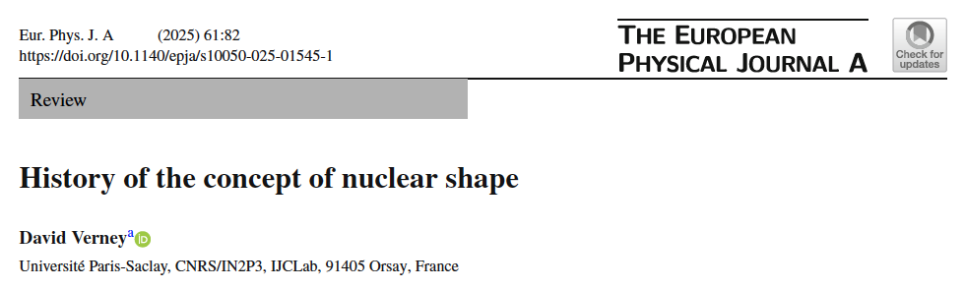
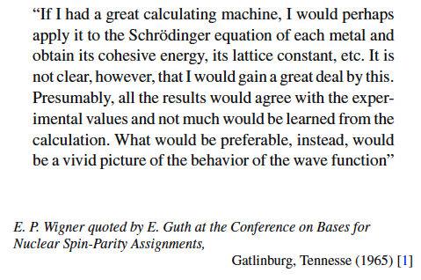
This was mentioned by
Andrew Stuchbery yesterday
as the statement given by
E. P. Wigner.
T-plot of Monte Carlo Shell Model
direct visualization of correlated
wave functions
results ~ Kumar invariant approach
Y. Tsunoda, et al. PRC 89, 031301 (R) (2014)

Slide 14
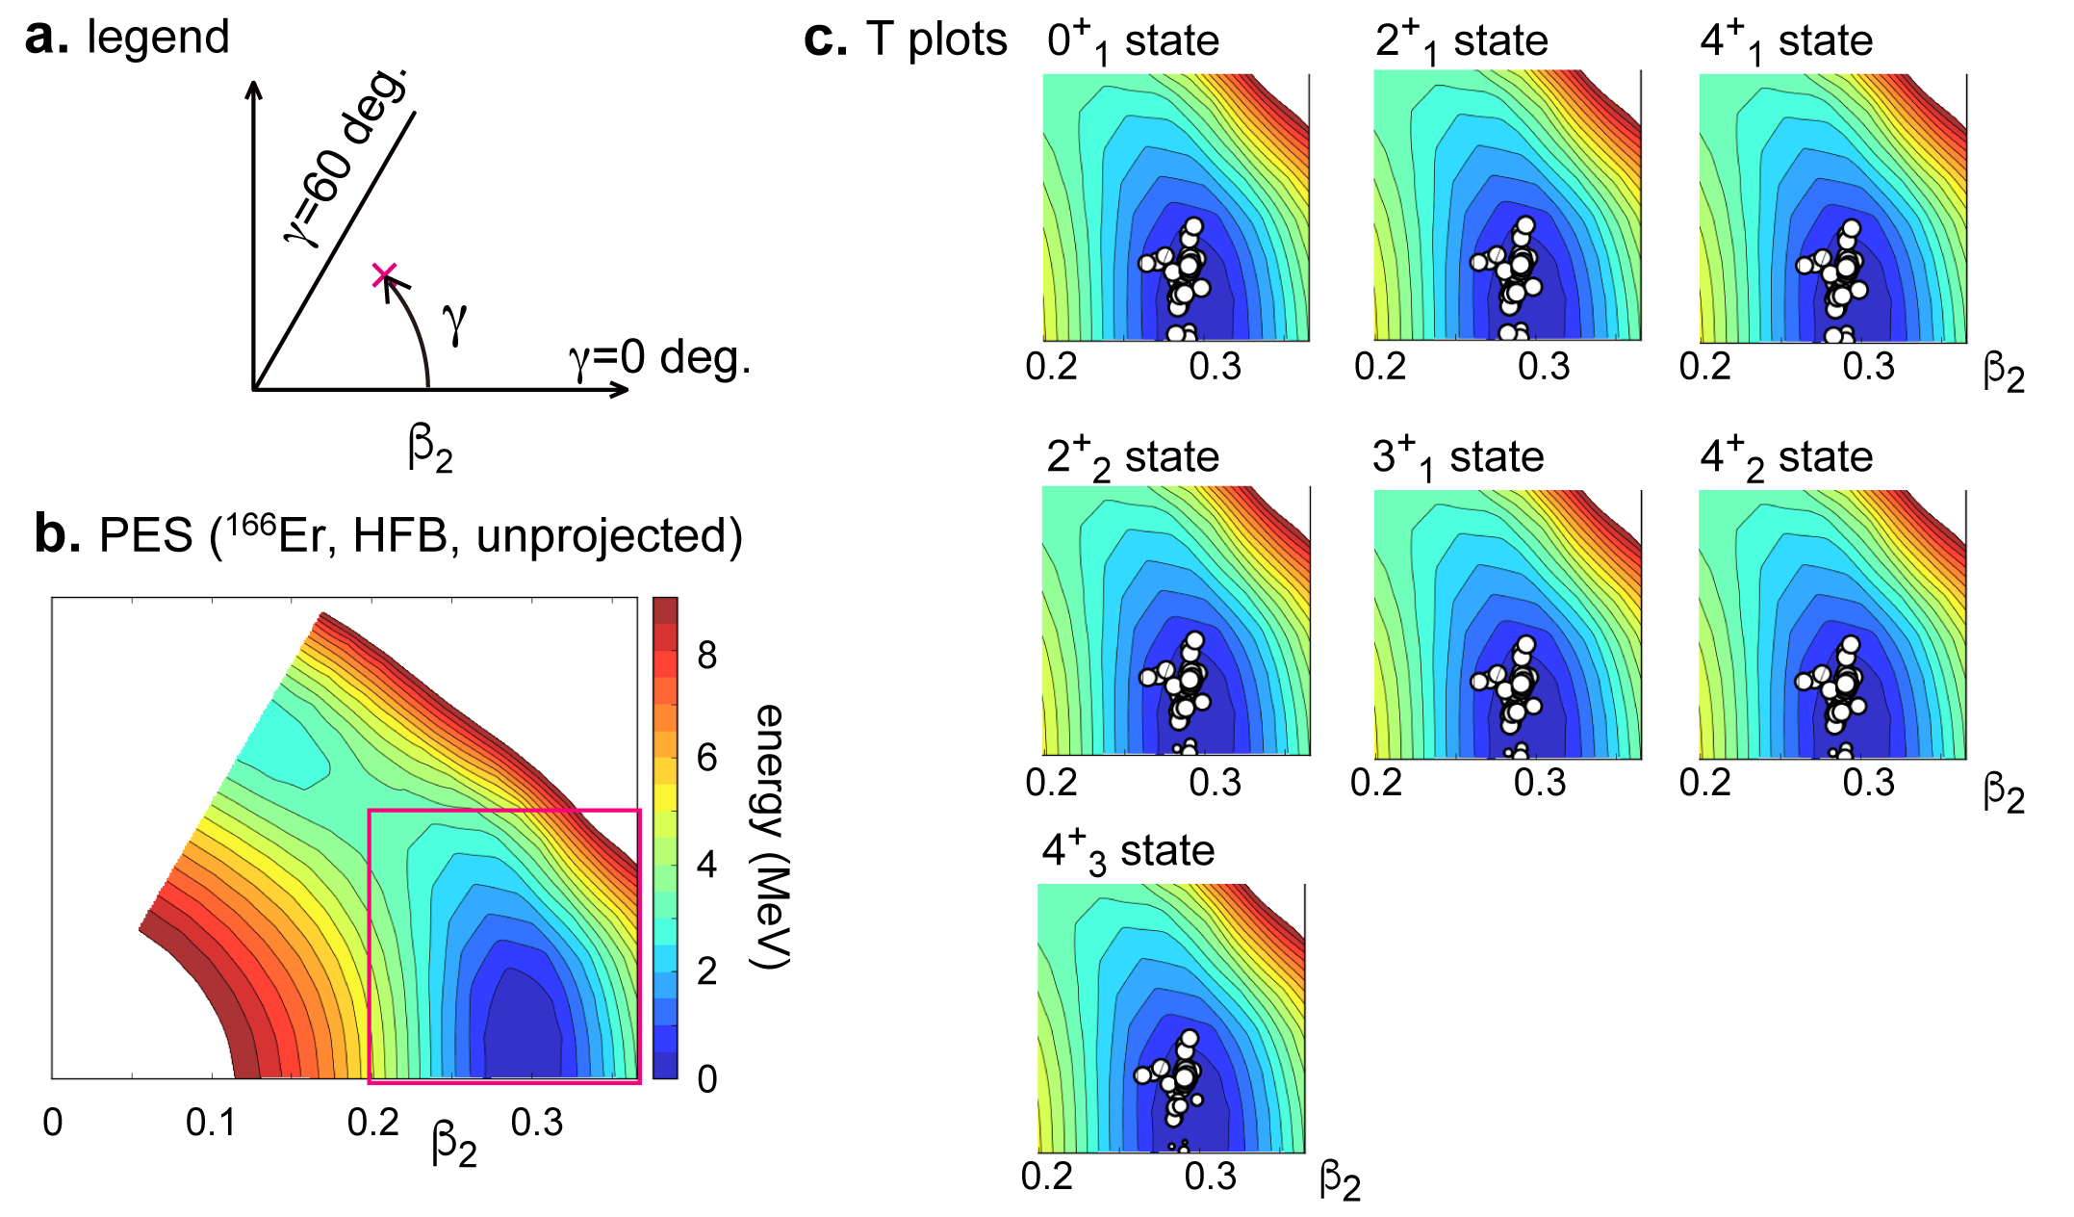

Shape variables and their visualization for the ground and lowest states of ¹⁶⁶Er
oblate
T-plot: mean position and spreading Distribution of basis vectors
triaxial
triaxial with
<γ> = 8.4 deg
K = 0
prolate
triaxial with
<γ> = 9.1 deg
K = 2
<γ> = 9.5 deg
cut
K = 4
Similar result from Kumar invariant
<γ> ~ 9.2 deg, <β₂> ~ 0.30

Slide 15
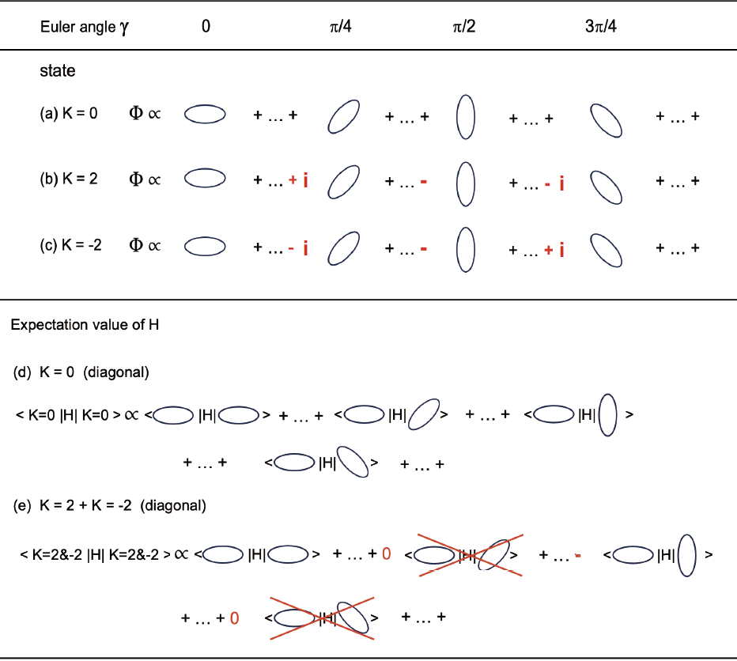
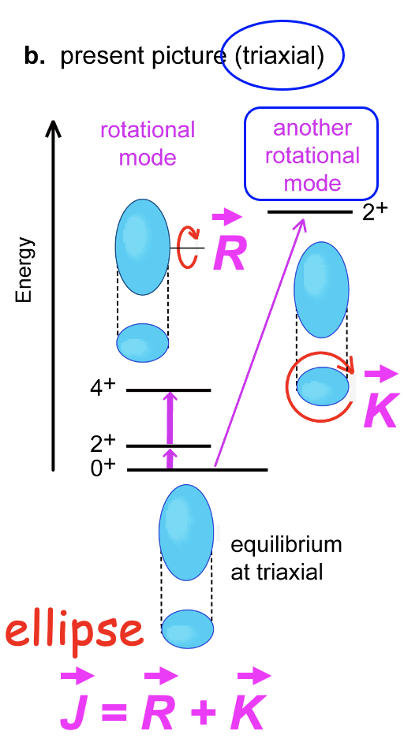
Broken rotational symmetry in the xy plane because of ellipse.
This symmetry is restored by the
projection onto a good K value
(different representations of the 2-dim. rotational group)
non-zero triaxial deformation
→ more binding energy
K=0
K=2
opposite
side view
top view
broken symmetry
less binding energy than K=0

Slide 16
Two origins and two appearances of triaxiality in deformed heavy nuclei
1. Small triaxiality due to symmetry restoration with K
If only this works, deformation parameter γ is typically up to 5 degrees.
This occurs in most (perhaps all) deformed nuclei.
2. Medium triaxiality mainly due to
monopole part of pn tensor force (through self-organization)
and/or
hexadecupole (multipole) part of pn central force
as verified by constrained HFB calc.
Both cases involve high-j orbitals, like g_{9/2,7/2} , h_{11/2,9/2} , i_{13/2,11/2} , etc.
Deformation parameter γ ranges from 6 to 14 degrees (or more).
This occurs in selected heavy deformed nuclei (~half ?).

Slide 17
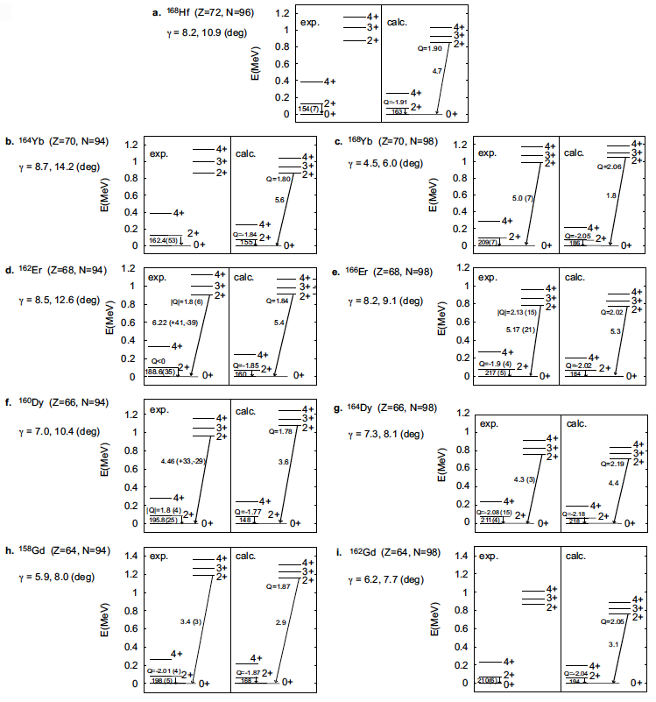
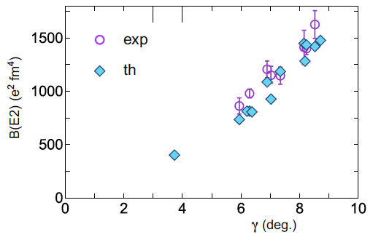
Systematic behaviors
by MCSM (QVSM)
Levels, B(E2)’s and
Q-moments
γ ~ Multiple CoulEx value
B(E2; 0⁺₁ -> 2⁺_{gamma} )
¹⁶⁶Er
¹⁶⁴Dy
¹⁵⁸Gd
B(E2) from 2⁺ at Ex~2.7 MeV of ¹⁵⁴Sm
γ = 3.7 deg (¹⁵⁴Sm)
supported by a recent experiment (γ = 5.0 +- 1.4 deg)
GDR (Kleemann et al., PRL 022503 (2025))

Slide 18
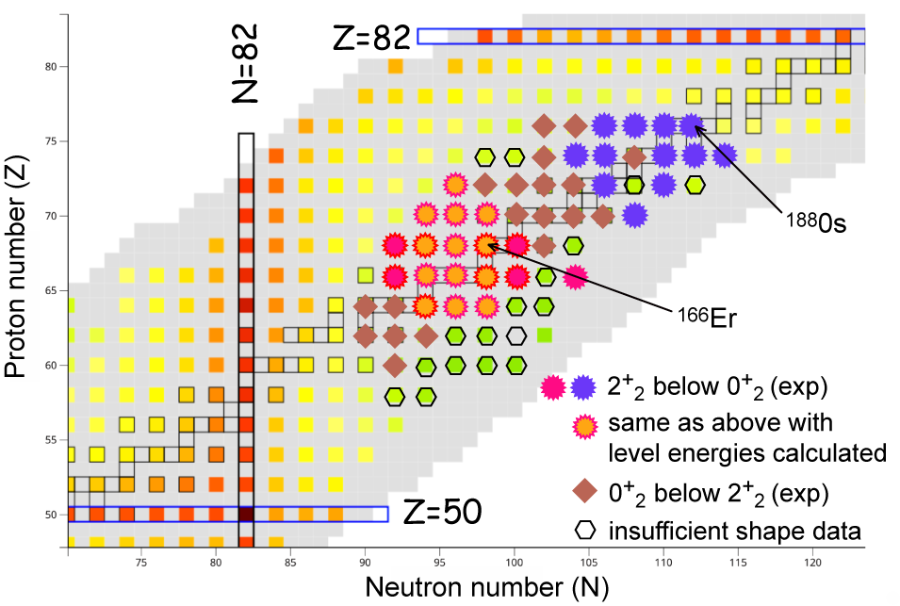
Appearance of triaxial shapes in the nuclear chart
medium
triaxiality
~ small triaxiality

Slide 19
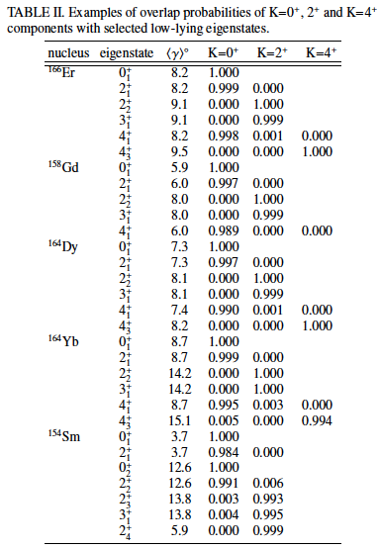
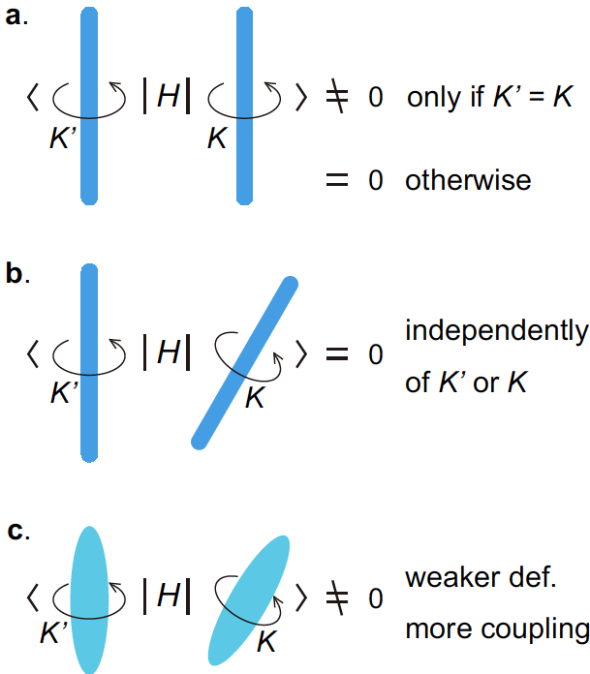
K quantum number is (practically) conserved with triaxiality
Robust mechanism for
good K with triaxiality
Rather strong K mixing may have been expected
in traditional picture for triaxial shapes.
In reality, K is now shown to be a good quantum number.
Can this be a general feature with molecules
and/or polymers ?
Is the bending of them
related ??
Dynamical symmetry as a many-body
effect (<−>Partial Dynamical Symmetry)

Slide 20
Outline
1. Quantum many-body formulation of “rotational energy”
2. Triaxiality and rotational states
3. Vibrational excitations – deformed case -
4. Vibrational excitations – spherical case -

Slide 21
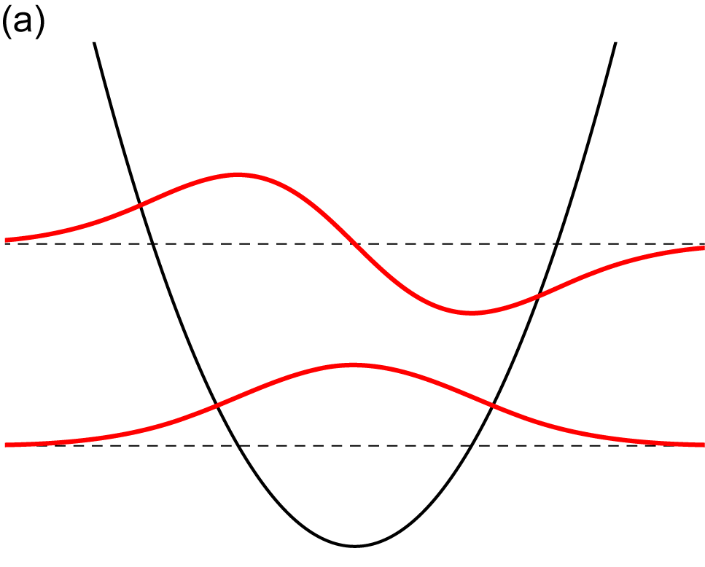
Energies and wave functions
of a particle confined in a
one-dimensional harmonic
oscillator potential
(= model of vibration)
“Vibrational” excitation of collective states
with respect to a collective variable
(for example, β ₂ and γ )
Our eigenstates are written as
/N_{i}
oscillation
amplitude
basis vector (many-body
state) with shape parameter
N_{i} : relevant norm
peak
E₁
node
Expected basic pattern of the amplitudes
peak
peak
E₀
at rest
reference (ex, ground) state
vibrational mode
peak
peak
“node”
amplitude
γ
γ
shape parameter
peak
chosen to be real positive

Slide 22
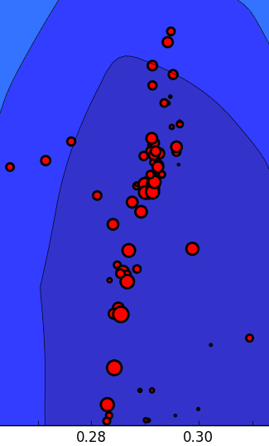
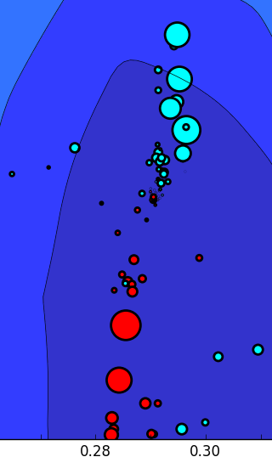
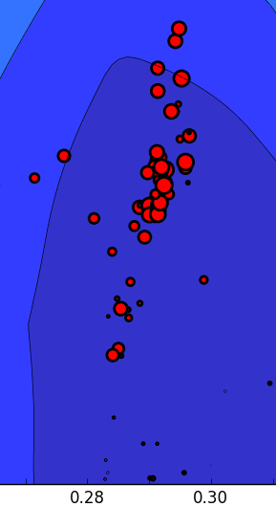
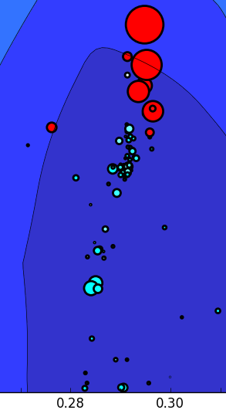
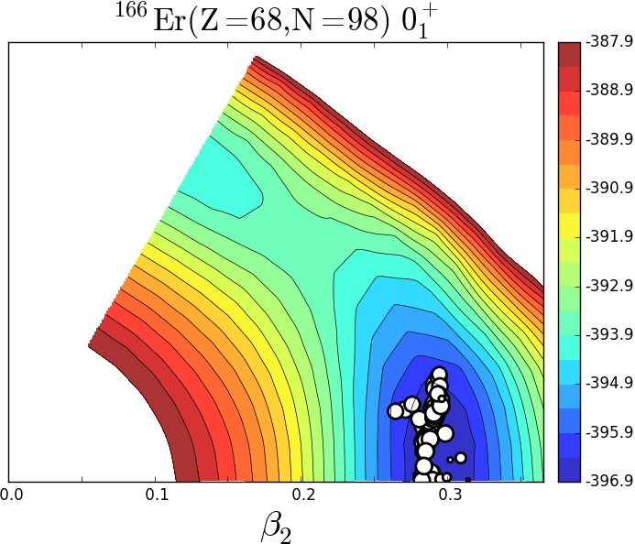
Do we still have vibrations ?
Advanced T-plot exhibiting also phases of amplitudes
Our eigenstates are written as
0⁺₁
0⁺₃
2⁺₂
2⁺₅
K=0
K=0 vib
K=2
K=2 vib
/N_{i}
amplitude
basis vector (many-body
state) with intrinsic shape
Usual T plot for the probability.
red (blue) circles : amplitudes are positive (negative)
amplitudes are defined to be positive for 0⁺₁ and 2⁺₂ state
Expected basic pattern of the amplitudes
reference (ex. ground) state
vibrational mode
amplitude
γ
γ

Slide 23
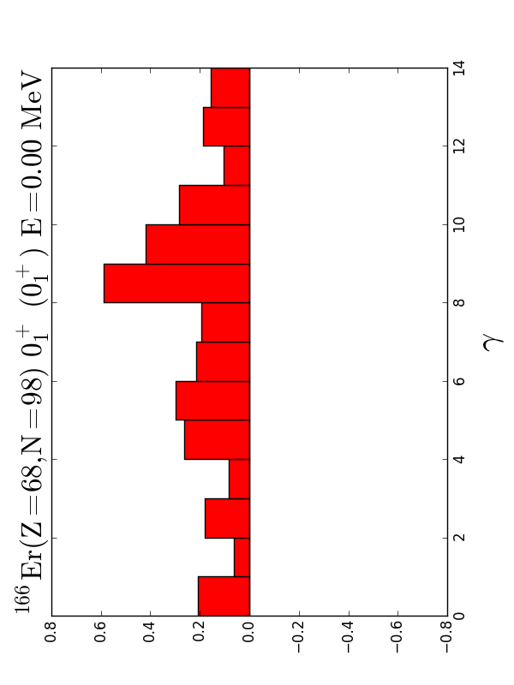
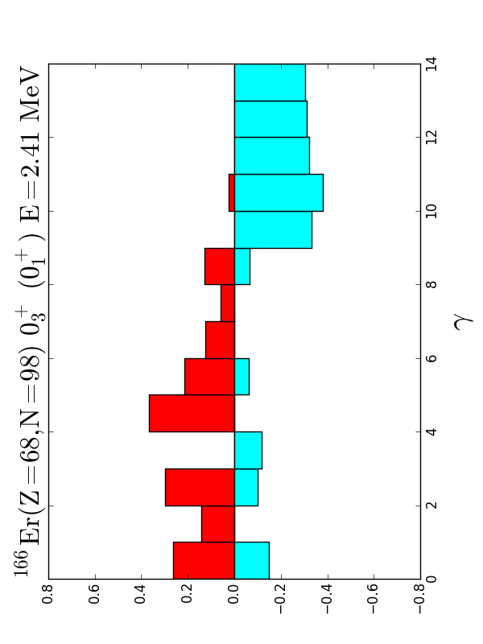
We can take superpositions within a given bin of γ, e.g. γ = 9 - 10 deg.,
separately for positive and negative amplitudes, where phases are defined by a reference state.
amplitudes are defined to be positive
for 0⁺₁ state as a reference state
positive
amplitude
negative
amplitude
0⁺₃ state
0⁺₁
0⁺₃
K=0
K=0 vib
γ
γ
red (blue) circles : amplitudes are positive (negative)
This is a clear and important signature of the vibration in quantum
many-body language. No semi classical arguments used.

Slide 24
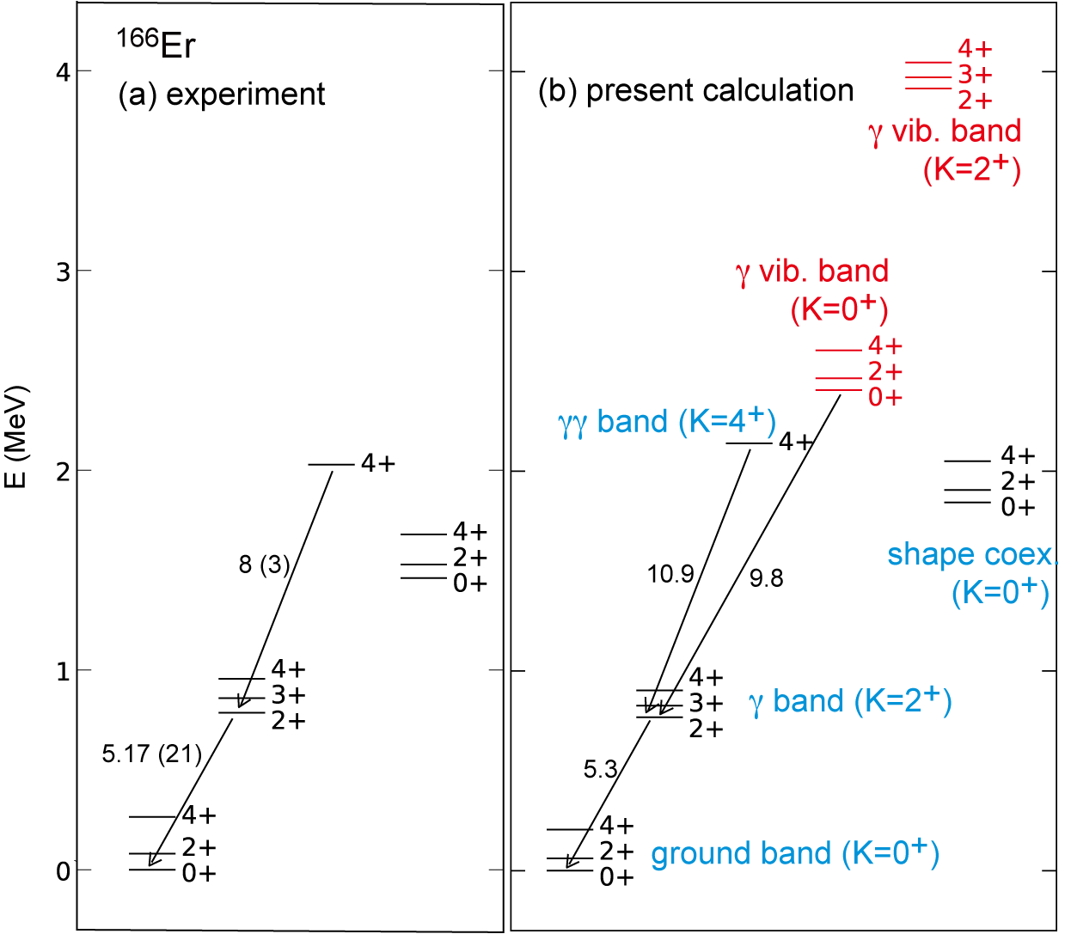
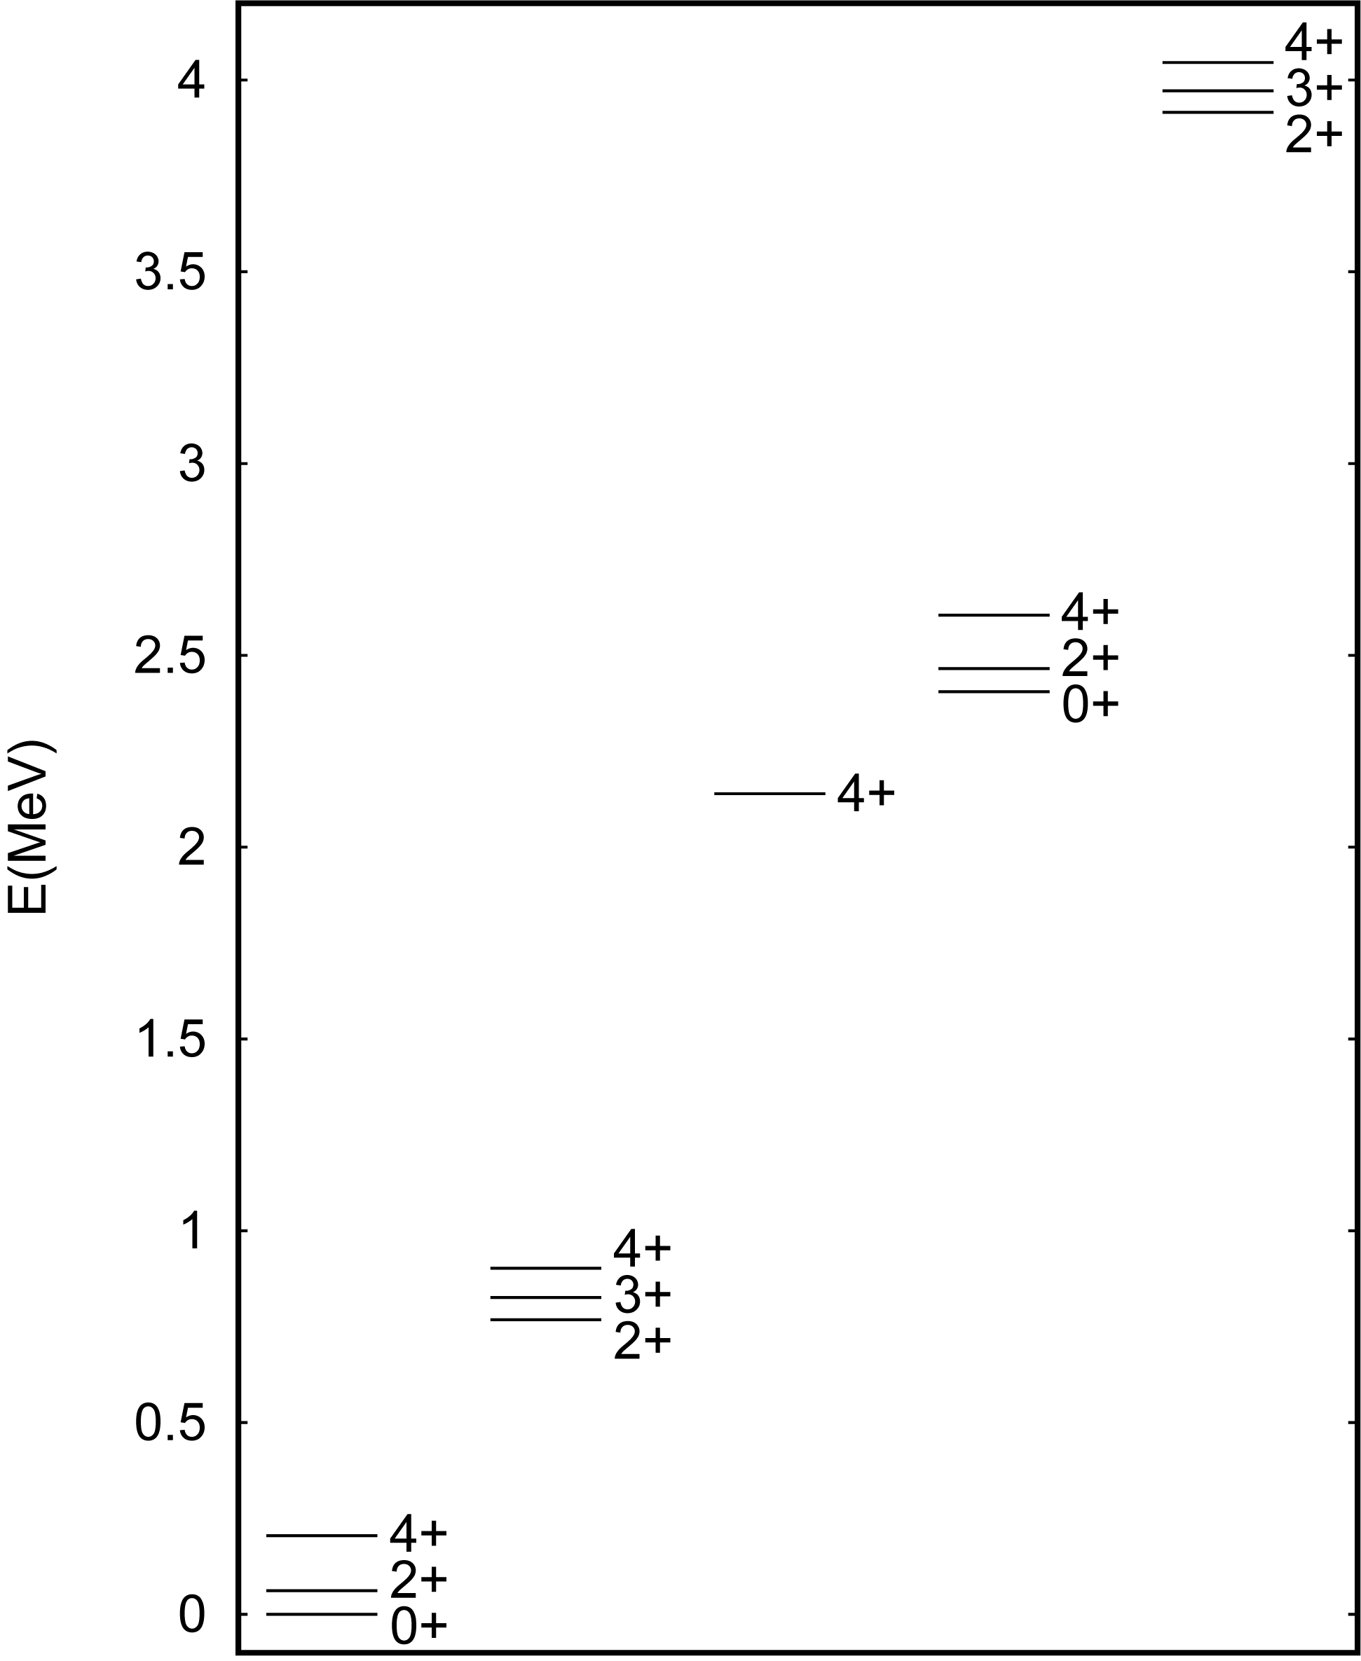
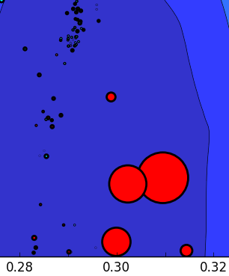
¹⁶⁶Er
B(E2) in W.u.
Level energies of ¹⁶⁶Er
including vibrational states
¹⁶⁶Er calc.
(basis vectors
in and around the
PES minimum as
seen in T-plot)
γ vibrational
K=2
xy plane cross section
of triaxial states
higher states
not shown
decay paths
0⁺₂
xy plane cross section of
γ vibrational states built on
triaxial states
11 W.u.
γ vibrational
K=0
"γγ" (K=4)
-
12 W.u.
→ both K=0 and K=2 arise
γ band (K=2)
K=2 ex. energy is higher than
K=0 one by the same reason as
that for the 2⁺γ band
ground band (K=0)

Slide 25
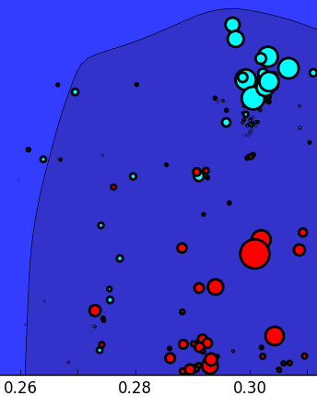
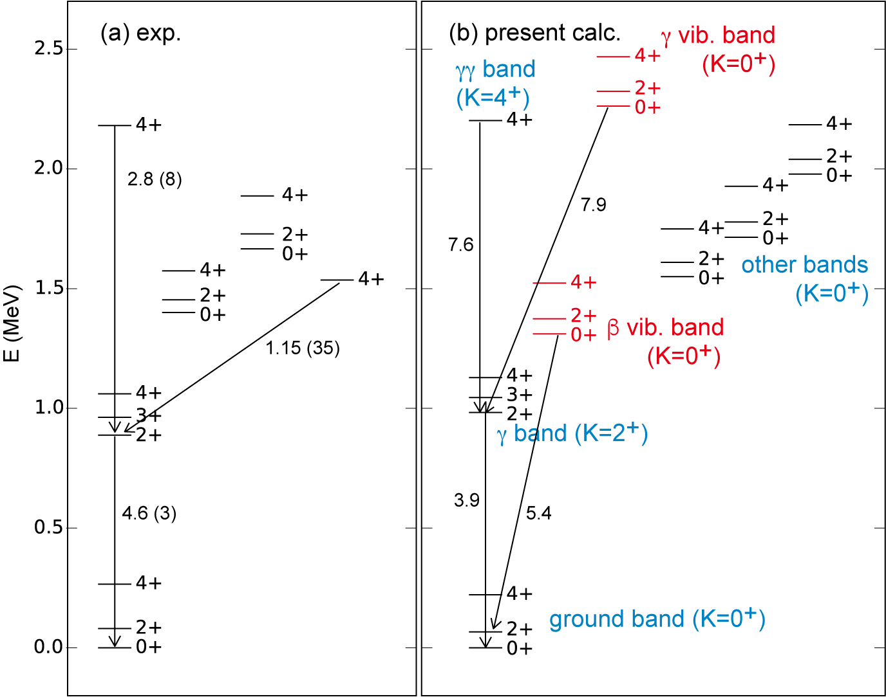
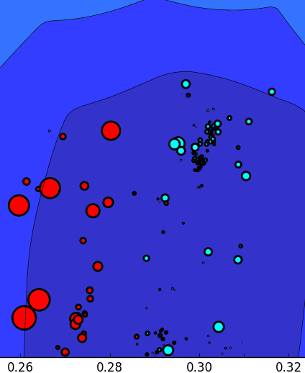
¹⁶²Dy
arrow :
major decay path
ground (γ=6.9 deg)

Slide 26
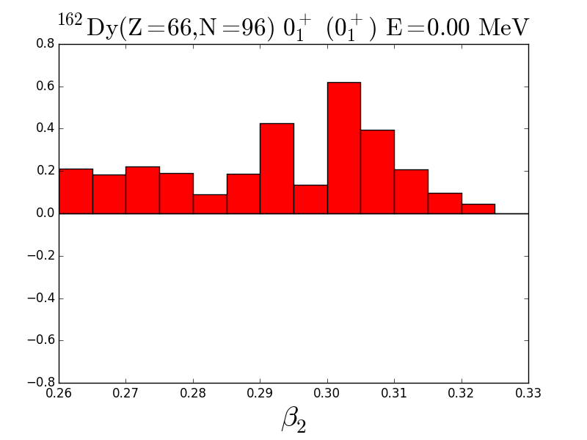
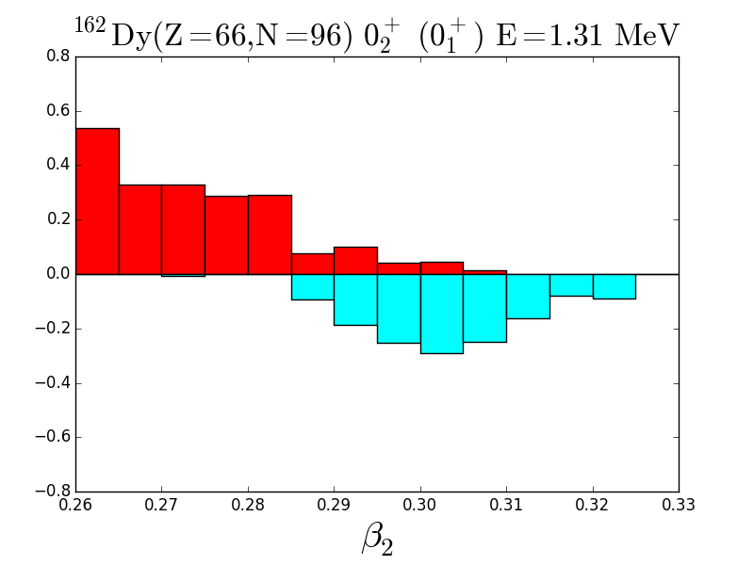
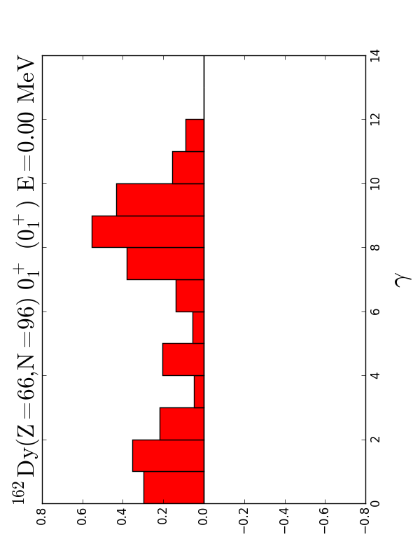
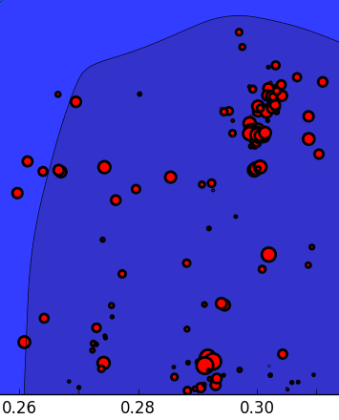
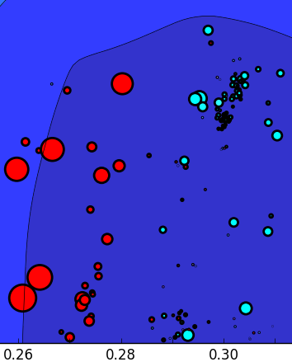
¹⁶²Dy
0⁺₂
PES bottom
wider than ¹⁶⁶Er
ground state
β – vibrational mode
β ₂
β ₂
0⁺₁
0⁺₂
K=0
K=0 vib
γ

Slide 27
Outline
1. Quantum many-body formulation of “rotational energy”
2. Triaxiality and rotational states
3. Vibrational excitations – deformed case -
4. Vibrational excitations – spherical case -

Slide 28
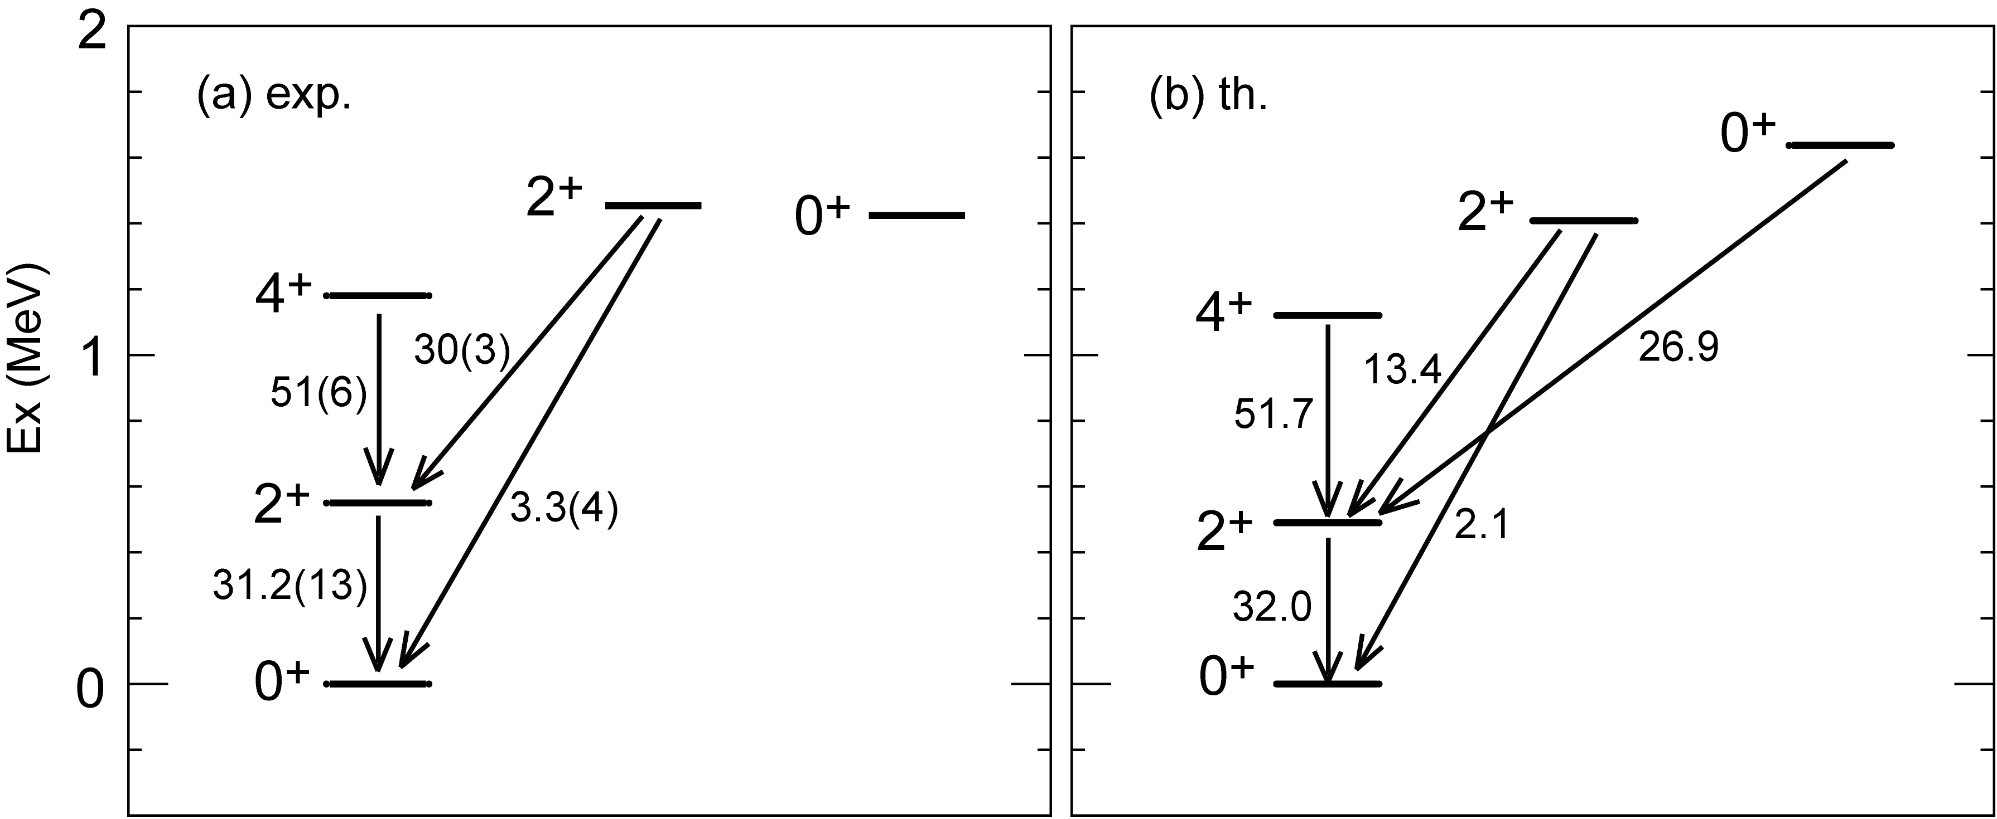
¹⁴⁸Sm : a typical vibrational nucleus with a (near-)spherical ground state
2-phonon (triplet)
1-phonon
0-phonon
from ensdf
by QVSM calc.

Slide 29
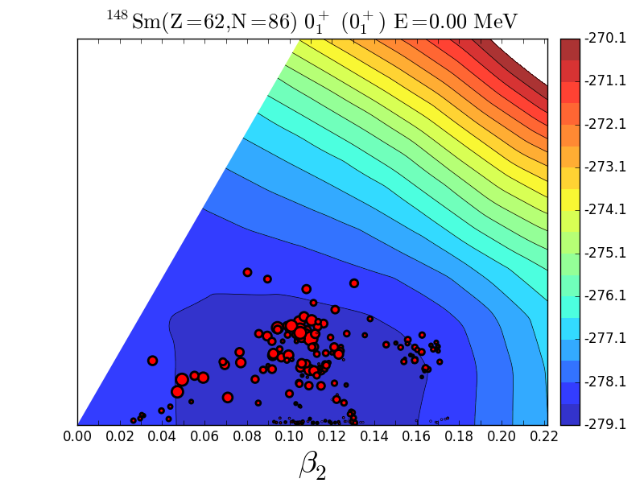

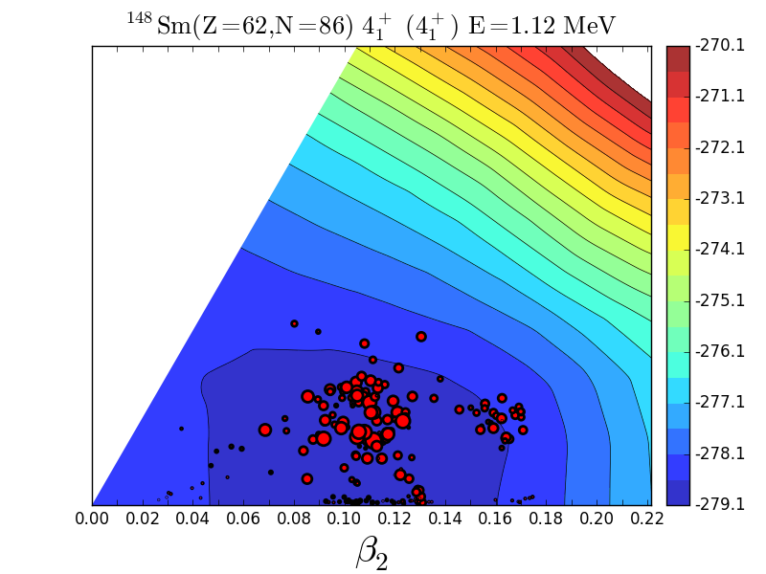


¹⁴⁸Sm Amplitude T-plots
0⁺₁
2⁺₁
1-phonon
4⁺₁
0-phonon
2-phonon
shifts to larger β ₂ (quadrupole phonon excitations)
orthogonality due to different J values. K ~ 0
Modest shifts of the distribution towards larger β ₂ in the sequence 0⁺₁ → 2⁺₁ → 4⁺₁
This may be interpreted as quadrupole phonon excitations.
0⁺₂
2-phonon
2⁺₂
2-phonon
vibration in a potential
shifts to K=2
The structure of 2⁺₂ looks like quadrupole phonon towards K=2.

Slide 30

Summary
1. Rotational excitation energy proportional to J(J+1) can be derived in quantum many-body
framework, without resorting to the quantization of the free rotation of classical rigid body.
2. Triaxial deformation occurs in virtually all deformed nuclei, because the symmetry
restoration gives more binding energy to triaxial K=0⁺ states. → “small triaxiality”
- no separation between intrinsic (spirit) and extrinsic (body) degrees of freedom -
3. Triaxiality is enhanced by tensor and central (hexadecupole) forces in some nuclei,
at least in 13 rare-earth nuclei, such as ¹⁶⁶Er, ¹⁶⁴Dy, ¹⁵⁸Gd.
Combined with symmetry restoration → “medium triaxiality” - almond v.s. rugby ball -
4. Band structure appears with practically conserved K quantum number with triaxiality,
clearly in contrast to the picture of Aage Bohr. Shape coexistence appears everywhere.
5. Vibrational excitations emerge from triaxial shapes, weak or strong deformation.
6. A lot of novel stuff are provided for the spectroscopy of heavy nuclei.
Reference:
arXiv:2303.11299v7 [nucl-th]; EPJ-A soon

Slide 31
E N D
Thank you

Slide 32
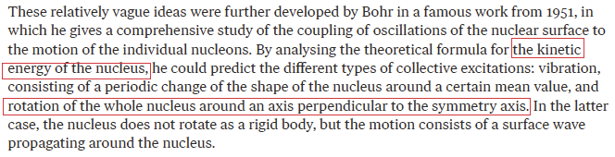

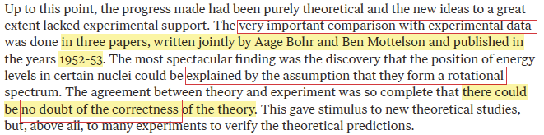
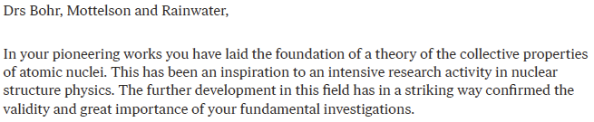
Nobel Prize 1975
rotation
……
J=4
ratio=1 : 3.33
ideal rotor:
Ex J(J+1) rule
J=2
J=0

Slide 33
Origin of the famous J(J+1)-K² rule of rotational excitation energy
conventional description
alternative view
classical mechanics
quantum mechanics for many-body system
time t, angle Ω(t)
rotation of rigid body
eigenstate with angular momentum h J
- superposition of states at varying angles
time t₀, angle Ω₀
H
- Hamiltonian H, including
interactions, couples
states created by
orienting the same
intrinsic state at different
angles
quantization of free rotation of this rigid body
→ eigenstate with angular momentum h J
- superposition of states
at varying angles
- The superposition is
made due to
specific angle dependence
of superposition amplitudes,
which are governed by J
- for axially symmetric shape,
J(J+1) rule is suggested
- just kinetic energy, no
interaction

Slide 34
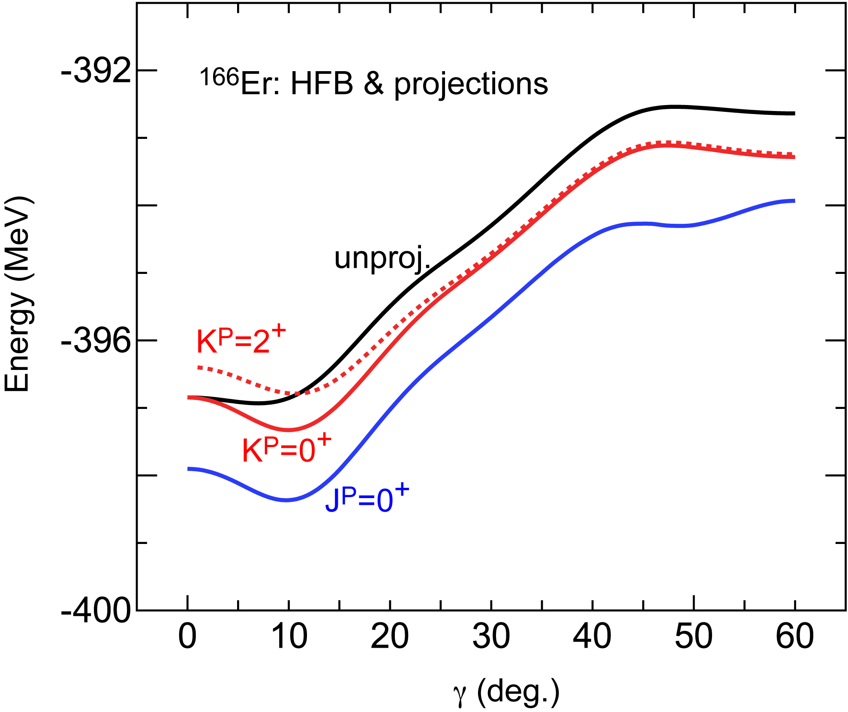
Unprojected and projected energies relative to γ=0 value as a function of γ
Along the cut (β = 0.3) in the PES
HFB with good particle number
for the same Hamiltonian
lowering of K=0⁺ projected state
the triaxiality gives
more binding energy to K=0⁺
triaxiality is not
a fluctuation but a mean effect
A non-trivial feature:
The flat bottom of the unprojected
PES is one of the crucial factors for
yielding the distinct triaxial minimum
after the projections onto K=0⁺ (or 2⁺).
QVSM 1st
QVSM

Slide 35


total unprojrcted
An anatomy of the energy of unprojected state relative to γ=0 value as a function of γ
decomposition into individual effects of
pn central, pn tensor and rest components
Further decomposition into monopole and multipole
components → major players for the flat bottom
tensor monopole int.
&
central high-rank multipole (hexadecupole) int.
(Q Q) int. gives more binding energy to more
deformed states, but is neutral for triaxiality,
because ~ ~

Slide 36
Basic formulation of Monte Carlo Shell Model
N_{B} : number of basis vectors
eigenstate
N_{p} : number of (active) particles
N_{sp} : number of single-particle states
amplitude
a
n-th basis vector (Slater determinant)
Projection op.
Superposition of original single-particle state
Minimize E(D) with respect to D utilizing
Quantum MC and variational methods
Bogoliubov state in the QVSM (advanced version)
Step 1 : Shift randomly matrix matrix D. (The initial guess can be taken from Hartree-Fock.)
Select the one producing the lowest E(D) (rate < 0.1 %)
Step 2 : Polish D by means of the conjugate gradient (CG) method variationally.

Slide 37




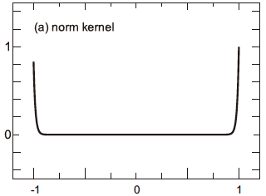





+ …
hierarchy expansion in terms of
a new feature in this analytic aspect
Legendre function satisfies the differential equation:
= F_{J}
norm and energy kernels
regions of cos β ~ 1 or -1
are relevant
similar expansion for β ~ -1
(MeV)

Slide 38


















energy for J is given by
{
+ …}
norms are treated similarly
norm kernel
We substitute the first two terms, also for those for the normalization,
for
Leading order (LO) & Next to LO (NLO) :
substituting
+
deviation ~ 1.5 % to direct projection in the tests so far

Slide 39


conventional view and theoretical approaches
Early and recent DFT approaches
Hayashi, Hara, Ring (1984) γ ~30 for ¹⁸⁸Os, but
¹⁶⁸Er was considered to be prolate.
Tajima et al. (1996) dominance of prolate
(γ =0) shape by Skyrme HF
Delaroche et al., PR C 81, 014303 (2010)
Gogny int. → 5-dim Bohr Hamiltonian
Axial symmetry
supposed to
dominate
this region
¹⁶⁶Er
Scamps, Goriely et al. (2021), γ =1.6 (1.2) deg
for ¹⁶⁶Er (¹⁵⁴Sm) by Skyrme HFB
Li et al., (2010); Yang et al. (2021)
Relativistic HB for ¹⁶⁶Er etc. γ ~ 6 deg., but
Ex(2⁺₂) higher by a factor of 1.5
γ smaller, mostly 0 for others of the interest
Robledo et al. (2008), PES by HFB with Gogny D1S for many (incl. ¹⁵⁴Sm)
Li et al. (2009),
Rel. EDF -> 5-dim coll. Hamiltonian,
Prolate minimum for ¹⁵⁴Sm

Slide 40
Questions and proposals were raised from other viewpoints, …
Davydov model
Davydov & Filippov, Nucl. Phys. 8 (1958)
J. Sharpey-Schafer et al. EPJ-A 55, 15 (2019)
Non-existence of γ-phonon from experimental standpoints
T. Yamazaki, Nucl. Phys. 49, 1 (1963) (passed away on the 31st of January)
Data from Multiple CoulEx experiments showed finite γ values, but no explicit strong claim
of triaxiality was made.
Cline et al (1986,1990), Fahlander et al (1992), Werner et al (2005), …
P. E. Garrett, J. Phys. G: Nucl. Part. Phys. 27, R1-R22 (2001)
critical review on β-phonon or β vibration
P. Boutachkov, A. Aprahamian, Y. Sun ei al., EPJ-A 15, 455 (2002)
triaxiality assumed in the deformed shell model

Slide 41
Possible description of “spherical to deformed shape (phase) transition”
As deformation increases from nucleus to nucleus (like ¹⁴⁸Sm to heavier ones),
the change of β ₂ within the yrast band becomes smaller.
A vibrational spectrum shows up when this change is finite.
If (almost) no change occurs, static deformation arises, where the same
intrinsic state is shared by band members.
➔ rotational excitation
An abrupt shape phase transition does not occur in Sm isotopes,
but occurs, for instance, between ⁹⁸Zr and ¹⁰⁰Zr.

Slide 42

¹⁶²Dy
0⁺₆
ground state
β ₂
γ – vibrational mode
0⁺₁
0⁺₆
K=0
K=0 vib.
γ
γ

Slide 43






¹⁵⁴Sm
Level scheme
and T-plot
2nd vibrational (γ direction)
1st vibrational (β direction)
dual β shape coex
γ~13 deg
β & γ (triaxial;
shape coex;
K=0 & 2)
ground
(γ=3.7 deg)

Slide 44

¹⁵⁴Sm : typical example of small triaxiality only
no flat bottom in the unprojected PES
modest minimum in K / J projected PESs
Energy of unprojected state relative
to γ=0 value as a function of γ
level energies
steep change ~ 7 MeV
(cf. ~4 MeV for 166Er)
K=2 excitation
γ ~ 13 deg.
There is a tendency
towards a more
prolate shape in
¹⁵⁴Sm
shape
coexistence
(2019 PRL)
γ ~ 3.7 deg.

Slide 45
Example of basic triaxiality
¹⁵⁴Sm : small triaxiality (gamma~3.7 deg.) in the ground band
medium triaxiality (gamma~13 deg.) in the beta+gamma bands
shape coexistence
shape coexistence

Slide 46

Systematics of deformation parameter γ
Is γ=2 degrees the minimum in this region of the Segre chart ?

