Slide 1
Anagrafica
Active Staff Members without Assigned FTE:
- Vittoria Ludovica Ciccarella – Laureanda Roma1 / Dottoranda Roma1(2025)
Elisa Di Meco – Dottoranda Tor Vergata
Ruben Gargiulo – Dottorando Roma1
Eleonora Diociaiuti – LNF
Daniele Paesani - LNS

Slide 2
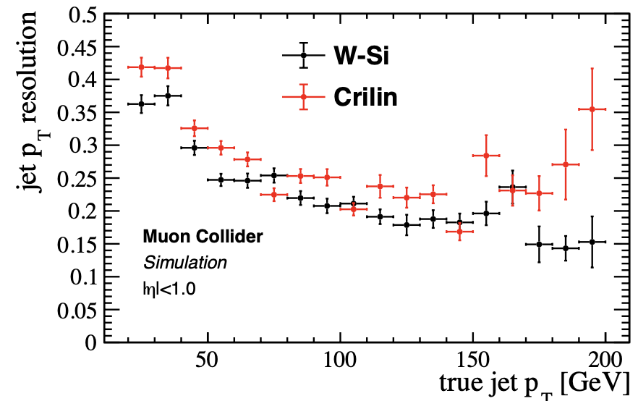
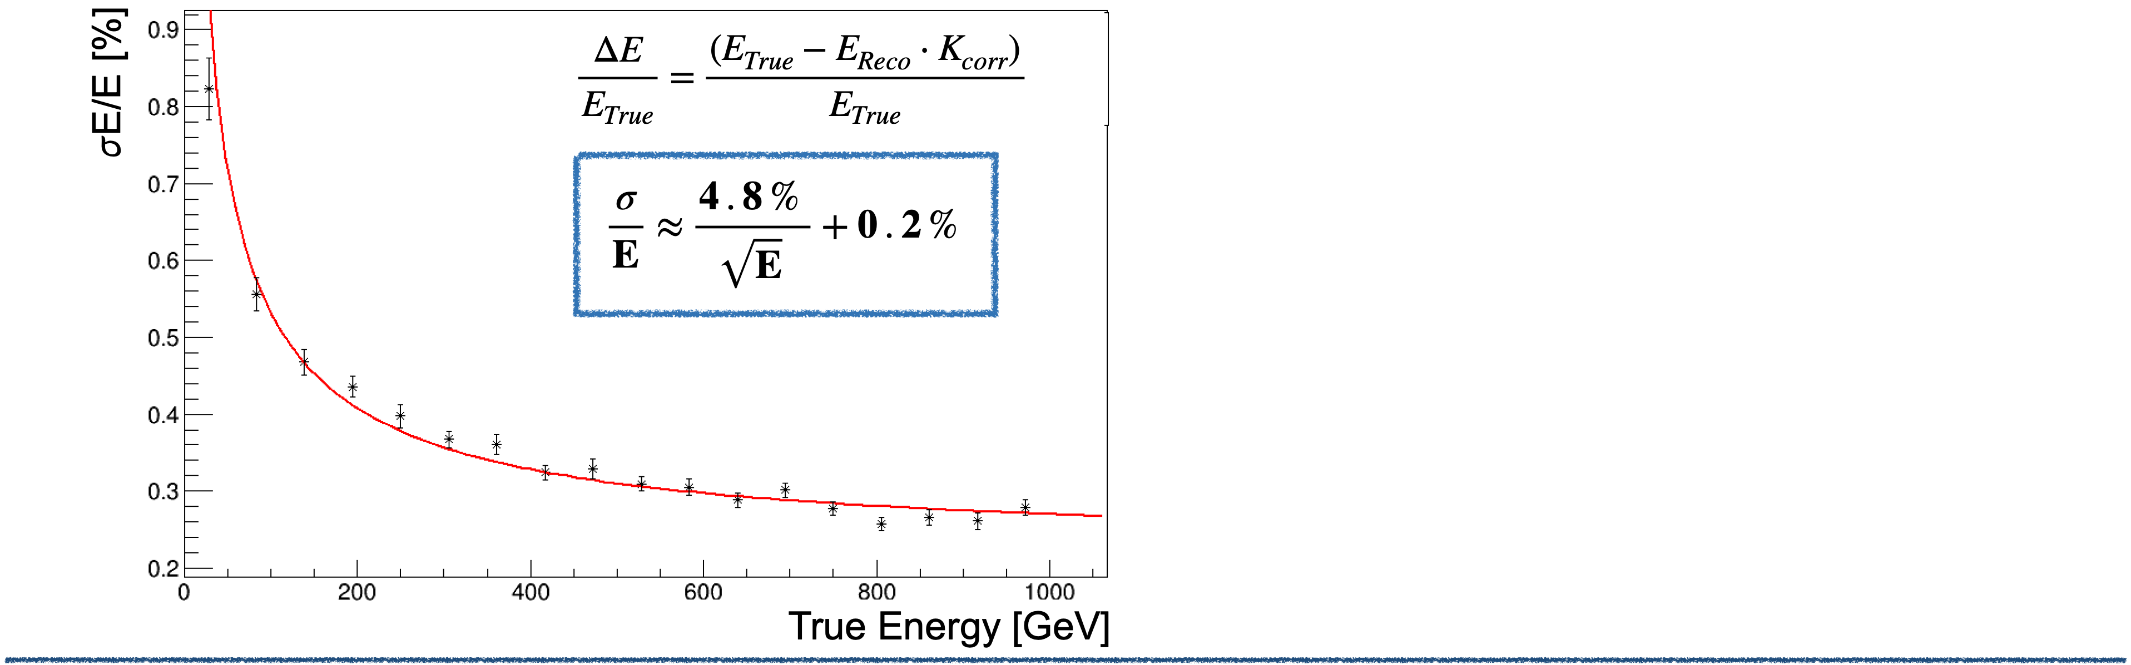
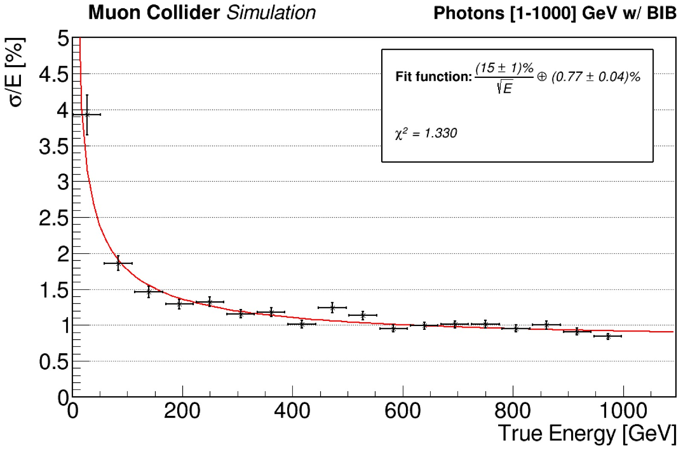
Simulated performances
ECAL barrel with Crilin technology implemented in the Muon Collider simulation framework
  Including digitization from real test-beam waveforms + BIB rejection with timing and longitudinal hit position
  5 layers with 45 mm length, 10 X 10 mm² cell area → 21.5 X₀
  In each cell: 40 mm PbF2 + 3 mm SiPM + 1 mm electronics + 1 mm air
Design optimized for BIB mitigation: with 4.5 cm layers, BIB energy is integrated in large volumes → reduced statistical fluctuations of the BIB energy deposit
Crilin 5 layers competitive wrt W-Si 40 layers → factor 10 less in cost (6 vs 64 Mchannels)
Muon Collider Simulation
Muon Collider Simulation
Photons [1-1000] GeV w/out BIB
$$\frac{σ_{E}}{E}∼\frac{15\%}{\sqrt{E\left[GeV\right]}}⊕0.8 \%$$
$σ(ΔE/E)$[%]
$σ(ΔE/E)$[%]
$$\frac{σ_{E}}{E}∼\frac{4.8\%}{\sqrt{E\left[GeV\right]}}⊕0.2 \%$$
w/o BIB
with BIB
Photons True Energy [GeV]
Photons True Energy [GeV]
Notes:
allows an easy assembly of the calorimeter and allows to assemble the calorimeter with submodules arranged in series and in parallel to obtain any configuration needed.
MZB which provides signal amplification and shaping, along with all slow control functions - individual bias regulation, temperature and current monitoring

Slide 3
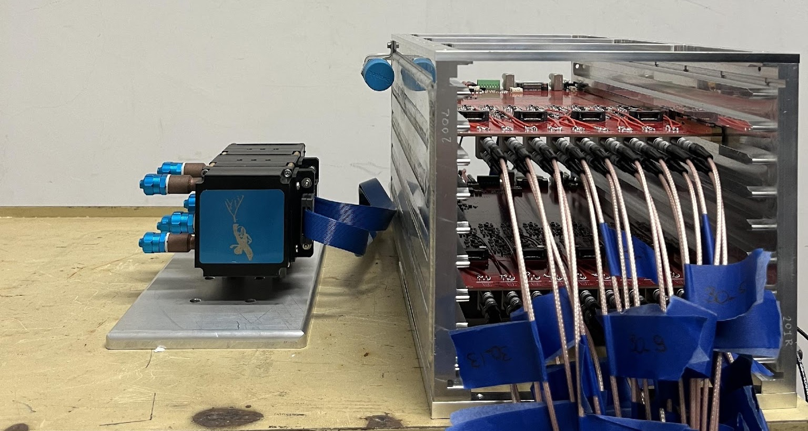
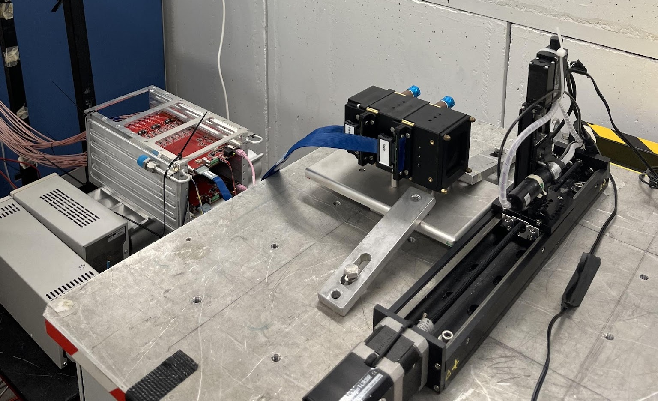
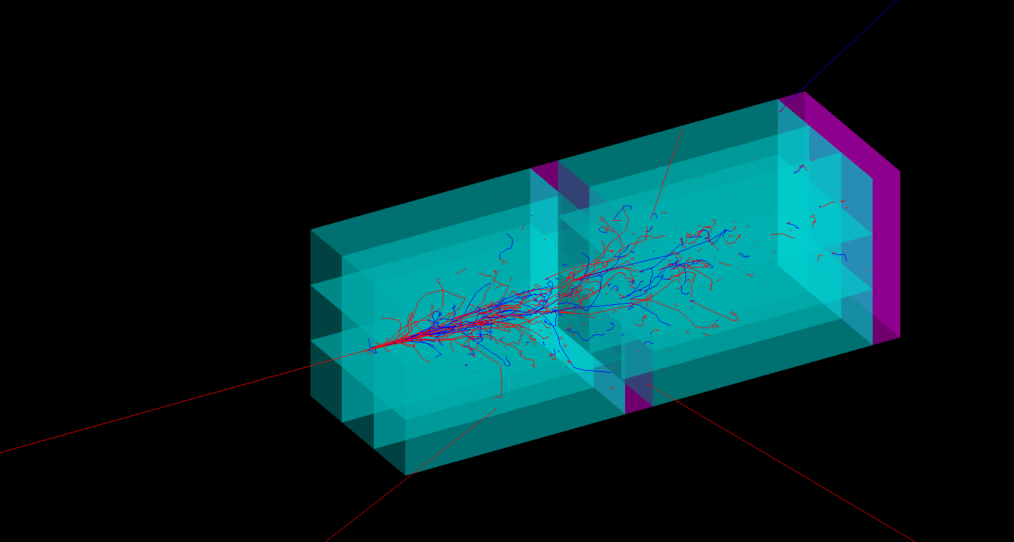
Beam test @ BTF
BTF, April 2024
Study of the LY loss of one layer of Proto-1 after Gamma ray irradiation
Beam: 450 MeV electrons with multiplicity 1
Beam centered on a different crystal at each run
Monte Carlo
Notes:
allows an easy assembly of the calorimeter and allows to assemble the calorimeter with submodules arranged in series and in parallel to obtain any configuration needed.
MZB which provides signal amplification and shaping, along with all slow control functions - individual bias regulation, temperature and current monitoring

Slide 4
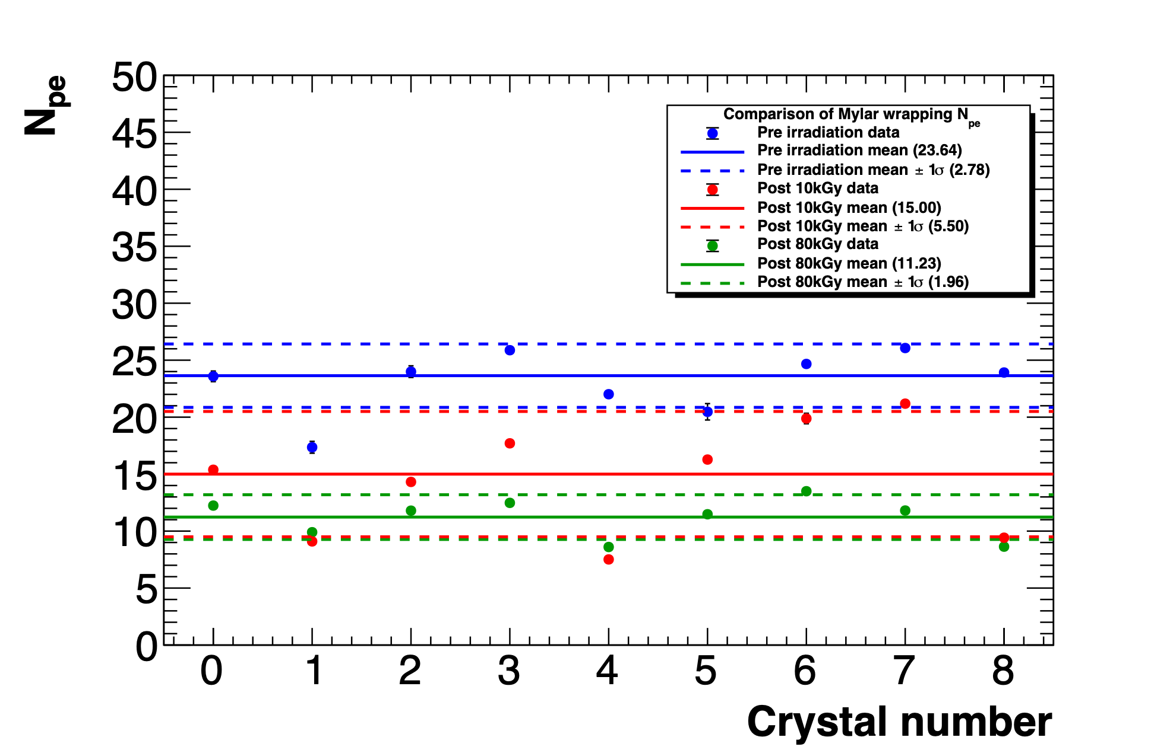
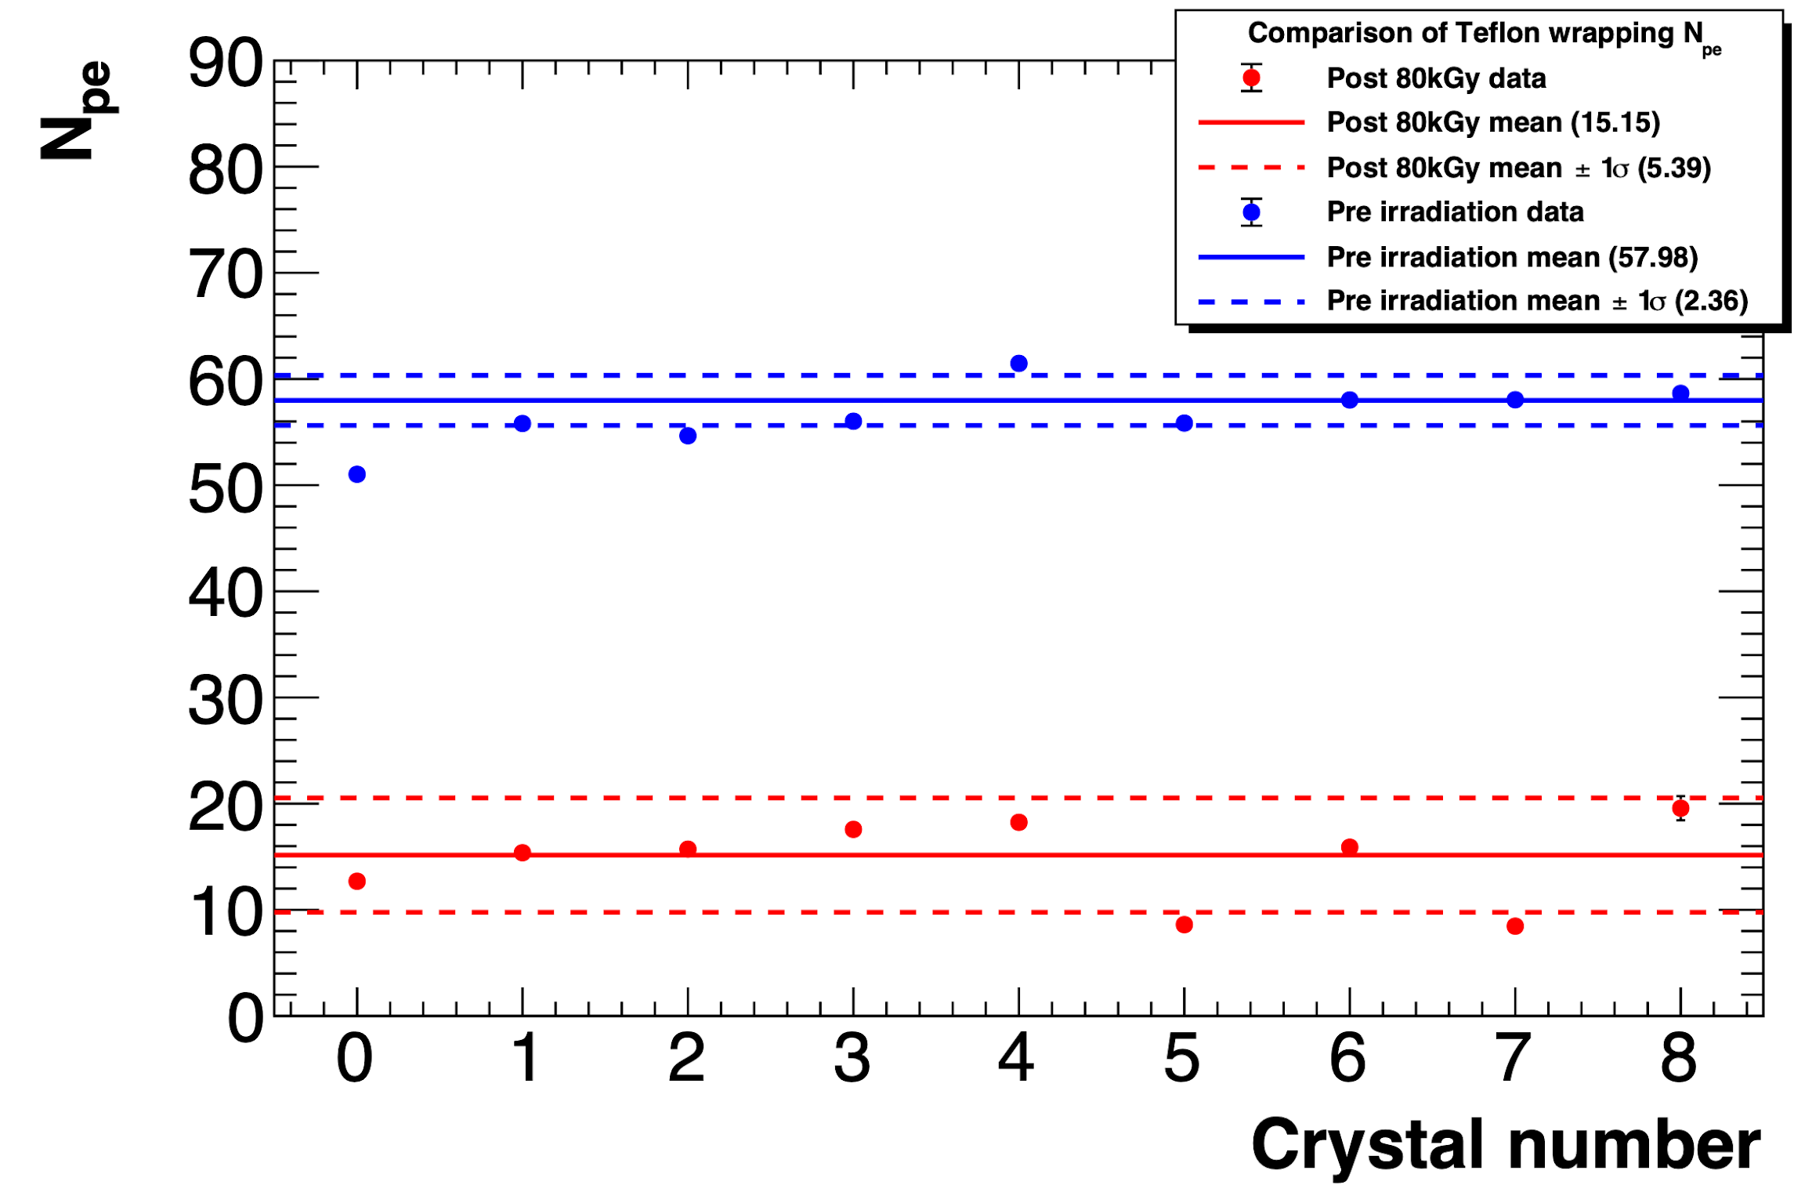
Beam test @ BTF: crystals
Crystals tested with two different wrapping, Teflon and Mylar, up to 80 kGy, with same SiPMs
LY loss evaluated through variation in number of photo-electrons
Teflon wrapping
Mylar wrapping
Mean Npe values of PbF₂ pre and post 80 kGy
irradiation
Mean Npe values of PbF₂ pre, after 10 kGy and
after 80 kGy irradiation
Notes:
allows an easy assembly of the calorimeter and allows to assemble the calorimeter with submodules arranged in series and in parallel to obtain any configuration needed.
MZB which provides signal amplification and shaping, along with all slow control functions - individual bias regulation, temperature and current monitoring

Slide 5
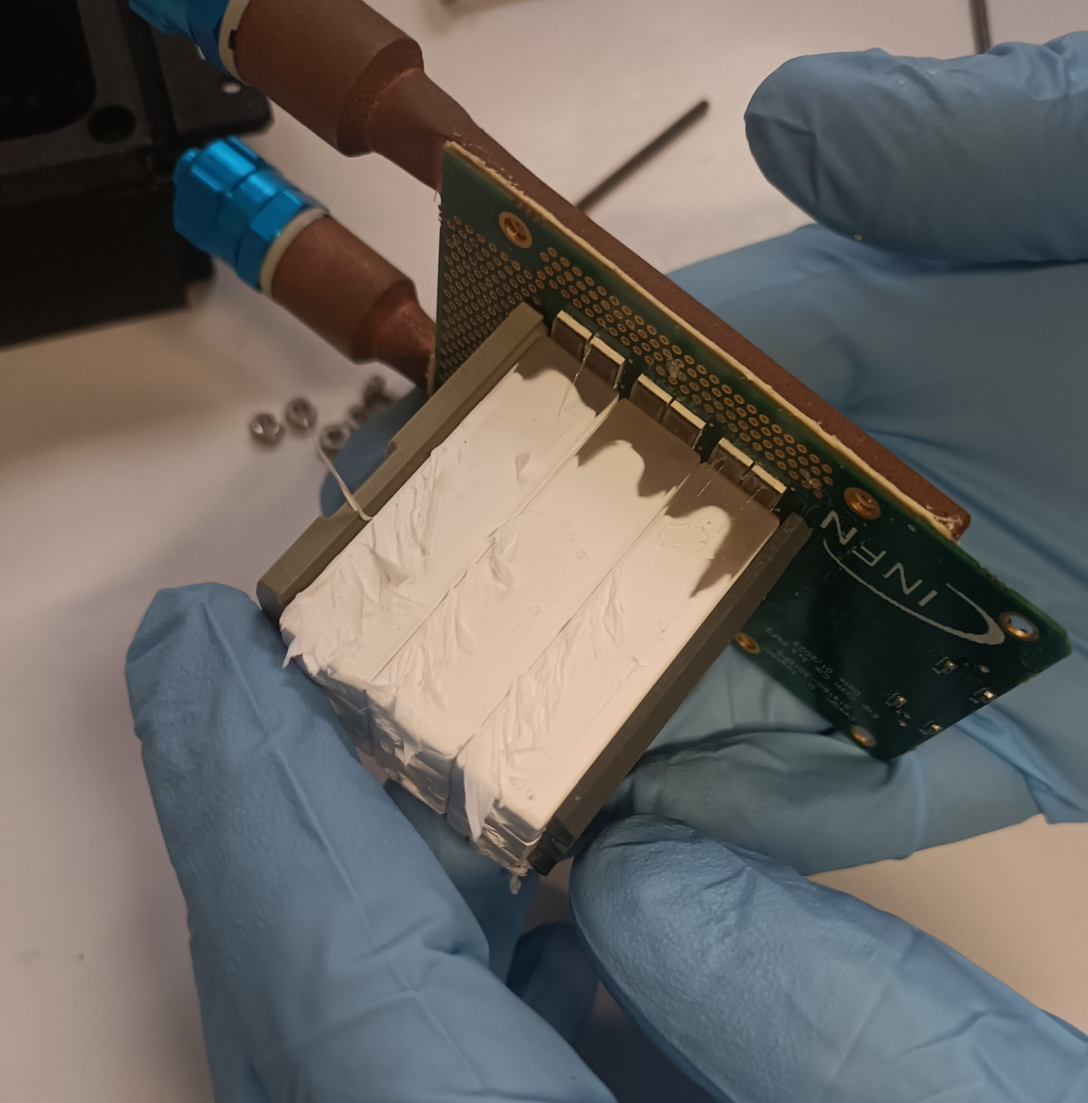
Beam test @ BTF: considerations
Considerable variability in crystals' response to radiation, despite SICCAS claiming use of high-purity (>99.9%) PbF₂ powder for crystal growth
Transparency loss was uniform length-wise in the crystals
Teflon was damaged and brittle
SiPM dark counts increases significantly with the absorbed dose
Good operation after extreme TID (16 times MuCol) at low energies :)
New tests planned to evaluate SiPMs PDE loss and optical grease degradation to disentangle LY losses due to crystals / SiPM
  → 3.5 keur
Notes:
allows an easy assembly of the calorimeter and allows to assemble the calorimeter with submodules arranged in series and in parallel to obtain any configuration needed.
MZB which provides signal amplification and shaping, along with all slow control functions - individual bias regulation, temperature and current monitoring

Slide 6
Crilin Module Prototype
9x9 crystals/layer – 5 layers
Aluminum matrix to hold the crystals:
  50-100 µm thickness between crystals
  Thicker (~ 2mm) in the external envelope with microchannels for cooling
Kapton strip for polarization and output signal:
  Handles polarization and output signals for each channel of two SiPMs in series.
Connectors at the back
of the 5 assembled modules.
95 mm
95 mm
94 mm
90.5 mm
Notes:
allows an easy assembly of the calorimeter and allows to assemble the calorimeter with submodules arranged in series and in parallel to obtain any configuration needed.
MZB which provides signal amplification and shaping, along with all slow control functions - individual bias regulation, temperature and current monitoring

Slide 7
PRIN - Abbiamo fondi per:
Riempire gli 81x5 cristalli e 81x2x5 SiPM
Elettronica per 100 canali 5x5 cristalli per layer con qualche aiuto dalla commissione:
  Cavi 3 keuro
  A5818 4.5 keuro (SJ)
ELETTRONICA (soluzione-0 per PRIN da estendere per DRD6)
Mezzanine per fornire Vbias ai SiPM (un bias ogni 9 SiPM), amplificazione veloce a ~ 1m dal calorimetro
Abbiamo bisogno di una risoluzione temporale <50 ps e di una risoluzione sulla carica <1%
Ogni mezzanina contiene 3 moduli da 9 canali → tot. 27 canali a mezzanine → tot. 4 mezzanine ~15keur
2 board di flash adc CAEN v2745 (4 Vpp – 125 Ms/s) + un canale fast ogni 9 per timing con flash adc CAEN v1742 (2 Vpp – 5 Gs/s) ~35keur

Slide 8
Soluzione con asic
Adattare un asic esistente per fare timing con ToT + ADC lento per la carica. Con un asic si potrebbero leggere i ~400 canali del prototipo senza sovraccarico di flash adc.
  Proposta di uno studio di fattibilità dell’applicazione di un asic ed eventuale realizzazione della board di interfaccia.
  10 keur su Torino → board asic
  5 keur su LNF → board di interfaccia
Vedi slide successiva

Slide 9
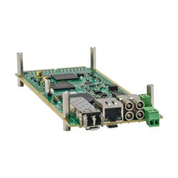
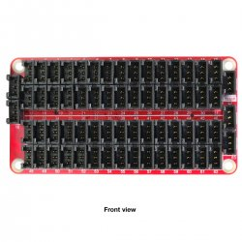
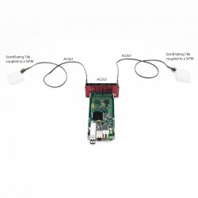
CAEN A5204 (https://www.caen.it/products/a5204/)
La CAEN ha in sviluppo (pronta per la distribuzione a gennaio 2025) una board che farebbe al caso nostro:
  - 64 chs, chip radioroc, acquisizione con pico TDC ed ADC
  Costo 9 keur su Torino/inventariabile
  3 keur adattatore A5253 e integrazione meccanica su LNF/consumi

Slide 10
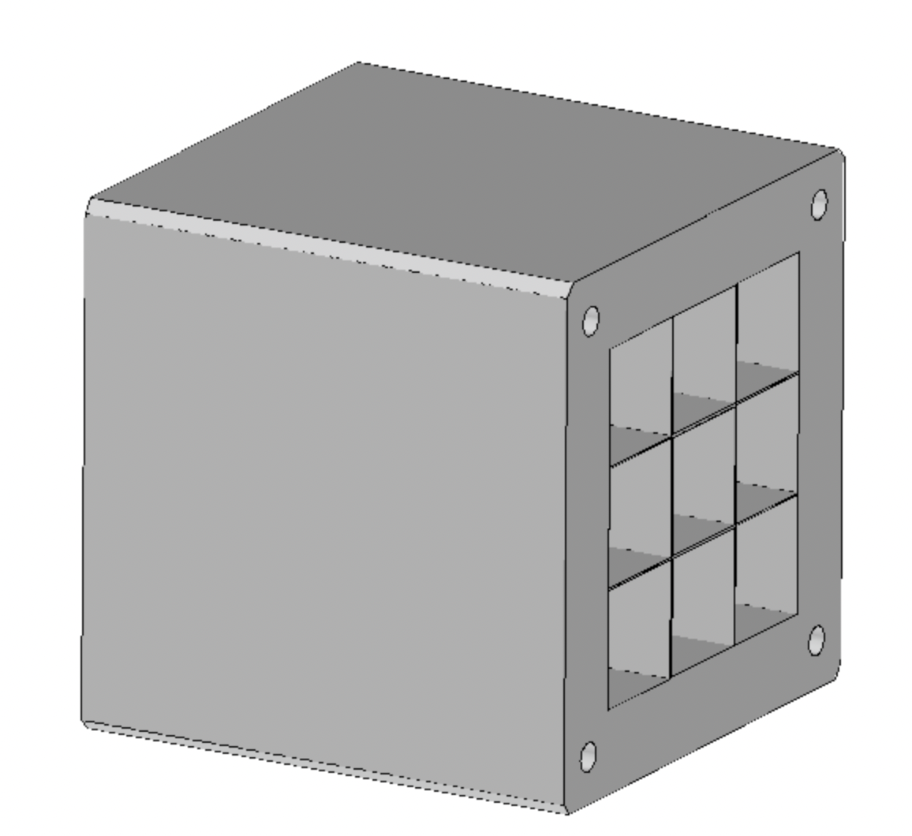
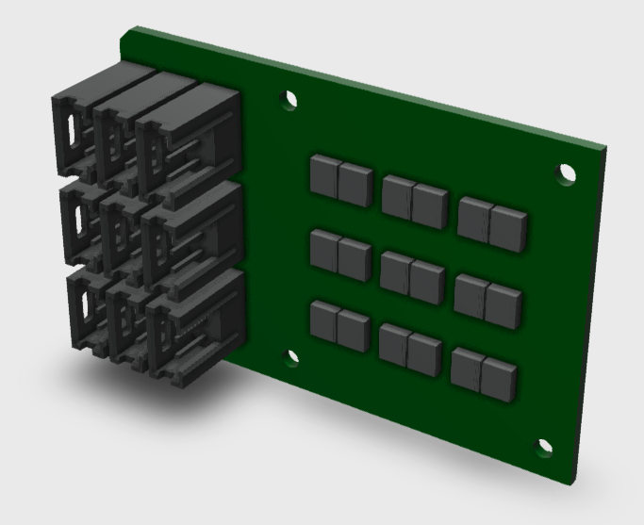
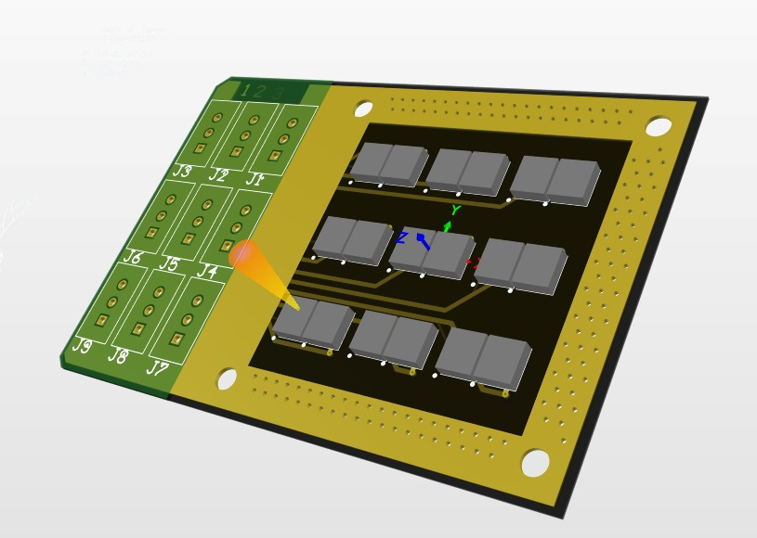
Stiamo sviluppando la una nuova matrice 3x3 per provare:
  - meccanica definitiva con 100 um Al o Cu per separazione tra i cristalli
  la board di elettronica
  L’elettronica di acquisizione (alla Proto-1 per il FEE, V1742 come digitizer) che poi sostituiremo con la board CAEN per confronto
Test beam al CERN parassitando CMS o con richiesta sottomessa al PS week 45 (richiesto lo sblocco del SJ missione di 6 keur)

Slide 11
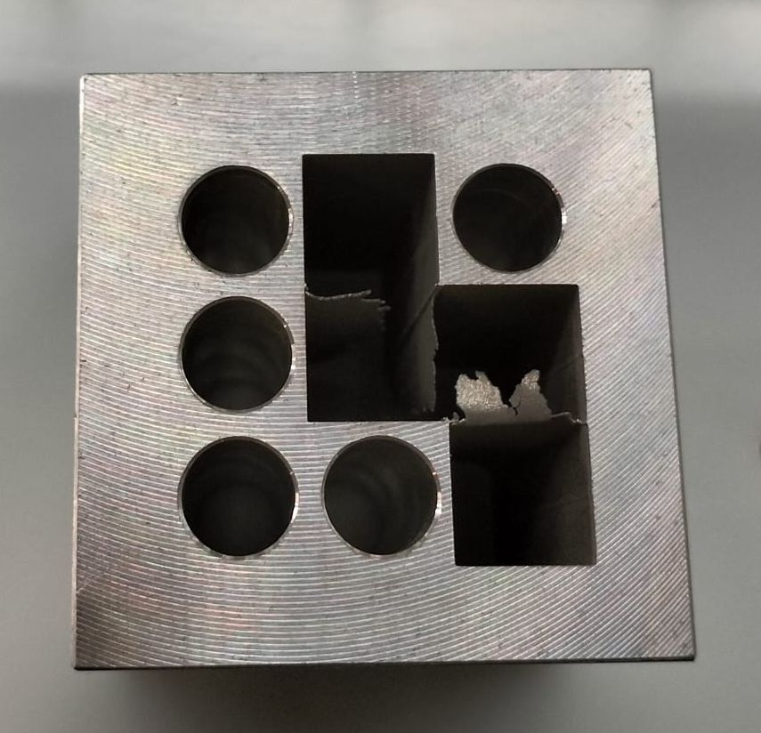
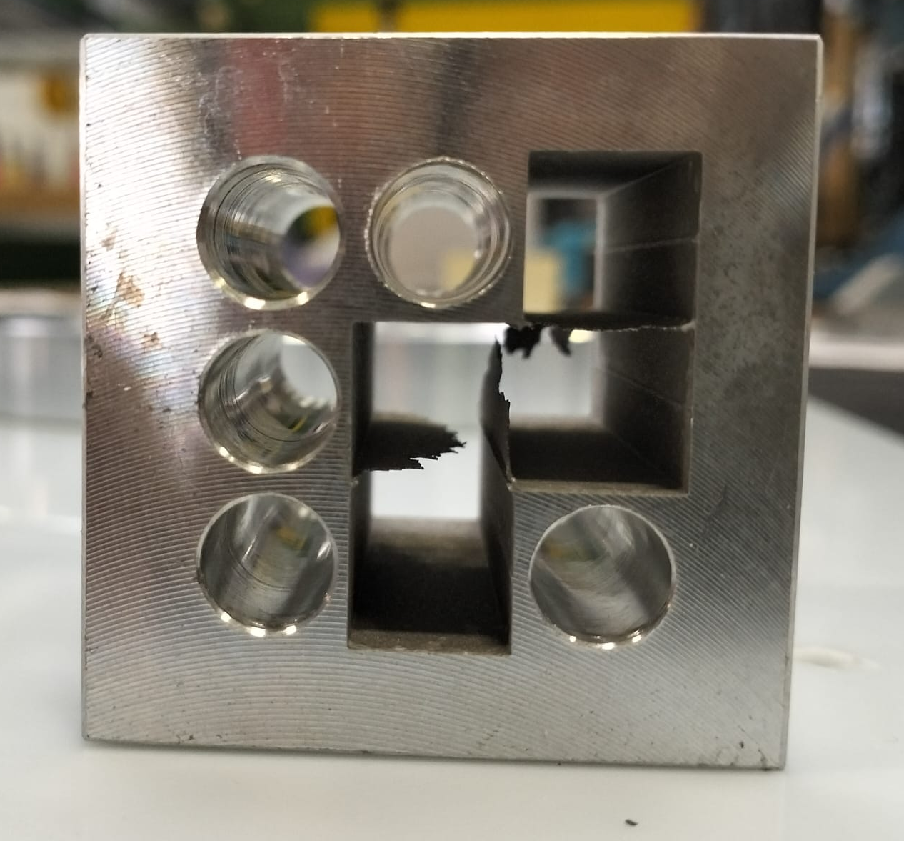
Richiesta aggiuntiva a settembre
Non riusciamo a costruire la matrice con separazione O(100 um) con la macchina ad elettroerosione a filo di Ferrara.
Stiamo vagliando 2 tecniche:
Stampa 3D al Gran Sasso (da Settembre) in acciaio inox
Elettroerosione a tuffo da ditta esterna, richiesta: 3 keuro di extra cost

Slide 12
RICHIESTE 2025 |  | keuro | SJ
Consumi | Test irraggiamento con laser blu cristallo+SiPM e SiPM da solo a Casaccia fino a 80kGy | 3.5
 | Scheda interfaccia mezzanine con board con asic TOPHIR2 | 5 → 3
 | Cavi interfaccia tra connettori sul kapton e mezzanine (x125 canali) | 3
Inventariabile | Modulo caen A5818 controllo digitizer |  | 4.5
Missioni | Metabolismo 3.9 FTE | 20
 | Test beam CRILIN al CERN ed attività correlate di integrazione con HCAL |  | 10
 | Conferenze e riunioni in preparazione prossima Strategy | 5
DRD6 Tak3
350 chs to acquire with respect
PRIN expectation of 100 chs
RICHIESTE DRD Crilin |  | keuro
Consumi | Mezzanine boards | 40
Inventariabile | Moduli CAEN V2745 64ch x 4board | 80
Institute 1 : INFN-LNF, Frascati (Italy)
Institute 2 : INFN-Padova, Padova (Italy)
Institute 3 : INFN-Torino, Torino (Italy)
Institute 4 : INFN-Trieste, Trieste (Italy)
Institute 5 : HZDR, Dresden (Germany)
Institute 6 : DIPC, San Sebastián (Spain)

