Slide 1
Multimodal lung cancer and metastasis classification using CT and PET: an Explainable AI Approach
next_AIM meeting
Bari, 17th October 2024
Lorenzo de Trizio, Pierfrancesco Novielli, Domenico Diacono, Donato Romano, Michele Magarelli, Pierpaolo Di Bitonto, Sabina Tangaro

Slide 2
Outline
A brief overview about Solitary Pulmonary Nodule (SPN);
Overview of CT and PET images;
Overview of Radiomic Features;
Metastasis Classification on Radiomic Features CT, PET and PET+CT

Slide 3
A solitary pulmonary nodule (SPN)
A solitary pulmonary nodule (SPN) is a round or oval lesion in the lung, usually less than 3 cm in diameter, surrounded by normal lung tissue.
NODULE TYPE
Benign:
Granulomas (often due to previous infections)
Hamartomas (benign tumors)
Scars
2) Malignant:
Primary lung cancer
Metastasis from other tumors
Scientific Goal: Classify the Type of Tumor Using Radiomics

Slide 4
Lung metastases occur when cancer cells from a primary tumor in another part of the body spread to the lungs through the bloodstream or lymphatic system. When they appear as solitary pulmonary nodules, they can be particularly dangerous.
Diagnostic approaches may include:
Observation with radiological follow-ups
PET-CT
Biopsy (transbronchial or transthoracic)
Surgical removal

Slide 5
CT Imaging (Computed Tomography)
Uses X-rays to create detailed images of internal body structures.
It is especially useful for visualizing lung anatomy and structure, highlighting the shape and size of lesions.
Provides precise information on lung nodules, tumors, and their location.
PET Imaging (Positron Emission Tomography)
Uses a radioactive tracer (usually glucose) to detect the metabolic activity of cells.
It is essential for distinguishing between normal and cancerous tissues, identifying areas of increased cellular activity, often indicative of a malignant tumor.
Helps evaluate the metabolism of tumor cells and the spread of metastases.
CT-PET Combination
The combination of CT and PET provides both anatomical and functional information, improving the accuracy in diagnosing and classifying lung lesions.

Slide 6
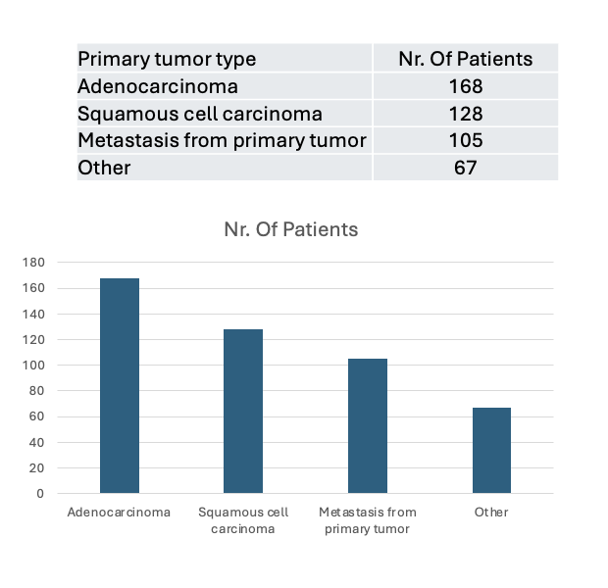
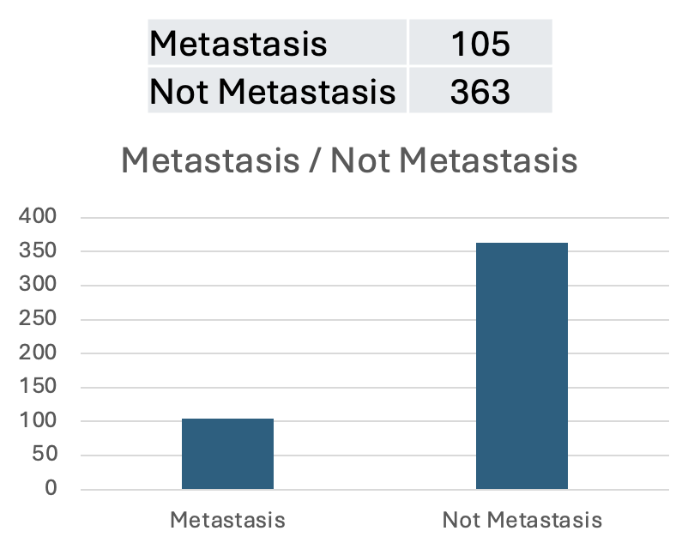
Dataset specifications
Dataset CT: 468 patients X 41 radiomics features
Dataset PET: 468 patients X 43 radiomics features
Dataset PET+CT: 468 patients X 84 radiomics features
(patients are common in both datasets)

Slide 7
CT - Radiomic features
First-Order Intensity Features: These measure the average intensity, variation, and distribution of intensity values in voxels without considering spatial arrangement. For example, meanValue_CT reflects the average voxel intensity, while EntropyH_CT measures the complexity of the intensity distribution.
Shape Features: These describe the size and shape of the Region of Interest (ROI). For instance, Sphericity_CT measures how closely the lesion’s shape resembles a sphere, and Volume_CT quantifies the volume.
Texture Features (GLCM): These examine how the intensity of a voxel relates to its neighboring voxels. For example, Homogeneity_GLCM_CT measures the similarity of intensity values between adjacent voxels, while Contrast_GLCM_CT assesses the difference between voxels with varying intensities.
Linear Pattern Features (GLRLM): These focus on sequences of voxels with the same intensity level. Features like SRE_GLRLM_CT (Short Run Emphasis) highlight short runs of voxels, while LRE_GLRLM_CT (Long Run Emphasis) considers longer voxel runs.
Local Pattern Features (NGLDM): These describe intensity differences between a voxel and its neighbors. For example, Coarseness_NGLDM_CT measures the texture’s "granularity," while Contrast_NGLDM_CT considers the intensity difference between neighboring voxels.
Zonal Pattern Features (GLZLM): These analyze zones of contiguous voxels with the same intensity. For instance, SZE_GLZLM_CT emphasizes small zones, and LZE_GLZLM_CT focuses on larger zones.

Slide 8
PET - Radiomic features
Statistical Characteristics (first-order features): Derived from statistical analysis of pixel intensities within the lesion; Provide information on intensity distribution and variability. Examples: SkewnessH_PET (asymmetry of intensity histogram), KurtosisH_PET (peakedness of distribution), EntropyH_PET (uncertainty in intensity distribution), SUVmin_PET (minimum uptake), SUVmean_PET (average uptake), SUVmax_PET (maximum uptake)
Shape Characteristics: Describe lesion size and geometry, providing information on regularity/irregularity (May correlate with malignancy). Examples: Sphericity_PET (measure of lesion sphericity), Compacity_PET (measure of lesion compactness relative to volume), Volume_mL_PET (lesion volume), TLG_mL_PET (total metabolic activity based on volume and mean SUV)
Texture feature GLCM (Gray Level Co-occurrence Matrix): Based on gray-level intensity co-occurrence matrix; Provide information on image texture: uniformity, contrast, pixel correlation. Examples: Homogeneity_GLCM_PET (texture uniformity), Energy_GLCM_PET (intensity uniformity), Contrast_GLCM_PET (local intensity variations)
Linear Pattern Features GLRLM (Gray Level Run Length Matrix): Describe lengths of pixel sequences with similar values; Provide information on texture granularity and complexity. Examples: SRE_GLRLM_PET (emphasizes short pixel sequences), LRE_GLRLM_PET (emphasizes long pixel sequences), HGRE_GLRLM_PET (measures importance of high-intensity pixel sequences)
Local Pattern Features NGLDM (Neighbouring Gray Level Dependence Matrix): Analyze dependency between intensity values of neighboring pixels; Provide information on texture complexity and coherence. Examples: Coarseness_NGLDM_PET (measures texture roughness), Contrast_NGLDM_PET (measures texture contrast)
Zonal Pattern Features GLZLM (Gray Level Zone Length Matrix): Focus on length of pixel zones with similar values; Provide information on zone size and uniformity. Examples: SZE_GLZLM_PET (emphasizes small texture zones), LZE_GLZLM_PET (emphasizes large texture zones), HGZE_GLZLM_PET (measures importance of high-intensity zones)

Slide 9
Workflow
Dataset (CT, PET, PET+CT)
RANDOM
dataset UNDERSAMPLING
First task: Undersampling
Second task: Classification
100 x rep.
10 folds
Cross-Validation
Metrics average:
F1 Score
Accuracy
Sensivity
Specificity
Precision
AUC / PRC
SHAP Values
XGBoost:
Training & Validation

Slide 10
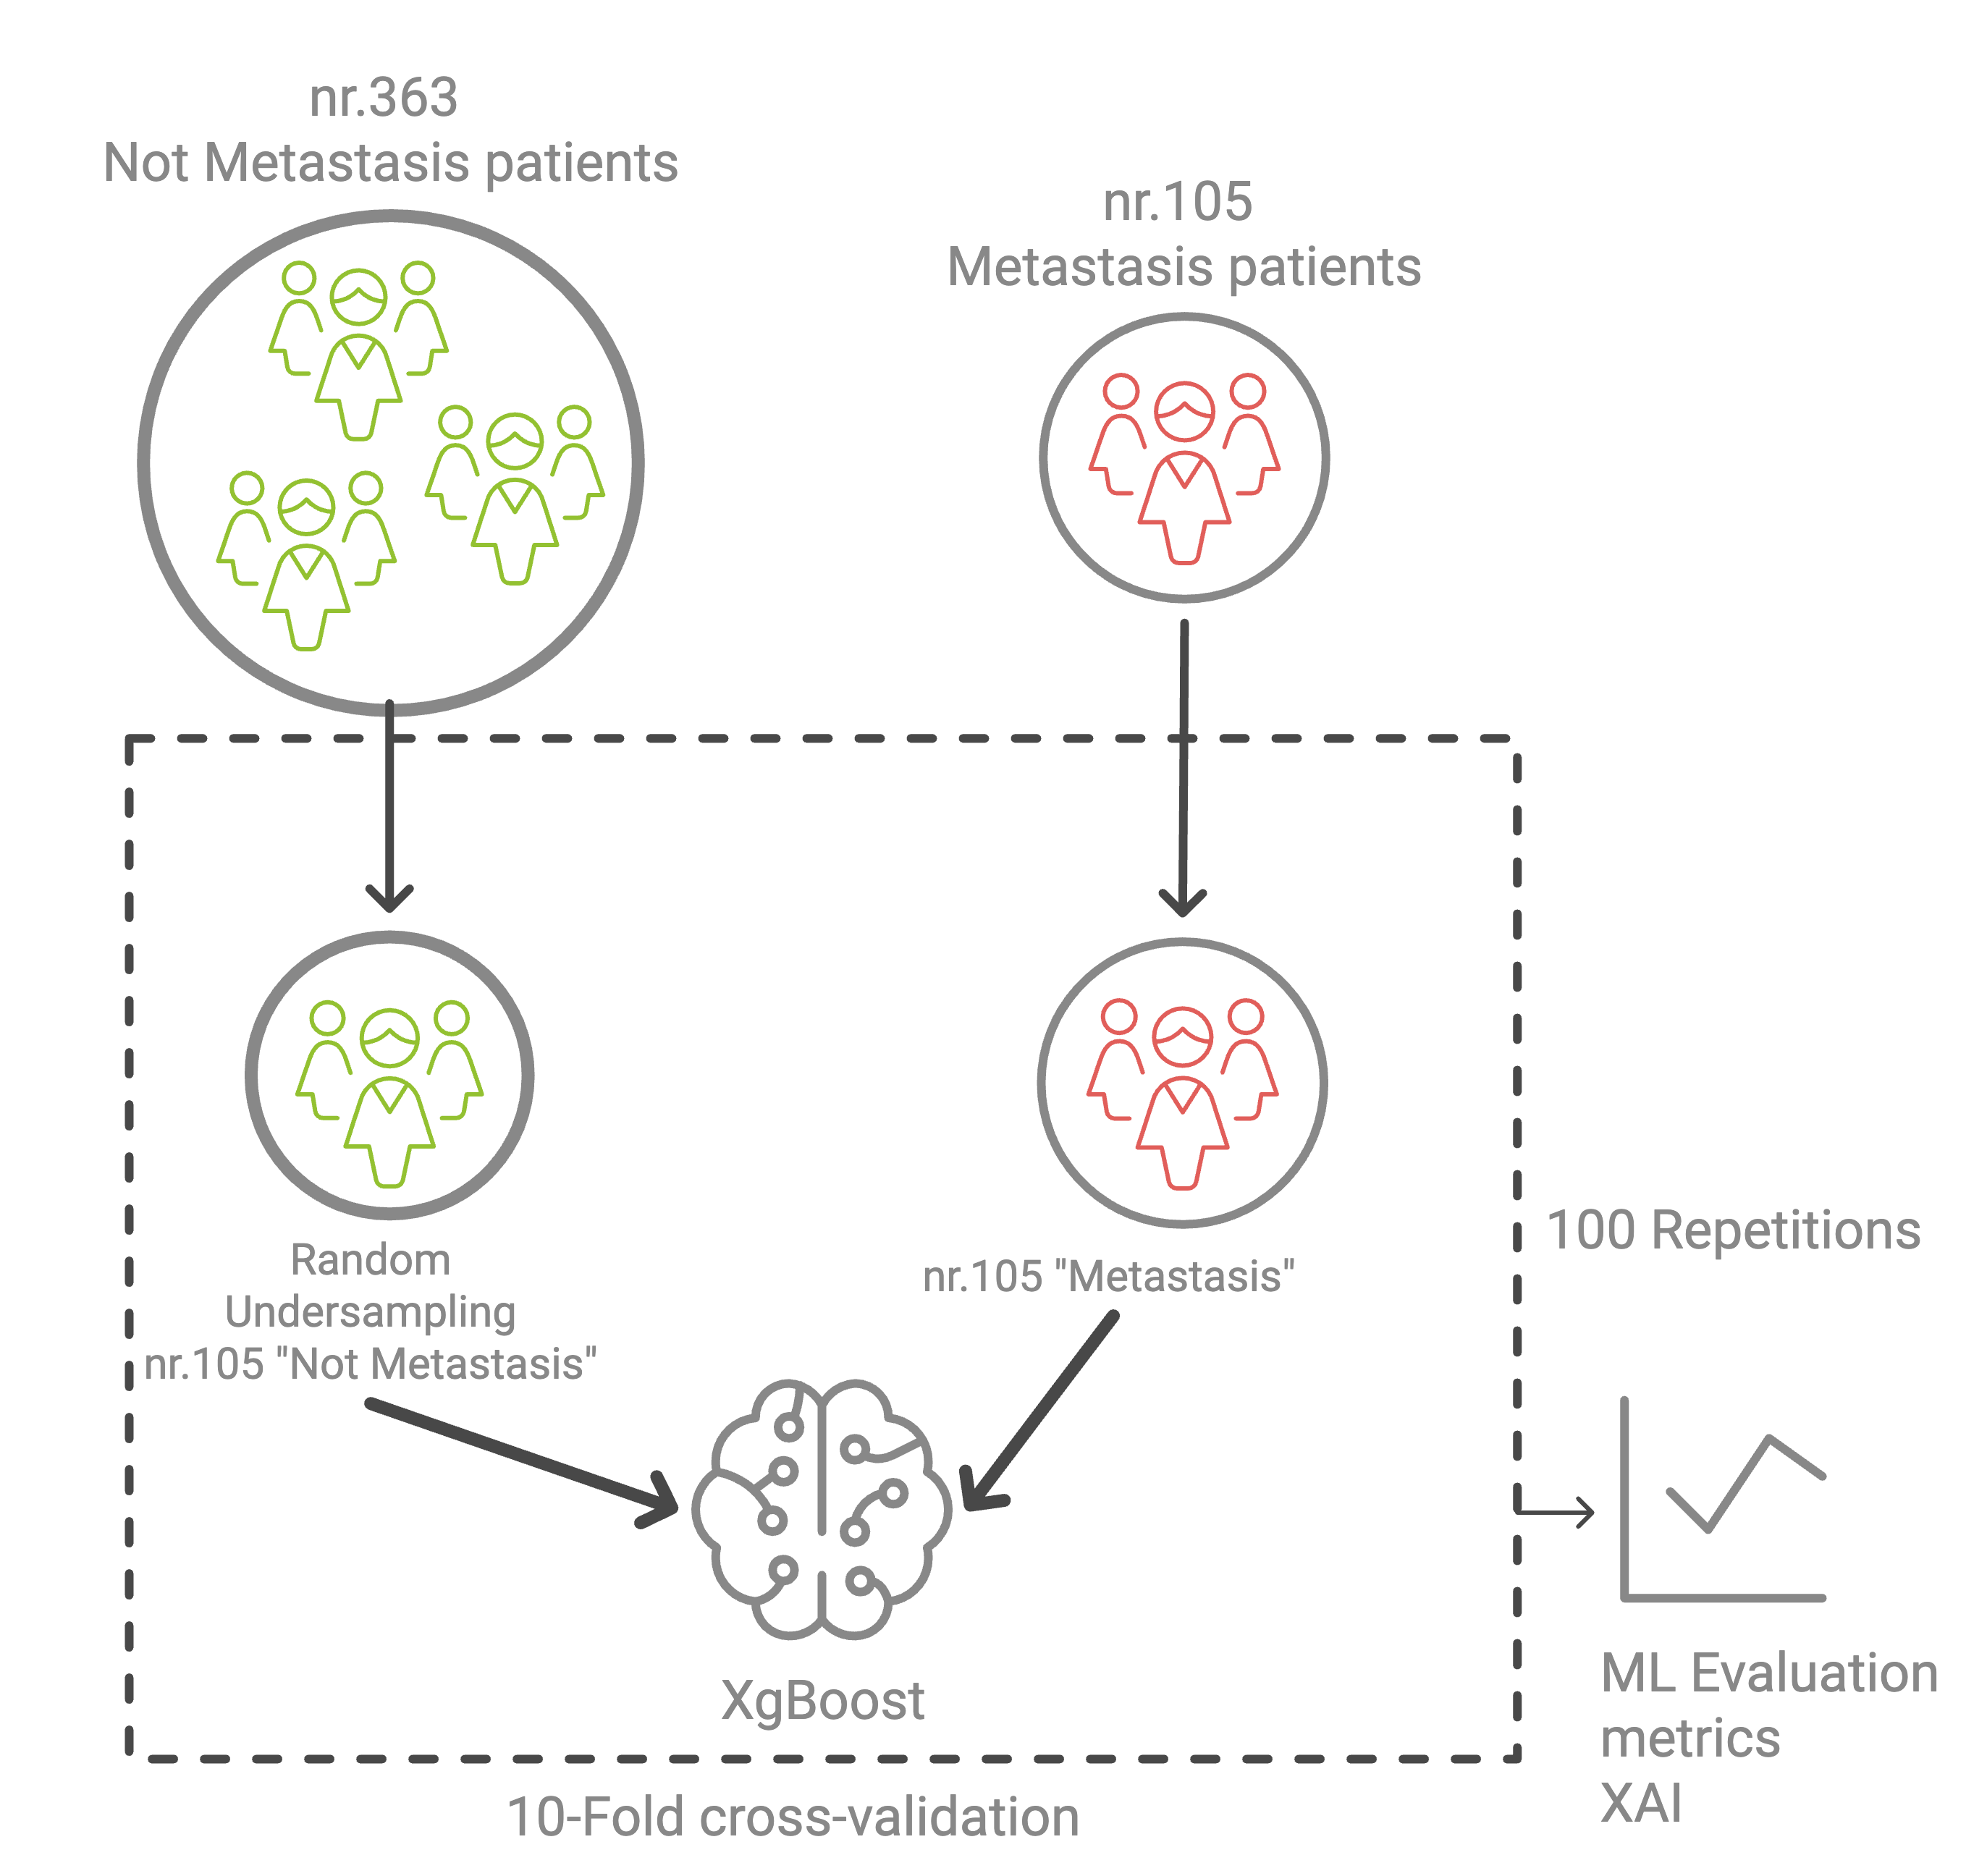
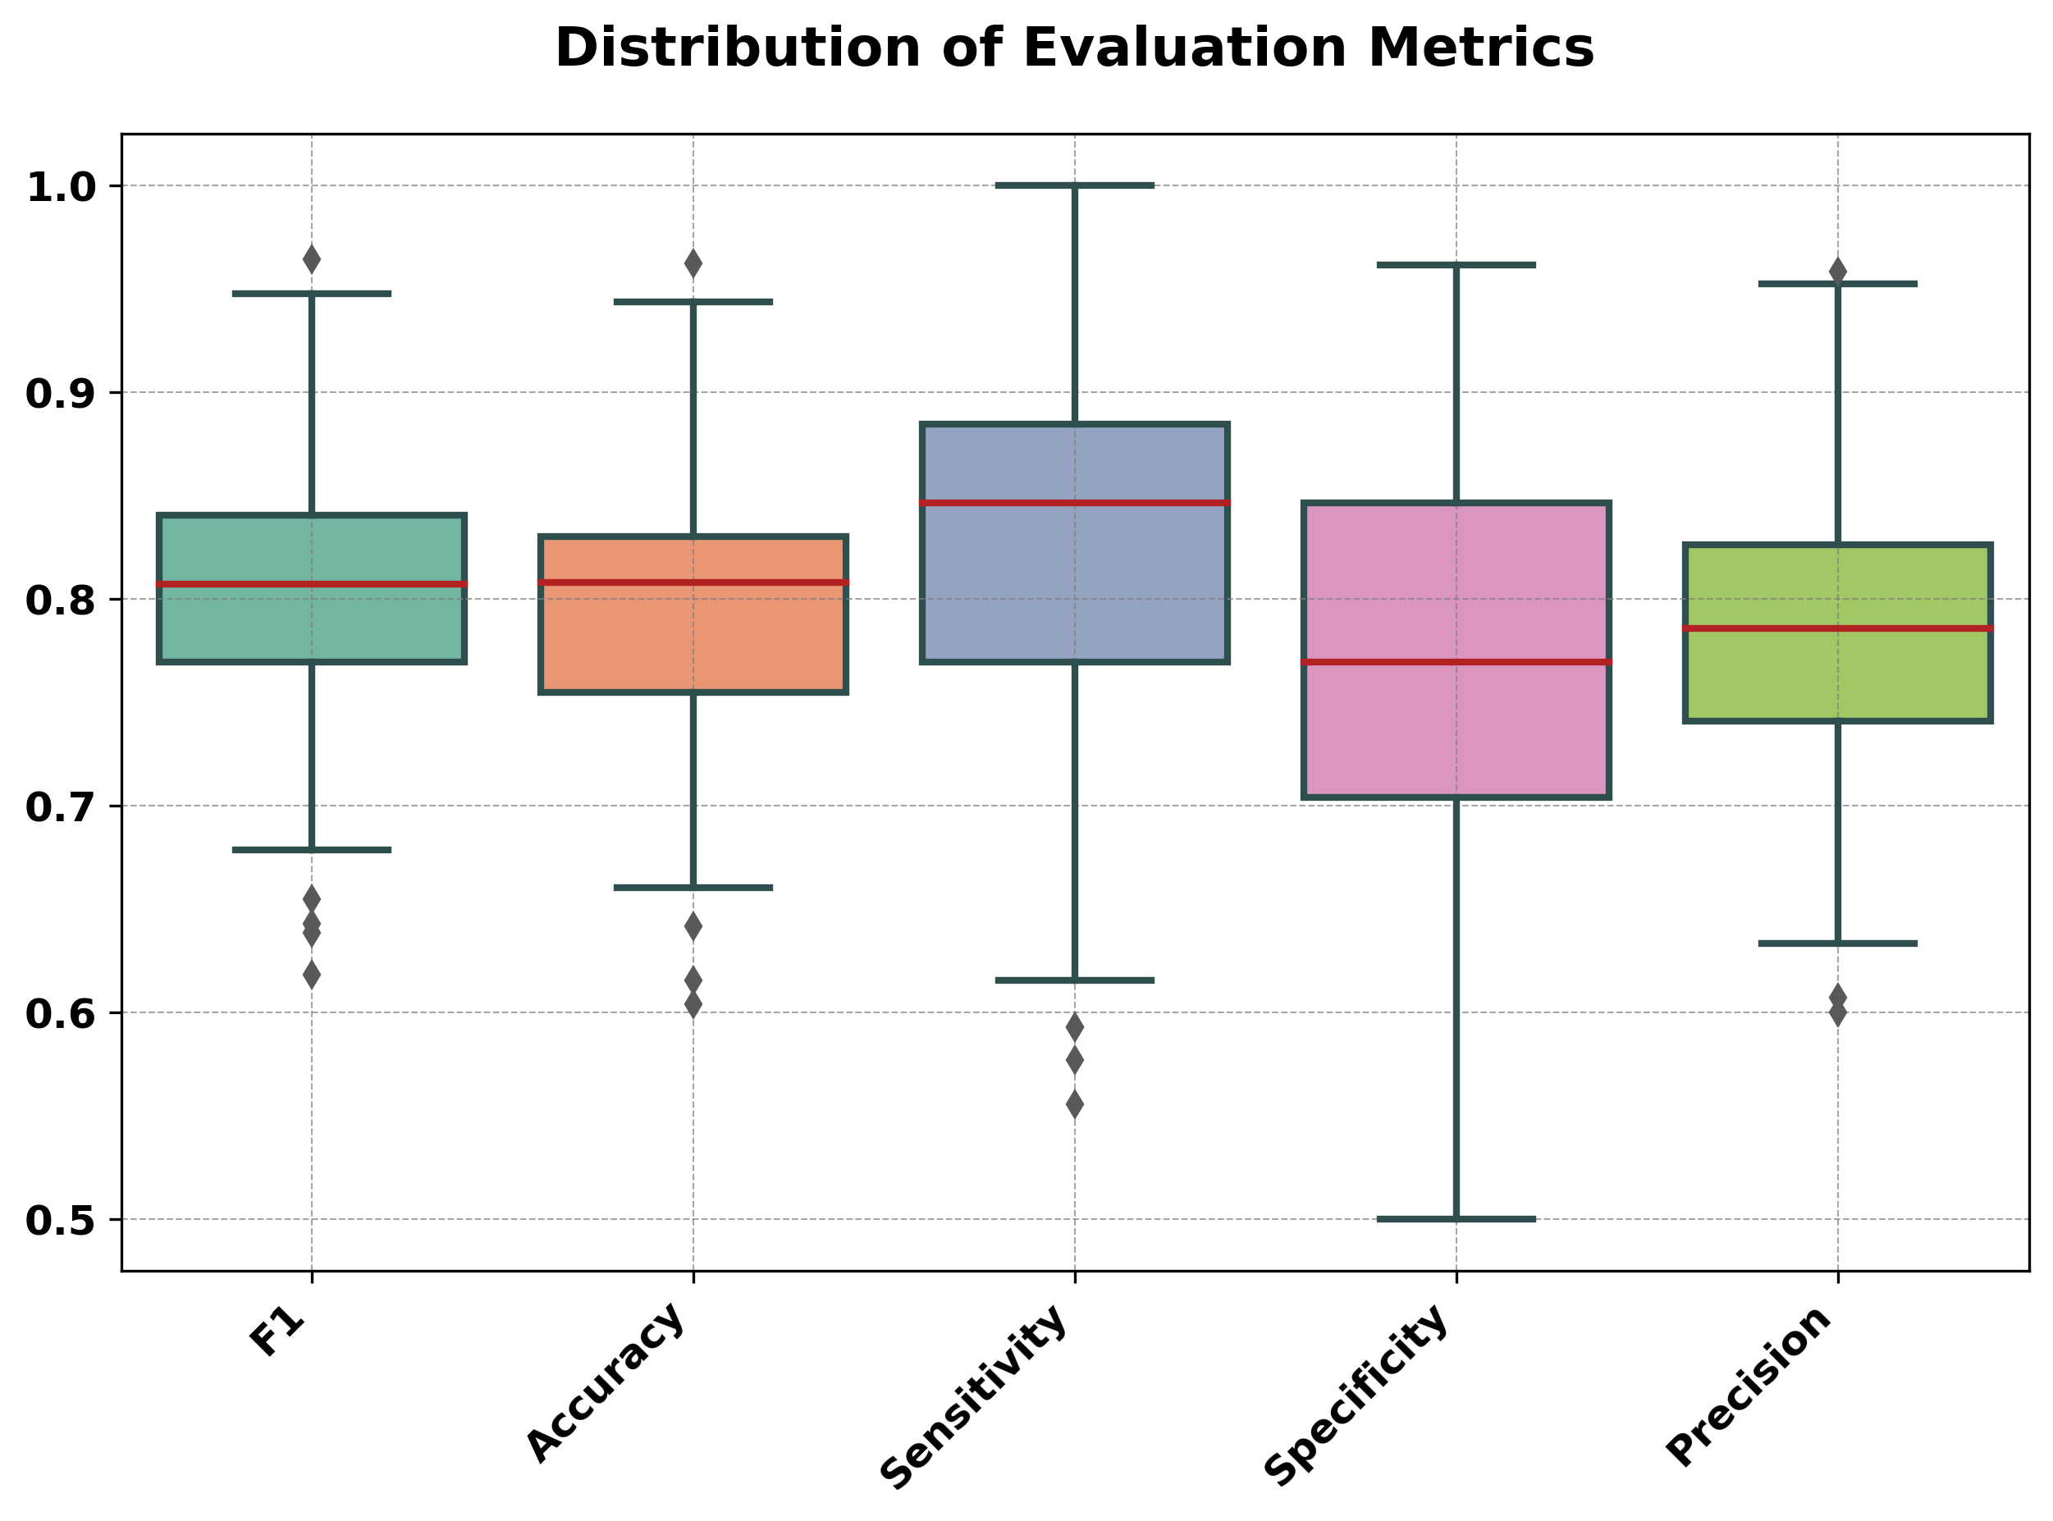
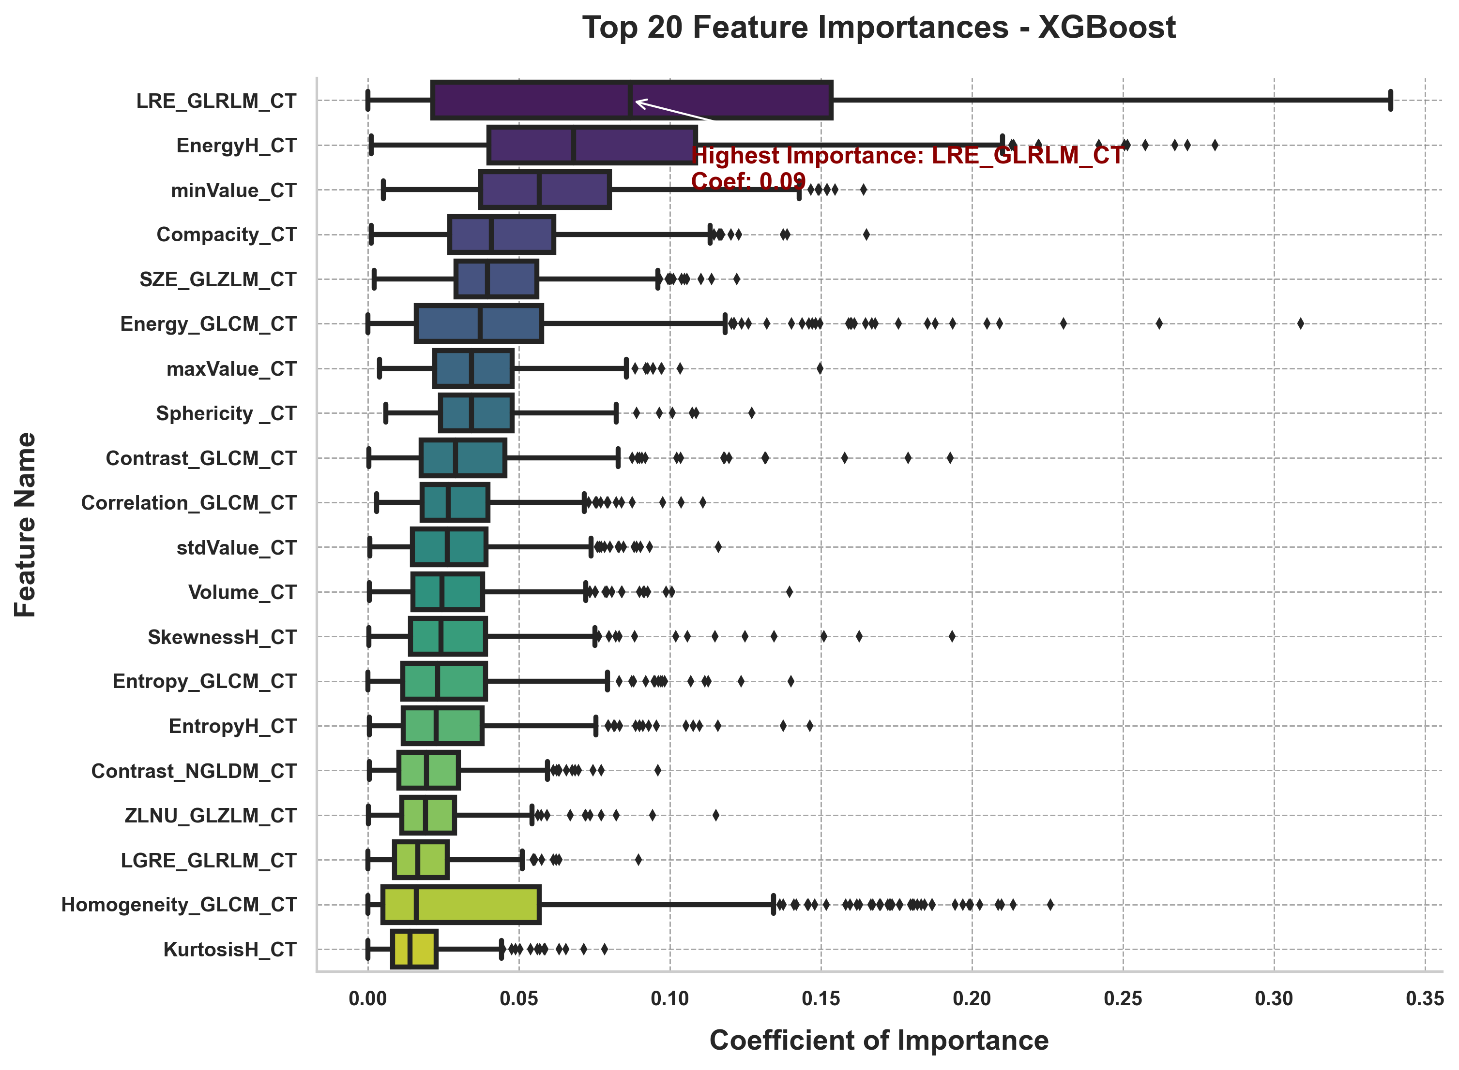
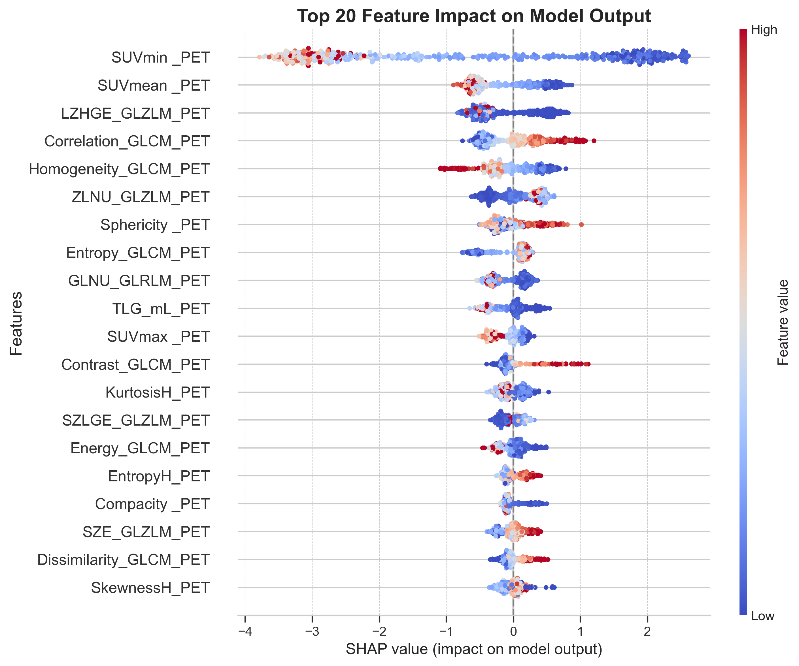
ROC Curve
ML performance
Features importance
XAI

Slide 11
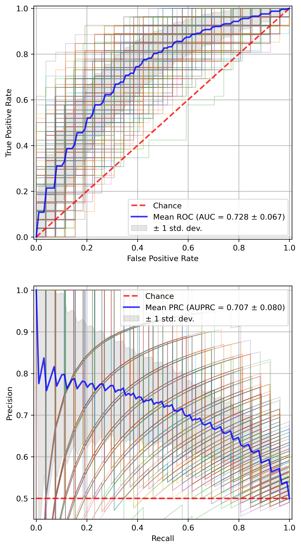
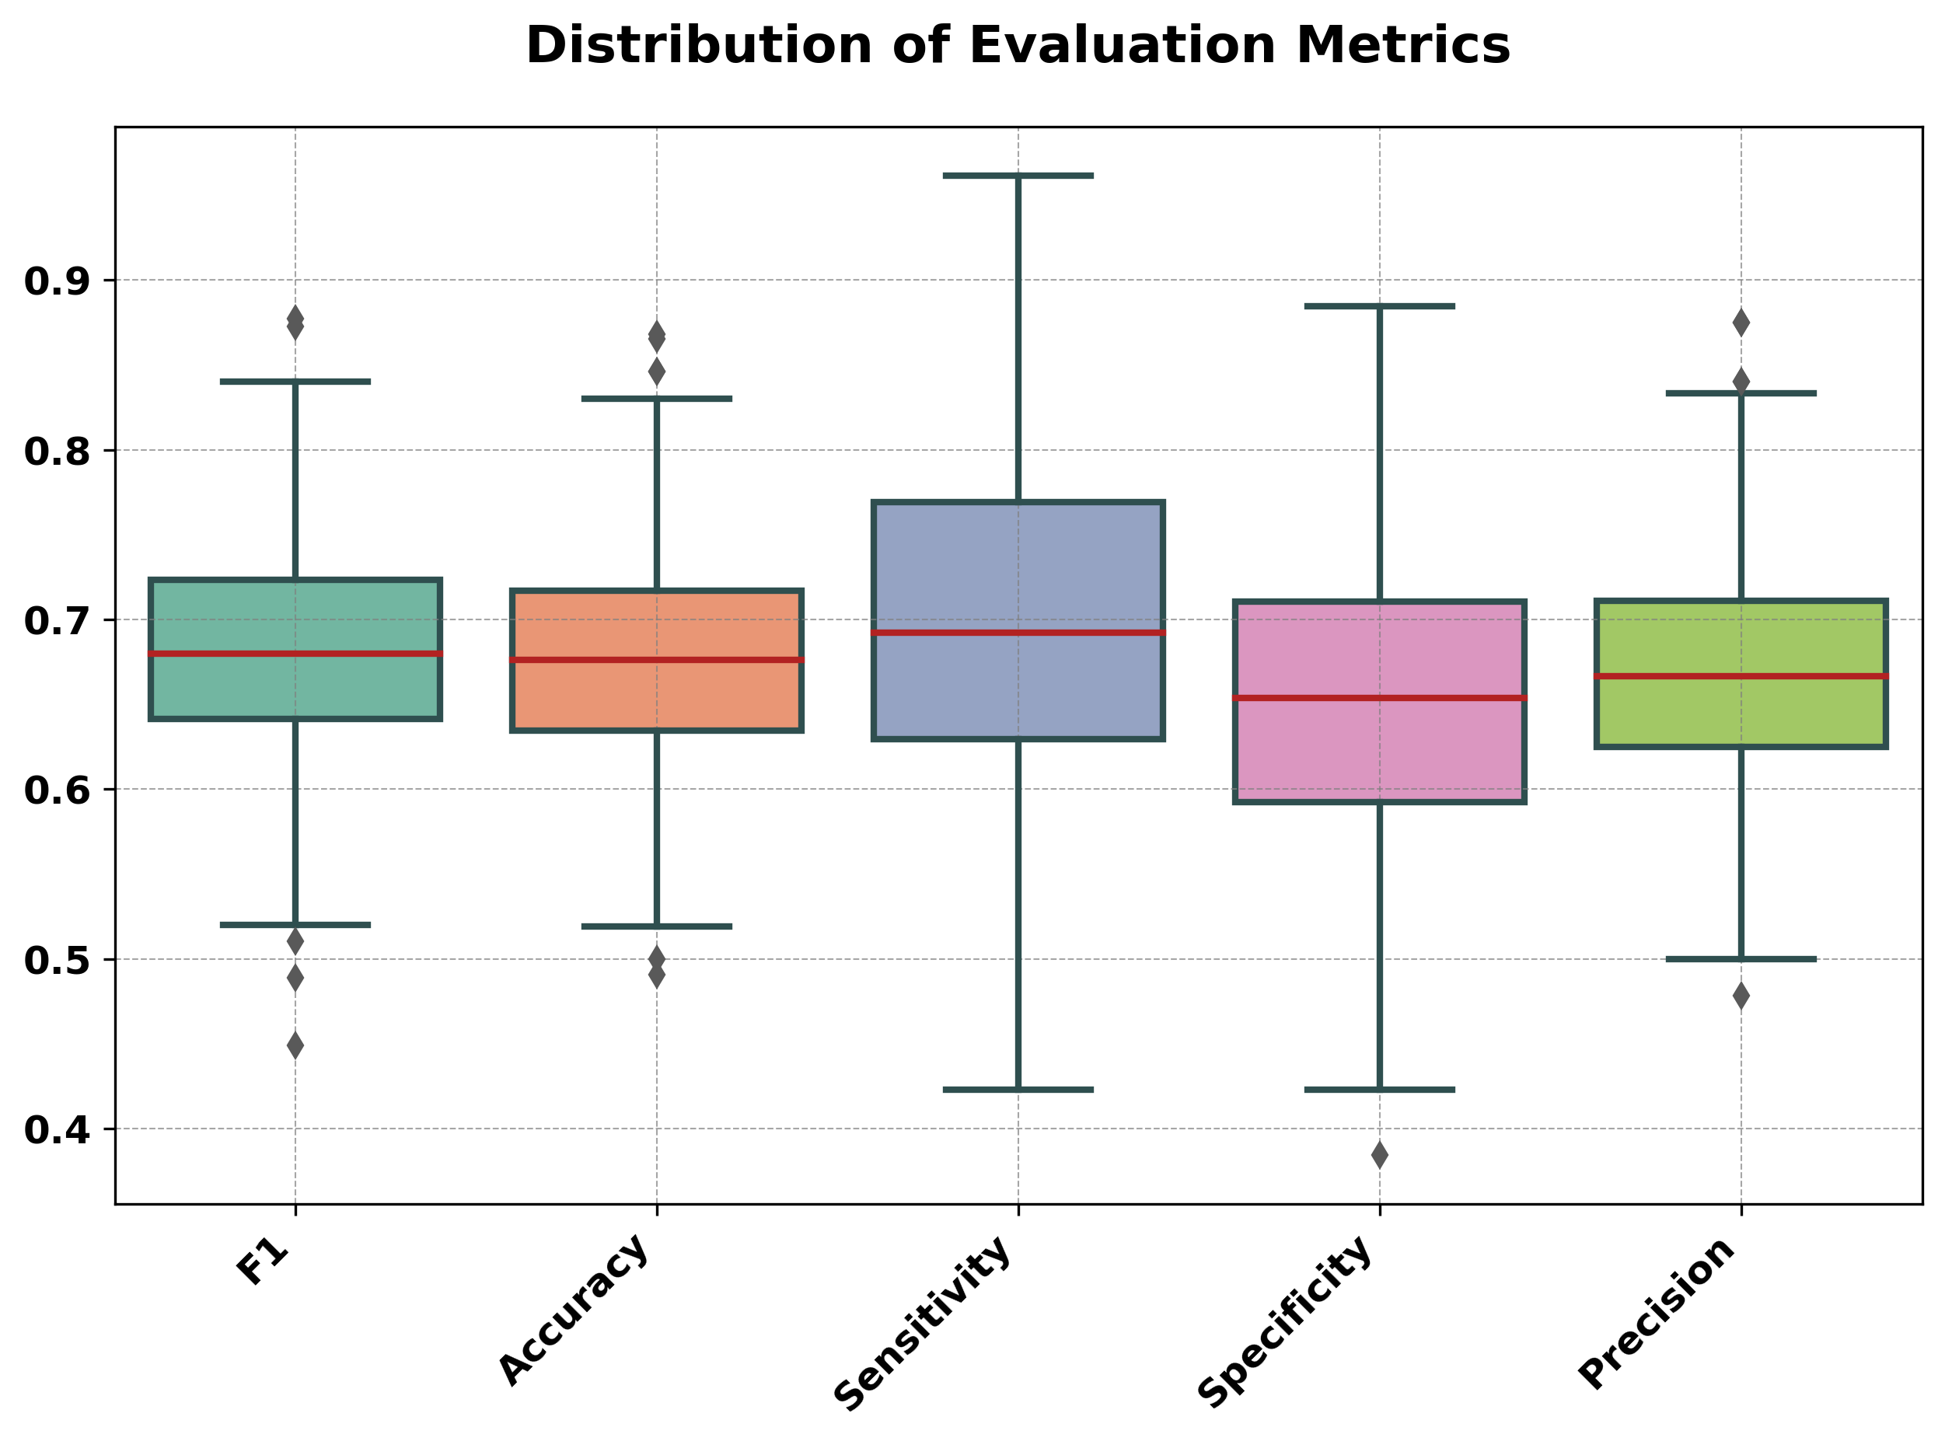
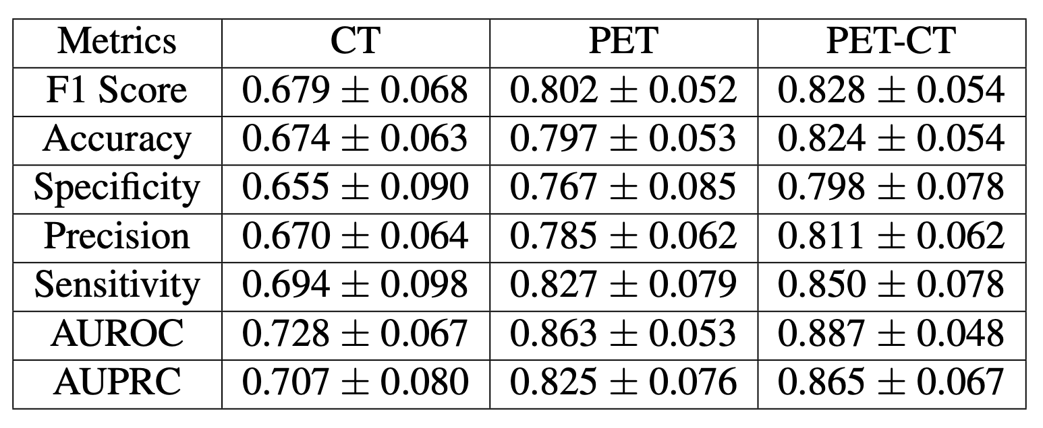
CT Images (XGBoost classification performances)

Slide 12
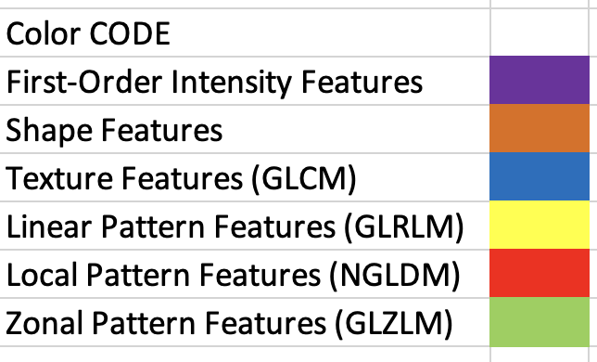
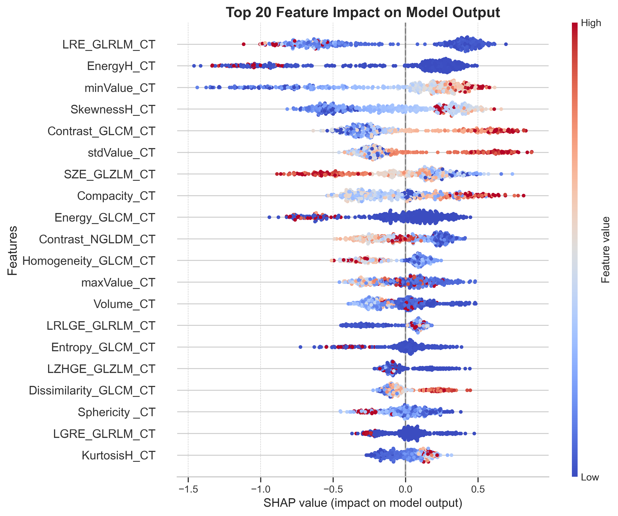
CT Images

Slide 13
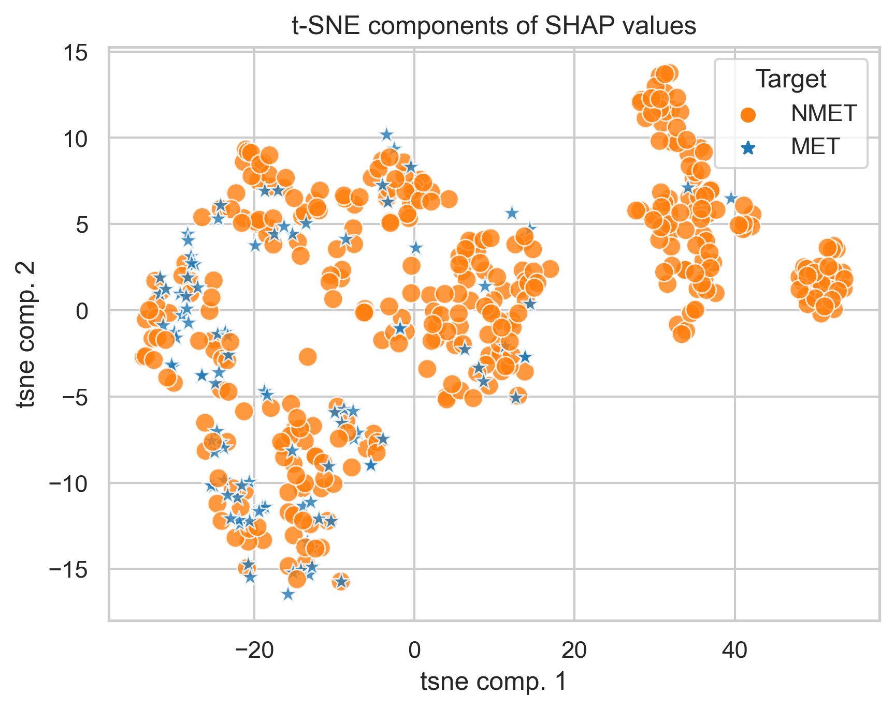
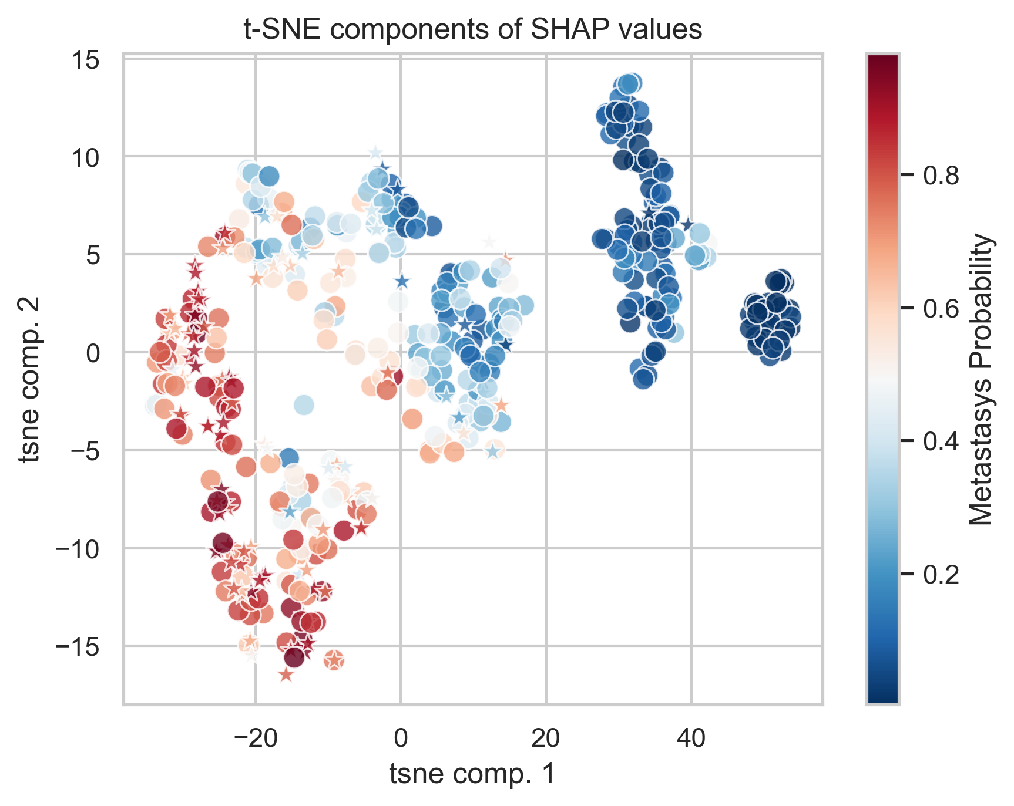
CT Images
t-distributed stochastic neighbor embedding

Slide 14
PET Images (XGBoost classification performances)

Slide 15
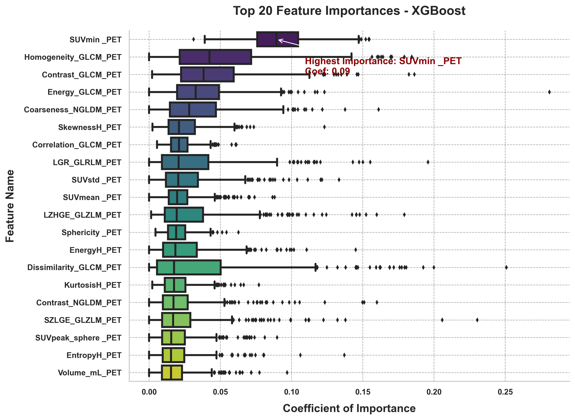
PET Images

Slide 16
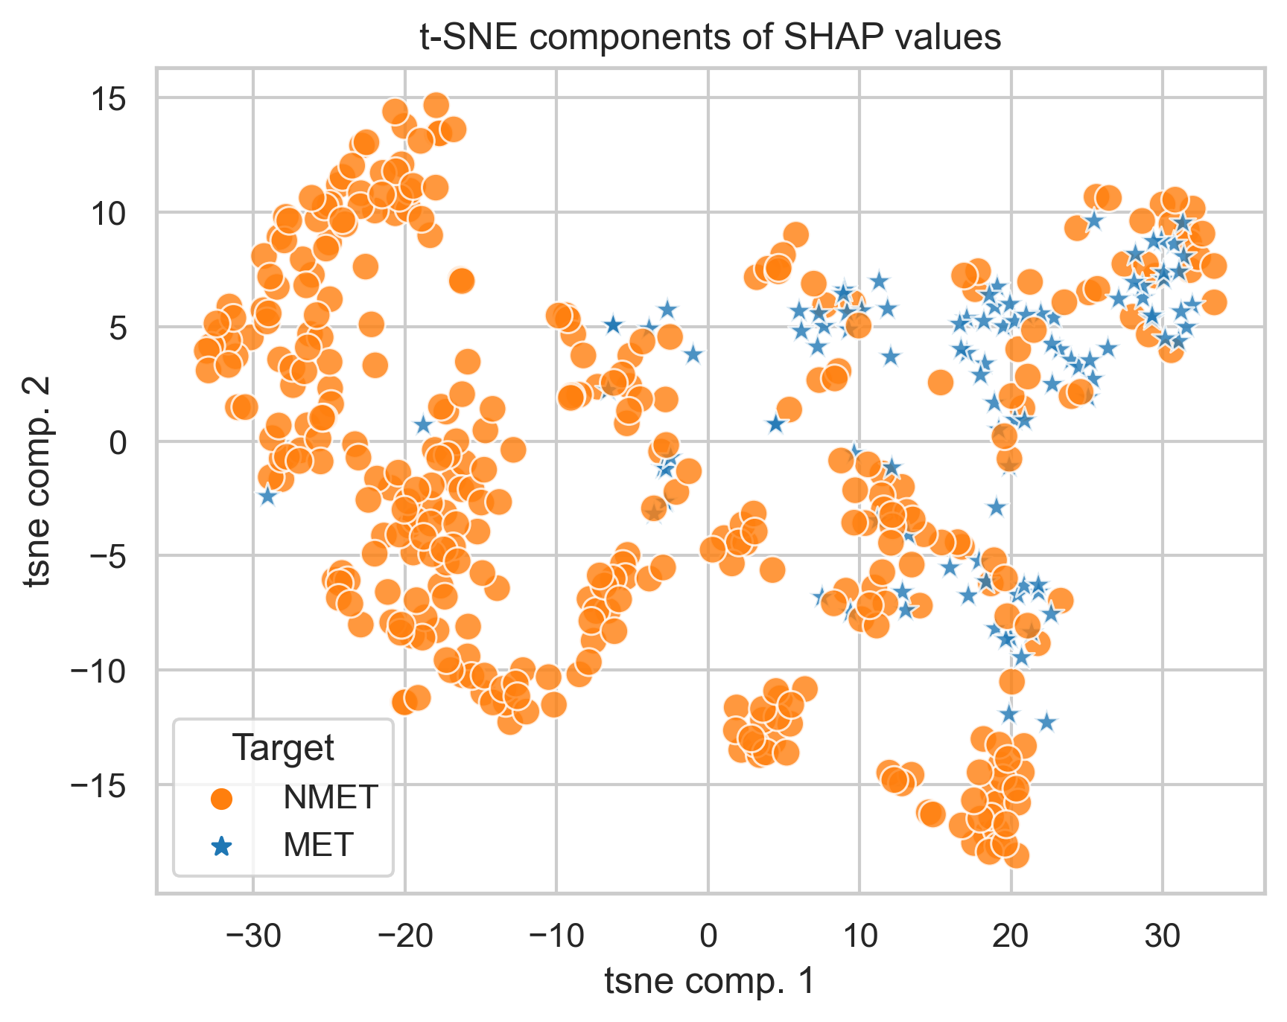
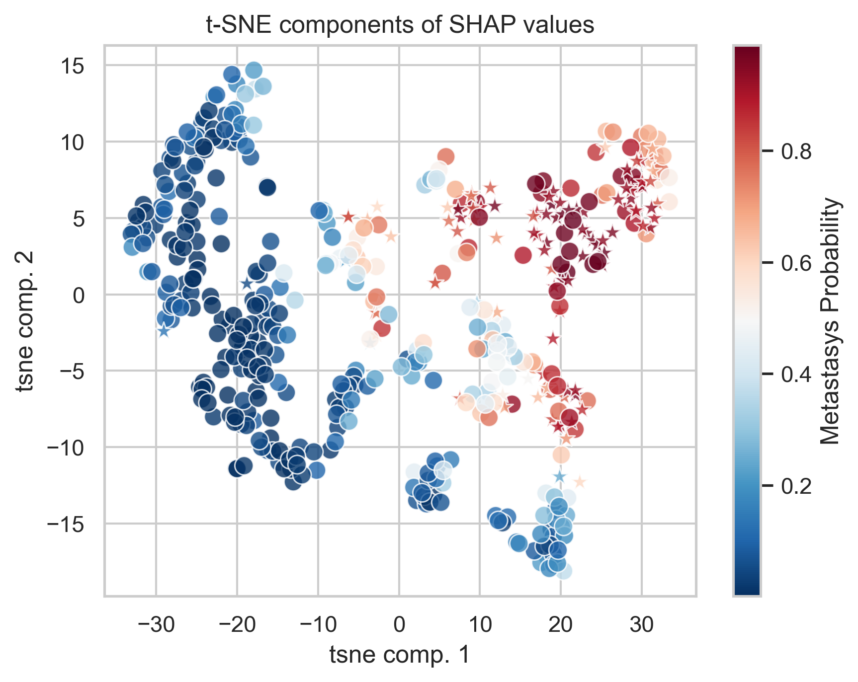
PET Images
t-distributed stochastic neighbor embedding

Slide 17
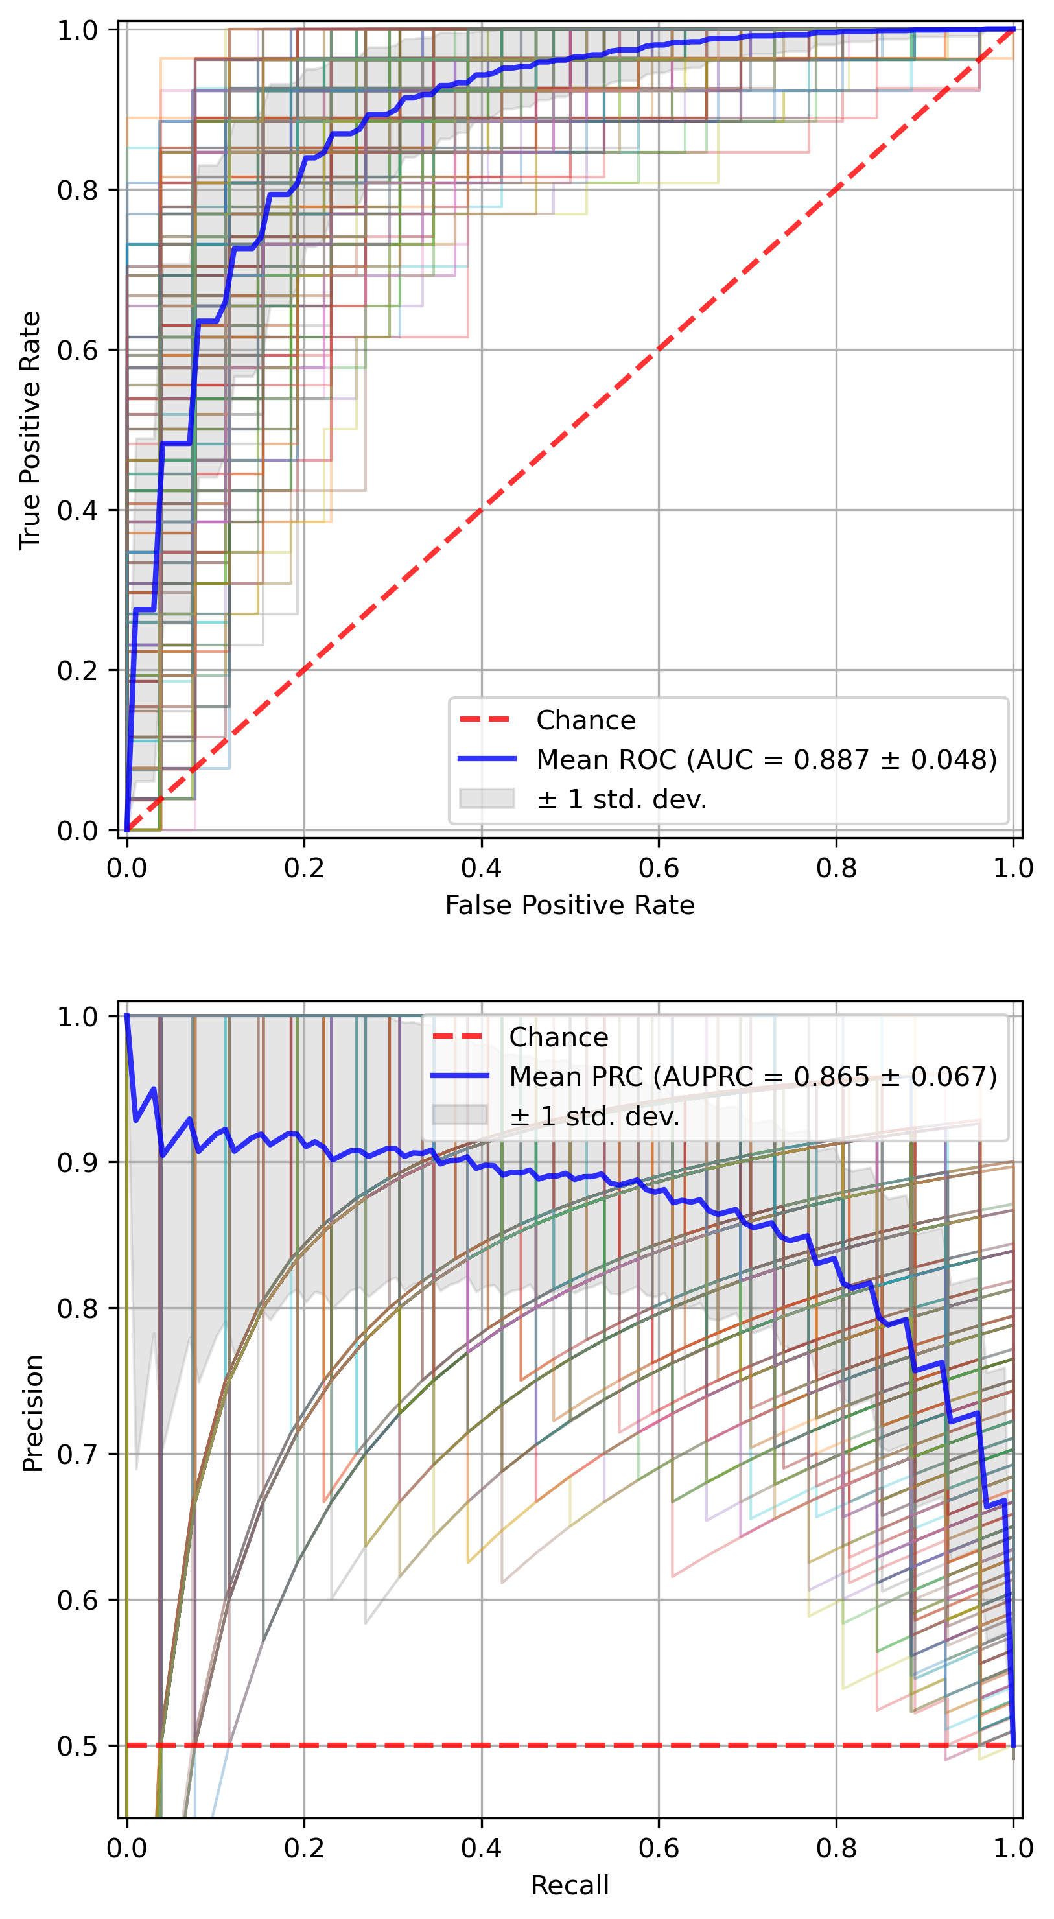
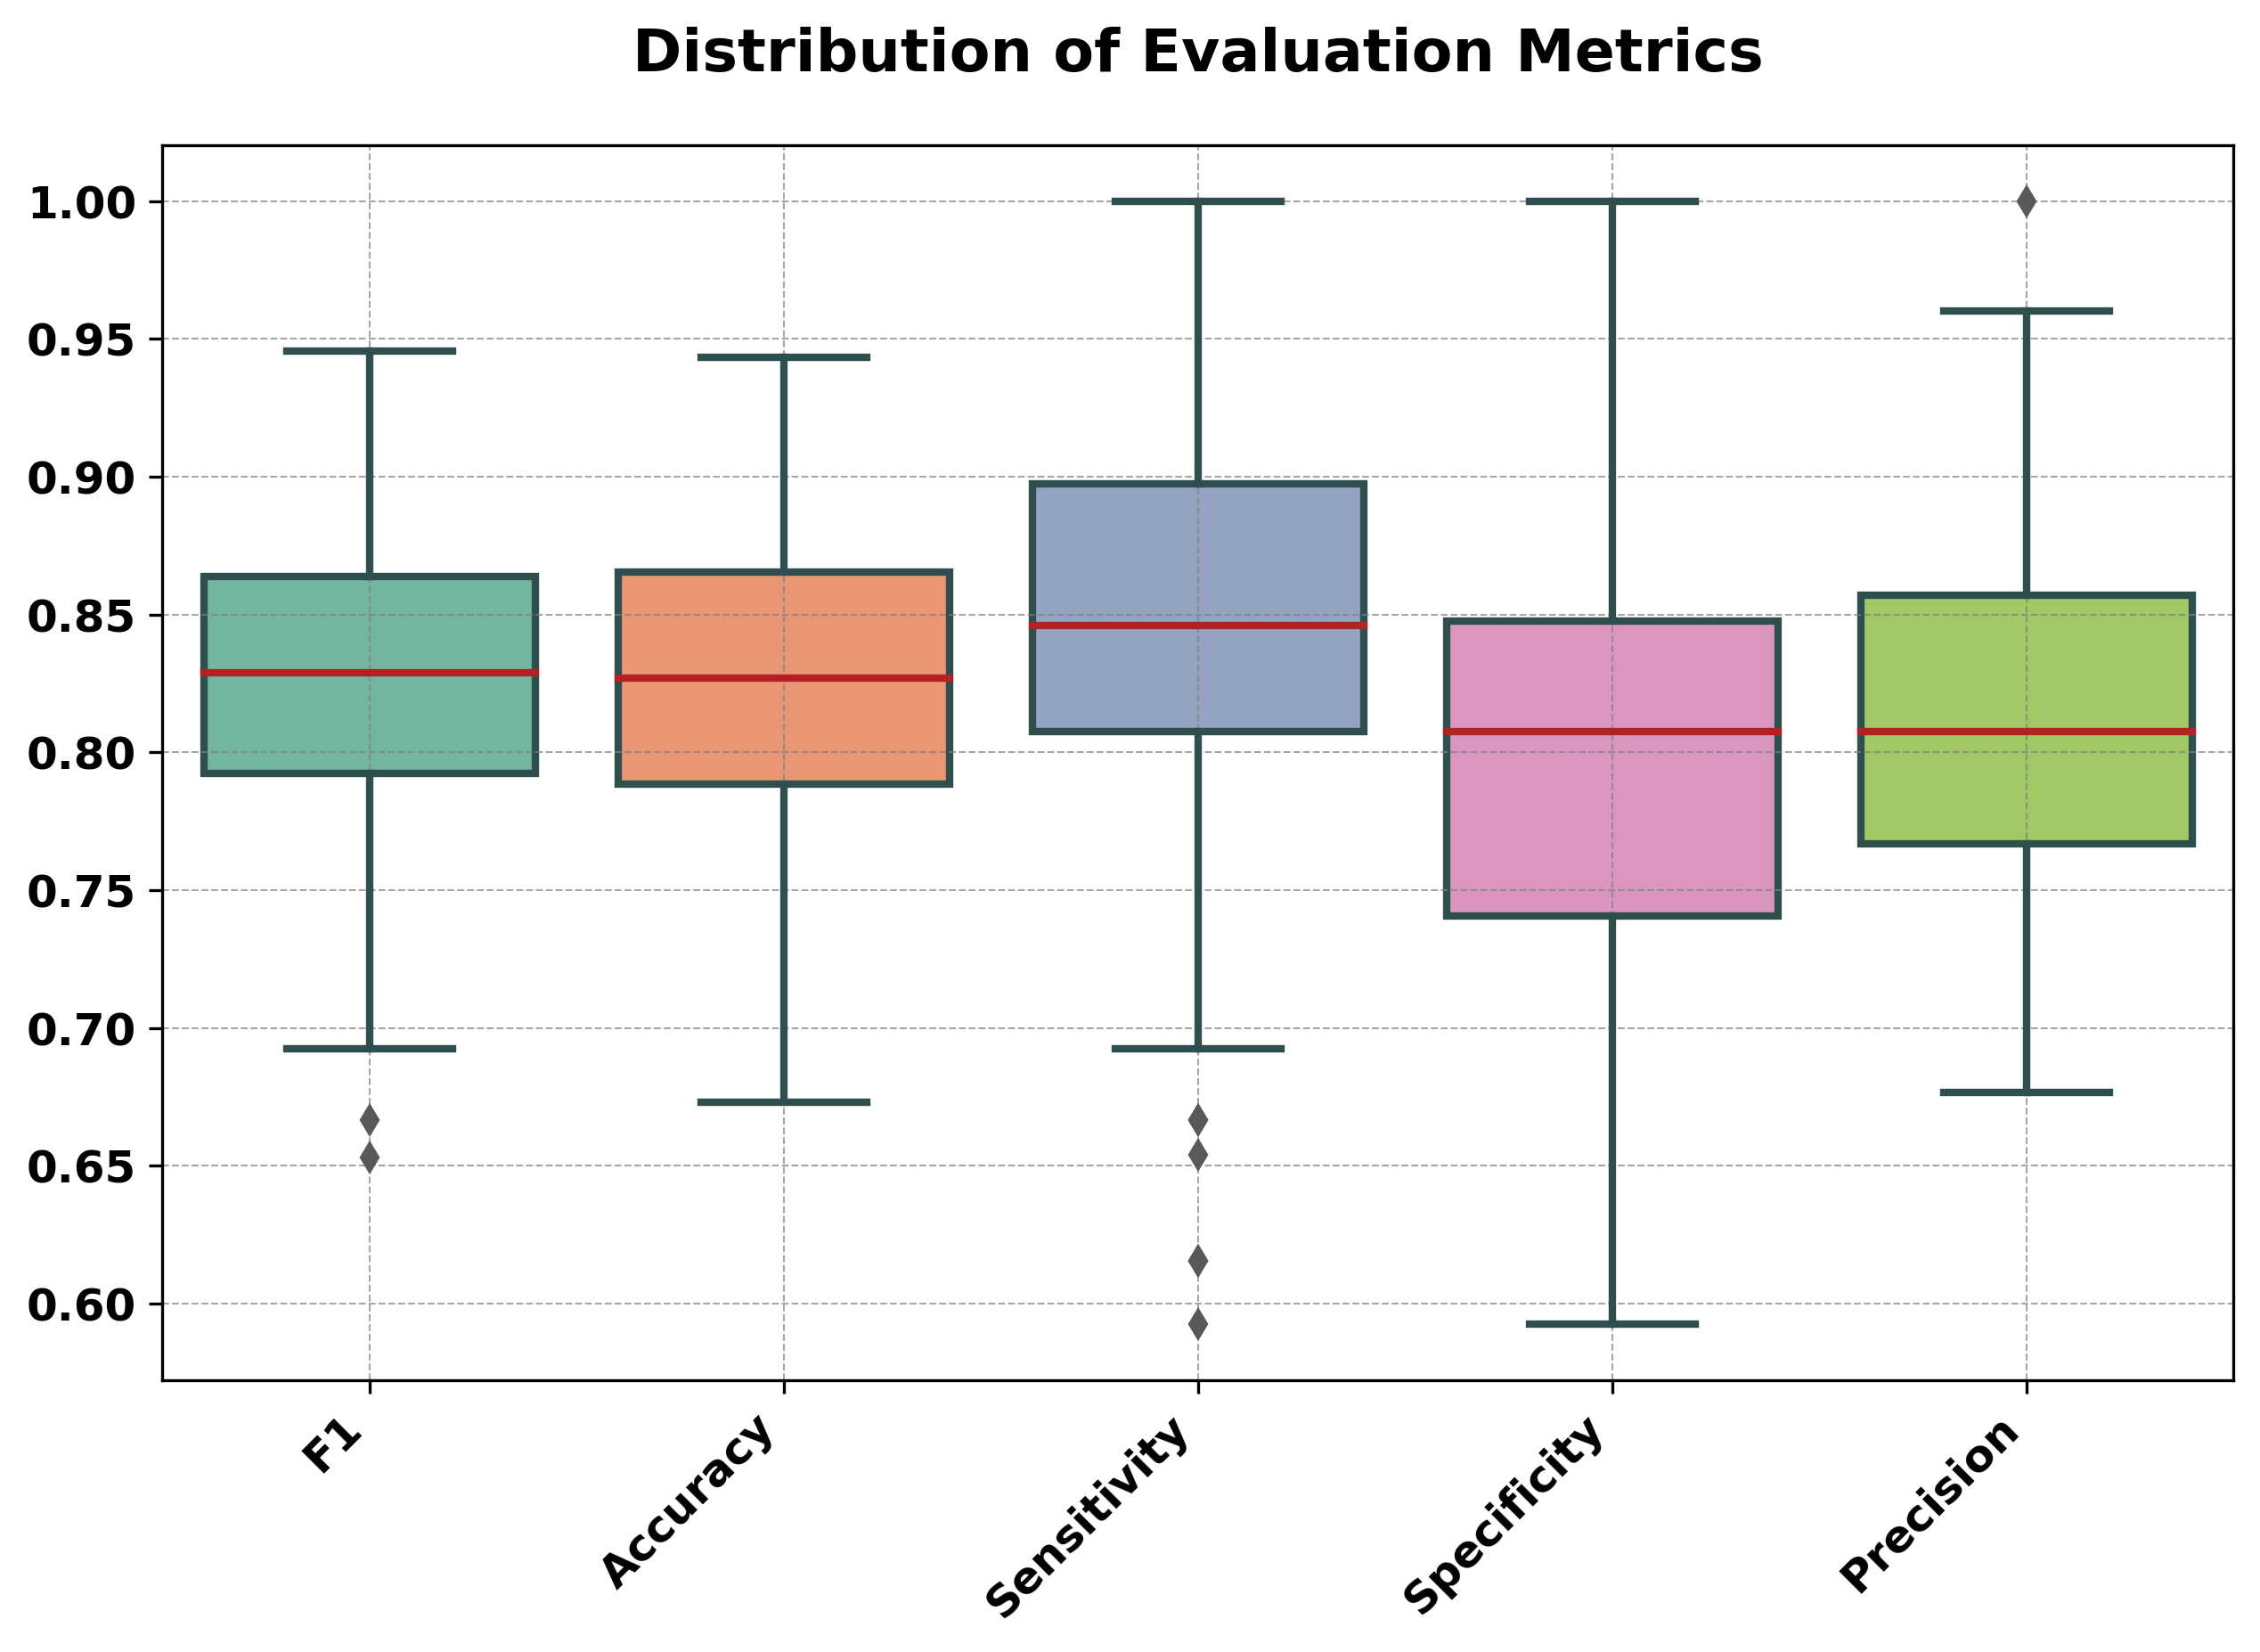
PET+CT Images

Slide 18
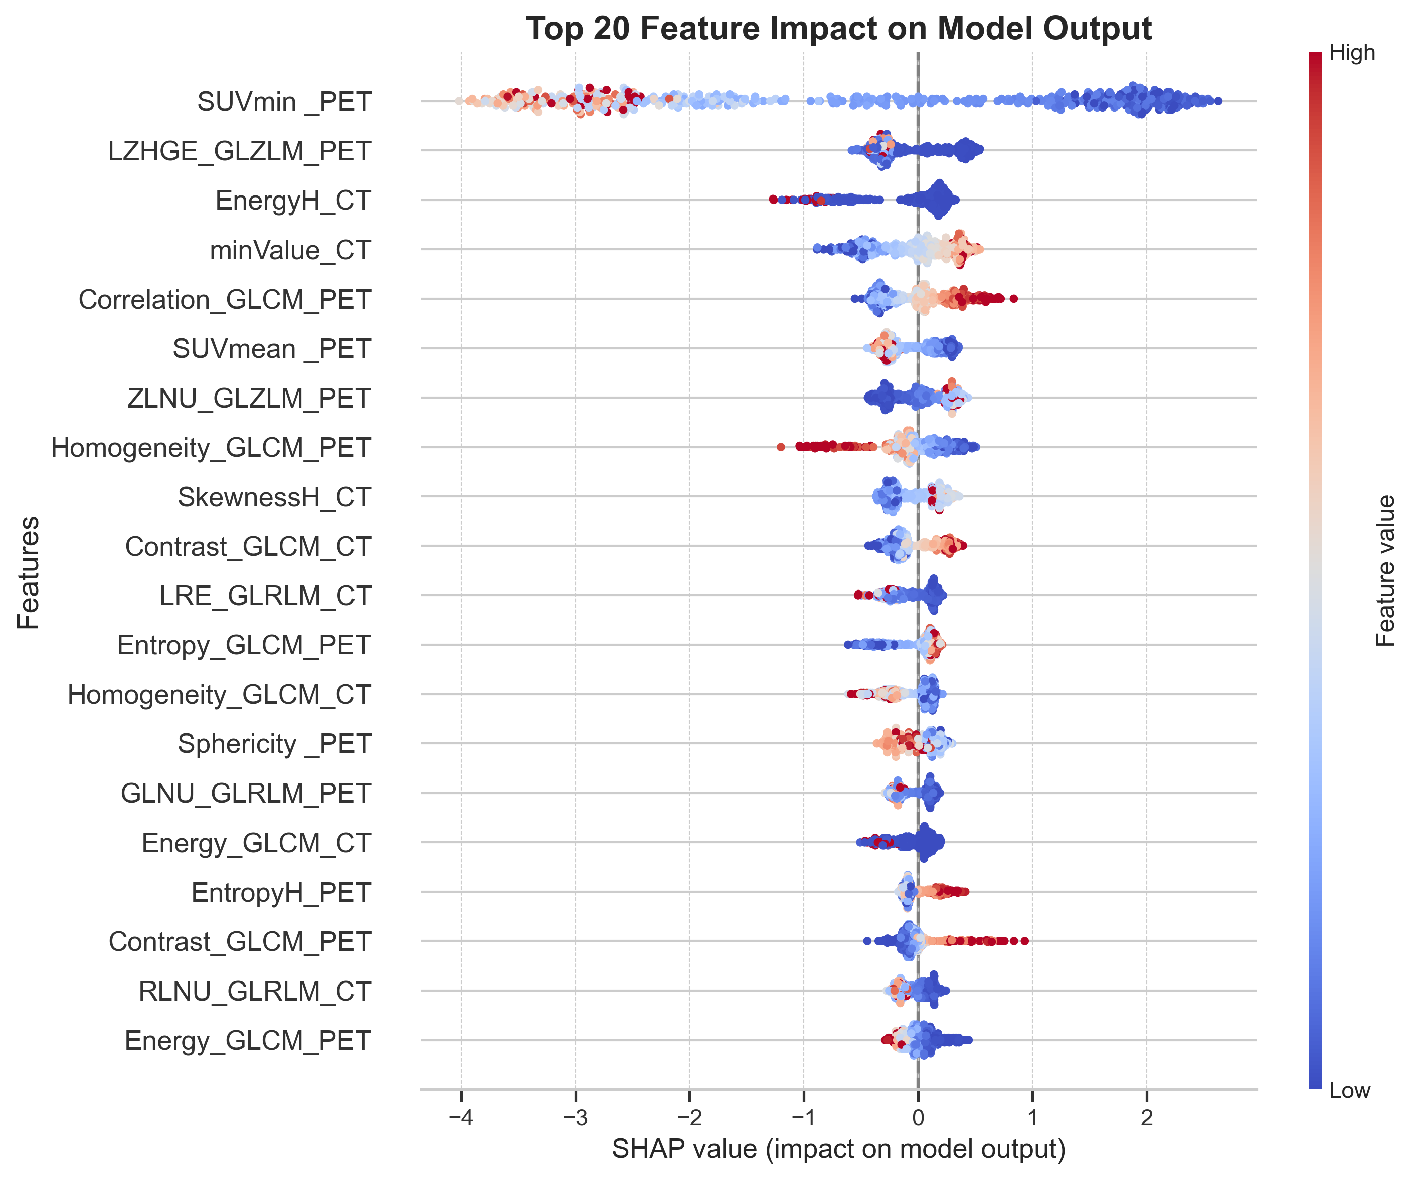
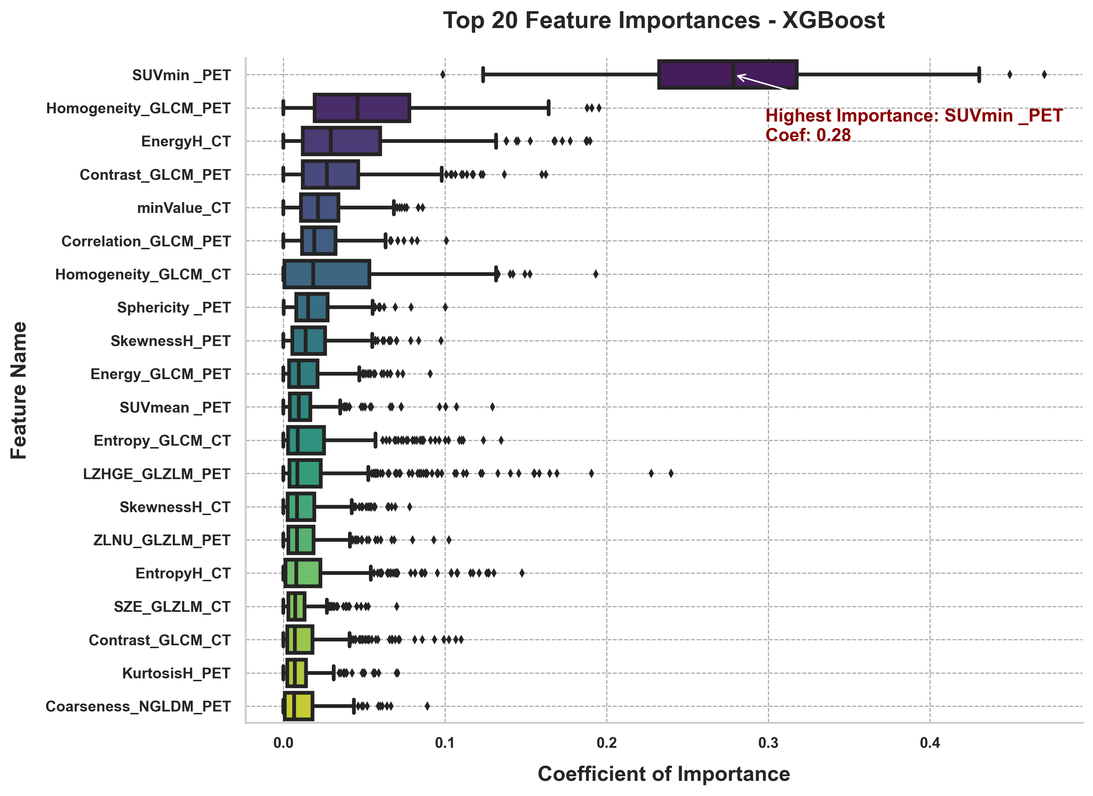
PET+CT Images

Slide 19
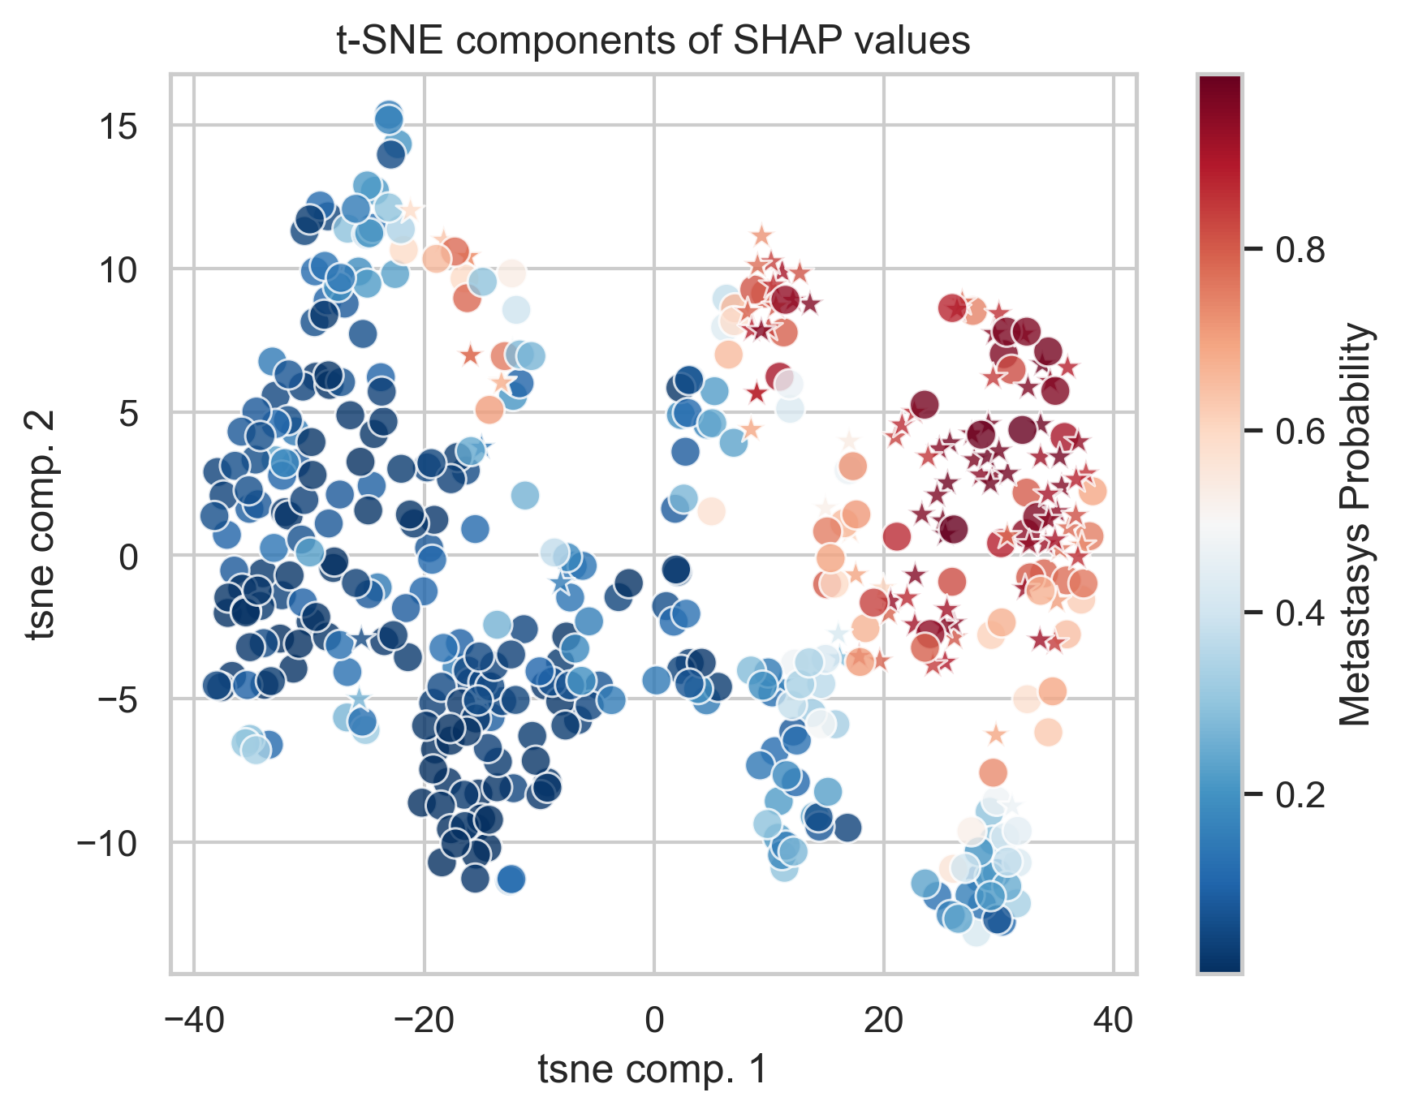
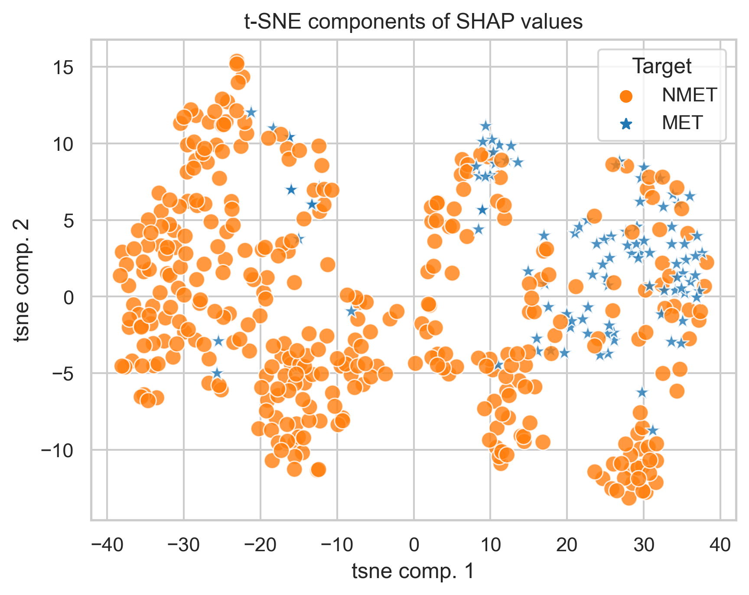
PET+CT Images
t-distributed stochastic neighbor embedding

Slide 20
Conclusions
Increased performance in joint fusion
Explainable Artificial Intelligence to transform ML black box into white box
Decision Support System (DSS) for Healthcare Personnel

Slide 21
Thanks for your attention

