Slide 1


Artificial
Intelligence in Medicine: next steps
Explainability in COVID-19 pneumonia:
Finding consistent features in a multicenter radiomic study and explaining the prediction of a multi-input deep model
Camilla Scapicchio, PhD
INFN Sezione di Pisa

Slide 2





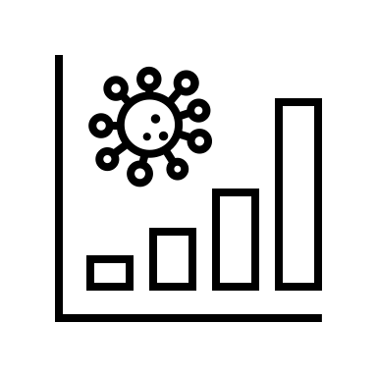

Outline
Covid19-WG
Explainability in Covid-19 pneumonia
ML pipeline for severity prediction
  Dataset and Aim
  Machine Learning pipeline
  Finding consistent features
Multi-input CNN for severity prediction
  Dataset and Aim
  Pipeline
  Explainability
Conclusions
C.Scapicchio, NEXT-AIM meeting, 17 October 2024

Slide 3

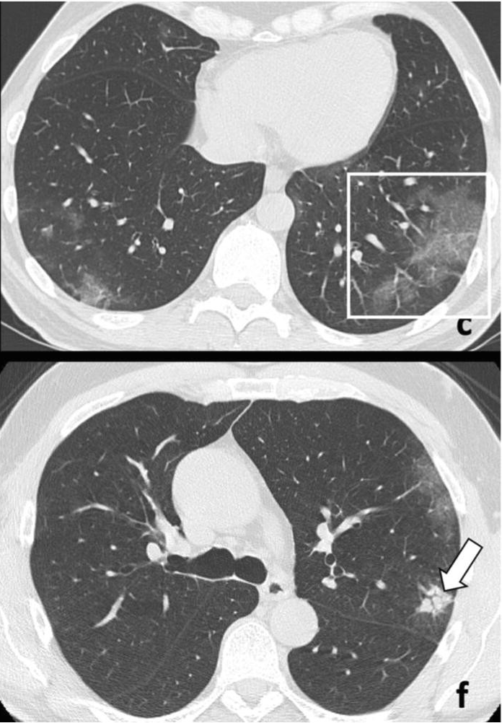
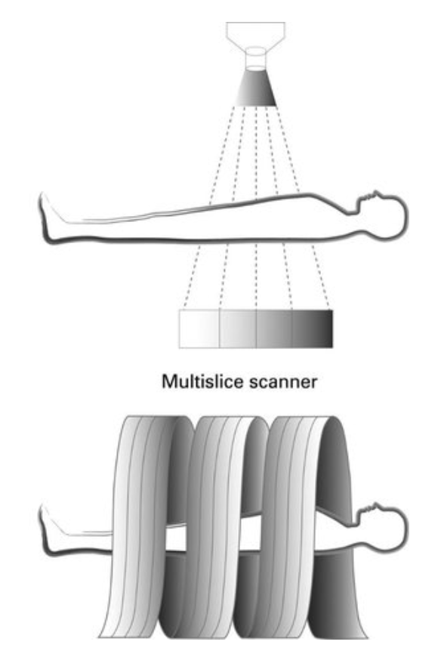
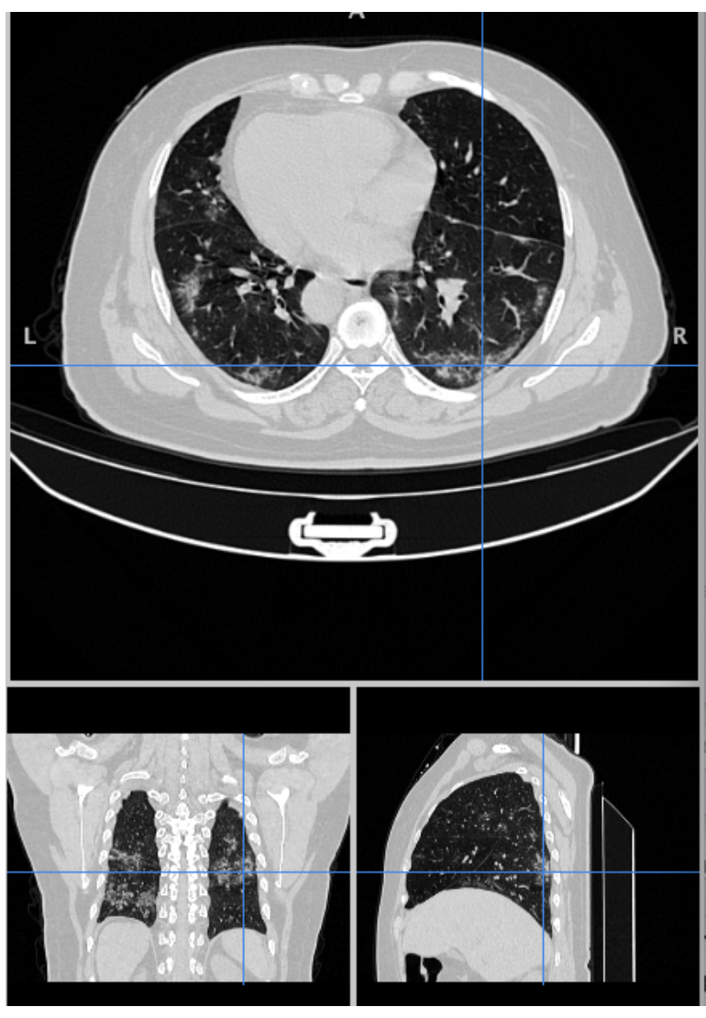
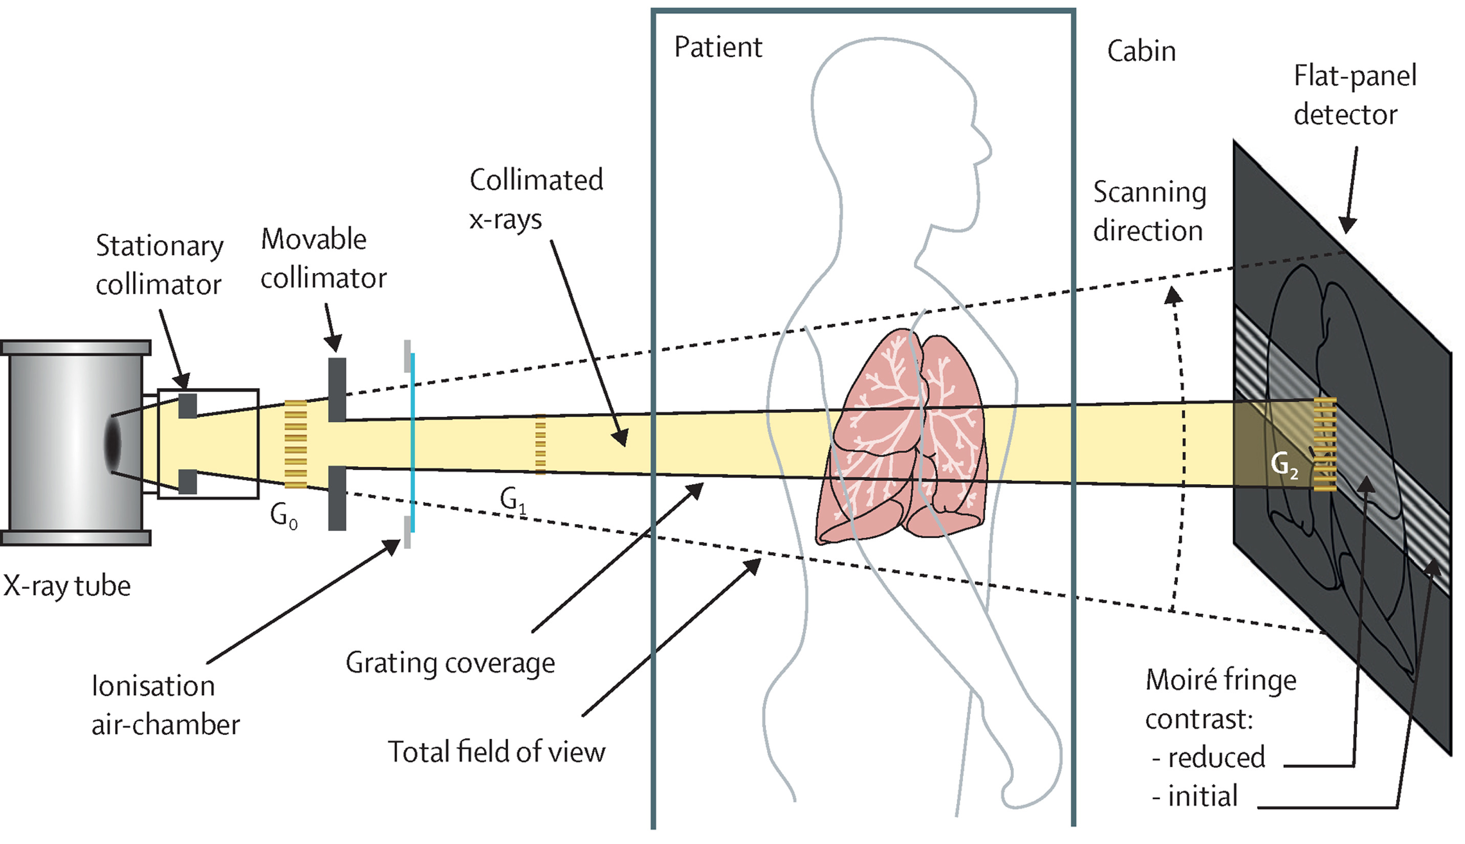
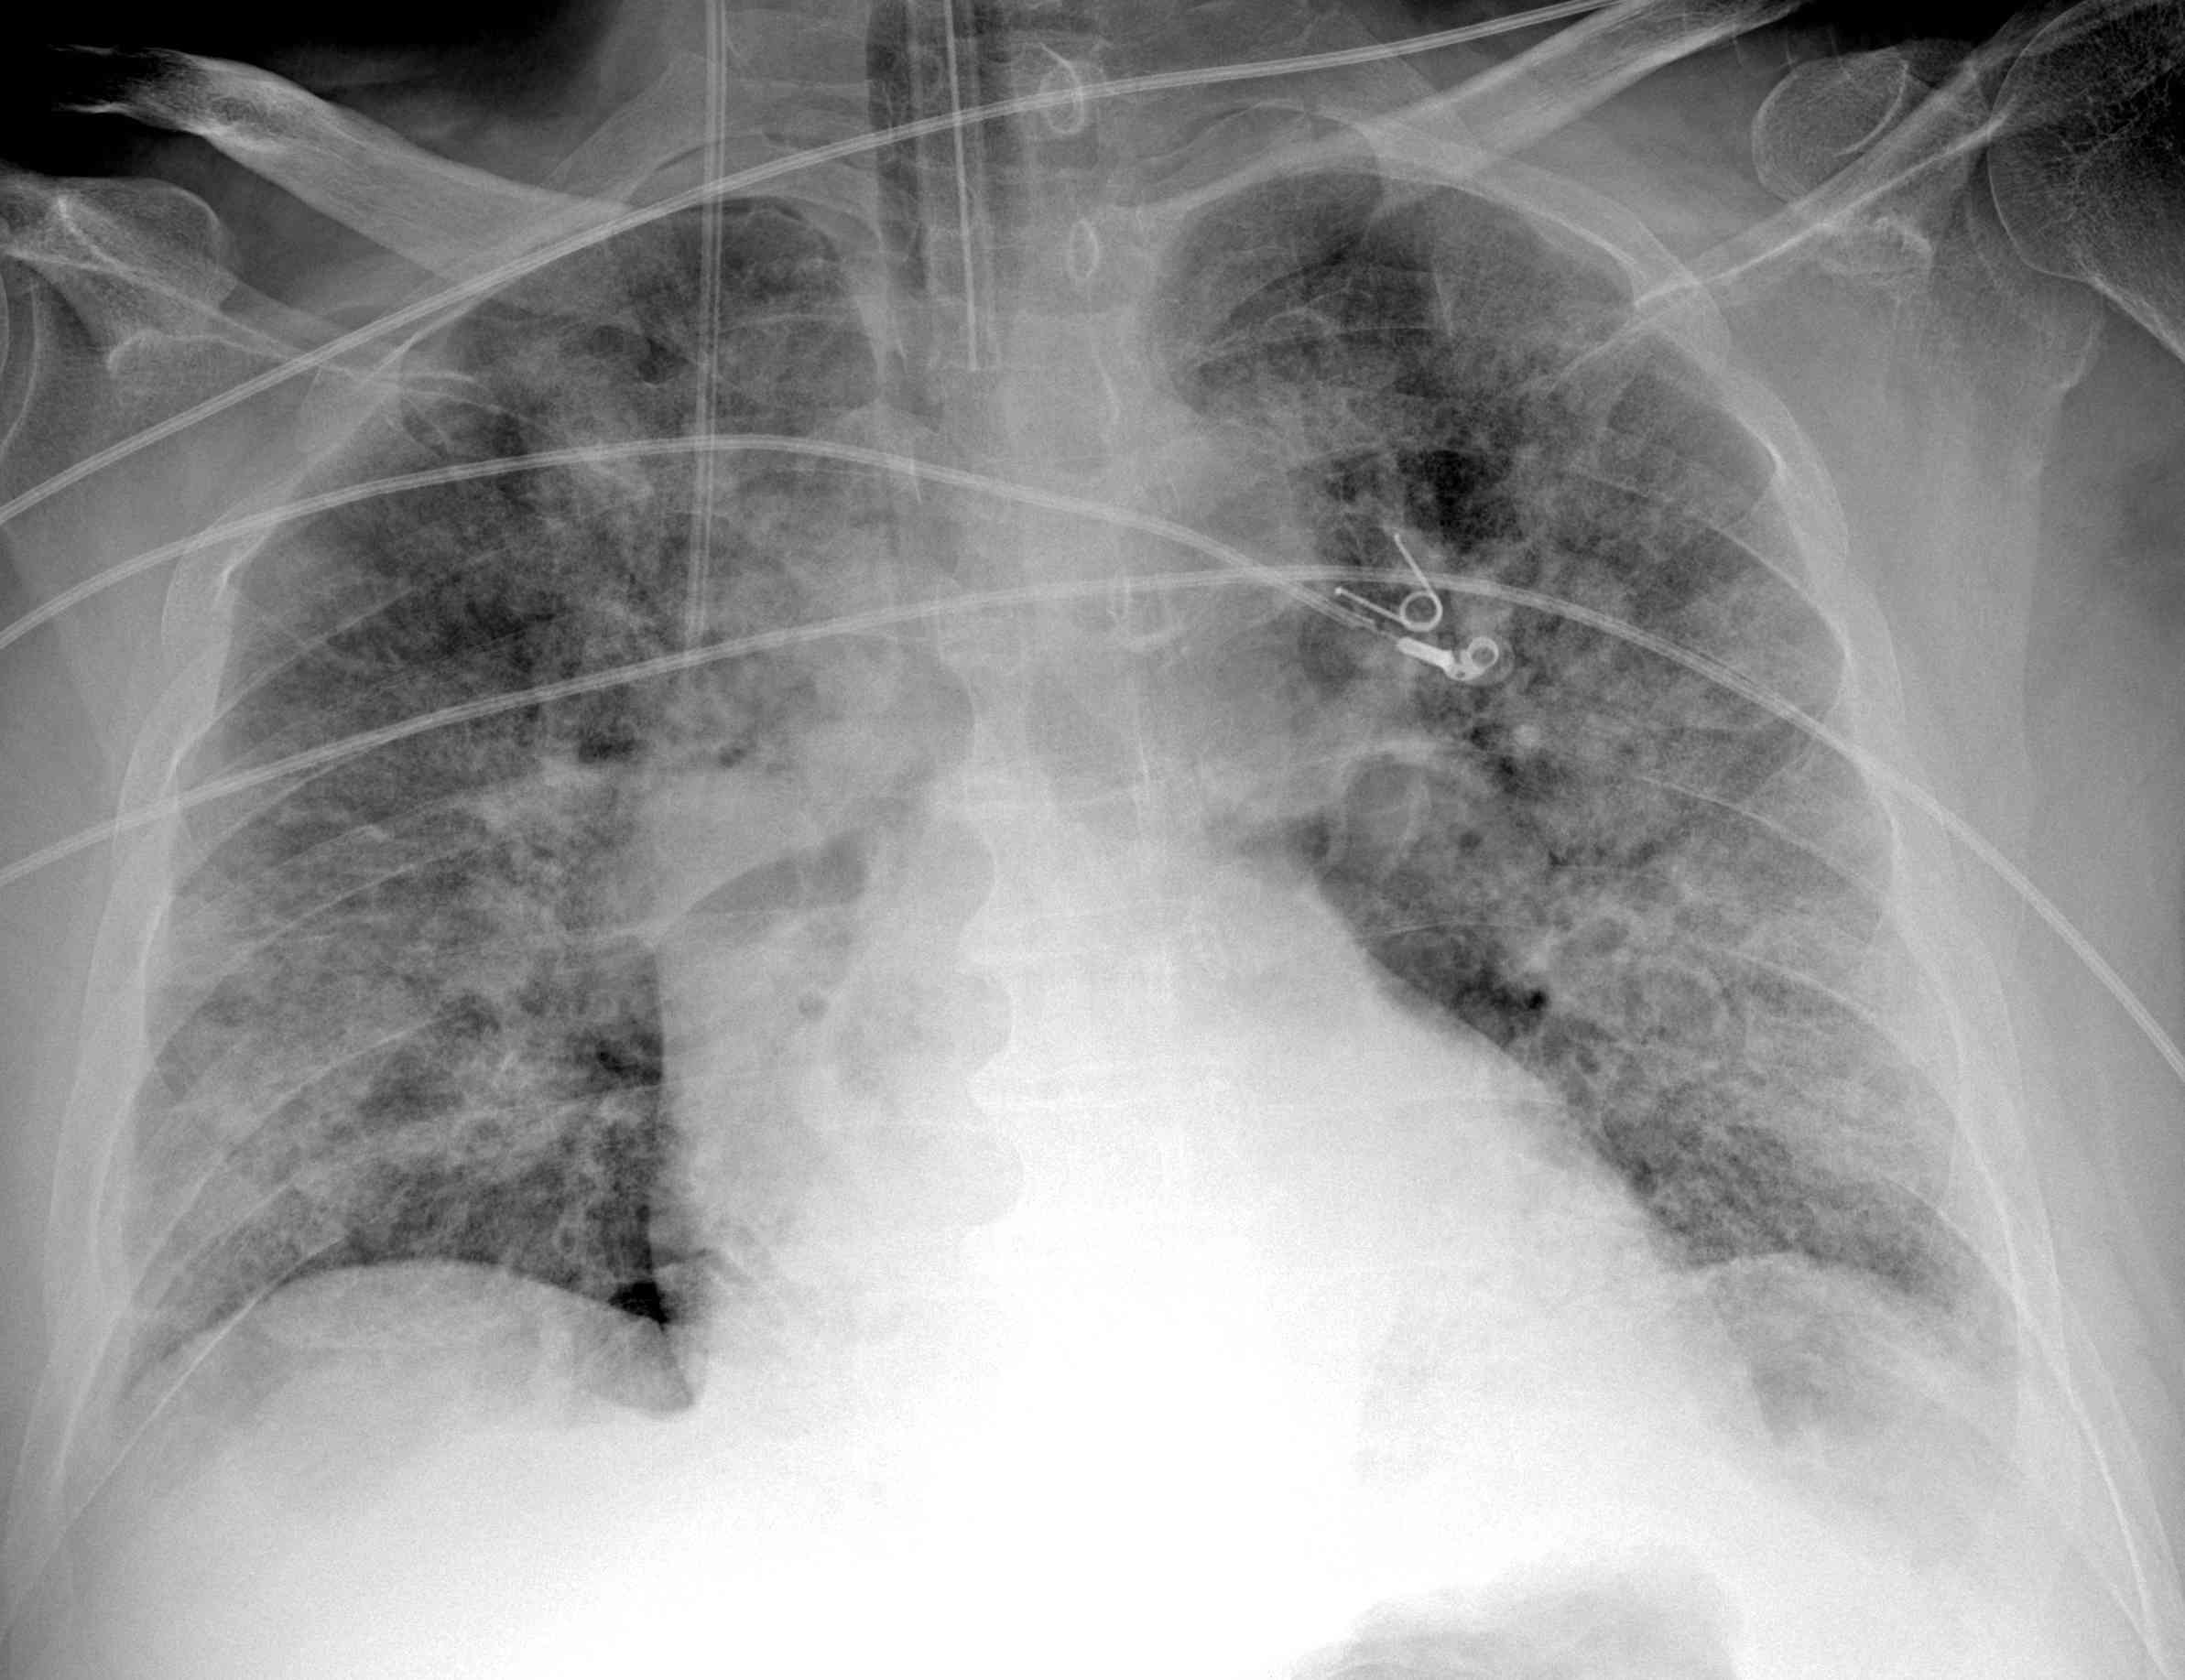
Covid19-WG [PI,MI,PV,GE,FI,PA,CA]
Both qualitative and quantitative characteristics of chest CTs can be used to define the severity of COVID-19 pneumonia
Signs of critical disease:
CT images (3D)
CXR images (2D)
GGO
Consolidation
C.Scapicchio, NEXT-AIM meeting, 17 October 2024

Slide 4
Explainability in Covid19 pneumonia
ML pipeline for severity prediction
Multi-input CNN for severity prediction
1) It is difficult to provide a meaningful explanation for a deep complex model.
2) Issues related to reproducibility and robustness impede the full trustworthiness.
Assessing robustness
CT scans
Finding consistent features in multicenter analysis
Possible harmonization strategies
1
Trustworthiness
and
Explainability
CXR and clinical feature
Explaining the prediction
Grad-CAM visualization
Clinical Features importance
2
C.Scapicchio, NEXT-AIM meeting, 17 October 2024

Slide 5
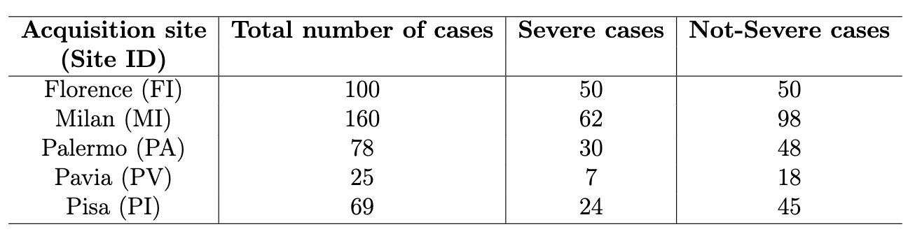
ML pipeline for severity prediction
Dataset
CT scans with the related clinical outcome on severity (died or intubated) about one month after CT acquisition from 5 clinical centers.
Different vendor machines, acquisition parameters, and reconstruction filters have been used.
Aim
Prediction of the clinical prognosis (severe / not severe) for COVID-19 patients by means of a traditional ML-based classifier trained on radiomics features extracted from CT scans.
C.Scapicchio, NEXT-AIM meeting, 17 October 2024

Slide 6

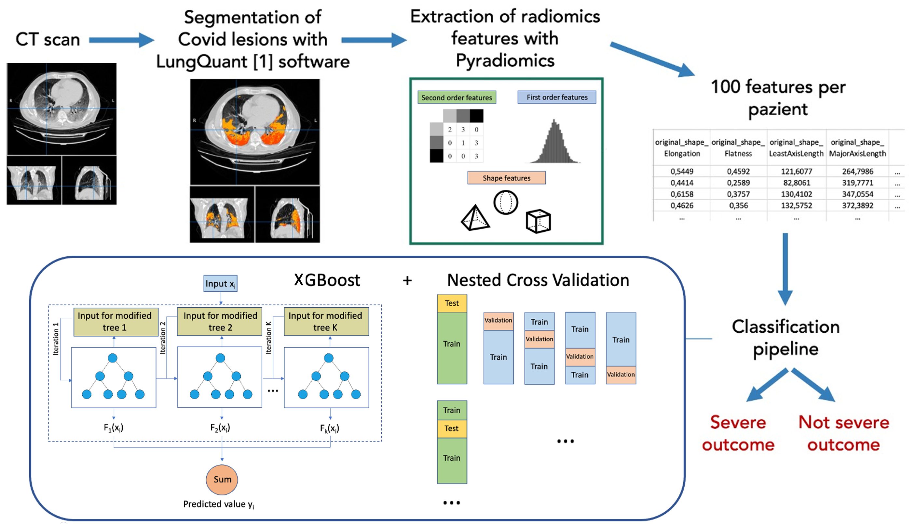
ML pipeline for severity prediction
Pipeline
10 trials
15% of the dataset in Test
4-fold CV of remaining 85%
gamma: [0.5, 1, 1.5, 2, 5]
max_depth: [3, 4, 5]
subsample: [0.6, 0.8, 1.0]
colsample_bytree: [0.6, 0.8, 1.0]
min_child_weight: [1, 5, 10]
learning_rate=0.02
n_estimators=600
objective='binary:logistic’
nthread=1
[1] Lizzi, F., et al. https://doi.org/10.1140/epjp/s13360-023-03896-4
C.Scapicchio, NEXT-AIM meeting, 17 October 2024

Slide 7
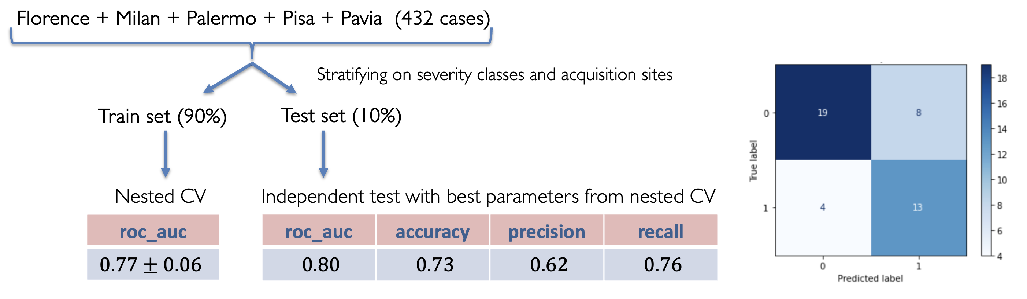
ML pipeline for severity prediction
First results
C.Scapicchio, NEXT-AIM meeting, 17 October 2024

Slide 8
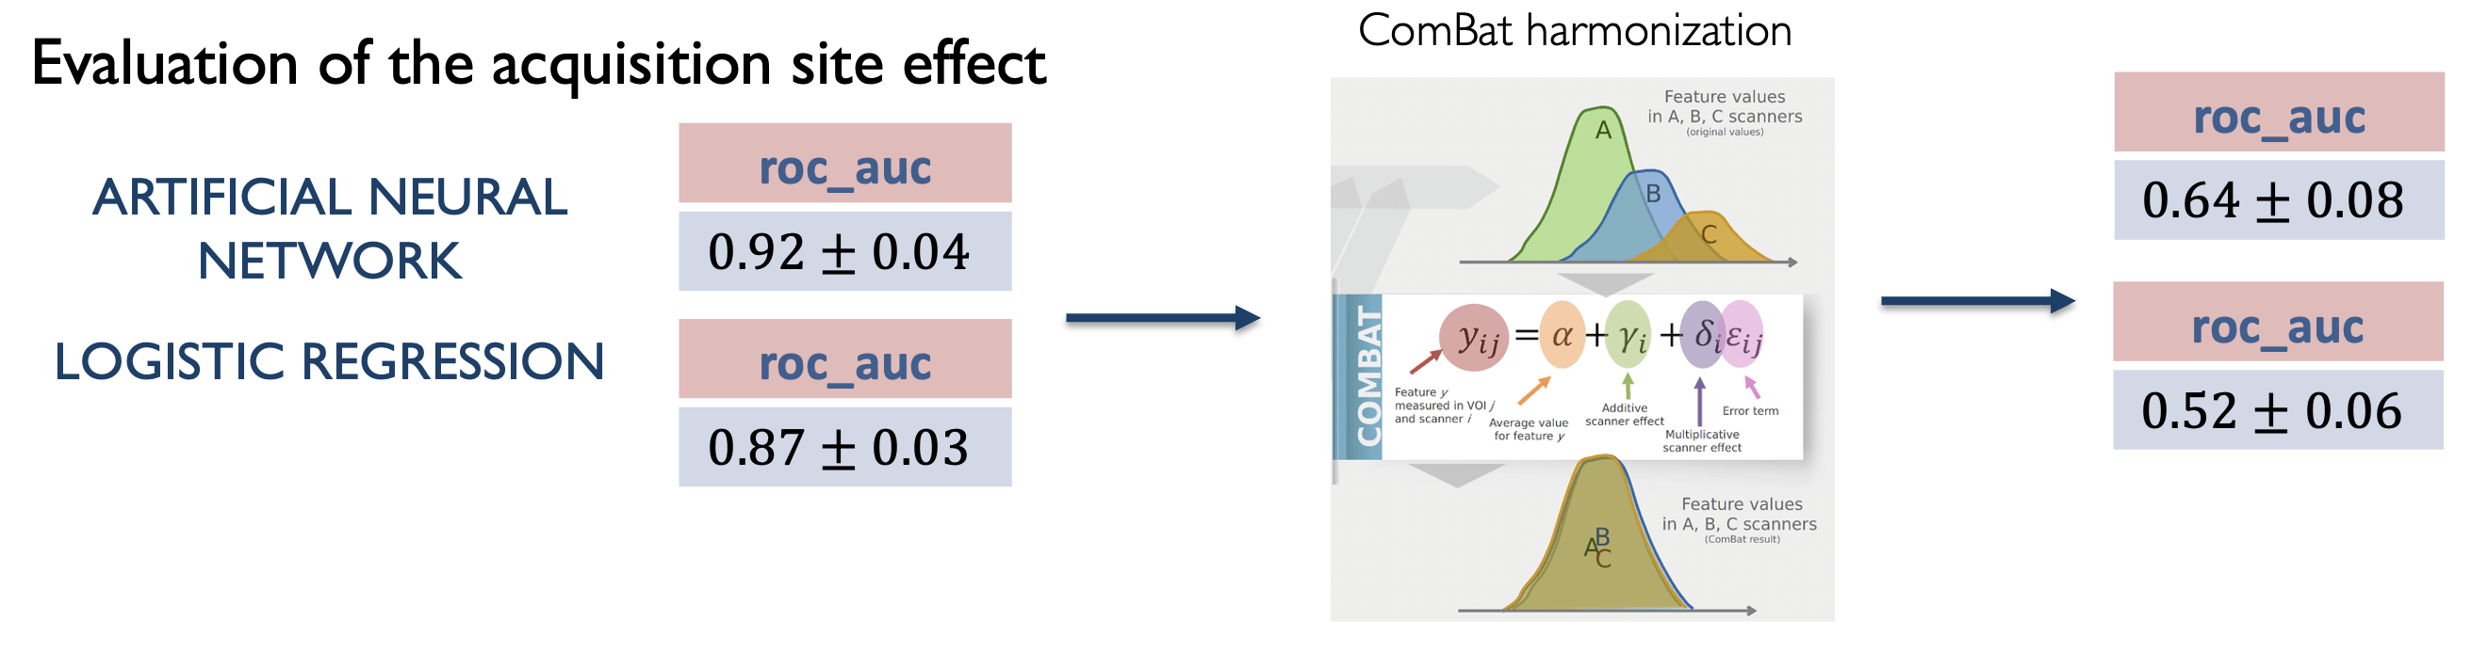
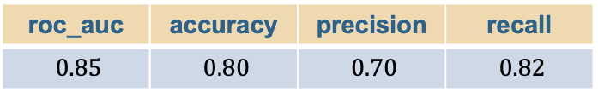
Finding consistent features
Severity prediction
roc_auc | accuracy | precision | recall
$0.85$ | $0.80$ | $0.70$ | $0.82$
Florence + Milan + Palermo + Pisa + Pavia (432 cases)
Analysis of consistent features
most relevant features selected on different datasets and with different selection methods
gldm DependenceNonUniformity
gldm GrayLevelNonUniformity
glrlm GrayLevelNonUniformity
glrlm RunLenghtNonUniformity
glszm GrayLevelNonUniformity
The same Non-Uniformity features are significant before and after data harmonization!
mRMR
Feature Importance
C.Scapicchio, NEXT-AIM meeting, 17 October 2024

Slide 9
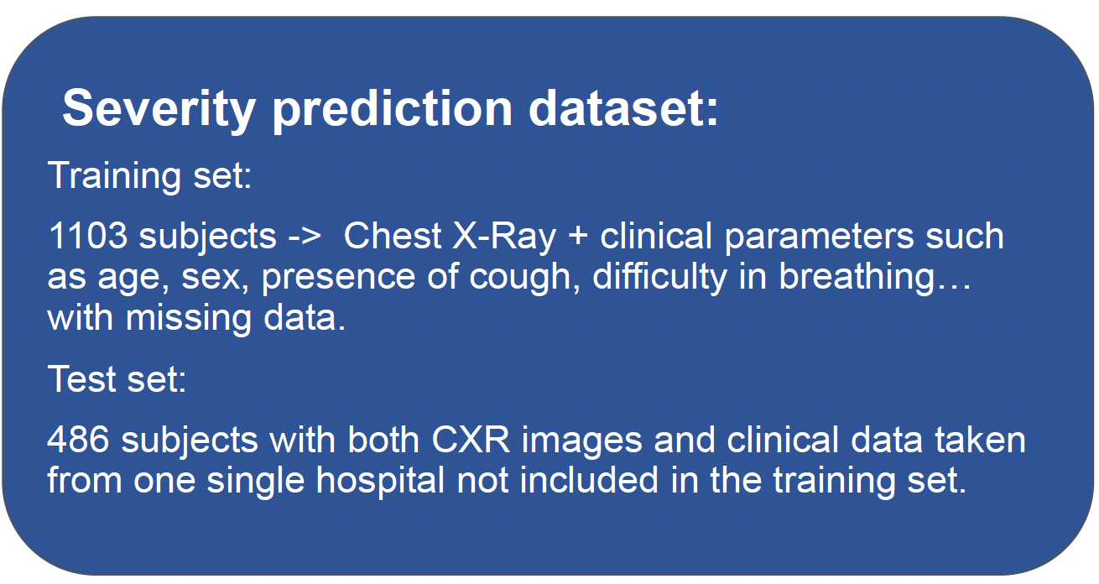

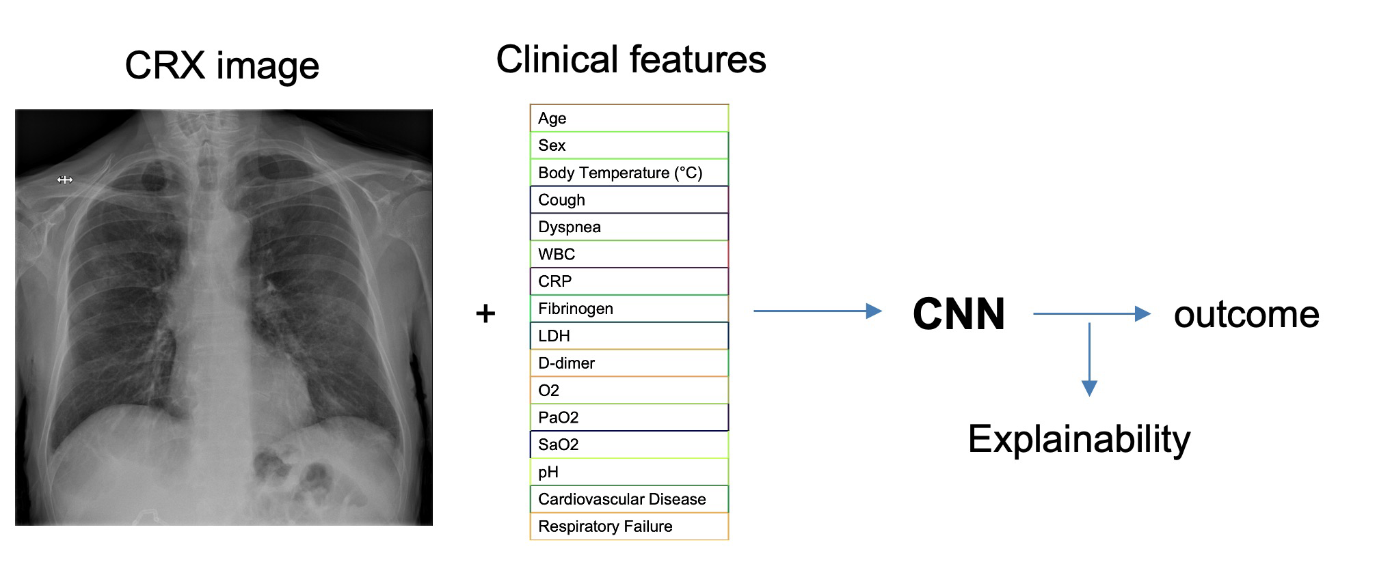
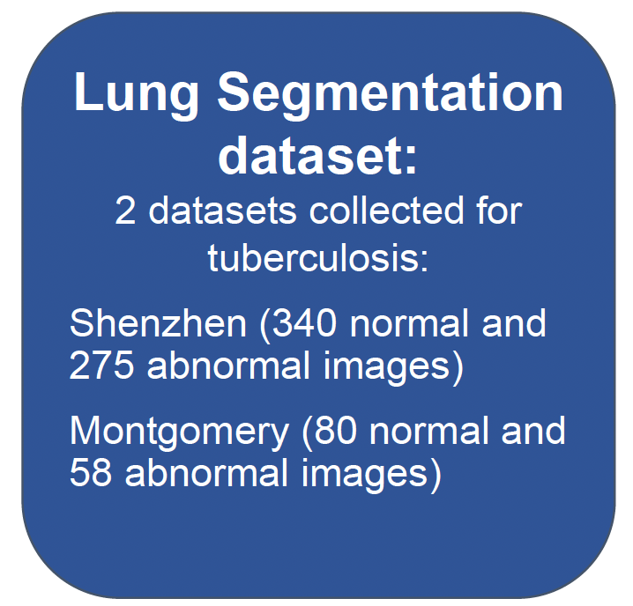
Multi-input CNN for severity prediction
Dataset
Aim
A fully automated algorithm for the prediction of COVID-19 patient severity outcomes based on Chest X-Ray images and clinical data.
AI4COVID Hackathon
(https://ai4covid-hackathon.it/)
C.Scapicchio, NEXT-AIM meeting, 17 October 2024

Slide 10
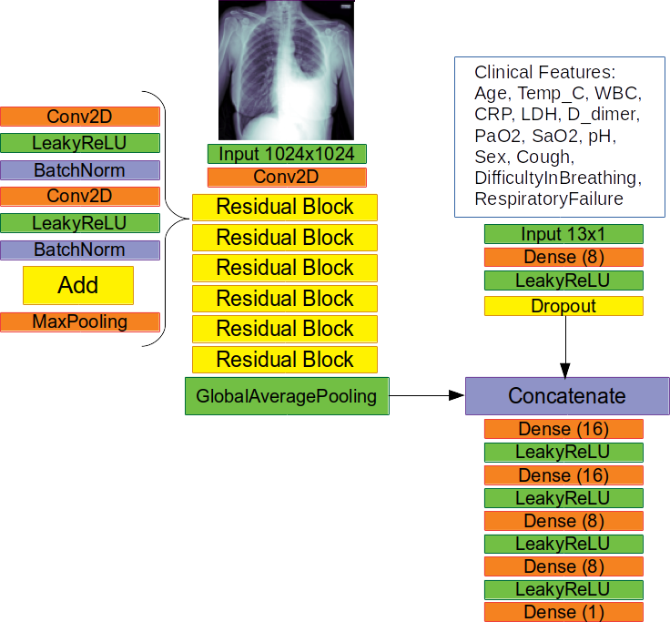
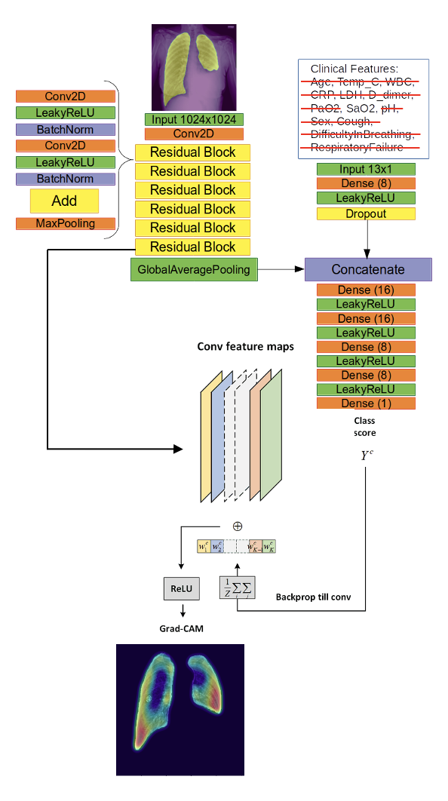
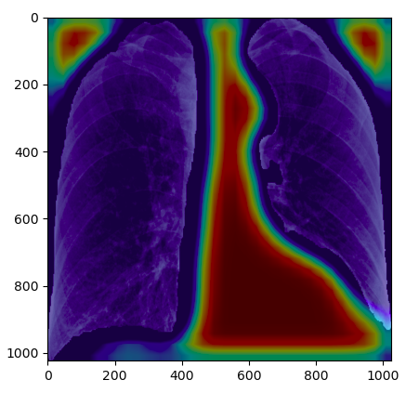
Multi-input CNN for severity prediction
Pipeline
Explaining
the prediction
The AIM-WG team achieved the 4th place with a 74% accuracy in predicting patient prognosis on the independent test set
Hyperparamters
Training for 100 epochs
Adam optimizer
Binary Cross-Entropy loss function
Accuracy as evaluation metric
C.Scapicchio, NEXT-AIM meeting, 17 October 2024

Slide 11
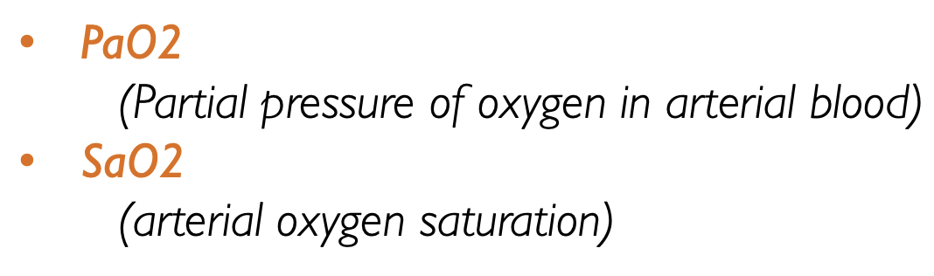


Explainability
By using only these features the performance is the same as obtained by using all the features.
Clinical features branch
Features that can better predict the outcome:
The explanation visualization enabled the detection of the bias and the optimization of the entire pipeline suggesting the addition of a segmentation step.
Images branch
C.Scapicchio, NEXT-AIM meeting, 17 October 2024

Slide 12
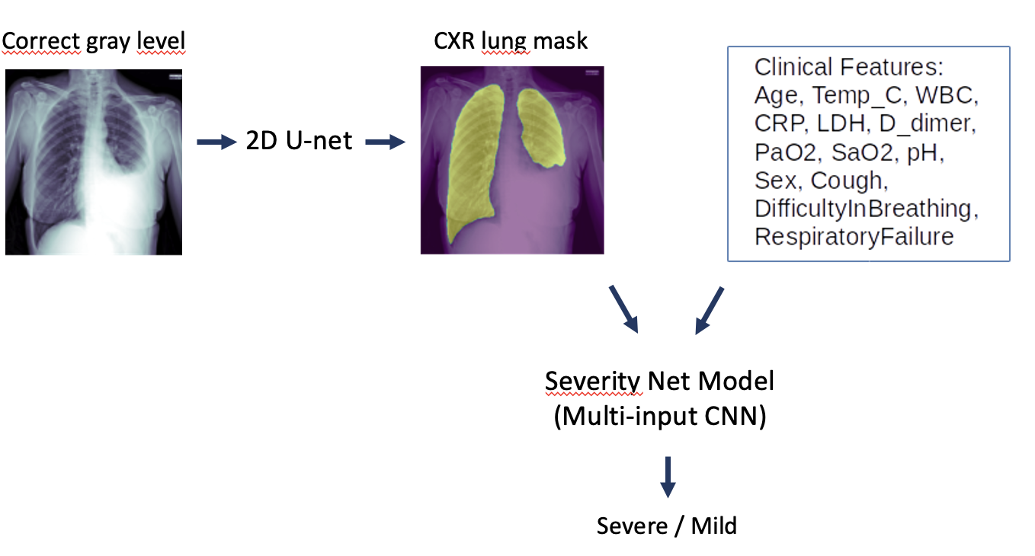
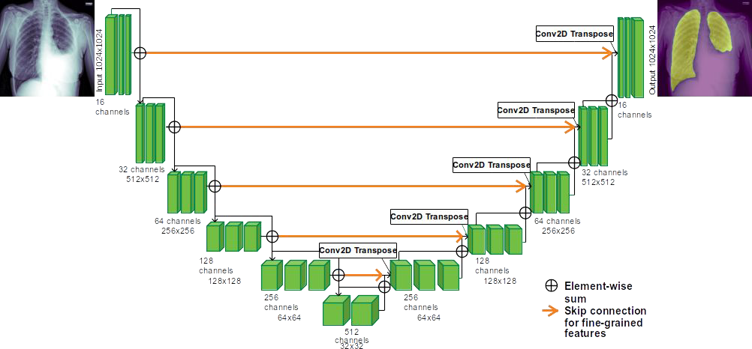
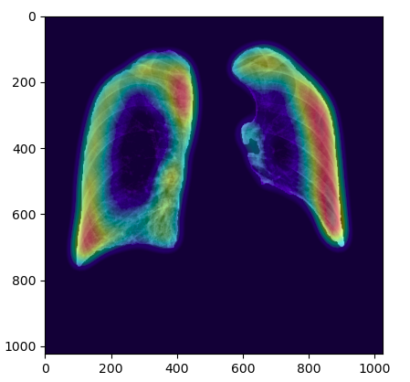
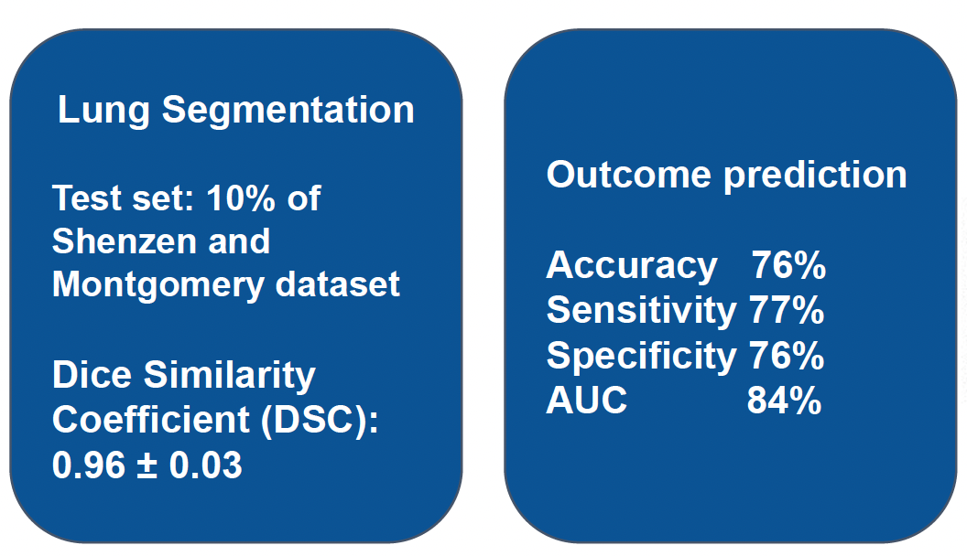
Pipeline optimization
This helped the network to concentrate on the right area of the image.
C.Scapicchio, NEXT-AIM meeting, 17 October 2024

Slide 13
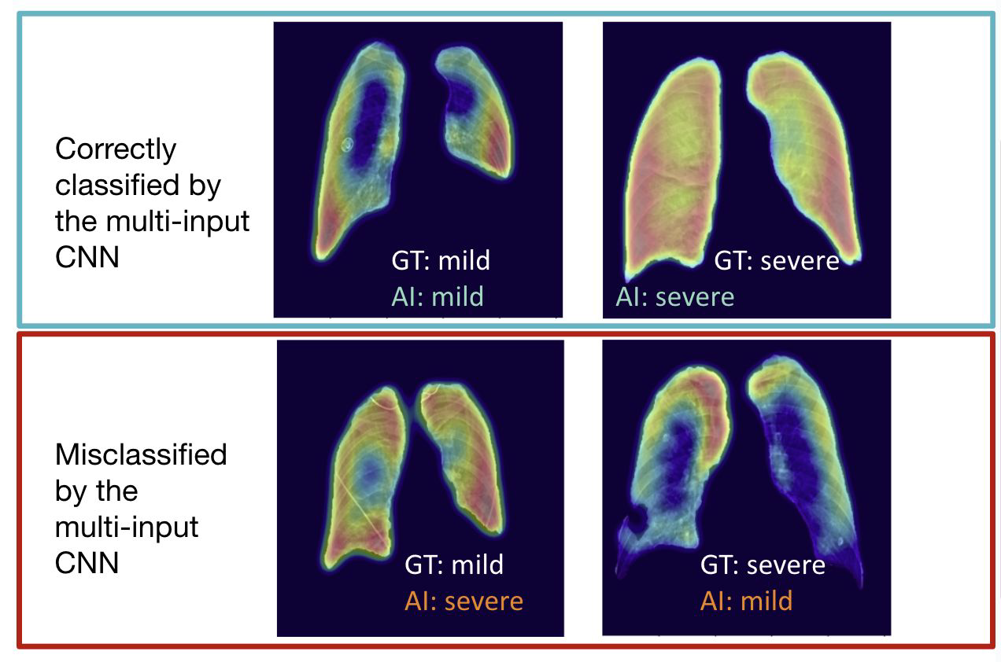
Explainability
C.Scapicchio, NEXT-AIM meeting, 17 October 2024

Slide 14
Conclusions
An ML pipeline trained on a multi-center dataset of radiomics features can predict the severity outcome for COVID-19 patients.
Some features mainly describing spatial inhomogeneity of the lesion appear to be robust with respect to the site and method of selection, and could therefore be specific to the pathology.
Scapicchio, C., et al. »COVID-19 severity prediction based on radiomic features extracted from lung ct scans using the Lungquant segmentation software." Physica Medica: European Journal of Medical Physics 115 (2023)
Lizzi, F. et al. (2024). A Multi-input Deep Learning Model to Classify COVID-19 Pneumonia Severity from Imaging and Clinical Data. https://doi.org/10.1007/978-3-031-64636-2_18
The multi-input CNN is able to predict the COVID-19 severity prognosis starting from both CXR images and related clinical variables.
The explanation is in line with the clinical routine.
C.Scapicchio, NEXT-AIM meeting, 17 October 2024

Slide 15


Thank you for your attention!
contact: camilla.scapicchio@pi.infn.it
Acknowledgments
Covid-19 WG people
Radiologists and Medical Physicists collaborating with the nextAIM project.
Collegues of the Data Center @ INFN Division of Pisa.

Slide 16
Back-up slides

Slide 17
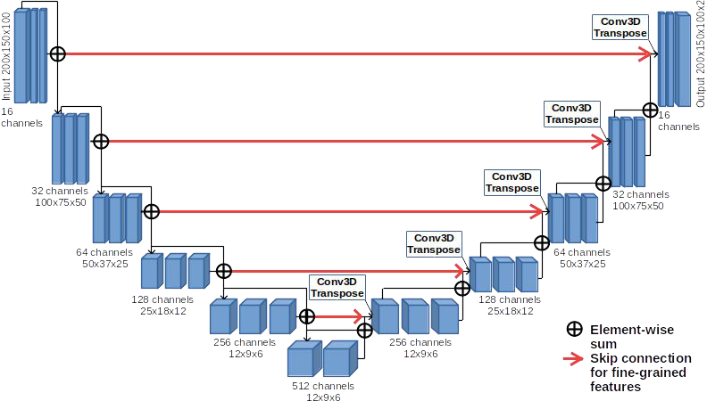
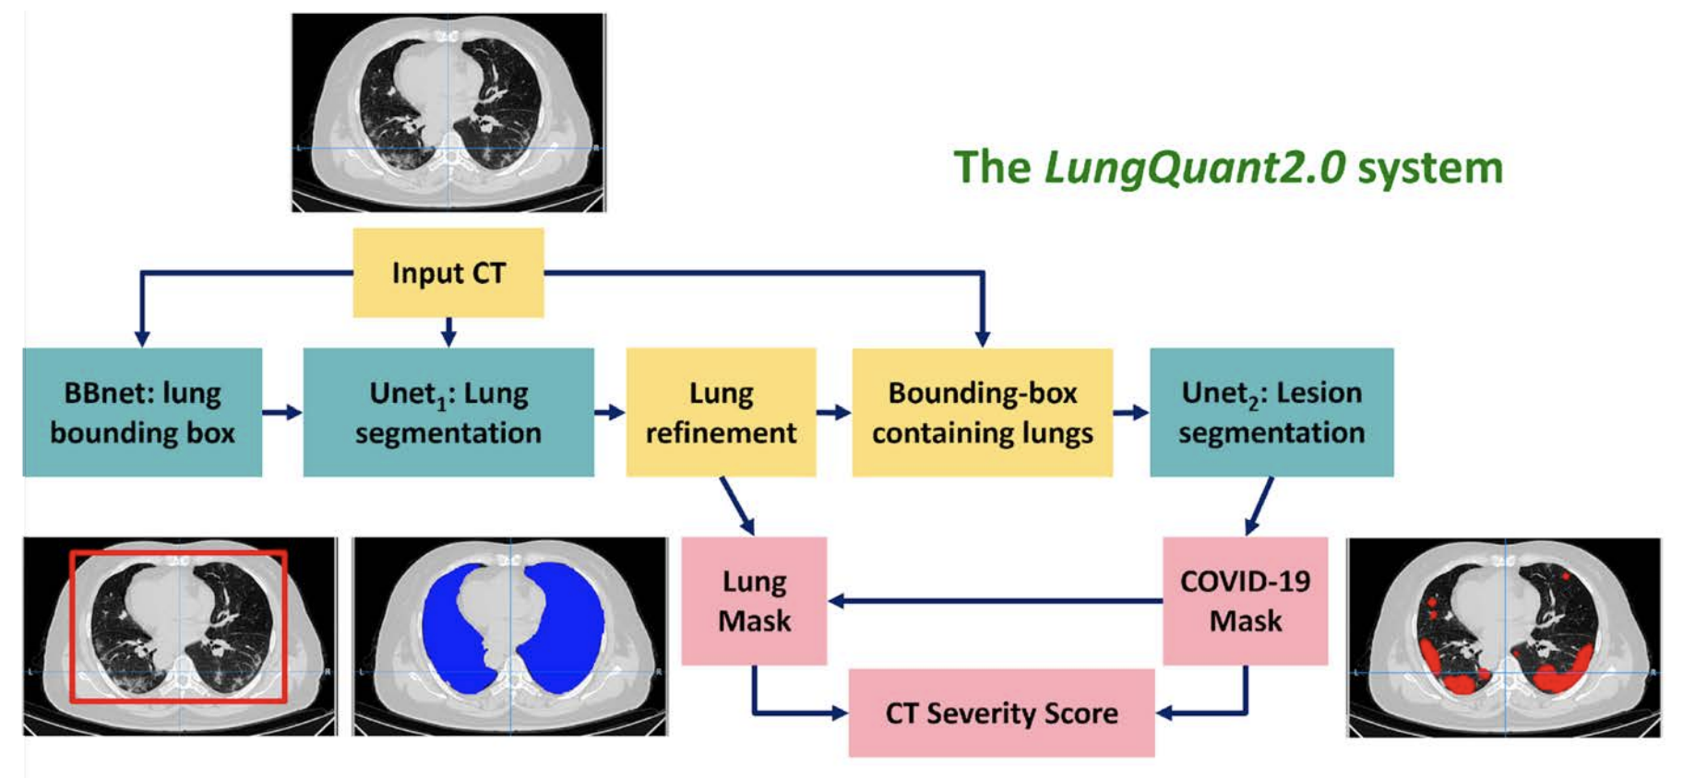


Il software di segmentazione LungQuant
U-net in cascata allenate per la segmentazione
  Maschera del polmone
  Maschera della lesione COVID-19
  CT-Severity Score (CTSS), indice di gravità del polmone coinvolto dall’infezione:1 (<5%), 2 (5%-25%), 3 (25%-50%), 4 (50%-75%), 5 (>75%)
[F.Lizzi et al. Quantification of pulmonary involvement in COVID-19 pneumonia by means of a cascade of two U-nets: training and assessment on multiple datasets using different annotation criteria. International Journal of Computer Assisted Radiology and Surgery, 2021.]
C.Scapicchio, NEXT-AIM meeting, February 2023

Slide 18
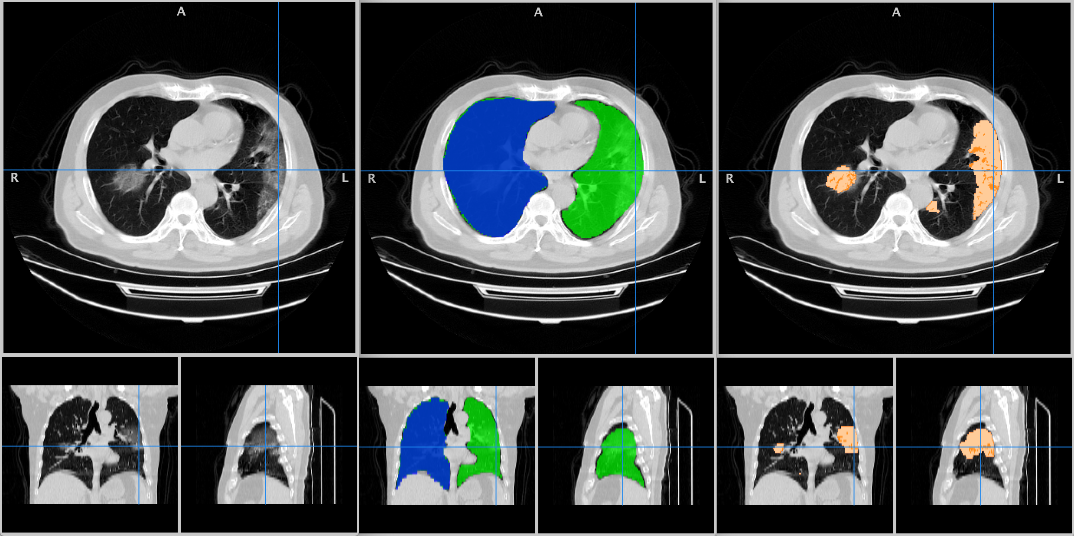
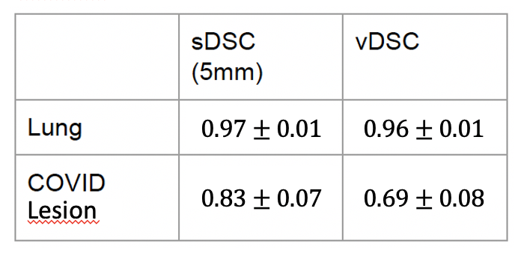
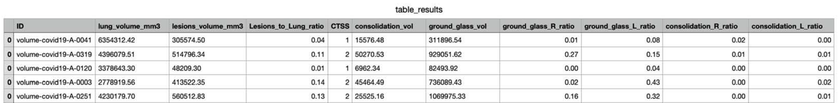
Il software di segmentazione LungQuant
Versione 2.0
CNN basata su regressione all’inizio della pipeline per predire il bounding box attorno ai polmoni.
Funzione per separare polmone destro e sinistro.
Soglia per distinguere GGO da consolidamenti.
CT-SS prediction: Accuracy: 80%
C.Scapicchio, NEXT-AIM meeting, February 2023

Slide 19
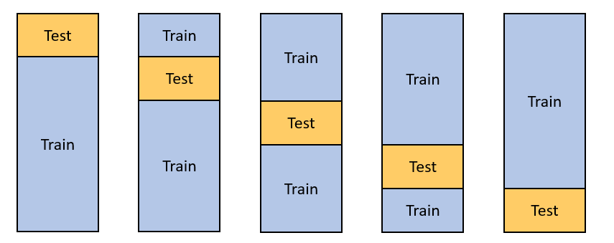
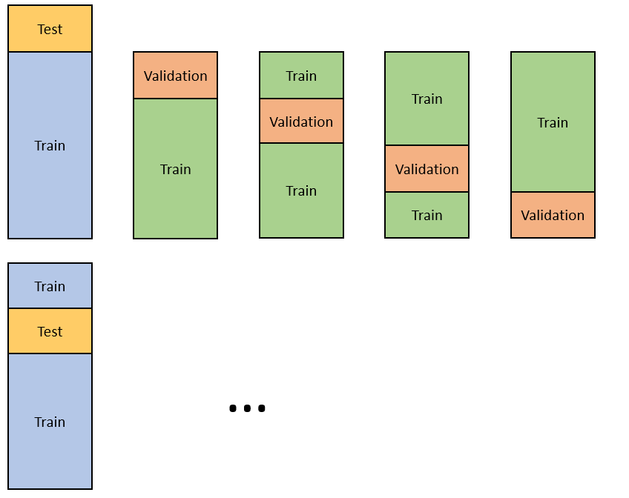
Machine Learning pipeline: Nested CV
La Cross-validation può essere usata sia per l’ottimizzazione degli iperparametri sia per stimare la generalizzabilità del modello. Tuttavia, usarla per entrambi gli scopi contemporaneamente può portare a una sottostima dell’overfitting dalla procedura stessa di ottimizzazione.
Serve un altro loop esterno di cross-validazione per valutare la generalizzabilità della performance.
CV
Nested
CV
10 trials
15% del dataset totale in Test
4-fold CV del restante 85% dei dati
C.Scapicchio, NEXT-AIM meeting, February 2023

Slide 20
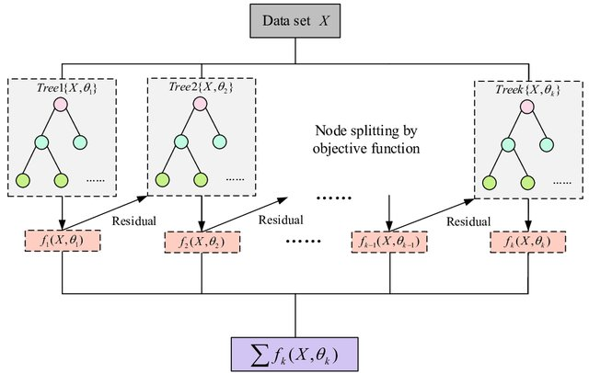
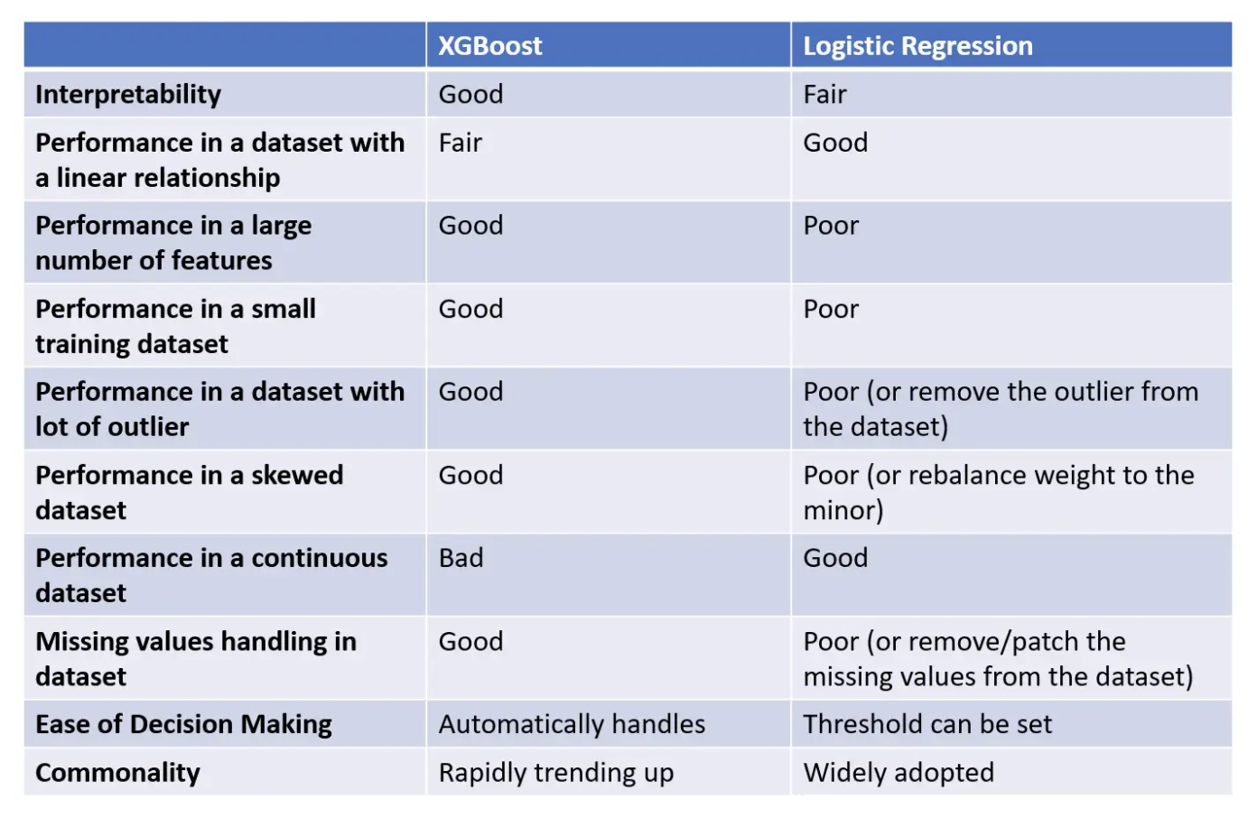
Machine Learning pipeline: XGBoost classifier
EXTREME
GRADIENT
BOOSTING
Alberi decisionali aggiunti in forma sequenziale per correggere gli errori di predizione del modello precedente.
Il peso delle variabili predette erroneamente dall'albero viene aumentato e queste variabili vengono poi date in pasto al modello successivo.
L’ensamble di tutti gli alberi dà un modello più robusto e preciso.
Gradient Boosting perché usa un algoritmo gradient descent per minimizzare la loss quando vengono aggiunti i modelli.
gamma: [0.5, 1, 1.5, 2, 5]
max_depth: [3, 4, 5]
subsample: [0.6, 0.8, 1.0]
colsample_bytree: [0.6, 0.8, 1.0]
min_child_weight: [1, 5, 10]
learning_rate=0.02
n_estimators=600
objective='binary:logistic’
nthread=1
C.Scapicchio, NEXT-AIM meeting, February 2023

Slide 21
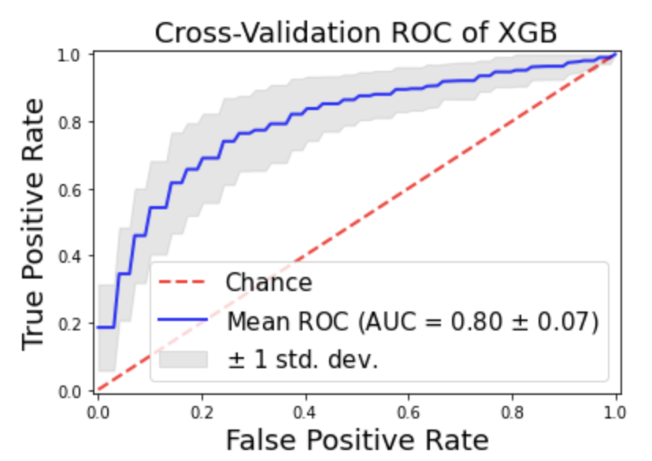
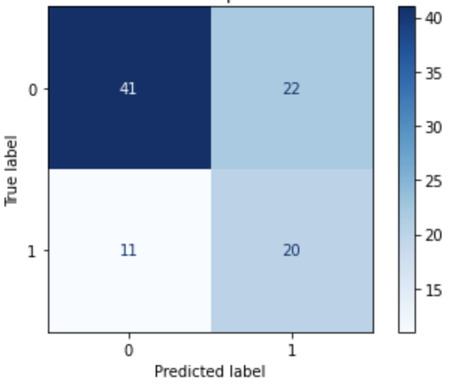
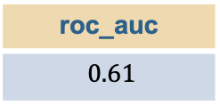
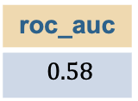
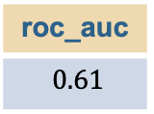
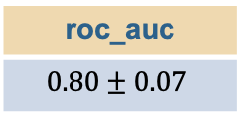
Combinazione dei dataset
Cross-Validazione (Firenze + Milano + Palermo B80f)
con best parameters ricavati dalla nested CV
roc_auc
$$0.80±0.07$$
Train (Firenze + Milano + Palermo B80f)
Test (Pisa + Pavia)
roc_auc
$0.61$
Train (Firenze + Milano + Palermo)
Test (Pisa)
roc_auc
$0.61$
roc_auc
$0.58$
Train (Firenze + Milano + Palermo)
Test (Pavia)
C.Scapicchio, NEXT-AIM meeting, February 2023

Slide 22
Parametri XGBoost
gamma: parametro di regolarizzazione
max_depth: profondità max dell’albero
subsample: fraction of the training set that can be used to train each tree
colsample_bytree: fraction of the features that can be used to train each tree.
min_child_weight: minimum sum of instance weight (hessian) needed in a child.
n_estimators: number of trees
objective: objective function
nthread: maximum number of threads available

Slide 23
Parametri per armonizzazione
 | PALERMO | PISA | PAVIA | FIRENZE | MILANO
Filtro di ricostruzione | B20f B80f | LUNG | FC51 – B80f | Parenchima | Diversi filtri sharp
Slice thickness | 1,0 mm | 2,5 mm | [0,5 - 2,0] mm | [1,0 – 2,0] mm | [1,0 – 3,0] mm
kVp, Pixel Spacing, Manufacturer, FOV (acq – rec), sex, age

Slide 24
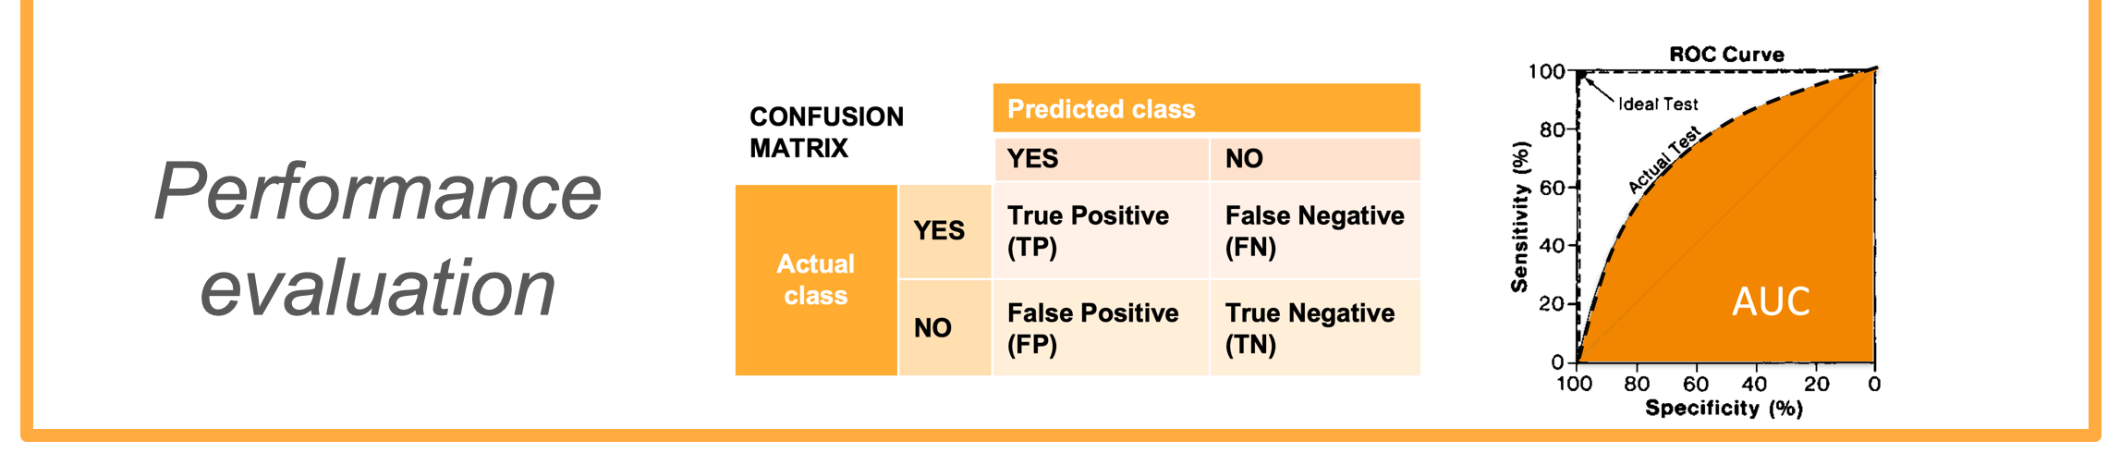
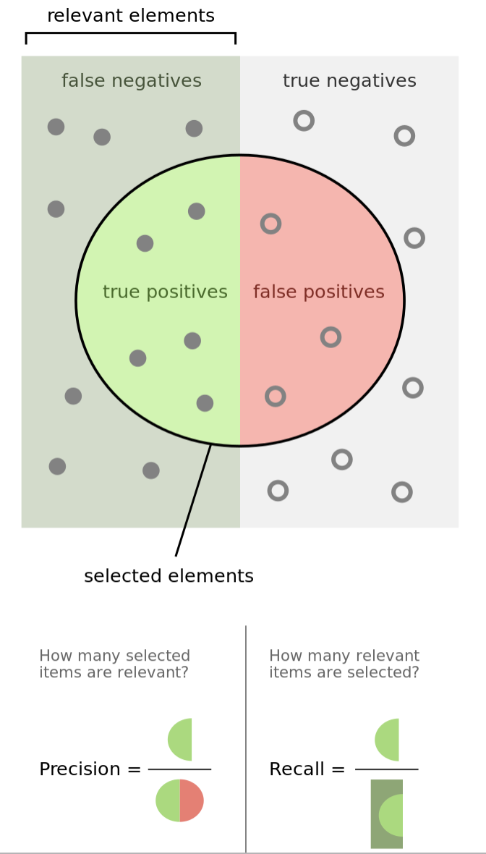
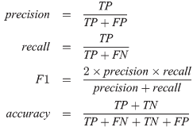
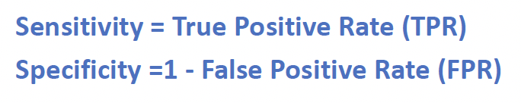
Performance metrics
Area Under the ROC Curve (AUC)

Slide 25
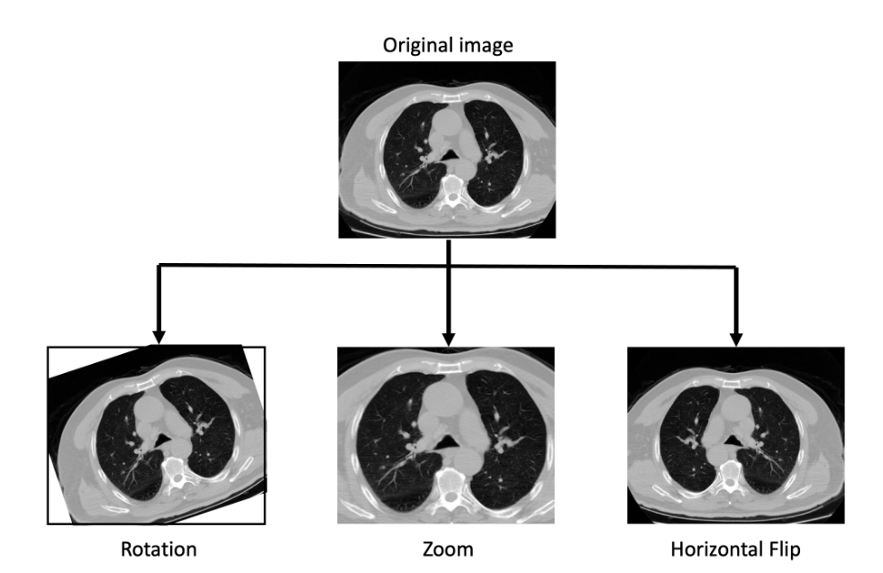
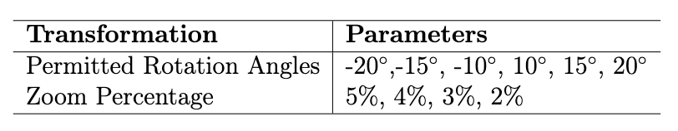
Pre-processing of CXR images
Gray level encoding
Image standardization by subtracting the mean and dividing by the standard deviation of each image.
Resize to 50x50 to allow for a light and small CNN
Lung segmentation
A contrast stretching between their 5th and 95th percentile and normalized.
Cropped and resized to 512x512.
Data augmentation: rotations, zoom, and horizontal flip
Severity prediction - clinical features
Categorical features: missing entries (few) replaced with the most frequent class
When missing in many patients and we filled it by training a K-Nearest Neighbors (KNN) algorithm to assign the value.
Continuous variables: missing data produced with univariate mean imputing.
Severity prediction - images
Same as for segmentation
Resize to 1024x1024
Each image was Z-scored

Slide 26
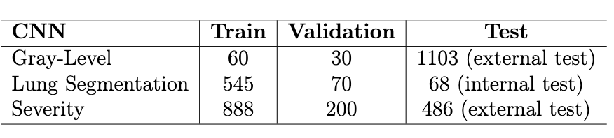
CXR images split
The Gray Net Model was trained on 120 pre-processed images selected by visual assessment among the 1103 ones of the AI4COVID dataset, 60 for each class. 30 images were used for the validation set. Then the prediction was computed on the whole AI4COVID training dataset.
The U-net devoted to lung segmentation was trained on the Shenzhen and Montgomery datasets, divided into a training set (80%), a validation set (10%), and a test set (10%). The performance was evaluated with the mean DSC on the internal test set.
For the Severity net, 888 images of the preprocessed dataset were used for the training of the model, 200 for the validation, and the 486 additional CXR scans made available during the challenge as an external test set.

Slide 27
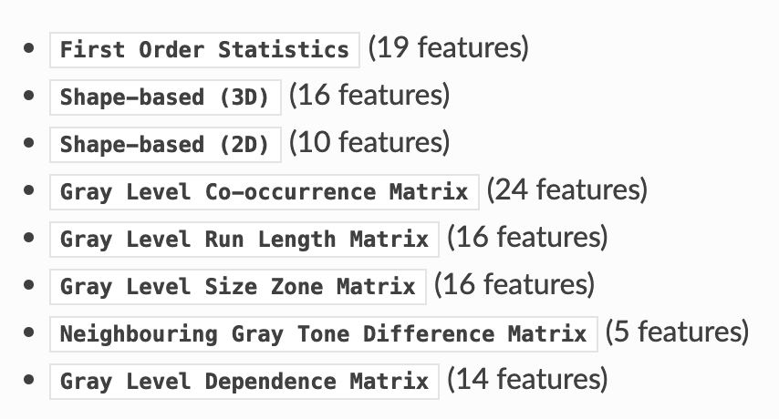
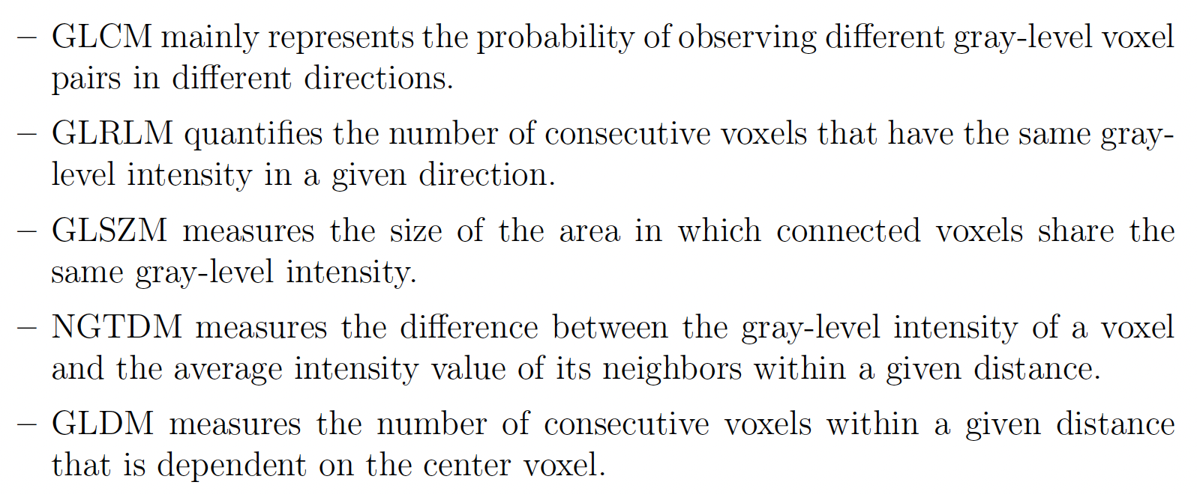
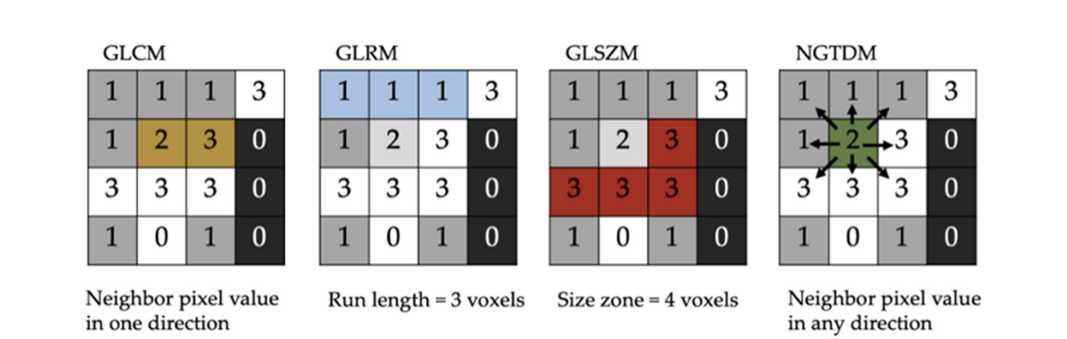
Radiomic features
[Scapicchio, Camilla, et al. "A deep look into radiomics." La radiologia medica 126.10 (2021): 1296-1311].

Slide 28
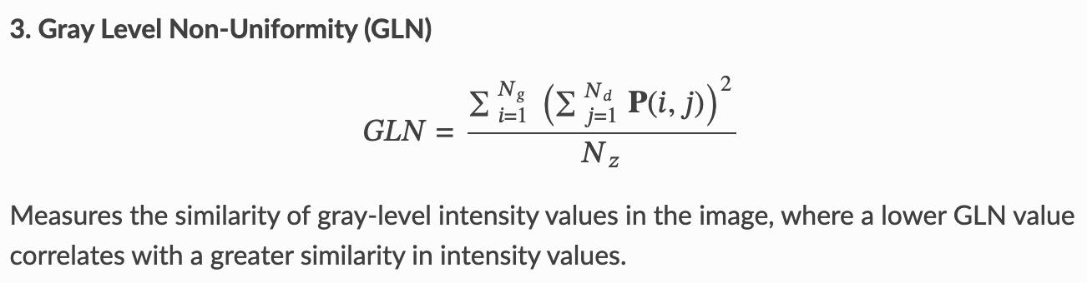
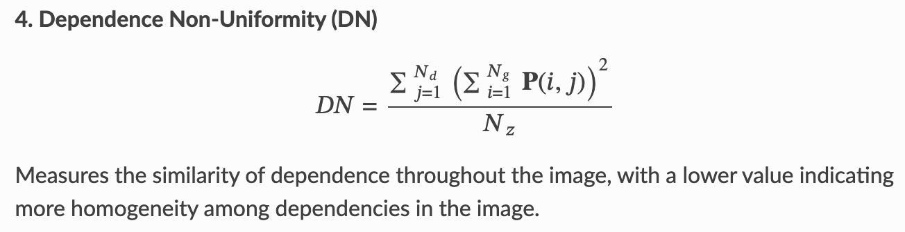



Radiomic features
GLDM
GLRLM
GLSZM

Slide 29
Feature Selection methods
minimum Redundancy – Maximum Relevance (mRMR): works iteratively by assigning a score to each feature given by the ratio of the feature's relevance for the target to be predicted and the redundancy with the features selected in the previous iteration. Thus, an algorithm that goes to select the k most significant and least redundant features for the target to be predicted, and agnostically concerning the type of classifier we use. The mrmr_selection publicly available package was used and imported in Python and k =15 was set as the number of selected features.
Feature Importance: this works by assigning a score to individual features based on relevance, but it does not consider redundancy with previous features and depends on the specific classifier used. Feature Importance in XGBoost was used through the feature_importances_ attribute of scikit-learn. Since the selected features can change in the various trials within the nested CV, to obtain a ranking of the features, a new score was given to each feature, which is the total score on all trials, given by the sum of the scores for individual trials. The first 15 features were then considered in this final ranking.
Mutual Information: which measures the uncertainty reduction for one variable given the known value of another variable. The mutual_info_classif function of scikit-learn was used, considering the 15 best features. 15 was chosen as the number of selected features as a typically applied empirical rule
(Widrow-Hoff learning rule) suggests approximately 10 data (in our case patients) for each imaging feature used in the model and, in this case, the most populated dataset of Milan with 160 patients was considered as a reference

Slide 30


ComBat HARMONIZATION METHOD
This method is based on the empirical Bayes frameworks and was initially developed for large-scale genomic data analysis to remove batch effects.
In medical imaging radiomics, batches refer to scanners, imaging protocols, individual imaging parameters, etc.
Unlike imaging harmonization, the ComBat method operates directly on the computed feature values to remove any batch-induced bias.
This is a data-driven method that identifies the protocol effect assuming that the value of each feature y, measured in the VOI j, with imaging protocol i, can be written as
α is the average value for feature y_{ij} ,
γ_{i} is an additive protocol effect,
δ_{i} is a multiplicative protocol effect affected by an error term (ε_{ij})
The compensation consists in estimating the model parameters α, γ_{i}, and δ_{i} by using a maximum likelihood approach on the basis of the set of available observations:

