Slide 1
Next – AIM 2024 • Bari
+39 333 9979399
nico.curti2@unibo.it
https://github.com/Nico-Curti
www.unibo.it/sitoweb/nico.curti2
Improved interpretability with DNetPRO classifier applied to radiomics data
with
Nico Curti, Sara Dalmonte, Riccardo Biondi,
Daniel Remondini
27/09/2024
Dept. of Physics and Astronomy, University of Bologna

Slide 2
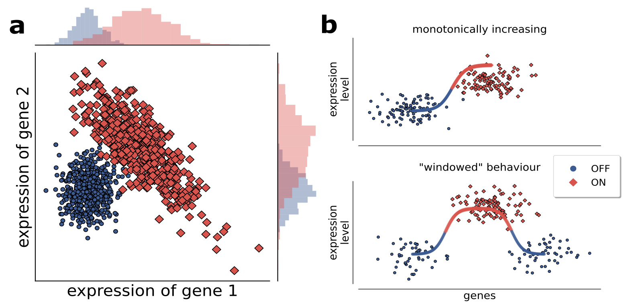
Big BioMedical Data
DNetPRO: A network approach for low-dimensional signatures from high-throughput data
High-throughput data (10³ – 10⁵ variables)
Looking for low-dimensional set of observables
Gene or Protein expression by an up/down regulation
Features selection is a critical step
Exploration of all feature space is an NP-hard problem
Few samples available
Ill-posed problem
Methods that select variables for multi-dimensional signatures based on single-variable performance can have limits in predicting higher-dimensional signature performance. As shown in the Fig. a, in which both variables taken singularly perform poorly, but their performance becomes optimal in a 2-dimensional combination, in terms of linear separation of the two classes.
Curti et al., Scientific Report, 2022

Slide 3
Big BioMedical Data
DNetPRO: A network approach for low-dimensional signatures from high-throughput data

Slide 4
2019
Cytokines
Alzheimer Disease
2022
TCGA
Method Release
2024
Radiomic
MRI & CT samples
2 years
Application to
Radiomic Data
2018
No Med App
Traffic
2020
Veterinary
mRNA samples

Slide 5
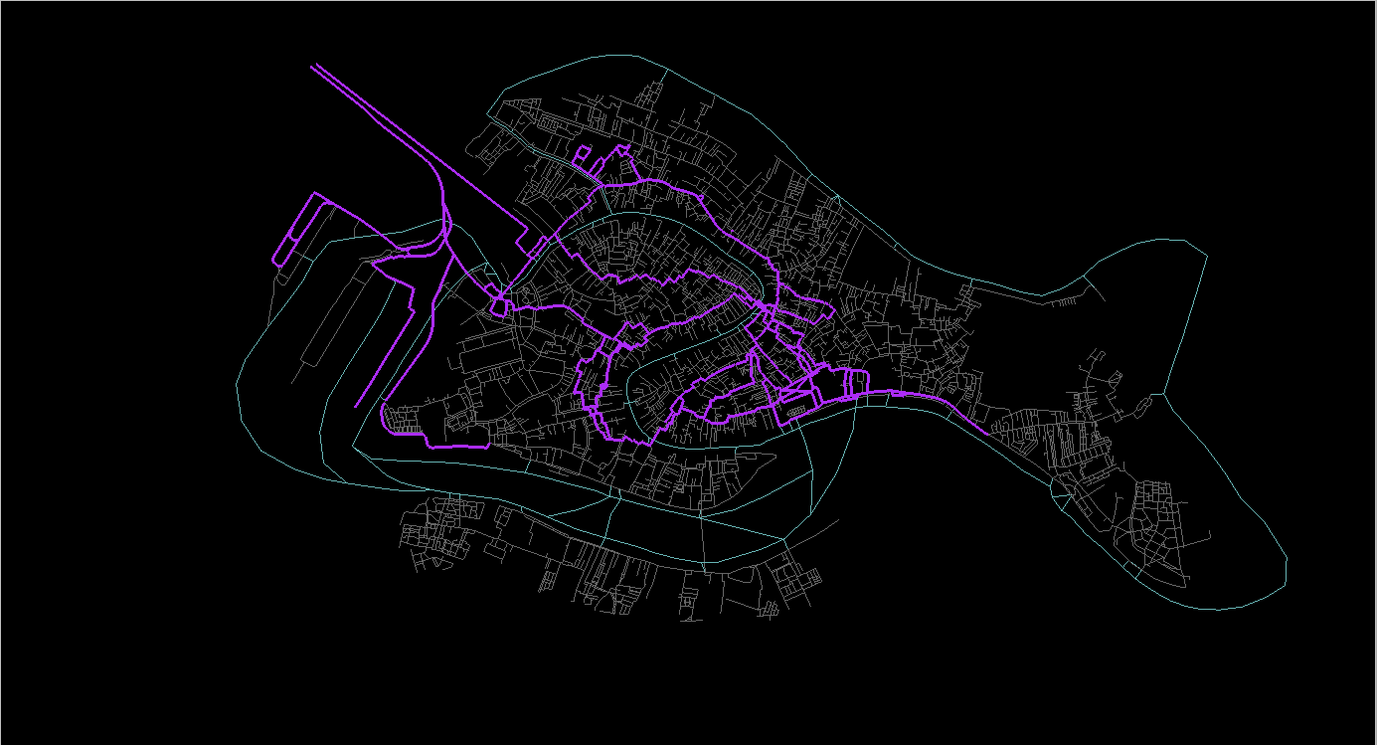
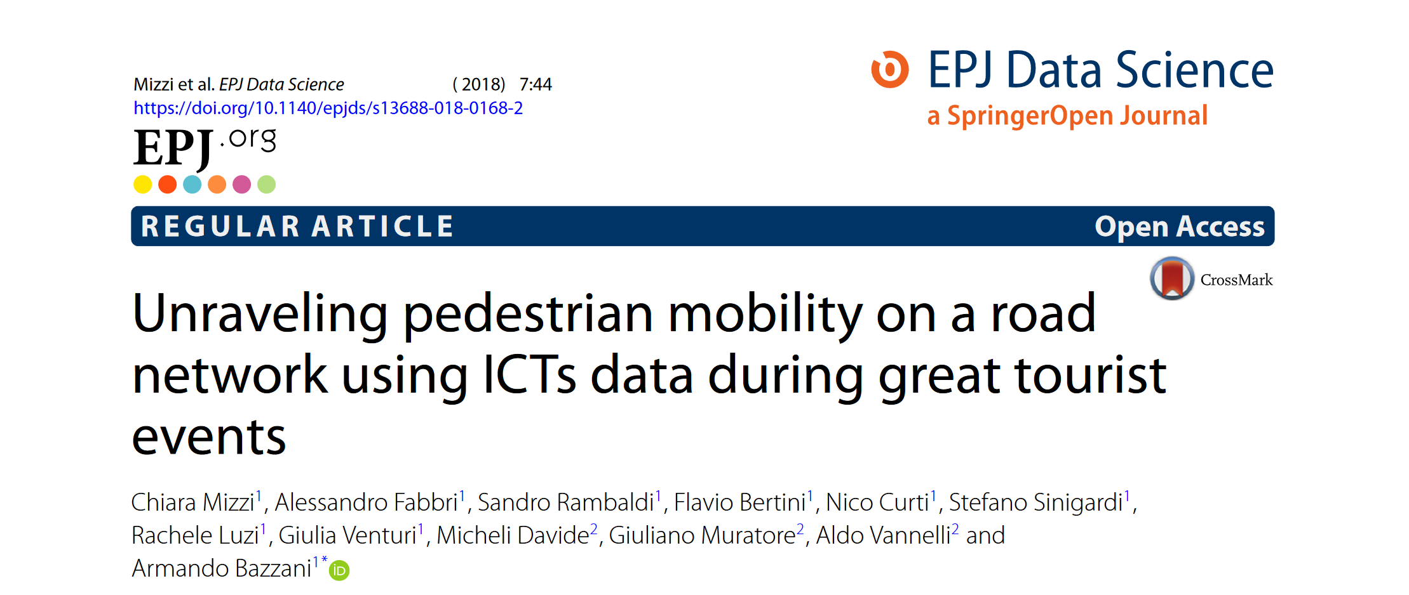
2018
2019
Cytokines
Alzheimer Disease
2022
TCGA
Method Release
2024
Radiomic
MRI & CT samples
2 years
Application to
Radiomic Data
2018
No Med App
Traffic
2020
Veterinary
mRNA samples

Slide 6
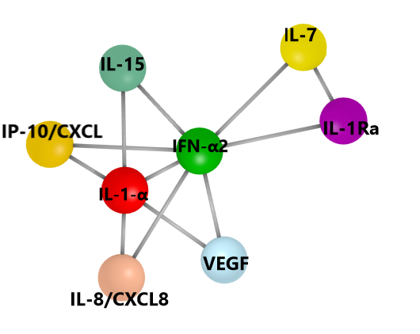
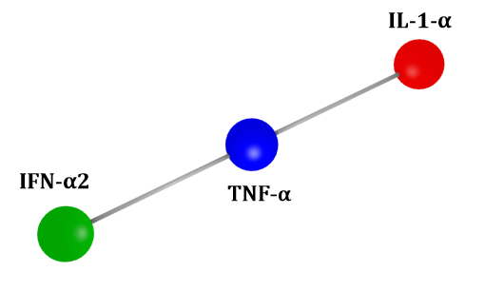
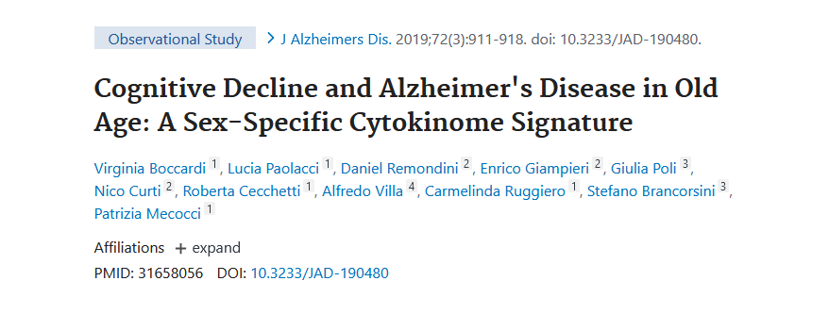
2019
2019
Cytokines
Alzheimer Disease
2022
TCGA
Method Release
2024
Radiomic
MRI & CT samples
Signature CTL vs MCI
Signature CTL vs AD
2 years
Application to
Radiomic Data
2018
No Med App
Traffic
2020
Veterinary
mRNA samples

Slide 7
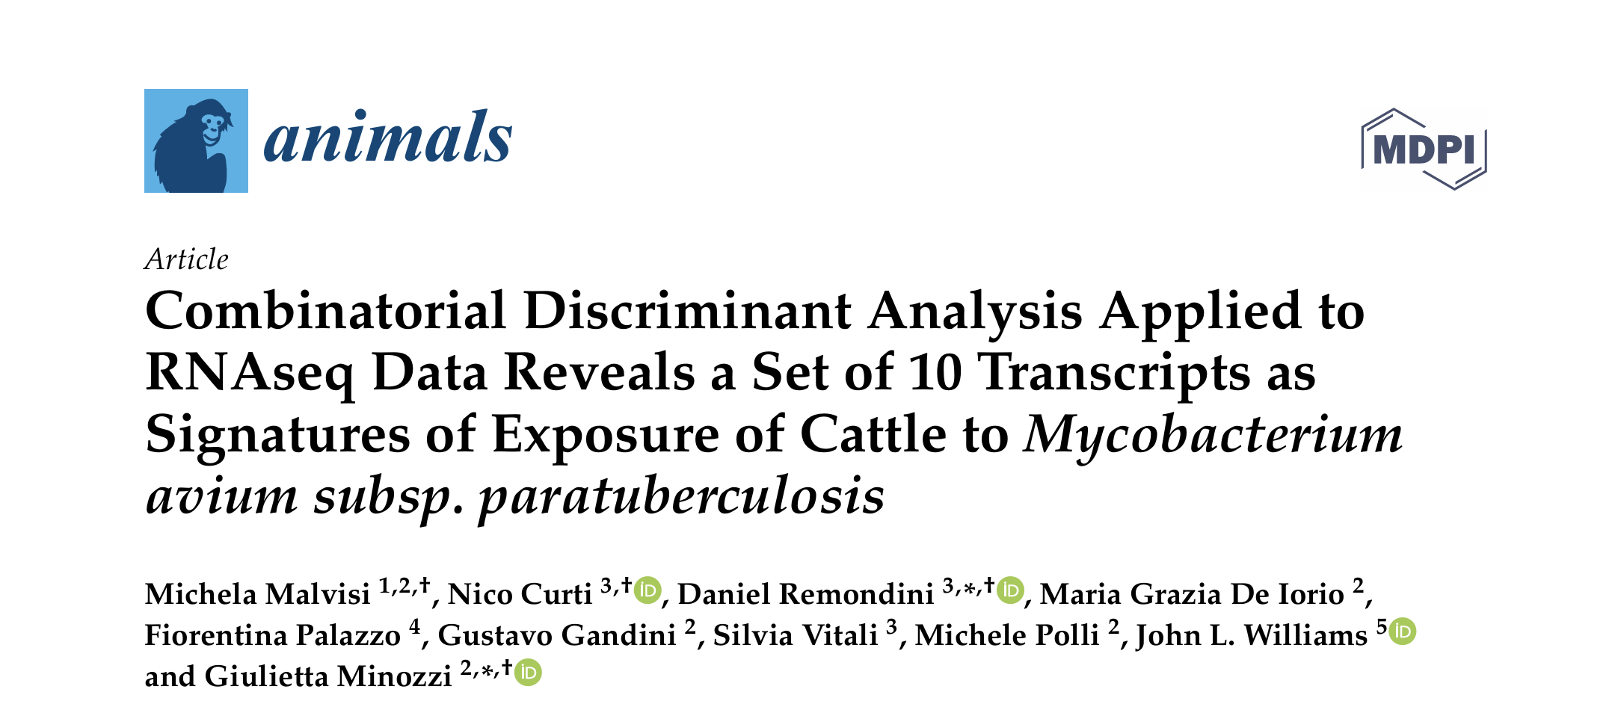
2020
2019
Cytokines
Alzheimer Disease
2022
TCGA
Method Release
2024
Radiomic
MRI & CT samples
2 years
Application to
Radiomic Data
2018
No Med App
Traffic
2020
Veterinary
mRNA samples

Slide 8
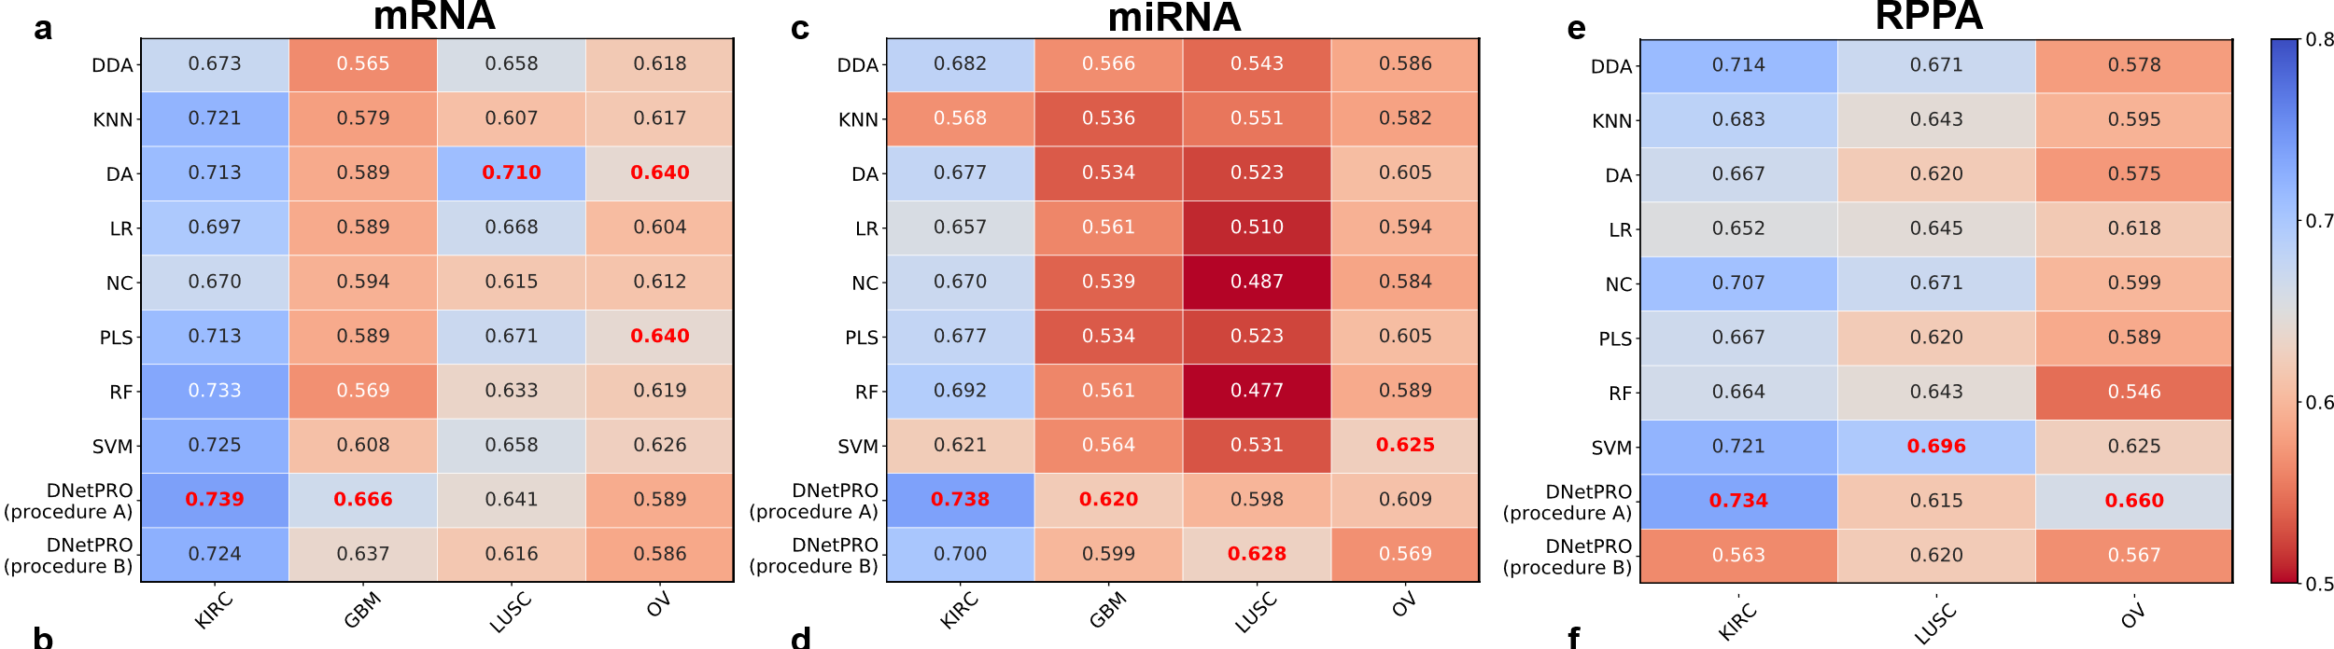
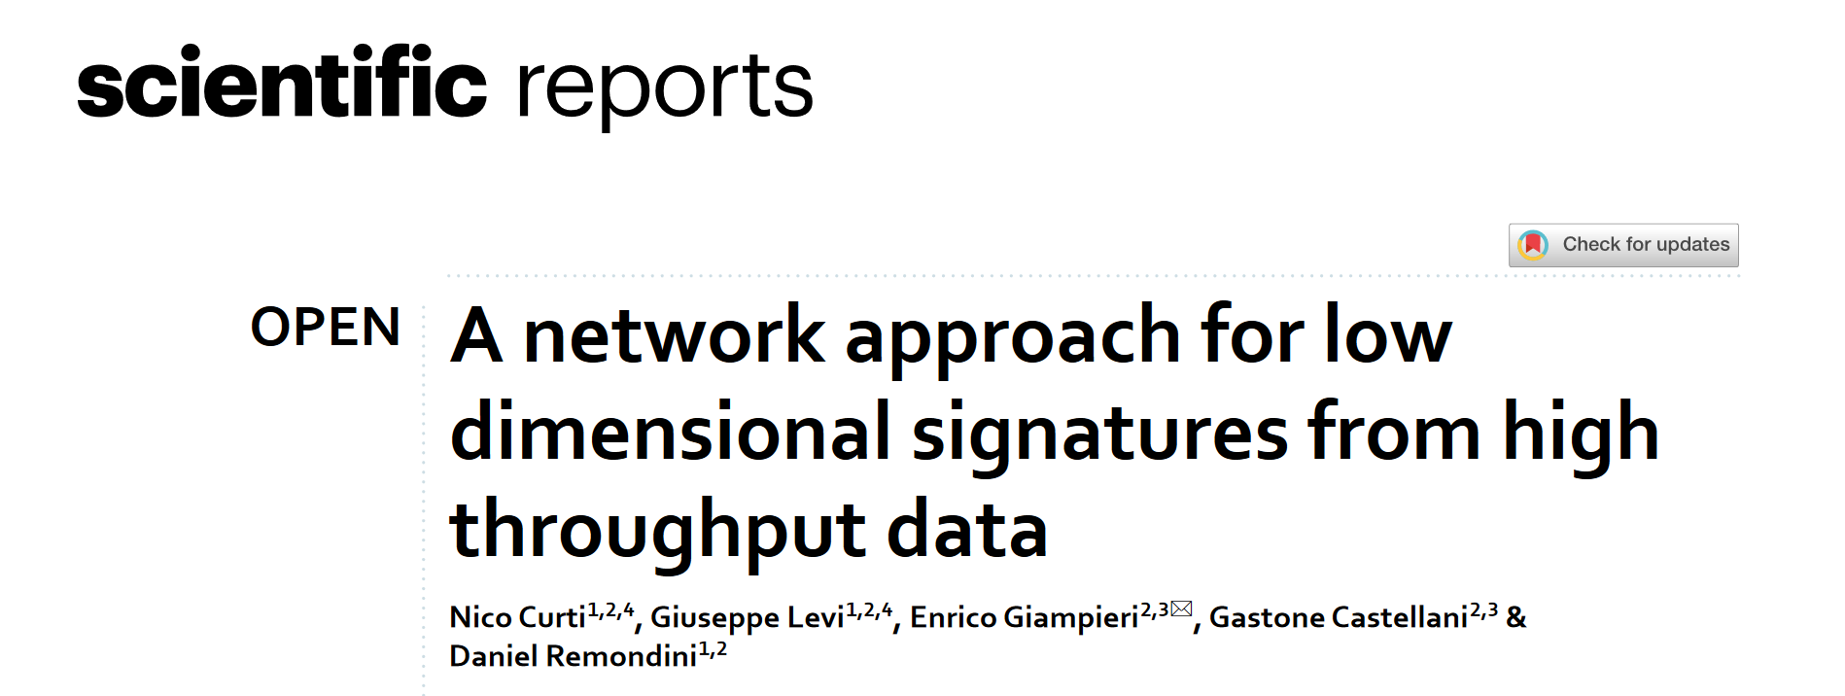
2022
2019
Cytokines
Alzheimer Disease
2022
TCGA
Method Release
2024
Radiomic
MRI & CT samples
2 years
Application to
Radiomic Data
2018
No Med App
Traffic
2020
Veterinary
mRNA samples

Slide 9
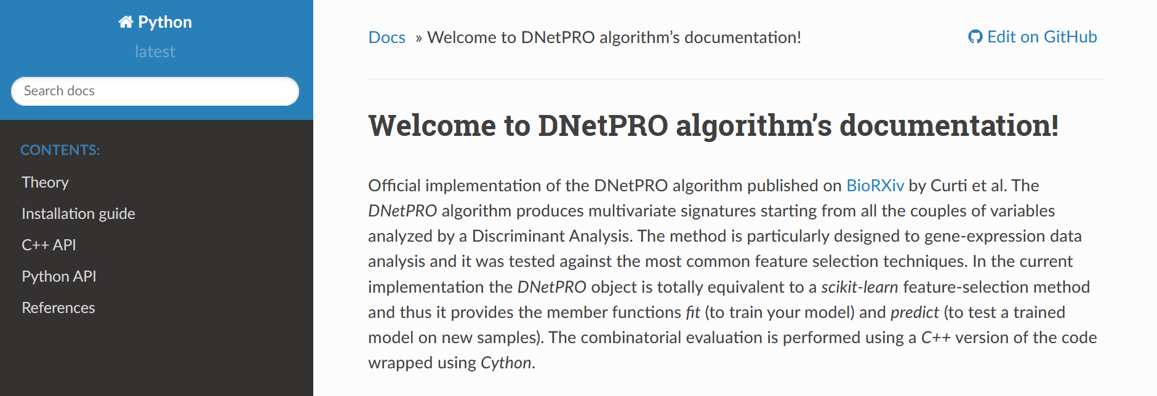
2022
2019
Cytokines
Alzheimer Disease
2022
TCGA
Method Release
2024
Radiomic
MRI & CT samples
2 years
Application to
Radiomic Data
2018
No Med App
Traffic
2020
Veterinary
mRNA samples

Slide 10
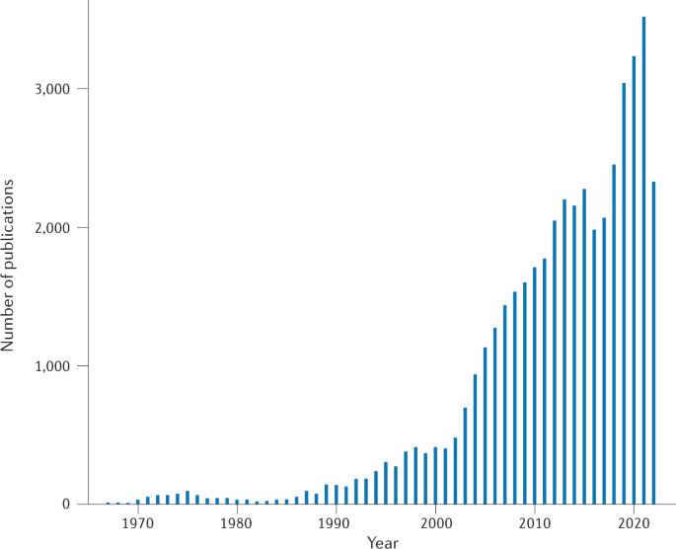
Radiomic Analysis
Radiomic Analysis is becoming a standard practice
in many medical applications
Number of publications per year since 1967.
Pros
Multiple features
Easy to use
Integration with other software
Use of Anatomical image information
Easy extraction of the results
Cons
Multi-dimensional analyses
Ill-posed problems
Large noise sources
Biases and batch effects in multi-center studies
Hard interpretation of the results
Huang et al.,
Nature Reviews, 2023
Vs

Slide 11
PET/CT Recurrent Rectal Cancer
1 hospital – IRCCS Sant’Orsola – Malpighi Bologna
44 patients – radial resection – primary rectal adenocarcinoma
PET/CT dataset – manual segmentation of lesions performed by expert radiologists
Full set of radiomic features – Original, Wavelet, and LoG
Classification pipeline – Locally Recurrent Rectal Cancer (LRRC) vs NO LRRC

Slide 12
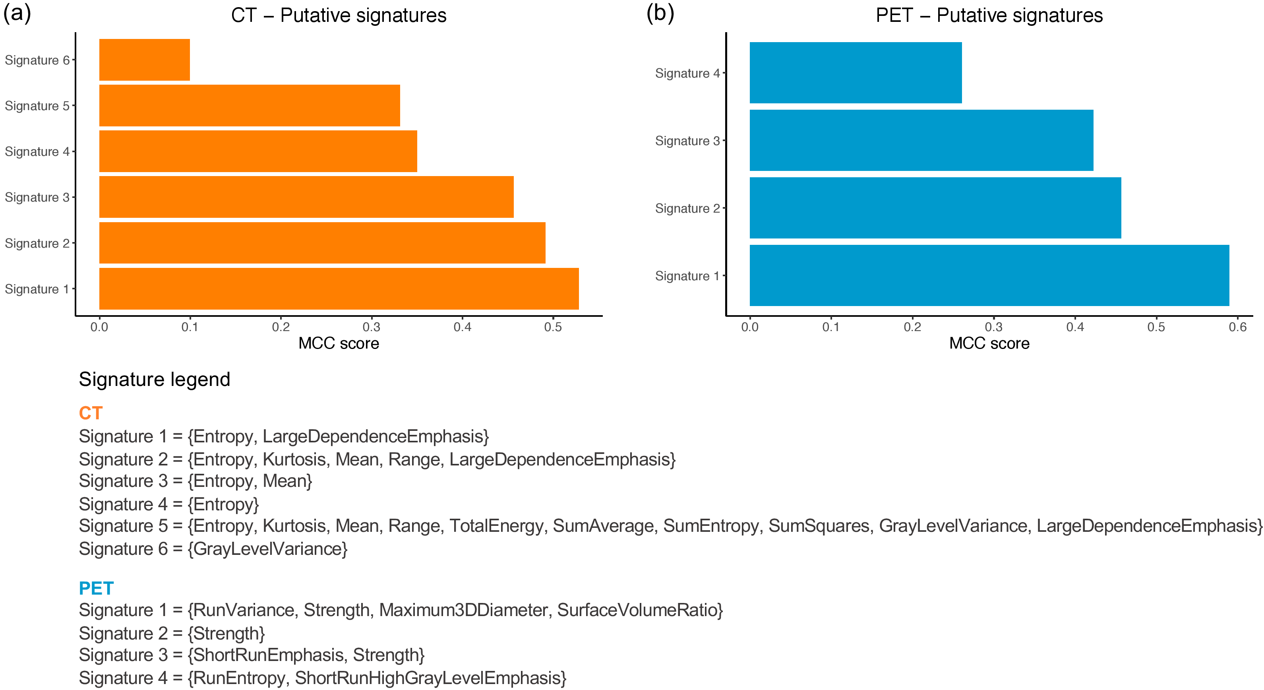
PET/CT LRRC - DNetPRO

Slide 13
PET/CT LRRC - DNetPRO
Under Review

Slide 14
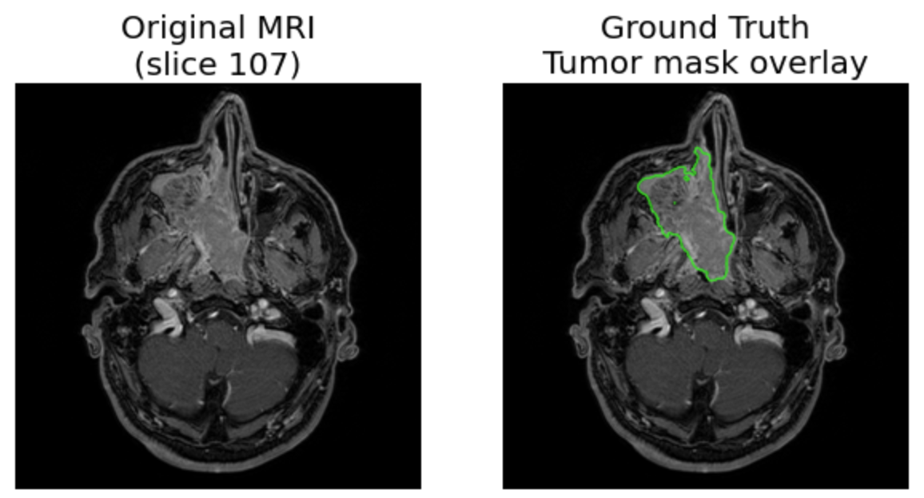
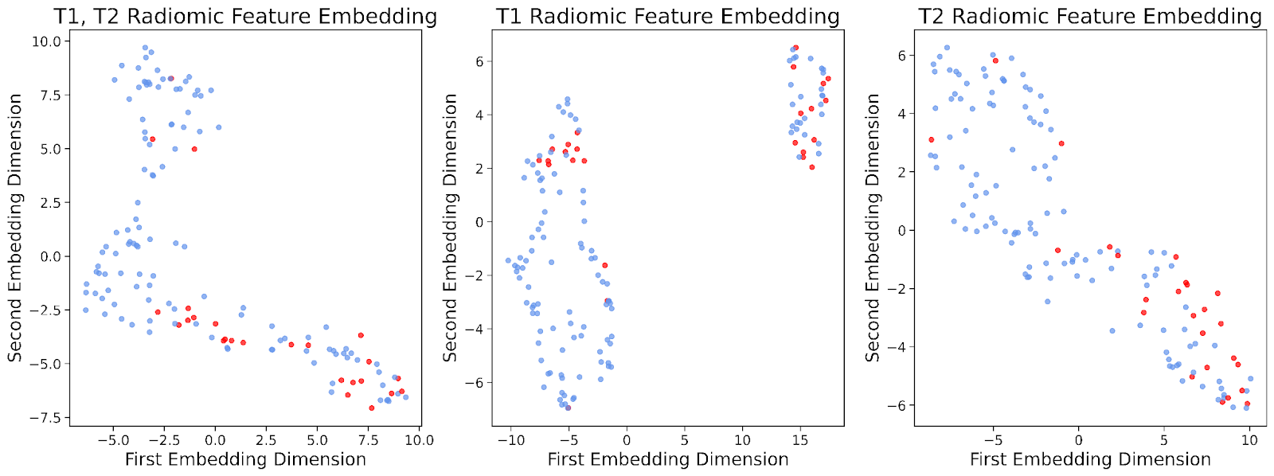
MRI Sinonasal tumors
2 hospitals – Como & Varese centres
New collaborations !! (*)
145 patients – sinonasal tumor – multiple tumor classes grouped as Malignant vs Benign
T1w & T2w – manual segmentation of lesions performed by expert radiologists
Full set of radiomic features – Original, Wavelet, and LoG
Classification pipeline – Malignant vs Benign Tumors
* Ospedale Sant’Anna – Como
Ospedale di Circolo – Varese

Slide 15
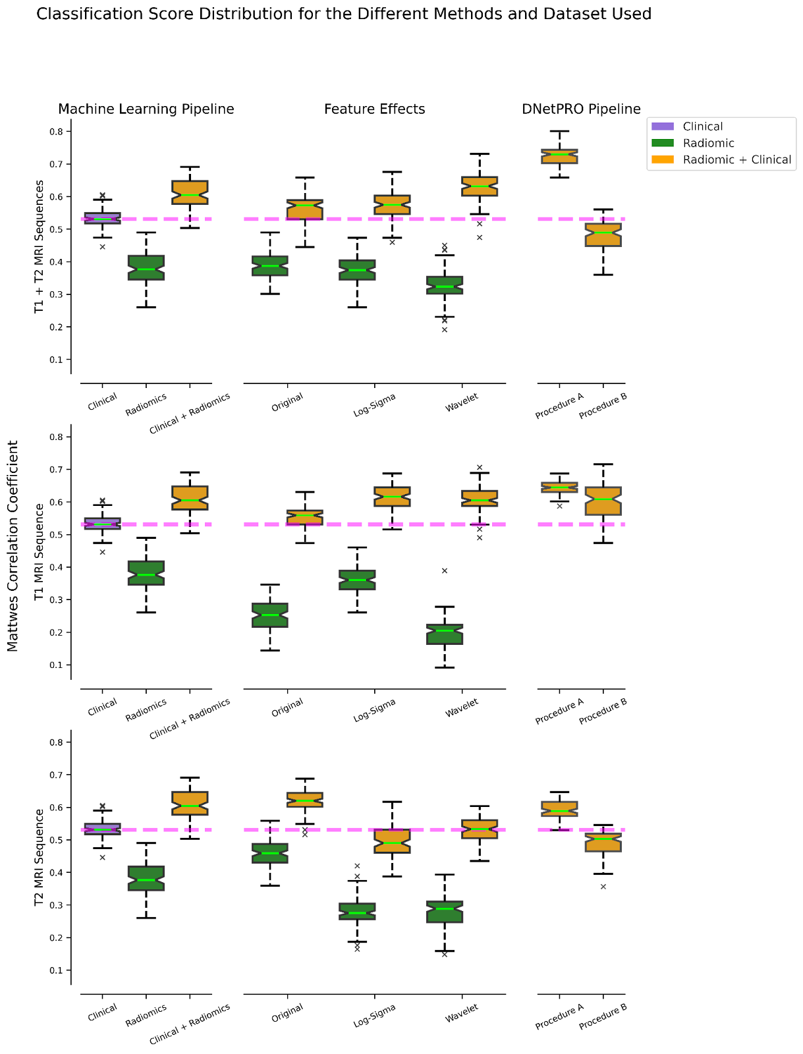
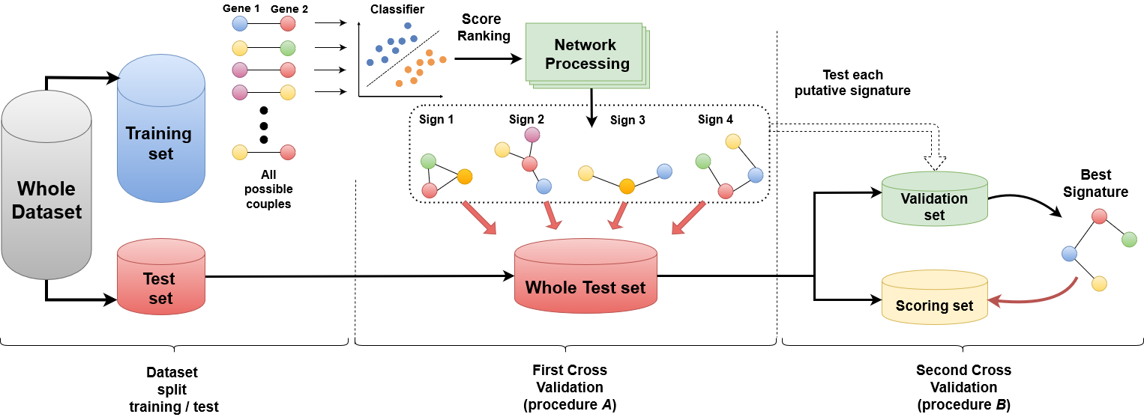
Sinonasal MRI - DNetPRO
Preliminary Results

Slide 16
Preliminary Results & Conclusions
DNetPRO as Novel approach to feature selection in AIM
Publicly available code in multiple languages
Applicability to different kind of samples (new in Radiomics!)
Computationally efficient on ill-posed like problems
Possibility to extract multiple (or just one) signatures
Easy Explainability of the results for biomedical (and clinical) applications
We are currently developing web (server) interface for public usages
https://github.com/Nico-Curti

Slide 17
Next – AIM 2024 • Bari
+39 333 9979399
nico.curti2@unibo.it
https://github.com/Nico-Curti
www.unibo.it/sitoweb/nico.curti2
Nico Curti, Sara Dalmonte, Riccardo Biondi,
Daniel Remondini
Dept. of Physics and Astronomy, University of Bologna

