Slide 1
Explainability for machine learning models and applications in clinical practice
next_AIM workshop on XAI techniques for medical data analysis
Nicola Lambri, PhD
Dipartimento di Fisica “Aldo Pontremoli”, Università degli Studi di Milano, Milan, Italy
Istituto Nazionale di Fisica Nucleare, Sezione di Milano, 20133 Milan, Italy
IRCCS Humanitas Research Hospital, Radiotherapy and Radiosurgery Department, Milan, Italy Humanitas University, Department of Biomedical Sciences, Milan, Italy

Slide 2
Agenda
Introduction: Patient-specific quality assurance (PSQA)
Purpose: Machine learning for virtual PSQA
Methods
Results
Applications in clinical practice
Next steps
Conclusions

Slide 3
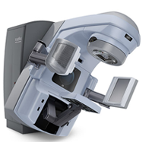
Introduction: Patient-specific quality assurance
Modulated radiotherapy (RT) plans should be verified before the beginning of the first treatment session (AAPM TG-218)
To identify discrepancies between calculated and delivered doses
The agreement is quantified with the gamma passing rate (GPR)
Plan optimization
Calculated dose
Measured dose
Gamma analysis (GPR)
time
Notes:
GPR is a percent (range 0%-100%)
The GPR considers both the dose difference and the physical distance
Usually a simple pass/fail approach is used (e.g., GPR(3%,2 mm)≥90%)

Slide 4
Agenda
Introduction: Patient-specific quality assurance (PSQA)
Purpose: Machine learning for virtual PSQA
Methods
Results
Applications in clinical practice
Next steps
Conclusions

Slide 5
Purpose: Machine learning for virtual PSQA
Measurement-based PSQA is a time-consuming and inefficient process which can slow down the RT workflow
Predictive models can provide a means to intercept potential failures
2023
Very few fields with low GPR
≈70,000 PSQA measurements

Slide 6
Agenda
Introduction: Patient-specific quality assurance (PSQA)
Purpose: Machine learning for virtual PSQA
Methods
Results
Applications in clinical practice
Next steps
Conclusions

Slide 7
Methods: Dataset creation
Heterogeneous dataset of 70,000 PSQA measurements (2013-2021)
Selection of VMAT arcs delivered on TrueBeam linacs (2018-2022)
Gamma analyses recalculated with a 3%/1 mm criterion
Skewed data: 83% of arcs with GPR 3%/1 mm ≥ 95%

Slide 8
Methods: Dataset creation and model assessment
Automatic export of 5522 VMAT plans
For each VMAT arc: 10 complexity metrics + 9 dynamic/static parameters*
Internal validation (1871 VMAT arcs):
Mean absolute error (MAE)
Sensitivity and specificity, 95% limit
SHAP
External validation:
341 VMAT arcs
Same equipment
* MATLAB software. Hernandez et al. 10.1016/j.phro.2018.02.002

Slide 9
Agenda
Introduction: Patient-specific quality assurance (PSQA)
Purpose: Machine learning for virtual PSQA
Methods
Results
Applications in clinical practice
Next steps
Conclusions

Slide 10
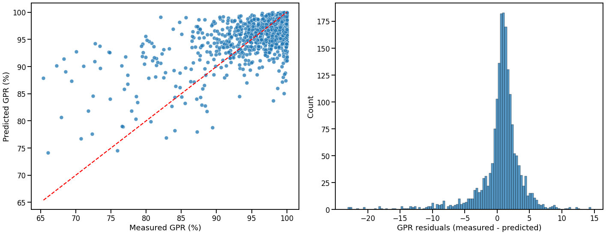
Results: Internal validation
MAE = 2.3%
Sensitivity = 61%
Specificity = 90%

Slide 11
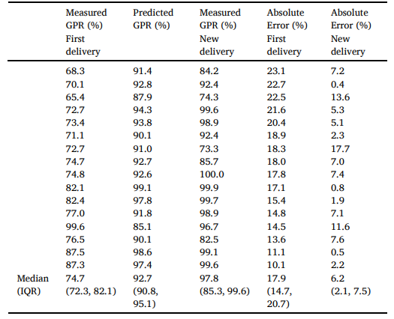
Results: Internal validation
MAE = 2.3%
Sensitivity = 61%
Specificity = 90%

Slide 12
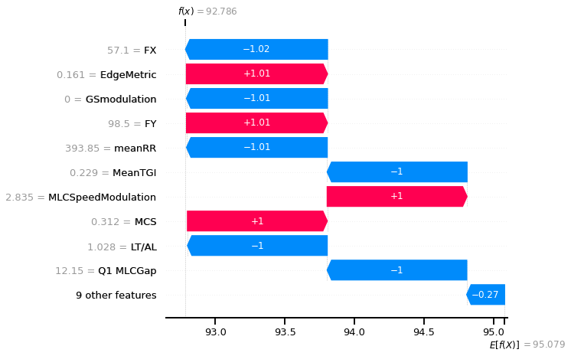
Results: Model explanation
Predicted GPR 92.8%
First delivery
GPR 70.1%
Second delivery
GPR 92.4%
Notes:
Brain case

Slide 13
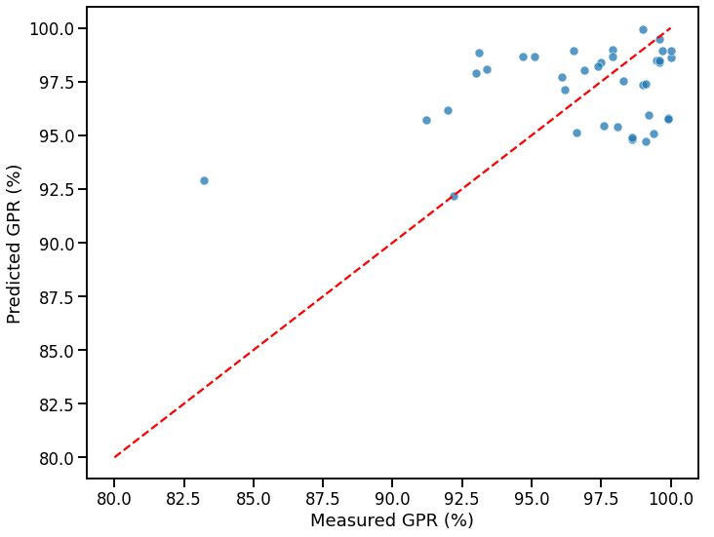
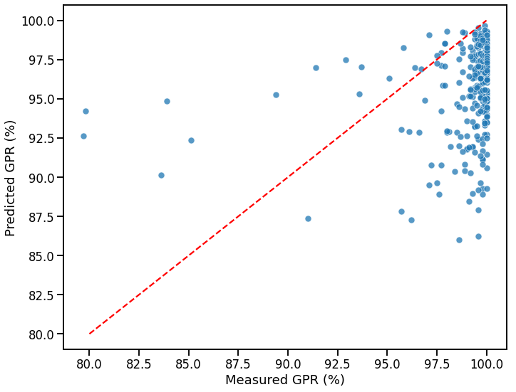
Results: External validation
MAE = 2.5%
Sensitivity = 25%
MAE = 3.9%
Sensitivity = 55%
Manual data extraction
Notes:
Institute 2:
<5% error (except one case)
37 VMAT arcs
Institute 3:
Underestimated GPR
304 VMAT arcs

Slide 14
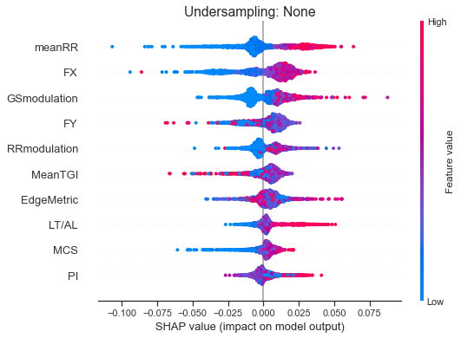
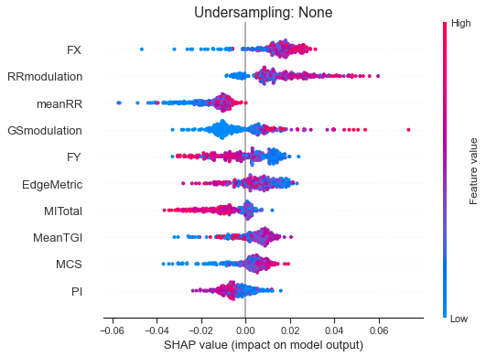
Results: Model explanation

Slide 15
Agenda
Introduction: Patient-specific quality assurance (PSQA)
Purpose: Machine learning for virtual PSQA
Methods
Results
Applications in clinical practice
Next steps
Conclusions

Slide 16
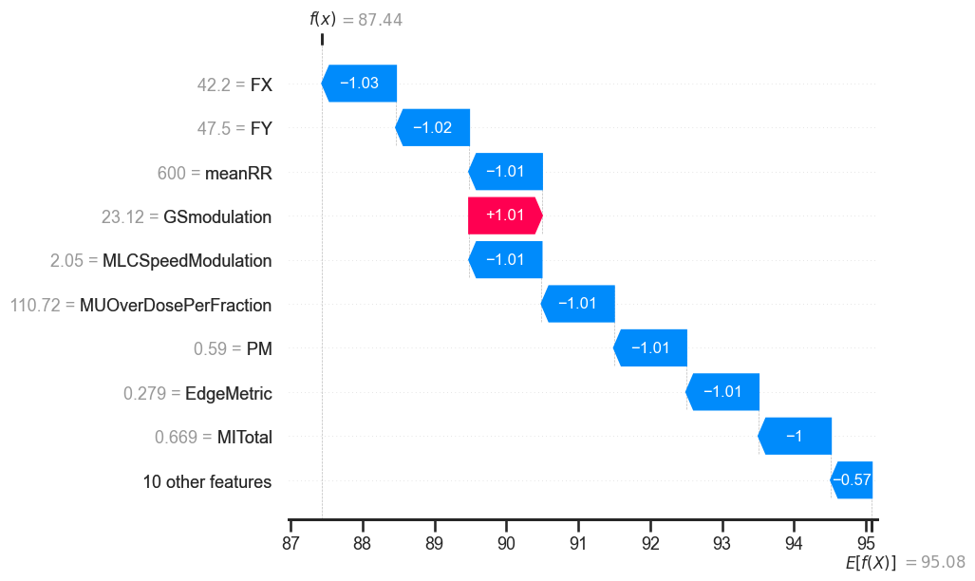
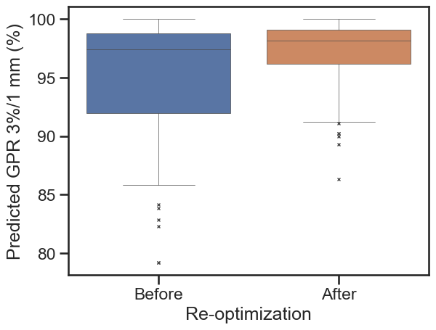
Application in clinical practice
GPR prediction just after plan optimization
Automated reports at the end of each day
*
Selected for ESTRO newsletter
2024
* Mann-Whitney p=0.007

Slide 17
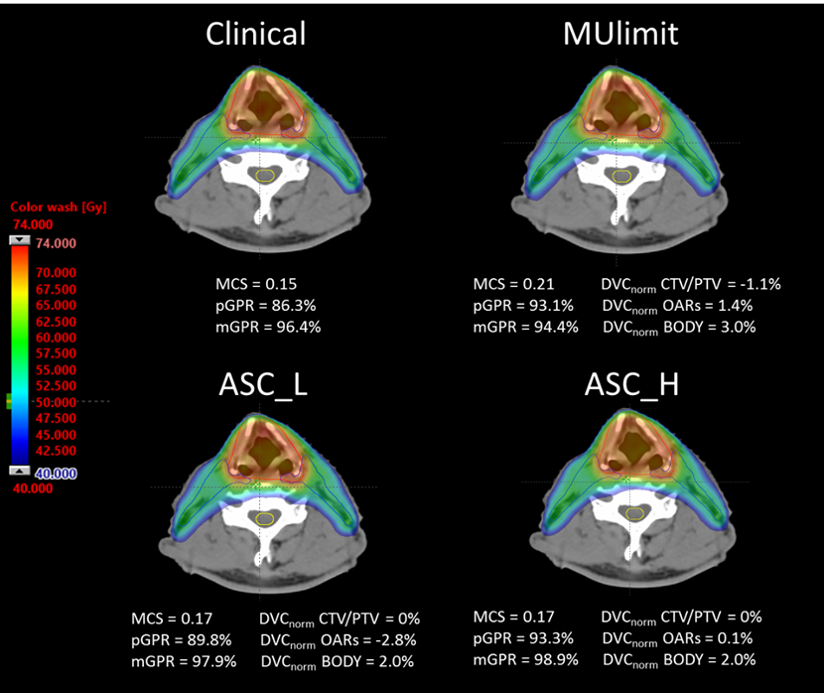
Application in clinical practice
Reoptimization of plans at risk of PSQA failure
Selection of cases knowing model limitations with explainability (small fields)
Replanning strategies to improve deliverability and maintain quality
2024

Slide 18
Agenda
Introduction: Patient-specific quality assurance (PSQA)
Purpose: Machine learning for virtual PSQA
Methods
Results
Applications in clinical practice
Next steps
Conclusions

Slide 19
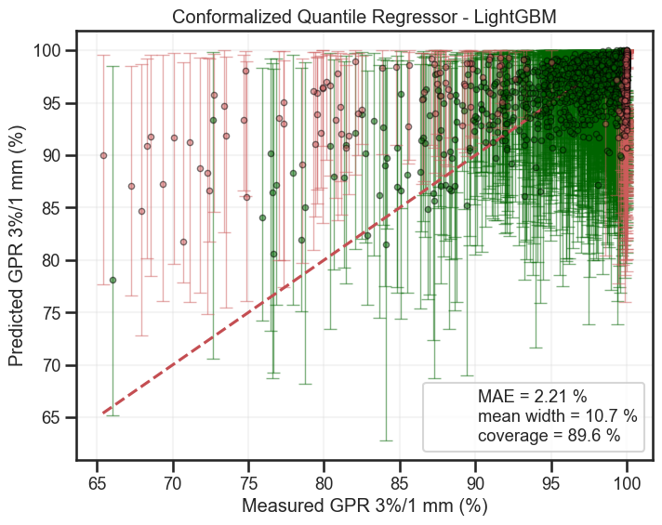
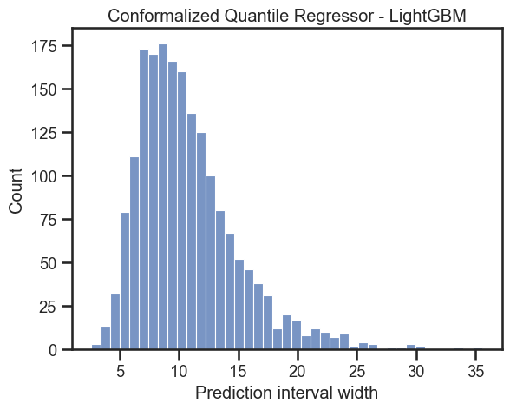
Next steps: Uncertainty quantification
Uncertainty quantification of model predictions
Automated data extraction at UCLH (work in progress)

Slide 20
Conclusions
Machine learning models can be integrated into clinical practice for virtual PSQA
Data extraction is challenging:
Automation
Multicentric settings
Privacy regulations
Model might not generalize well:
Transferability
Explainability
Uncertainty quantification
Notes:
Ease of access and use, especially in small centers where data is scarce or lack of expertise

Slide 21
THANK YOU
nicola.lambri@humanitas.it

Slide 22
Extra

Slide 23
Virtual QA: Multicentric studies
701 IMRT plans (two institutions)
Model retrained locally
2017
1835 VMAT plans (seven institutions)
Error increased with tighter criteria
2021
749 VMAT arcs (four institutions)
2024

Slide 24
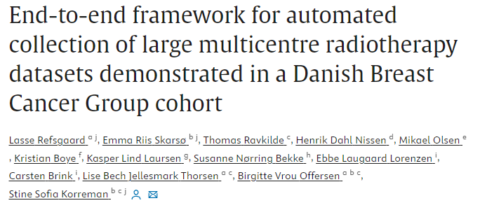
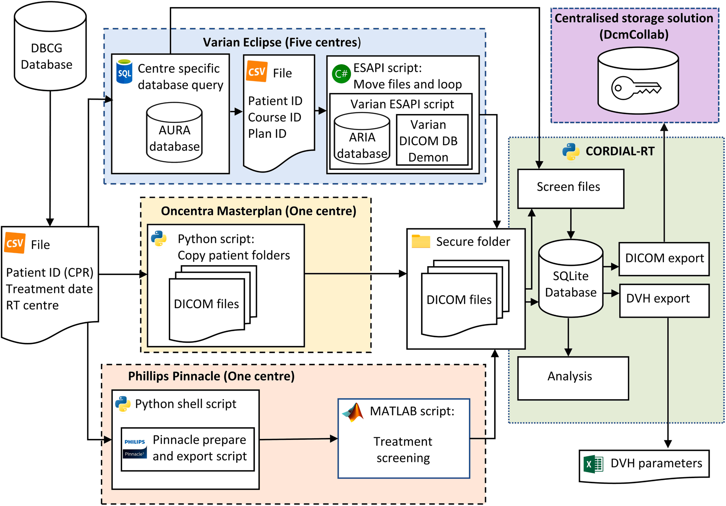
Data extraction in multiple centers
Identification of relevant cases
Different storage systems
Different data formats
Different software
Security
Privacy regulations
2024

Slide 25
The pyramid of QA
Octavius
Epiqa: if PD analysis edge case (e.g., HyperArc)
Portal Dosimetry (PD): if ≤ 5fr and warning/fail of Mobius3D
Mobius3D: for all treatments
Complexity and virtual PSQA: for all treatments
Independent measurement system
Independent analysis software
Measurement
Independent calculation system
Predictive model
Credits: A.B.

Slide 26
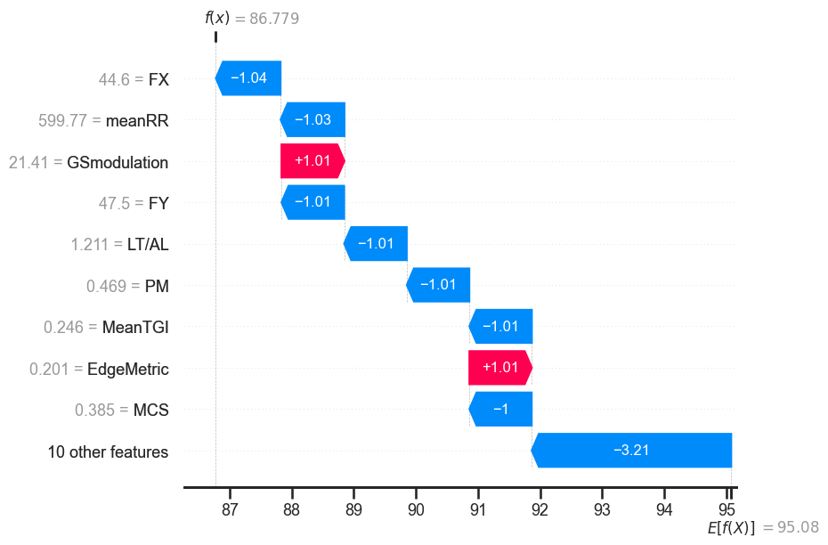
Automated report
Field 1
Field 2

Slide 27
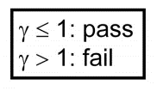
Gamma analysis
Composite test combining dose difference and physical distance
Dose
ΔD_{max} = 3%
DTA = 2 mm
DTA
ΔD
γ < 1
γ > 1
Δd
Position
ΔD_{max}
γ ≥ 90%
Measured dose
γ < 90%
Reference dose
Notes:
Dose difference (DD, e.g. 3%) for low dose gradients
Distance to agreement (DTA, e.g. 1-3 mm) for high dose gradients

Slide 28
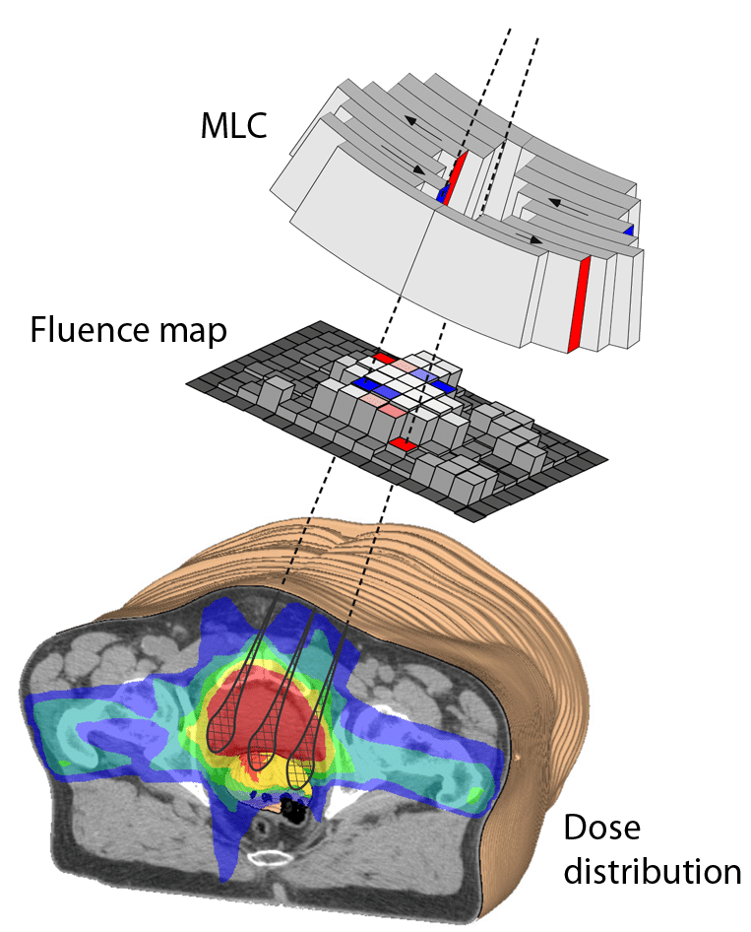
Complexity metrics
Complexity metrics can be categorized into three groups:
Fluence
Deliverability
Accuracy
Siggel, M. (2012) Concepts for the efficient Monte Carlo-based treatment plan optimization in radiotherapy.
McNiven, A.L. et al. (2010) A new metric for assessing IMRT modulation complexity and plan deliverability. Med. Phys. 37:505-515. https://doi.org/10.1118/1.3276775
Younge, K.C. et al. (2012) Penalization of aperture complexity in inversely planned volumetric modulated arc therapy. Med. Phys. 39:7160-7170. https://doi.org/10.1118/1.4762566
Chiavassa S. et al. (2019) Complexity metrics for IMRT and VMAT plans: a review of current literature and applications. Brit. J. Radiol. 92:1102 https://doi.org/10.1259/bjr.20190270
Notes:
Fluence metrics exclusively consider the resulting fluence of a modulated plan or beam.
Hypothesis: highly heterogeneous fluence reflects a high level of complexity.
Limitation: the same fluence map could be generated either by a single large beam or by a combination of successive small beams.
Deliverability metrics focus on machine capability of delivering the treatment as planned due to the variation of mechanical (gantry, MLC) and dosimetric (dose rate, MU) machine parameters.
Accuracy metrics aim to quantify the parameters identified as most likely to compromise accurate dose calculation due to the machine modelling and algorithm inaccuracy in the TPS.
Deliverability and accuracy metrics are linked.

Slide 29
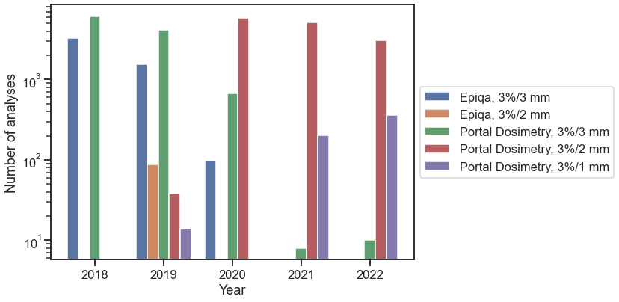
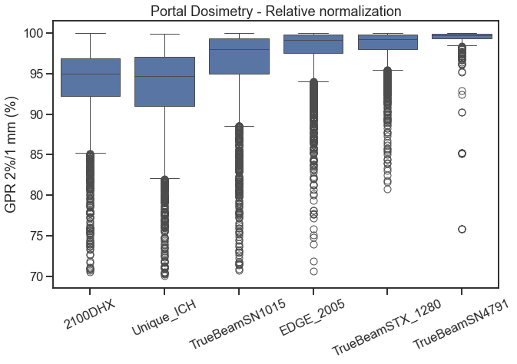
Methods: Data exploration
PSQA analyses were heterogeneous:
Gamma criteria and software
GPR dependent on the treatment unit
Notes:
Internal department guidelines for the gamma criteria changed over the years
Systematically lower GPR for DHX and Unique machines which are now dismissed

Slide 30
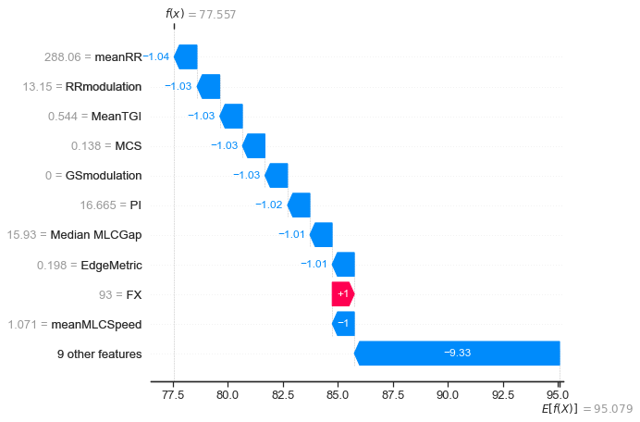
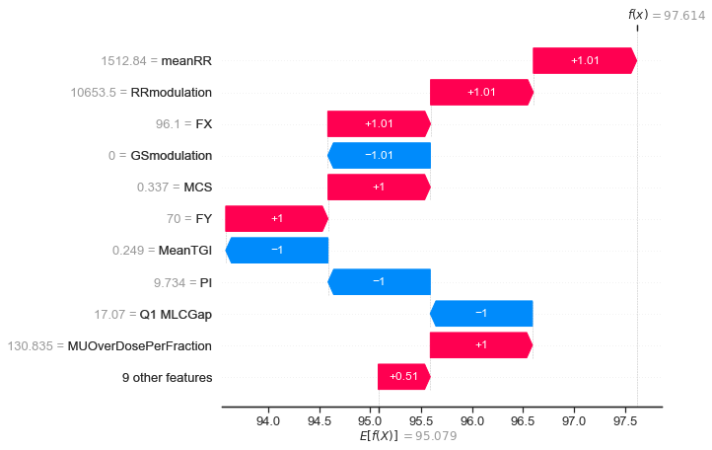
Model explainability
Head and neck
Measured
GPR 72.3%
Measured
GPR 100%
Abdomen
Predicted
GPR 77.6%
Predicted
GPR 97.6%
Lambri et al. Multicentric evaluation of a machine learning model to streamline the radiotherapy patient specific quality assurance process. Phys Med. 2023

