Slide 1





An explainable-by-design end-to-end framework based on prototypical part learning for lesion detection and classification in DBT images
Andrea Berti
next_AIM meeting
Bari, 16th October 2024
Notes:
Good morning, my name is Andrea Berti, I’m almost at the end of my PhD at the department of information engineering of the university of Pisa, I’m a research fellow at the Institute of Information Science and technologies of the National Research Council, and I collaborate with the INFN. Today I will talk to you about our proposed approach for an explainable-by…

Slide 2
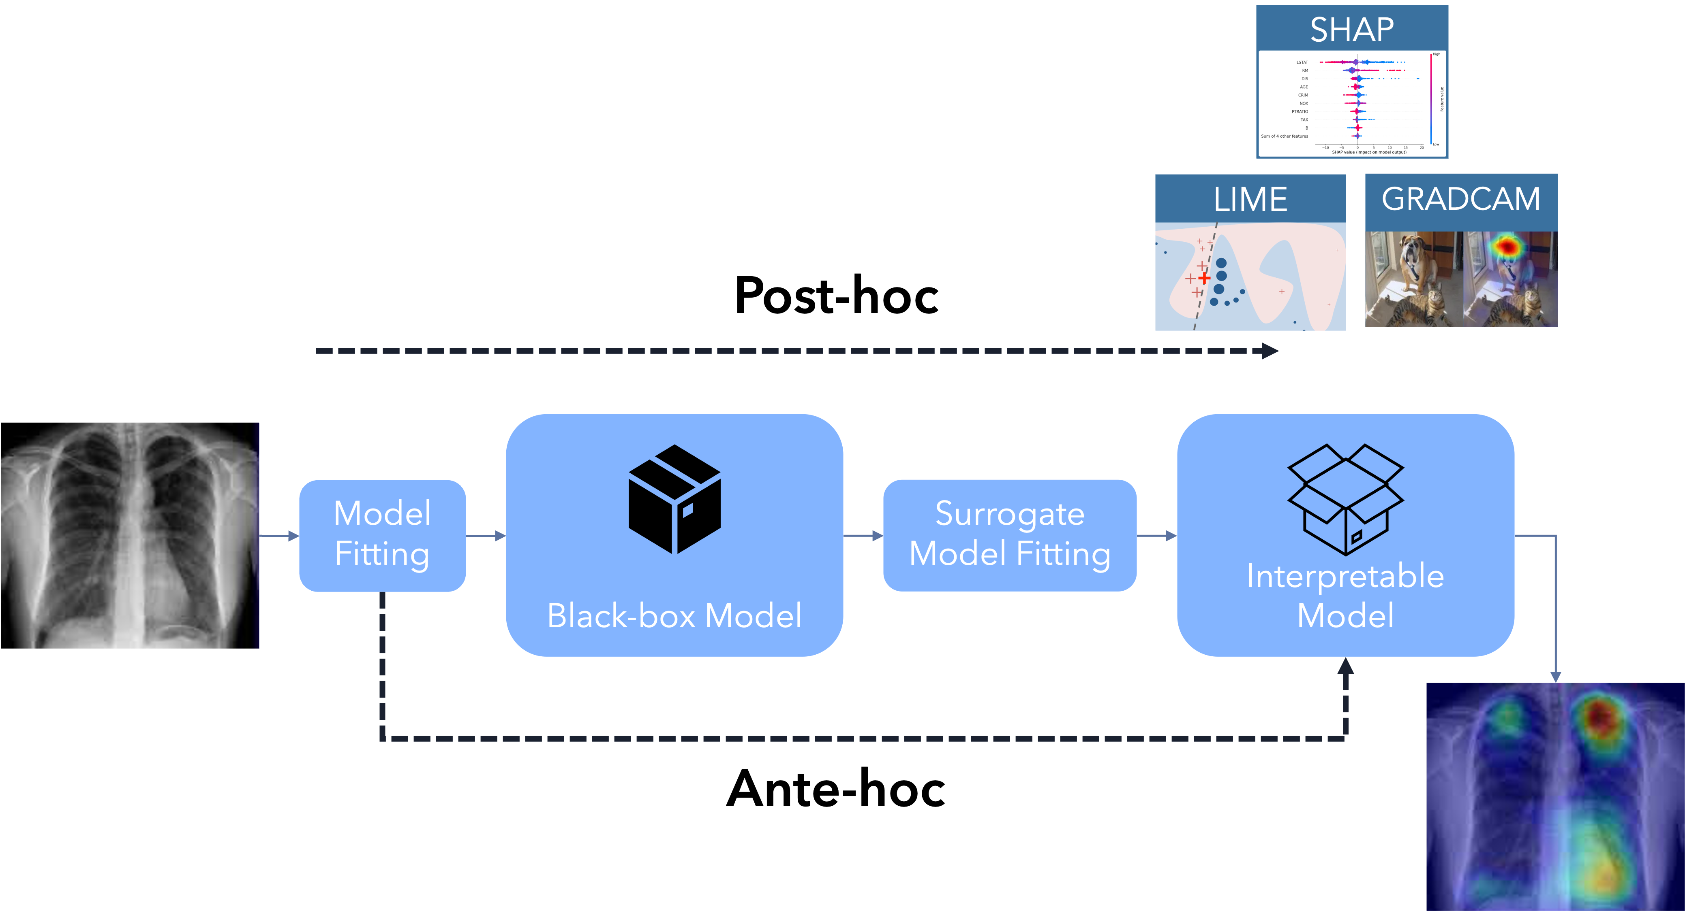
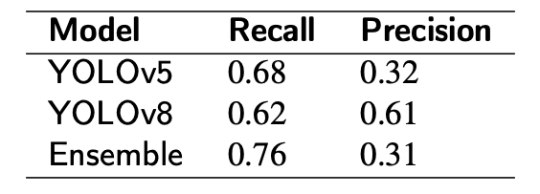
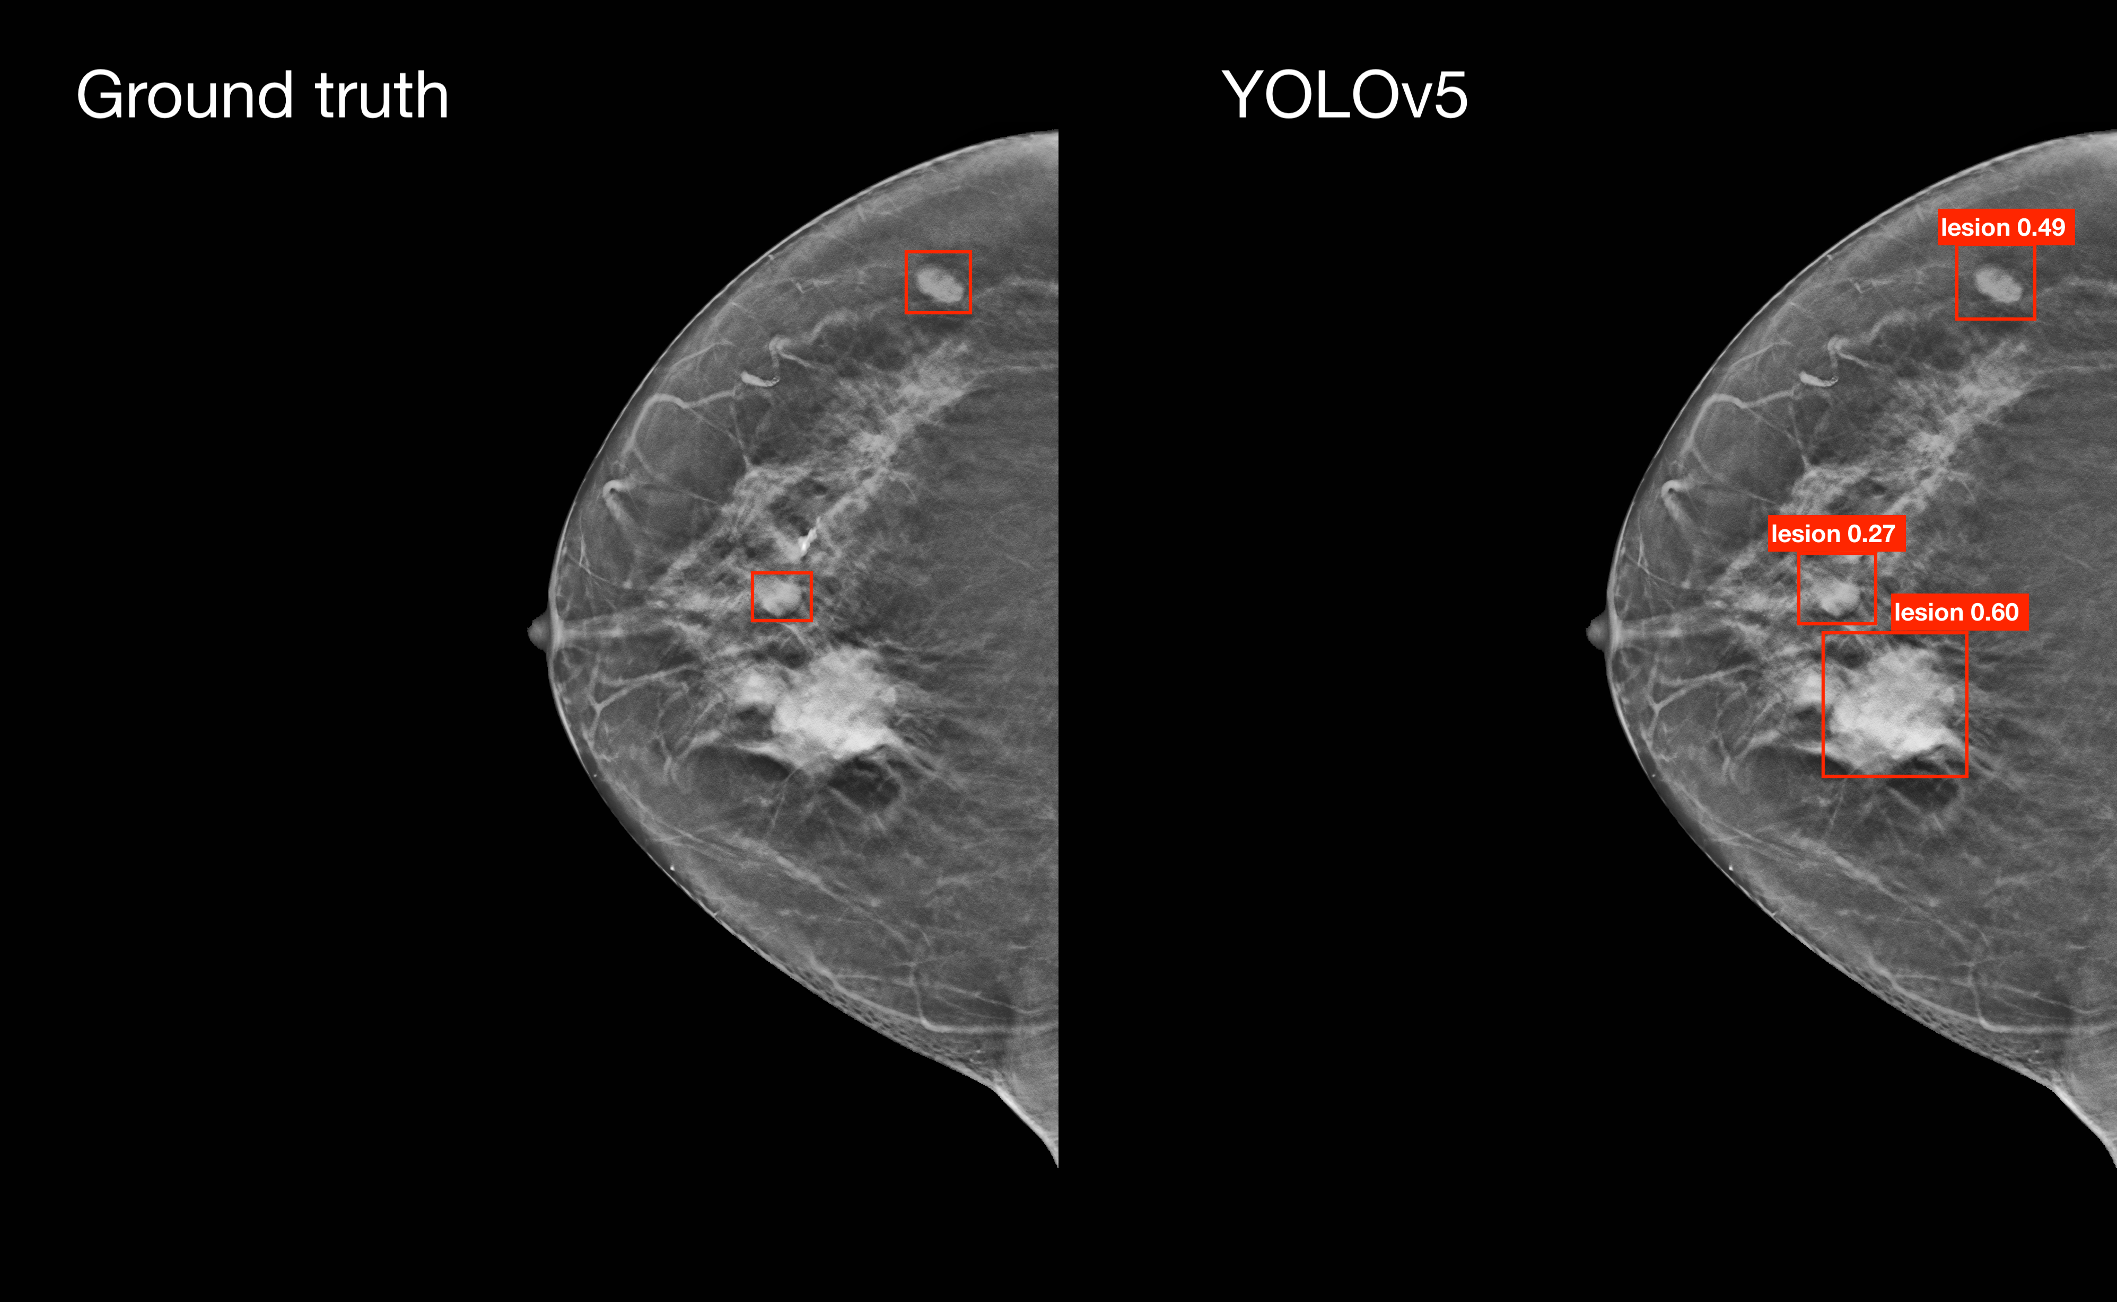
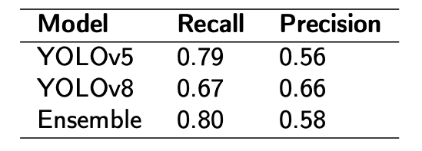
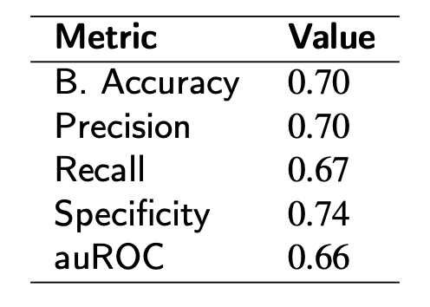
Overview
Ante-hoc explainability
Our proposed approach
Numerical results
Clinical feedback
Notes:
We’ll see what explainability-by-design, or ante-hoc explainability, means, I’ll go through our approach, then show the results and the clinical feedback on them

Slide 3
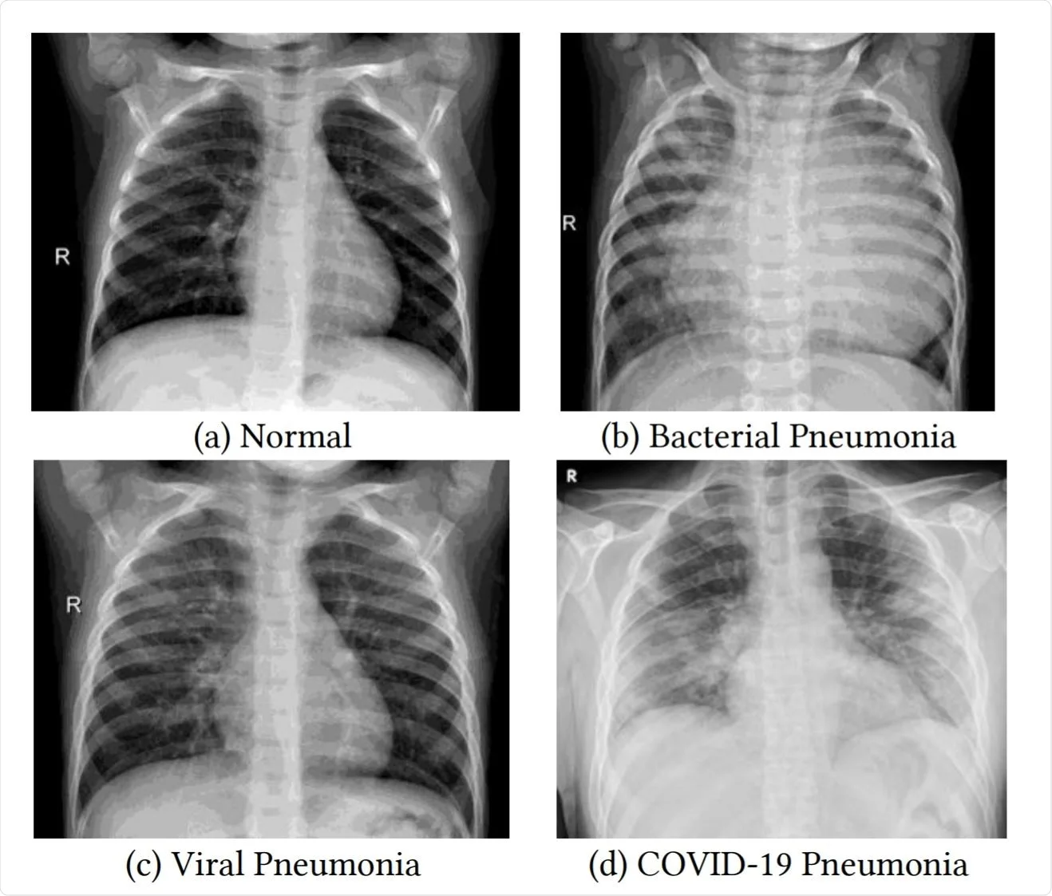

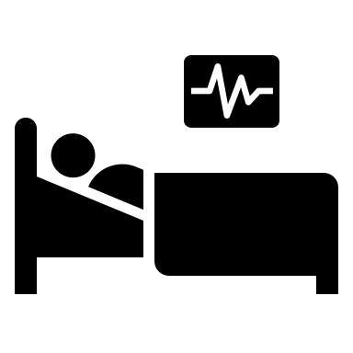
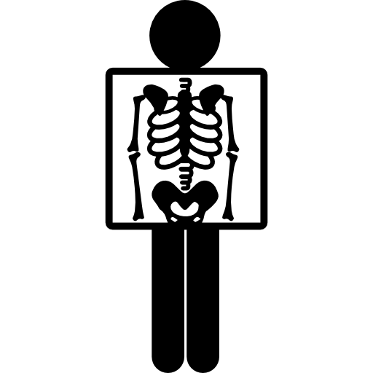

Why explainability
Zech, J. R., Badgeley, M. A., Liu, M., Costa, A. B., Titano, J. J., & Oermann, E. K. (2018). Variable generalization performance of a deep learning model to detect pneumonia in chest radiographs: a cross-sectional study. PLoS medicine, 15(11), e1002683.
Normal
Pneumonia
Notes:
No need to talk to you about the importance of explainable artificial intelligence

Slide 4
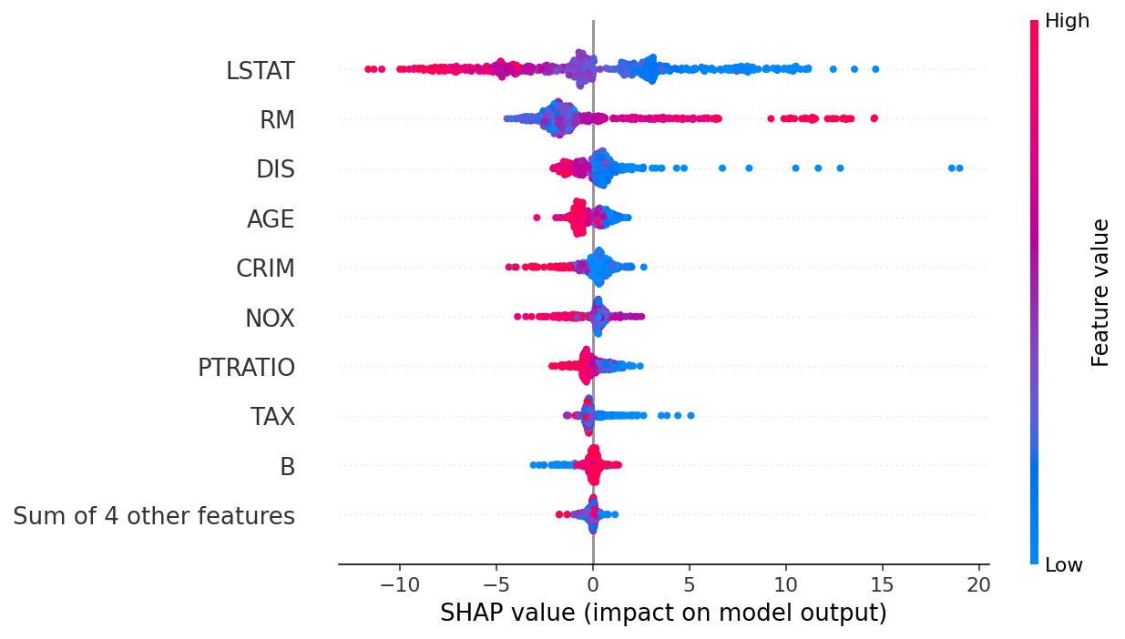
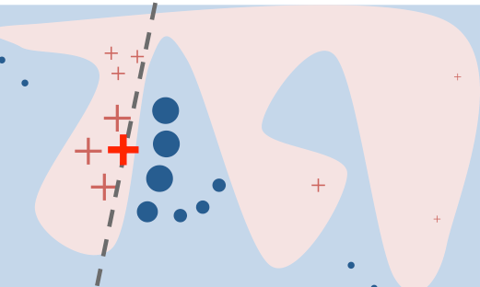
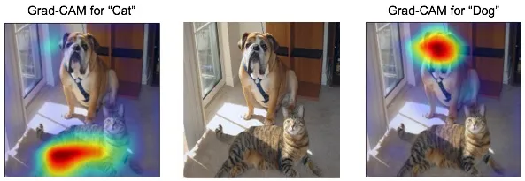
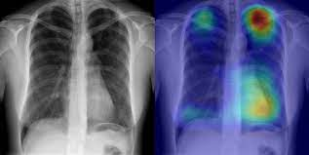

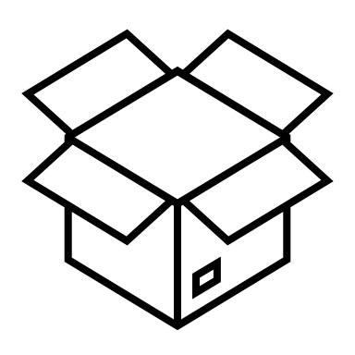
Ante-hoc explainability
SHAP
LIME
GRADCAM
Post-hoc
Black-box Model
Interpretable Model
Model Fitting
Surrogate
Model Fitting
Ante-hoc
Notes:
There are basically two approaches to get the explanations.
The first one, which is the most famous one is Post-hoc explainability, where one tries to explain, somehow, an already existing, already trained black-box models. The thing is, it works on approximations. Under this umbrella of approaches are some famous ones such as SHAP, LIME, and GradCAM.
The second one, which is also more recent, is Ante-hoc explainability. The idea here is to avoid using a black-box model in the first place and build instead a model that is inherently transparent. So, together with an outcome, it already provides an explanation. The reasoning process is therefore transparent.

Slide 5
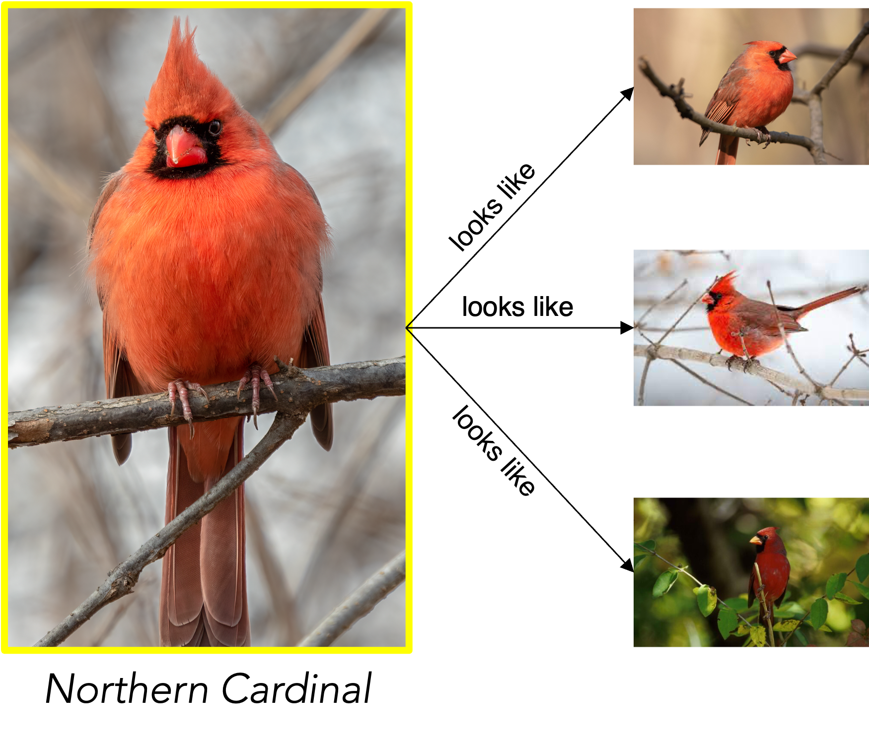
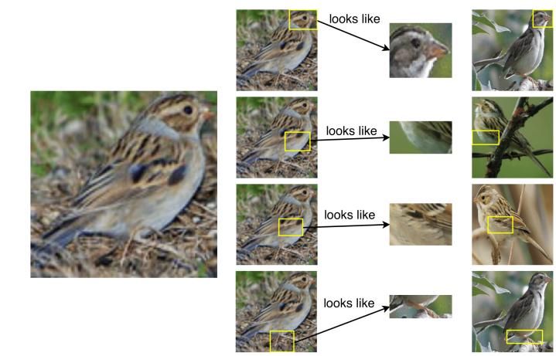
Case-based reasoning
Prototypical Learning
Prototypical Part Learning
This looks like that: deep learning for interpretable image recognition
Chen, Li, et al. 2019, NeurIPS
Notes:
An example of ante-hoc explainability is through case based reasoning, which can be of two kinds.
On the one hand, prototypical learning, learns some whole-training-images that are characteristic for each class. Those are called prototypes and are used at inference time to perform the classification by similarity.
On the other hand, prototypical part-learning consists in learning prototypes based on patches of training images, and not whole images. When presented with a new image, the model performs the classification by similarity between those patches and the test-image patches. This latter approach was introduced by Chen, Li, et al in a network called ProtoPNet.

Slide 6
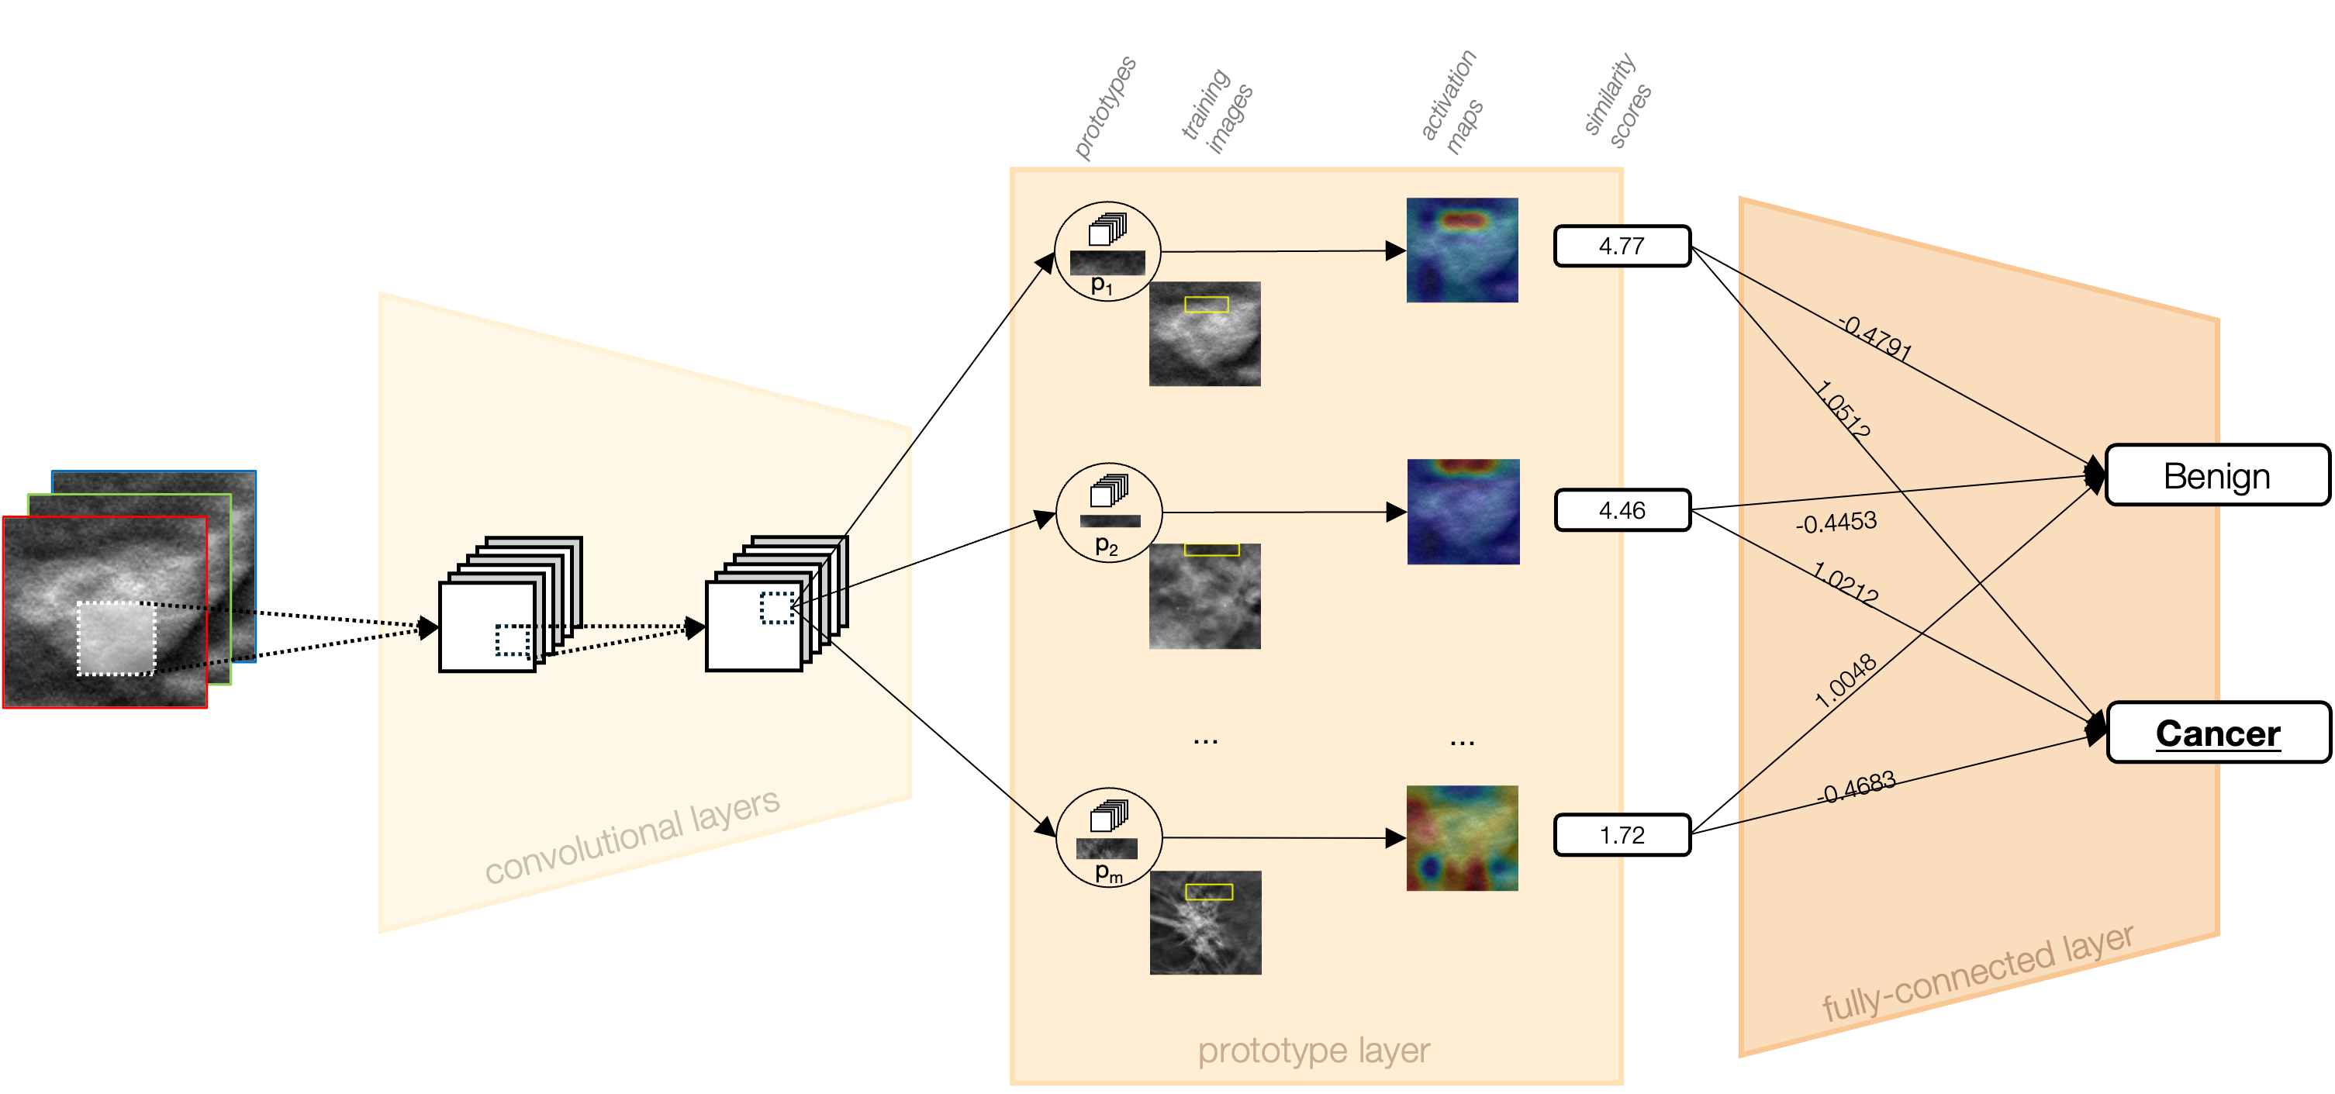
ProtoPNet
Notes:
This is the structure of ProtoPNet, it consists of a convolutional block that is meant to extract some features. It’s layers can be taken from state of the art convolutional neural networks such as Densenet an Resnet, and its weights can be used pretrained for instance on imagenet.
Next is the prototype layer, which is what sets protopnet apart from conventional CNNs, that is where the prototypes, which are learnt during training via a clustering algorithm, are stored, and compared, at inference time with all the patches of the analysed image. Well, to be precise, it’s the patches of the latent representation of the test image that are compared to the latent representation of the prototypes. If you want more details, you can ask me later. Those prototypes, as I said, are patches of some training images that are representative for each class. When introduced, protopnet was used on bird species classification and the prototypes were the beak of one species and the paws of a different one, for instance. In the case of breast masses, that could be some mass edges, some tissue patterns, and so on.
This layer assigns a similarity score for each compared item, creating also an activation map for the similarities. Those similarity scores are then combined together in the fully connected layer, basically they are summed up together, and the class with the highest score is assigned to the image.

Slide 7

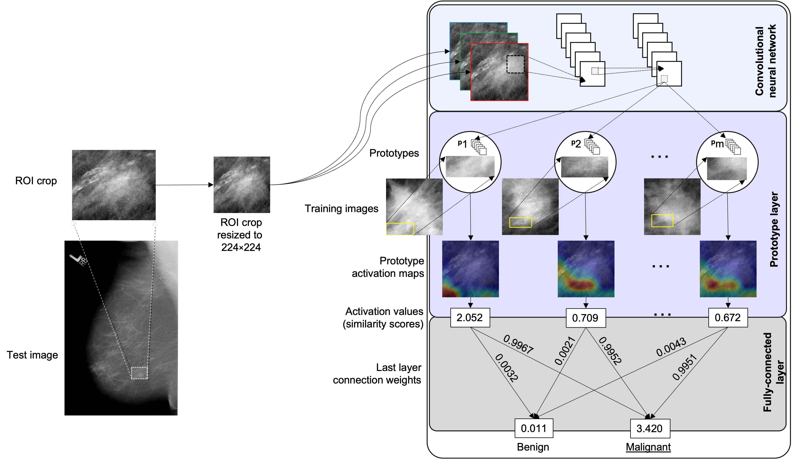
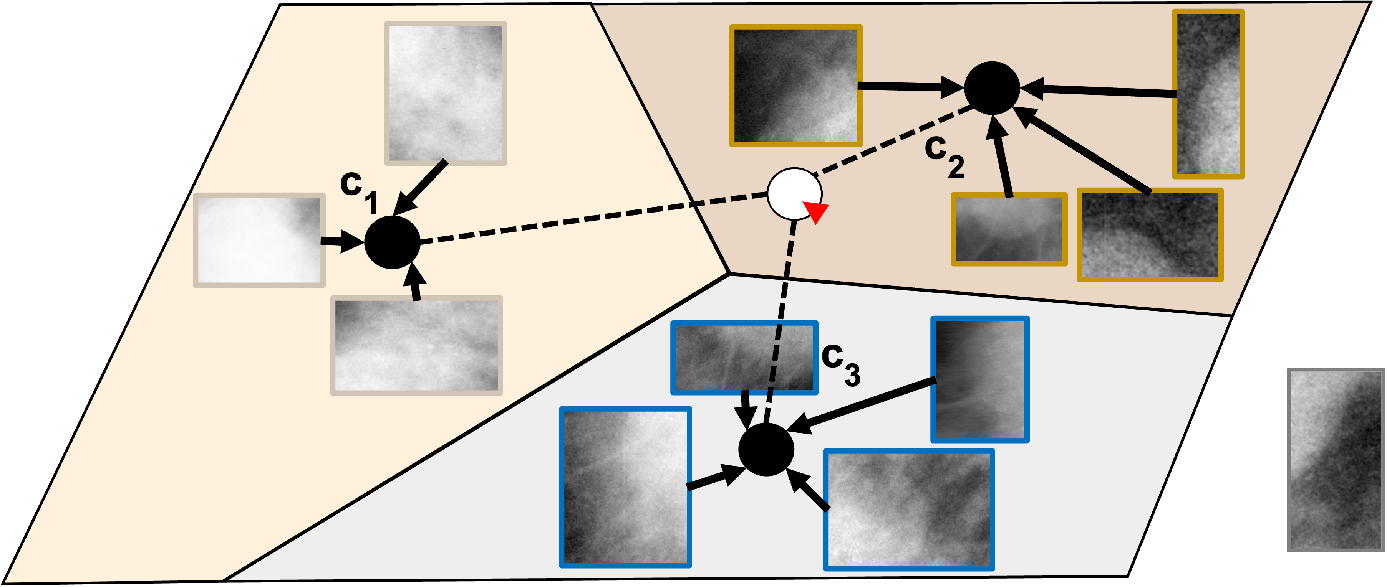
Mammogram images
Artificial Intelligence for Healthcare Applications
2nd International Workshop
August 21st, 2022
On the Applicability of Prototypical Part Learning in Medical Images: Breast Masses Classification Using ProtoPNet
with G. Carloni, C. Iacconi, M. A. Pascali and S. Colantonio (ISTI-CNR)
https://doi.org/10.1007/978-3-031-37660-3_38
Notes:
As I was saying before, ProtoPNet was introduced, in the original paper, on natural images, birds and cars. Medical images are quite different, and in general way more challenging, so utilising protopnet on medical images was not, in principle, straightforward. In a previous work we slightly modified ProtoPNet to run on medical images and used it for breast mass classification from mammography images, which we presented at the AI for healthcare applications at ICPR 2022.

Slide 8

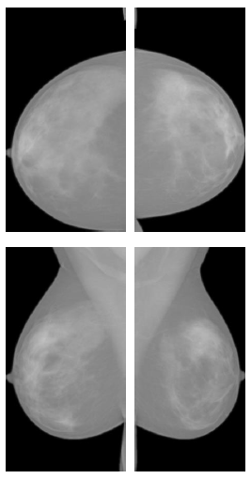

Digital Breast Tomosynthesis
Mammography
DBT
Less tissue superposition
Greater clarity and detail
Better for cancer detection
Time consuming analysis
Cranio-Caudal
(CC)
Takes one image from the top and one from the side.
Takes multiple images in an arc-like pattern, creating a detailed image.
Medio-Lateral Oblique
(MLO)
Notes:
In this work we shifted focus from mammography to digital breast tomosynthesis. If mammography acquires two views of the breast, from the top and from the side, DBT performs multiple irradiations over an arc, and is therefore able to reconstruct a small volume of tissue, which has several advantages, such as less tissue superposition, greater clarity and detail, and, potentially, better cancer detection, but since the number of images is higher, because of all the slices, the analysis is much more time consuming

Slide 9
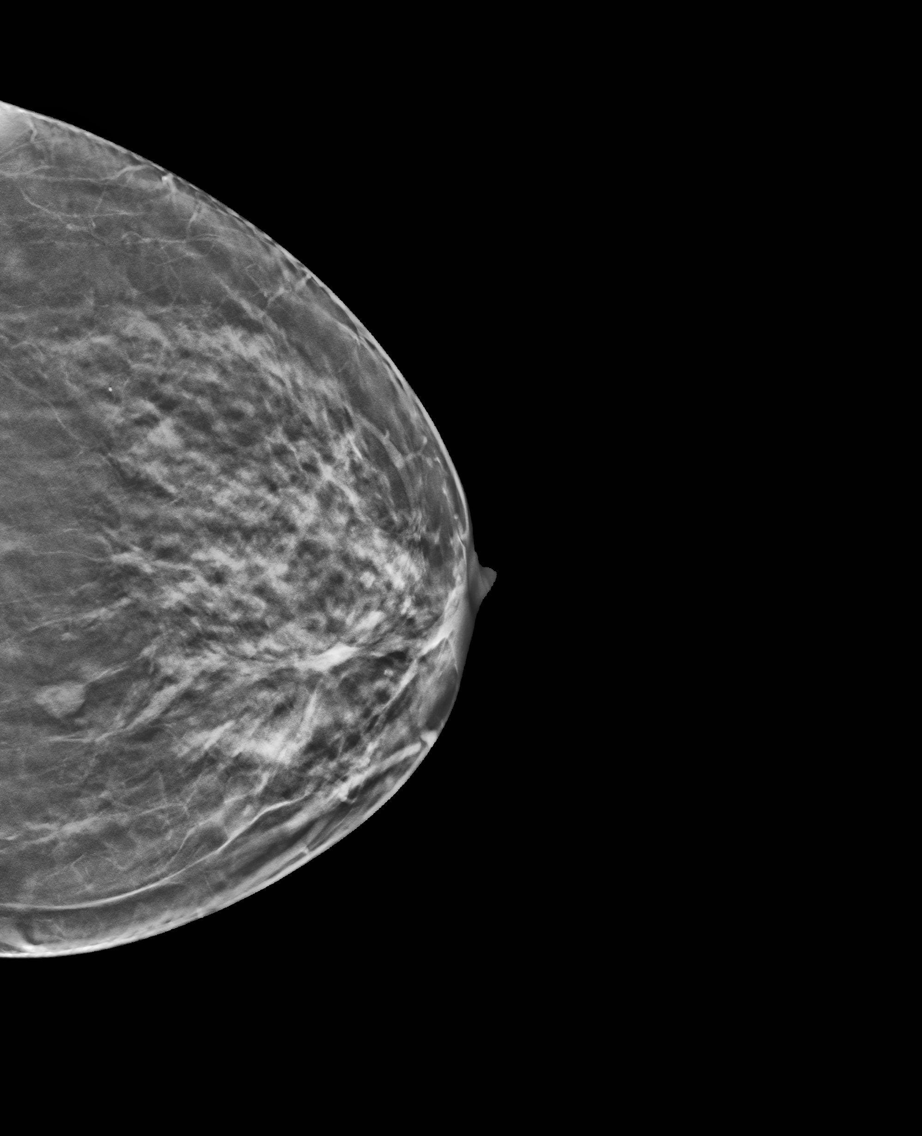


End-to-end framework
lesion 0.11
EXPLAINABLE
CLASSIFICATION
lesion 0.47
This lesion is
DETECTION
Benign
Cancer
Because…
Notes:
What we aimed at developing, therefore, was an end-to-end framework for detecting and classifying breast lesions from DBT acquisitions. And we wanted that framework to have an explainable-by-design classification step, in other words it’s based on ProtoPNet, which gives a classification which is something like “this lesion is cancer, because”, so we have the classification and its explanation

Slide 10
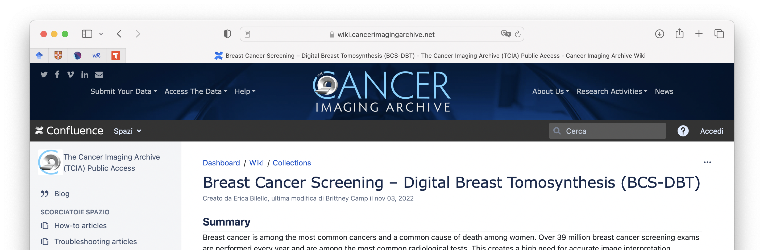
Dataset preparation
Detection Module:
CLAHE
4609
patients
101
patients
With mass biopsy
and bounding box
Notes:
The only publicly available dataset of DBT images is the BCS-DBT dataset, hosted on the cancer imaging archive. It consists of acquisitions from almost 5000 patients, which is amazing, right? Well, it is not. Almost all of them had no lesions, and only a small fraction of the ones with lesions had bounding boxes to identify them, which we need. This means that we had, at best, 100 patients, which is a very small number for deep learning. After selecting them, for the detection step we applied CLAHE that is a common preprocessing technique.

Slide 11
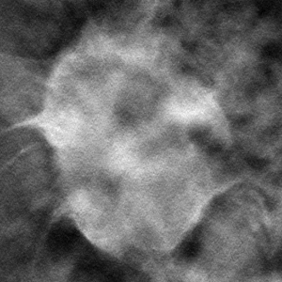
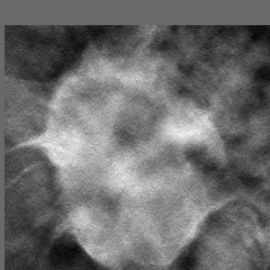
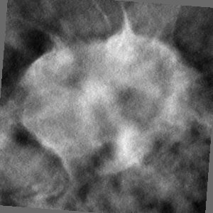
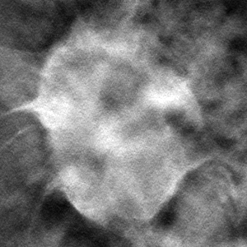
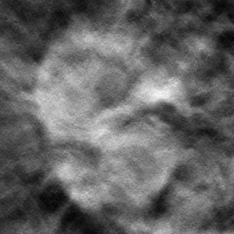
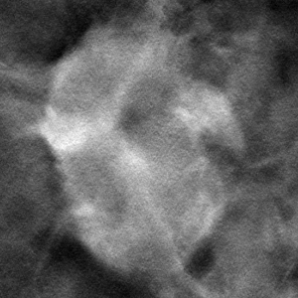
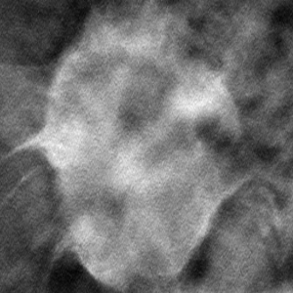
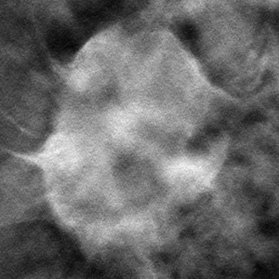
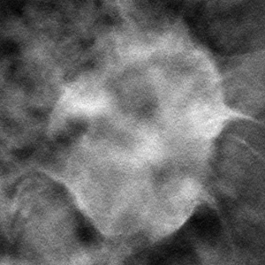
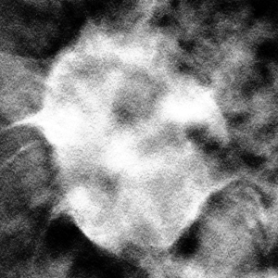

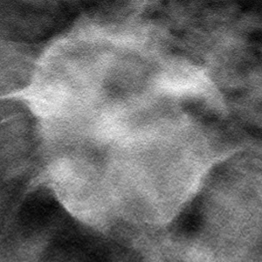
Dataset preparation
Classification Module:
Standard Data Augmentation
Inter-slice Data Augmentation
Notes:
And then, given the extremelly limited size of the dataset, we applied two tipes of data augmentation. The first one is standard data augmentation, with transformations such as translations, rotations, shear, and so on. The second one consisted in using different slices of a same lesion that appear slightly differently as you maybe can see, to further enhance the visual variety of the dataset. The inter slice data augmentation

Slide 12
Results for detection module
YOLOv5 vs YOLOv8 vs Ensemble
Ensemble has the best recall,
followed by YOLOv5
YOLOv8 has the best balance
In general, high number of false positives
Deeper analysis in the clinical feedback part
Notes:
For the detection module, we decided to utilise YOLO, and specifically two versions of yolo that proved to work better on medical images, v5 and v8. V8 was also the state of the art, now I think that the v9 version was released a couple of months ago. We also investigated an ensemble of the them to check for optimal results. You can see the results here, The ensemble has the best precision, followed by yolov5, v8 seems to have the best balance between precision and recall. In general however, as you can see, we have a problem of false positives, but we’ll discuss that better wen we’ll reach the section on the clinical feedback

Slide 13
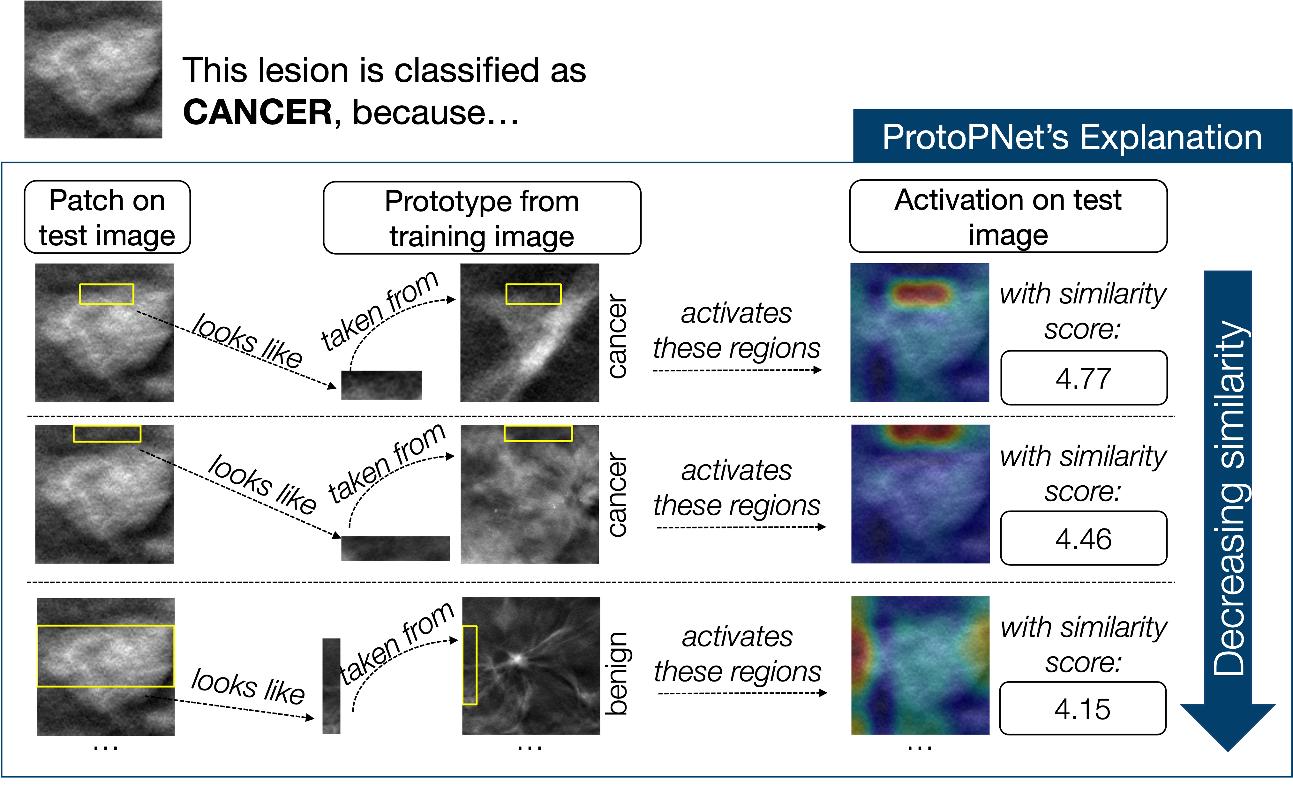
Results for classification module
Accuracy and Precision at 70% on test set
Results of ProtoPNet in line or higher than with ResNet
Notes:
Regarding the classification module based on ProtoPNet we got respectable/decent performance. We got 70% accuracy on the test set, and in general all the metrics were in line or generally higher than those obtained with the baseline
Resnet18, which we chose because we chose its layers for the convolutional block. You can see here an example of a cancerous mass correctly classified by protopnet and this one is the explanation it provides. Protopnet finds similarities between patches of the image, here, and the prototypes, here, the lower the row, the lower the similarity. And for each one it returns the activation map and the similarity score.

Slide 14
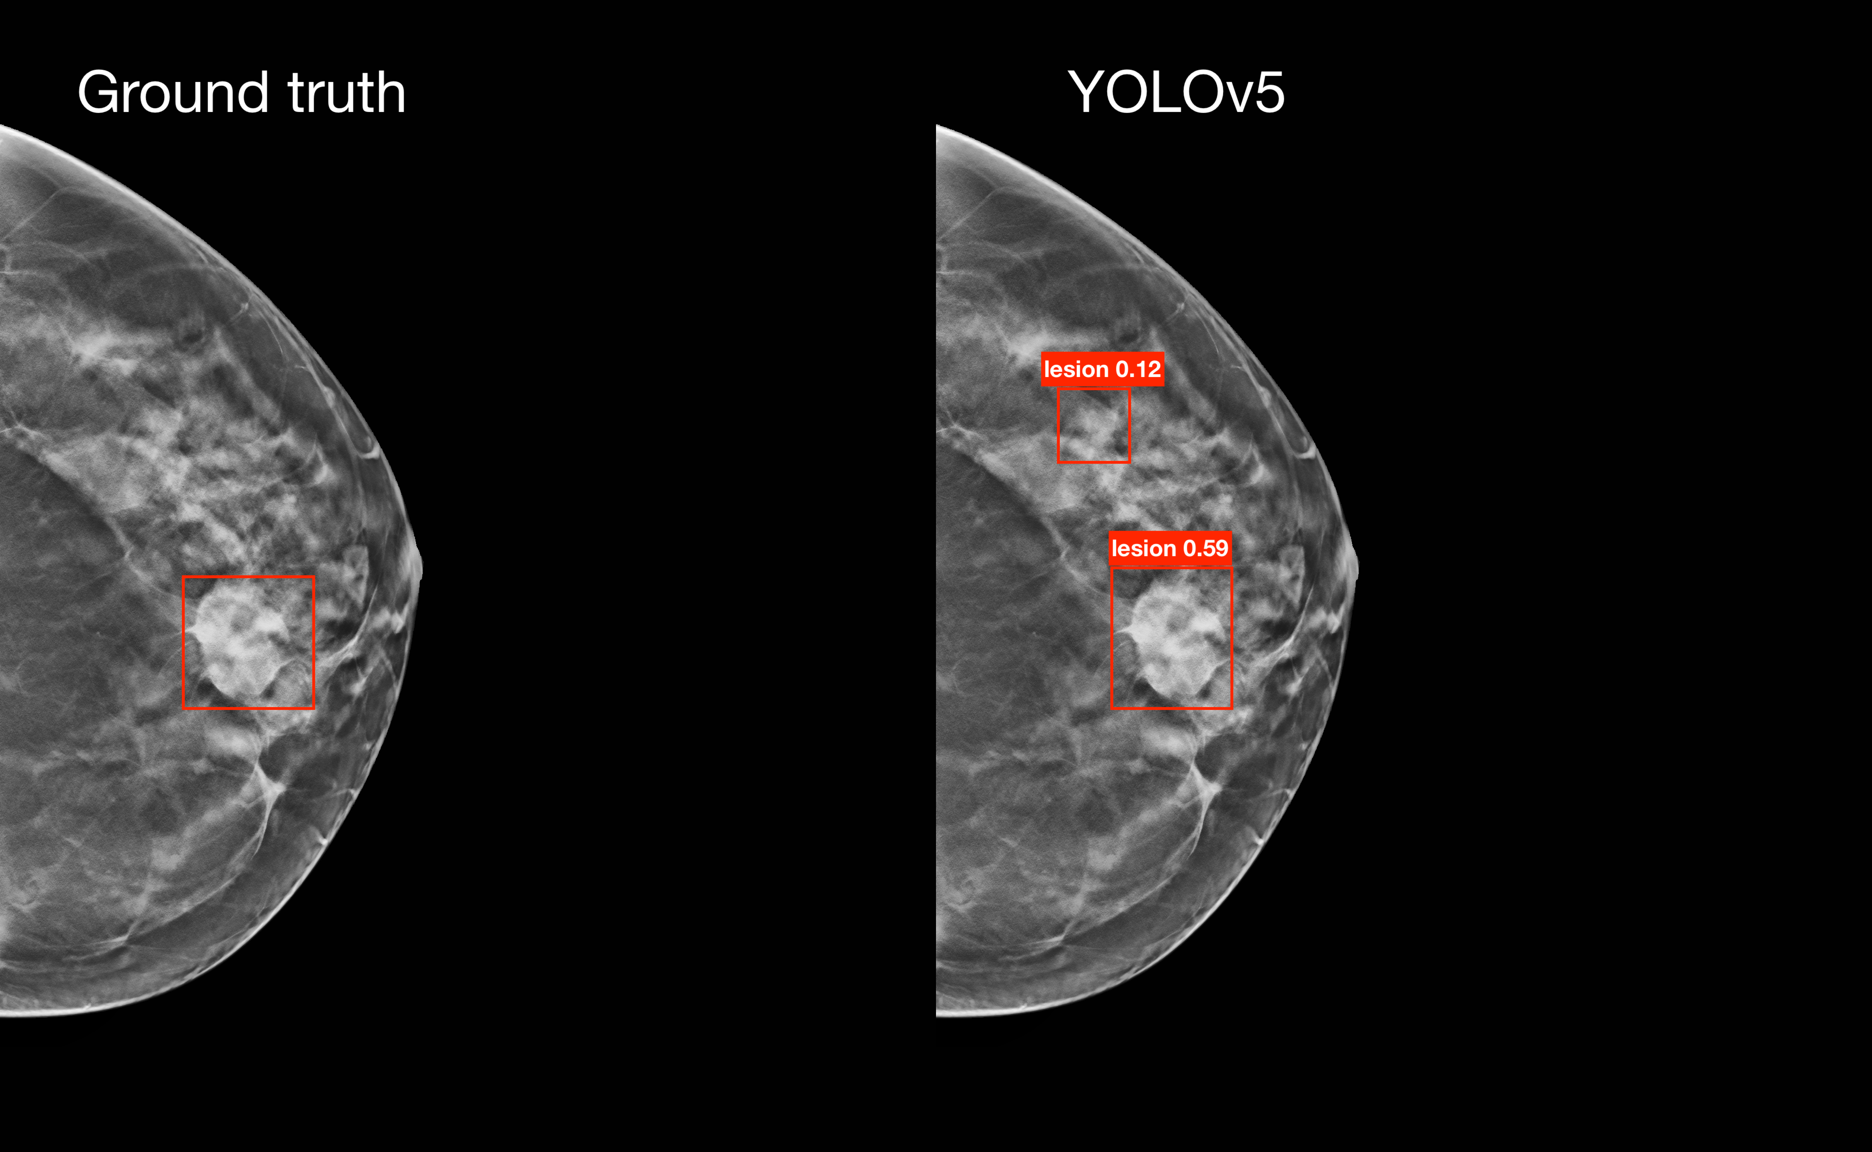
Clinical feedback: detection
Ground truth annotation accuracy: approximative annotation for multiple slices, bounding boxes missing for visible masses
Classification of false positives:
most of the false positives were not normal tissue (non-annotated lesions, low-VPP masses, lymph nodes,…)
Notes:
Let’s move now to the the clinical analysis of these results. We wanted to better understand why, basically, we were identifying a large number of false positives. We showed the results to two experienced radiologists and collected the feedback, and we foud two interesting results. There is a problem in the accuracy of the annotations, where some visible masses, that our model found, where not in the ground truth. The second observation is that most of the false positives our model identified were not actual normal tissue, but were some other kind of entities such as lymph nodes, non-annotated lesions etcetera

Slide 15
Clinical feedback: detection
One of the two radiologist stated:
The model makes errors not too dissimilar from those a radiologist might make; it errs as a radiologist could. It depends a lot on experience, as they too can make mistakes and confuse, for example, a glandular island with a mass, thus requiring further investigation with ultrasound, especially in very dense breasts. However, some of these uncertain cases are already excluded by comparing multiple consecutive slices.
Notes:
She also said that the model made errors that are in line with what a radiologist could do, A radiologist could mistake a glandular island a mass, as our model did, and they would typically ask for further investigation, especially for very dense brests, wich is a problem our model also had. However, if we consider the true false positives, our metrics change quite a lot and the precision increases.

Slide 16




Clinical feedback: classification
Task 1
Task 2
Task 3
Clinical significance of prototypes:
Are the learnt prototypes clinically-relevant markers for the classes?
Adherence in concepts of similarity:
Does the mathematically-based similarity learnt by ProtoPNet adhere with that of the radiologists?
Trust in the classifications:
Do radiologists trust the classifications, based on the explanations
1
2
3
4
5
Notes:
For the classification step, we wanted to investigate three aspects, first the clinical validity of the prototypes, second if the concept of similarity that ProtoPNet learnt, which is based on maths and numbers, aligns with that of a radiologist, which is based on many more pieces of information, experience and previously encountered cases. Third the overall trust in a classification based on the explanations provided. We asked the two radiologists to rate on a scale, with three indicating neutrality, and going from 1 strongly negative to 5 strongly positive. And we obtained a final sentiment score by weighting for the score and averaging for the number of items

Slide 17
Clinical feedback: classification
Task 1
Clinical significance of prototypes:
Benign prototypes better than malignant prototypes
Benign:
  R1: 3/5 with Sc > 3 (Sc_{avg} = 3.1)
  R2: 4/5 with Sc > 3 (Sc_{avg} = 3.6)
  Sc_{avg} = 3.4
Cancer:
  R1: 2/5 with Sc > 3 (Sc_{avg} = 2.2)
  R2: 0/5 with Sc > 3 (Sc_{avg} = 1.6)
  Sc_{avg} = 1.9
Notes:
Regarding the first task we observed the better quality of the benign prototypes that received an overall positive score and the cancer ones that got a pretty negative sentiment score.

Slide 18
Clinical feedback: classification
Task 2
Adherence in concepts of similarity:
22 randomly selected cases of similarity utilised by ProtoPNet during classification:
R1: 14/22 with Sc > 3 (Sc_{avg} = 3.1)
R2: 10/22 with Sc > 3 (Sc_{avg} = 2.6)
Sc_{avg} = 2.9
Notes:
Regarding the adherence in the concept of similarity we got an overall neutral sentiment score

Slide 19
Clinical feedback: classification
Task 3
Trust in the classifications:
22 randomly selected cases, showed first 5 similarities:
Higher discrepancy between the two radiologists’ opinions
R1: 13/22 with Sc > 3 (Sc_{avg} = 2.9)
R2: 7/22 with Sc > 3 (Sc_{avg} = 2.2)
Sc_{avg} = 2.6
Notes:
And for the trust in the classifications, we observed a higher discrepancy between the two radiologists, indicating that trust is a pretty personal and volatile aspect, but overall, we didn’t have particularly high scores. That probably reflects the problems in the dataset

Slide 20
Conclusions
Preprint: https://dx.doi.org/10.2139/ssrn.4904445
Detection module performance: in line with literature
Classification module performance: limited literature available, challenging comparison
Clinical feedback on detection:
  Approximative annotations
  False positives are “usually” not normal parenchima
  Similar behaviour to that of a radiologist
Clinical feedback on classification:
  Benign prototypes better than cancer
  Overall neutral Sc on the concept of similarity
  Higher discrepancy in scores on classifications
Notes:
So, in conclusion, we had performance with the detection module that were in line with the literature, for the classification module a comparison is much more challenging, since literature on that is quite scarce. From the cclinical feedback on the classification module we found out some major issues in the ground truth regarding annotations that were approximative or missing sometimes, which definitely confused our models. From that on the classification module we opbserved the better quality of benign prototypes over cancer ones an overall neutral sentiment score on the adherence of the concept of similarity learnt by Protopnet and that of the radiologists and higher discrepancy regarding appreciation of the single classifications, which probably highlights the core issues of the dataset.

Slide 21
Thank You
any questions?
Andrea Berti
andrea.berti@isti.cnr.it
Notes:
This concludes my presentation…

Slide 22
An explainable-by-design end-to-end framework based on prototypical part learning for lesion detection and classification in DBT images
Andrea Berti
next_AIM meeting
Bari, 16th October 2024

Slide 23
Overview
The importance of explainability
Ante-hoc explainability
The ProtoPNet architecture
ProtoPNet on medical images:
  Mammography
  Digital Breast Tomosynthesis (DBT)
  Prostate cancer

Slide 24
Back-up slides
Notes:
The second use case was on prostate cancer

Slide 25
ProtoPNet architecture (inference)
Notes:
We’ll see the structure of ProtoPNet through how it works at inference time. It is composed of three blocks. The first one is the convolutional block.

Slide 26
ProtoPNet architecture (inference)
Notes:
Then there is the prototype layer.
that compares each element of the latent representation of the image with the latent representation of each one of the previously learnt prototypes, giving a similarity score.

Slide 27
ProtoPNet architecture (inference)
Notes:
And lastly, the fully connected layer.
that basically puts together the similarity scores of the prototypes of the same class, and then the class with the highest score is assigned to the test image.

Slide 28
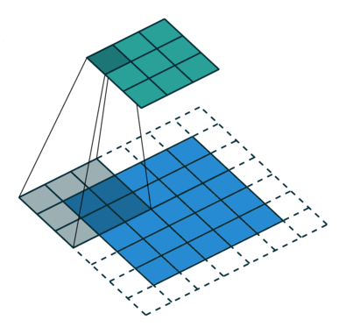
Convolutional layers
Feature extraction:
  VGG
  ResNet
  DenseNet
Pretrained on ImageNet
Original Image
224 x 224 x 3
Latent Representation
7 x 7 x D
Notes:
The convolutional block is composed of several convolutional layers and their structure can come from different famous baseline architectures, either VGGs, Resnets or Densenets, and the weights pretrained on imagenet. This way, starting with an image of dimensions 224 by 224 by three (colour channels), after the convolutional block, we end up with a latent representation of dimensions 7 by 7 by a certain number of filters.

Slide 29
Prototype layer
0.5
0.5
0.5
0.5
0.2
0.2
0.2
0.5
0.9
0.9
0.5
0.2
0.2
0.2
0.5
1.4
0.9
0.5
0.2
0.2
0.2
L₂ distance
0.9
1.4
0.9
0.5
0.2
0.2
0.2
1.4
0.5
0.9
0.9
0.5
0.2
0.2
0.2
Similarity
Score
0.5
0.5
0.5
0.2
0.2
0.2
0.2
Prototype p_{j}
1 x 1 x D
0.2
0.2
0.2
0.2
0.2
0.2
0.2
Latent Representation
7 x 7 x D
Activation Map
Notes:
Each element of the latent representation is then compared, in the prototype block, with the latent representations of each one of the previously learned prototypes. The comparison is based on an L2 distance, which is then converted into a similarity score for each element of the matrix, and then to a global one.

Slide 30
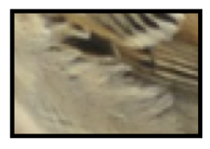
Fully connected layer
Prototype p₁
3.9
…
Prototype p₂
Cardinal
1.4
Clay coloured sparrow
…
…
Prototype p_{m}
2.6
Common yellowthroat
Notes:
Those similarity scores are then passed to the fully connected layer, where they are put together, roughly adding up all the similarity scores for the same class, and selecting the class with the highest similarity score.

Slide 31
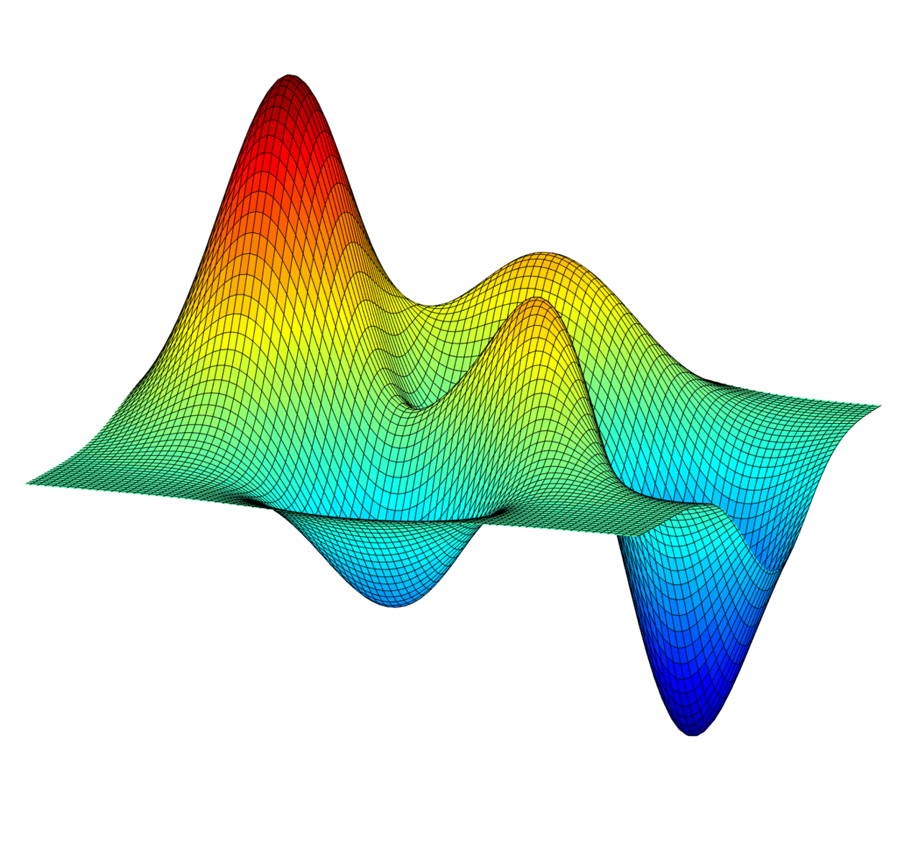
The training algorithm
Three stages:
Stage 1: Stochastic Gradient Descent of layers before last layer
Stage 2: Projection of prototypes
Stage 3: Optimization of last layer
Notes:
Up until now we’ve talked about the previously learned prototypes and the inference process, but how does ProtoPnet learn those prototypes, and learn in general? The training process develops through three stages

Slide 32
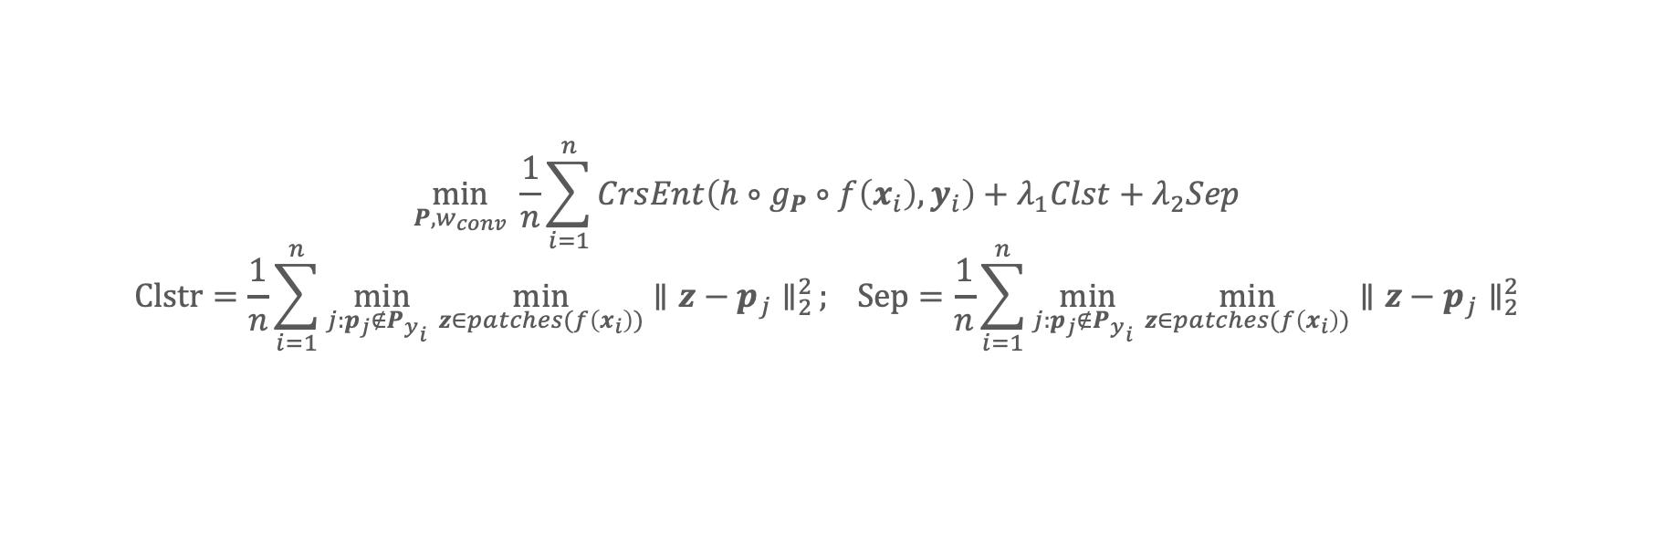
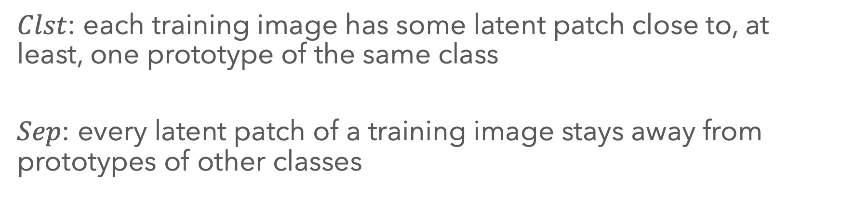
The training algorithm
Stage 1: SGD of layers before last layer
$$\min_{P,w_{conv}} \frac{1}{n}\sum_{i=1}^{n}{CrsEnt\left(h∘g_{P}∘f\left(x_{i}\right), y_{i}\right)+λ_{1}Clst+λ_{2}Sep}$$
$$Clstr=\frac{1}{n}\sum_{i=1}^{n}{\min_{j:p_{j}∉{P_{y}}_{i} }\min_{z∈patches(f\left(x_{i}\right))}{{∥z−p_{j}∥}_{2}^{2}}}; Sep=\frac{1}{n}\sum_{i=1}^{n}{\min_{j:p_{j}∉{P_{y}}_{i} }\min_{z∈patches(f\left(x_{i}\right))}{{∥z−p_{j}∥}_{2}^{2}}}$$
$Clst$: each training image has some latent patch close to, at least, one prototype of the same class
$Sep$: every latent patch of a training image stays away from prototypes of other classes
Notes:
The first stage is a stochastic gradient descent of all layers before the last layer.
The cost function that has to be minimised consists of three terms.
Of course there is the cross-entropy to penalise wrong classification.
Then there is a clustering term that encourages each training image to have some latent patch close to at least one prototype of the same class.
And lastly, there’s a separation term that forces the training patches of a training image to stay away from prototypes of different classes.

Slide 33
The training algorithm
Stage 2: Projection of prototypes
$p_{j}←\arg{\min_{z∈𝒵_{j} }}∥z−p_{j}∥_{2}$, where $𝒵_{j}=\{\tilde{z}:\tilde{z}∈patches\left(f\left(x_{i}\right)\right)∀i s.t. y_{i}=k\}$
Each prototype projected onto the nearest latent training patch of the same class
Notes:
So, in the previous stage, we cluster the patches of the training images and now the centroids of that clustering algorithm become the prototypes of the classes. But since we want the prototypes to be real pieces of real images, we project the centroids onto the nearest latent patch. Basically, going from a continuous to a discrete space.

Slide 34
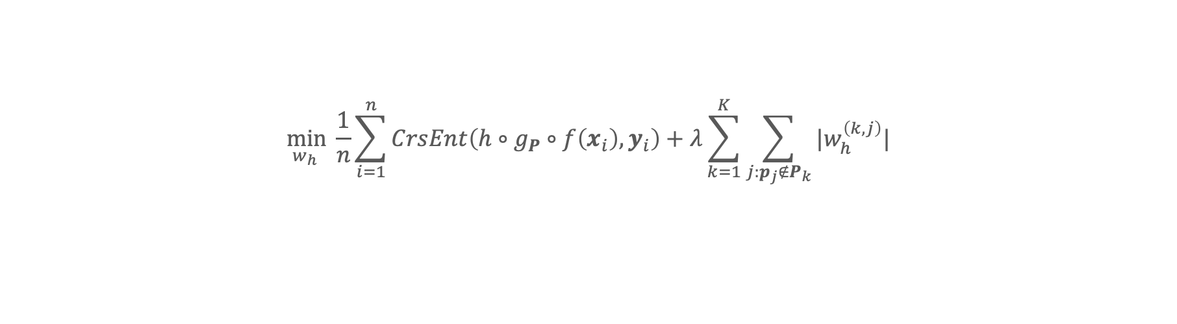
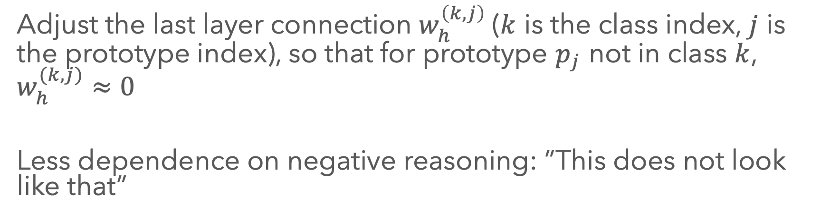
The training algorithm
Stage 3: Optimization of last layer
$$\min_{w_{h} } \frac{1}{n}\sum_{i=1}^{n}{CrsEnt\left(h∘g_{P}∘f\left(x_{i}\right), y_{i}\right)+λ\sum_{k=1}^{K}{\sum_{j:p_{j}∉P_{k}}{|w_{h}^{\left(k,j\right)}|}}}$$
Adjust the last layer connection $w_{h}^{\left(k,j\right)}$($k$ is the class index, $j$ is the prototype index), so that for prototype $p_{j}$ not in class $k$, $w_{h}^{(k,j)}≈0$
Less dependence on negative reasoning: ”This does not look like that”
Notes:
And lastly in the final stage, we fix the weights of the previous blocks and optimize the last layers, so that the weights connecting a class and its prototypes are around one, and the weights connecting the prototypes to different classes is around zero

Slide 35
Results classification
ProtoPNet
Baseline:
  B. Accuracy 0.64
  Precision 0.64
  Recall 0.58
  Specificity 0.72
  AuROC 0.64

Slide 36

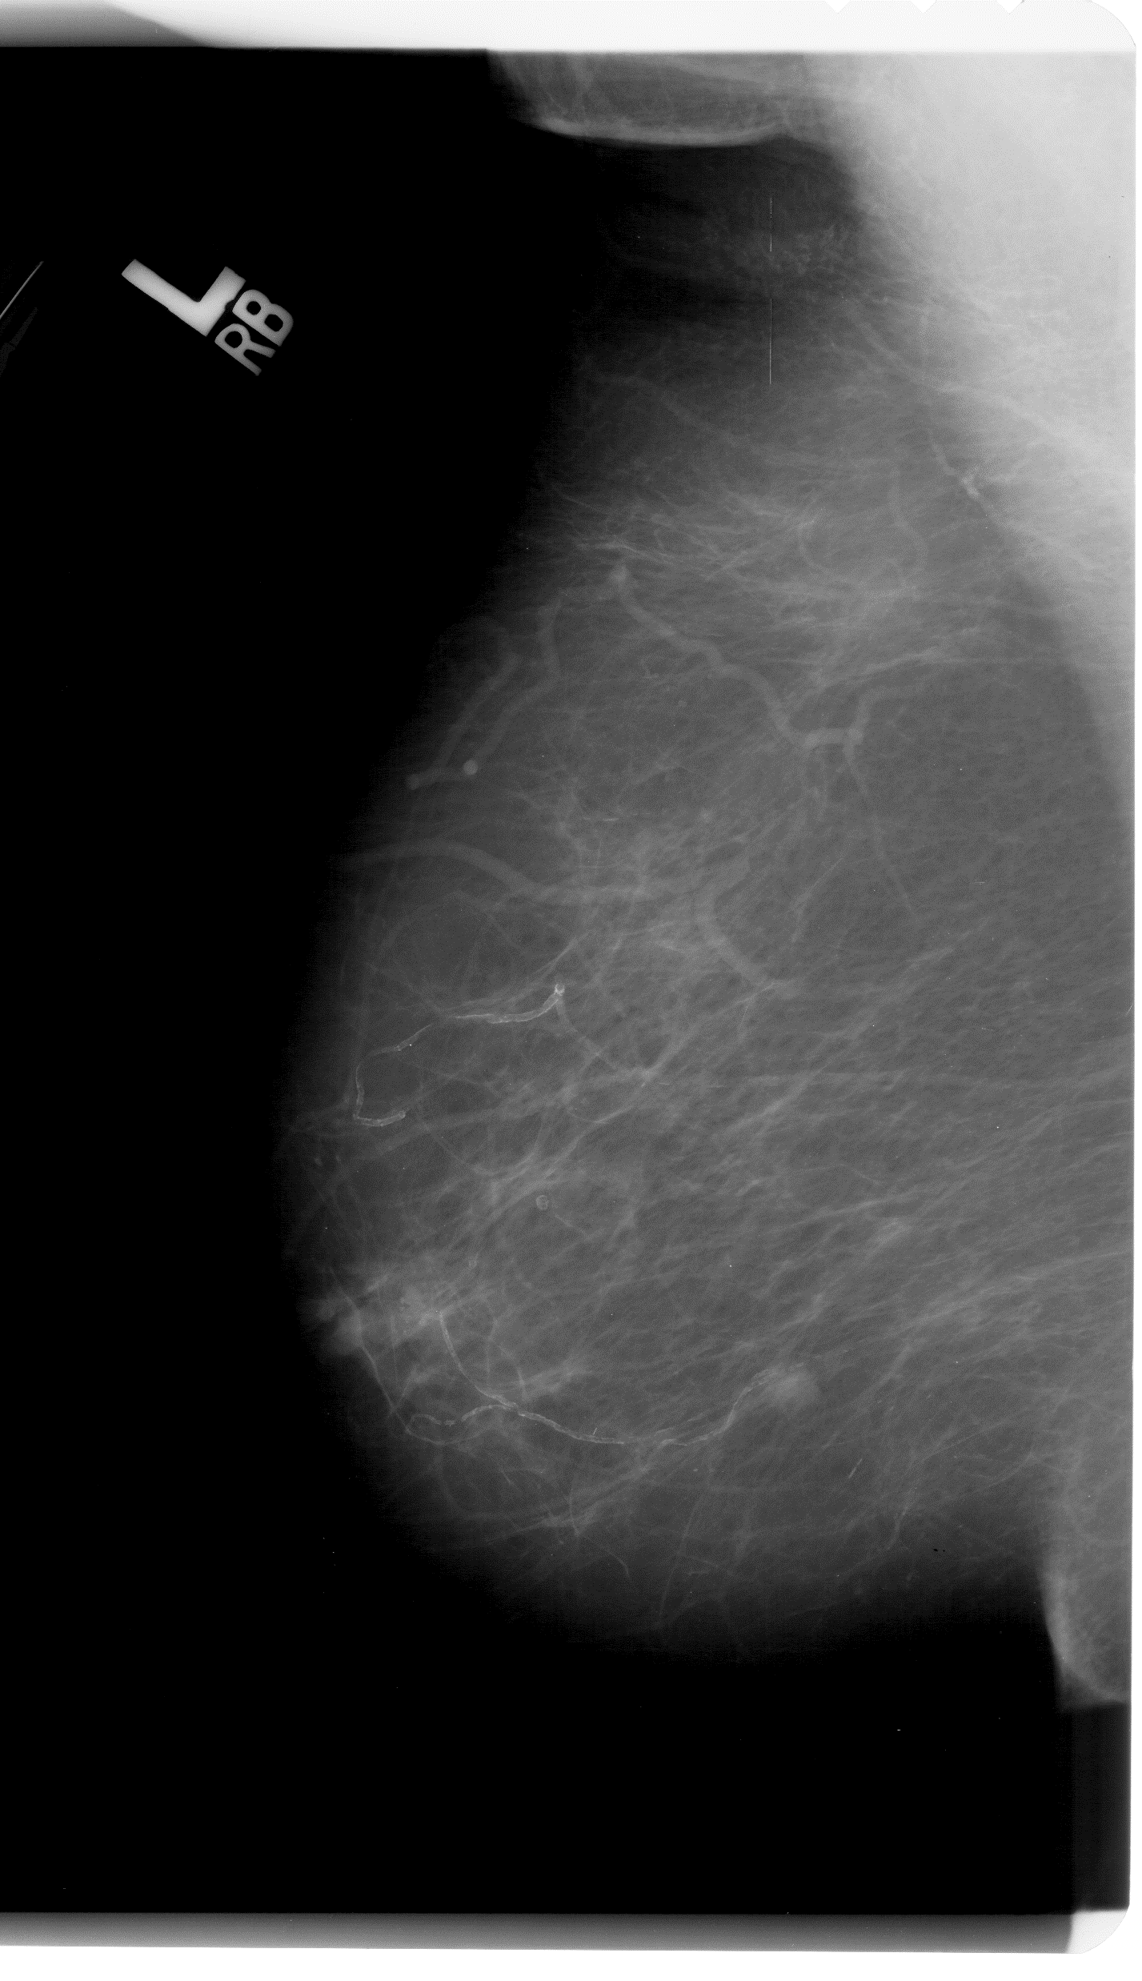
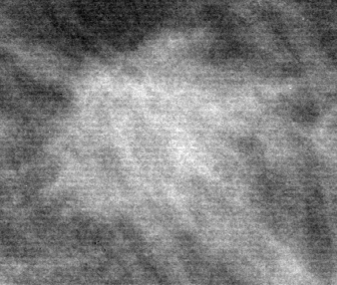

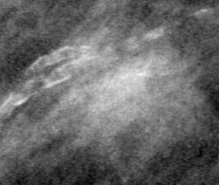
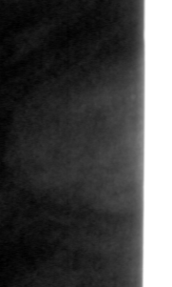
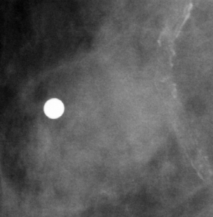
CBIS-DDSM Dataset
Dataset
selection
CBIS-DDSM (Curated Breast Imaging Subset of DDSM)
Cleaning and Balancing
Training | Benign | 577
 | Malignant | 637
Test | Benign | 194
 | Malignant | 147
528
528
131
131
Notes:
As I said, in our work we aimed at exploring the applicability of ProtoPNet to the medical domain. Thus, we selected the CBIS-DDSM dataset, a publicly available dataset of mammogram images containing mass crops, labelled as benign or malignant. The dataset already provides the split into train and test set. However, several problematic images were in the dataset, like the examples here. We thus carried out a cleaning and balancing process as a preparation for the dataset. The final cohort, thus, consisted of 528 images for each class in the training set and 131 for each class in the test set.

Slide 37

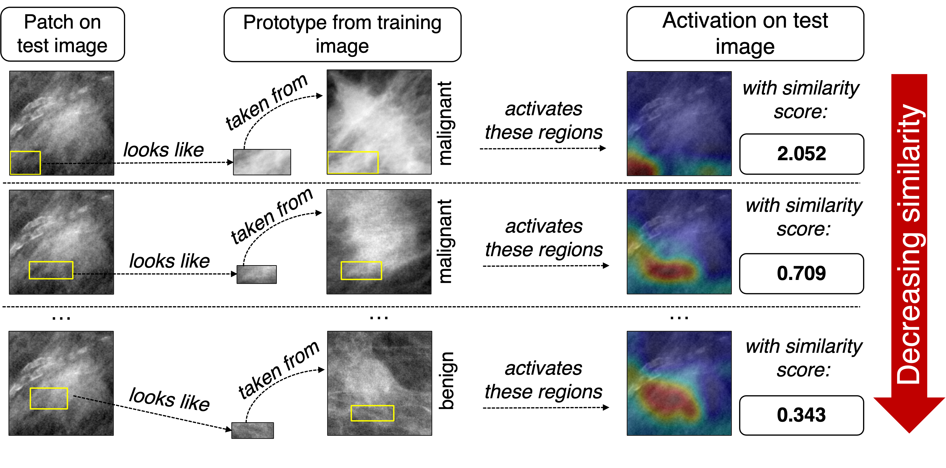
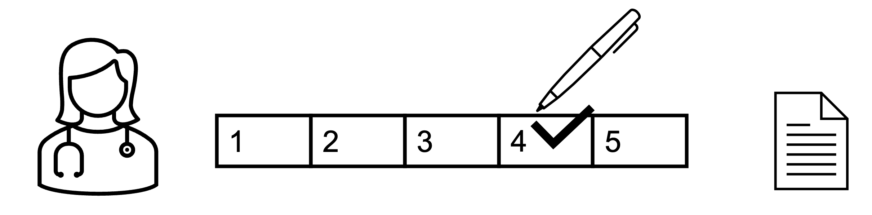
Results of our work
Test image: malignant
Predicted as: malignant
Notes:
Here you can see an example of a classification and explanation provided by ProtoPNet for a correctly classified malignant mass: in the first column there is the patch, on the test image, that was of interest for ProtoPNet. In the second column you can see the prototype that is similar to that patch, and the training image it was taken from. In the last column there is the similarity score, together with the activation map on the test image. And the lower the row, the lower the similarity. And you can see, for instance here, that the most activated prototype/prototypes are from the malignant class, and then going down the last one is benign.
Since it’s easier to understand what a prototype representing a beak or a paw actually mean but it’s harder when I represents parts of a medical image, we also asked a radiologist to rate the quality of the prototypes, of the similarities used by the network as well as of the whole explanations.

Slide 38




A Clinical Viewpoint On The Outputs Of ProtoPNet
Task 1
Task 2
Task 3
How relevant are the learned prototypes to recognize benign and malignant breast masses?
How clinically significant is the prototype activation on each test image?
To what extent do you like the way explanations are delivered, i.e., “are they convincing and relevant for assisting a radiologist?”
1
2
3
4
5
Notes:
As you may expect, given the highly specific task, a strong domain knowledge is necessary to understand those explanations and the quality of prototypes learned.
So, we asked a radiologist with 16 years of experience to provide a clinical viewpoint for three tasks.
- First, we wanted to understand how relevant the prototypes learned by ProtoPNet were for their respective class.
– In the second task we wanted to investigate whether the similarity concept learned by ProtoPNet was comparable to that of a radiologist. In other words, how significant the prototype activation on the test images was.
- In the third task, we wanted to examine the overall quality of explanations, that is, if they were convincing and relevant to the radiologist.
For the three tasks, she assigned scores from 1 to 5.

Slide 39
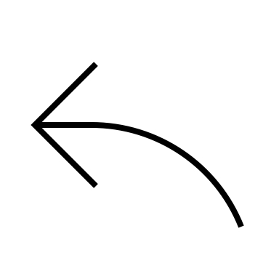
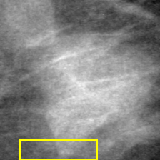



A Clinical Viewpoint On The Outputs Of ProtoPNet: Task 1
>= 3/5
Generic or non-significant prototype
1
Prototype for a benign mass
2
Class | Good prototypes
Benign | $$50\%$$
Malignant | $$88\%$$
3
Prototype for a malignant mass
4
5
Highly class-specific prototype
Notes:
Starting from the first task, a rate of 1/5 represented a generic or non-specific prototype whereas 5/5 was for highly class-specific ones. Here are two examples of a 1-score and a 5-score cases. Overall, only 50% of benign prototypes were considered acceptable by the radiologist (i.e., with a score greater that 3), but 88% of malignant prototypes were deemed good. So, it seems that the network managed to learn better and more specific prototypes for malignant masses.

Slide 40




A Clinical Viewpoint On The Outputs Of ProtoPNet: Task 2
Patch and prototype are not clinically similar
1
Activation on test image
Prototype from train image
2
Good activations
$$66\%$$
3
4
5
Patch and prototype share common clinical information
Notes:
Concerning task 2, we provided the radiologist with patches of test images and the corresponding activated prototypes. We then asked her to rate from 1 to 5 how similar those two regions were. Here, a score of 1/5 was for non-clinically similar portions, whereas a score of 5/5 indicated that the patch and the prototype shared a common clinical information.
For this task, 66% of all the activations were deemed good.

Slide 41





A Clinical Viewpoint On The Outputs Of ProtoPNet: Task 3
Non-relevant regions of the image are highlighted / relevant ones are missed
1
Patch on test image
Prototype from training image
Activation on test image
2
with similarity score:
taken from
Predicted class | Good explanations
Benign | $$50\%$$
Malignant | $$89\%$$
malignant
3
2.139
4
taken from
with similarity score:
malignant
5
0.857
Really agree with the explanation: all the relevant regions are recognized
Notes:
Finally, for the third task we asked the radiologist to rate the explanation for some test images, without knowing the actual ground truth.
Here, lower scores were assigned to explanations where non-relevant regions were highlighted and/or relevant ones were not recognized, whereas higher scores were for explanations where all the relevant regions to the radiologist were recognized by the network.
As a result, only 50% of benign-predicted masses had an explanation compelling to her, whereas 89% of malignant-predicted masses had a convincing explanation. So, similar numbers to those from Task 1.

Slide 42
Results of our work
Classification results acceptable but insufficient to enter the clinical practice
Prior domain knowledge to critically benefit from ProtoPNet’s explanations
Explanations for malignant masses: highly plausible, valuable, and intuitive to a radiologist. However, this is not true for benign masses yet
Radiologist: highly intuitive and satisfactory form of the explanations
Notes:
As a result of this work, we obtained decent performance, that were comparable between ProtoPnet and a black-box model. We saw that some domain knowledge is necessary to fully appreciate the results from the network. We found out that the prototypes and the explanations for malignant masses were of higher quality with respect to benign masses. But all in all, the radiologist really appreciated the intuitiveness of the form of the explanations provided

Slide 43
Differences from original ProtoPNet
Dataset:
  From natural images to medical images → generation of 3-channel images from single-channel medical images
Training framework:
  Presence of hold-out test set: assess the final performance, after training in Cross-Validation
  Fixed LR value and Early-stopping during training process
Architectural changes:
  2D Dropout and a 2D Batch-norm layer after each add-on convolutional layer
  Number of classes: 2
Clinical feedback on the quality of output explanations

Slide 44

Implementation Environment
Cluster “AI@Edge” of ISTI-CNR, composed by four nodes, each with the following specifications:
  1× NVIDIA®A100 40 GB Tensor Core (GPU),
  2× AMD - Epyc 24-Core 7352 2.30 Ghz 128 MB,
  16x DDR4-3200 Reg. ECC 32 GB module = 512 GB.
Python 3.9.7 on CentOS 8, back-end libraries of PyTorch (version 1.9.1, build py3.9-cuda11.1-cudnn8005).

