Slide 1
State of the Play of Explainability in Medical Imaging
Approaches, trends and challenges
Sara Colantonio
Istituto di Scienza e Tecnologie dell’Informazione Consiglio Nazionale delle Ricerche

Slide 2
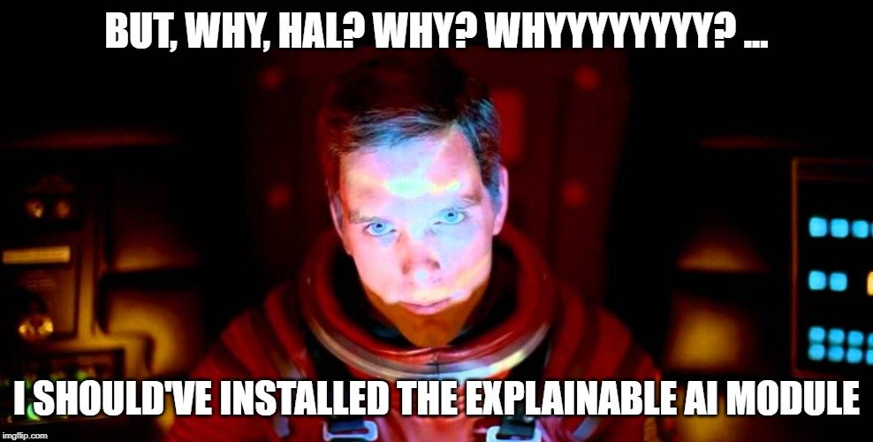

Slide 3









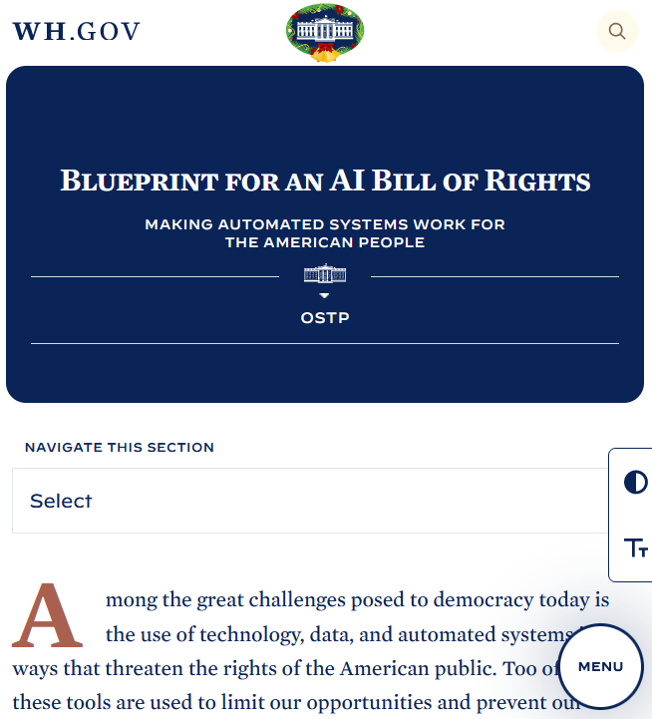





Explainability
To provide meaningful and actionable explanations about the logics behind the predictions by an AI model
Core requirement also to ensure transparency

Slide 4
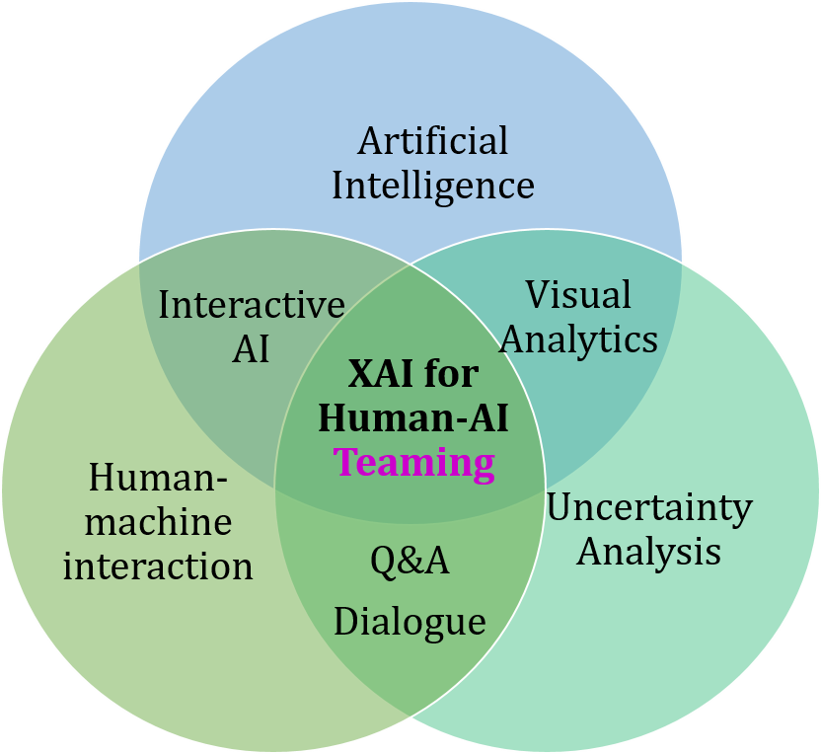
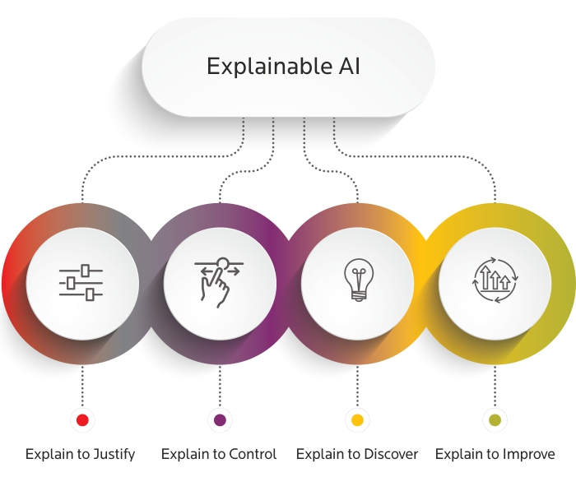
A general perspective
Human – AI teaming
Interested actors:
understand why
understand why not
know when the model succeeds or fails
know when to trust the model
know when the model errs
Broader definition
  intelligible or comprehensible AI: everything that makes AI understandable (also data, performance metrics,…)

Slide 5
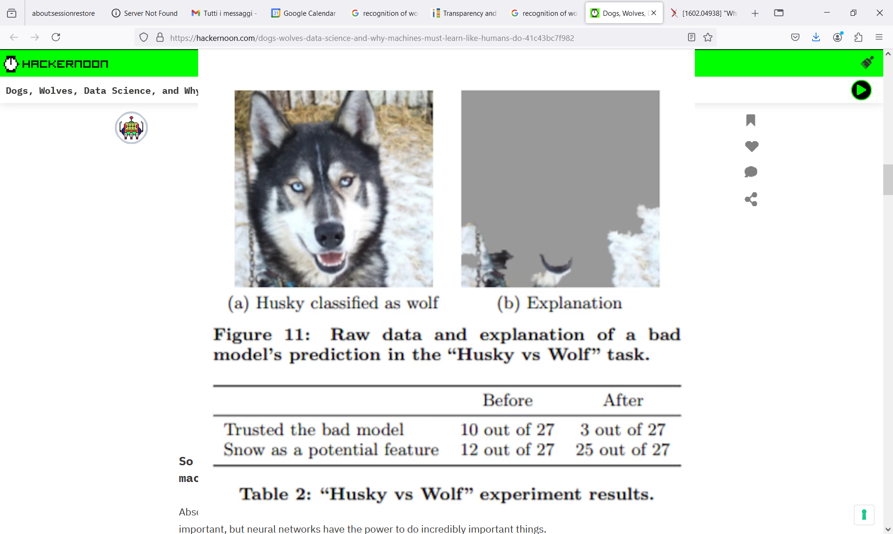
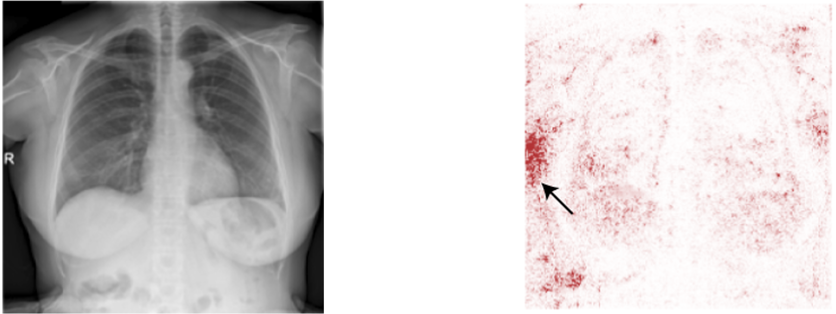
A recent awareness
A COVID-19 positive case
Important pixels
M.T. Ribeiro, S. Singh, and C. Guestrin. “Why should I trust you?”: Explaining the Predictions of Any Classifier" KDD 2016
DeGrave, Alex J., Joseph D. Janizek, and Su-In Lee. "AI for radiographic COVID-19 detection selects shortcuts over signal." Nature Machine Intelligence 3.7 (2021): 610-619.
Notes:
.

Slide 6
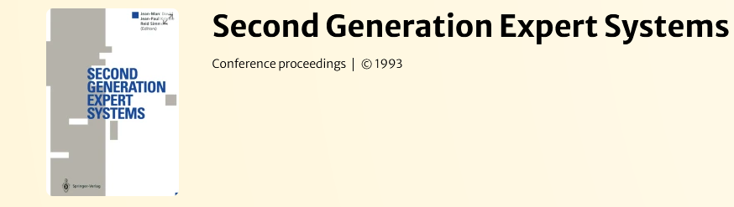
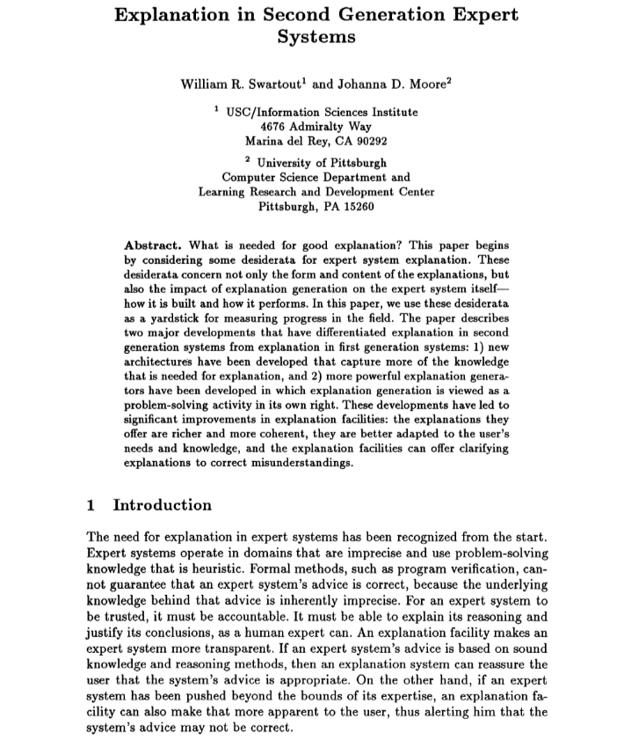
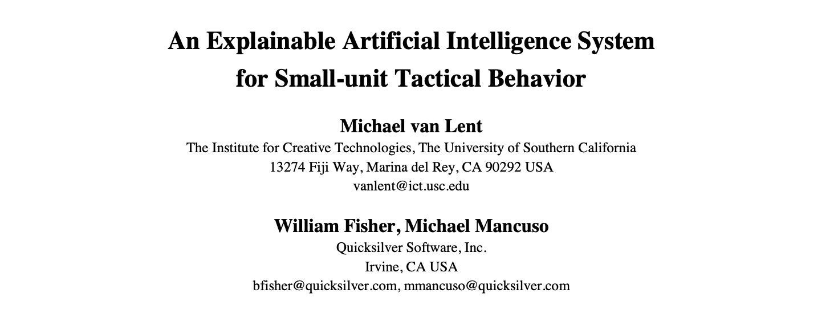
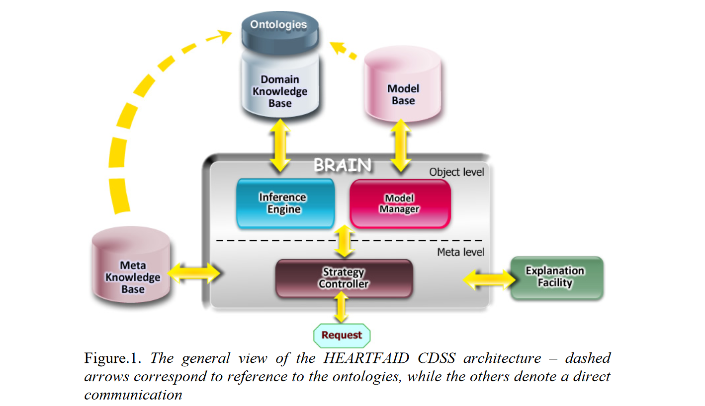
…but an old quest
2004
1993
2007
S Colantonio, M Martinelli, D Moroni, O Salvetti, F Perticone, et al.. An Approach to Decision Support in Heart Failure. SEMANTIC WEB APPLICATIONS AND PERSPECTIVES (SWAP 2007), Dec 2007, Bari, Italy.
Notes:
.

Slide 7
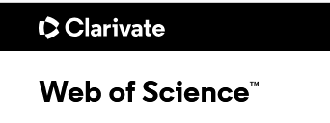
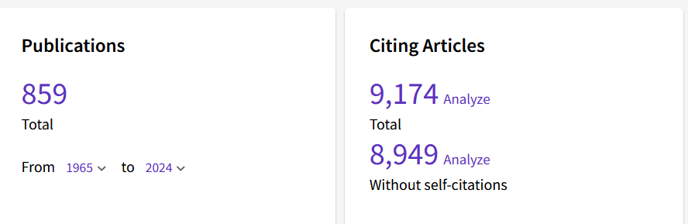
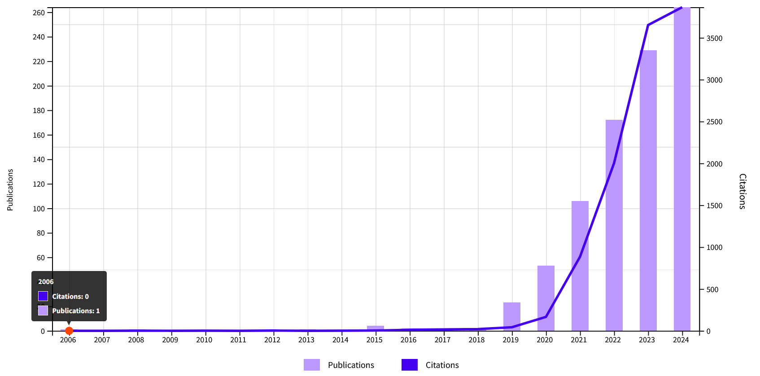
Publication trends in medical imaging
(Explainab* OR Interpretab*) AND (Artificial Intelligence) AND (Medical Imaging)

Slide 8

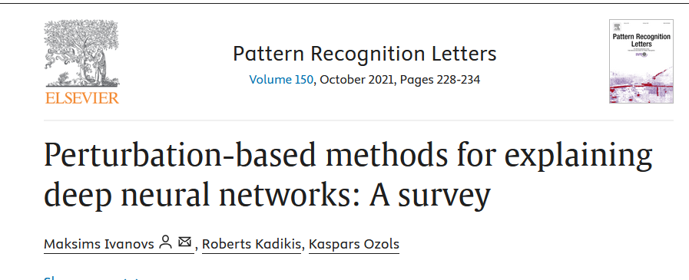

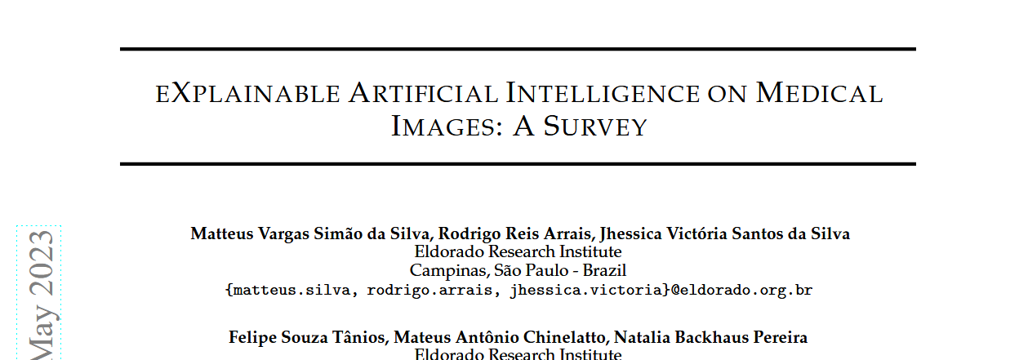

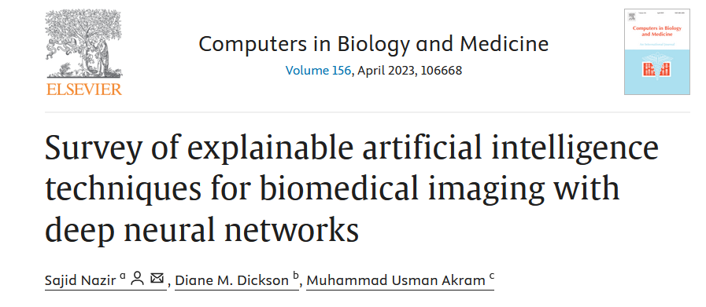
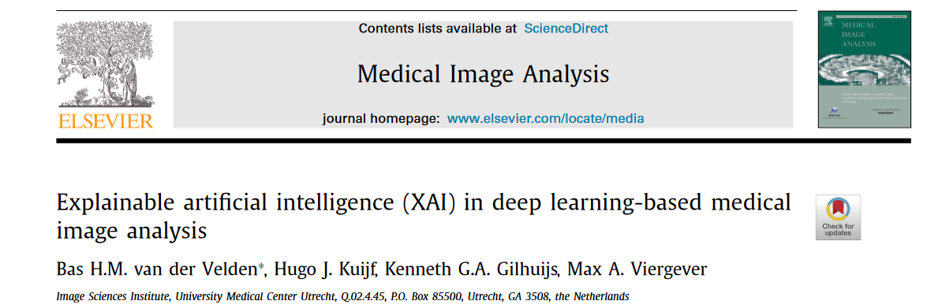
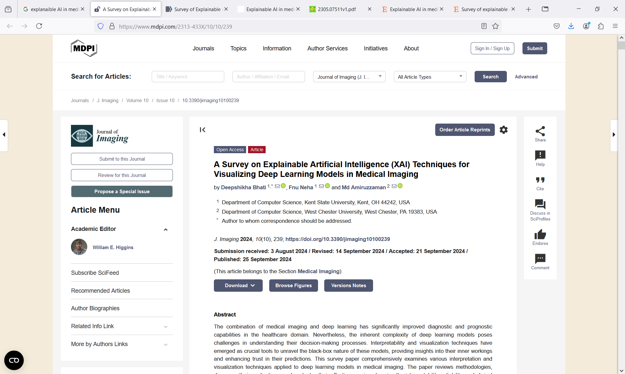
Surveys

Slide 9

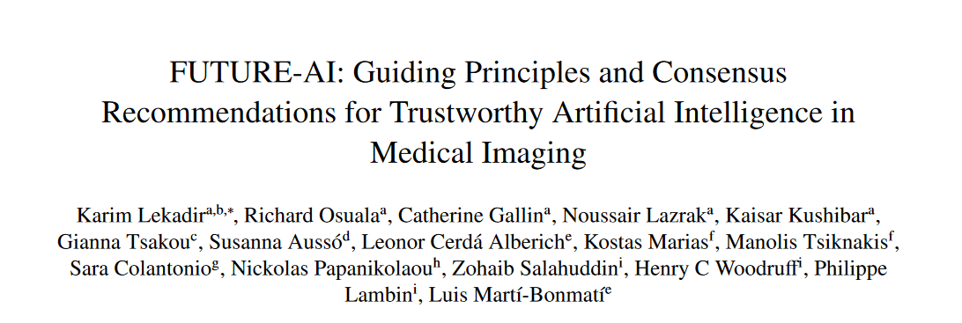

Guidelines

Slide 10
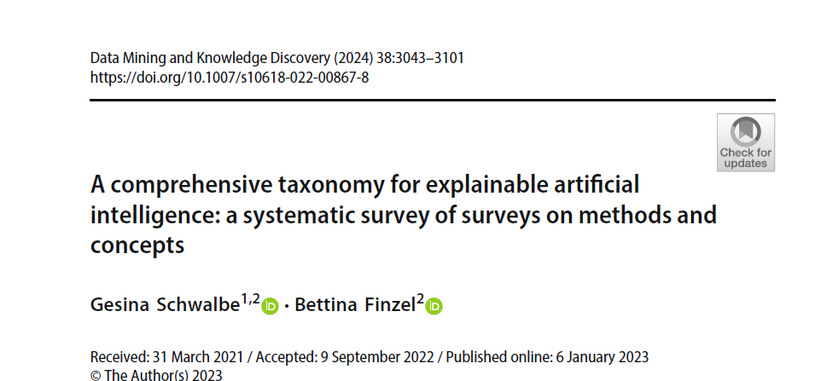
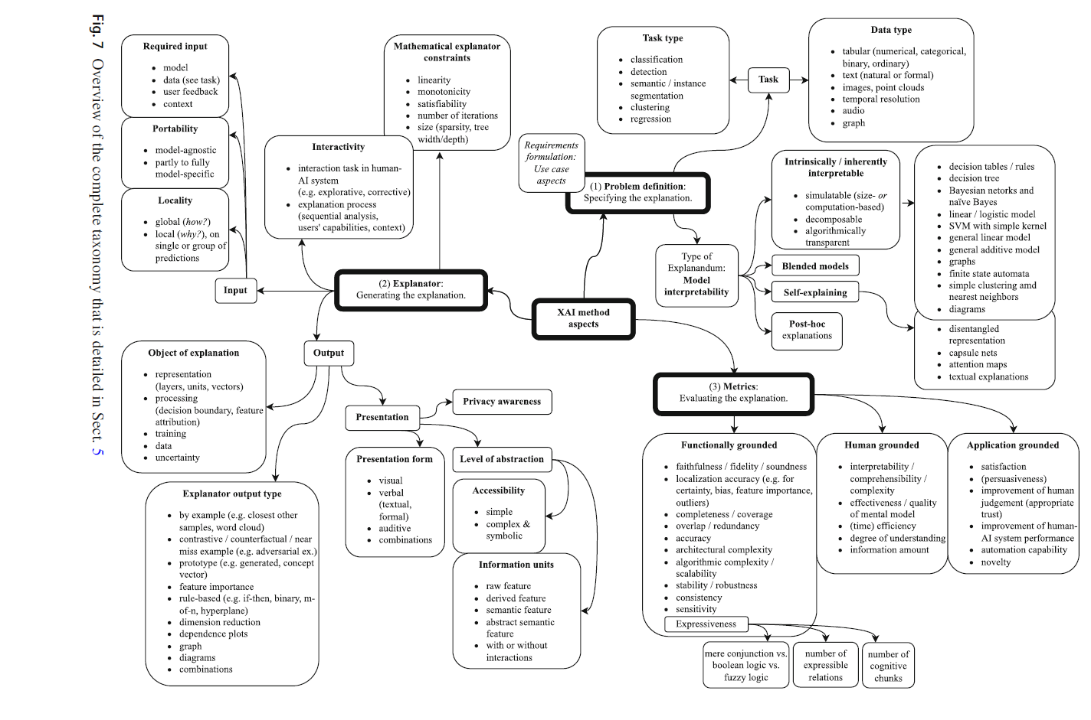
A comprehensive taxonomy

Slide 11
A simplified version in medical imaging
Explainability approaches
Ante-hoc approaches
Post-hoc approaches
Simple methods
More complex explainable by design methods
Model explanation methods
Outcome explanation methods
Logic based
Attention based
Causality based
Feature relevance
Knowledge distillation
Visual saliency
Rule or text based
Data driven
Concept based
Prototype based
Feature relevance
Counter
factual

Slide 12
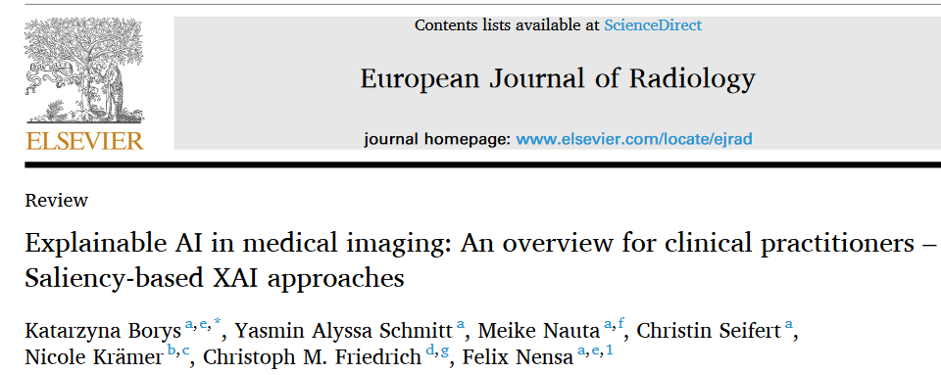
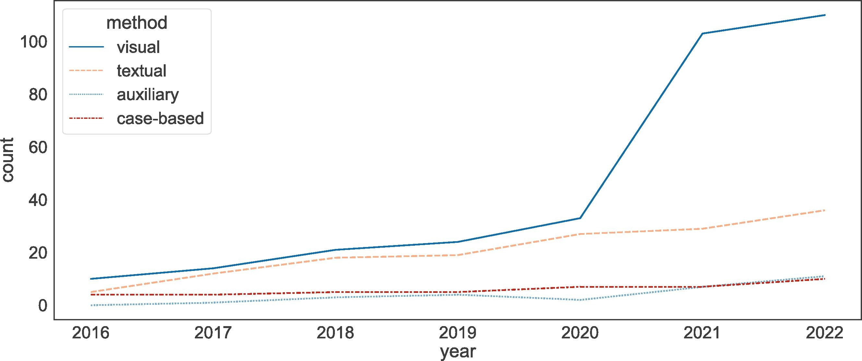
Post-hoc methods: visual saliency

Slide 13
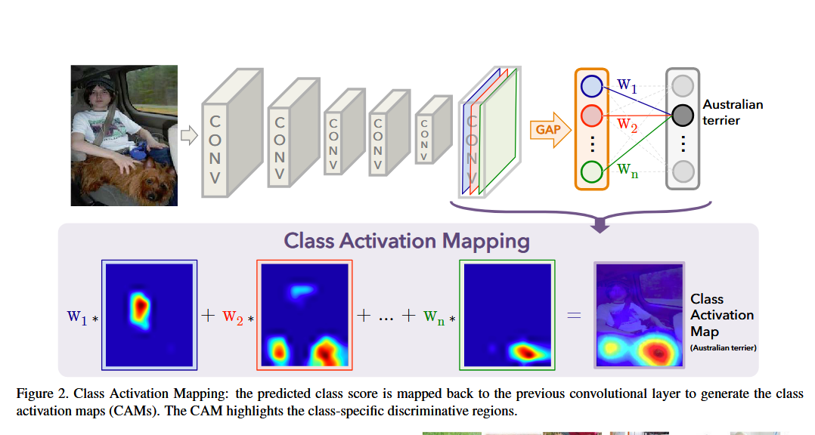
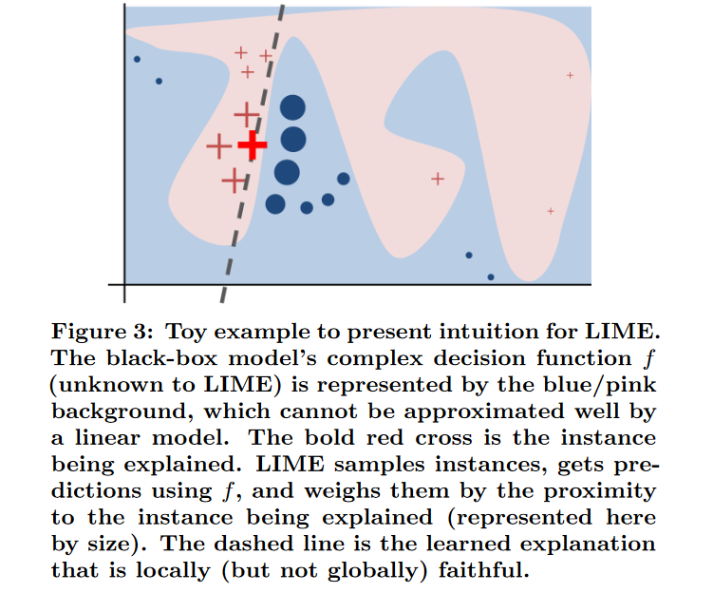
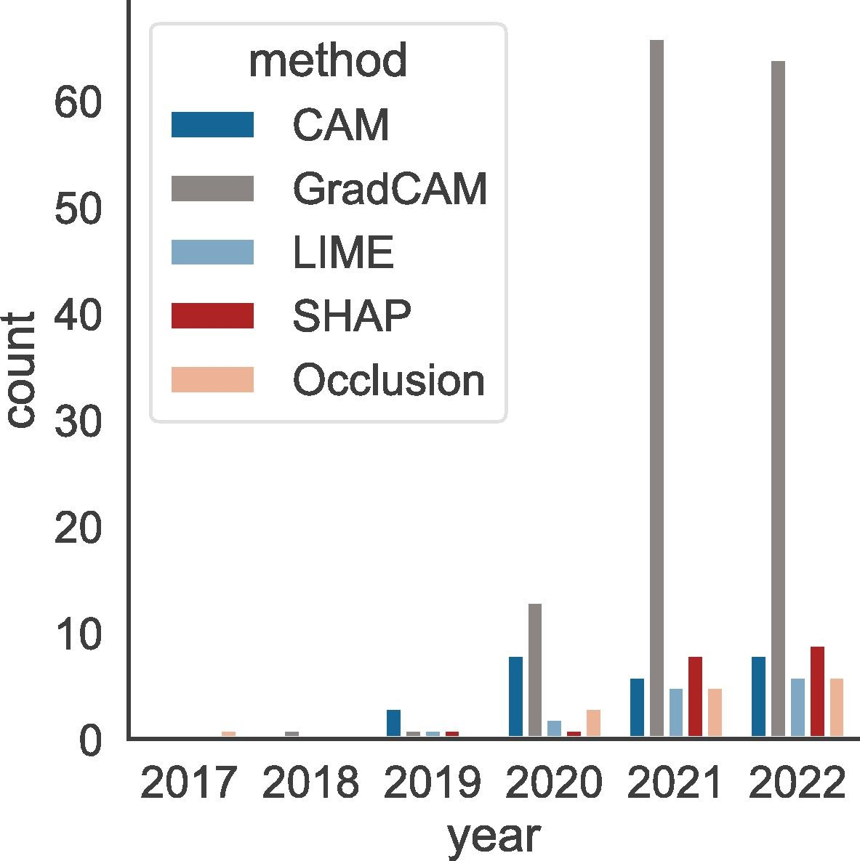
Post-hoc methods: visual saliency
Gradient based
Occlusion or pertubation based
GRAD-CAM
LIME
B. Zhou, A. Khosla, A. Lapedriza, A. Oliva and A. Torralba, "Learning Deep Features for Discriminative Localization," 2016 IEEE CVPR, Las Vegas, NV, USA, 2016, pp. 2921-2929, doi: 10.1109/CVPR.2016.319.
M.T. Ribeiro, S. Singh, and C. Guestrin. 2016. "Why Should I Trust You?": Explaining the Predictions of Any Classifier. In Proceedings of the 22nd ACM SIGKDD International Conference on Knowledge Discovery and Data Mining (KDD '16).
Grad-CAM++ Eigen CAM

Slide 14
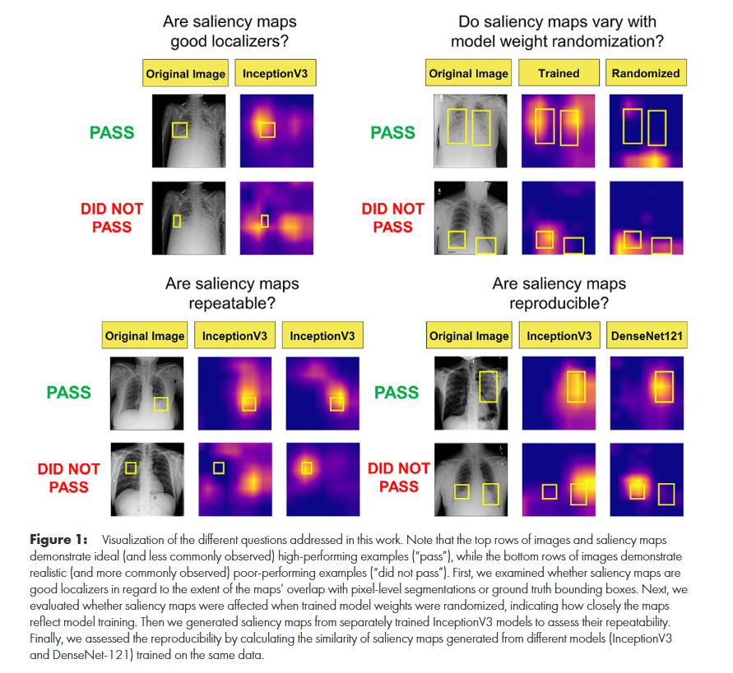
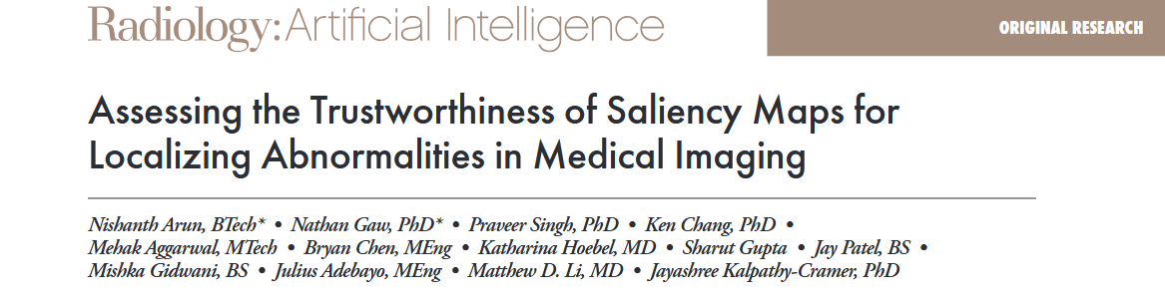
Post-hoc methods: visual saliency
Pros:
  Specific for images
  Simple
  Easily available implementations
  High impact
Cons
  Mostly outcome prediction
  Noisy
  Inaccurate
2021

Slide 15
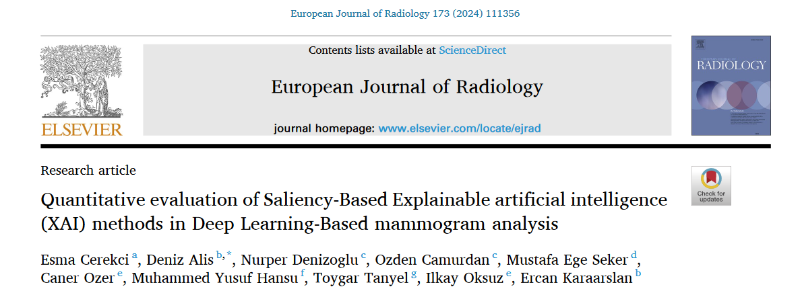
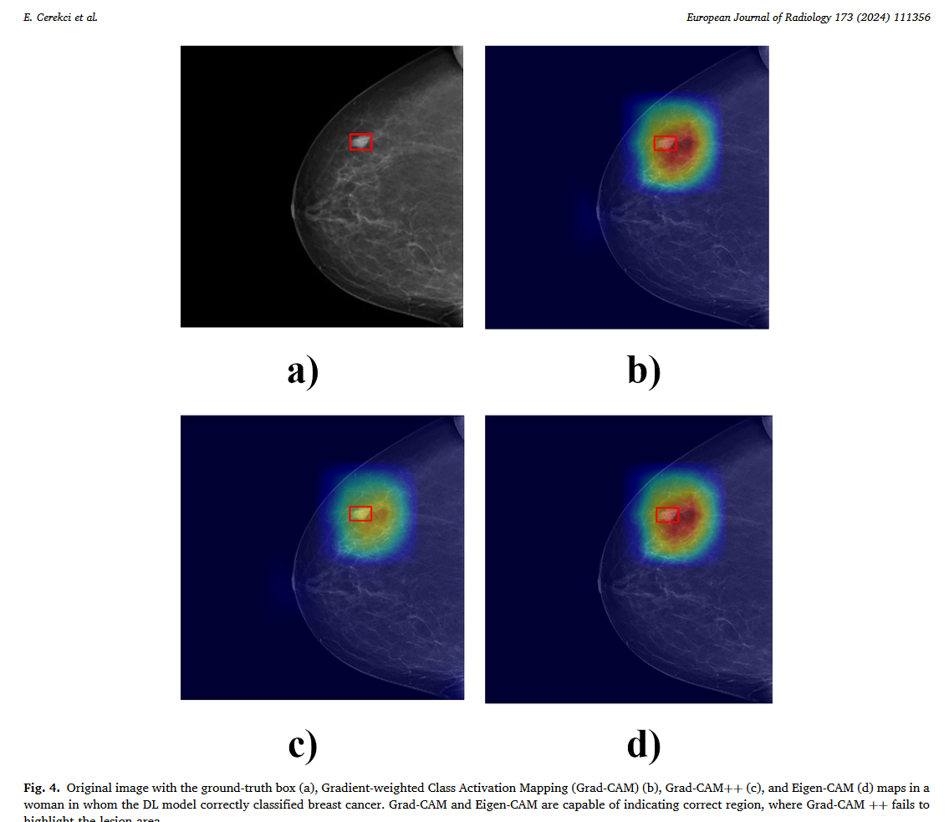
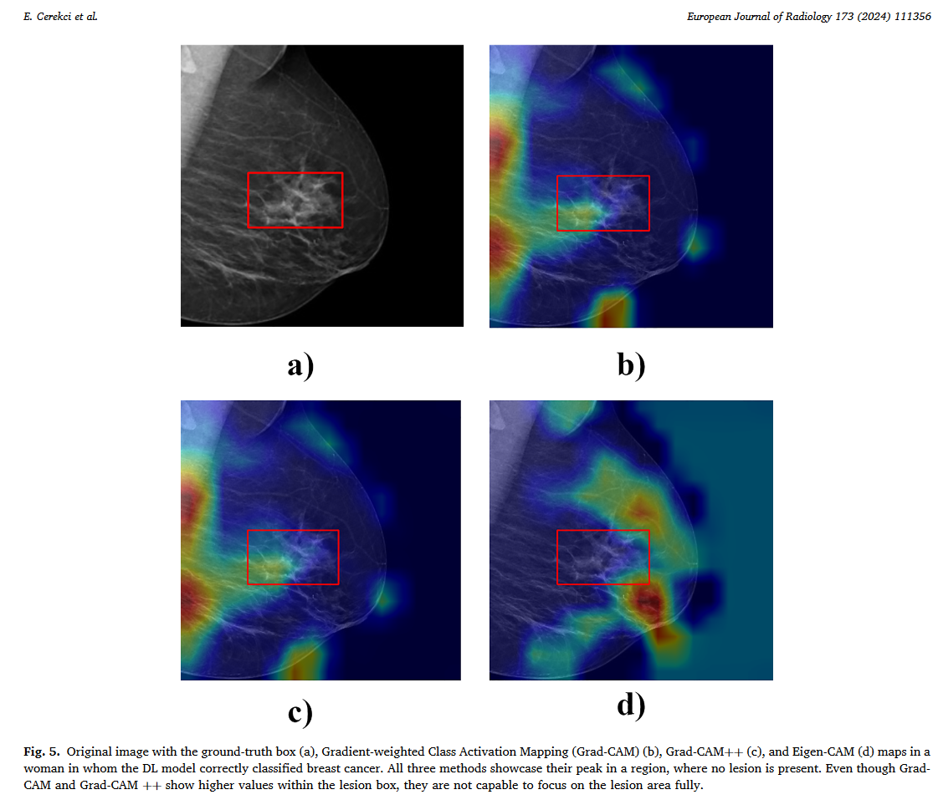
Post-hoc methods: visual saliency
The Pointing Game Scores for Grad-CAM, Grad-CAM++, and Eigen-CAM were 0.41, 0.30, and 0.35 in women with cancer

Slide 16
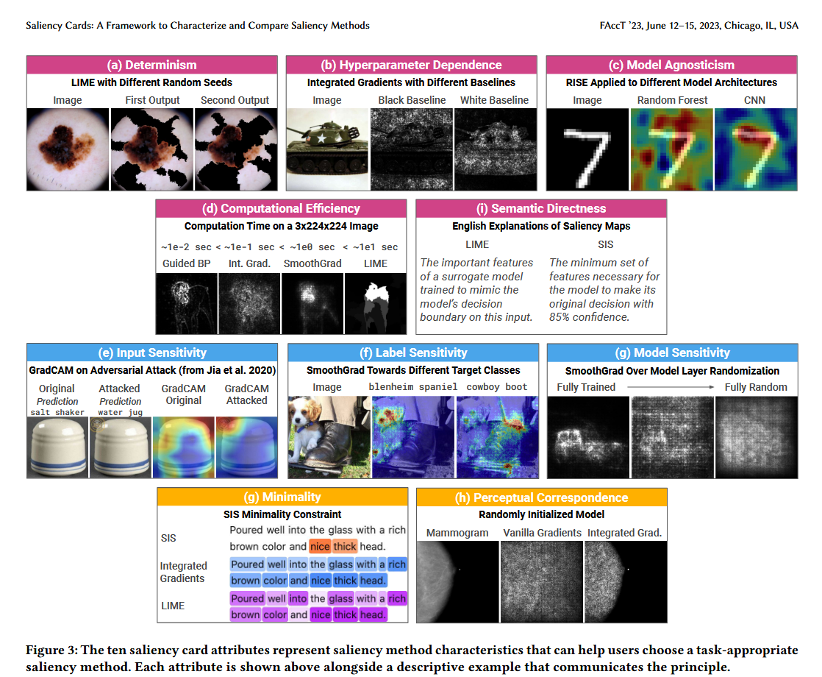
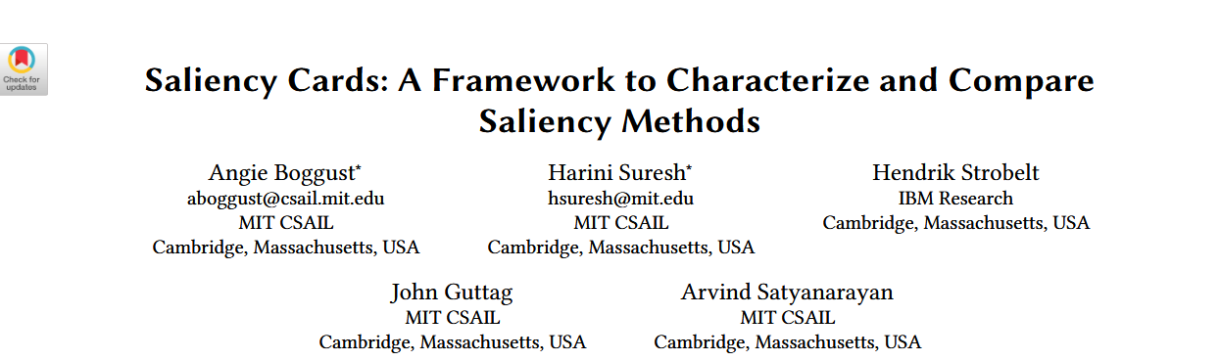
Post-hoc methods: visual saliency

Slide 17
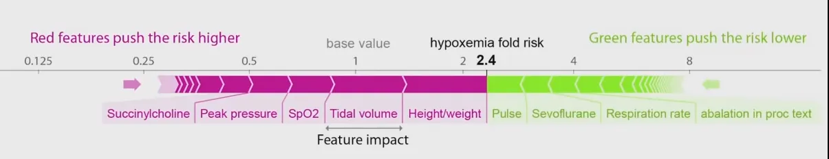
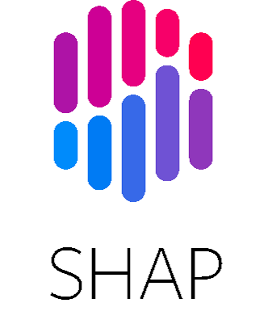
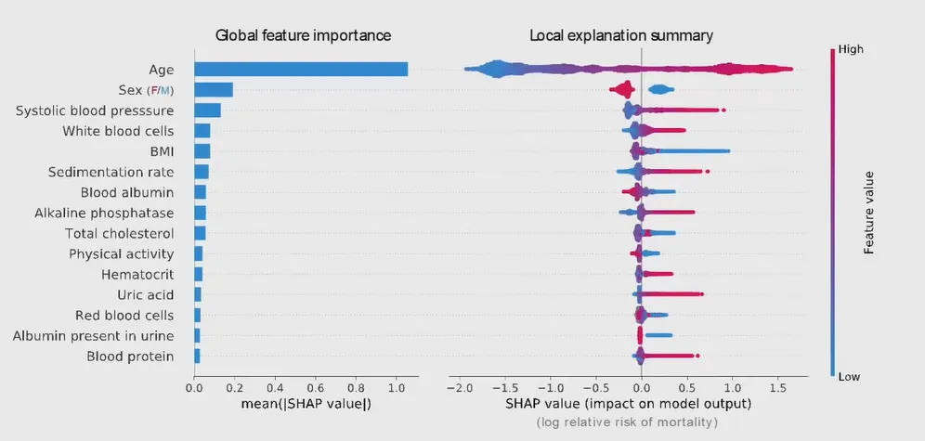
Post-hoc methods: feature relevance
Historical approach for tabular data
Lundberg, Scott M., et al. "From local explanations to global understanding with explainable AI for trees." Nature machine intelligence 2.1 (2020): 56-67.

Slide 18
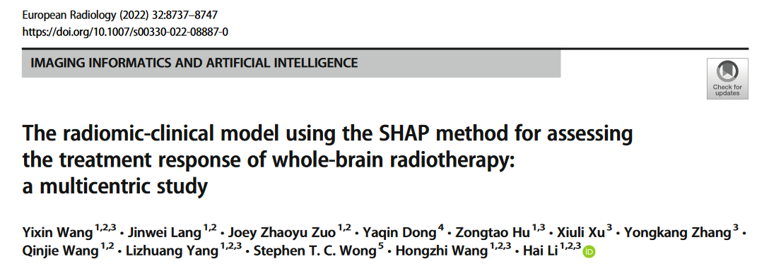

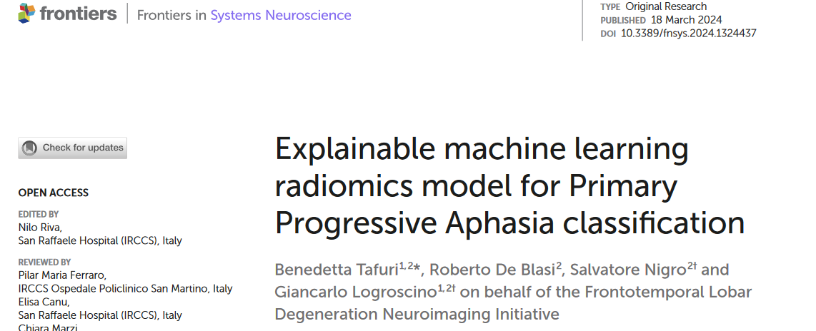
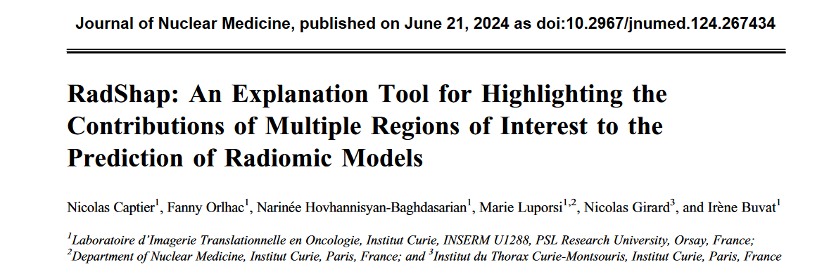
Post-hoc methods: feature relevance
Radiomics-based

Slide 19

Post-hoc methods: feature relevance
Pros
  Well-documented and easy to use
  Straightforward when feature are easily understandable
  Some like SHAP both local and global
  Better when providing info on feature contribution to decision
Cons
  Computational expensive
  Difficult if features are not easily intelligible (Gray Level Co-occurrence Matrix)
  Need for improvement in output display

Slide 20
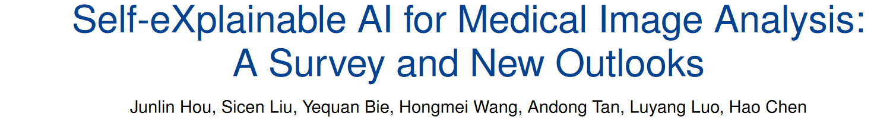
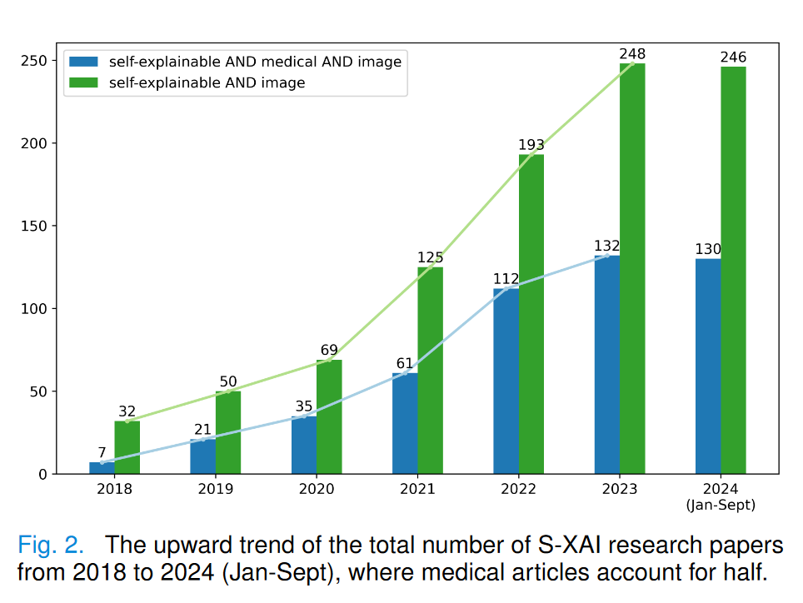

Ante-hoc approaches: Explainable by design

Slide 21
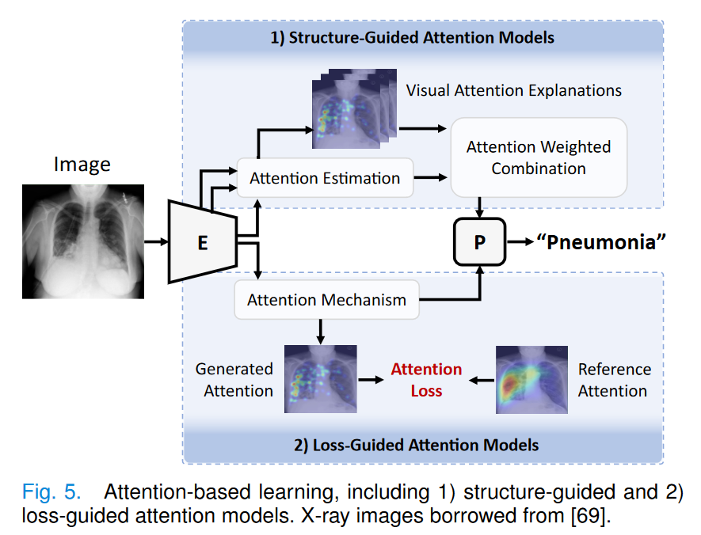
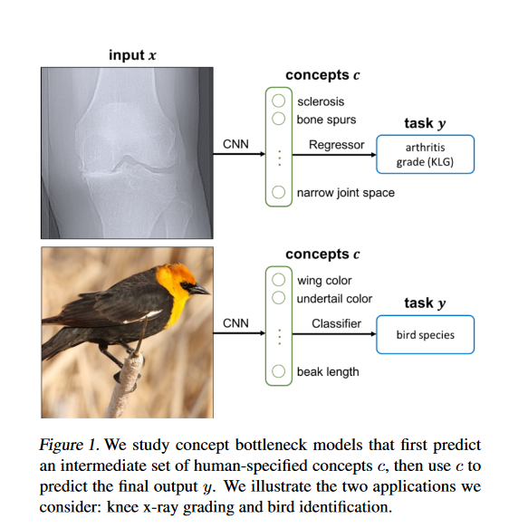
Ante-hoc approaches: attentions and concepts
Attention based
Concept based
Concept Bottleneck Models
Hou et al. Self-eXplainable AI for Medical Image Analysis: A Survey and New Outlooks. arXiv, Oct 2024
Koh et al., “Concept bottleneck models,” in Int conf on machine learning 2020

Slide 22
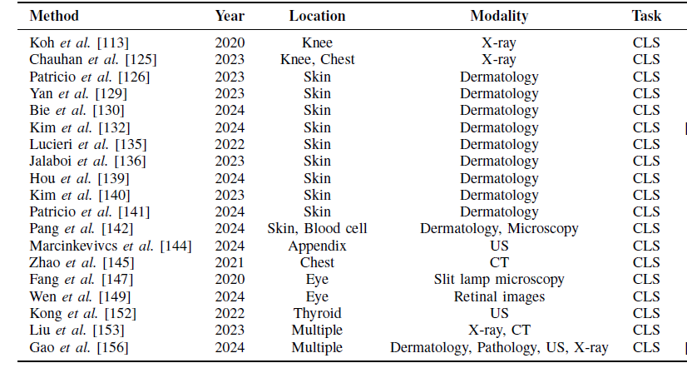
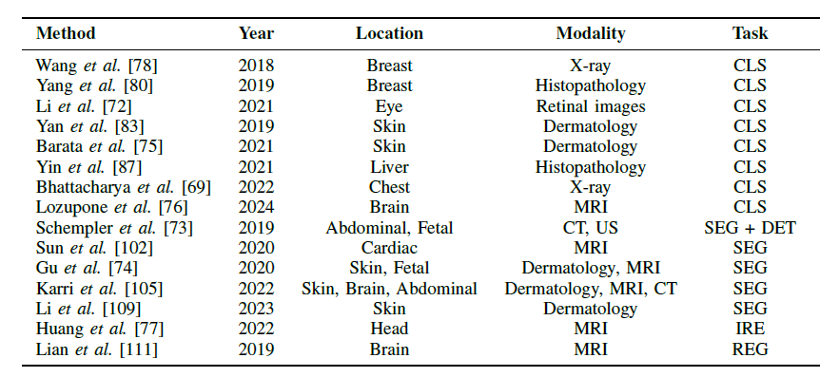
Ante-hoc approaches: attentions and concepts
Attention based
Concept based
Pros
  Offer insigths into the functioning of the model
Cons
  The understandability of attention maps and their relevance to the decisions are still not certain
Pros
  High potential, could be understood also by patients
Cons
  Need for annotations
  The performance-explainability trade-off not always good
Hou et al. Self-eXplainable AI for Medical Image Analysis: A Survey and New Outlooks. arXiv, Oct 2024

Slide 23
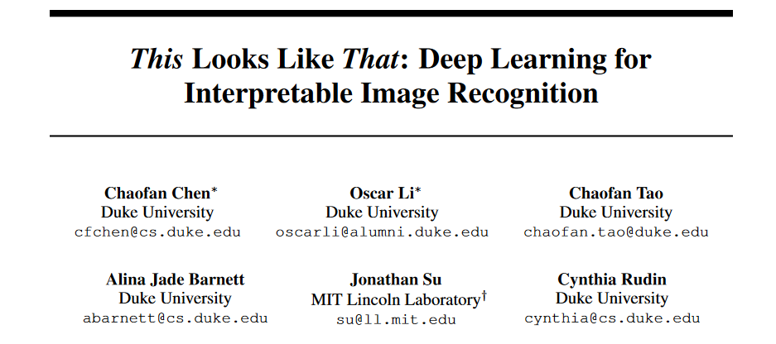
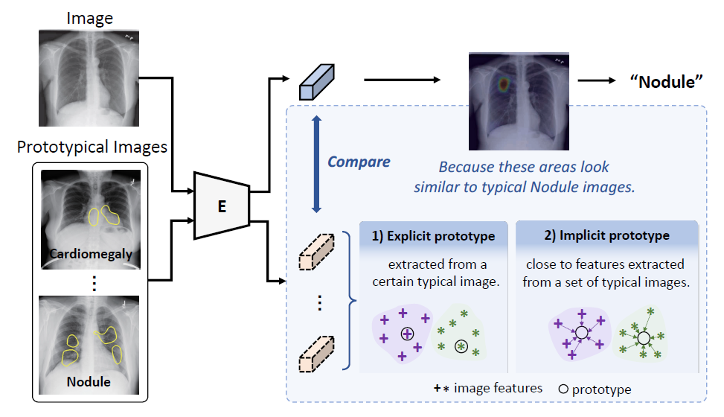
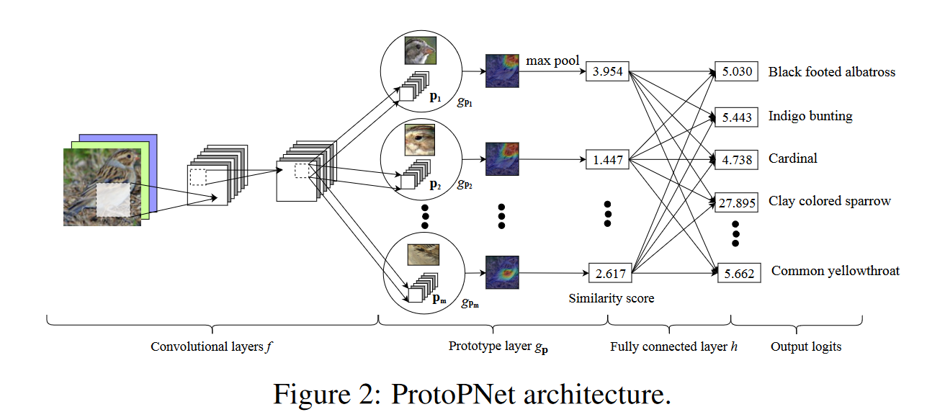
Ante-hoc approaches: prototypical learning
Explicit prototypes
NIPS 2019
ProtoPNet
Hou et al. Self-eXplainable AI for Medical Image Analysis: A Survey and New Outlooks. arXiv, Oct 2024

Slide 24
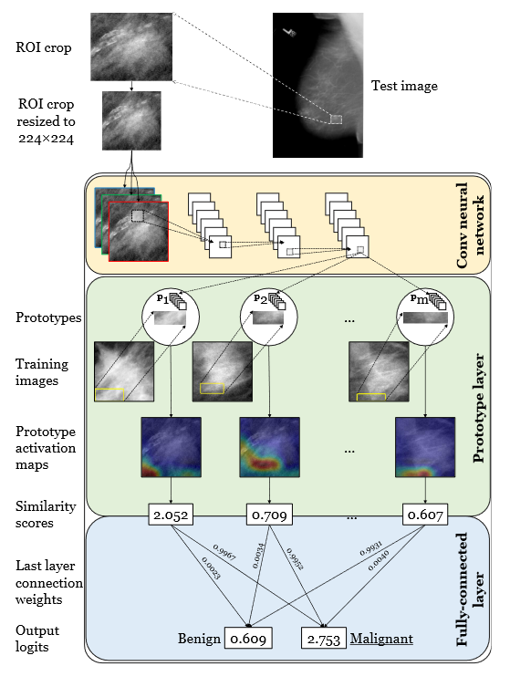
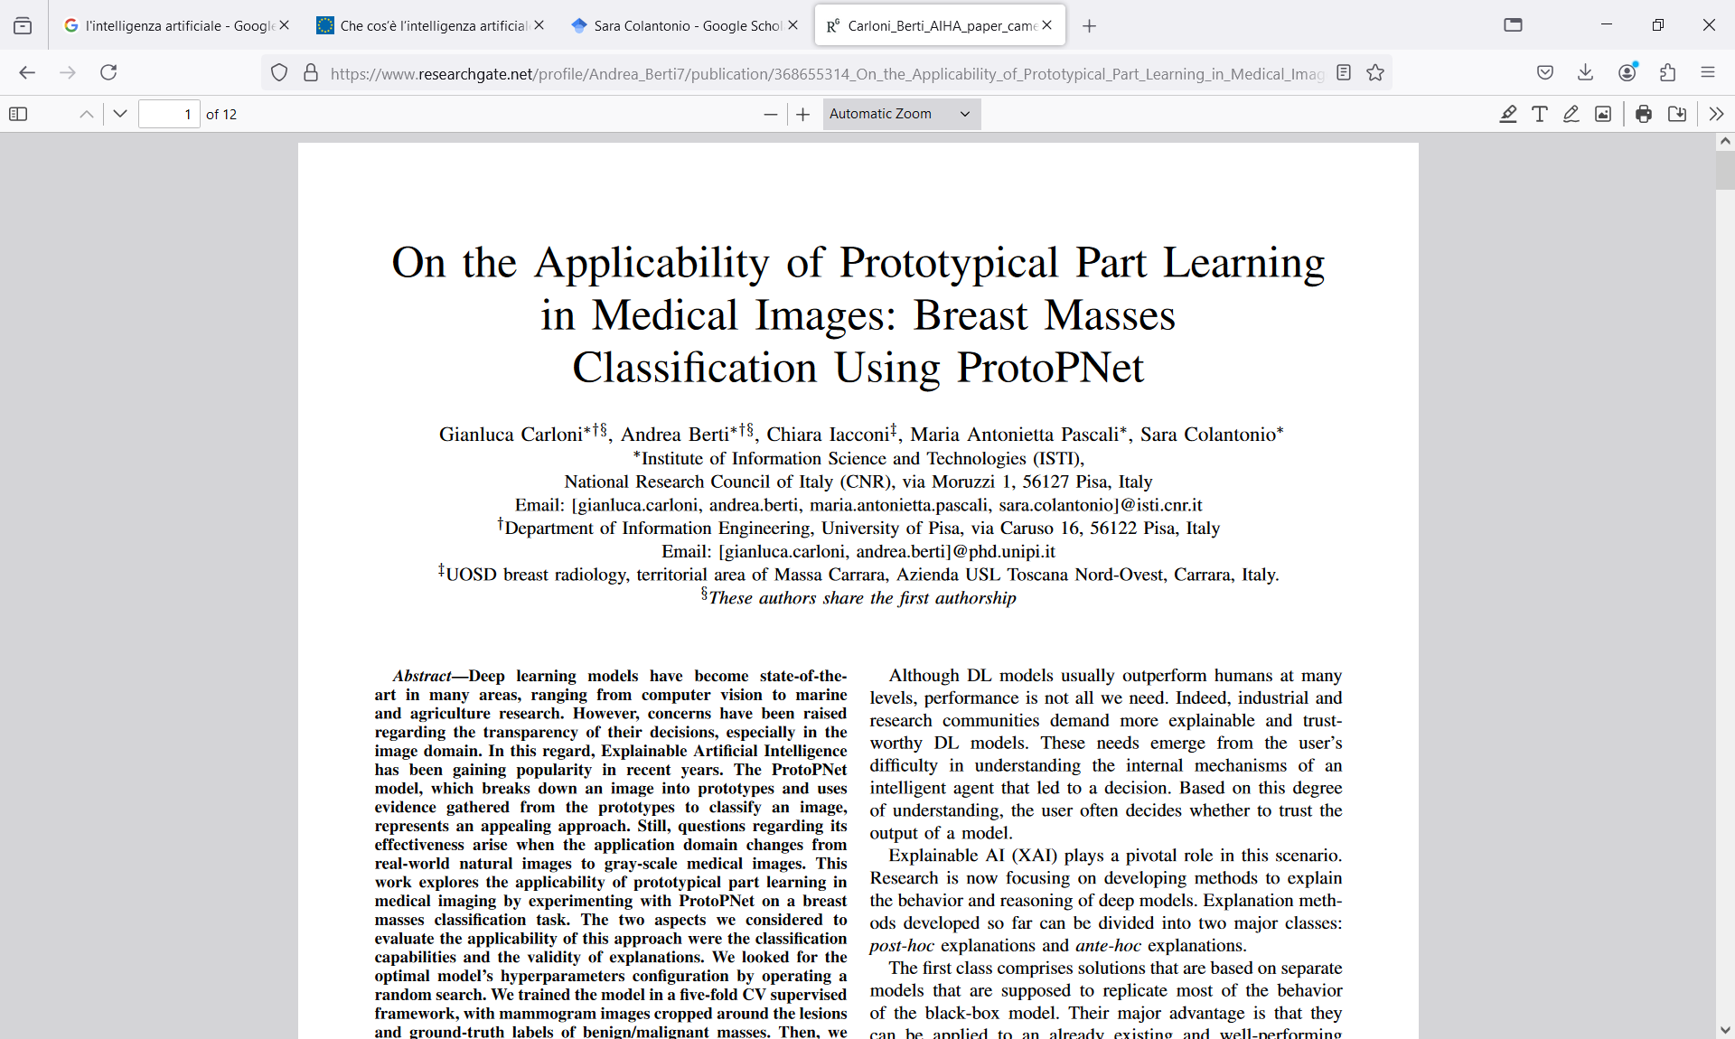
Ante-hoc approaches: prototypical learning
Explicit prototypes
ICPR 2022
Hou et al. Self-eXplainable AI for Medical Image Analysis: A Survey and New Outlooks. arXiv, Oct 2024
Notes:
.

Slide 25
Ante-hoc approaches: prototypical learning
Explicit prototypes
NIPS 2019
ProtoPNet
ProtoMetric - ProtoDeform
Hou et al. Self-eXplainable AI for Medical Image Analysis: A Survey and New Outlooks. arXiv, Oct 2024

Slide 26


Ante-hoc approaches: prototypical learning
Implicit prototypes
CVPR 2023
Hou et al. Self-eXplainable AI for Medical Image Analysis: A Survey and New Outlooks. arXiv, Oct 2024

Slide 27
Ante-hoc approaches: prototypical learning
Pros
  Good performance and implicit prototype-based models generally outperform explicit ones
  Can support case-based reasoning
Cons
  Computationally demanding
  Prototypes not always interpretable
Hou et al. Self-eXplainable AI for Medical Image Analysis: A Survey and New Outlooks. arXiv, Oct 2024

Slide 28

Ante-hoc approaches: causality
Correlations vs causation
Spurious correlations

Slide 29





Ante-hoc approaches: causality

Slide 30



Ante-hoc approaches: causality
MICCAI 2021

Slide 31
Ante-hoc approaches: causality
Pros
  Powerful and promising
  Useful for explaining and discovering
Cons
  Still in its early stage
  Strong effort in modelling domain knowledge and causal relationships
  Computationally intensive

Slide 32

Tailoring to the specific audience
A. Barredo Arrieta, N. Díaz-Rodríguez et al. Explainable Artificial Intelligence (XAI): Concepts, taxonomies, opportunities and challenges toward responsible AI, Information Fusion, Vol. 58, 2020, pp 82-115, https://doi.org/10.1016/j.inffus.2019.12.012
Must match the complexity capability of the recipient
Must match the domain knowledge of the recipient

Slide 33

Human-centred design
H. Chen, C. Gomez, et al. Explainable medical imaging AI needs human-centered design:
guidelines and evidence from a systematic review. npj Digital Medicine (2022) 5:156 ; 10.1038/s41746-022-00699-2

Slide 34
Evaluation metrics
Explanation
Content
Presentation
Social interaction
Completness
Compactness
Relevance
Consistency
Composition
Coherence
Contrastivity
Confidence
Controllability
Covariate variance
Qualitative
Quantitative
Ispired to M. Nauta, J Trienes, et al. . 2023. From Anecdotal Evidence to Quantitative Evaluation Methods: A Systematic Review on Evaluating Explainable AI. ACM Comput. Surv. 55, 13s, Article 295 (December 2023), 42 pages. https://doi.org/10.1145/3583558

Slide 35



Our experience with consultations
Reliability and robustness, along with certification and transparency were the most valued features to trust AI models. Reliability is verified with on-field usage
Explanations and data transparency were the most desired features. The model’s outcomes should be motivated, but the model itself can be not necessarily interpretable
The prediction outcomes of an AI model should be accompanied by a confidence value and send an alert when the confidence is low

Slide 36




Thematic sessions
Radiomics models
Deep learning models

Slide 37




Selected approaches
SHAP: SHapley Additive exPlanations
ProtoPNet: Self-explaining model based on prototypes

Slide 38
Conclusions and take-home messages
Explainability old quest but recent explosion
Approaches should be selected carefully and having first cleared their purpose
Explanations would benefit from multiple techniques
Metrics are still an open issue
Confirmation bias
A key mandate:
    A throughout engagement of clinical stakeholders is key to respond to real needs and co-design models that can be trusted
The full potential of explainability has yet to be realised, but there is still a big open question

Slide 39



The Accuracy vs Explainability Dilemma

Slide 40





sara.colantonio@isti.cnr.it

Slide 41





Toolkits
Open source
Notes:
Collezionano i metodi più assodati e utilizzati

Slide 42




The ladder of causation
Counterfactuals
Intervention
Knowledge
→ Three levels of cognitive ability
The ladder of causation,
a.k.a. Pearl’s Causal Hierarchy (PCH)
Association
Notes:
Here, on the right, you can see three types of cognitive ability which are involved

Slide 43
Notes:
hen et al. [3] introduced the Pro-
totypical Part Network (ProtoPNet), an intrinsically inter-
pretable model with a predetermined number of prototypical
parts per class. To classify an image, the similarity between
the latent encoding of a prototype and an image patch is
calculated by measuring the distance in latent space. The
resulting similarity scores are weighted by values learned
by a fully-connected layer. The explanation of ProtoPNet
shows the reasoning process for a single image, by visual-
izing all prototypes together with their weighted similarity
score. The explanation can therefore be understood as a
scoring sheet, although with a fixed number of class-specific
prototypes leading to large explanations which have been
shown to contain redundant prototypes [22]. In contrast, our
prototypes can be shared between classes and explanation
size is minimized
After pretraining the prototypes, we unfreeze the last
linear layer and train the model as a whole
We implement the linear classification layer as an inter-
pretable scoring sheet that looks for (only positive) class
evidence in an input sample. Summing up the relevance of
present prototypical parts allows the model to find evidence
for multiple classes or for none (

Slide 44

The challenges
Technical level
  Validation most often on small internal subsets
  Lack of multi-centre datasets
  Limited generalization capacity (domain complexity)
  Lack of standardised reporting and evaluation procedure
Human and organizational levels
  Lack of prospective validation and RCTs
  Contrasting news about the potential and the risks of AI
  Overall trust by radiologists
    Transparency
    Accountability issues
Notes:
The reasons for the limited routine adoption are MANY
we might grouped them
at a technical level, where one of the main challenges is the limited generalization capacity of AI models developed so far, as most of them are validated on small, internal subsets of data, as the examples I showed you before, which may not be representative of the larger and more diverse population of patients.
Additionally, there is a lack of standardized reporting and evaluation procedures for AI models, which makes it hard to compare and assess their performance and reliability.
at the human and organizational level, the main challenge is the trust and acceptance of AI tools by radiologists and other stakeholders. Prospective randomized controlled trials (RCTs) are needed and may serve the scope, by showing the clinical utility and safety of AI applications, but there is an global call for more transparency of the AI models, as this can help to build trust and confidence in their decisions.
And of course, there is still the big open question about the liability and responsibility when AI models are used for diagnostic purposes in practice.

Slide 45





Slide 46




National Research Council
Pisa Research Area
Notes:
I would like to give you a visual glimpse of CNR research area in Pisa and of my institute, which is located more or less where I have placed the logo. The area is actually larger than what you see in the slide, as there are more buildings on the left corner that have been cut. Actually Pisa research area is the largest among CNR research areas.

Slide 47



















































Signals & Images Lab
Research Staff
Post-docs
Sara Colantonio
Computer Scientist
Claudia Caudai
Mathematician
Giulio Del Corso
Mathematician
Silvia Gravili
Communication sc.
Kristina Sinaga
Mathematician
Research fellows and PhD students
Andrea Berti
Medical Physicist
Gianluca Carloni
Biomedical Eng
Eva Pachetti
Biomedical Eng
Danila Germanese
Biomedical Eng
Maria Antonietta Pascali Mathematician
Notes:
In particular, within ISTI, I’m with the Signals and Images Lab, a lab of more than forthy members, among permanent research staff, research fellows and phd students. And among them, I have the honour and the pleasure to work with a multidisciplinary team of researchers that work in the field of AI and computer vision with particular focus on their applications to the health and wellbeing of individuals

Slide 48






Conclusions
AI has a high potential to aid medical diagnostics
Still a way to go to address existing challenges towards trust and uptake in clinical practice
FUTURE-AI is meant to help developers to deliver trustworthy tools also within RCTs
Data and AI model Passport*
T
raceability
Uncertainty estimation techniques** and physics informed methods
R
obustness
Explainable by design deep learning***
E
xplainability
* Colantonio et al. AI trustworthiness in prostate cancer imaging: a look at algorithmic and system transparency, EMBS Special topic, 2023
** Del Corso et al. Radiomics-based Reliable Predictions of Side Effects after Radiotherapy for Prostate Cancer, accepted at ISBI 2024
*** Carloni et al. On the applicability of prototypical part learning in medical images: breast masses classification using ProtoPNet, ICPR, 2022

