Slide 1
next_AIM
Artificial Intelligence in Medicine (AIM): next steps
Alessandra Retico
Istituto Nazionale di Fisica Nucleare
Sezione di Pisa
alessandra.retico@pi.infn.it
next

Slide 2
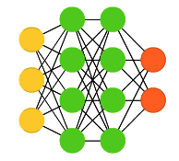
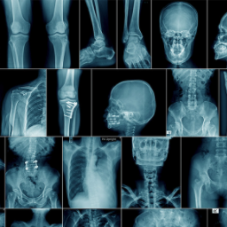
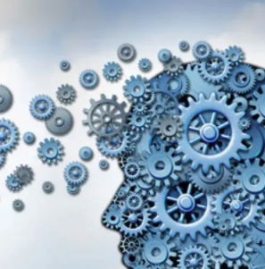
Outline
The next_AIM experiment
Artificial Intelligence (AI) in medicine: the INFN experience
Status of the activities
Connections with other projects on AI
Open issues, future perspectives and new projects

Slide 3
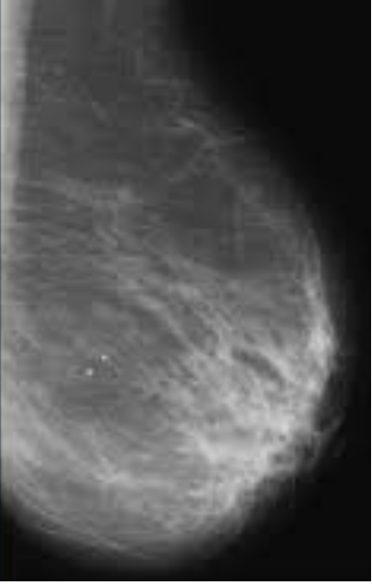
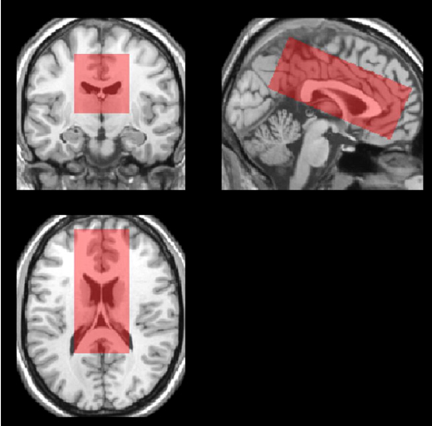
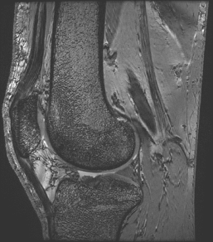
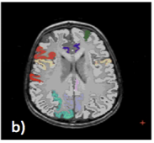
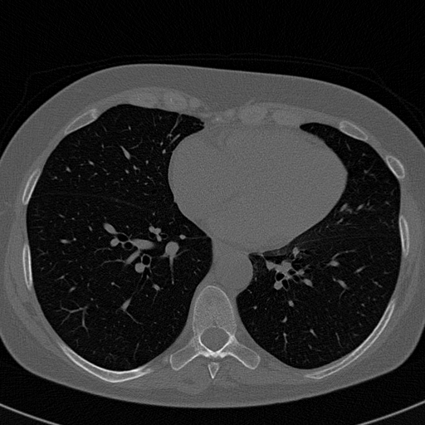
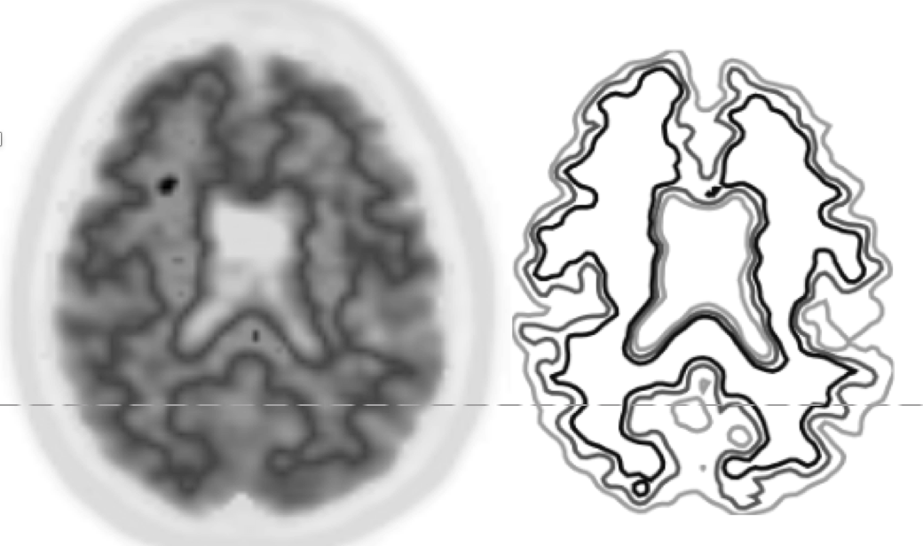
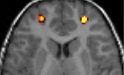
Overview of development of medical image analysis systems @ INFN
'90
Old-fashion (rule-based) Decision Support Systems
since 2000
Hand-crafted feature extraction and Machine Learning analysis (Radiomics and ML)
since 2015
Deep-Learning based analysis
nowadays
Trustworthy AI
INFN CSN5 funded projects
2019-2021 AIM
2022-2024 next_AIM
2025-2027 AIM_MIA

Slide 4
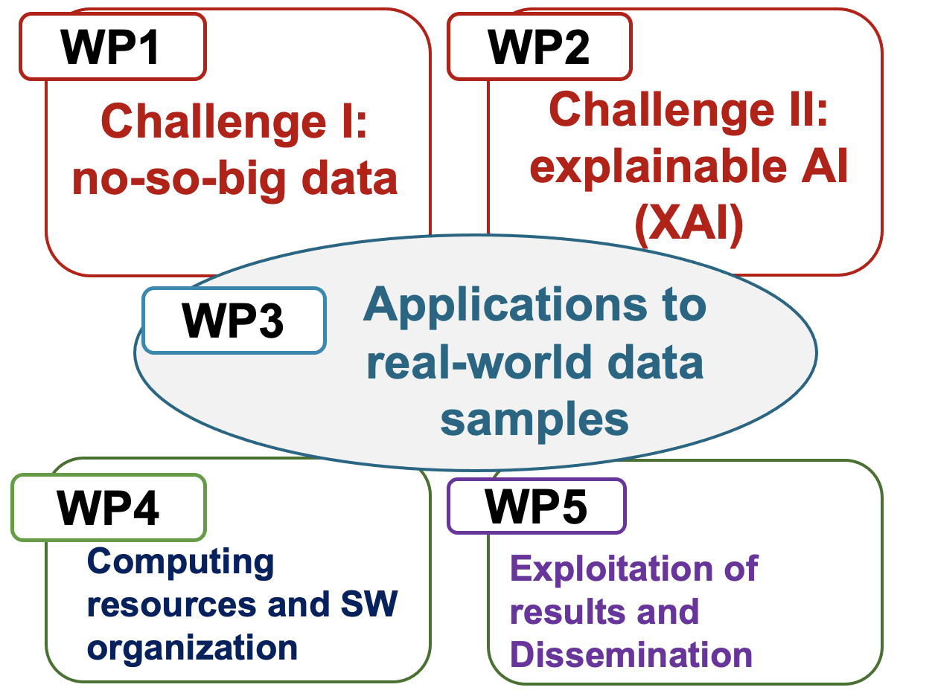
The Artificial Intelligence in Medicine (AIM) INFN Project
Artificial Intelligence to become the next revolution in medical diagnostics and therapy.
New image processing and data analysis strategies, including radiomics approaches, need to be developed and extensively validated.
AIM’s objectives
next_AIM’s objectives
next
AIM1: Multicenter data
harmonization
[INFN, CSN5, 2019-2021]
[INFN, CSN5, 2022-2024]
Principal Invest.: A. Retico
11 Research Units:
Bari (S. Tangaro) Bologna (D. Remondini) Cagliari (P. Oliva) Catania (M. Marrale) Firenze (C. Talamonti) Genova (A. Chincarini) Lab. Naz. Sud (G. Russo)
Milano (C. Lenardi)
Napoli (G. Mettivier)
Pavia (A. Lascialfari)
Pisa (M.E. Fantacci)
Principal Invest.: A. Retico
13 Research Units:
Bari (S. Tangaro) Bologna (D. Remondini) Cagliari (P. Oliva) Catania (M. Marrale) Ferrara (G. Paternò) Firenze (C. Talamonti) Genova (A. Chincarini) Lab. Naz. Sud (G. Russo)
Milano (C. Lenardi)
Napoli (G. Mettivier)
Pavia (A. Lascialfari)
Padova (A. Zucchetta)
Pisa (M.E. Fantacci)
AIM2: Quantification
AIM3: Predictive models
AIM-covid19-WG
Long-standing collaboration with Italian hospitals and IRCCS and with international consortia for data sharing

Slide 5
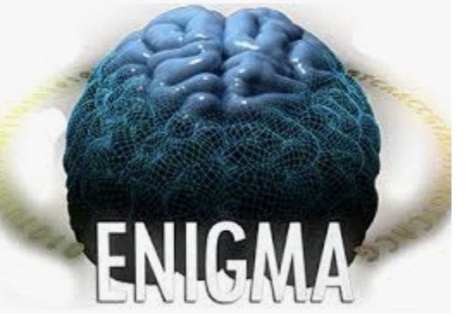
The Artificial Intelligence in Medicine (AIM) INFN-CSN5 Project
Multidisciplinar team: researchers from INFN divisions and University Departments collaborate closely with Radiologists, Clinicians, Medical Physicists and Technicians of Clinical Centers to develop innovative solutions based on AI
Clinical partners
IRCCS S. Martino (GE)
IRCCS Stella Maris (PI)
IRCCS Gaslini (GE)
IRCCS Centro S. G. di Dio (BS)
IRCCS G.Paolo II (BA)
IRCCS Mondino (PV)
IRCCS SDN (NA)
IRCCS IRST Meldola (FC)
IRCCS Bellaria (BO)
IRCCS S. Orsola (BO)
EU / consortia
EADC (EU)
EDLBC (EU)
ADNI (US)
ABIDE (EU/US)
ENIGMA (WW)
IMAGO7 (PI)
Azienda Osp. Univ. Pisana (PI)
Azienda Osp. Univ. Careggi (FI)
Osp. Pediatrico Meyer (FI)
Ospedale Cardarelli (NA)
Azienda Sanitaria Cuneo 1 (CN)
IFO-Ist. Naz. Tumori Regina Elena (RM)
ASST Niguarda (MI)
Policlinico di Bari
Policlinico di Palermo
Policlinico Univ. di Napoli
Policlinico San Matteo (PV)
Scientific associations
Italian Association of Medical Physics (AIFM)

Slide 6
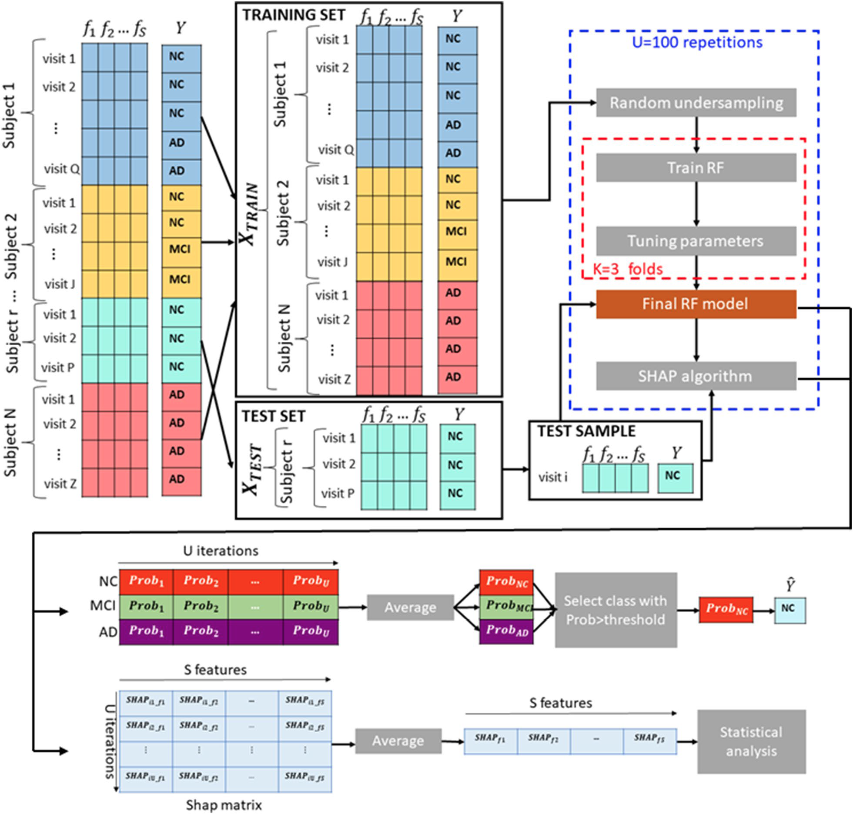
next_AIM - Artificial Intelligence in Medicine: next steps
INFN-CSN5
WP1
WP2
https://www.pi.infn.it/aim/
AIM [2019-2021]
next_AIM [2022-2024]
Challenge I:
no-so-big data
Challenge II:
explainable AI (XAI)
Project coordinator:
A. Retico, Pisa
13 Research Units:
Bari (S. Tangaro) Bologna (D. Remondini) Cagliari (P. Oliva) Catania (M. Marrale) Ferrara (G. Paternò) Firenze (C. Talamonti) Genova (A. Chincarini) Lab. Naz. Sud (G. Russo)
Milano (C. Lenardi)
Napoli (G. Mettivier)
Pavia (A. Lascialfari)
Padova (A. Zucchetta)
Pisa (M.E. Fantacci)
Strategies for efficient learning with limited data samples.
Evaluation of robustness and reliability of trained models.
Make AI results understandable to humans.
Which image/data features are relevant to make a decision?
XAI
WP3
Applications to real-world data samples include ….
WP4
Evaluation of the robustness of radiomic features in multiparametric MRI and its impact on predictive value of AI models
Robust implementation of explainable AI methods
Computing resources
and SW repository organization
ReCaS, IBiSCo, INFN-Cloud + local HW resources
Long-standing collaboration with Italian centers (hospitals and IRCCS) and with international consortia for data sharing
WP5
Exploitation
of research
results and communication
conferences, publications and outreach,
collaboration with
Ubaldi L, Saponaro S, Giuliano A, Talamonti C, Retico A. Deriving quantitative information from multiparametric MRI via Radiomics… Phys Medica 2023;107:102538 https://doi.org/10.1016/j.ejmp.2023.102538.
Lombardi A, Diacono D, Amoroso N, Biecek P, Monaco A, Bellantuono L, … Tangaro S, Bellotti R. A robust framework to investigate the reliability and stability of explainable artificial intelligence …. Brain Informatics 2022; 9:17. https://doi.org/10.1186/s40708-022-00165-5.

Slide 7
Tasks of WP3: real-world study cases
Sedi partecipanti |  |  |  |  |  |  |  |  |  |  |  |  | Task | Topic
 |  |  |  | FE |  |  | LNS |  | NA |  | PI |  | T1 | Radiomics in Digital Breast Tomosynthesis (DBT)
 | BO |  |  | FE |  |  |  |  | NA |  | PI |  | T2 | Super-Resolution in Medical Imaging
 | BO |  | CT |  |  |  |  |  |  |  |  |  | T3 | Radiomics in prostate cancer
 | BO |  | CT |  |  |  |  |  |  |  |  |  | T4 | Radiomics and DL in tcMRgFUS
 | BO |  |  |  | FI | GE | LNS |  |  |  |  |  | T5 | Nuclear Imaging Quantification and Radiomics
BA |  | CA | CT |  |  |  |  |  |  | PD | PI |  | T6 | Connectivity in functional MRI and EEG
 |  | CA | CT | FE | FI | GE |  | MI |  |  | PI | PV | [T7] | Radiomics and Deep Learning analysis of CT and patients’ data in COVID-19
 |  |  |  |  |  |  |  | MI |  |  | PI | PV | T8 | Radiomics and ML-segmentation on Facio-Scapulo-Humeral dystrophy (FSHD), lung and liver tumor
 |  |  |  |  |  |  |  |  |  |  |  | PV | T9 | ML on Imaging data of 10B uptake tracks and dose monitoring by Compton cameras
 |  |  |  |  | FI |  |  |  |  |  | PI |  | T10 | Artificial intelligence for monitoring RT response in soft-tissue sarcomas
 |  |  |  | FE |  |  |  |  |  | PD |  |  | T11 | Machine Learning techniques for cardiological applications
 |  |  |  |  | FI |  |  |  |  |  | PI |  | T12 | Application of NLP techniques to clinical notes towards the automated reading of instrumental data

Slide 8
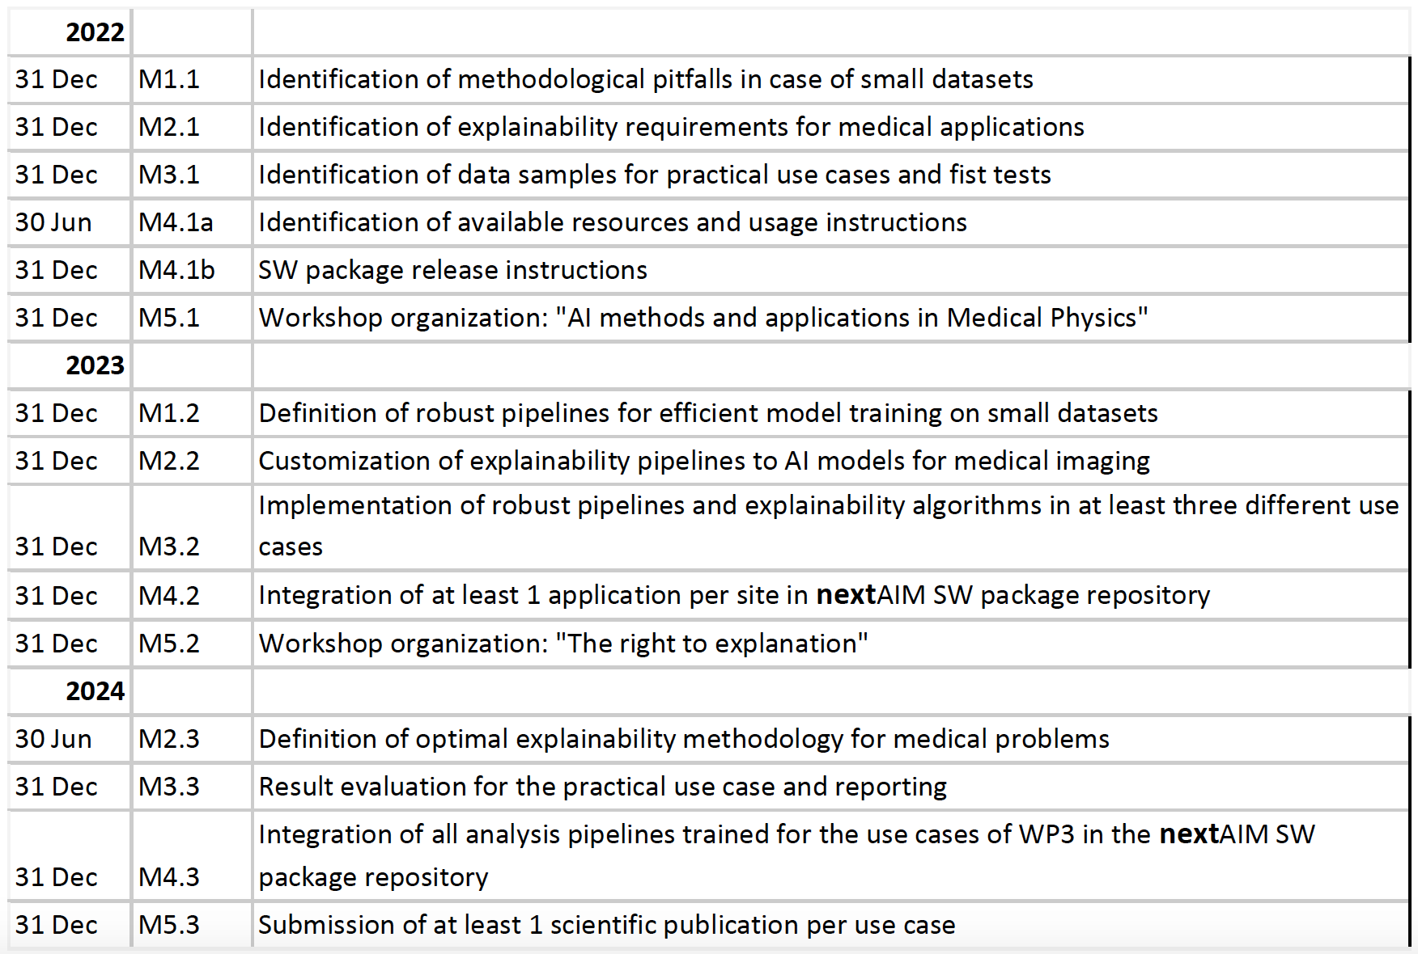
Next_AIM milestones
WS AI@INFN, Bologna 2-3 Maggio 2022 https://agenda.infn.it/event/29907/
State of the art and challenges in AI
Speaker: Daniel Remondini
Deep Learning in Medical Image Analysis
Speaker: Francesca Lizzi
Trustworthy AI in medical applications
Speaker: Angela Lombardi
The Workshop “AI methods and applications in Medical Physics”
Has been postponed to 2024.
We organized in 2023 a 3-day General Collaboration Meeting in Milan in February 2023 https://agenda.infn.it/event/34599/
31 Dec M2.4
Workshop “The right to explanation”
16-18 October 2024 Bari, https://agenda.infn.it/event/42734

Slide 9
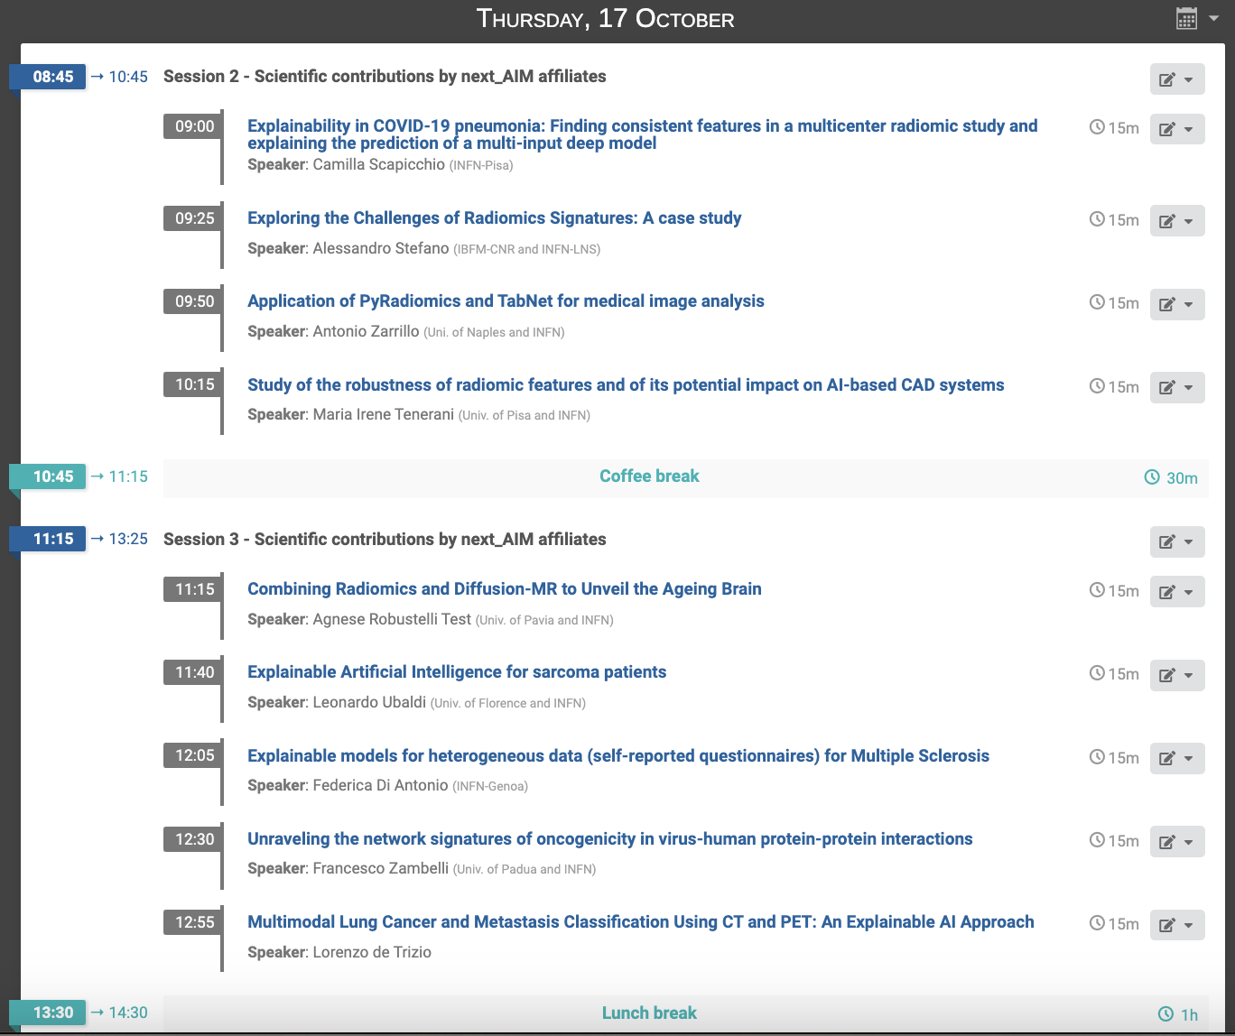
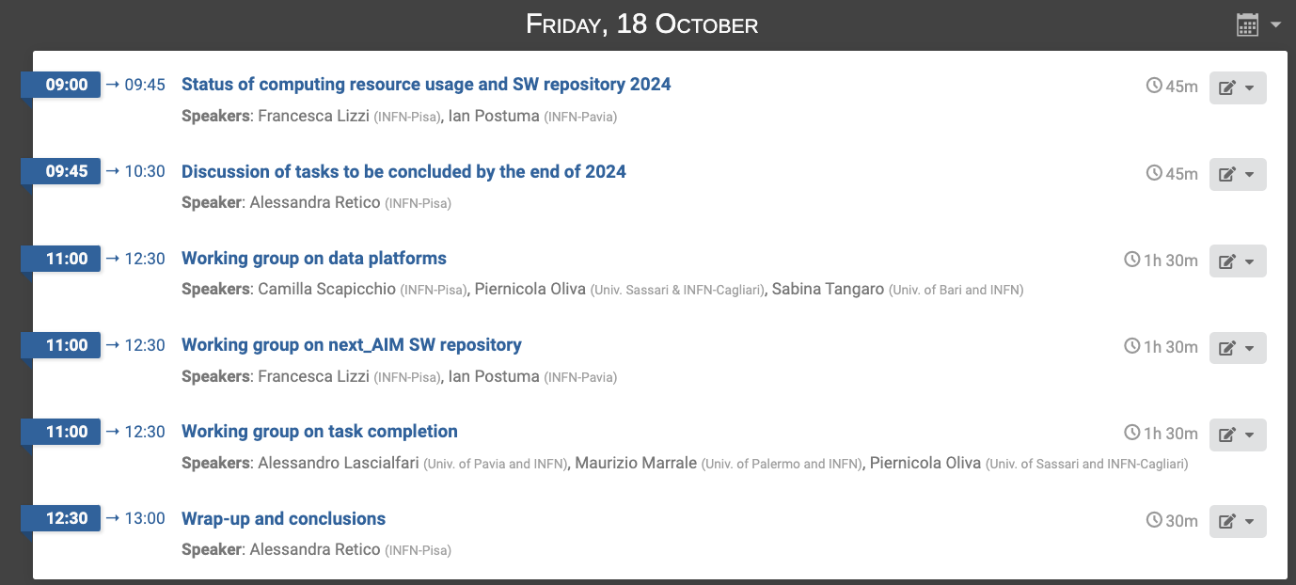
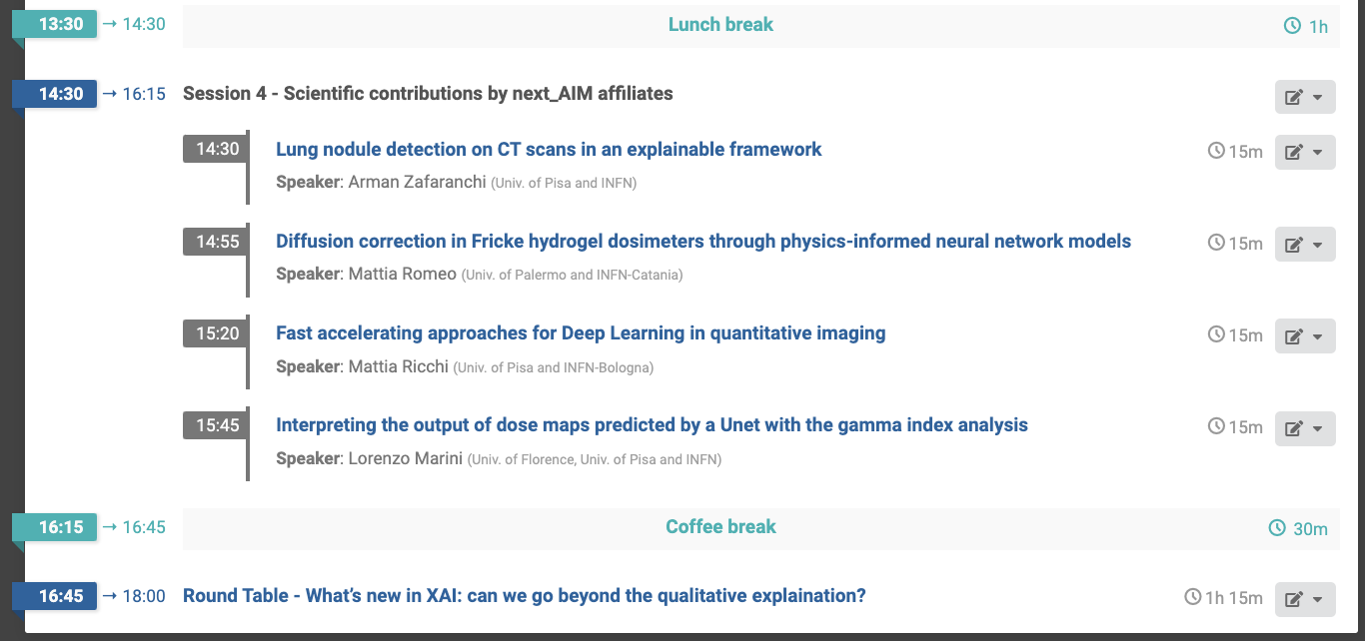
https://agenda.infn.it/event/42734/
Short presentations
→ enough time for discussion
First session
on Friday
→ SW repository
→ Working groups
Scientific sessions on Wednesday and Thursday:
→ short presentations
→ enough time for discussion
Networking!
← Round table

Slide 10
Connections with external entities and other projects
Collaboration with Italian Association of Medical Physicists (AIFM)
A 5-year research framework agreement has been renewed in January 2024 between INFN and the Italian Association of Medical Physicists (AIFM). This agreement foresees the collaboration between the parties for the synergistic realization of common research objectives in the healthcare field.
A. Retico, M.E. Fantacci, M. Marrale and C. Lenardi are members of the
Research Committee of AIFM
C. Talamonti coordinates the AI working group of AIFM
A. Lascialfari is the chair of the Research Committee of AIFM
C. Lenardi is in the Executive Board of AIFM
https://fisicamedica.it/
Example of joint activities
Organization of joint webinars INFN-AIFM on research topics related to the use of AI in the medical field, https://fisicamedica.it/formazione/agenda-eventi-formativi/come-affrontare-insieme-le-sfide-dellia/
Participation of AIFM medical Physicists to INFN projects
Joint organization of workshop, training opportunities and dissemination events (e.g. Bright-Nights)
Collaboration with other associations
A. Chincarini is a member of the Executive Board of European Alzheimer’s Disease Consortium (EADC, https://eadc.online/) and a member of the Neurological Study Committee of the Italian Association of Nuclear Medicine (AIMN, https://aimn.it/)
C. Testa is a member of the Executive Board of the Italian Chapter of the International Society of Magnetic Resonance in Medicine (AIRMM, https://www.ismrm.it/it/airmm/)
24 ottobre 14:30
Lezione pratica.
M. Ferrante,
Tor Vergata, Roma

Slide 11
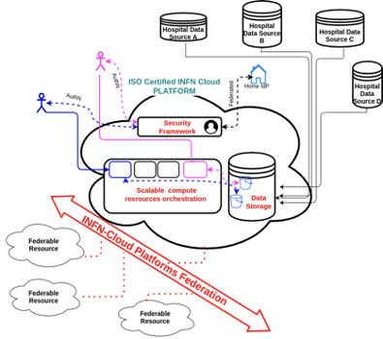
INFN-AIFM joint initiative to support AI development in Medicine
INFN and AIFM have a framework agreement for scientific collaboration
The joint effort by the Medical Physics and High Energy Physics communities led to the design of a dedicated computing infrastructure which can link Clinical, Medical Research and Technical Research Centers.
The INFN-cloud based computing infrastructure is:
especially suited for training AI models
equipped with secure storage and communication systems (ISO/IEC 27001 27017 27018)
compliant with data protection regulation (GDPR)
It would be able to accelerate the development and extensive validation of AI-based solutions for Medical Imaging.
https://www.cloud.infn.it/
[Retico A, Avanzo M, Boccali T, Bonacorsi D, Botta F, Cuttone G, Martelli B, Salomoni D, Spiga D, Trianni A, Stasi M, Iori M, Talamonti C.,
Enhancing the impact of Artificial Intelligence in Medicine: A joint AIFM-INFN Italian initiative for a dedicated cloud-based computing infrastructure. Phys Medica 2021;91:140–50. https://doi.org/10.1016/j.ejmp.2021.10.005.]

Slide 12
Connections with external entities and other projects
PNRR
M4C2 – CN ICSC – Centro Nazionale di Ricerca in High Performance Computing, Big Data and Quantum Computing – Spoke 8 – In silico Medicine and Omics data
M4C2 – PE1 FAIR - Future Artificial Intelligence Research – Spoke 8 – Pervasive AI
M4C2 – PE6 HEAL - Health Extended ALliance for Innovative Therapies, Advanced Lab-research, and Integrated Approaches of Precision Medicine – Spoke 2
M4C2 – ECS Tuscany Health Ecosystem (THE) – Spoke 1 and Spoke 4
M4C2 – ECS Robotics and AI in SociEty (RAISE)
M6C2 – POC - Predictive tools for precision medicine in prodromal stages of neurodegeneration: quantification of molecular imaging and integration with other biomarkers
…
Ministry of Health
Piano Operativo Salute (POS) - T2 - Rete TELENEURART – Rete Pediatrica per il tele-monitoraggio e la tele-riabilitazione dei disturbi e delle disabilità del neurosviluppo tramite l’individuazione e l’analisi di biomarker digitali, identificati tramite intelligenza artificiale
RF2021 (PNRR) – Probing neuroinflammation in the prodromal stages of alpha-synucleinopathies. A multimodal neuroimaging, neurophysiological, neuropsychological proof-of-concept study
…
Notes:
Ricerca Finalizzata

Slide 13
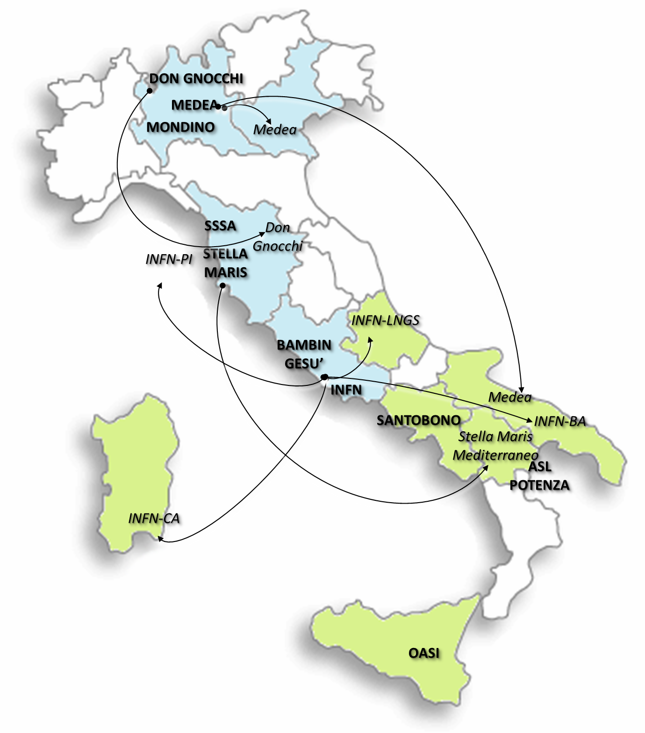
x
Rete Pediatrica per il tele-monitoraggio e la tele-riabilitazione dei disturbi e delle disabilità del neurosviluppo tramite l’individuazione e l’analisi di biomarker digitali, identificati tramite intelligenza artificiale
PI: IRCCS Stella Maris
PI INFN: P. Oliva (INFN-CA)
INFN groups:
BA: S. Tangaro, G. Donvito
LNGS: A. Galante
PI: A. Retico
Obiettivi:
costruire un database condiviso di dati clinici, di scale funzionali, di imaging e di genomica nell’ambito dei principali disturbi e disabilità del neuro-sviluppo
sviluppare modelli di intelligenza artificiale per individuare biomarker digitali per il tele-monitoraggio e la tele-riabilitazione al fine di personalizzare le terapie

Slide 14
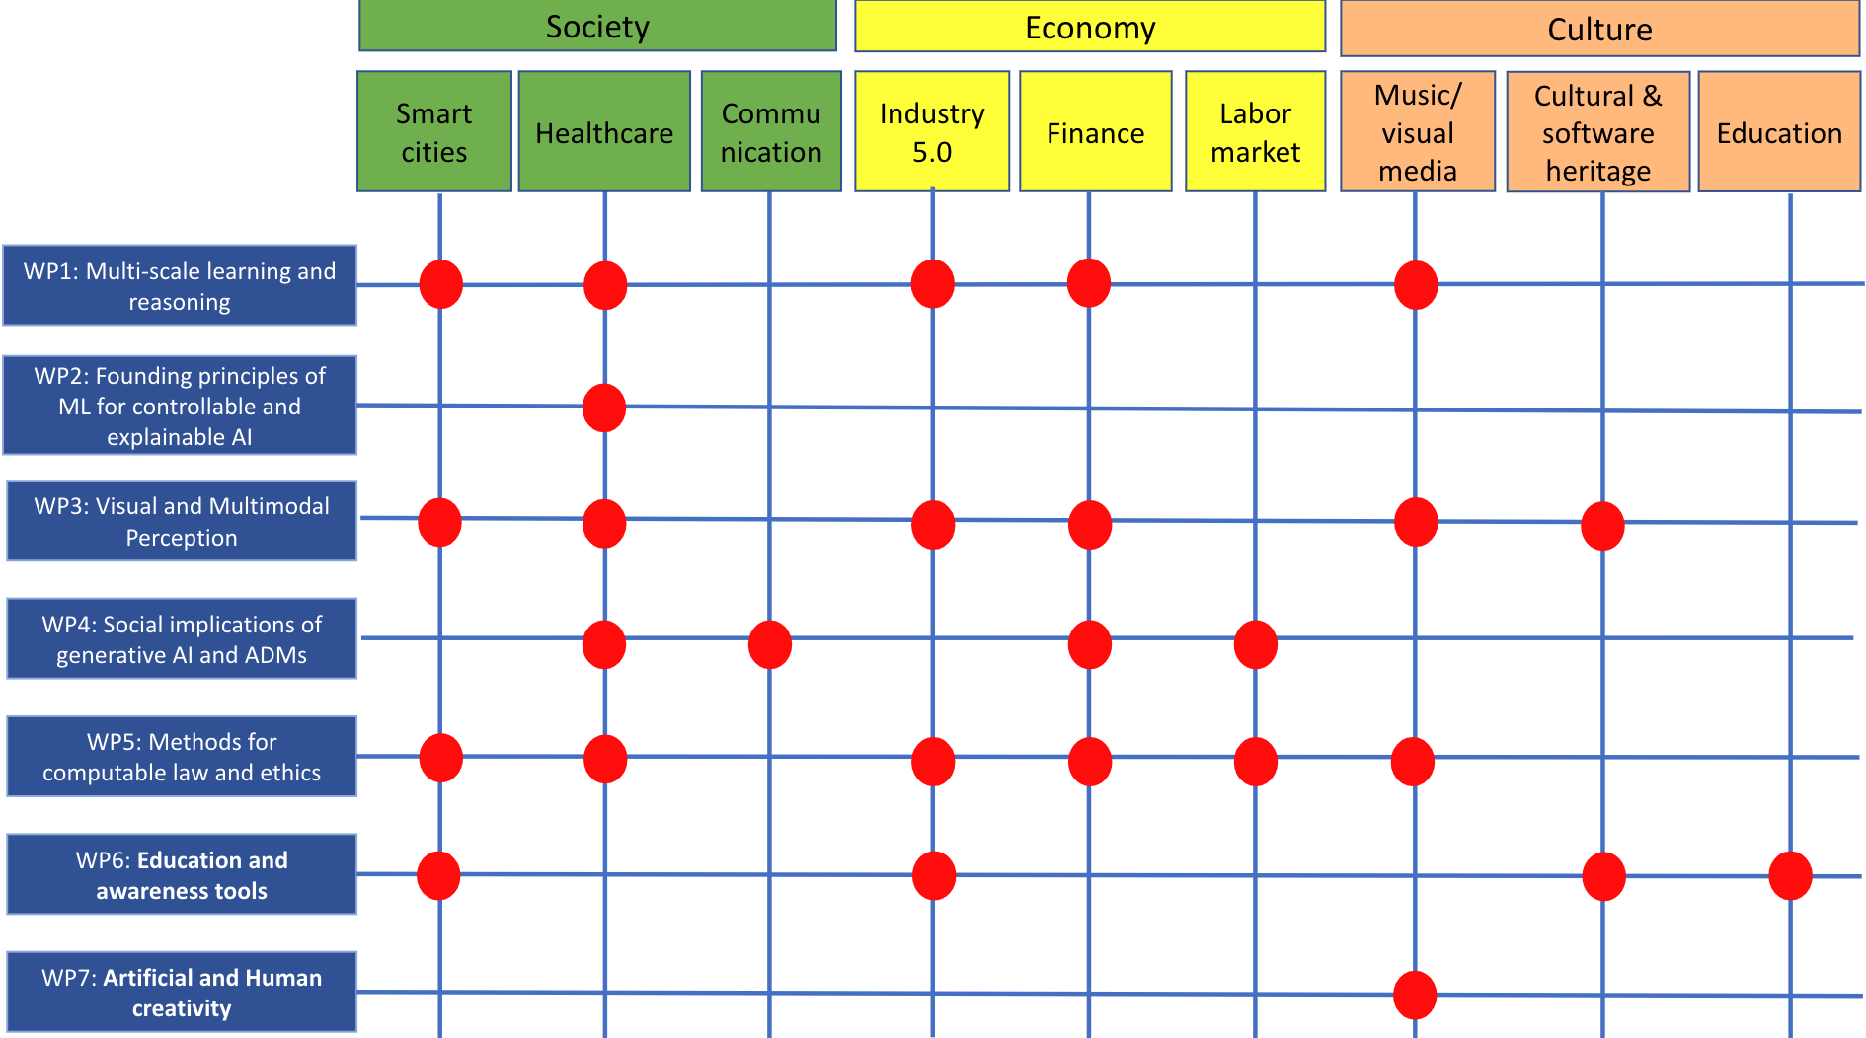
PNRR PE1 – FAIR: Future AI Research
Spoke 8: Pervasive AI Coordinated by M. Milano, University of Bologna
WP8.8. Experimental use cases in pervasive domains Leader INFN – PI: A. Retico, co-PI: A. Chincarini
INFN TD: F. Lizzi (PI), F. Sensi (GE)
WP8.8
Experimental use cases
WP8.8 provides the experimental framework for the formal results achieved on WP8.1-8.7 of Spoke 8.
INFN coordinate the use case development in three big macro sectors:
society (smart cities, e.g. Bologna digital twin, and personalized medicine)
economy (industry 5.0, finance/banking and labor market)
culture (cultural and sofware heritage, humanistic AI and music)
A. Retico - next_AIM - Artificial Intelligence in Medicine (AIM): next steps

Slide 15
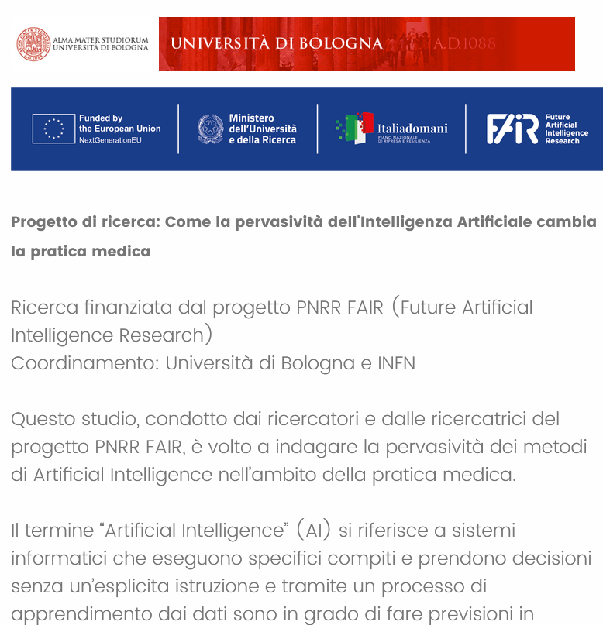
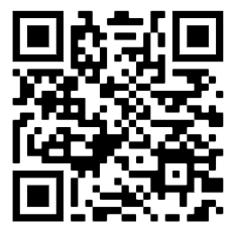
PNRR PE1 – FAIR: Future AI Research
WP8.8. Experimental use cases in pervasive domains Leader INFN – PI: A. Retico, co-PI: A. Chincarini
Survey on AI impact in Medicine
UniBO (WP8.4 L. Sartori, C. Binelli, Dep. of Social Sciences) and INFN (WP8.8 A. Retico, A. Chincarini, F. Lizzi, F. Sensi)
The survey investigates expectations, diffusion and familiarity of AI tools from healthcare professionals (Physicians and Medical Physicists) in clinical environment
Proponents aim at using survey results to suggest guidelines for users, developers and legal experts for the correct use and design of AI tools
Take part in the survey!
https://unibodisa.eu.qualtrics.com/jfe/form/SV_eV8bdQfAkGcTuBw
A. Retico - next_AIM - Artificial Intelligence in Medicine (AIM): next steps
Notes:
Opinions are collected, among others, on sensitive topics such as responsibility, personal data treatment, and medical certification

Slide 16
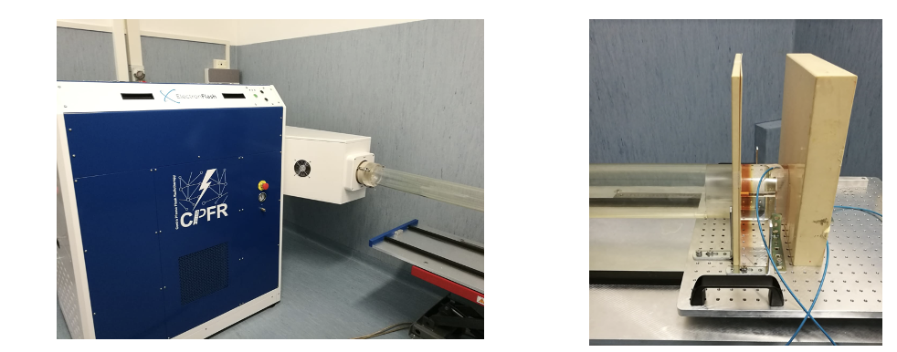
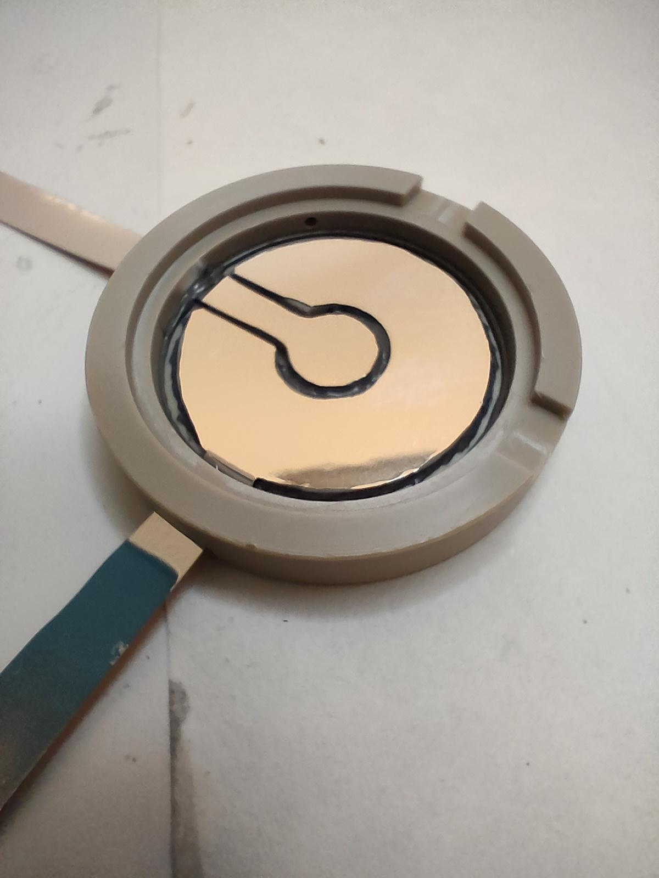
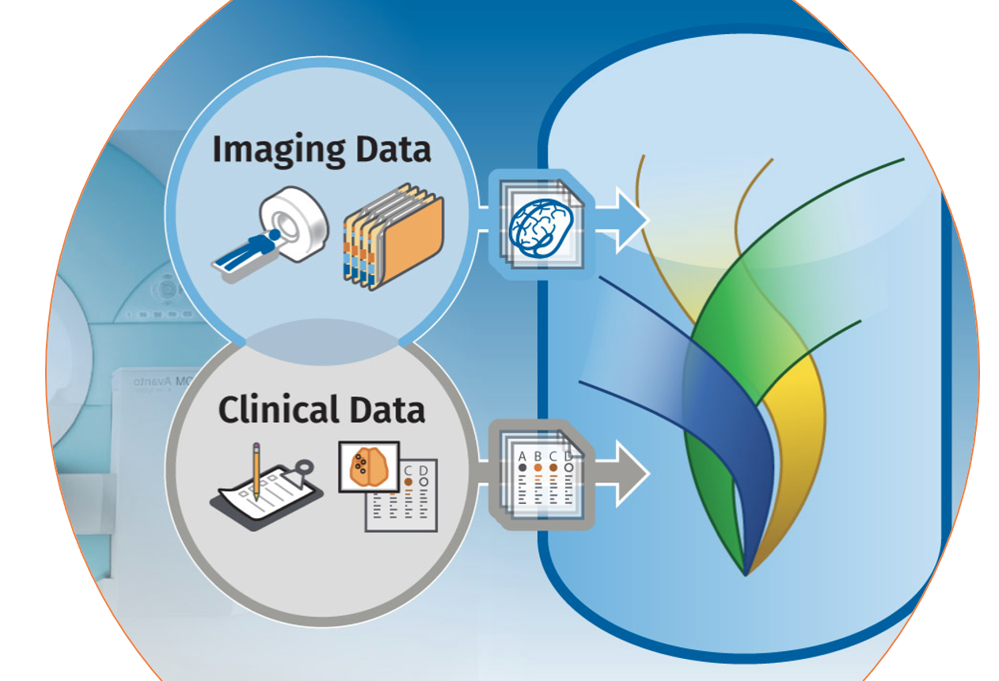
PNRR ECS THE Tuscany Health Ecosystem INFN and Univ. of Pisa are involved in Spoke 1 - ADVANCED RADIOTHERAPIES AND DIAGNOSTICS IN ONCOLOGY coordinated by L. Gizzi (CNR, Pisa)
The CPFR (Centro Pisano Flash RadioTherapy), partnered
by INFN, is ready to perform in vitro experiments to investigate basic mechanisms and parameter dependency of FLASH effect
INFN is contributing to the prototyping of a suitable dosimeter for ultra-high dose-per-pulse and dose rates (Di Martino et al, 2022 doi:10.1016/j.ejmp.2022.08.010)
XNAT
INFN is developing an informatic platform for data storage, sharing and automated data processing based on the XNAT technology (www.xnat.org) to support the research interactions between WPs
A dedicated technologists has been recruited (C. Scapicchio, INFN Pisa)
The INFN group in THE: A Retico, C Scapicchio, S Lossano, M Celentano, A Formuso, E Mazzoni, T Boccali, A Moggii, A Kraan, S Arezzini
Notes:
dosimeter

Slide 17
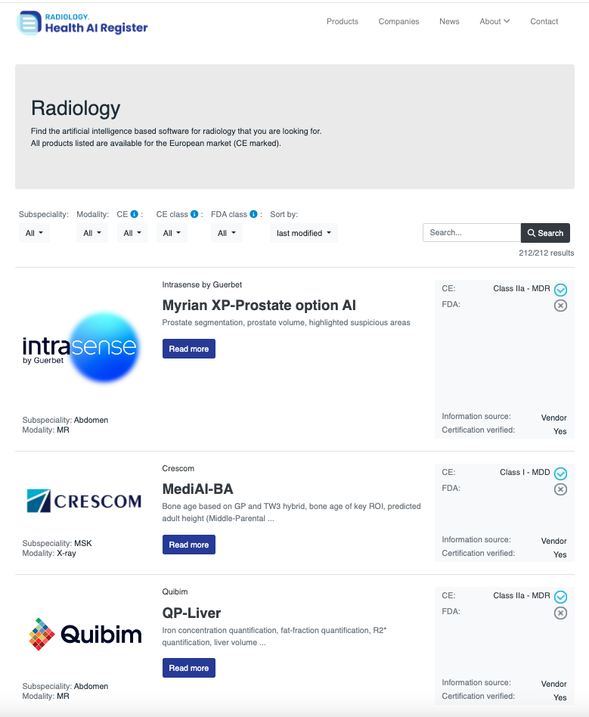
From R&D to the market
https://radiology.healthairegister.com/
CE marked AI-based tools available on the market
A review of 100 CE marked software products was carried out and made available online
An extensive bibliographic research on the scientific evidence of the validity of these products has highlighted that:
For 64 products out of 100, no evidence of efficacy has been published in a peer-reviewed journal.
Only 18 products out of 100 demonstrated a relevant (potential) clinical impact with studies on: impact on diagnostic thinking, on the patient's diagnostic/therapeutic pathway or on costs.
[van Leeuwen, K. G., Schalekamp, S., Rutten, M. J. C. M., van Ginneken, B., & de Rooij, M. (2021). Artificial intelligence in radiology: 100 commercially available products and their scientific evidence. European Radiology, 31(6), 3797–3804. https://doi.org/10.1007/s00330-021-07892-z]
INFN CNTT funded projects connected with AIM, next_AIM, …
CNTT R4I → INFN Spin-off DORIAN (https://www.dorian-tech.com/), A. Chincarini, P. Bosco, F. Sensi … (GE)
CNTT R4I project Deeplook (A deep learning computed diagnosis support for digital breast tomosynthesis), G Mettivier (NA)

Slide 18
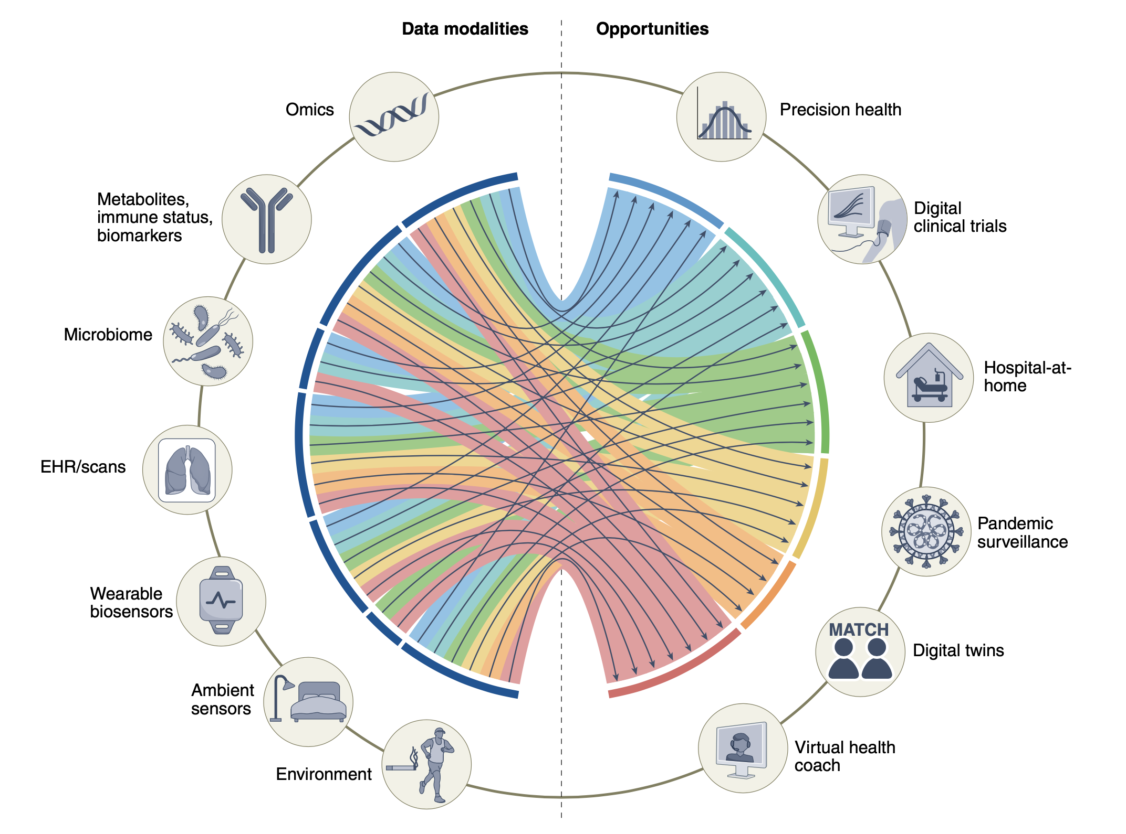
Methodological open issues and challenges
Big data collections and advanced computational approaches (including AI-based ones) are needed to fully exploit the potential of the large amount of digital information available for each patient nowadays
The integration of the complementary information is expected to:
increase the understanding of human health and disease conditions
allow personalized preventive, diagnostic and therapeutic strategies
UK Biobank (started in 2006) enrolled more than 500k participants to follow for 30 years.
The integration of these very distinct types of data remains a challenge.
[Acosta et al (2022). Multimodal biomedical AI. Nature Medicine, 28(9), 1773–1784. https://doi.org/10.1038/s41591-022-01981-2]

Slide 19
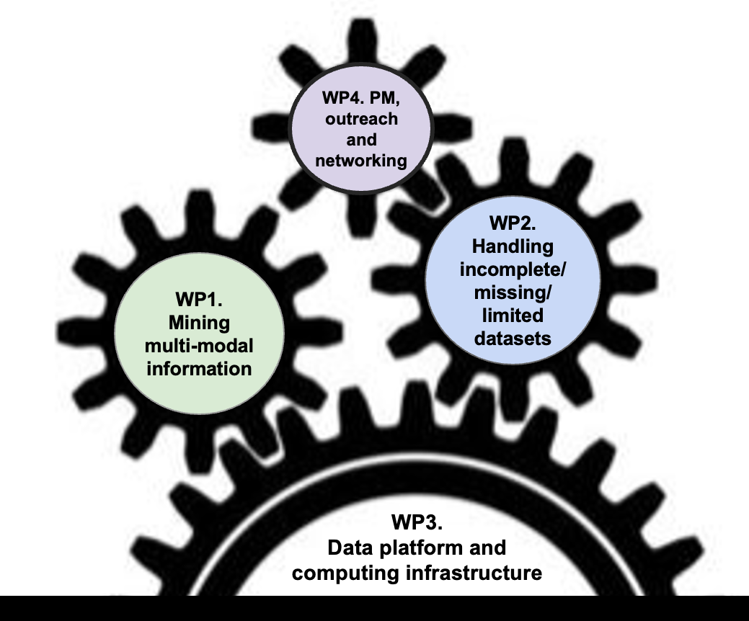
Artificial Intelligence in Medicine: focus on Multi-Input Analysis (AIM_MIA)
General goal: to take a step forward in the development and validation of AI-based tools for medical data analysis
Funded by INFN, CSN5: 2025-2027
Precision medicine promises improved health by accounting for individual variability in genes, environment, and lifestyle.
Big data collections and advanced analytics approaches (including AI-based methods) are needed to fully exploit the potential of the large amount of digital information available today for each patient.
Resp. Naz.: A. Retico
12 Research Units:
Bari (S. Tangaro) Bologna (D. Remondini) Cagliari (P. Oliva) Catania (M. Marrale) Ferrara (G. Di Domenico) Firenze (C. Talamonti) Genova (A. Chincarini) Lab. Naz. Sud (G. Russo)
Lecce (G. De Nunzio)
Milano (C. Lenardi)
Pavia (A. Lascialfari)
Pisa (M.E. Fantacci)
Objectives
Mining multi-modal information
Handling incomplete/missing/limited datasets
Development of a dedicated data and computing platform

Slide 20
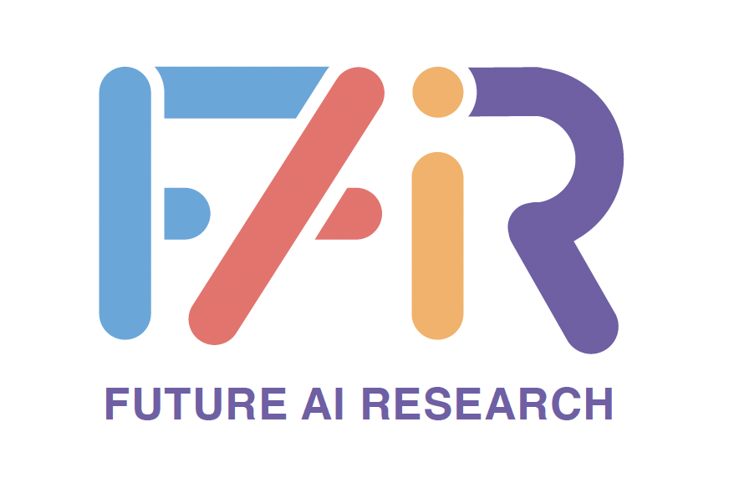
Thank you for your kind attention!
next
Research partly supported by: Artificial Intelligence in Medicine next_AIM, https://www.pi.infn.it/aim project funded by INFN-CSN5; FAIR-AIM project funded by Tuscany Government (POR FSE 2014-2020); PNRR - M4C2 - Partenariato Esteso "FAIR - Future Artificial Intelligence Research" - Spoke 8, and PNRR - M4C2 - Centro Nazionale "ICSC – Centro Nazionale di Ricerca in High Performance Computing, Big Data and Quantum Computing" - Spoke 8, funded by the European Commission under the NextGeneration EU programme.
Contact: alessandra.retico@pi.infn.it
INFN, Pisa Division
https://www.pi.infn.it/aim/

