Slide 1
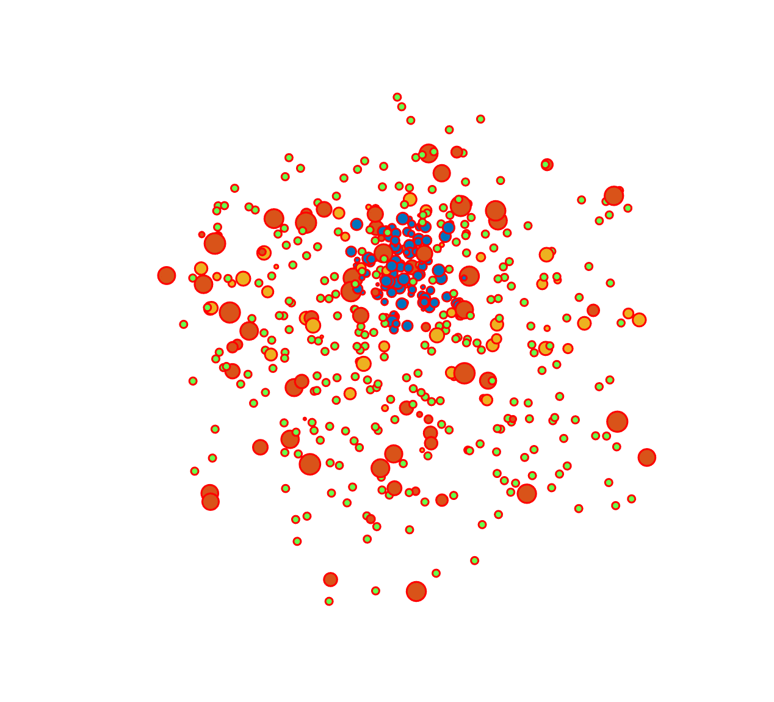
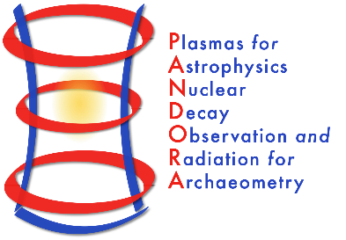
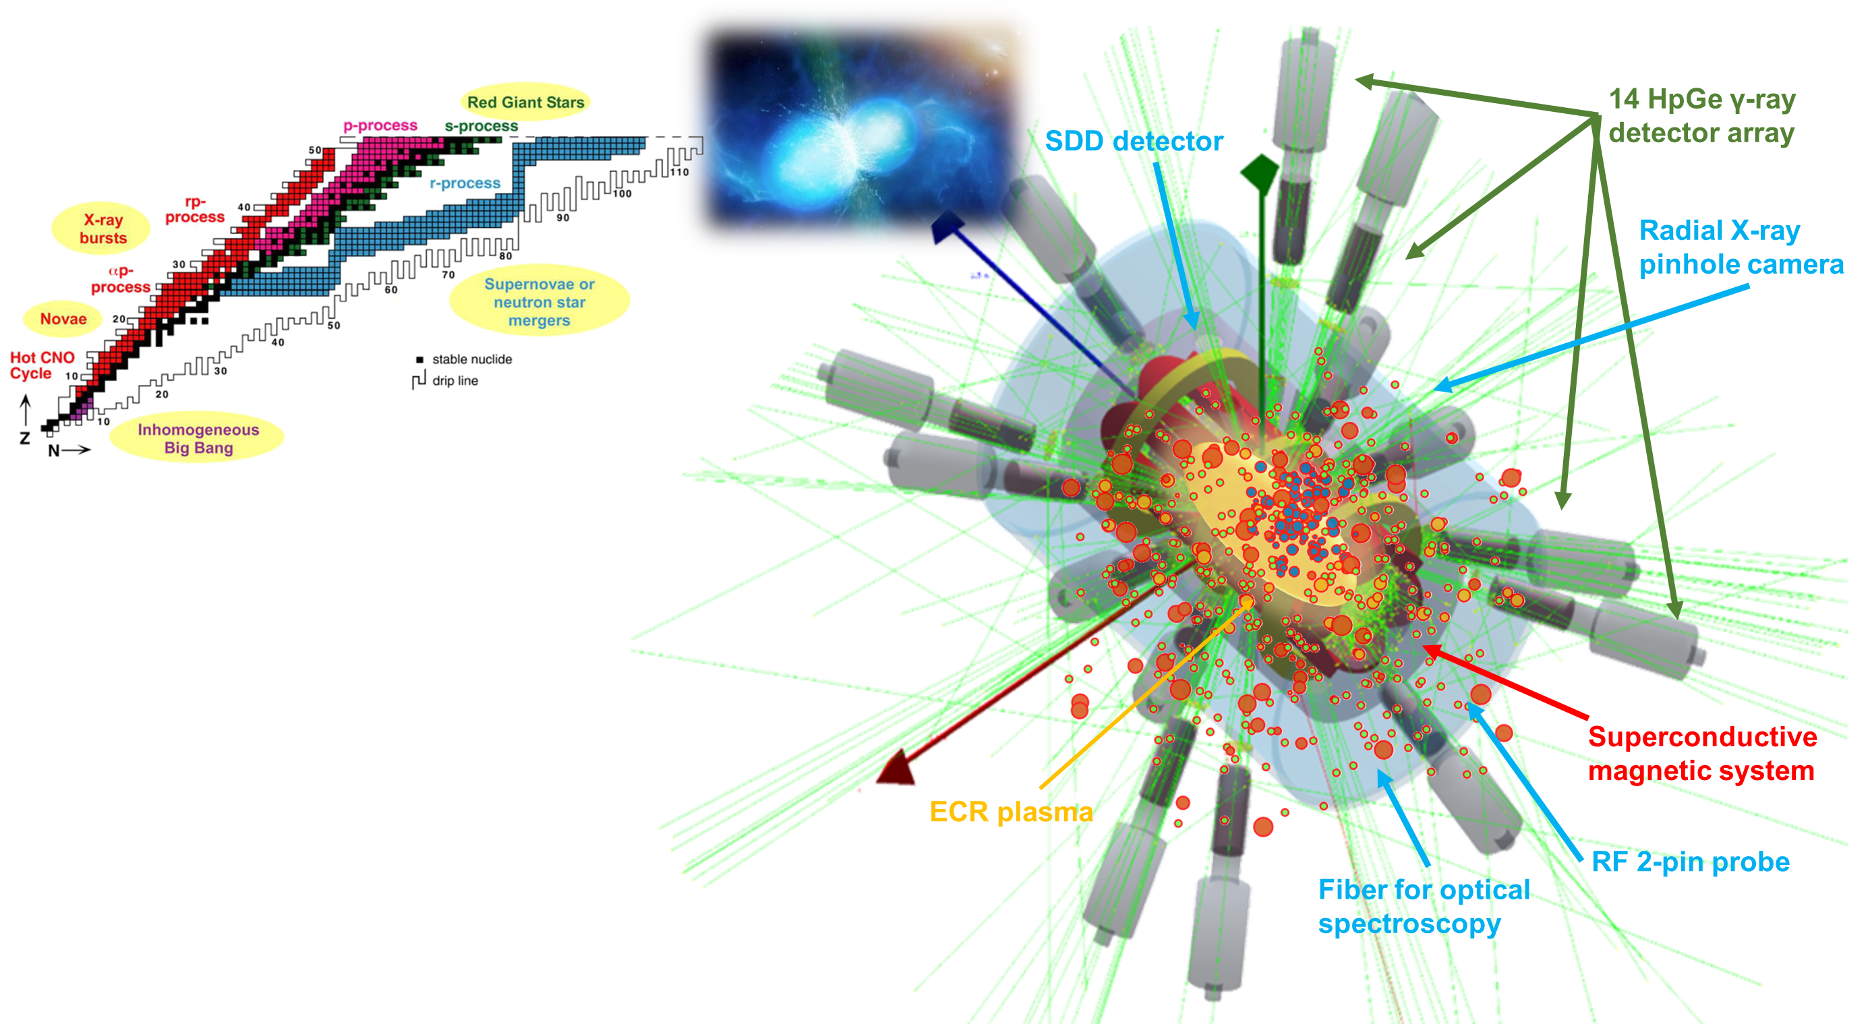
Gedankenexperiment for PANDORA – Plasma Modelling
Bharat Mishra and Angelo Pidatella on behalf of the PANDORA collaboration
Istituto Nazionale di Fisica Nucleare – Laboratori Nazionali del Sud – Catania (Italy)

Slide 2
3rd PANDORA Progress Meeting – Legnaro – October 7-8, 2024
Outline
Why model ECR plasmas?
Bridge the gap between stars and the lab
Test competing models of in-plasma decay rates
How can we study ECR plasmas?
Particle-in-Cell (PIC) codes for ECR plasma electrons
Particle-in-Cell Monte Carlo (PIC-MC) codes for ECR plasma ions
OBSERVABLES FOR MODEL VALIDATION
How do ECR plasmas affect β-decay rates?
PIC-MC codes for injected radio-isotopes
3D maps of decay rates in realistic ECR plasmas
Conclusions and Future Outlook for PANDORA
THEORY AND SIMULATIONS 1 – Gedankenexperiment for PANDORA – Plasma Modelling
B. Mishra and A. Pidatella – INFN - LNS

Slide 3
3rd PANDORA Progress Meeting – Legnaro – October 7-8, 2024
Outline
Why model ECR plasmas?
Bridge the gap between stars and the lab
Test competing models of in-plasma decay rates
How can we study ECR plasmas?
Particle-in-Cell (PIC) codes for ECR plasma electrons
Particle-in-Cell Monte Carlo (PIC-MC) codes for ECR plasma ions
OBSERVABLES FOR MODEL VALIDATION
How do ECR plasmas affect β-decay rates?
PIC-MC codes for injected radio-isotopes
3D maps of decay rates in realistic ECR plasmas
Conclusions and Future Outlook for PANDORA
THEORY AND SIMULATIONS 1 – Gedankenexperiment for PANDORA – Plasma Modelling
B. Mishra and A. Pidatella – INFN - LNS

Slide 4
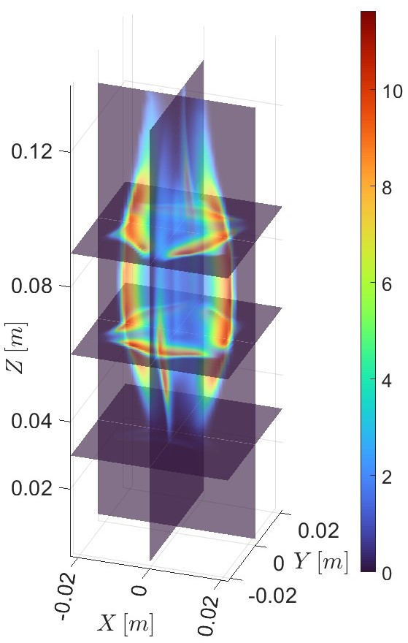
3rd PANDORA Progress Meeting – Legnaro – October 7-8, 2024
Why model ECR plasmas
Objective 1: Check if decay rates are changing in the plasma → qualitative
Objective 2: Check how much the decay rates are changing in the plasma → quantitative
Pure experiment, no theory
Experiment + theory
Measure λ* along line of sight of detector
Measure n_{e}, kT_{e} and CSD in the same region
Map λ* to plasma properties and extrapolate to stars
Calculate plasma properties
Generate maps of decay rates and γ-emission
Test with experimental data and extrapolate model to stars
Can’t measure plasma properties along each cone of sight
THEORY AND SIMULATIONS 1 – Gedankenexperiment for PANDORA – Plasma Modelling
B. Mishra and A. Pidatella – INFN - LNS

Slide 5
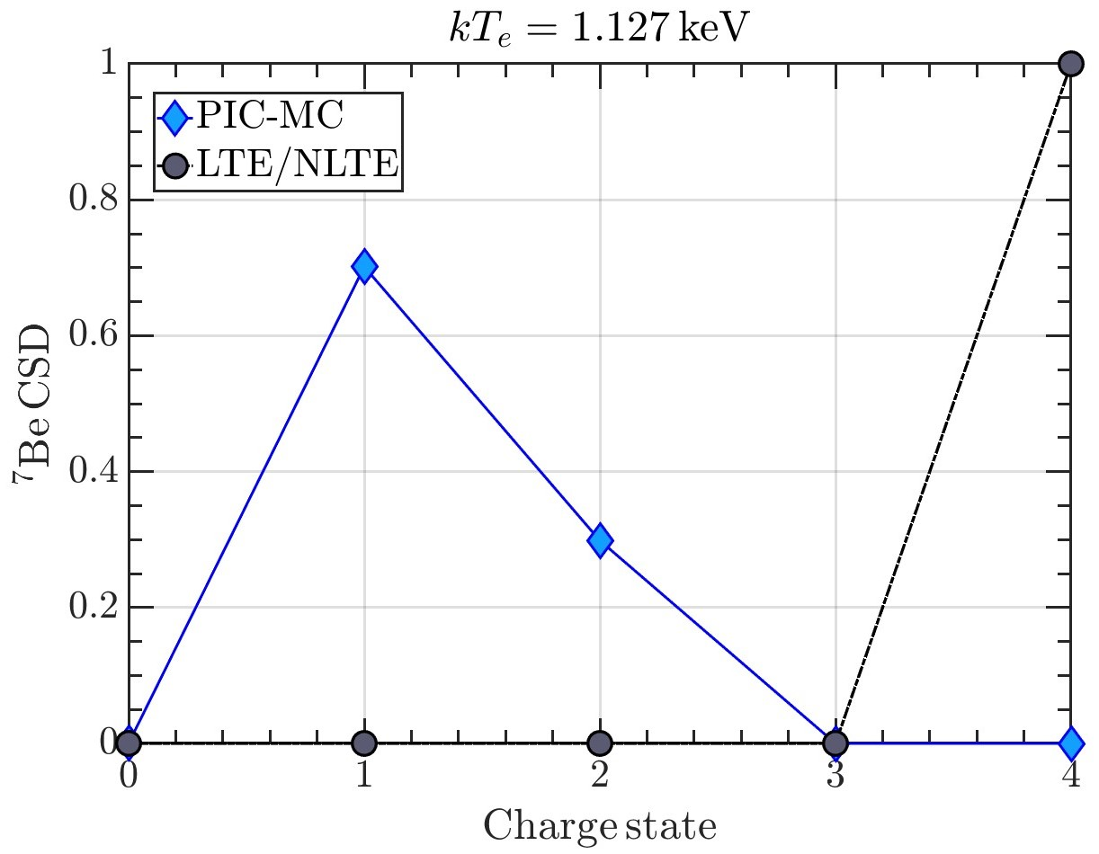
3rd PANDORA Progress Meeting – Legnaro – October 7-8, 2024
Why model ECR plasmas
So we need to model plasmas. But why complicate it?
Systematics: Takahashi-Yokoi
In-plasma decay models
Ab-initio: DHF
CSD calculated under assumption of locality does not match real physics where particle transport needs to be considered
A full 3D-NLTE plasma dynamics model must be developed and combined with decay rates for each charge state and excitation level to generate realistic picture of PANDORA
THEORY AND SIMULATIONS 1 – Gedankenexperiment for PANDORA – Plasma Modelling
B. Mishra and A. Pidatella – INFN - LNS

Slide 6
3rd PANDORA Progress Meeting – Legnaro – October 7-8, 2024
Outline
Why model ECR plasmas?
Bridge the gap between stars and the lab
Test competing models of in-plasma decay rates
How can we study ECR plasmas?
Particle-in-Cell (PIC) codes for ECR plasma electrons
Particle-in-Cell Monte Carlo (PIC-MC) codes for ECR plasma ions
OBSERVABLES FOR MODEL VALIDATION
How do ECR plasmas affect β-decay rates?
PIC-MC codes for injected radio-isotopes
3D maps of decay rates in realistic ECR plasmas
Conclusions and Future Outlook for PANDORA
THEORY AND SIMULATIONS 1 – Gedankenexperiment for PANDORA – Plasma Modelling
B. Mishra and A. Pidatella – INFN - LNS

Slide 7
3rd PANDORA Progress Meeting – Legnaro – October 7-8, 2024
ECR plasma simulation pipeline
PIC SIMULATIONS FOR ELECTRONS
3D, steady-state maps of n_{e} and E_{e}
PIC-MC SIMULATIONS FOR PLASMA IONS
PIC-MC SIMULATIONS FOR ISOTOPE IONS
3D, steady-state maps of <Z> and n_{i}
3D, steady-state maps of <Z> and λ*
First level input to all codes and therefore precision needed
Observables: Soft X-ray spectroscopy, interferometry, polarimetry, profilometry, Thomson scattering
Second level input to in-plasma decay code
Observables: Faraday cup, optical emission spectroscopy, X-ray fluorescence
Observables: PANDORA
THEORY AND SIMULATIONS 1 – Gedankenexperiment for PANDORA – Plasma Modelling
B. Mishra and A. Pidatella – INFN - LNS

Slide 8
3rd PANDORA Progress Meeting – Legnaro – October 7-8, 2024
Particle-in-Cell Simulations
PIC is a technique to simulate plasma.
Self-consistent, steady-state solution
N macroparticles, each representing a certain number of real particles, are initialised and transported according to equations of motion
The simulation domain is divided into a grid, and particle trajectories leaves traces at grid points which leads to an occupation map
Occupation maps are scaled to density maps according to some physical law, and fields are calculated on grid points using FEM/FDM
(i-1,j-1)
(i-1,j)
(i-1,j+1)
(i-1,j-1)
(i-1,j)
(i-1,j+1)
(i-1,j-1)
(i-1,j)
(i-1,j+1)
(i,j-1)
(i,j)
(i,j+1)
(i,j-1)
(i,j)
(i,j+1)
(i,j-1)
(i,j)
(i,j+1)
(i+1,j-1)
(i+1,j)
(i+1,j+1)
(i+1,j-1)
(i+1,j)
(i+1,j+1)
(i+1,j-1)
(i+1,j)
(i+1,j+1)
THEORY AND SIMULATIONS 1 – Gedankenexperiment for PANDORA – Plasma Modelling
B. Mishra and A. Pidatella – INFN - LNS

Slide 9
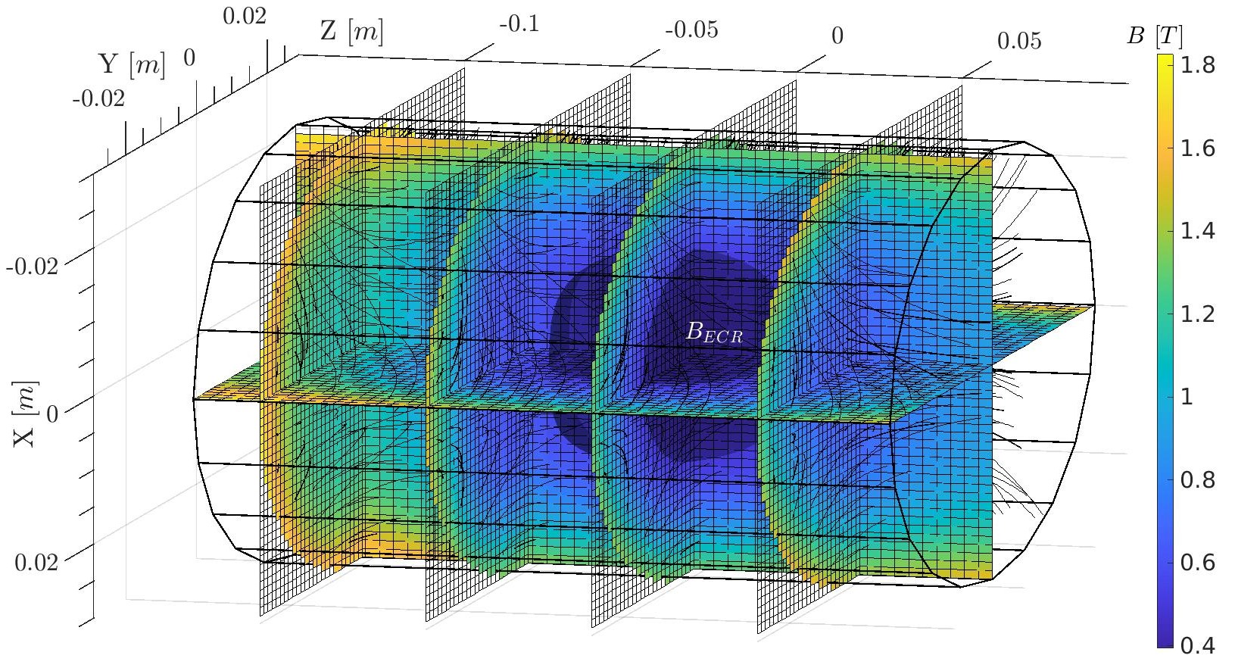
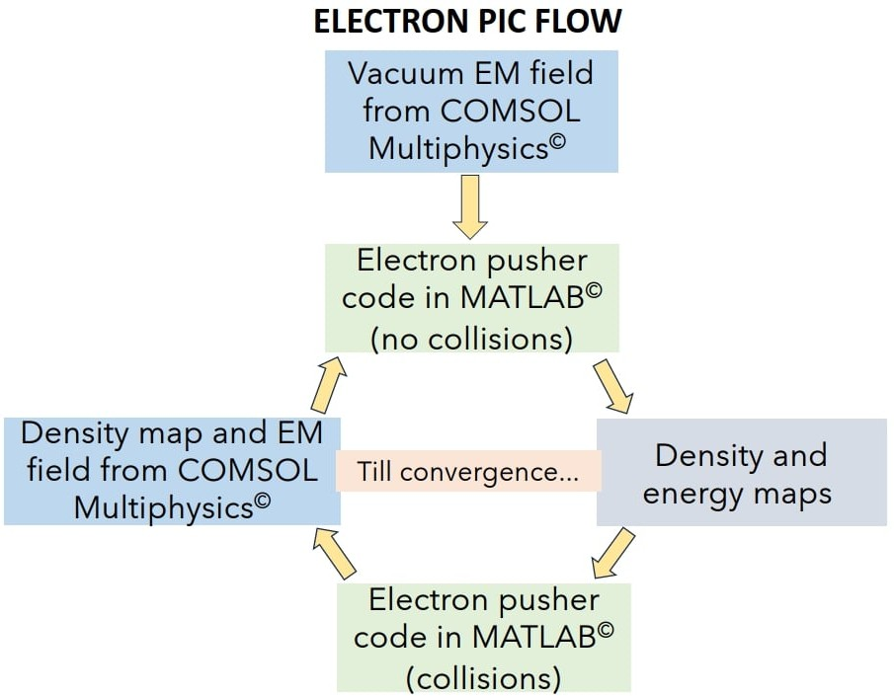
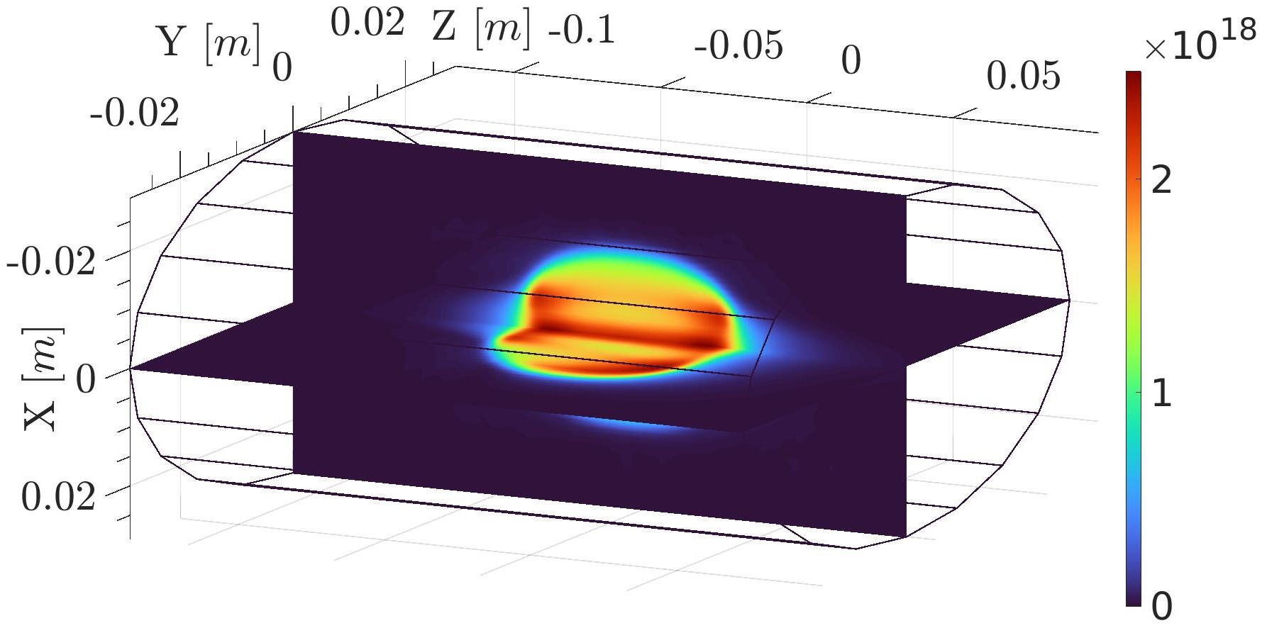
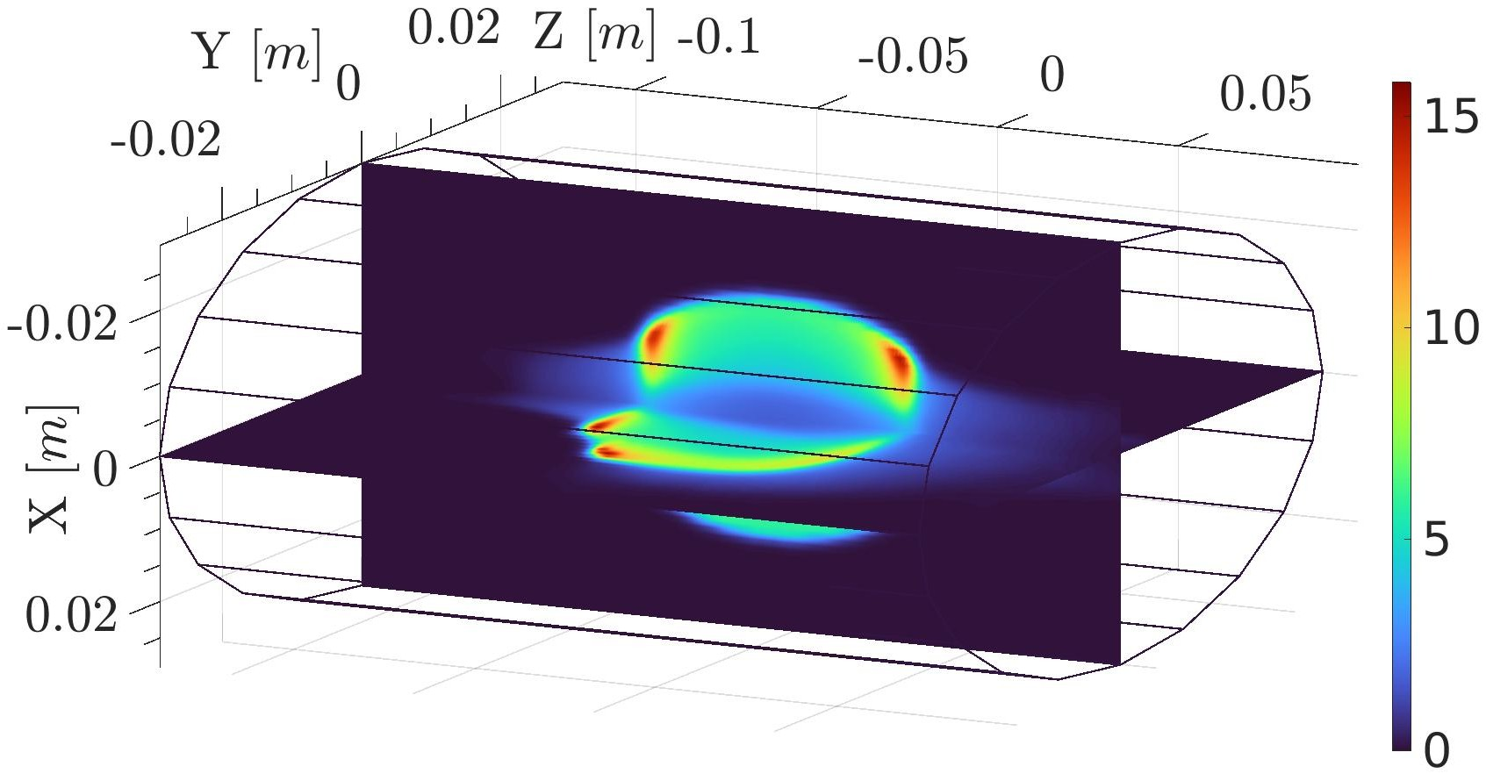
3rd PANDORA Progress Meeting – Legnaro – October 7-8, 2024
ECR Plasma Electron Simulations
PIC simulation for ECR plasma electrons
Description: Vlasov-Maxwell equation
Scaling: Plasma cutoff density
Self-consistency: Microwave EM field
D. Mascali, G. Torrisi et al , Eur. Phys. J. D. 69, 27 (2015)
G. Torrisi, D. Mascali et al, JEWA 28, 9 (2014)
A. Galatà et al, Front. Phys. 10, 947194 (2022)
R = 29 mm
L = 210 mm
Electron density n_{e} (m⁻³) and mean energy E_{e} (keV) maps for A-HPC obtained from PIC simulations.
THEORY AND SIMULATIONS 1 – Gedankenexperiment for PANDORA – Plasma Modelling
B. Mishra and A. Pidatella – INFN - LNS

Slide 10
3rd PANDORA Progress Meeting – Legnaro – October 7-8, 2024
ECR Plasma Ion Simulations
PIC simulations for ECR plasma ions:
Description: Vlasov-Maxwell equations + Balance equation
Scaling: Quasineutrality with electron density
Self-consistency: Electron density and energy maps
B. Mishra et al, Front. Phys. 10, 932448 (2022)
B. Mishra, EPJ WoC 275, 02001 (2023)
Ion Transport
Transport in EM fields under Lorentz force
Collisions by Fokker-Planck equation
MC Sampling
3 core modules
Electron impact ionization (EI)
Ion impact charge exchange (CEX)
Density Scaling
Iterative scaling of ion occupation map
THEORY AND SIMULATIONS 1 – Gedankenexperiment for PANDORA – Plasma Modelling
B. Mishra and A. Pidatella – INFN - LNS

Slide 11
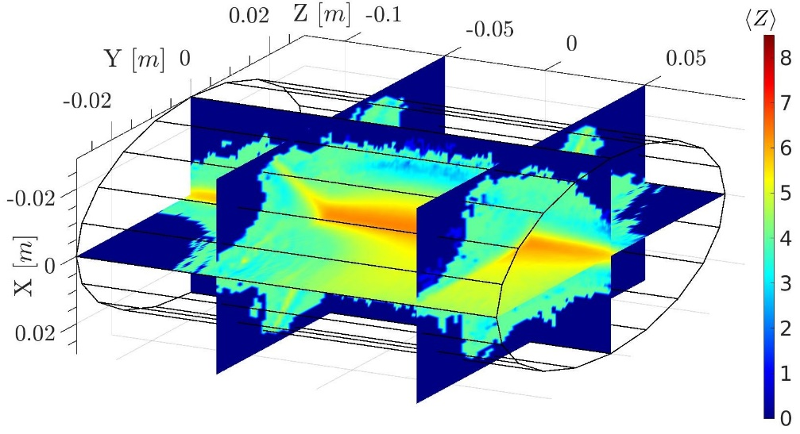
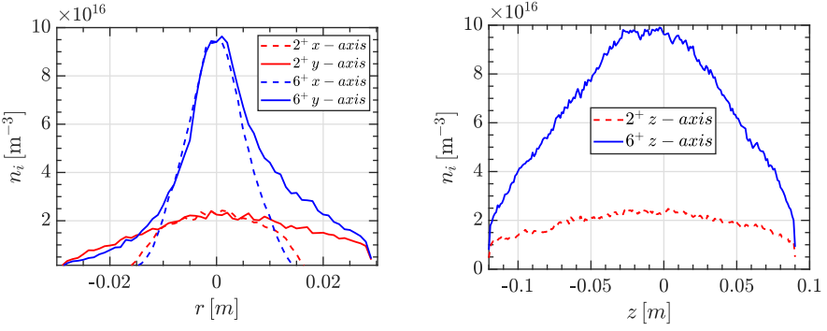
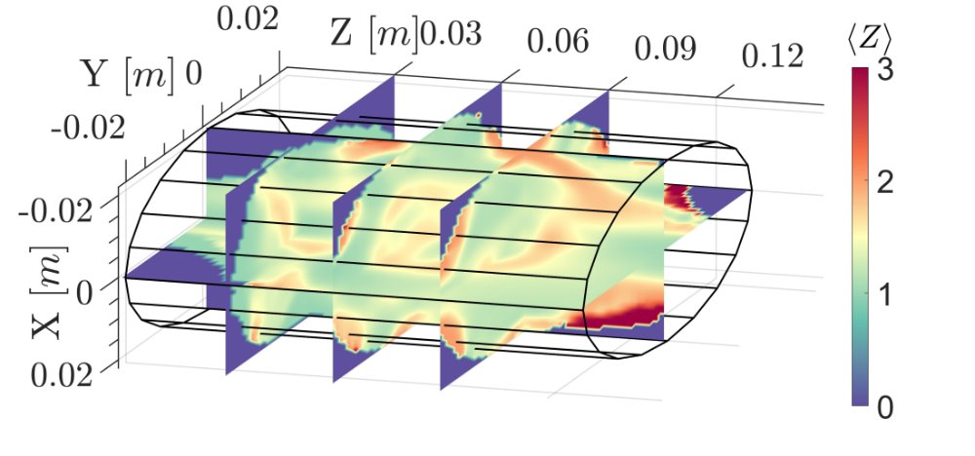
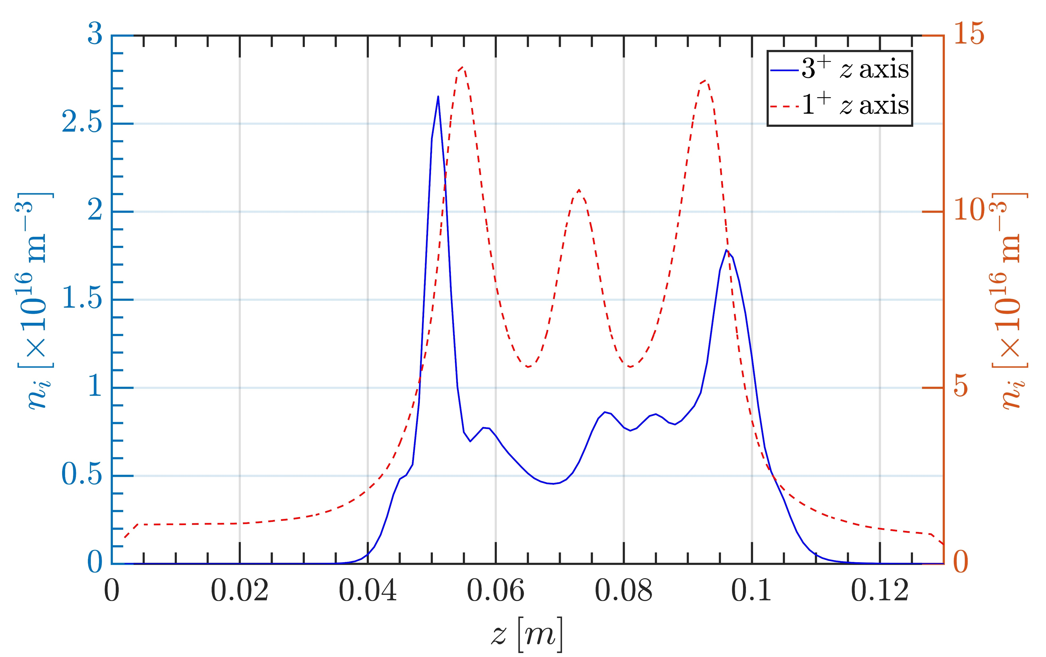
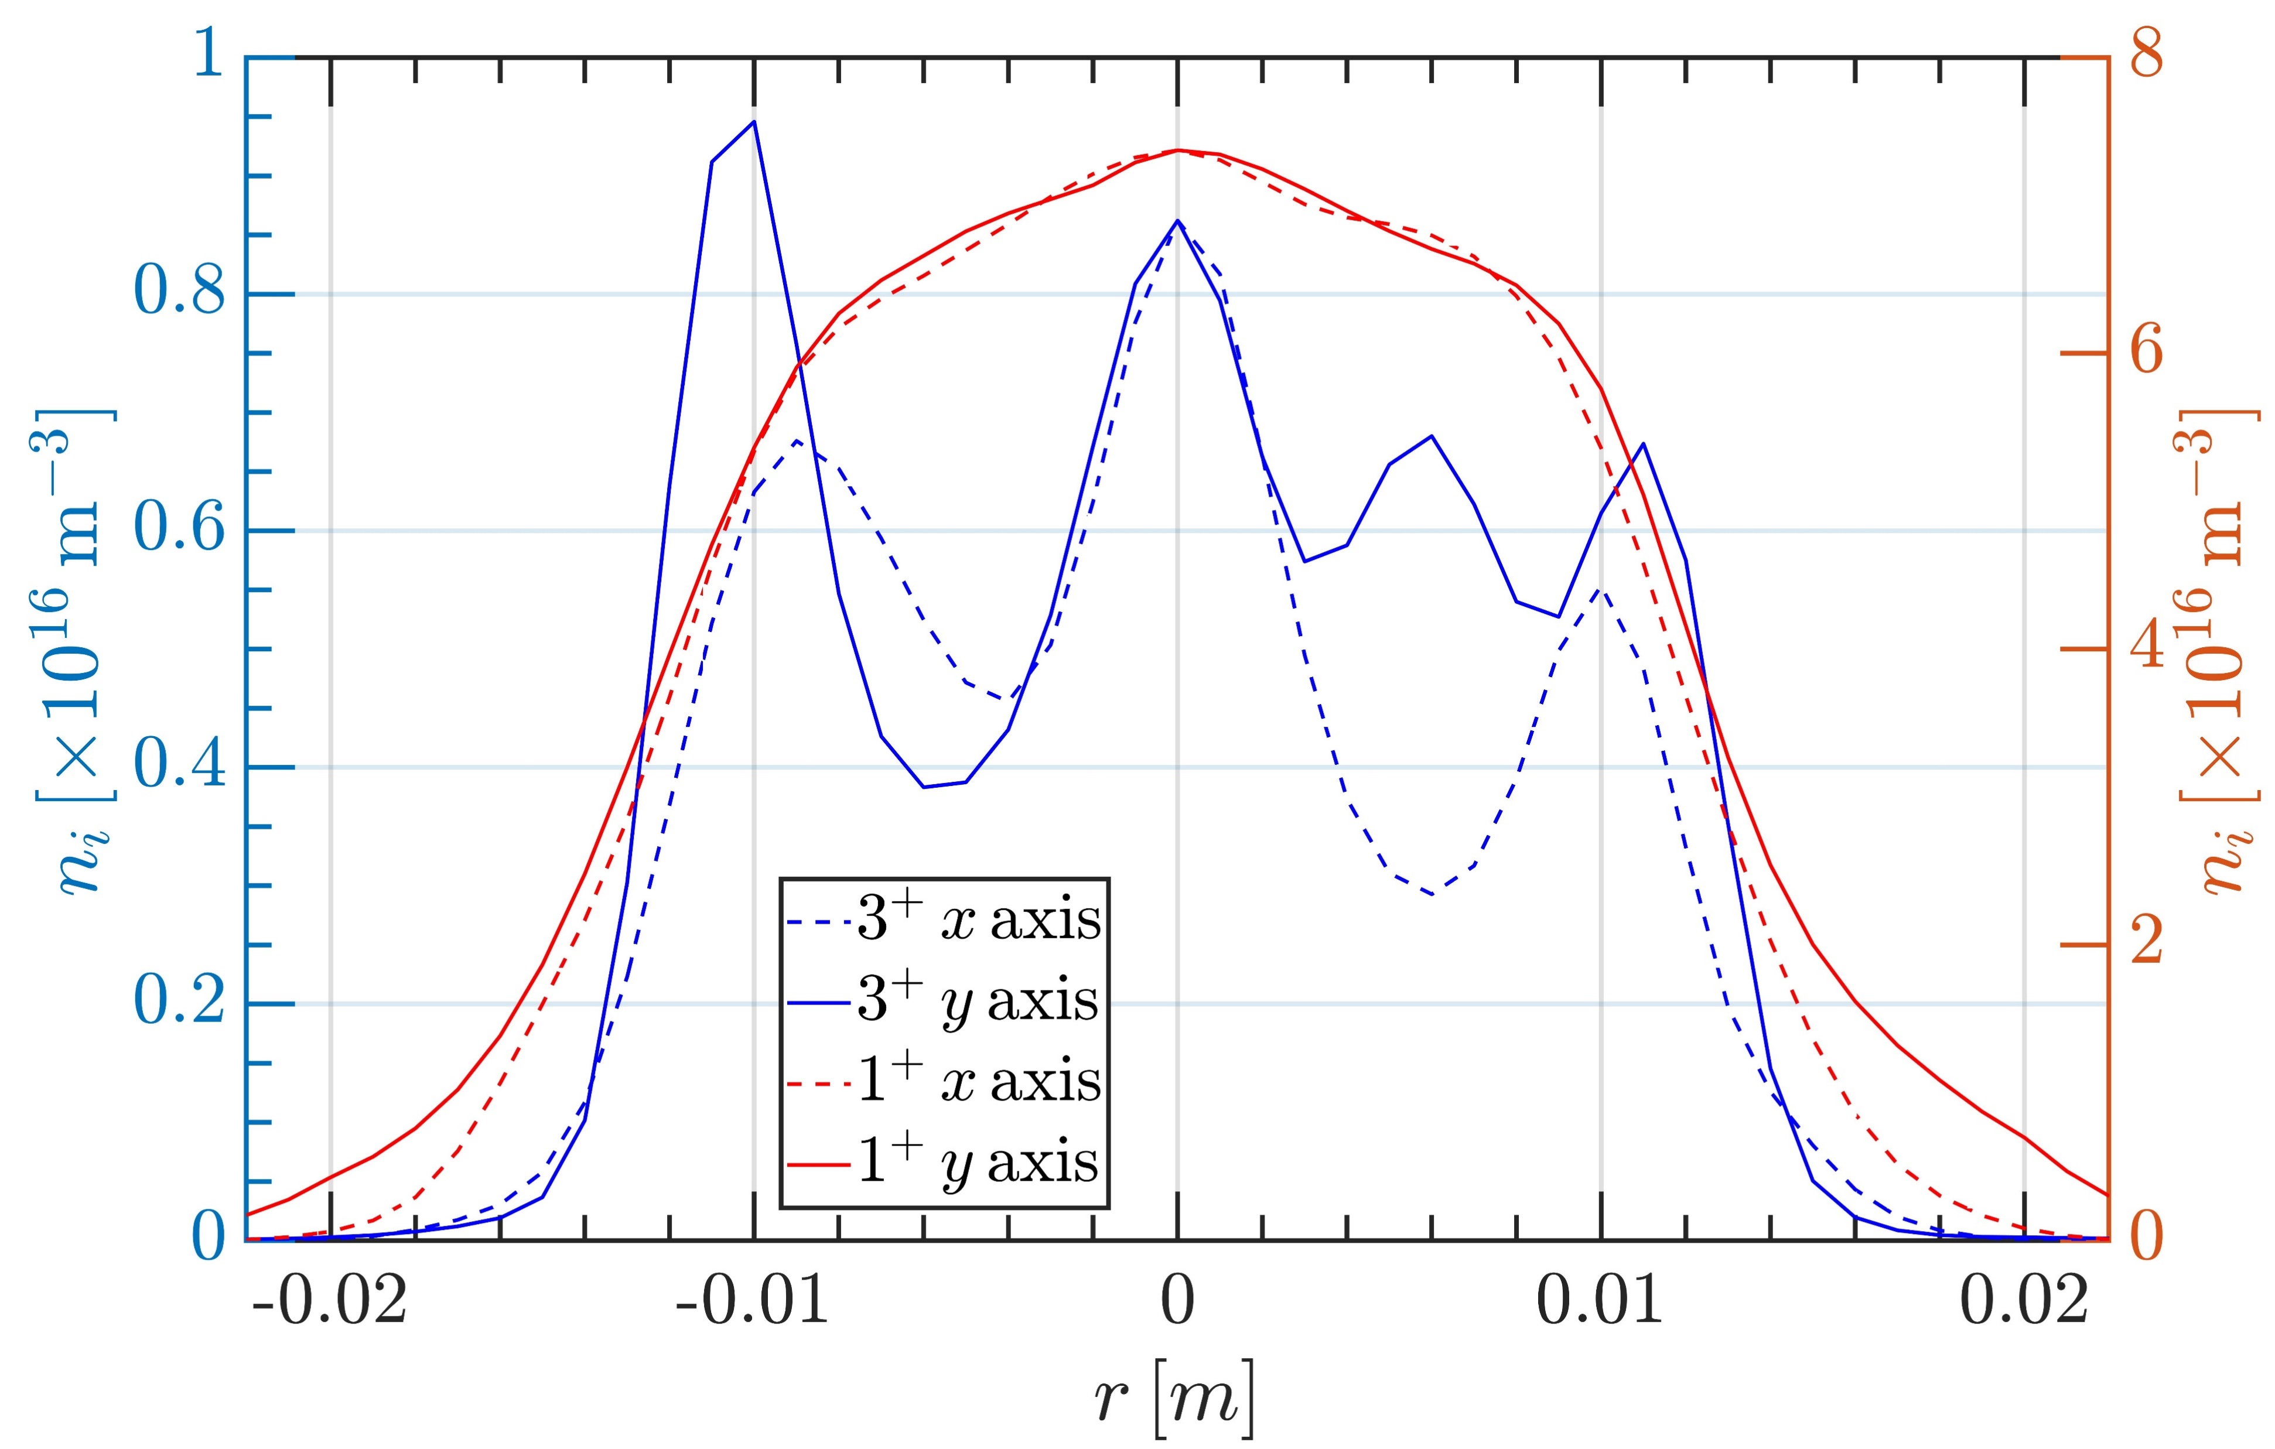
3rd PANDORA Progress Meeting – Legnaro – October 7-8, 2024
ECR Plasma Ion Simulations: Results
The main results of the PIC-MC simulations are 3D steady-state maps of ion density in for each ionisation stage and <Z>
Higher charge states tend to accumulate in the near-axis region because they are generated from lower charge states through EI in those same regions with high E_{e}, and they are strongly confined by E_{DL} and diffusion
<Z> of Ar plasma in A-HPC ECRIS as calculated using PIC-MC code (top) and of O plasma in LEGIS (bottom)
n_{i} of Ar²⁺ and Ar⁶⁺ in A-HPC ECRIS along the radius and axis in A-HPC (top) and same for O¹⁺ and O³⁺ in LEGIS (bottom)
Results may vary according to the geometry of the system, the magnetostatic field and type of ions (which govern particle transport), and steady state n_{e}, kT_{e} maps
THEORY AND SIMULATIONS 1 – Gedankenexperiment for PANDORA – Plasma Modelling
B. Mishra and A. Pidatella – INFN - LNS

Slide 12
3rd PANDORA Progress Meeting – Legnaro – October 7-8, 2024
ECR Plasma Simulations: Radioisotopes
Radio-isotope ions can be simulated using the same PIC-MC codes, but density maps will evolve according to mass number conservation, and rate-matrix will be more complex
B. Mishra, EPJ WoC 275, 02001 (2023)
Ion Transport
Transport in EM fields under Lorentz force
Collisions by Fokker-Planck equation
MC Sampling
For CSD
For LPD
Density Scaling
Scaling coefficient
Transfer coefficient
Concentration
THEORY AND SIMULATIONS 1 – Gedankenexperiment for PANDORA – Plasma Modelling
B. Mishra and A. Pidatella – INFN - LNS

Slide 13
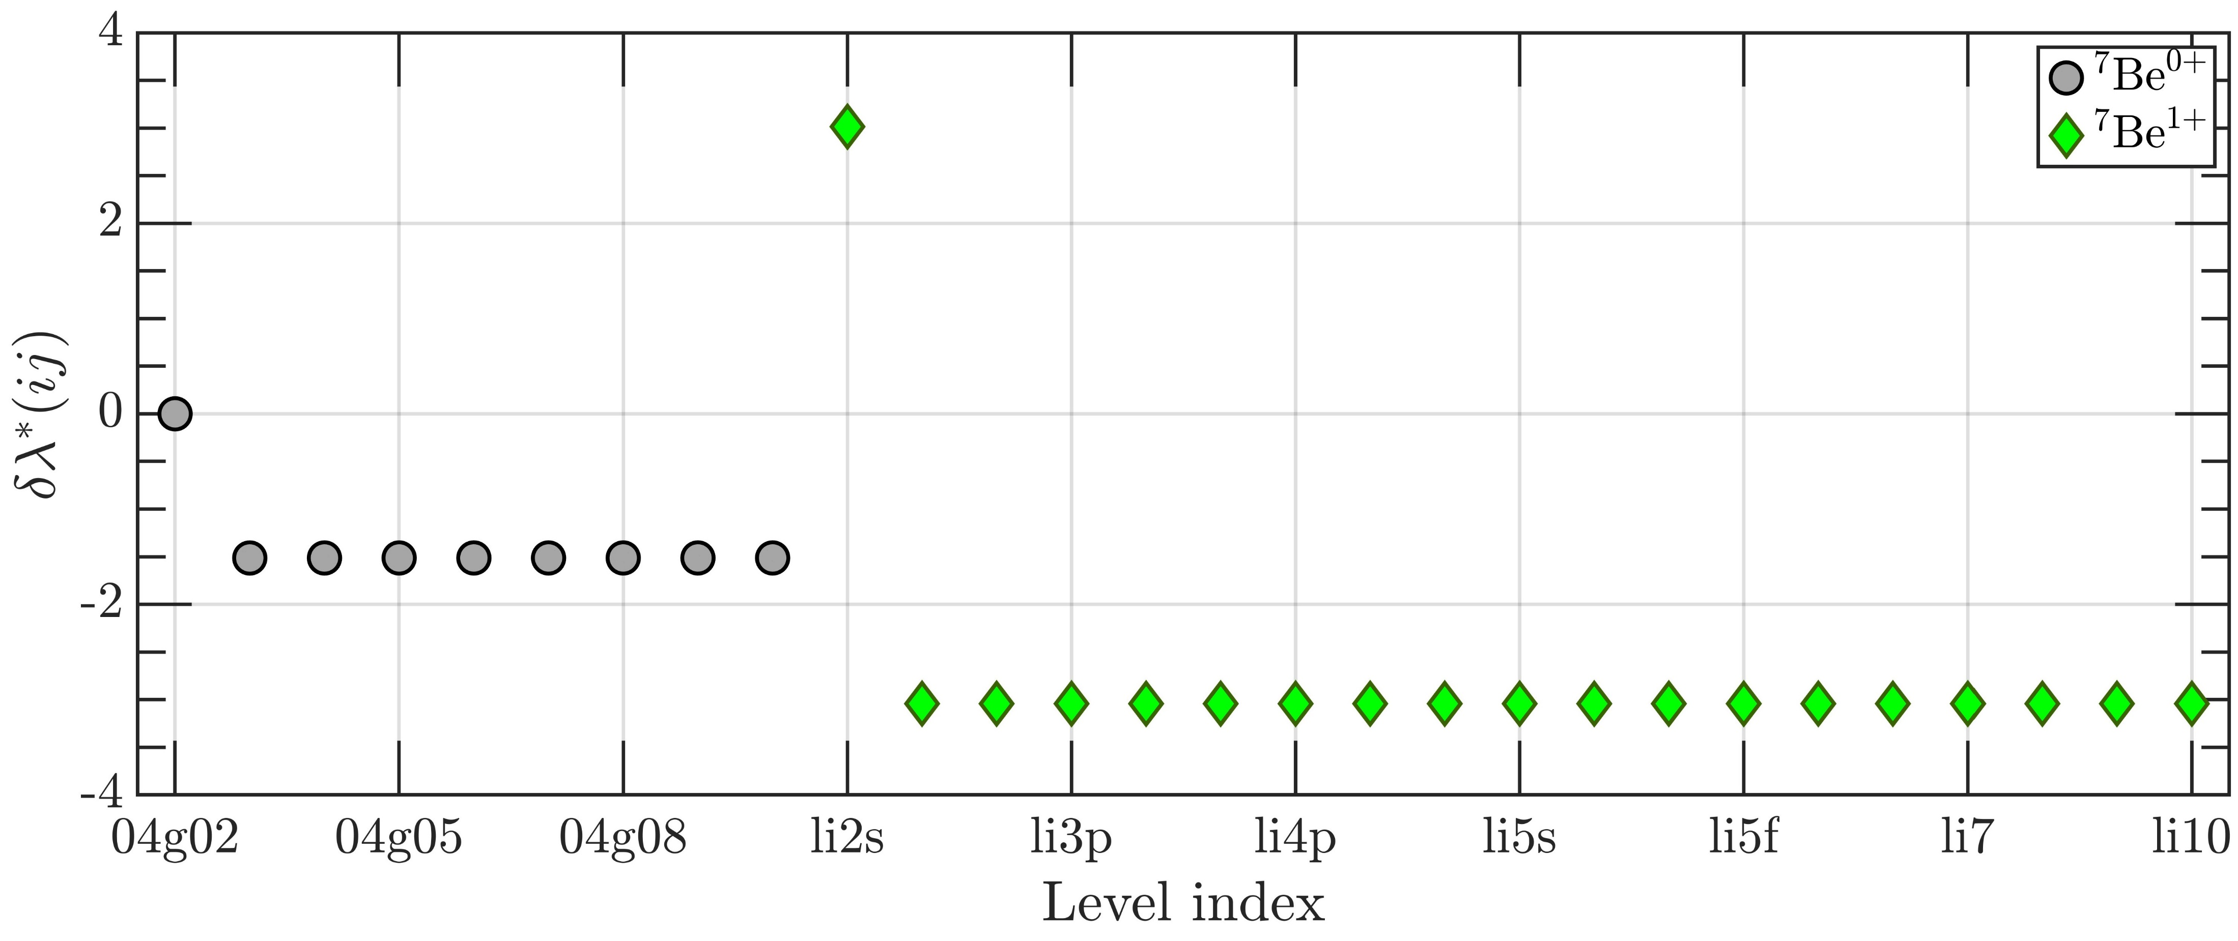
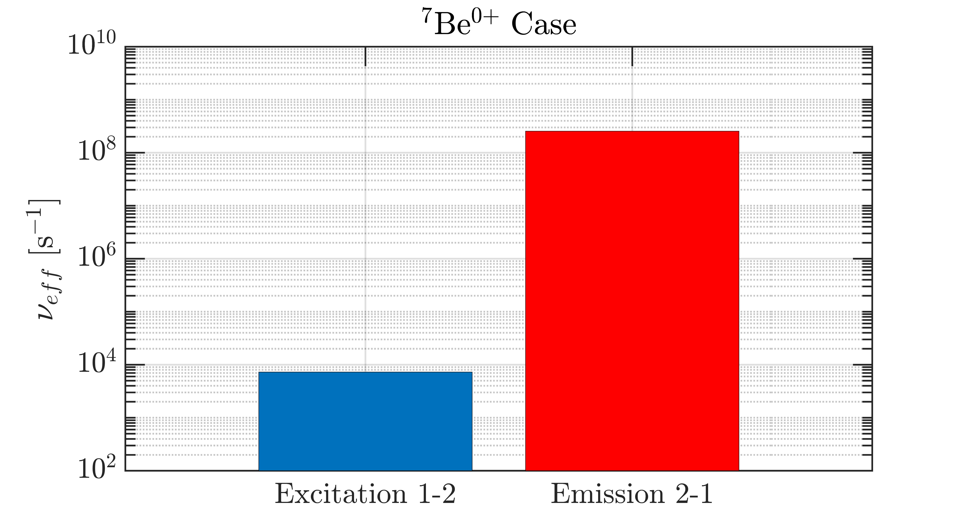
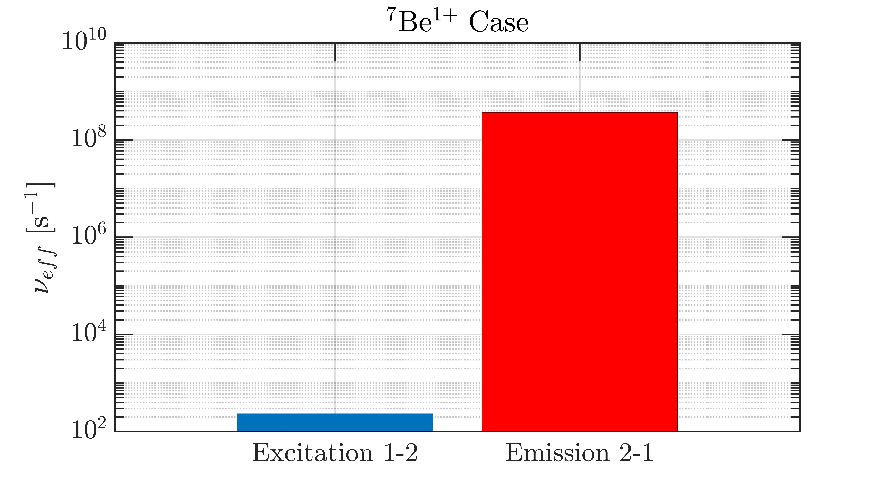
3rd PANDORA Progress Meeting – Legnaro – October 7-8, 2024
ECR Plasma Simulations: Radioisotopes
An attempt was made to verify whether the corona model can be applied to model LPD in ECR plasmas
F. Cittadini, Master Thesis
Electron impact collisional excitation rate
Superlevels
Spontaneous emission rate
Corona model NOT applicable. Each process needs to be balanced by its own inverse process
THEORY AND SIMULATIONS 1 – Gedankenexperiment for PANDORA – Plasma Modelling
B. Mishra and A. Pidatella – INFN - LNS

Slide 14
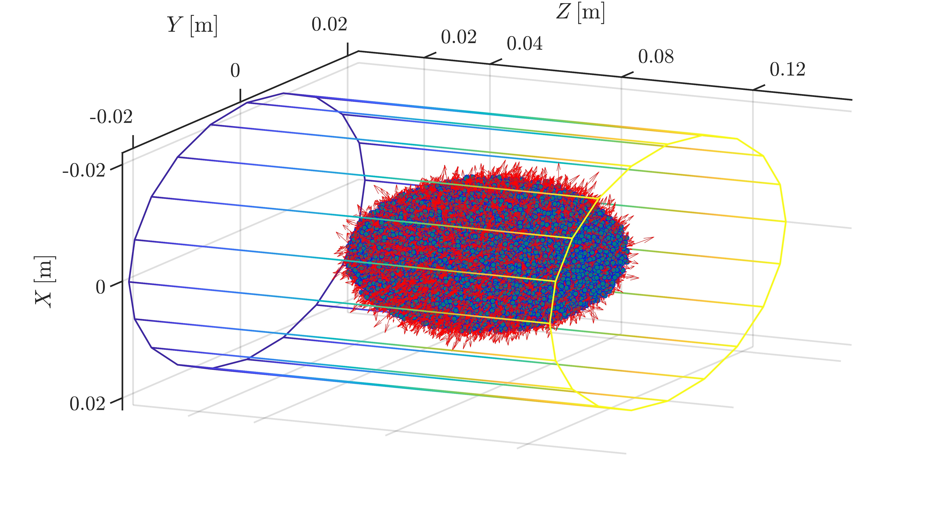
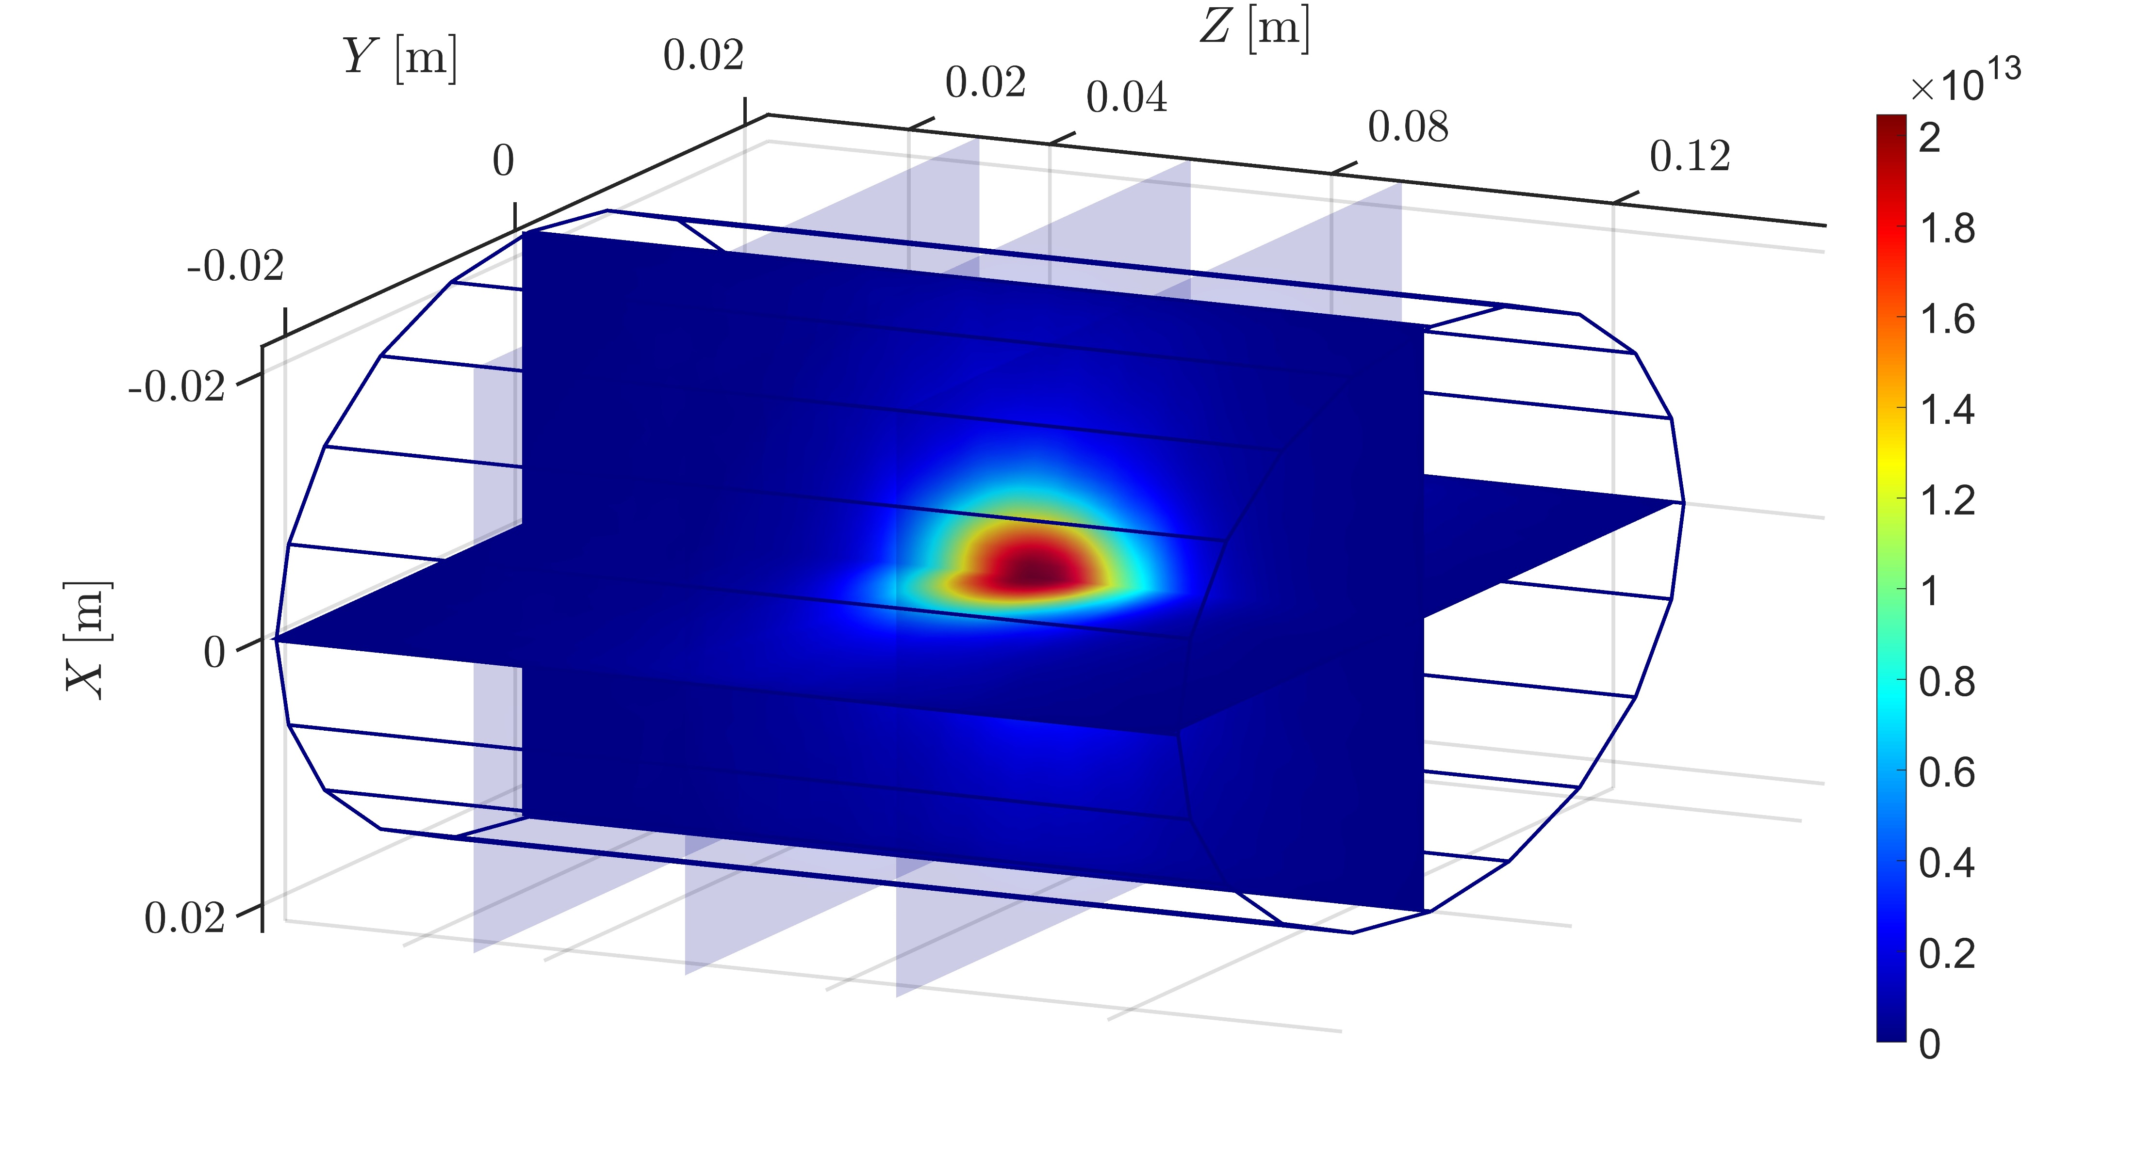
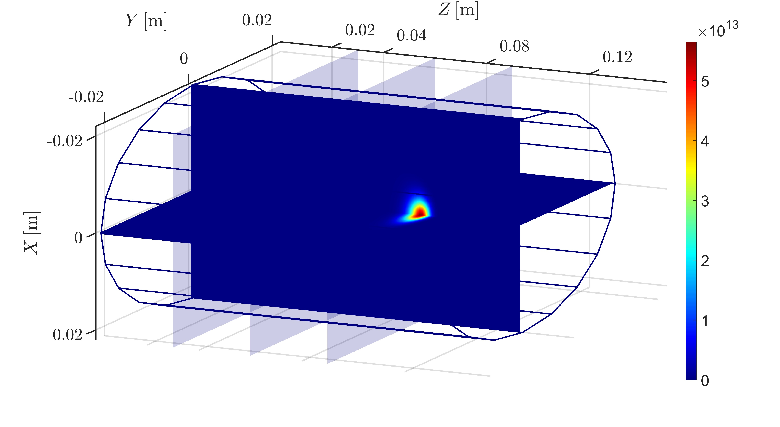
3rd PANDORA Progress Meeting – Legnaro – October 7-8, 2024
ECR Plasma Simulations: Radioisotope Results
The main results of the PIC-MC simulations are 3D steady-state maps of ion density, the CSD and the LPD. For now, all ions are taken to be in ground state, till collisional de-excitation is included in the atomic processes
First calculations show sharp contrasts in density distribution of ⁷Be⁰⁺ (left) and ⁷Be²⁺ (right) in the plasma, leading to very different CSD in different regions of the plasma
The initial distribution of ⁷Be⁰⁺ macroparticles was assumed to be a Gaussian plume (top right), just for sake of a gedankenexperiment.
The CSD and decay maps vary according to injection conditions
THEORY AND SIMULATIONS 1 – Gedankenexperiment for PANDORA – Plasma Modelling
B. Mishra and A. Pidatella – INFN - LNS

Slide 15
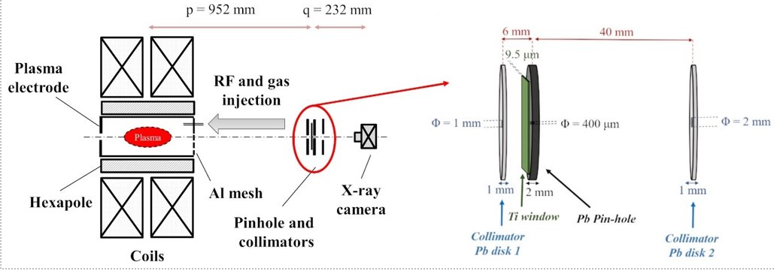
3rd PANDORA Progress Meeting – Legnaro – October 7-8, 2024
ECR Plasma Electrons Benchmark: Soft X-ray Spectroscopy
Plasma diagnostic technique developed by INFN – LNS, Catania and ATOMKI, Debrecen to study properties of warm/hot electrons in ECR plasma using volumetric and space-resolved soft X-ray spectroscopy (2 < E_{hν} < 30 keV)
R. Racz, D. Mascali et al , Plasma Sources Sci. Technol. 26, 075011 (2017)
D. Mascali et al, Rev. Sci. Instrum. 87, 02A510 (2016)
Volumetric X-ray emission from near-axis region, measured using SDD detector + collimator
Space-resolved X-ray emission from different plasma zones, measured using CCD camera + pinhole
THEORY AND SIMULATIONS 1 – Gedankenexperiment for PANDORA – Plasma Modelling
B. Mishra and A. Pidatella – INFN - LNS

Slide 16
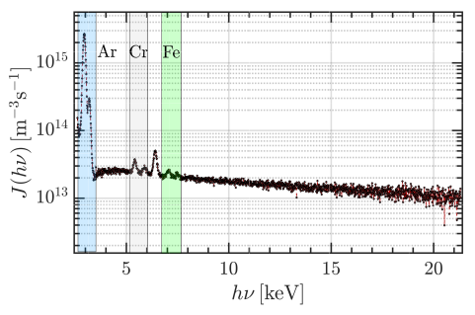
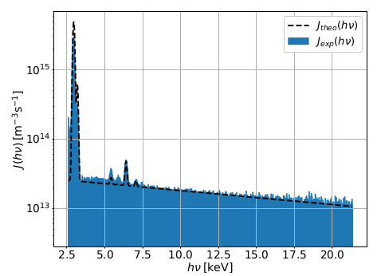
3rd PANDORA Progress Meeting – Legnaro – October 7-8, 2024
ECR Plasma Electrons Benchmark: Soft X-ray Spectroscopy
Raw data from SDD detector can be converted into X-ray emissivity density by calibration with Fe lines and correction for quantum efficiency and dead time
B. Mishra et al , Phys. Plasmas. 28, 102509 (2021)
B. Mishra et al, Cond. Matter (2021)
n_{e}n_{i} ~ 1.32x10³² m⁻⁶
expected n_{e} ~ 10¹⁶ m⁻³
k_{B}T_{e} ~ 21.15 keV
n_{e,loss} ~ 10¹² m⁻³
estimated j_{av} ~ 2-3 mA/cm²
EMISSIVITY MODEL REPRODUCES EXPECTED PLASMA PARAMETERS!
Plasma Emissivity Model
THEORY AND SIMULATIONS 1 – Gedankenexperiment for PANDORA – Plasma Modelling
B. Mishra and A. Pidatella – INFN - LNS

Slide 17
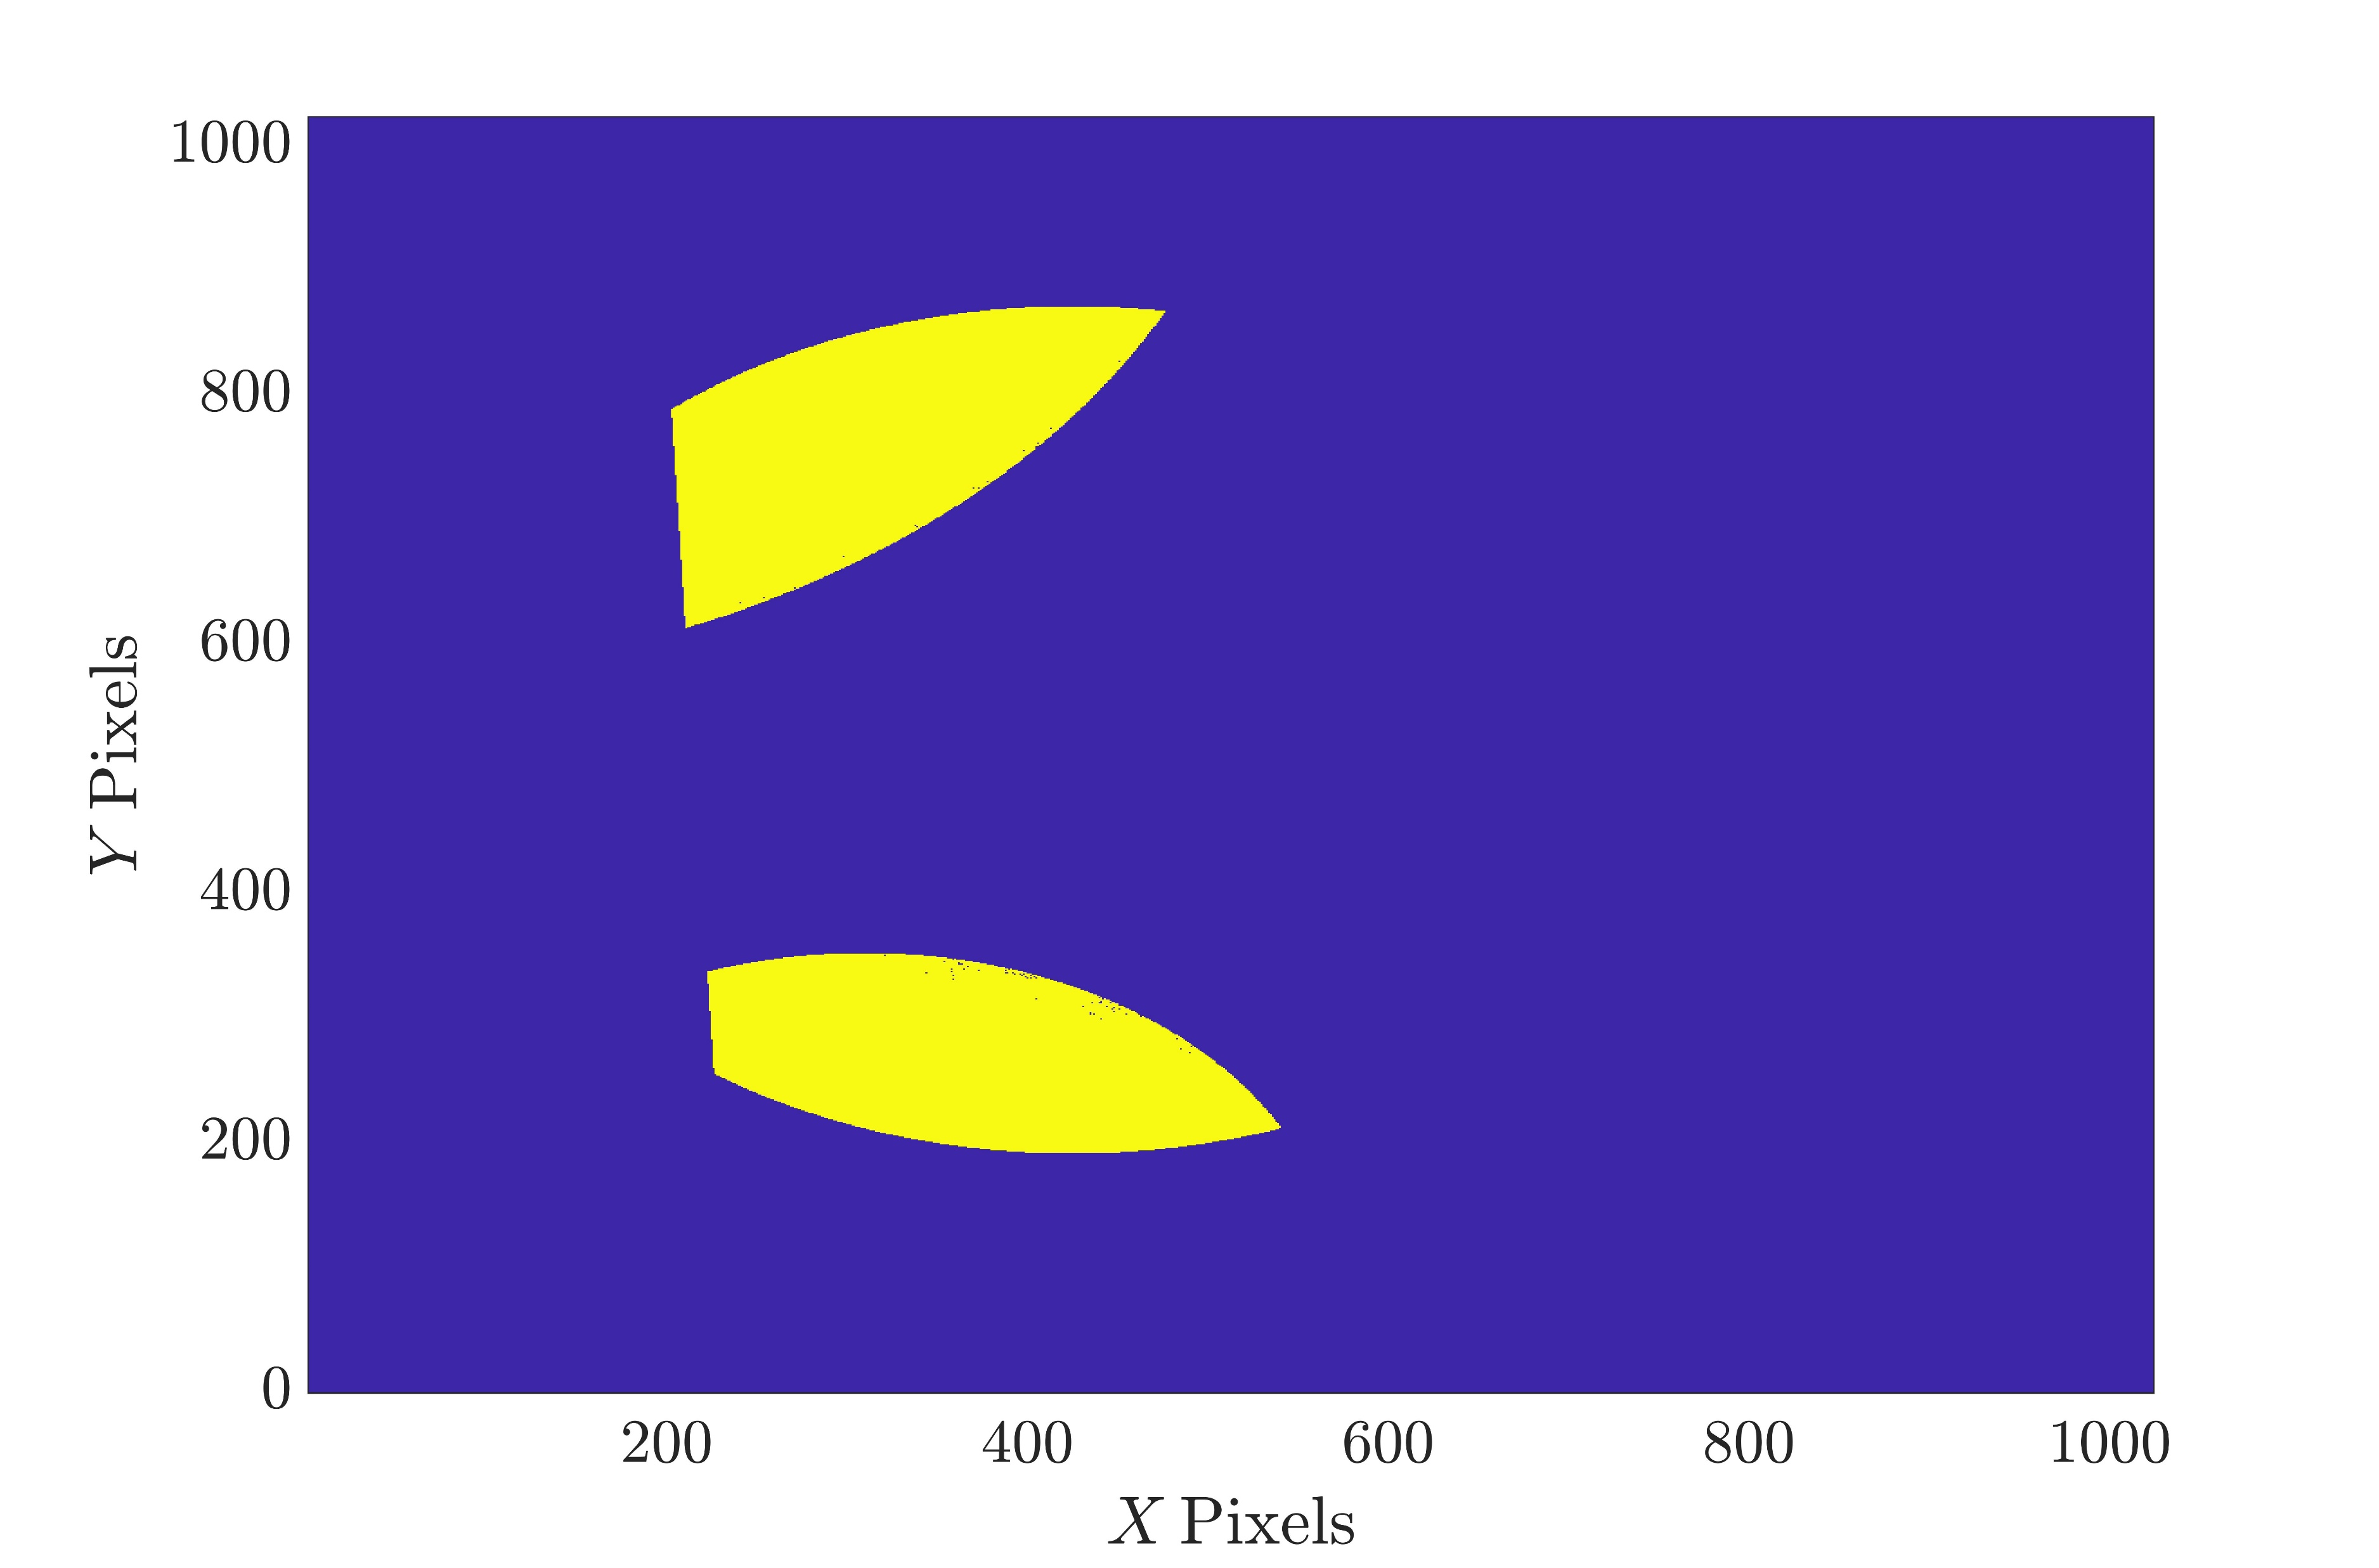
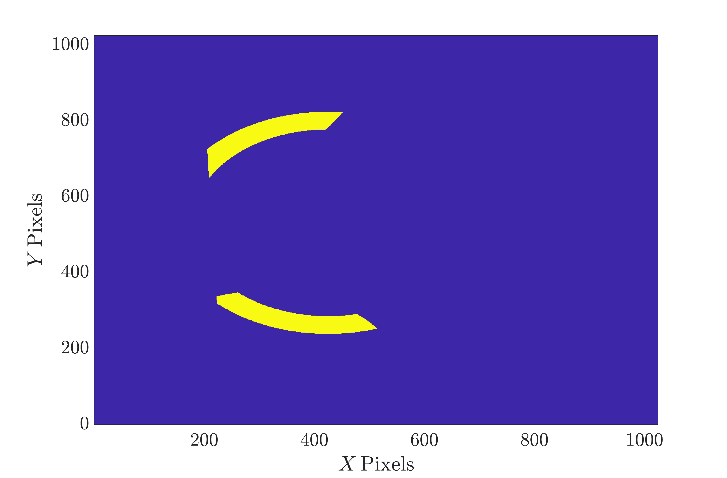
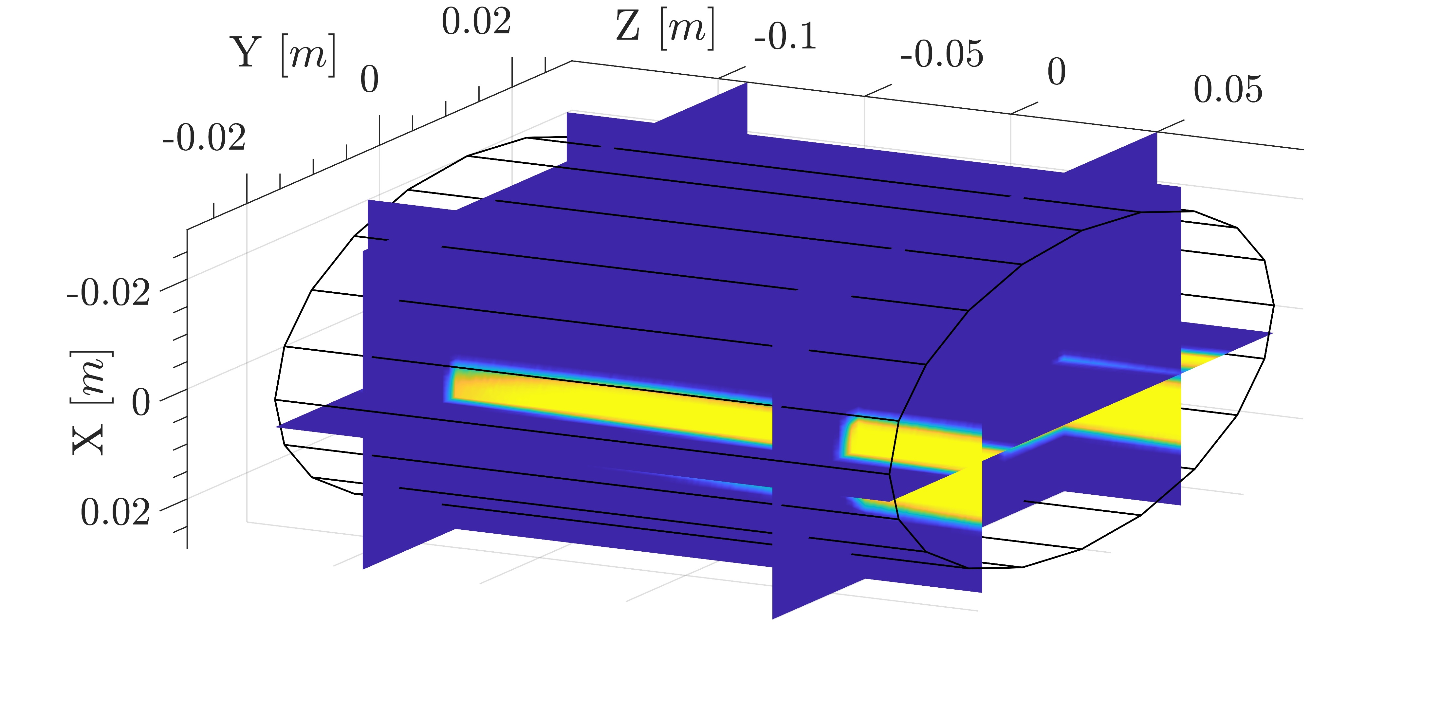
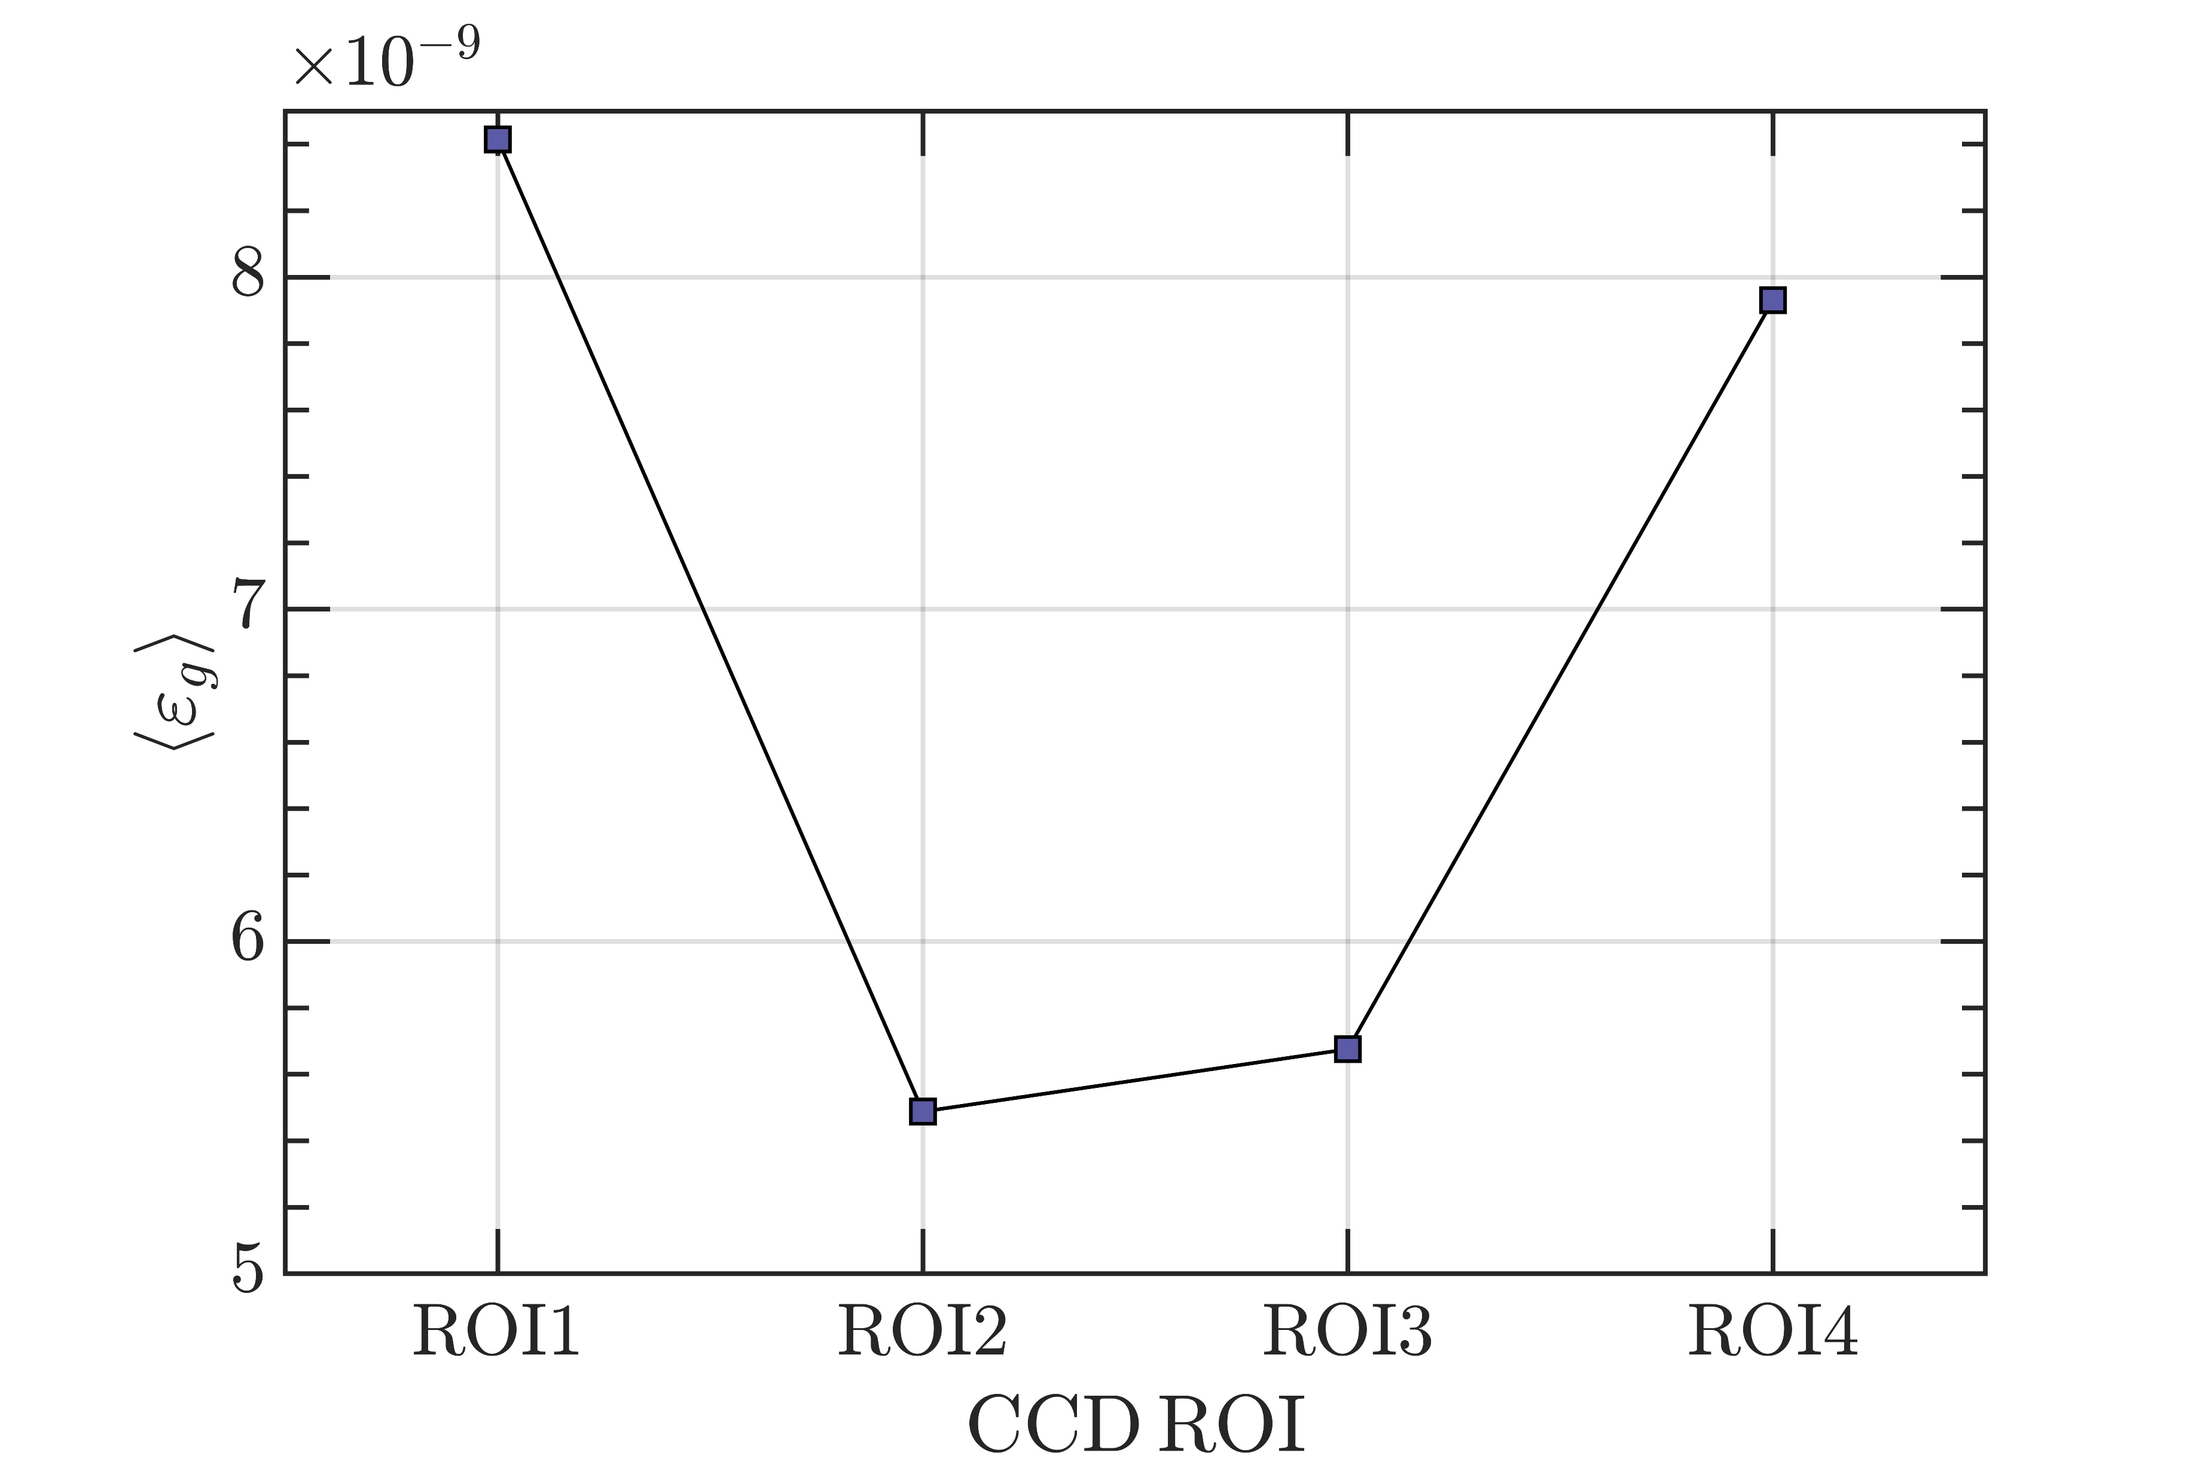
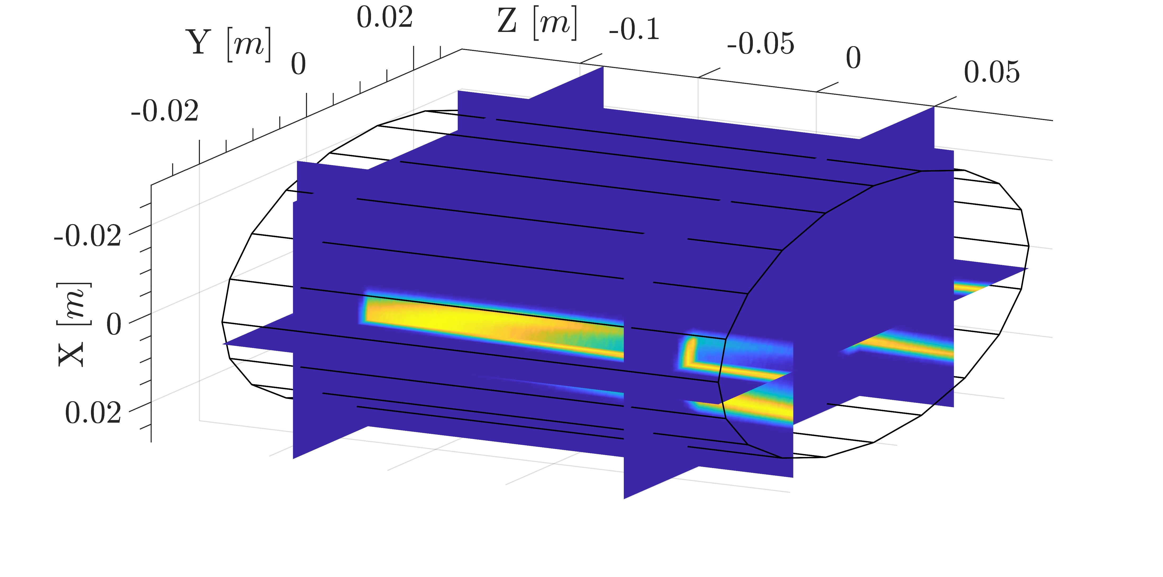
3rd PANDORA Progress Meeting – Legnaro – October 7-8, 2024
ECR Plasma Electrons Benchmark: Soft X-ray Spectroscopy
Groups of pixels (ROIs) can be selected on the CCD and raw binary data can be converted into soft X-ray spectrum using Single Photon Counting (SPhC) algorithm.
E. Naselli et al, Condens. Matter 7, 1 (2022)
G. Finocchiaro et al, Phys. Plasmas 31, 6 (2024)
X-Ray Emissivity Density
Soft X-ray spectrum can be converted into X-ray emissivity density J(hν) by calculating the emissivity volume V_{P} and geometrical efficiency Ω_{g}
Ray-tracing MC simulation
B. Mishra et al , Phys. Plasmas. (2021)
B. Mishra et al, Cond. Matter (2021)
Ray-tracing code evaluates the region of the plasma seen by CCD ROI
THEORY AND SIMULATIONS 1 – Gedankenexperiment for PANDORA – Plasma Modelling
B. Mishra and A. Pidatella – INFN - LNS

Slide 18
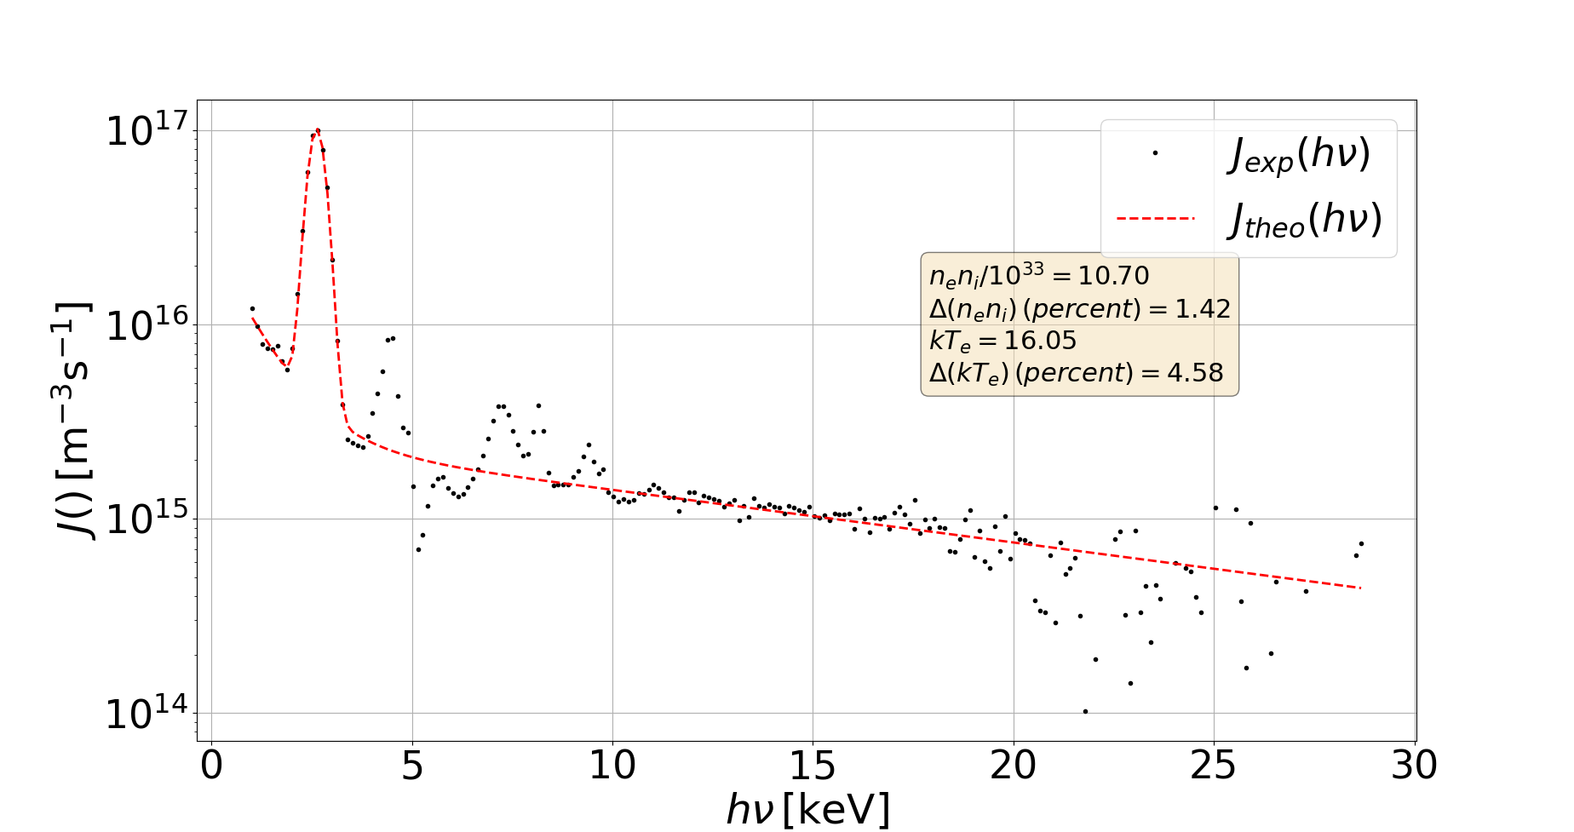
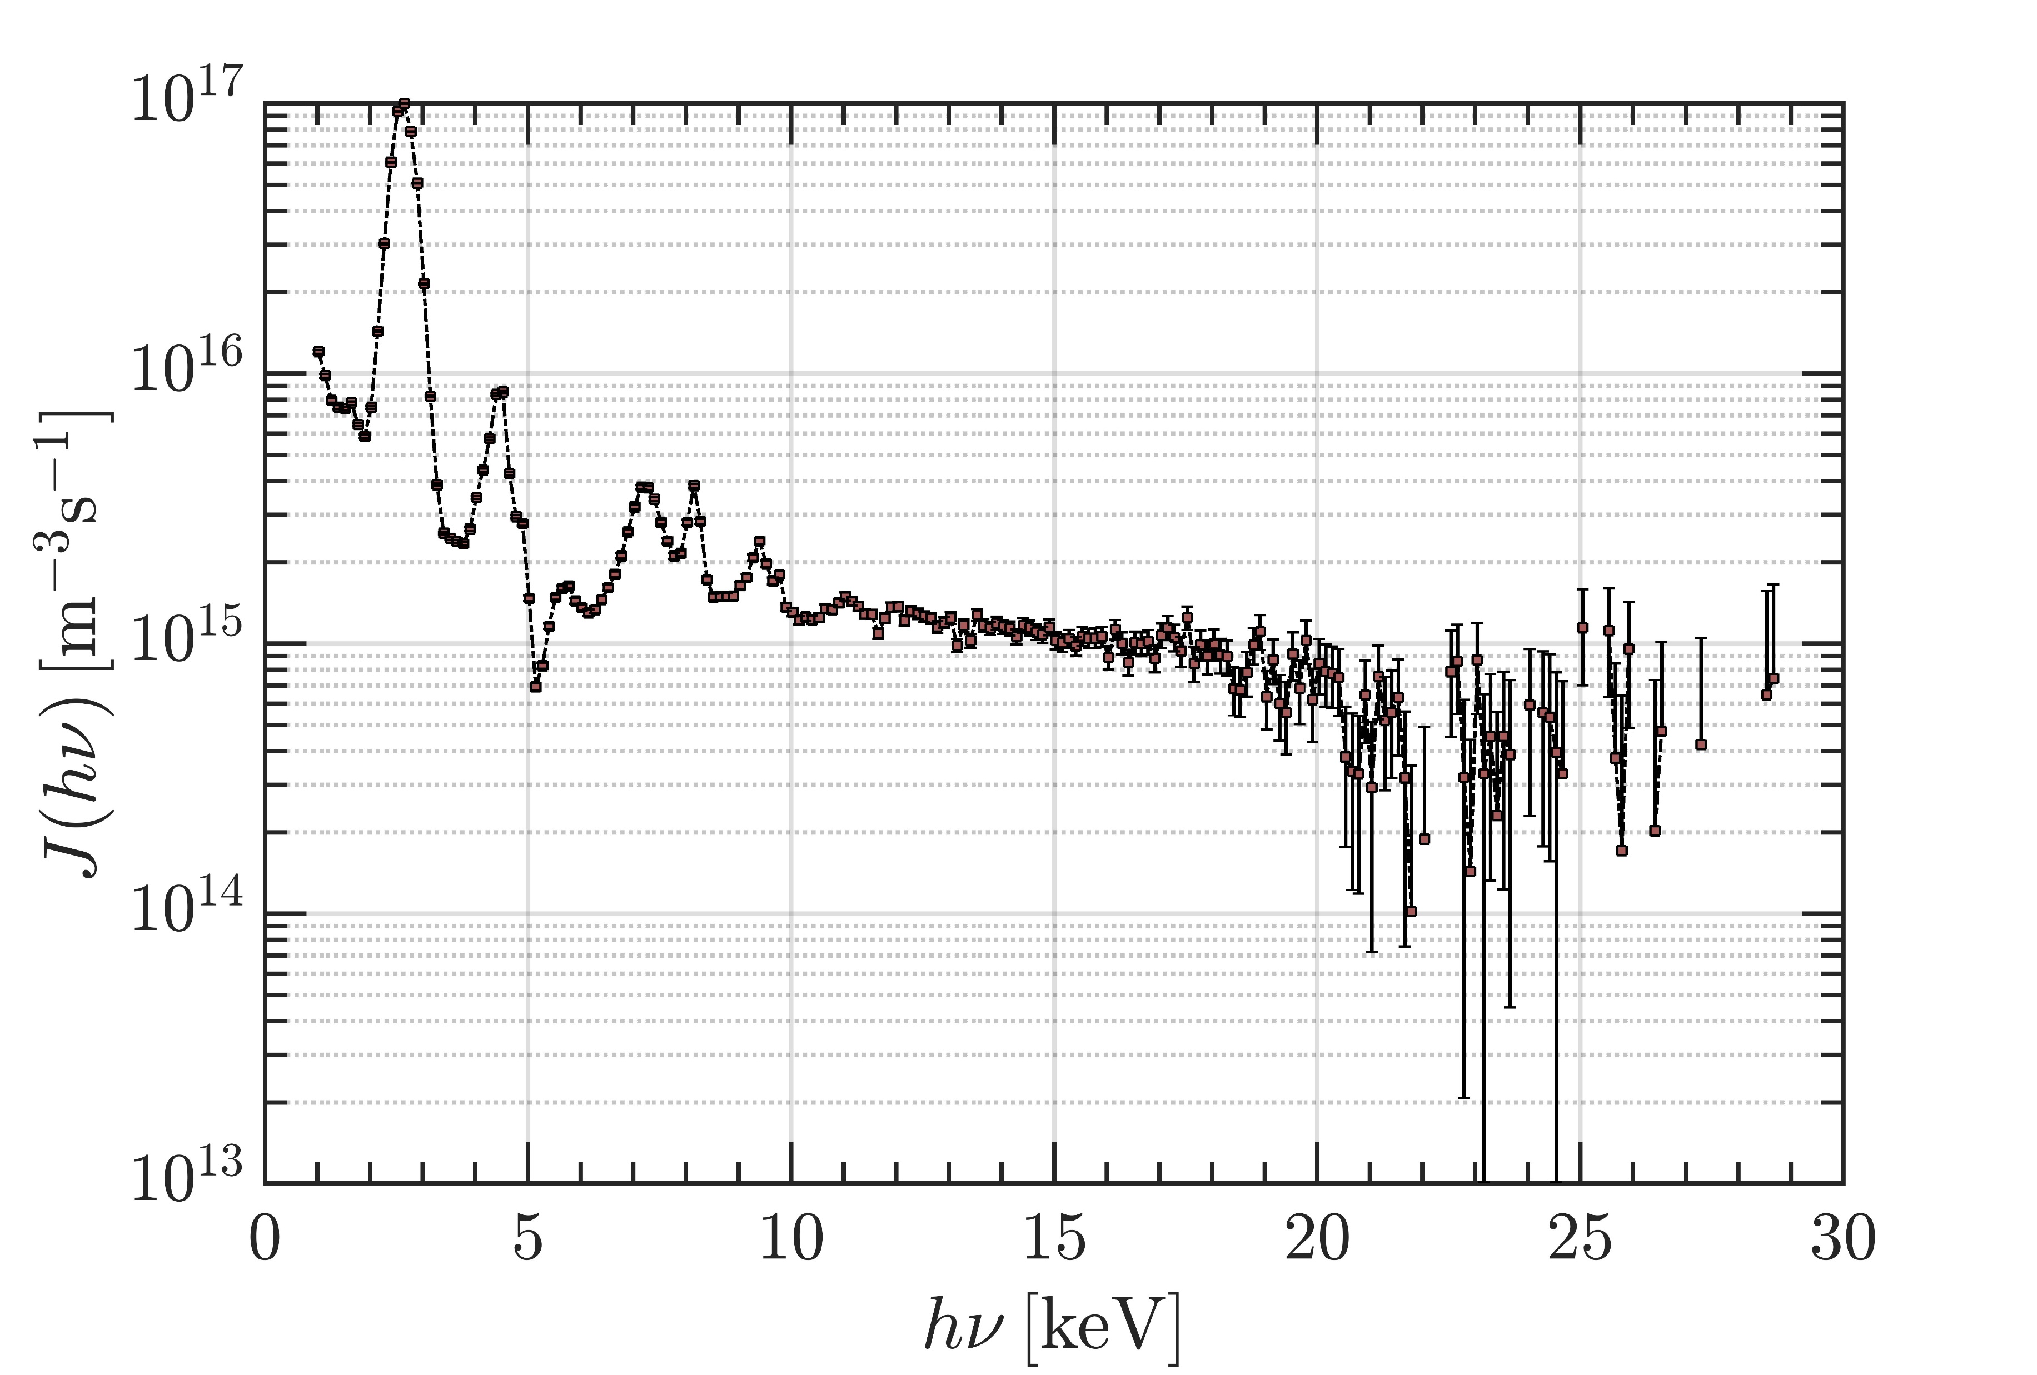
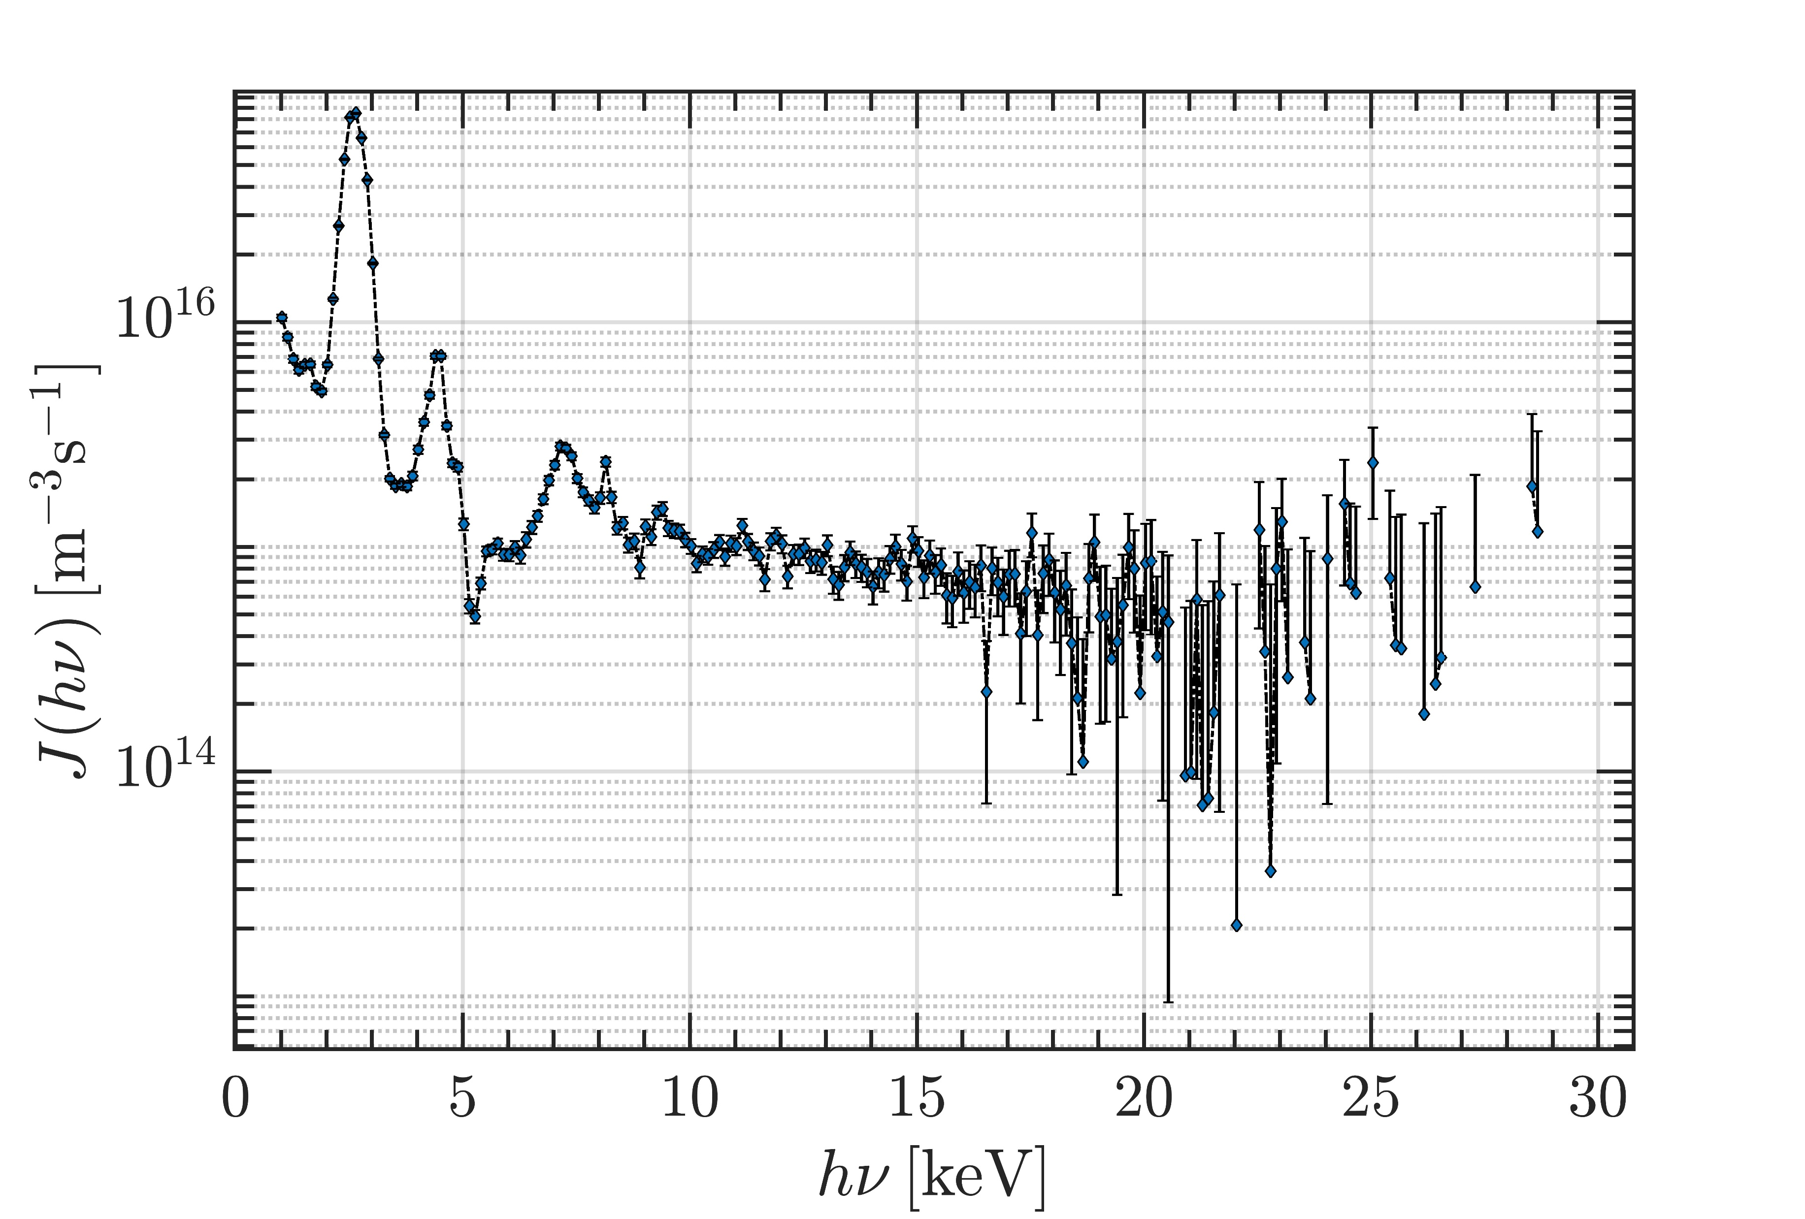
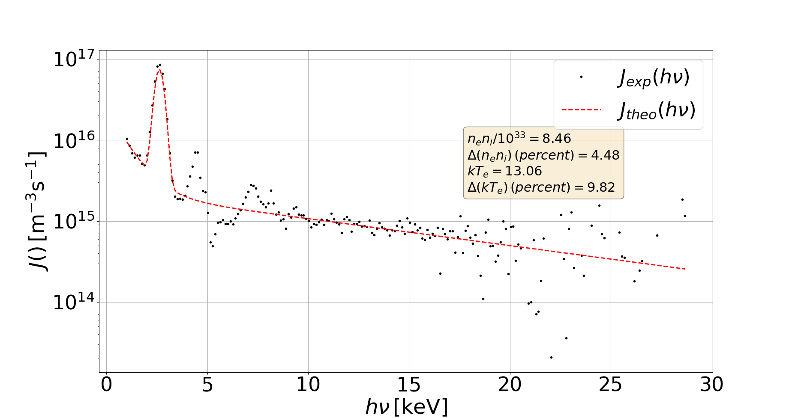
3rd PANDORA Progress Meeting – Legnaro – October 7-8, 2024
ECR Plasma Electrons Benchmark: Soft X-ray Spectroscopy
CCD ROIs
Warm electron n_{e} and kT_{e} can be extracted from the emissivity by performing an inverse σ-fit, neglecting spurious dips and Ti/Ta fluorescence peaks
X-Ray Emissivity Model
THEORY AND SIMULATIONS 1 – Gedankenexperiment for PANDORA – Plasma Modelling
B. Mishra and A. Pidatella – INFN - LNS

Slide 19
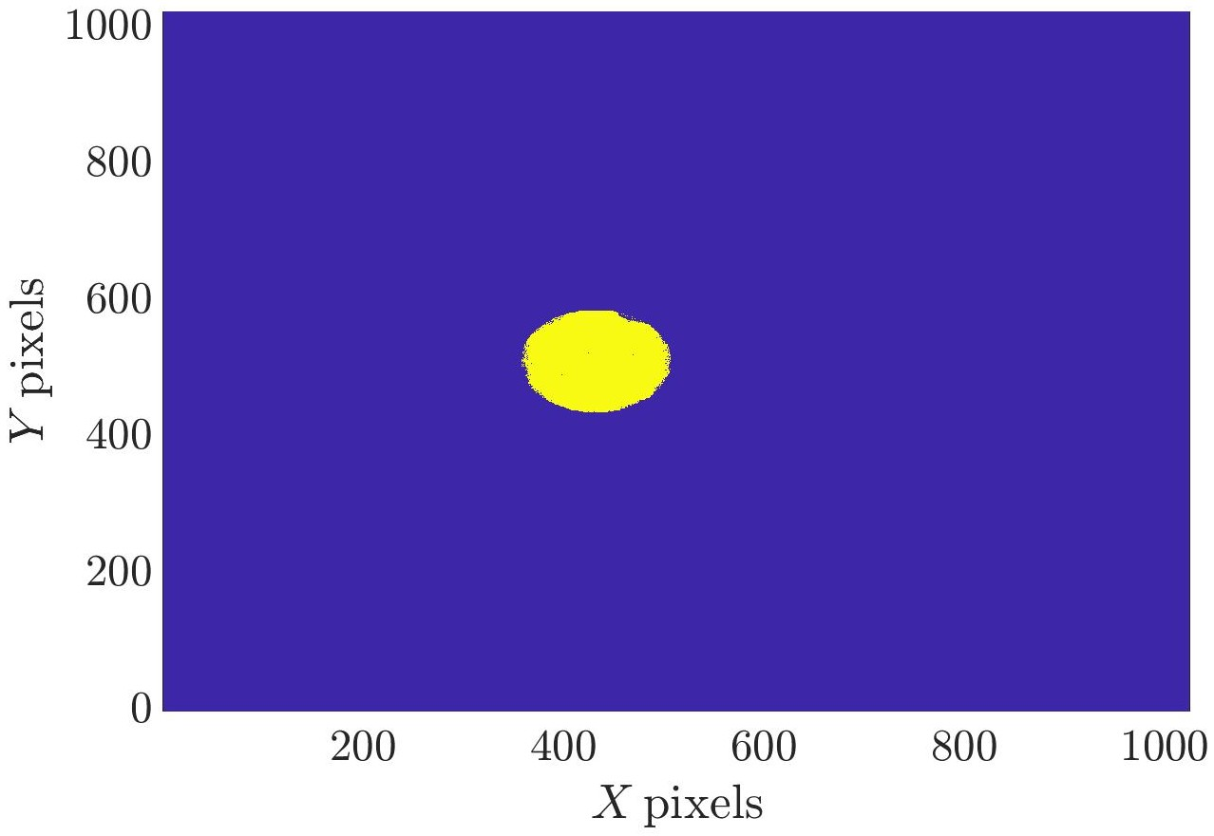
3rd PANDORA Progress Meeting – Legnaro – October 7-8, 2024
ECR Plasma Electrons Benchmark: Soft X-ray Spectroscopy
Extracting warm electron parameters from different plasma zones generates observables against which the PIC simulation results can be benchmarked
RESULTS MATCH WELL!
NEW TECHNIQUE WHICH MEASURES LOCAL DENSITY AND TEMPERATURE AND ALSO BENCHMARKS PIC SIMULATIONS.
THEORY AND SIMULATIONS 1 – Gedankenexperiment for PANDORA – Plasma Modelling
B. Mishra and A. Pidatella – INFN - LNS

Slide 20
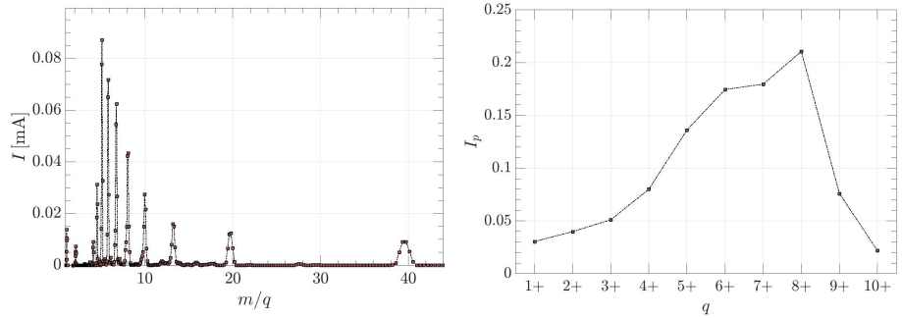
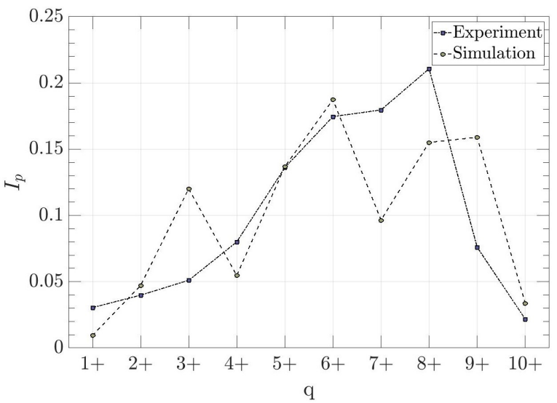
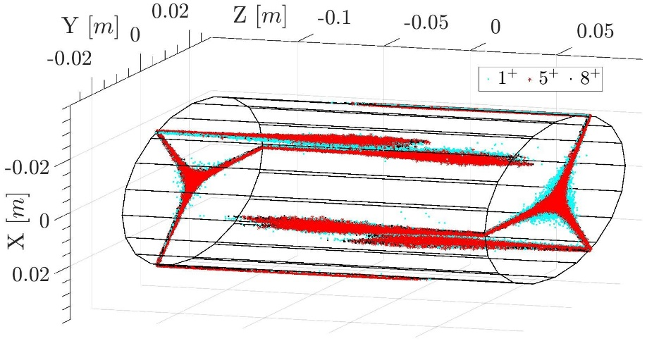
3rd PANDORA Progress Meeting – Legnaro – October 7-8, 2024
ECR Plasma Ion Benchmark: Ion Current Profile
The PIC-MC simulations can be benchmarked against certain observables from experiment for purposes of validation
Current profile in Faraday cup
Current recorded in the Faraday cup as a function of ion m/q ratio in A-HPC and corresponding current profile
MODEL PREDICTS CURRENT PROFILE QUITE SIMILAR TO MEASURED PROFILE!
ONE OF THE FEW COMPLETE AND SELF-CONSISTENT ECRIS MODELS
PIC-MC simulations also generate data on particles lost from the plasma domain, including walls, and extraction hole

Slide 21
3rd PANDORA Progress Meeting – Legnaro – October 7-8, 2024
Outline
Why model ECR plasmas?
Bridge the gap between stars and the lab
Test competing models of in-plasma decay rates
How can we study ECR plasmas?
Particle-in-Cell (PIC) codes for ECR plasma electrons
Particle-in-Cell Monte Carlo (PIC-MC) codes for ECR plasma ions
OBSERVABLES FOR MODEL VALIDATION
How do ECR plasmas affect β-decay rates?
PIC-MC codes for injected radio-isotopes
3D maps of decay rates in realistic ECR plasmas
Conclusions and Future Outlook for PANDORA
THEORY AND SIMULATIONS 1 – Gedankenexperiment for PANDORA – Plasma Modelling
B. Mishra and A. Pidatella – INFN - LNS

Slide 22
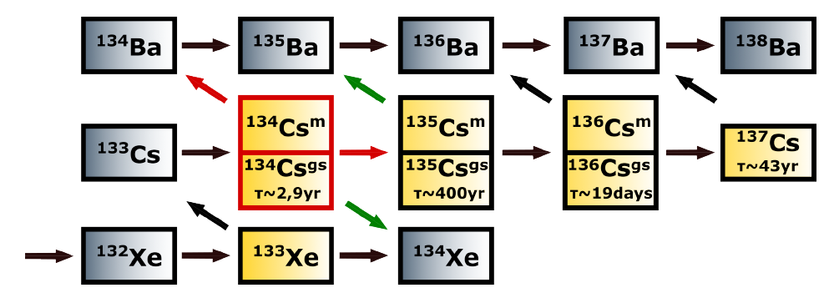
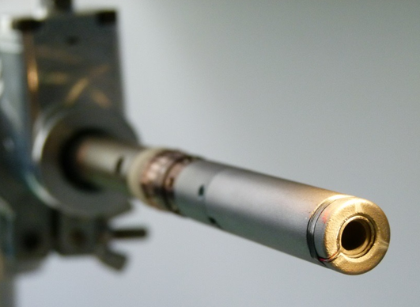
3rd PANDORA Progress Meeting – Legnaro – October 7-8, 2024
PIC-MC codes for injected radio-isotopes: evaporation dynamics of ¹³⁴Cs in the plasma
Focus: poisoning of γ-ray signal-to-background ratio at HpGe detection array from decaying ¹³⁴Cs neutrals deposited on chamber wall
Injection via resistively heated ovens for Cs (~420 K) - 1 ppm w.r.t. plasma ion density
Isotope | t_{1/2} [ yr ] | E_{γ} [ keV ]
¹⁷⁶Lu | 3.78 · 10¹⁰ | 202.88 & 306.78
¹³⁴Cs | 2.06 | 795.86
⁹⁴Nb | 2.03 · 10⁴ | 871.09
Expected measurement time for ¹³⁴Cs: 12 h
Expected quantity used: 5.5E-10 mg of ¹³⁴Cs
Study of metallic atoms diffusion, transport, and deposition in ECR plasma evidencing the plasma role on a space-dependent ionisation
Courtesy of F. Maimone and GSI colleagues
Reaction maps: self-consistent Particle-In-Cell PANDORA plasma simulation (EM field coupled to particle motion in trap) providing 3D plasma electron/ion density and energy maps
Mishra, B., et al., Front. in Physics, 10, 932448, (2022)
Galatà, A., et al., Front. in Physics, 10, 947194, (2022)
Pidatella, A. et al., Plasma Phys. Control. Fusion 66 (3), 035016 (2024)
THEORY AND SIMULATIONS 1 – Gedankenexperiment for PANDORA – Plasma Modelling
B. Mishra and A. Pidatella – INFN - LNS

Slide 23
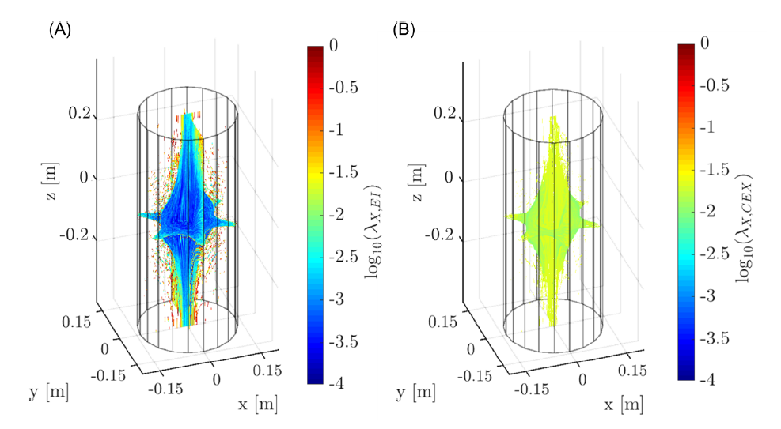
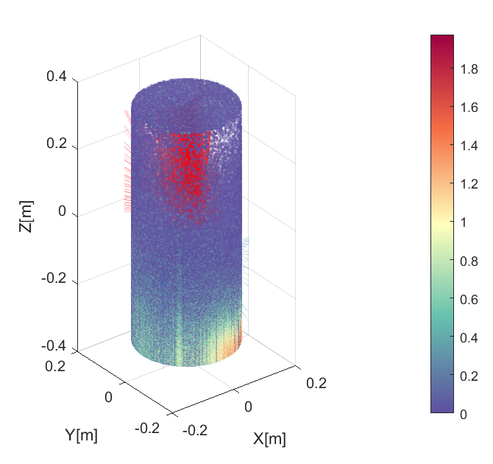
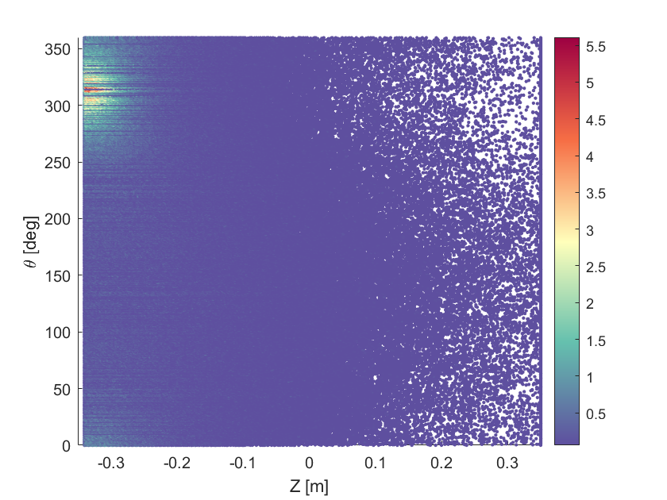
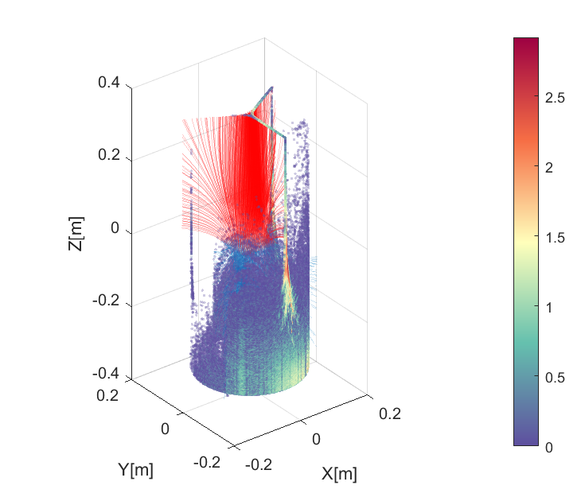
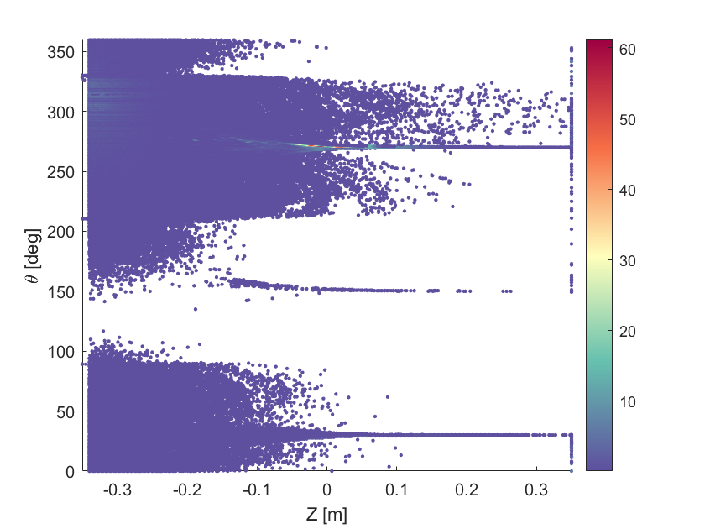
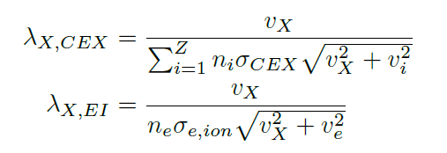
3rd PANDORA Progress Meeting – Legnaro – October 7-8, 2024
PIC-MC codes for injected radio-isotopes: evaporation dynamics of ¹³⁴Cs in the plasma
D = 280 mm
Max. deposition ~ oven location
NO PLASMA
Deposited: 100 %
L = 700 mm
log10(deposited)
EI/CEX mean-free path
WITH PLASMA
Oven: non-axisymmetric and tilted towards chamber center
Cross-section for electron impact (EI) and charge-exchange (CEX) ionisation only 0⁺->1⁺
Lotz, W., Zeitschrift fur Physik 216, pp. 241–247, (1968).
Deposited: 78 %
Reacting: 47 %
Simulation features:
N. particles: 10⁶, T_{sim} = 3e-3 s, δt = 1e-8 s
Müller, A. et al., Phys. Lett. A, 62A:391-4, (1977).
THEORY AND SIMULATIONS 1 – Gedankenexperiment for PANDORA – Plasma Modelling
B. Mishra and A. Pidatella – INFN - LNS

Slide 24
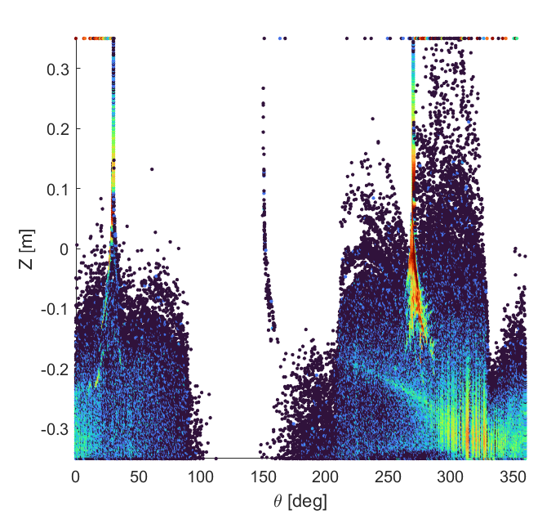
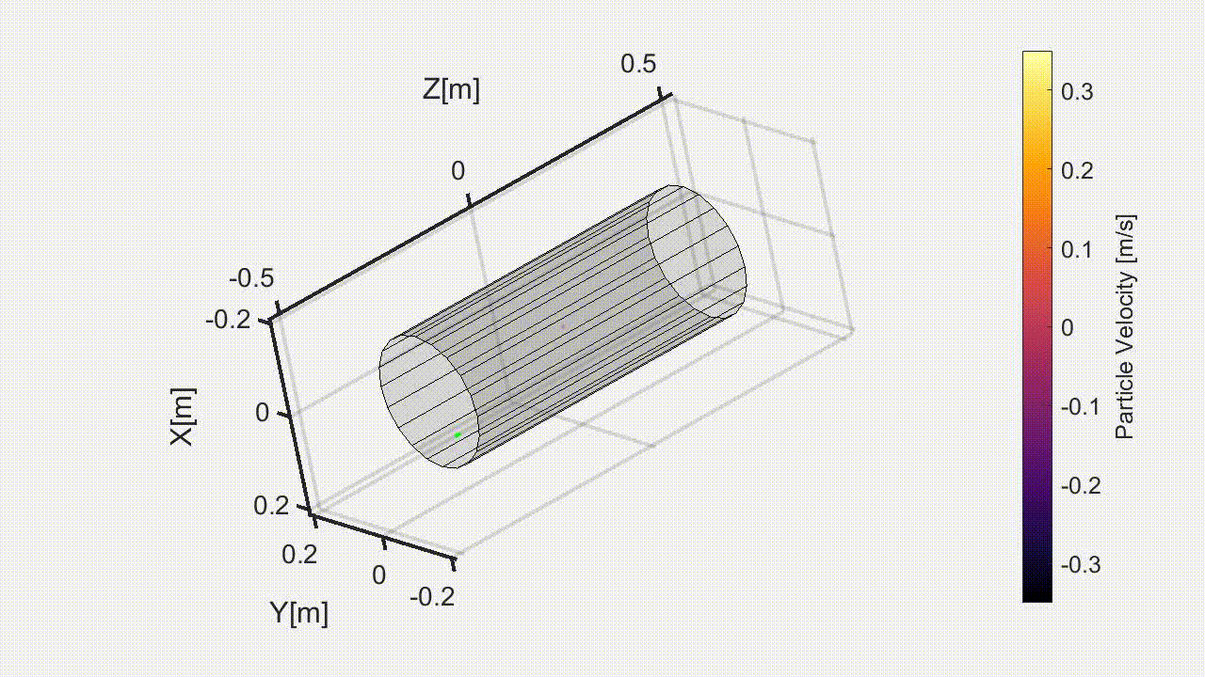
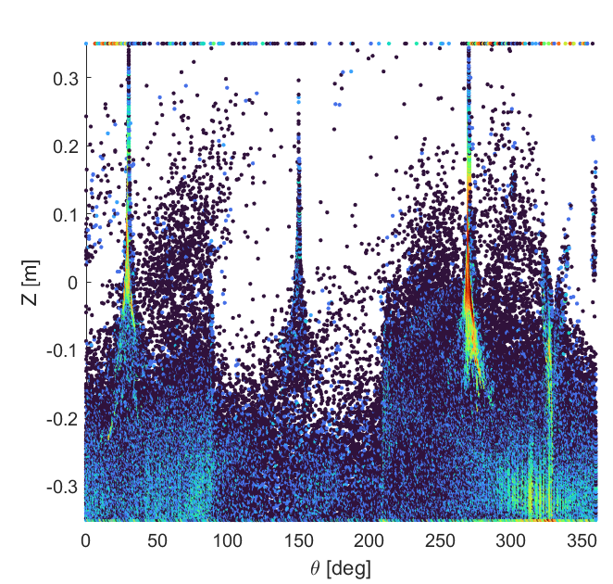
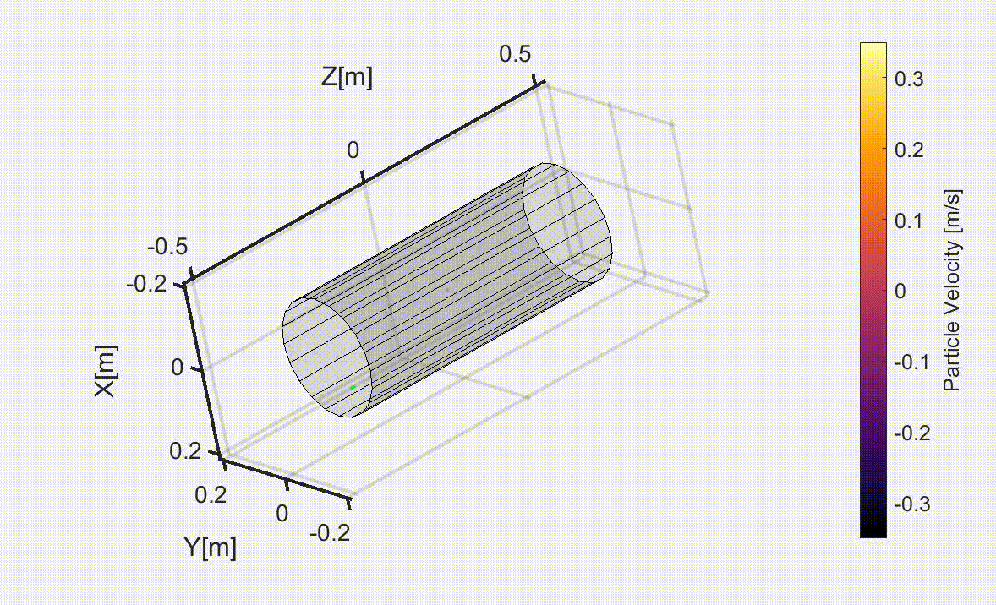
3rd PANDORA Progress Meeting – Legnaro – October 7-8, 2024
PIC-MC codes for injected radio-isotopes: evaporation dynamics of ¹³⁴Cs in the plasma
¹³⁴Cs diffusion & transport– no hot screen
MAIN RESULT: γ signal arising from deposited short lived β-decaying Cs isotopes at the trap’s wall is negligible along the detection sight-lines
¹³⁴Cs – diffusion & transport with hot screen (870 K)
About the impact on the gamma detection see talk by D. Santonocito
N° Ionisations 10² higher than no hot screen case
THEORY AND SIMULATIONS 1 – Gedankenexperiment for PANDORA – Plasma Modelling
B. Mishra and A. Pidatella – INFN - LNS

Slide 25
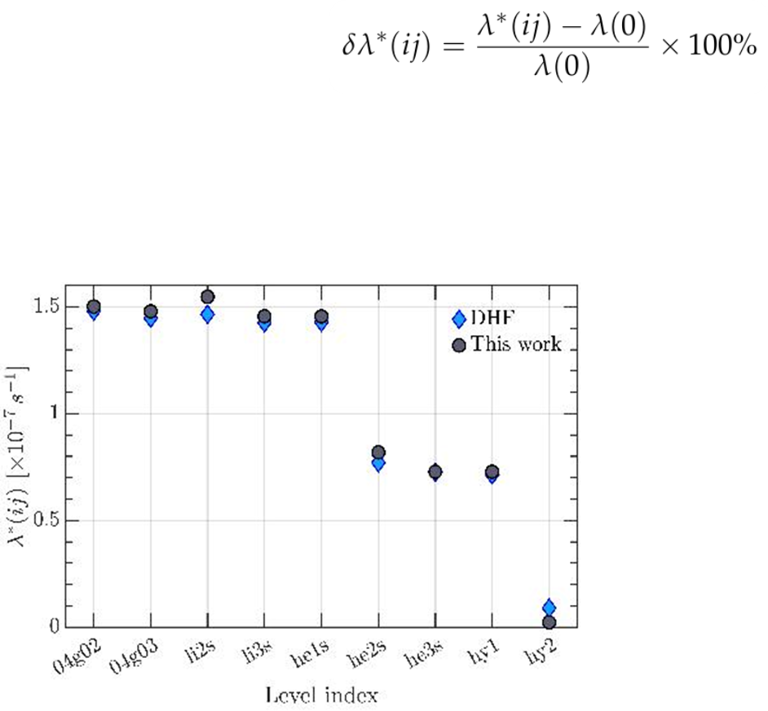
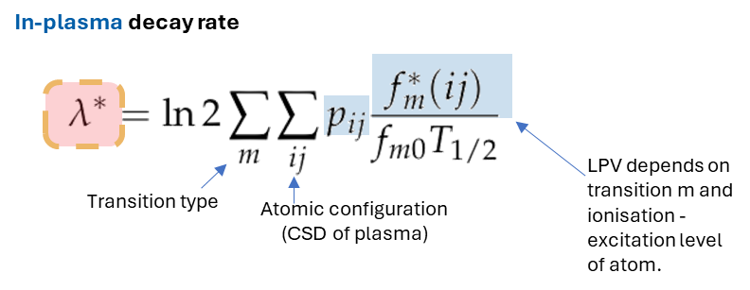
3rd PANDORA Progress Meeting – Legnaro – October 7-8, 2024
3D maps of decay rates in realistic ECR plasmas: ⁷Be case
About the nuclear decay in plasma theory see talk by B. Mishra
Mishra, B, Pidatella, A. et al., arXiv:2407.01787 , https://doi.org/10.48550/arXiv.2407.01787
THEORY AND SIMULATIONS 1 – Gedankenexperiment for PANDORA – Plasma Modelling
B. Mishra and A. Pidatella – INFN - LNS

Slide 26
3rd PANDORA Progress Meeting – Legnaro – October 7-8, 2024
3D maps of decay rates in realistic ECR plasmas: ⁷Be case
PIC simulations of reacting ⁷Be ions in ECR plasma:
Description: Steady-state maps of plasma electrons and ions +Balance equation (EI + CEX) + W.I.P. : atomic excitations (electron collisional (de)excitation)
Self-consistency: Electron/ion density and energy maps
Scaling: Fraction of buffer ion density
PIC-MC simulated 3D ⁷Be CSD and E.C. half-life in ECR plasma
Mishra, B, Pidatella, A. et al., arXiv:2407.01787 , https://doi.org/10.48550/arXiv.2407.01787
MODEL GENERATES 3D E.C. DECAY RATES IN ECR PLASMA!
THEORY AND SIMULATIONS 1 – Gedankenexperiment for PANDORA – Plasma Modelling
B. Mishra and A. Pidatella – INFN - LNS

Slide 27
3rd PANDORA Progress Meeting – Legnaro – October 7-8, 2024
3D maps of decay rates in realistic ECR plasmas: ⁷Be case
Impact of different isotope injection conditions and atomic excitation
⁷Be– starting normal distribution
⁷Be– starting injection of 1+ beam
⁷Be– in-plasma half-life only GS
⁷Be– in-plasma half-life only GS (up 2⁺)
⁷Be– in-plasma half-life with 1st ES (up 2⁺)
THEORY AND SIMULATIONS 1 – Gedankenexperiment for PANDORA – Plasma Modelling
B. Mishra and A. Pidatella – INFN - LNS

Slide 28
3rd PANDORA Progress Meeting – Legnaro – October 7-8, 2024
Outline
Why model ECR plasmas?
Bridge the gap between stars and the lab
Test competing models of in-plasma decay rates
How can we study ECR plasmas?
Particle-in-Cell (PIC) codes for ECR plasma electrons
Particle-in-Cell Monte Carlo (PIC-MC) codes for ECR plasma ions
OBSERVABLES FOR MODEL VALIDATION
How do ECR plasmas affect β-decay rates?
PIC-MC codes for injected radio-isotopes
3D maps of decay rates in realistic ECR plasmas
Conclusions and Future Outlook for PANDORA
THEORY AND SIMULATIONS 1 – Gedankenexperiment for PANDORA – Plasma Modelling
B. Mishra and A. Pidatella – INFN - LNS

Slide 29
3rd PANDORA Progress Meeting – Legnaro – October 7-8, 2024
Conclusions and Future Outlook for PANDORA
In-plasma decay rate study NEEDS to disentangle PLASMA from NUCLEAR contributions
PLASMA MODELLING UPGRADE
CR model in PIC-MC code: LPD including inverse atomic processes
RT solver
GENERATING NUCLEAR DECAY OBSERVABLES to BENCHMARK NUMERICAL PREDICTIONS
GSI: experimental proposal (2026-27) to study different ¹³⁴Cs singly-charged/bare isotopes decay in storage rings to validate generalized TY theory, bound-state vs. continuum predictions
ERNA: ⁷Be³⁺ and bare activation measurements (2025)
THEORY
EXPERIMENTS
EXPERIMENTS
THEORY
GENERATING NEW PLASMA OBSERVABLES to BENCHMARK NUMERICAL PREDICTIONS
ATOMKI: experimental campaign (2024) to study plasma instability, gas dynamics, electric field and CSD distribution
NUCLEAR MODELLING UPGRADE
Ab-initio DHF models to constrain the electronic contribution
Shell model calculations to constrain the nuclear contribution
THEORY AND SIMULATIONS 1 – Gedankenexperiment for PANDORA – Plasma Modelling
B. Mishra and A. Pidatella – INFN - LNS

Slide 30
3rd PANDORA Progress Meeting – Legnaro – October 7-8, 2024
Next steps…
Observables: Electron simulations
Investigate possibility to perform plasma tomography with space-resolved spectroscopy
Include recombination spectrum into plasma emissivity model
Fit spectra from mixture of gases to extract n_{e} and kT_{e} independently of ion density (ATOMKI campaign)
Observables: Ion simulations
Model optical emission spectra through radiation transport
New method to evaluate current extracted from plasma and comparison with Faraday cup measurements
Possibility to study measure profile and magnitude of double layer electric field (ATOMKI campaign)
THEORY AND SIMULATIONS 1 – Gedankenexperiment for PANDORA – Plasma Modelling
B. Mishra and A. Pidatella – INFN - LNS

Slide 31
3rd PANDORA Progress Meeting – Legnaro – October 7-8, 2024
3rd PANDORA Progress Meeting – Legnaro – October 7-8, 2024
Additional Slides...
ECR plasma ions can be simulated PIC-MC codes, which evolve the density maps of successive ionization stages self-consistently with electron density and energy maps given as input
B. Mishra et al, Front. Phys. 10, 932448 (2022)
B. Mishra, EPJ WoC 275, 02001 (2023)
BUFFER IONS BALANCE EQUATION:
Stationary electron density and energy maps
1⁺ PIC loop
Neutrals’ map
Stationary electron density and energy maps
1⁺ occupation map n₁
Electrostatic field map from 1⁺
2⁺ PIC loop
Neutrals’ map
Stationary electron density and energy maps
3⁺ PIC loop
1⁺ occupation map n₁
2⁺ occupation map n₂
Electrostatic field map from 1⁺ and 2⁺
Neutrals’ map
Till convergence...

Slide 32
3rd PANDORA Progress Meeting – Legnaro – October 7-8, 2024
Additional Slides...
Ion Transport
Being charged particles, ions in an ECR plasma move under the influence of EM fields (self-generated and external) and undergo collisions with other plasma species
EM transport
Collisions
Numerical implementation of Fokker-Planck equation using superpotential formalism by MacDonald and Rosenbluth
W.M. MacDonald, M.N. Rosenluth and W. Chuck, Phys. Plasmas 107, 350 (1957)
A. Galatà et al, Plasma Sources Sci. Technol. 25 (2016)
Magnetostatic field profile in A-HPC ECRIS
Numerical implementation of Lorentz force using Boris method, with correction by Zenitani and Umeda
J.P. Boris, Proc. 4th Naval Conf. on Numerical Simulation of Plasmas
S. Zenitani and T. Umeda, Phys. Plasmas 25 (2018)
Equation of motion for charged particles under Lorentz force

Slide 33
3rd PANDORA Progress Meeting – Legnaro – October 7-8, 2024
Additional Slides...
MC Sampling
Ions in a plasma can interact with each other and electrons to undergo competing reactions.
Ion transport occurs simultaneously with reactions, which can be sampled using MC methods
The plots comparing the frequencies of the various processes offer insight into the dynamics of atomic processes as a function of ionisation stage.
Under conditions of perfect confinement, the simulated EI and CEX coefficients would resemble these plots
Comparison between EI and CEX frequencies in A-HPC with argon (top) and LEGIS with oxygen (bottom)
Electron impact ionization (EI)
Ion impact charge exchange (CEX)

Slide 34
3rd PANDORA Progress Meeting – Legnaro – October 7-8, 2024
Additional Slides...
Density Scaling and CSD
The results of ion transport + MC sampling are 3D accumulation maps which denote relative particle occupation in each simulation cell, and transfer coefficient which weigh the accumulation maps according to EI and CEX reactions.
The accumulation maps can be scaled by considering global charge neutrality with electrons
Example: After simulating first 3 charge states…
Scaling the density also helps evaluating self-consistently the electrostatic double layer field
D. Mascali et al, Rev. Sci. Instrum. 83 (2012)
K. Takahashi, T. Kaneko and R. Hatakeyama, Phys. Plasmas 15 (2008)
Transfer coefficients
Scaling coefficient
Iterative evolution of the double layer electrostatic field arising self-consistently with charge separation in the plasma, along y- and z-axes

Slide 35
3rd PANDORA Progress Meeting – Legnaro – October 7-8, 2024
Additional Slides...

