Slide 1
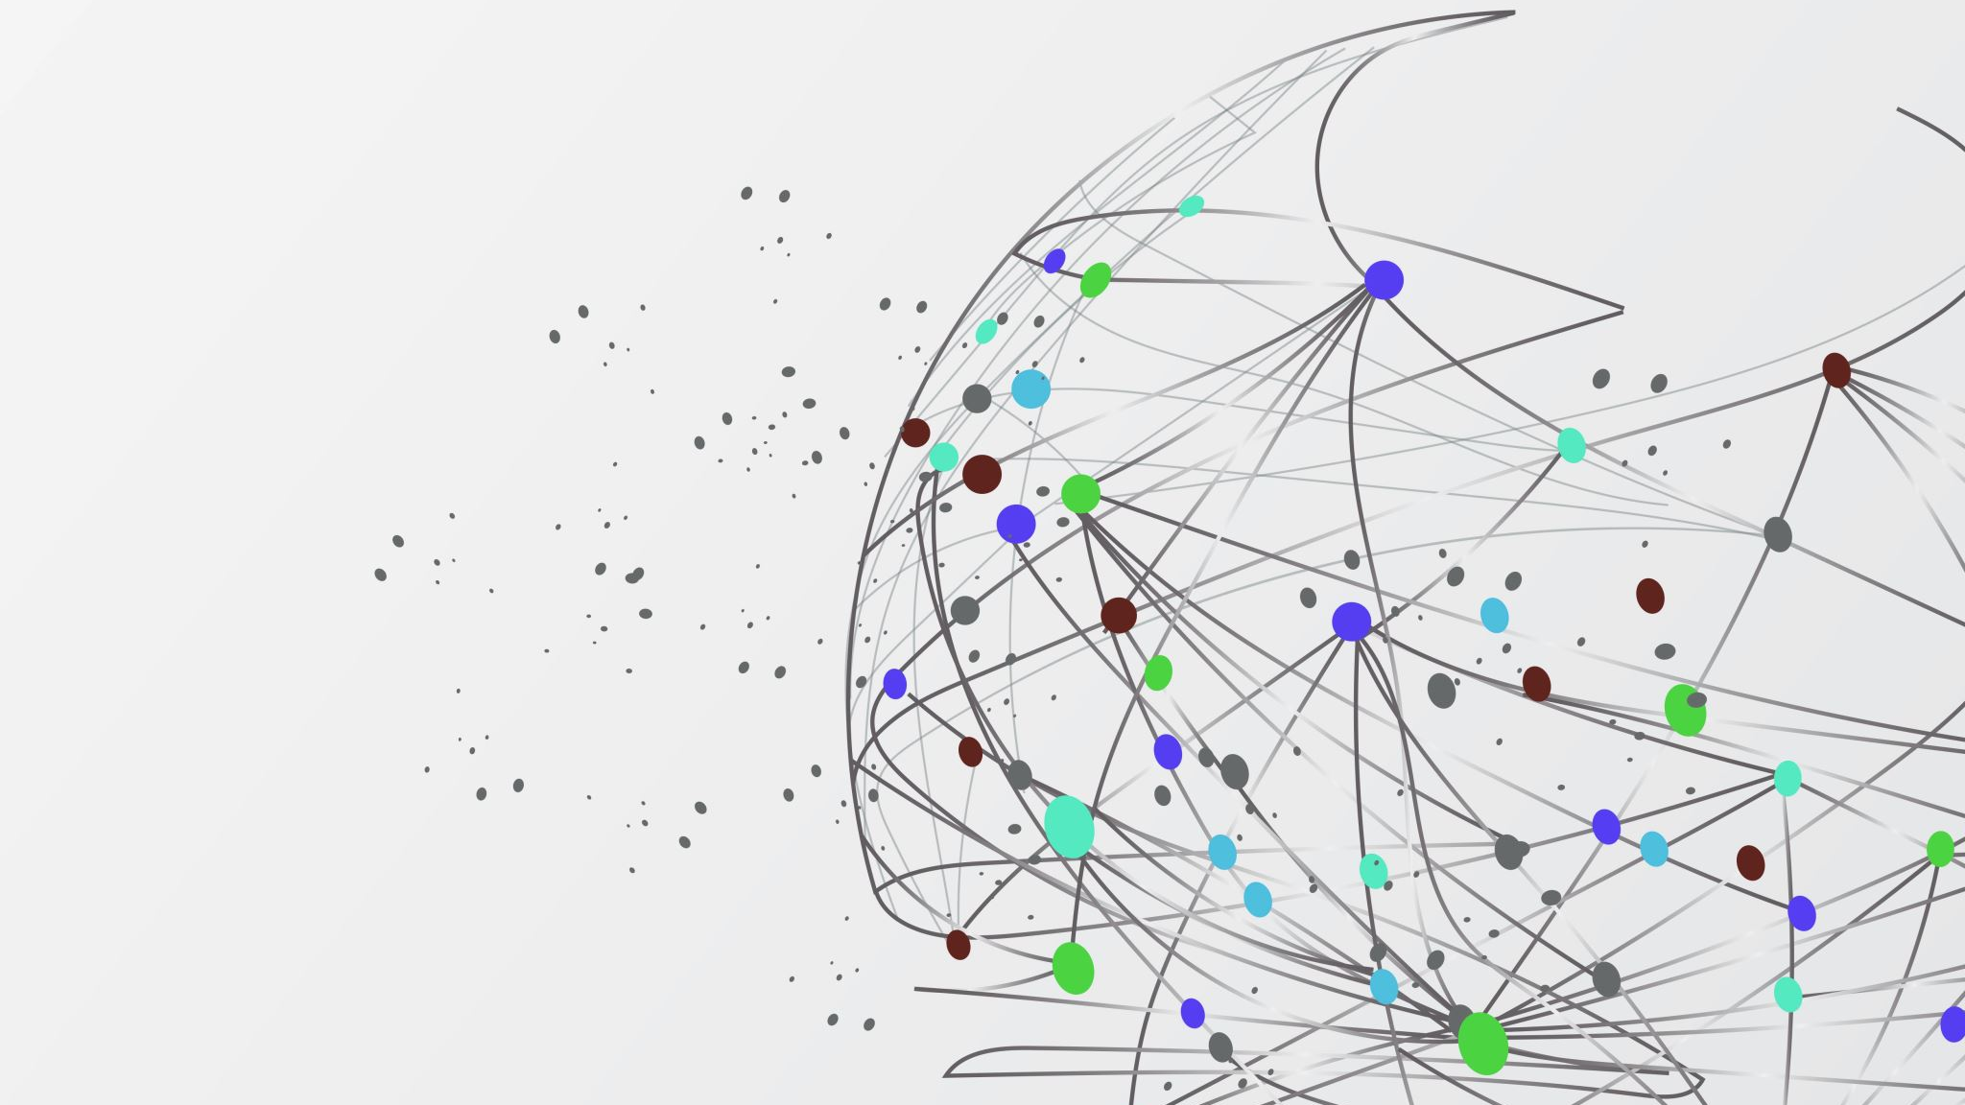
DAQ for HPGe array
A. Goasduff N. Toniolo

Slide 2
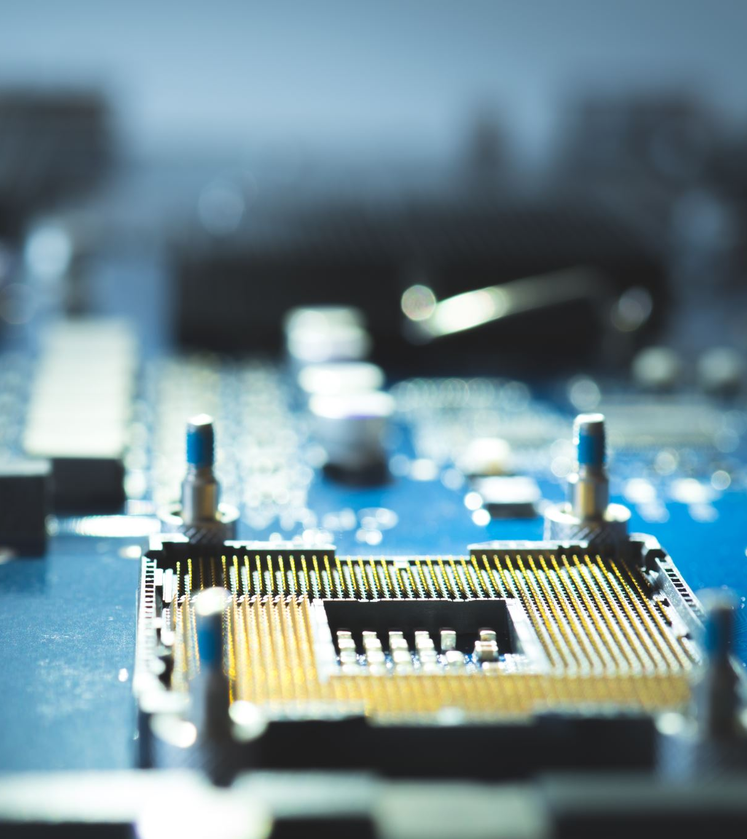
Hardware
CAEN DIGITIZER V1:
VME boards
Single ended input channels (8/16 channels)
250 MS/s
Firmware: Trapezoidal filter (DPP-PHA)
Conversion Differential to Single-Ended
CAEN CONET2 Bridge:
A3818 PCIe board with 2/4 input link. Each link can manage up to 8 boards
Maximum length 50m
DAQ Servers
Available SuperMicro (AGATA/GALILEO) and HP server (physics b-DS) compatible with the A3818 PCIe board

Slide 3
XDAQ system
Distributed DAQ system
Used for CMS@CERN
Dedicated application for PISOLO, EXOTIC, GALILEO, PRISMA, Ancillary AGATA developed in C/C++
Digitizer CAEN already supported (version 1 and 2, DPP-PHA/DPP-PSD)
Modular run control
Developed in Python2.7 and ported to Python3.9
Dedicated interfaces towards psi style e-log, grafana, epics interface, … all
Both CLI and GUI based on Web Interface (ugly but functional)

Slide 4
XDAQ Architecture
CAEN V1725
CAEN A3818
Software platform developed at CERN and design specifically for the development of distributed DAQ
Standard DAQ framework for CMS experiment
XDAQ provides:
Platform independent services
Peer-to-peer communication between DAQ blocks
SOAP messaging for configuration/control/monitoring
Main Features:
Device access
Configuration, control and monitoring
Maintainability and portability
Scalability
Long standing experience at LNL:
GASP spectrometer
PRISMA/PISOLO,EXOTIC spectrometers
GALILEO spectrometer
AGATA ancillaries
NEEDLE @ HIL
Readout Unit
Data Filtering
Event Builder
TCP receiver

Slide 5
User supplied actors
Skeleton of data treatment actor in C/C++
For PANDORA:
Low level data reduction:
Energy selection?
External conditions?
Improved timing performances

Slide 6
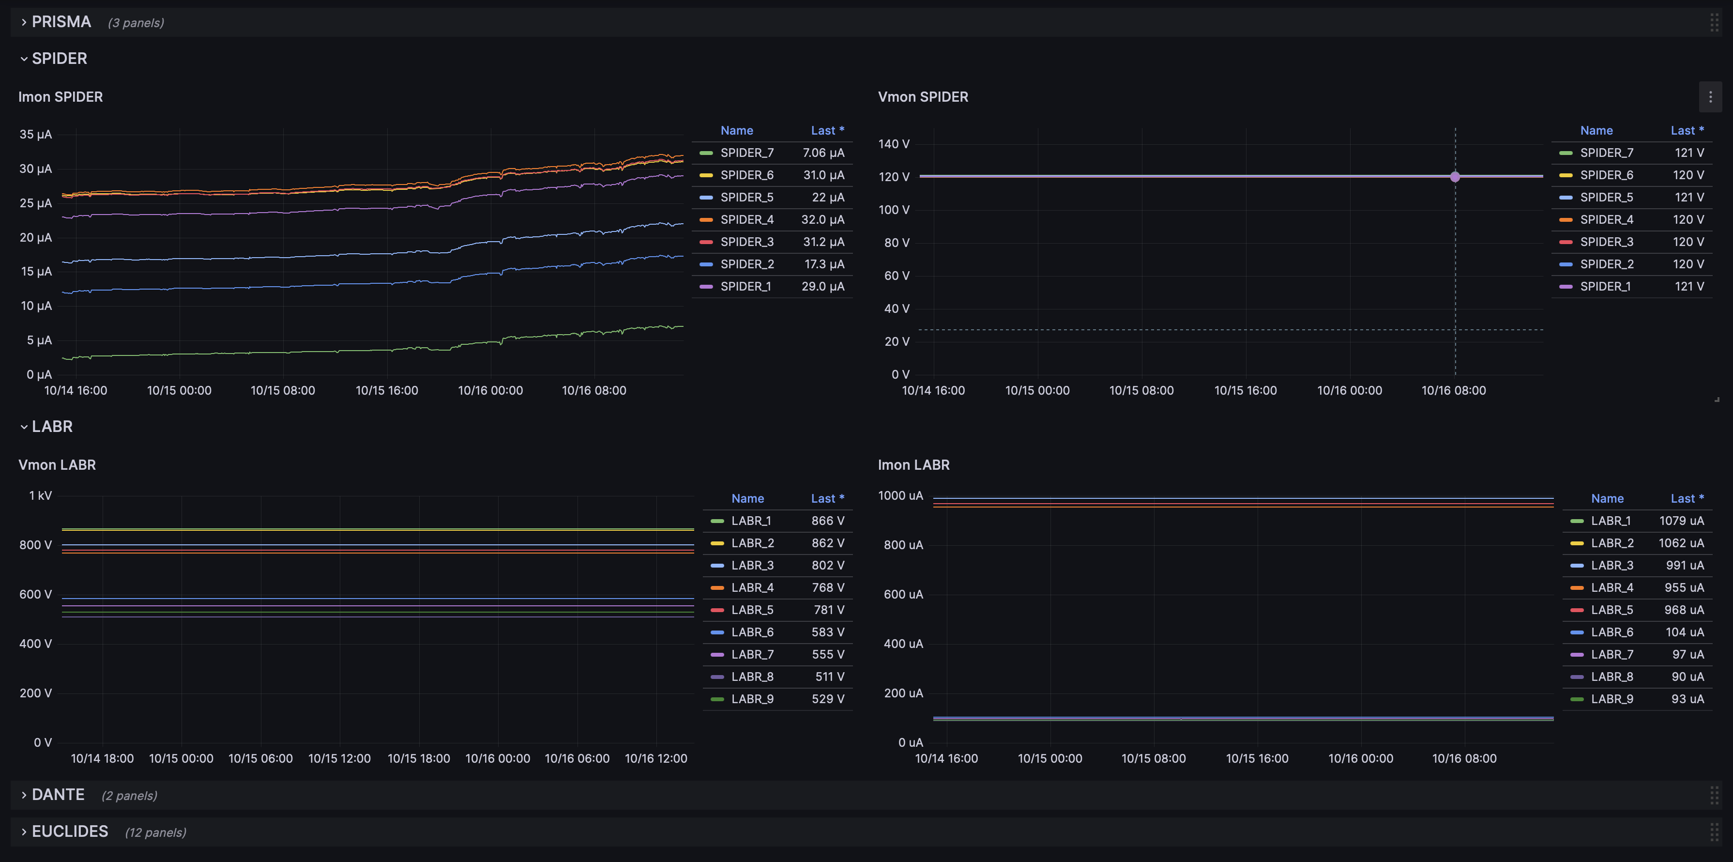
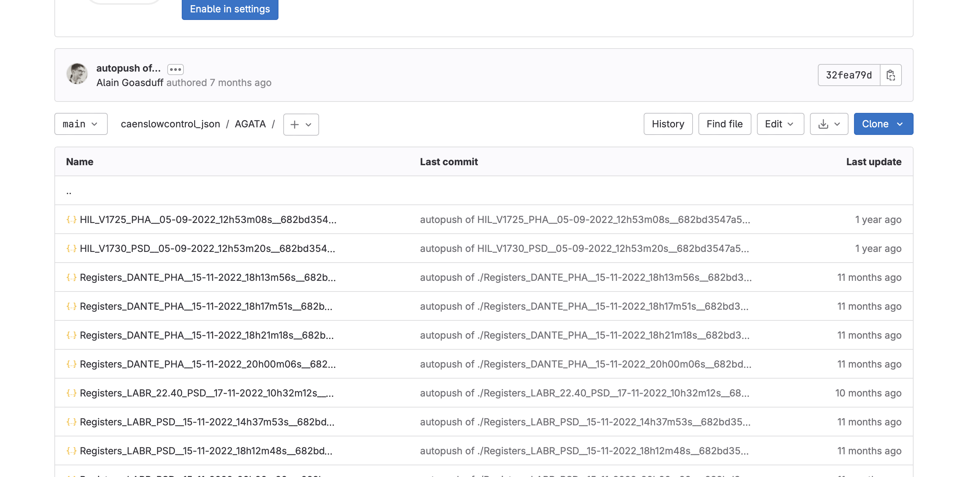
Monitoring and MetaDAta generation

Slide 7
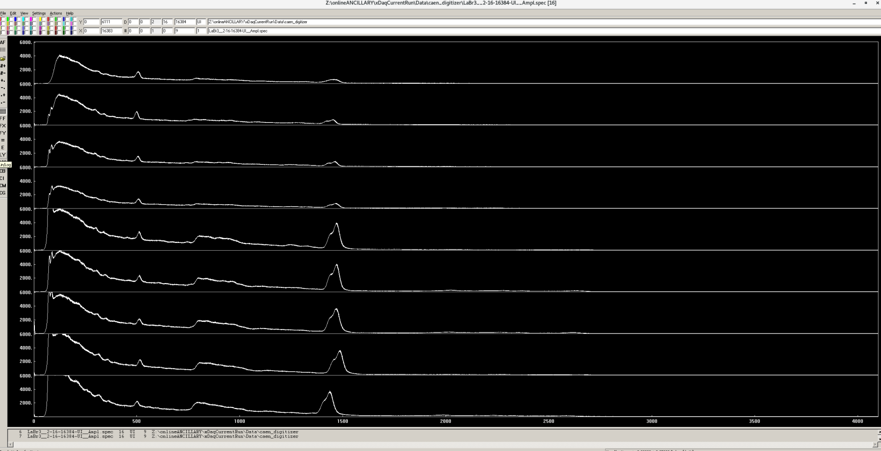
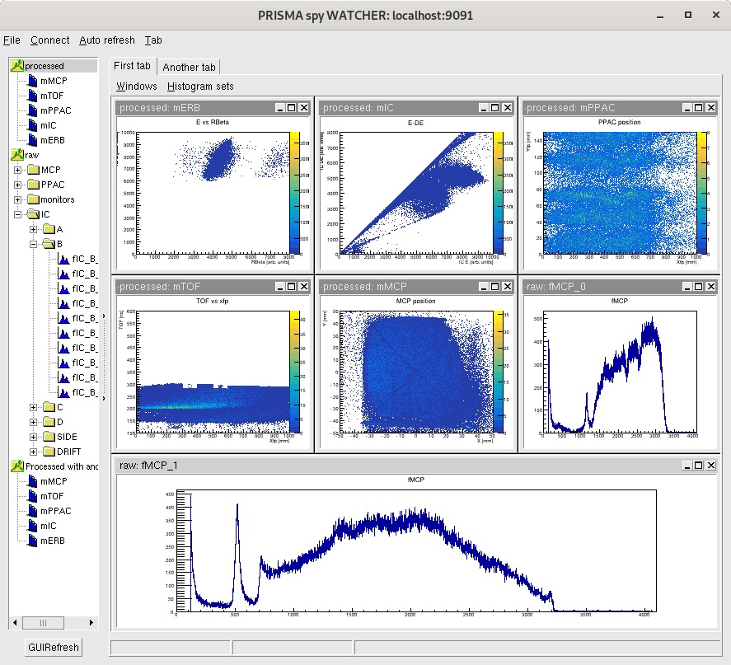
Data quality monitoring
Typical spectra written on disk:
Quick and easy visualisation
Possibility to reset the spectra using the run control
Monitoring of the ancillary data quality at different level of the DAQ:
Data filtering
Event builder

Slide 8
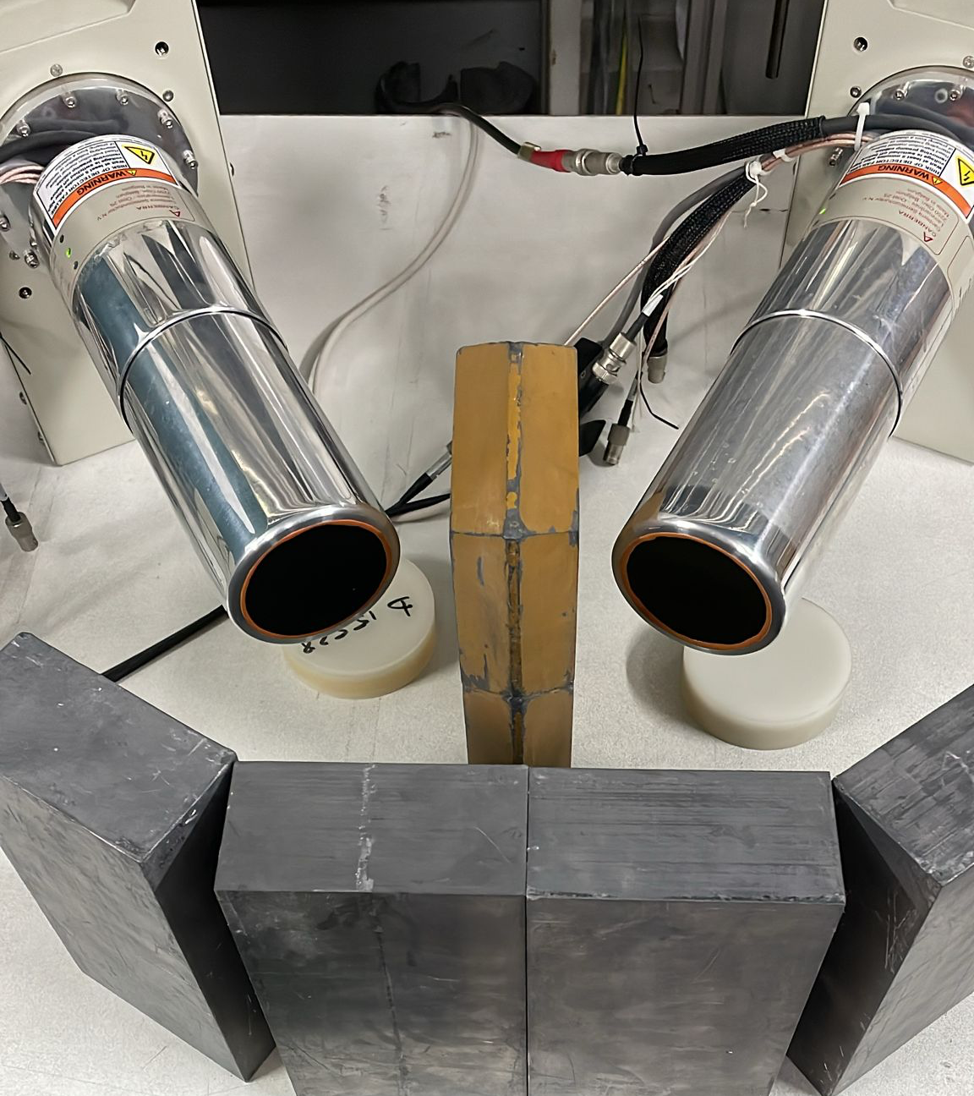
Test bench
2 Cryo-pulse 5
1 NIM crate for the detector HV (CAEN N1471H) and pre-amplifier power supply
1 4U VME crate for the digitizer V1725
Supermicro server (DAQ + control HV)

Slide 9
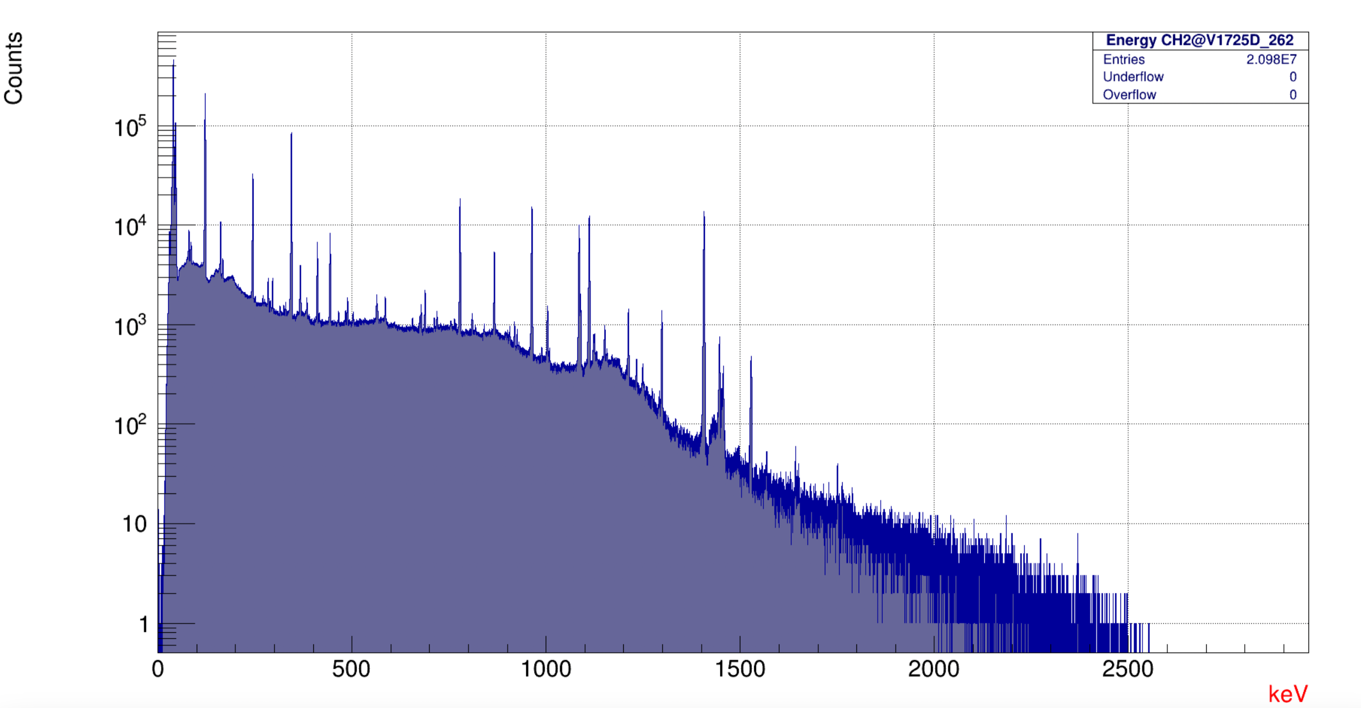
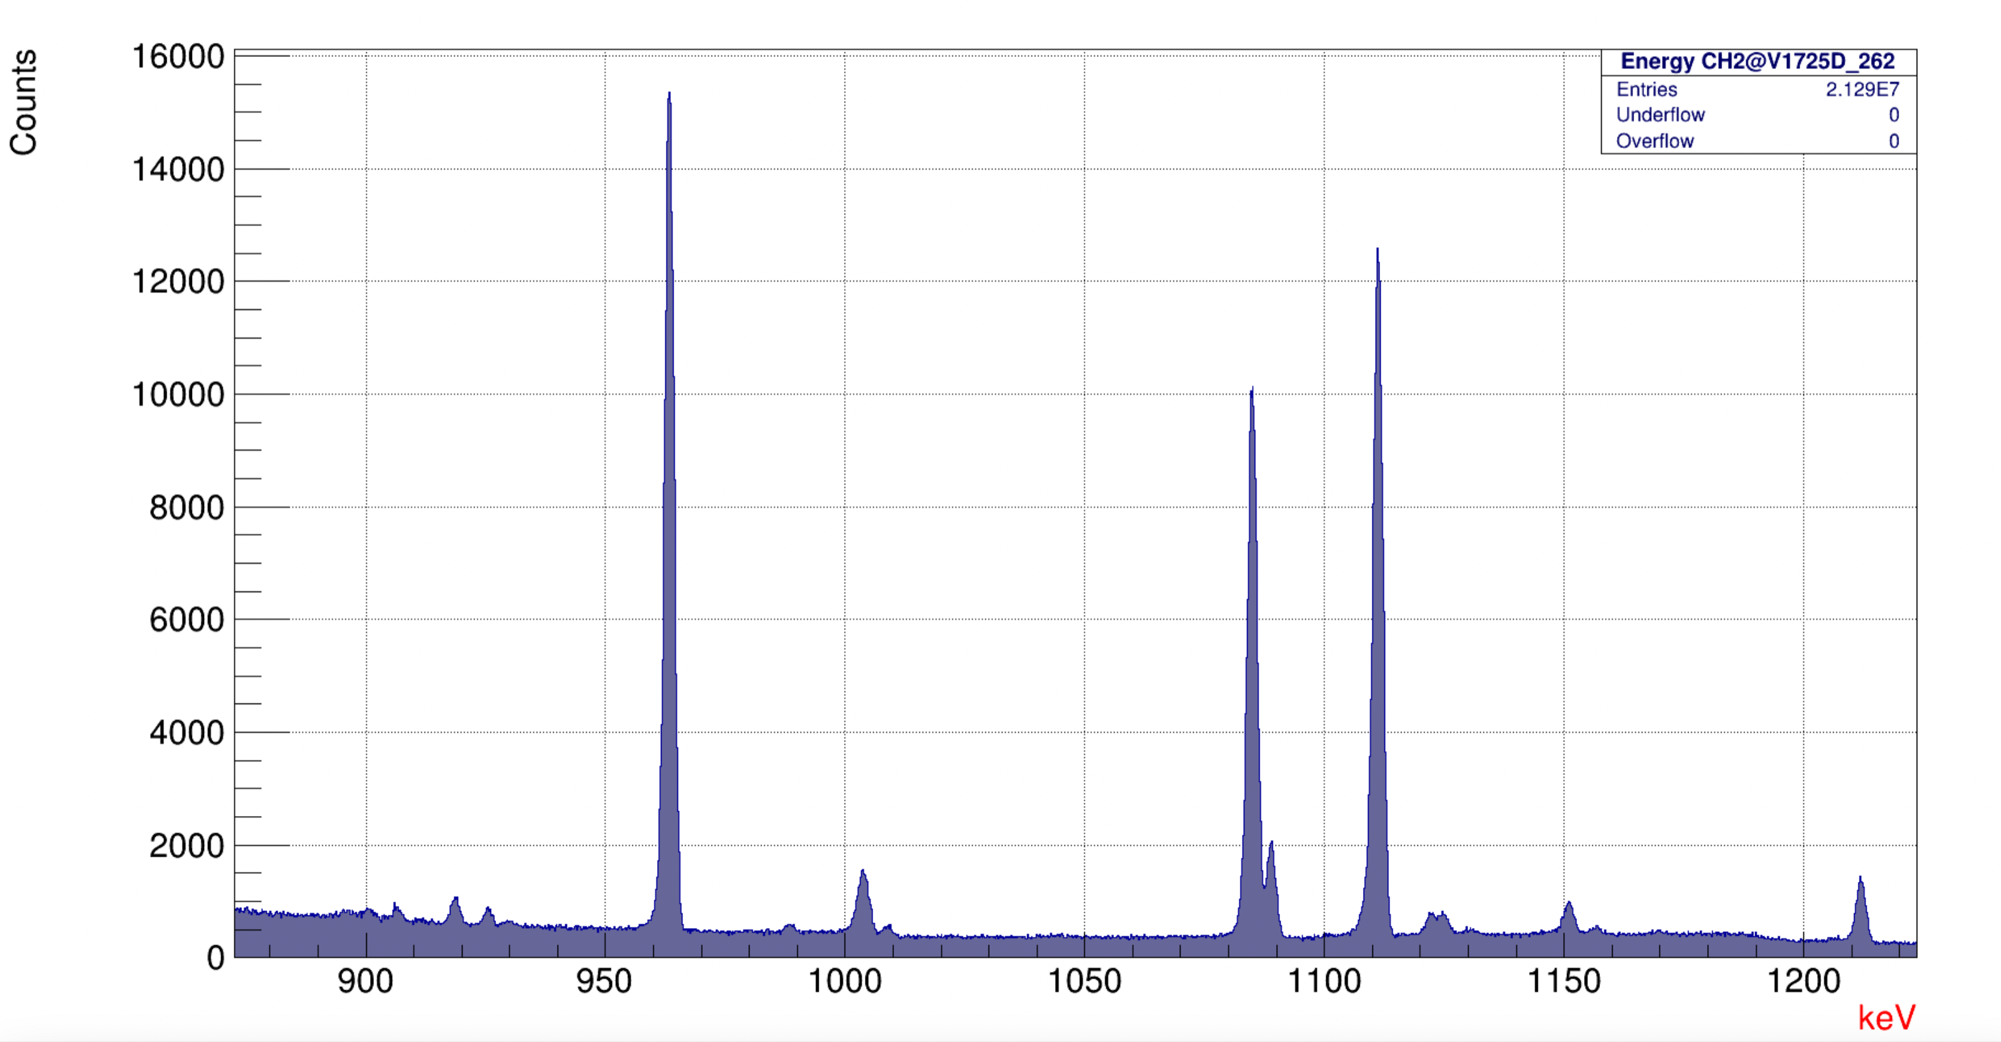
DAQ Test Detection setup
2 HPGe CANBERA Cryo-Pulse 5
Bias: -5kV, Imon < 1 nA
Resolution 2.3 keV FWHM @ 1.4 MeV (6 kHz rate, shaping 6 µs, baseline)

Slide 10
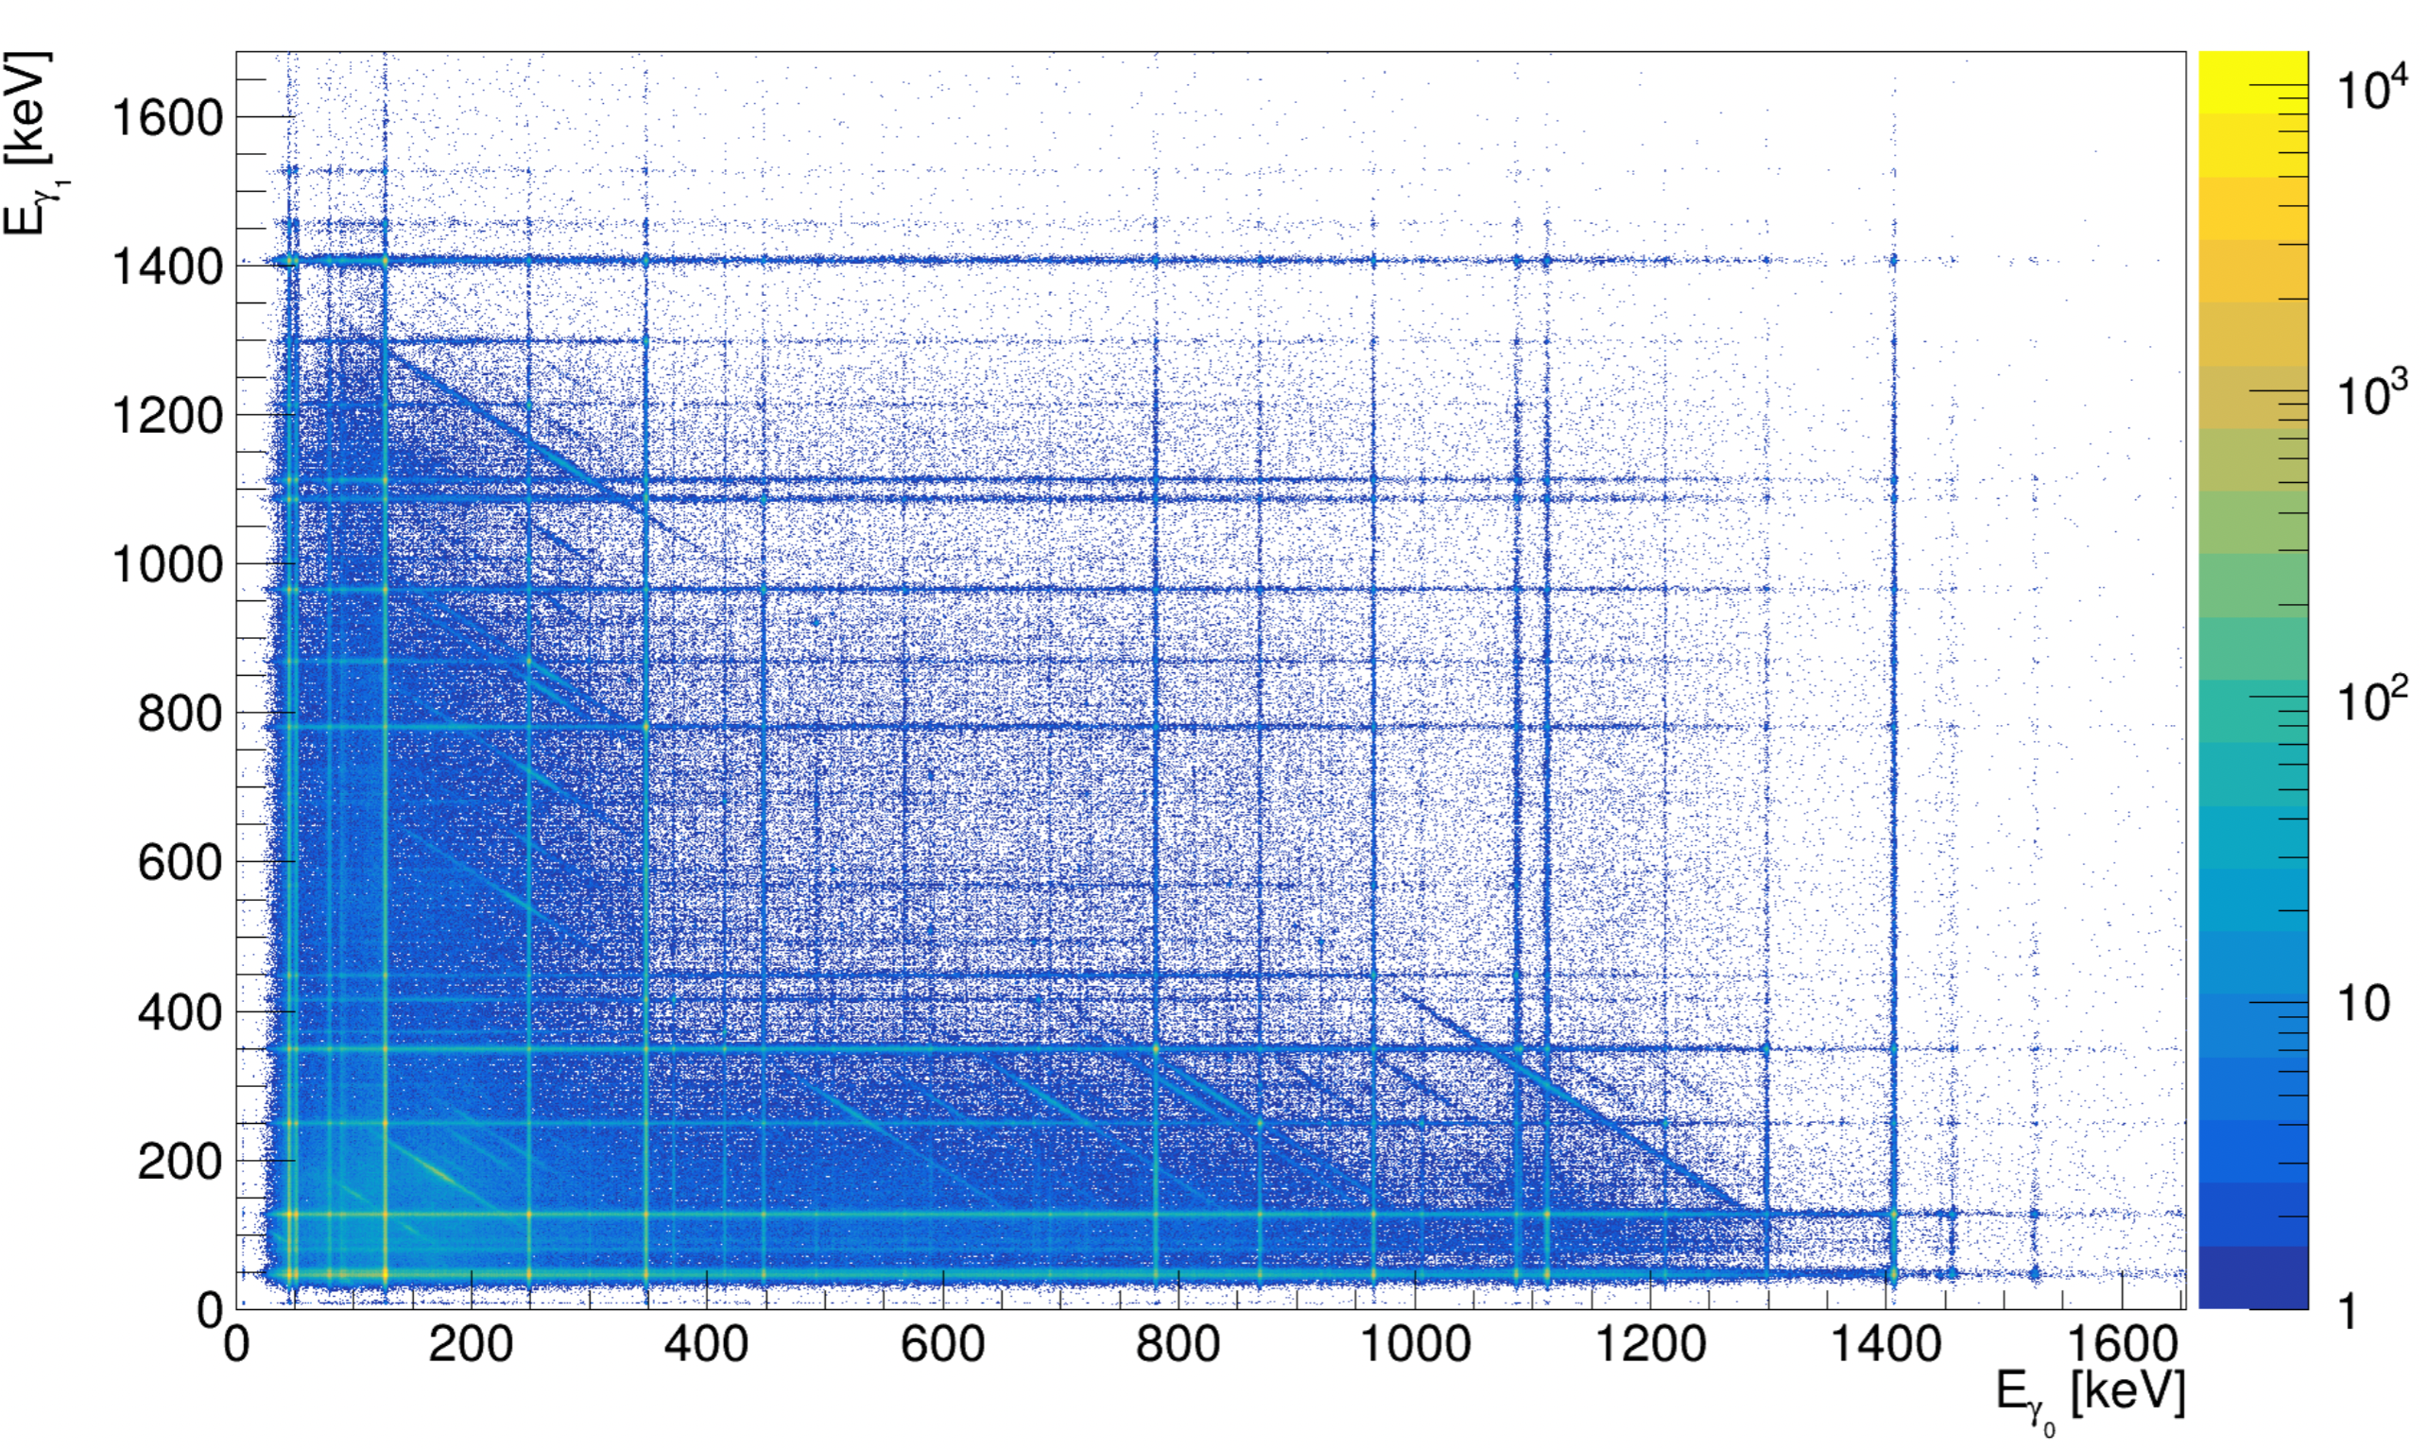
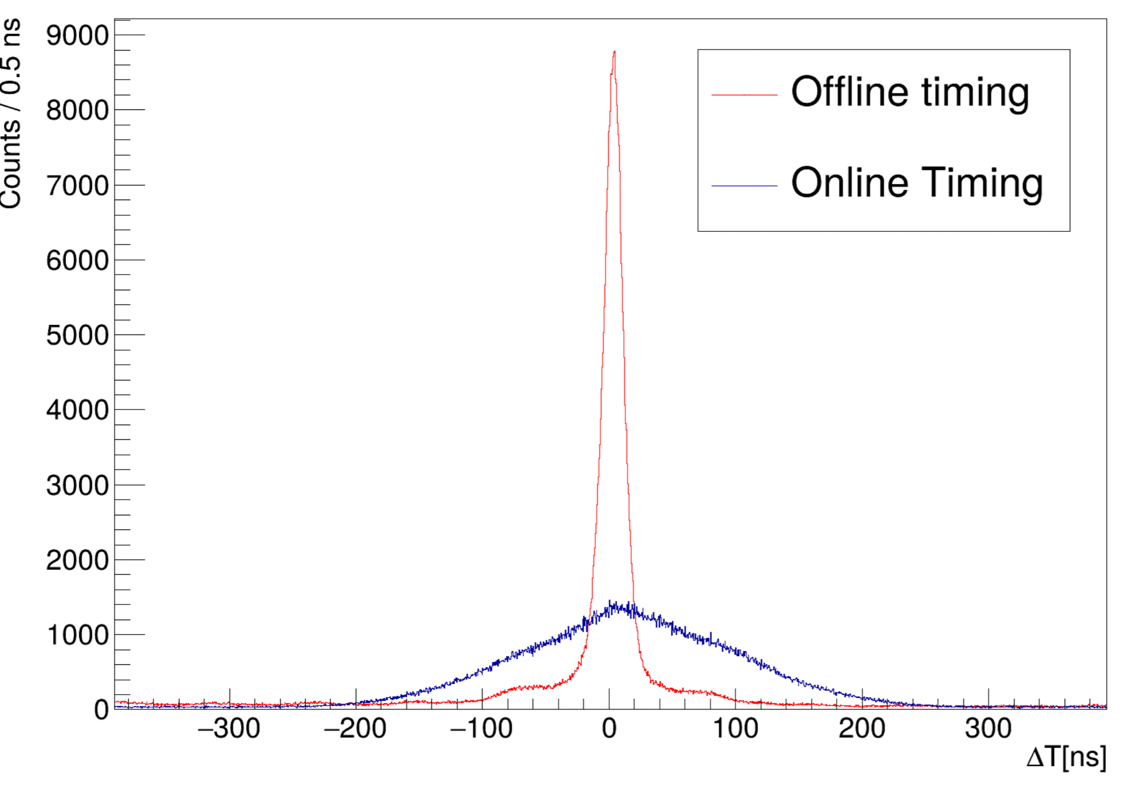
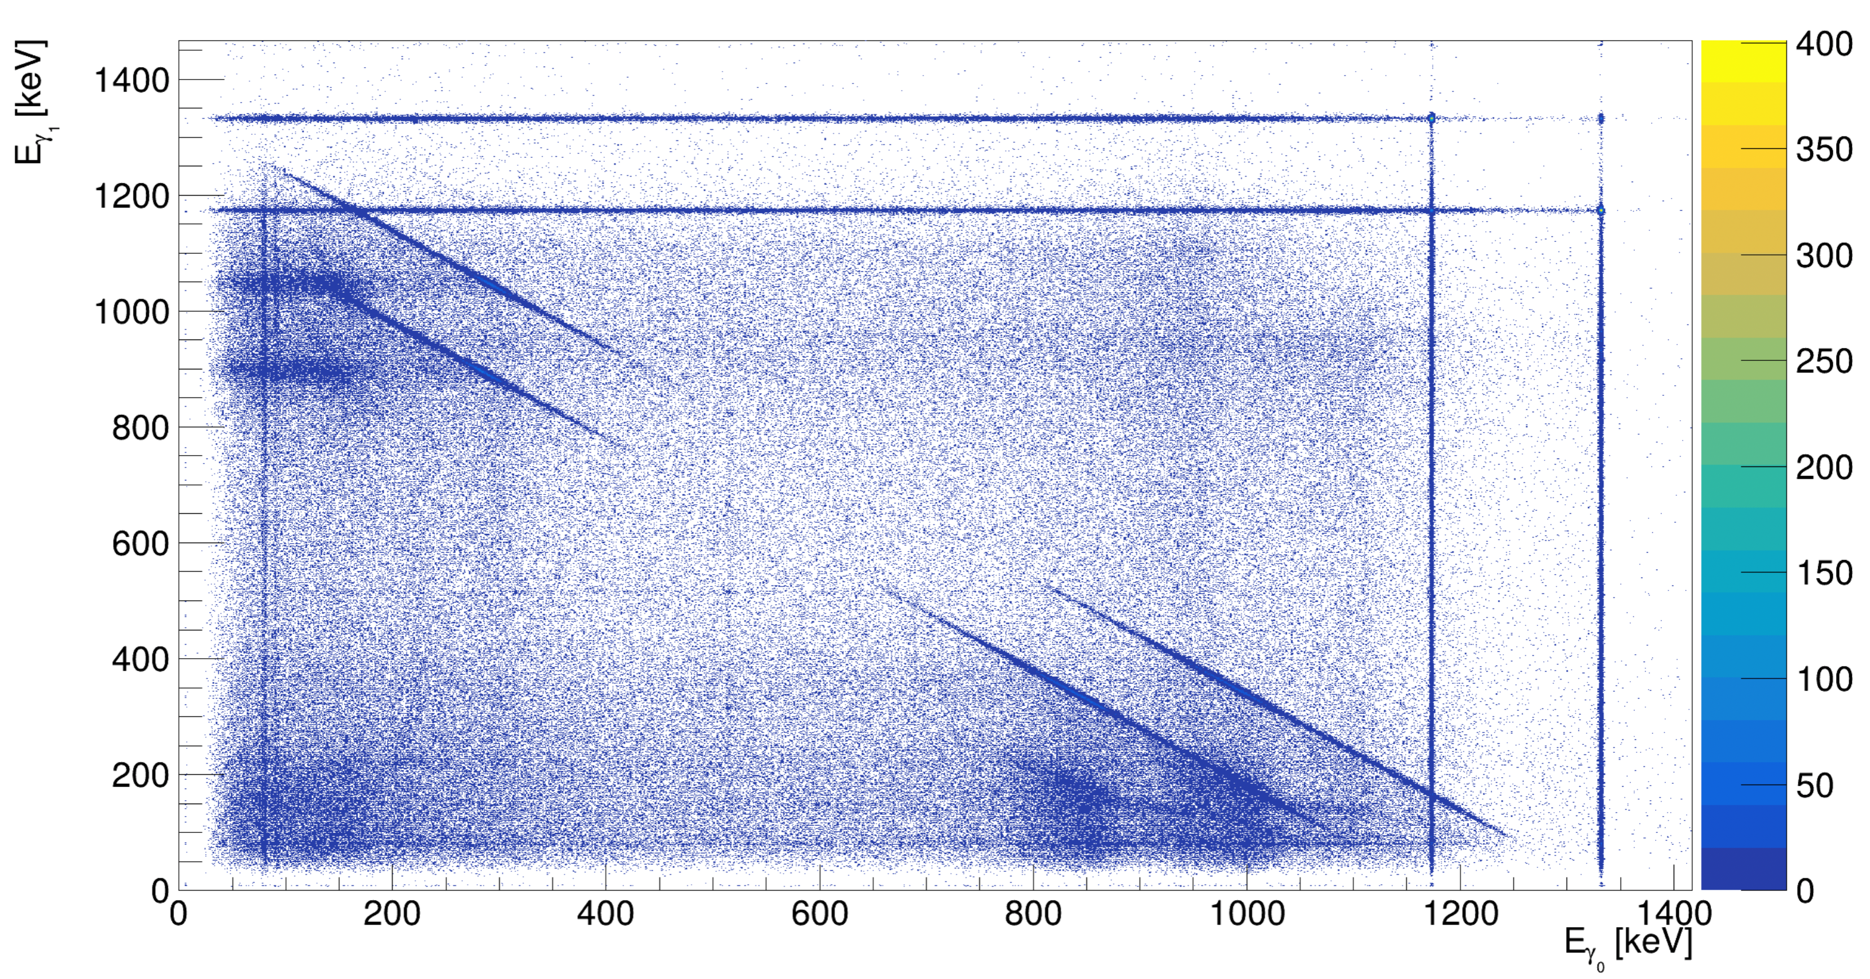
Online reconstruction of coincidences
The XDAQ event builder reconstruct the events based on the time stamp information

Slide 11
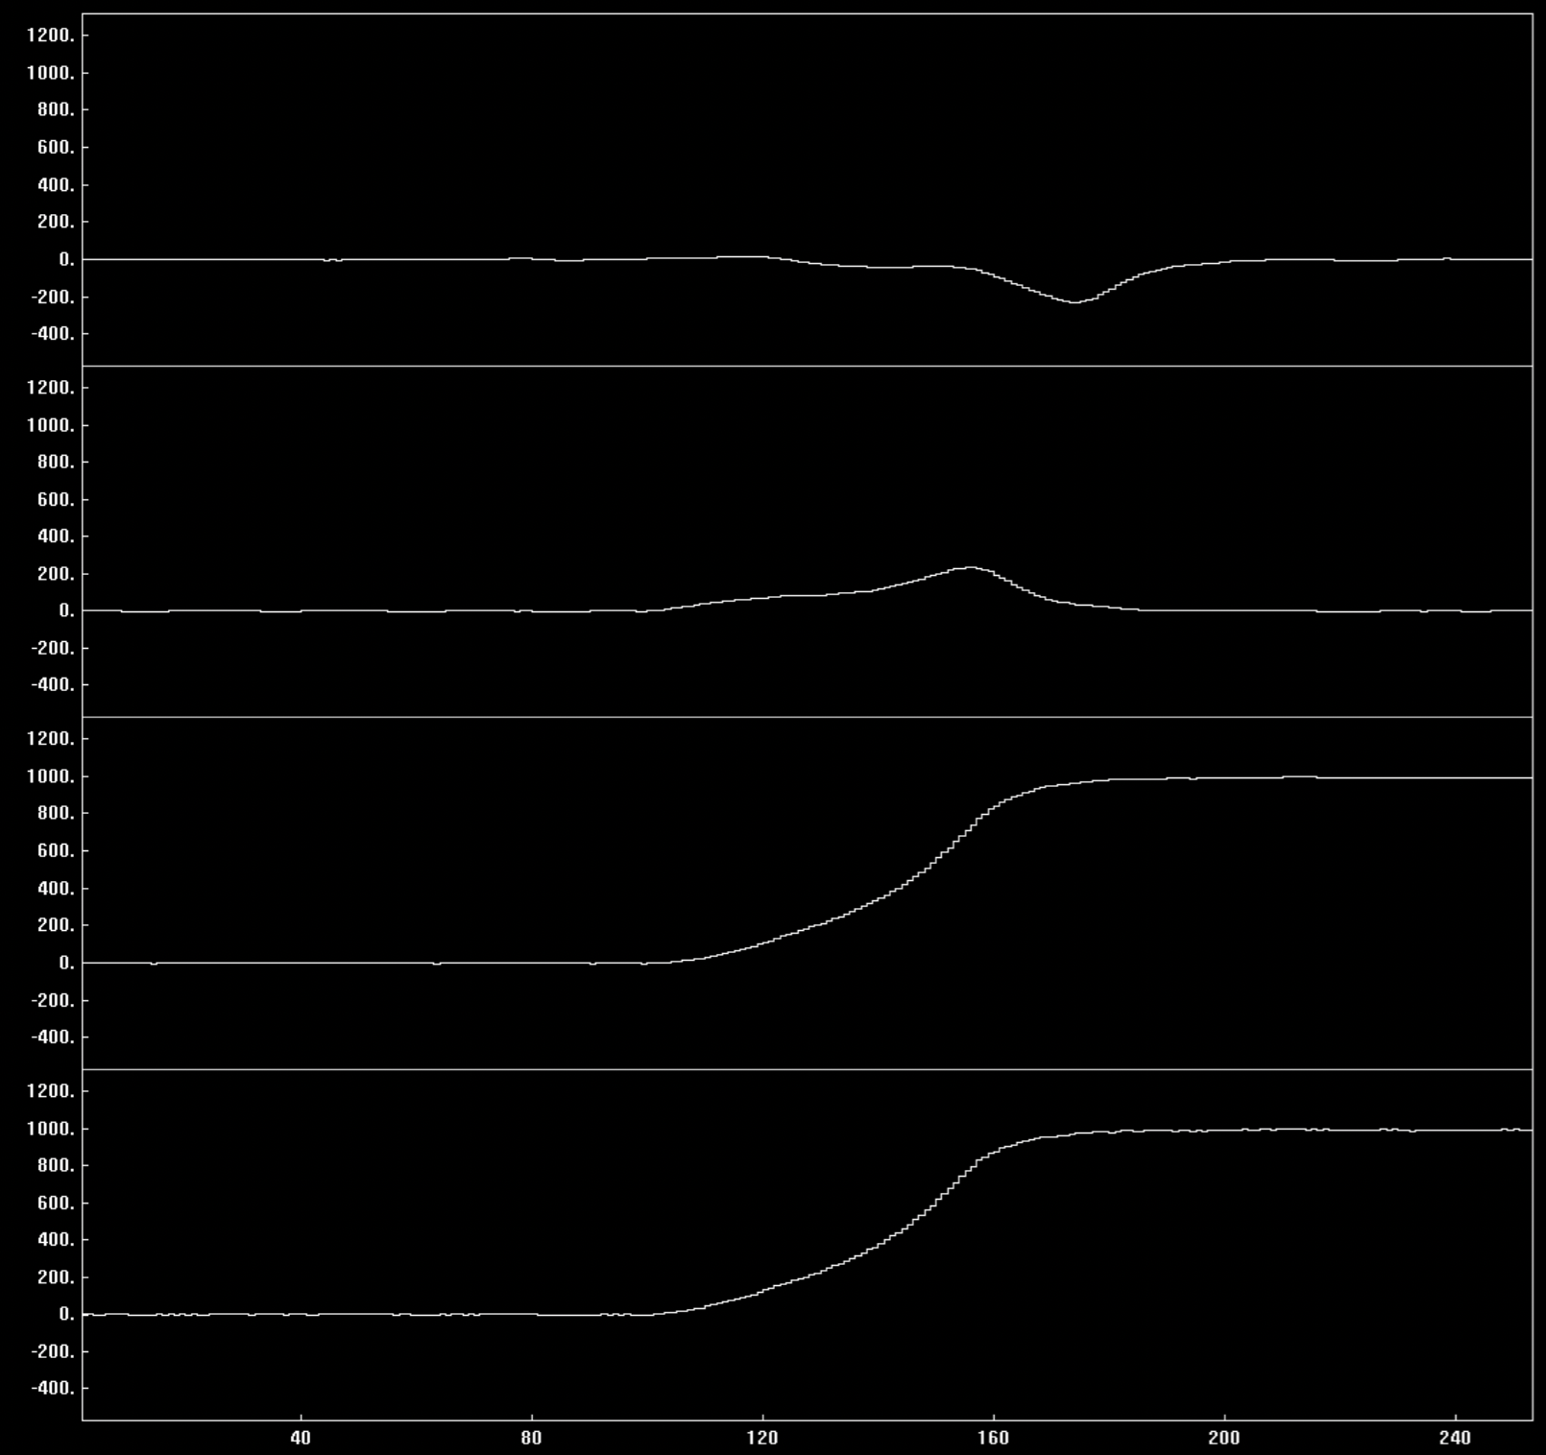
Offline timing performed at the LF
256 samples of the input signal are reprocessed at the LF:
moving average
Differentiation and integration
CFD

Slide 12
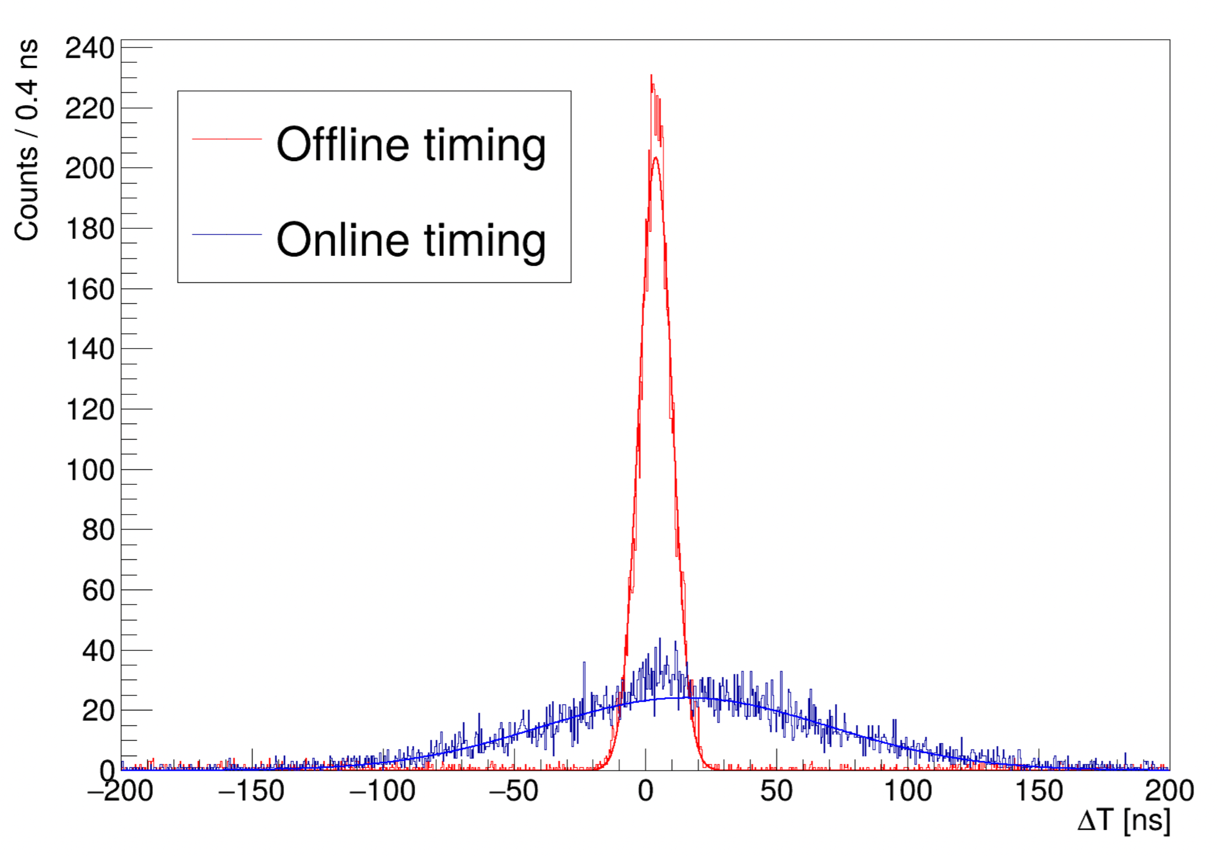
Effect on the time resolution
Gated on the ⁶⁰Co coincidence:
Online resolution: 128 ns
Offline resolution: 15 ns
Improvement by a factor 8
Cost: Size of the single event: 36 B → 548 B
In the present configuration it is not feasible for PANDORA (391 MB/s vs 60 MB/s)

Slide 13
Simulated Acquisition cycle using dual timers
Logical signal from the tape:
- 0 moving
- 1 stopped
RESET THE TS OF THE DIGITIZER
Logical signal from the beam:
- 0 beam-off
- 1 beam-on

Slide 14
Effect of the tape signal on the data
1
2
3
4
5
6
7
8
9
10
11

Slide 15
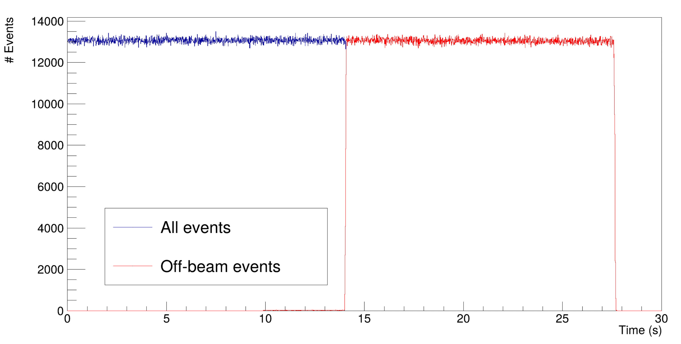
Effect of the beam signal

Slide 16
Conclusion
Detectors have been upgraded and tested with rate up to 100 kHz
Limitation on the detection efficiency due to the pile up rejection algorithm
DAQ system is ready to be installed at LNS
Experience in remote gestion (NEEDLE@HIL, Warsaw)

