Slide 1
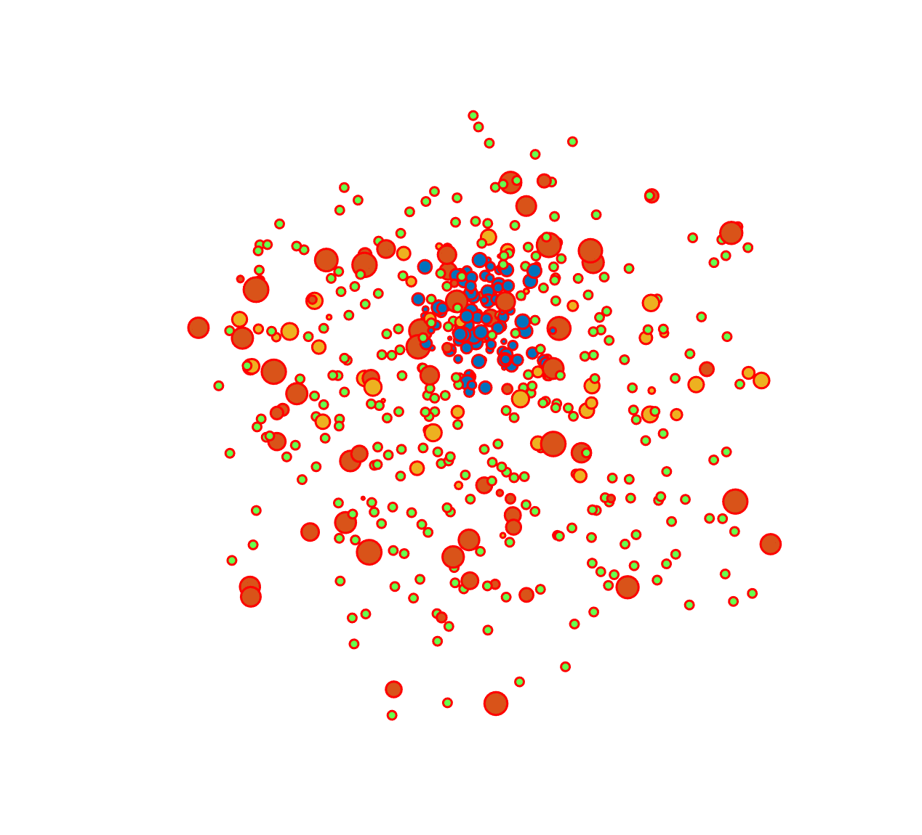
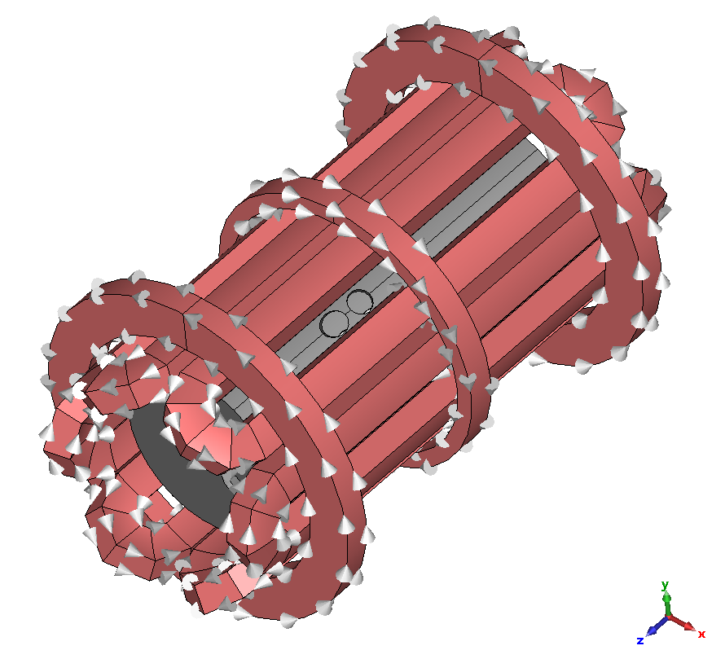
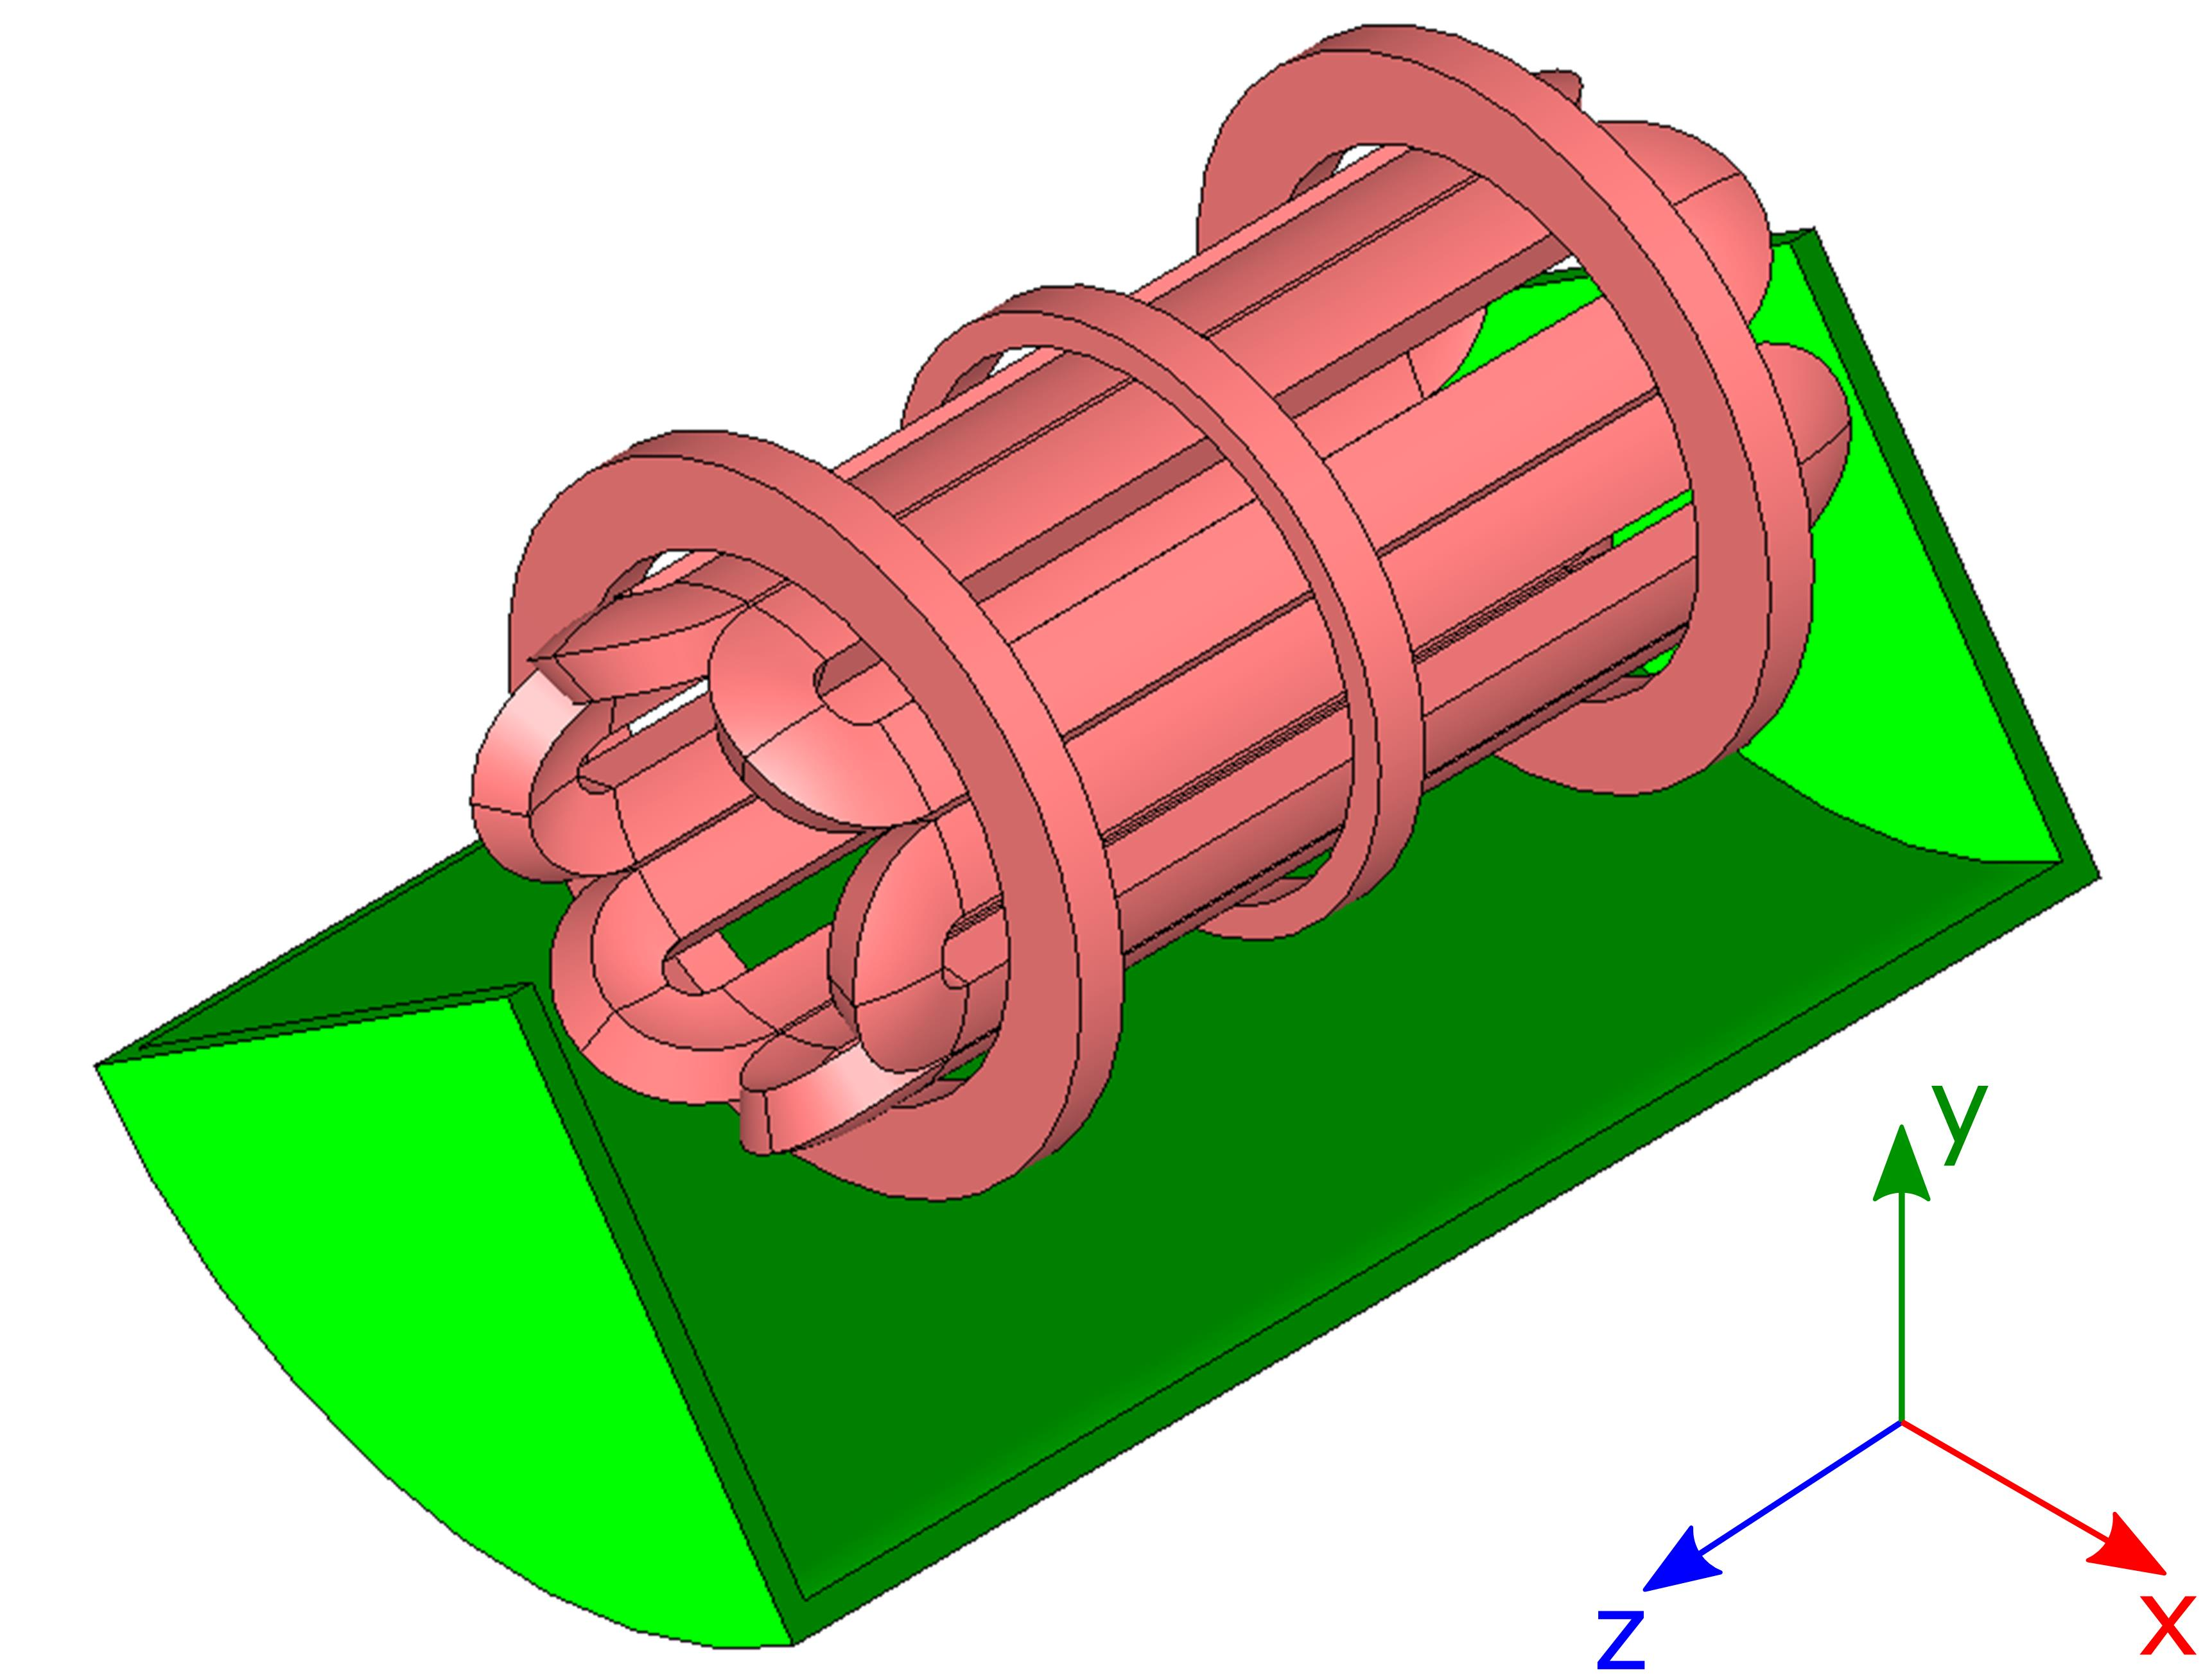
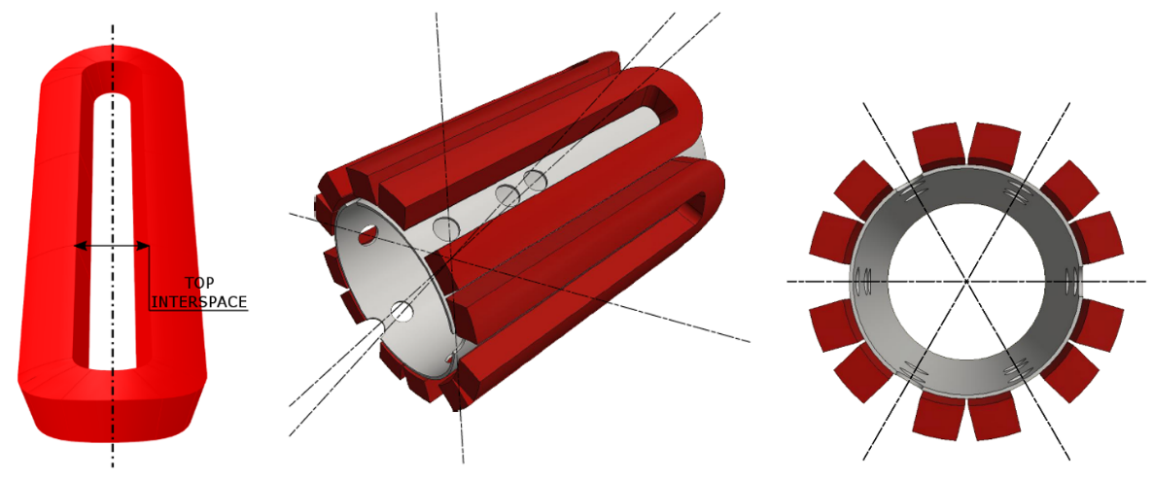
The PANDORA plasma trap:
numerical modeling and technical design
Giorgio S. Mauro on behalf of the PANDORA collaboration
Istituto Nazionale di Fisica Nucleare – Laboratori Nazionali del Sud – Catania (Italy)

Slide 2
3rd PANDORA Progress Meeting – Legnaro – October 7-8, 2024
Outline
Introduction
Magnetic system: required performances and geometry
OPERA numerical design and simulation results
CST Studio Suite validation
Magnetic system procurement status
Technical design from first ranked company
Conclusion and perspectives
The PANDORA plasma trap: numerical modeling and technical design
G. S. Mauro – INFN - LNS

Slide 3
3rd PANDORA Progress Meeting – Legnaro – October 7-8, 2024
Outline
Introduction
Magnetic system: required performances and geometry
OPERA numerical design and simulation results
CST Studio Suite validation
Magnetic system procurement status
Technical design from first ranked company
Conclusion and perspectives
The PANDORA plasma trap: numerical modeling and technical design
G. S. Mauro – INFN - LNS

Slide 4
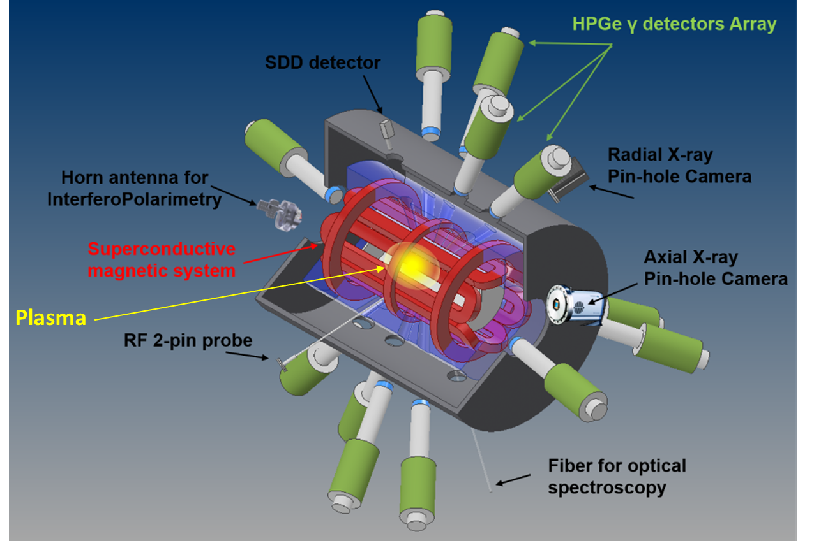
3rd PANDORA Progress Meeting – Legnaro – October 7-8, 2024
Introduction
PANDORA goal: to study if and how the lifetimes of selected β–decaying nuclei is affected by the ionization state and by the plasma “environment”.
A NEW CHALLENGE: Reproduce in laboratory some stellar-like conditions and measure the expected variations of nuclear lifetime in β–decaying nuclei.
Necessity of a plasma-confining magnetic system that allows to have long plasma lifetime and sufficient flexibility and accessibility for several diagnostics.
Mascali et. al, Universe 2022, 8, 80
Electron Density: 10¹² – 10¹⁴ cm⁻³
Electron Temperature: 0.01 – 100 keV
Ion Temperature: ~ 1 eV
Ion Density: 10⁶ - 10¹¹ cm⁻³
See talk by D. Mascali
The PANDORA plasma trap: numerical modeling and technical design
G. S. Mauro – INFN - LNS

Slide 5
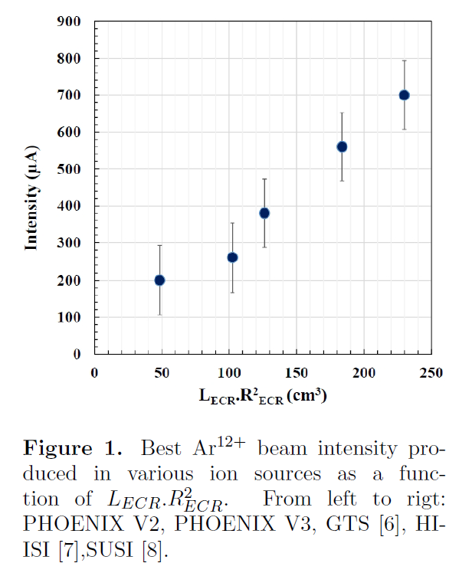
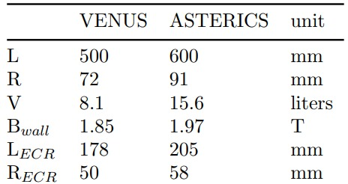
3rd PANDORA Progress Meeting – Legnaro – October 7-8, 2024
Introduction
Two crytical points to take into account:
plasma confinement time;
magnetic system feasibility.
The total ion confinement time inside the trap can be written as:
$τ_{i}^{q}≅7.1×{10}^{−20}{\left(\frac{l}{2}\right)}^{2}lnΛ_{ij}\frac{q^{2}}{T_{i}^{5/2}}n_{e}\sum_{j}{\sqrt{A_{j}}}{〈q〉}_{j}$
($lnΛ_{ij}$denotes the Coulomb logarithm ($lnΛ_{ij}$= 10 - 15), $A_{j}$ the atomic mass number)
$τ_{i}^{q}$ ~ B_{max}/B_{min}
Both plasma chamber length and magnetic field mirror ratio play a fundamental role for reaching high charge states.
PANDORA plasma trap: optimal compromise between performances and feasibility.
Mascali et. al, Review of Scientific Instruments 85, 02A511 (2014)
INFN-LNS, Catania (IT) ECRIT – PANDORA: @ 18 GHz operation, L_{ECR}*R²_{ECR} ~ 1130 cm³
T. Thuillier et al 2024 J. Phys.: Conf. Ser. 2743 012059
The PANDORA plasma trap: numerical modeling and technical design
G. S. Mauro – INFN - LNS

Slide 6
3rd PANDORA Progress Meeting – Legnaro – October 7-8, 2024
Introduction
Design Parameters | VENUS | SECRAL | SECRAL II | RIKEN | FECR | PANDORA
Superconductor | NbTi | NbTi | NbTi | NbTi | Nb₃Sn | Nb₃Sn
B_{inj} [T] | 4 | 3.7 | 3.7 | 4 | ≥ 6.4 | 1.7 - 3
B_{ext} [T] | 2 - 3 | 2.2 | 2.2 | 2.2 | ≥ 3.4 | 1.7 - 3
B_{hex} [T] | 2 | 1.7 | 2 | 2.1 | ≥ 3.4 | 1.6
B_{peak} [T] | 7 | 7.8 | 7.8 | 7.4 | 11.8 | 8.5
Mirror length [mm] | 500 | 420 | 420 | 500 | 500 | 700
Pl. chamber ID [mm] | 150 | 116 | 125 | 150 | 150 | 280
f_{rf} primary [GHz] | 28 | 24 | 28 | 28 | 45 | 18
kW primary | 10 | 7 | 10 | 10 | 20 | 4.8
f_{rf} secondary [GHz] | 18 | 18 | 18 | 18 | 45 - TBD | 21
kW secondary | 2.4 | 3 | 2.4 | 2.4 | TBD | 1.5
D. Leitner, 10th Int. Particle Accelerator Conf. (IPAC’19), doi:10.18429/JACoW-IPAC2019-WEXPLS1
The PANDORA plasma trap: numerical modeling and technical design
G. S. Mauro – INFN - LNS

Slide 7
3rd PANDORA Progress Meeting – Legnaro – October 7-8, 2024
Outline
Introduction
Magnetic system: required performances and geometry
OPERA numerical design and simulation results
CST Studio Suite validation
Magnetic system procurement status
Technical design from first ranked company
Conclusion and perspectives
The PANDORA plasma trap: numerical modeling and technical design
G. S. Mauro – INFN - LNS

Slide 8
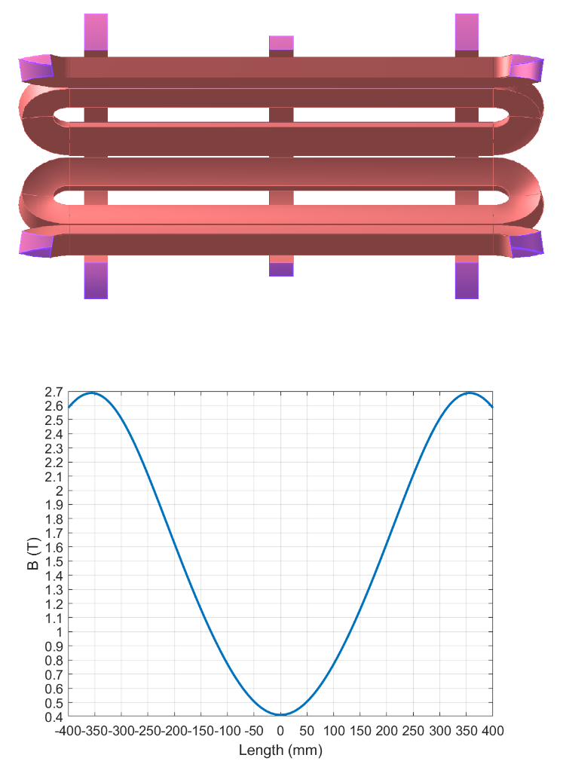
3rd PANDORA Progress Meeting – Legnaro – October 7-8, 2024
Magnetic system: required performances and geometry
The PANDORA’s trap has been designed to operate at 18 + 21 GHz.
The magnetic system, fully superconductive, consists of:
#3 axial coils that generates the axial magnetic field;
#6 hexapole coils that generates the radial magnetic field.
It will enclose a plasma chamber with inner radius R_{CH_IN} = 140 mm and length L = 700 mm.
MAGNETIC FIELD REQUIREMENTS
B_{inj} max @ z = - 350 mm | 3 T
B_{inj} operative range | 1.7 T – 3 T
B_{ext} max @ z = 350 mm | 3 T
B_{ext} operative range | 1.7 T – 3 T
B_{min} @ z = 0 mm | 0.4 T
B_{hex} @ R_{CH_IN} = 140 mm | 1.6 T
Lhe | Free
Warm Bore radius | 150.5 mm
Distance between mirrors | 700 mm
Stray field (as above specified) | Less than 0.2 T
Mauro et. Al, Front. Phys., Sec. Nuclear Physics​, Volume 10 - 2022
The PANDORA plasma trap: numerical modeling and technical design
G. S. Mauro – INFN - LNS

Slide 9
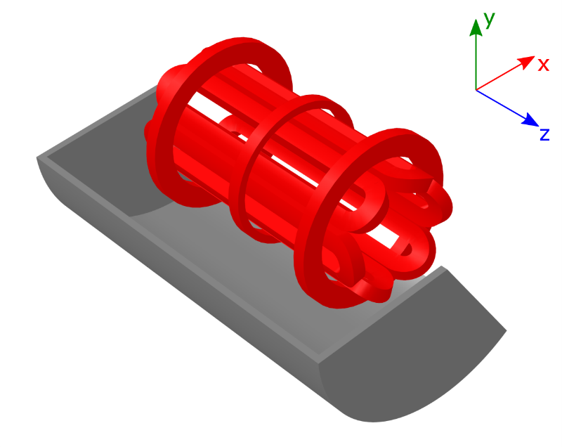
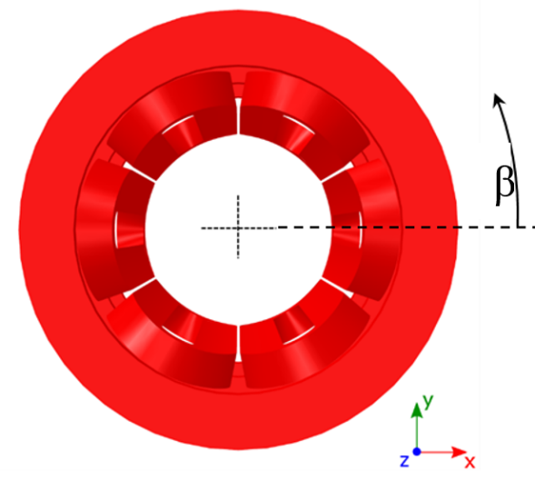
3rd PANDORA Progress Meeting – Legnaro – October 7-8, 2024
Magnetic system: required performances and geometry
SEXT-IN-SOL configuration. The hexapole conductors (racetracks) will be azimuthally placed, with poles at β = 0, 60, 120, 180, 240, 300-deg.
For diagnostics purposes, it is needed to keep up to 18 lines of sight between the warm bore radius and the external iron yoke, through the cryostat and the cold mass.
Solution: placing the holes along the axis of each hexapole conductor.
Each line of sight shall pass through the center of the magnetic system (z=0).
The PANDORA plasma trap: numerical modeling and technical design
G. S. Mauro – INFN - LNS

Slide 10
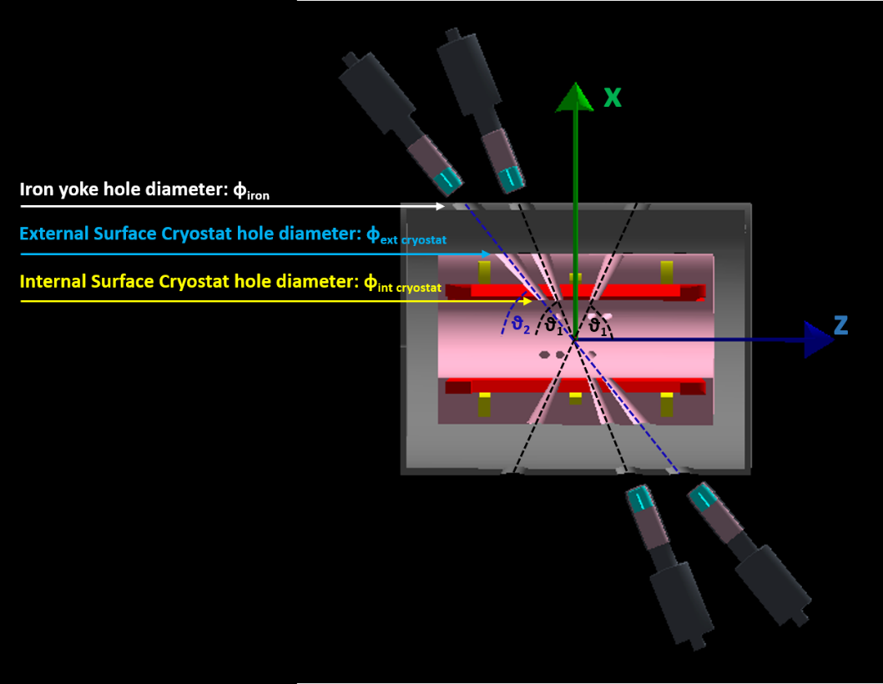
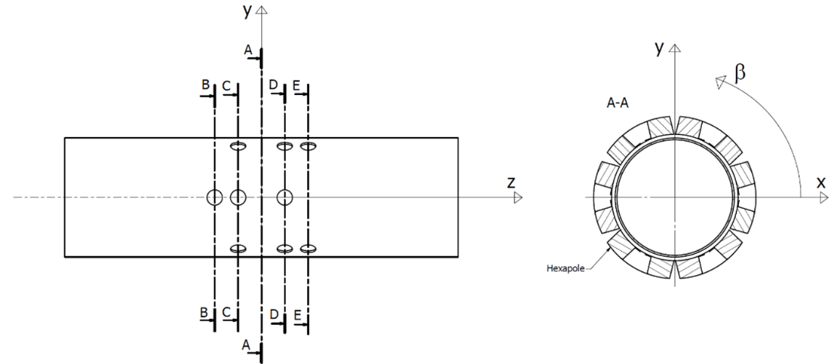
3rd PANDORA Progress Meeting – Legnaro – October 7-8, 2024
Magnetic system: required performances and geometry
18 detectors (12 HPGe) will surround the magnetic system.
Each triplet of holes has been placed, along the magnetic system axis, in order not to intercept the magnetic branches.
The magnetic trap will employ a single, bulk cryostat that will enclose both the three axial coils and the hexapole.
The cryostat plays also the role of multi-collimator for the HPGe array, suppressing the sources of background arising from photons coming from the walls and not directly from the plasma core, thus improving the signal-to-noise ratio.
PARAMETER | DESCRIPTION | VALUE | RANGE
Φ_{iron} | Iron yoke holes diameter | 88 [mm] | 86-90 [mm]
Φ_{int_cryostat} | Warm bore radius diameter | 41 [mm] | 40.5-41.5 [mm]
θ₁ | 1st inclination angle (2 holes) | 68 [deg] | 67-69 [deg]
θ₂ | 2nd inclination angle (1 hole) | 51 [deg] | 50-52 [deg]
Naselli et. al, Front. Phys., Sec. Nuclear Physics​, Volume 10 - 2022
See talk by D. Santonocito
The PANDORA plasma trap: numerical modeling and technical design
G. S. Mauro – INFN - LNS

Slide 11
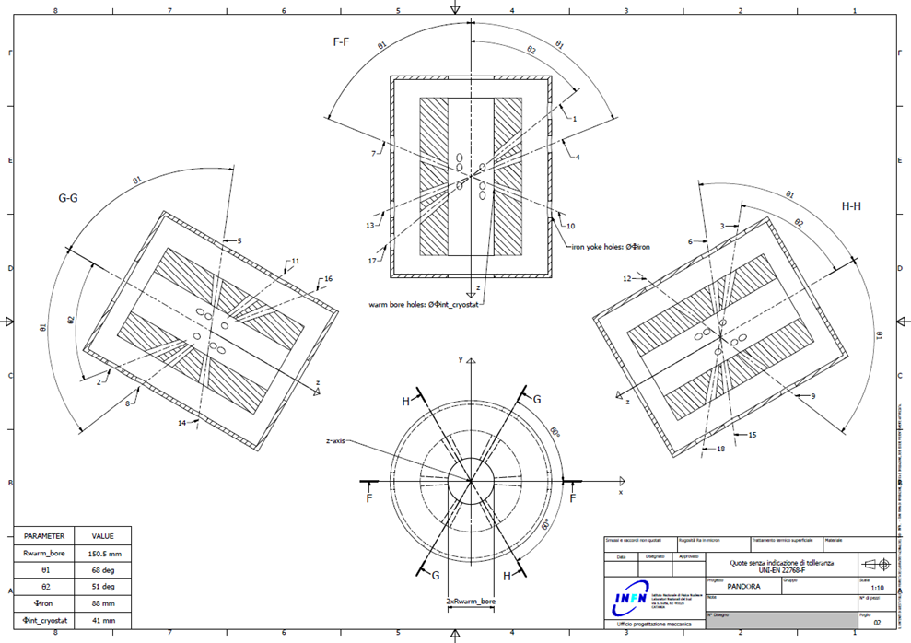
3rd PANDORA Progress Meeting – Legnaro – October 7-8, 2024
Magnetic system: required performances and geometry
A number of detailed magnetic system conceptual drawings have been created.
In particular, the actual (simulated) geometries of the cryostat and iron yoke are depicted.
Conceptual drawings show the detector holes required inclination angles and collinearity along specified magnetic system cut planes.
The PANDORA plasma trap: numerical modeling and technical design
G. S. Mauro – INFN - LNS

Slide 12
3rd PANDORA Progress Meeting – Legnaro – October 7-8, 2024
Outline
Introduction
Magnetic system: required performances and geometry
OPERA numerical design and simulation results
CST Studio Suite validation
Magnetic system procurement status
Technical design from first ranked company
Conclusion and perspectives
The PANDORA plasma trap: numerical modeling and technical design
G. S. Mauro – INFN - LNS

Slide 13
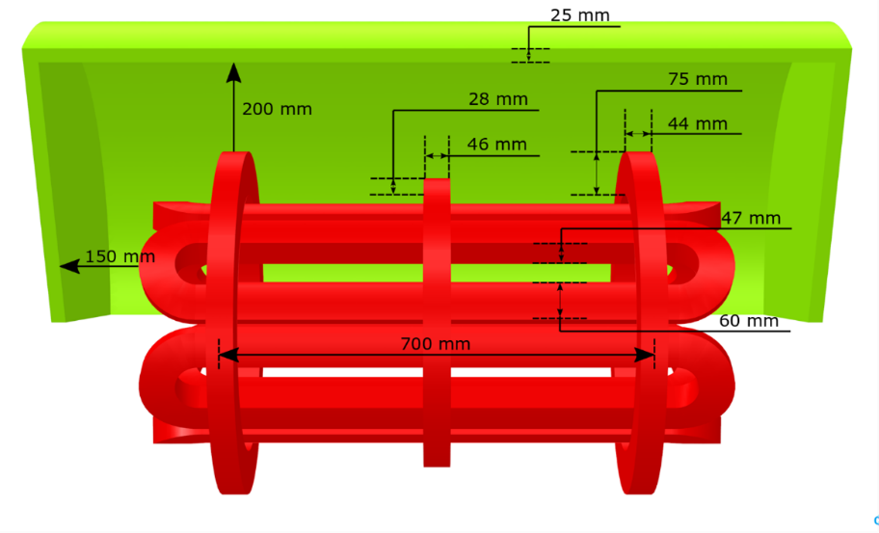
3rd PANDORA Progress Meeting – Legnaro – October 7-8, 2024
OPERA numerical design and simulation results
The magnetic system has been simulated with the commercial software OPERA.
The geometry and current densities employed for the simulations have been chosen in order to reach the magnetic field profile needed.
Two magnetic field profiles have been simulated, named case 1 (18 GHz) and case 2 (21 GHz).
AXIAL COILS
Coil inner radius (INJ, MED, EXT) | 225 / 225 / 225mm
Coil outer radius (INJ, MED, EXT) | 300 / 253 / 300 mm
Center of coil (INJ, MED, EXT) | -350 / 0 / 350 mm
Coil width (INJ, MED, EXT) | 44 / 46 / 44 mm
HEXAPOLE
Hexapole inner radius | 165 mm
Hexapole outer radius | 212 mm
AXIAL COILS
Case 1 (INJ, MED, EXT) | -330 / 220 / -330 [A/mm²]
Case 2 (INJ, MED, EXT) | -365 / 235 / -365 [A/mm²]
HEXAPOLE
Case 1 and 2 | ± 95 [A/mm²]
The magnetic trap is surrounded by an ARMCO iron yoke (green object).
The PANDORA plasma trap: numerical modeling and technical design
G. S. Mauro – INFN - LNS

Slide 14
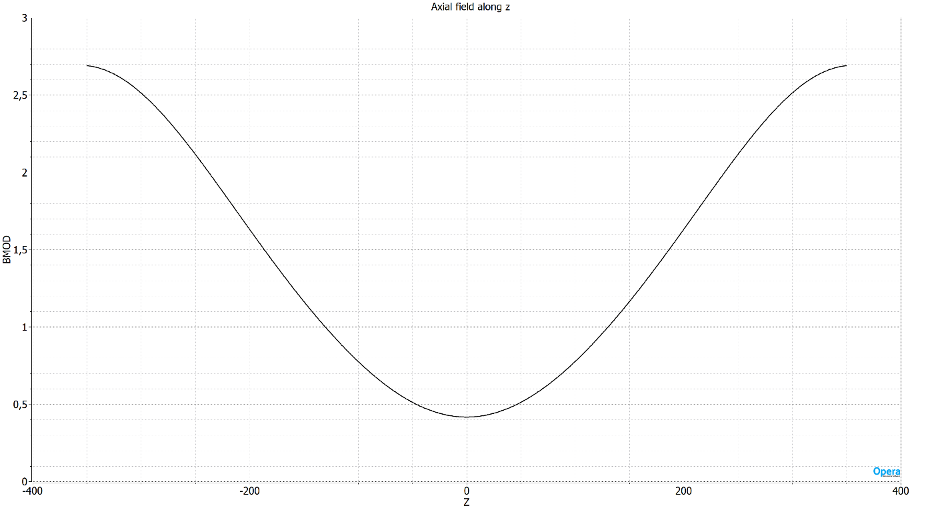
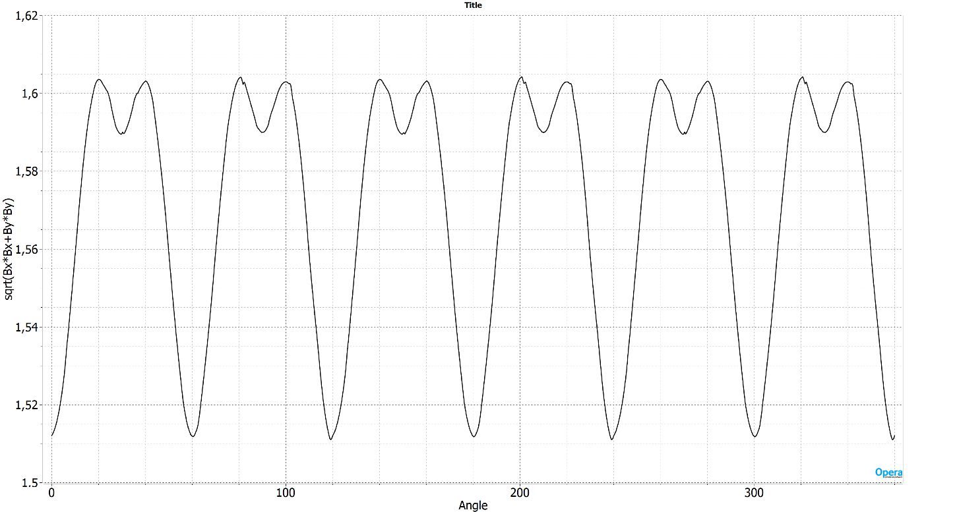
3rd PANDORA Progress Meeting – Legnaro – October 7-8, 2024
OPERA numerical design and simulation results
Radial field component module (|B_{rad}|=$\sqrt{B_{x}^{2}+B_{y}^{2}}$) of the hexapolar stand-alone structure on a circumference of radius R_{CH_IN} = 140 mm (chamber inner radius) and axial position z = 0 mm.
Magnetic field module |B| along plasma chamber z-axis.
The PANDORA plasma trap: numerical modeling and technical design
G. S. Mauro – INFN - LNS

Slide 15
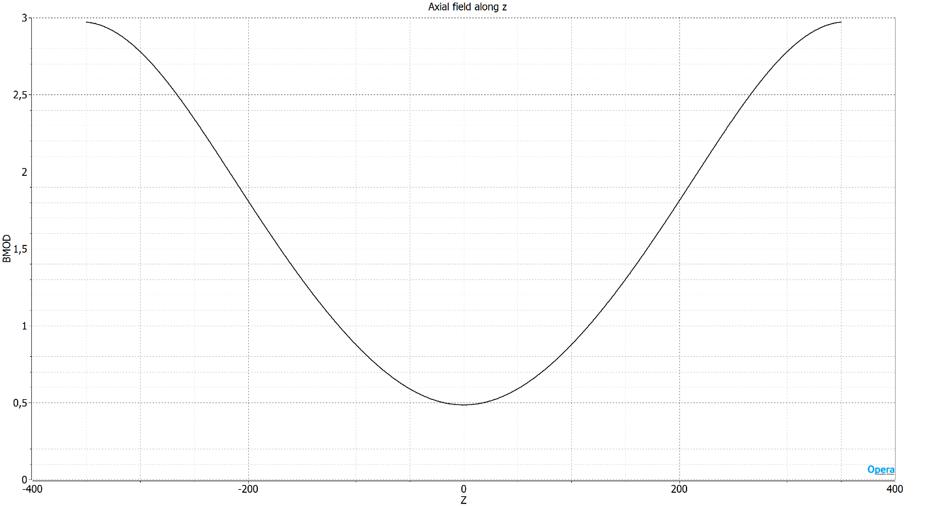
3rd PANDORA Progress Meeting – Legnaro – October 7-8, 2024
OPERA numerical design and simulation results
Radial field component module (|B_{rad}|=$\sqrt{B_{x}^{2}+B_{y}^{2}}$) of the hexapolar stand-alone structure on a circumference of radius R_{CH_IN} = 140 mm (chamber inner radius) and axial position z = 0 mm.
Magnetic field module |B| along plasma chamber z-axis.
The PANDORA plasma trap: numerical modeling and technical design
G. S. Mauro – INFN - LNS

Slide 16
3rd PANDORA Progress Meeting – Legnaro – October 7-8, 2024
Outline
Introduction
Magnetic system: required performances and geometry
OPERA numerical design and simulation results
CST Studio Suite validation
Magnetic system procurement status
Technical design from first ranked company
Conclusion and perspectives
The PANDORA plasma trap: numerical modeling and technical design
G. S. Mauro – INFN - LNS

Slide 17
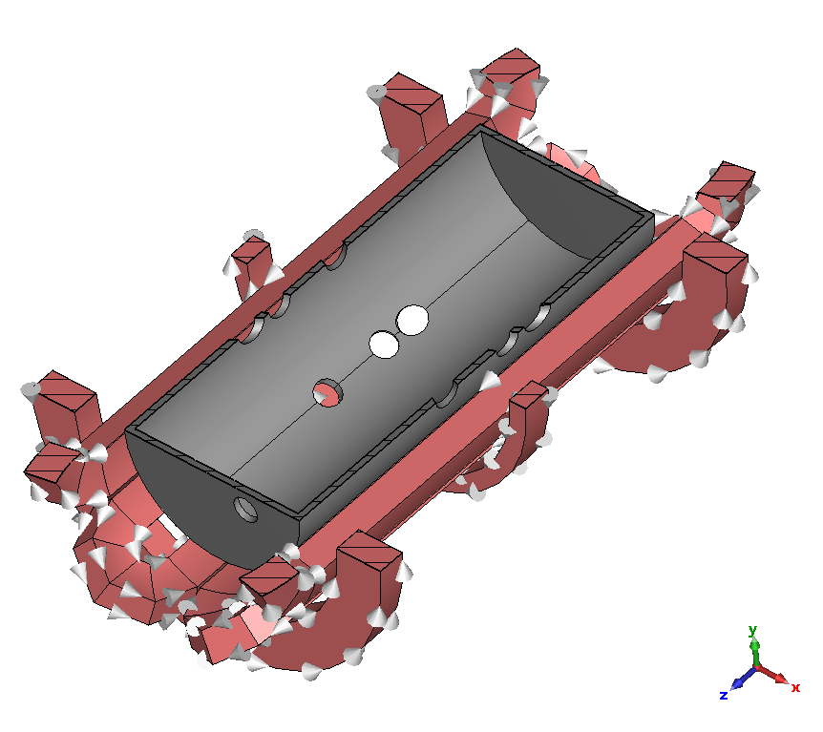
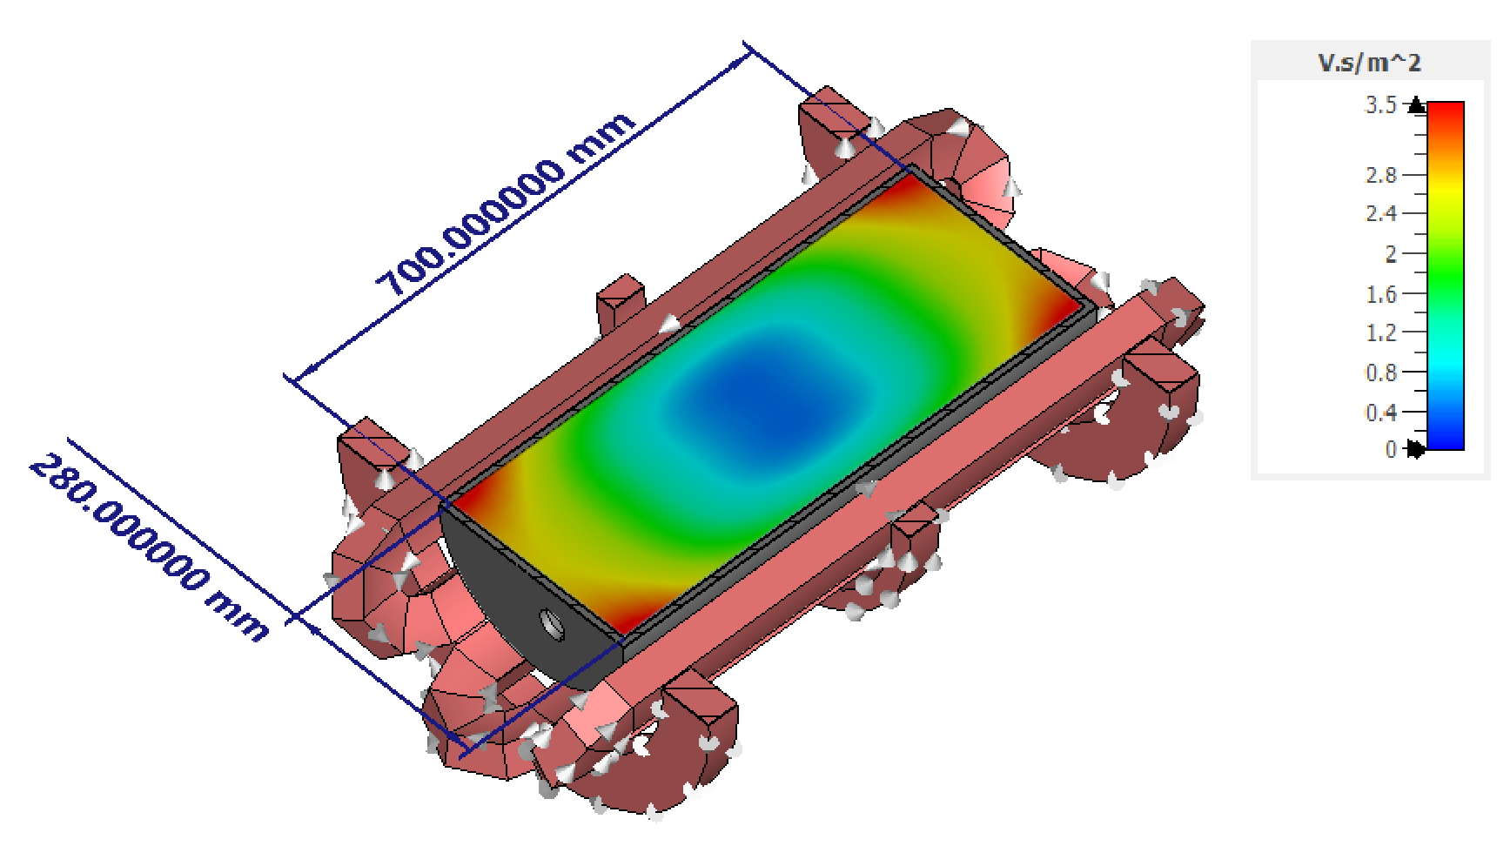
3rd PANDORA Progress Meeting – Legnaro – October 7-8, 2024
CST Studio Suite validation
OPERA magnetic system design validated with CST Studio Suite commercial simulator;
Identify the positions of the magnetic branches, where B-field is intense, for the correct gamma ray detectors placement.
In fact, in these positions a rather strong Bremsstrahlung radiation generated in the plasma is present due to the intense flux of electrons escaping the magnetic trap.
The PANDORA plasma trap: numerical modeling and technical design
G. S. Mauro – INFN - LNS

Slide 18
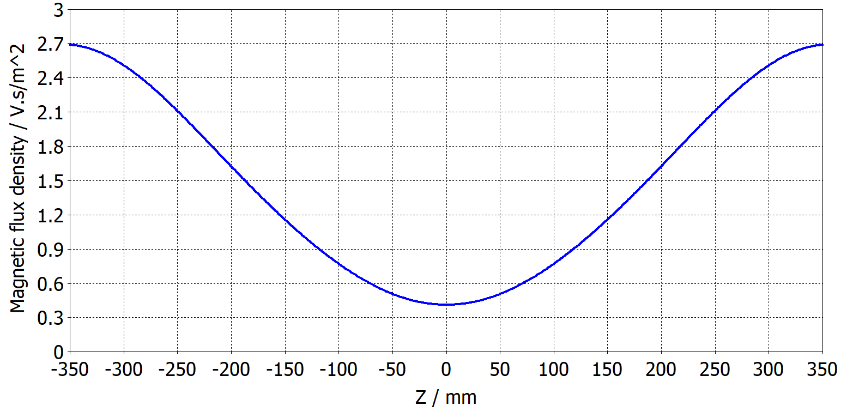
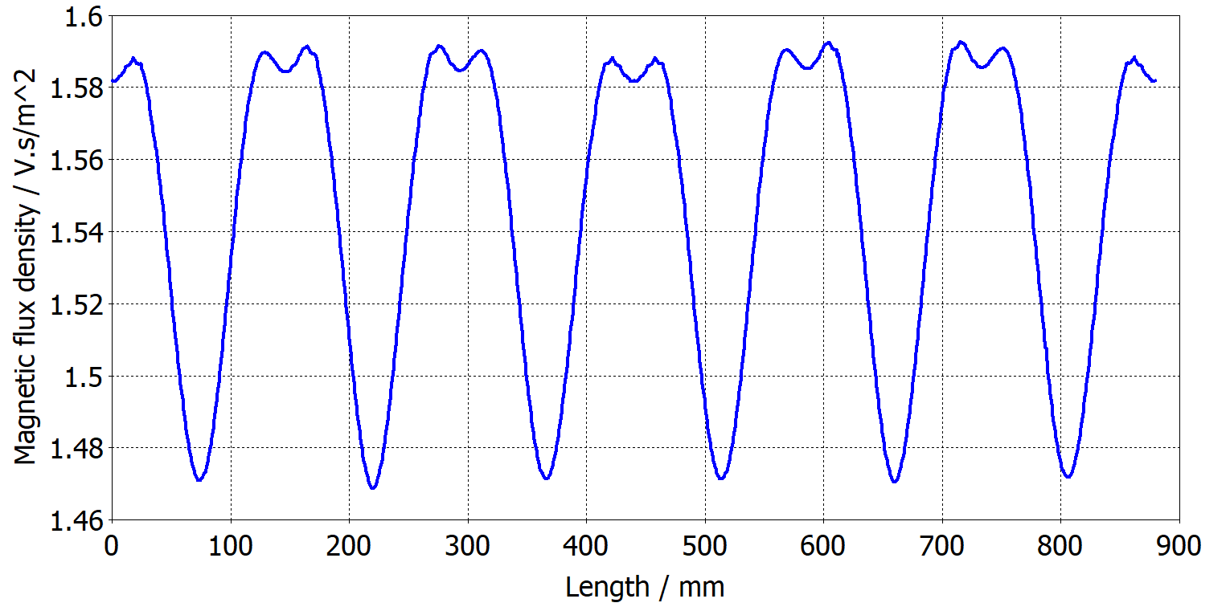
3rd PANDORA Progress Meeting – Legnaro – October 7-8, 2024
CST Studio Suite validation
Simulation results almost equivalent to those obtained with Opera.
The PANDORA plasma trap: numerical modeling and technical design
G. S. Mauro – INFN - LNS

Slide 19
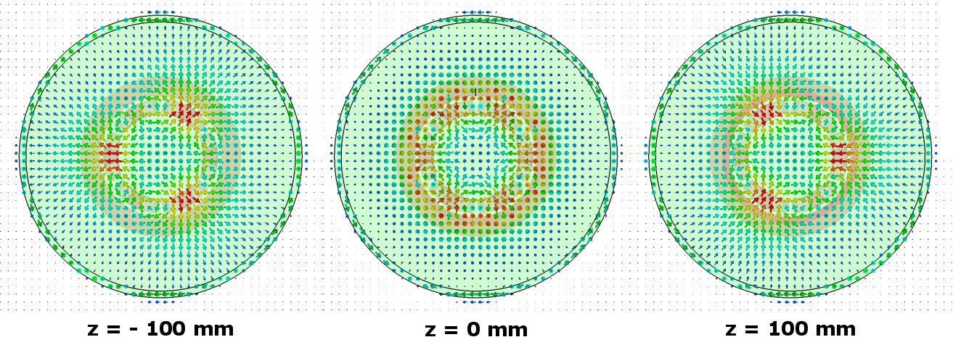
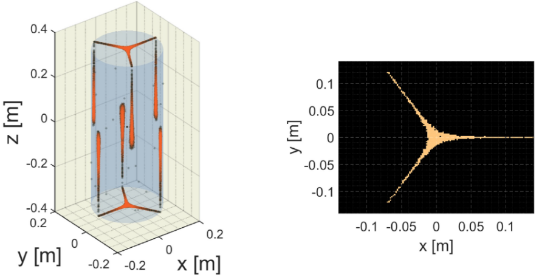
3rd PANDORA Progress Meeting – Legnaro – October 7-8, 2024
CST Studio Suite validation
Numerical simulations have also been performed to identify the positions of the magnetic branches that need to be avoided when placing the array of gamma ray detectors.
In these positions a rather strong Bremsstrahlung radiation generated on the plasma chamber wall is present due to the intense flux of electrons escaping the magnetic trap, that decreases the detectors performance.
The distribution of lost electrons on chamber walls due to the magnetic branches has been calculated through the use of a MATLAB particle mover code, using the magnetic field results from simulations.
Informations relevant for: dimensioning of the bias disk, plasma diagnostics, MW injection waveguides and isotope injection system optimal placement.
See talk by A. Pidatella
The PANDORA plasma trap: numerical modeling and technical design
G. S. Mauro – INFN - LNS

Slide 20
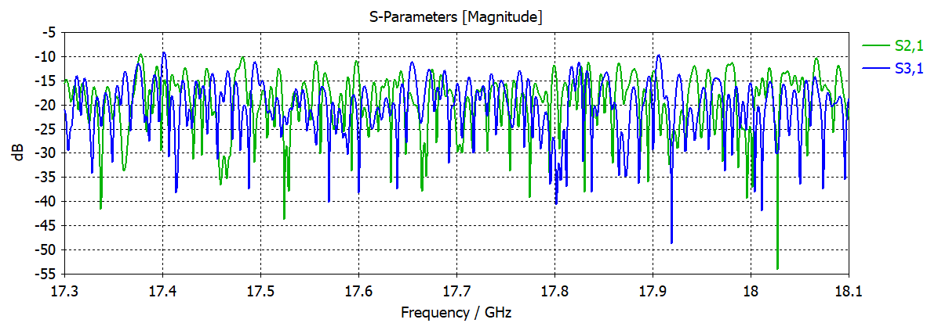
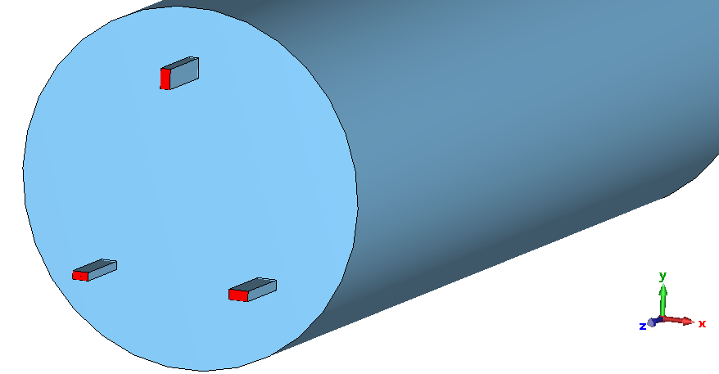
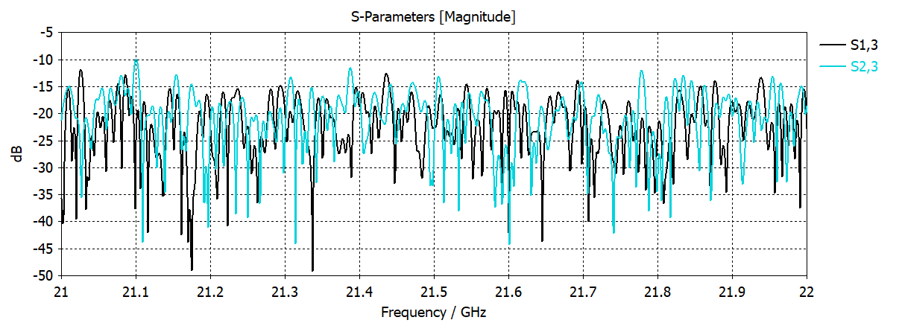
3rd PANDORA Progress Meeting – Legnaro – October 7-8, 2024
CST Studio Suite validation
The position (off-axis microwave injection position) and reciprocal orientation angle between the three waveguides ports shall be chosen so that: power “crosstalk” is minimized.
PORT 1
< -10 dB
< -10 dB
PORT 3
< -10 dB
PORT 2
See talk by G. Torrisi
Simulated “Transmission”/”Cross-Coupling coefficient S_{2,1} S_{3,1,} S_{1,3}, S_{2,3} < -10 dB
The PANDORA plasma trap: numerical modeling and technical design
G. S. Mauro – INFN - LNS

Slide 21
3rd PANDORA Progress Meeting – Legnaro – October 7-8, 2024
Outline
Introduction
Magnetic system: required performances and geometry
OPERA numerical design and simulation results
CST Studio Suite validation
Magnetic system procurement status
Technical design from first ranked company
Conclusion and perspectives
The PANDORA plasma trap: numerical modeling and technical design
G. S. Mauro – INFN - LNS

Slide 22
3rd PANDORA Progress Meeting – Legnaro – October 7-8, 2024
Magnetic system procurement status
The procurement strategy was discussed and elaborated with the PANDORA collaboration group.
The magnetic system is a complex component of the project, whose technical specifications could change during the realization.
It has been decided that the most proficient way to obtain the magnetic system design is to adopt a competitive dialogue procedure between the partecipating companies.
The procedure consisted of a continous exchange of informations between the suppliers and INFN, that allowed the latter to chose the best solution the market had to offer.
Total magnetic system cost: about 1.6M€
The PANDORA plasma trap: numerical modeling and technical design
G. S. Mauro – INFN - LNS

Slide 23
3rd PANDORA Progress Meeting – Legnaro – October 7-8, 2024
Magnetic system procurement status
The procurement procedure consisted of three phases:
Pre-qualification: the Contracting Authority (INFN-LNS) publish the DoR, the Evaluation Criteria and the Pre-qualifications requirements. The suppliers able to accomplish the pre-qualification requirements partecipated at the Competitive Dialogue.
Competitive dialogue: the selected suppliers elaborated their proposal (Technical Documentation) basing on the DoR. During this phase, the best technical solutions were identified (two companies emerged from the procedure).
Tender Phase: the Contracting Authority putted on to tender the best technical solutions emerged in the previous phase.
The tender has been finalized in June 2024.
The first ranked was the Chinese company Xi'an Superconducting Magnet Technology.
The PANDORA plasma trap: numerical modeling and technical design
G. S. Mauro – INFN - LNS

Slide 24
3rd PANDORA Progress Meeting – Legnaro – October 7-8, 2024
Magnetic system procurement status
The FAT will be performed in presence of qualified INFN personnel. The essential list of tests is reported below:
Cryostat leak test.
Axial magnetic field measurement along z-axis (x=0 mm, y=0 mm).
Radial magnetic field measurement along the R = 70 mm and R = 140 mm circumferences (10-degree step) and for 14 sections covering the 700 mm long plasma chamber (50 mm step).
Check stray field values and verify if compliants with requirements.
Energisation of whole magnetic system at max operating parameters for 24 hrs.
Check the collinearity of the axes for pair holes (details about the verification of this will be matter of discussion).
The PANDORA plasma trap: numerical modeling and technical design
G. S. Mauro – INFN - LNS

Slide 25
3rd PANDORA Progress Meeting – Legnaro – October 7-8, 2024
Outline
Introduction
Magnetic system: required performances and geometry
OPERA numerical design and simulation results
CST Studio Suite validation
Magnetic system procurement status
Technical design from first ranked company
Conclusion and perspectives
The PANDORA plasma trap: numerical modeling and technical design
G. S. Mauro – INFN - LNS

Slide 26
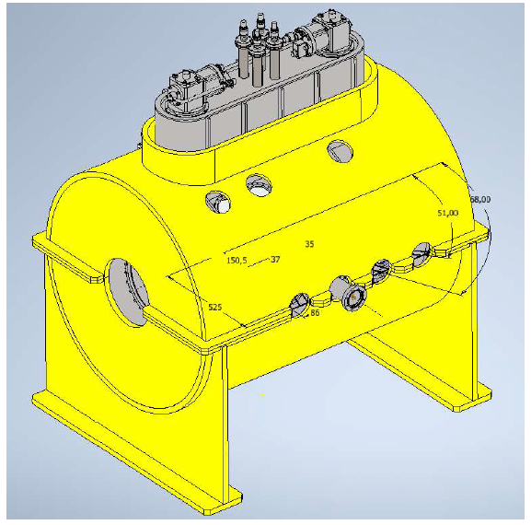
3rd PANDORA Progress Meeting – Legnaro – October 7-8, 2024
Technical design from first ranked company
A magnetic trap layout has been developed by the first ranked company, reproducing the magnetic field of the specification.
Because of the combination of high field and current on the injection solenoids, a standard Western Superconducting Nb3Sn/bronze wire has been selected.
Solenoids have been arranged so that they could be supplied with the same current. A current of 186.4 A will circulate in the solenoids, while a current of 108 A will circulate in the hexapoles.
NOTE: full layout structural analysis is in progress.
The PANDORA plasma trap: numerical modeling and technical design
G. S. Mauro – INFN - LNS

Slide 27
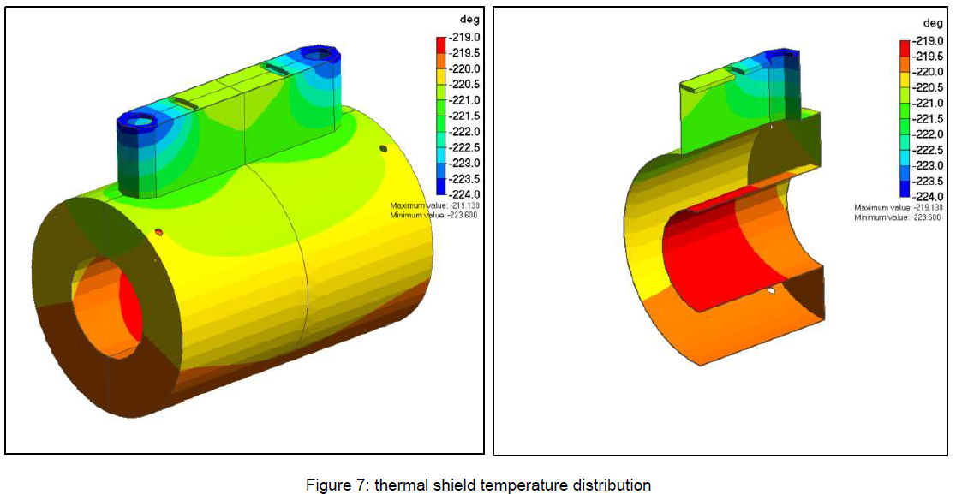
3rd PANDORA Progress Meeting – Legnaro – October 7-8, 2024
Technical design from first ranked company
Finite element simulations have been done to assess the soundness of the thermal design and check that temperature distributions are consistent with the correct operation of the magnet.
Shield walls and central bore have been considered as made out of aluminium alloy.
Heat loads have been set on a simplified model of the thermal shield, where a 15 mm thick OFHC plate is connected to a 3 mm-thick aluminum shield.
Interfaces of the cryocoolers with the top OFHC plate have been set to 48.4 K (-224.6°C).
Temperature on the top plate, where the heat leak from the current leads is directed, is around 51 K (-222°C).
The calculated temperature distribution evidences a temperature gradient of 5 K, with a peak of 54 K (-219°C) that is compatible with the maximum (64 K) allowed by the CryoSaver Current Leads.
Thermal shield temperature distribution
The PANDORA plasma trap: numerical modeling and technical design
G. S. Mauro – INFN - LNS

Slide 28
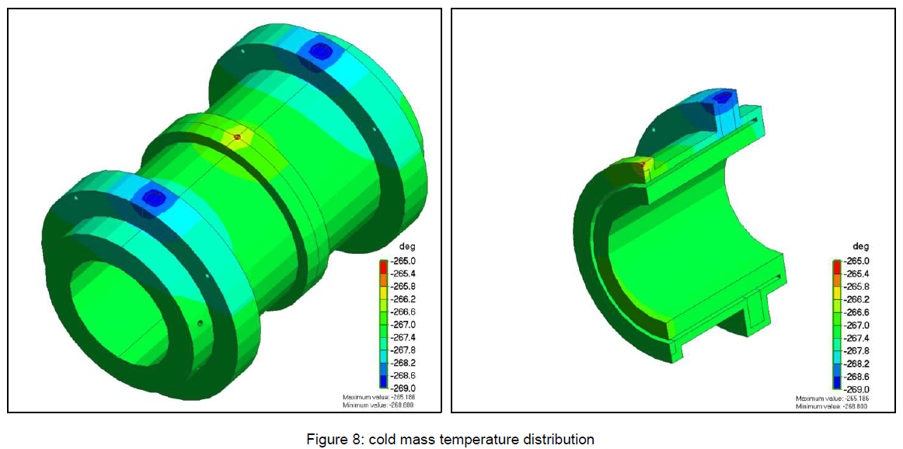
3rd PANDORA Progress Meeting – Legnaro – October 7-8, 2024
Technical design from first ranked company
Inner cylinder has been considered as a full aluminum element, while the solenoid coils have been assumed as made out of an isotropic material with a thermal conductivity of 3 W/m K @ 4.2 K.
Interface with the 2nd stage crycoolers cold finger has been set to -268.8°C (4.2K), while the input coming from solenoid current leads has been applied at the center of the magnet.
Results indicate a reasonable operating temperature peak below 7 K on the central solenoid and below 6 K on the injection solenoids.
Cold mass temperature distribution
The PANDORA plasma trap: numerical modeling and technical design
G. S. Mauro – INFN - LNS

Slide 29
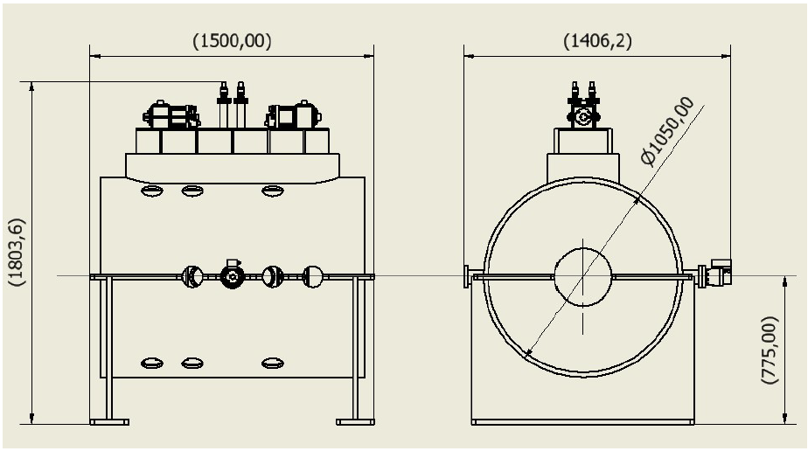
3rd PANDORA Progress Meeting – Legnaro – October 7-8, 2024
Technical design from first ranked company
The general arrangement of the magnet features a cold mass vacuum-isolated inside a cryostat that, on its turn, is housed inside a magnetic yoke.
The magnet will be equipped with 4 current leads: a couple to bring current to the solenoids, another couple to bring the current to the hexapoles.
Cryocoolers are vertically arranged, in a service turret positioned on top of the vacuum vessel, that houses also the current leads.
Estimate mass of the full structure is 2622 kg:
Magnetic yoke: 1457 kg;
Cryostat: 441 kg;
Thermal shield: 68 kg;
Cold mass: 586 kg;
Cryocoolers: 70 kg.
The PANDORA plasma trap: numerical modeling and technical design
G. S. Mauro – INFN - LNS

Slide 30
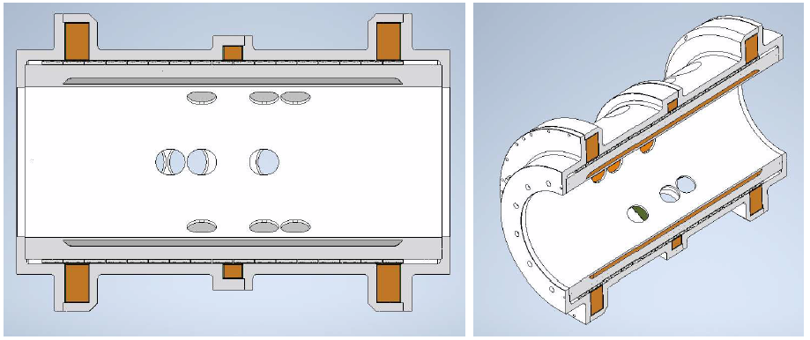
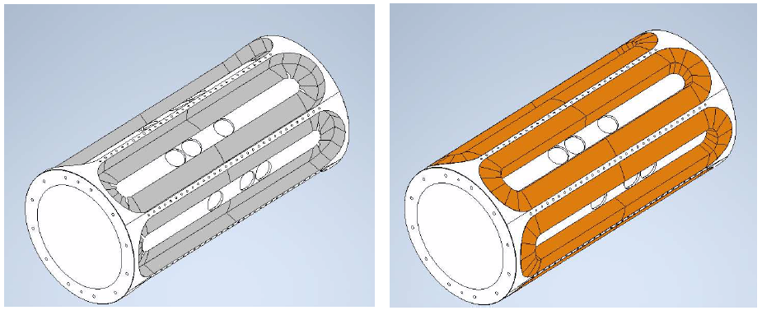
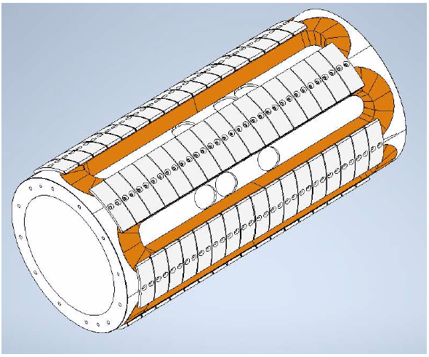
3rd PANDORA Progress Meeting – Legnaro – October 7-8, 2024
Technical design from first ranked company
Coils are housed in a mechanical structure made of several components machined out of forged aluminium alloy cylinders.
Hexapoles are housed in appropriate recesses machined on the central cylinder, where they are finally embedded.
Hexapoles are kept in position against radial forces by means of brackets.
The PANDORA plasma trap: numerical modeling and technical design
G. S. Mauro – INFN - LNS

Slide 31
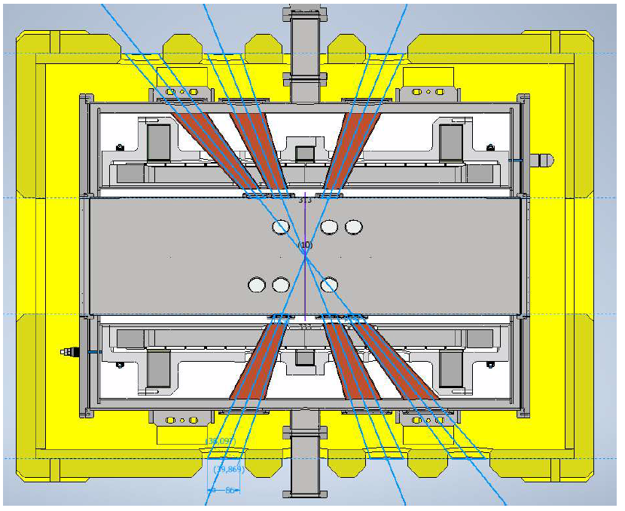
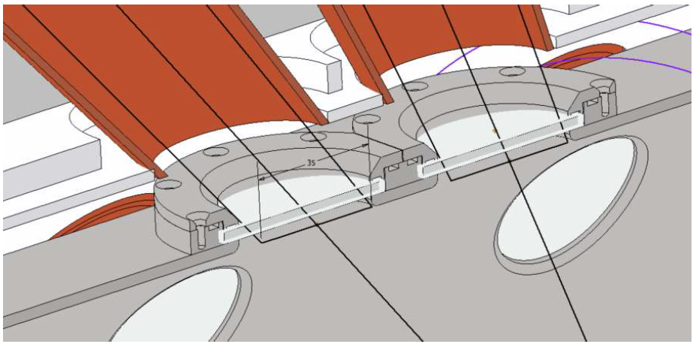
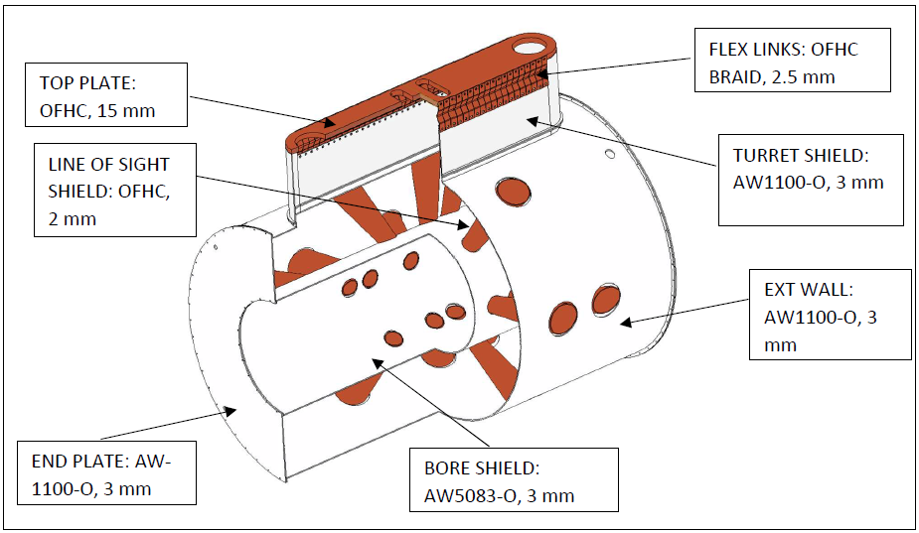
3rd PANDORA Progress Meeting – Legnaro – October 7-8, 2024
Technical design from first ranked company
Detailed Geant4 simulations have been performed at INFN-LNS to obtain the optimal dimensions of the cryostat tapered holes that will act as collimators for the HPGe detectors.
The arrangement of the 18 lines of sight as required in the technical specification showed to be rather challenging.
Most of the difficulties are concentrated at the level of the vacuum vessel warm bore, where windows will be clamped against it by means of a screwed frame.
Copper conical shielding elements will be employed around the lines of sight to protect the cold mass against radiation from the quartz/aluminum windows.
The design requires rather accurate manufacturing and assembling.
The PANDORA plasma trap: numerical modeling and technical design
G. S. Mauro – INFN - LNS

Slide 32
3rd PANDORA Progress Meeting – Legnaro – October 7-8, 2024
Outline
Introduction
Magnetic system: required performances and geometry
OPERA numerical design and simulation results
CST Studio Suite validation
Magnetic system procurement status
Technical design from first ranked company
Conclusion and perspectives
The PANDORA plasma trap: numerical modeling and technical design
G. S. Mauro – INFN - LNS

Slide 33
3rd PANDORA Progress Meeting – Legnaro – October 7-8, 2024
Conclusion and perspectives
PANDORA magnetic trap will operate at the frequencies of 18 and 21 GHz.
According to these operating frequencies, a minimum-B magnetic system design has been carried out.
The PANDORA magnetic system has then been validated with commercial simulation softwares OPERA and CST, showing excellent agreement with each other in terms of field profiles.
A detailed Document of Requirements, containing all the magnetic field and geometry requirements and specifications, has been compiled.
Tender procedure for the PANDORA magnetic system ended in June 2024.
First studies and mechanical drawings from the first ranked company are available. A detailed interaction between supplier and INFN will begin during next months.
The FAT will be performed 12 months after signing the contract.
Thank you!
The PANDORA plasma trap: numerical modeling and technical design
G. S. Mauro – INFN - LNS

