Slide 1
FOOT
Study on vertex
FACULTY OF PHYSICS
CURRICULUM: Fundamental interactions: Theory and Experiment
Luana Testa, Christian Finck, Marco Toppi
testa.1913445@studenti.uniroma1.it

Slide 2
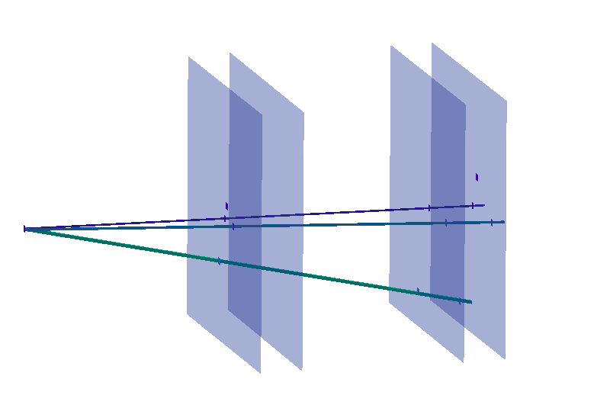
Study on Vertex
Vertex reconstruction algorithm
Acquire distributions to assess the algorithm's performance:
CNAO2023
Comparison with MC
Comparison with previous campaign
CNAO2022
GSI2021
Classification of Vertices:
-1 no BM (check only for not valid vertex)
0 Diffusion
1 Valid vertex: is a fragmentation vertex
2 Nuclear reaction
(not valid vertex consist of only one track)

Slide 3
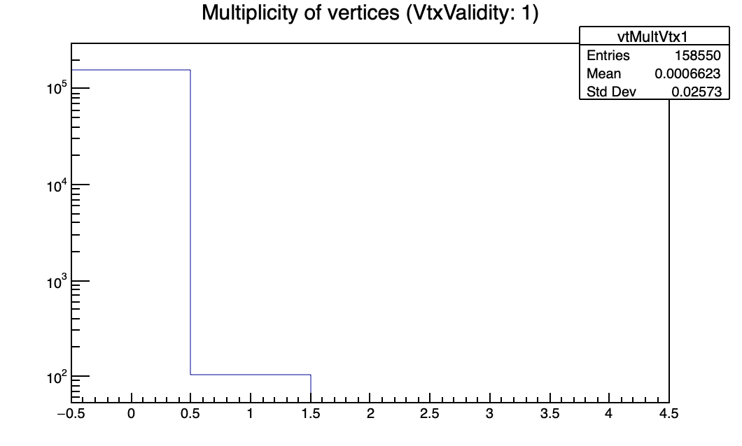
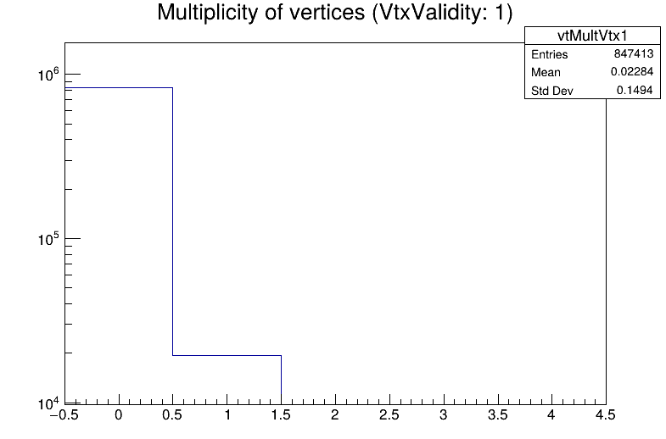
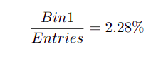
Old configuration
“Valid” and “not valid” vertex classifications
Entries: Events with a single track in the BM and at least one track in the vertex
Bin 0: event with 0 valid vertex
Bin 1: event with 1 valid vertex
Layer 3= OFF
CNAO2023
Run: 6136
MC: CNAO23_PS
Bin 0: event with 0 valid vertex
Bin 1: event with 1 valid vertex
Run: 6124

Slide 4
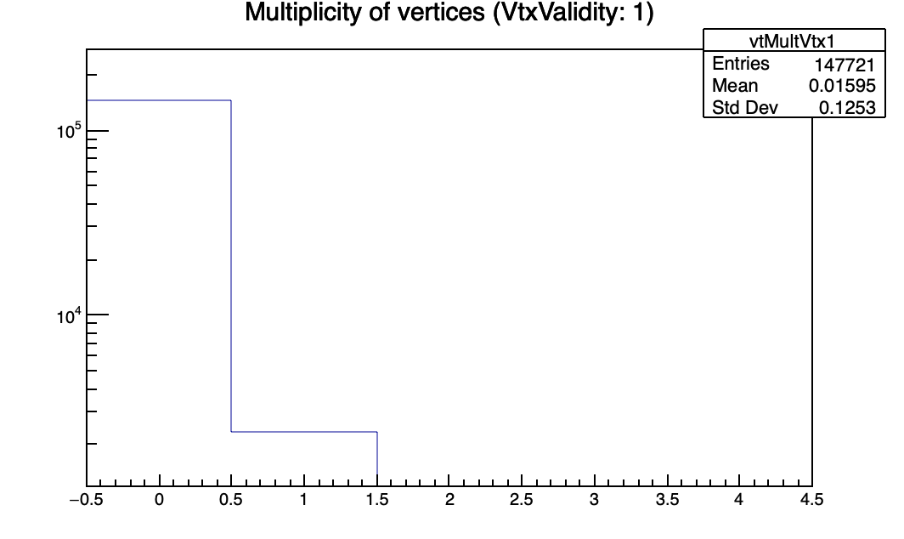
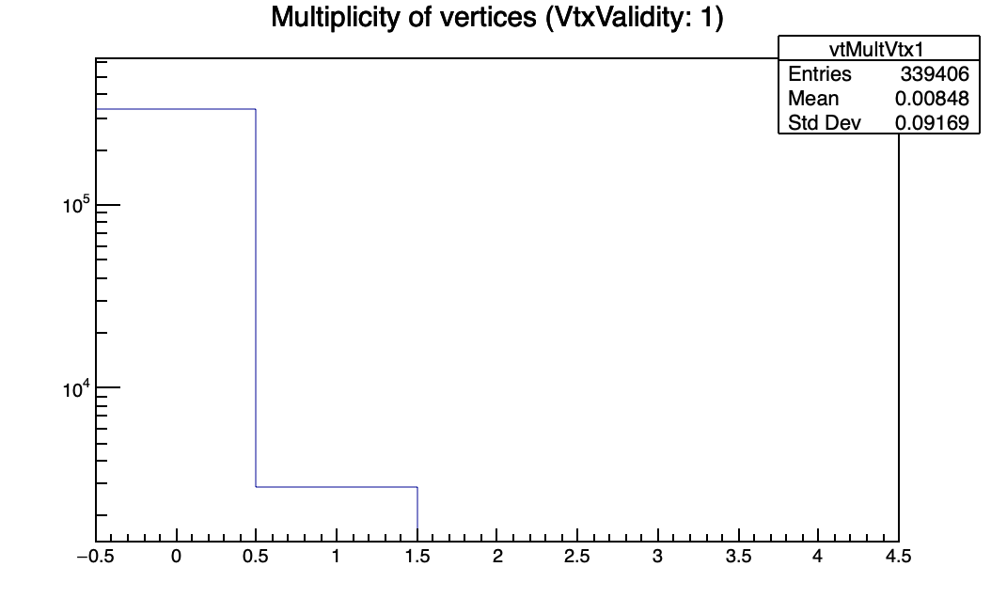
Layer 3= OFF
GSI2021
CNAO2022
Run: 4305
Run: 5468

Slide 5
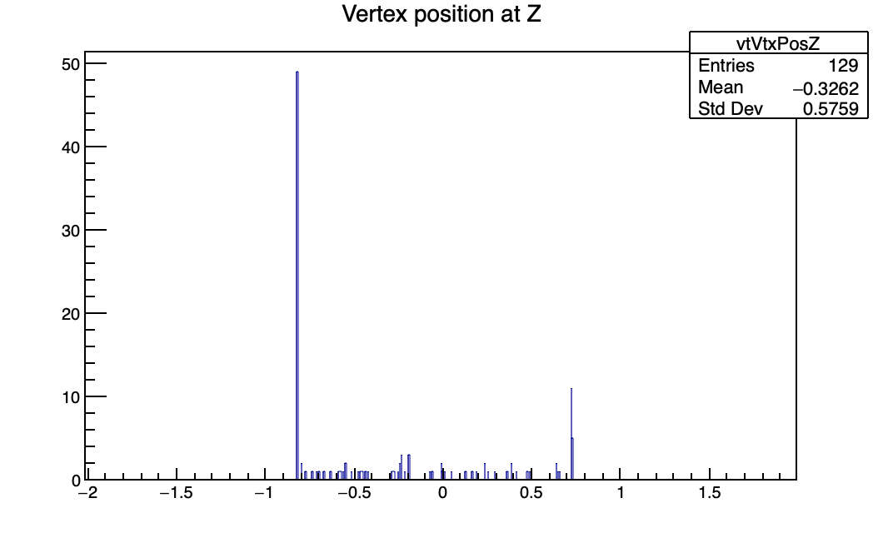
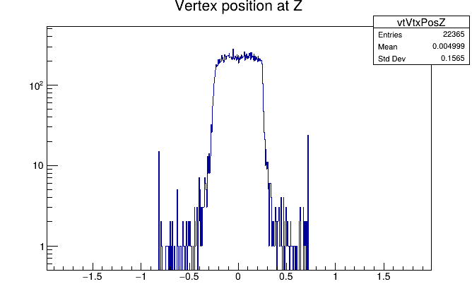
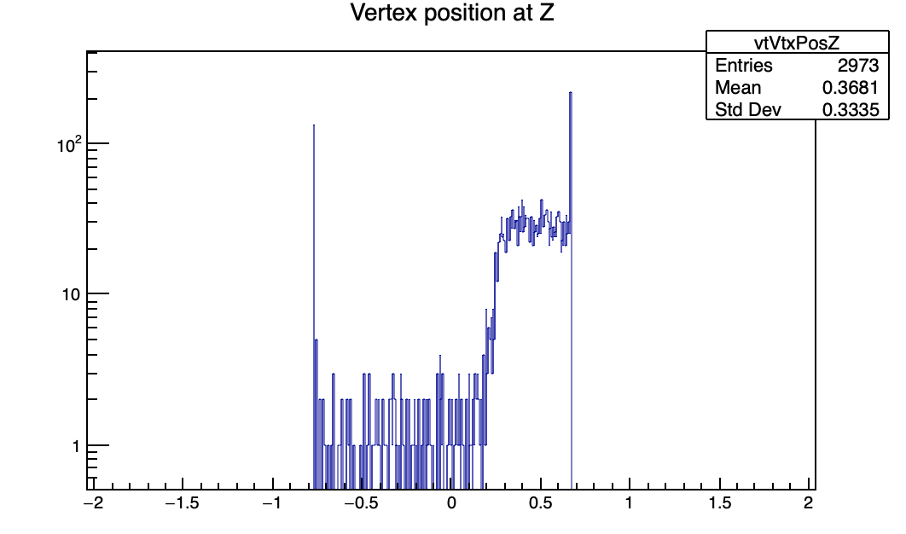
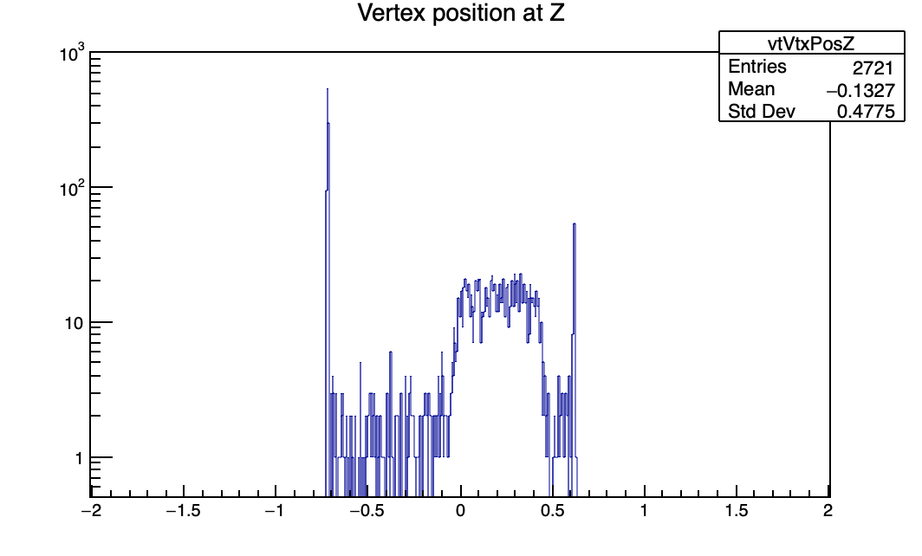
Z position of valid vertex
CNAO2023
Run: 6136
MC CNAO23_PS
CNAO2022
Run: 5468
GSI2021
Run: 4305

Slide 6
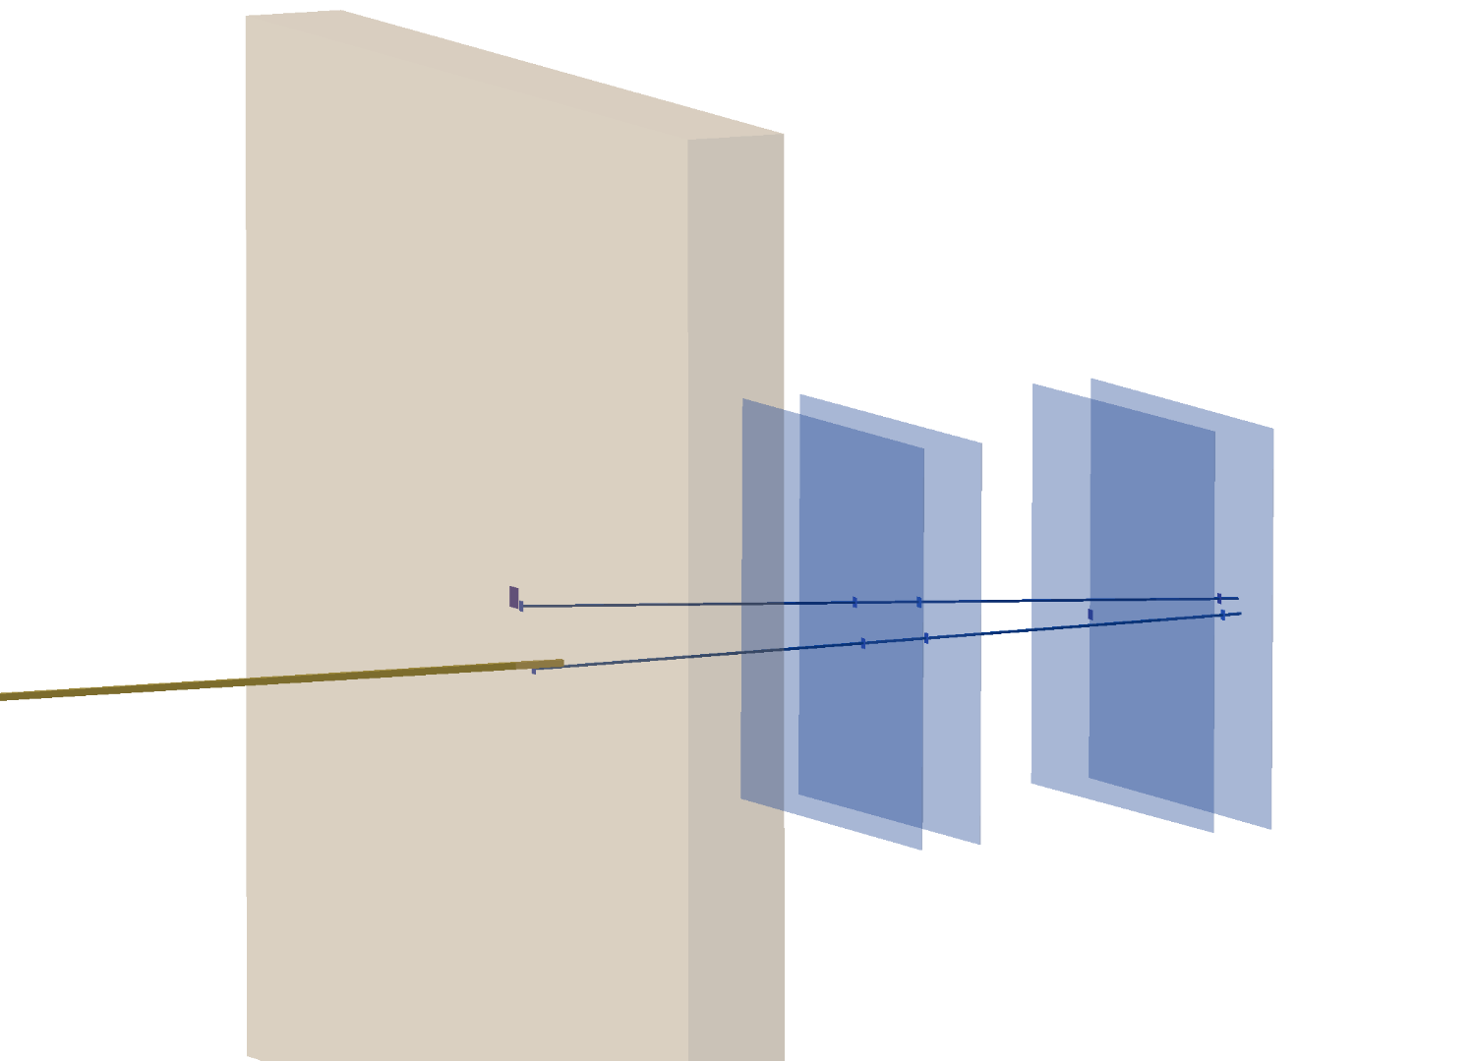
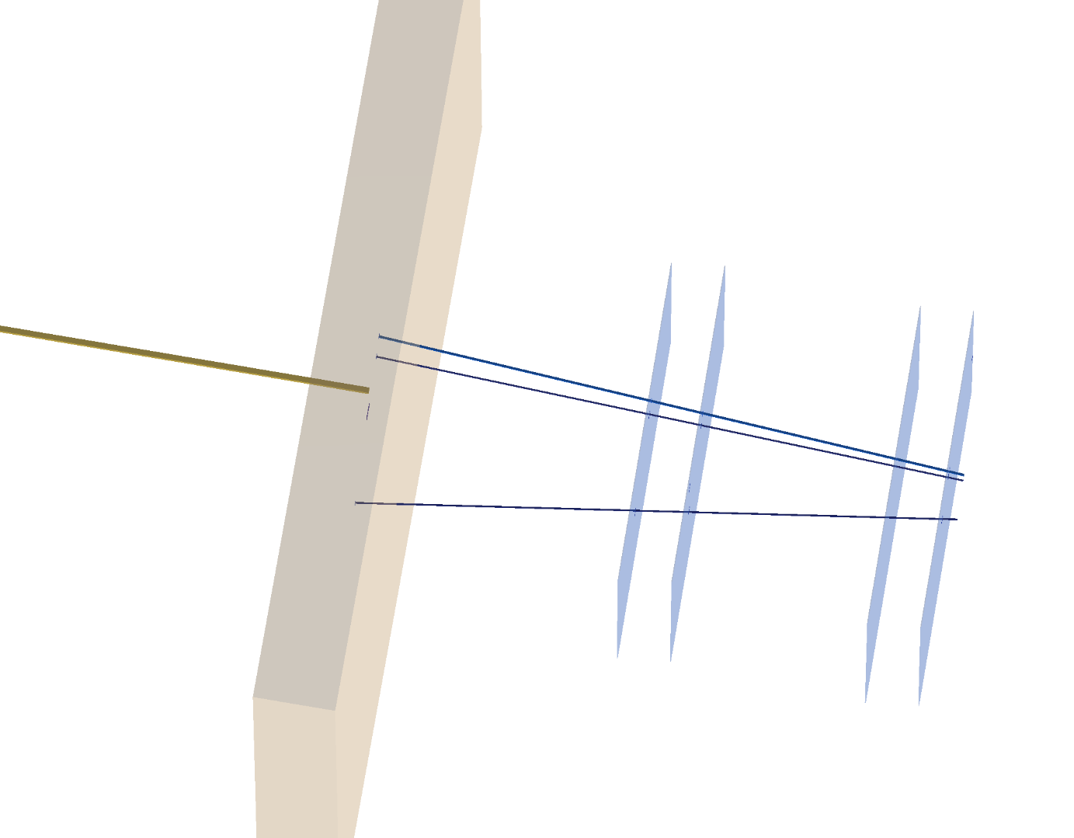
Event display
Old config.: 4 3 2 1.
BEAM
X
New config.: 1 2 3 4.
run: 6136 event:536
run: 6136 event:384
By examining the event display, it was observed that for several events, the vertices appeared to be present but were oriented in the opposite direction.
Now in Shoe the vertex is in the right position
Still needed some inter-alignment (Chris) and alignements with other detectors (Yun)
In the new configuration the “inefficient” layer is the number 2
From now on, the new configuration will be used

Slide 7
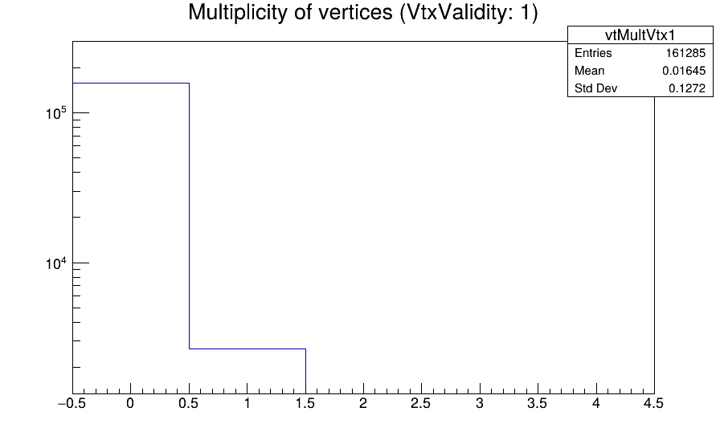
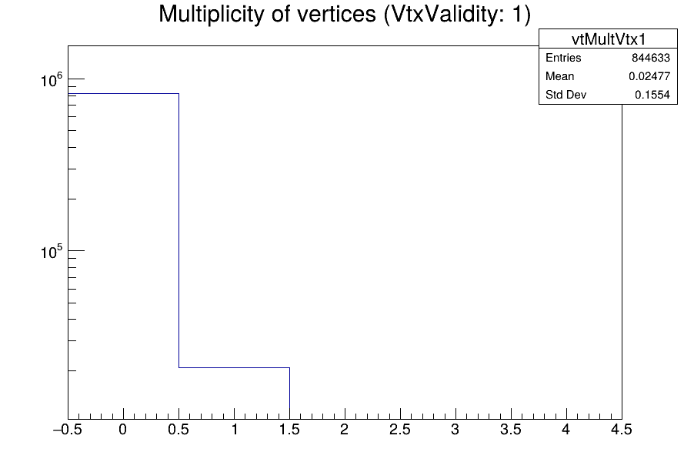
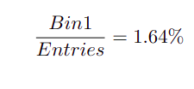
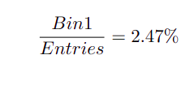
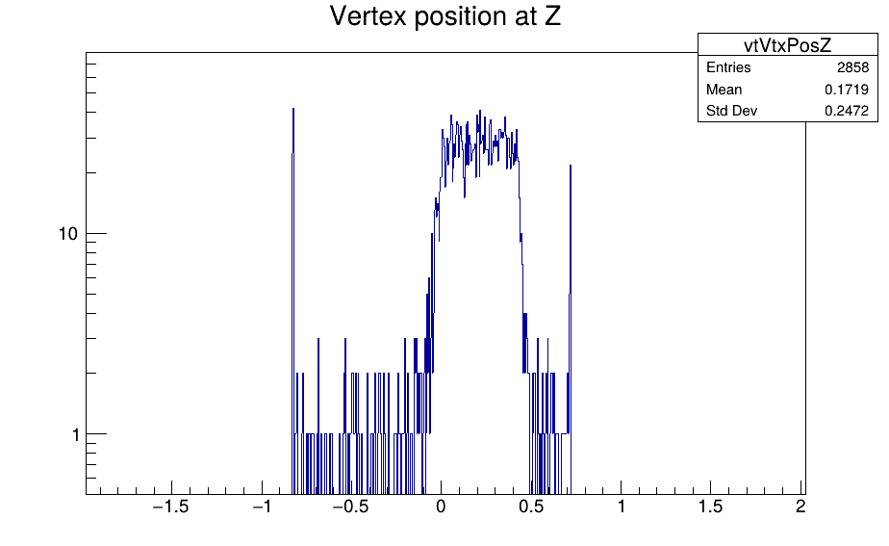
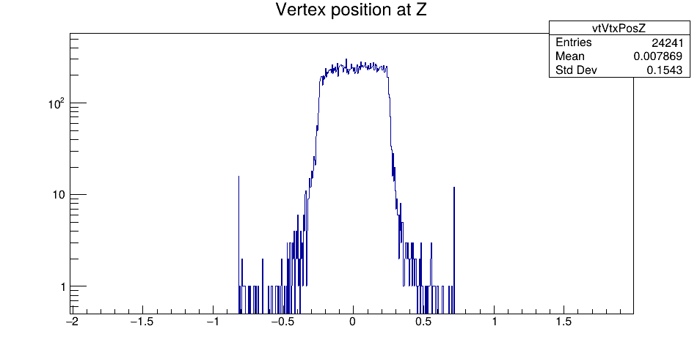
Valid Vertex
New configuration
CNAO2023 Run: 6136
Layer 2= OFF
MC: CNAO23_PS
Z position of valid vertex
Run: 6136
MC
Z [cm]
Z [cm]

Slide 8
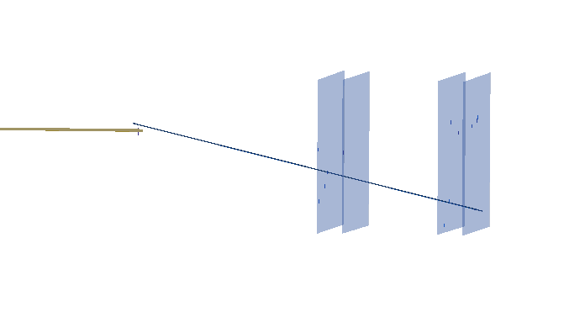
Are we losing tracks?
By examining the event display, it appears that with one of the four layers turned off (layer 2), and since we need at least three layers to reconstruct a track, some particles are not detected by one of the three functioning layers, making it impossible to track them.
Additionally, it appears that there are significantly more flag 2 vertices in the data compared to the Monte Carlo (we will examine this in detail later).
We are losing tracks?
Is the threshold too high?
TW points:3
charge : 2
charge : 3
charge : 1
Study:
All run ->Threshold study
Protons run

Slide 9
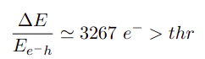
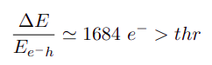
Threshold M28
M28 :
100 MeV Protons
Energy for electron-hole pair production:
200 MeV Protons
1 GeV Protons (MIP)
* NIST PSTAR program

Slide 10
Threshold studies with 2 cm All target
entries= event with 1BM and at least 1 vtx-track
run | valid vtx/entries
6064 | (4,65±0.12)%
6065 | (4,76±0.16)%
6066 | (4,95±0.29)%
6067 | (4,84±0.29)%
6068 | (4,86±0.12)%
MC | (7.15±0.03)%
These runs are referred to as threshold studies, but currently, from the logbook, it is not very clear whether only the inner track threshold is varied or also that of the vertex. Therefore, there are two possibilities:
if only the inner track threshold is varied, the study on valid vertices does not provide useful information
if the vertex threshold is also varied since the percentages of valid vertices remain consistent within uncertainties as the threshold varies, indicating that it does not appear to be a threshold dependence
Why do the data deviate so much from the MC?
Are we losing particles (e.g., protons)?
Can Flag 2 events be valid vertices that we can recover?
Is it possible that some of the valid vertices we are observing have missing tracks, and if so, can we recover them?

Slide 11
Flag 2
In Shoe already implemented by Chris the code to flag the “nuclear reaction” (flag 2: only 1 track in vtx with θ>θ_MS)
Up to now it was not used in reconstruction, we want put it back after fix some bags
We are interested to recover event like: C -> B+p, with missing proton in the VD
What the algorithm do:
BM_direction -> θ_BM=direction.Theta()
Trk_direction -> θ_Trk=Trk_direction.Theta()
(θ_BM- θ_Trk) < Scattering_angle
Correction:
BM_direction
Trk_direction
BM_direction.Angle(Trk_direction)< Scattering_Angle
Scattering_angle:
The angle obtained in this way seems to be too small, now all invalid tracks are assigned a flag of 2.
An angle of 0.2 rad seems to be a better cut. A detailed study is expected in the future through the MC.
*The Angle() method in ROOT calculates the angle between two vectors.

Slide 12
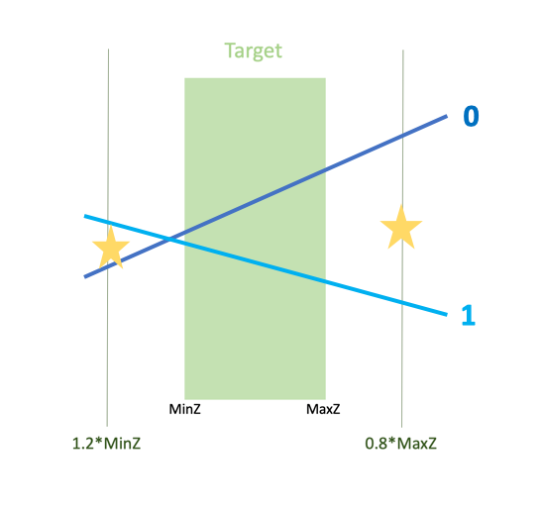
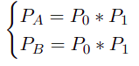
Some vertices lost
We fix a small bug in the vertex algorithm, that was preventing to reconstruct some valid vertex! 💪💪
For each pair of tracks it create 2 vertices as the middle point of the intersection of the 2 tracks with the 2 plane
Calculate the probability of each trace to belong to the found vertices
A B
If slope ==0?
Sometimes (when the vtx is in the center of the target) the slope turns out to be 0, so the program enters the else and redefines B. It can happens that by doing so the vtx turns out to be outside the range in which it is searched for.
Solution: When the slope is 0 we tighten the range at the two extremes A=A+0.1 and B=B-0.1 (0.1 for All and 0.01 for C and Poly).

Slide 13
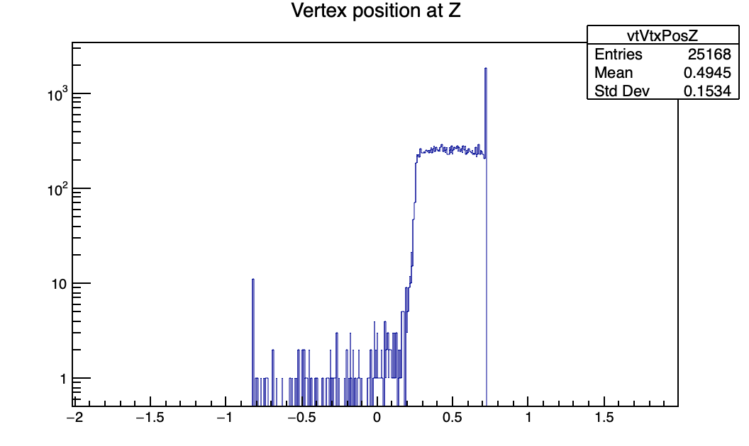
Misposition of the vertexes with respect to the target (in data and in MC)
CNAO2022: run 5468
CNAO2023: run 6136
GSI2021_MC
Only in the MC campaigns: CNAO23PS_MC, CNAO2022_MC, GSI21PS_MC the position of the vertices is center in the target
Is there some reconstruction algorithm effect or is only geometry?

Slide 14
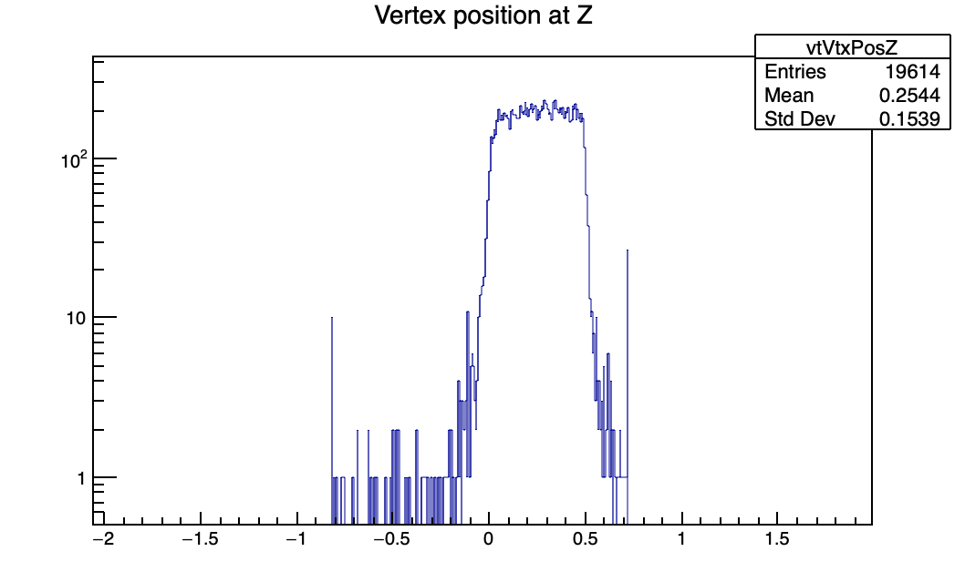
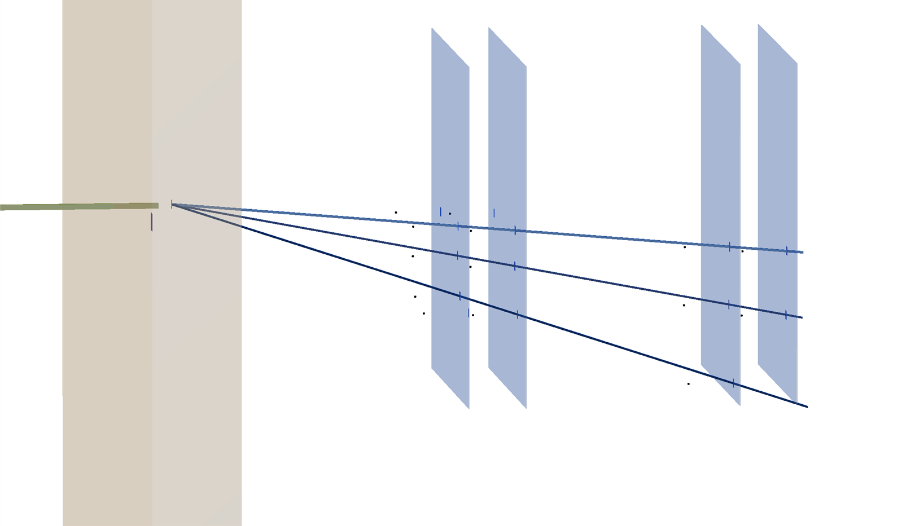
Center of the target: MC
GSI2021_MC
CNAO2023_MC
Event6_12C_CNAO2023_MC
Event0_16O_C_400_1_GSI2021_MC
The reconstructed MC deviates from the true MC (the dots).
Solution: It was only a matter of geo-files to be fixed (not committed yet)

Slide 15
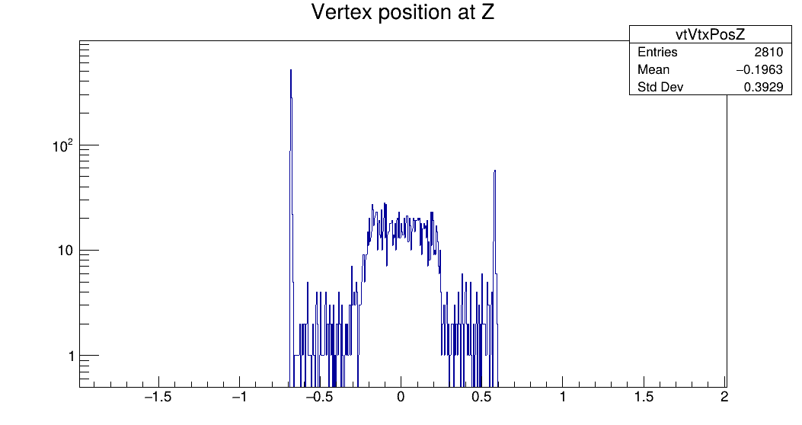
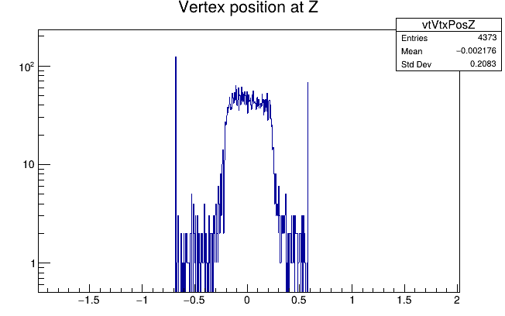
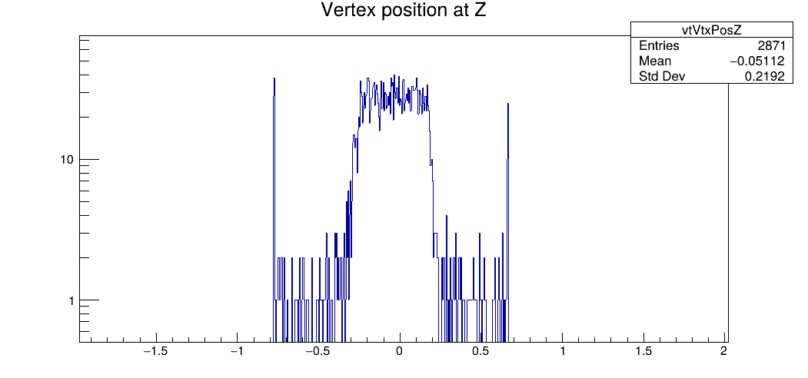
2. DATA
GSI2021: run 4305
VtxPosZ: 2.10 VtxPosZ: 1.90
The shift appears to be associated with a measurement error: the vertexes position measurements is more precise
Although the difference is very small (on the order of 2 mm) it has a significant impact when we require the vertex to be within the target
Modified the geo files: not yet committed is Shoe
CNAO2022: run 5468
VtxPosZ: 2.35 VtxPosZ: 1.90
CNAO2023: run 6136
VtxPosZ: 2.60 VtxPosZ: 2.35

Slide 16
Pile-up
Is the pile-up a real problem for the vtx?
Looking at the events through DisplayFOOT we can see that the vertex is able to reconstruct the valid vertexes even when there are primaries in the same event, and at the same time if in an event there are multiple tracks but they are all primaries the algorithm is able to recognize them.
If the valid vertex was the one matched with the BM and the fragments detected by subsequent detectors, could we recover this type of event?

Slide 17
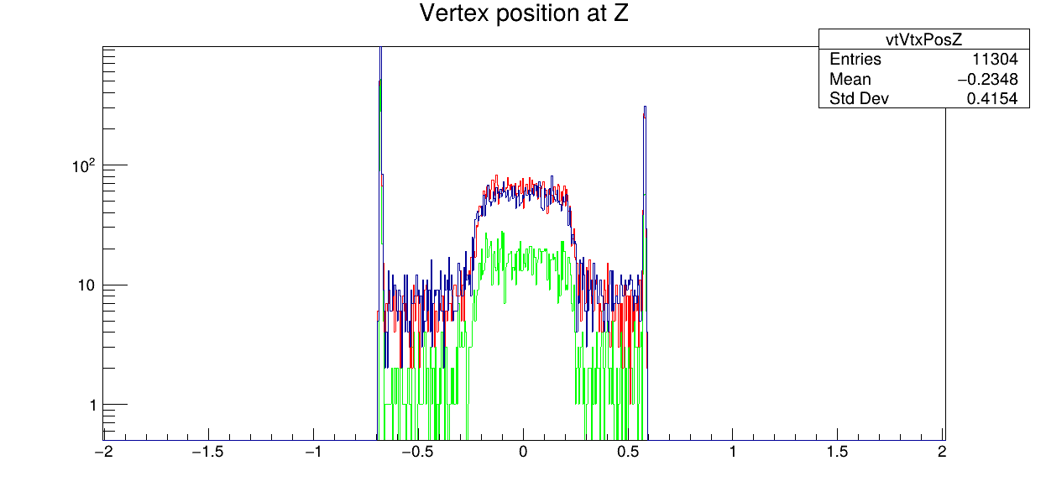
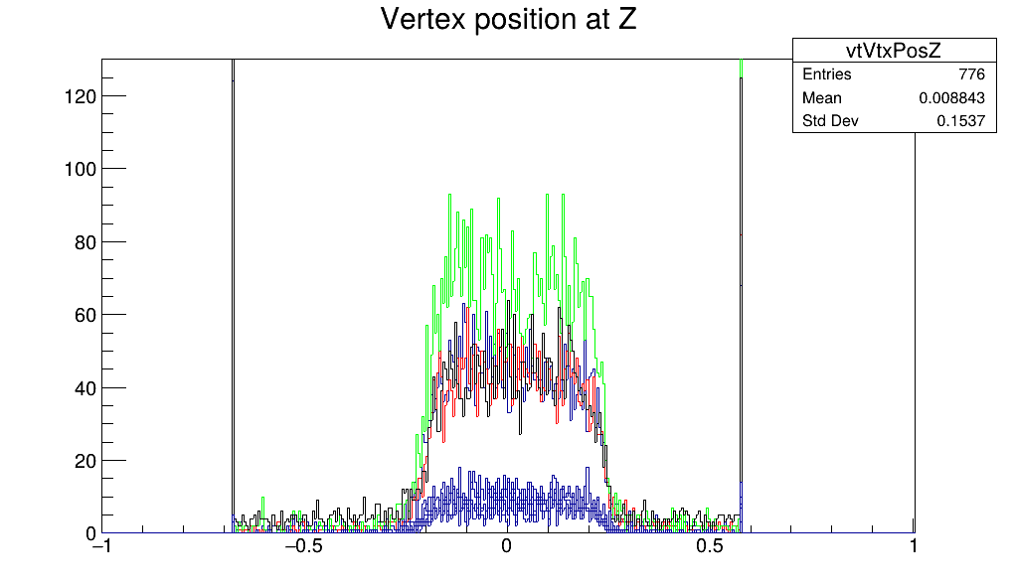
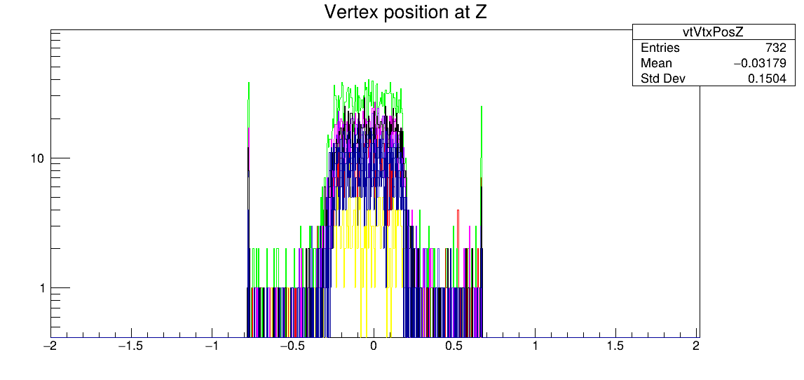
PileUp
GSI2021 CNAO2022 CNAO2023
Looking across different campaigns, we now observe a peak corresponding to the target in all of them. This is linked to the higher fragmentation probability within the target compared to that in air.
However, upon closer examination, it appears that in GSI2021, valid vertices outside the target are present in higher percentages compared to other campaigns. Could this abundance of valid vertices outside the target be an effect of higher PileUp in GSI2021? Or is there some vertexes algorithm to be understood?

Slide 18
Next steps
Study of post-tracking
Studies on layer 2 (Activating it introduces only noise or, despite its low efficiency, it allows us to recover some tracks?)
Efficiency studies for different configuration (protons 100-200 MeV, C 200 MeV, O 200-400 MeV)
PileUp studies:
Differences between the different campaigns
Using the global tracking are we able to recover some valid vertex that have PileUp?
Interesting Aspects to Explore
Use the proton runs on All and with the help of the inner track to measure the efficiencies of the vertex layers
Potential Measurements for CNAO2024
Using a new layer 2 to estimate efficiencies of the other 3 layers (if efficiency does not decrease over time)

Slide 19
Thank you for your attention!

