Slide 1

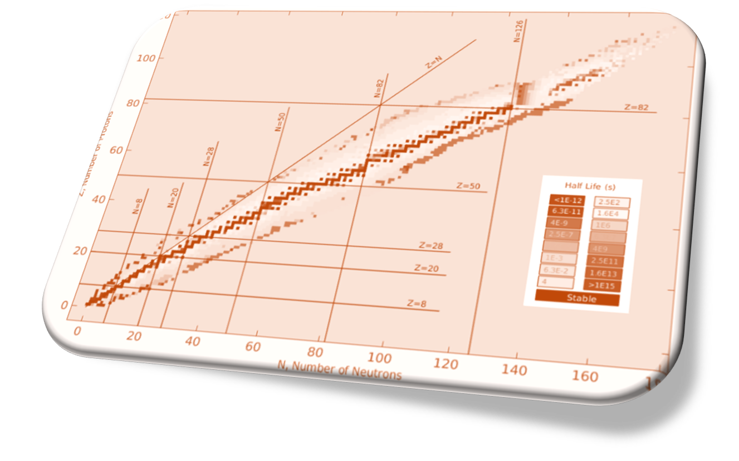
Review CSN3
R. Nania - 30th September 2024
Thanks to P. Giubellino, P. Antonioli, A. Dainese, N. Jacazio, L. Cosentino, D. Santonocito, L. Venturelli, S. Leoni, A. Nannini, M. La Cognata, C. Agodi
https://web.infn.it/csn3/index.php/it/
How nuclear physics can contribute to the European Strategy for Particle Physics (ESPP)

Slide 2

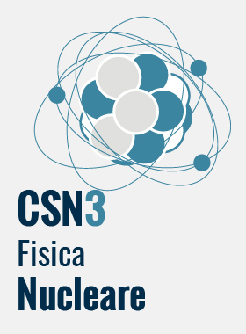
1
CSN3
Research Lines 2024
Following NUPECC indications
CSN3
QUARKS AND HADRON DYNAMICS
KAONNIS (LNF) , JLAB12 (JLAB), MAMBO (Mainz-Bonn), ULYSSES (JPARC), EIC (BNL)
CNS1
CSN2
2
NUCLEAR STRUCTURE AND REACTION MECHANISM
FORTE, GAMMA, CHIRONE, NUCL-EX, NUMEN_GR3, PRISMA_FIDES
(LNS, LNL, GANIL,
ISOLDE, GSI, RIKEN,….)
PHASE TRANSITION IN HADRONIC MATTER
ALICE (CERN) , NA60_PLUS(CERN)
3
CNS2
INFN-E
CNS4
INFN-ACC
CSN5
4
5
NUCLEAR ASTROPHYSICS
ASFIN, ERNA, LUNA , n_TOF, PANDORA (LNS, LNL, LNGS, CIRCE , CERN…)
FUNDAMENTAL INTERACTIONS
LEA (CERN), JEDI (Jülich),VIP (LNGS), FAMU (RAL)
CNS2
6
Applications and societal benefits
FOOT (GSI,CNAO,TIFPA, HIT)
SPESMED (LNL)
INFN-4LS

Slide 3
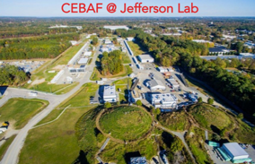
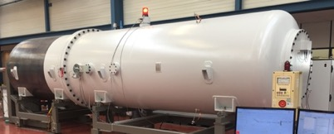
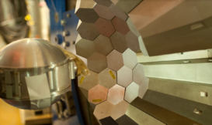
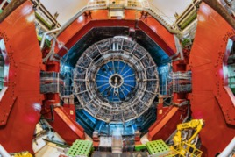
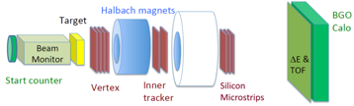
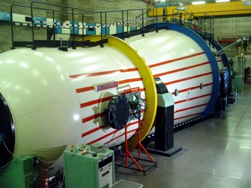
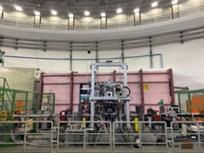
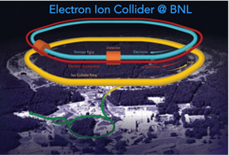
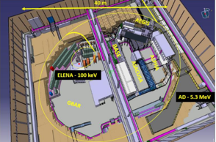
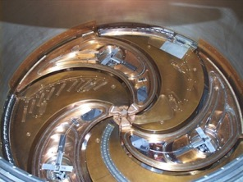
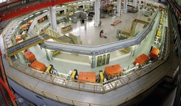

INFN Third Commission on Nuclear Physics
Huge energy interval covered. Many Laboratories involved around the world.
N_TOF, LUNA, ERNA
GAMMA/AGATA
FOOT
ALICE
JLAB
Energy
keV
MeV
GeV
TeV
JEDI
SIDDHARTA
EIC
LEA
NUMEN, ASFIN2,NUCLEX, CHIRONE, FORTE
Web site for 2022 workshops in INFN laboratories https://web.infn.it/nucphys-plan-italy/
Publications EPJ FOCUS site https://epjplus.epj.org/component/toc/?task=topic&id=1894
See also the review paper on PID techniques prepared mostly by young researchers
Trends in particle and nuclei identification techniques in nuclear physics experiments

Slide 4
ECFA guidelines for inputs from national HEP communities to the European Strategy for Particle Physics
2) The ESG's remit explicitly states that “The Strategy update should include the preferred option for the next collider at CERN and prioritised alternative options to be pursued if the chosen preferred plan turns out not to be feasible or competitive”.
It is imperative that the European HEP community should provide explicit feedback on both the preferred and alternative options for this “next collider at CERN”, which will be the Laboratory's next flagship project, and an explanation of any specific prioritisation.

Slide 5
ECFA guidelines for inputs from national HEP communities to the European Strategy for Particle Physics
4) The remit given to the ESG also specifies that “The Strategy update should also indicate areas of priority for exploration complementary to colliders and for other experiments to be considered at CERN and at other laboratories in Europe, as well as for participation in projects outside Europe.” It would thus be most useful if the national inputs explicitly included the preferred prioritisation for non-collider projects. Specific questions to address:
a) What other areas of physics should be pursued, and with what relative priority?
b) What are the most important elements in the response to 4a)? (The set of considerations in 3b should be used).
c) To what extent should CERN participate in nuclear physics, astroparticle physics or other areas of science, while keeping in mind and adhering to the CERN Convention? Please use the current level and form of activity as the baseline for comparisons.

Slide 6

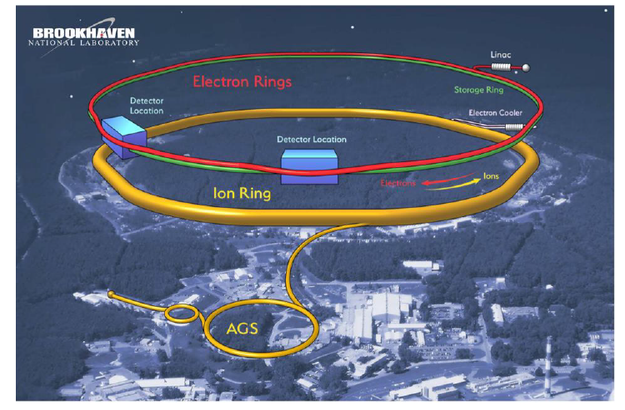
High Energy Frontier
ELECTRON ION COLLIDER @ BNL.
Project Design Goals
• High Luminosity: L= 10³³ – 10³⁴cm⁻²sec⁻¹, 10 – 100 fb⁻¹/year
• Highly Polarized Beams: 70%
• Large Center of Mass Energy Range: Ecm = 29 – 140 GeV
• Large Ion Species Range: protons – Uranium
• Large Detector Acceptance and Good Background Conditions
• Accommodate a Second Interaction Region (IR)
Start operation 2032-2033

Slide 7
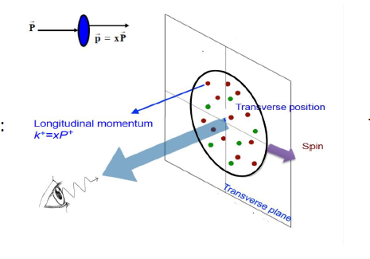
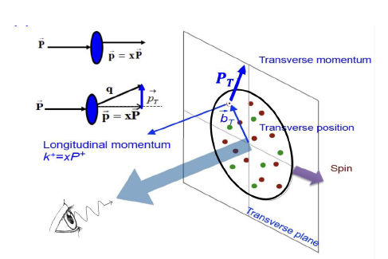
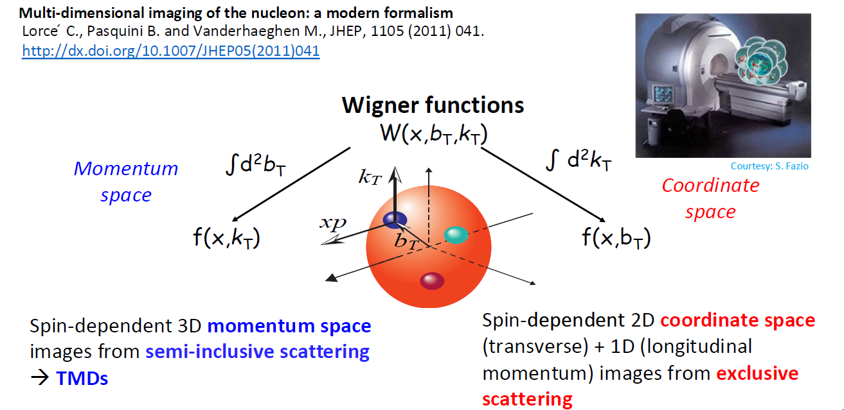
High Energy Frontier
From this vision
To this vision
→ Transverse Momentum Distribution
(TMDs)s
→ Generalized Parton Distributions
(GPDs)
Program already started by JLAB at lower energies

Slide 8
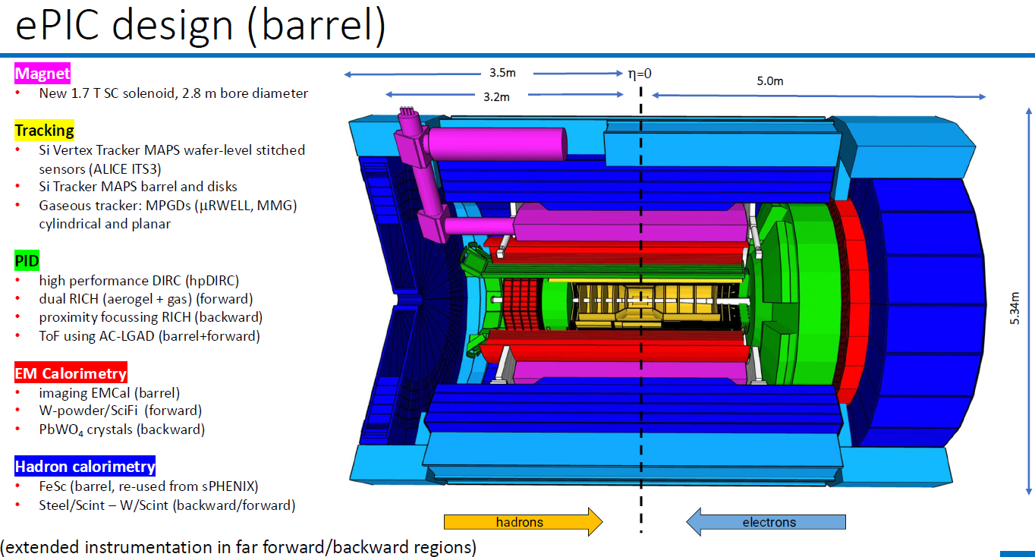
High Energy Frontier
Large collaboration with LHC and FCC groups for detector developments (CERN Detector Road MAP)

Slide 9
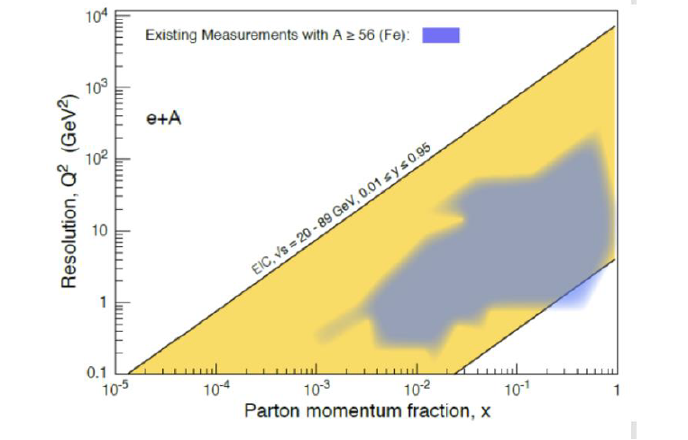
High Energy Frontier
DGLAP and saturation models offer different prediction (Q² , A, x dependence)
channels → di-hadron angular correlations, diffractive particle production in eA
strategy→ large Q² span at fixed x performing A scan!

Slide 10
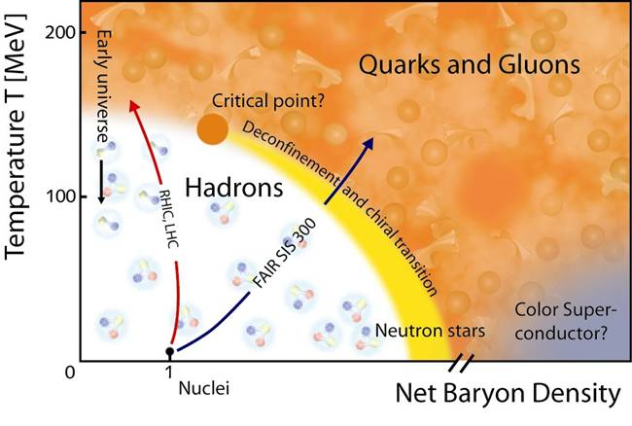
High Energy Frontier
The exploration of the phase diagram
of strongly interacting matter
LHC/FCC
NA60+ proposal CERN SpS
Strong LHC program with all experiments involved and long range plans already under discussion

Slide 11
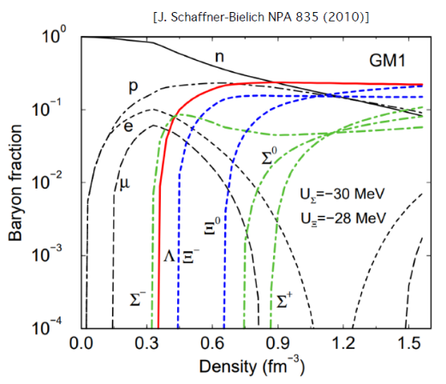
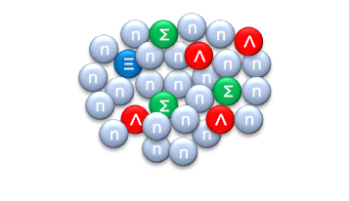
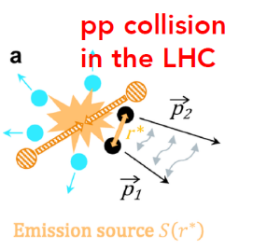
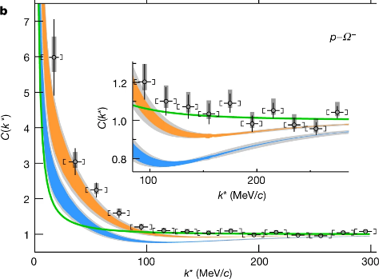
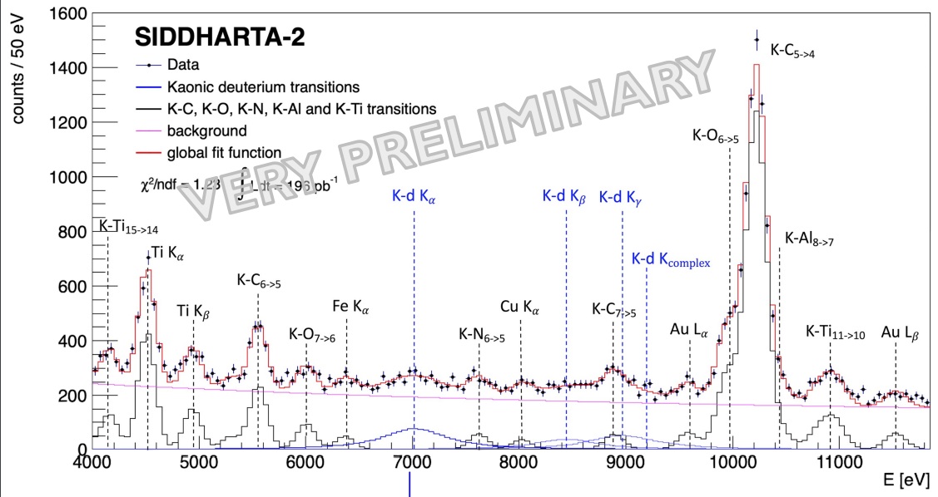
Via particle correlations at LHC
CSN3
How to study interactions among quarks in stars ?
Nature 588, pages232–238 (2020)
Via Kaonic atoms
A more precise kaonic helium/deuterium measurement in gas by SIDDHARTA-2 at the DAΦNE

Slide 12
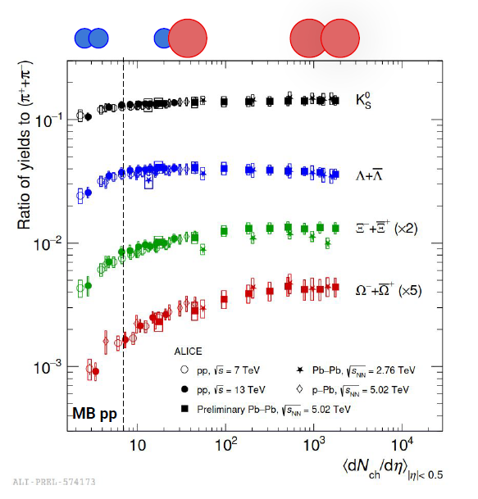
High Energy Frontier
An example of strong interconnection among different size systems (pp,pPB and PbPb collisions) at LHC : the importance of particle multiplicity.
NB: LHC/RHIC important achievement marks the passage from a description purely thermodynamic to QCD based Monte Carlo approaches.
Core-corona models → EPOS4
Models of microscopic interactions of strings → Pythia 8.3
See here
Question: is HI-LHC event comparable to what expected at FCC ?

Slide 13
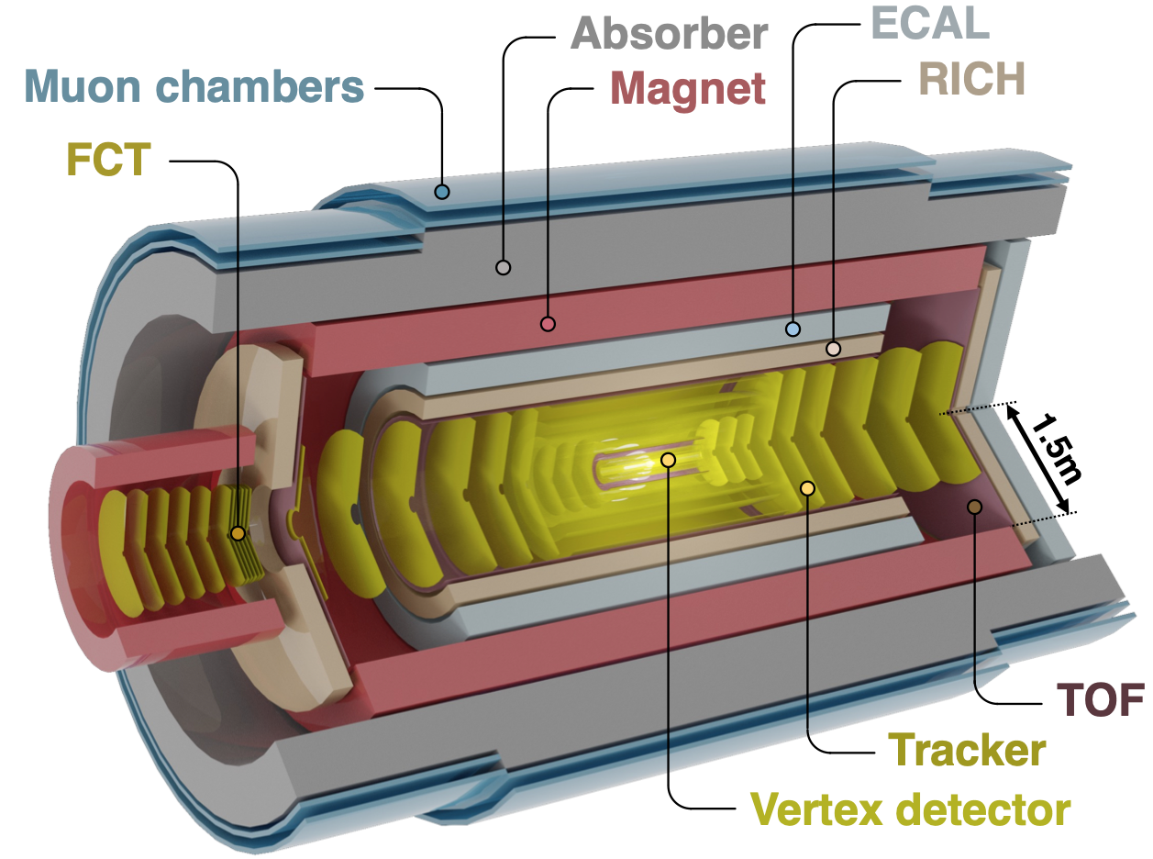
High Energy Frontier
Novel and innovative detector concept
Compact and lightweight all-silicon tracker
Retractable vertex detector
Extensive particle identification
Large acceptance
Superconducting magnet system
Continuous read-out and online processing
ALICE 3 detector proposal for Runs 5-6 ( > 2034)
ALICE 3 LoI: CERN-LHCC-2022-009

Slide 14

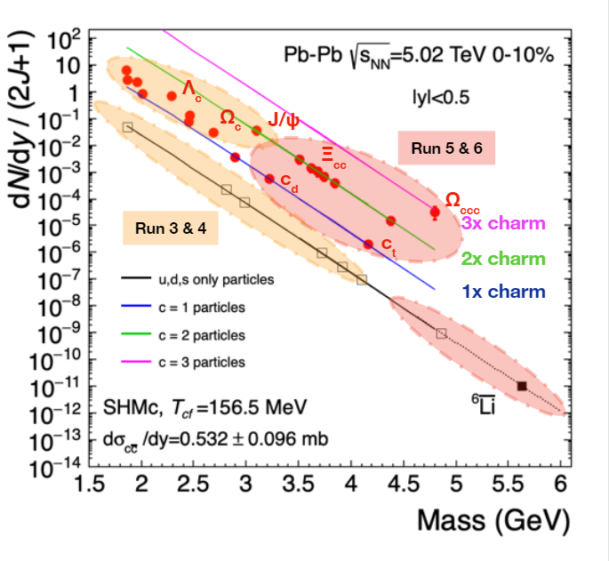

High Energy Frontier
ALICE 3 physics goals
e⁻
e⁺
Precision measurements of dileptons
  evolution of the quark gluon plasma temperature
  mechanisms of chiral symmetry restoration
  in the quark-gluon plasma
Systematic measurements
of (multi-)heavy-flavoured hadrons
  transport properties
  in the quark-gluon plasma
  mechanisms of hadronisation
  from the quark-gluon plasma
Hadron correlations
  hadron-hadron interaction potentials
  net-baryon and net-charm fluctuations
c/b
c̅/b̅
Ω_{ccc}
c
c
c
c̅
c̅
c̅
c
c
c̅

Slide 15
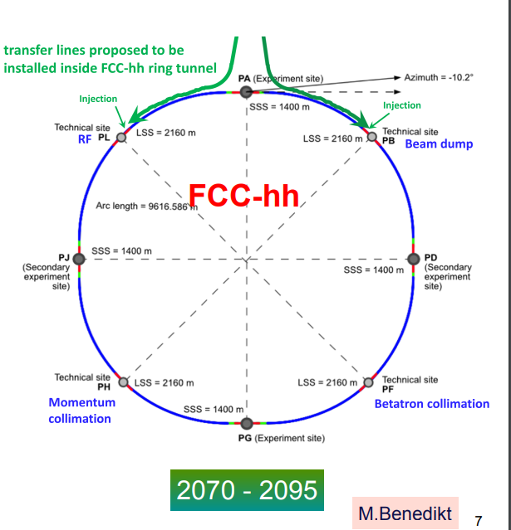
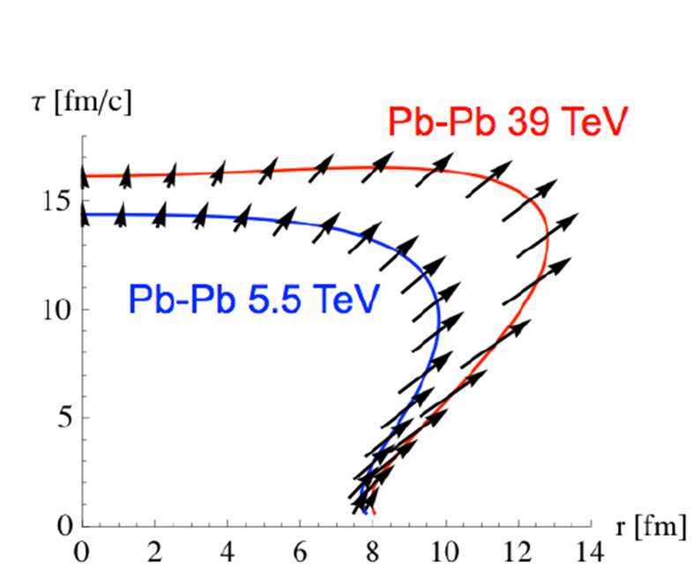
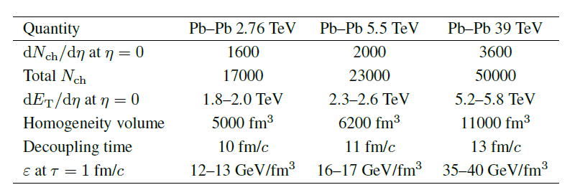
High Energy Frontier
Heavy Ion Physics at FCC

Slide 16
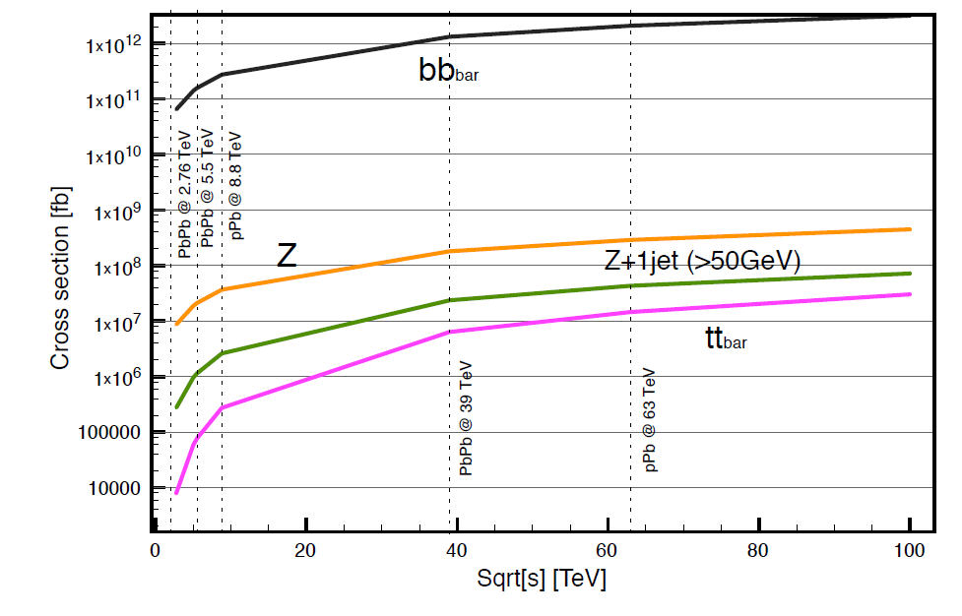
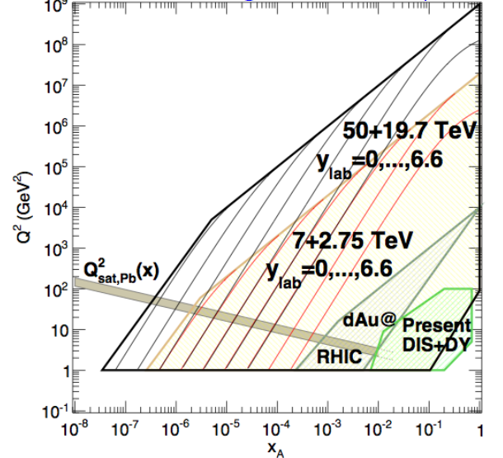
High Energy Frontier
Pb-Pb at FCC: 39 TeV; L_{int} >100x LHC programme
Unique studies of the Quark-Gluon Plasma
Larger temperature → thermal production of charm, Y(1S) melting
Larger √s and L_{int} → new hard observables, e.g. top, Higgs, to characterize the QGP
Unique studies of high-density initial state
Access to saturation region (down to x<10⁻⁶)
Access to [small-x, large-Q2] region with top, W, Z
See https://arxiv.org/abs/1605.01389v3

Slide 17
Other programs at CERN that ESPP cannot miss

Slide 18
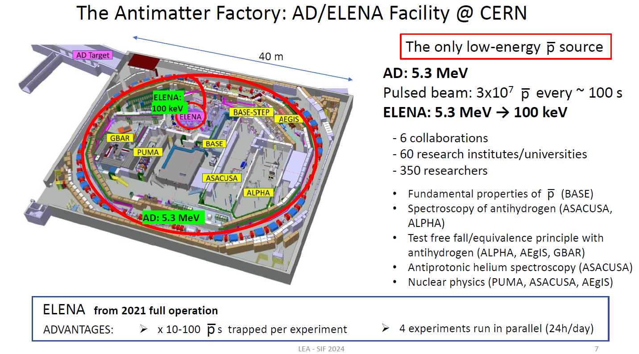
Antimatter studies
The Antimatter Factory : AD/ELENA Facility @ CERN

Slide 19
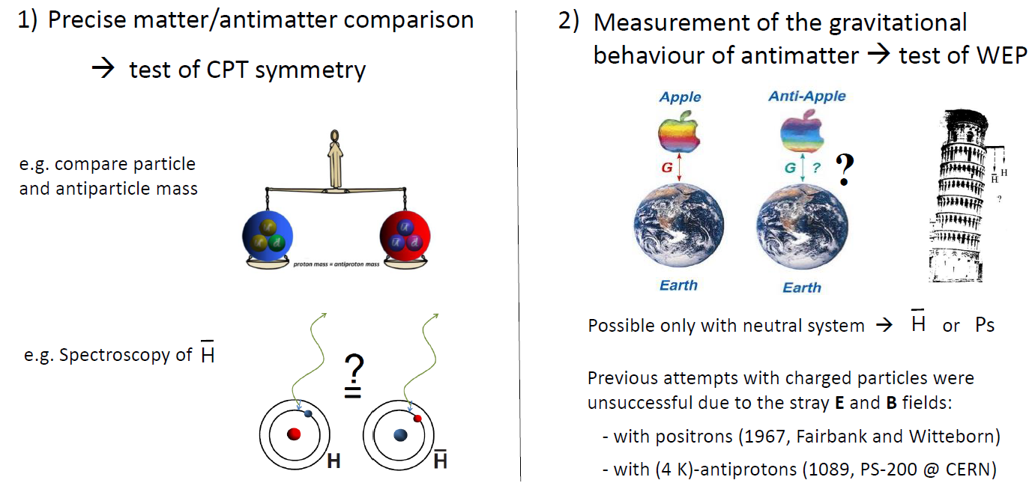
Antimatter studies
Which studies with antimatter at low energy
Consequences:
  particle/antiparticle: equal mass, lifetime; equal and opposite charge and magnetic moment
  atom/antiatom: identical energy levels
NB: CPT invariance is inside the Standard Model.
No measurements of CPT violation exists
Consequences:
  two bodies of different compositions and/or mass fall at the same rate in a gravitational field Newtonian version
NB: From General relativity no difference expected
Quantum gravity theories may allow differences

Slide 20
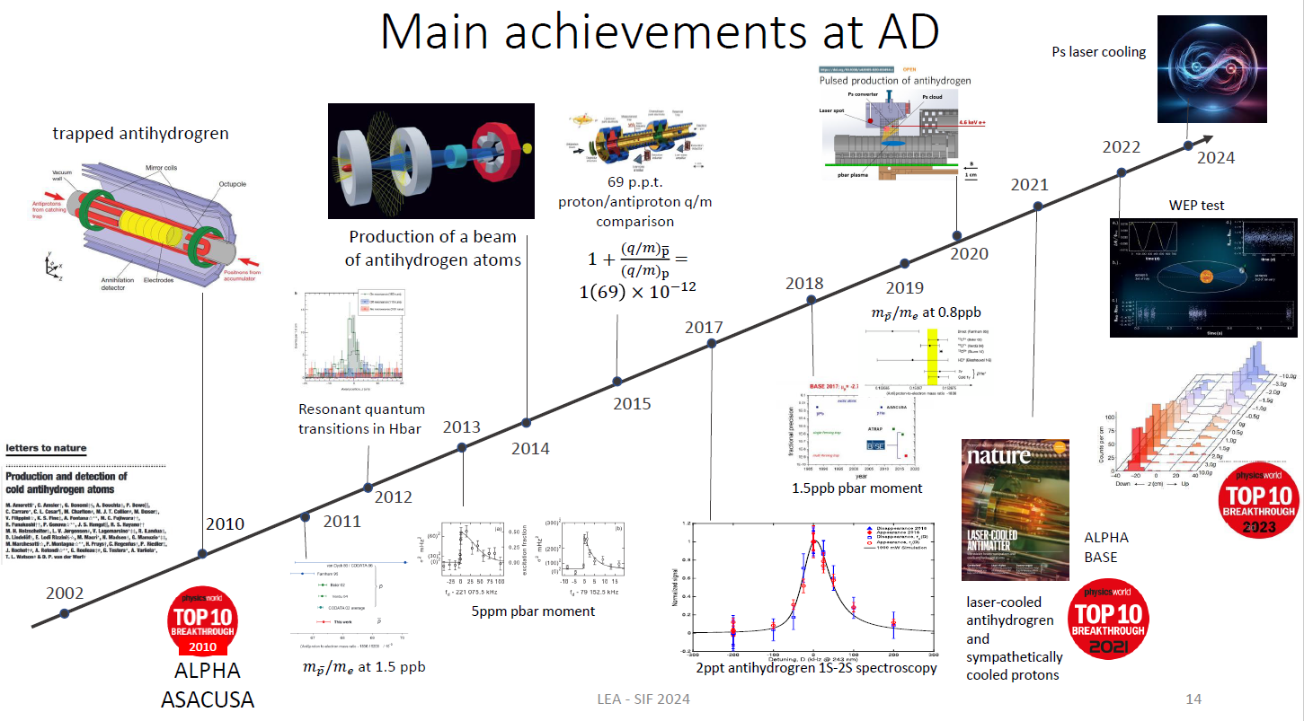
Antimatter studies

Slide 21
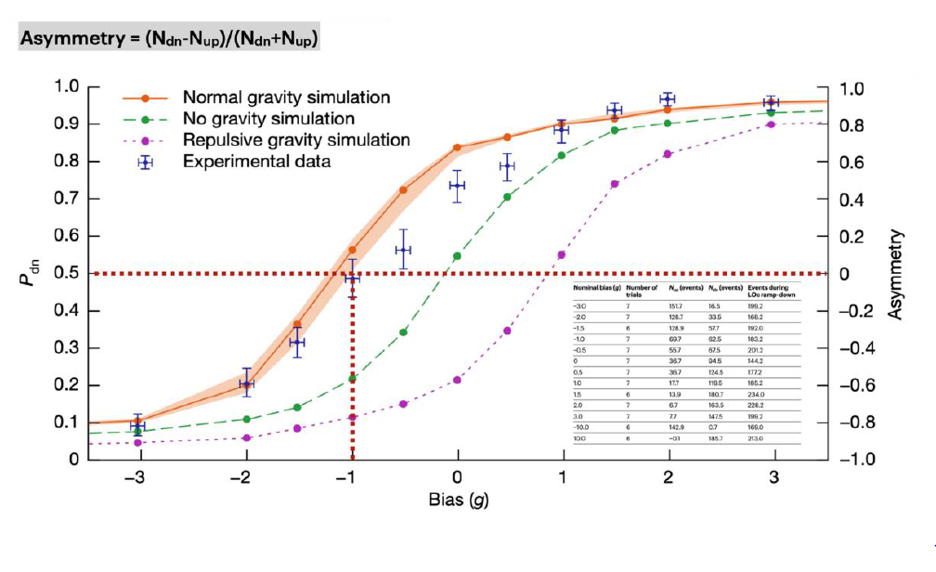
Antimatter studies
First Experimental result on antimatter and gravitation (ALPHA Coll.) : motion of antihydrogen is due to a combination of magnetic-trap field and gravitational field

Slide 22
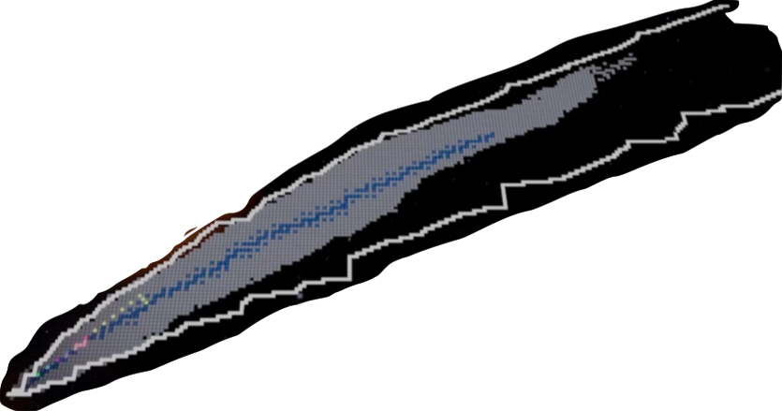
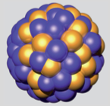
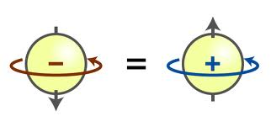
Nuclear Structure
OUR PLAYGROUND: the NUCLEAR Chart
ATOMIC NUCLEI
Many Body Quantum Systems
248 Stable
n
p
Symmetry
Principle
~3000 discovered
Effective
Nuclear Force
> 7000 estimated
in the Universe
dripline
Proton number Z
… a research field with an enormous
discovery potential
Neutron number N

Slide 23
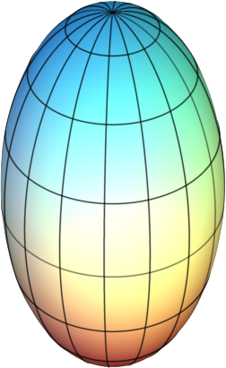
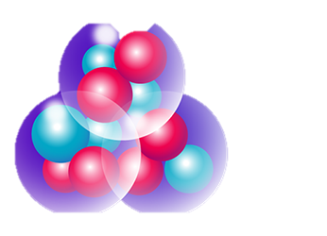
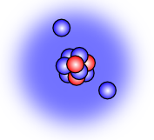
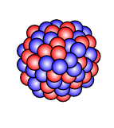
A PUZZLE of INFORMATION
SHELL STRUCTURE and MAGIC NUMBERS
SHAPES and DEFORMATIONS
248 Stable
82
²⁰⁸Pb
50
¹⁰⁰Sn
¹³²Sn
126
> 7000 estimated
in the Universe
dripline
Proton number Z
28
⁷⁸Ni
82
20
⁴⁸Ca
¹²C
¹¹Li
²⁰⁸Pb
… a research field with an enormous
discovery potential
8
¹⁶O
50
3α
20
28
8
Neutron number N

Slide 24
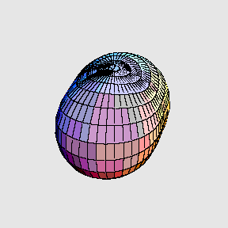
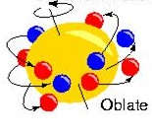
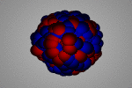
A PUZZLE of INFORMATION
SHELL STRUCTURE and MAGIC NUMBERS
SHAPES and DEFORMATIONS
COMPLEX EXCITATIONS
248 Stable
82
²⁰⁸Pb
50
¹⁰⁰Sn
¹³²Sn
126
> 7000 estimated
in the Universe
dripline
28
^{Collective excitations}
Proton number Z
⁷⁸Ni
82
^{Few nucleons}
^{excited}
^{Rotations}
20
⁴⁸Ca
¹²C
¹¹Li
²⁰⁸Pb
8
¹⁶O
50
3α
20
28
^{Vibrations}
^{GIANT}
^{DIPOLE}
^{RESONANCE}
8
Neutron number N

Slide 25
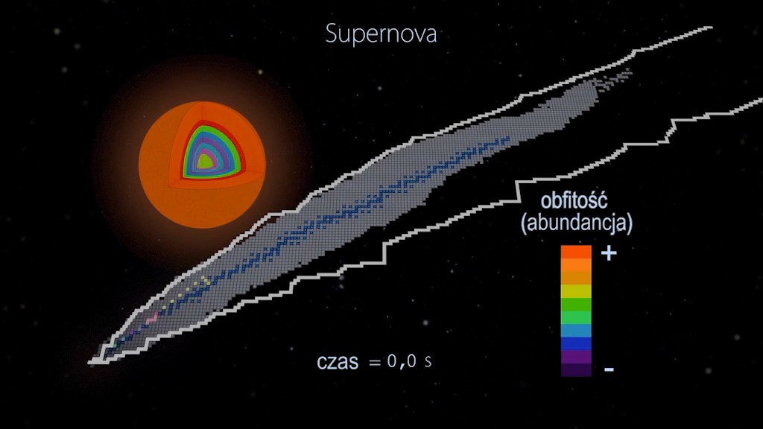
HEAVY ELEMENTS production
in Supernova explosions, neutron star mergers
abundances
dripline
Stable Nuclei
Proton number Z
time
hours
Neutron number N
from CEA Sciences - “La Physique Nuclèaire”
https://www.youtube.com/watch?v=VZHpAwSGYZE

Slide 26
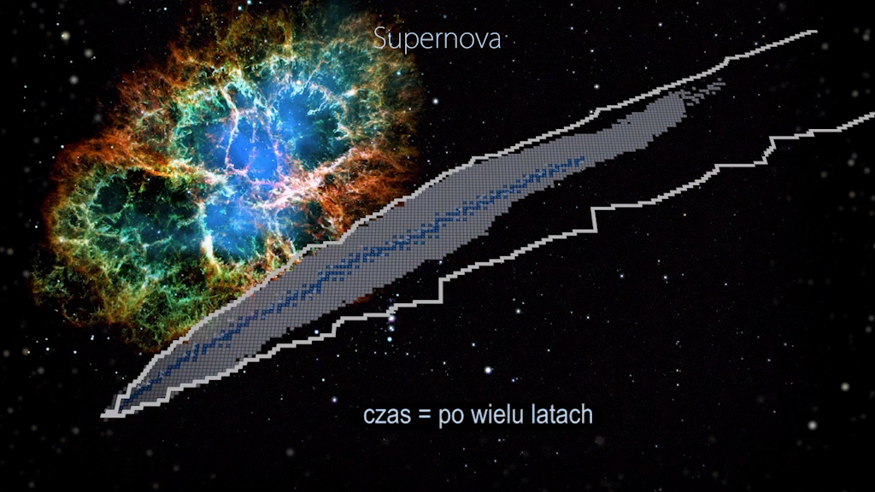
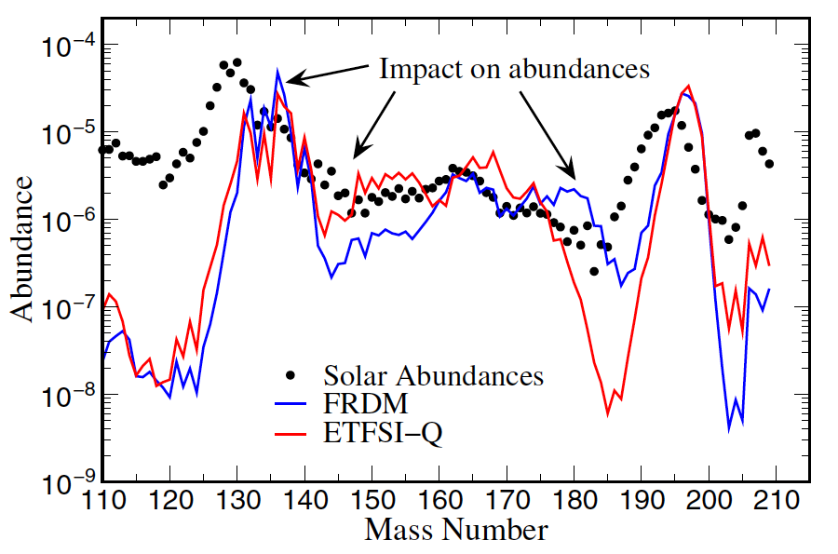
Understanding ABUNDANCES
of elements we are made of
r
r - process
dripline
Element Abundances
Proton number Z
248 Stable
Neutron number N
from CEA Sciences - “La Physique Nuclèaire”
https://www.youtube.com/watch?v=VZHpAwSGYZE

Slide 27


Nuclear reactions at CERN
n_TOF facility at CERN
n_TOF
Comparison to other neutron beam facilities
NEAR station
proton beam
n_TOF has the world-wide highest instantaneous flux (neutrons/pulse), while being competitive also in term of average flux (neutrons/second).
EAR1 has the widest energy range available

Slide 28


Nuclear reactions at CERN
Neutron-induced reactions
Big Bang and stellar nucleosynthesis
Investigation of nuclear level densities
Advanced nuclear technology
Transmutation of nuclear waste
Accelerator driven systems
Nuclear fuel cycle investigations
Medical Applications
...
First ²³⁵U(n,f) cross section data above 200MeV!!
The International Atomic Energy Agency (IAEA) strongly requests new data for up to 1GeV.

Slide 29


Nuclear reactions at CERN
The Isotope mass Separator On-Line facility (ISOLDE) at CERN is a facility dedicated to the production of a large variety of radioactive ion beams: more than 700 different beams of isotopes from 70 chemical elements
@CERN
Approved experiments involving INFN
Measurement of neutron capture cross section on ¹³⁴Cs through surrogate reaction (d,pγ) at ISS
Two-phonon octupole collectivity in the doubly-magic nucleus ¹⁴⁶Gd
Probing Shape Coexistence in neutron-­deficient ⁷²Se via Low Energy Coulomb Excitation
Spectroscopy of particle-phonon coupled states in ¹³³Sb by the cluster transfer reaction of ¹³²Sn on ⁷Li: an advanced test of nuclear interactions
Spectroscopy of low-lying single-particle states in ⁸¹Zn populated in the ⁸⁰Zn(d,p) reaction
Search for shape coexistence in 80 Zn via (t,p) reactions
GAMMA meeting 20 Maggio 2024
Shape coexistence and N=50 gap: Coulex reactions on ground and isomeric states in N=49 ⁷⁹Zn, ⁸¹Ge isotones
Study of neutron-rich ⁵¹⁻⁵³Ca isotopes via beta-decay
Beta-decay spectroscopy of ²⁷Na and ²²O for isospin asymmetry studies in the sd shell
performed last year

Slide 30
Other INFN programs outside CERN that ESPP cannot miss and their connection with different CERN and international projects

Slide 31



National and International Laboratories
for CSN3 experiments
CSN3
TIFPA
CNAO
LNL
LNGS
LNF
Circe
LNS

Slide 32







Expected by 2025-2026
In operation
SPES at the LNL
https://web.infn.it/spes/
LUNA-MV accelerator of the Bellotti Ion Beam Facility at the LNGS
http://l.infn.it/lngs-accel.
Approved in design phase
Expected by 2026
LNF and EuPRAXIA
https://www.eupraxia-project.eu
POTLNS at the LNS https://potlns.lns.infn.it/en/

Slide 33



CSN3
LNL
LNL-LNS complementarity
SPES
LNS
From ¹⁴Be to ⁶⁸Ni,
40 *A MeV (A=132)

Slide 34



Neutrino and Nuclear reaction
Neutrino-less double beta decay (NLDBD) – measurement of the Nuclear matrix element with NUMEN/MAGNEX @LNS
Double Charge Exchange Reaction
MAGNEX

Slide 35







Reaction dynamics and nuclear structure @ LNL and LNS
The complex TANDEM-NEW Cyclotron -FRAISE @ LNS
The complex TANDEM+ALPI+PIAVE and SPES @ LNL
CHIMERA
AGATA: Advanced Gamma-ray Tracking Array
NB: Esperimento itinerante ( GANIL, GSI , LNL….)

Slide 36

The AGATA campaign at LNL (since 2022)
Coulomb excitation
Search for octupole structures in the light U Th and Pa isotopes via Multinucleon transfer reactions
(A. Goasduff G. De Angelis)
Octupole correlations in the neutron deficient plutonium isotopes (J.F.Smith,D.Mengoni )
Transfer reactions
Accessing neutron-rich nuclei close to ²⁰⁸Pb via multi-nucleon transfer reactions (F. Galtarossa, T. Mijatovic)
Decay-out of the oblate, triaxial and highly-deformed bands in ^{136,137}Nd (C. Petrache/O. Stezowski )
Understanding the nature of 0⁺ states in ¹¹⁰Sn and ¹¹²Sn and ¹⁰⁸Cd
( N. Marginean, M.Ciemala, F.Crespi)
Probing Multiple Shape Coexistence in ¹¹⁰Cd with Coulomb Excitation (M.Zielinska, K.Wrzosek Lipska, A.Nannini, P.Garrett)
Lifetimes in the ¹⁹⁶Os region populated with multinucleon transfer reactions
(D. Brugnara, M. Sedlak, J. Pellumaj)
Pathway to nuclear structure in heavy neutron rich nuclei in the vicinity of N=126 and nuclei northwest of ¹³²Sn via multinucleon transfer reactions (P.Reiter)
Search for a Josephson-like effect in the ¹¹⁶Sn+⁶⁰Ni system
(L. Corradi, S. Szilner)
Probing nucleon nucleon correlations in the ⁴⁸Ca+²⁰⁸Pb system below the Coulomb barrier
(T. Mijatovic L. Corradi)
Combined lifetime and transition-probability measurements in ⁹⁶Zr via unsafe Coulomb excitation (M. Zielinska, F. Ercolano, N. Marchini, J.J. Valiente Dobon)
Two-Phonon Octupole excitation in ⁹⁶Zr
(D. Stramaccioni, J.J. Valiente-Dobon, A. Gadea)
Shape Coexistence Coulex of ⁷⁴Se
(W.Korten, K.Wrzosek Lipska, E.Clement)
Coexisting Shapes in ⁹⁶Zr
(D. Doherty, N. Marchini, M. Zielinska)
The emergence of enhanced collectivity near magic nuclei: Coulomb excitation of ⁶⁰Ni (K. HadinskaKleck, N. Marchini, M. Rocchini,)
Fusion fission for gamma ray spectroscopy of neutron rich nuclei around N=50 (A. Gottardo, M. Caamano, D. Ramos, JJVD)
Nuclear structure in the vicinity of the Z=28 neutron rich isotopes with AGATA and PRISMA
(R.M.Pérez Vidal, S.Bottoni, E.Sahin,A.Illana, J. Benito, J. Ljungvall, M. Doncel, A.Gadea, L.M. Fraile)
Study of shape coexistence in ⁶⁰Fe via lifetime measurement of excited 0⁺ states (G.Pasqualato/J.Ljungvall)
The low energy fusion in the system ¹²C + ²⁶Mg (G. Montagnoli)
Precise measurement of the B(E2; 2⁺₁ → 0⁺₁) in ⁵⁶Ni (F. Galtarossa, A. Gottardo)
Test of the CKM unitarity and the existence of Fierz interference through the measurement of superallowed beta decay of light nuclei
(J.Ha/F.Recchia )
Lifetime measurements around ⁴⁸Ca
(C. Fransen, A. Gottardo, D. Menogni)
Evolution of the mixing between single particle and intruder configurations at N=20 (F. Galtarossa, A. Gottardo)
Shell and shapes above ⁵⁶Ni: lifetime measurements in ground-state and side band of ⁶⁰Zn (E. Pilotto, G. Pasqualato)
Spectroscopy and lifetime measurements toward the Island of Inversion (K.Wimmer, S.Bottoni, G.Benzoni, F.Recchia, P.Aguilera)
Lifetime of the 6793 keV state in ¹⁵O (J.Skowronski, E. Pilotto)
Lifetime measurements intruder states towards the island of inversion along the N=20 shell closure (Z. Irene, D. Brugnara)
8

Slide 37


Astrophysics Nuclear reactions in stars: nuclei abundance, star evolution, multimessanger physics
Stellar Nuclear Reactions in the Laboratory:
Experimental Challenges at low energy
Different Experimental methods:
Extrapolation from higher energies
Direct Measurements (LUNA)
Indirect Measurements (Trojan Horse Method)

Slide 38



Nuclear Astrophysics in laboratories
CSN3
Bellotti Ion Beam Facility @ LNGS
The 3.5 MV Accelerator Singletron “LUNA-MV” can provide Proton, Alpha and Carbon beams (Evolution in 30 years from LUNA 50 through LUNA 400)

Slide 39



Nuclear Astrophysics in laboratories
¹⁷⁶Lu: lifetime vs. T – theoretical predictions
CSN3
…. However !
Stars are made of matter in plasma state where nuclei behaviour could be different
In future, nuclear astrophysics studies will require measurements in extreme conditions different from earth laboratories.
Courtesy of A. Mengoni
Takahashi et al. 1987, Phys Rev C 36, 1522
The PANDORA experiment (2025)
Build a plasma trap where ion species are confined in a magnetic field and a plasma is created with:
Electron density: ${10}^{12}÷$ ${10}^{14}$ ${cm}^{−3}$
Electron temperature: 0.1 $÷$ 100 keV
Ion density: ${10}^{11}$ ${cm}^{−3}→$ relies on the radiactive isotope concentration in plasma
Ion temperature: $\sim$ 1 eV $→$ Ions are cold: no access to the excited states
PANDORA: only ground state will be studied $→$T too low to investigate variation on the isomeric state

Slide 40




Nuclear Astrophysics in laboratories
Laser induced plasma physics at LNS and LNF
LNS
Possible physics topics
Stopping power in plasma
Radioisotope production
Hydrogen generation
Positron, proton, electrons generation
Nuclear reaction scheme
https://link.springer.com/article/10.1140/epjp/s13360-023-04358-7
LNS : I-LUCE - INFN - Laser indUCEd radiation production
Laser
Conventional ions
E2: nuclear and warm dense matter
E1: radiation production
LNF
LNF

Slide 41
Astrophysics nuclear reactions in stars
A comparison between magnetic and laser induced physics with plasma
CSN3
Magnetic confinement (PANDORA)
PRO:
Long-living plasma (order of weeks)
Steady state dynamical equilibrium for density and temperature (by compensating ion losses)
Hence, over days/weeks constant values for charge state distribution of in-plasma ions
Online monitoring of plasma density, temperature, volume, at any energy domain in nLTE conditions
CONS:
Low density/high temperature plasma: non local termal equilibrium (nLTE conditions )
Difficult “plasmization” of solid/metallic isotopes
No access to nuclear excited state studies (too low T)
Laser-induced plasma
PRO:
High density plasma, reaching local thermodynamical equilibrium (LTE)
Fully thermodynamical equilibrium allows, in principle, to estimate the population of nuclear excited states
CONS:
Difficult to implement diagnostics following on-time the fast time-variation of plasma parameters
Short living plasma, with duration much shorter than typical lifetimes of isotopes involved in stellar nucleosynthesis
Workshop@LNF 4-6 December 2024
Notes:
Se si riuscisse a caratterizzare con sufficiente precisione il plasma si potrebbe pensare di effettuare misure di attivazione

Slide 42






Nuclear reactions for medicine
SPES-γ
Medical radionuclides production with SPES-MED @ LNL
CSN3
https://www.prismap.eu/
LARAMED
In this multi-disciplinary research activity nuclear physics plays a key role in the optimization of medical radionuclides production, exploiting innovative routes
Strong collaboration also with LNS and CERN
Notes:
SPES-gamma prevede l’utilizzo del fascio di protoni fornito dal ciclotrone (35-70 MeV) per applicazioni in ambito medicale, in particolare per la produzione di radionuclidi e radiofarmaci.
Sono attivi due approcci, uno che sfrutta la tecnica ISOL (progetto ISOLPHARM), uno che sfrutta l’attivazione diretta del bersaglio (progetto LARAMED).
Quando SPES sarà operativo, i LNL saranno un centro di ricerca unico in Europa, proprio perché in grado di sfruttare entrambe le tecniche per la produzione di radionuclidi medicali. INFN-LNL è infatti già coinvolto nel consorzio europeo PRISMAP (per la produzione e l’utilizzo di radionuclidi e radiofarmaci innovativi) come facility emergente. In questo contesto a novembre 2022 abbiamo ospitato il primo workshop prismap ai LNL ed è stato sottolineato l’importante ruolo che l’INFN potrà avere a livello europeo ed internazionale.
Queste attività di ricerca, altamente inter e multi-disciplinari (come si vede dalla figura a destra), vedono la fisica nucleare giocare un ruolo centrale perché permette di esplorare nuove reazioni per la produzione di radionuclidi promettenti e non ancora disponibili alla ricerca clinica. Queste tematiche sono state approfondite anche nel workshop nuclear physics mid term plan, svoltosi ai LNL ad aprile 2022.

Slide 43



Nuclear reactions for medicine
CSN3
FOOT: (FragmentatiOn Of Target)
Cross section measurements for hadro-therapy and for evaluation of possible dangers for astronauts. CNAO-GSI-Heidelberg
Calorimeter BGO
Magnets
Target
Micro Strip
Beam Monitor
1 m
Start Counter
Inner Tracker
ΔE-TOF scintillator
Vertex
Pre-target region
Tracking region
downstream region

Slide 44
INFN Nuclear Physics in ESPP
High energy frontier
Support to EIC, HL-LHC , FCC-hh
CERN complementary projects
Support to AD/ELENA , ISOLDE , n_TOF
Importance of connections with lower energies nuclear physics studies
Nuclear Matrix element for Neutrinoless double beta decay
Studies of the caracteristics (structure, shape, cross section, dynamics) of the elements of the nuclear chart
SPES-LNL, POT- LNS (with other national laboratories like RAL, GANIL, FAIR) complemetary to ISOLDE
Nuclear astrophysics reactions and connections with astrophysics measurement, star evolution and multimessanger studies
Particular attention to lower energies reactions.
LNGS, LNS, LNL, LNF, CIRCE (complementary to n_TOF)
Medical applications
Hadro-theraphy , Radionuclides production .
SPES-LNL, LNS, CNAO, TIFPA

