Slide 1
Italian Summer Students, Magnet Systems, Program Examples
Luciano Elementi
Electrical and System Engineer
July 23, 2024

Slide 2
Outline
Intro
AC-Dipole, Purpose, Measure
Kickers
Special Projects
Permanent Magnets
Specialty Machines
Others

Slide 3
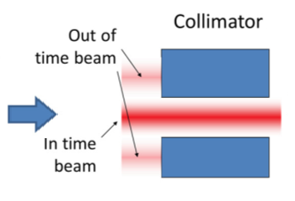
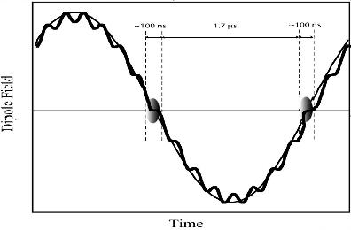
AC-Dipole, Extinction:
~200 ns
~1.5 μs
Prompt backgrounds
live window
Pulsed, with a short separation, on the order of a muon life time
Detector is “listening” while there is “nothing” i.e. between bunches
Most significant background is created by beam (protons) in between bunches which therefore need to be suppressed → ≤ 10⁻¹⁰ extinction.

Slide 4
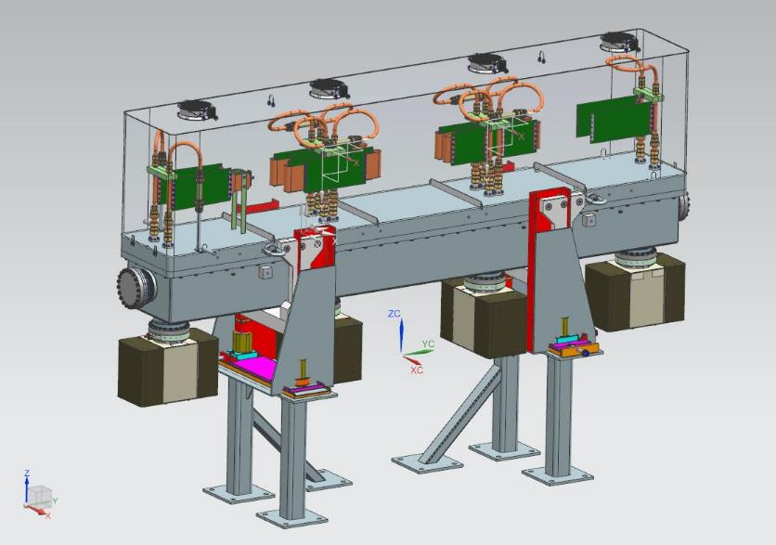
AC-Dipole
Ferrites (Blue) are required,
This is a single loop magnet, First of a kind
Rendering of the AC-Dipole Installation Roughly behind the g-2 building

Slide 5
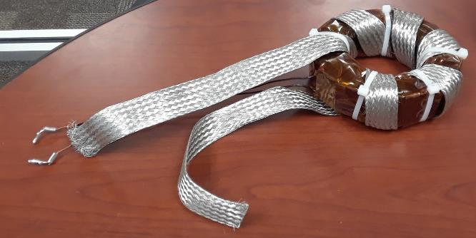
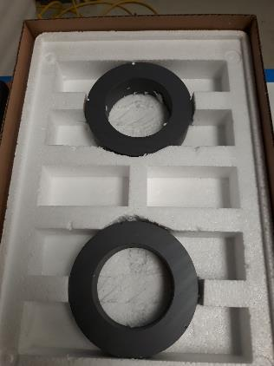
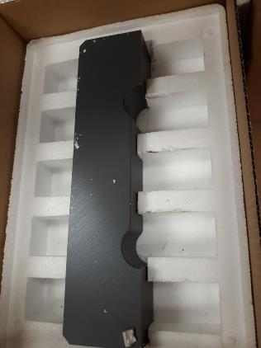
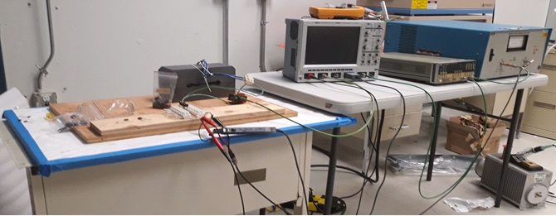
Ferrites
Ferrites (electrical) testing to determine the field distribution and the power consumption of the magnet (modeling) and receiving sample of toroids and bricks from our vendors

Slide 6
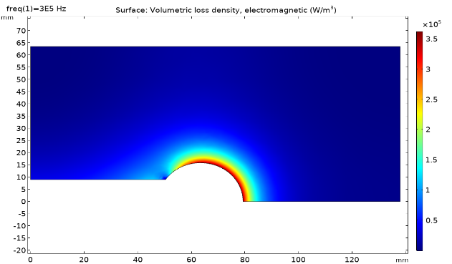
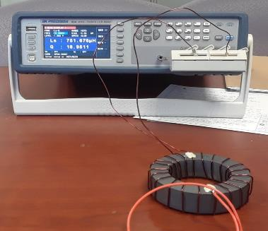
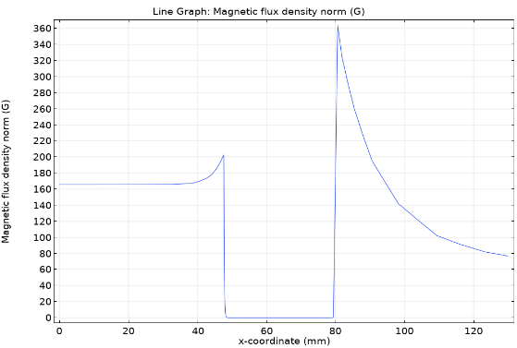
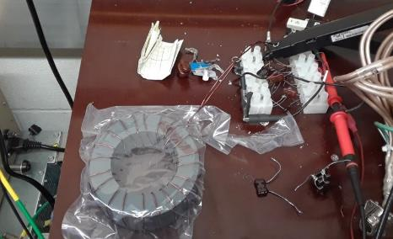
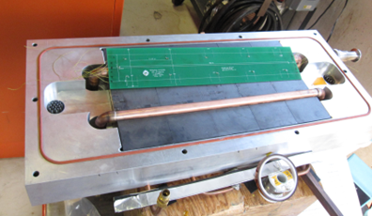
Study, Modeling, and Findings

Slide 7
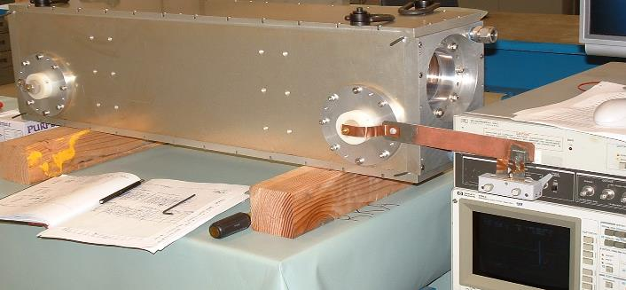
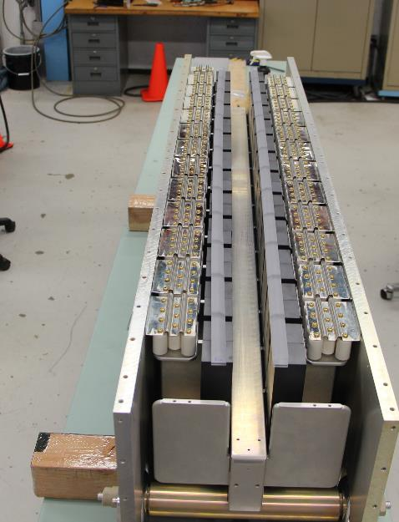
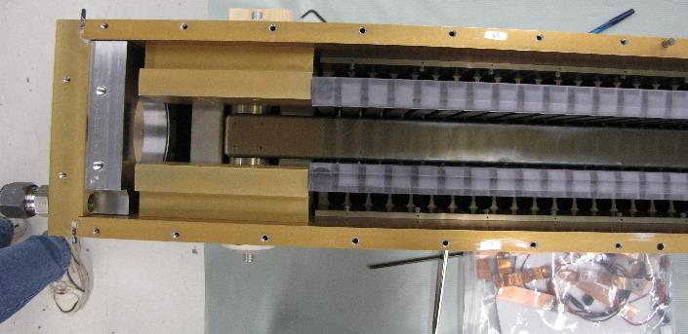
Kicker Magnet
RKE, 10 Ohm magnet currently in production.
One of the 50 Ohm magnet which was fully tested.

Slide 8
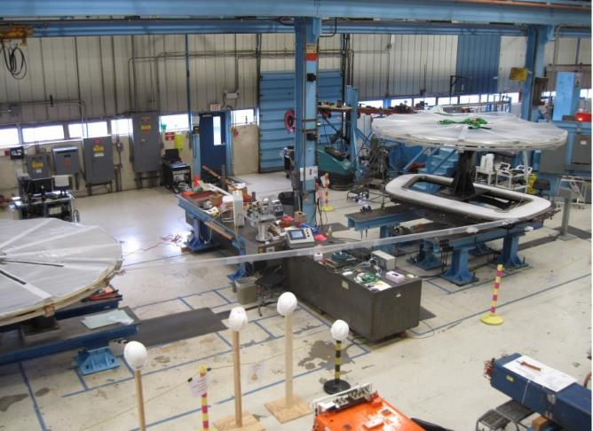
Special Projects, e.g. CLAS 12
Turn-to-Turn Short Detection:
Winding Area, all automation

Slide 9
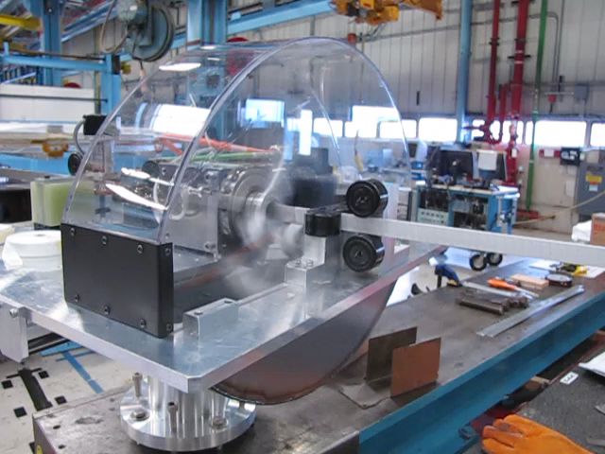
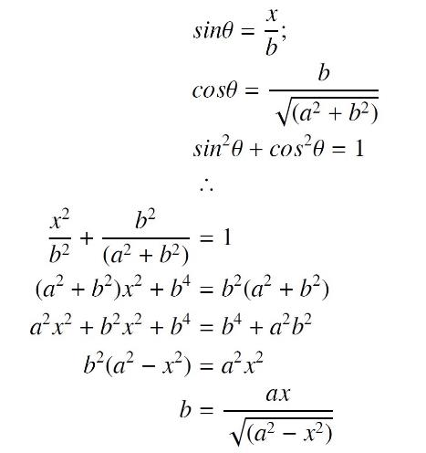
Special Projects, e.g. Wrapping Machine
Automatic Wrapping Machine

Slide 10
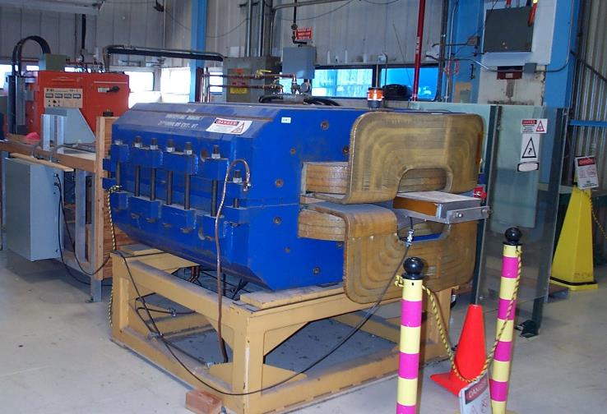
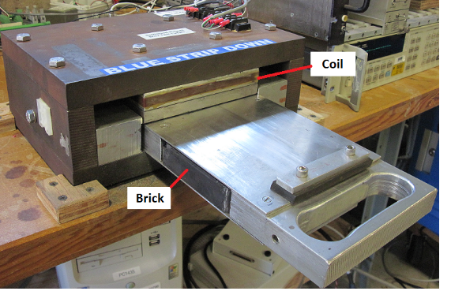
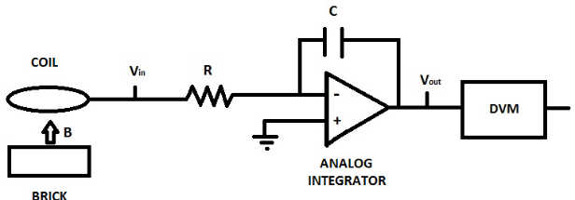
Permanent Magnets Magnetizer + QA
Magnet and Power Supply on the back

Slide 11
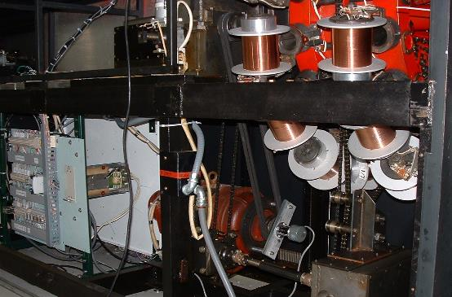
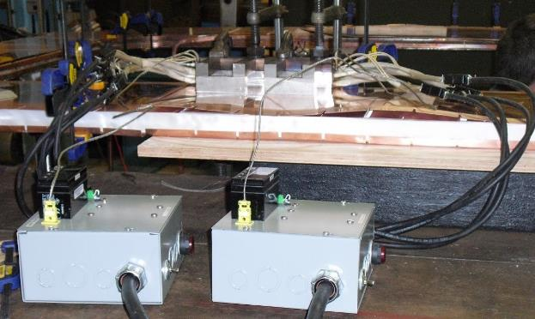
Others:
Cable Making Machine
Soldering
Welding Machine
High Pressure Rinse Systems
Ovens and Furnaces
… And other light industrial processes

