Slide 1
July 23-24 2024
NET@INFN CNAF (TIER1)
Bilateral workshop Serbian Tier1-CNAF
S.Zani (in behalf of the entire Network Department of INFN CNAF)

Slide 2
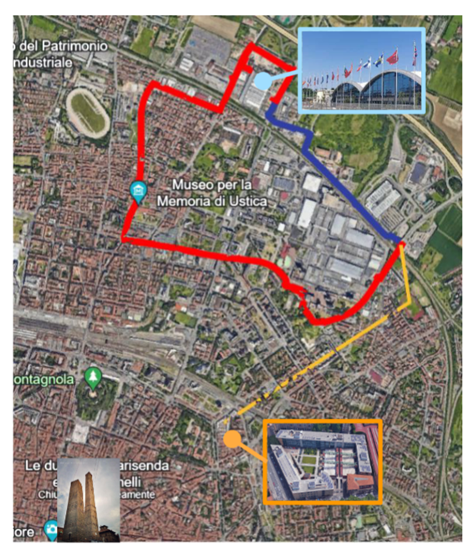
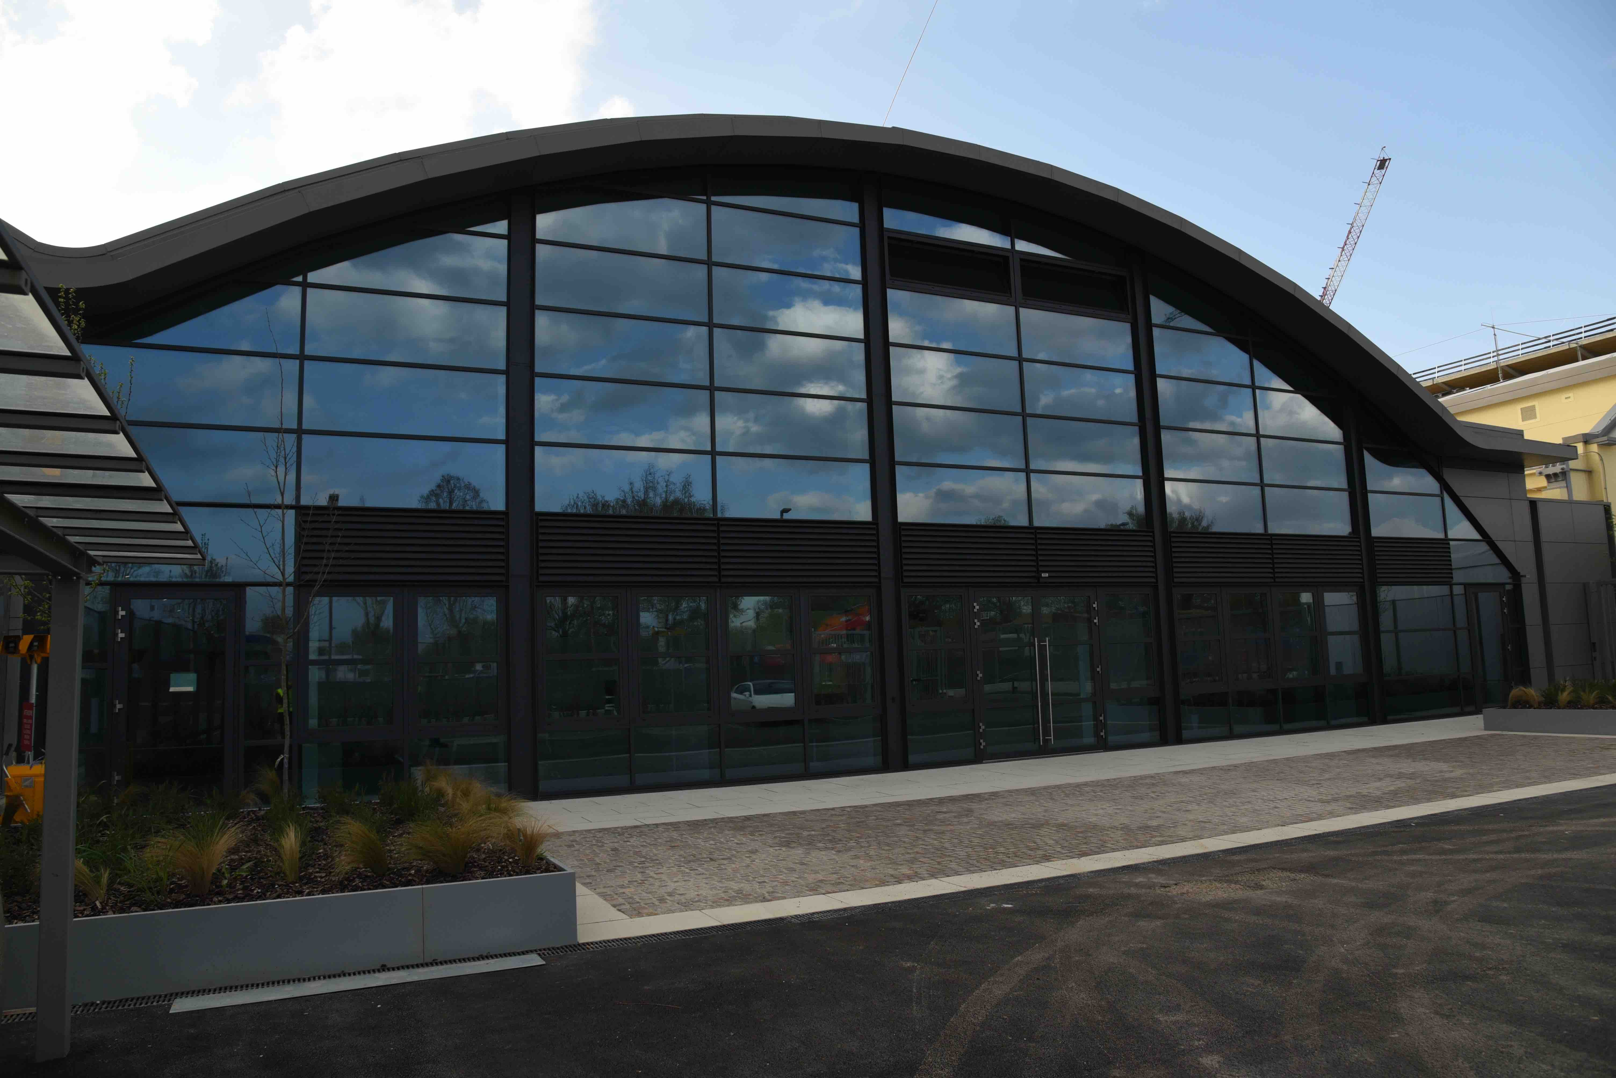
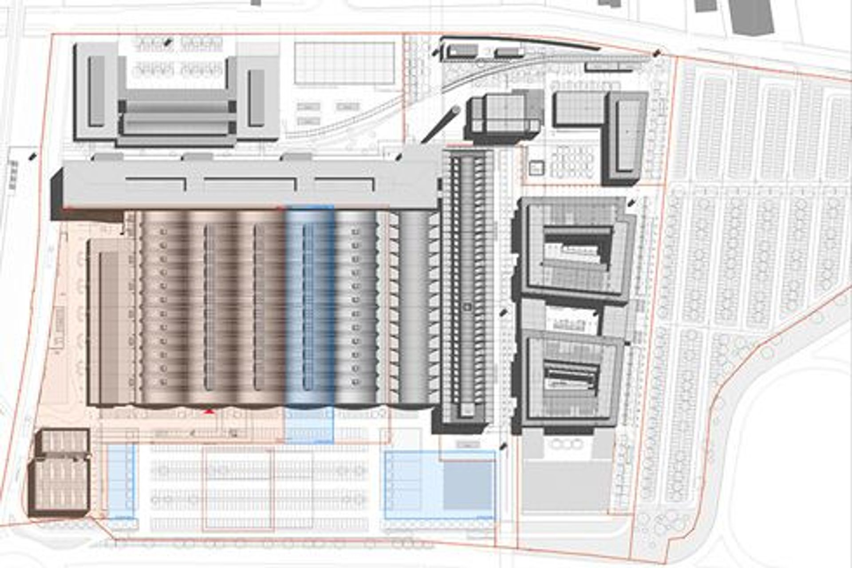
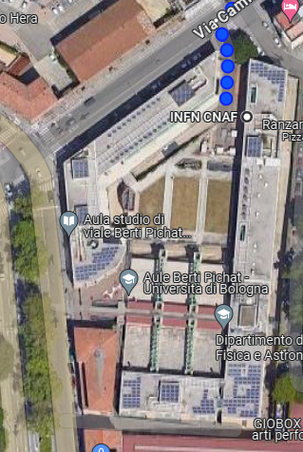
New Datacenter state of art
New Datacenter at Technopole
2,4km walking distance
7 km far fiber path
NEW DATACENTER
(Via Stalingrado)
B5 Building OK
CURRENT
DATACENTER
(Viale Berti Pichat)
ECMWF
CINECA
INFN
B5
C2

Slide 3

Physical connectivity of the building
Fiber access from Via Ferrarese
Technopole AREA
Differentiated optical fiber accesses are foreseen for network operators from the two sides of the Technopole Area (Via Stalingrado e Via Ferrarese)
At the time of this presentation more than 140 single mode fibers have been installed by Lepida e TIM entering form via Ferrarese.
K2
INFN
ECMWF
CINECA
Fibers in the other way (From Via Stalingrado) will be installed as far as the underground big anti flooding water expansion pool will be finished
Anti flooding
pool
WORK IN PROGRESS
Fiber access from Via Stalingrado
(To be done)

Slide 4
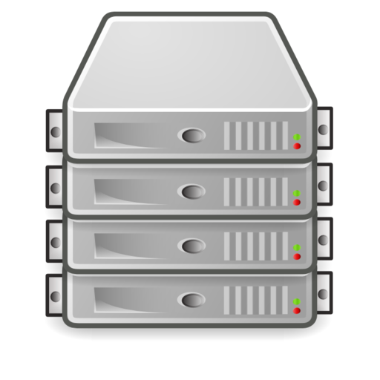
Areas of the new Datacenter
Cold water (26°C inlet) only for Air cooling (Cold isle) system (Up to 16 kW/Rack)
100m
FARMING
NOC
SOC
MEETING
ROOM
High Density
And
Expansion
AREA
LOW Density Computing
AREA
INFN DC
Building
B5
“Temperate” water (36°C inlet) for DLC and cold water for Air Cooling
Up to 80kw/Rack
TAPE
LIBRARY
NETWORK
30m
CNAF-Leonardo
Direct cabling connection <100m
High Density
Expansion
AREA
CINECA DC
Building
C2
16x100Gb Ethernet
LEONARDO
OPN/ONE
Skyway
Skyway
IB
Dragon Fly
IB
IB
CORE-1
A7812
CORE-2
A-7812
IB
IB
IB
FARMING / STORAGE
Resources
FARMING / STORAGE
Resources
LEONARDO

Slide 5
INFN CNAF TIER1 (Current architecture at CNAF in Viale Berti Pichat)
2 Core Switch Routers
152 x 100 Gbps
288 x 10/25 Gbps
120 Switches (mainly TOR)
Circa 5500 x 1 Gbps
Circa 400 x 10Gbps
General IP
LHC OPN/ONE
4x10Gb/s
4x10Gb/s
Main data flows: Disk Server (GPFS) →WNs
More than 600 Gbps sustained.
CINECA
Hosted Resources
100Gb/s
100Gb/s
VPC (Virtual Port Channel)
Cisco 95K
DCI
Nexus 9516
VPC Link
Nexus 9516
Cisco 95K
NE 10032
TR
400 Gb su
1,2 Tb/s
TR
All disk servers directly conneted to COREs 2x 100Gb/s (NO OVERSUBSCRIPTION)
Simple L2 LAG
Disk servers (GPFS)
TOR
TOR
TOR
. . . . . . . . . . . . .
All resources are connected to both Core Switches
TOR switches shoud handle VLAN (802.1Q) – Routing done on COREs (Simple configuration on TOR) permits to use switches produced by different vendors (Cisco, Juniper, Huawey, Lenovo, DELL, Extreme Networks, Super Micro).
Farming Resources

Slide 6

Network@TP
PHASE 1 numbers
10x 100GE WAN Ports
12x 100GE DCI – CNAF
120 100GE Ports (Storage)
60 100GE Ports (Farming)
16x100 GE Leonardo
General IP
2x100 Gbps
LHCONE
LHC OPN/ONE
SSNN
CLOUD@CNAF
NG FW
2x100 Gbps
4x100 Gbps
LHCOPN
Up to 16x100G
EPIC
General IP
Leonardo
SW/Router
IB/ETH GW
CNAF
Berti-Pichat
Transponder
Transponder
1,2Tbps
T1-CORE1
ARISTA
7812-R3
T1-CORE2
ARISTA
7812-R3
1,6 Tbps
IB/ETH GW
DCI
Vxlan switching e routing wire speed
690 Tbps di throughput (Up to more than 800 x 400Gb ports)
6 Tbps
9,6 (4,8 net) Tbps
TOR
TOR
Disk Server
Disk Server
Disk Server
Disk Server
FARMING
TOR
TOR
STORAGE
6

Slide 7
Datacenter Extension
Between Current CNAF site and New Technopole site
INFN DC
(Old site)
INFN DC
(TECHNOPOLE)
Transponders
Transponders
MUX A
MUX A
10x100G Ethernet(DCI)
7km
10x100G Ethernet(DCI)
G30-1
G30-1
DCI
1,2Tbps
(3,2Tbps)
Available
CISCO
Nexus 9516
CISCO
Nexus 9516
ARISTA
7812
ARISTA
7812
vPC
MUX B
MUX B
G30-2
G30-2
Collapsed
IP FABRIC
Stackwise
Virtual
C-9500
C-9500
2x100G (General IP)
A-7280
2x100G (General IP)
A-7280

Slide 8
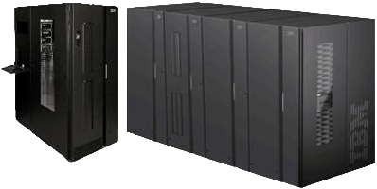
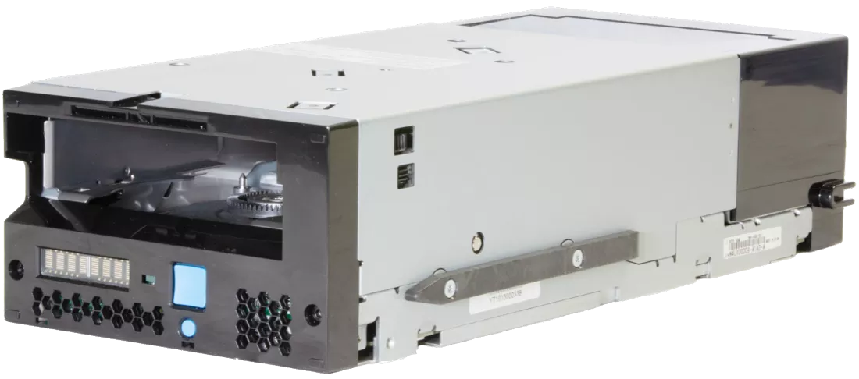
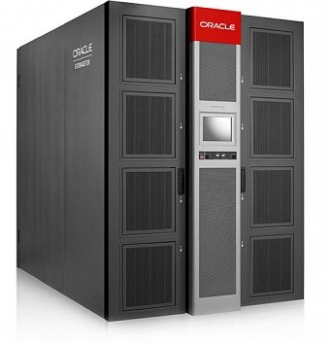
Tape Area Network Extension
INFN DC
(Via Berti Pichat
Old site)
INFN DC
(TECHNOPOLE)
Transceiver FC SFP+
FC 32 Gb LWL on SM Fiber (10Km)
Brocade
IBM TS4500
19 Tape Drive
IBM TS1160
New IBM TS4500
18 Tape Drive
IBM TS1170
FC Switch
FC Switch
SAN 64B-6
2 Dedicated Dark Fibers (7 km)
FC Switch
FC Switch
SAN 64B-6
Tape data transfer will be done on this extension
Dedicated Dark Fibers are in place
LW 10Km FC Transceivers acquired and installed on Berti Pichat FC Switches
New IBM TS4500 Tape Library and new FC Switches
1st IBM lib to be relocated at TP
The data migration will continue through the remote SAN, until the Oracle lib will be emptied
Oracle SL8500
- 20 Tape Drive
- 42 PB to be migrated
- To be dismissed
TSM – HSM
7 Servers
(old)
TSM – HSM
7 Servers
(new)

Slide 9
DC Transfer phases
LHC OPN/ONE
LHC OPN/ONE
B5
C2
100Gb/s
100Gb/s
Nx100Gb/s
Nx100Gb/s
DCI 1,2Tb/s
8x100 Gb/s
IB/ETH GW
TR
TR
CORE
CORE
8x100Gb/s
IB/ETH GW
800Gb/1Tb (T1-T1 + T1-WAN)
Nexus 9516
Nexus 9516
TOR
TOR
TOR
TOR
CORE /
SPINE
CORE /
SPINE
2x100G (General IP)
Nexus 7018
DCI Between the two Datacenters
Data copy and devices transfer
Swap of the Wide Area Network Routing as far as hardware resources have been moved to the new Datacenter
Decommissioning of the old datacenter
TOR
TOR
TOR
TOR
Leonardo
TIER1
Berti Pichat
INFN
CINECA

Slide 10
Conceptual CORE network Configuration
General IP
WAN
General IP
WAN
Possible Scale UP
Evolution
SW/Router-1
SW/Router-2
Router-1
Router-2
Underlay: IS-IS
Overlay: VLXLAN BGP EVPN
OPN/ONE
SPINE
SPINE
CORE-1
A7812
CORE-2
A-7812
Collapsed
IP Fabric
OPN/ONE
ESI
DC
CORE-3
DC
CORE-1
DC
CORE-2
DC
CORE-4
L2 LACP
Port Channel
FARMING or STORAGE
Resources
ESI
OTHER
Resources
FARMING or STORAGE
Resources

Slide 11
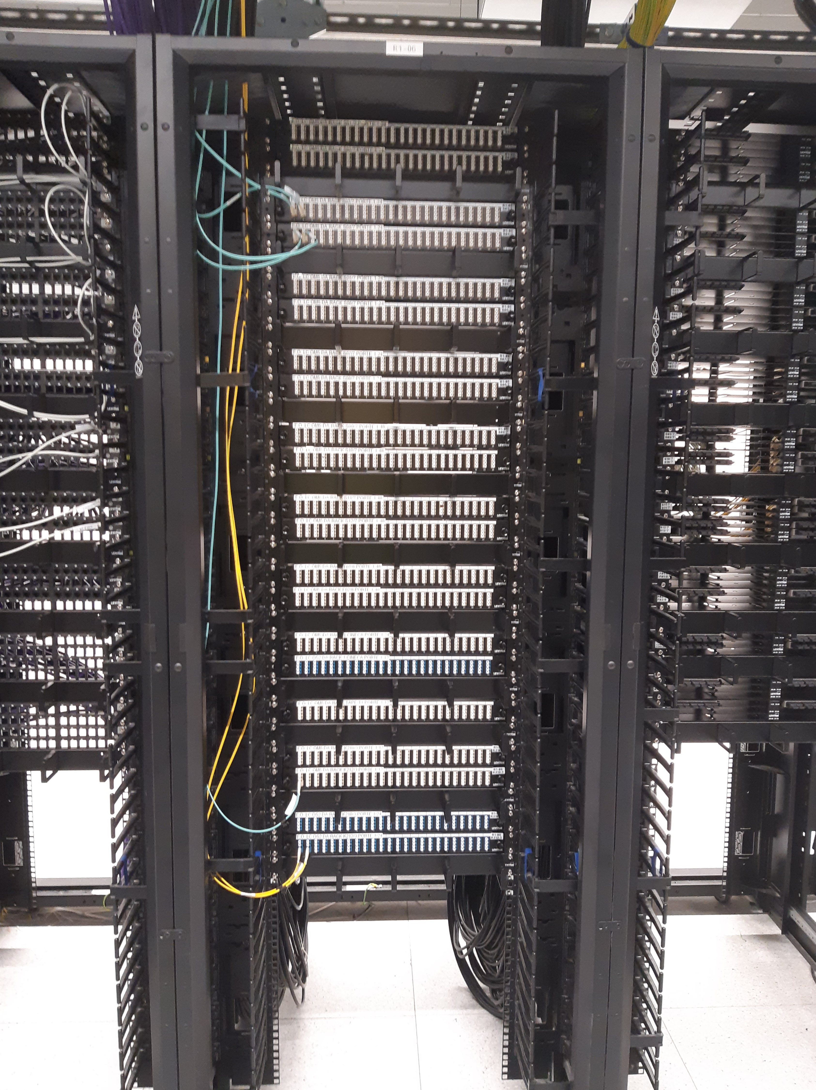
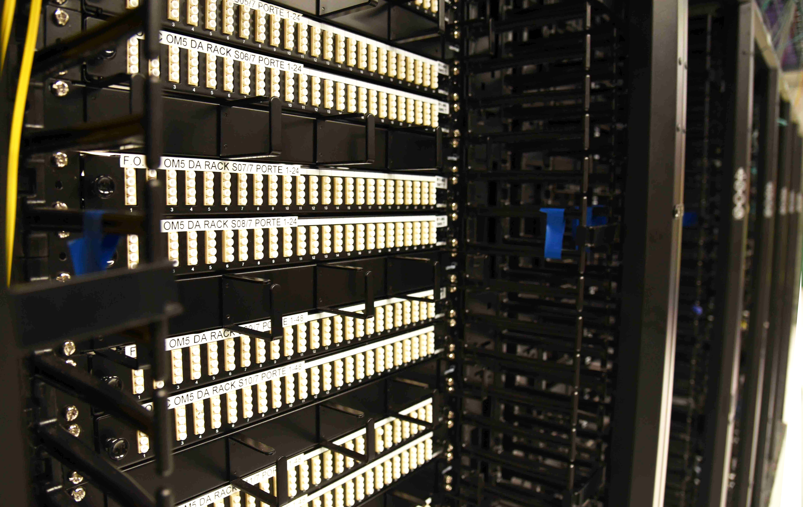
Cabling
The Cabling system is concentrated from every row in the Network Room (Close to center of the building)
LC-LC MM (OM5) →1-100Gb Ethernet
LC-LC SM->1-400Gb →Longer distance and 400G-FR4 Ethernet
MPO-12 MM (OM5) →40G-SR4, 100G-SR4, 400G-SR4.2 Ethernet
MPO-12 SM →400G Ethernet (400G-DR4)
RJ45 →1-10Gbps

Slide 12
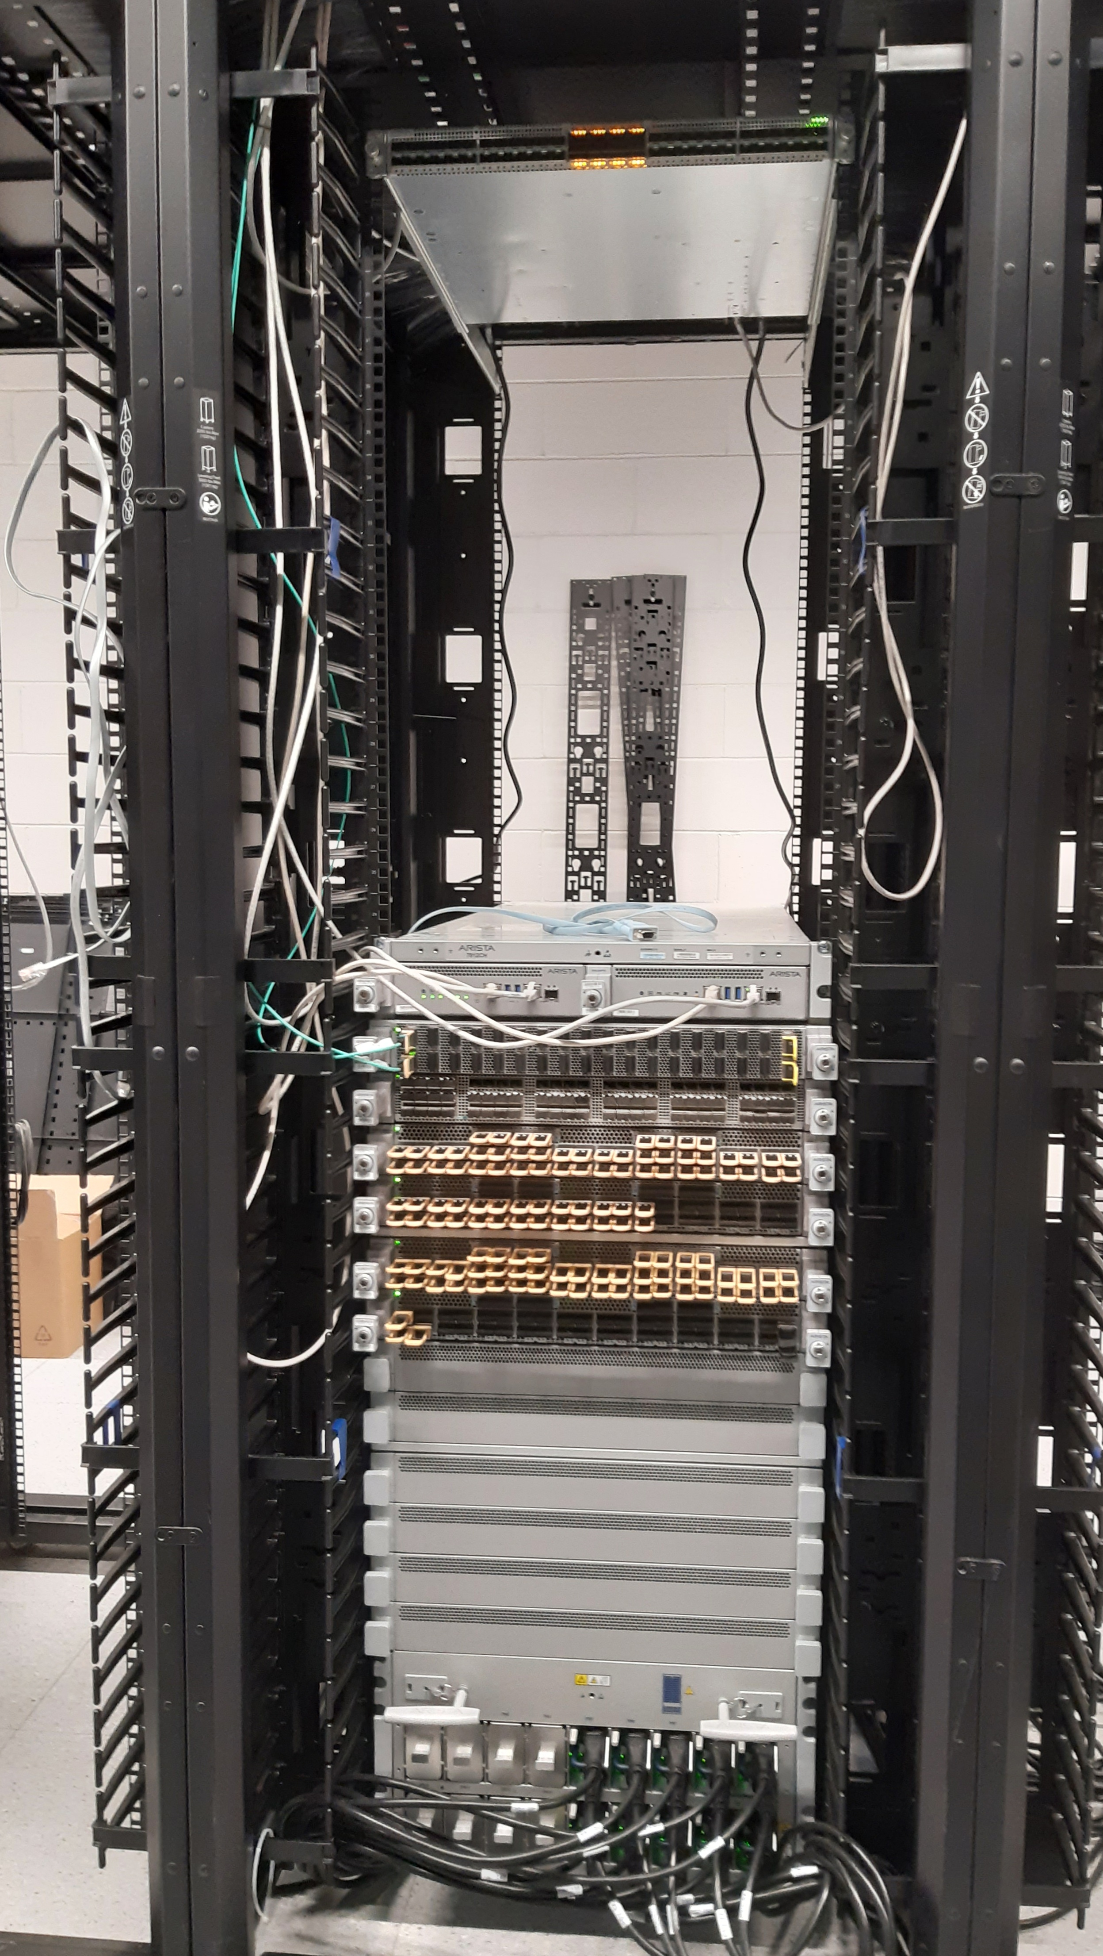
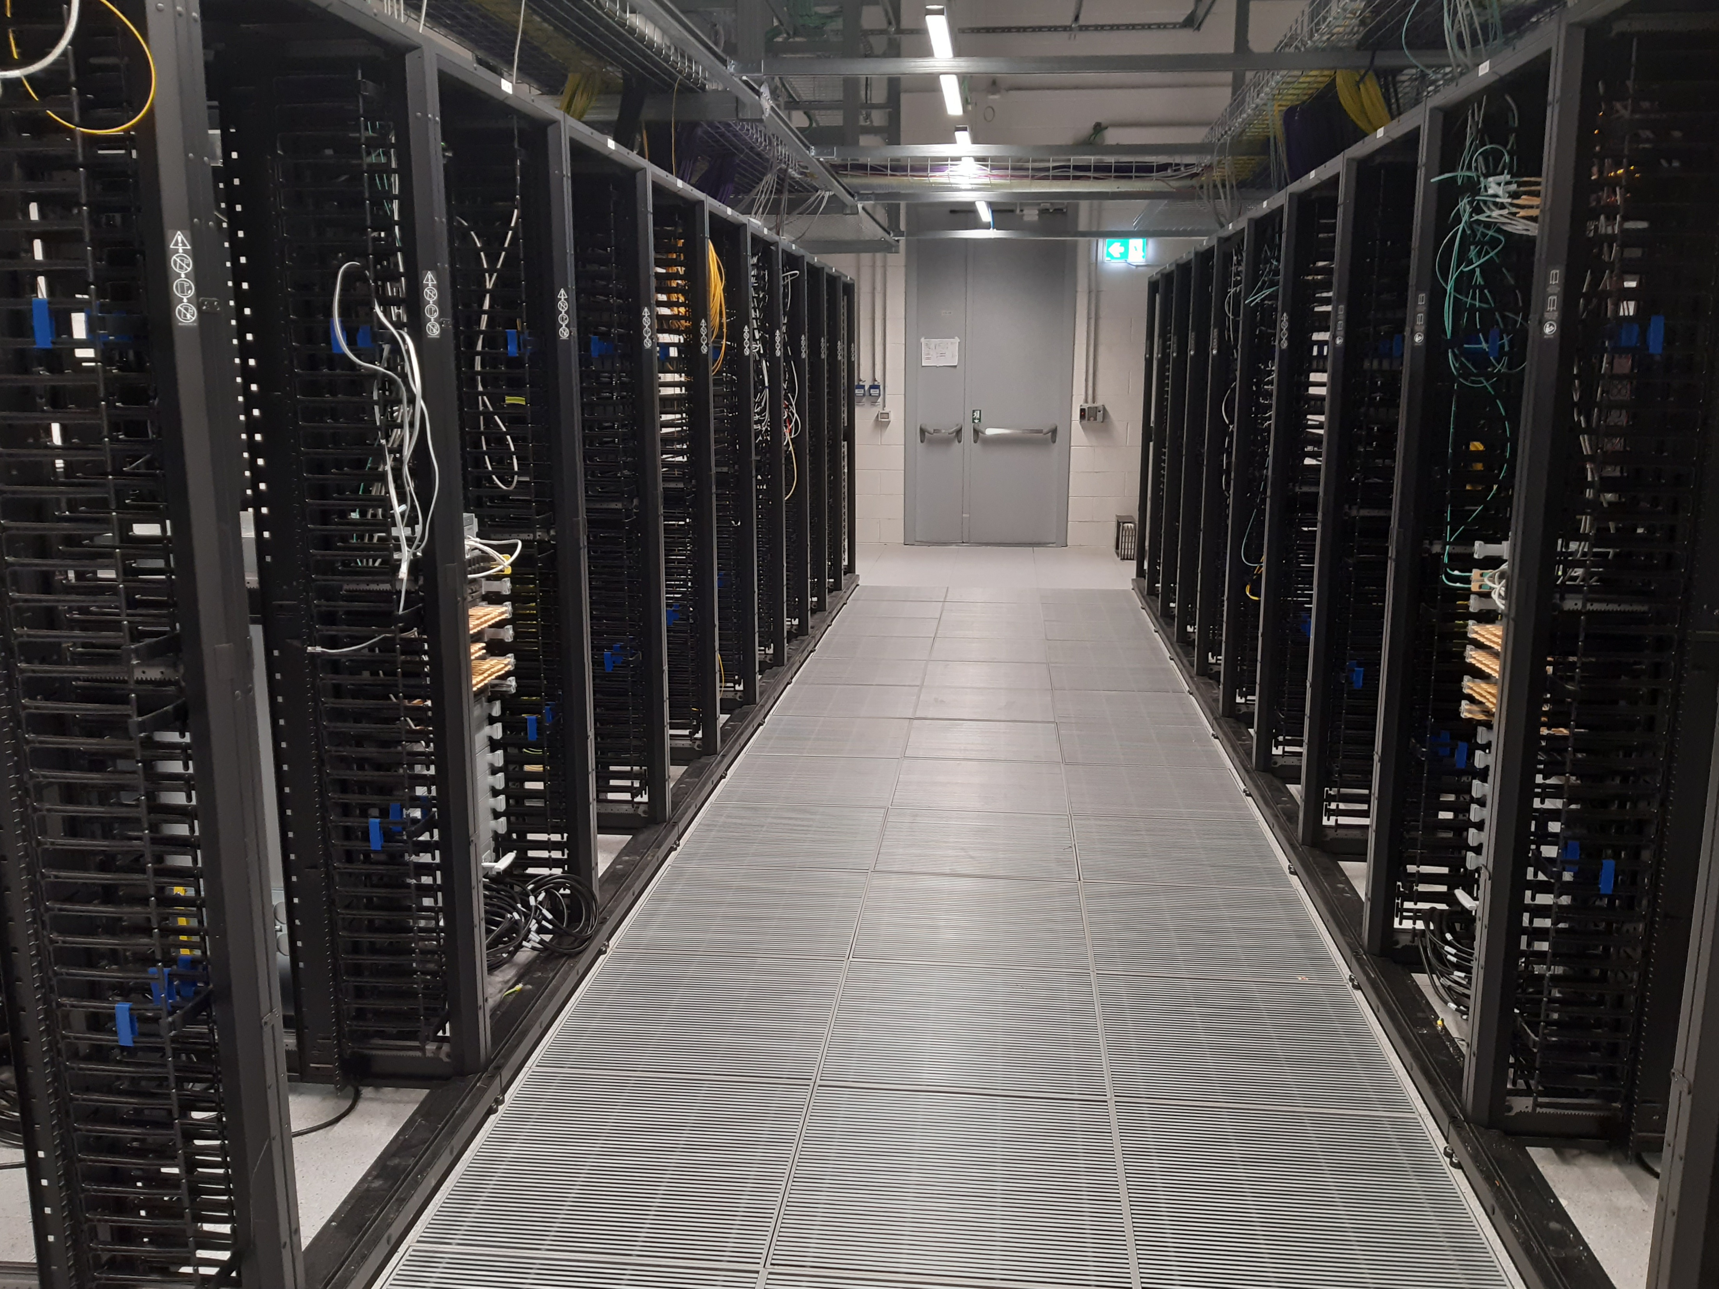
Network Area
ONE OF THEN TWO
CORE AND ROUTER RACKS
Cabling system from Network Area to every row in place
2x Modular Core Switch/Router (ARISTA 7812) –TIER1 Scientific DC
2x ”Switch/Router” (ARISTA 7280) – General Internet Access
15x Management Switch
2 Racks for GARR POP
ARISTA 7280
NETWORK ROOM
ARISTA 7812

Slide 13
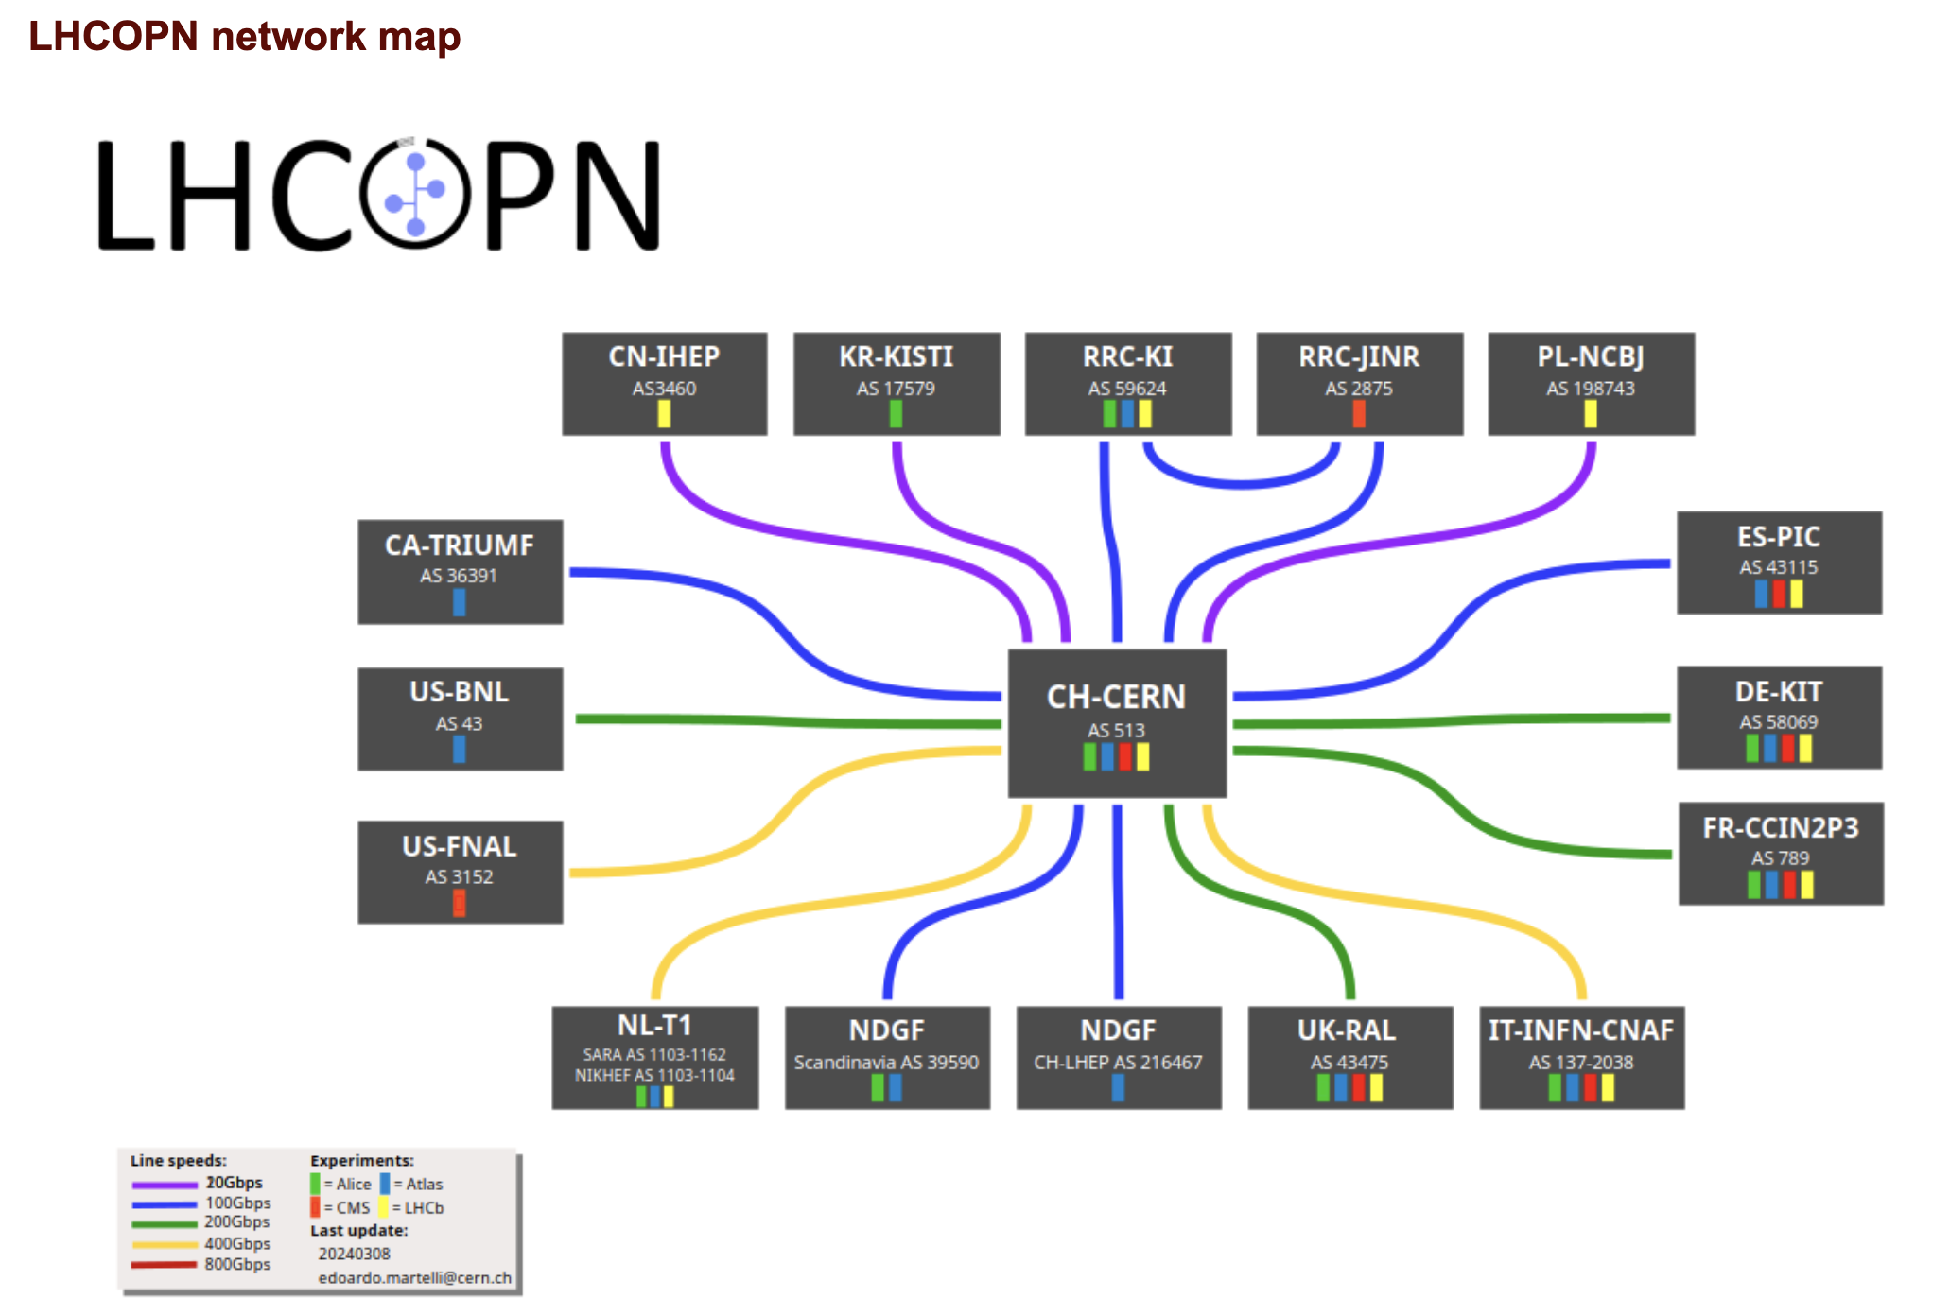
LHCOPN
Optical
Private
Network
The LHCOPN is the private IP network that connects the Tier0 and the Tier1 sites of the LCG.
The LHCOPN consists of any T0-T1 or T1-T1 link which is dedicated to the transport of WLCG traffic and whose utilization is restricted to the Tier0 and the Tier1s.
ONLY IPs of WLCG Resouces have to be announced on this network
INFN CNAF
Italian TIER1
https://twiki.cern.ch/twiki/bin/view/LHCOPN/WebHome

Slide 14
LHCONE
Open
Network
Environment
https://twiki.cern.ch/twiki/bin/view/LHCONE/WebHome
LHCONE is an L3VPN service to connect T2s to T2s and T1s to T2s
More than 140 Sites connected to this network
As for LHCOPN ONLY IPs of WLCG Resouces have to be announced on this network

Slide 15
LHCONE MAP
INFN CNAF
TIER1

Slide 16
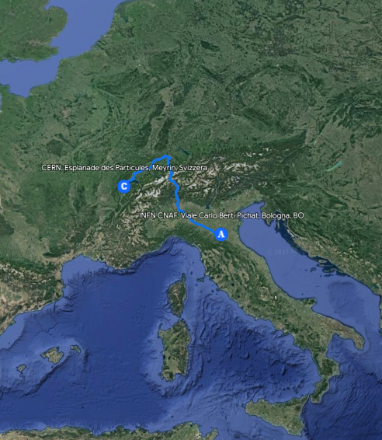




CERN – CNAF DCI
As presented last year we have a pilot link based on multidomain Spectrum sharing Connection.
We activated a 4x100Gbps used as LHCOPN link for INFN-T1
Geneva
CERN DC
Bologna
CNAF DC
Nx100 G
or
Nx400 G
Nx100 G
or
Nx400 G
TRX
TRX
1.6 Tbps
Add/Drop
Add/Drop
GEANT
Open Line System
ROADM
ROADM
GARR
Open Line System
8x AMP
3x AMP
Milan PoP
16

Slide 17
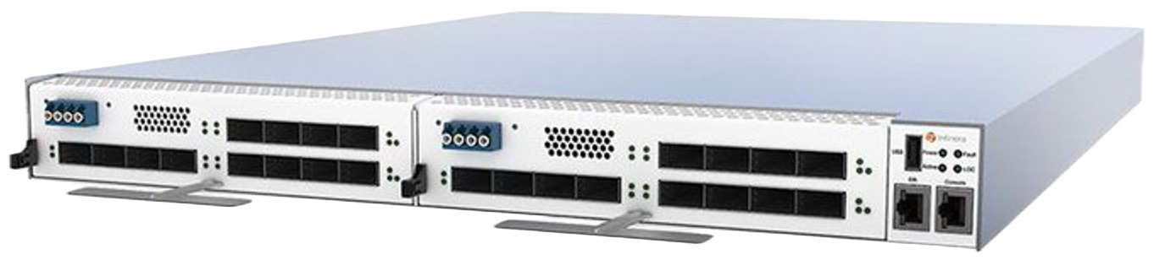
CERN-CNAF DCI (Pre production)
Primary and backup path CERN-CNAF
CNAF
CERN
2 Transponders
Infinera G30@CNAF
LHC-OPN traffic on DCI Link 4x100 Gbps
2 Transponders
Infinera G30@CERN
PRIMARY PATH (as-path: 2038-513)
SCS
Spectrum Sharing (1,6Tbps over 400Ghz)
1000 km
4x100G
4x100G
0
Nexus 9516
Nexus 9516
CERN Router1
CERN Router2
L3 Overlay
LHC-ONE
LHC-OPN (Backup)
2x100G
2x100G
Router GEANT
Router GARR
BACKUP (as-path 2038-137-20965-513

Slide 18
That’s it

Slide 19
Backup Slides

Slide 20
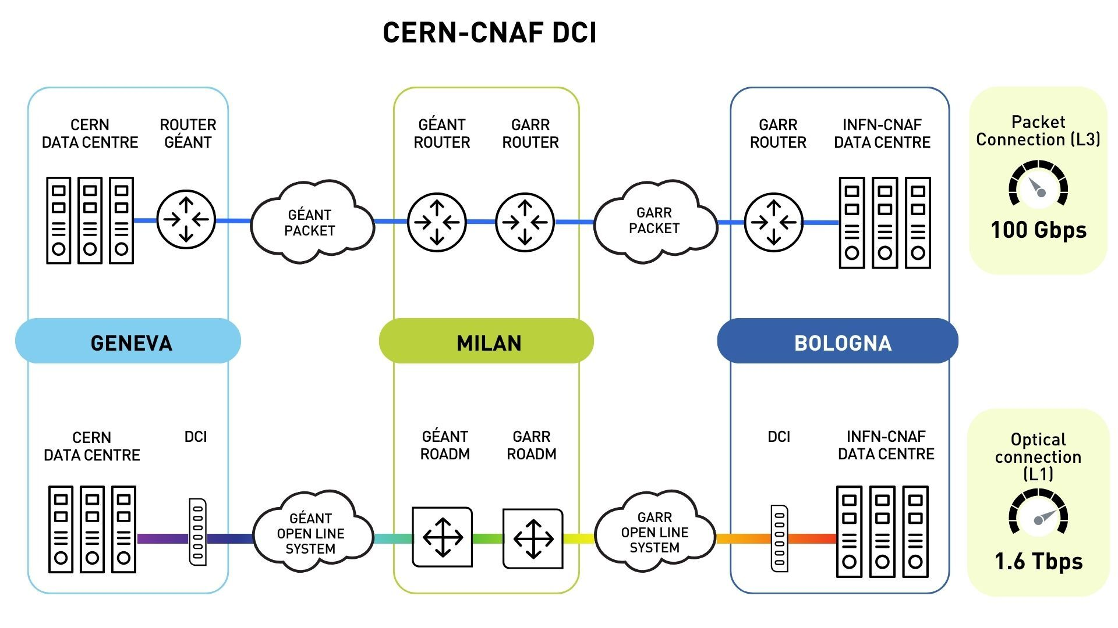
CERN-CNAF DCI
RTT
15 ms
RTT
9.5 ms
Courtesy GARR

Slide 21
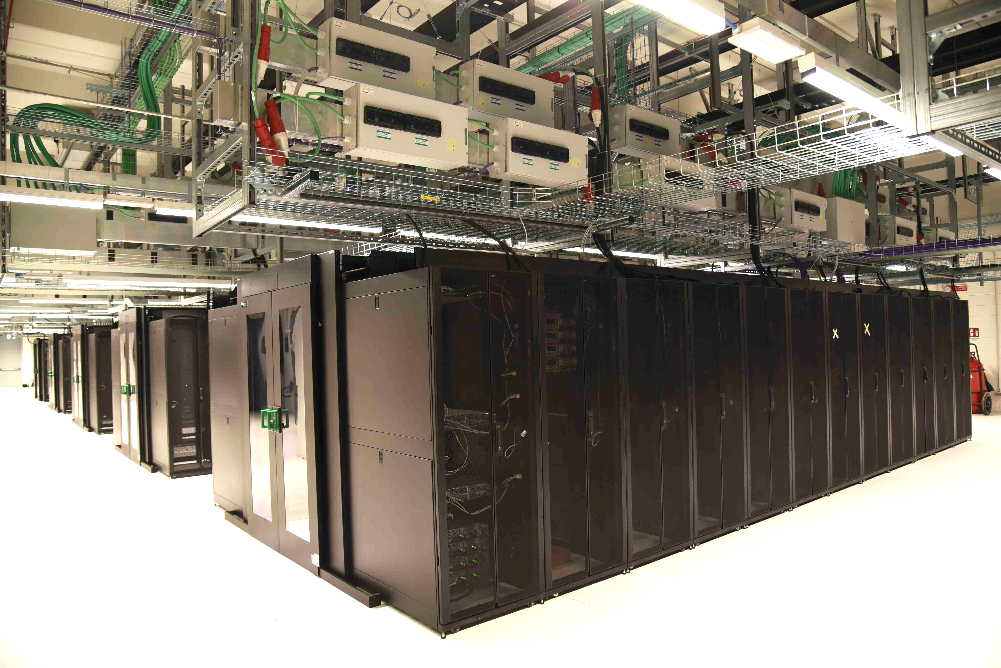
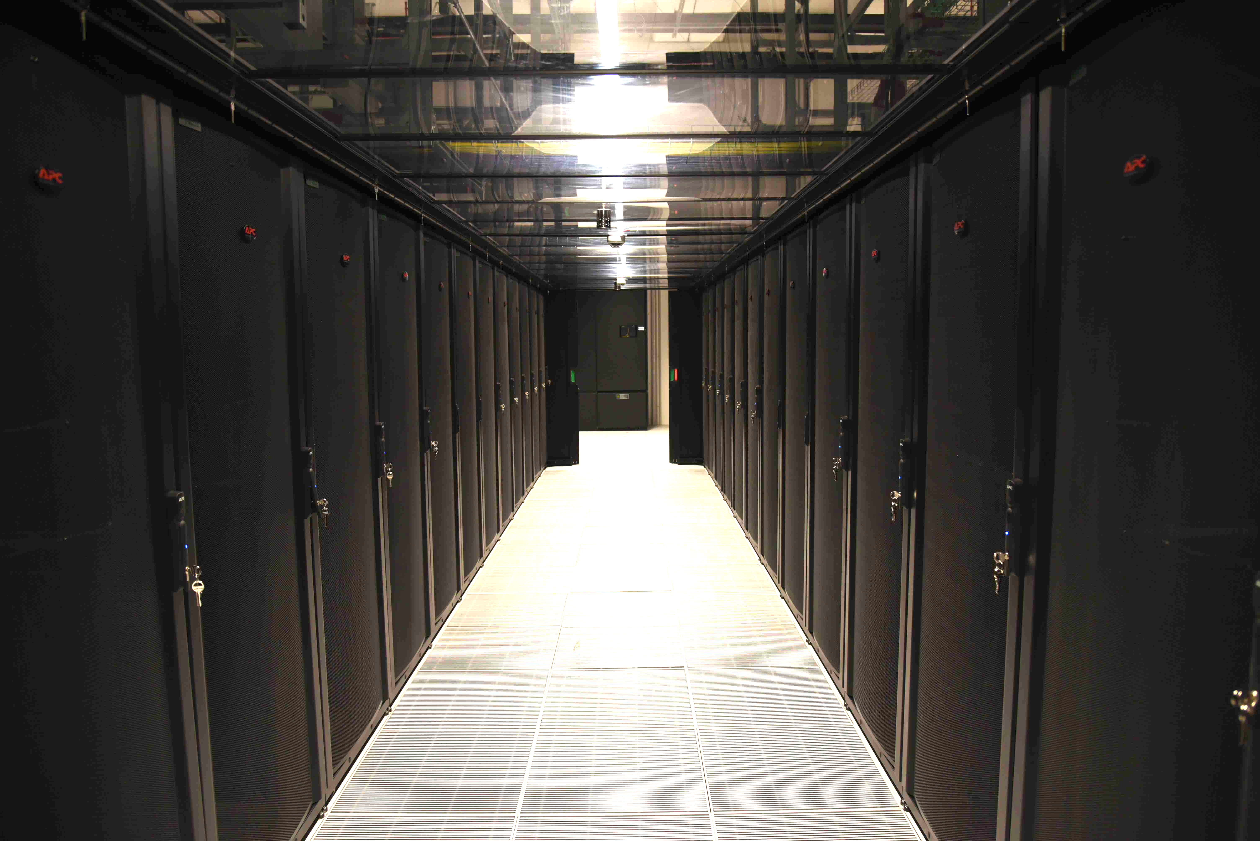
Low density Area
150 racks in place
Under Floor Cooling System operational
First Computing and storage resources
First 5 CPU Racks transferred in the new data center In low density area →In production
First 64 PB of new storage resources are installed in the new data hall → configuration in progress

Slide 22
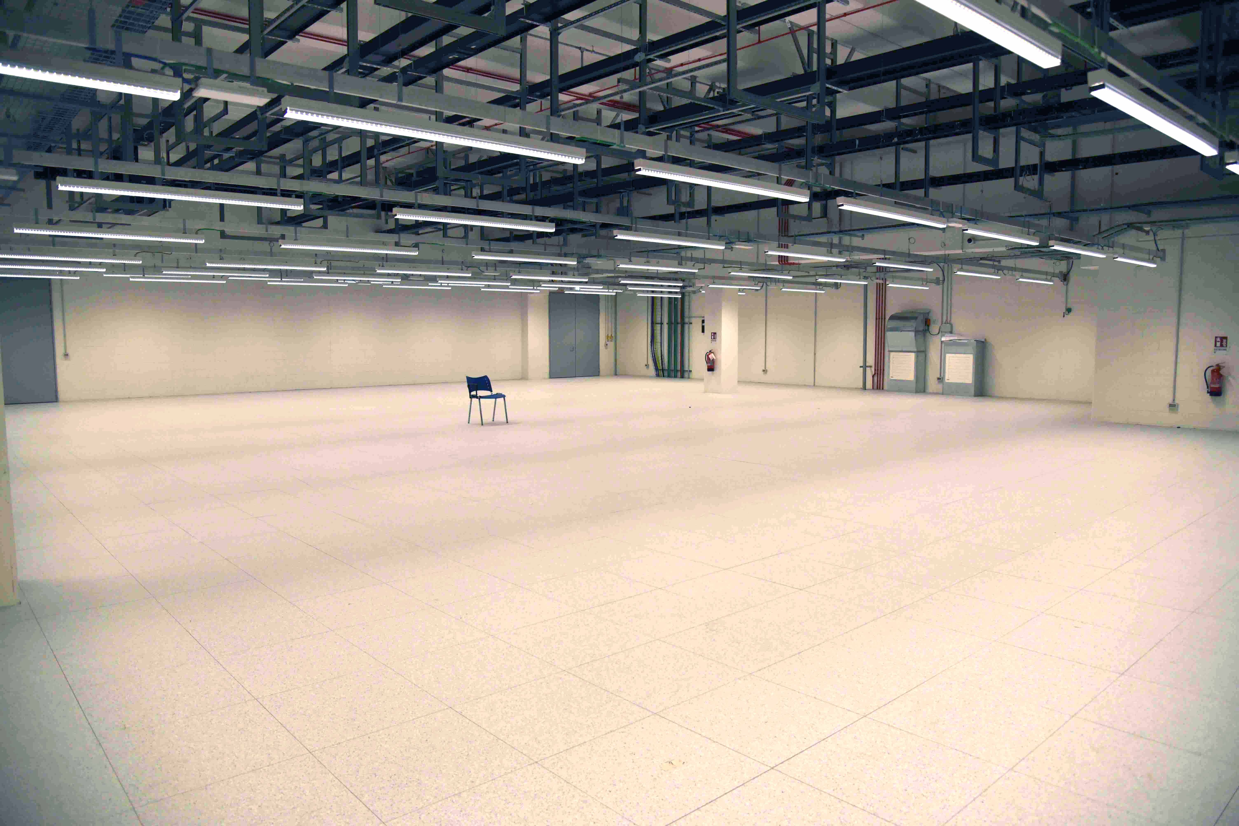
High Density and expansion area
FREE EXPANSION AREA
Network Cabling racks are in place
The High density farming area can host 3 rows of 16 Racks full of DLC systems (Up to 80 kw/Rack) or very dense air cooled systems (Up to 30kw/Rack)
An Expansion area of about 800 sqm is available for future use

Slide 23
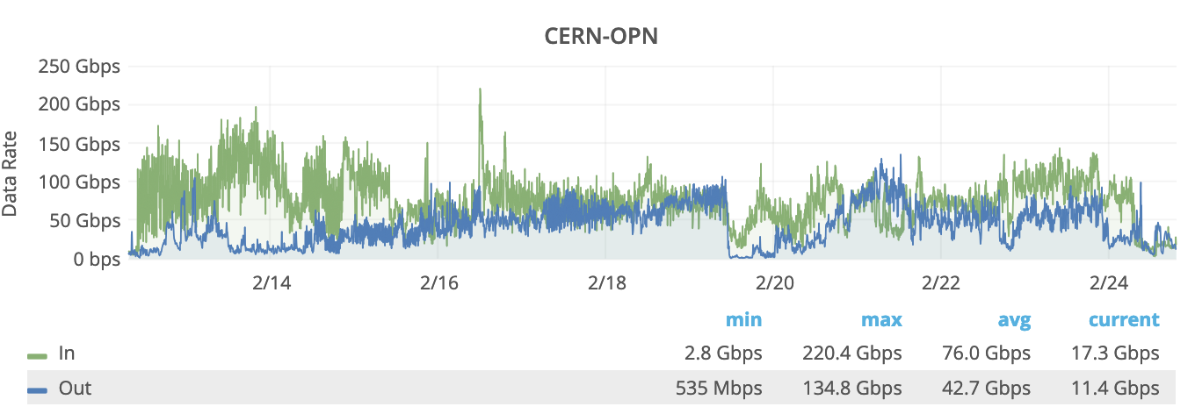
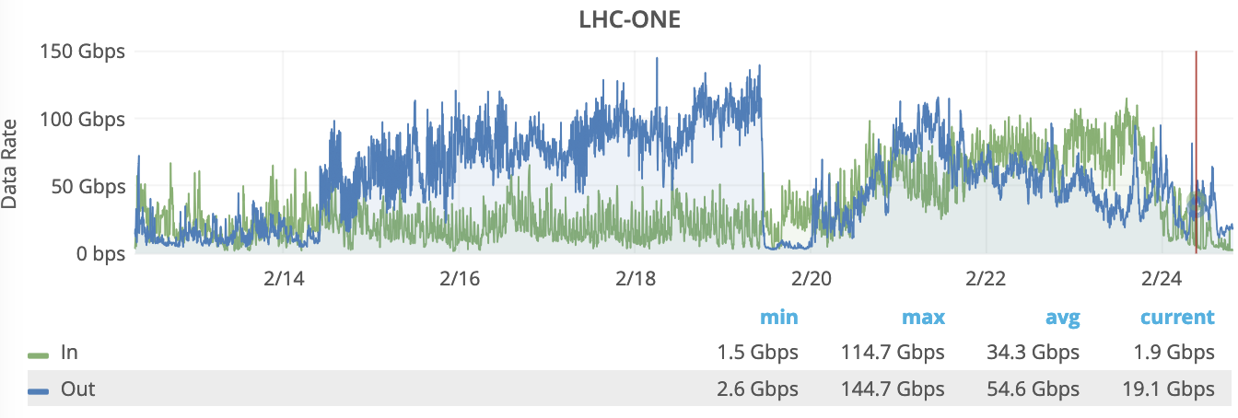
Data Challege 2024 (Using DCI link)
On 400Gbps CNAF-CERN DCI Reached 220 Gbps (5 minute average)
On LHCONE (T1-T2 + T1-T1 per FZK e IN2P3) Reached 145 Gbps
Quite good rates reached (>200Gbps) and network don’t represent a limit for the data movement (Never saturated)

Slide 24
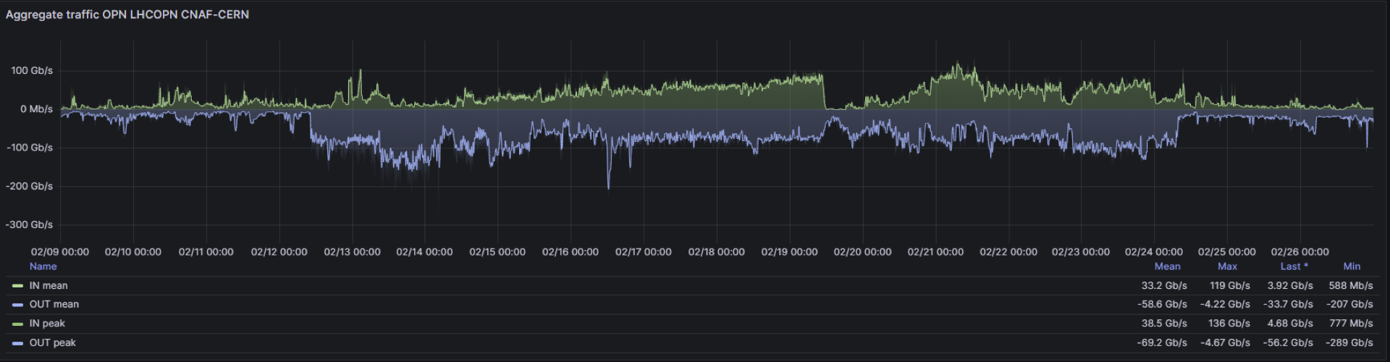
Telemetry (On transponders)
Data observed via Telemetry on transponder devices (peaks close to 300Gbps)
285 Gbps
Telemetry gives us instant data (not average) and it is better to observe peaks.

Slide 25
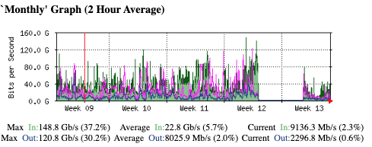
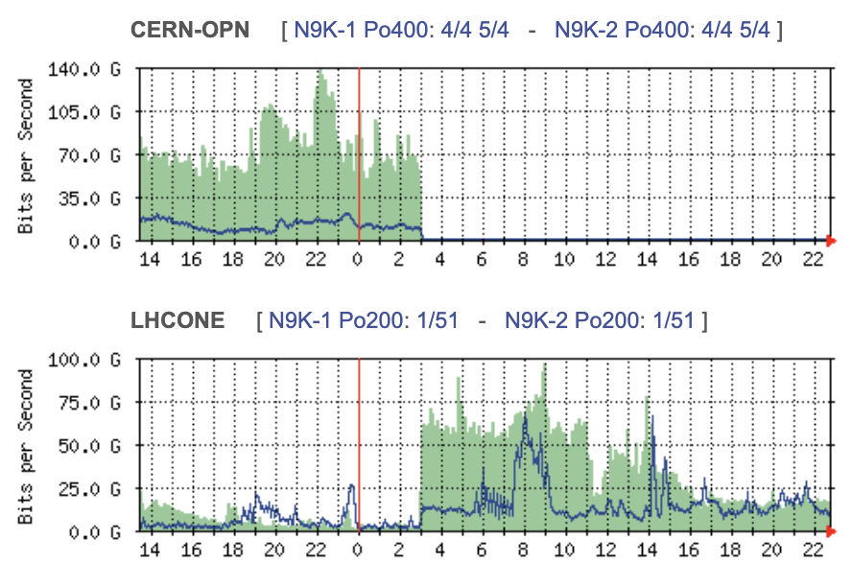
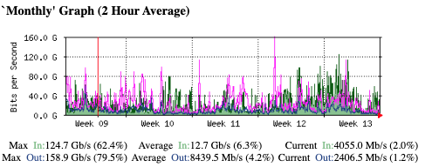
Fiber CUT on DCI (22/3/2024 – 27/3/2024)
During “CUT time” traffic
Flowed on LHC-ONE “Routed” Path
CUT 22/3/2024
OPN CERN – CNAF DCI
OPN-ONE CERN – CNAF (backup)

Slide 26




CERN-CNAF DCI (Next steps)
DCI on spectrum sharing is ready for production
Pilot activities will continue
400Gbps and multiple 400Gbps Ethernet connections
Extension of the pilot to the new datacenter @Tecnopolo
Try to find a second optical path for redundancy
Improve automation on optical network programmability
Acknowledgments:
GARR Optical : Colantonio, Vuagnin
GARR Packet : Inzerilli, Marletta, Valiante
GARR DC & DevOps : Cesaroni, Chiarelli, Marzulli
CNAF Team: Zani, De Girolamo
CERN Team: Martelli
GEANT Team: SCS Team, Roberts
GARR Management/Amm/CTS

Slide 27
Connection to Leonardo
General IP
WAN
16x100Gb Ethernet
OPN/ONE
Syway 2
Syway 1
IB
IB
IB
IB
IB
IB
CORE-1
A7812
A-7812
Dragon Fly
ESI
L2 LACP
Port Channel
LEONARDO
FARMING or STORAGE
Resources

Slide 28
