Slide 1
Laboratorio Acceleratori e Superconduttività Applicata
Dario Giove
10th July 2024

Slide 2
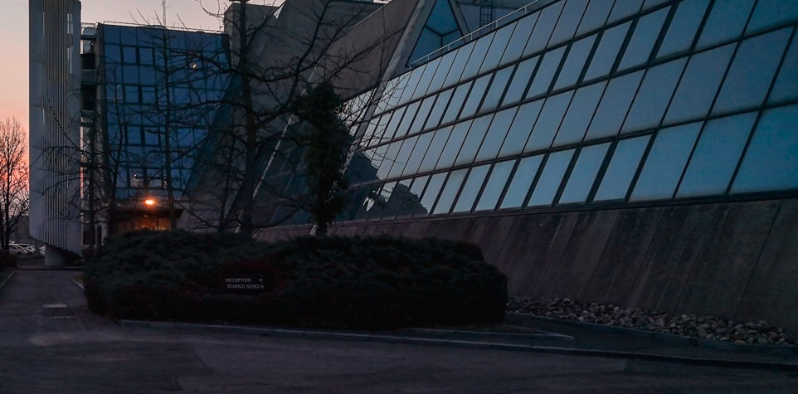
What is LASA ?
The INFN laboratory LASA (short for Laboratorio Acceleratori e Superconduttività Applicata, i.e. Laboratory for Accelerators and Applied Superconductivity), in Segrate, at the outskirts of Milano, is an internationally Excellence Particle Accelerator technology center since nearly thirty years.
The LASA develops advanced technologies for superconductivity, cryogenics and the productions of high intensity DC and RF electromagnetic fields.
As the name suggests, the LASA laboratory is dedicated to the study and development of innovative acceleration schemes and applications of advanced superconductivity both to accelerators and to other fields of physics.
The activities carried out since the early 90s in different sectors of accelerator physics and cryogenics applied to both magnets and RF cavities, have allowed the establishment of unique skills, which result in the possibility for INFN to play an important rule in support of international projects of particle physics.
2

Slide 3
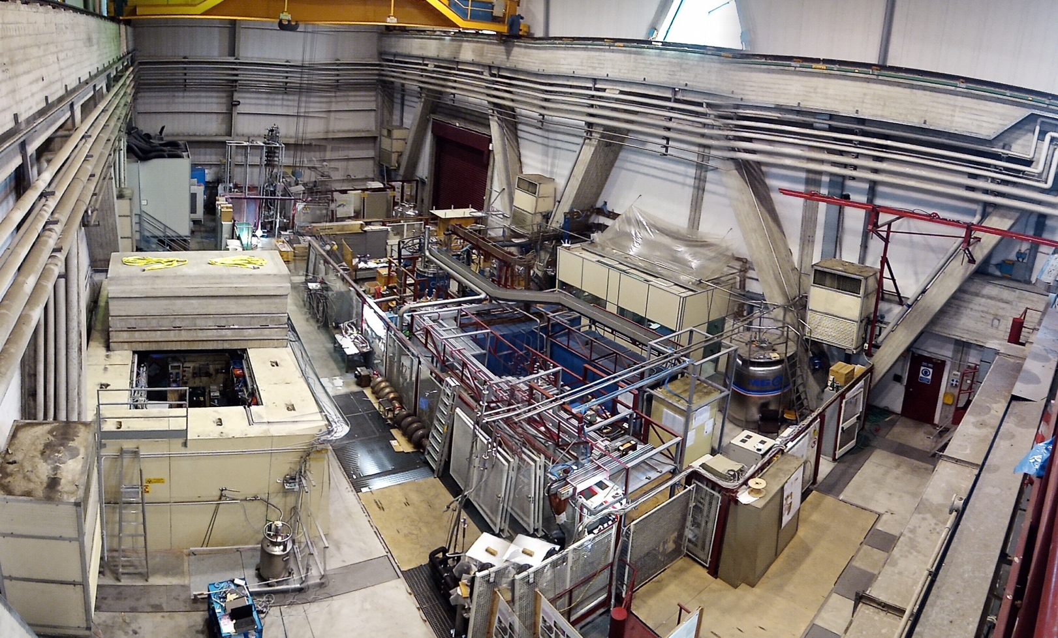
Main Experimental Hall
Clean room
class 100
& HPR
UPW production
High Brightness Beam Test Facility
High field solenoids
SC wire testing area
SCRF cavities
Vertical test area
High current PS
Test Station for long magnets & High Current
Astaroth area
3

Slide 4
A new strategy for the Laboratory
In the period 2020/2021 a review of the strategy of the laboratory has been carried out under the influence of MAC suggestions and a new approach in the management of the laboratory.
This new strategy focused on a laboratory mission capable of supporting the activities considered essential to LASA:
• clear identification of research areas for which the LASA, for historical reasons, of existing skills, of available equipment, is a natural headquarters
• increase in scientific and technological R&D activities, to approach a balance between these and the activities requested and financed in a dedicated way by INFN
• strengthening of collaborations between our laboratory and national and international communities
• consolidation of the laboratory infrastructure
• upgrading of the main components of the cryogenic plant in view of the design of a new liquefier with performance suitable for the foreseen 10 years of activities
4

Slide 5
A new strategy for the Laboratory
• upgrading of laboratories and organizational structures (even if not immediately declinable as services)
• request for new staff, taking advantage of the different possibilities available, aimed at strengthening the structure of the laboratory as a whole both in terms of researchers, technologists and technical collaborators (the latter particularly necessary)
• training of young people hired on a fixed-term basis
• general staff training with regard to workplace safety issues and use of specific equipment (mechanical, electronic and laser)
• opening of the laboratory to local relations
5

Slide 6
Clear Identification of Research Areas
The research areas already funded at LASA and on which the laboratory has focused in recent years, cover the following topics:
Superconducting magnets
superconducting cavities
design of an ERL-type linear accelerator with 2 experimental stations to generate coherent X radiation, THz radiation and a beam line for applications in the medical field (BriXsino project)
normal conducting cavities developments
sustainable approach in the design of elements for accelerators
advanced optics applications
radioisotope study.
6

Slide 7


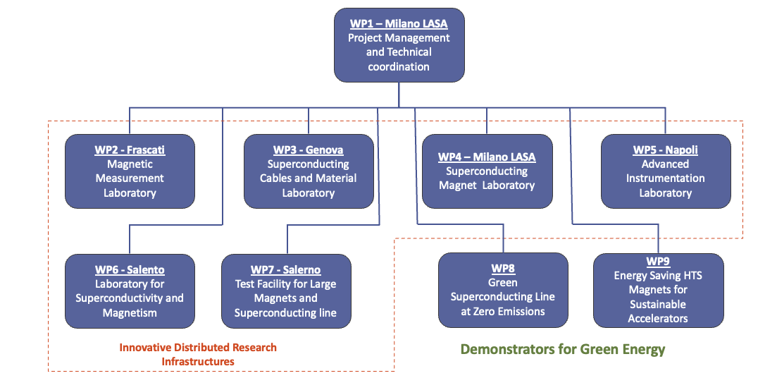

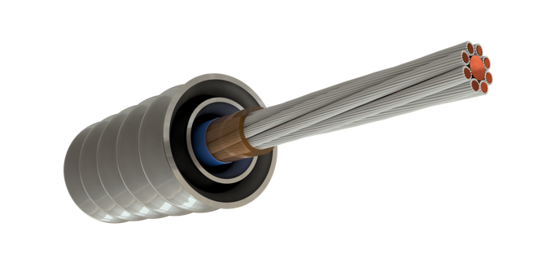
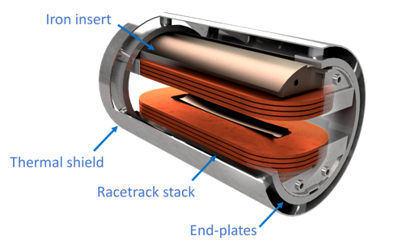
Infrastructure
Green Sc Line
HTS R&D and construction
See specific presentation
Green SC Line 1 GW
25 kV-40 kA in MgB2
HTS dipole
10 T @ 20 K

Slide 8


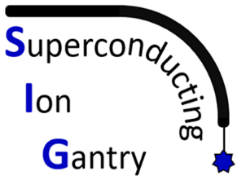




Strengthening of International and National Collaborations

Slide 9
A new layout for LASA
As part of the PNRR-IRIS program and with a significant specific contribution provided by the INFN in 2023, the construction of an extension based on two laboratories will begin within the LASA premises: one called SML (Superconducting Magnet Laboratory) and the other AATF (Advanced Accelerator Test Facility) for a total of 2100 m² spread over an underground bunker and two external floors.
These new laboratories will be available in 2025.

Slide 10
A new layout for LASA

Slide 11
A new layout for LASA

Slide 12
A new layout for LASA

Slide 13
Main Infrastructures
A new liquefier is in the final stage of issuing the orderwill be operative within 20 months.
This has been a 4 MEuros investment from INFN.
13

Slide 14
LASA based activities on SC Magnets & Superconductors

Slide 15
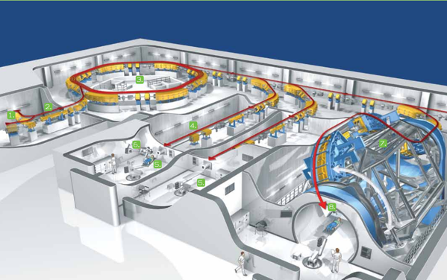
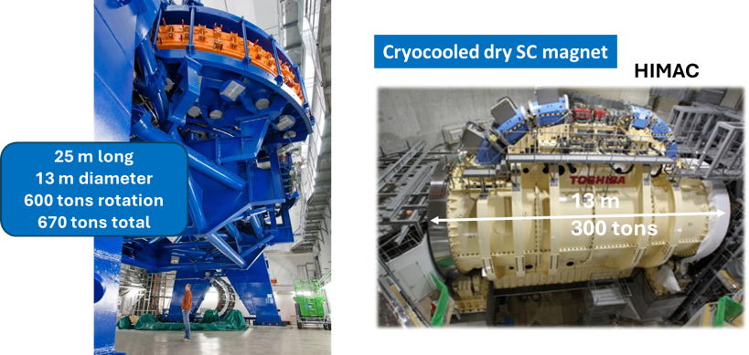
HADRON THERAPY with heavy ions studies: new SC Gantry
SEEIST
Accelerator & Gantry halls : resistive magnet vs SC magnets
HIT - Heidelberg Ion Beam Therapy Center
Resistive dipoles 1.5 T
Curvature radius of about 4.5 m
Four 90 degree dipoles at 3.5 T
Curvature radius of about 2 m
Study HITRIplus (M. Vretenar et al.)

Slide 16
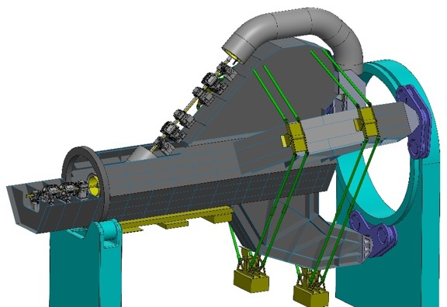
EU projects for new Gantry based on SC magnets
Main advantages:
Reduction of weight (300 → 50 ÷100 tons)
  Reduce the number of magnets (B = 3→4 T)
Footprint and cost reduction
  Total cost of facility is about 200-250 Meuro (50 Meuro for the gantry);
  Compact accelerator and gantry → less civil construction.
Reduce Power consumption (SC vs NC magnets);
SC Magnet Target
B = 4 T
Θ=45°
Top = 4.7 K
dB/dt =0.4 T/s
Curv. Radius = 1.65 m
Main disadvantage:
Need of cryogenic system (Top > 4.7 K, no liquid helium);
Carbon Ion Beam rigidity Bρ= 6.6 Tm
New: HITRIplus & EuroSIG
Three INITIATIVEs funded in 2021
(all ending 2025)
H2020- Hitriplus – WP8 (LASA and GE)
H2020-I.FAST- WP8 (LASA and GE)
EuroSIG (CERN-CNAO-INFN(LASA+GE) and MedAustron
  EuroSIG Italy → Call CSN5-2021 SIG now financed by SIG_PNR
Project vision
Final prototypes
2025-2027 -1 M€
Gantry construction
(for CNAO)
2026-2029
Magnets: 6 M€ (@ IRIS)
Total Gantry: 15 M€

Slide 17










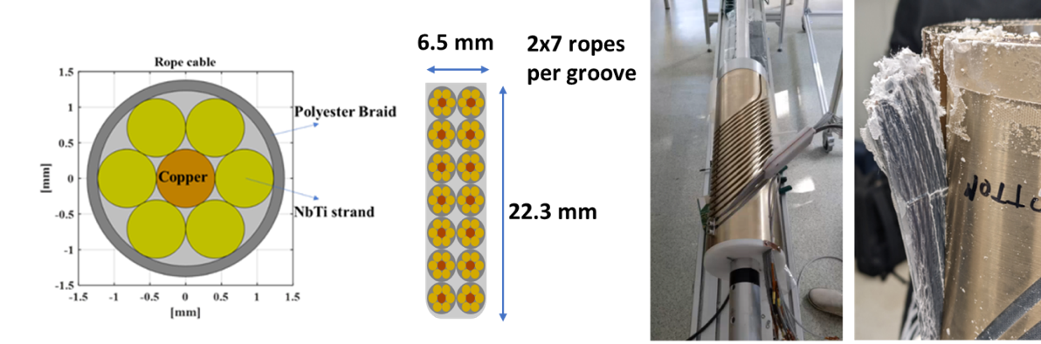
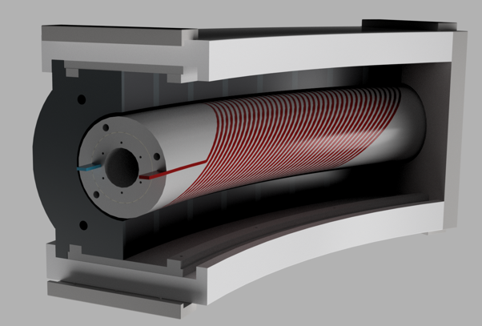
HITRIplus WP8 – Superconducting magnet design and demonstrator
Budget INFN: 200 k€ (ca. 65% LASA, 35% Ge)
EU projects: HITRIplus
Courtesy of E. De Matteis (INFN)
First technical and financial assessment of various magnet designs: Canted cosine theta layouts with several superconductors (NbTi, Nb3Sn and HTS);
Construction and test of a small demonstrator for feedback useful for accelerator as well as gantry final magnet design.
Curved CCT layout magnet based on NbTi
Conductor: rope 6 NbTi +1 copper core strands with a double braid of polyester;
Definition of the curved former construction (critical point):
Curved sectors obtained from straight Al-Br tube and radially pinned;
Magnet Assembly
Final demonstrator

Slide 18









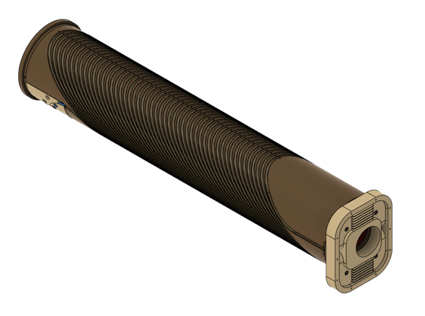
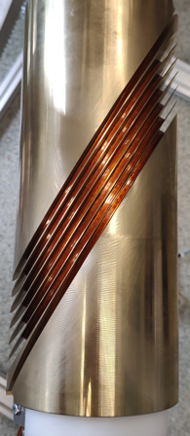
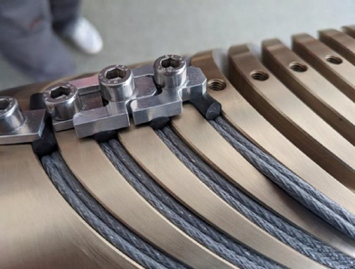
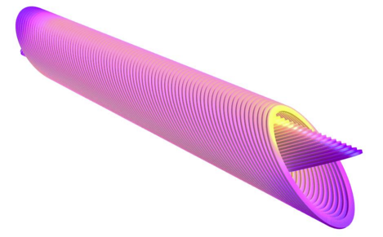

EU projects: I.FAST
Courtesy of E. De Matteis (INFN)
I.FAST WP8 – Innovative superconducting magnets
Budget INFN (ca 200 k€)
Exploring Canted Cosine Theta with HTS superconductor (main goal), preceded by a combined function CCT based on LTS → involving the industries that want to learn about the CCT magnets;
Construction of the two straight demonstrators, with magnet test and validation
Demo 1: Combined CCT based on NbTi
Demo 2: CCT based on HTS (REBCO Tape)
4 T dipole + 5 T/m quadrupole;
Ramped at 0.2- 0.4 T/s → challenge is the heat extraction generated by superconductor, and former;
4 T dipole with a new Top of 20 K;
Quench protection is demanding;
50 W of losses (compatible with conduction cooling);
Final demonstrator (view without shell)
Ropes winding detail
Mockup coil (2 cables yet) completed
Outer layer
Splice box

Slide 19




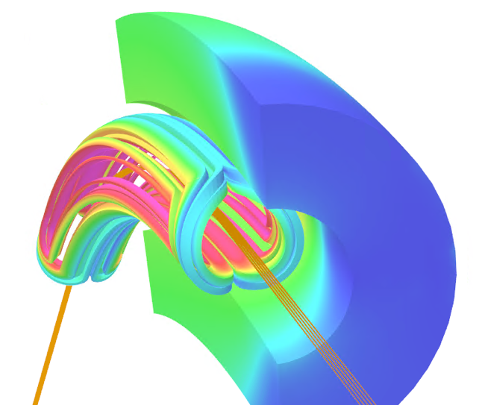
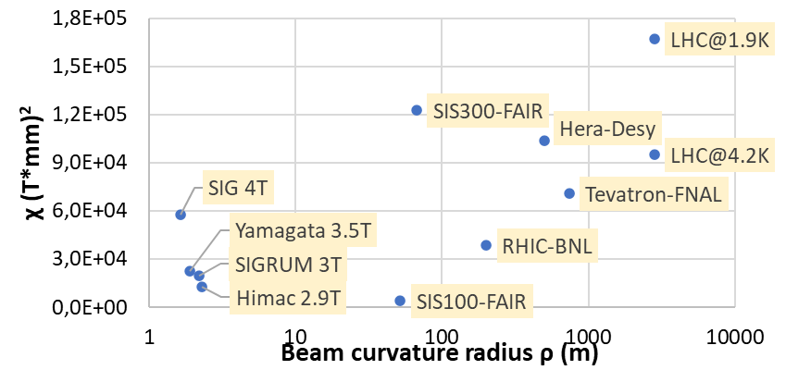
SIG
Courtesy of M. Prioli (INFN)
EuroSIG
Design, construction and test of a curved superconducting demonstrator magnet (SDM-c) for ion gantries,
within the EUROSIG 4-parties agreement;
Main demonstrator magnet parameters:
  Cos-θ coils (LTS - NbTi)
  Pure dipolar field: 4 T
  Bore diameter: 80 mm
  Small curvature radius: 1.65 m
  Angular sector: 30° (demo.) - 45° (prototype)
  High field ramp-rate: 0.15 T/s (demo.) - 0.4 T/s (prototype)
  Compatible with conduction cooling (no LHe)
  but no optimization
Budget 1260 k€ (600 from SIG_PNR ; 250 CERN; 350 CNAO)
Complexity

Slide 20
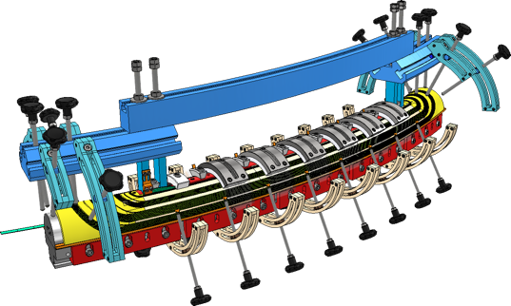
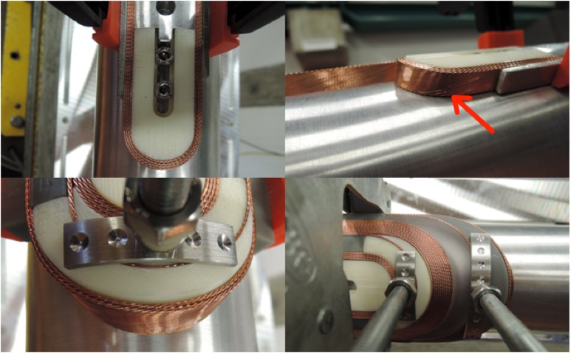
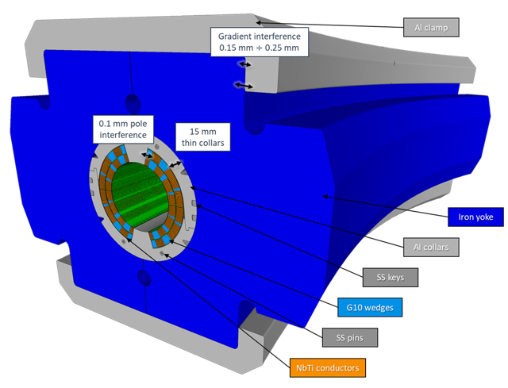
SIG-Status
Winding tooling
Conceptual design report delivered, review completed → green light for the winding trials;
The present focus is on proving the windability and assembly of a curved magnet:
  Coil components and winding-curing tooling procured
  First straight winding completed
  → First curved winding planned in September
Mechanical structure
First SIG winding trial at LASA!
Waiting for final cable by CERN

Slide 21




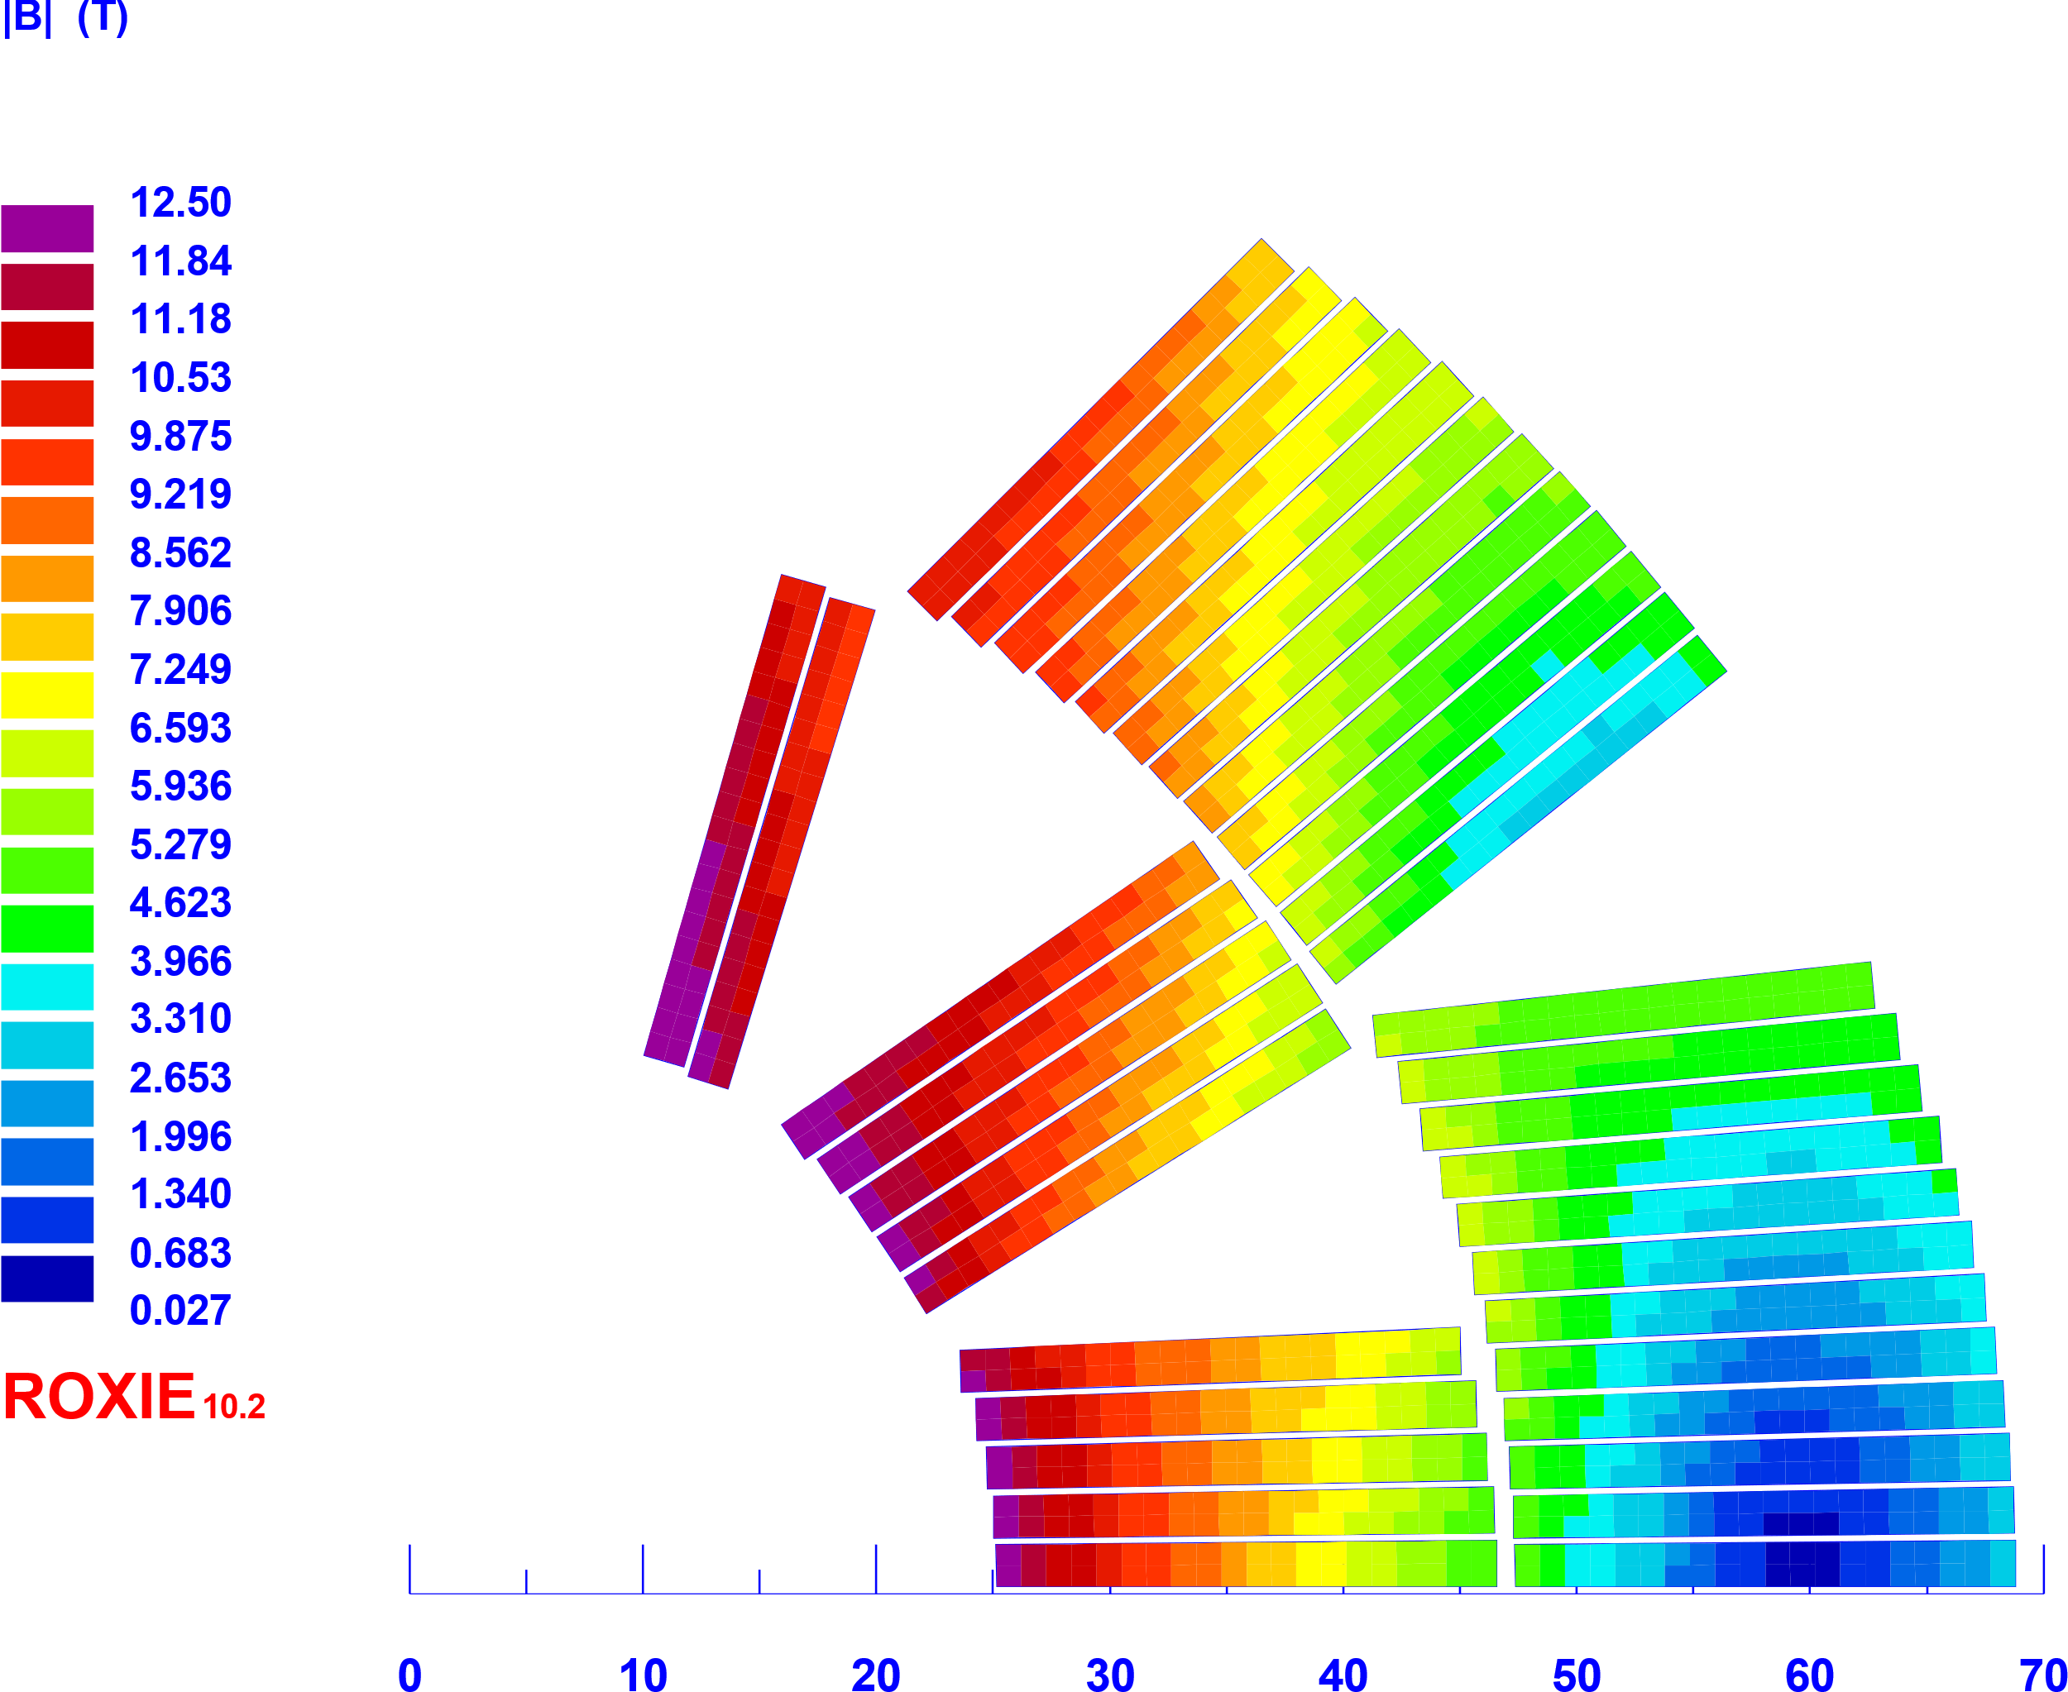
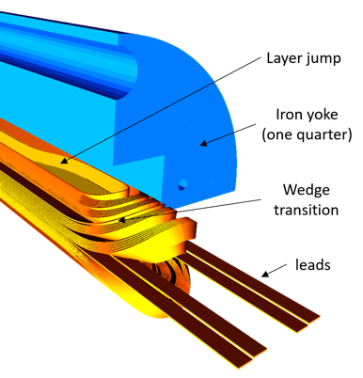
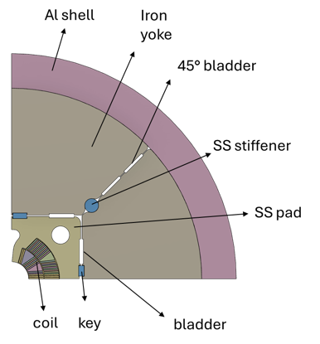
INFN – Nb3Sn Magnet Activity
INFN-Genova
INFN-LASA-Mi
CERN provides the magnet components
(cable, spacers, etc.)
FalconD 12 T dipole – project overview (ca. 6 M€ budget project)
The project includes the following activities:
At ASG superconductors, the manufacturing of
  1 dummy pole wound with copper cable
  2 practice poles wound with Nb3Sn cable
  3+2 poles wound with Nb3Sn cable for the single aperture dipole
At INFN-LASA lab (Milan), the bladder and key assembly and test @4.2 K (LHe) of the FalconD magnet
At CERN, final test @1.9 K
INFN is responsible for the magnet design, assembly, and preliminary test @ 4.2 K
(at LASA laboratory in Milan)
ASG Superconductors is hired by INFN to fabricate the coil (7 Nb3Sn + 1 dummy copper)
9.85 mm
R.Valente
N. Sala (GE)

Slide 22
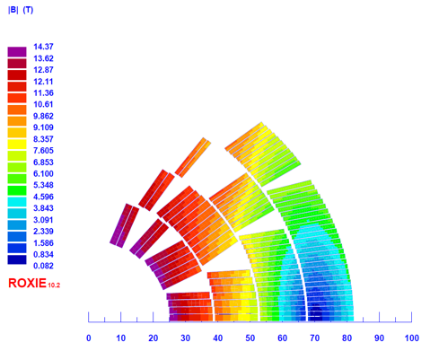
High Field Magnet Collaboration (ESSP-2020-2027)
Next step for an FCC-hh dipole : agreement under way 2025-2030 ∼ 10 M€
Evolution of INFN – Nb3Sn Magnets Activity inside HFM
Towards deep Nb3Sn R&D phase
After the FalconD project, the INFN can profit of:
Experience and results obtained from FalconD INFN-CERN collaboration
Availability of FalconD spare coils to further practice
The tooling for assembly and test inherited by FalconD and the new infrastructure of IRIS to fabricate magnets
INFN proposal to HFM
Re-use the FalconD coils to fabricate a double-aperture dipole
Design and fabricate a 4-layer cos-theta dipole to achieve 14 T
Parameter | HF cable (DEM-1.1) | LF cable (11T dipole)
Strand number | 22 | 38
Strand diameter (mm) | 1.1 | 0.7
Bare width (mm) | 13.2 | 14
Bare inner thickness (mm) | 1.892 | 1.204
Bare outer thickness (mm) | 2.0072 | 1.3261
Operating current (A) | 9820 | 9820
Insulation (mm) | 0.15 | 0.15
Keystone angle | 0.5° | 0.5°
Cu/NCu | 0.9 | 1.15
Area insulated cable (mm²) | 30.28 | 22.29
Operating point on «peak field» LL (1.9 K) | 79% | 75%
JC @ 16 T, 4.2 K (A/mm²) | 1200 | 800
J_{overall} (A/mm²) | 324 | 440
J_{SC} (A/mm²) | 892 | 1443
W_{eqv} (mm) | 44
Bore field (T) | 14
High Field cable
Low Field cable
4
3
2
1
R.Valente

Slide 23
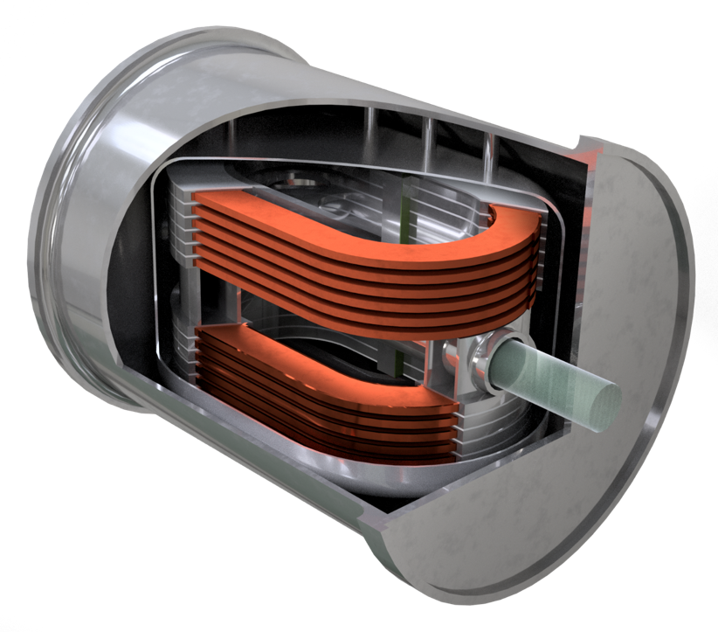
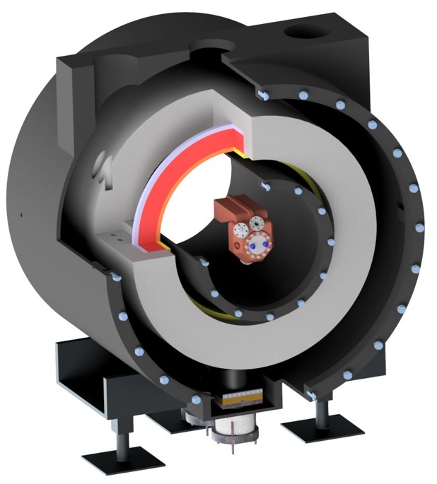
IRIS and the Muon Collider are the present driver for a next generation Magnets in HTS
Split Coil - RFMTF
Magnet Test Facility for RF (and other use)
ESMA
Energy Saving MAgnet
M. Statera
S. Sorti

Slide 24
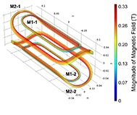
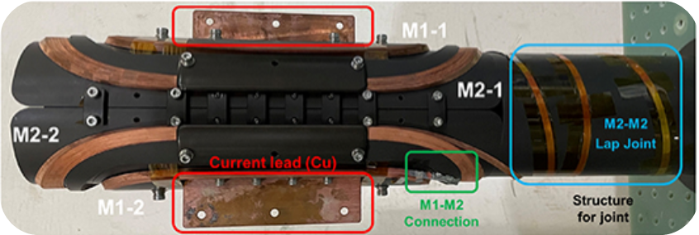

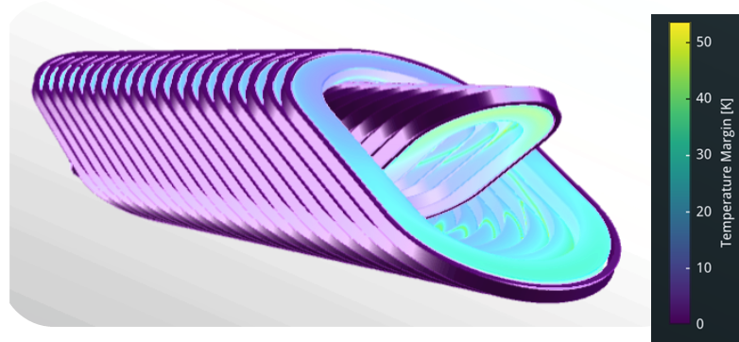

Final goal: a dipole accelerator magnet in HTS for the FCC-hh (15-20 T @ 20 K!)
S. Mariotto
Small HTS tape dipole : Prof. S. Hahn (Seoul U.)
HTS based HF dipole for FCC-hh via HFM contract
2025-2029 (∼2+4 M€)
Also for MC!
Special shape CCT for dipole fields
S. Sorti

Slide 25

The evolution of the magnets in the IRIS timeline
FCC ee/hh
pre-construction (MC? LH line?)
HTS4Fusion
SC Gantry construction
Nb3Sn & HTS for FCC (ee-hh) R&D
HTS for MC R&D
Energy saving: SC line, HTS for fusion
2020
2025
2030
Hadron therapy
Falcon D
Muon Collider R&D
IRIS Construction

Slide 26
Superconducting RF cavities
26

Slide 27

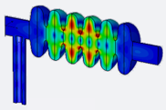
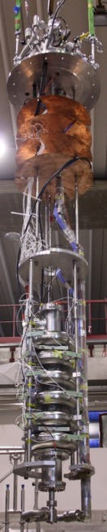
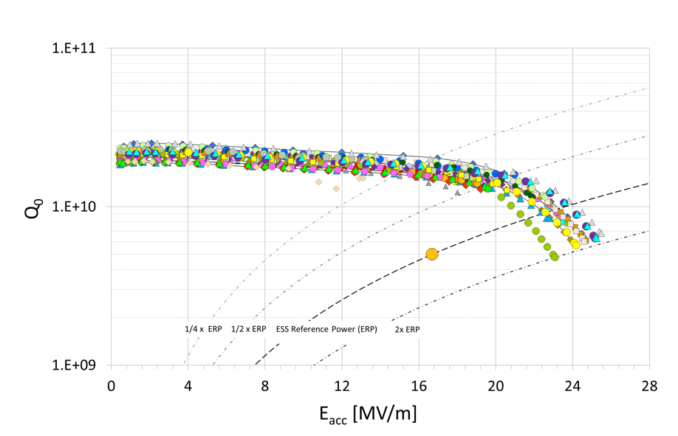
INFN in-kind contribution to ESS
Cavity LifeCycle
Contribution and goals
36 (+2) SC cavities, 1 Nb suppliers, 1 industry,
1 recipe (BCP), 1 qualified lab for VT test
ESS medium β (0.67) Q₀ = 5·10⁹ @ 16.7 MV/m
4 additional cavities requested by ESS as
further In-Kind.
Tender in progress
How it works:
Definition of Nb specs and QC
Optimization of RF and mechanical design
Definition of detailed production specs
PED sound engineering practice
Infrastructures adapted and qualified
QC plan developed including all partners
Manage documentation (INFN Alfresco based)
and database developed for analysis of key
production parameters
Cold VT at LASA for «special» cavities
(more diagnostics available)
QA/QC Plan
High Order Mode
1742.466 MHz
ESS cavity on LASA insert
36 cavities at CEA (string assembly)
Cavity tuning machine
All cavities installed in the tunnel by this Summer
ESS Acceptance Goal
E_{acc} = 16.7 MV/m
Q₀ = 5·10⁹

Slide 28
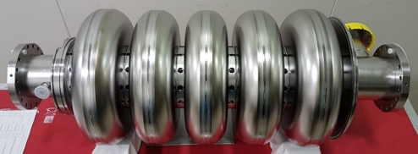

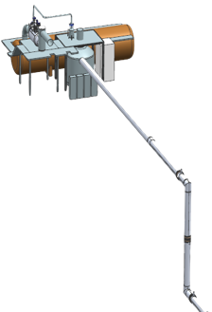






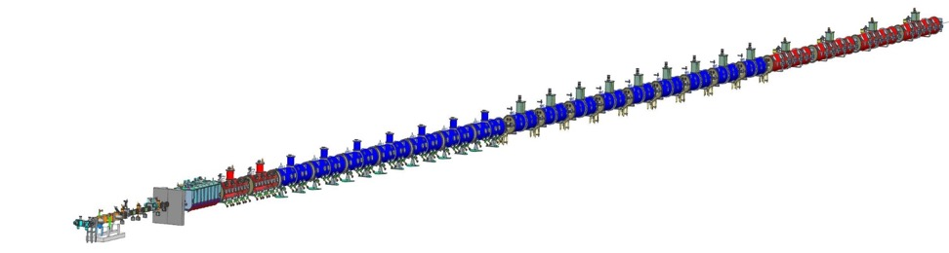





INFN in-kind contribution to PIP-II
INFN LASA provided a novel RF design for the LB650 cavities, compliant to Fermilab technical interfaces and specifications (outstanding Q₀ requirements).
INFN-LASA contribution will cover the needs of LB650 section:
2 proto cavities to validate processing and tech. transfer
38 SC cavities required to equip 9 cryomodules with 2 spares, delivered as ready for string assembly.
Qualification via vertical cold-test provided by INFN through a
qualified cold-testing infrastructure acting as a subcontractor
Compliance to the PIP-II System Engineering Plan
PIP-II LB650 Project Specifications
Acc. Gradient | 16.9 MV/m
Q₀ | 2.4 10¹⁰
RF rep rate | 20 Hz to CW
Beta | 0.61
INFN Deliverable Components | Acceptance Early Date
LB Jacketed Cavities (Batch 1 - Qty 4) and Pre-Series (Qty 2) | Aug-2025
LB Jacketed Cavities (Batch 2 - Qty 4) | Oct-2025
LB Jacketed Cavities (Batch 3 - Qty 4) | Dec-2025
LB Jacketed Cavities (Batch 4 - Qty 4) | Feb-2026
LB Jacketed Cavities (Batch 5 - Qty 4) | Apr-2026
LB Jacketed Cavities (Batch 6 - Qty 4) | Jun-2026
LB Jacketed Cavities (Batch 7 - Qty 4) | Aug-2026
LB Jacketed Cavities (Batch 8 - Qty 4) | Oct-2026
LB Jacketed Cavities (Batch 9 - Qty 4) | Nov-2026
Cryoplant
Elliptical
HB650 X 4
24 Cavities
650 MHz
Elliptical
LB650 X 9
36 Cavities
650 MHz
Single Spoke
SSR1 X 2
16 Cavities
325 MHz
Single Spoke
SSR2 X 7
35 Cavities
325 MHz
CDS
HWR
8 Cavities
162.5 MHz
H- Ion source
833 MeV
516 MeV
177 MeV
RFQ
PIP-II linac layout
800 MeV, 2 mA, H- beam, CW compatible
10 MeV
32 MeV
2.1 MeV

Slide 29
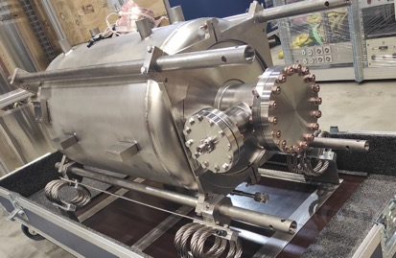
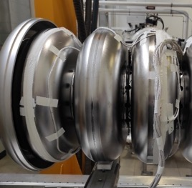
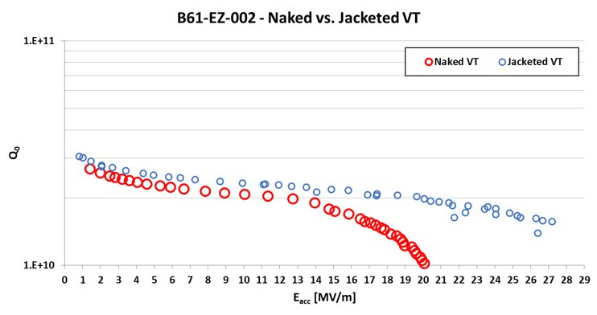
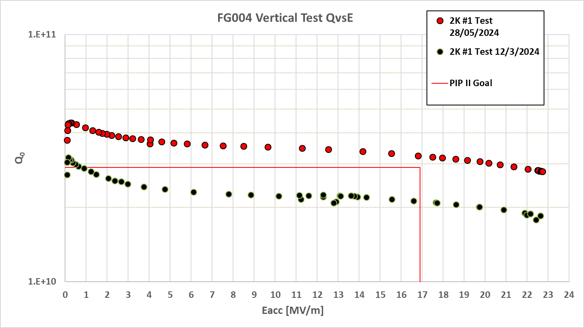
LB650 R&D at LASA – Cavities
R&D in view of High-Q and know-how transfer to industry
  Prototypes to develop proper surface treatments
      B61-EZ-001 jacketed and tested at FNAL
      B61-EZ-002 jacketed and tested at LASA
      B61S-EZ-001 single cell treated and tested at FNAL
      B61S-EZ-002 treated, jacketed and tested at LASA
      B61S-EZ-003 single cell processed and tested at LASA
  Develop diagnostic for treatment process control
  Analytical Field-Emission model
  Cavity transport boxes developed; prototypes built
Main procurements in view of the series production
  RRR300 Nb tender: 1st batch delivered and ready for Eddy Current Scanning. 2nd and 3rd batches in Sept. 24.
  Agreement with DESY in progress for Eddy current scanning
  and series cavity vertical tests
  Cavity manufacturing, treatment and preparation:
  selection approved by INFN GE, now signing contract.
B61-EZ-002 VT results – naked vs. jacketed
B61S-EZ-003 Q₀ rise following perfect compensation of residual B field

Slide 30
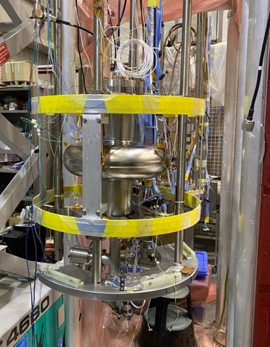
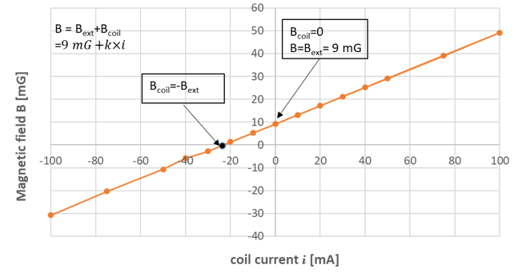
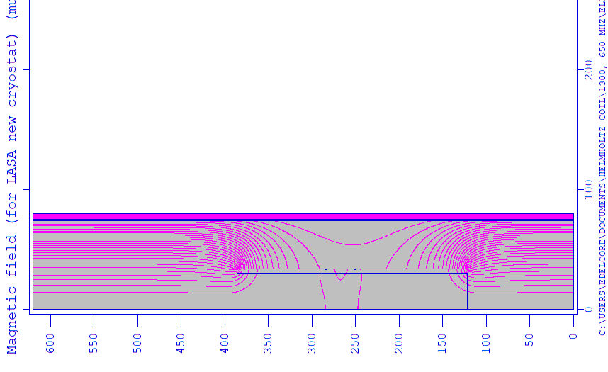
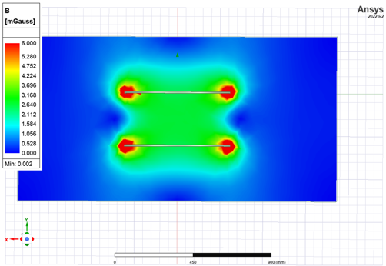
LB650 R&D at LASA – Magnetic environment
Helmoltz coil (PIP-II)
Prepare LASA VT station for High-Q₀ measurements
Lower residual magnetic field via active compensation
Faster cool-down rate across SC transition
Coil windings, control system and frame
  Helmholtz coil design and frame design completed.
  Coil windings and control system will be done at LASA
  The system has been successfully tested on LB650 single-cell
Design transferred also to new 1.3 GHz R&D cryostat
  Coils maintenance and position adjustment realized through a support structure connected to magnetic shield and cryostat.
T = 300 K
Simulations of field profile
T = 10 K
Helmoltz coil
Open outer shield
(r = 340mm)

Slide 31
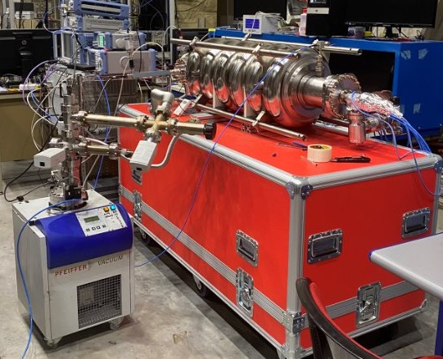
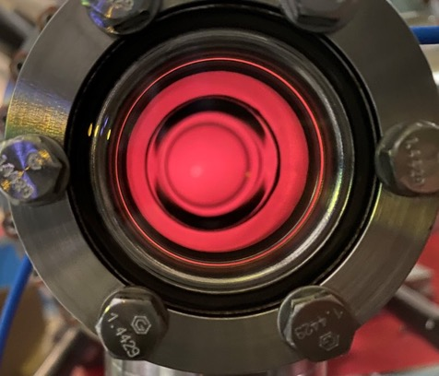
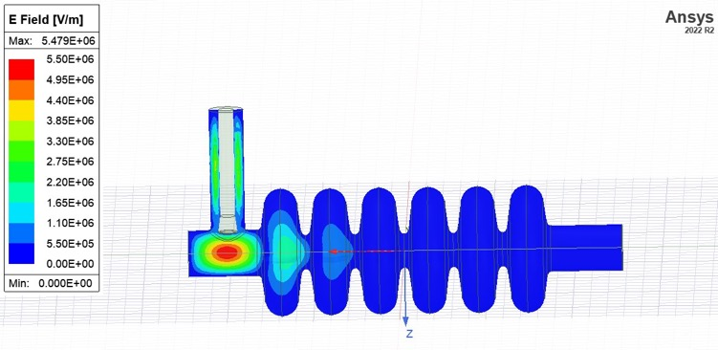
Ongoing R&D activities – other SRF themes
Many SRF R&D topics are being addressed within international collaborations:
Plasma Processing test setup
Plasma processing: an emerging cleaning solution for SRF cavities affected by field emission triggered from impurities present on the inner cavity wall.
      Preliminary tests done; plasma successfully ignited with
      1.45 GHz HOM on an ESS cavity prototype, next
      application to PIP-II LB650 cavities.
      Key point is to develop a technique that can be performed on the cavity dressed for vertical test, without additional hardware!
Mid-T baking: promising cavity surface treatment toward
High-Q / High-G goal
Diagnostics: different techniques applied to the diagnostic of cavity performances and limitation features during single cavity and cryomodule test.
High-Pressure Rinsing: the optimization of HPR parameters is of primary importance in avoiding field emission in operation.
… and others: mode-mixing during power rise, variable coupler
for cavity vertical test, cryomodule design.
Ignited plasma as seen through beam-pipe viewport
Ignition HOM E-field profile

Slide 32
Ongoing R&D activities - Strategy
Foreseen activity (3 years):
Surface treatments development for reaching High-Q / High-G
perfomances (single-cells)
Industrialization: from single to multicell cavity
R&D on cavity ancillaries (tuner, magnetic shield, etc.)
R&D for High-Q/High-G cavities:
1-cells 1.3 GHz: surface and thermal treatments development
and qualification
  E-XFEL (baseline), Mid-T , two-step baking
  Cold VT (qualification) at LASA and in other labs
9-cells 1.3 GHz: industrialization (9-cells) of the developed process
Mid-T
Upgrade of LASA VT system:
New cryostat dedicated to R&D:
Design specifically for R&D on TESLA type single- and multi-cell cavities
  Optimized insert installation and removal process
  Liquid Helium inventory needed for a test down by 4 times
  Active B-field compensation by design
New acquisition system:
  Dedicated RF amplifier, RF control system from analogic to digital
China
Baking with N₂ infusion
Two-step
JLab
32

Slide 33
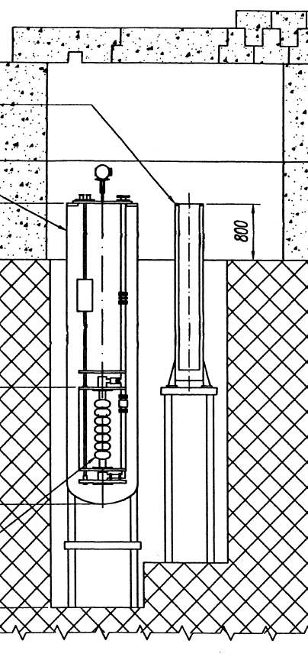
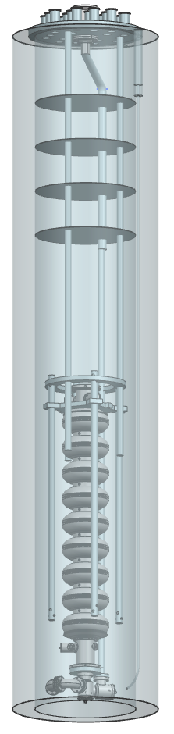
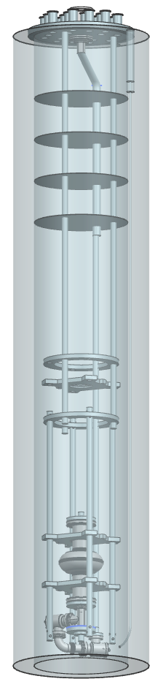

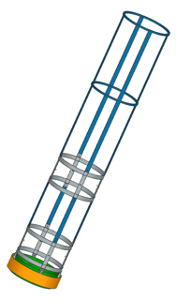

Ongoing R&D activities - Strategy
Cryostat and ancillaries
Dedicated «small» cryostat
  L = 3000 mm, OD 610 mm, max. cold volume 250 l
  1.3 GHz cavities (two single-cell/one 9-cell)
  Short cold test cycle
  ¼ of the Lhe required (w.r.t large cryostat)
Cryostat insert
  Cavity installation and removal optimized
External magnetic shield
  Available and qualified
  Bottom part will be re-annealed
  after machining (cryostat integration)
New cryostat
Magnetic shield
Helmoltz coils
Coils frame
Cryostat ID700 mm
Bunker Side view
Cold VT configurations

Slide 34


Ongoing R&D activities - Synergies
ILC Technology Network (ITN), 2-4 years
derived from ILC IDT (ILC International Development Team) to support pre-lab technological
priorities as identified by the International Expert Panel
  March ’23: budget approved by Japan; KEK-CERN agreement: signed in July 2023
  INFN Milano LASA involved in ILC SRF activities (R&D and industrialization of 1.3 GHz cavities)
  Activities foreseen in 2023-2026
    Treatments targeted to ILC goal (single and 9-cell cavities) towards industrialization with qualified vendors
    Harmonization of pressure vessel codes (PED/ASME/HPGS)
    Fine Grain and Mid Grain Nb studies for single and 9-cell cavities -> in view of the cost reduction
    Assembly at KEK of an ILC cryomodule with 1 EU cavity, 1 US cavity and 6 Japan cavities
EAJADE, 4 years
Staff exchange network for accelerator R&D within elementary particle physics
  Exchange between:
    EU labs/univeristy and US-Japan labs/universities
    EU labs/university and EU industries
  started in March 2023, 4 years duration
  Six WPs
  INFN responsibility: WP2 lead beneficiary L. Monaco
  (State-of-the-art high-gradient, high-efficiency, reduced-cost
  radio-frequency structures and power Sources)
ILC cavity Goal
Marie Skłodowska-Curie Actions Staff Exchanges

Slide 35





Photocatodes
INFN Cs₂Te Network
Cs₂Te (UV sensitive)
  «Reference» photocathodes for user facility based on high brightness
  electron source
    High QE
    Low dark current
    Alkali Antimonide (Visible sensitive)
Requires XUHV (≈ 10⁻¹¹ mbar) since more sensitive than Cs₂Te
Designed and assembled at LASA deposition system for “green” films in
collaboration with DESY-PITZ
Operation of “green cathodes” in RF Gun at PITZ
    Good emittance
    Good response time
    Limited lifetime (vacuum pressure and E_{acc})
    Affected by field emission (lower w.f. than Cs₂Te)
    Future Activities
Different growing processes (T, thickness, etc.)
….
    Long operative lifetime
    Reliable growing process
KCsSb Emittance
Dark Current
KCsSb Growth Chamber
KCsSb Response time
A new set of photocathodes, produced in June '24, is under test in these days at PITZ. They are four cathodes with different growning procedure. Results by end of July

Slide 36


Photocatodes – Stress test
The operation of advanced CW high brightness
electron sources based on photocathodes requires
their operation to very high repetition rate.
Up to now, few facilities have run photocathodes
with such high repetition rate:
  1 MHZ (LASA Cs₂Te) APEX, LCLS-II, etc.
  1.3 GHz (KCsSb) BerlinPRO, etc.
As part of the INFN activity preliminary to BriXSino,
we want to learn how to deal with these
operation modes and how the photocathodes
behave.
  The Mo photocathode has
  been operated at 45 kV
  limited by field emission
  A first elecron beam has
  been extracted recently
  Hardware upgrade in
  progress
DC Gun
Photocathode
Manipulator
Connection
to suitcase
Laser
Power | 10 W
Wavelength | 1040 nm
Pulse length | 10 ps
Single Bunch Repetition Rate | 92.857 MHz
IR->UV Efficiency | 1 %
Cs₂Te
QE | 1-10 %

Slide 37
Outlook on future activities
  PIP-II cavity series production:
    Complete Quality Control on Niobium components for cavity production
    Define "External" QC activities with related measurements and checks
    Continue R&D with prototypes (single and multicell) to improve production process parameters for the series production
  R&D towards European Strategy:
    High-Q / High-G R&D on cavity recipes and ultimate performances in view of the EU Strategy (ILC Technical Network, Muon Collider, FCC)
    Cavity design and tuner studies (Muon Collider)
    Staff exchange program between EU, Japan and US for the sharing of SRF experience sharing (EAJADE)
  BriXSinO:
    HB²TF already funded and under construction at LASA for the BriXSinO injector
    An ERL technology demonstrator, our group involved for SRF
    R&D collaborations being discussed:
      With DESY in view of a possible near-CW operations: new design for 3.9 GHz cavities, develop tuner for SRF Gun.
      With CEA for common SRF themes: treatments, plasma processing etc.
2026/27
2026/27
2025/...
…/2030

Slide 38
BriXsino Project

Slide 39
Energy Recovery Linac Basic Principle
Energy-recovery linac (ERL) is a new class of electron accelerators used for generating an electron beam of high-average current and small emittance achieving the highest average beam brightness. In an energy- recovery linac, an electron beam from an injector is accelerated in a superconducting linear accelerator; the beam is then transported to a recirculation loop. In the recirculation loop, the beam is utilized for particular applications such as X-ray generation. After the recirculation, the spent electron beam is injected again into the superconducting accelerator so that the electrons are decelerated. This deceleration can be accomplished by putting the electrons in the phase opposite to the acceleration. Therefore, the energy of the accelerated electrons is converted back into the rf energy and recycled to accelerate the succeeding electrons.
The energy recovery technology has a significant impact on modern accelerator applications because the ERL can accelerate a high-power electron beam with small-capacity rf generators.
In addition to this excellent conversion efficiency, the ERL has an advantage essential to the generation of high-brightness electron beams. Since an electron bunch in an ERL goes to a beam dump after deceleration and another fresh electron bunch is accelerated at every turn, the electron beam in the ERL maintains a small emittance.

Slide 40

Overview of ERL Facilities
Costs
Brixsino: 45 MeV@5 mA- 225 KW 50% efficiency
Technology

Slide 41
Relevant Milestones for BriXSinO
Starting from 2019 a group of researchers from INFN LASA, with their knowledge of Superconducting technology and accelerator design, and from the Università degli Studi of Milan, expert in radiation, has been the core element of a larger collaboration, collecting collaborators from other INFN groups, INFN-Ferrara, INFN-Napoli, LNF, Universities as Naple, Ferrara, Politecnico of Milan, Institutions as the CNR and Hospitals like San Raffaele, aimed to propose and design a test-facility that would enable addressing the physics and technology challenges posed by the ERL generation, hoping to make in a short-to-mid-term scenario a significant advance in the Italian and INFN contest.
In June 2022 a Technical Design Report of an experimental research infrastructure, named BriXSinO (Brilliant source of X-rays based on Sustainable and innovative accelerators) has been submitted for attention to the INFN Executive Council. The document summarizes the results of a couple of years of research activities and included the proposal to identify the INFN-LASA laboratory as the ideal site to install this facility. A detailed plan, related to the expected costs and time scale, was included too.
The project foresees the development of the accelerator related elements typical of an ERL-based facility and the installation of a couple of experiments related to Compton sources for high flux X-rays and high power coherent Terahertz radiation.

Slide 42
Relevant Milestones for BriXSinO
In September 2022 the first part of the accelerator, a High Voltage photoinjector DC operated followed by a couple of room temperature cavities, has been partly funded by INFN within the frame of a national tender under the supervision of the CSN5 Committee (HB2TF project).
In October 2022 a further funding was provided by INFN to complement a first allocation made in 2021 aimed at establishing a dedicated test stand for BriXSinO laser related research aspects. In this framework we obtained a maximum power of 30 kW in air in the Fabry Perot prototype cavity.
In March 2023 a revised version of the original Technical Design Report of BriXSinO has been discussed by the proposers and the Director of the Milan INFN unit at the presence of the INFN Executive Council and the chairs of the INFN MAC and the INFN-Accelerator committee.
As part of the PNRR-IRIS program and with a significant specific contribution provided by INFN, in 2024, the construction of two laboratories will begin within the LASA premises: one called SML (Superconducting Magnet Laboratory) and the other AATF (Advanced Accelerator Test Facility) for a total of 2100 m² spread over an underground bunker and two external floors.
In July 2023 a Horizon Europe application named “Innovate for Sustainable Accelerating Systems with Energy Recovery” (iSAS) has been approved and a specific item in the program is represented by the development of an innovative RF power coupler for the superconductive linac foreseen in BriXSinO.

Slide 43
BriXSinO Principle of Operation
A newly conceived scheme of ERL with counter propagating beams is proposed in BriXSinO.
5 mA of average electron beam current in CW mode with a time structure organized in a regular repetition rate up to 100 MHz, i.e. bunch spacing 10 ns. The users will have the freedom to use the beam quality and phase space as they wish, while also saving a large portion of the electron beam kinetic energy for recovering the beam power through deceleration in the same Superconducting (SC) Linac.
It is similar in parameters and dimensions to a storage ring, with the very much larger recovery of the 225 kW beam power (>90%). Moreover, the electron bunches in BriXSinO travel through the full orbit back-and-forth just one time, while, conversely, in a storage ring electrons travel over many turns (namely > 1010) so their phase space quality must be very carefully preserved to avoid instabilities that may seriously impact the storage ring life-time.
Therefore in a storage ring the user access to the beam phase space is very limited, while in a ERL the user can degrade significantly the phase space quality of the electron beam, while preserving the kinetic energy carried by electrons.

Slide 44

BriXSinO Principle of Operation
The importance of BriXSinO is then twofold.
From one hand, it will act as test facility for fundamental questions and strategies of Dynamics and Energetic by hosting experiments for maximizing the energy sustainability and minimizing the AC power consumption.
From the other hand, it will work as user facility by providing large quality coherent THz and X-Rays emission from its high brightness accelerated electron beam, enabling important and advanced applications

Slide 45
BriXSinO Revised Project
The BriXSinO proposal has been reviewed during the past 2 years to address a set of observations received during the period and to redefine a more flexible and scalable schedule related to the development of the project. Moreover, we add some methodological considerations on the way to drive the development of the facility.
The experience gained during the first year of the HB²TF project suggested a couple of methodological improvements.
The first one is that we decided to focus all our efforts toward the development of a test facility devoted to accelerator related aspects in the original project. This recognizes that the final goal of our project will be the design and construction of a demonstrator of a sustainable machine based on the ERL concept using the two-way linac approach. We include in the accelerator developments the optical Fabry-Perot cavity because it will allow fundamental tests on the quality of the ERL-grade electron beams generated.
The applications of the high-quality beams we will provide in such a frame will be faced in a next distinct phase that may be analyzed when the basic building blocks of the facility will be ready, tested or at least completely designed.
The second is related to the fact that the project will take a significant advantage sharing ideas and exchanging experiences under the supervision of an external steering committee.
The fact that, as previously reported, the ERL related field of research involves a number of expertise in different areas and that we are willing to put into operation the facility in a short time-scale compared to the experience of other labs in the past, calls for the necessity of being supported by a continuous discussion and comparison of our ideas with people independent from the proposal group. These people may be part of the ERL international accelerator community (along with a support from the INFN Institutional committees as MAC and INFN-A) and will help us to better identify the right path in the frame of open questions or may support us with their experience.

Slide 46

BriXSinO Revised Schedule
Development and construction of the injector and first beam line transport based on 2 RF bunchers and few magnetic elements to allow the injection in a SC booster. The final beam will have an energy of the order of 1 MeV.
Development and construction of a beam line which foreseen an acceleration process of the electron beam up to 10 MeV. At the end of this phase a beam suitable to be injected in a SC linac will be available and, at the same time, an experimental line at the maximum energy and current of 5 mA will permit experimental runs.
Development and construction of a SC linac able to accelerate the beam up to 45 MeV at the maximum current of 5 mA with beam parameters suitable for the ERL process or for the reacceleration to double the energy.
Development and construction of a minimal recirculating arc coupled to the Linac of phase 3 to test the Energy Recovery and the the double-accelerating way. A suitable beam dump to fit the requirements in terms of power will be included in this phase.
Development and construction of an experimental set-up for one of the two experiments foreseen in the original report of BriXSinO.
In the interval between phase 1 and phase 2 the injector will be transferred in the bunker.

Slide 47
HB2TF: a High Brightness Beam Test Facility
A positive impact on the evolution of BriXSinO in the past 2 years has been played by the funding from INFN CSN5 of the project named HB²TF.
The first year of the project (2023) resulted in an improved design of the injector and of the next booster stage to focus toward a 10 MeV electron beam. The main problems related to the identification of the commercial elements to be purchased or to be specifically designed for the scope and then identifying constructors to be involved in the process have been solved.
HB²TF availed itself of the collaboration of a team coming from all the INFN National Laboratories (besides obviously the LASA researchers) and this has been proven a winning condition as reported above and this is the reason we will export this model also for BrixSinO. At the same time the collaboration with JLab resulted in an improved design of the injector with respect to the starting point inherited from that specialized laboratory. Today we have some specialized components those intellectual property is in charge of INFN and that will be used also in other injectors under construction in the world.

Slide 48
HB2TF
A positive impact on the evolution of BriXSinO in the past 2 years has been played by the funding from INFN CSN5 of the project named HB²TF.
The first year of the project (2023) resulted in an improved design of the injector and of the next booster stage to focus toward a 10 MeV electron beam. The main problems related to the identification of the commercial elements to be purchased or to be specifically designed for the scope and then identifying constructors to be involved in the process have been solved.
HB²TF availed itself of the collaboration of a team coming from all the INFN National Laboratories (besides obviously the LASA researchers) and this has been proven a winning condition as reported above and this is the reason we will export this model also for BrixSinO. At the same time the collaboration with JLab resulted in an improved design of the injector with respect to the starting point inherited from that specialized laboratory. Today we have some specialized components those intellectual property is in charge of INFN and that will be used also in other injectors under construction in the world.

Slide 49
Status
The experience related to HB2TF is of significant importance for BriXSinO since this first step was considered the most critical for the project due to the fact that at LASA we never faced the construction of a complete injector with all the scientific aspects involved (High Voltage DC power supplies, advanced mechanics, laser beam generation and transport, room temperature cavities and power couplers, SS RF amplifiers).
Next steps toward the accelerator are related to superconducting cavities expertise and this, due to the long experience of the involved group, make us comfortable.
We do not expect any significant show-stopper.
Moreover, the collaboration with IJCLab and CEA within the frame of the iSAS European program is related to the development of a linac section with superconducting cavities and related power couplers. This will reflect in a considerable exchange of experience with the French colleagues during the construction of these devices that will reinforce the experience we have at LASA.

Slide 50



Status

Slide 51

Status
The electromagnetic design of the 2 RF bunchers has been completed and it has been summarized in a devoted document (as requested in the milestones of the project)
We just report a table that summarizes the result of the study along with some pictures that describes the fields reached.
3D mesh and profile for E and H field in Buncher 1.
Parameter “g ” is the effective gap length that is 17 cm corresponding to a cavity beta 0.74.

Slide 52
Status
The first year of the project (2023) resulted in an improved design of the injector and of the next booster stage to focus toward a 10 MeV electron beam. The main problems related to the identification of the commercial elements to be purchased or to be specifically designed for the scope and then identifying constructors to be involved in the process have been solved.
During 2024 the main events may be summarized as in the follow:
the experimental area at LASA started to be ready for use
received the 350 kV DC power supply for the photocathode and the SF6 insulating gas vessel is redy to be ordered
the optical table in the experimental area has been assembled an is in use
the laser beam has been transported in the experimental area and the quality seems suitable (150 m path !)
the photocathode chamber will be available for the end of 2024 (remarkable delay due to administrative issues)
the ceramic high voltage machining is in progress: we expect to receive in November 2024
supports for the accelerators will be delivered in September
main vacuum pumps and valves are going to be delivered
the design of the first RF buncher has been frozen and we will order in September
the RF power amplifier characteristics has been defined radioprotection simulations have been performed in detail (we expect to send the documentation for 200 kV operations in September (one month expected to obtain the permission)

Slide 53


Status

Slide 54
Laser Laboratory
In 2021 we started to set up an optical laser lab @ LASA.
The major part of the funds come from BriXsinO but the lab has been fundamental for CSN5 funded experiments as Ethiopia (THz generation) and T4QC (Technologies for Quantum Computing)

Slide 55
Muon Collider Partecipation

Slide 56
Muon Collider
Two facility concepts have been considered in the past years as pathways to the future of particle physics at the energy frontier in Europe: FCC-hh, a 100 TeV circular hadron collider and CLIC, a 3 TeV linear lepton (i.e. electron-positron) collider. They are improved versions of projects realised in the past. The expected cost and power consumption are 24 GCHF and 580 MW for FCC-hh and 18 GCHF and 590 MW for CLIC.
The recent European Accelerator R&D Roadmap (https://arxiv.org/abs/2201.07895) includes a 10 or more TeV Muon Collider.
This novel interest is based on two considerations:
The recognition of the physics potential of a lepton collider with a centre-of-mass energy of 10 TeV or more.
The recent advances in technology that make the realisation of a muon collider plausible.
The Muon collider promises to expand the lepton collider energy reach. Muons are much heavier than electrons and with a much reduced synchrotron radiation, allowing acceleration and collision of the beam in rings, even at multi-TeV energies. This results in compact dimensions and promises high efficiency and limited cost. The tunnel length of a 10 TeV muon collider is expected to be similar to the 3 TeV CLIC and significantly smaller than FCC-hh. Because muons are point-like particles, in contrast to the composite hadrons, a muon collider may have a physics case of comparable interest than a 100 TeV hadron collider.

Slide 57


Organization
Study Leader Daniel Schulte
    Deputies: Andrea Wulzer, Donatella Lucchesi, Chris Rogers
Collaboration Board (ICB)
  Elected chair : Nadia Pastrone
Steering Board (SB)
  Chair Steinar Stapnes,
  CERN members: Mike Lamont, Gianluigi Arduini,
  Dave Newbold (STFC), Mats Lindroos (ESS),
  Pierre Vedrine (CEA) , ICB chair and SL and deputies
International Advisory Committee (IAC)
MoC signed by CERN CEA INFN STFC-RAL ESS IHEP
and different universities in EU, US, China
Donatella Lucchesi
Dario
Giove
Lucio Rossi

Slide 58









Muon Collider Magnet team
Newcomer
10 T dipole for acceleration
Fusion like - designed by F4E
20 T -1MW on target
2 km
Field up to 20 T
½ m bore
About 1500 coils
40 T
Small bore
Cable sample by L. Bottura
Dipoles
15T / 140 mm
Quadrupoles
G 300 T/m
120 mm
Nb3Sn and HTS
Producing parameters maps
The SC magnets are coordinated by INFN
RCS
Shared R&D on conductor properties
Task 7.2
Task 7.3
Task 7.4

Slide 59
Muon Collider General View
Proton driven Muon Collider Concept (MAP collaboration)
Past work has demonstrated several key muon collider technologies and concepts, and gives confidence that the facility concept is viable. Component designs have been developed that can cool the initially diffuse beam and accelerate it to multi-TeV energy on a time scale compatible with the muon lifetime.
While the muon collider promises high benefits it also poses a significant risk. No muon collider has yet been built. The facility is based on advanced concepts and technologies.

Slide 60


Muon Collider Cooling Channel

Slide 61
Muon Collider Cooling Channel
The primary focus of this R&D project is to lay out a conceptual design of the RF systems for a Muon Collider Complex (MCC), based on a consistent set of parameters for all RF cavities and associated systems to be integrated into the cooling cells of the MCC taking into consideration the results related to the beam dynamics study.
Specifications for the design of all RF cavities will be defined (frequency, gradient, length, B-field, aperture). Then a full set of parameters for the cavities will be calculated, serving as a base for their conceptual design and integration in the cooling cells. The impact of beam loading on the muon energy spread will also be assessed at this stage and appropriate mitigating actions will be recommended.
In parallel, as a second main activity, an experimental activity focused to study and enhance the present comprehension of the intrinsic concepts that influence the break down rate of RF cavities submitted to strong magnetic fields will be carried out. We plan to define realistic solutions to mitigate the breakdown and provide guidance for the design and the fabrication of high gradient RF cavities that stand the strong magnetic fields required in a muon cooling channel. We will extend the results so far obtained in the framework of the MAP activities and explore whether it is possible to push these values at the light of the latest developments in RF and magnet technology.

Slide 62
Muon Collider Cooling Channel
Define and design the compact multiple-cavity module, with efficient frequency tuning and RF power feeding systems. In the cooling channel, the voltage in each segment requires multiple cavities or one LINAC with multiple cells. In order to have strong solenoid fields, the cavity design should be as compact as possible in the transverse
direction.
Design and machine prototypes for a compact full scale cavity (with power coupler, full set of diagnostics for power levels and temperature distribution along with extensive breakdown diagnostics, thermal cooling channels) able to fit within a solenoid with a useful bore of maximum 450-500 mm. The cavity must be able to move longitudinally
within the solenoid to experience different level of magnetic field, due to the power scheme of the solenoid coils (a split coil design is foreseen).
Design of the split coil for the RF cavities test and test of new technology for HTS coils, based on NI (non-insulated) winding. In reality it means with finite turn-to-turn resistance. Though counter-intuitive this technology make easier the protection of HTS magnets, so far one of the big challenge of HTS. A small but significant model coil will be designed and built as a first step toward the Split Coil Facility for the RF tests and for the focusing solenoids of the Cooling Cell of the MC. The coil will also serve as thermal mock-up to evaluate the cryogenic losses: this is inscribed in the ambitious line to operate the Mun Collider magnets at 10-20 K. Therefore also the magnetic facility for RF breakdown test will be cooled at 10-20 K with gas or by solid conduction by cryocooler.

Slide 63
Muon Collider Cooling Channel
4000 RF cavities
2500 Solenoid Coils
Linac: ~1-5 ms
SNS: 402.5, 805 MHz
ESS, SPL, CERN-L4: 352, 704 MHz
PIP-II: 325, 650 MHz
Muon cooling RF
Many frequencies in Buncher, Rotator, Merge, Final Cooling
Cooling cells have two harmonic frequencies:
  MAP: 325, 650 MHz
  Alternative: 352, 704 MHz
Accelerator SRF
LA, RLA: ~1-10 ms
  MAP: 325, 650 MHz
  CERN-L4, SPL, ESS: 352, 704 MHz
Rings: CW
  MAP: 1300 MHz (very high)
  LEP: 352 MHz; LHC: 400 MHz
  FCC: 400, 800, 650(?) MHz
  CEPC: 650 MHz

Slide 64
Muon Collider Cooling Channel
We are in an advanced phase of design related to a couple of tests stands:
A DC HV test stand with pulsed capabilities embedded in 1 T magnetic field
A high power (10 MW) S band RF test stand to power a 2856 MHz RF cavity installed in the bore of a SC magnet (see next slides for the magnetic part).
The DC Test Stand may be installed immediately in the existing experimental area @ LASA. We are discussing the design of the pulsed power supply with S. Calatroni (CERN) and the people of his group. Orders for the first components will be placed within summer 2023 and a first version will be ready for the end of this year.
The S band RF test stand may be installed in the AATF in the new building, taking advantage of all the infrastructures we will have at that time (2025) and adding a RF power equipment.

Slide 65

Muon Collider Cooling Channel
DC based experimental test stand
All the elements available or ordered (supported by CSN1 funds)

Slide 66
Muon Collider Cooling Channel
Muon Collider test stand (RFMF) Magnet
The test stand is a very god opportunity to :
  Test the magnetic system by building a prototype with characteristics near to final (at least for same cooling cells)
  R&D on HTS technology to increase the TRL which is critical for the Cooling Cell and for the collider ring
  Test the integration principle of the cooling cells in near-to-final conditions
For these reason in additon to the general design of the MC CC magnets and of the magnets of the collider ring, the LASA magnet team of the MC, pursue to design two test stand configurations:
      Large size split coils (for 704 MHz, i.e. 700 mm free RT bore) needed at the end for a finale integration and functional test
      A smaller size (for 3 GHz system, i.e. 350 mm free RT bore) that would allow to build the facility with moderate cost
HTS conductor will be purchase in the next months (paid by the special project INFN ESPP-Mucol for 150 k€) → 2024 start assembling and testing small/medium size coils to experiment HTS technologies: Non-Insulated or partial insulated vs insulated conductor.

Slide 67


Muon Collider Cooling Channel
With cryostat
Two stage
cryocooler
Coil support structure
Vacuum vessel
Tie rods for repulsion and compression forces
SC HTS coils

Slide 68
REBCO Tape related activities
A 5 km Rebco Tape sample has been ordered in November 2023 to perform tests on the material and the capability to handle it at LASA.
Unfortunately the order was available only in late march 2024.
At the same thanks tests carried out at CERN on the same material from the same supplier result in dimensional non conformities. The supplier had the time to face the problem and perform a repair action. The delivery at LASA of the materials is foreseen for the end of July 2024.

Slide 69

3 cells RF preliminary structure

Slide 70



Activities foreseen in 2025
Refine the study for a single 704 MHz and 1 GHz cavity
Build a prototype
Design a complete 3 cells model useful for the demonstrator tests of the Muon Collider
Design the magnets for the cooling cell prototype and define integration process
Build a prototype for the main elements of the cooling cell for the demonstrator
Put and maintain in operation the pulsed DC test and perform extensive analysis of the behavior of copper and aluminum electrodes after different surface treatments.
Main challenges
Force management (30 MN range)
Access for waveguide
Conduction cooling

Slide 71
Physics applied to Medicine

Slide 76

Critical Elements
Organization
LASA is part of the INFN Milan Unit and its internal organization has to respect the boundaries due to a INFN unit. The LASA coordinator does not have an externally recognized rule and even the only LASA people that provides some general activities (computing infrastructure and cryogenic plant) reports to the Milan Unit.
PNRR related effects
The IRIS project is a remarkable event for INFN. The delay in getting the new building resulted in heavy requests on available space @LASA and on the already poor technical services in the lab . These have effects on other activities.
Funding
LASA is part of the INFN Milan Unit and it does not have a dedicated budget to support the infrastructure
requirements from the experiments so far discussed. This results in great constraints.
In the last couple of years the University of Milan has reduced the maintenance activities (indeed not
compliant since nearly 20 years)
Staff
There has been a relevant increase in staff @ LASA but this has been limited to the IRIS project (due to related funds) so all the other projects and the laboratory maintenance and basic services are still in a critical situation .

Slide 77
Services request
This is an old time problem.
Our proposal for 2025 is the following:
Mechanical workshop: add one staff resource
General services: add, at least, a staff resource (we are approaching the duplication of the building !)
Mechanical Design: add one staff resource for the design and a mechanical draftman
Electronic services: ask for 4-6 months at the existing service
Administration: add one staff resources
Looking at the requirements for the services we have to note that such a configuration recalls in a reduced way what existed @LASA 20 years ago.
77

Slide 78

Thanks for your attention !

