Slide 1





CH4rLiE
Associate Professor. Dr. Daniele Dondi
Director in Laboratory of Radiation Chemistry and EPR Spectroscopy
Department of Chemistry, University of Pavia, 27100, Italy.
Thursday, July 4th, 2024

Slide 2
Experiments
Experiments for drying Z-5 zeolite under vacuum
Experiment-1
100mg of Z-5 sample is dried under high vacuum at 200°C(immediately removed)
Experiment-2
100mg of Z-5 sample is dried under high vacuum at 200°C(removed after 3 hours)
Experiment-3
100mg of Z-5 sample is dried under high vacuum at 200°C(removed after 5 hours)
Experiment for drying Z-5 in Muffle furnace
Experiment-1
100mg of Z-5 sample is dried in muffle furnace at 400°C(3 hours)
Experiment-2
100mg of Z-5 sample is dried in muffle furnace at 600°C(after 3 hours)
Experiment-3
100mg of Z-5 sample is dried in muffle furnace at 550°C(after 4 hours)

Slide 3
TGA of Z-5 200°C 25-1000°C @ 20 °C/MIN

Slide 4
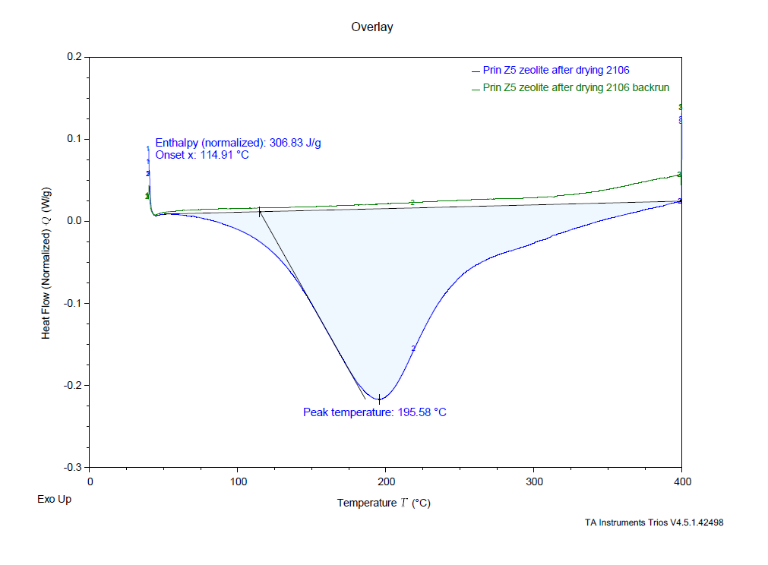
DSC of Z-5 200°C : at 40-400°C @ Ramp 5°C/min to 400°C

Slide 5
TGA of Z-5 200°C 5Hr 25-1000°C @ 20 °C/MIN

Slide 6
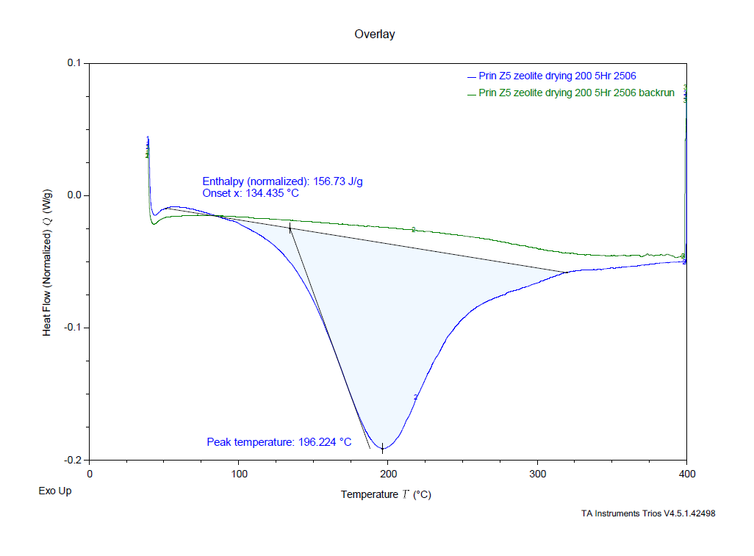
DSC of Z-5 200°C 5Hr : at 40-400°C @ Ramp 5°C/min to 400°C

Slide 7
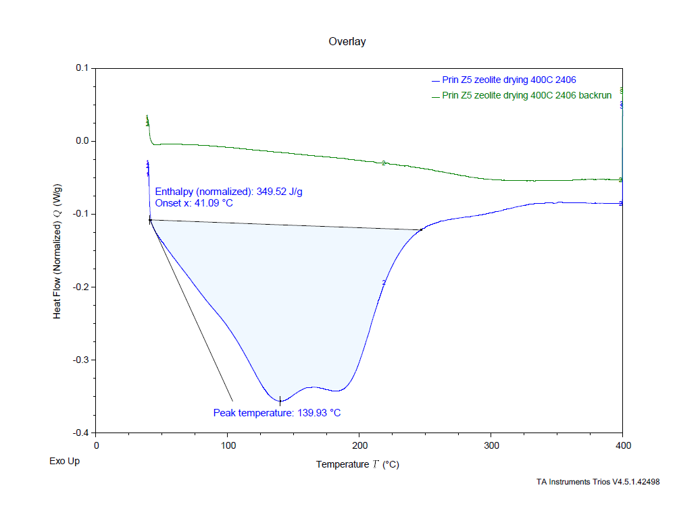
DSC of Z-5 400°C : at 40-400°C @ Ramp 5°C/min to 400°C

Slide 8
TGA of Z-5 600 °C 25-1000°C @ 20 °C/MIN

Slide 9
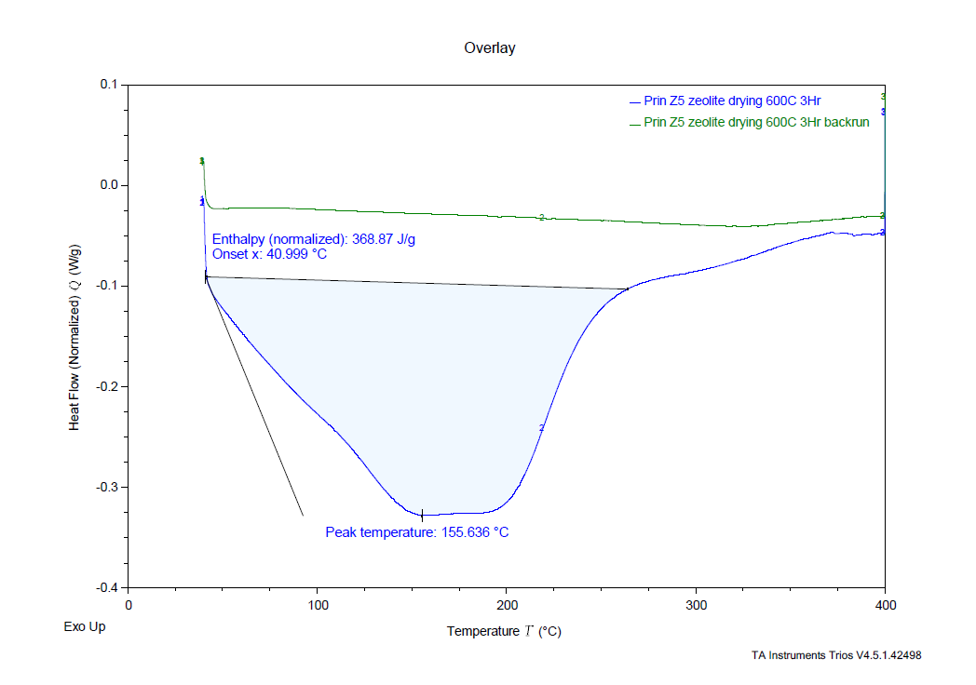
DSC of Z-5 600°C : at 40-400°C @ Ramp 5°C/min to 400°C

Slide 10
TGA of Z-5 550 °C 25-1000°C @ 20 °C/MIN

Slide 11
Conclusion and further Experiments
Drying of zeolites proved to be difficult.
The experiments under high vacuum and heating in Muffle Furnace even at 600C failed to remove moisture from the sample.
We doubt that after heating of the sample, The time taken for introducing the sample to atmosphere is when the Zeolite recaptures moisture from the atmosphere.
We are planning an experiment to heat the zeolite in an oven flushing nitrogen before and after heating the sample and removing sample for Measurement under nitrogen. We hope that avoiding the contact of the sample with atmosphere will show removal of moisture from Zeolites.

Slide 12
Gas chromatography-Mass spectrometry for Barn samples 25/03/24
Samples obtained from the Barn are Measured in the order 4A, 6A, 5A, 2A, 3A, 1A
Samples were observed for CH₄(16), NH₃(17), H₂O(18), N₂(28), O₂(32), CO₂(44)
Samples 5A, 2A, and 3A shift in signals were observed

Slide 13
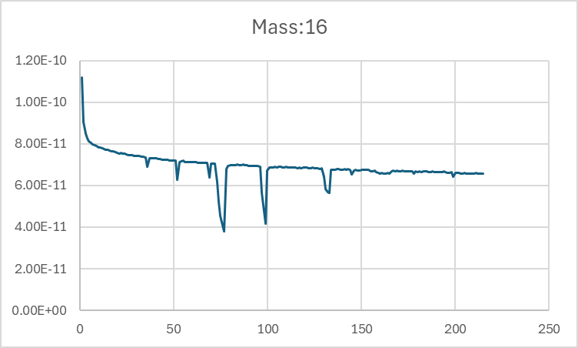
CH₄
4A
6A
5A
2A
3A
1A

Slide 14
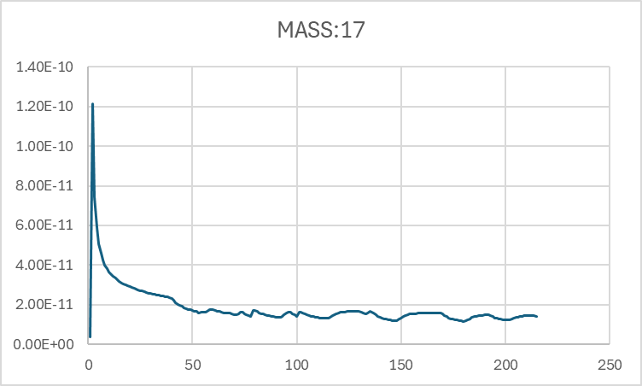
NH₃
4A
6A
3A
1A
5A
2A

Slide 15
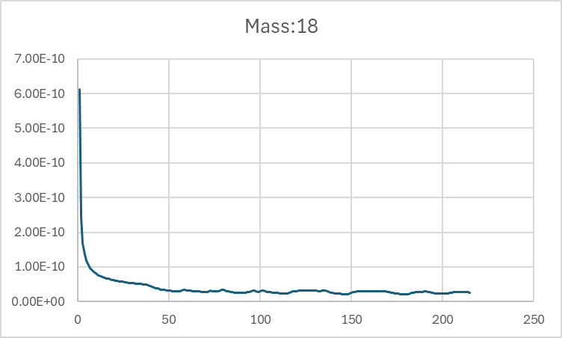
H₂O
4A
2A
3A
1A
6A
5A

Slide 16
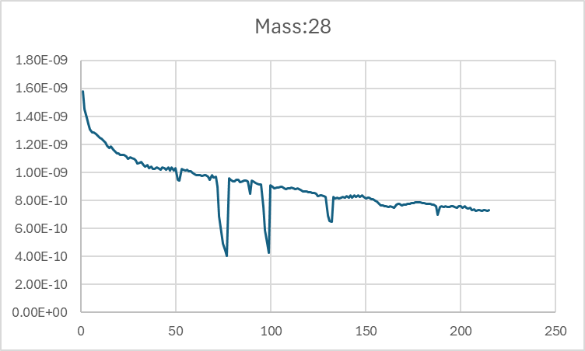
N₂
4A
6A
5A
2A
3A
1A

Slide 17
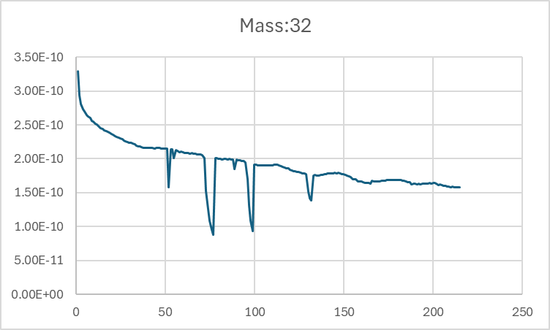
O₂
4A
6A
5A
2A
3A
1A

Slide 18
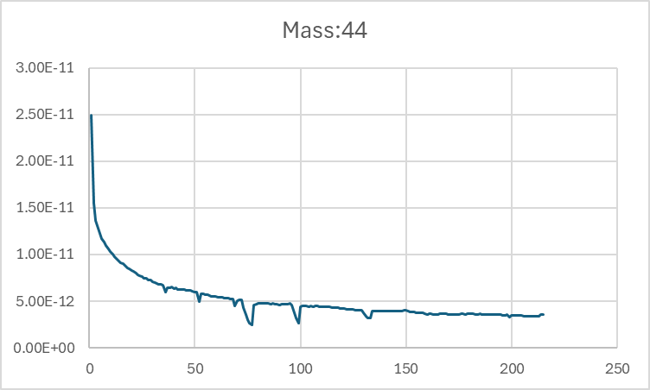
CO₂
4A
6A
5A
2A
3A
1A

Slide 19
Acknowledgement
Thank you

