Slide 1


ICSC_progetto_comunicazione**
Spoke 2 - FUNDAMENTAL RESEARCH & SPACE ECONOMY
Tommaso Boccali (INFN – PI)
INFN Meeting, July 8° 2024

Slide 2
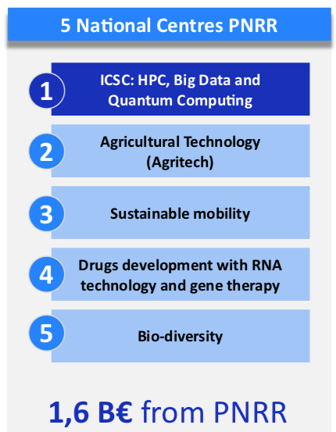
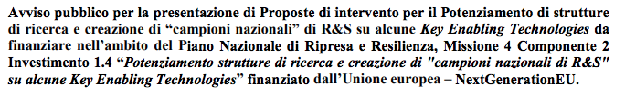
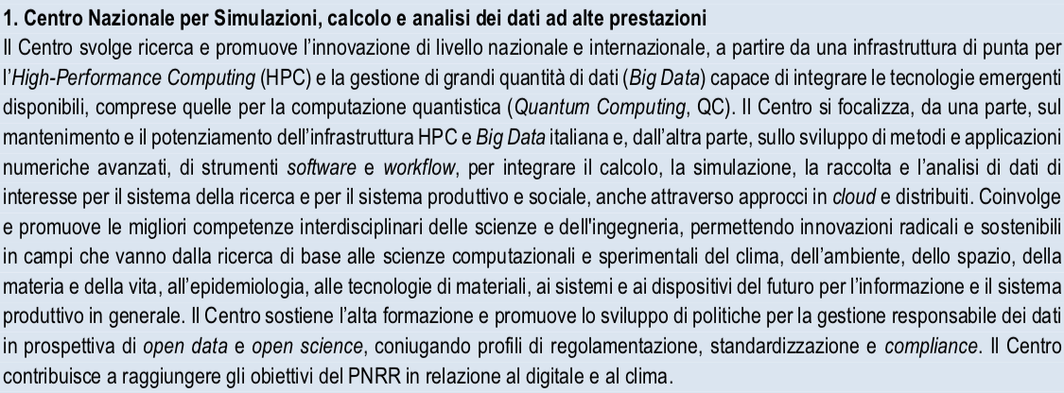
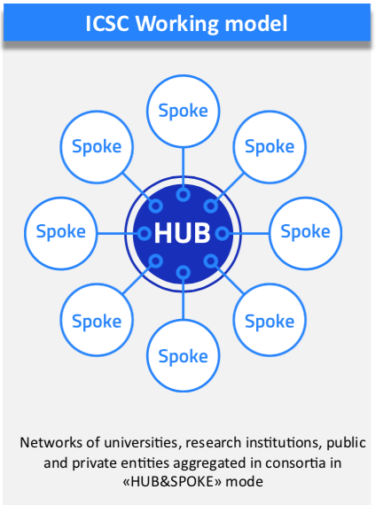
The National Center for Big Data, HPC and Quantum Computing

Slide 3

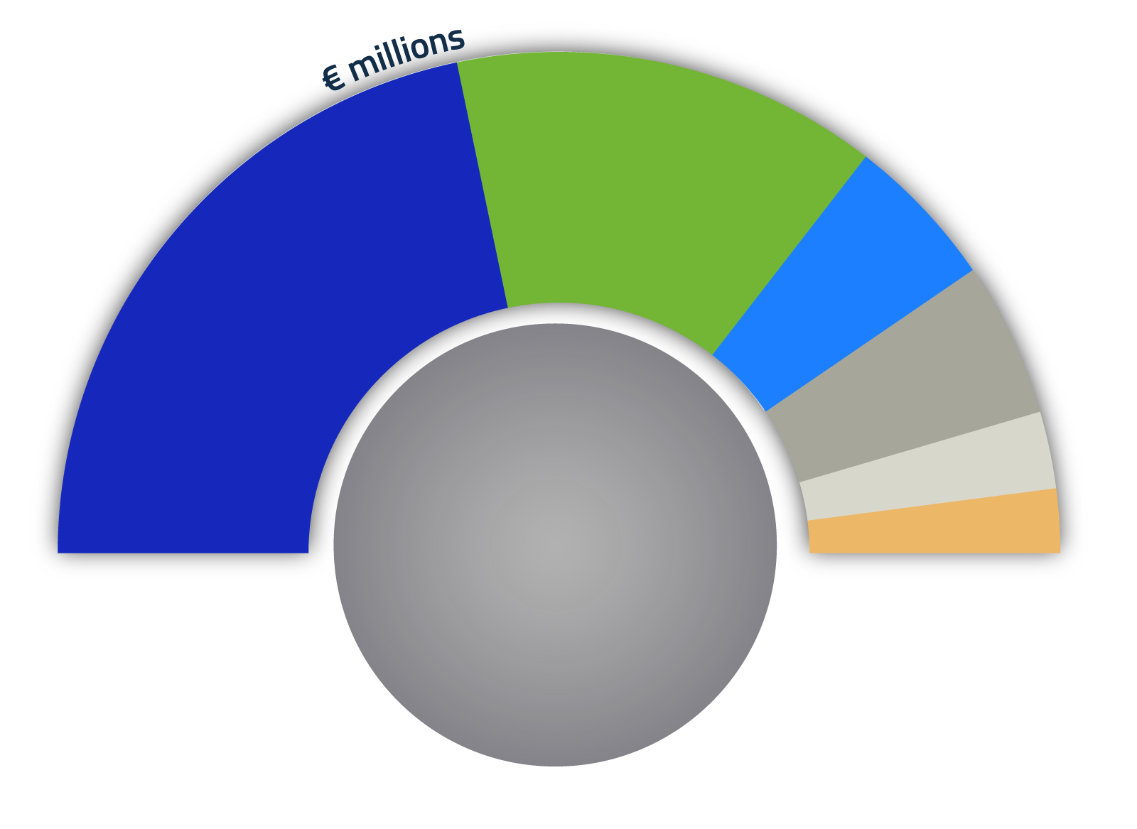
INFRASTRUTTURE
STAFF
INNOVATION
BANDI A CASCATA
PHD
COSTI INDIRETTI
88
31.8
139.1
32
320 M€
41%
Al sud
15.9
13.2
Budget in milion Euro 2022-25
~1500 staff
~400 new researchers
~200 PhD + grants

Slide 4
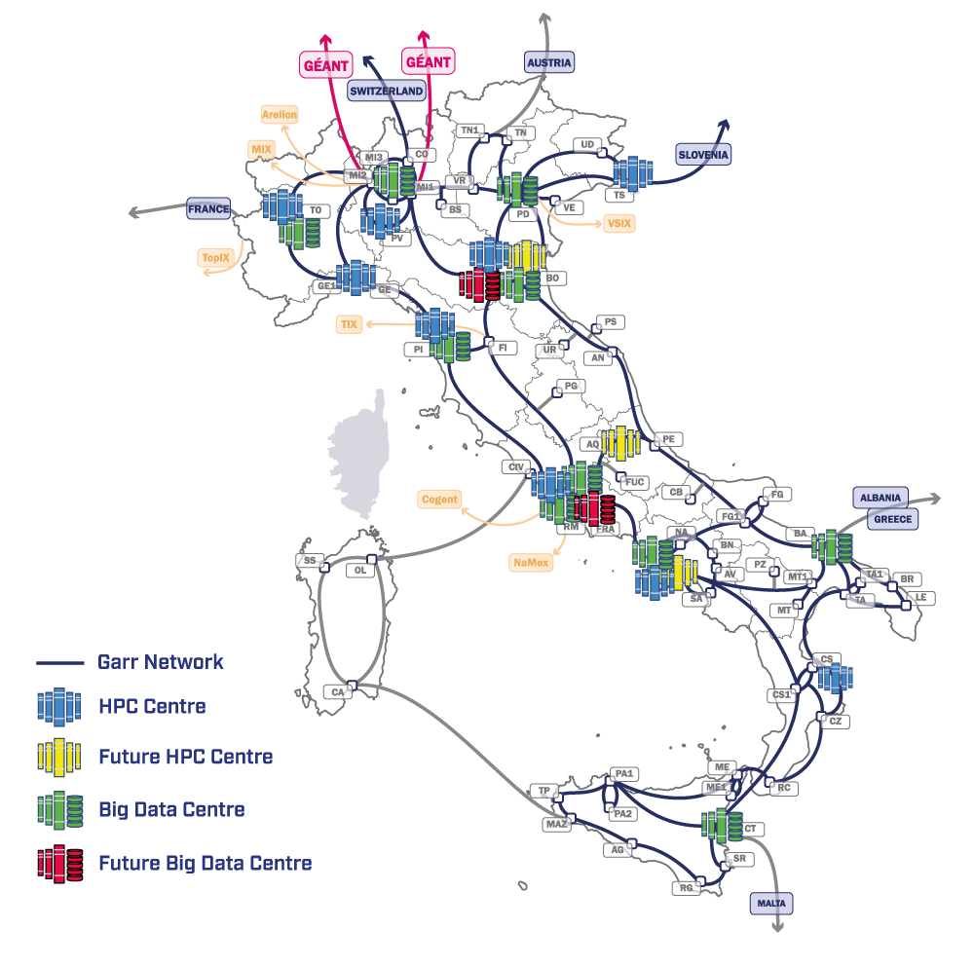
ICSC Structure
SUPERCOMPUTING CLOUD INFRASTRUCTURE
2
0
1
ISTRUZIONE E FOåRMAZIONE, IMPRENDITORIALITÀ,
TRASFERIMENTO DI CONOSCENZE, POLICY, OUTREACH
FUNDAMENTAL RESEARCH
& SPACE ECONOMY
FUTURE HPC
& BIG DATA
3
4
ICSC includes
10 thematic spokes
  #1 e #10 on technology
  #2-#9 on application domains
1 Infrastructure (#0)
ASTROPHYSICS & COSMOS OBSERVATIONS
EARTH
& CLIMATE
5
6
ENVIRONMENT
& NATURAL DISASTERS
MULTISCALE MODELING
& ENGINEERING APPLICATIONS
7
8
IN-SILICO MEDICINE
& OMICS DATA
MATERIALS &
MOLECULAR SCIENCES
9
10
DIGITAL SOCIETY
& SMART CITIES
High-level teams of experts integrating
the Spokes working groups (mixed cross-sectional teams)
QUANTUM COMPUTING

Slide 5
The Spoke 2 of ICSC in one slide
1
2
ISTRUZIONE E FORMAZIONE, IMPRENDITORIALITÀ,
TRASFERIMENTO DI CONOSCENZE, POLICY, OUTREACH
FUNDAMENTAL RESEARCH
& SPACE ECONOMY
FUTURE HPC
& BIG DATA
Spoke Leader Institution: INFN
Co-Leader Institution: INAF
Academic Affiliates: 13 Universities+ 2 Public Research Institutions
Private Affiliates (via Innovation Grants): 7 Large Enterprises
  Being formalize in these very days
3
4
ASTROPHYSICS & COSMOS OBSERVATIONS
EARTH
& CLIMATE
5
6
ENVIRONMENT
& NATURAL DISASTERS
MULTISCALE MODELING
& ENGINEERING APPLICATIONS
7
8
IN-SILICO MEDICINE
& OMICS DATA
MATERIALS &
MOLECULAR SCIENCES
9
10
DIGITAL SOCIETY
& SMART CITIES
QUANTUM COMPUTING

Slide 6
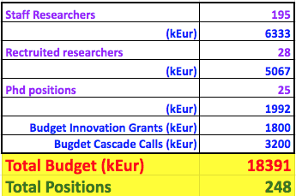

Slide 7

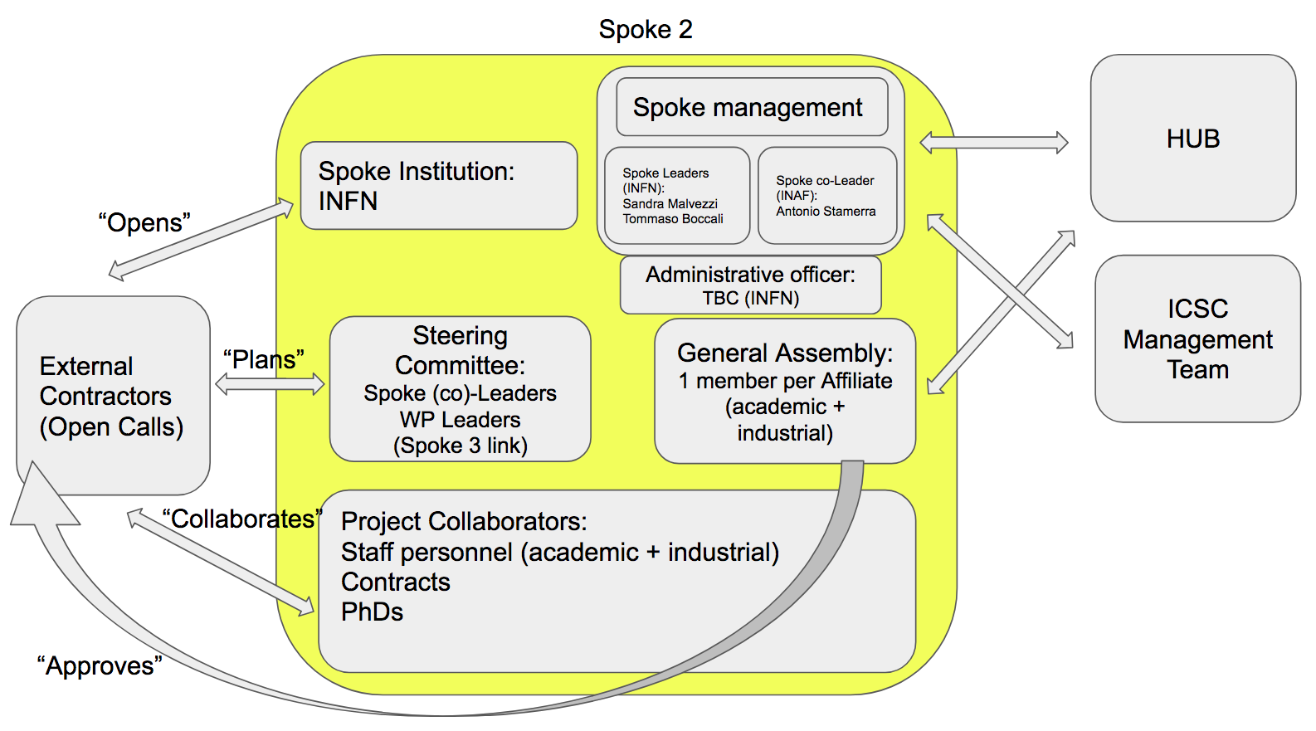
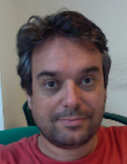

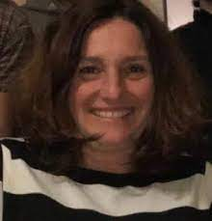
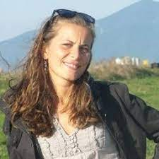
Spoke Organization
Spoke Leaders (INFN):
  Sandra Malvezzi (MIB)
  Tommaso Boccali (PI)
Spoke Co-Leader (INAF):
  Antonio Stamerra (OAR)
Financial Officer (INFN):
  Simona Petronici (PI)
  + team
Boards:
  Steering Committee: SLs, WPLs, WP3 link
  General Assembly: Affiliates

Slide 8
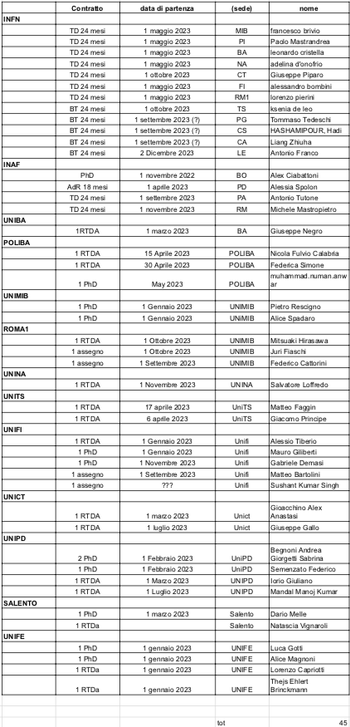
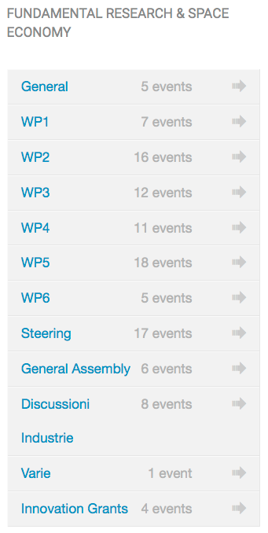
Organization in Numbers
Using INFN Agenda for meeting, and INFN SYMPA for mailing lists
  To-date: 21 mailing lists, 110 meetings in agenda
Recruitment:
  More positions than anticipated (co-funding, synergies) – 45 to-date

Slide 9
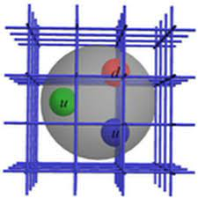
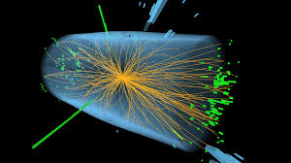
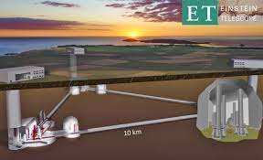
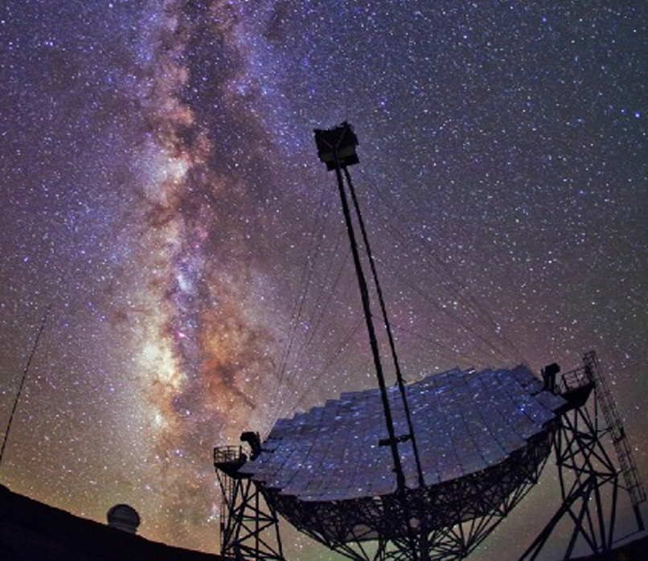
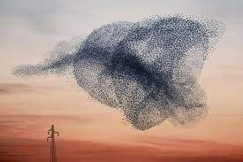
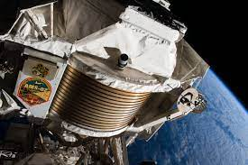
Who are “we?
9

Slide 10
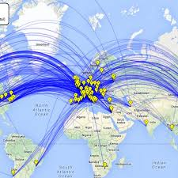

Why our communities need an ICSC
The Worldwide LHC Computing GRID
Since at least 2 decades, research at the fundamental frontier is heavily “computing bound”
  Latest (and next) generation experiments collect data at the Exabyte and beyond
  Simulation efforts in theoretical and experimental physics are at the Exascale
  We have been forced to develop in-house solutions when nothing was available, with a good success. But it is now due time to evolve to a shared infrastructure model
    The Web, the GRID, …
Examples:
  LHC has has already surpassed the global scale of several Exabytes of Data, and more than 1 Million CPU cores
  Lattice QCD simulations are, with Meteo, the main driver and benchmark for HPC systems
Lattice QCD on HPC

Slide 11
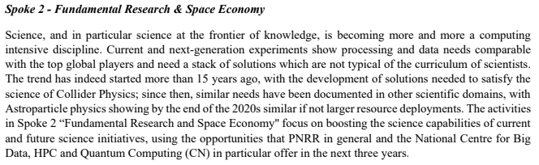
Overall Spoke 2 goals
“no basic science, but computing FOR basic science”
“share solutions between partners”
“use the CN infrastructure as enabling technology”
11

Slide 12
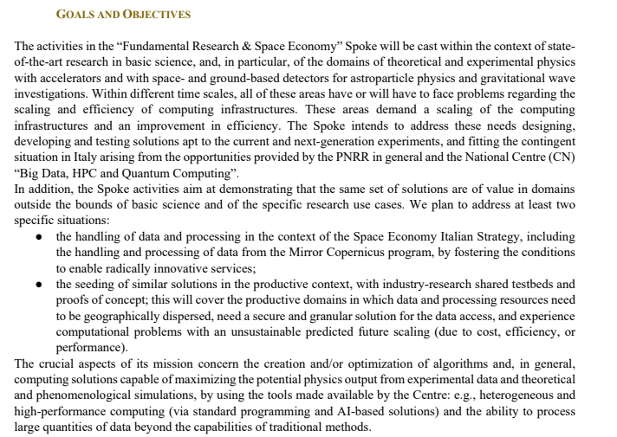
“design and test novel computing oriented solutions”
“go outside the academic environment; not to teach, but to share experience in both directions”
Some high level ideas / keywords
12

Slide 13

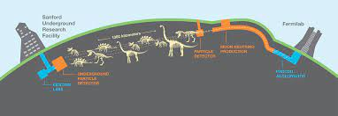
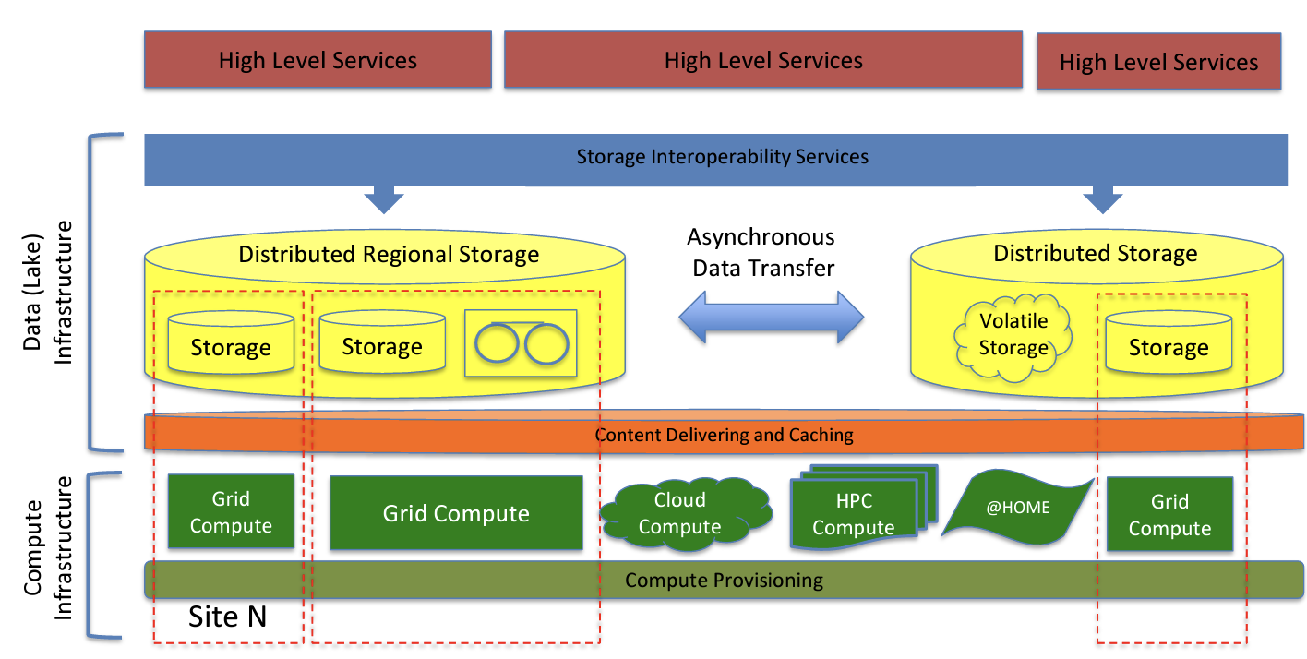

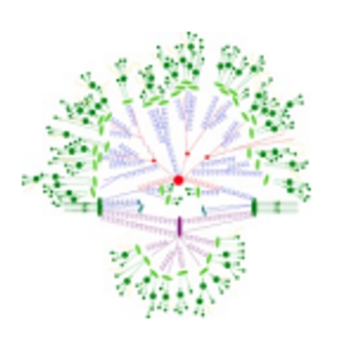
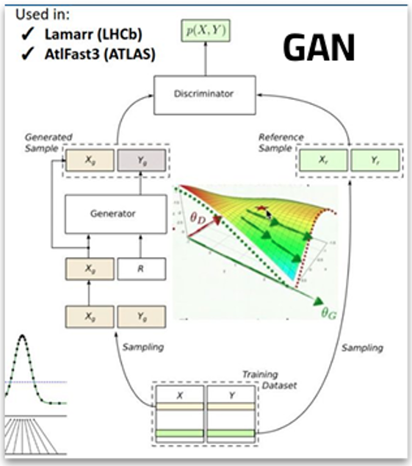
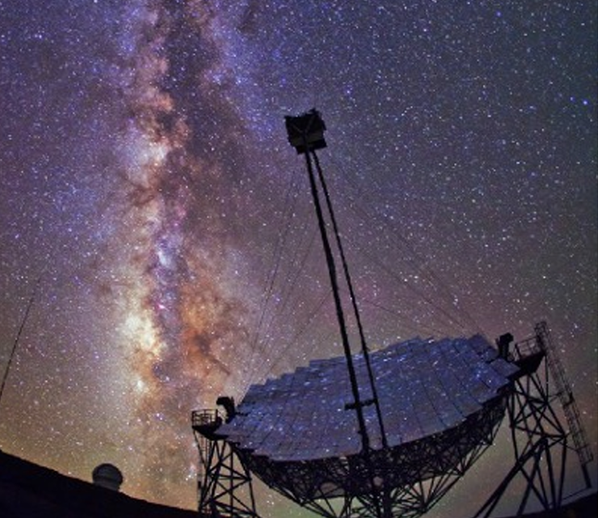


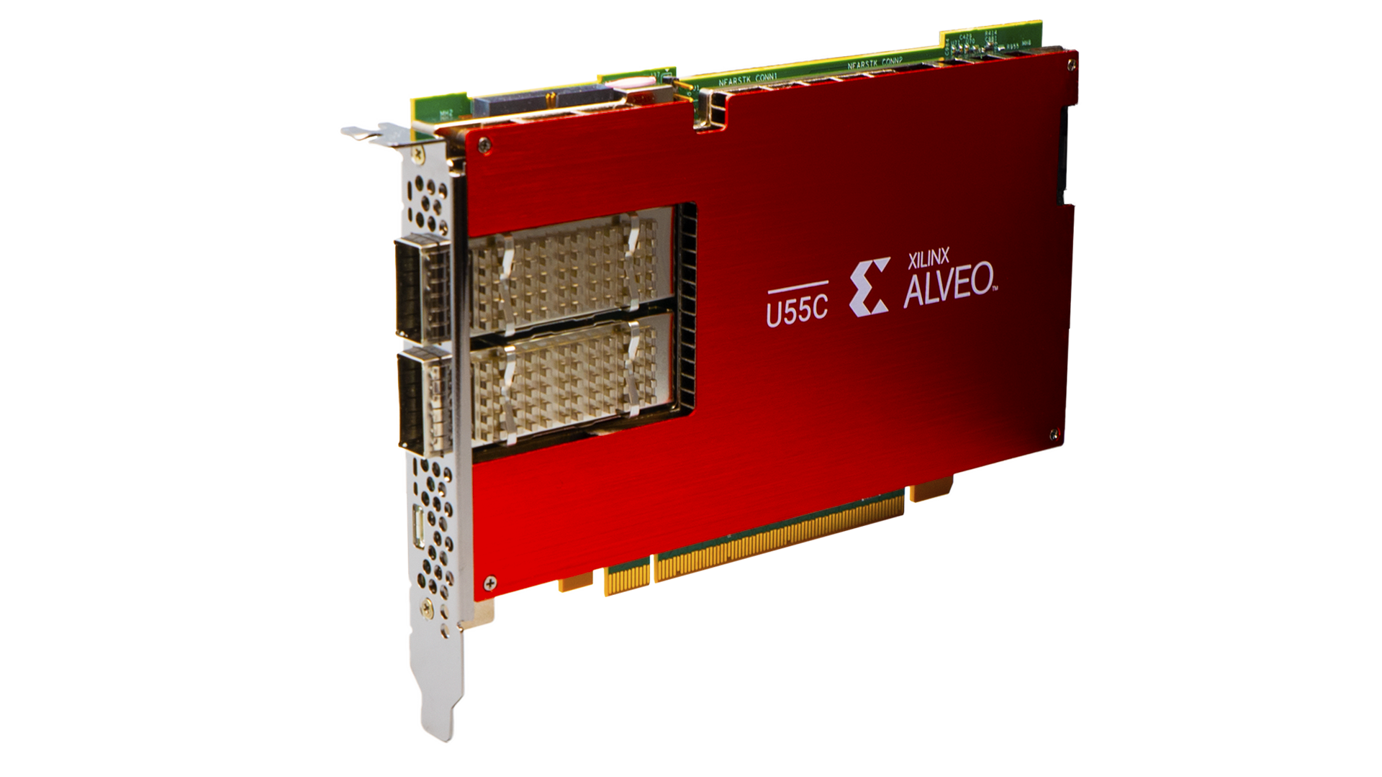



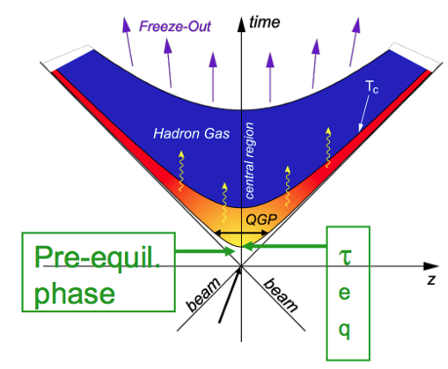


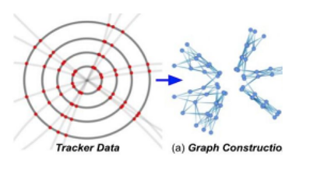
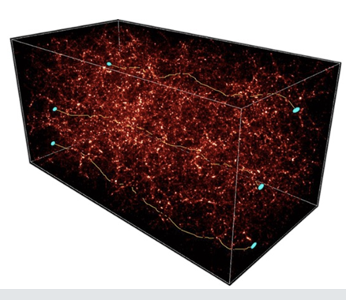

Work Package Structure
WP1: tools and algorithms for Theoretical Physics
WP2: tools and algorithms for Experimental Collider Physics
WP3: tools and algorithms for Experimental Astroparticle Physics and Gravitational waves
WP4: tools for porting / optimization on new architectures (low power, GPU, FPGA, …)
WP5: data management on the distributed CN infrastructure
WP6: cross domain initiatives, + space economy

Slide 14
Work Packages – the structure
  “technological” WPs: they harvest / investigate technical solutions in computing, on the infrastructure of the ICSC and beyond, and provide support / training for these; at the same time propose these to a larger audience, including industries
We defined 2 types of Work Packages:
  “scientific” WPs: they analyze the needs of the (sub-)domain, and pose open problems for which advanced computing solutions are needed
Has a need; searches for a solution
WP1/2/3
WP4/5/6
Has a technology; searches for a test use case

Slide 15
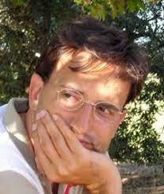
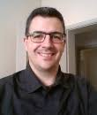
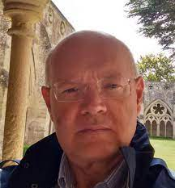
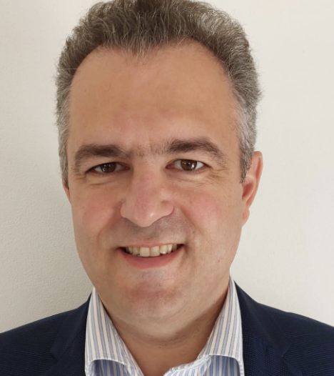
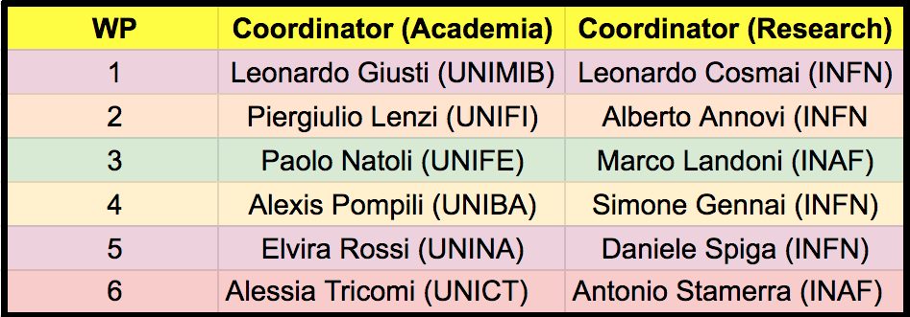
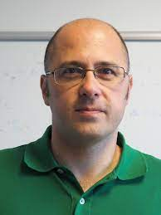
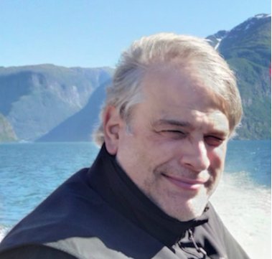
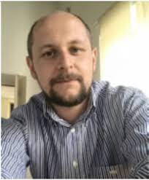
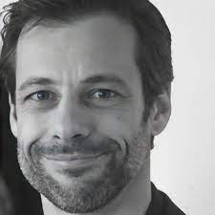
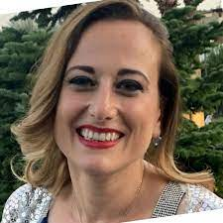
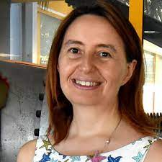
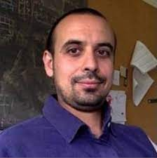
WP leaders
Strategy: in each WP, appoint one coordinator from Academia and one from Research Institutions

Slide 16
Plan of Work
planning and identification: the first year of the project is dedicated to a landscape recognition for interesting state-of-the-art use case; its outcome is a work plan identifying the activities on which the core part of the project will be focusing - in particular, algorithms and services to be accomplished;
a realization phase, in which the actual development is performed via the staff/ hired personnel; the outcome is usable algorithms / services, documented (alpha/beta level) and ready to be tested on a larger scale;
a validation phase, in which the outcomes of the realization phase are verified in testbeds and proofs of concept, and benchmarked in order to assess their adherence to the specifications;
4. a wrap-up phase, in which results are analysed and consolidated in reports and white papers to be used as guidelines for similar use cases.
All the activities designed in the submitted project with a standard 4-phase plan over the three years
We are now in the crucial year: the realization phase
MS4,5
Y1
MS6
MS7
Y2
MS8
MS9
Y3
MS10

Slide 17
Plan of work
The first year was dedicated to team-building and to the identification “bottom-up” of relevant computing-bound scientific use cases (WP1-2-3) and realization solutions (WP4-5-6)
”Our” definition of Flagship projects is:
  We define a category of projects, in the same subdomain (a.g. algorithms for Gravitational Waves detection)
  In each category, we select a Flagshig project which is the driver, and on which we base milestones and KPIs
In the initial definition of the project, we had put “at least one flagship per WP”; we later (MS4) revised it to “at least 2 flagships per WP, possibly shared between scientific and technical WPs”

Slide 18
Milestones (MSX, X:1 -- 10)
Used as checkpoints with the referees
  …
  MS4: Aprile 2023
  MS6: Aug 2023
  MS7: Feb 2024
  MS8: June 2024
  MS9: Oct 2024
  MS10: Aug 2025
At each milestone:
  Scientific Reports
  Check on expenditure
  Check on articles, conferences, …

Slide 19
MS4 used as a checkpoint for MS6; MS6 →
6 Landscape reports produced to assess the needs from fundamental research, and the technology drivers available with the ICSC and beyond
19 Flagship projects defined and fully defined (Milestones, KPIs, resource request to the ICSC, …)
Not going for any detailed explanation here, just flashing titles and scopes

Slide 20






Landscape Documents

Slide 21
Flagships – 19 in total
WP1 (4): «Multilevel Hybrid Monte Carlo for lattice QCD», «QCD under extreme conditions», «Advanced Calculus for Precision Physics (ACPP)», «Large Scale Simulations of Complex Systems»
WP3 (7): «Frequency Hough (FH) Transform analysis on GW continuous sources», «Efficient use of machine learning and GPUs in cosmological data analysis: from theory to likelihood to statistical inference», «Inference of cosmological and astrophysical population properties from GW observations with and without electromagnetic counterparts», «Development of innovative analysis techniques using realistic simulations of the upgraded Auger Observatory within the context of a machine learning environment», «Detection and classification of SSO in Euclid Simulated data», «Pipeline optimization for space and ground based experiments (PSGE)», «Hydrodynamical simulations to test the nature of dark matter»
WP2 (5): «Advanced Machine Learning - Flash Simulation and bleeding edge applications», «Porting Algorithms on GPU», «Ultra-fast algorithms running on FPGA», «Validation of HEP reconstruction code on ARM», «Quasi interactive analysis of big data with high throughput»

Slide 22
WP4 and WP5 do not have specific Flagship, but participate to most of the other flagships, with themes like
GPU / FPGA utilization
Low power computing with ARM
High rate analysis solutions on the Data Lake
Machine learning at large scale
Fast simulations via generative networks,
…
WP6 (3): «Enhancing Geant4 Monte Carlo Simulations through Machine Learning Integration», «Fast Extended Computer Vision», «AI algorithms for (satellite) imaging reconstruction»

Slide 23
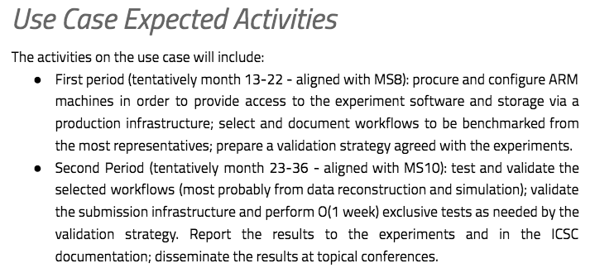
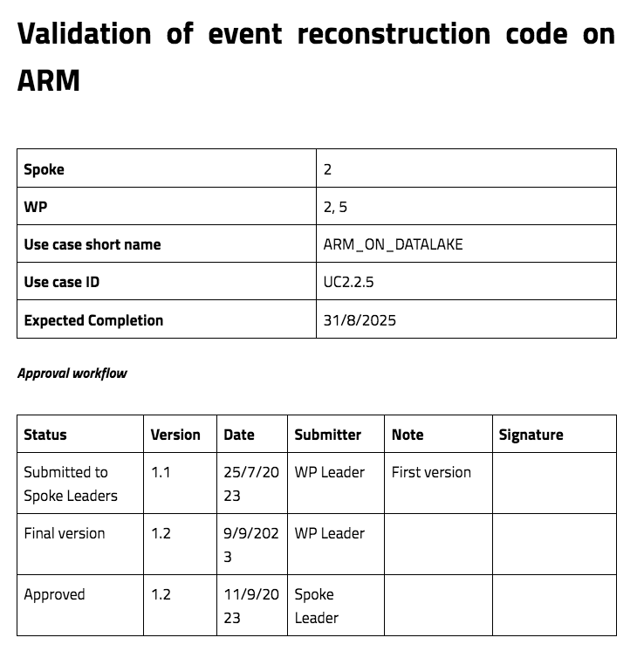
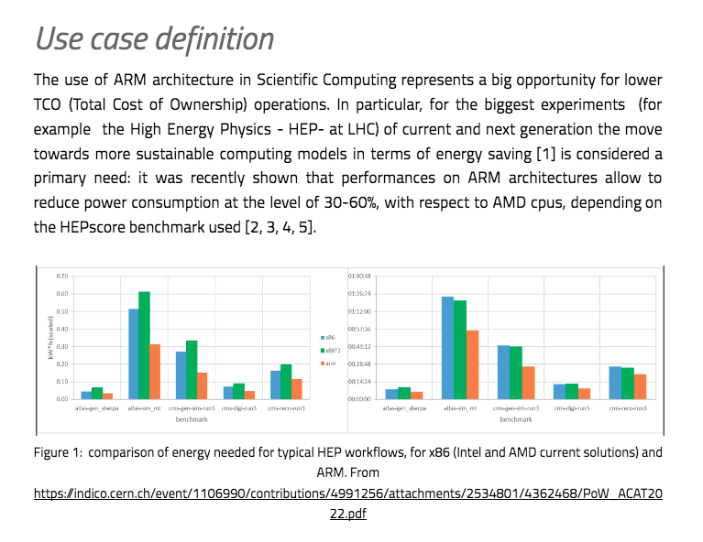
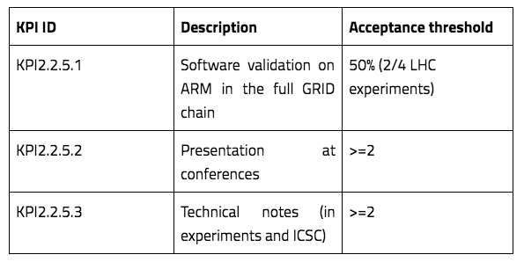
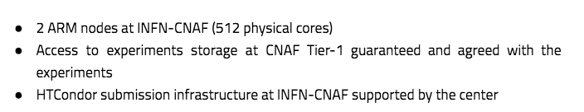
An example of a Flagship

Slide 24
M4C2: “Dalla ricerca all’impresa”
Major focus of ICSC is to include theproductive system as a first citizen in the project, via two mechanisms
  “Innovation Grants”: 1.8 MEur budget in Spoke 2 for projects shared with partner industries
    First tranche by MS6, a second tranche later
  “Cascade Calls”: 3.2 MEur budget in Spoke 2 for projects in part destined to external industrial partners
    In the project initially in MS4, centrally delayed

Slide 25
Innovation Grants
Drivers:
  Find commonalities between needs in research and industry, and test industrial use cases with similar technologies as in the flagship use cases
  Give access to ICSC infrastructures to PoCs from the industrial system
Money allocation:
  The company uses / acquires internal manpower and/or equipment
  The company asks academia to hire additional positions for a shared use case on (for example) industrial data
Technology points of contact:
  Machine Learning use cases (streams, images, …)
  High rate data analysis on distributed data
  Data Management solutions for Big and Distributed data
  …
From LHC reconstruction techniques to industrial use cases: GANs, PIML, DL
From distributed analysis on multisource physics data to … any data
From the Exabyte-level data management of LHC to the management of any data

Slide 26
11 innovation grants activated (Sept 2023 – Aug 2025)
Eni:
  (with Spoke 0): enable the Eni Green Data Center in Ferrera Erbognone for Spoke2/WP1 use cases
  Predictive maintenance on ENI’s industrial plants
  Physics Inspired ML per l’utilizzo di risorse naturali
  ELectrode-electrolyte Interface in Operando, a multiscale modeling approach
Leonardo + TASI:
  (with Spoke 3) Interoperable Datalake: Data management + Block Chain pilot for Space Economy data
UnipolSAI + SOGEI + IFAB:
  (with Spokes 0, 1, 3, 4, 5): monitoring urban areas’ danger and vulnerability situations for prevention and assurance evaluation
  A second project to further fund the effort
Intesa Sanpaolo:
  (with Spoke 5 and TASI): finding correlations between satellite images and financial situation of agricultural enterprises
  (with Spokes 3 and 10): Fraud detection on streams of financial data
IFAB:
  SowStain (Digital Twins for Precision Agriculture) – Spokes 2,4,5,9
  SAFE (Secure anomaly detection edge AI system For critical Environments)

Slide 27
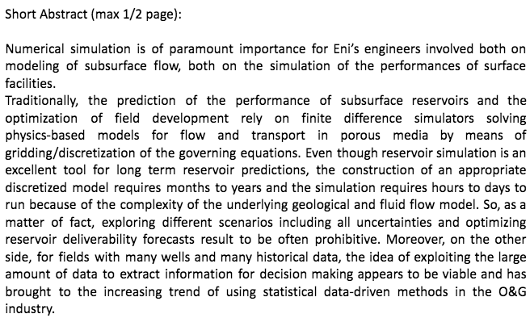
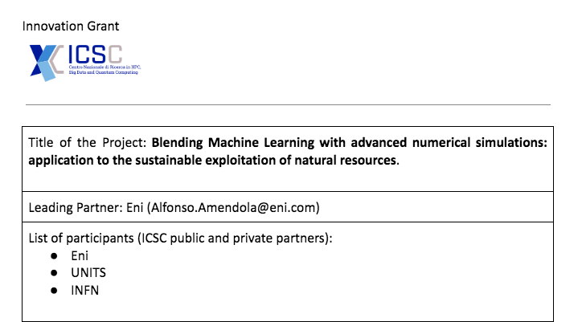



The IG projects
They are designed as full projects, with milestones, KPIs, deliverables

Slide 28

Innovation Grants
All the budget (and then some) allocated by MS6, with 43% in southern regions
Companies have decided in most cases to fund the academia
  Not always easy for them to get accounted for by the PNRR
  A major goal is to attract talents and they are more easily found via the academia

Slide 29
Cascade Calls (i.e. funding for external partners)
The Cascade Calls were designed in the initial project as a means to extend the ICSC actions beyond the limited number of partners
Extending to:
  Academia: involve some of the Universities / Research Institutions not selected for ICSC, allowing them to propose use cases to enrich the Spoke 2 scientific program
  Private Companies: request services and actions (top down) and asking for industrial use cases (bottom up)
    Remember: the external private partners will not be reimbursed at 100%, so even the services should be interesting to them. It is not a procurement!
ICSC centrally requests them to be at least 50% towards the productive system (in addition to 50% in Southern regions)
Current status →

Slide 30

As of July 2024
All cascade calls assigned (3.1xMEur)

Slide 31
Personnel (INFN)
7 TD (“tempo determinato” ) positions:
  PI, BA, CT, RM1, FI, MIB, NA
5 Technological Grants (“borse tecnologiche”)
  CA, PG, TS, LE, CS
5 AdR (“assegni di ricerca”)
  NA, CNAFx2, FI, PG
We would like to organize meetings in which we have the chance to
  Know each other
  Give you news about the project advancement

Slide 32
Access to computing resources
The ICSC RAC (Resource Allocation Committee) accepts requests for IT resources, for large scale processings
  For Spoke2, O(40) requests submitted and all accepted
We/you can still submit new requests, if there is something new. Requests are:
  For CPU hours on HPC, Grid, Cloud
  For GPU hours on HPC and Cloud
  POSEX/Cloud storage
Link is here
  Please drop me a line before….

Slide 33

Conferences, talks, papers
We need to demostrate the effort by INFN (and in general) via talks, conferences
We have prepared instructions, here
In some cases, we proceeded centrally:
  CMS, ATLAS, LHCb, ALICE, Virgo (asap), Auger: they included acknowledgements to ICSC already
100+ conferences communicated

Slide 34

Spoke2 GitHub
We prepared a GitHub repository for Spoke2
Idea is
  If you start from scratch / you have only private code, you can ask me for a sub repository;
  If for some reasons you cannot use Spoke 2 and you have your own repository, it is ok. We will ask you for time to time to fork a copy under Spoke2 repository.

Slide 35

Papers, Conferences, Tools…
We are asking our collaborators to help us keep a list of relevalnt papers / contribution to conferences
We are admittedly, a bit late, with O(20) conferences + O(10) papers
But …
  The major Experiments at LHC have evaluated the ICSC as a sizeable source of support and solutions. We have negotiated putting ICSC as an acknowledgements in all papers which used the technologies we are proposing
We will move now to the same request to smaller experiments
Tools:
  We just created a Spoke-wide GitHub repository to allow for a coherent view of the codes
  We have a GDrive area for the Boards / the WPs

Slide 36
Conclusions
For those we meet for the first time, welcome to ICSC Spoke2 / INFN !
For anything, you can obviously contact me at tommaso.boccali@pi.infn.it or skype (tomboc73)
Questions?

