Slide 1
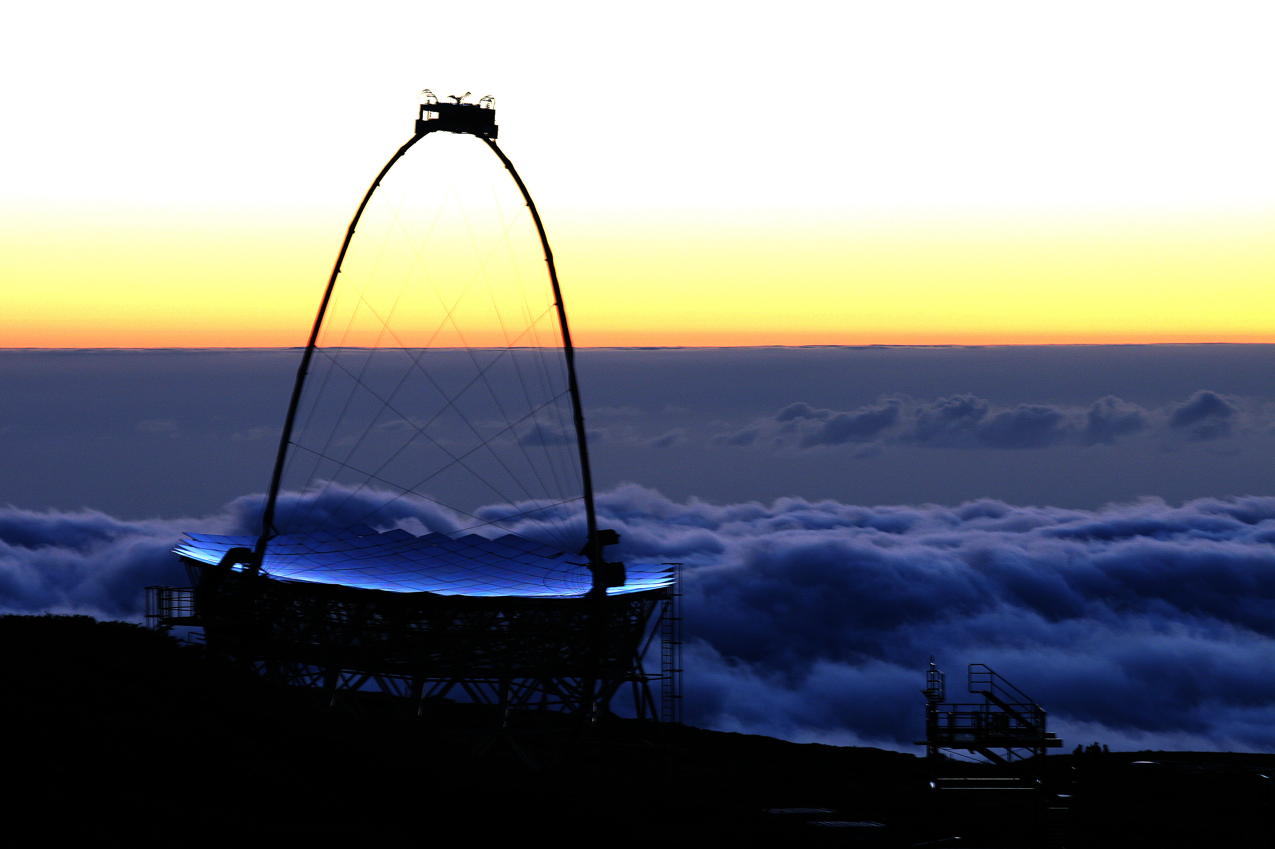
Highlight results from the MAGIC telescopes
Elisa Prandini (Padova University & INFN)
on behalf of the MAGIC Collaboration
IFAE
Ferrara 12 April 2012

Slide 2

Outline
MAGIC: a low energy threshold IACT
Recent results
  Galactic
  Extragalactic
Final remarks

Slide 3
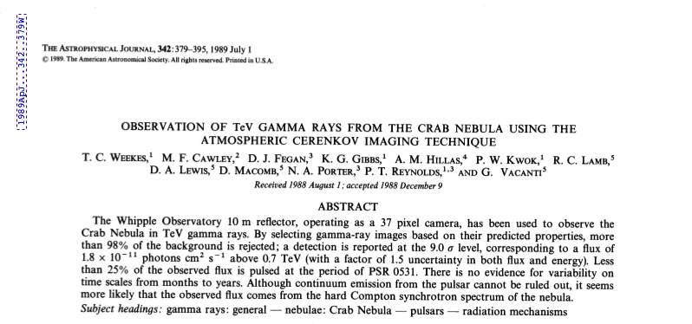
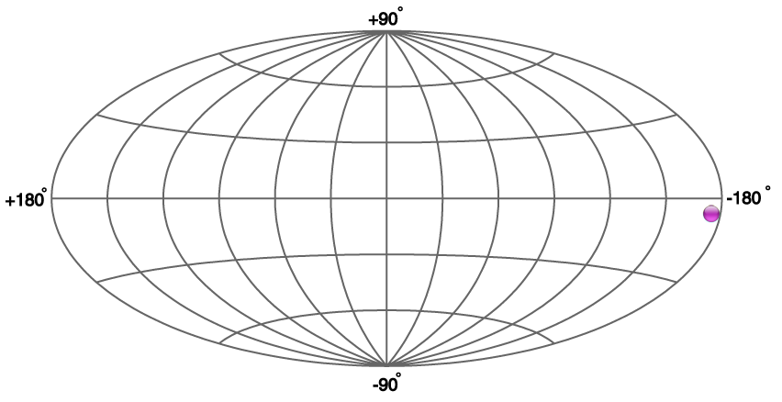
The Very High Energy Domain
VHE: stands for 100 GeV < E < 30 TeV
  This is the typical energy range of a IACT Telescope (MAGIC, HESS, VERITAS)
  This energetic window was opened in 1988 by Whipple
Discovery of a significant flux of TeV gamma-rays from the Crab Nebula

Slide 4
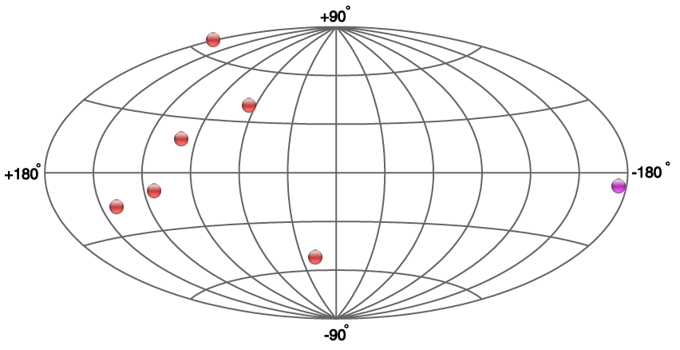
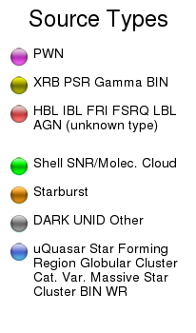
10 years later: 1999
6 new sources detected (extragalactic)

Slide 5
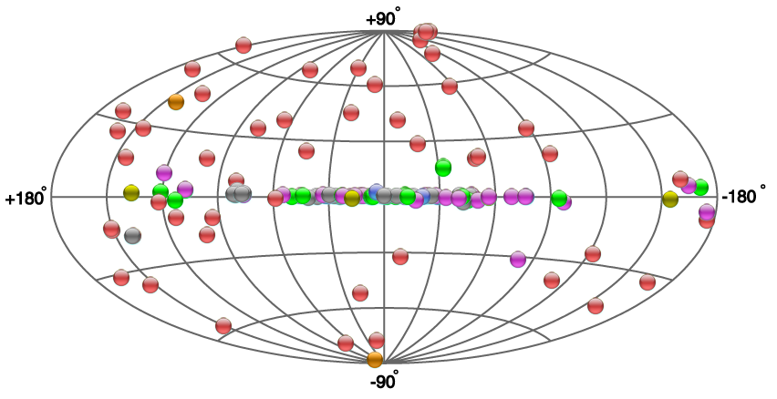
Now: the VHE sky in April 2012
>130 sources

Slide 6
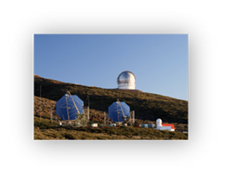

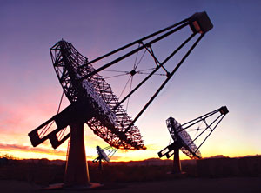
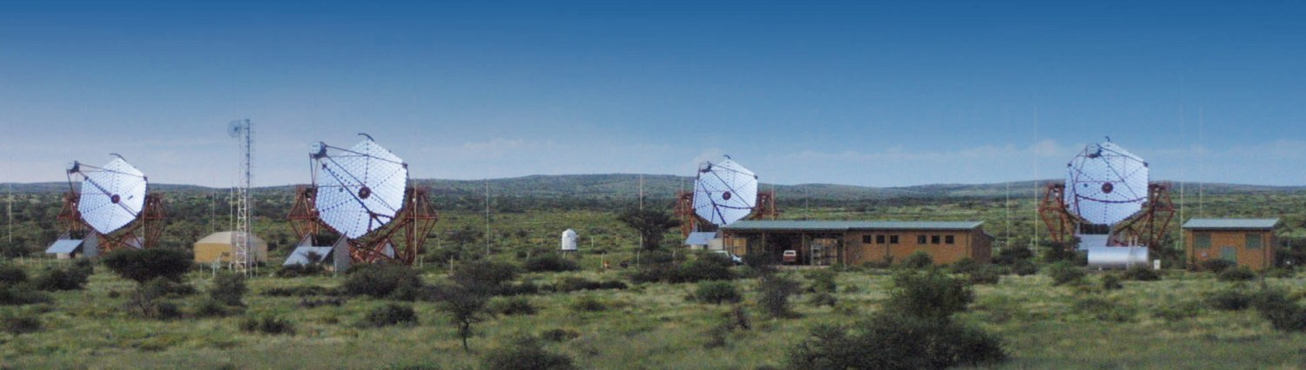
Main IACT Observatories in the world
MAGIC
VERITAS
H.E.S.S.

Slide 7
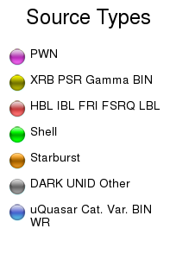
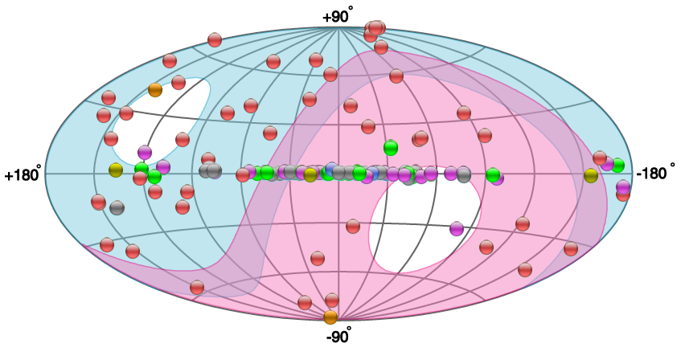
The TeV Sky
MAGIC & VERITAS
H.E.S.S.
From: TeVCat http://tevcat.uchicago.edu/

Slide 8
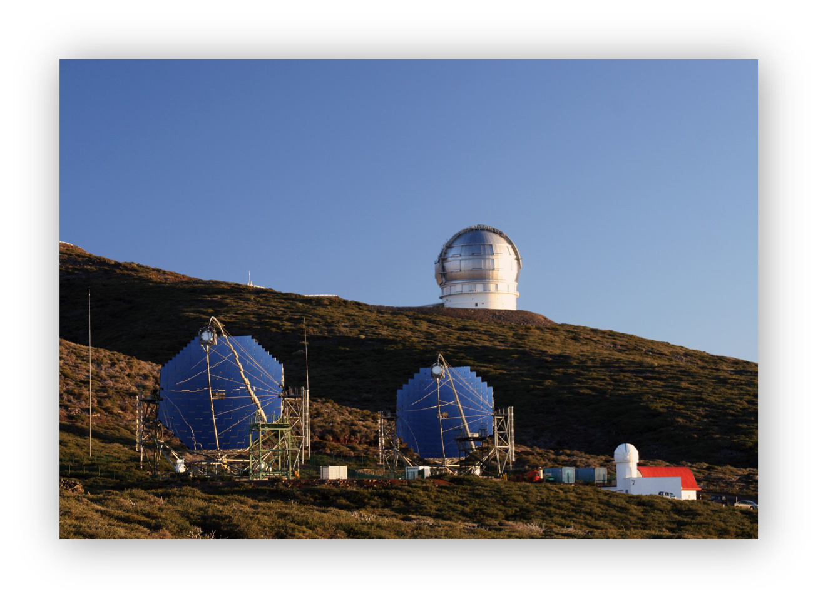
The MAGIC Telescopes
Energy threshold ~50 GeV (~ 25 GeV with a special trigger)
FOV 3.5º
Energy Resolution ~16% (E>300 GeV)
Angular Resolution ~0.07º (E>300 GeV)
Sensitivity (5 σ in 50 hours) ~0.8% Crab Nebula flux (> 250 GeV)
MAGIC I (2004)
MAGIC II (2009)

Slide 9
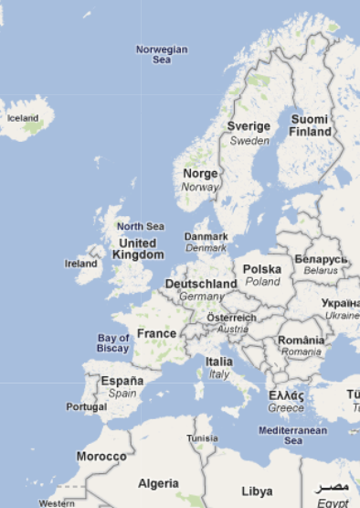
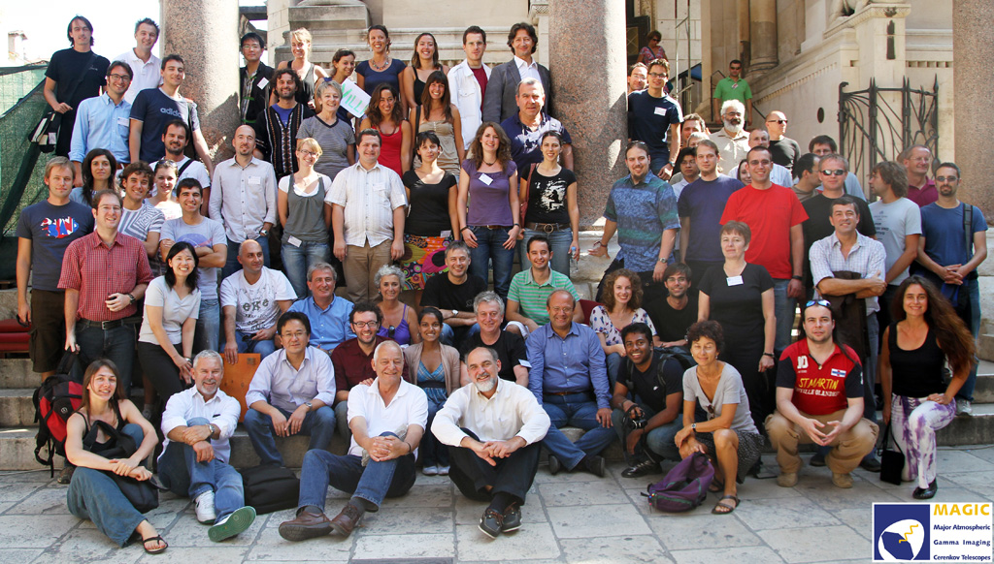
The MAGIC collaboration
Bulgaria Sofia
Croatia Consortium
Finland Tuorla Observatory
Germany DESY Zeuthen, Dortmund, MPI Munich, U Wuerzburg
Italy INFN Padova, INFN Siena/Pisa, U Siena, INFN Udine, INAF consortium, U Insubria
Poland U Lodz
Spain U Barcelona, UAB Barcelona, IEEC-CSIC Barcelona, IFAE Barcelona, IAA Granada, IAC Tenerife, U Complutense Madrid
Switzerland ETH Zurich
MAGIC in La Palma, Canary Islands, Spain

Slide 10
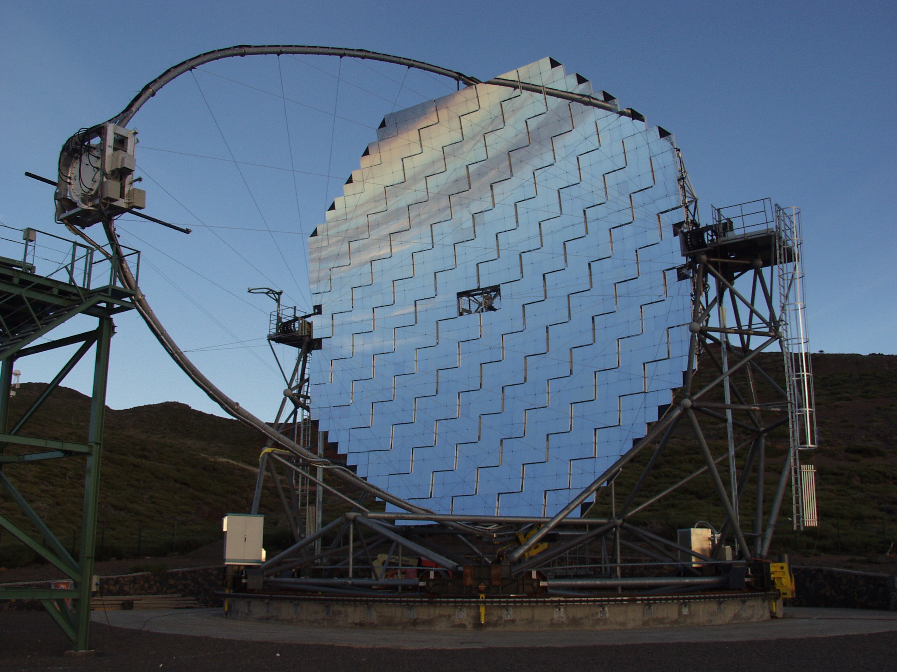
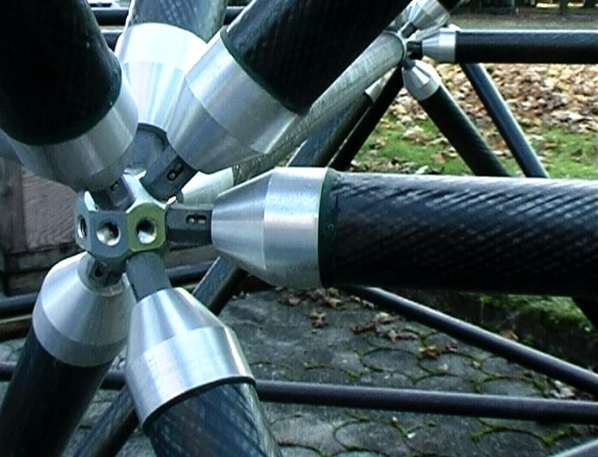
MAGIC: The Instrument
CAMERA
MIRRORS
STRUCTURE
SIGNAL TRANSPORT
IPE
ACQUISITION SYSTEM
IPE
IPE
NET
CE

Slide 11
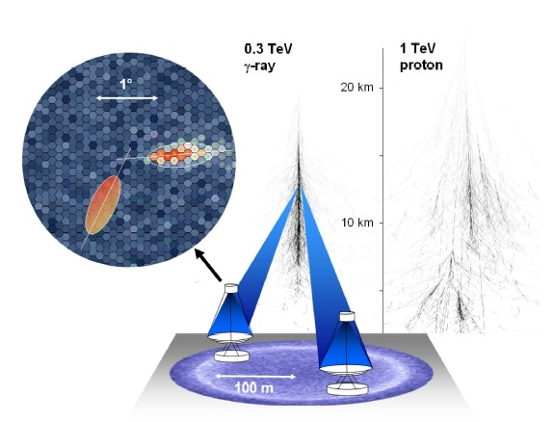
Detection technique

Slide 12
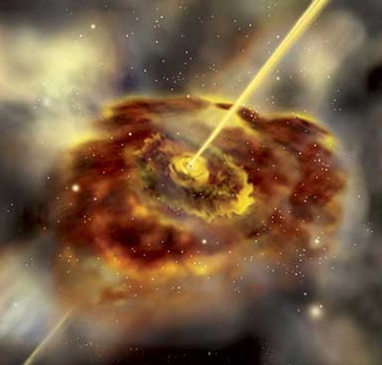
MAGIC Astrophysics
Source detection and monitoring
Cosmology and fundamental physics

Slide 13
MAGIC Achievements
3 new sources in the last months!
9 discoveries in the last 2 years
New discoveries
ToO program
MWL campaigns
Optical triggers
HE γ-rays triggers
Characterization of the SED
Combined information
… and open search fields
Dark matter emitters
GRBs
…

Slide 14
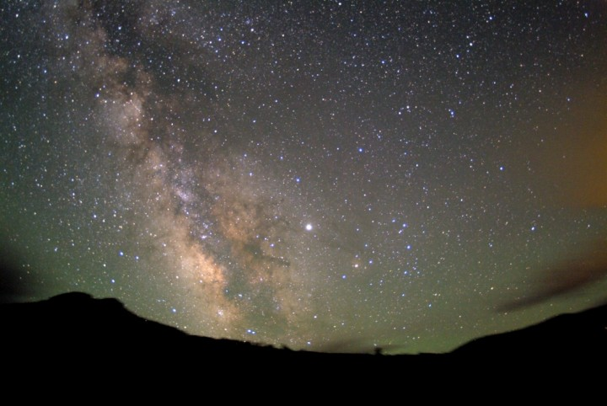
MAGIC
Sources
pulsars
Supernova
Remnants
X-ray binaries

Slide 15
MAGIC
Sources
FSRQs
pulsars
Supernova
Remnants
BL Lac
X-ray binaries
radiogalaxies

Slide 16
MAGIC
Sources
FSRQs
pulsars
GRBs
Supernova
Remnants
Dwarf Galaxies
BL Lac
X-ray binaries
Galaxy Clusters
Unidentified objects
radiogalaxies

Slide 17
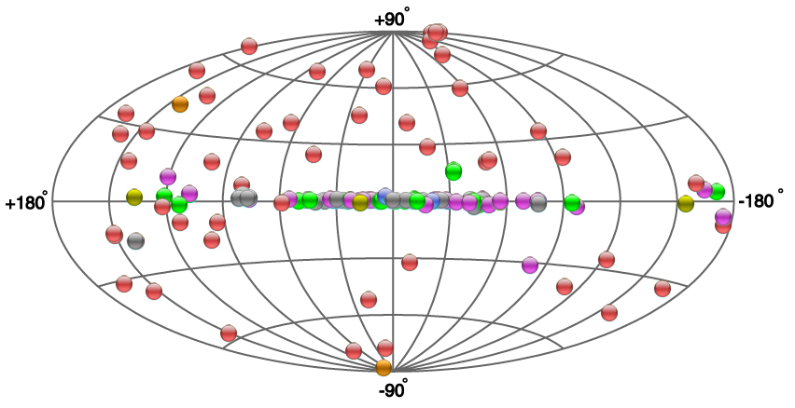
Latest Discoveries
1ES 1727+502
1ES 0647+250
1ES 0033 +595
3 new extragalactic objects

Slide 18
MAGIC Achievements
3 new sources in the last months!
9 discoveries in the last 2 years
New discoveries
ToO program
MWL campaigns
Optical triggers
HE γ-ray triggers
Neutrino triggers
Characterization of the SED
Combined information
… and open search fields
Dark matter emitters
GRBs
…

Slide 19
Target of Opportunity Observations
Discovery of new sources
Study of eventual correlations
Optical ToOs: very successful
Fermi ToOs: promising
Neutrino ToOs

Slide 20
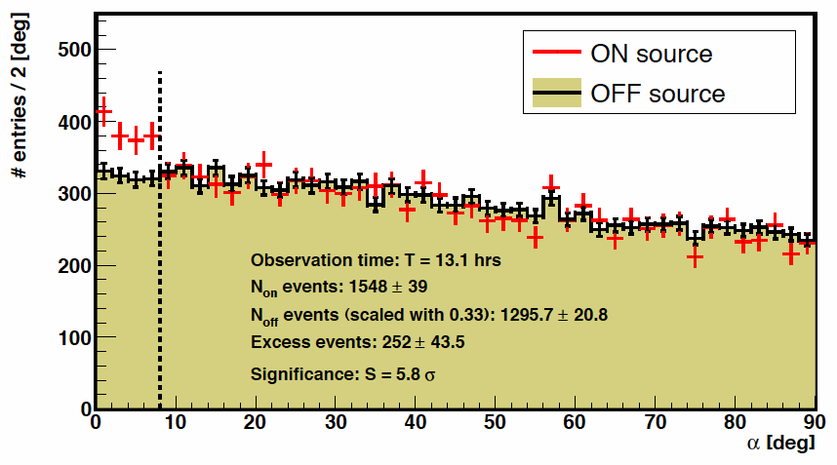

Target of Opportunity Observations
Discovery of new sources
Study of eventual correlations
Optical ToOs: very successful
Fermi ToOs: promising
Neutrino ToOs
Example - the discovery of S5 0716+714:
MAGIC 13.1h
S=5.8 σ
ApJ 704 (2009) L129

Slide 21
MAGIC Achievements
3 new sources in the last months!
9 discoveries in the last 2 years
New discoveries
ToO program
MWL campaigns
Optical triggers
HE γ-ray triggers
Neutino triggers
Combined information
Characterization of the SED
… and open search fields
Dark matter emitters
GRBs
…

Slide 22
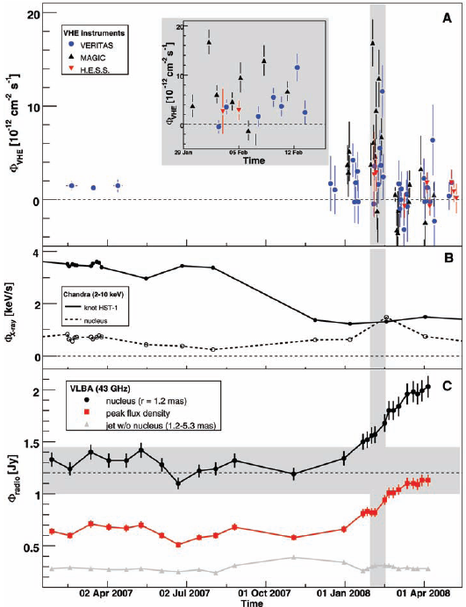
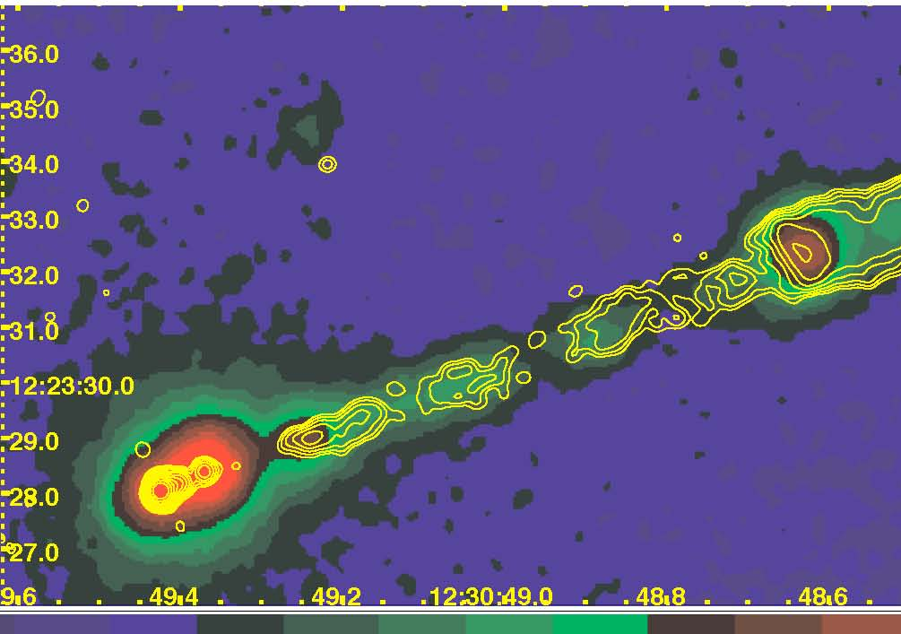
Joint HESS-MAGIC-VERITAS campaign of M87 (Science 2009)
The M87 radio-galaxy Jet
Colours: 0.2 - 6 keV (Chandra)
Contours: 8 GHz radio (VLA)
VHE
HST-1
Core
Knot A
Knot D
knot HST-1
Chandra
X-ray
nucleus
Shared monitoring HESS, MAGIC VERITAS
Confirmation of day-scale variability at VHE
Evidence of central origin of the VHE emission (60 Rs to the BH)
nucleus
Radio
Peak flux
jet

Slide 23
MAGIC Achievements
3 new sources in the last months!
New discoveries
ToO program
MWL campaigns
Optical triggers
HE γ-ray triggers
Neutino triggers
Characterization of the SED
Combined information
… and open search fields
Dark matter emitters
GRBs
…

Slide 24
Outline
MAGIC: a low energy threshold IACT
Recent results
  Galactic
  Extragalactic
Final remarks

Slide 25
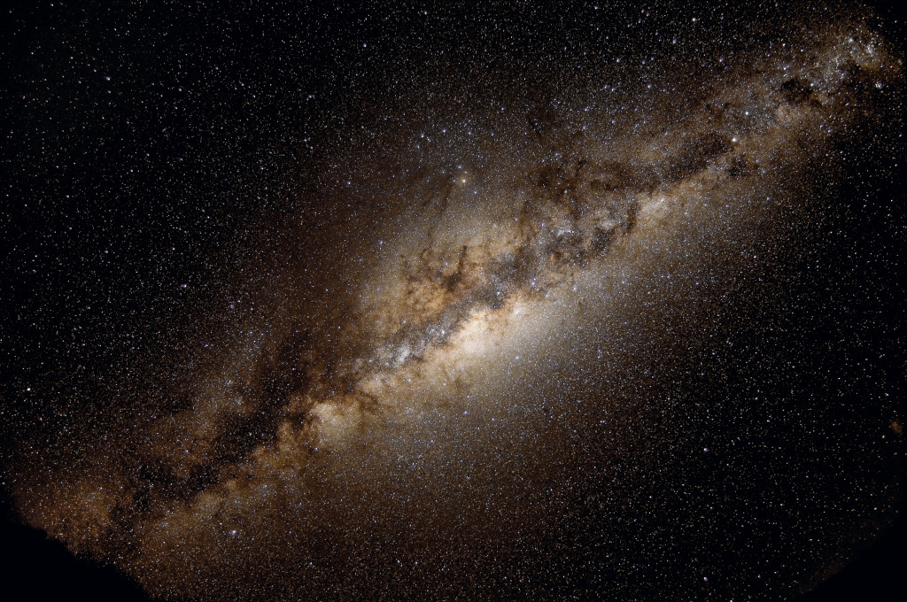
Galactic Sources

Slide 26
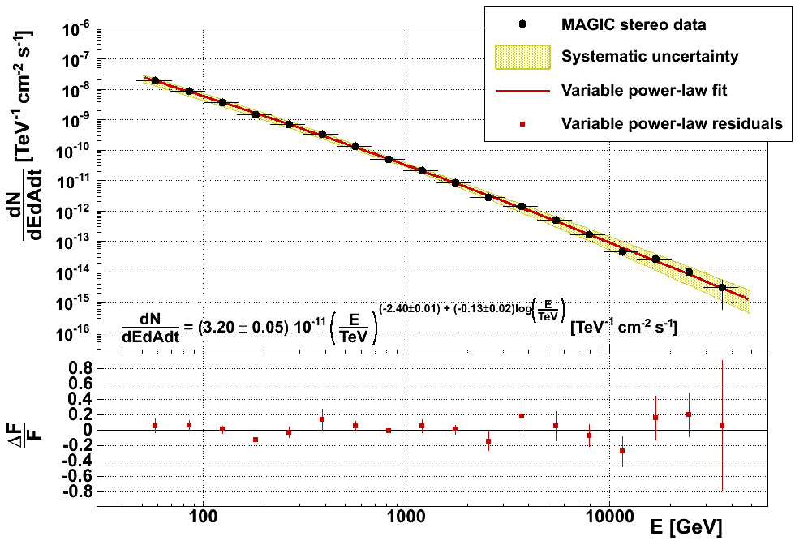
Crab Nebula
Standard candle of VHE astronomy and archetypal PWN
49 hrs (ZA: 0°-50°) in the last two winters (2009-2011). New analysis techniques to lower further the energy threshold
preliminary
Zanin et al. arXiv:1110.2987

Slide 27
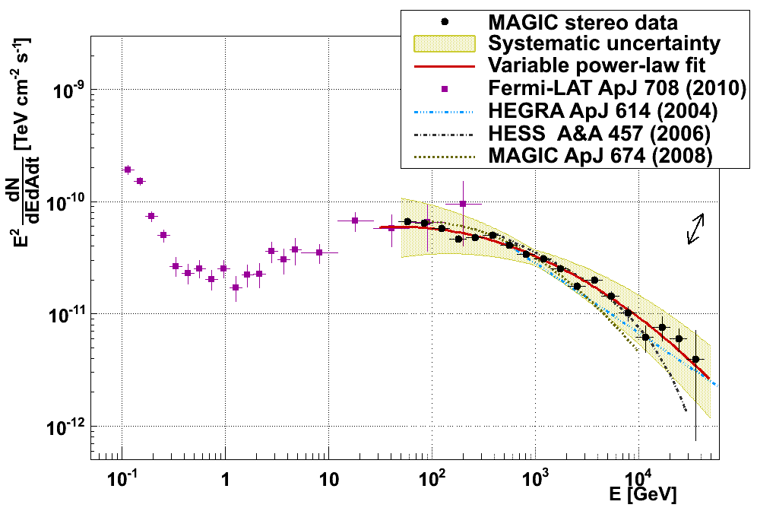
Crab Spectral Energy Distribution
Given the systematic
impossible to exclude the cutoff
at E > 10 TeV
Inverse Compton peak estimation
(MAGIC + Fermi):
59 ± 6 GeV
stat. err. only
MOST PRECISE
IC PEAK
MEASUREMENT SO FAR
PRELIMINARY
Zanin et al. arXiv:1110.2987

Slide 28
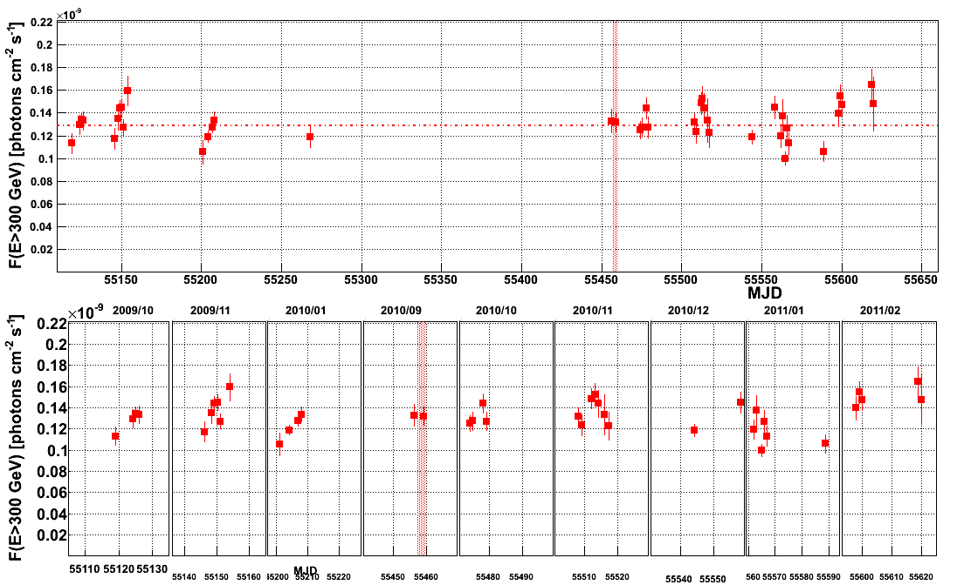
Crab variability >300 GeV
After reports of flares of hours/days in AGILE & Fermi and ARGO-YBJ and of year-long variability in X-rays… is Crab stable at TeV?
PRELIMINARY
Observation same day as GeV flare in Sept 2010: no increase at 1 TeV (ATel#2967)
F(E > 300 GeV) = (1.29 ± 0.03_{stat} ± 0.23_{sys} ) 10⁻¹⁰ photons cm⁻² s⁻¹
No indication for variability > 300 GeV (probability of 95% constant flux considering the systematic error)

Slide 29
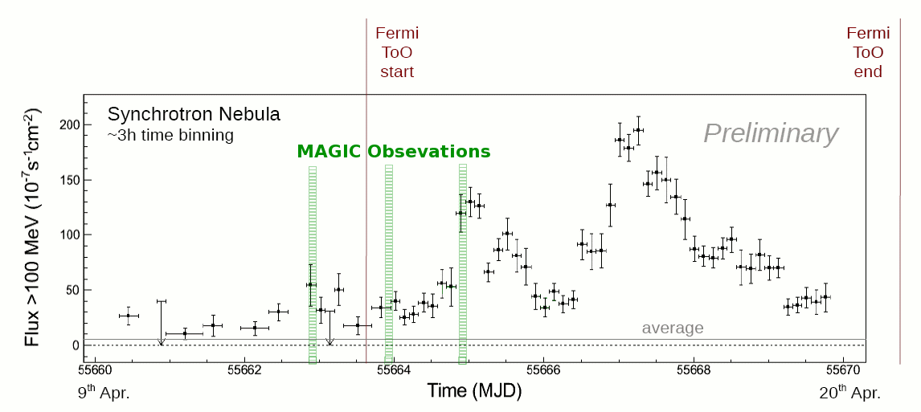
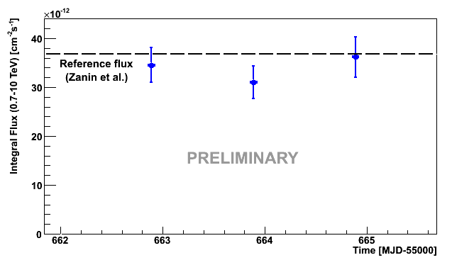
Crab April 2011 GeV flare
MAGIC observations
FERMI
Fermi curve, Credits:
Rolf Bueler for Fermi
PRELIMINARY
MAGIC
3 nights of data in April 12—14, 2011 just on top of a 3 hrs Fermi bin when flux >100 MeV was 15 times higher than the steady flux.
No variability observed in flux between 700 GeV and 10 TeV.

Slide 30
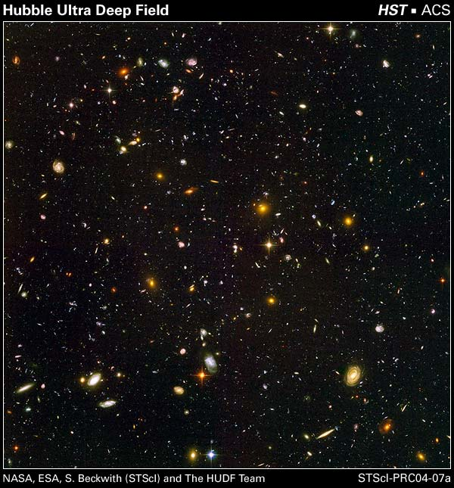
Extragalactic Sources

Slide 31
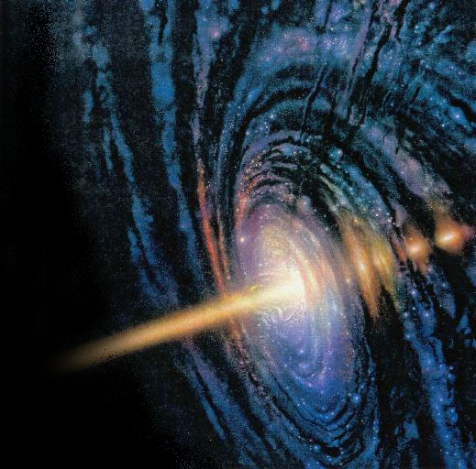
VHE Extragalactic emitters: AGN
Supermassive black holes accreting matter
Depending on the viewing angle:
  Blazars
  Radiogalaxies
Emission:
  synchrotron
  Inverse Compton (alternative: hadronic models)
νF_{ν}
Simplified SED
eV keV MeV GeV TeV
log(E)

Slide 32
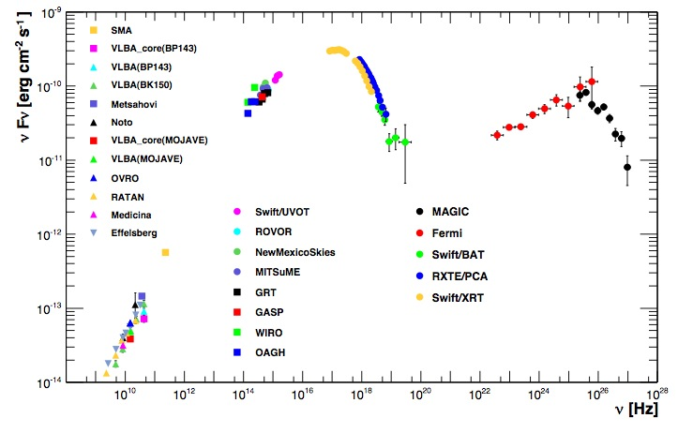
Mkn 421 Mwl view
Overlap with Fermi/LAT at “low” energies!
FERMI
MAGIC
ApJ accepted

Slide 33
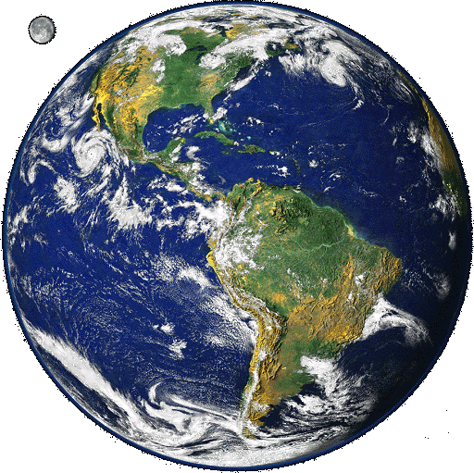
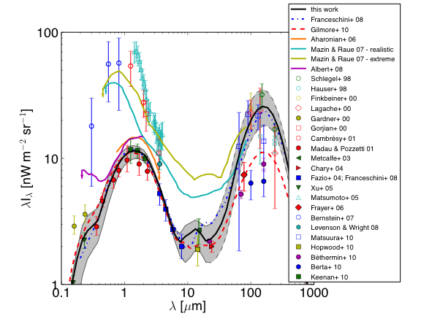
VHE photons absorption by the Extragalactic Background Light
x
x
x
VHE photon + diffuse light
→ electron-positron pair production
γ_{VHE}γ_{EBL} → e⁺e⁻
Absorption:
dF/dE_{obs}= (dF/dE_{em}) e^{-τ}
Dominguez et al. (2011)

Slide 34
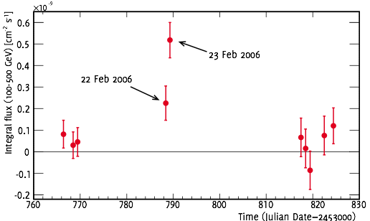
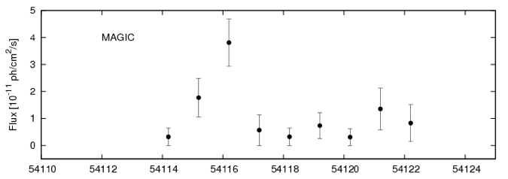
3C 279
MAGIC Coll.,
Science 320 (2008) 1752
MAGIC: E>100 GeV
Discovered in 2006
The farthest VHE object (z=0.54)
6.2σ
2.2σ
2007 observations: confirms 2006 signal and short timescale variations
MAGIC: E>150 GeV
MAGIC Coll.,
A&A 2011, 530, A4 (2011)

Slide 35
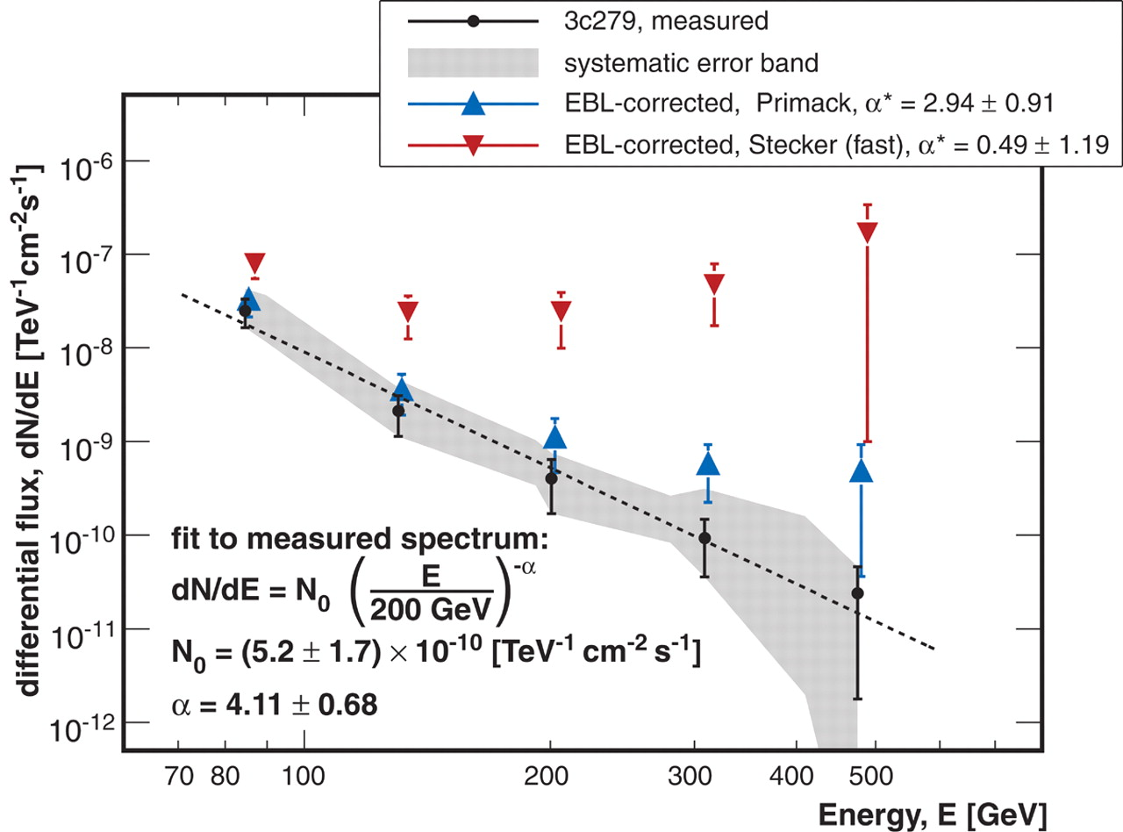
3C 279: the spectrum
MAGIC Coll.,
Science 320 (2008) 1752
MAGIC Coll.,
A&A 2011, 530, A4 (2011)

Slide 36
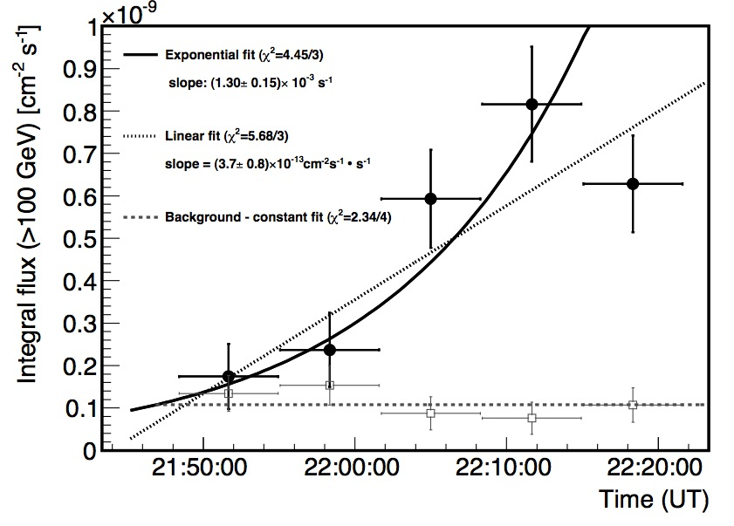
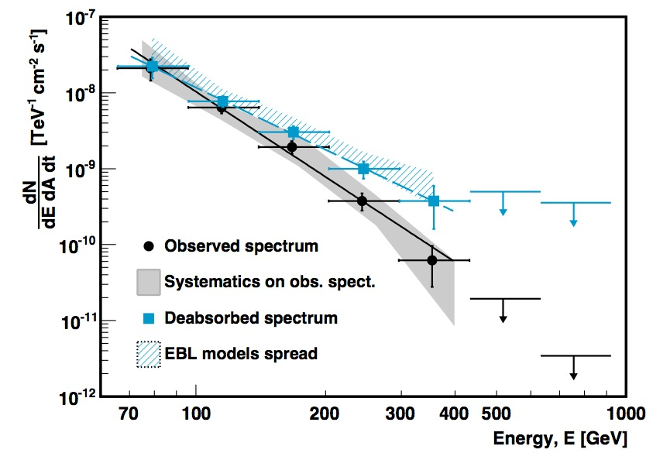
PKS 1222+21:
MAGIC Discovery!
The second most distant TeV emitter (z ~ 0.432)
One night of detection:
  17th June 2010
Rapid variations!
No cut-off observed:
  Emitting region constrained to lie outside the BLR
MAGIC Coll.,
ApJ Letters 2011, 730 L8
Challenge for blazar emission models

Slide 37
Outlook: MAGIC upgrade
The MAGIC telescopes were shut down on June 15th, 2011 to perform a major upgrade of the hardware:
  Both telescopes will be equipped with a new 2 GSamples/s readout based on DRS4 chip (linear, low dead time, low noise).
  The camera of MAGIC-I be upgraded from 577 to 1039 pixels to match the camera geometry and the trigger area of MAGIC-II.
  Both telescopes will be equipped with sumtrigger covering the total conventional trigger area.
We expect slightly better sensitivity for point sources and significantly better performance for extended source

Slide 38
Conclusions
Strong points of MAGIC
Future plans
Low energy threshold
  Overlapping with Fermi
  Deep universe
New stereoscopic system
Fast repositioning (sensitivity to transients: GRB)
Moon observations
MAGIC upgrade (improve low energy sensitivity):
  M1 Camera
  Trigger
  Readout electronics
… many new discoveries!!
Improved trigger acceptance and energy threshold
Less noise

Slide 39
Conclusions
Strong points of MAGIC
Future plans
Low energy threshold
  Overlapping with Fermi
  Deep universe
New stereoscopic system
Fast repositioning (sensitivity to transients: GRB)
Moon observations
MAGIC upgrade (improve low energy sensitivity):
  M1 Camera
  Trigger
  Readout electronics
… many new discoveries!!
Improved trigger acceptance and energy threshold
Less noise
Thanks!

Slide 40
Backup Slides

Slide 41
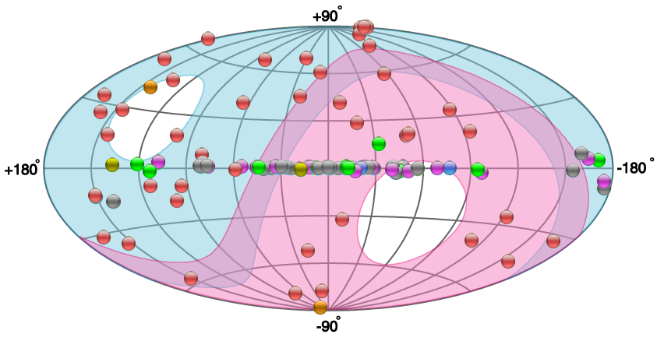
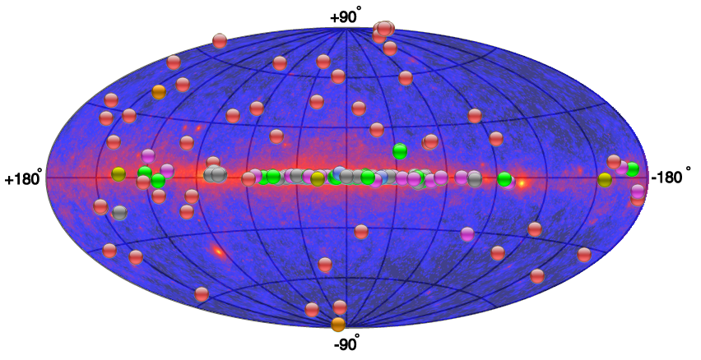
The TeV Sky
From: TeVCat http://tevcat.uchicago.edu/
~ 50 extragalactic objects
~ 60 galactic objects

Slide 42
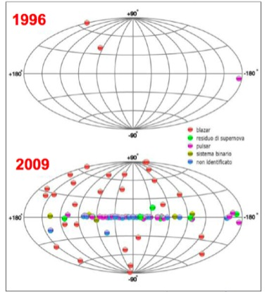
The VHE γ-ray sky: a new field

Slide 43
Blazars SED: beaming effects
  Collimation (sinθ=1/γ)
  Time: Δt_{obs}= Δt_{em}/δ
  Energy: ν_{obs} = δ ν_{em}
  Luminosity: L_{obs} = δ^{p} L_{em}
  Rs < cΔt_{var} / (1+z)
νF_{ν}
Simplified SED
eV keV MeV GeV TeV
log(E)
= Doppler factor, ∼10
p ~ 4

Slide 44
Detection technique

Slide 45
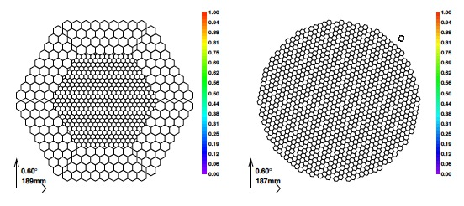
MAGIC Camera
M1: 377 0.1º PMTs, 180 0.2º
M2: 1039 0.1º PMTs
QE ~ 30%

Slide 46
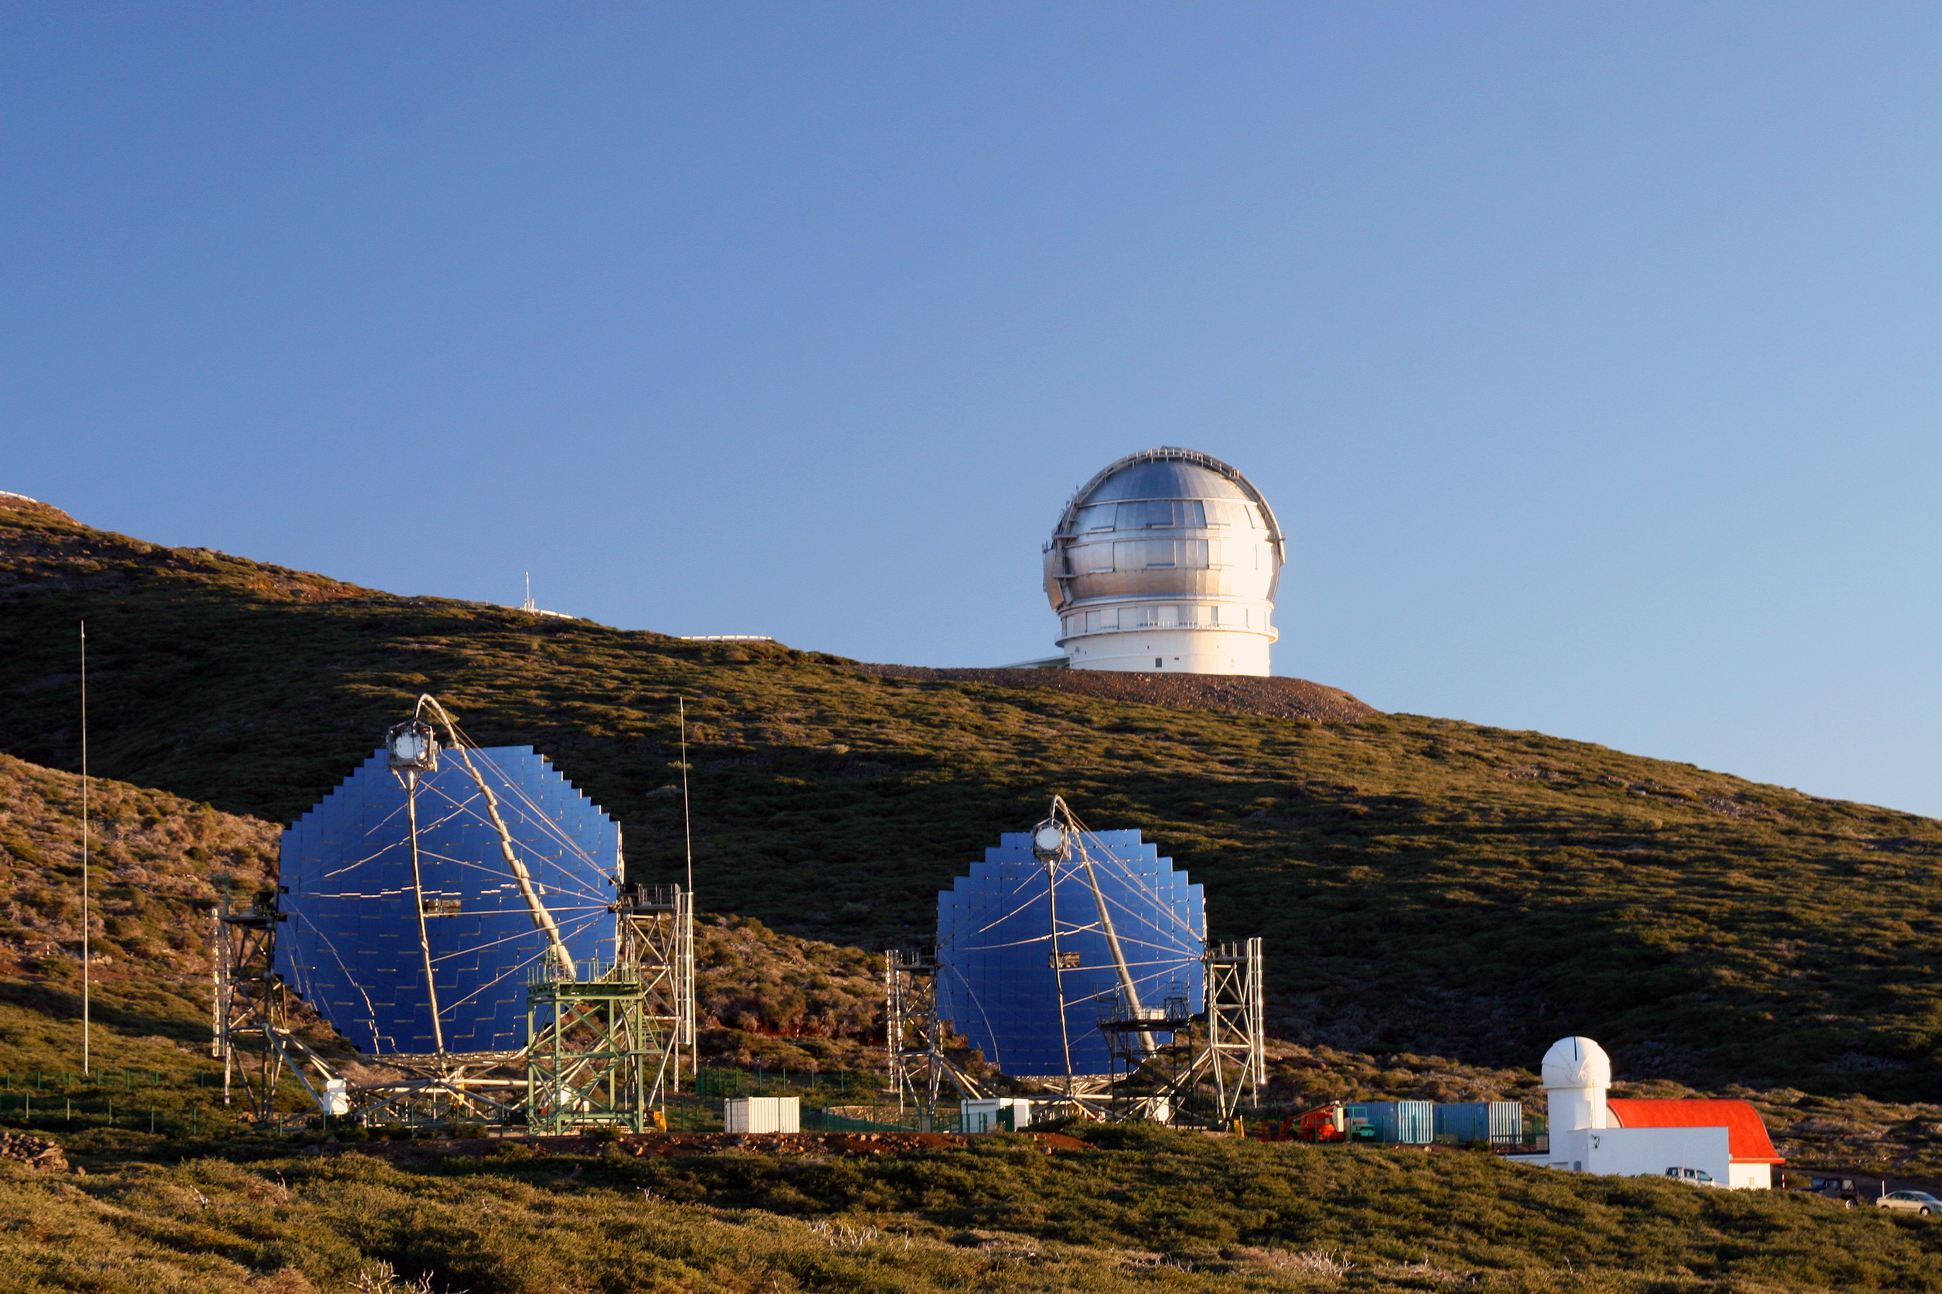
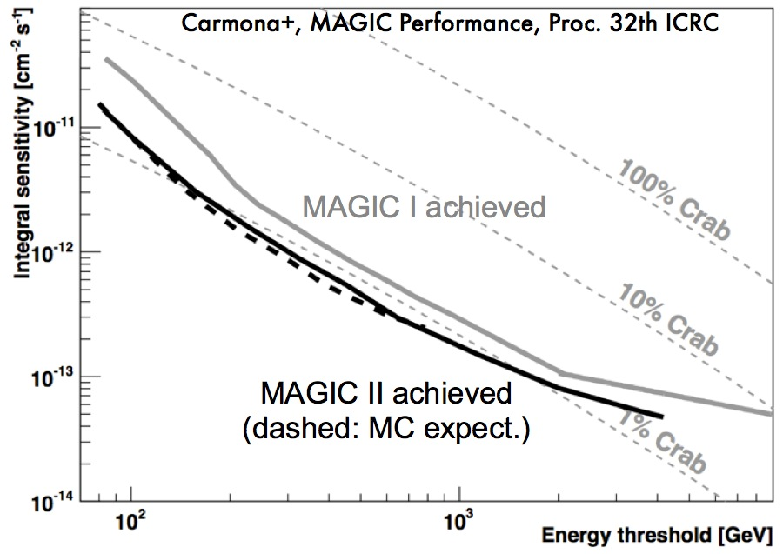
The stereo Improvement (2009)
The Sensitivity:
a factor of two more sensitive above 250 GeV,
up to factor 3 at 100 GeV
required observation time for detection greatly reduced!

Slide 47
MAGIC Trigger
Multi-level:
  L0: threshold
  L1: temporal and spatial coincidence (topology)
  L2: topological constraints to the images (flag mode)
  L3: stereo coincidence

Slide 48
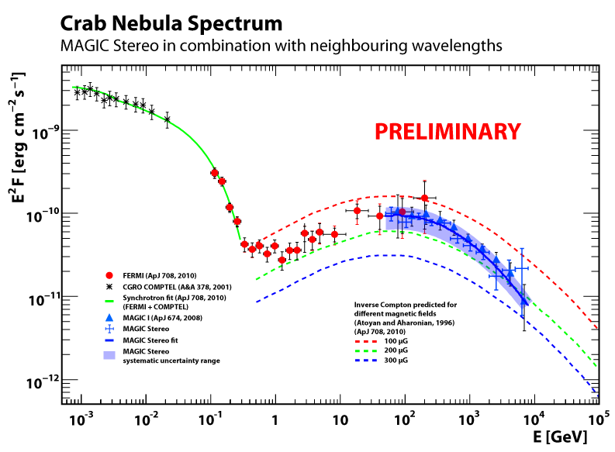
Our standard candle: the Crab Nebula
3.2 hours of Crab Nebula data
stereoscopic system
November 2009
Complete coverage!
preliminary

Slide 49
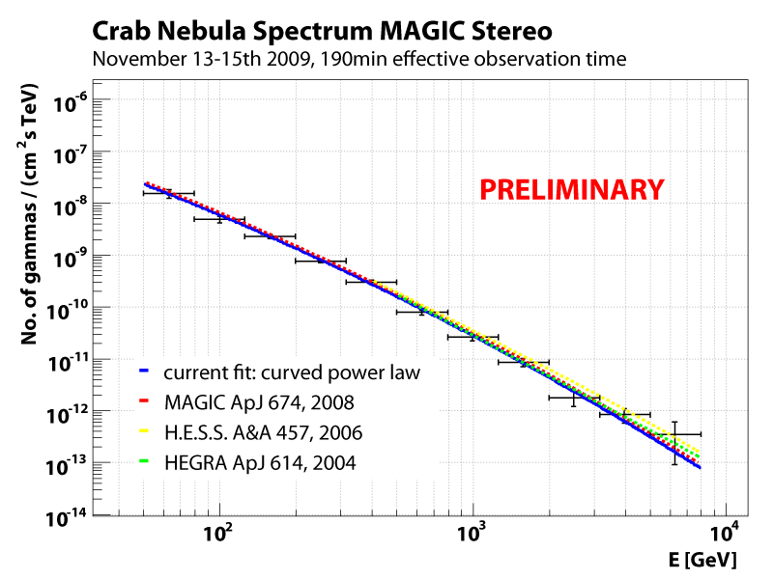
Our standard candle: the Crab Nebula
3.2 hours of Crab Nebula data
stereoscopic system
November 2009
Low energy!

Slide 50
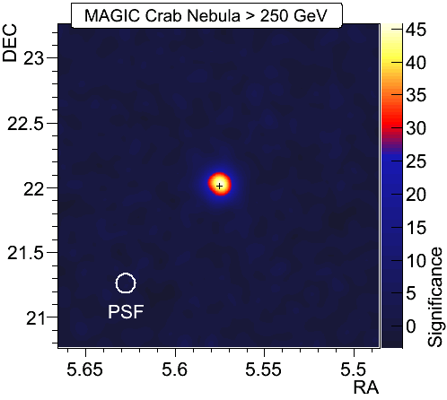
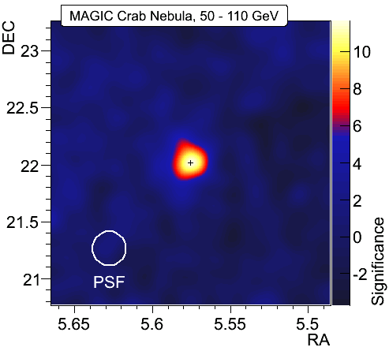
Our standard candle: the Crab Nebula
Low energy range
→ overlap with Fermi!

Slide 51
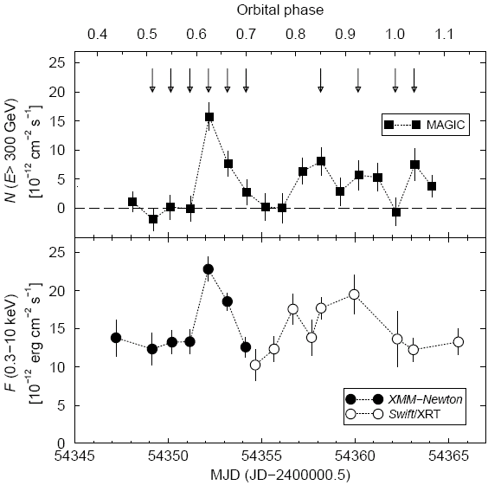
VHE γ-ray emission from Binary Systems
    LSI +61 303
Discovered by MAGIC in 2006
Correlation between X and VHE γ emission
  Suggests leptonic processes are at work.
MAGIC Coll.
ApJ Lett 706 (2009) 27

Slide 52

VHE γ-ray emission from Binary Systems
    LSI +61 303
Discovered by MAGIC in 2006
Correlation between X and VHE γ emission
  Suggests leptonic processes are at work.
    Cyg X-3
Large MWL efforts!
MAGIC measured upper limits
MAGIC Coll.
ApJ 721 (2010) 843
MAGIC Coll.
ApJ Lett 706 (2009) 27

Slide 53


HESS J0632+057
Discovered by H.E.S.S
variable (non detection by VERITAS)
Possible binary system (compatible with VHE and X-ray sources)
January & February 2011:
Increased X-ray activity (Swift-XRT Atel) from Jan 23th 2011 on till at least Feb 6th
ToO observations:
  VERITAS (Atel #3153): 7&8 February Flux 4% Crab > 400 GeV
  MAGIC (Atel #3161): 7-9 February Flux 3.4% Crab > 200 GeV
Magic signal detection

Slide 54


Pulsar Observations: the Crab Nebula
Pulsars: Energy cutoffs at few GeV ➙ very difficult for IACTs
MAGIC is the only Cherenkov telescope that has detected a pulsar:
  Special low-energy “Sum-Trigger” system
  Lower threshold (but higher systematics)
Crab Nebula pulsar phaseogram
(Oct 2007 – Jan 2009)
Determinant to constrain model:
→ discards production mechanisms close to the pulsar surface, where the B-field is too high
Clear signal

Slide 55

Crab: the Pulsar
Models for high energy emission (polar cap, outer gap) predict exponential or superexponential cutoffs in pulsar spectra at a few GeV
In fact that’s what Fermi has been observing for all pulsars at 100 MeV - 10 GeV
Question is: can we see pulsed gammas from the Crab beyond the expected cutoffs?

Slide 56


Crab pulsar: previous results
ApJ 674, 2008
Back in Oct. – Dec. 2005 with std. trigger (>60 GeV): 2.9σ excess in P2.
Oct. 2007 – Feb 2008 with “sum trigger” (> 25 GeV): 6.4σ excess in P1+P2!
Science 322, 2008

Slide 57



New:
Mono observations 2007-09
MAGIC, ApJ, 742, 43 (2011)
From Oct. 2007 to Feb. 2009, 59 hours
Sum Trigger, E >25 GeV
Time-averaged spectra
6.7 σ
3.0 σ
5.8 σ
Inconsistent with the extrapolation of the exponential cutoff (>5 σ).
Spectra between 25 GeV and 100 GeV show a power law.

Slide 58



HOT NEWS: after 73 more hours of stereo data
MAGIC, submitted to A&A (2012)
Sum of Both Peaks
First Peak
Second Peak
Nebula
Time-averaged spectra
Mono
LAT
Stereo
Preliminary
Preliminary
VERITAS
Stereo data provides precise spectra up to 400 GeV
No gap between Fermi and MAGIC
We can even produce spectra for both peaks separately
Mono/stereo spectra agree… and go well beyond a cutoff at few GeV!

Slide 59


A Recent Discovery:
IC 310 (Mono & Stereo)
Fermi (10-100 GeV)
Head tail radio galaxy
Observation triggered by Fermi (hard spectra)
Complex FoV
Variable emission (since 2008)
Inner jet emission location favored
E > 400 GeV
MAGIC Coll.,ApJ Lett.
723 (2010) L207-212

Slide 60
A Recent Discovery:
IC 310 (Mono & Stereo)
Fermi (10-100 GeV)
Head tail radio galaxy
Observation triggered by Fermi (hard spectra)
Complex FoV
Variable emission (since 2008)
Inner jet emission location favored
E > 400 GeV
MAGIC discovery (E<400 GeV)!! ATel October 2010
MAGIC Coll.,ApJ Lett.
723 (2010) L207-212

Slide 61

Long term study of
Bright Extragalactic
Sources
Mkn 421, Mkn 501, 1ES 1959+650, 1ES 2344+514, PG 1553+113
Strategies: MWL campaigns, ToOs
ApJ 2012, Vol. 748, 46

Slide 62


γ-γ opacity
Absorption:
dF/dE_{obs}= (dF/dE_{em}) e^{-τ}
EBL Model
Dominguez et al. (2011)
The Energy Threshold plays a key role!

Slide 63
3C 279
MAGIC: E>100 GeV
Discovered in 2006
The farthest VHE object (z=0.54)
6.2σ
2.2σ
MAGIC Coll.,
Science 320 (2008) 1752
Index 4.1+-0.68

Slide 64

Dark Matter Search with MAGIC
γ-rays from DM self-annihilation
Dwarf Galaxies (High mass-to-light ratio)
MAGIC ULs from good candidates:
  Segue I
  Willman I
  Draco
MAGIC Coll, submitted to JCAP
MAGIC Coll, ApJ 697,1299 (2009)
Peresus Cluster
MAGIC-1 only Nov-Dec 2008
MAGIC Coll, ApJ, 679, 428 (2008)
Galaxy clusters (~80% is DM)
Perseus (z = 0.018)
Constraints on emission:
  from Cosmic Rays
  through Dark Matter annihilation
  from NGC 1275 (Now detected at VHE)
MAGIC Coll, ApJ 710 (2010) 634

Slide 65

CR e⁻ + e⁺ spectrum
Borla Tridon et al. arXiv:1110.4008
First result based on only 14h of observations: measured e± spectrum in the energy range between 100 GeV and 3 TeV.
Preliminary results fitted by a power-law with index Γ=−3.16±0.06_{stat}±0.15_{sys}.
Spectrum in good agreement with previous measurements (bump observed by ATIC cannot be excluded or confirmed).
preliminary

