Slide 1
SAND Construction and Installation Schedule – Risk Management
C. Montanari
FNAL – INFN
INFN CSN1 DUNE Review - July 12, 2024

Slide 2
Goals, assumptions and strategy
  The main goal of the schedule is to have the detector fully operational by the time the neutrino beam is turned on.
  The following assumptions come from the official construction schedule of the ND site and the beam facilities.
    Start of ND site beneficial occupancy: End of September 2028.
      The availability of the experimental hall is presently conditioned by the availability of funds for the construction.
    Beam available (checkout): June 2031.
  The assumption is made that SAND will be the first to be installed in the ND hall, before starting the installation of ND-LAr and TMS.
    This choice minimizes risks and costs.
    The occupation of the ND main hall must be minimized (≤ 6 months).

Slide 3
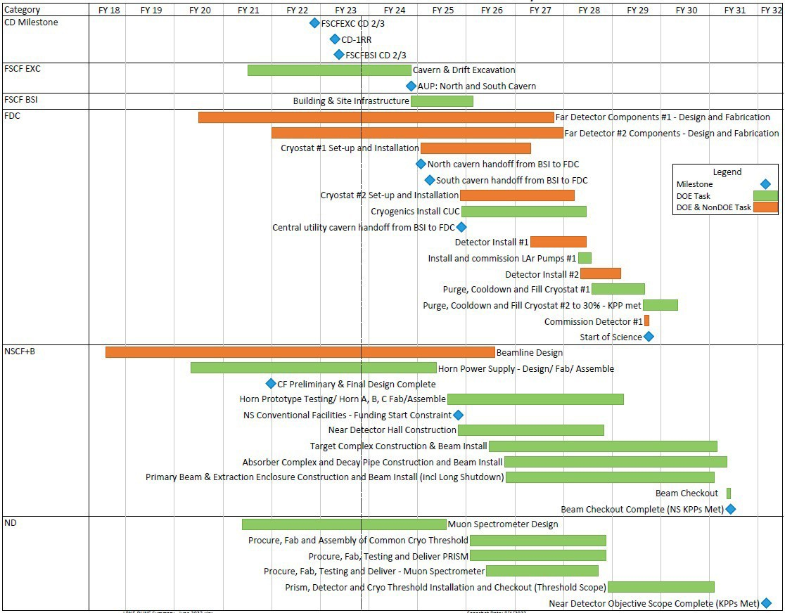




Think to the future, focus on the present
Far Site
Far Site
Notes:
Fiscal Year display
June 2023 reporting cycle
Based on “CD-1RR ESAAB” funding profile
Early completion
dates shown
Near Site
F Update

Slide 4
Goals, assumptions and strategy (cont.)
  The following assumptions come from the present status of SAND:
    Magnet, with Yoke, and ECAL are both available in Frascati.
      Magnet requires some re-certification and replacement/revamping of electrical components.
      ECAL requires some replacement of PMTs, a new HV system and readout electronics.
    The choice of the technical solution for the inner tracker is still to be made.
      Decision will be taken by Spring 2025
      Independently from the chosen solution prototyping and optimization are required.
      Funding situation for the inner tracker has to be clarified.

Slide 5
Goals, assumptions and strategy (cont.)
  The following strategic choices are proposed
    Minimize the work to be done in the shared part of the experimental hall → time limit ≈ 6 months
      Assemble in this area only those parts that cannot be installed in the alcove: Yoke, Magnet, Calorimeter, support structure for the Inner Tracker and GRAIN.
      Ensure that most of installation can be done in the alcove.
      Manage interference with ND-LAr and TMS installation (materials movement and staging).
    Perform an extensive set of tests during the construction and assembly of the detectors (prioritize reliability over schedule).

Slide 6
Proposed timeline for SAND – construction and delivery (I)

Slide 7
Proposed timeline for SAND – construction and delivery(II)

Slide 8
Proposed timeline for SAND – construction and delivery (III)

Slide 9
Proposed timeline for SAND – Installation (I)
ND Hall available for installation

Slide 10
Proposed timeline for SAND – Installation (II)

Slide 11
Proposed timeline for SAND – Installation (III)
SAND Positioned and ready for internal elements installation

Slide 12
Proposed timeline for SAND – Installation (IV)

Slide 13
Proposed timeline for SAND – Installation (V)
Beam checkout

Slide 14
SAND Assembly Sequence in the Main Cavern – 1 – Yoke-I
Alcove
Shaft
Main Cavern

Slide 15
SAND Assembly Sequence in the Main Cavern – 2 – Magnet
Alcove
Shaft
Main Cavern

Slide 16
SAND Assembly Sequence in the Main Cavern – 3 – Yoke-II
Alcove
Shaft
Main Cavern

Slide 17
SAND Assembly Sequence in the Main Cavern – 4 – Platforms
Alcove
Shaft
Main Cavern

Slide 18
SAND Assembly Sequence in the Main Cavern – 5 – End Caps
Alcove
Shaft
Main Cavern

Slide 19
SAND Assembly Sequence in the Main Cavern – 6 – Calorimeter
Alcove
Shaft
Main Cavern

Slide 20
SAND Assembly Sequence in the Main Cavern – 7 – Inner Struct.
Alcove
Shaft
Main Cavern

Slide 21
SAND Assembly Sequence in the Main Cavern – 8 – Close EC
Alcove
Shaft
Main Cavern

Slide 22
SAND Assembly Sequence in the Main Cavern – 10 – Move
Alcove
Shaft
Main Cavern

Slide 23
SAND Assembly Sequence in the Main Cavern – 11 – Open EC
Alcove
Shaft
Main Cavern

Slide 24
Risk Management

Slide 25
Overview
Activities on KLOE components (Yoke, magnet and ECAL) and on GRAIN are progressing with well-defined schedules, budgeting, support and sharing of responsibilities. As an integral part of the engineering design, the involved working groups will produce detailed risk analyses. Each sub-project will undergo a review as part of the approval process of their respective parts of the DUNE-ND TDR. The first of these reviews concerns KLOE-TO-SAND and is going to take place on July 22-23, 2024. GRAIN design review is planned for the first months of 2025. A preliminary risk analysis of the magnet transport was used to define the post-delivery testing procedures at Fermilab.
Also, activities on slow controls, DAQ, timing and computing are well-covered within the general framework of Fermilab infrastructures and DUNE project.
INFN-DOE MoU covers most of SAND-related activities. DOE specific responsibilities, carried by Fermilab, include engineering support for inspection, assessment and approval of equipment at Fermilab as well as technical coordination, onsite logistics and support for onsite integration and installation.
A relevant sub-component, presently not part of INFN and DOE deliverables is the inner tracker, for which INFN provides a given financial support to cover risks and limited contributions.

Slide 26
About SAND’s Straw Tubes Tracker
In September 2021, after a dedicated review process, a solution based on straw tube arrays interleaved with thin targets (STT) was selected as SAND inner tracker against a solution primarily based on a massive, high-granularity and density scintillator (3DST). The main driver of this choice was the much wider physics program associated with the STT option, the much better integration with KLOE magnet and ECAL performances and, most importantly, the ability to isolate a statistically relevant sample of neutrino-proton interactions, by making use of a combination of pure carbon (graphite) and polyethylene (C₂H₄) targets.
Several groups have expressed the intention to participate to the STT construction, some infrastructures have been identified and readied for straws production, and one infrastructure has been identified for the module's assembly, although it requires funding and work to be readied. Two other infrastructures for the assembly are being considered, their availability is to be verified. At least 3 infrastructures, equipped with appropriate tooling, are required.
Until now, most of the groups that declared intention to contribute have found little or no support from their respective funding agencies. Their continuing efforts in support of the activity, is recognized and highly valued. Requests for construction funding have been submitted to some agencies; no funding has been awarded, except the one from INFN, that has supported a significant part of the design and prototyping and is bound to the presence of funding from other sources to support the majority (at least 75%) of construction and assembly.
There is a significant uncertainty on the total amount of resources needed to build the STT in due time to satisfy the experiment goals. This adds to the uncertainty on the time still required to arrive to an engineering design appropriately dealing with the relevant technical risks.

Slide 27
Risk Management of SAND’s Inner Tracker
Given the large uncertainties associated with STT design and construction, SAND management, several months ago, started to explore alternative solutions that would retain the core STT capabilities for physics, but with a much simpler, cost/time-effective and manageable design.
The alternative solution being explored is based on multi-wire drift chambers (DCH) interleaved with thin targets of the same thickness and materials as those foreseen for the STT. Preliminary evaluations indicate that such solution would offer similar performance as the STT with a significantly reduced complexity and much lower number of readout channels (15% to 25% wrt STT).
A single assembly site would be needed for the drift chambers and the possibility to have it at Fermilab is presently being explored:
  The risks associated with transport will be eliminated;
  The risks associated with multiple construction sites will be eliminated;
  An assembly site at Fermilab would facilitate contributions from US-based groups.
A small DCH prototype (≈ 30 x 30 cm²) has been built at INFN-Bologna. A larger prototype is being constructed (80 x 120 cm²) to be exposed to test beams for performance measurements and comparisons with the STT.
At the last DUNE Collaboration meeting, the Inner Tracker Working Group was asked to prepare a detailed risk analysis of the two solutions that would inform a formal review and selection process to be conducted between the end of 2024 and the beginning of 2025.

Slide 28
Backup

Slide 29
Preliminary Risk Analysis of SAND’s Trackers
C. Montanari
FNAL – INFN Pavia
DUNE Collaboration Meeting, Restricted session on SAND’s Trackers – May 23, 2024

Slide 30
Foreword
  What follows is e very preliminary risk analysis of the two solutions presently under study for SAND’s inner tracker: the Straw Tubes Tracker (STT) and the Drift CHambers (DCH).
  This analysis is not intended to be by any means exhaustive (this is part of the Design and Prototyping phase), but rather to capture some major risks related to each solution. Given the preliminary nature of this analysis and the incomplete design status, the risk assessment is based on arbitrary, although somewhat reasonable, assumptions. Therefore, no conclusion can be driven, but a precise assessment of these risks and the related mitigation strategy are deemed as mandatory for a correct evaluation of each solution.
  The realization of each detector can be divided in four phases, flowing one into the next one:
    Design and prototyping;
    Materials procurement and construction;
    Installation and commissioning;
    Operation.

Slide 31
Risk analysis matrix
A standard risk matrix is being used.
The risk impact is defined in terms of detector functionality as follows:
Very low: < 1% loss of detector functionality
Low: 1% ÷ 10% loss of detector functionality
Medium: 10% ÷ 25% loss of detector functionality
High: > 25% loss of detector functionality
Risk probability is necessarily contextual and, in some cases, qualitative.
Impact of delays is evaluated in terms of detector loss of functionality assuming readiness for day 0.
Time constraints:
Building beneficial occupancy: mid 2028
Inner tracker installation window: early 2029 to half 2030
Detector commissioning start: second half 2030
Risk Probability | Risk Impact
 | Very Low | Low | Medium | High
Very High | Moderate | Major | Critical | Critical
High | Minor | Moderate | Major | Critical
Medium | Minor | Moderate | Major | Critical
Low | Minor | Minor | Moderate | Major
Very Low | Minor | Minor | Minor | Moderate

Slide 32
Design and prototyping phase
  The main risk associated with this phase is the time needed to arrive to a final engineering design, supported by adequate prototyping and testing.
  The final design, in addition to drawings, assembly, handling and transport procedures, should include:
    detailed production, assembly and installation schedules (including transport to Fermilab);
    detailed risk analysis, with associated risk mitigation strategies, and a description of QA/QC processes;
    an assessment of the required resources in terms of capital investment, infrastructures, manpower and the necessary contingencies, also accounting for the results of the above risk analysis.
  Both STT and Drift Chambers are presently in this phase. Although the STT is far more advanced, being in the process of design, prototyping and optimization since more than 2.5 years, it is not yet clear when a final design will be available, in view of the complexity of the project. The design of the Drift Chambers is very preliminary and, also in this case, time for completion cannot be estimated, even though the project is expected to be much simpler the one of STT.
  For both designs, finalization of requirements for the front-end electronics is on the critical path, considering development costs, possible long lead times and the necessity to have it installed before testing of the detector modules could take place.
  The deadline for completion of engineering design is estimated to be early 2025 for the STT (4 years for construction) and early 2026 for the Drift Chamber (2 years for construction).

Slide 33
Materials procurement and construction phase
  Preliminary to this phase is resource finding, securing and allocation in accordance with the estimates of the final design. Resources consist in funding, infrastructures and manpower.
    This step may take a significant amount of time, especially for funding, that requires a precisely defined budget, some iteration with funding agencies, approvals and allocation withing their larger budgets.
  For the STT, several groups have expressed the intention to participate to the construction, some infrastructures have been identified and readied for straws production, and one infrastructure has been identified for the modules production, although it requires funding and work to be readied. Two other infrastructures for the assembly are being considered, their availability is to be verified. At least 3 infrastructures, equipped with appropriate tooling, are required. Until now, most of the groups that declared intention to contribute have found little or no support from their respective funding agencies. Their continuing efforts in support of the activity, is recognized and highly valued. Requests for construction funding have been submitted to some agencies; no funding has been awarded, until now, except the one from INFN, that has supported a significant part of the design and prototyping and is bound to the presence of funding from other sources to support the majority (at least 75%) of construction and assembly.
  For the Drift Chambers, the activity is presently carried on by two INFN groups. By previous experience, one infrastructure, with a clean room of adequate size, is sufficient to build the chambers. Additional manpower is required for construction and assembly. Until now, no funding for construction has been requested.
  At this stage, it seems unlikely that either the STT and the Drift Chamber projects will be in the condition to secure a significant amount of construction funding before the second half of 2025.

Slide 34
Materials procurement and construction phase (cont.)
  Materials procurement is subject to a lead time due to administrative procedures that can take from few to several months, in some cases up to one year, depending on the value and complexity of the contract. Considering the two projects, the risk that some contracts require more than one administrative cycle (due to insufficient budget, unavailability of suppliers, unavailability/shortage of materials and consequent redesign) can be considered low or moderate. STT has already performed a survey for possible suppliers while Drift Chamber project relies on commonly available materials. A particular case is represented by the front-end electronics, that requires at least two orders (pre-production and production).
  Materials procurement requires dedicated QA/QC processes to minimize the risk of materials non-conformities, materials rejection, if detected, with consequent loss of time and, potentially, of money or, if not detected, construction of defective components.
  Before starting modules production, all necessary tools need to be procured, assembled commissioned and thoroughly tested. The minimum lead time between the start of procurement and the start of assembly of the modules is, for both projects ≈ 1 year. Due to the higher complexity and the required larger number of specialized tools the risk of a significantly longer time (18 months) for the STT project is moderate, while the impact is medium (20% loss of construction time).

Slide 35
Materials procurement and construction phase (cont. 1)
  For the STT, the highest impact risk is represented by the possibility of opening of a straw during commissioning or operation (e.g. due to weld failure, breaking of the mylar due to undetected damage or nonconformity, aging, …). In the present design, a failure probability significantly larger than 10⁻⁶ would result in the non operability of one to several views in more modules. Precise assessment of the straws failure rate at production, definition of QA/QC processes to certify the required reliability, and definition of handling procedures as well as environmental conditions for long term storage and operation, are fundamental requirements.
  Considering that several construction sites are involved, a high degree of coordination is required for the production of STT modules, with referent people moving from one site to the other to ensure personnel training, production uniformity, problems identification and solving, propagation of information, etc..
  For the Drift Chambers, highest impact risks are breaking of wires and high voltage discharges (due to dust or surface imperfections), both potentially compromising functionality of large fractions of the chambers. Wiring control, accurate design and test of the HV distribution and cleanliness are fundamental requirements.
  For the STT breaking of wires will most like result in shorts to ground, potentially compromising readout on several other channels, also, continuous discharges may damage the straw. Similar electromagnetic disturbances would happen in case of discharges, especially if occurring on the pins. Careful design and test of the HV distribution in also in this case a fundamental requirement as well as timely identification and removal/replacement of potentially broken wires.

Slide 36
Installation and commissioning
  For both the STT and Drift Chambers the highest impact risks come from handling and, especially, from transport. Significant damage probability for special (expensive) transport range from 1% to 2%, and even higher, if multiple carriers are involved. The analysis required to reduce both the impact and the probability of such risks is rater articulate, although standard; air transport w.r.t. water and ground is usually safer. Ultimately, minimization of movements is the most effective approach.
  Risks related to commissioning are usually considered from minor to moderate, if an appropriate risk analysis is performed with definition of appropriate procedures and reactions to non functionalities or unexpected behaviors are thoroughly thought, discussed and planned. For both projects highest impact risks are related to the activation of the gas system (risk of contamination or over pressurization) and of the HV system.

Slide 37
Operation
  During operation, the highest impact risks come from failures, causing loss of beam time and, possible damage of components (HV, gas system). These risks have to be dealt with at the design phase, by implementing appropriate redundancies and QA/QC processes.
  Ageing of the straw’s material is a concern for the STT, requiring precise definition and control of environmental conditions (temperature and humidity).

Slide 38
Summary tables
STT
Drift Chambers
Event | Prob | Impact | Risk
Late engineering | Low | Medium | Moderate
F/E Electronics definition | Low | Medium | Moderate
No or late funding |  | High | Critical
Late procurement |  | Medium | Mod/Maj
Logistic | Medium | Medium | Major
Straw Failure | ? | Medium | ?
HV Failure (mitigated) | Low | Low | Minor
Transport (mitigated) | Low | Medium | Moderate
Aging | ? | Medium | ?
Event | Prob | Impact | Risk
Late engineering | Low | Low | Minor
F/E Electronics definition | Low | Medium | Moderate
No or late funding |  | High | Critical
Late procurement |  | Low | Moderate
Logistic | Low | Medium | Moderate
Wires failure | Low | Medium | Moderate
HV Failure (mitigated) | Low | Low | Minor
Transport (mitigated) | Low | Medium | Moderate
Note that, in these tables, the columns of risk mitigation and mitigated risk are not present.

