Slide 1
STT prototype construction and assembly
Fabrizio Raffaelli
INFN Pisa
SAND CSN1 review
Frascati, July 12, 2024

Slide 2
Outline
Prototypes construction
Future design validation
Summary
<numero>

Slide 3
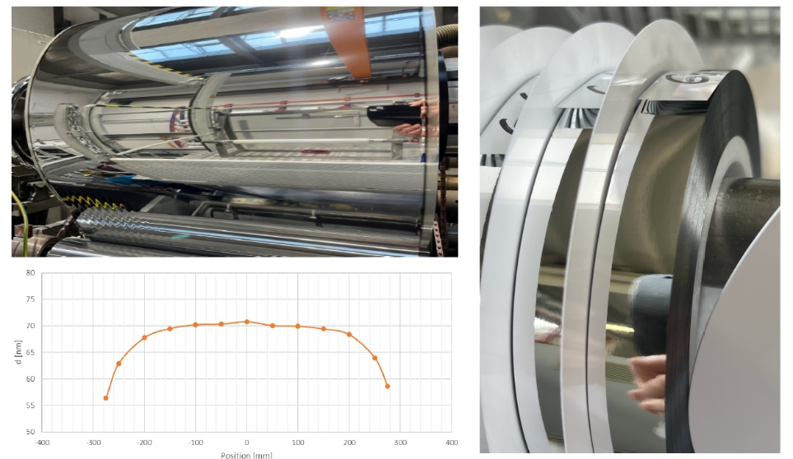
Components of straw tube tracker: the film
Straw tubes are made of a film of 19 μm with double side Aluminum of 70 nm.
Hostaphan® RNK is an highly transparent, biaxially oriented coextruded film made of polyethylene terephthalate (PET)).
The double side Aluminum metalization improves straw tightness.
The double side Aluminum metalization improves straw tightness.
<numero>

Slide 4
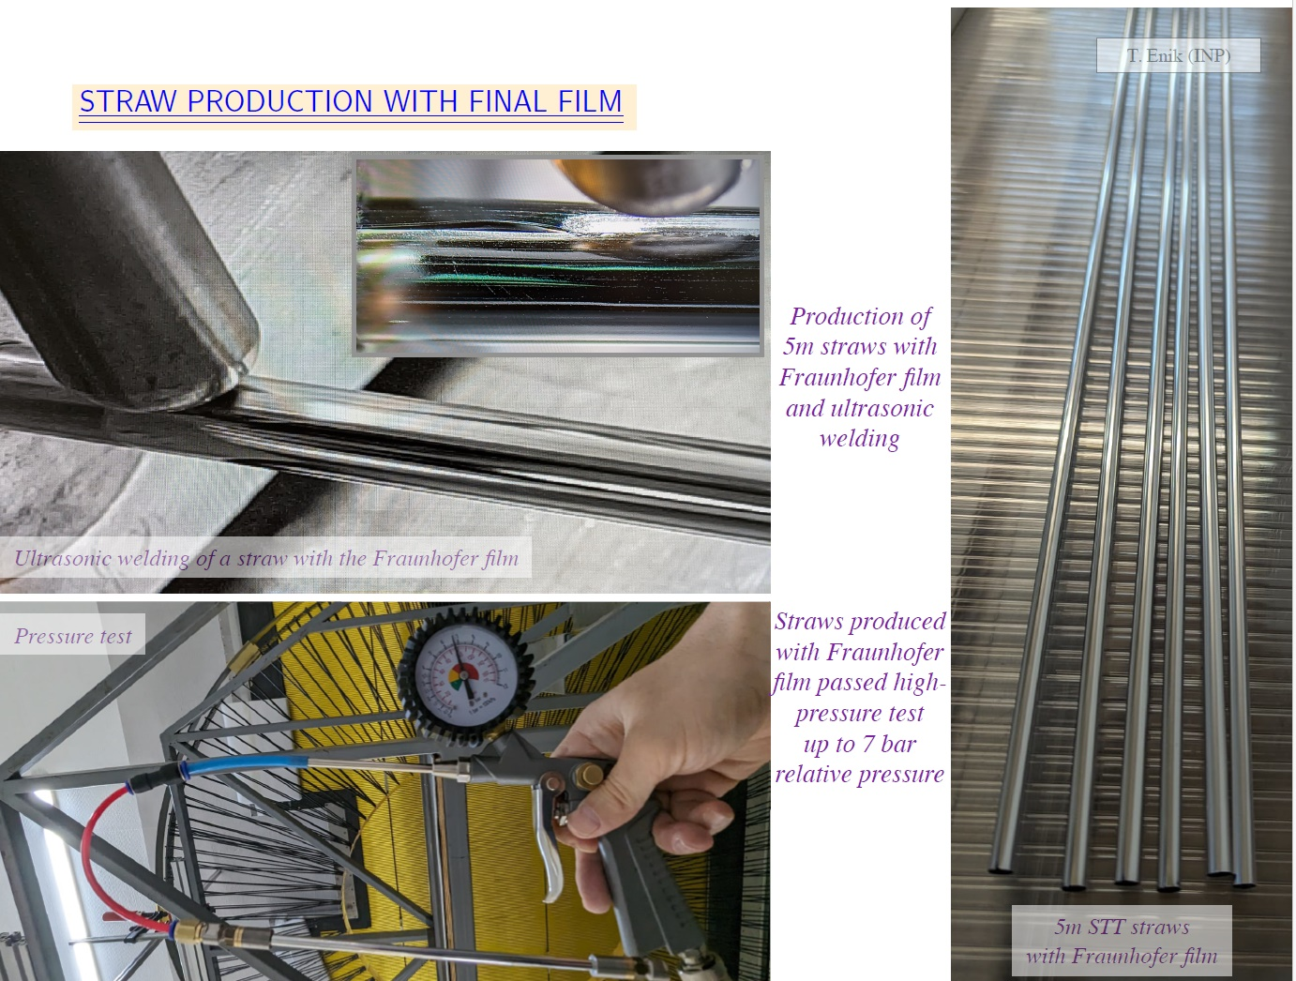
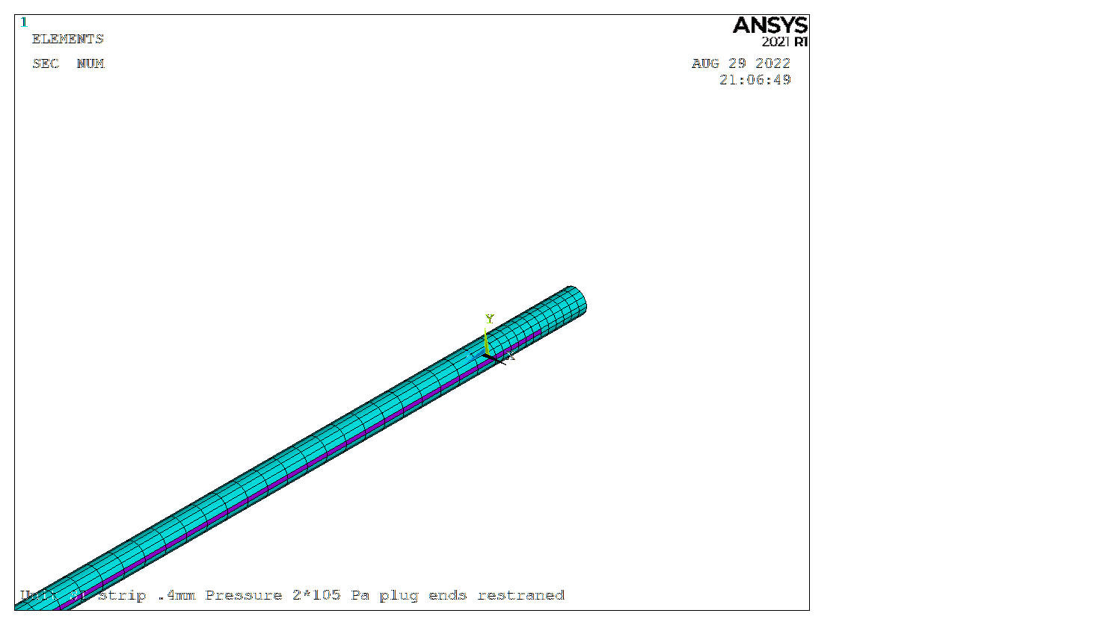
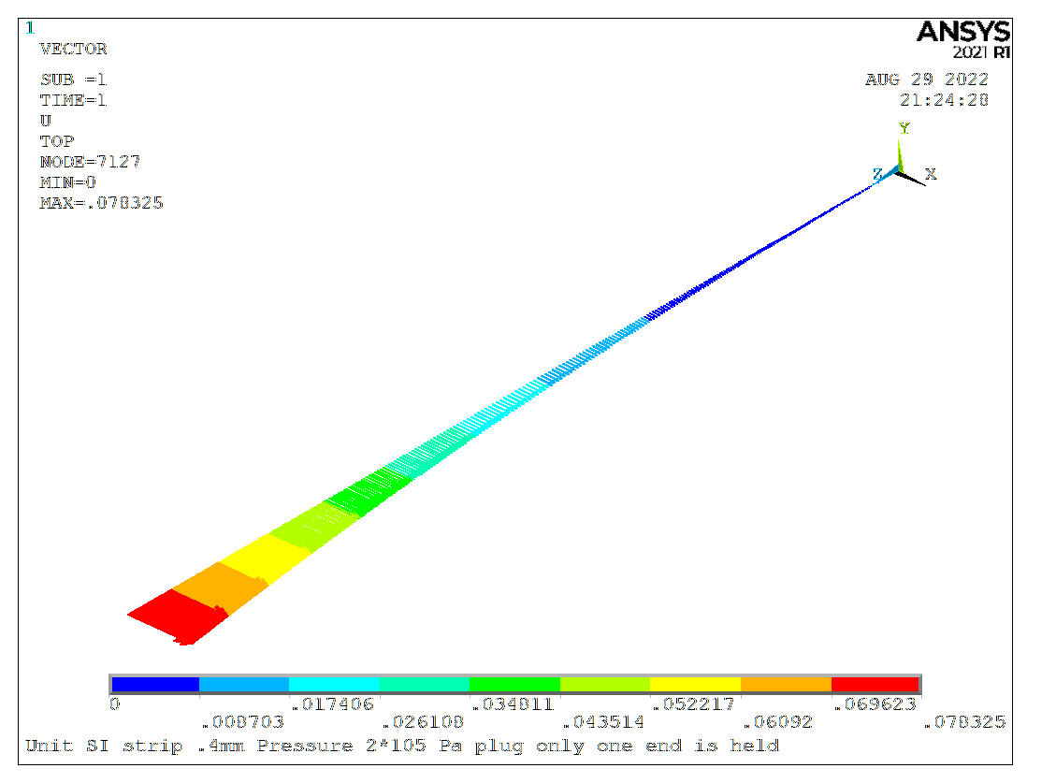
Components of straw tube tracker: the tubes.
Welded seam
Straw tubes with 5 mm diameter are built from the film using ultrasonic welding.
Visual and overpressure checks are performed to accept the straws.
A detailed mechanical analysis has been performed. Results have been validated by the experimental tests.
<numero>

Slide 5
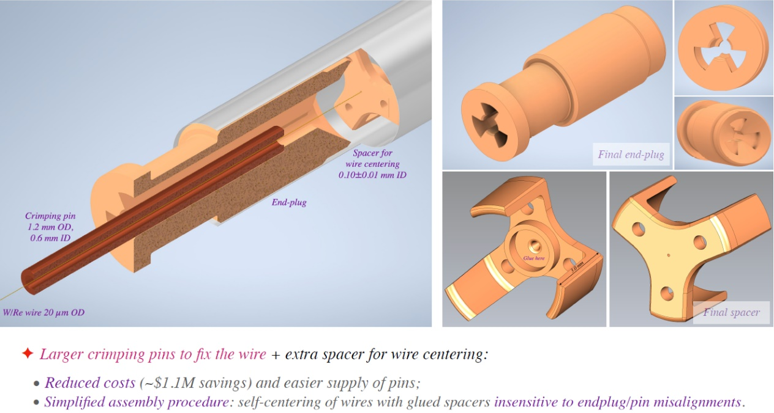
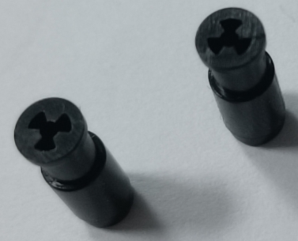
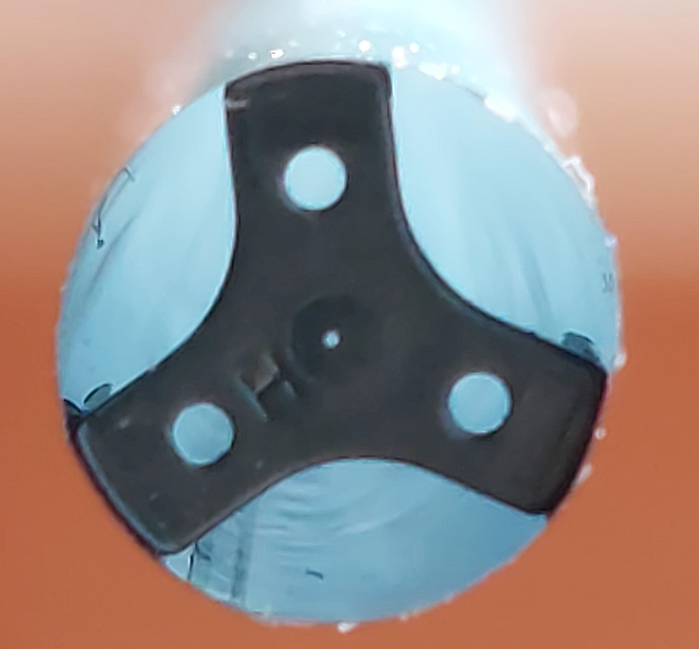
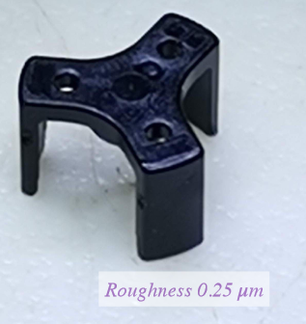
Components of straw tube tracker: wire, spacers and endplugs.
A gold tungsten rhenium of 20 μm is inserted in the straw and stretched using the crimping pins inserted in the end plugs.
The wire is kept in position by some spacers.
100 μm hole
End plugs are glued to the straw tube.
Spacers and end plugs are made in polycarbonate using injection molding ensuring very smooth surface (roughness 0.25 μm) at low cost for a large production.
<numero>

Slide 6
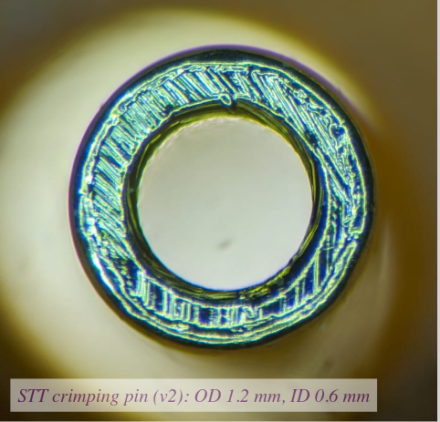
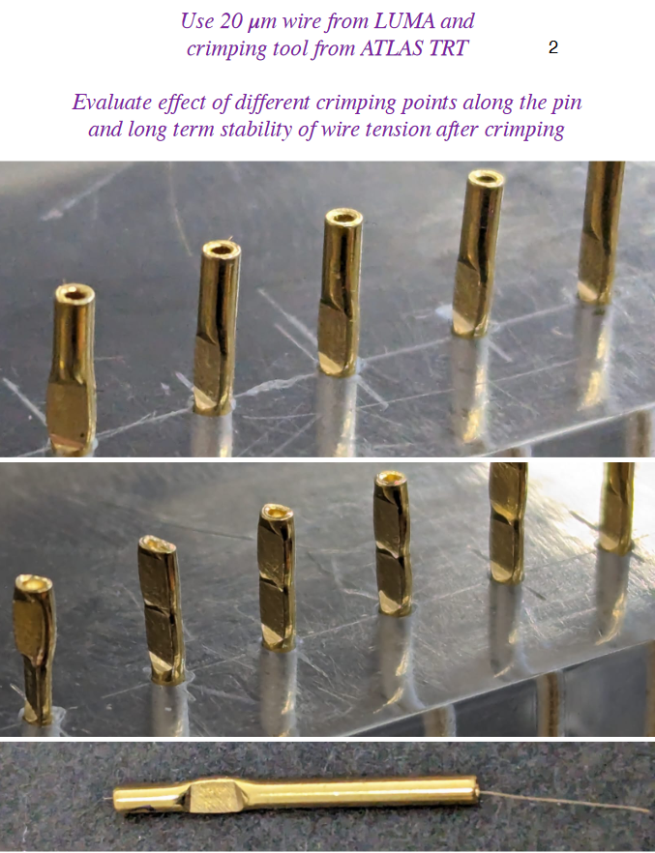
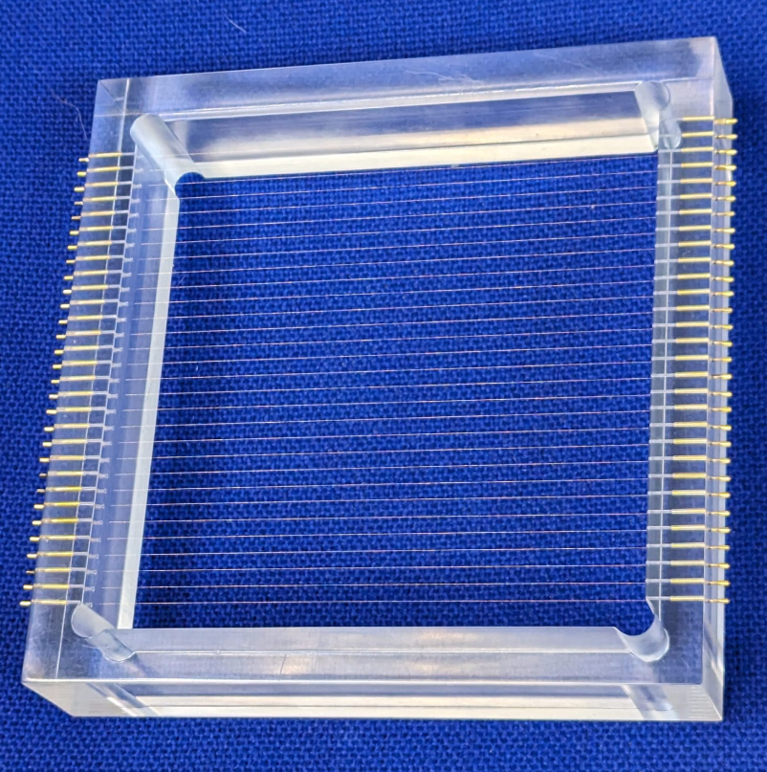
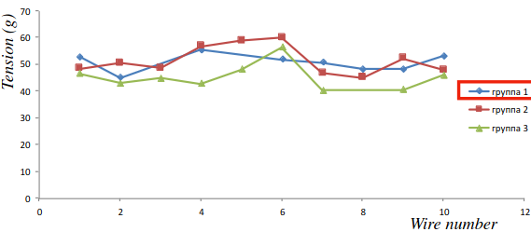
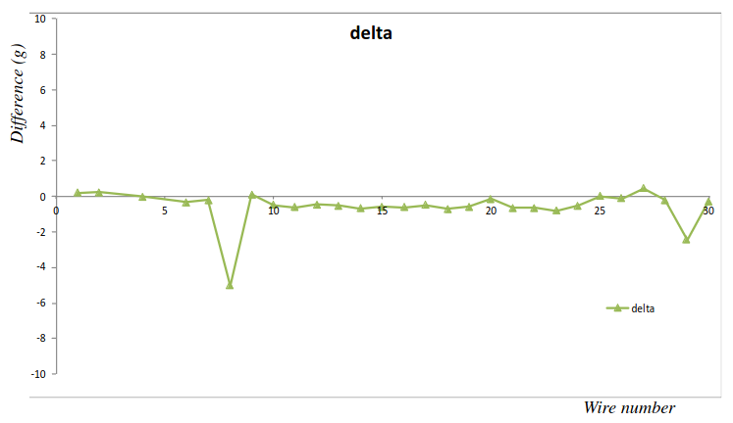
Components of straw tube tracker: crimping pins
The wire is stretched and crimped to the gold plated cooper pins.
Crimping test: variation of nominal tension (50g) after 2 weeks
<numero>

Slide 7
Components of straw tube tracker: supporting structure requirements
The alignment and stability of the straw tube tracker is ensured by a rigid frame where the straws are glued.
Straws will be filled with a mixture of argon/CO₂ (70/30) and operated at 2 bar absolute pressure.
During the assembly straw tubes will be pressurized at 3 bar of absolute pressure to be safely handled and glued to the supporting structure.
The key requirements for this structure are:
Straw alignment accuracy: 100 μm;
withstand a gas pressure of 2 bar with an appropriate safety factor;
gas tightness (better than straws);
No straw compression during construction, handling, and transportation;
ensure minimum required tension on the wires;
Fit in calorimeter inner volume (including the external mechanical structure);
Ensure an average tracker density (without targets) of 0.005 +/- 5% kg/m³
<numero>

Slide 8
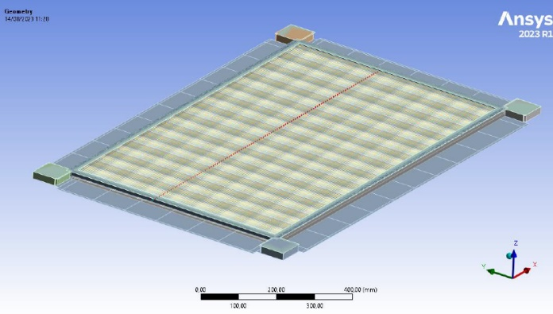
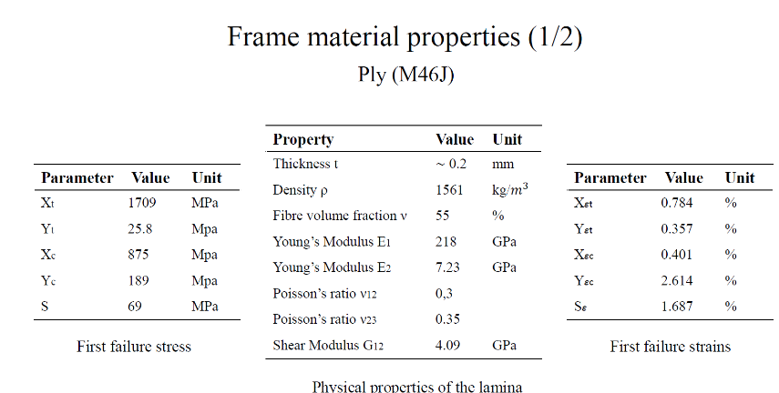
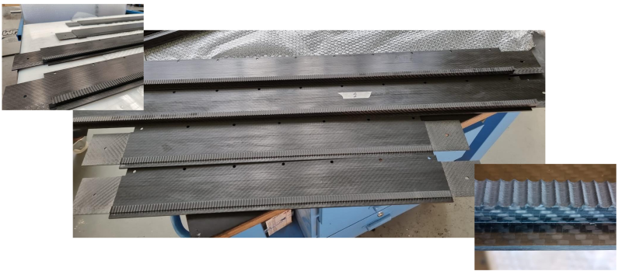
Components of straw tube tracker: carbon fiber frame
Internal beam elements
Pre-stressed
Internal spring elements pre-stressed
The frame structure is made by 18 plies 0/90.
Mechanical simulations and the construction of the first prototype have validated the design
<numero>

Slide 9
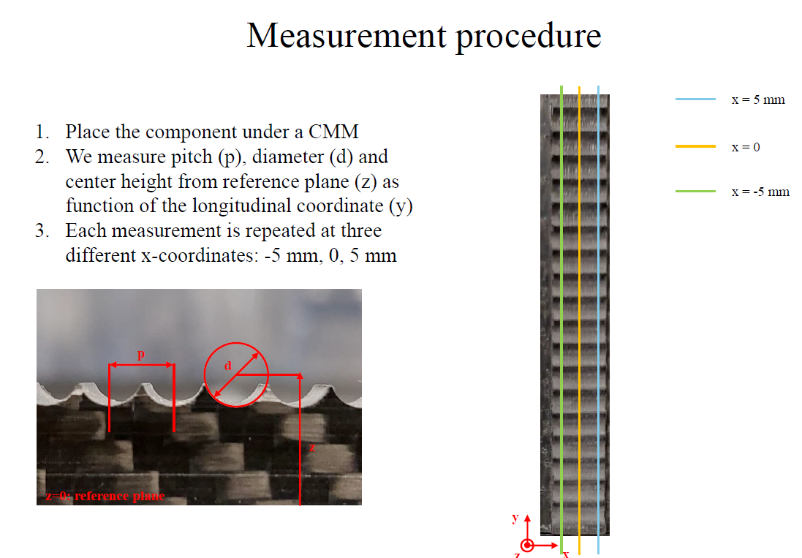
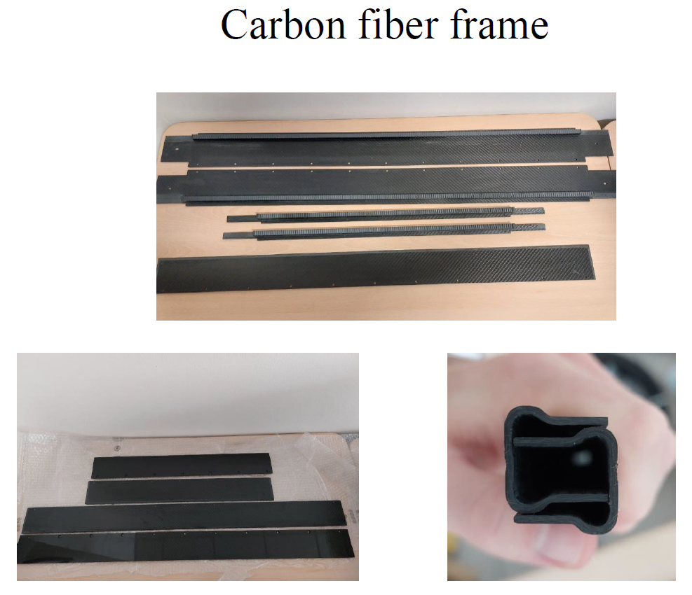
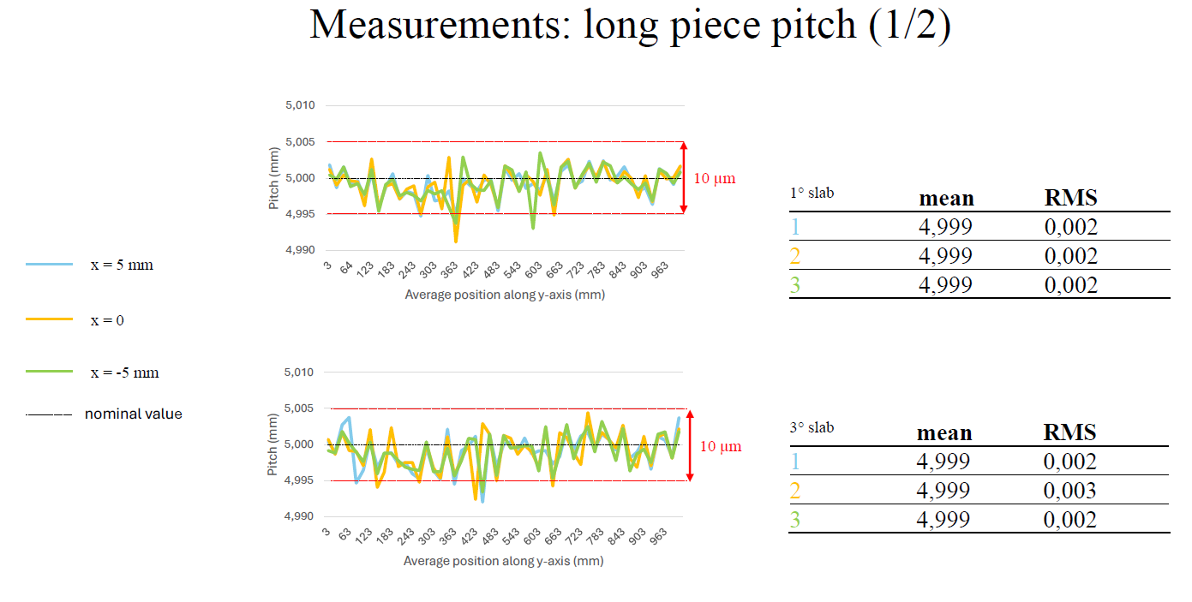
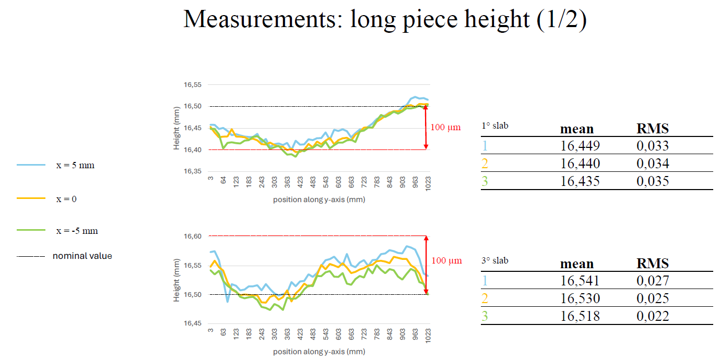
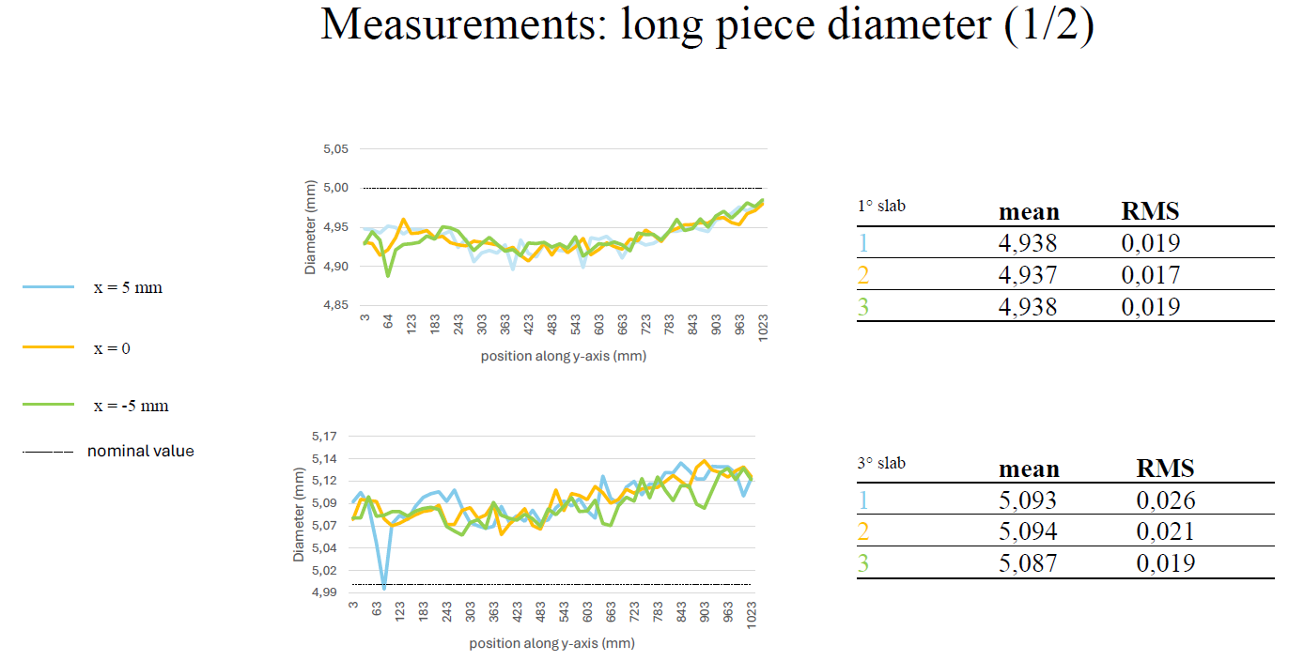
Components of straw tube tracker: carbon fiber frame characterization
RMS measurement results:
- pitch: < CMM resolution
- diameter: 20 μm
- height: 30μm
<numero>

Slide 10
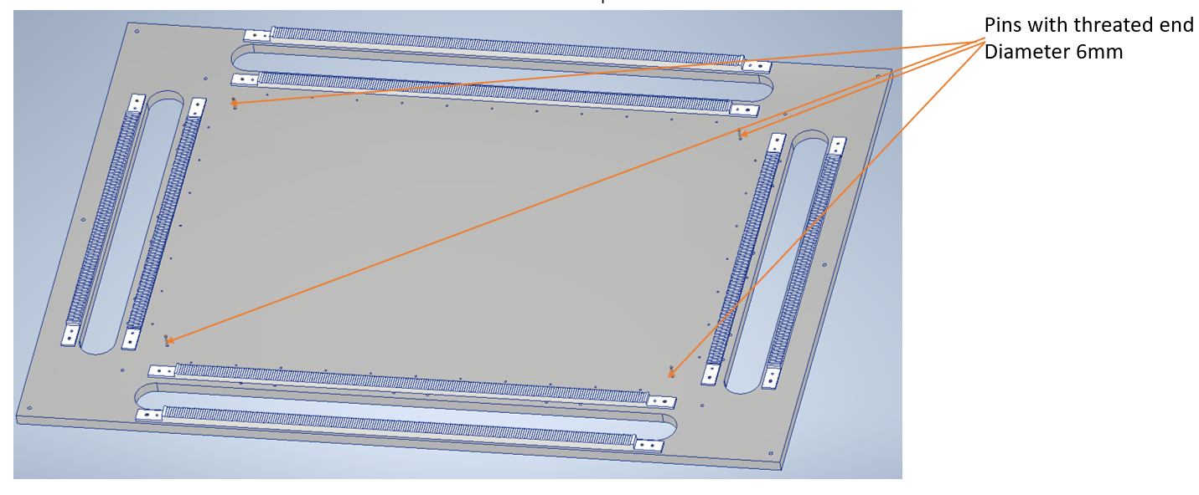
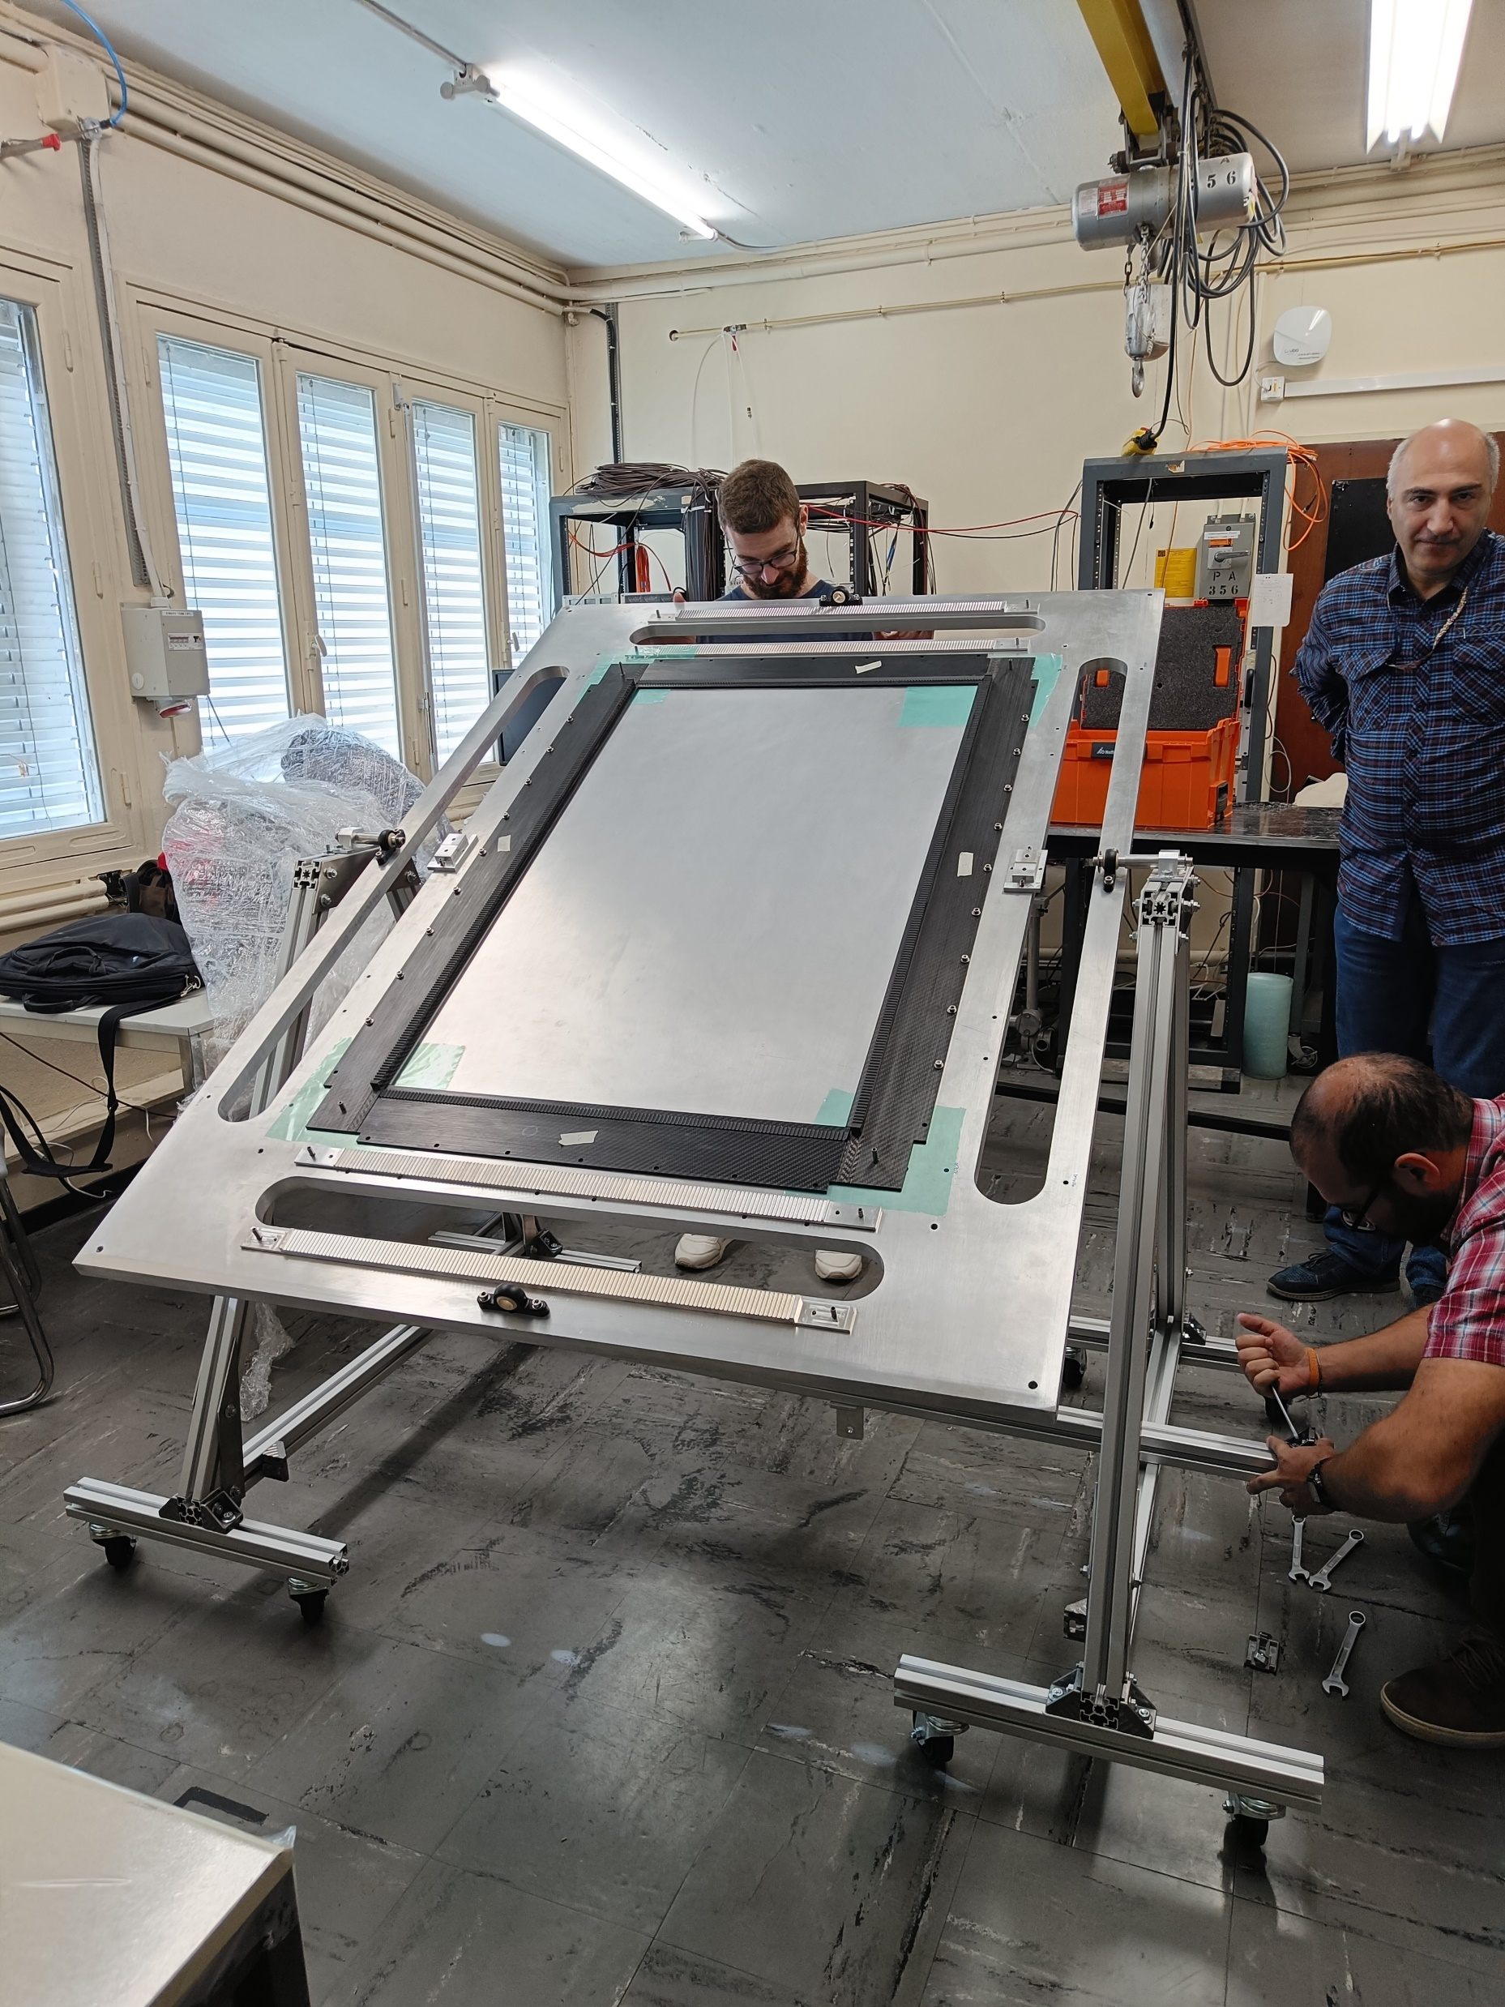
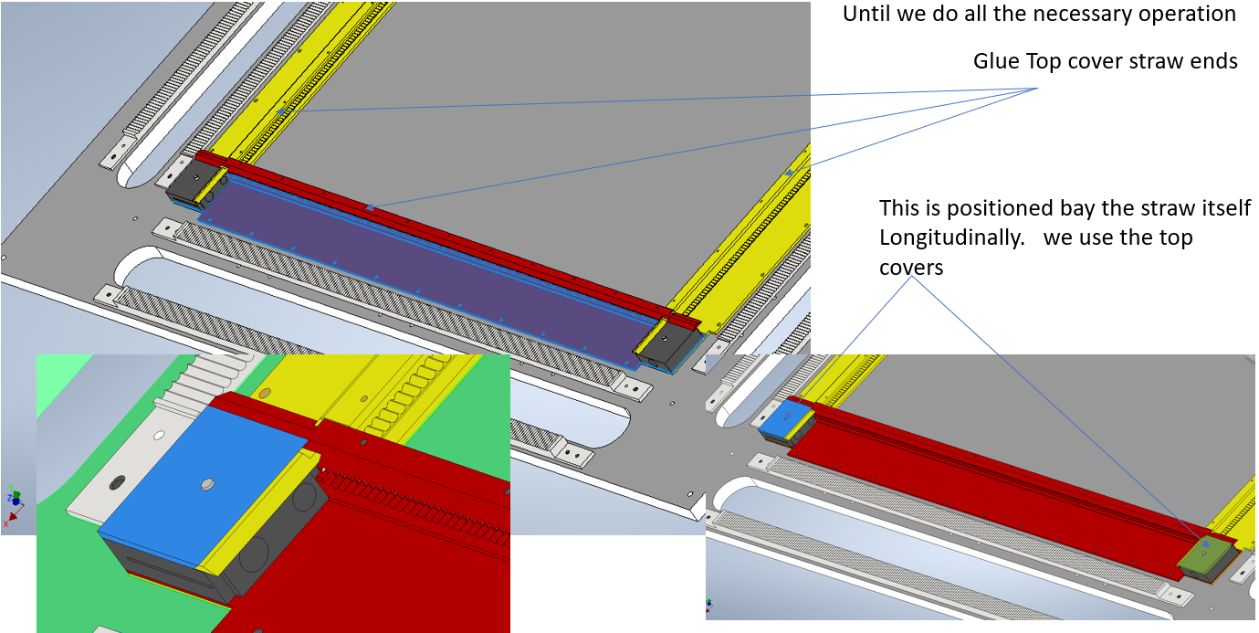
Components of straw tube tracker: the mounting table
A mounting table has been used to accurately align the carbon fiber frame parts and the straws for the construction of the 120x80 cm prototypes.
Supporting
Saddles
The table can be easily moved, together with the straw module, thanks to an ad-hoc rotating supporting structure
<numero>

Slide 11
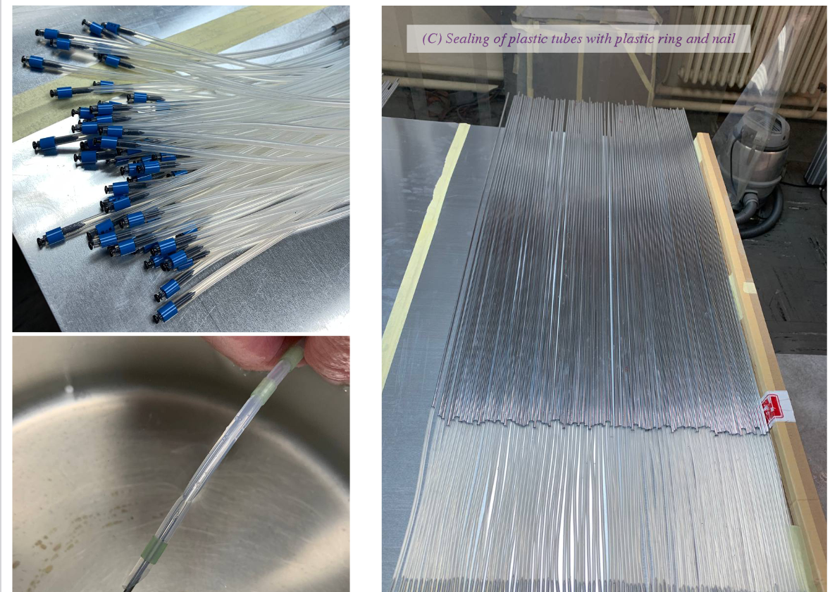
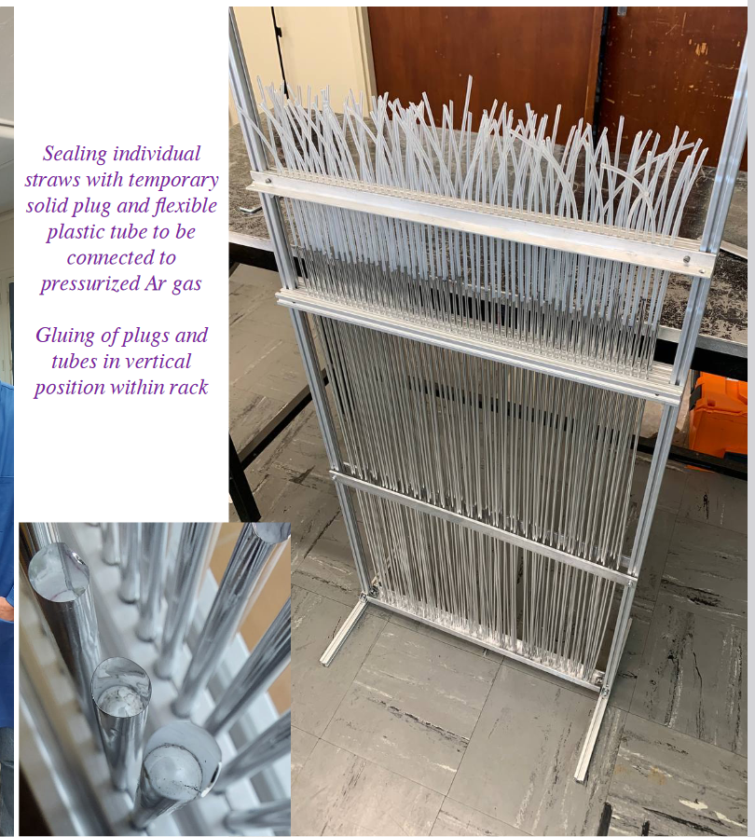
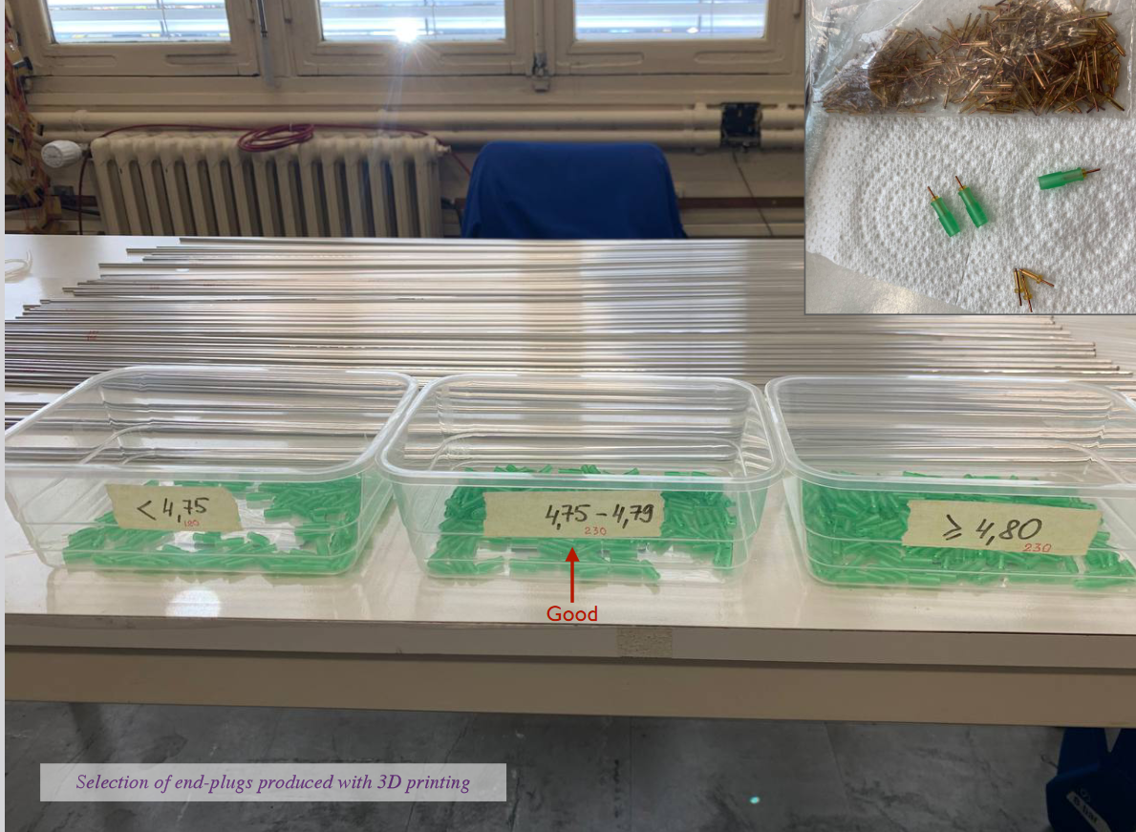
80x120 cm Cern prototype: straw tube preparation
<numero>

Slide 12
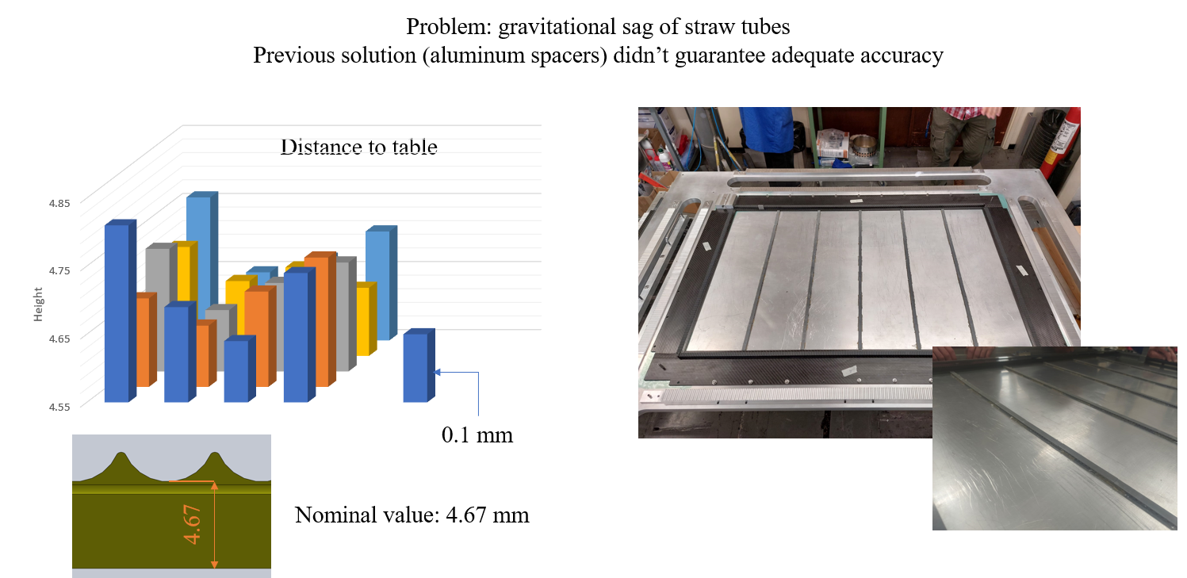
80x120 cm Cern prototype: planarity checks and fixes
<numero>

Slide 13
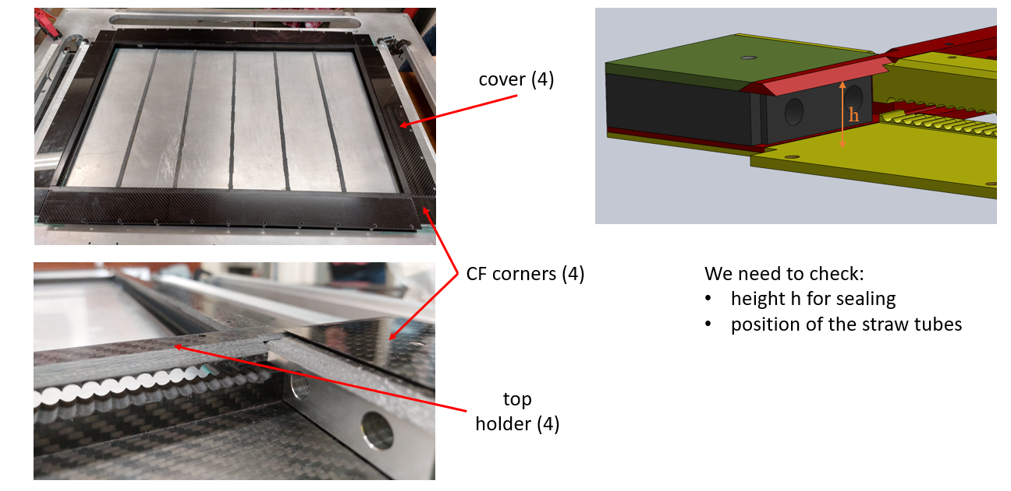
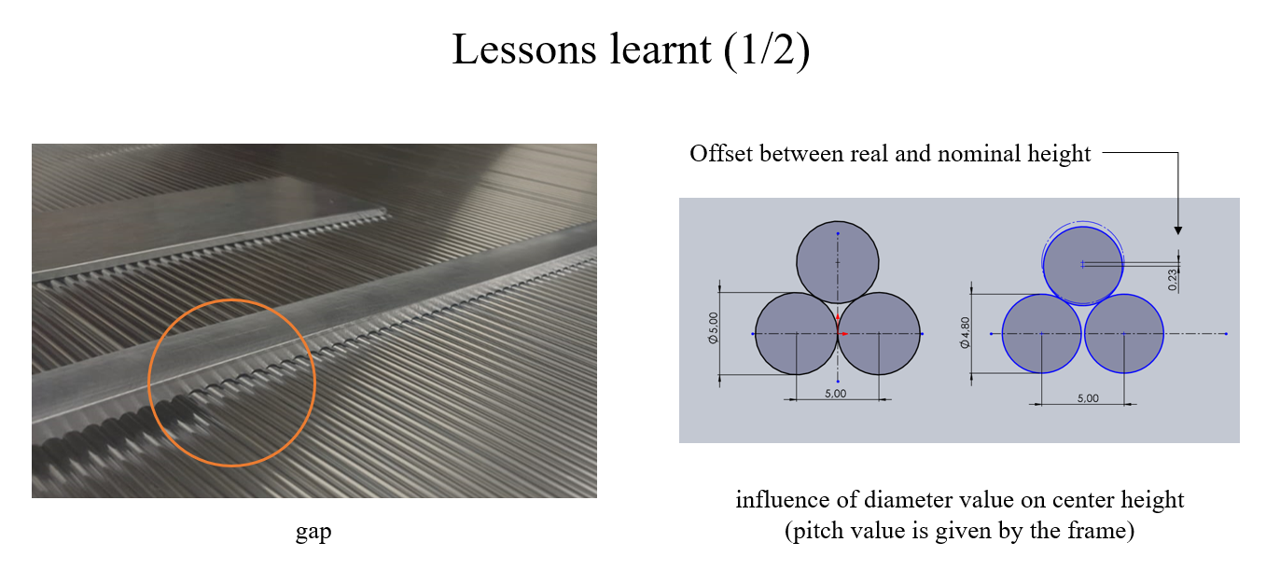
80x120 cm Cern prototype: calibration of top cover position
<numero>

Slide 14
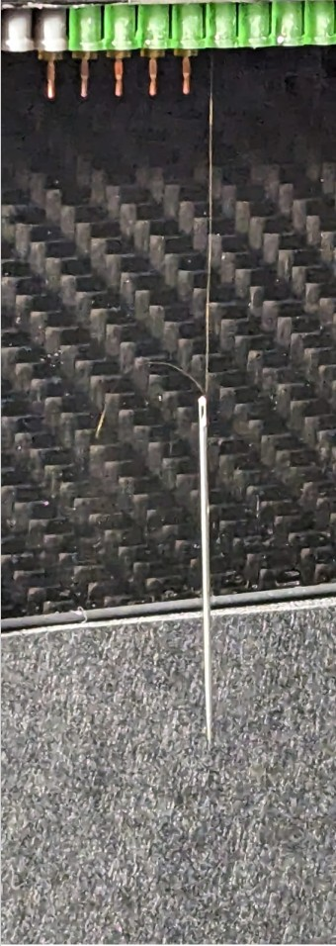
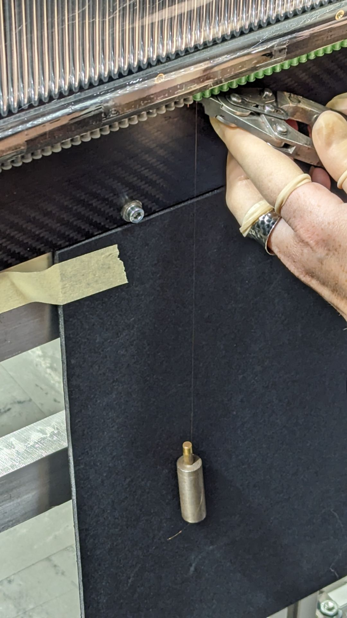
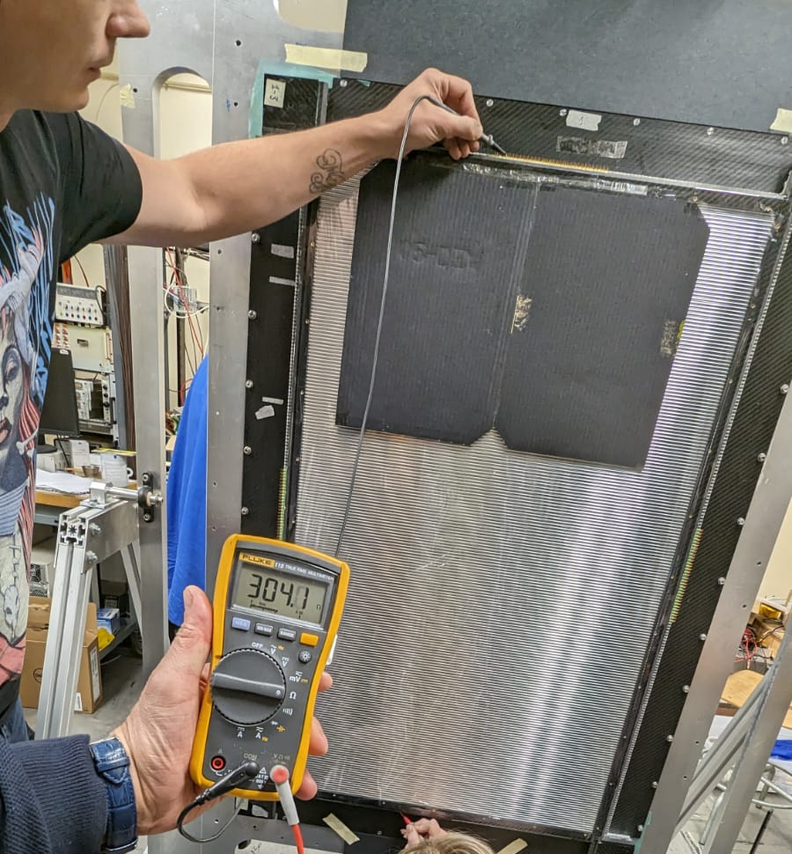
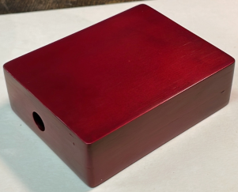
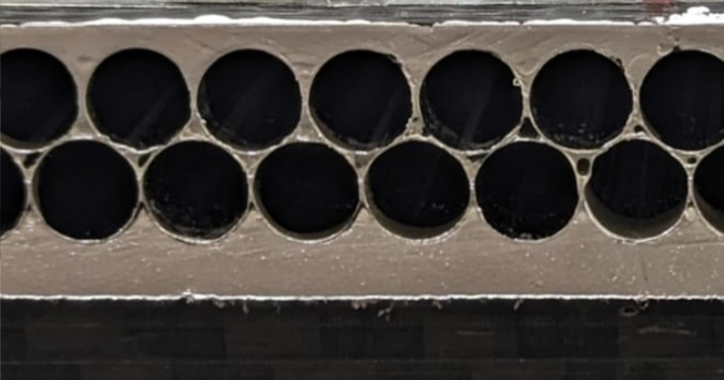
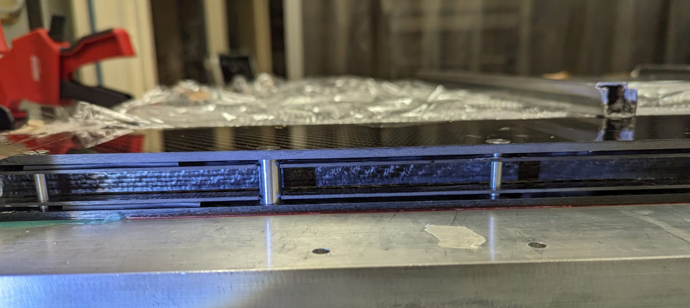
80x120 cm Cern prototype: assembly procedure
5. End plugs insertion and temporary blocking
7. Wiring and crimping (T=50g)
1. Frame parts gluing
8. Resistance and Tension check
3. Straw cutting to frame end
9. Endplugs sealing
2. Straws gluing
4. Conductive paint covering
6. Table in vertical position.
10. Final frame closing
<numero>

Slide 15
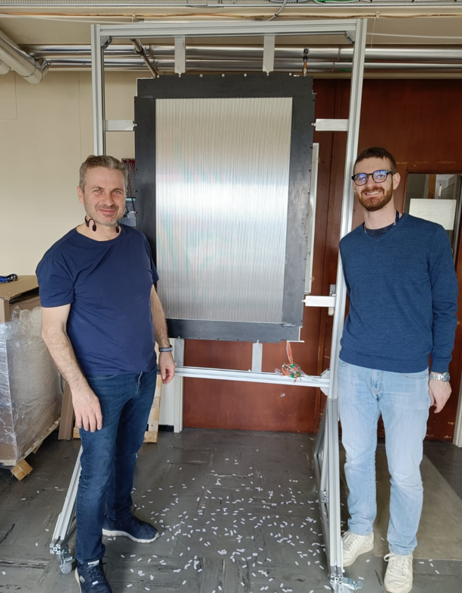
80x120 cm Cern prototype: lessons learned
Straw tubes, produced by GTU, arrived to Cern in August
A month has been needed to prepare the straw tubes (valve tests, connection to collector, pressure tests).
The month of September has not be used (waiting for Carbon Fiber frame)
In October we have preformed two dry runs fixing the alignment of the mounting table and the straw layers, developing additional mounting tools.
Gluing and wiring has been done in November. Involving 5 people for gluing and 2 for wiring. (only 64 (XX)+64 (YY) straws have been wired).
We can estimate that, having all material ready and tested (and excluding the need to develop new mounting tools), 4 people continuously working for 4 weeks can assembly and test a module of this size (functional tests and burn in not included)
First prototype at CERN
<numero>

Slide 16
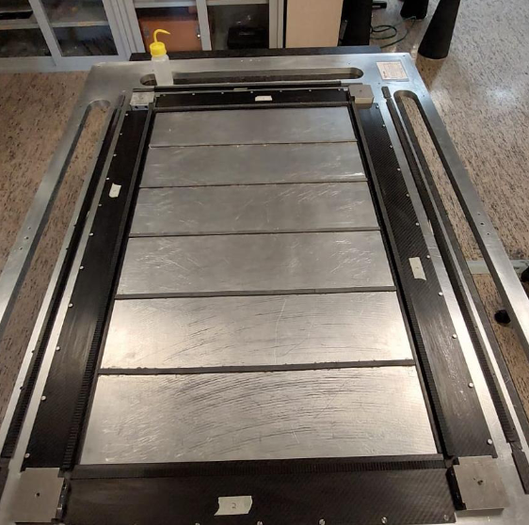
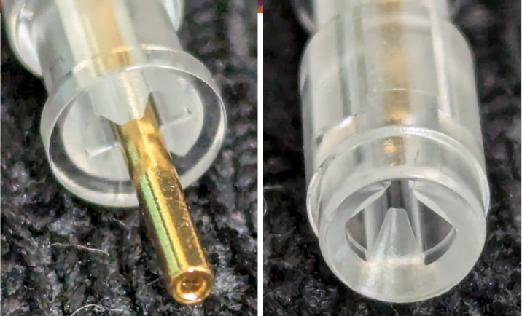
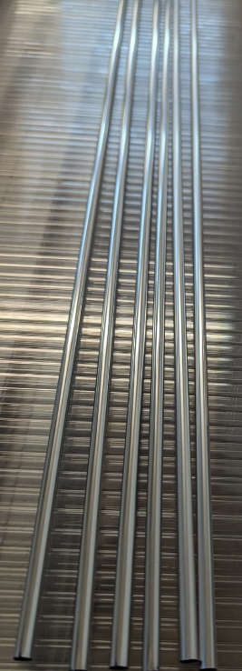
80x120 cm Pisa prototype: goals
A new 80x120 cm prototype will be assembled in Pisa in September to test the final endplugs, pins and spacers. Straws built using the new Fraunhofer film will be used.
<numero>

Slide 17
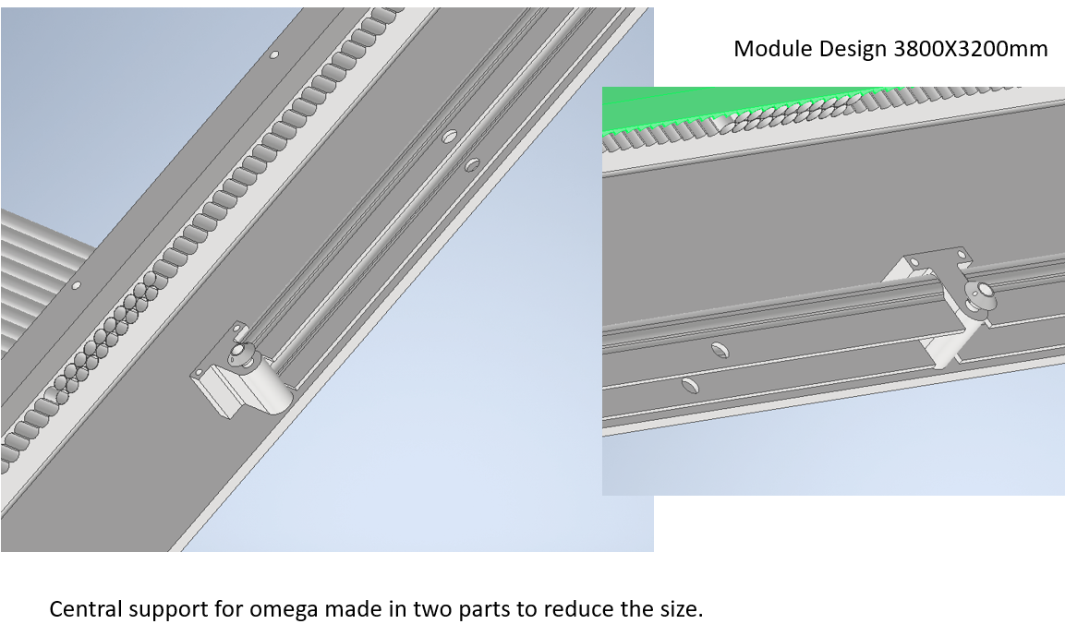
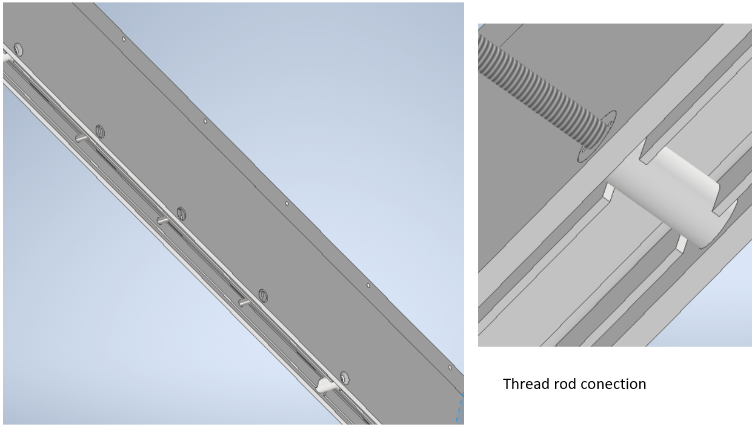
Full scale module studies
The full scale prototype (3800X3200mm) is the final step for the straw tracker design validation. This can allow us to estimate in detail the required time and to face and solve all the technical issues. However this prototype needs an investment in term of man power and tooling much larger than the previous prototype. We started to extend the design to a full scale module and to study the integration of the straw layers with radiator and graphite layers.
Improvement of Carbon frame design
<numero>

Slide 18
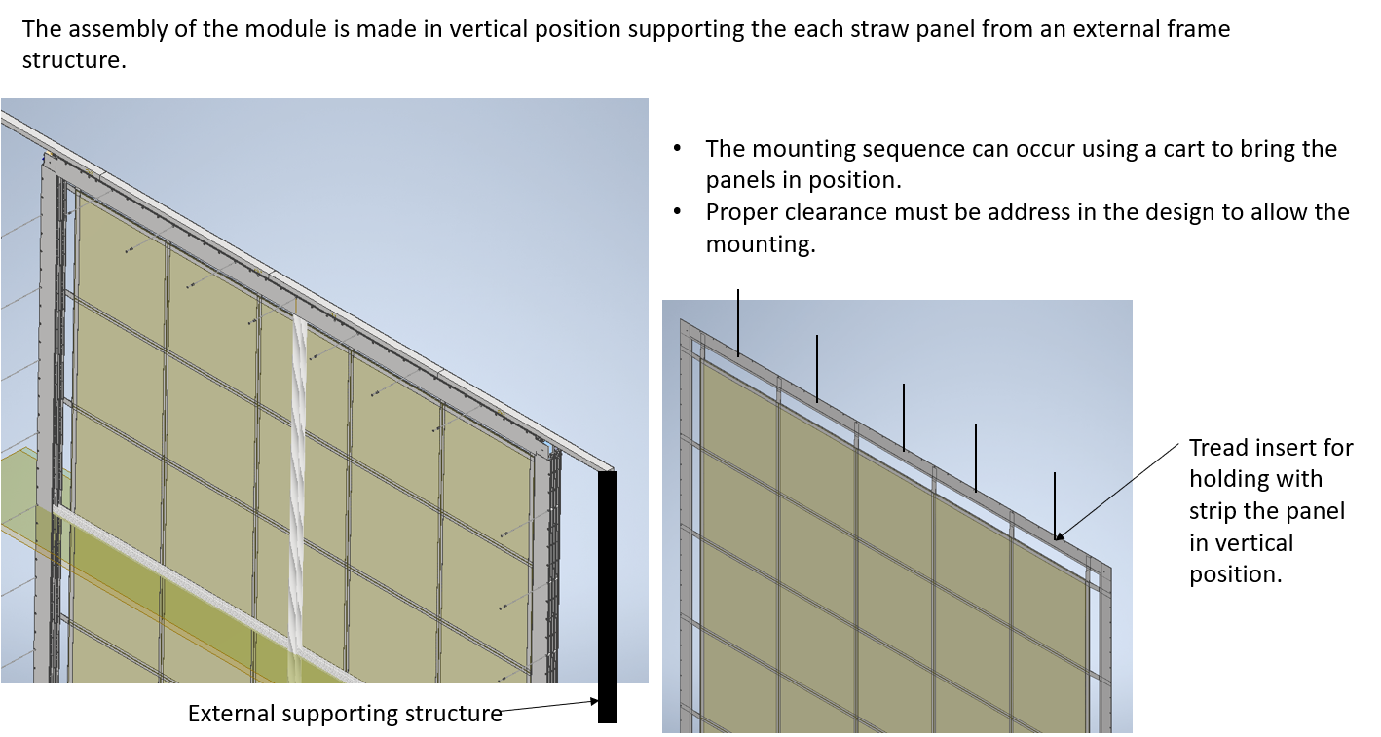
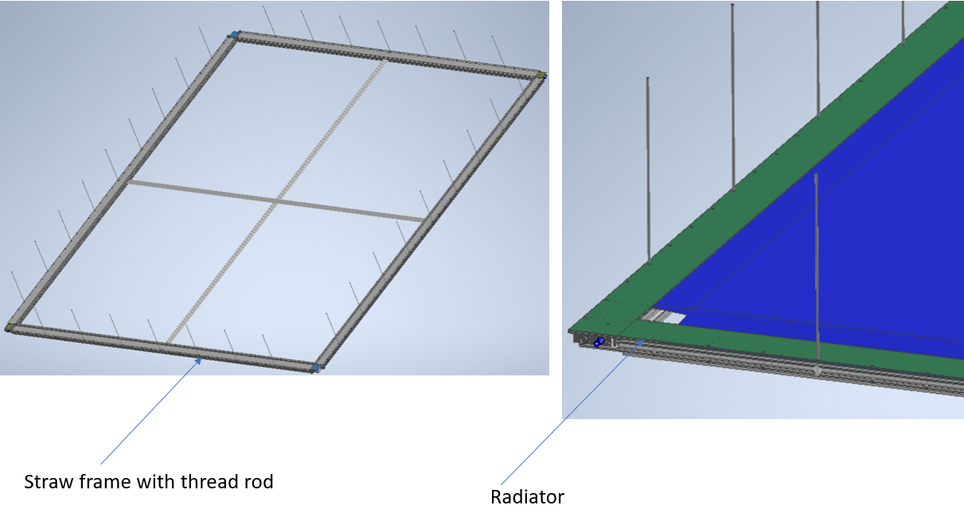
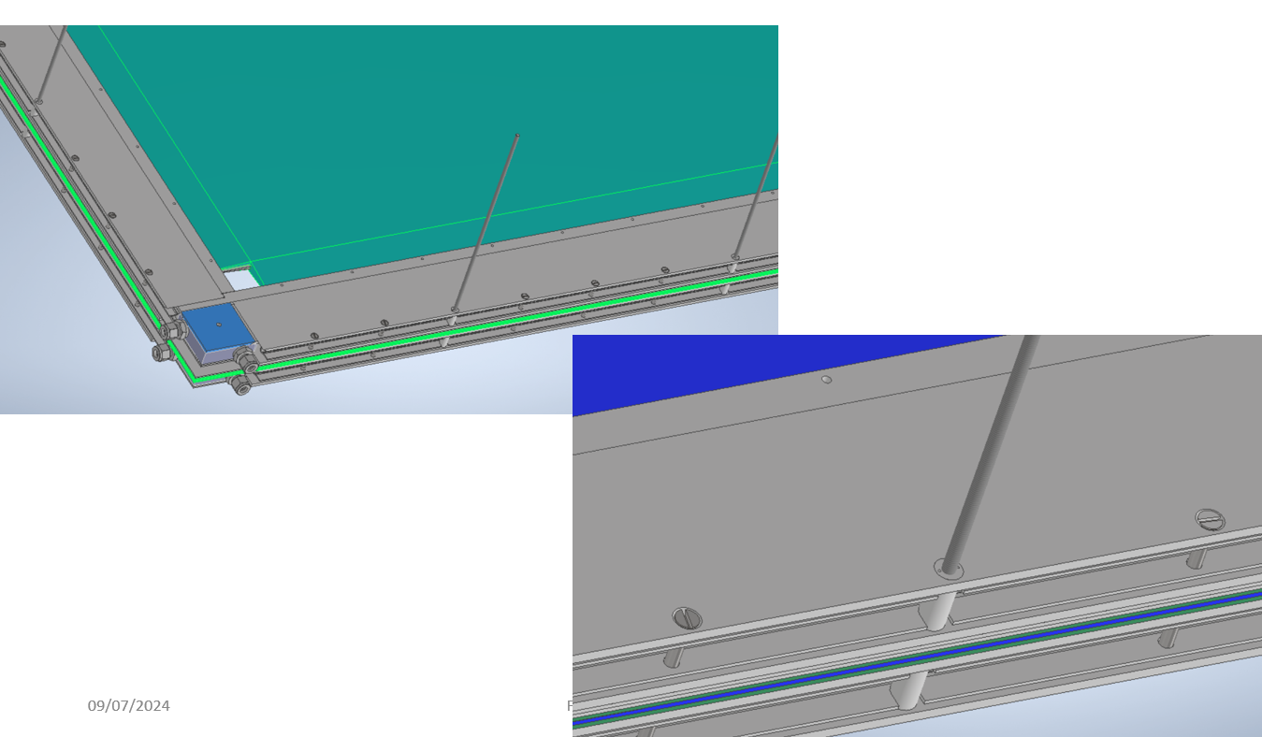
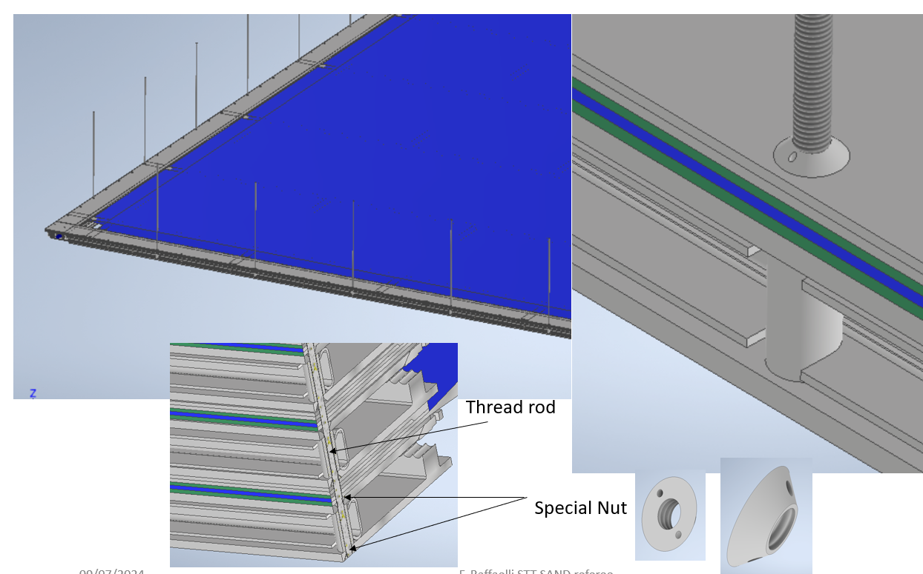
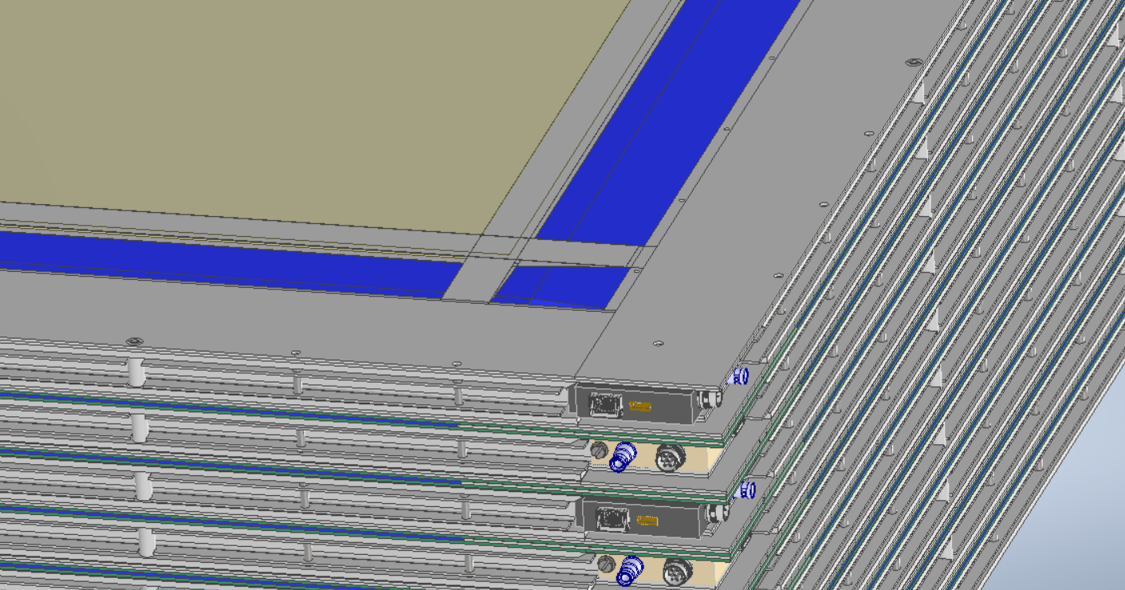
Target integration and supermodules
<numero>

Slide 19
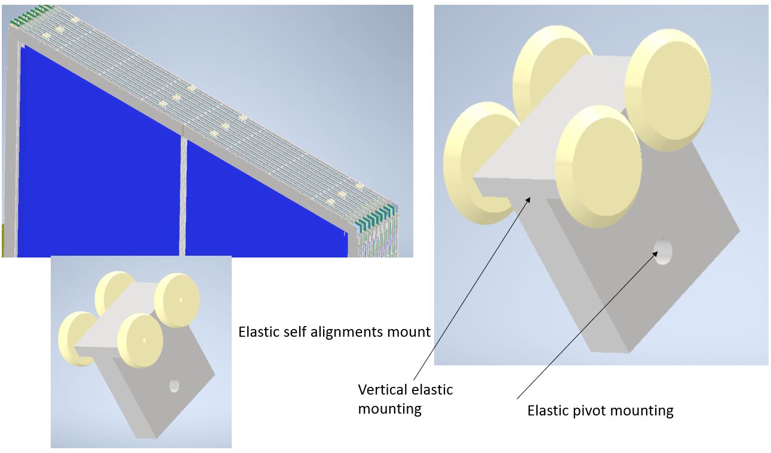
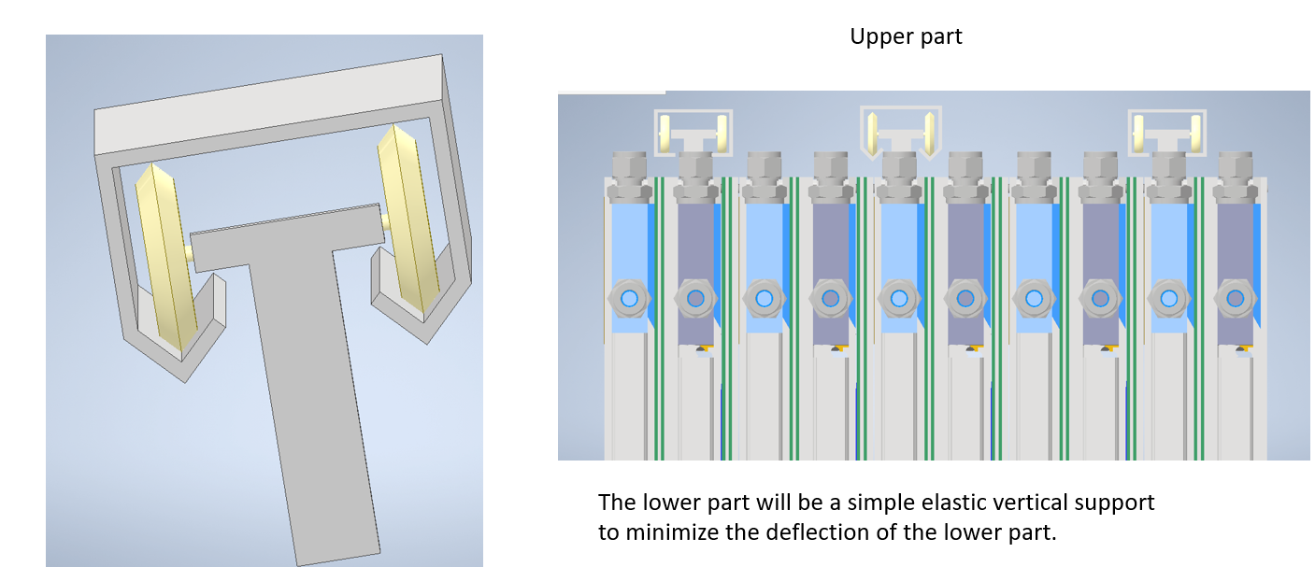
External mechanical support
An external frame will hold the super module in vertical position while mounting, transporting, inserting, and extracting it inside SAND. More work needed (lack of man power) to verify with FEA that the deformation is compatible with our requirements.
Guiding rolling
Simple elastic support self align
The lower part will be a simple elastic vertical support to minimize the deflection of the lower part.
<numero>

Slide 20
Summary
We consider the construction of the second 80x120cm prototype in Pisa as an important step to test the final design: various “final” components (end plugs, spacer, crimping pins, straws) will be used and the assembly procedure will be further developed.
The new prototype could also be used to validate the gas flow and cooling and a preliminary version of the readout electronics.
The full scale design of a super module requires more engineering work. An important effort is required to finalize a design that integrates all the components and the mechanical interface with the rest of the SAND detector. Additional work and man power is needed to design the tools necessary for constructing, handling and mounting a full scale module.
The construction of a full scale prototype would be crucial to validate the proposed design and the assembly procedure of the full detector.
<numero>

Slide 21
BACKUP
<numero>

Slide 22
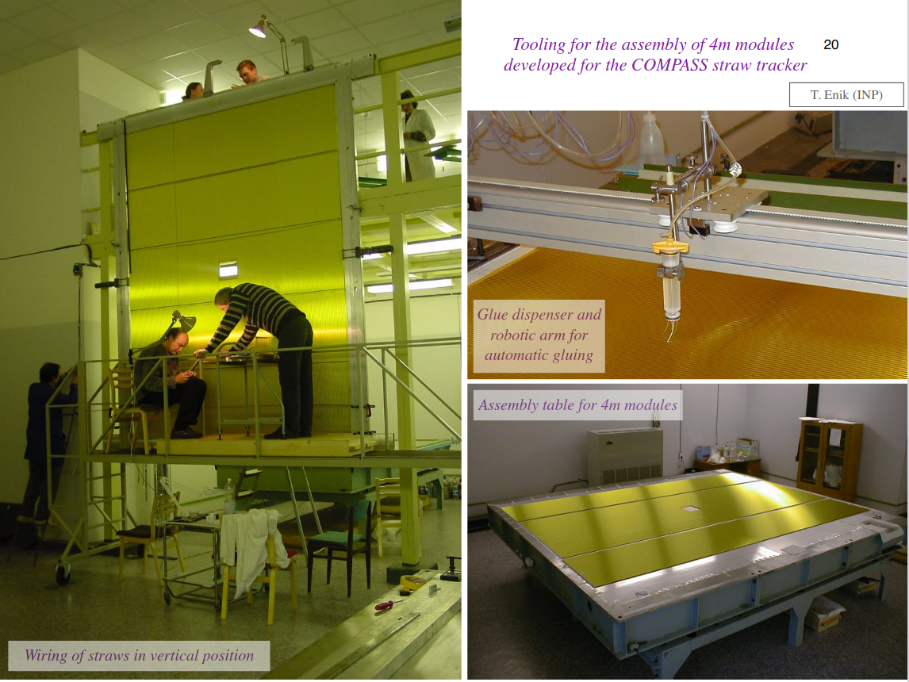
Tools for assembling a 4 m module
The mounting table, glue dispenser and wiring tools, already used to build the COMPASS straw tracker, are available
<numero>

