Slide 1
Optics and reconstruction with Coded Aperture masks
Valentina Cicero
CSN1 Review of SAND
11/07/2024

Slide 2
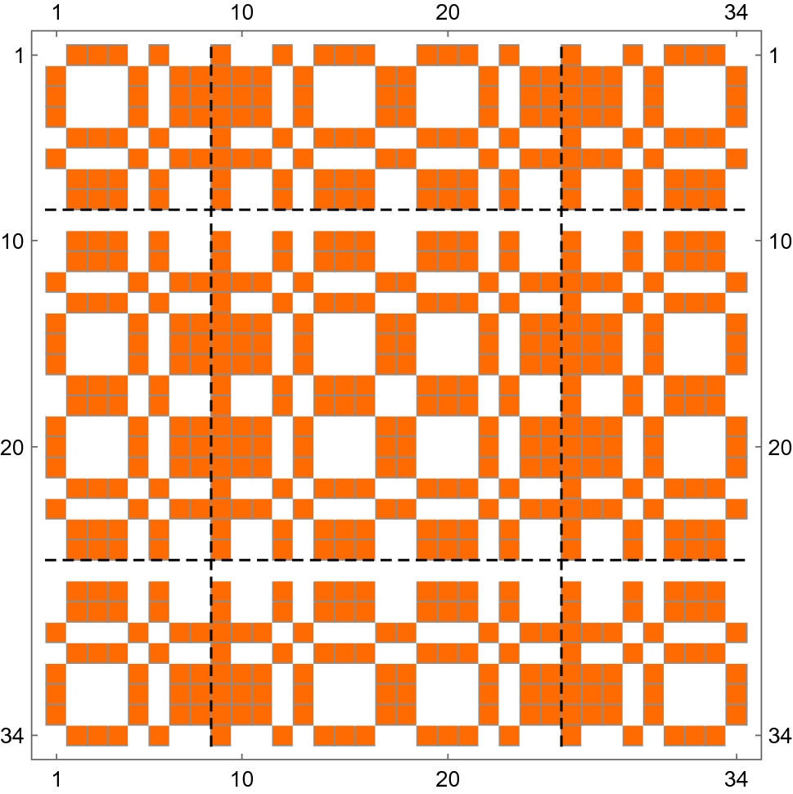
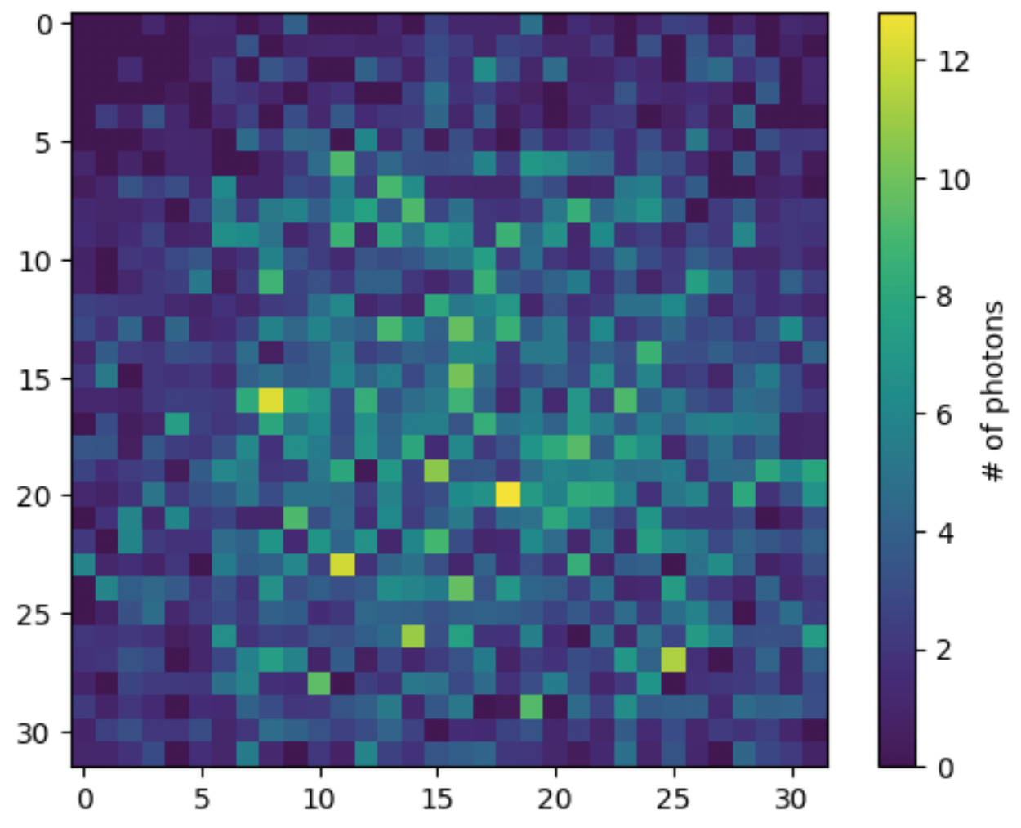
Coded aperture (CA) imaging
Sensor matrix
A Coded aperture mask is a thin sheet of opaque material with a well-defined pattern of holes placed at a fixed distance from a sensor plane.
conceptually the evolution of a single pinhole camera
A matrix of multiple pinholes improves light collection
Advantages:
Light transmission (depends on mask pattern/holes size, usually ~50%)
Compact design
Robust and easy to build
concept
Coded aperture mask
The image formed on the sensor is the superimposition of multiple pinhole images

Slide 3
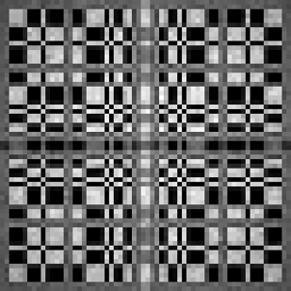
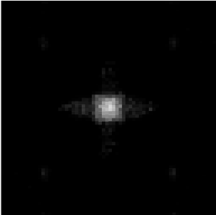
Reconstruction with CA masks
For FAR field imaging (e.g. Astrophysics applications):
the original image can be obtained with a deconvolution process where the decoding matrix is derived from the mask pattern
$$O^{′}\left(x,y\right)=I \left(x,y\right)⊗H (x,y)$$
Source
detected
image
Decoding matrix
Source
Mask pattern
Encoded image
Reconstructed image
$$M\left(x,y\right)⊗H\left(x,y\right)=δ(x,y)$$
mask
for NEAR field imaging (i.e. GRAIN scale) and low light yields:
- more complex and computationally intensive algorithms are typically implemented
(Filtered Back Projection, Maximum Likelihood Expectation Maximization algorithms…)

Slide 4
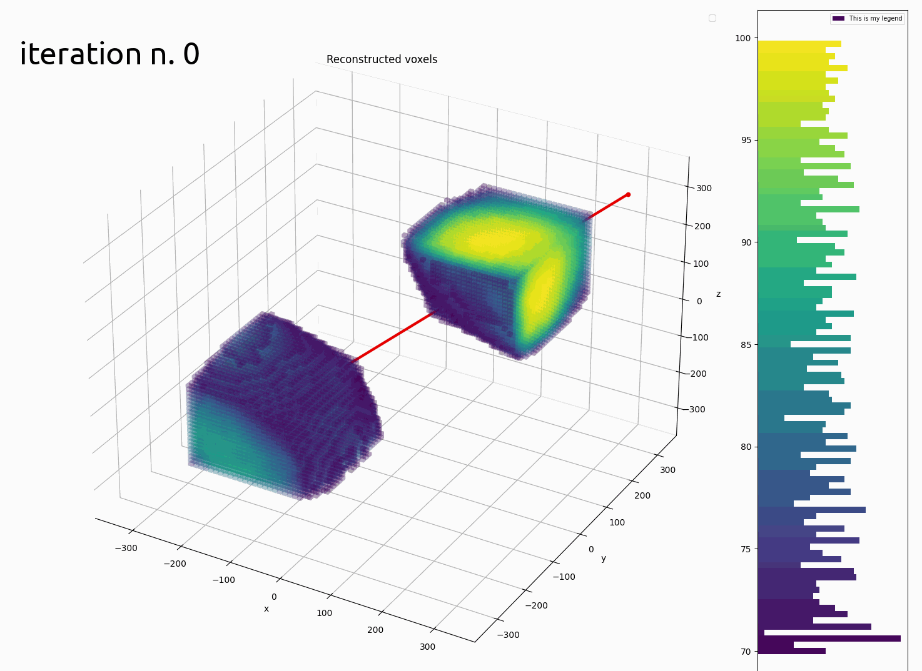
GRAIN Reconstruction algorithm
Directly reconstructs in 3D dimensions the initial photon source distribution in a segmented volume (voxels)
Combines information of multiple cameras at once
Maximum Likelihood Expectation Maximization (MLEM) algorithm:
iteratively converges to the photon source distribution that maximizes the likelihood of detecting the observed images
Implemented for execution on (multiple) GPUs

Slide 5
GRAIN Reconstruction algorithm
Photon counting is described by a Poissonian pdf:
$$f\left(H_{s}\right|{[λ}_{s}])=e^{−[λs]} \frac{{[λ_{s}]}^{H_{s}}}{H_{s} !}$$
$${[λ}_{s}] = \sum_{j}{λ_{j }p(j,s)}$$
p(j,s) probability of a photon that originated in voxel j is detected by pixel s
H_{s} number of detected photons by sensor s
[$λ_{s}$] detected photons expectation value
$λ_{j}$ unknown photon emission in voxel j
Likelihood for all sensors:
Reconstruction algorithm:
$$λ_{j}^{k+1}=\frac{λ_{j}^{k}}{\sum_{s}{p\left(j,s\right)}}⋅\sum_{s}{\frac{H_{s}⋅p\left(j,s\right)}{\sum_{j}{p(j,s)}⋅λ_{j}^{k}}}$$
$$\prod_{s}{e^{−[λs]} \frac{{[λ_{s}]}^{H_{s}}}{H_{s} !}}$$
maximization
k iteration number

Slide 6
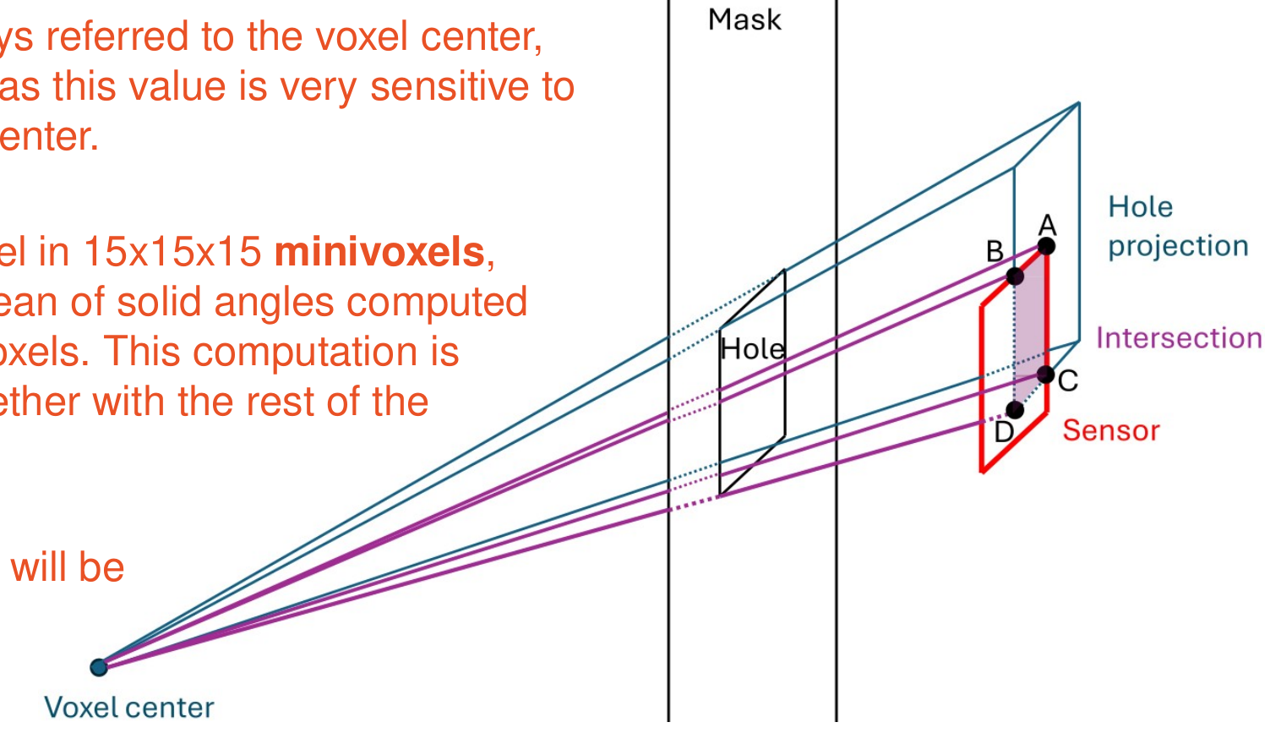
GRAIN reconstruction algorithm
The algorithm key element is the accurate computation of p(j,s)
p (j,s) = P geometry (j,s) * P LAr (j,s) * P sensor (s)
Solid angle subtended by visible sensor area through mask holes
Sensor Photon Detection Efficiency
Photon absorption in LAr
Depends on distance between voxel and sensor

Slide 7
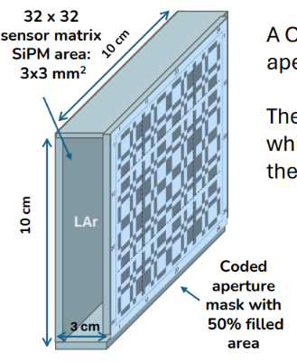
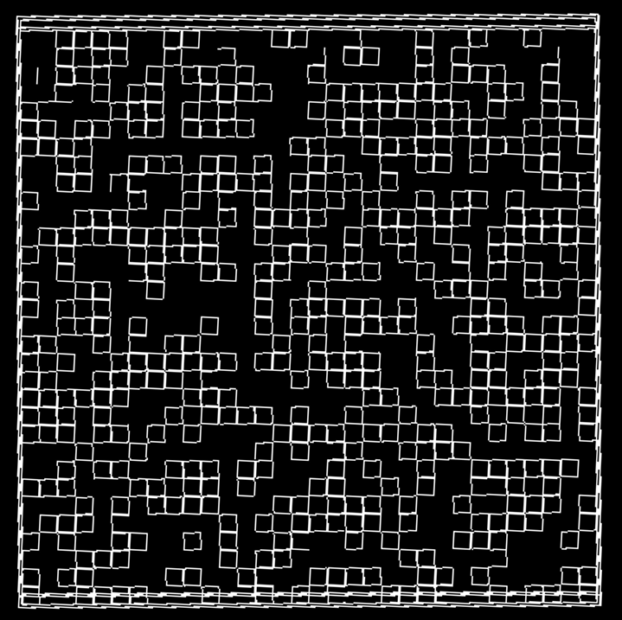
GRAIN CA imaging system
Sensor matrix:
32 x 32 Silicon Photomultipliers (SiPM)
SiPM active area: 3x3 mm²
Coded aperture mask:
Random uniform pattern of holes
Holes aligned to SiPMs, area: 3x3 mm²
Distance from sensors: 3 cm
60 cameras in GRAIN
covering elliptic sides + bottom and top rows
Camera design was
optimized with simulations in simplified geometry
Mask pattern

Slide 8
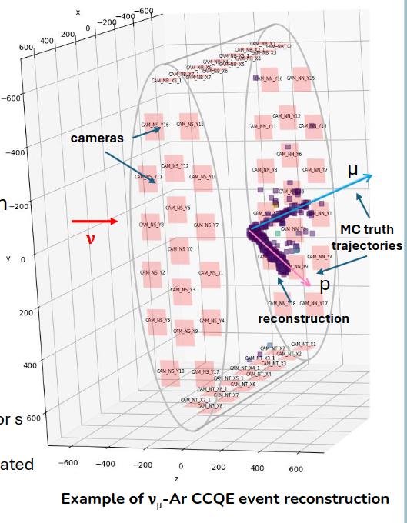
Example of reconstructed neutrino event
ν – Ar Charged Current Quasi-Elastic scattering
Reconstruction:
12 mm voxel size
200 algorithm iterations
Shown voxels with estimated photon emission ~> 5% of max value

Slide 9
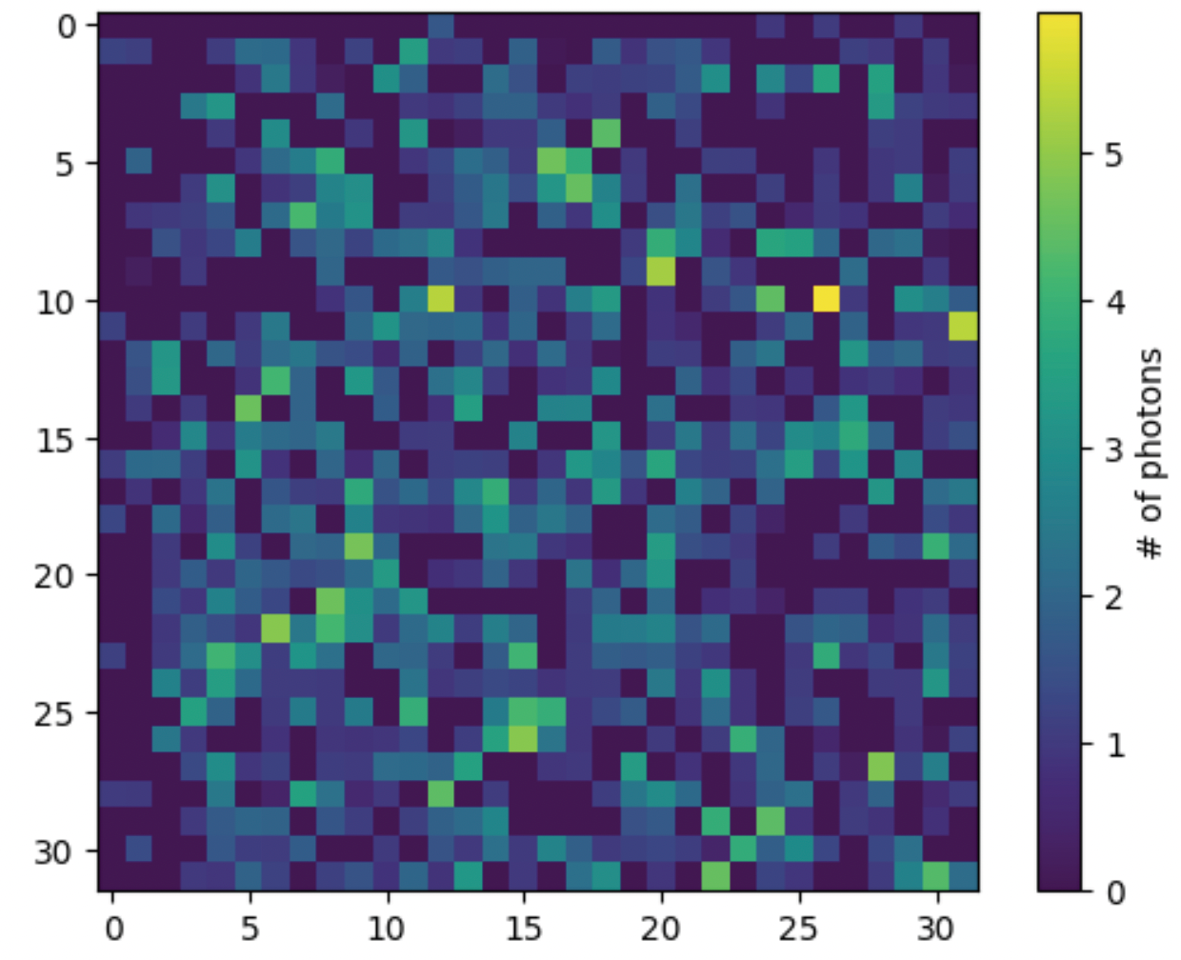
Simulation and reconstruction chain
Event generation
(Genie)
Energy deposits simulation
(Edep-sim)
Propagation of optical photons in LAr simulation
(GEANT4)
Detector response simulation
3D MLEM reconstruction
3D tracks:
Start/end direction
Containment in GRAIN
Matching with tracker
Energy deposited
Track finding and fitting
Camera images
Calorimetry

Slide 10
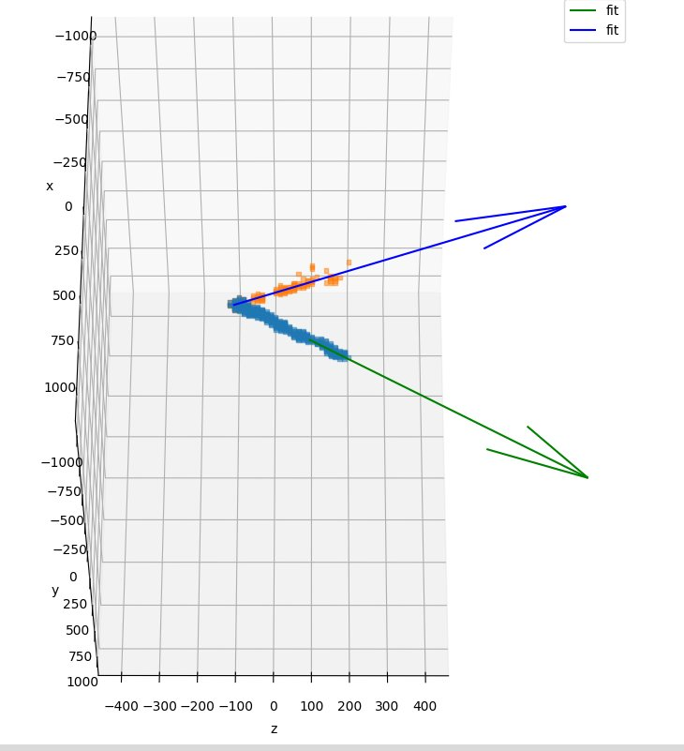
Reconstruction analysis
Development of analysis tools for the Coded Aperture Masks 3D reconstruction is in progress.
Analysis steps:
Thresholding
Track finding:
Weighted 3D Hough transform for lines
match voxels to track seeds
Track fitting:
minimization of squared distance weighted with voxel scores
Trajectories from fit

Slide 11
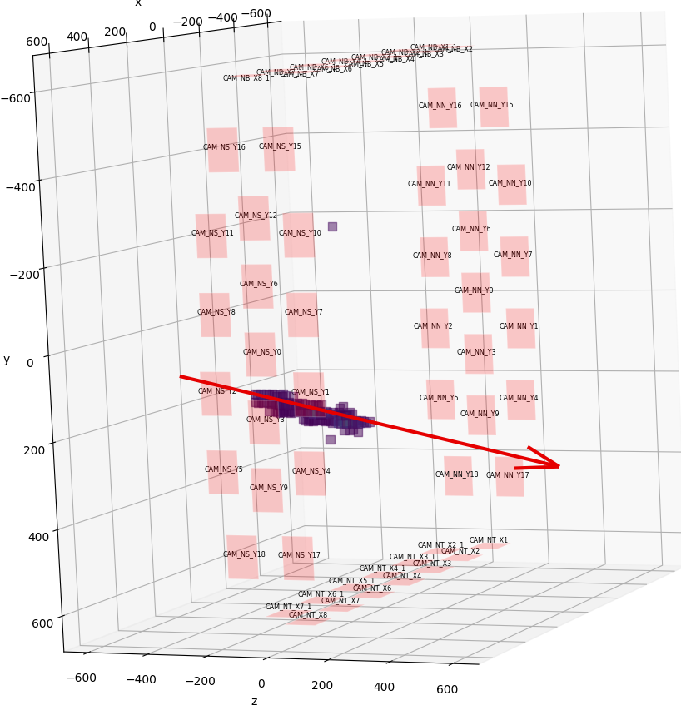
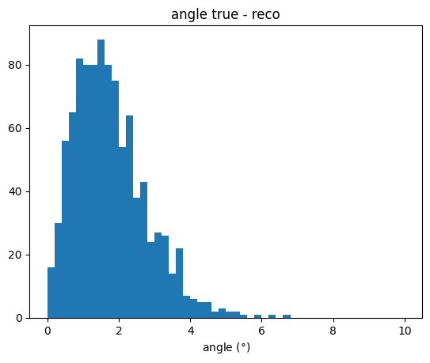
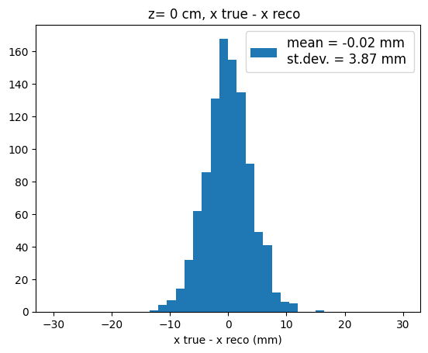
Muon reconstruction in GRAIN
Simulated sample:
1k muons crossing GRAIN along z
Origin position: ( [-30, + 30], [-30, + 30], -50) cm
Direction: θ = [160, 180], φ = [0, 360]
Energy = (1 ± 0.3) GeV
Reconstruction:
Voxels size = 18 mm
Iterations = 200
Reconstruction time: ~ 3.5 min / event
Angle between MC and reconstructed track direction
Track position residuals at z = 0 cm
Residual distribution of track position at z = -50 cm

Slide 12
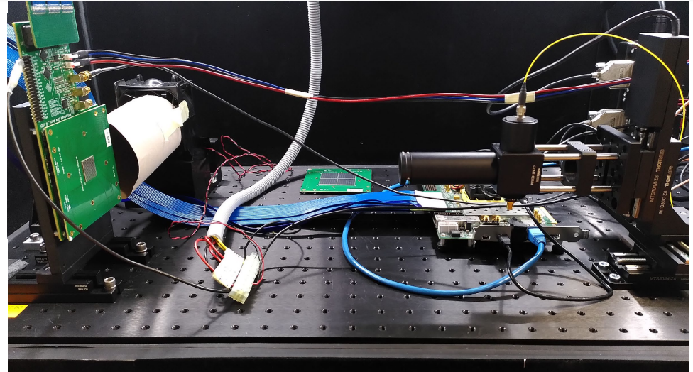
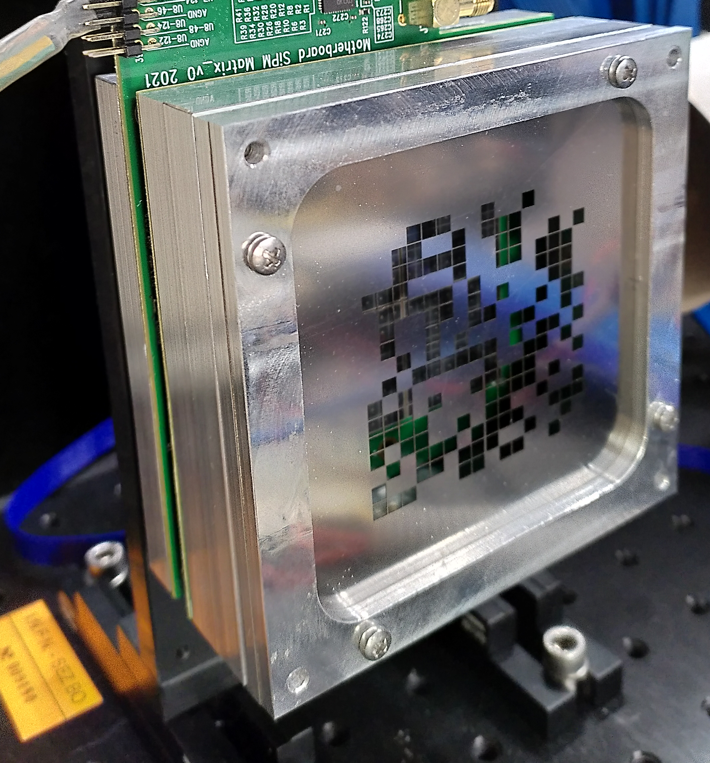
Camera prototype
SiPM matrix
(1 mm pitch)
Built 2 camera prototypes:
16 x 16 SiPM matrix
SiPM area 3x3 mm²
Mask: stainless steel sheet 120 um thick, laser cut
Front end electronics with 8 ALCOR ASIC
DAQ with a Xilinx FPGA board
to be tested in LAr at ARTIC facility at Genoa with cosmic rays
Laser with focusing optics
for calibration
Front–end board with ALCOR
Mask with spacers to adjust distance
SiPM matrix
(3 mm pitch)

Slide 13
Conclusion
A tracking and calorimetry system for GRAIN based on the imaging of LAr scintillation light is being designed
A “camera” of GRAIN imaging system will be based on matrices of SiPM coupled either to VUV lenses or Coded Aperture masks
For the CA system we implemented a MLEM algorithm that directly reconstructs the event in 3D, with GPU acceleration
First CA camera prototypes with 16 x 16 pixels have been built and will be tested in LAr in the incoming months.

