Slide 1


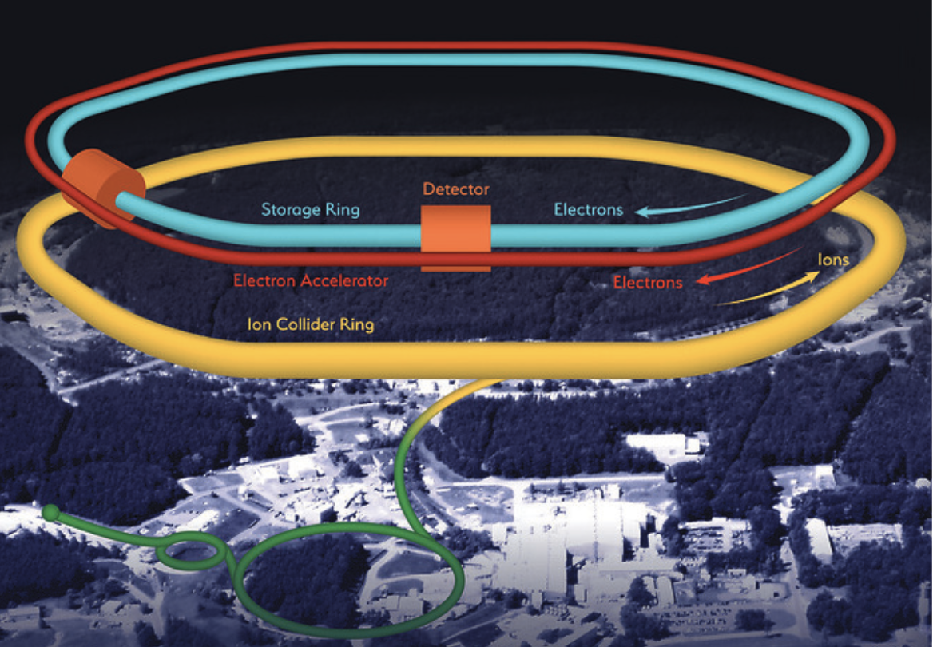
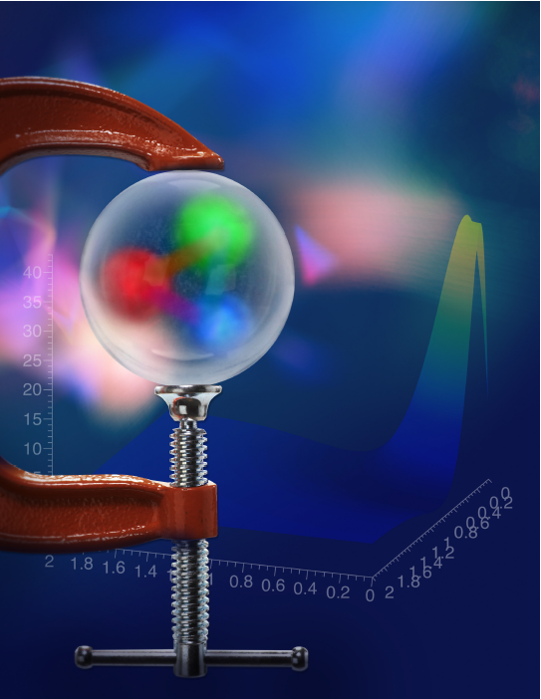
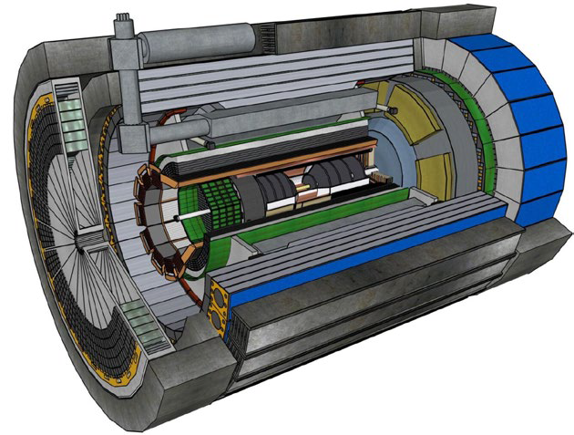
Consiglio di Sezione Roma Tor Vergata
July 11th 2024
The ePIC Experiment (former EIC_NET)
Annalisa D’Angelo
University of Rome Tor Vergata & INFN Rome Tor Vergata Rome – Italy
The ePIC detector at the Electron Ion Collider
Brookhaven National Laboratory
Upton, NY, USA

Slide 2

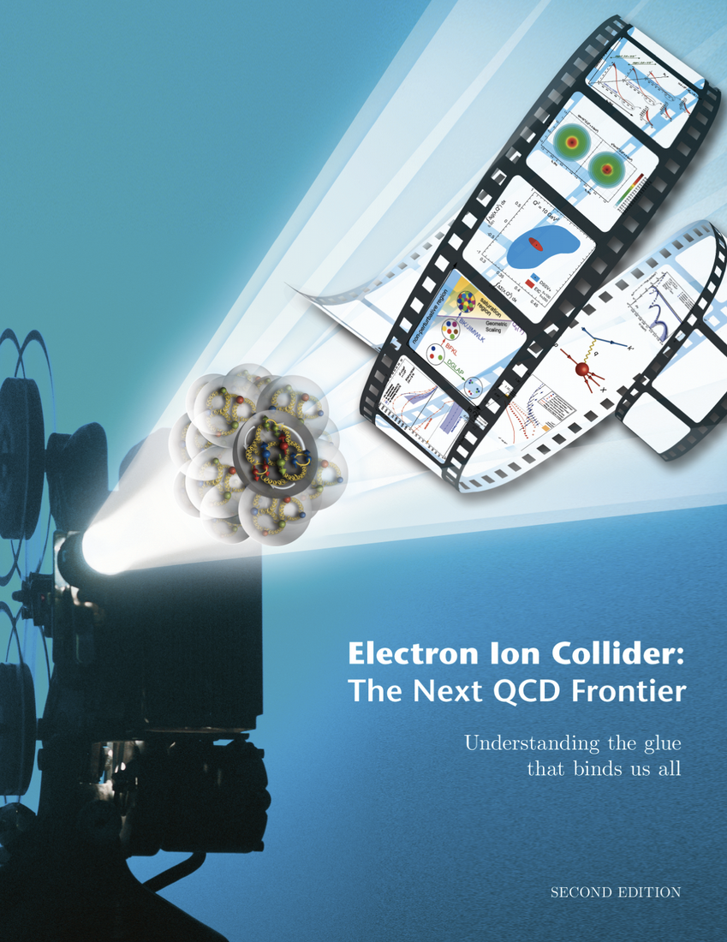

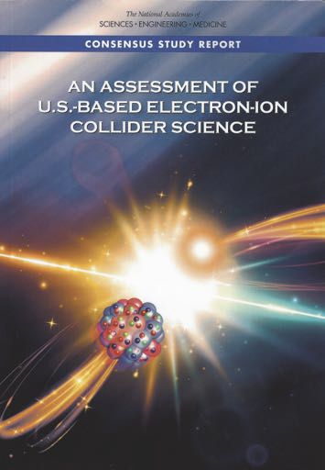


The Path to the EIC project
2010
“Gluons and the quark sea at high energies: distributions, polarization, tomography”, INT - Seattle, Sept 13 - Nov 19 2010, arXiv:1108.1713
Electron Ion Collider: the Next QCD Frontier”, E.P.J. A52 (16) 268, arXiv:1212.1701 - 1200 citations on Inspire
2012 - White Paper
2015
Long Range Plan recommendations
2018
Assessment by the US National Academy of Science “The Committee finds that the science that can be addressed by an EIC is compelling, fundamental and timely”
2022
Yellow Report Nucl. Phys. A 1026 (2022) 122447
2023
NSAC - Long Range Plan
We recommend the expeditious completion of the EIC as the highest priority for facility construction

Slide 3
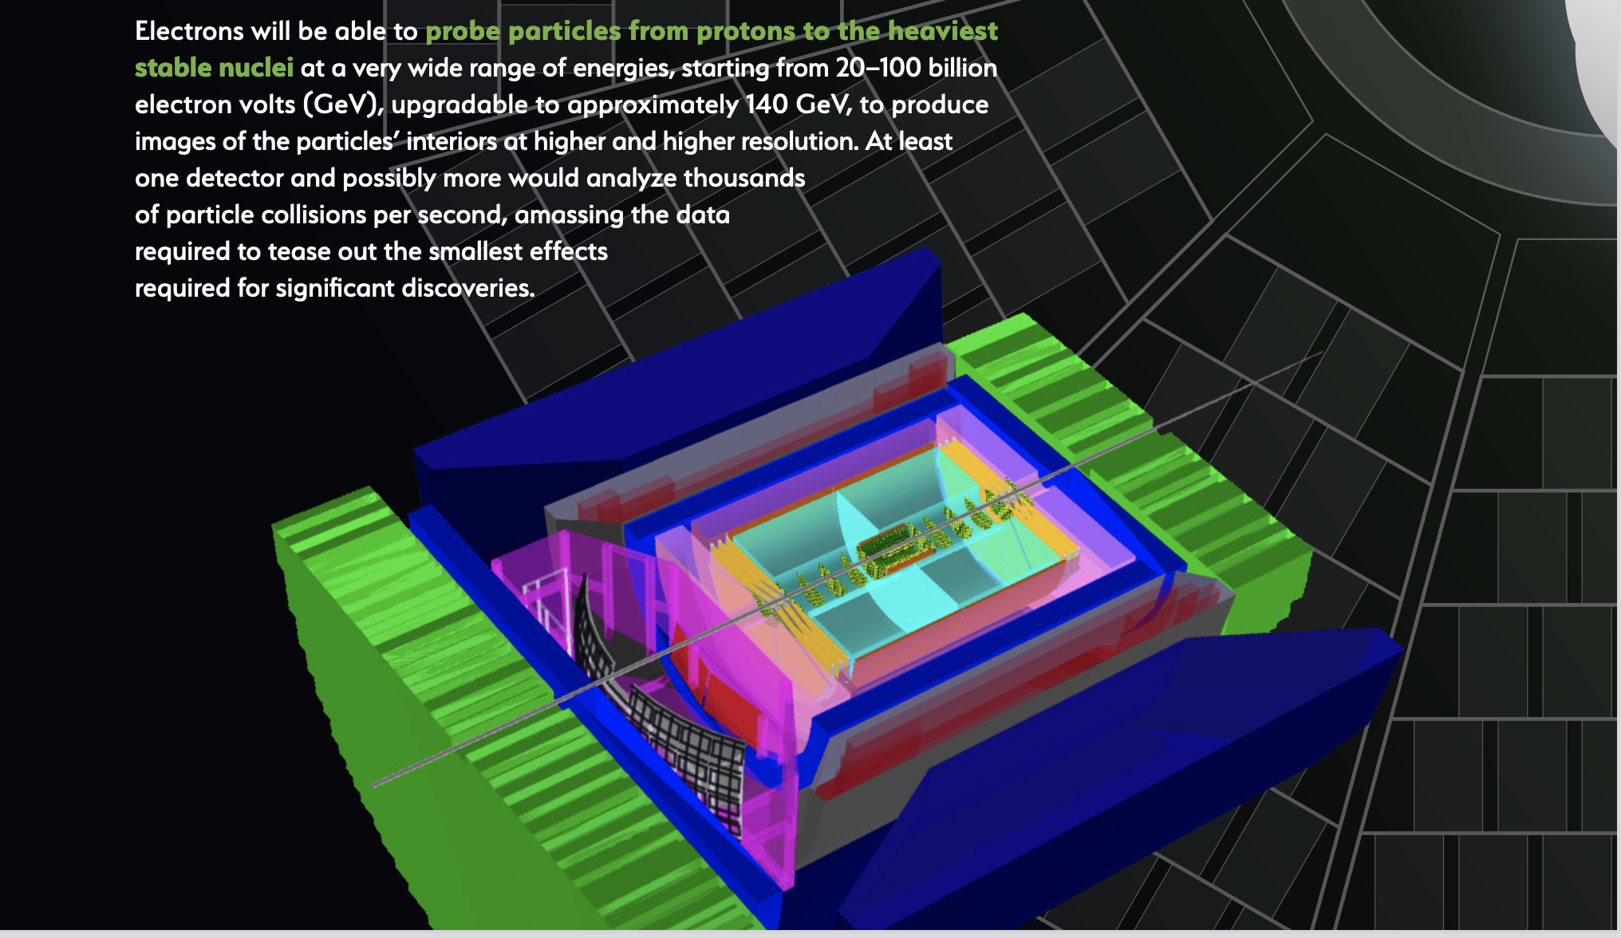
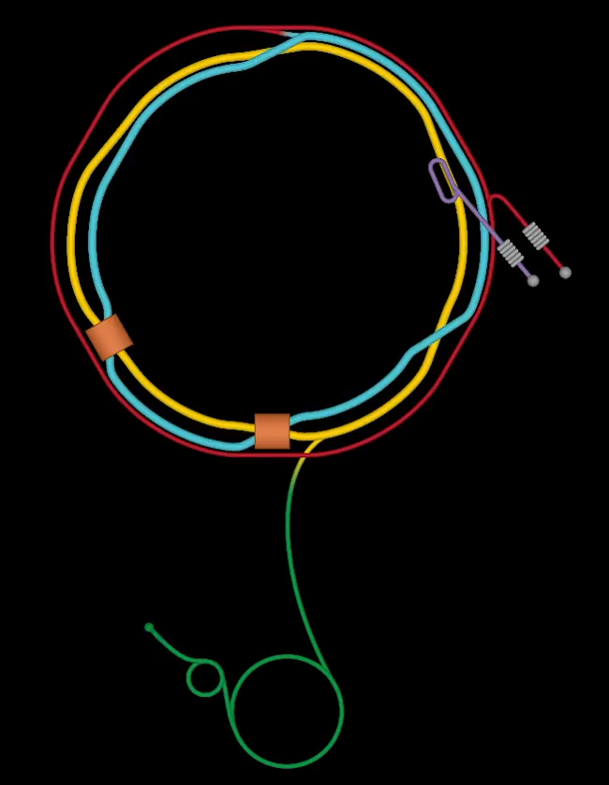
EIC @ BNL
E_{e} =40-140 GeV
Electron-Ion Collider
101 INFN Physicists
16 INFN Institutes
ePIC
Si Vertex detector
Dual RICH
Streaming Read-out
MPGD Endcap trackers

Slide 4
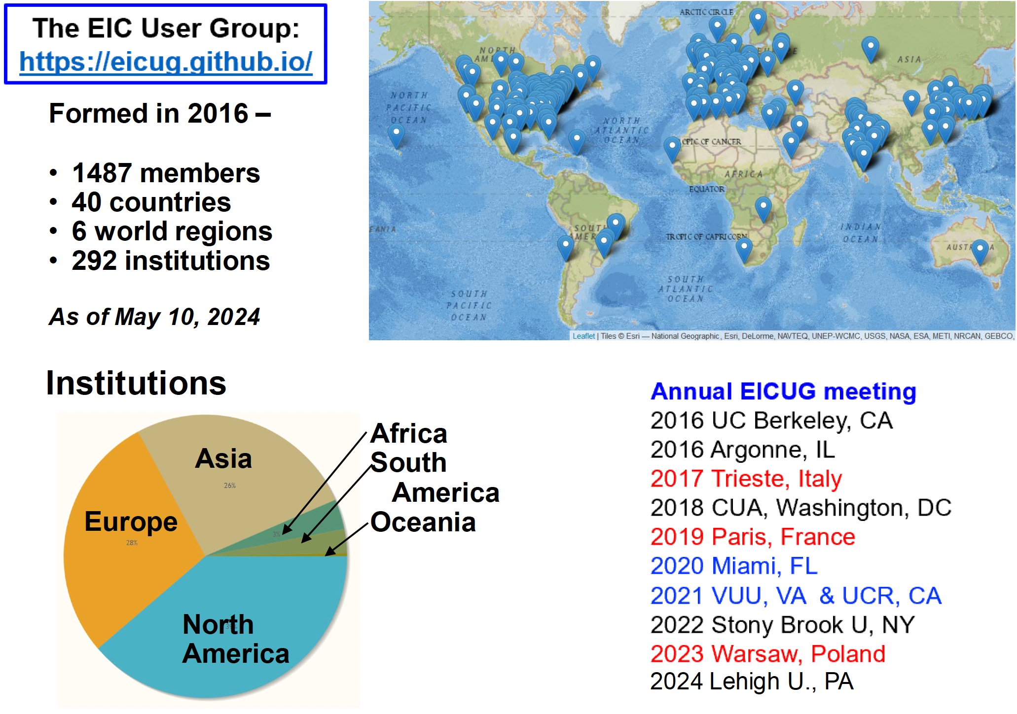
The EIC- ePIC International Collaboration
101 INFN Physicists
16 INFN Institutes
INFN In-Kind Responsibilities
Si Vertex detector
Dual RICH
Streaming Read-out
MPGD Endcap trackers
January 2025
Villa Mondragone
~
~

Slide 5
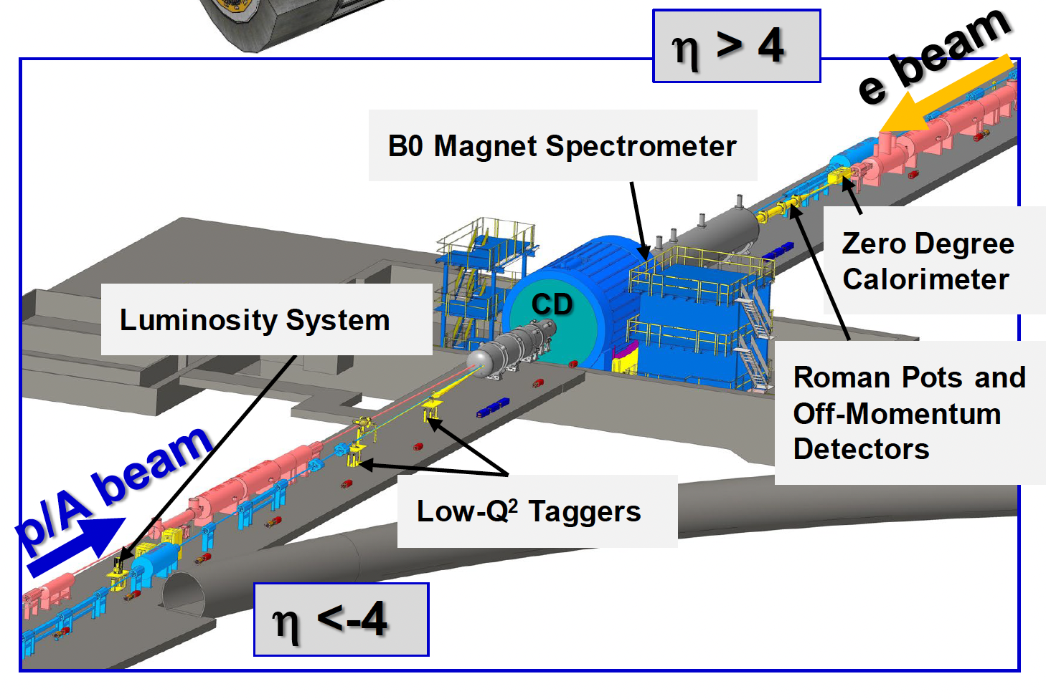


The ePIC detector
$$−4<η<4$$
The Central Detector
The Far Forward and Far Backward Detector
~
~

Slide 6
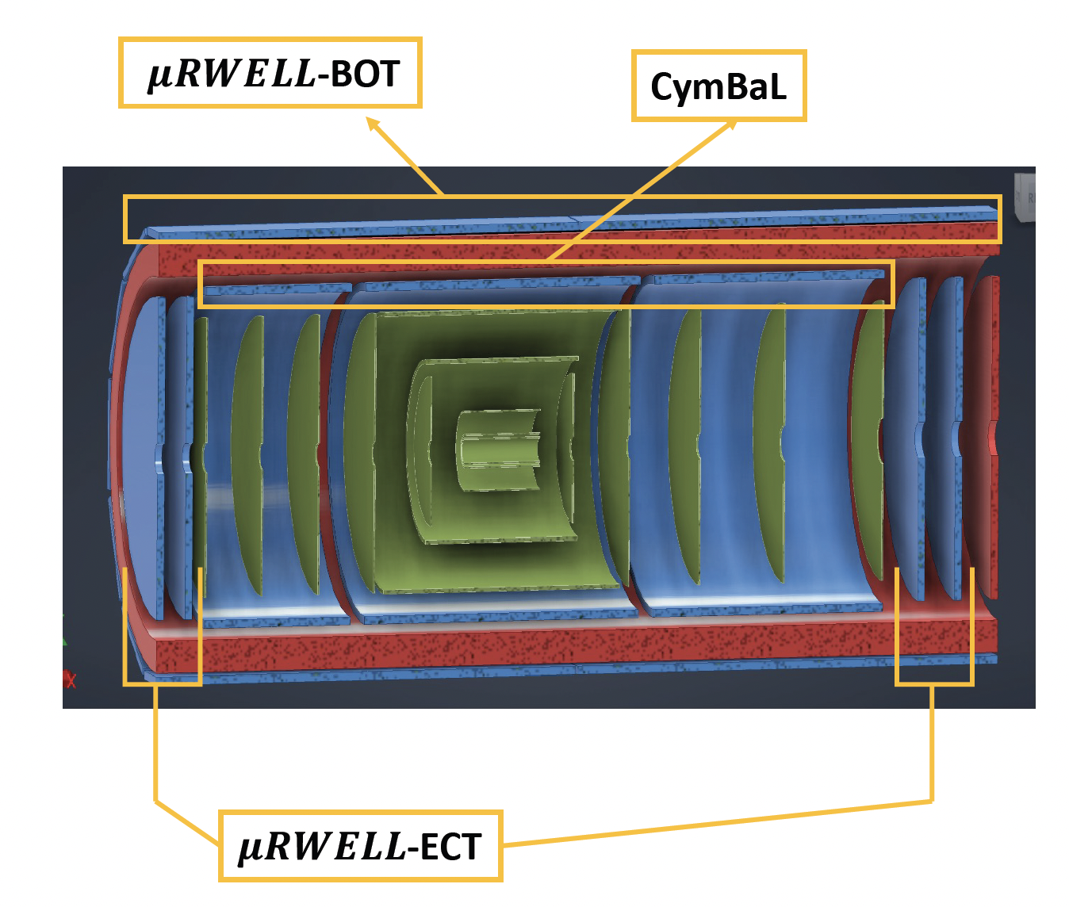
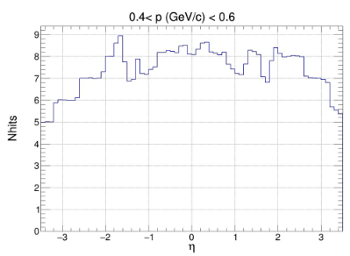


Scope of the MPGD endcaps in ePIC detector tracking
Adding two MPGD Endcap Tracking (ECT) disks both in the hadronic and in the leptonic regions increased the number of hits in the |η| > 2 region to improve pattern recognition.
-3.61$<η<−1.72$
Present Configuration
1.99$<η<$3.44
Present ePIC tracker geometry
6

Slide 7

Technical Performance Requirements
Time resolution 10 ns or less to provide tracking timing
  Fast rise time ~ 20 $÷$ 50 ns
  Peaking time 50 ns
  Sampling faster than 50 MHz
Low material budget
  1-2 % X₀ - it will be the minimum compatible with the chosen technology
Spatial resolution: 150 $μ$m or better
  <150 $μ$m intrinsic spatial resolution for perpendicular tracks
  Technological optimizations to retain 150 $μ$m resolution for inclined/curved tracks
High Efficiency
  Single detector efficiency ~ 96 –97 % $→$ 92 –94 % combined efficiency for two disks
7

Slide 8
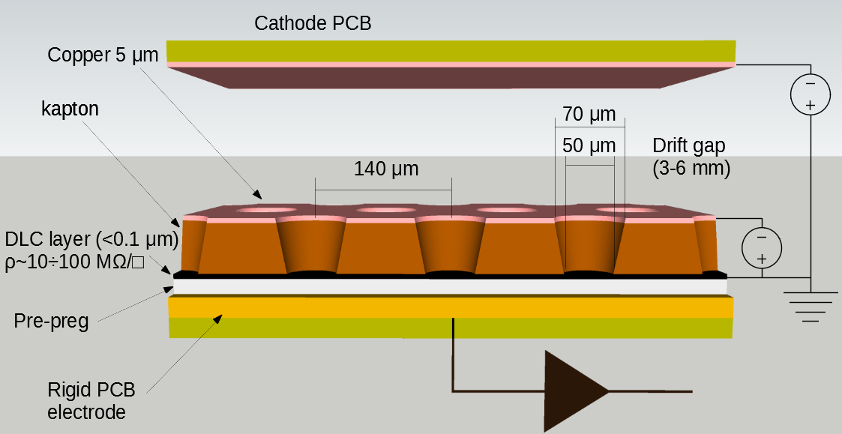
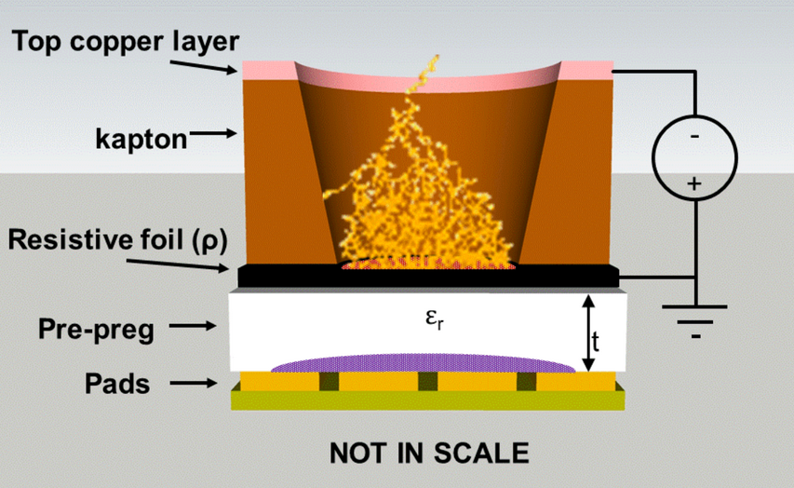
Detector Technology Choices μ-RWELL
The core is the μ-RWELL_PCB, realized by coupling three different elements:
-2400V
Ar:CO2:CF4 45:15:40
1
-600V
2
3
a WELL patterned kapton foil acting as amplification stage (GEM-like)
1
a resistive DLC layer (Diamond-Like-Carbon)
for discharge suppression with
surface resistivity ~ 50÷100 MΩ/□
Applying a suitable voltage between the top Cu-layer and the DLC the WELL acts as a multiplication channel for the ionization produced in the conversion/drift gas gap.
2
3
a standard readout PCB
8

Slide 9
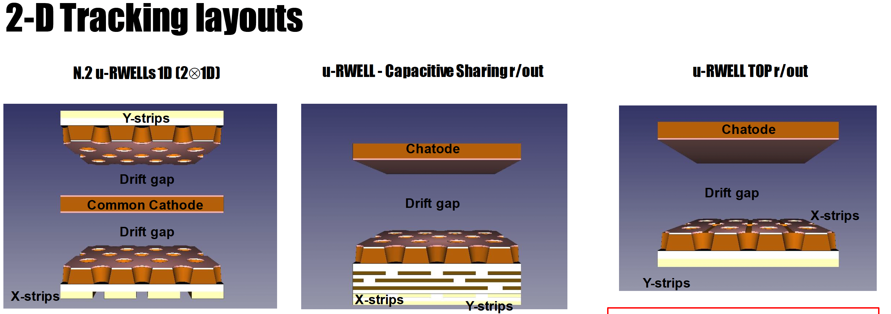
June 2023 test beam
June 2023 test beam
October 2022 test beam
1200 μm pitch
300 μm vs 1000 μm strips width
10 x 10 cm² active surface
83 channels
“Compass-like” strip configuration
Capacitive sharing
780 μm pitch
300 μm width
10 x 10 cm² active surface
128 channels
X –strips Top read-out
Y – strips standard read-out
780 mm pitch
300 mm width
10 x 10 cm² active surface
128 channels
9

Slide 10
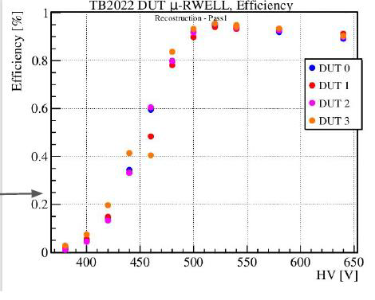
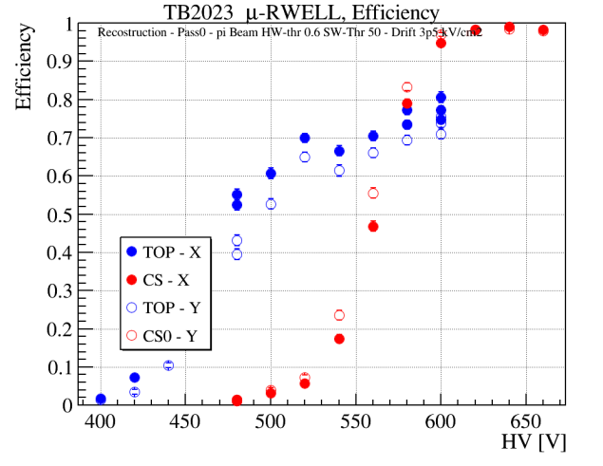
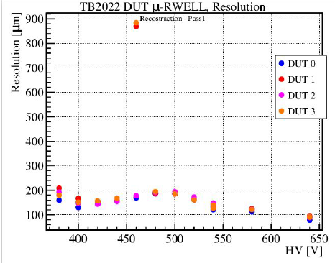
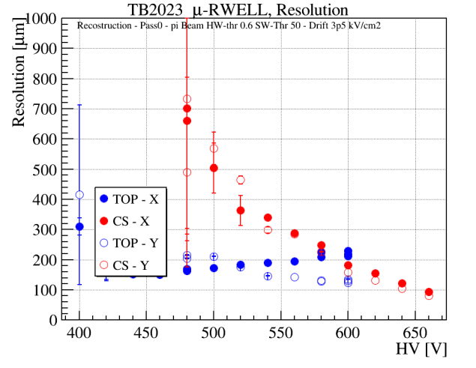
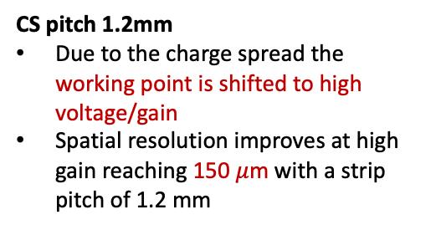
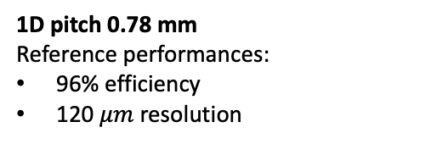
2-D Tracking layouts
CS & TOP
1D pitch 0.78 mm
Reference performances:
96% efficiency
120 $μm$ resolution
CS pitch 1.2mm
Due to the charge spread the working point is shifted to high voltage/gain
Spatial resolution improves at high gain reaching 150 $μ$m with a strip pitch of 1.2 mm
2x1D
CS & TOP
Top-read-out pitch 0.78 mm
low-voltage/gain operation but low efficiency level (80%) due to the geometrical dead zone on the segmented amplification stage
2x1D
October 2022 test beam
June 2023 test beam
10

Slide 11
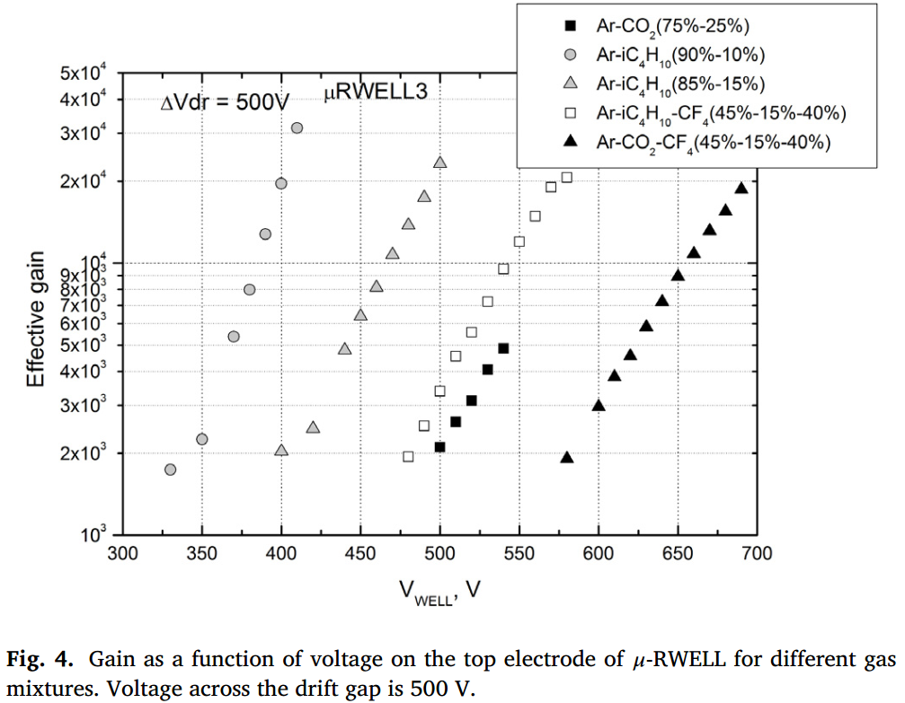
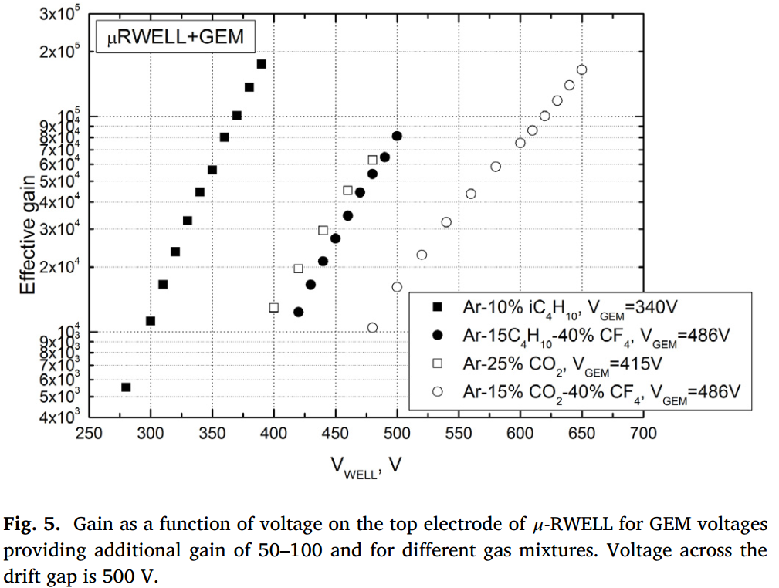
μ-RWELL + GEM – Gain
L. Shekhtman, Nuclear Inst. and Methods in Physics Research, A 936 (2019) 401–404
μ-RWELL + GEM
μ-RWELL
G~60000
G~2000
11

Slide 12
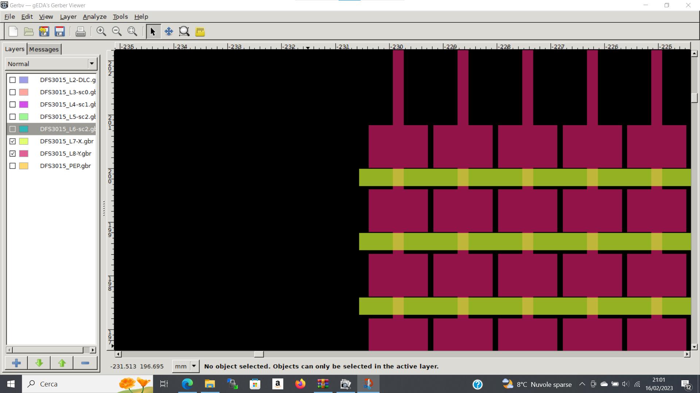
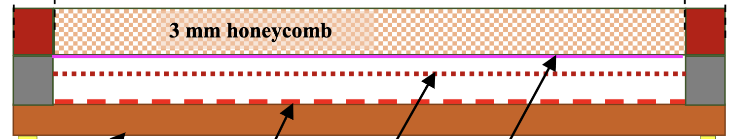


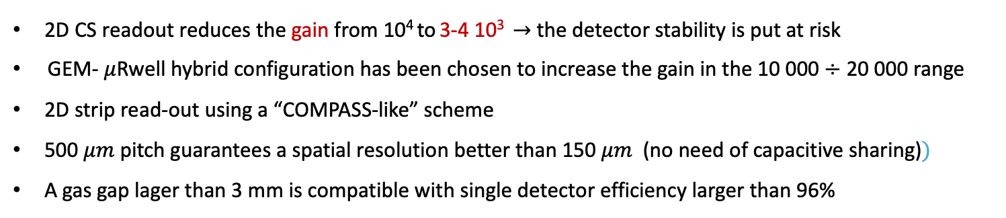
Detector Technology Choices: GEM+$μ$Rwell
GEM - $μ$Rwell Technology
3/6 mm gas gap
2/3 mm transfer gap
PCB read-out
$μ−$Rwell
GEM
cathode
2D CS readout reduces the gain from 10⁴ to 3-4 10³ $→$ the detector stability is put at risk
GEM- $μ$Rwell hybrid configuration has been chosen to increase the gain in the 10 000 $÷$ 20 000 range
2D strip read-out using a “COMPASS-like” scheme
500 $μm$ pitch guarantees a spatial resolution better than 150 $μm$ (no need of capacitive sharing)$⁡)$
A gas gap lager than 3 mm is compatible with single detector efficiency larger than 96%
12

Slide 13
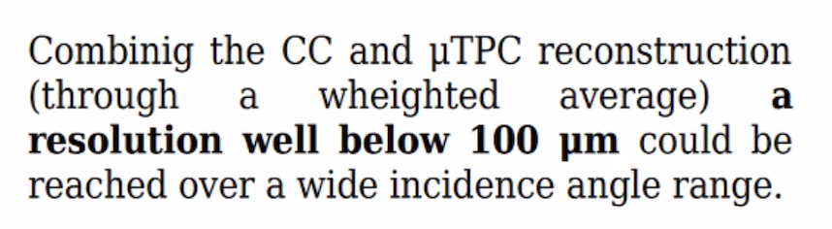
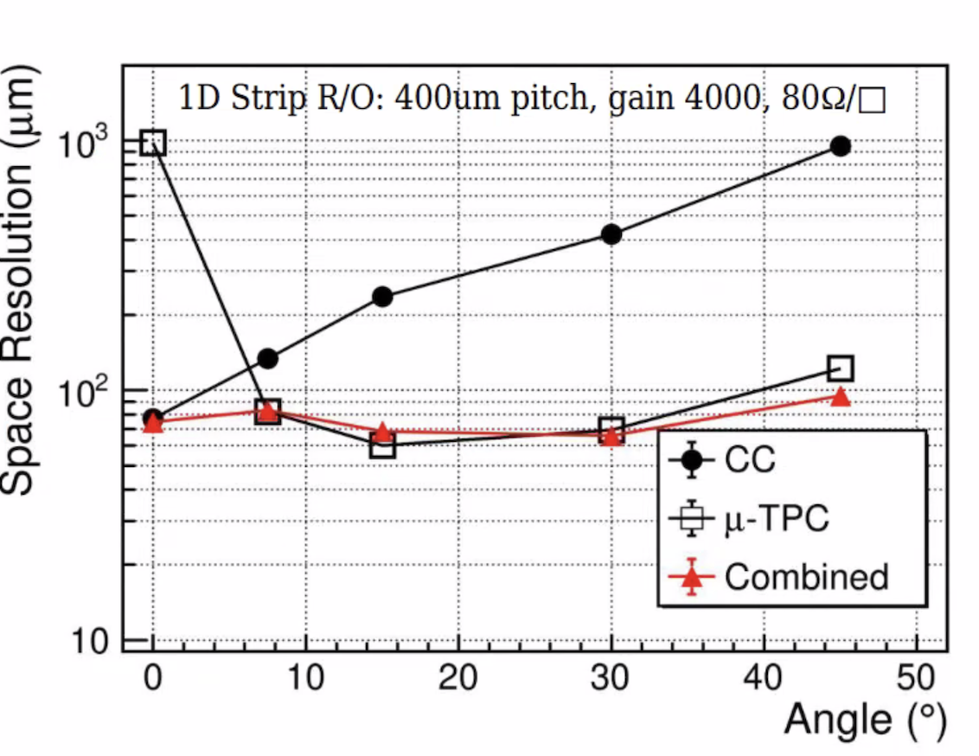
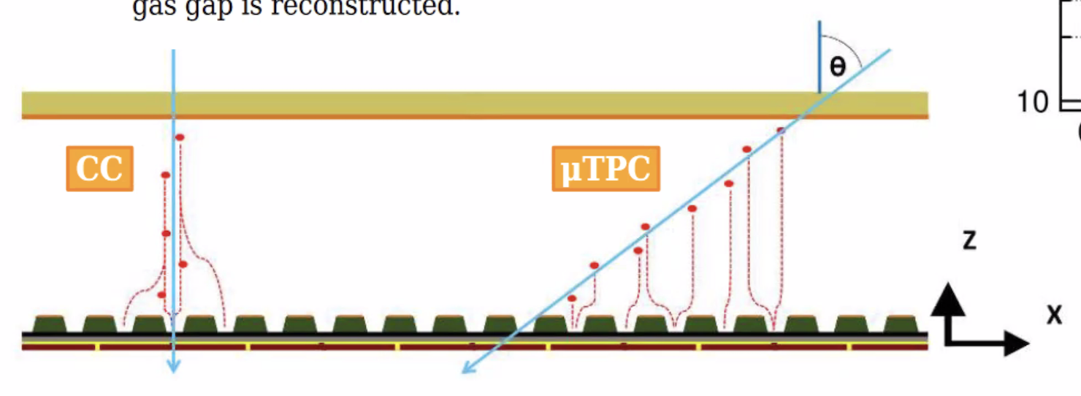

Detector Technology Choices: GEM+$μ$Rwell+ $μ$ TPC
GEM - $μ$Rwell Technology
3/6 mm gas gap
2/3 mm transfer gap
PCB read-out
$μ−$Rwell
GEM
cathode
CC= Charge Centroid
Next test beam Oct/Nov 2024
13

Slide 14

Detector Technology Choices: Detector sectors overlap
1000 mm
1000 mm
$\left|η\right|$>1.99
525 mm
525 mm
14

Slide 15
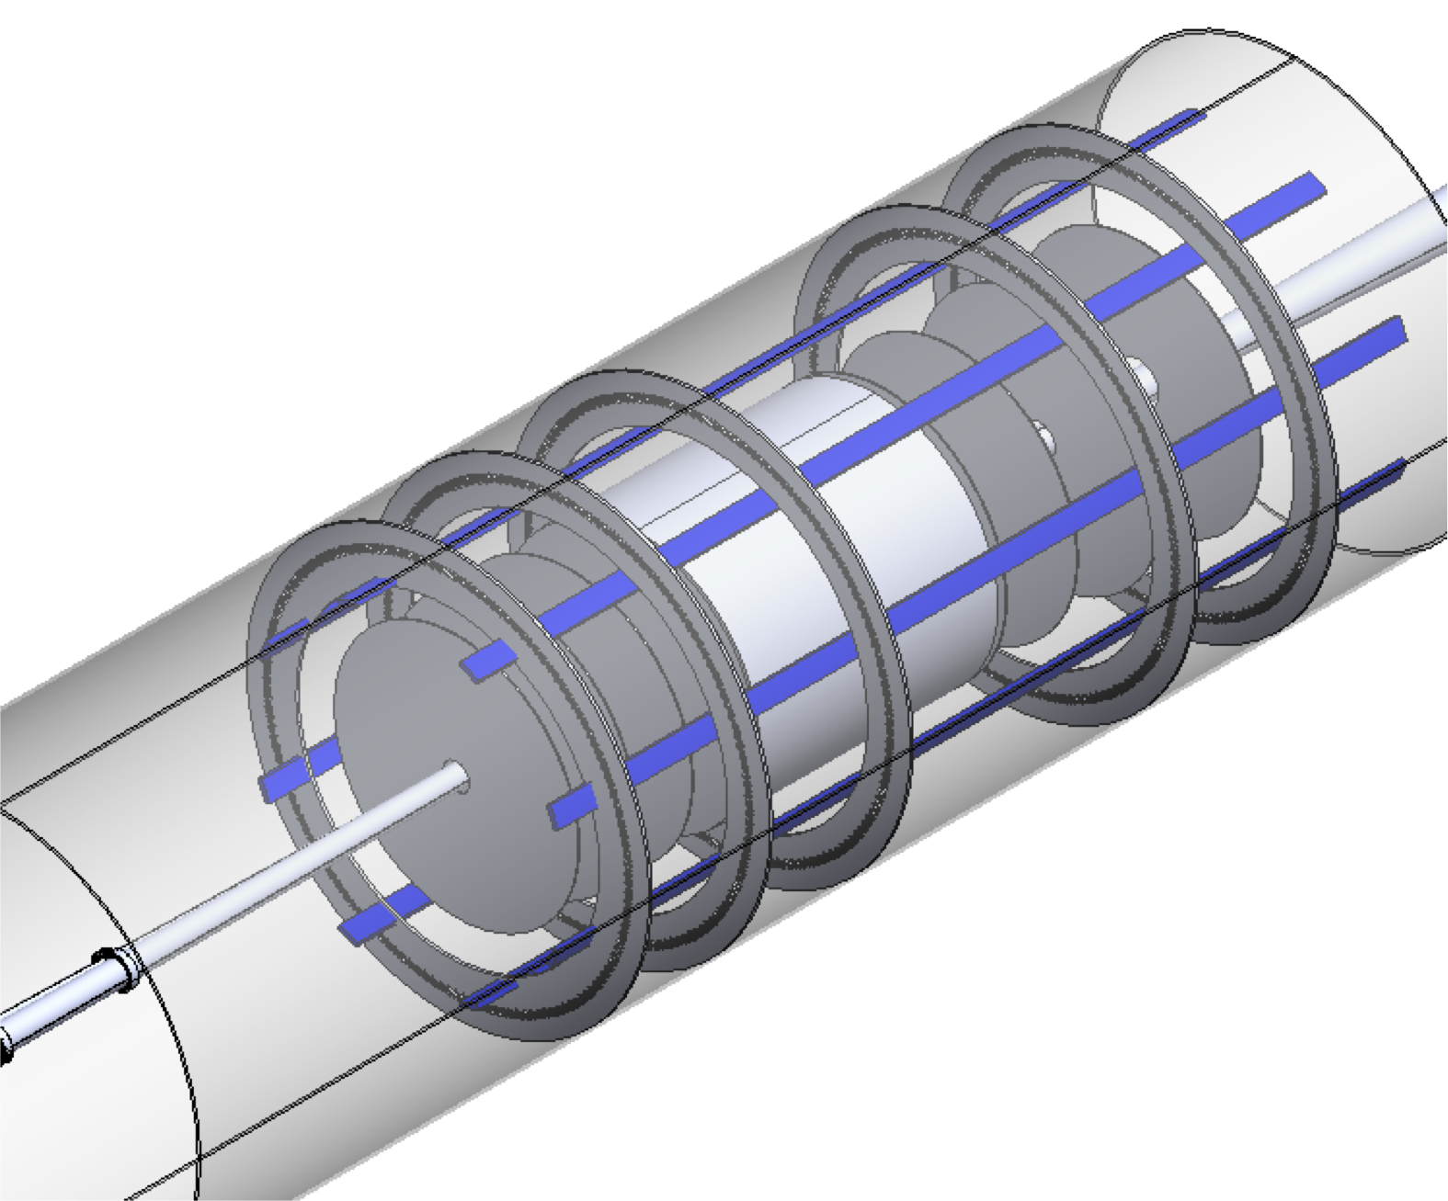
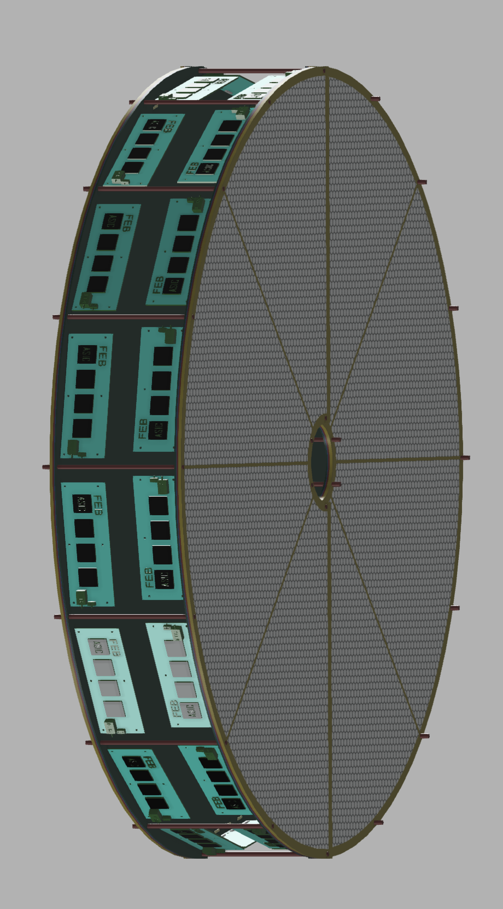
Endcap Detectors Integration in ePIC
The assigned envelope will include the detectors and the FEB electronics.
The disks will be attached together and to the support frame under design.
15

Slide 16
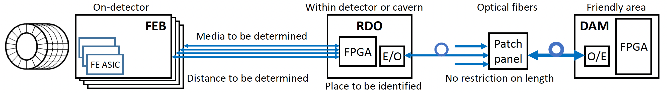
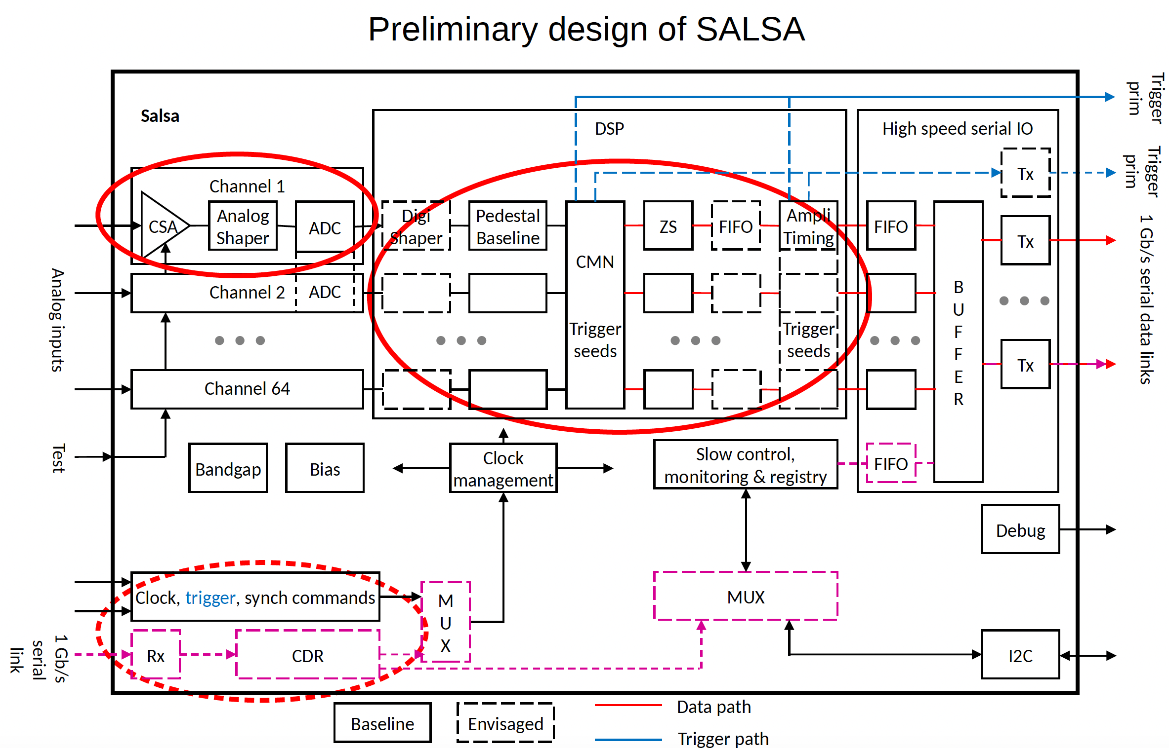
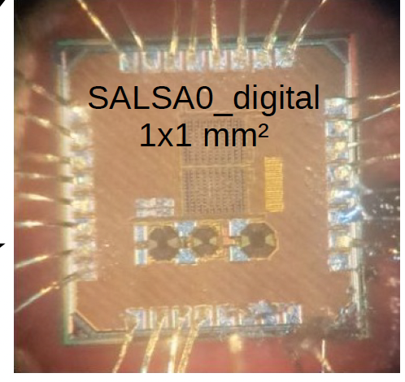
FEB – RDO – DAQ electronics
FEB is based on new SALSA chip designed and produced by the Saclay/San Paulo group for all MPGD detectors
Specific FEB form factor must be designed to fit each detector requirements
Roberto Ammendola
16

Slide 17

INFN Involvement timeline
August 2023: Interest of INFN groups to contribute to the MPGD trackers
1 year time to make the final decision about the INFN responsibility of the endcap construction
Joined DRD-1 and eRD108 communities
December 2023: Direct contact with ePIC management (Rolf Ent)
ePIC/DOE management agreed that INFN takes the leadership of MPGD ECT
eRD108 $→$ PED project: 30 k$ from DOE to provide a design by the end of 2024.
March 2024: Incremental Design and Safety Review (PDR)
Detector technical choices and project design communicated to the management
Very positive feedback
May 2024: MPGD ECT working group reinforced
Interest expressed by Paolo Musico (INFN GE) and local RM TV digital electronic group to contribute to the FEB design
Interest expressed by Temple University to contribute to the Lepton Disks construction
Support from the local INFN Director: electronics workshop and clean room
17

Slide 18
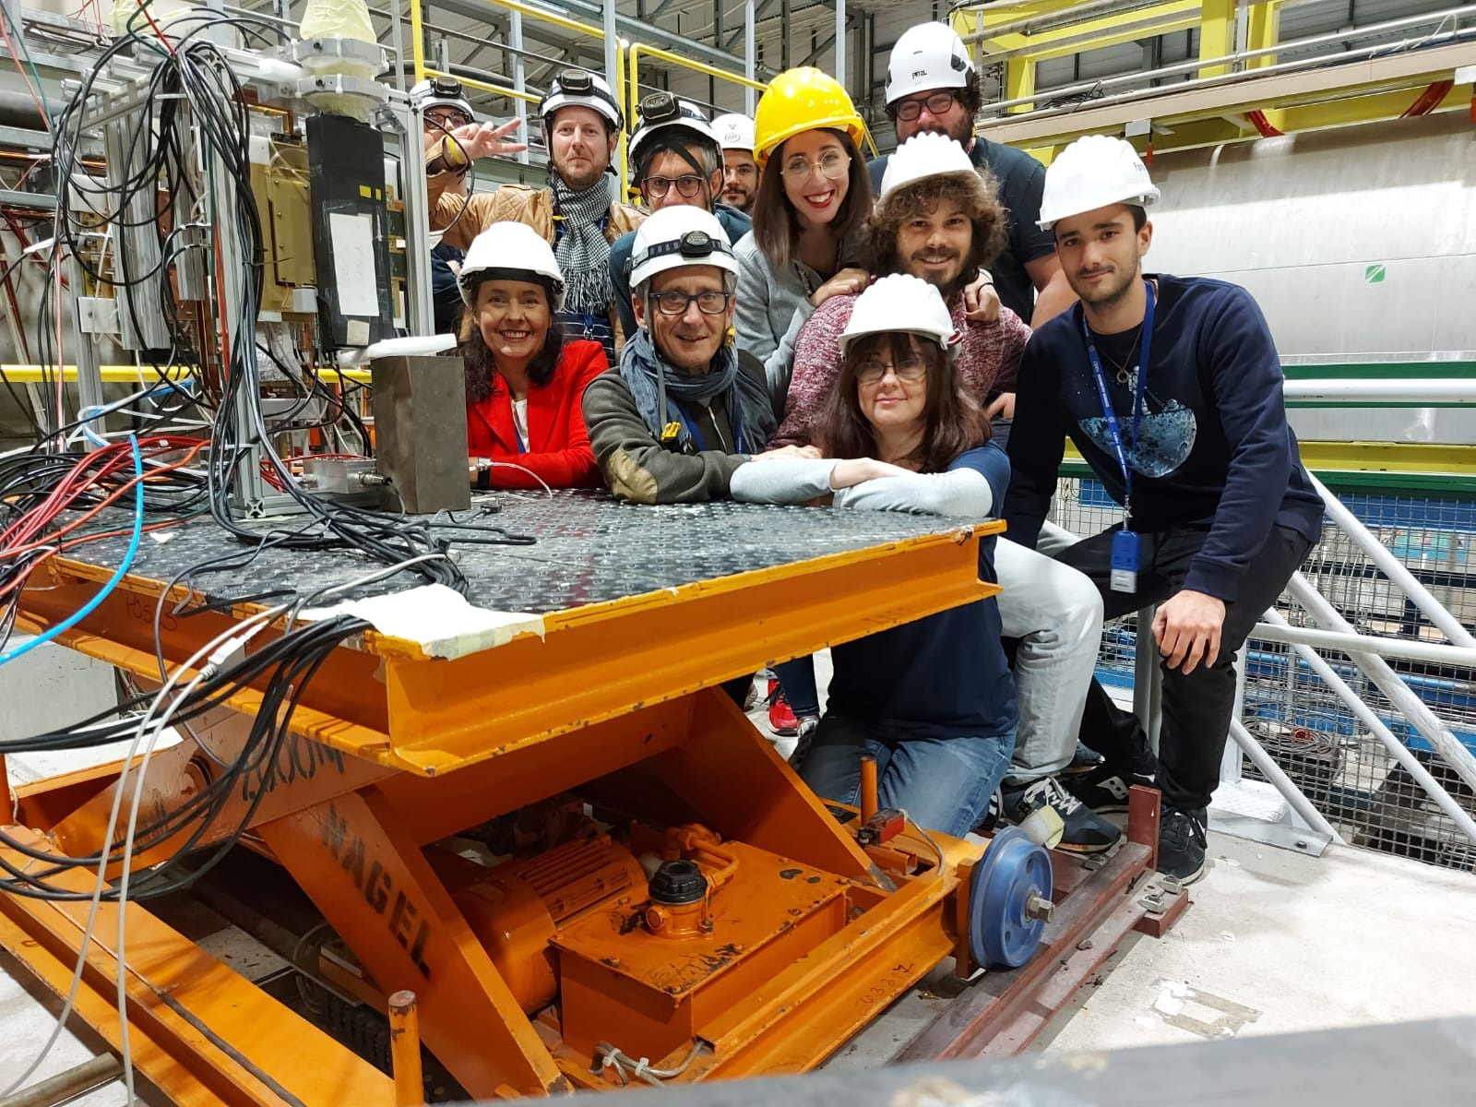

Involved Institutions & Workforce
INFN Workforce:
Roma Tor Vergata
Coordinator: A. D’Angelo,
Detector Hardware and QA: E. Sidoretti (PhD) A. Fantini, L. Lanza, Post Doc
Simulation & Reconstruction: L. Lanza, A. Fantini, R. Di Salvo
FEB Electronics: R. Ammendola
Genova
FEB Electronics: Paolo Musico, M. Battaglieri (streaming ro)
Catania
Simulation & Reconstruction: Mariagela Bondi’
The is performed in close connection with:
the group of Gianni Bencivenni @ INFN LNF and with the JLab detector group (Kondo Gnanvo, Seung Joon Lee)
INFN coordinates the GEM-$μ$Rwell MPGD ECT – for both the Hadron and Lepton Disks
INFN will provide the Hadron Disks and related electronics as In-kind contributions
Temple U. (Bernd Surrow , Matt Posik, ….) have expressed interest for the Lepton Disks.
18

Slide 19
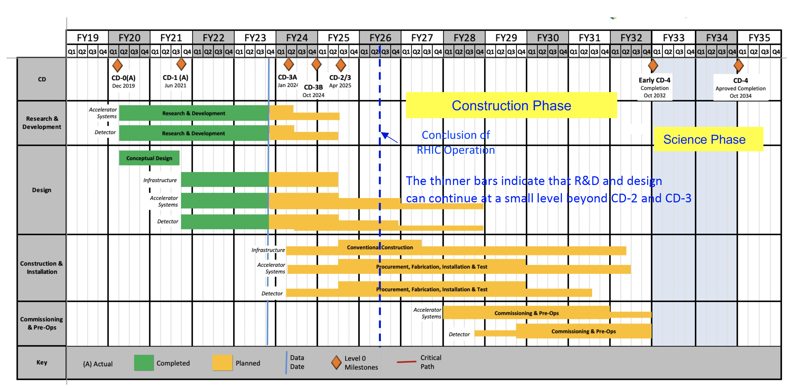
Fabrication and Assembly Plans
Design by end of 2024
2025 - 2026 pre-production and Engineering Test Article
2027 - 2029 production & QA
2030 Commissioning & Installation
MPGD Timeline |  |  | DURATION (years)
START DATE | END DATE | DESCRIPTION
3/1/24 | 12/31/24 | Detectors Overall Design | <1
1/1/25 | 12/31/26 | Pre - Production | 2
1/1/27 | 31/12/29 | Production & QA | 3
1/1/30 | 6/1/30 | Commissioning & Installation | 0.5
19

Slide 20
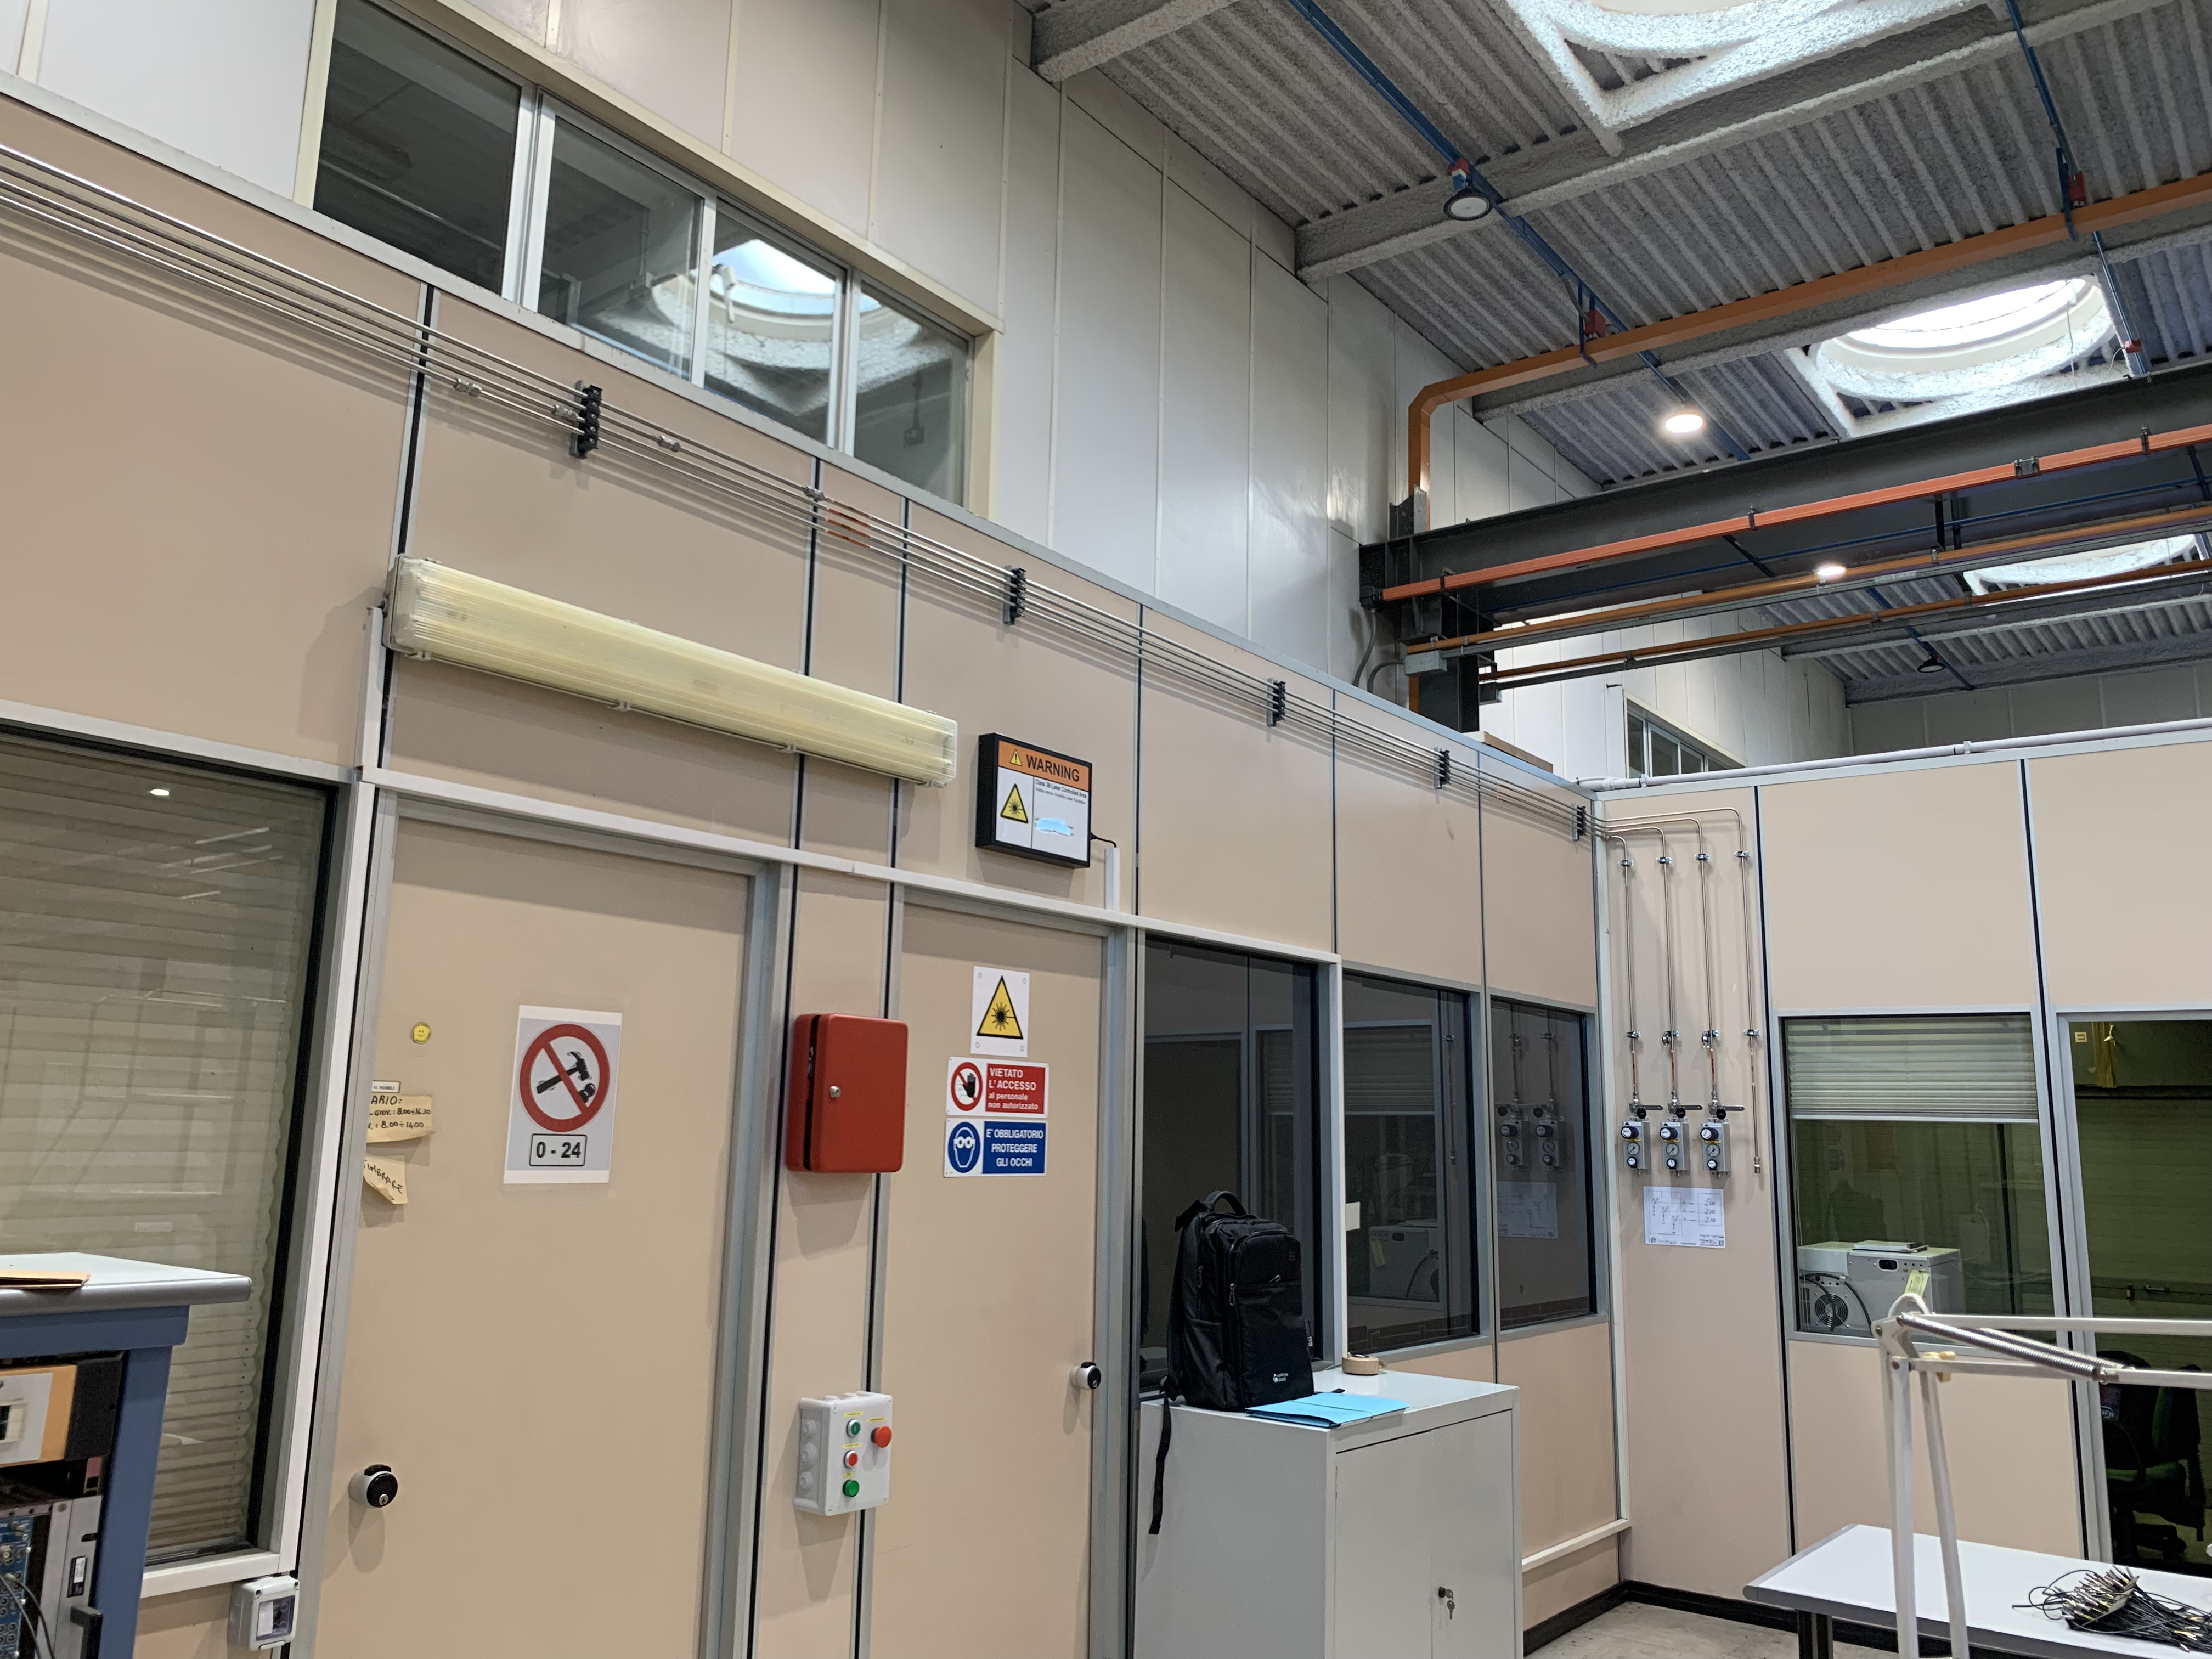
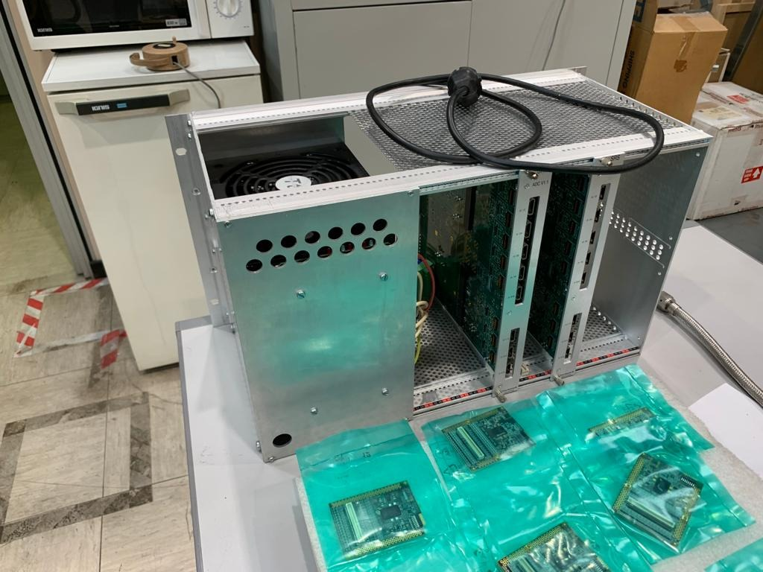
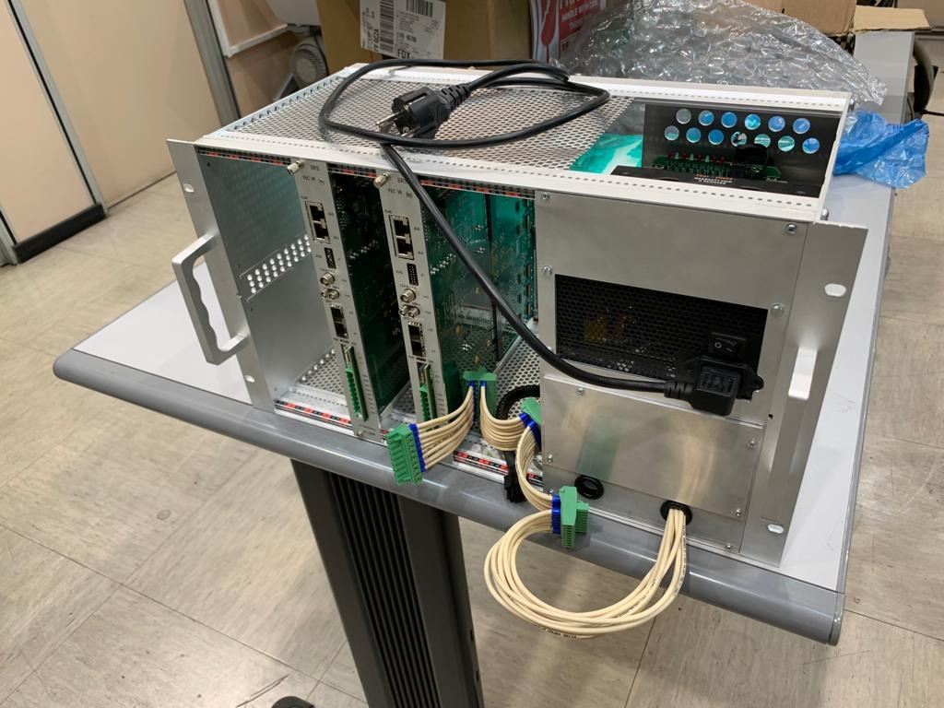
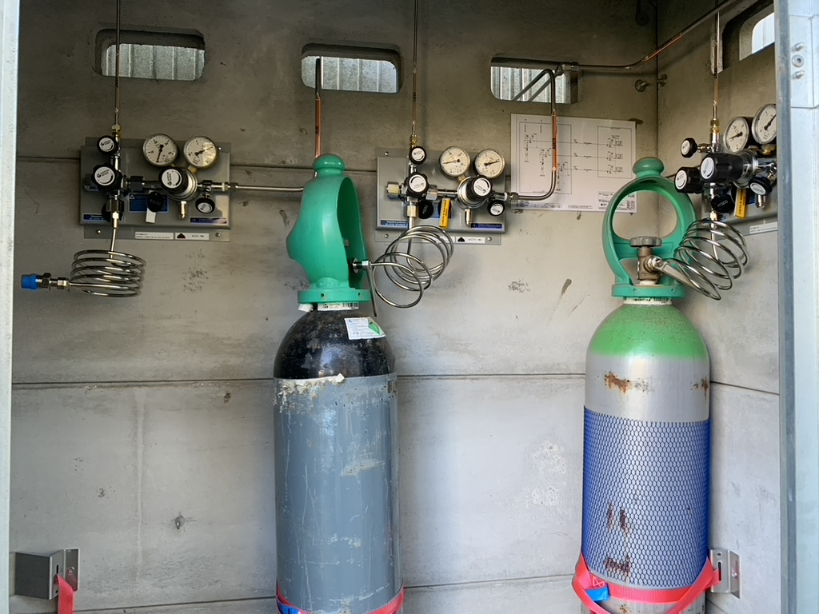
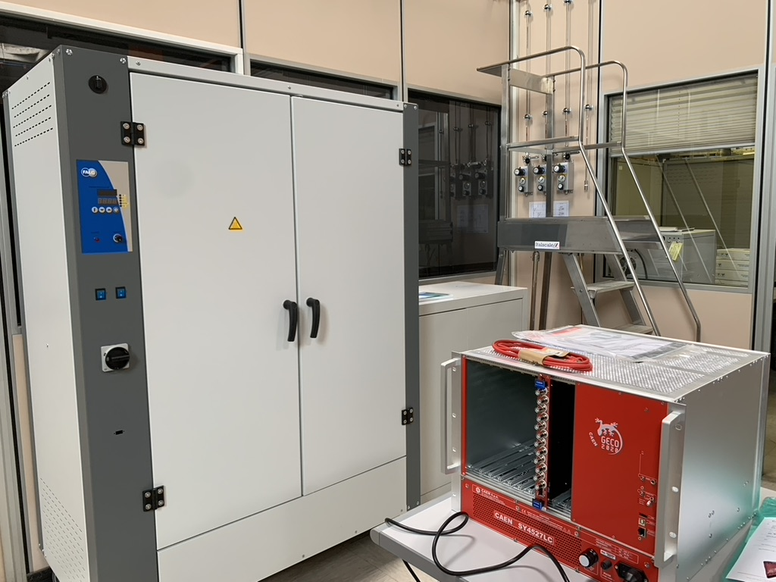
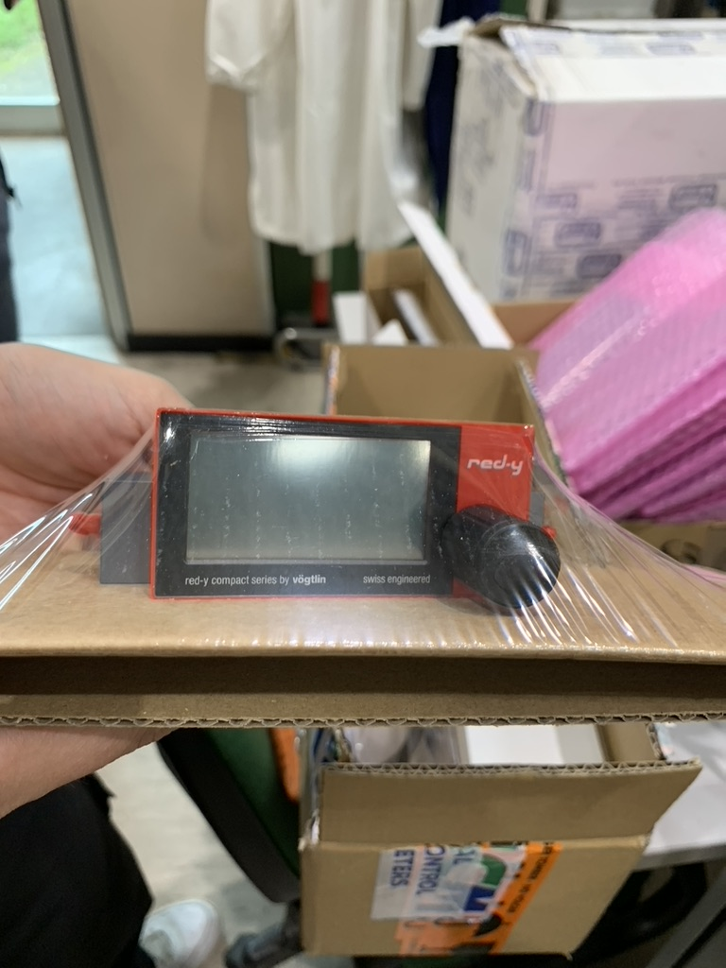
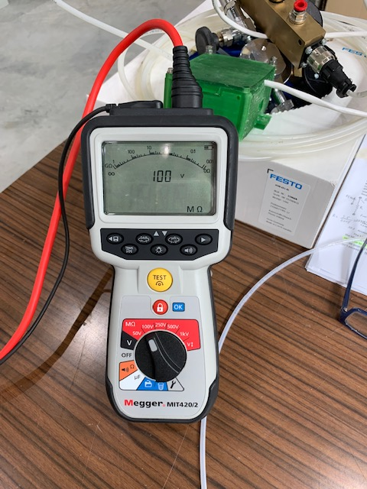
Infrastructures – synergies with JLAB12
The gas distribution system has been installed
APV25 based SRS DAQ
The oven and the
CAEN HV supply are available
Flow controller
The gas mixture
(Ar /CO2/CF445%/15%/40%) and N2 bottles are available
Megger Tester
20

Slide 21

2025 Roma TV Activity
Coordinate the MPGD endcap tracking project
Complete the analysis of GEM-$μ$Rwell 10x10 cm² test beam data:
  characterization of detector gain, efficiency and position resolution
Study the detector response to bend/inclined tracks:
  analysis of $μTPC$mode in 2D
Design and procure the first large area Engineering Test Articles
Implement an emulator of the SALSA chip response to the GEM-$μ$Rwell detector
Contribute to the TDR
Organize the January 2025 ePIC General Meeting at Villa Mondragone
21

Slide 22
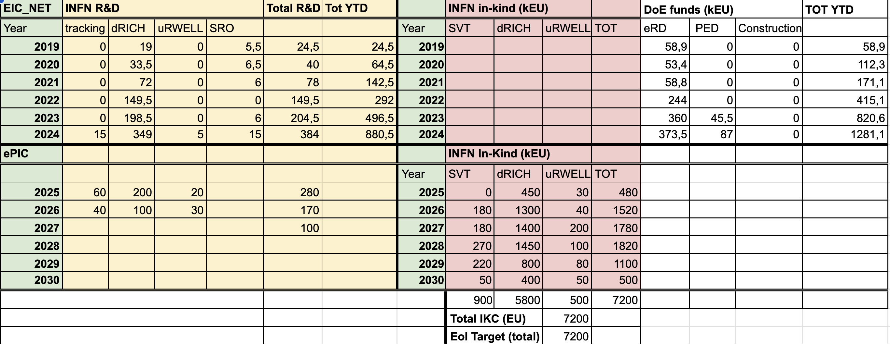
Financial Plan
5050 k€ R&D + 500 k€ coreK
22

Slide 23
2025 Roma TV Financial Requests - Workforce
Roma Tor Vergata
Researchers | Position | FTE
Annalisa D’Angelo | P.O. | 50%
Lucilla Lanza | RTDb | 30%
Roberto Amendola | Tecnologo | 20%
Alessia Fantini | Ric. Univ. | 30%
Rachele Di Salvo | I Ric. INFN | 10%
Bruno Benkel * | Assegnista Tec. | 100%
Gaetano Salina | Dir. Ricerca INFN | 20%
Karolina Armonaite | Assegn. altro ente | 20%
Totale FTE |  | 2.8
* Nuova posizione assegnista attivata su fondi DOE- PED2024
23

Slide 24
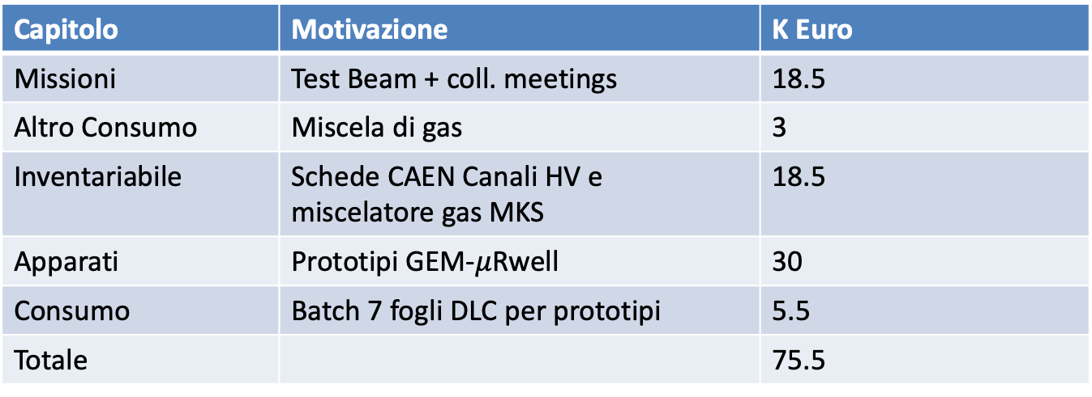
2025 RM TV Financial Requests
Capitolo | Motivazione | K Euro
Missioni | Test Beam + coll. meetings | 18.5
Altro Consumo | Miscela di gas | 3
Inventariabile | Schede CAEN Canali HV e miscelatore gas MKS | 18.5
Apparati | Prototipi GEM-$μ$Rwell | 30
Consumo | Batch 7 fogli DLC per prototipi | 5.5
Totale |  | 75.5
Milestone: 31/12/2025 – Design and procurement of the first Engineering Design Test Article
24

Slide 25
Back-up slides

Slide 26
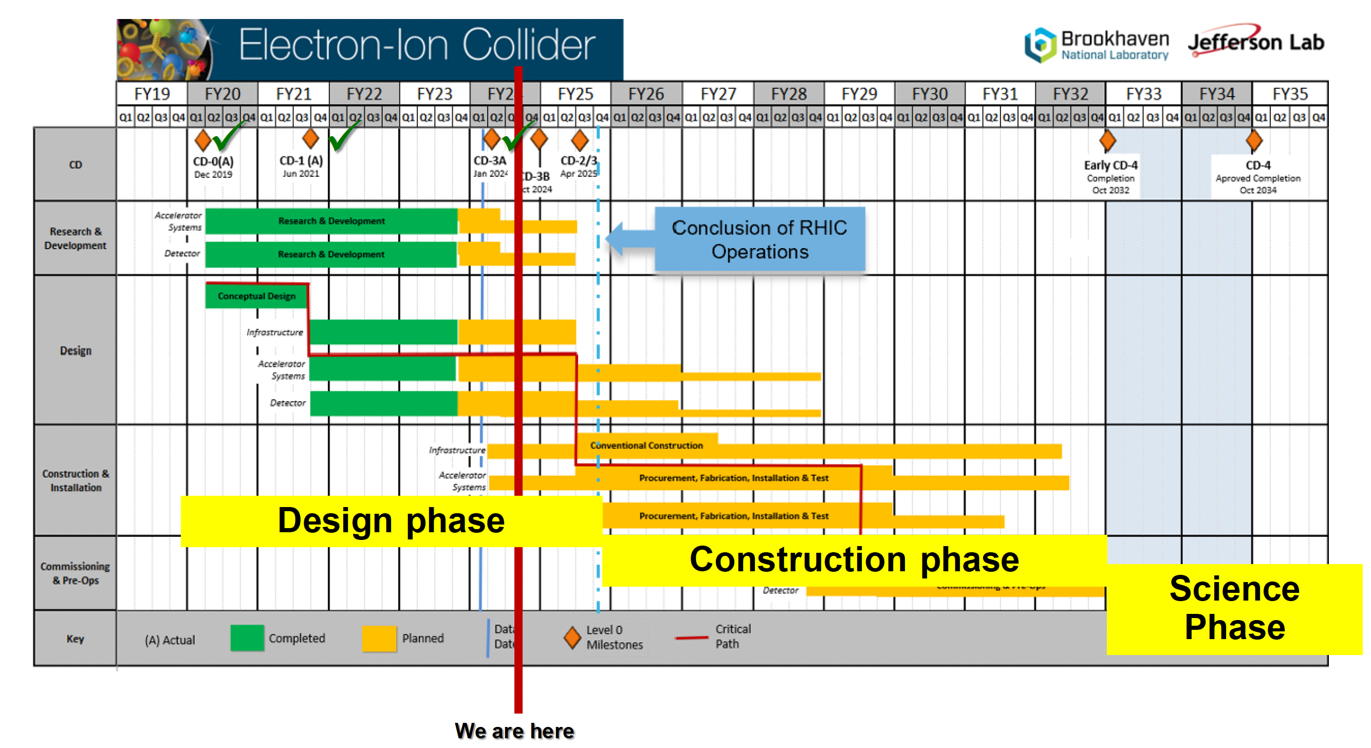
The ePIC Schedule
~
~

Slide 27
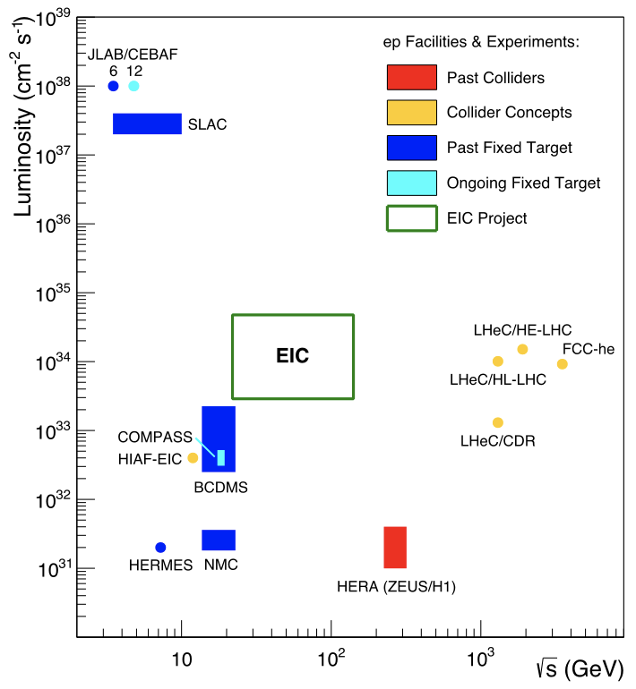

EIC @ BNL
E_{e} =100-140 GeV
Electron-Ion Collider
X1000
If we ask for: - high luminosity and wide range in s
- polarized electron & light-ion beams
- large variety of ion beams
EIC stands out as unique facility

Slide 28

Generalized detector design considerations
Highly integrated design between detector and accelerator
~
~

Slide 29

29

Slide 30


DVCS – The Quintessential Process
GPDs are universal and can be determined in any suitable reaction
Deeply Virtual Compton Scattering
x – longitudinal quark momentum fraction
hard vertices
2ξ – longitudinal momentum transfer
γ
N’
t – four momentum transfer to final N
N
GPD(x,ξ,t)
“handbag” mechanism
t
H, E : spin-independent GPDs
H, E : spin-dependent GPDs
~
~
~
~

Slide 31


Accessing GPDs
ep → e'p'γ
e'
e
e'
e
e'
e
DVCS
+
Bethe-Heitler (BH)
p
p'
p
p'
p
p'
d⁴σ
~ |τ_{DVCS} + τ_{BH}|²
Measure one of various spin asymmetries:
dQ²dxdtdΦ
e.g. polarized beam + unpolarized target:
τ_{DVCS} : derived from GPDs
σ⁺ − σ⁻
σ⁺ + σ⁻
Δσ
2σ
τ_{BH} : derived from Form Factors
A =
=
~ Im(τ_{DVCS})τ_{BH}
~
X. Ji, Phys. Rev. D 55, 7114 (1997)
Δσ_{LU} ~ sinφ Im{F₁H + ξ(F₁+F₂)H +kF₂E} dφ
H(ξ,t)
(other terms kinematically suppressed)
~
~

Slide 32
Accessing GPDs
Different spin asymmetries are sensitive to different GPDs
σ⁺ − σ⁻
σ⁺ + σ⁻
Δσ
2σ
Polarized beam, unpolarized target:
A =
=
~
Δσ_{LU} ~ sinφ Im{F₁H + ξ(F₁+F₂)H +kF₂E} dφ
H(ξ,t)
kinematically suppressed
Unpolarized beam, longitudinal target:
~
~
H(ξ,t), H(ξ,t)
Δσ_{UL} ~ sinφ Im{F₁H+ξ(F₁+F₂)(H +ξ/(1+ξ)E) -...} dφ
kinematically suppressed
Unpolarized beam, transverse target:
Δσ_{UT} ~ sinφ Im{k(F₂H – F₁E) + …} dφ
H(ξ,t), E(ξ,t)
~
kinematically suppressed

Slide 33


Accessing the Forces & Pressure on Quarks
Nucleon matrix element of EMT contains:
Shear forces inside the nucleon
M₂(t) : Mass distribution inside the nucleon
J (t) : Angular momentum distribution
d₁(t) : Shear forces and pressure distribution
∫dx x [H(x,ξ,t) + E(x,ξ,t)] = 2 J(t)
∫dx x H(x,ξ,t) = M₂(t) + 4/5 ξ² d₁(t)
Separate M₂(t) and d₁(t) through measurements at small/large ξ.
Measuring these form factors, we learn about confinement forces.
V. D. Burkert, L. Elouadrhiri & F. X. Girod
Nature, 557 396-399 (2018)
Notes:
The nucleon matrix element of the energy-momentum tensor is known to contain 3 form factors. They describe ….. and can only be measured directly in elastic graviton-nucleon scattering. However, these form factors appear as moments of the unpolarized GPDs as shown here. The quark angular momentum in the nucleon is given by the 2nd moment of the sum of GPD H and E. The mass and pressure distribution of the quarks are given by the 2nd moment of H where the pressure is probed by parameter xi.

Slide 34


Exotic hadrons via photoproduction at EIC
COMPASS proved
that photo-production of exotic states is possible
COMPASS, PLB 783 (2018) 334
O (10⁵) XYZ events in six months at 10³³ cm-² s⁻¹ luminosity @EIC
Z $→$J/$ψ$ $π$ ⁺ (and J J/$ψ$ $→$e⁺e⁻)
It has been studied by the JPAC group

Slide 35




$Z$ photoproduction
The $Zs$ are charged charmonium-like $1^{+−}$ states close to open flavor thresholds
Focus on $Z_{c}{\left(3900\right)}^{+}→J/ψ π^{+}$, $Z_{b}{\left(10610\right)}^{+},Z_{b}^{′}{\left(10650\right)}^{+}→Υ(nS) π^{+}$
The pion is exchanged in the $t$-channel
Sizeable cross sections especially at Low Energies
A. Pilloni – Exotic hadron spectroscopy

Slide 36





$X$ photoproduction
Focus on the famous $1^{++} X\left(3872\right)→J/ψ ρ,ω$
Studying also $X\left(6900\right)→J/ψ J/ψ$ (assumed $0^{++}$)
𝛚 and 𝛒 exchanges give main contributions:
need to assume the existence of a OZI-suppressed $X\left(6900\right)→J/ψ ω$
Extremely suppressed cross sections at HE: LE most promising
A. Pilloni – Exotic hadron spectroscopy
36

Slide 37

Studying exotic hadrons nature via eA
3 10⁴ – 1.5 10⁵ events assuming
300 fb-1intergrated luminosity
Pan-Pan Shi et al., arXiv:2208.02639
37

Slide 38





Semi-Inclusive-Deep-Inelastic-Scattering (SIDIS)
π⁺
p(e,e’π⁺)X
S. Diehl et al Phys Rev Lett 128, 062005 (2022)
Input to TMD program to extract 3D images in quark momentum space.
0.13 < x_{B} < 0.52
z=$\frac{E_{π}}{ν}$
0.3 < z < 0.7
High statistics enabled binning in several kinematical quantities for a total of 344 bins

Slide 39


The unresolved nature
Elementary particles
Nature
States could also be mimic by
Rescattering effects
Quarks & gluons
Color-singlet mesons and baryons
PRD 92 (2015) 071502
PLB 757 (2016) 231
PLB 757 (2016) 61
and others
strong interaction
(long-distance effects)
Compact tetra/pentaquark
Hadronic molecules
PRL 105 (2010) 232001,
PRL 115 (2015) 122001
PRD 100 (2019) 011502 (R)
and others
Diquark-antidiquark
PRD 71, 014028 (2005)
PLB 662 424 (2008)
qqg hybrid, glueball or mixture
Color Forces
Hadrocharmonium/adjoint charmonium
PLB 666 344 (2008)
PLB 671 82 (2009)
Nuclear Forces
39

Slide 40



Exclusive (quasi-real) photoproduction
XYZ have so far not been seen in photoproduction: independent confirmation
Not affected by 3-body dynamics: determination of resonant nature
Experiments with high luminosity in the appropriate energy range are promising
We study near-threshold (LE) and high energies (HE)
Couplings extracted from data as much as possible, not relying on the nature of XYZ
M. Albaladejo et al. [JPAC], PRD
$$<λ_{𝒬}λ_{N}^{′}|T|λ_{γ}λ_{N}>=\underset{V,ℰ}{∑}\frac{ef_{V}}{m_{V}}𝒯_{λ_{V}=λ_{γ},λ_{𝒬}}^{α_{1}⋯α_{j}}𝒫_{α_{1}⋯α_{j};β_{1}⋯β_{j}}ℬ_{λ_{N}λ_{N}^{′}}^{β_{1}⋯β_{j}}$$
Bottom vertex from standard photoproduction pheno,
exponential form factors to further suppress large t
Top vertex from measured $𝒬→Vℰ$ decay width
VMD is used to couple the incoming photon
to a vector quarkonium V
A. Pilloni – Exotic hadron spectroscopy

Slide 41

Missing Baryons in QCD Phase Transition

Slide 42




Why N* ? From the Hydrogen Spectrum to QCD
Niels Bohr (1922)
Spectral series of hydrogen
Understanding the hydrogen atom’s ground state requires understanding its excitation spectrum.
Understanding the proton’s ground state requires understanding its excitation spectrum.
From Bohr model of the atom to QED.
From the Constituent Quark model to QCD.

Slide 43

LQCD N* & Δ Spectra
Exhibit the SU(6)×O(3)-symmetry features
Counting of levels consistent with non-rel. quark model
Striking similarity with quark model
No parity doubling
4
5
3
1
2
3
2
1
1
1
2
2
1
Δ(1232)
N(938)
Problems are not solved!
Robert G. Edwards, Jozef J. Dudek, David G. Richards, Stephen J. Wallace
Phys.Rev. D84 (2011) 074508

Slide 44

Electroexcitation of N*/Δ resonances
Central question in hadron physics:
what are the relevant degrees of freedom at varying distance scale?
[56,2⁺]
2
N(1680)5/2⁺
N(1720)3/2⁺
Probe resonance strength vs photon virtuality Q
L_{3q}
[70,1⁻]
N(1675)5/2⁻
N(1520)3/2⁻
N(1535)1/2⁻
1
[56,0⁺]
0
Δ(1232)3/2⁺
N(940)
N(1710)1/2⁺
N(1440)1/2⁺
[70,0⁺]
0
1
N [ħω]
2

Slide 45



Electroexcitation kinematics
Measured σ are decomposed using UIM or fixed-t DR to extract N* & Δ helicity amplitudes.

Slide 46

Electrocouplings of the ‘Roper’ in 2016
LF RQM: I. Aznauryan, V.B. arXiv:1603.06692
Quark-core contributions from DSE/QCD
J. Segovia et al. PRL 115 (2015) 171801.
Meson Baryon cloud inferred from CLAS data as the difference between data and the quark-core evaluation in DSE/QCD.
V. Mokeev et al., PR C 93 (2016) 025206.
N(1440)1/2⁺
Non-quark contributions are significant at Q²< 2.0 GeV².
The 1st radial excitation of the q3 core emerges as the probe penetrates the MB cloud.

Slide 47

MB Contribution to electro-excitation of N(1535)1/2⁻
N(1535)1/2⁻
is consistent
with the 1st
orbital excitation
of the nucleon.
Meson-baryon cloud may account for discrepancies at low Q².

Slide 48

MB Contribution to electro-excitation of N(1675)5/2⁻
Measures the meson-baryon contribution to the γ* p N(1675)5/2⁻ directly.
Can be verified on γ* n N(1675)5/2⁻ which is not suppressed

Slide 49




Back to the basics of Hadron Physics
Where we are:
Elastic lepton scattering determined the nucleon's charge & magnetism distributions in sphere with <r_{ch}> $≈$ 0.84 fm
Largest fraction of energy in proton (x) carried by 3 valence quarks (2u,d), but very small fraction of proton spin
Nucleons show additional dynamically generated quark-antiquark pairs & gluons carrying low fraction of energy
Quark & gluon longitudinal momentum fractions have been well mapped out Nucleon spin & mass have large contributions from quark-gluon dynamics, described by QCD

Slide 50



How did we learn this?
Deep Inelastic Scattering (DIS)
Q² = s $∙$ x $∙$ y
s center-of-mass energy squared
Q² resolution power
x the fraction of the nucleon’s
momentum carried by the struck
quark (0 < x < 1)
y inelasticity
As a probe, electron beams provide unmatched precision of the electromagnetic interaction
Direct, model independent determination of parton kinematics and spin of physics processes at the leading order
Additional information obtained indirectly from hadron-collider measurements

Slide 51



Nucleon Structure Evolution
elastic scattering
deep-exclusive scattering
deep-inelastic scattering
Transverse quark distribution in coordinate space
Correlated quark space and
momentum distributions – GPD
Longitudinal quark distribution in momentum space

Slide 52

QCD exploration at EIC
REQUIREMENTS
Access to gluon dominated region and wide kinematic range in x and Q2
Access to spin structure and 3D spatial and momentum structure
Accessing the highest gluon densities
Studying observables as a function of x, Q2, A, hadronic flavour, …
THE EIC COLLIDER PROVIDES
Large center-of-mass energy range:
√s = 21 -140 GeV
Polarized electron, proton and light nuclear beams
≥ 70%
Nuclear beams, the heavier the better (from H to U)
High luminosity (100 x HERA): 10³³⁻³⁴ cm⁻² ^{s-1}

Slide 53
History of Nucleon Structure Studies
1950-1960: Does the proton have finite size and structure?
  Elastic electron-proton scattering
    the proton is not a point-like particle but has finite size – seen through charge and current distribution in the proton G_{E}/G_{M}
Nobel prize 1961- R. Hofstadter
1960-1990: What are the internal constituents of the nucleon?
  Deeply inelastic scattering
    discover quarks in ‘scaling’ of structure function - measure their momentum and spin distributions
Nobel prize 1990 - J. Friedman, H. Kendall, R. Taylor
Today: Unraveling a 3-D image of the quark and gluon distributions, including mass, spin, and pressure distributions

Slide 54



Critical QCD Questions Addressed
How do properties of colorless hadrons emerge from the confined dynamics of colored quarks and gluons?
QCD is the most complex part of the Standard Model
At Nucleon mass scale (1 GeV), dynamics is highly nonlinear and leads to confinement of partons. How do N mass / size / spin emerge from these dynamics?
“Nucleons are the stuff of which our world is made.
As such they must be at the center of any discussion of why the world we actually experience has the character it does.”
Nathan Isgur, 2000
Derek B. Leinweber – University of Adelaide

Slide 55



Critical QCD Questions Addressed
How do massless quarks acquire mass?
Effective quark mass depends on its momentum
numerical simulations
of unquenched lattice QCD
(Bowman et al.)
M=M(p)
m₀=m_{HM}
Dyson-Swinger equation
(Bhagwat et al.)
dressed quark
bare quark
dressing kernel
mass composition
<2% Higgs mechanism
>98% non-perturbative strong interaction
Almost all the nucleon mass comes from the energy spent to bind the quarks inside it!

Slide 56



Critical QCD Questions Addressed
How are the quarks and gluons, and their intrinsic spins distributed in space & momentum inside the nucleon? What is the role of the angular momentum ?
SIDIS and TMDs measurements toward a 3D imaging of the proton

Slide 57
Critical QCD Questions Addressed
How is color confinement realized in the force and pressure distributions and stabilize nucleons?
Electro-magnetism
Vector
Tensor
Gravity
Q_{p} μ_{p}
M_{p} J_{p} D_{p}
PCAC
g_{A} g_{P}
Weak interaction
Study GPDs and their moments from DVCS

Slide 58




Critical QCD Questions Addressed
Where does gluon saturation set in ? Universal gluonic matter at high density ? quark-gluon interactions in nuclear matter ?
Gluon self-interaction leads to the proliferation of the number of gluons
Unitarity → gluons must recombine to balance splitting (saturation)

Slide 59
Critical QCD Questions Addressed
How do properties of colorless hadrons emerge from the confined dynamics of colored quarks and gluons?
      Measure the Q² dependence of hadrons electrocouplings and form factors
How do massless quarks acquire mass?
Access the Energy - Momentum Tensor and the Gravitational Form Factors
How are the quarks and gluons, and their intrinsic spins distributed in space & momentum inside the nucleon? What is the role of the angular momentum ?
SIDIS and TMDs measurements toward a 3D imaging of the proton
How is color confinement realized in the force and pressure distributions and stabilize nucleons?
Study GPDs and their moments from DVCS
Where does gluon saturation set in?
Study deep processes o Nuclei
The EIC scientific program addresses all these questions

Slide 60

The ePIC Central Detector
~
~

Slide 61

The ePIC Solenoid
~
~

Slide 62

The ePIC Tracking
~
~

Slide 63

The ePIC Silicon Tracking
~
~

Slide 64

The ePIC MPGD Tracking
~
~

Slide 65


The ePIC Calorimeters
~
~

Slide 66

The ePIC PID
high performance DIRC (hpDIRC)
Dual radiator RICH
(dRICH)
Aerogel and C₂F₆
proximity focusing RICH
Low Gain Avalanche Detector
~
~

Slide 67

The ePIC detector
~
~

Slide 68


More on Technical Performance Requirements
Rate Capability
  Not critical ~ 1 kHz/cm² or less
Radiation Hardness
  Not critical for the detectors
  Important for FEBs and RDO electronics boards
Temperature Stability
  Not critical for the detector performances
  Detector calibration should consider gas pressure variations
Electronics power consumption and cooling
  SALSA ASIC consumption ~ 15 mW/channel at 1.2V $→$ 60 W/disk
  Air vs liquid cooling is under study at Saclay
68

Slide 69

Final Considerations

