Slide 1
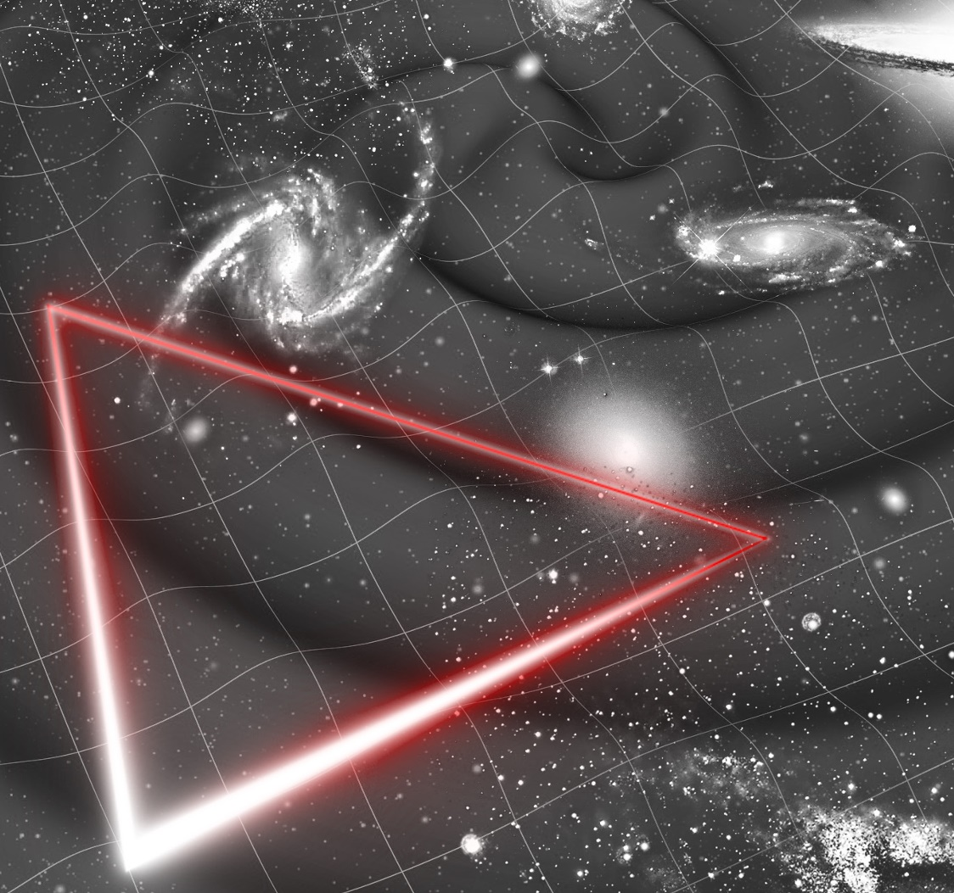





LISA – Preventivi 2024
Carlo Zanoni
(on behalf of Rita Dolesi and the LISA team)

Slide 2
Questions addressed by GW (AdV+, ET/LISA)
Fundamental questions in Gravity:
  New/further tests of GR
  Exploration of possible alternative theories of Gravity
Fundamental questions in particle physics
Probing the EOS of neutron stars
Cosmology and Cosmography with GWs
Accurate Modelling of GW waveforms
GW models in alternative theory of gravitation
What is the explosion mechanism in Supernovae?
What is the history of SuperMassive black holes?
GW Stochastic Background? Probing the big bang?
Multimessenger Astronomy in 3G?
Fundamental interactions, Dark matter, dark energy
Inflation, additional interactions, dark matter
Nuclear physics, quark-gluon plasma
Cosmology
Cosmology
Nuclear physics
Cosmology
Astroparticle, GRB, Neutrino Physics
Credit: M. Punturo 2020

Slide 3
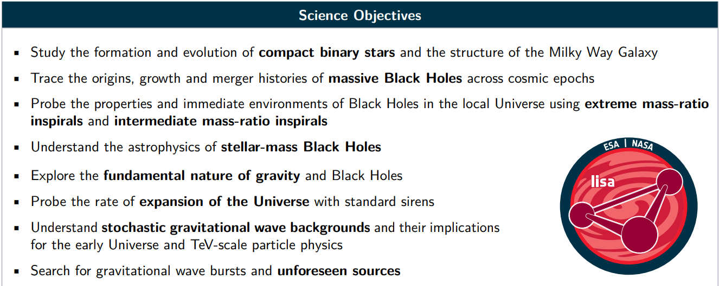
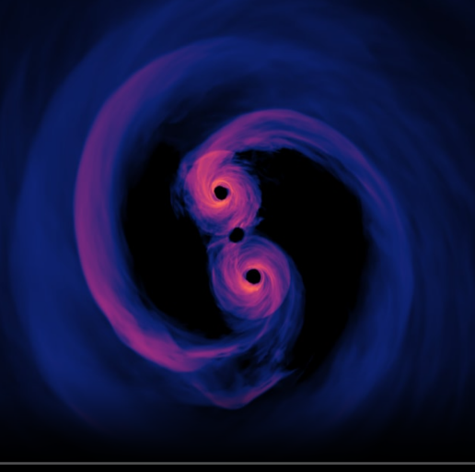
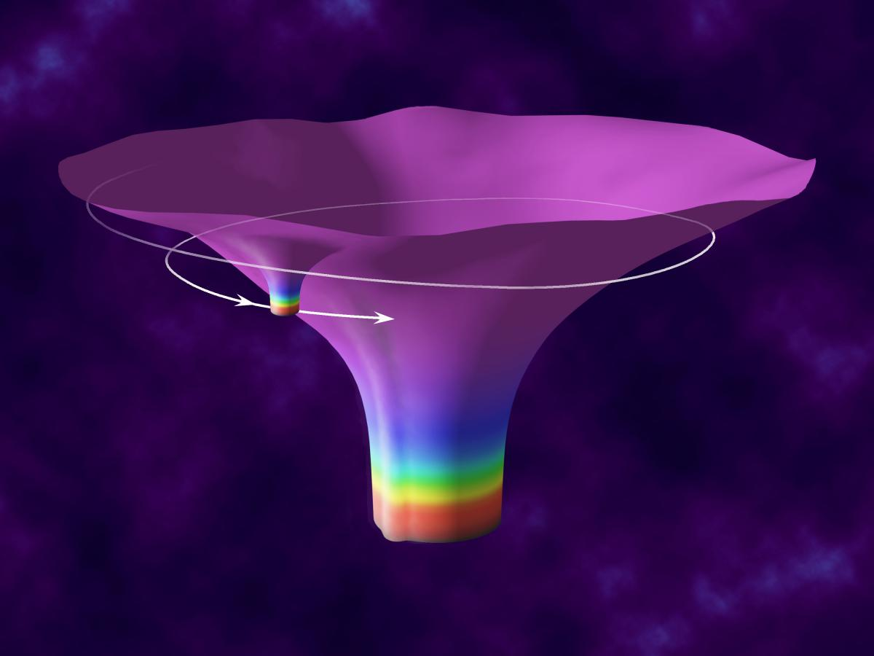
LISA science objectives
LISA Definition Study Report - ESA-SCI-DIR-RP-002 https://arxiv.org/ftp/arxiv/papers/2402/2402.07571.pdf
Some of the uniqueness of LISA
Supermassive Black Holes binaries
with high signal to noise
Extreme Mass Ratio Inspirals
Inspiral of stellar–mass compact object into massive black hole. If the compact object is a white dwarf, possible electromagnetic counterpart
Test the properties of the space time around massive dark objects. the presence of dark matter which causes a different phase evolution.
Credits to NASA SVS

Slide 4
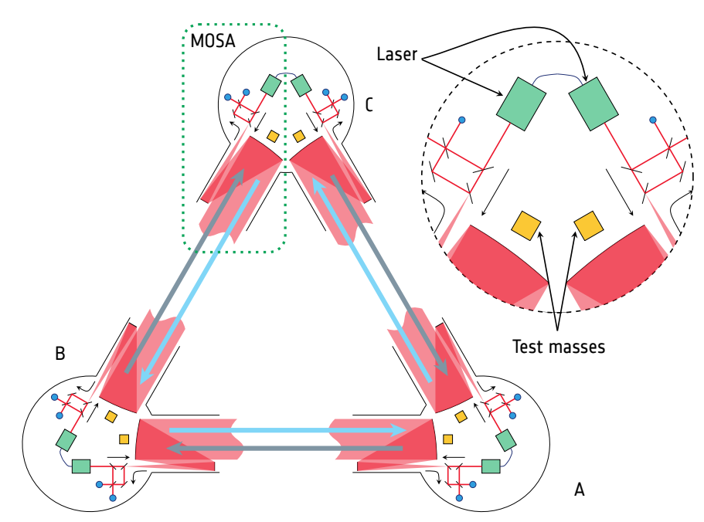
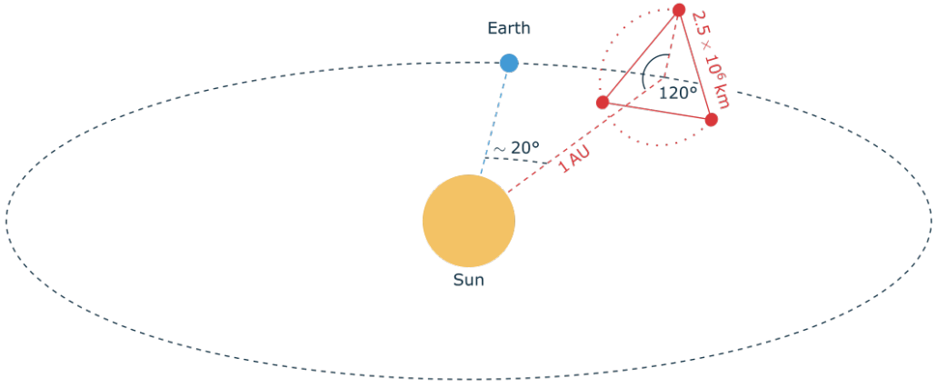
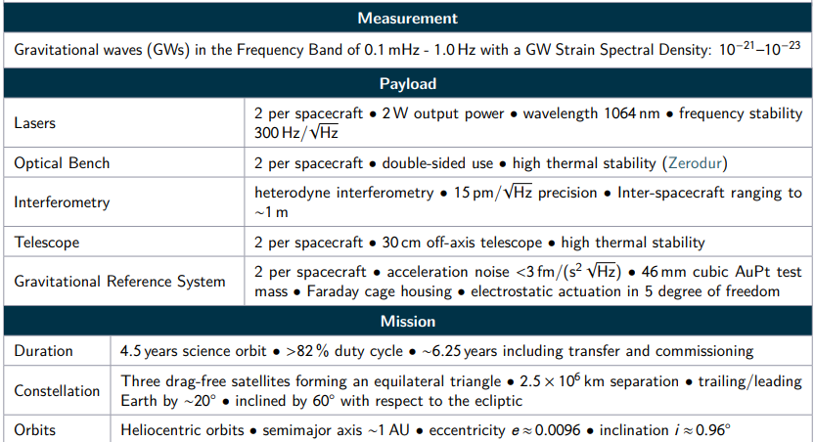
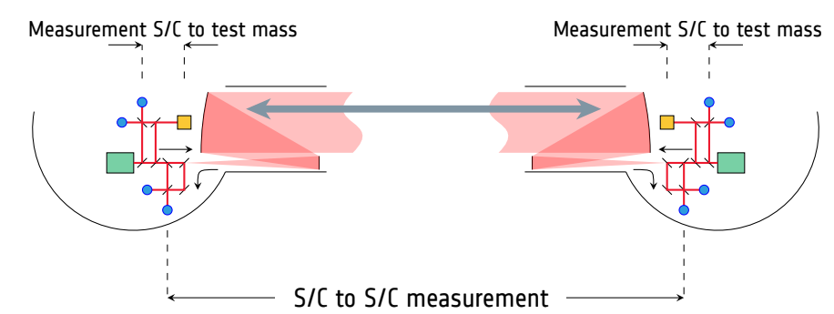
LISA concept
LISA Definition Study Report - ESA-SCI-DIR-RP-002 https://arxiv.org/ftp/arxiv/papers/2402/2402.07571.pdf

Slide 5
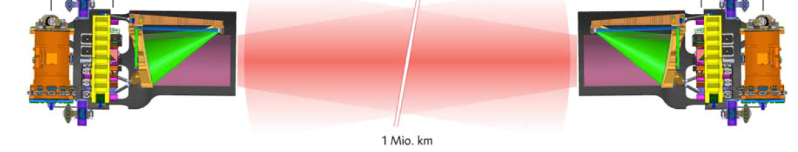
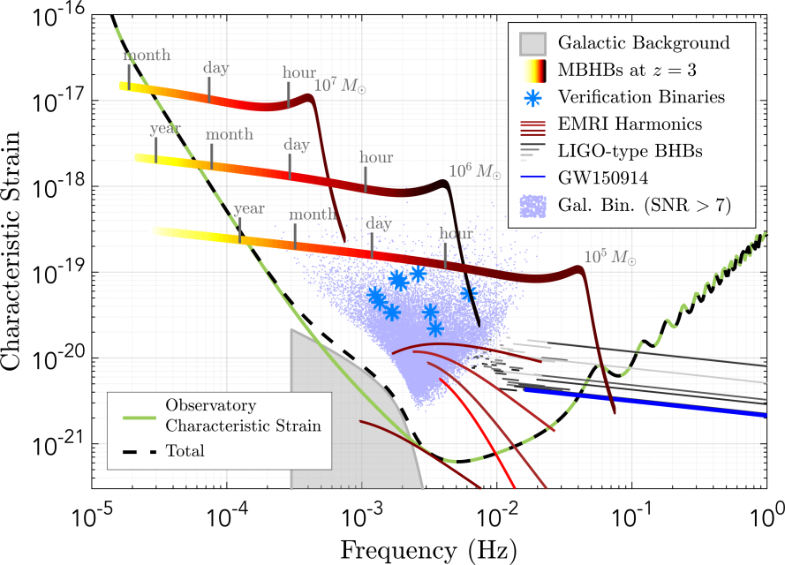
LISA Sensitivity
Measure acceleration between free-falling test masses (TM) 2.5 million km apart
  3 parts: TM-SC, SC-SC, SC-TM
  Spacecraft controlled to follow TM:
  drag-free control (nm/Hz^{1/2} level)
2.5 Million km
Interferometer readout noise,
15 pm/Hz^{1/2}
(High freq limit)
TM acceleration noise,
3 fm/s²/Hz^{1/2}
(Low freq limit - crucial for SMBH)

Slide 6
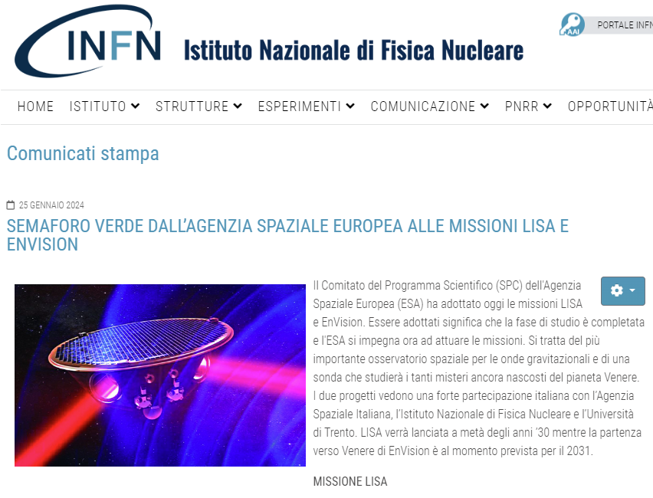
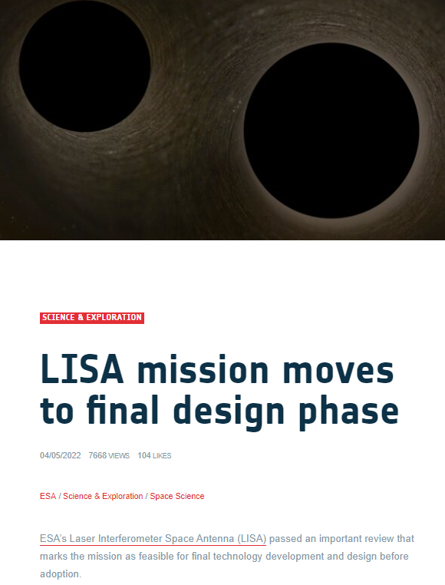

LISA is an adopted mission (Jan-24)
On the trail of the:
LPF success,
GW observations on-ground and
intense preparatory work since 2017
and recognizing:
a robust scientific case and
the technical feasibility (TRL > 5)
the LISA study becomes a project and starts its implementation.

Slide 7
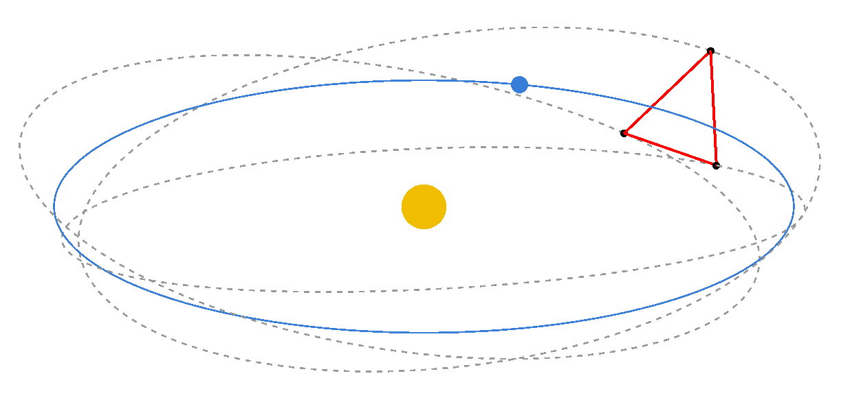
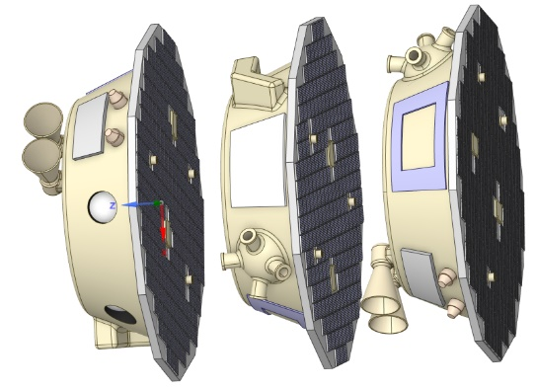
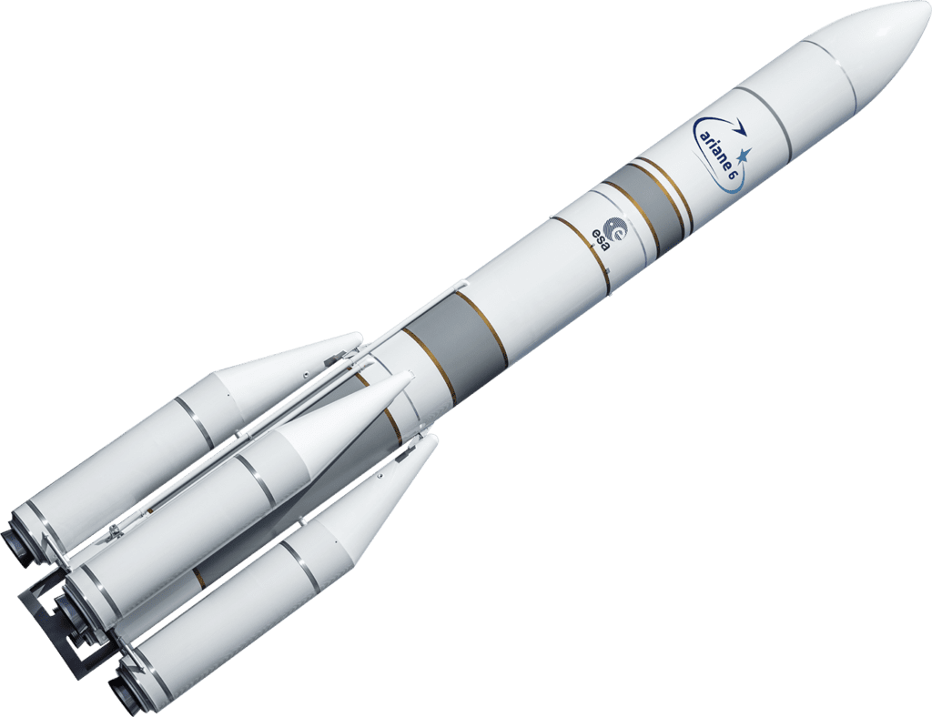
LISA Product Breakdown (notional)
LISA
Ground segment
Space segment
Spacecraft
Payload
Moving Optical Sub-Assembly
Interferometry Detection System
Gravitational Reference System
Telescope
ESA
Customer Furnished Items (CFIs)

Slide 8
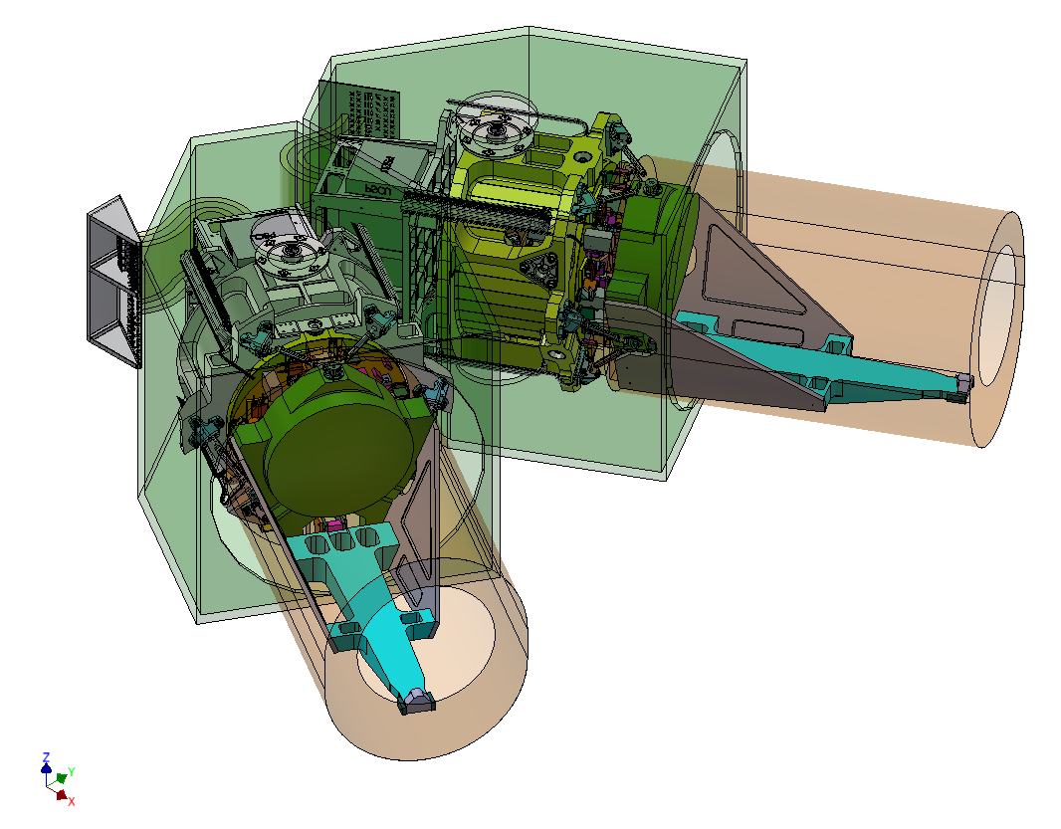
LISA Product Breakdown (notional)
LISA
Ground segment
Space segment
Spacecraft
Payload
Moving Optical Sub-Assembly
Interferometry Detection System
Gravitational Reference System
Telescope
ESA
Equivalent to VIRGO end-station
Customer Furnished Items (CFIs)

Slide 9
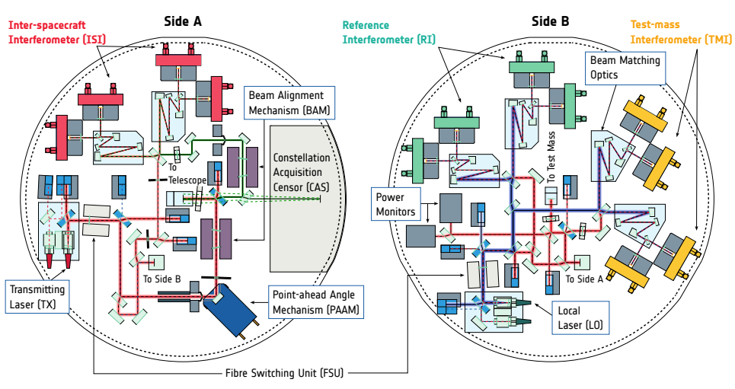

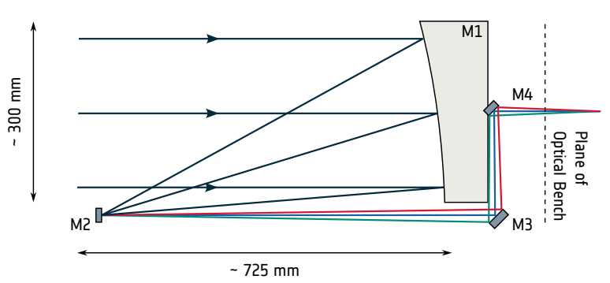

LISA Product Breakdown (notional)
LISA
Ground segment
Space segment
Spacecraft
Payload
Moving Optical Sub-Assembly
Interferometry Detection System
Gravitational Reference System
Telescope

Slide 10
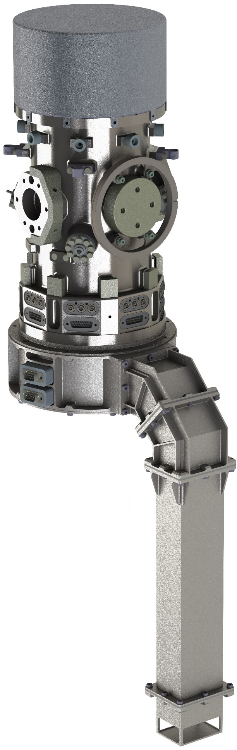



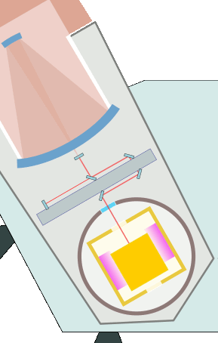
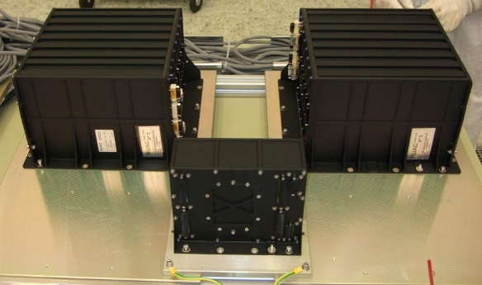

LISA Product Breakdown (notional)
LISA
Ground segment
Space segment
Spacecraft
Payload
Moving Optical Sub-Assembly
Interferometry Detection System
Gravitational Reference System
Telescope
The GRS is the system that impacts the most the acceleration noise performance of the free-falling TM.

Slide 11
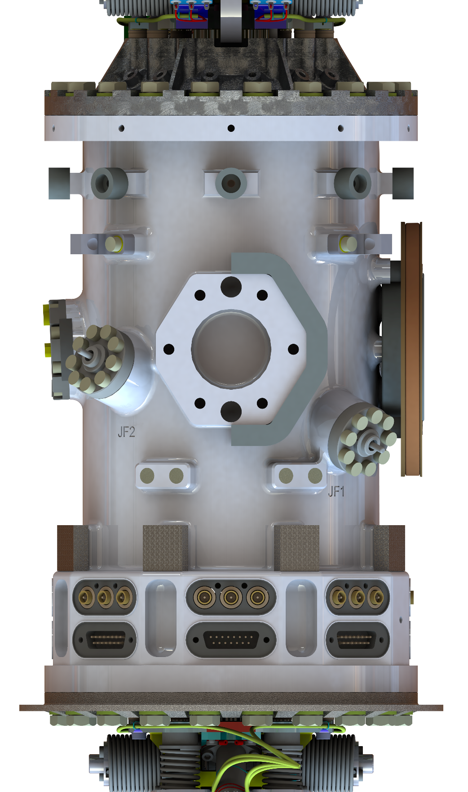
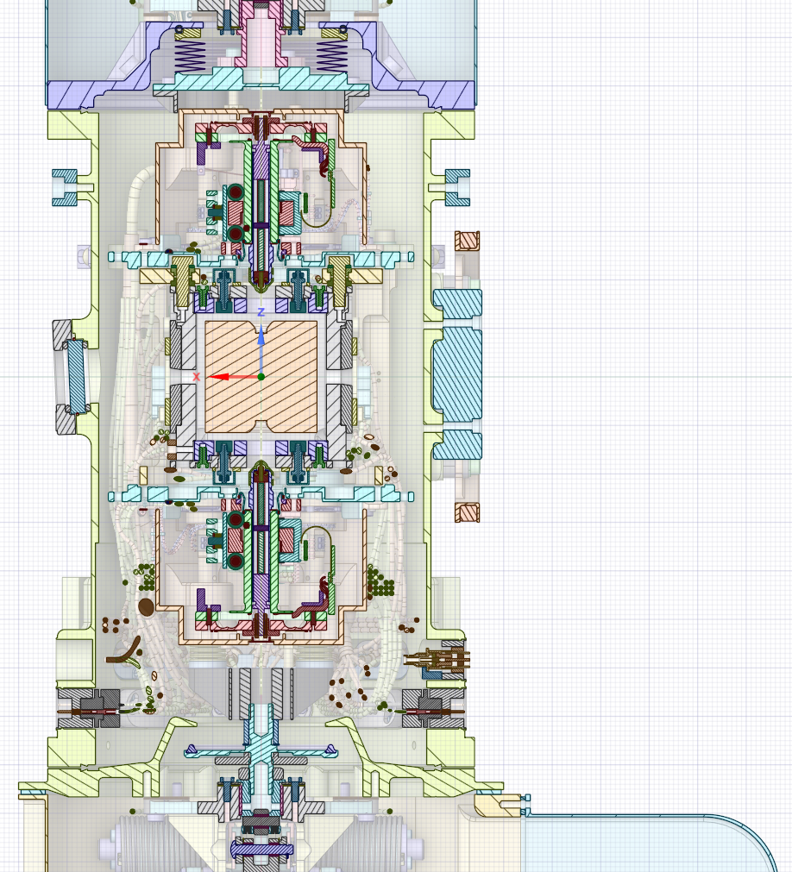

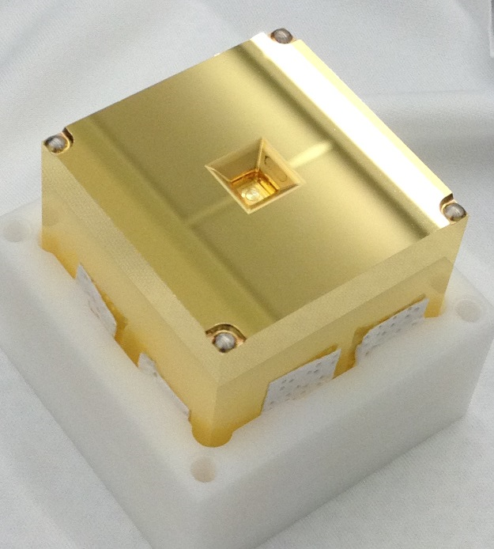
Gravitational Reference System
Design and testing done for LPF, with support from INFN.
Electrode Housing (EH)
Mb electrodes coated in Au
Test Mass (TM)
1.96 kg in Au-Pt

Slide 12
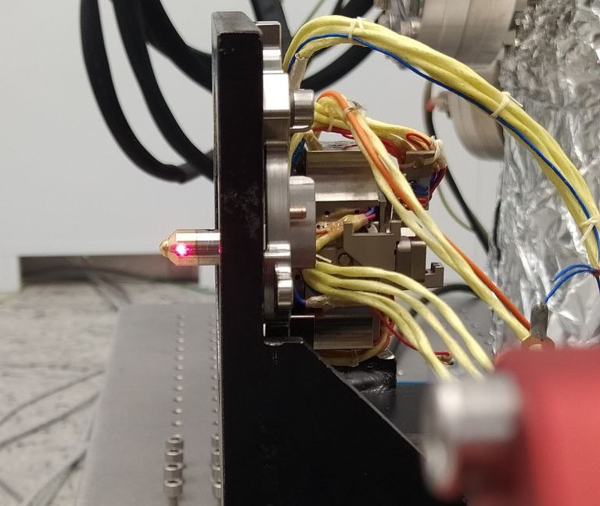
Gravitational Reference System
Launch lock (CVM)
Grabbing positioning and release mechanism (GPRM)

Slide 13
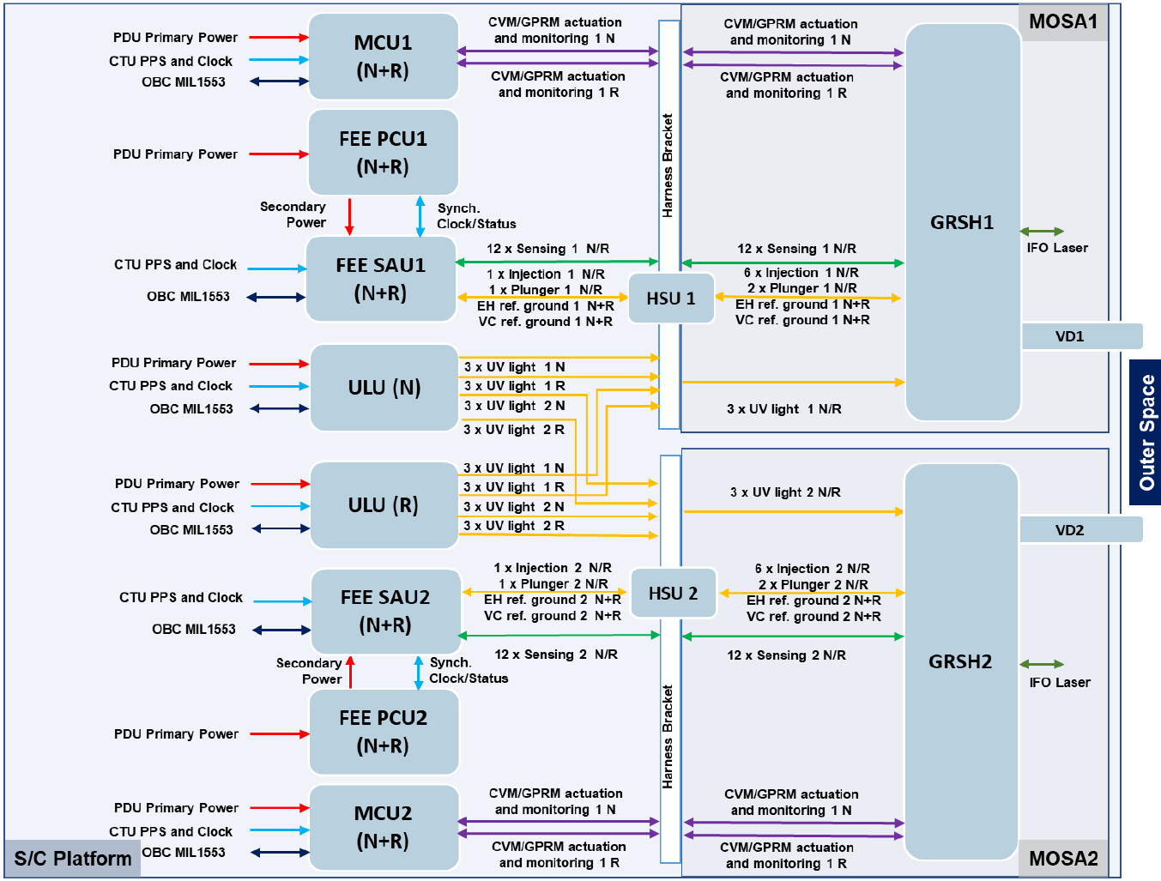


GRS Avionics and Architecture
GRS
FEE 2
SAU 2
PCU 2
GRSH 2
TM 2
MCU 2
SAU/PCU Harness 2
SAU/GRSH Harness 2
EH 2
CVM 2
GPRM 2
VC 2
VD 2
BMs 2
HSU 2
GRS-1
CMD
GRS-2
GRSH 1
TM 1
EH 1
CVM 1
GPRM 1
VC 1
VD 1
BMs 1
FEE 1
SAU 1
PCU 1
SAU/PCU Harness 1
SAU/GRSH Harness 1
HSU 1
MCU 1
ULU N
FOH N/R
ULU R

Slide 14


GRS Procurement and Management Scheme
ESA project
ASI
Lead scientists' board
GRS PI team (UTN/INFN)
GRS executive office (UTN/INFN, ASI)
PRODEX/SSO
NASA
GRS technical coordination office
(chair: UTN/INFN, OHBI)
GRS industrial architect
(OHBI)
MCU subsystem provider (OHBI)
GRSH subsystem provider (OHBI)
GRS FEE subsystem PI (ETH)
GRS CMD subsystem PI (UFL)
GRS FEE subsystem provider (TASCH)
PCU provider (OHBI)
SAU provider (TASCH)
Harness provider (OHBI)
Digital Control Unit (TASCH)
Reference Unit (OHBI)
Analog Unit (ETH)
Motherboard(OHBI)
Inter-connection Unit (OHBI)
TBC

Slide 15
Ruolo INFN in LPF e LISA
Al progetto di un osservatorio di onde gravitazionali dallo spazio, INFN ha partecipato con grande lungimiranza fin dalla proposta iniziale di LISA Pathfinder.
Ha sostenuto i gruppi scientifici nella fase di definizione e prototipazione del sensore inerziale con masse in caduta libera indispensabile alla rivelazione delle onde gravitazionali, e nello sviluppo dell’innovativa strumentazione di verifica a terra.
I test con pendoli di torsione supportati dalla CSN2 sono l’unica occasione per la verifica a terra di performance di caduta libera
Tali contributi sono stati cruciali per il successo della missione LISA Pathfinder e lo saranno per LISA, confermando e estendendo allo spazio il ruolo INFN come istituto di ricerca di riferimento per la comunità scientifica italiana impegnata nella realizzazione di osservatori di onde gravitazionali.
Analoga partecipazione è stata rilanciata per LISA, in stretta sinergia con ASI, rafforzata da un importante supporto al Systems Engineering

Slide 16
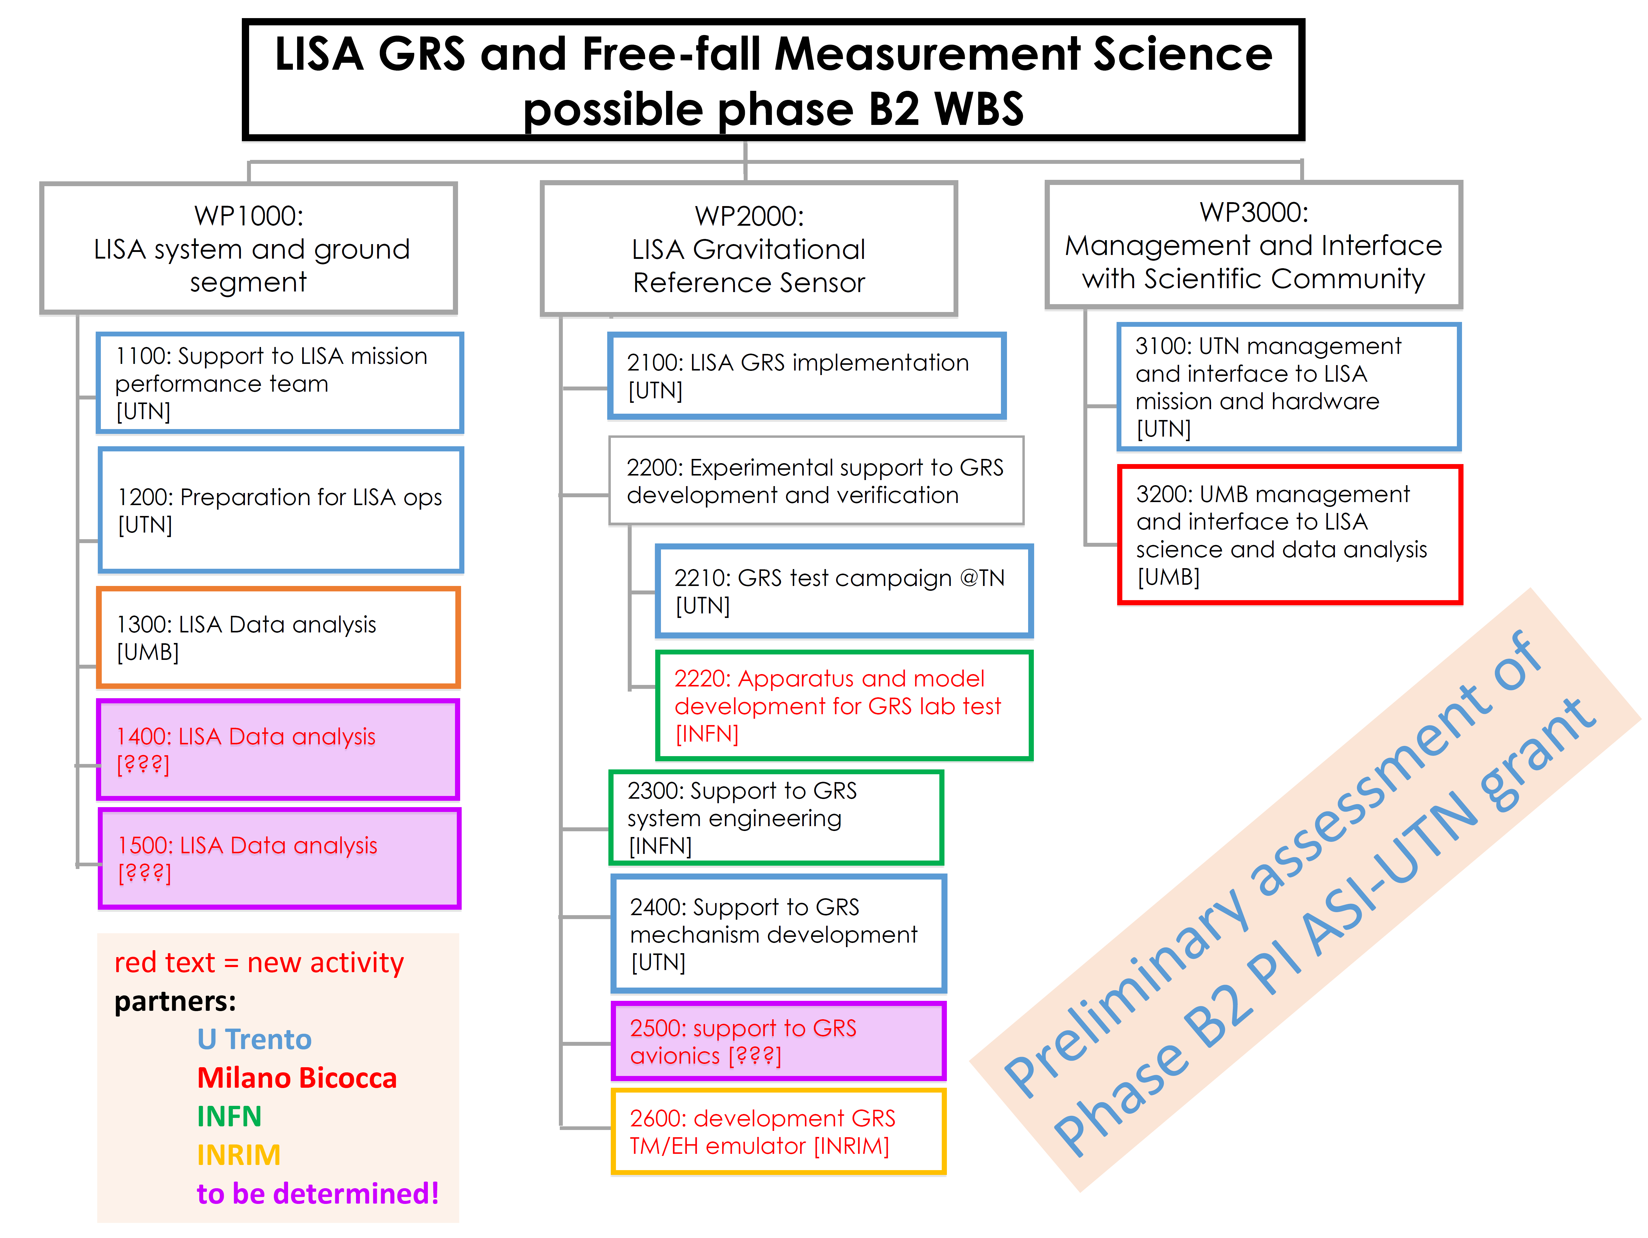
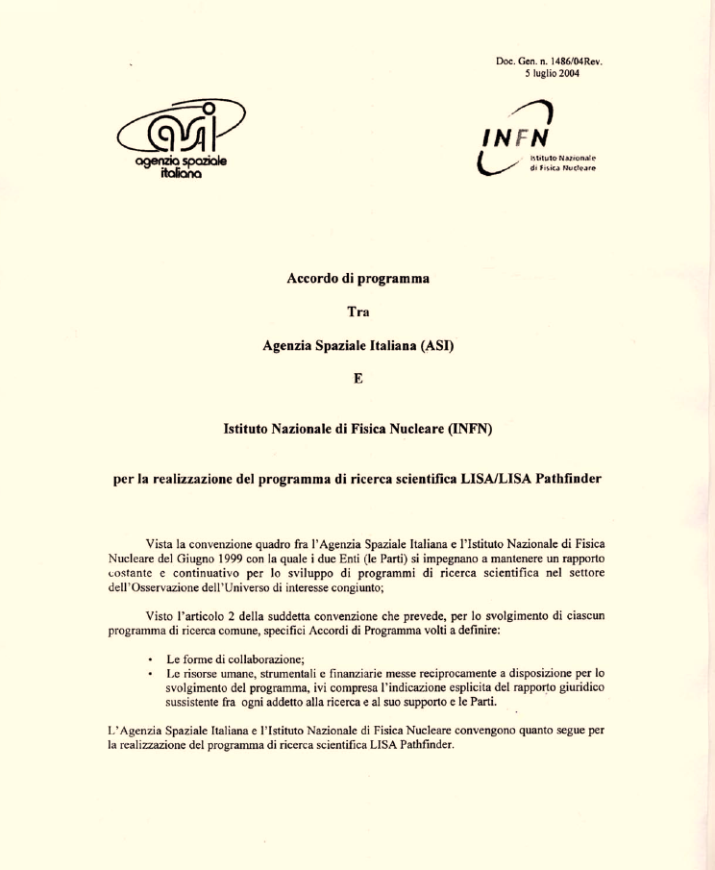
Accordi INFN-ASI
Accordo di programma INFN/ASI
Per LISA Pathfinder
Accordo ASI/UniTN/INFN/MiB
Per LISA fase A/B1
(fino giugno luglio 2024)
In progress:
Rinnovo Accordo ASI/UniTN/INFN/MiB….
Per LISA fase B2
Estensione del coinvolgimento INFN in LISA
Tavolo negoziale 8 luglio 2024

Slide 17
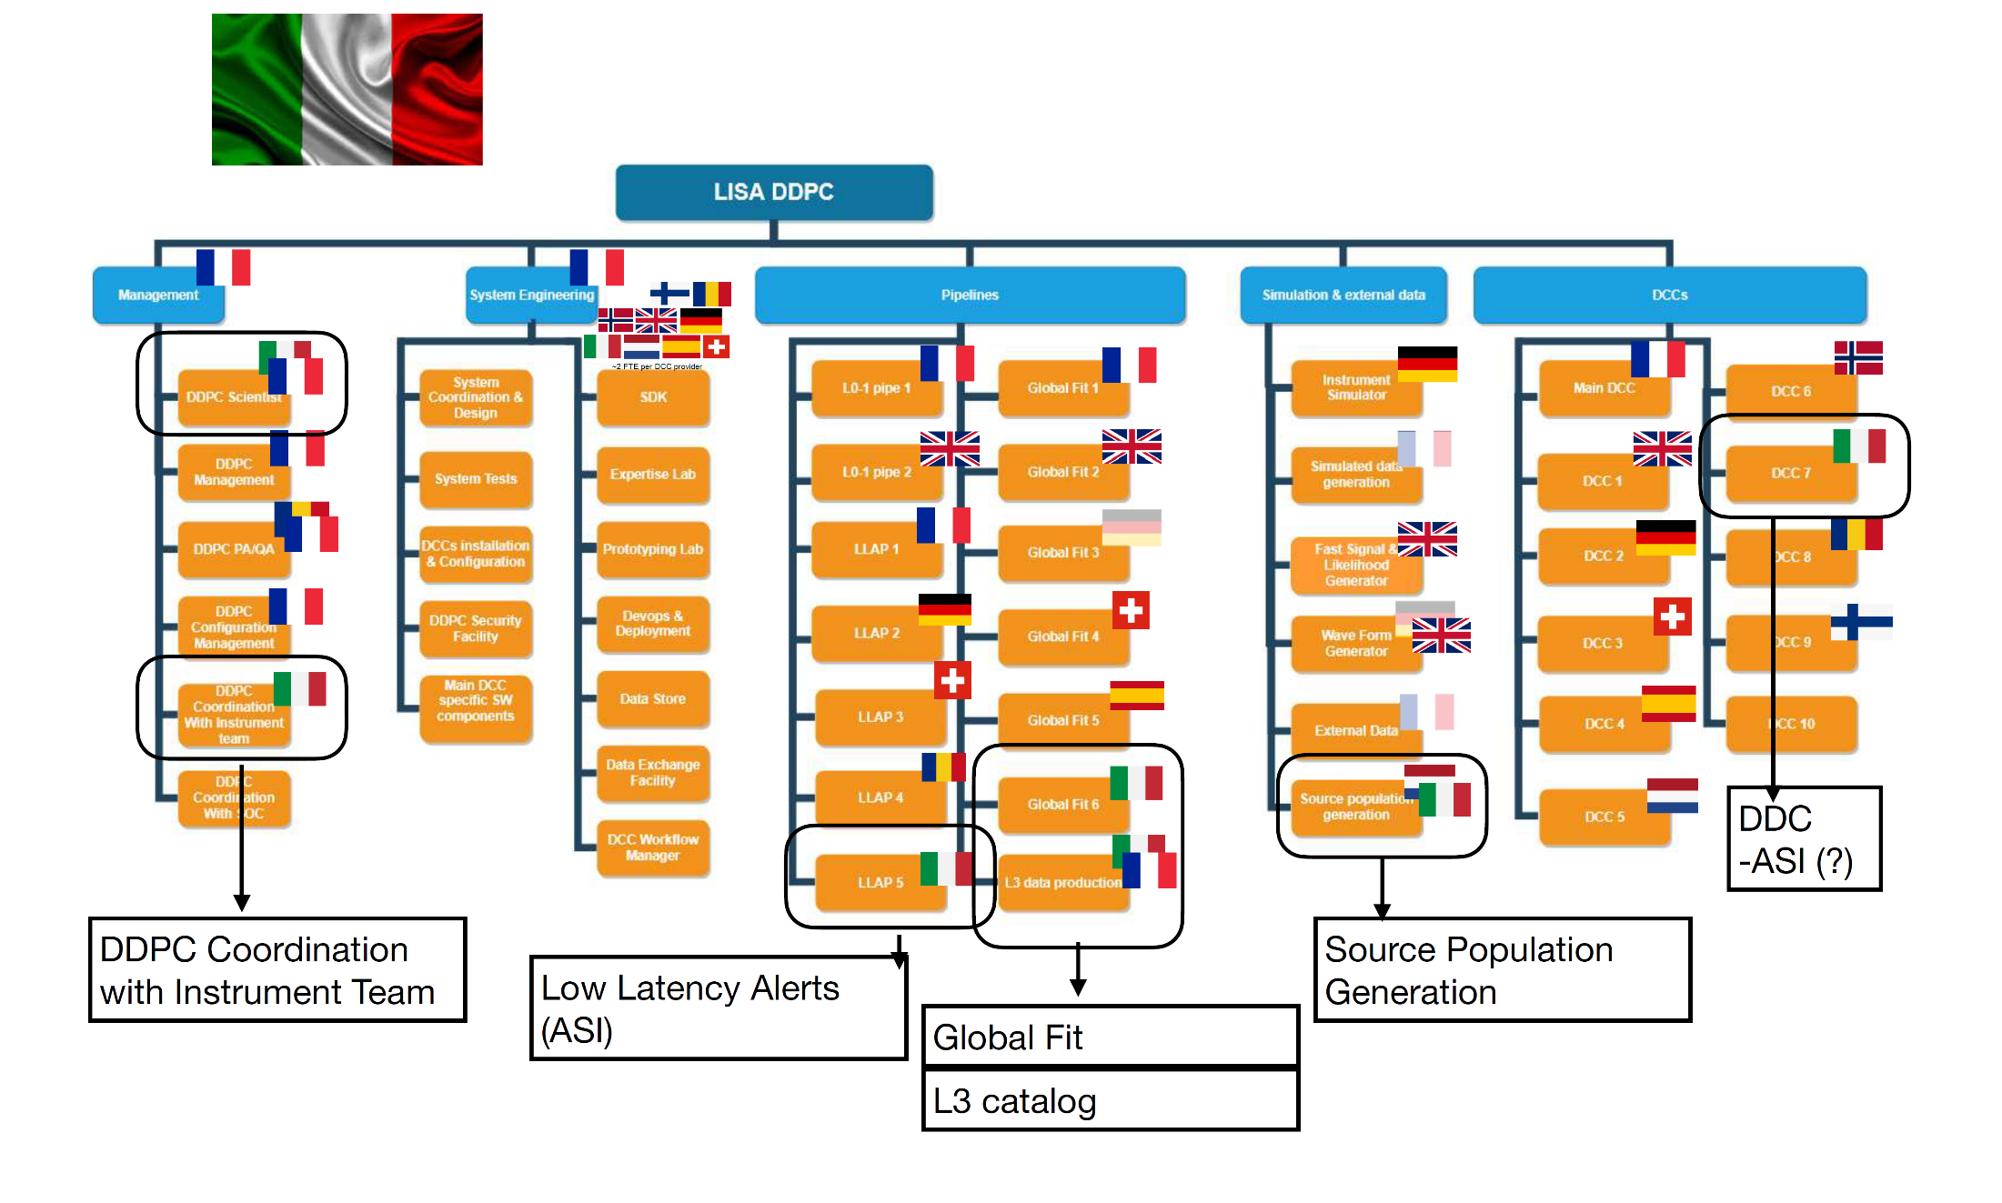

LISA Distributed Data Processing Centre DDPC
Nel MLA, ASI supporta il DDPC con attività specifiche → necessità di stabilire un piano e delle risorse e come saranno distribuite tra ASI, università e istituti (INFN, INAF…).
Gruppi teorici italiani sono già coinvolti, e.g. Milano Bicocca nell’accordo ASI e PI di un PRIN.
Kick off meeting del DDPC in giugno 2024
https://sites.google.com/unimib.it/lisa-phase-a/home

Slide 18
LISA is an adopted mission
Phase 0
Concept
Phase A
Feasibility
Phase B1
Preliminary definition
Phase B2
Preliminary definition
Phase C/D
Detailed definition and production
Phase E
Operation
2017
2018-2021
2022-2024
2024-2027
2028-2035
2035++
Mission Definition Review
Mission Formulation Review
Adoption
Launch
(2035)
Development
Implementation
Next year is dedicated to:
  Finalization and release of technical specifications (systems engineering)
  → ITT for prime selection (ESA)
  Co-engineering with selected prime and ESA

Slide 19
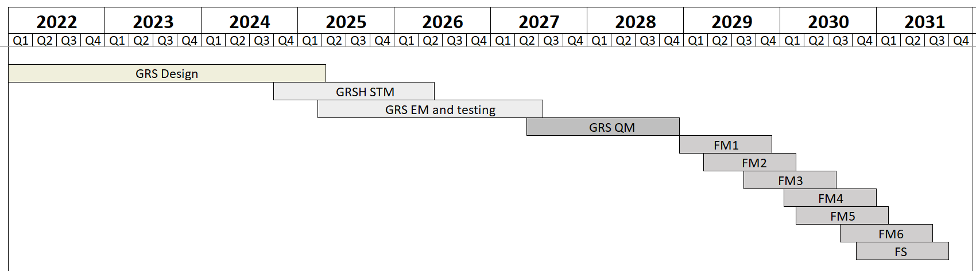
GRS Schedule
Phase 0
Concept
Phase A
Feasibility
Phase B1
Preliminary definition
Phase B2
Preliminary definition
Phase C/D
Detailed definition and production
Phase E
Operation
2017
2018-2021
2022-2024
2024-2027
2028-2035
2035++
Mission Definition Review
Mission Formulation Review
Adoption
Launch
(2035)
Development
Implementation
Co-engineering

Slide 20
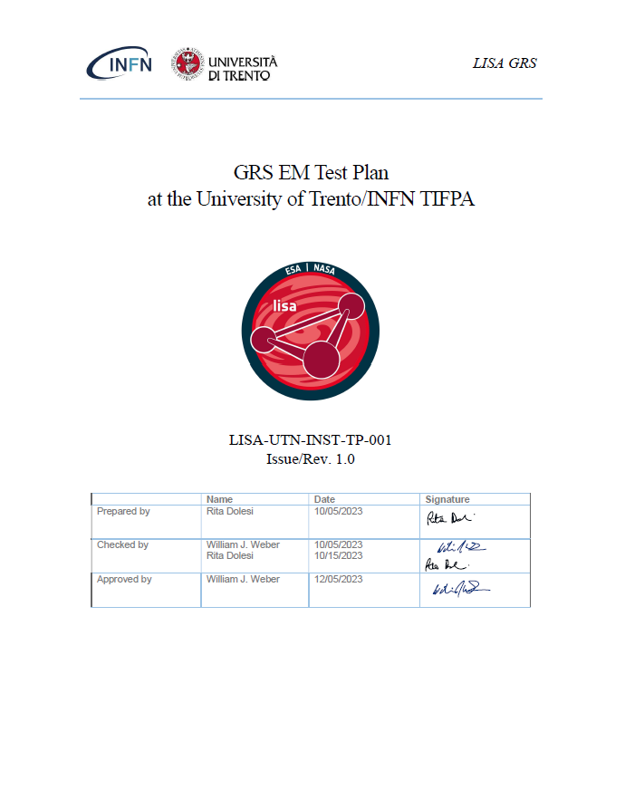
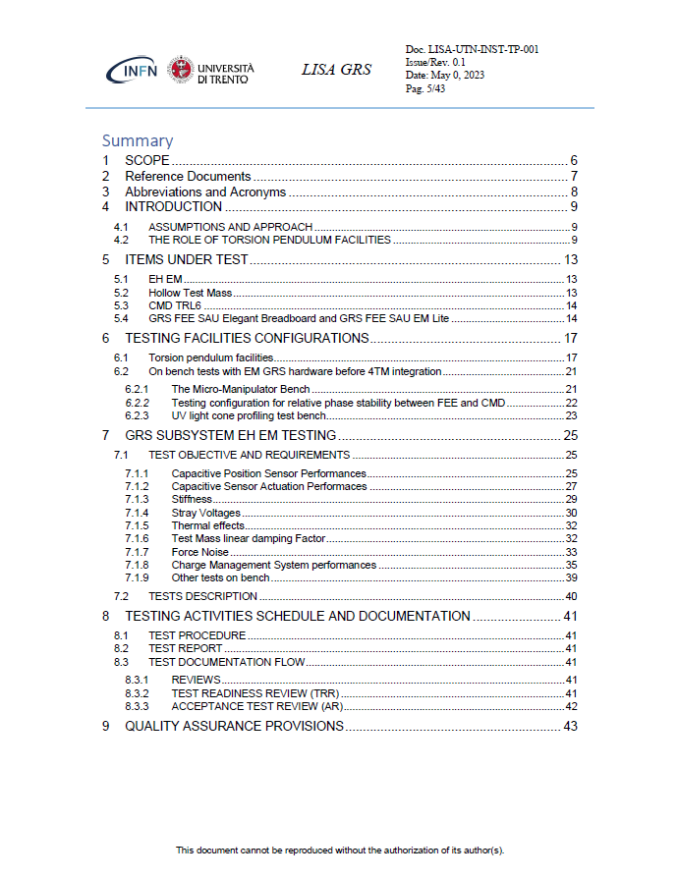
GRS EM Test Plan @ UniTN/TIFPA
Preliminary description of the individual test campaigns
List of requirements whose compliance is demonstrated or supported by these tests
Description of facilities
Test configuration

Slide 21
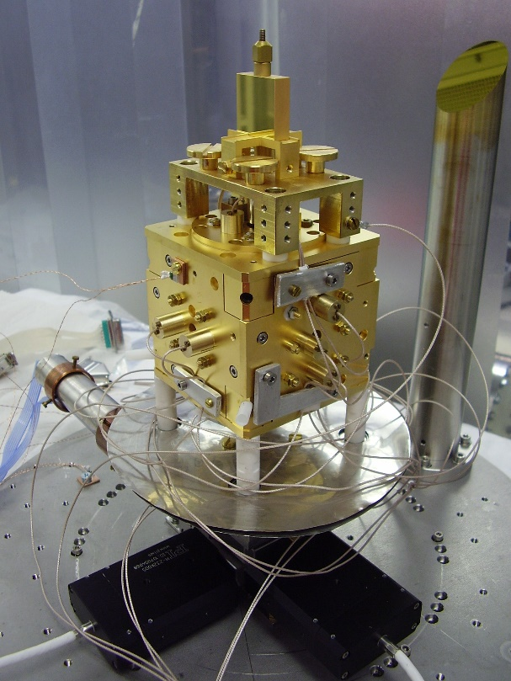
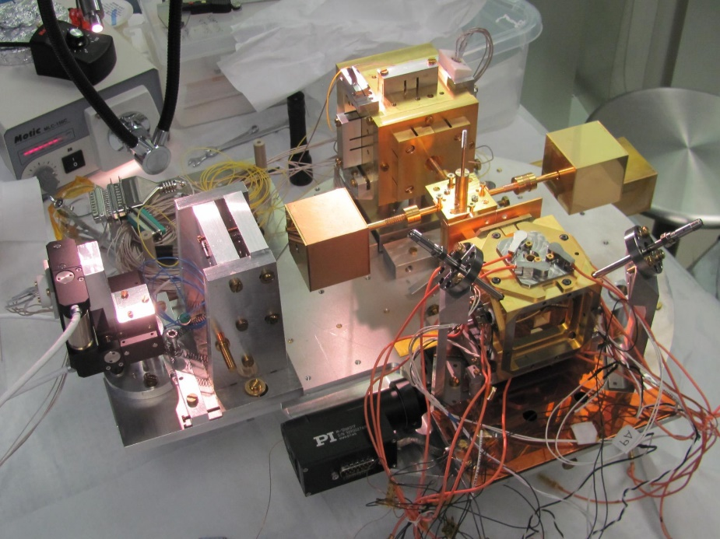
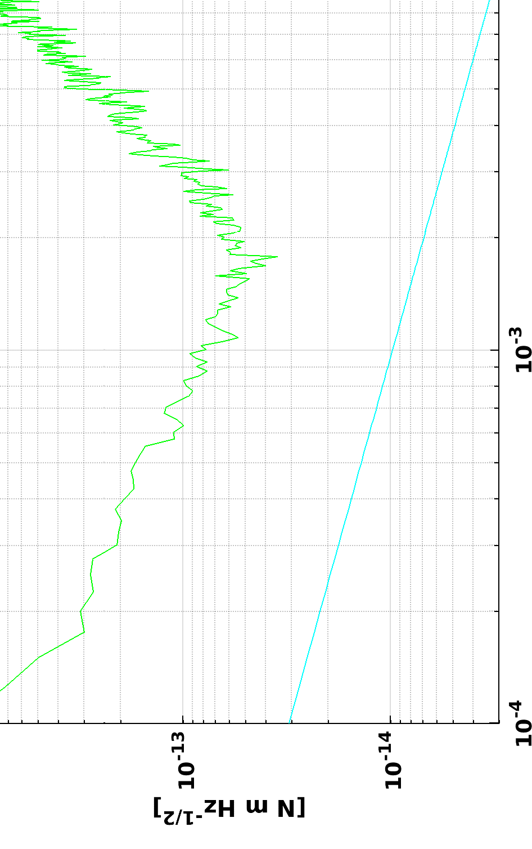
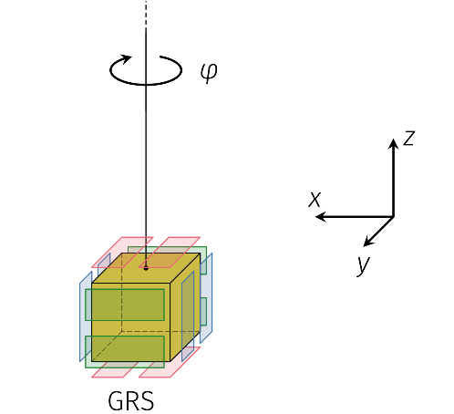
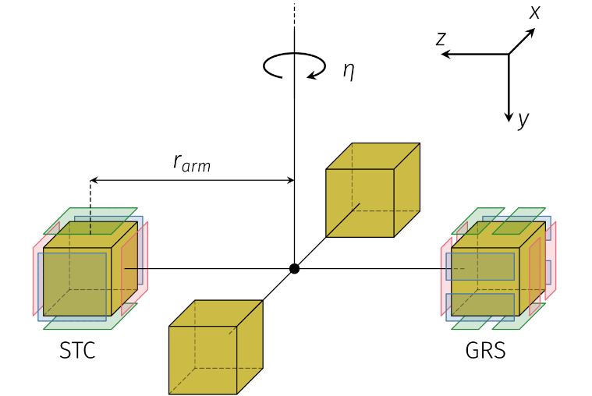
Torsion pendula
Torsion pendula can measure small forces and are the only tools to test the LISA free-fall on ground:
1TM torsion pendulum: more sensitive, but to torques only
4TM torsion pendulum: directly sensitive to forces as TM is mounted off-center (~10 cm arm)
Funded by CSN2
1.5 pm/s²/Hz^{1/2}
300x LISA SciRD
250 fm/s²/Hz^{1/2}
80x LISA SciRD
 | Force @ 2 mHz
1 TM | 7 × 10⁻¹⁶ N in 1 hour
4 TM | 10⁻¹⁵ N in 1 hour

Slide 22
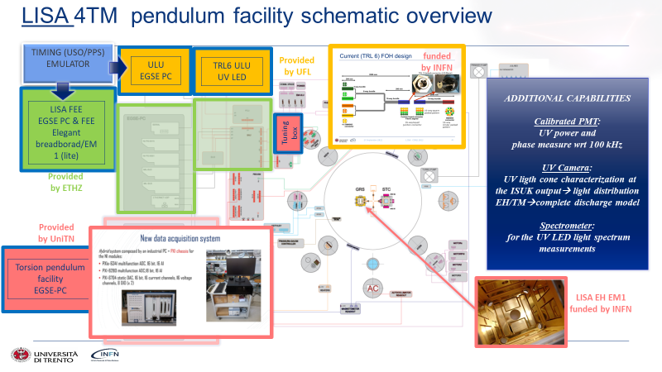
Torsion pendula

Slide 23
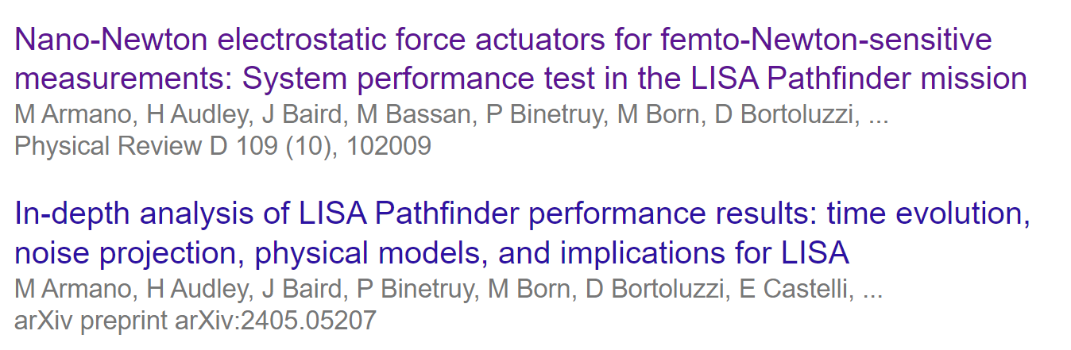
Torsion pendula

Slide 24
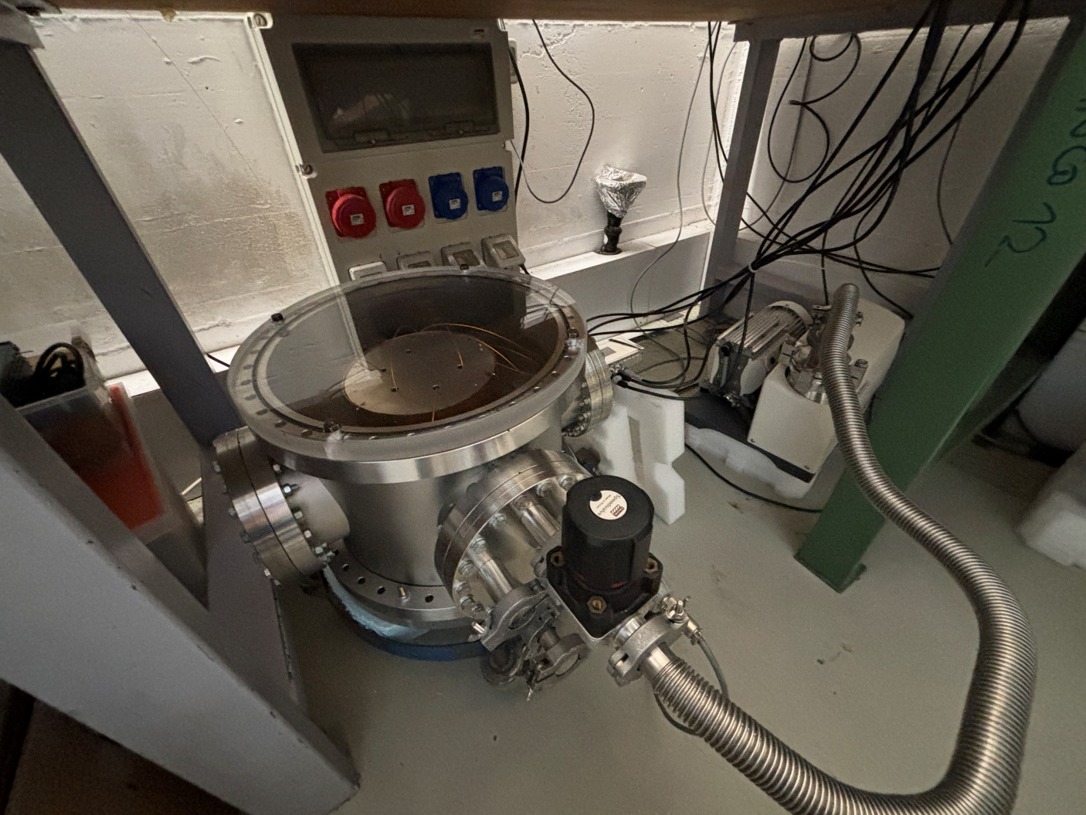
E2E Discharge Tests
Measure directly the charge on a TM, with a variety of discharge strategies.
Tests started in late 2023.
Similar (or same) apparatus to be used at proton-therapy for a representative charging experiment.

Slide 25
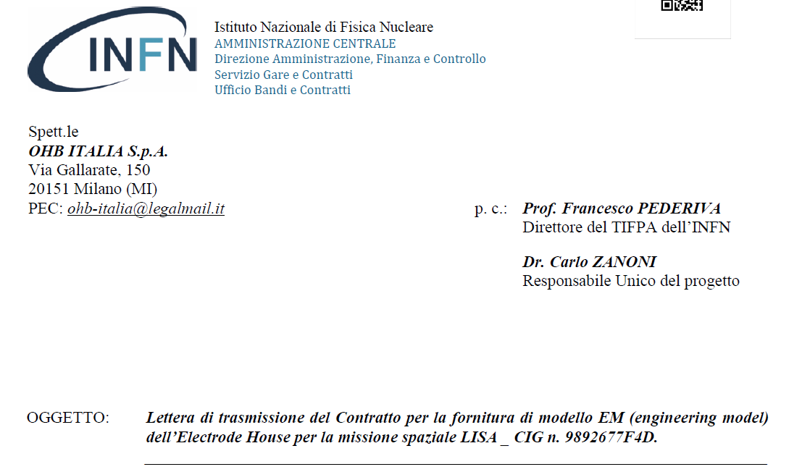
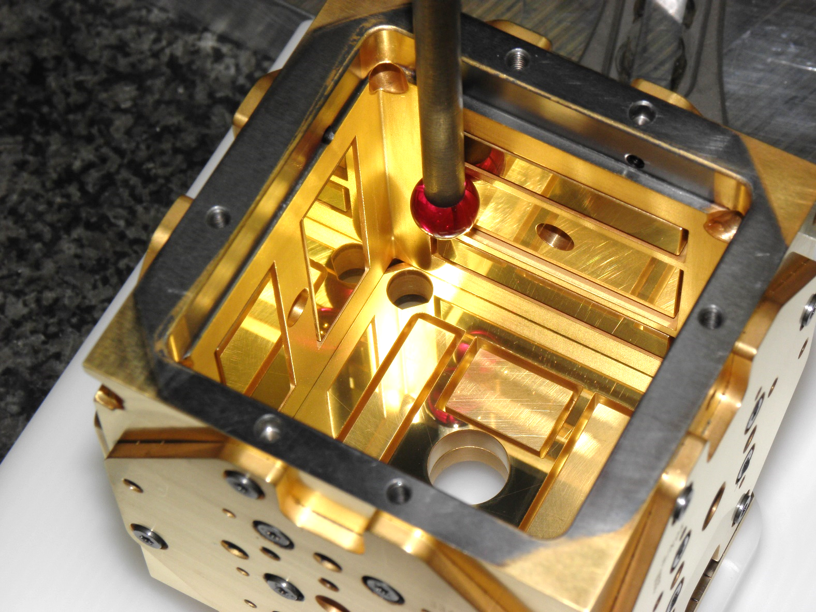
Procurement Engineering Model Electrode Housing
Funded by CSN2

Slide 26
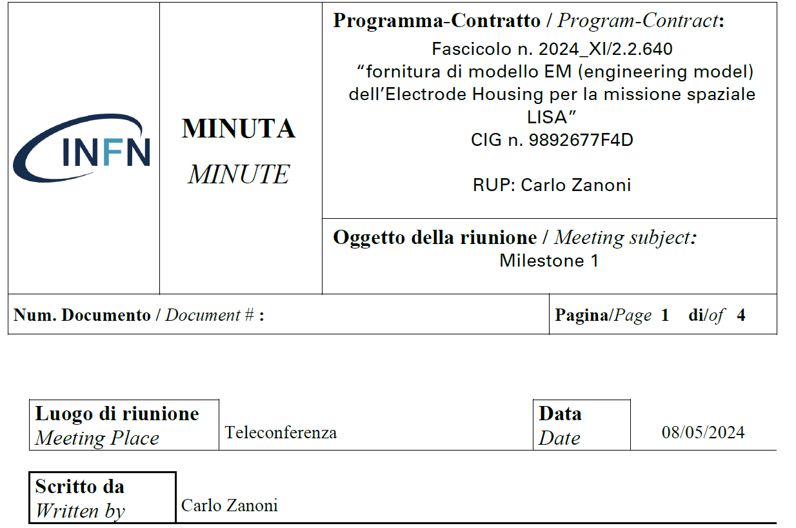
Procurement Engineering Model Electrode Housing
Kick-off: 04 March 2024
  58k EUR of pre-payment
1st milestone: 08 May 2024
  58k EUR transfer

Slide 27
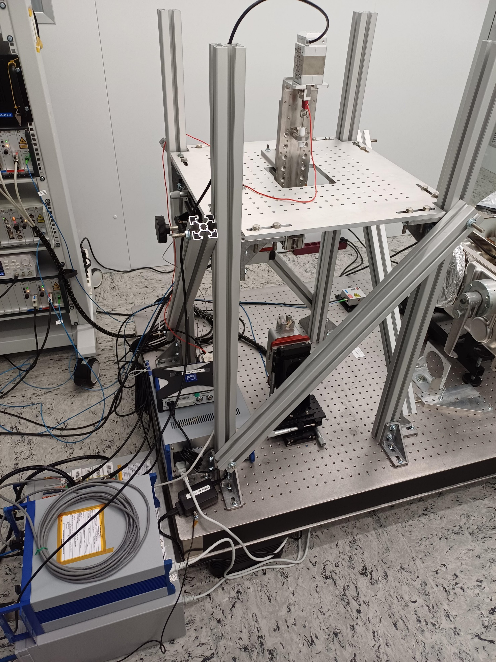
GPRM testing
Tests concluded in March 2024
Basis for the definition of the new GPRM baseline (Apr-24)
Interesting R&D outputs on friction between titanium and Teflon
Getting ready for comprehensive GPRM EM tests towards the end of 2024
NEW:
Caging Mechanism Modeling
Funded by CSN2

Slide 28
Stato Impegni 2024/richieste 2025
Missioni
  esaurita quota LISA su Dotazioni Gr 2, con luglio esauriti anche fondi LISA (chiederemo anche sblocco di 1K€ SJ)
Acquisti:
  64 k€ +35 k€ SJ da spendere
  Principalmente destinati a costruzione di masse di test rappresentative di quelle di volo per i pendoli di torsione; per contenere i costi siamo in attesa di definizione/accordi tra OHB e fornitori delle TM di volo.
  Stiamo eleborando piano B alternativo di spesa da proporre se necessario alla CSN2 di settembre.

Slide 29
Richieste 2025 (preliminare)
Richieste di missione per partecipazione a incontri CSN2/referee, congressi e workshop internazionali: 25k EUR
Attività di laboratorio: aggiornamento delle facility con pendolo di torsione per aumentarne le performance e la rappresentatività: 30-60k EUR
Richieste di strumenti software (già in uso con licenze INFN): ANSYS, MatLab, COMSOL, Solidworks

Slide 30
Personale
16 ricercatori/tecnologi, circa 13.5 FTE
Cognome | Nome
Bortoluzzi | Daniele
Cavalleri | Antonella
Ciani | Giacomo
Chiavegato | Vittorio
Dal Bosco | Davide
Dalla Ricca | Edoardo
Dimiccoli | Francesco
Dolesi | Rita
Ferroni | Valerio
Marzari | Francesco
Mezzena | Renato
Sala | Lorenzo
Vetrugno | Daniel
Venturelli | Francesco
Weber | William
Zanoni | Carlo

Slide 31
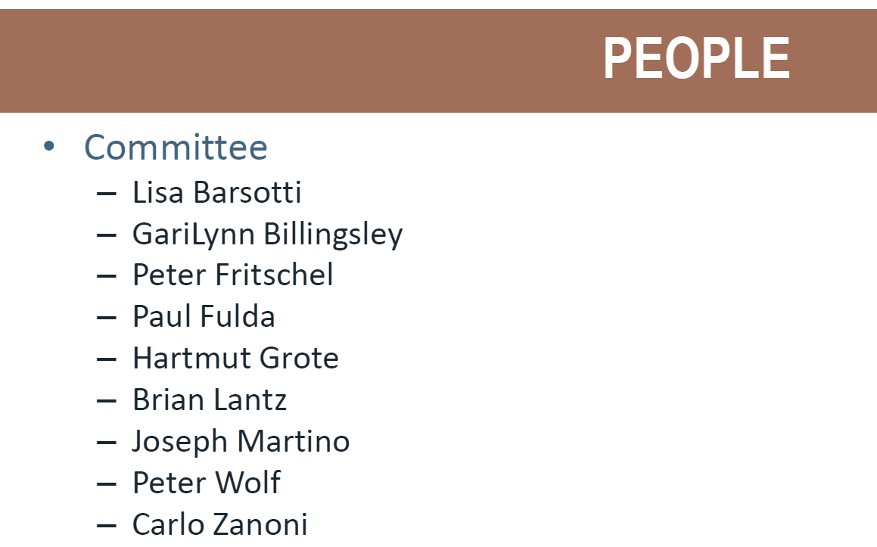
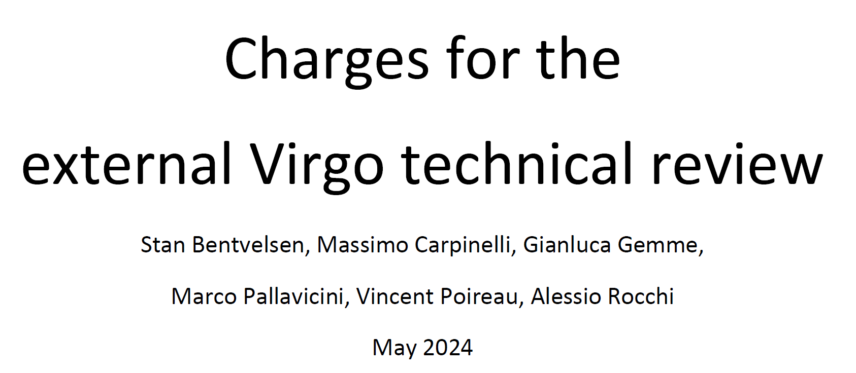
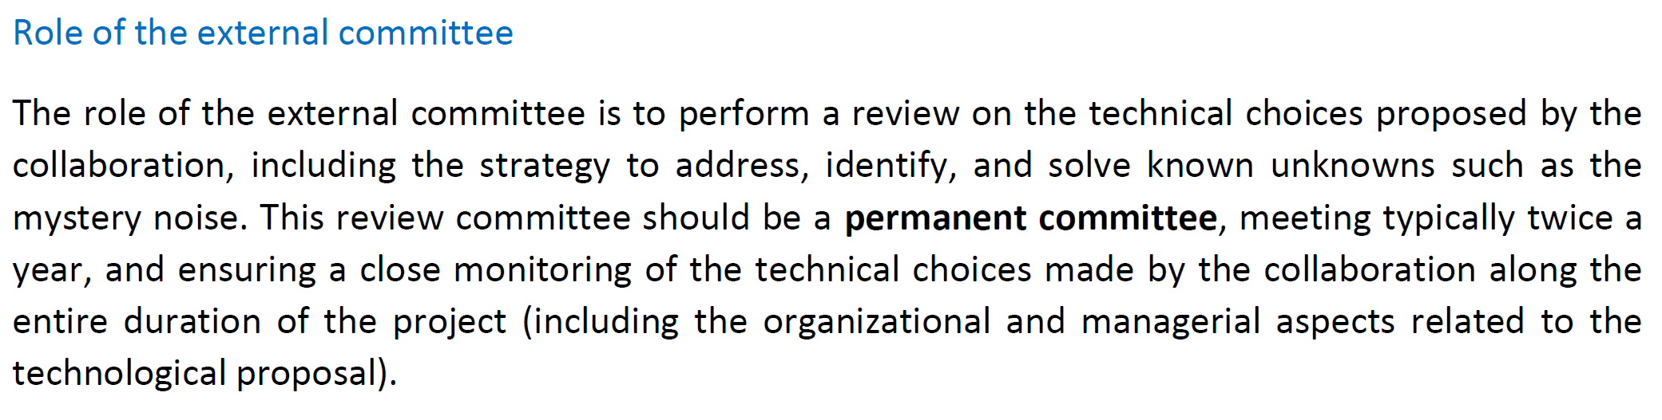
Support to ground-based GW

