Slide 1
QUAX
QUaerere Axion
Detection of cosmological axions through their coupling to photons
Sezioni/Centri INFN partecipanti
Laboratori Nazionali di Frascati (LNF)
Laboratori Nazionali di Legnaro (LNL)
Sezione di Padova (PD)
Sezione di Napoli, Gruppo Collegato di Salerno (SA)
Trento Institute for Fundamental Physics and Applications (TIFPA)
Personale afferente 2024 in totale 11 FTE - 25 persone
Personale afferente 2024 al TIFPA 0,6 FTE – 2 persone
P. Falferi 30%, R. Mezzena 30%
Durata esperimento 3 (R&D) +3 anni (data taking) (2021-2026)
Finanziamento QUAX totale (k€)
2022 2023 2024
Richieste 530 250 275
Assegnazioni 429 302 174
Responsabile nazionale
Giovanni Carugno (PD)
Responsabili locali
Giuseppe Ruoso (LNL)
Claudio Gatti (LNF)
Domenico D’Agostino (SA)
Paolo Falferi (TIFPA)
Finanziamento QUAX TIFPA (k€)
2022 2023 2024
Richieste 9 10 10
Assegnazioni 7 9 5,5

Slide 2
QUAX – QUaerere AXion
The axion is a hypothetical particle introduced to solve the so-called strong CP problem.
It is a neutral, very light (1 µeV < m < 10 meV) particle having negligible interaction with the ordinary matter.
It is an interesting candidate as a main component of dark matter.
Photon coupling: Due to the motion of the solar system in the galaxy, Dark Matter axions are converted into rf photons inside a resonant cavity immersed in a strong magnetic field (inverse Primakoff effect)
Expected rf power
Axion
mw cavity

Slide 3
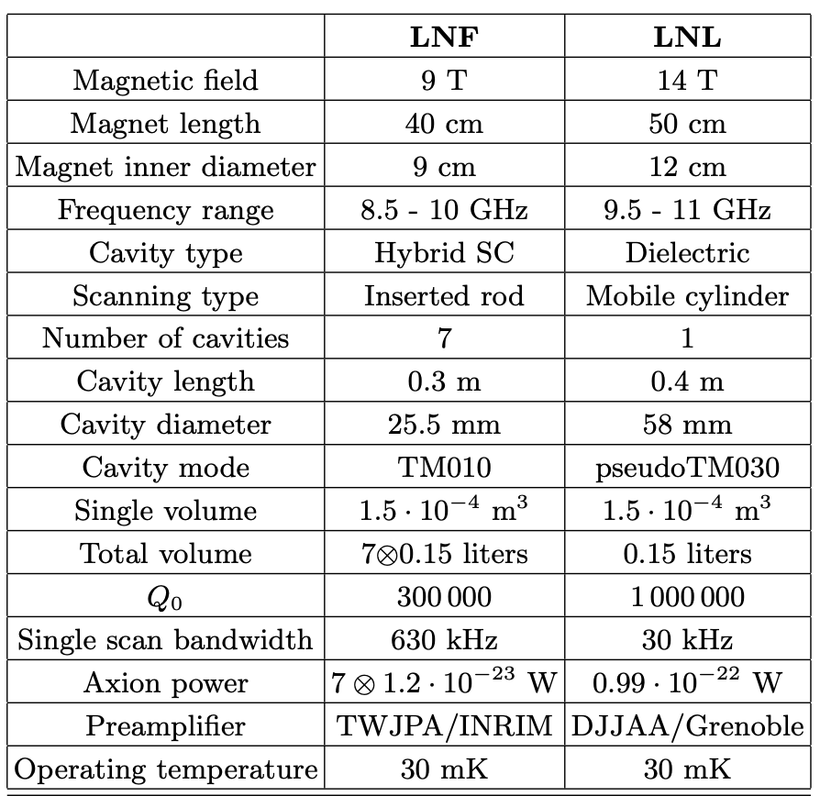
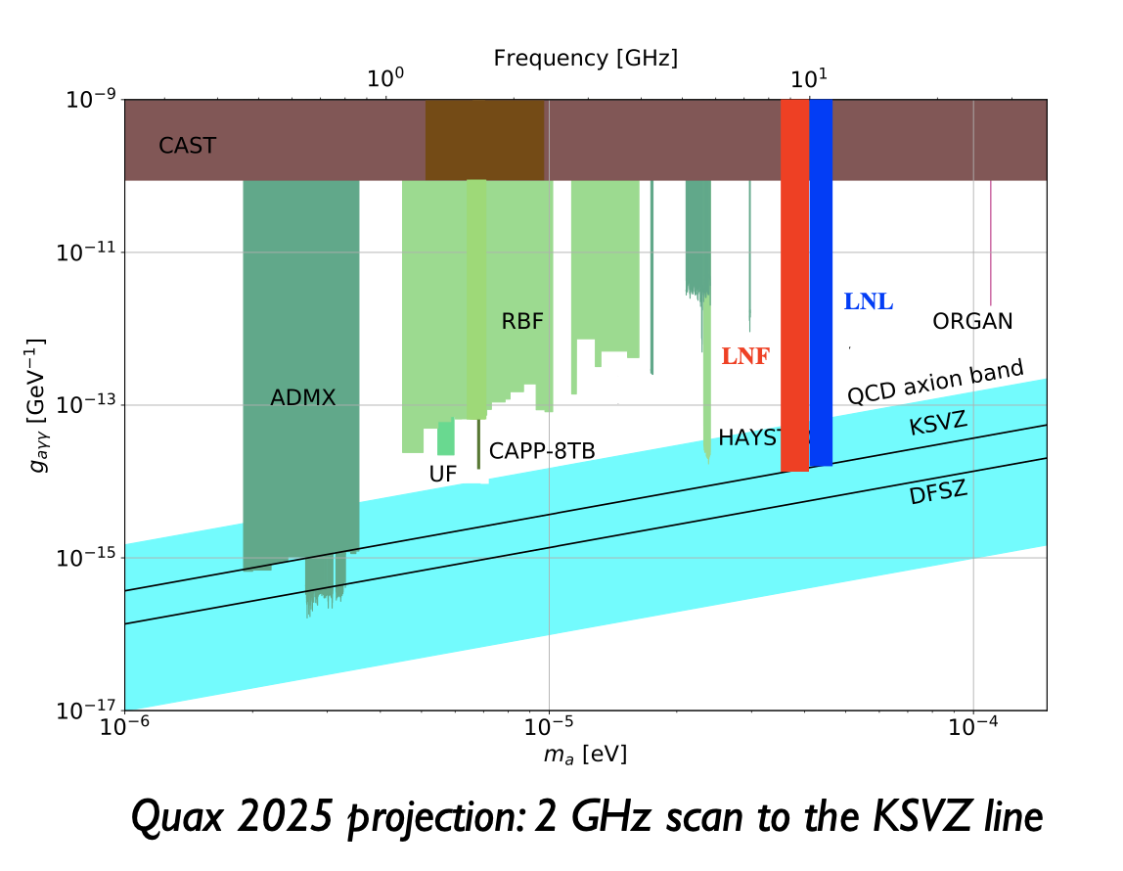
QUAX HALOSCOPES (@LNL @LNF)

Slide 4
QUAX ACTIVITY IN 2024 @ LNL AND LNF
LNL
2-3 months of data taking with 10.5 GHz, Cu/sapphire cavity at 8 T, Q=2x10^5, tuning 50 MHz, TWPA (N. Roch, Grenoble)
Acquisition of a new magnet at 14 T, L=0.5 m, Phi=0.1 m: under acquisition, in use at the end of 2025
Completion of automated dilution unit control system and radio frequency system data acquisition
Development of Single Microwave Photon Detector (E. Florin, Paris), arriving in September
LNF
Data taking with 8.5 GHz Cu cavity at 9 T, Q=10^5, tuning 50 MHz, parametric amplification (TWPA (N. Roch) or wide band JPA (NIST)) Tuning 6 MHz @ 8,8 GHz and 8T
New dilution refrigerator (no magnet) for Quantum Technologies order in progress
Development of superconducting cavities (e.g. Nb3Sn, Q=10^6 at 9T) No field Q=20*10^6, in high field 120*10^3k, -> NbTi film

Slide 5
QUAX ACTIVITY IN 2025 @ LNL AND LNF
LNL
Dilution Unit Refrigerator to be Implemented via PLC ( Not yet arrived)
Install New magnet 14 Tesla, 0,5 m Length, 0,1 m inner bore diameter
Install New Photonic Cavity with tunable frequency
New Dilution Machine for Quantum Counter based on Trasmon Qubit
Complete the set up for axion photon coupling high sensitivity search
Continue R&D on axion electron coupling
LNF
Search for axions (50-100 MHz around 9 GHz)
Completion of equipment automation
Completion of Quax computing on INFN Cloud
DAQ improvement with FPGA
Development of a cryogenic calibrated thermal noise source
YBCO cavity
Axion detection test with the photon counter of the Qub-IT project (CSNV)

Slide 6
Activity at TIFPA in 2025
Development of KI-TWPA (Kinetic Inductance - Traveling Wave Parametric Amplifier) to be applied in Quax haloscopes
Noise characterization of cryogenic amplifiers
Calibration of thermometers down to 20 mK
TIFPA REQUESTS 2025 (Dotazioni)
Expenditures | Description | K€
Consumables | Cryospares, rf components, cryoperm shields, liquid helium | 7
Missions | Experimental Runs | 3
 | Totale | 10
Total Requests 2025: ≈ 2024 (275 k€ -> 174 k€)

Slide 7
END

Slide 8
EXTRA MATERIALS

Slide 9
* elenco delle pubblicazioni 2024: "Search for Axion dark matter with the QUAX-LNF tunable haloscope", A. Rettaroli et al., accepted for publication in PRD
* elenco delle presentazioni a conferenza 2024 Ci sono da parte dei colleghi di LNL e LNF ma non le ho trovate
* stato degli impegni di spesa 2024 a metà dell'anno. Assegnati 2.5k missioni, 3k consumo, spesi zero
* stato degli impegni di missione 2024 a metà dell'anno 0€
* indicazione schematica delle attività pianificate per il 2025 Vedi slide
* dettaglio analitico delle persone coinvolte nella sigla con relativa percentuale 2025 Vedi slide
* dettaglio delle spese preventivare per il 2025 Vedi slide

Slide 10
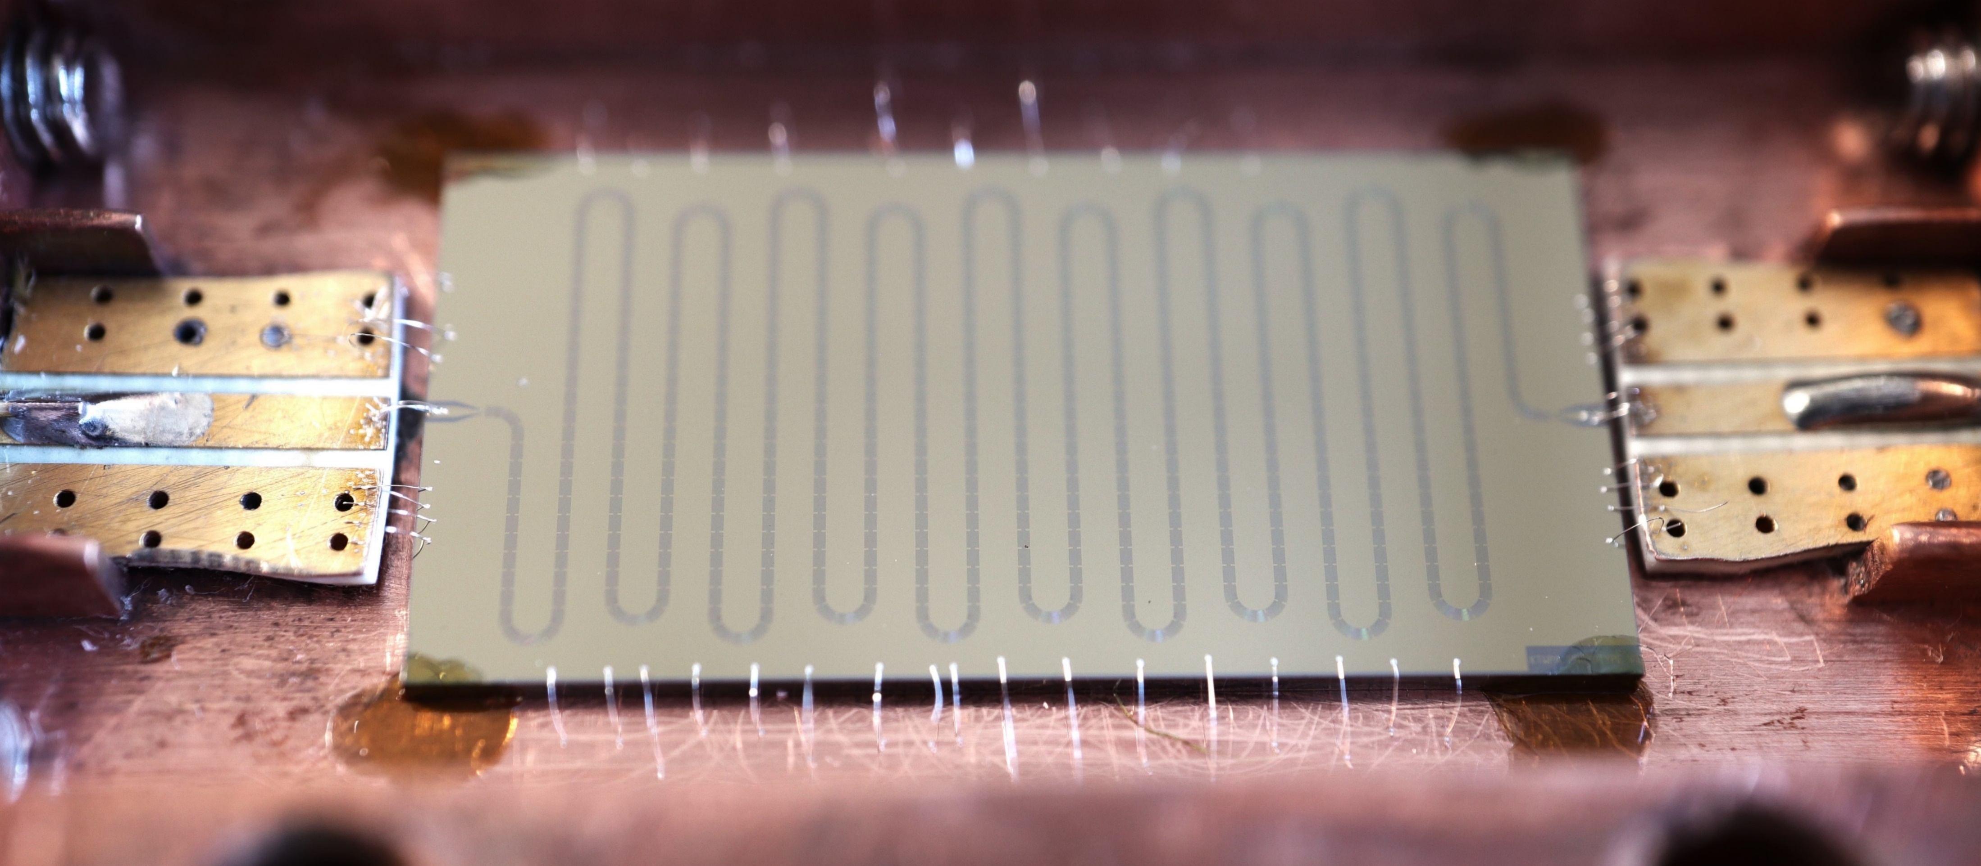
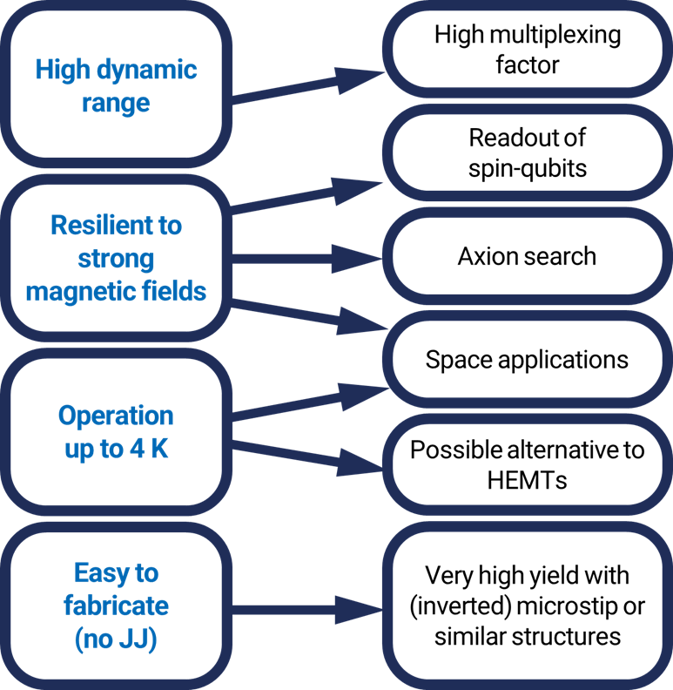
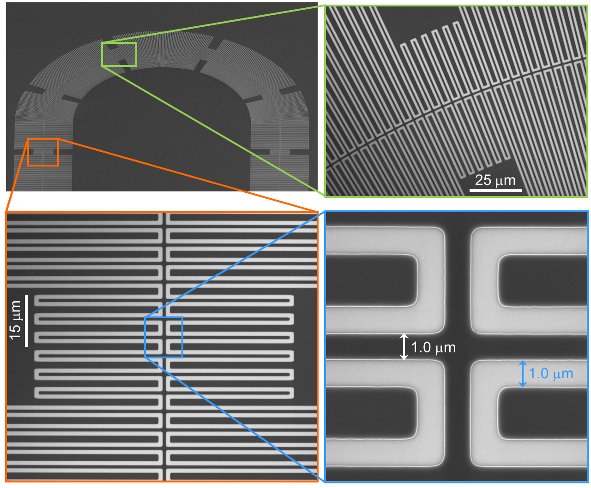
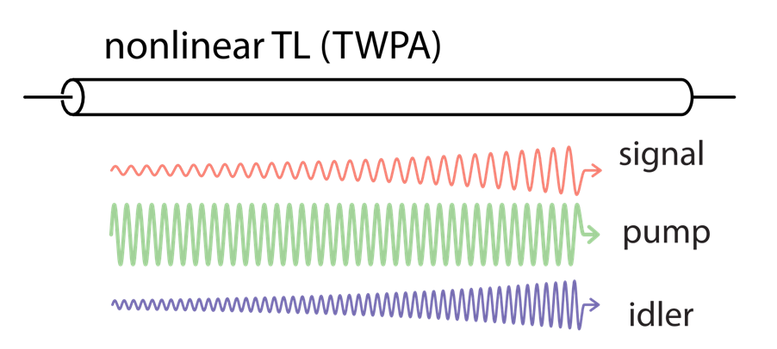
Kinetic Inductance Traveling Wave Parametric Amplifier – KI-TWPA

Slide 11
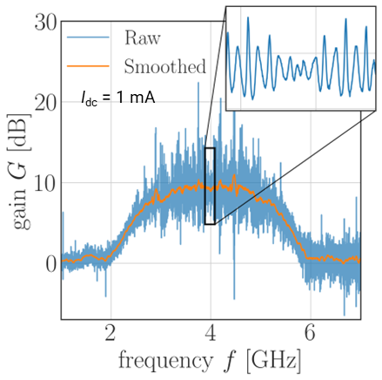
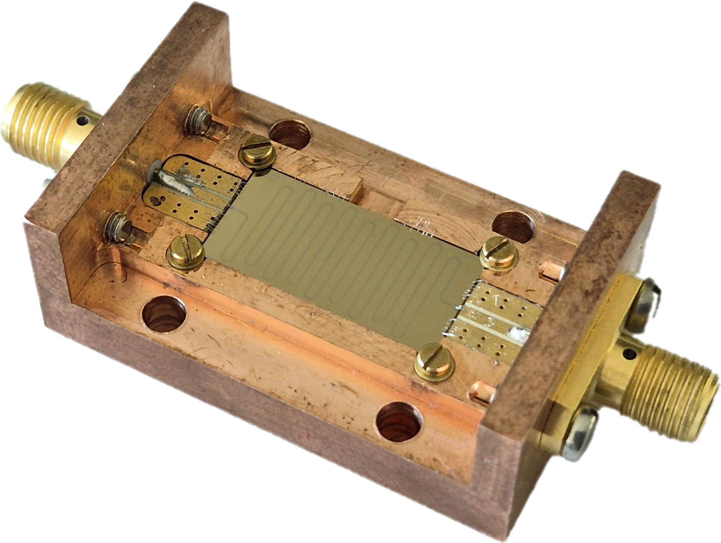
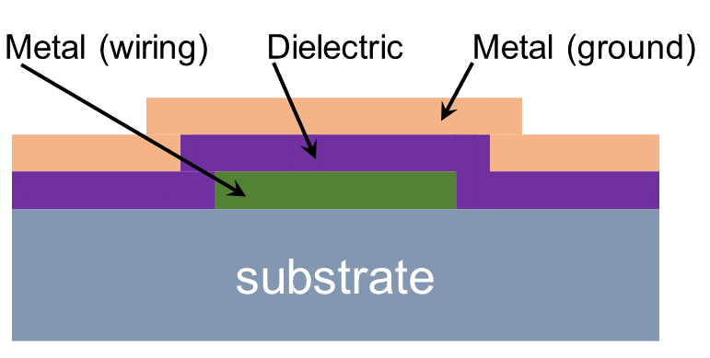
Kinetic Inductance Traveling Wave Parametric Amplifier – KI-TWPA
1st generation: CPW geometry
CONS
Low fabrication yield
Long device (33 cm for 20 dB gain)
Difficult grounding
2nd generation: inverted microstrip geometry (2025 activity)
PROS
High fabrication yield
Shorter device
Easy grounding
More compact device
CHALLENGES
Low-loss dielectric film
Increase LK

Slide 12
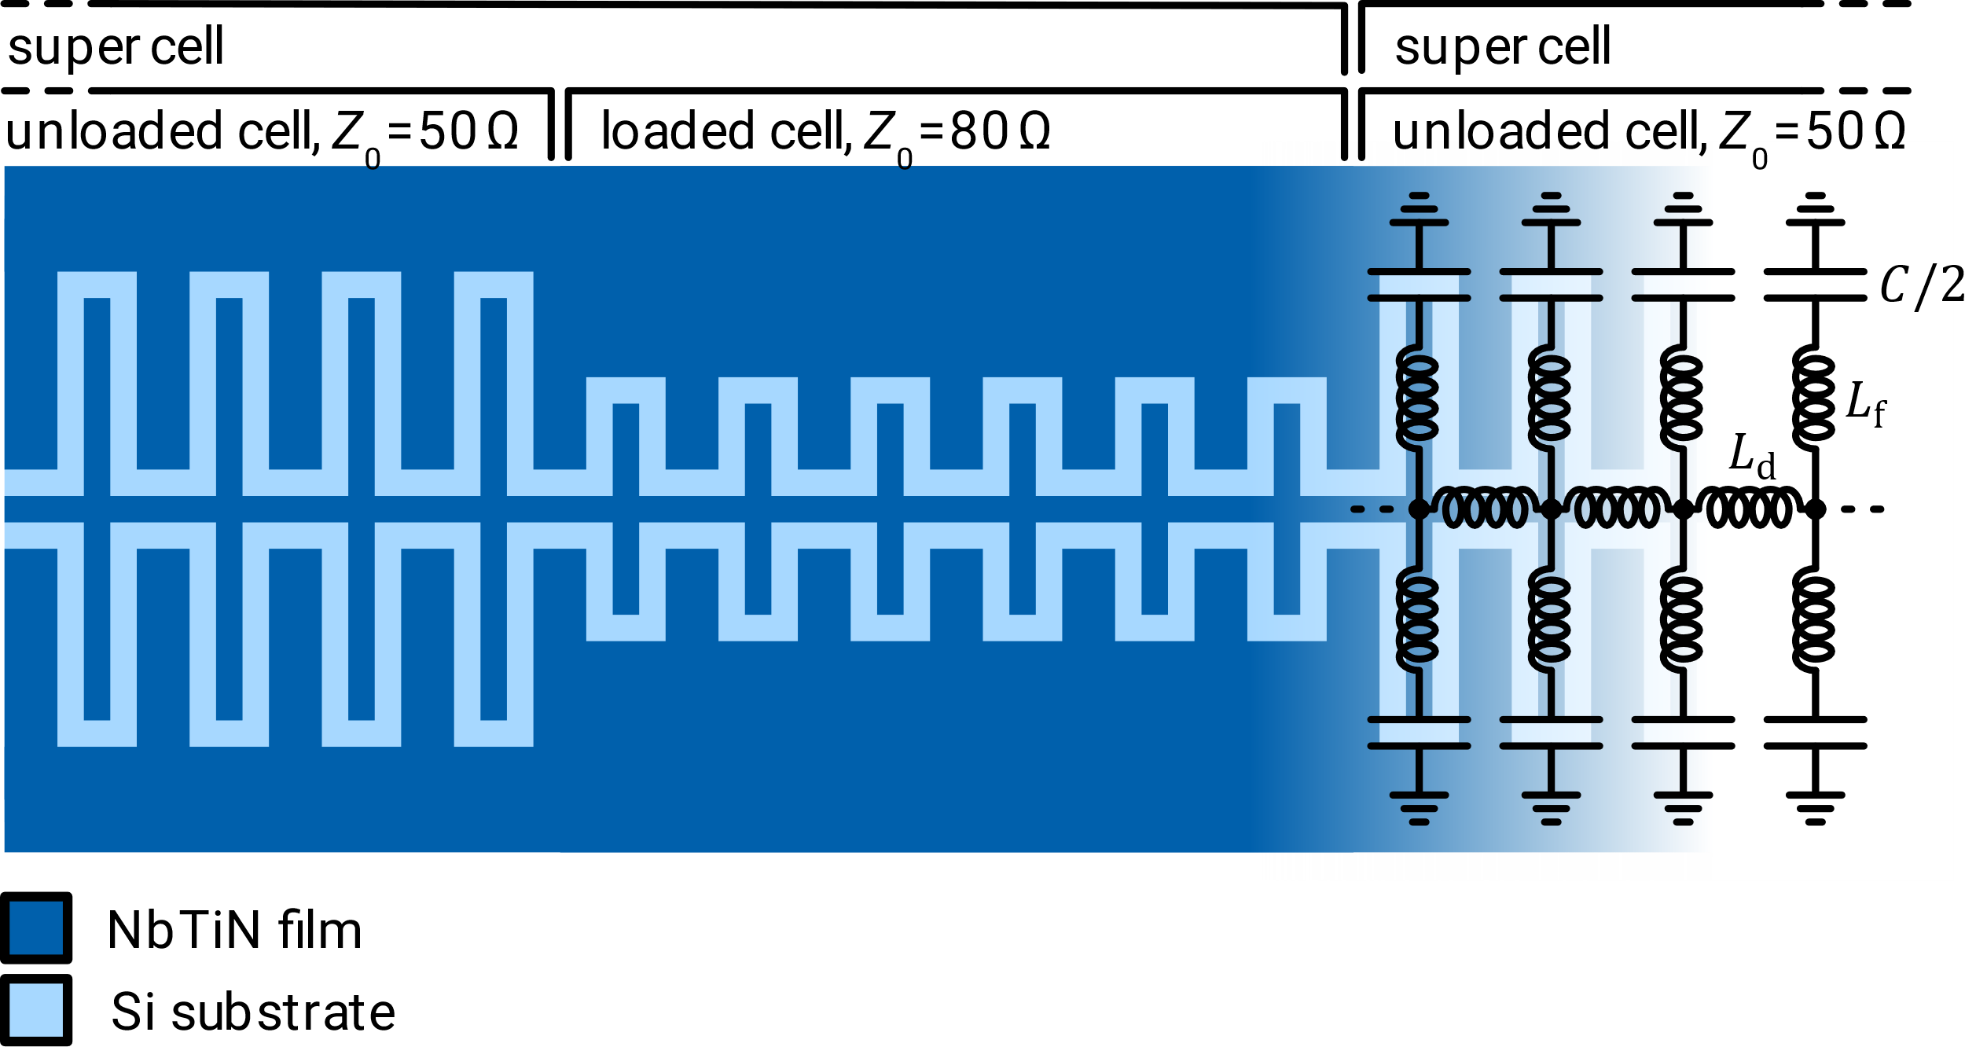
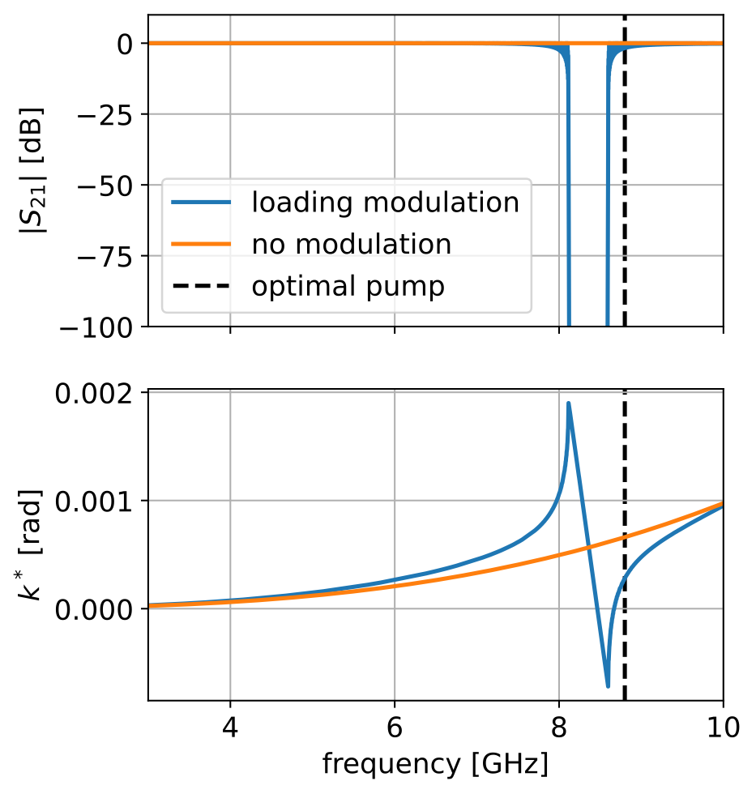
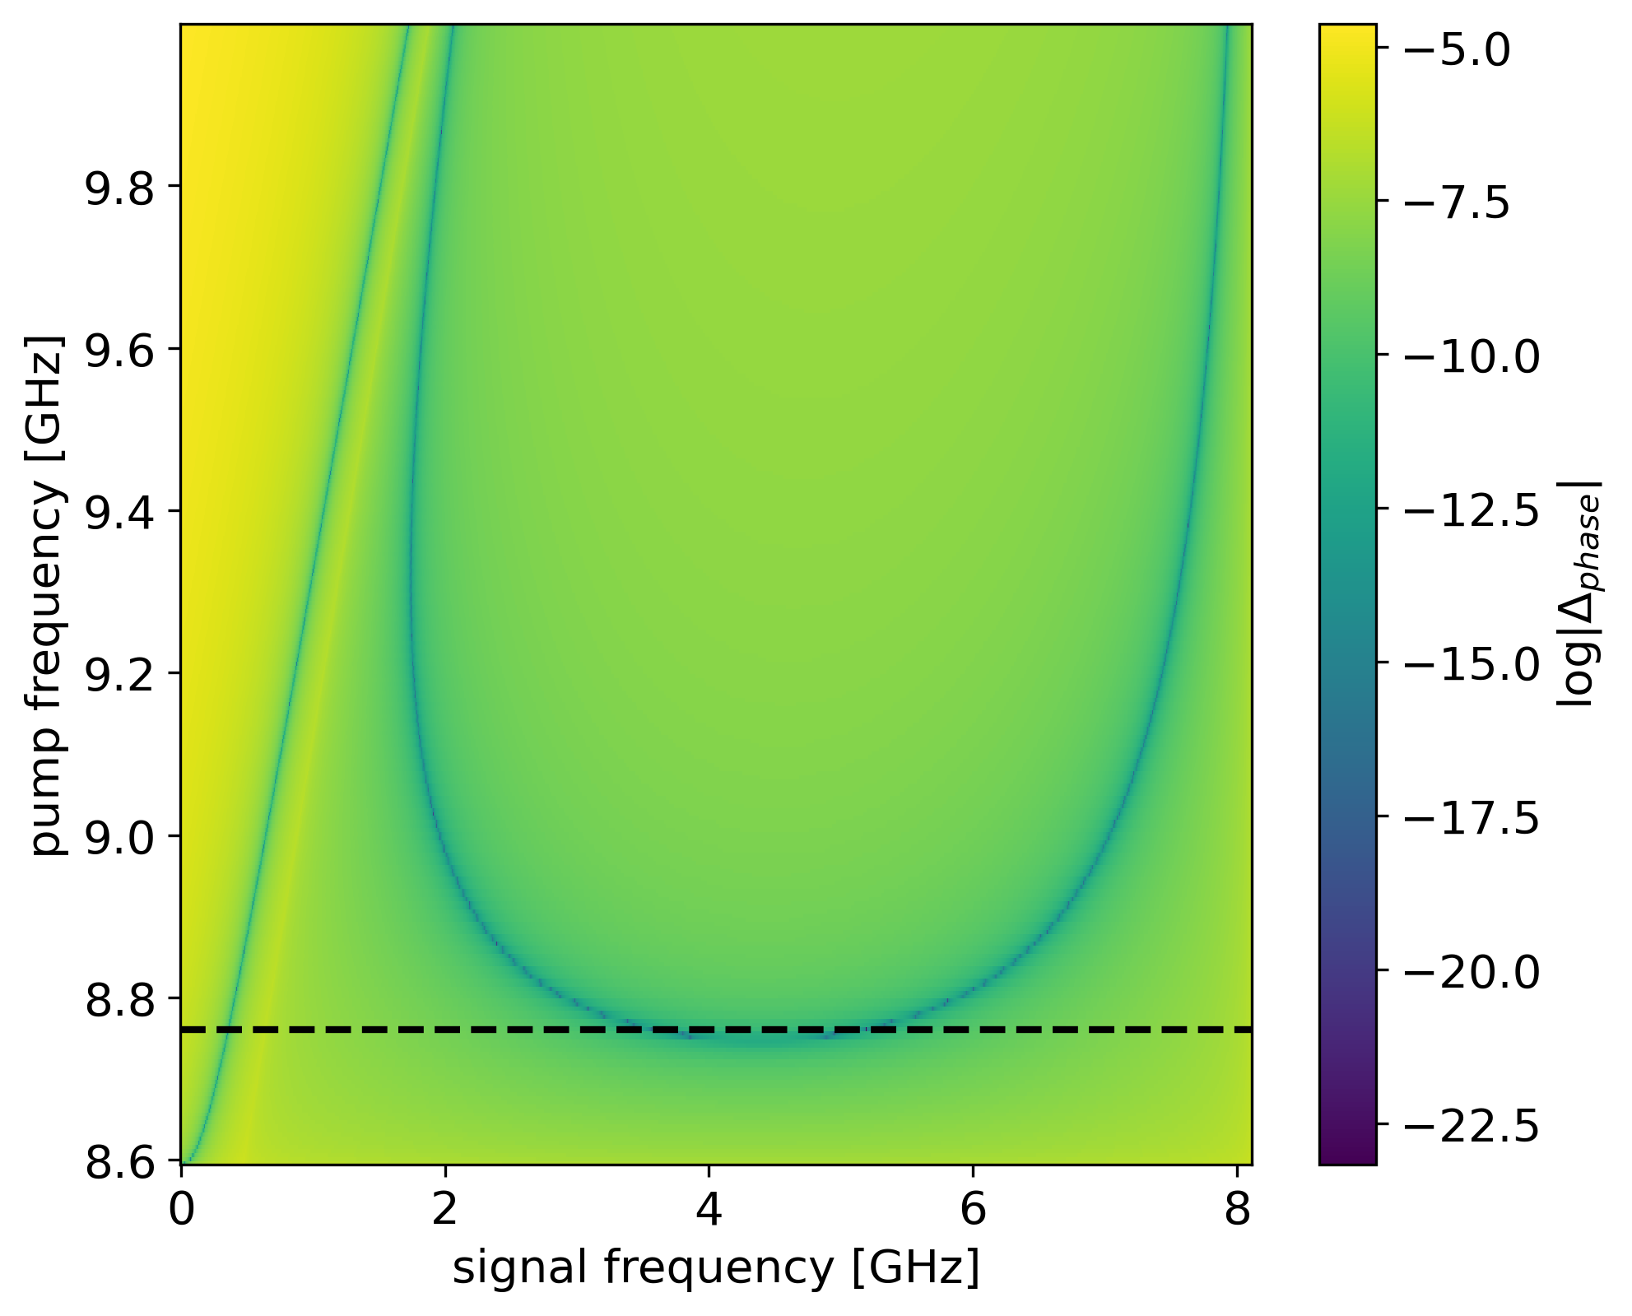
Anatomy of a KI-TWPA
Weakly dispersive artificial transmission line:
Series of CPW sections (cells) flanked by IDC fingers → decrease phase velocity
Phase-matching: periodic increasing of the line impedance (loading) → stopband
Amplification occurs only when pump, signal and idler are phase matched: dispersion limits bandwidth to chosen range and prevents parasitic processes.
Phase matching condition (3WM):
Δ_{k} = k_{p} – k_{s} – k_{i} = 0

Slide 13
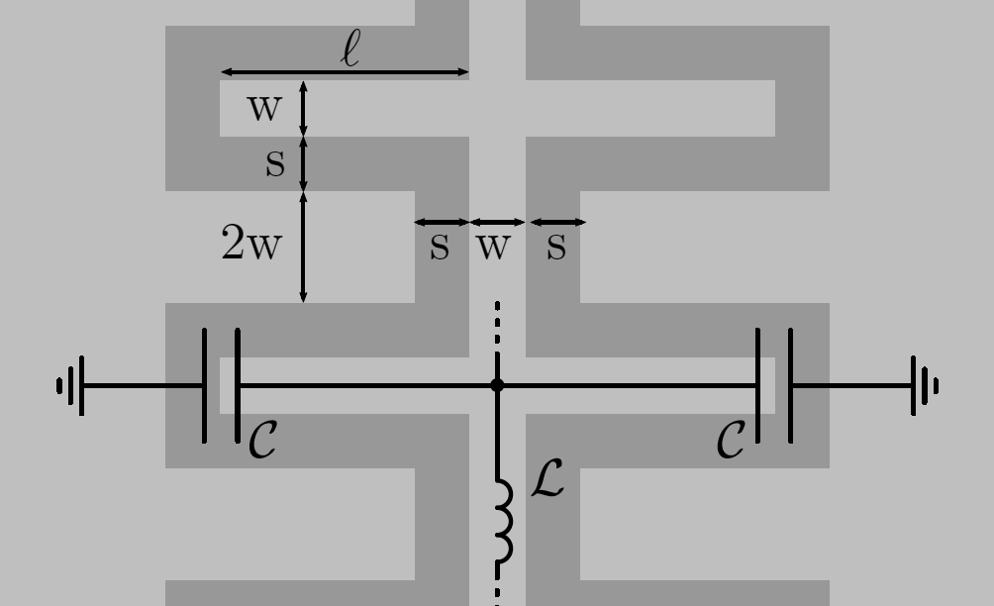
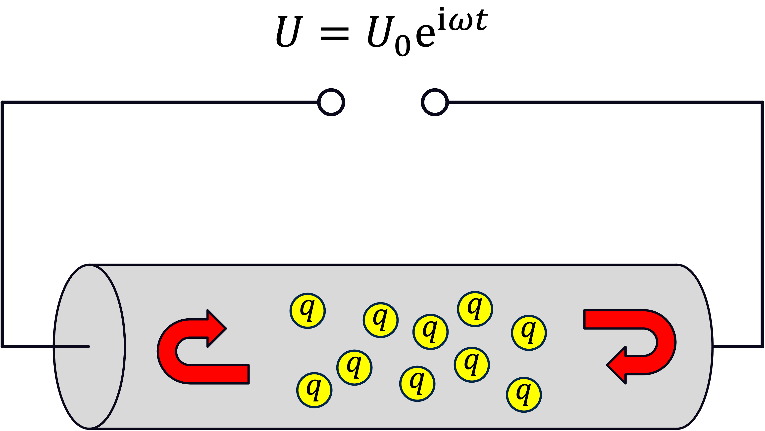
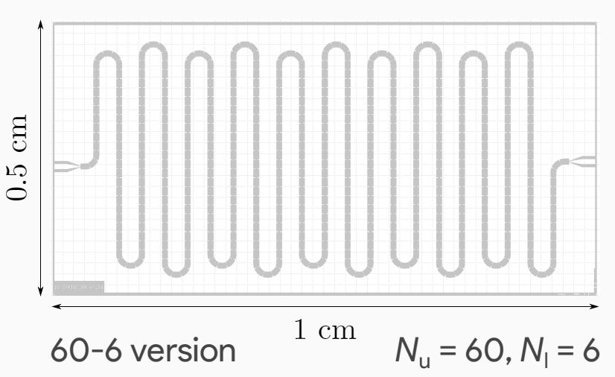
Ingredients to develop a KI-TWPA
Phys. Scripta 98 (2023) 12, 125921
IEEE Trans. Appl. Supercond. 34,3 (2024) 1700605
J. Low. Temp. Phys. (2024)
Material with high kinetic inductance
⟹ high-resistivity superconductors
(NbN, NbTiN, …)
Transmission line design
L₀ = 8.5 pH/sq
w = s = 1
Supercell:
unloaded cells + loaded cells
Transmission line arranged in a meander-shaped geometry
$$⇒ L\left(I\right)≈L_{0}∙\left(1+\frac{I^{2}}{I_{∗}^{2}}\right)$$
$$L_{0}= \frac{R_{S} \text{ℏ}}{π Δ}$$
$$I_{∗}∝1/\sqrt{R_{n}}$$

Slide 14
R&D Activity
Electron coupling: the axion DM cloud acts as an effective RF magnetic field on electron spin exciting magnetic transitions in a magnetized sample and producing rf photons
Axion
MS – Magnetized sample
Expected rf power
Wind

