Slide 1
The Technical Design Report (TDR) for SAND in the ND complex
Paolo Bernardini, Lecce
DUNE, Italian Collaboration Meeting
October 30th, 2024

Slide 2
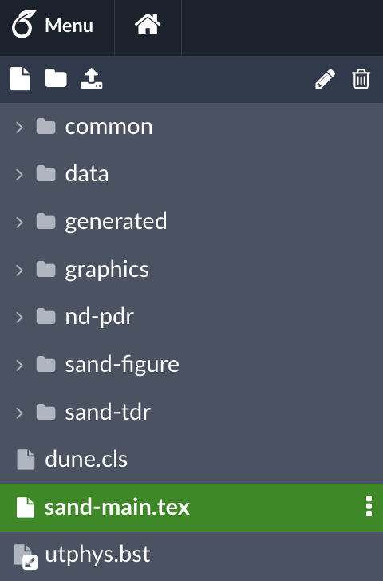
An overleaf is adopted according to
LATEX conventions for LBNF/DUNE documents
shared with SAND people
H.A. Tanaka (ND tech. coordinator)
A.E. Heavey (scientific editor)
The figures in sand-figure and the files in sand-tdr
are input for sand-main.tex
Dedicated overleaf for GRAIN
and SOFTWARE Working Groups,
periodically copied in main overleaf

Slide 3
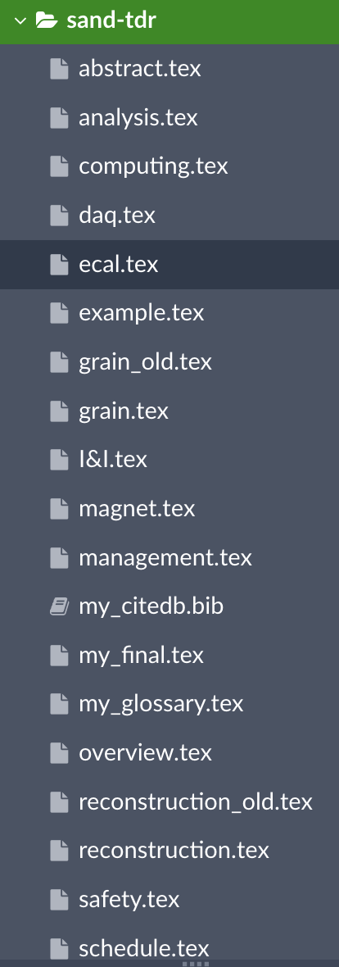
Sections in the SAND chapter
Overview (requirements & opportunities)
Lead/Scintillating-Fiber Calorimeter (ECAL)
Superconducting Magnet
Liquid Argon Active Target (GRAIN)
Tracker
Data Acquisition (DAQ) Architecture
Detector Control (DCS)
Detector Safety System (DSS)
Software & Computing
Event Reconstruction
Analysis
Installation & Integration
Safety
Organization & Management
Time Schedule
Possible Upgrades
my_glossary.tex
my_citedb.bib
Calibration spread
in several sections
New DUNE words and new references
in evidence (at the file end)

Slide 4
7 pages
Updated according to the task-force document
(approved in DUNE general meeting, May 2024)
To do: careful reading and corrections (LS e CM)
Possible improvements (mainly in Sec. 1.1.4)
Notes:
L’ho scritto io

Slide 5
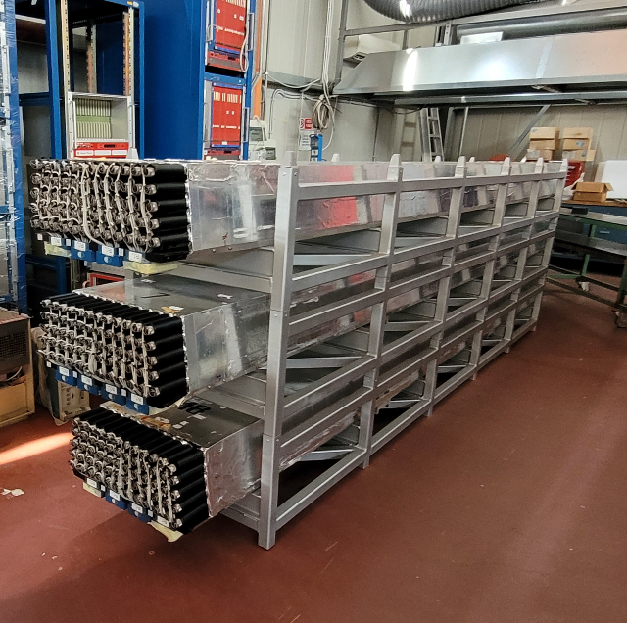
66 pages
Draft available in time
July 22-23, 2024 - Preliminary Design Review (PDR)
To be updated according to PDR recommendations
Expand hazard & risk analysis, shipping details, resources loaded schedule and cost analysis
Gantt & milestones to be updated
Refinements expected within October 31
Talk by
Antonio D.D.
Notes:
Antonio Di Domenico, Danilo Domenici
Endcap / Francesco Noto

Slide 6
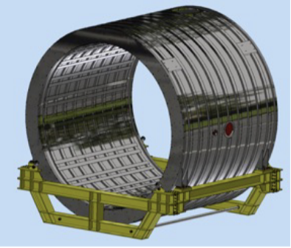
25 pages
Draft available in time
July 22-23, 2024 - Preliminary Design Review (PDR)
To be updated according to recommendations
Update of design, dismounting and shipping of the yoke
Possible improvements (mainly in Sec.s 1.3.4, 1.3.5, 1.3.6)
Refinements expected within October 31
Notes:
1.3.6 Milestones (presenti anche in ECAL Section)
Vannozzi, Delle Monache

Slide 7
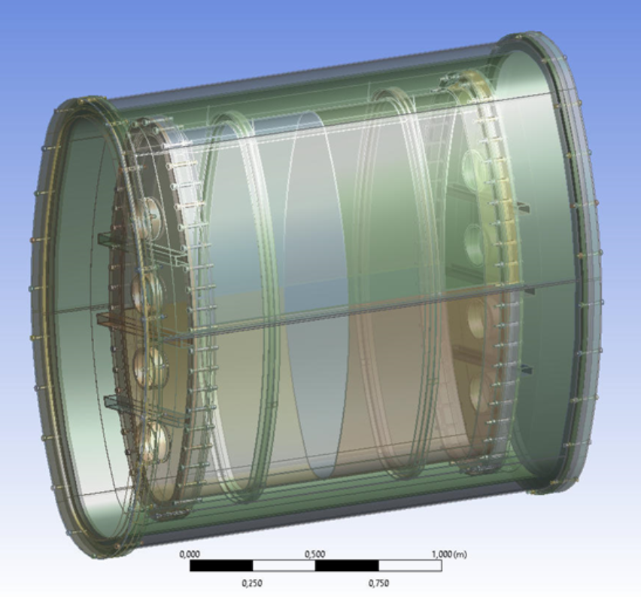
28 pages
Present - physics requirements - mechanics - lens description
- SiPM arrays - ASIC requirements
To be completed - coded mask description - reconstruction with voxels*
- 3D reconstruction* - performances
To be written - prototypes - DAQ & slow control - calorimetry
- calibration - cryogenics - integration & installation
Next check: November 15 Complete draft: November 30
* another section ?
Notes:
Sintetizzare 3D recnstruction e metterla alla fine, articolo in preparazione da citare
Possibile spostamento dei paragrafi sulla ricostruzione

Slide 8
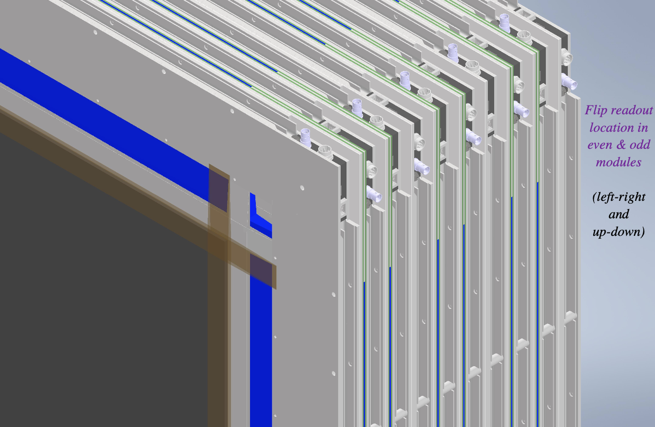
6 pages
Present - figures and tables about STT geometry
Missing – 14 subsubsections about STT
- subsection about Drift Chamber
- subsection about Gas System
Next check: November 31 Complete draft: December 2024
Notes:
Contatto con Roberto PETTI
Sirri, Di Falco

Slide 9
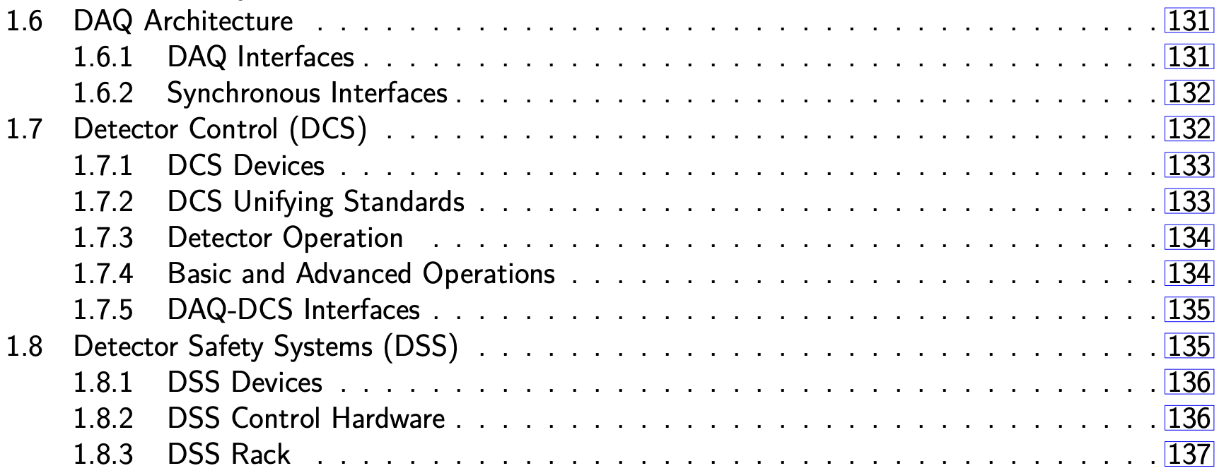
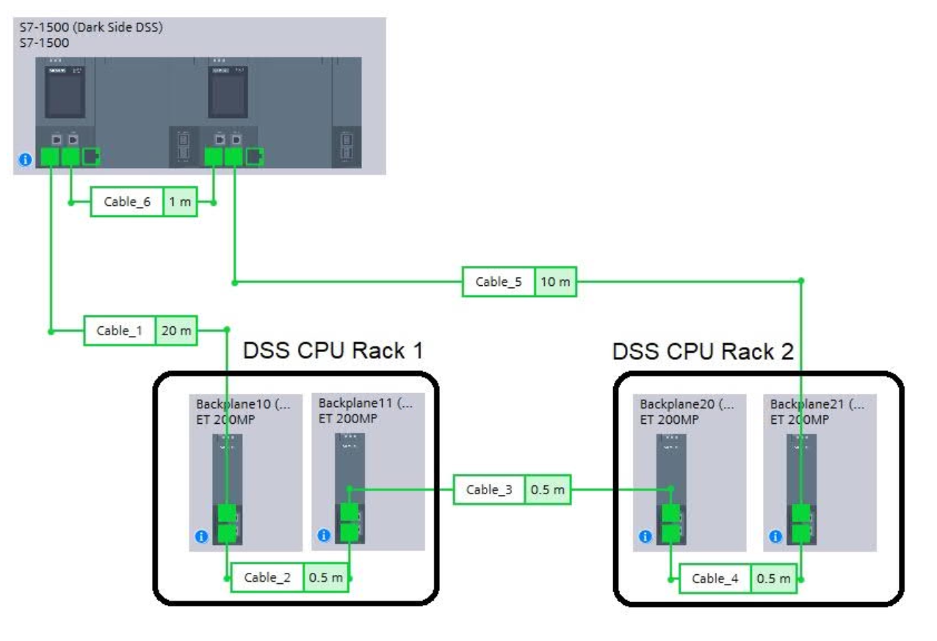
8 pages
Ready draft - DSS
To be completed - DAQ (expected data rates, interfaces)
- DCS (preliminary layout, DAQ interfaces)
Next check: ?? Complete draft: ??
Notes:
Sergio Di Domizio – GE, Camillo Mariani - Virginia Tech, Nicolò Tosi - BO
ECAL, STT, GRAIN – DAQ interfaces, DAQ– DCS interfaces
ICD utilizzabile per il TDR ?

Slide 10
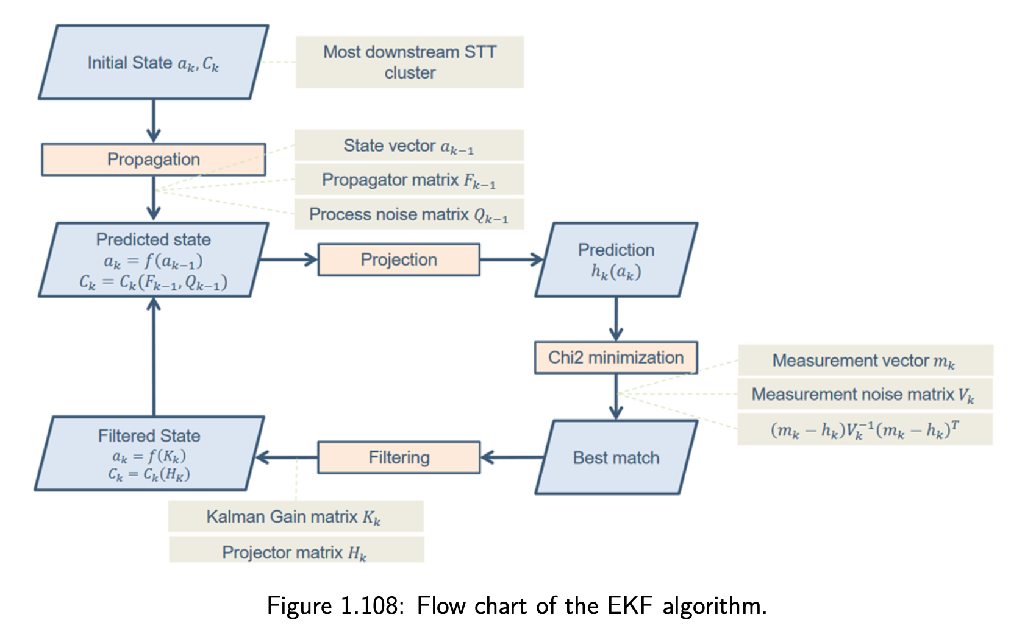
25 pages
Present - GRAIN simulation - ECAL simulation & clustering
- Kalman filter (with B) - edep-sim output
Missing - simulation of ν fluxes, geometries
- reconstruction in GRAIN*, ECAL
- Common Analysis Files - computing architecture
- event display - integration
Complete draft: December 24
* another section ?
Notes:
Matteo Tenti, Valerio Pia, Denise Casazza

Slide 11
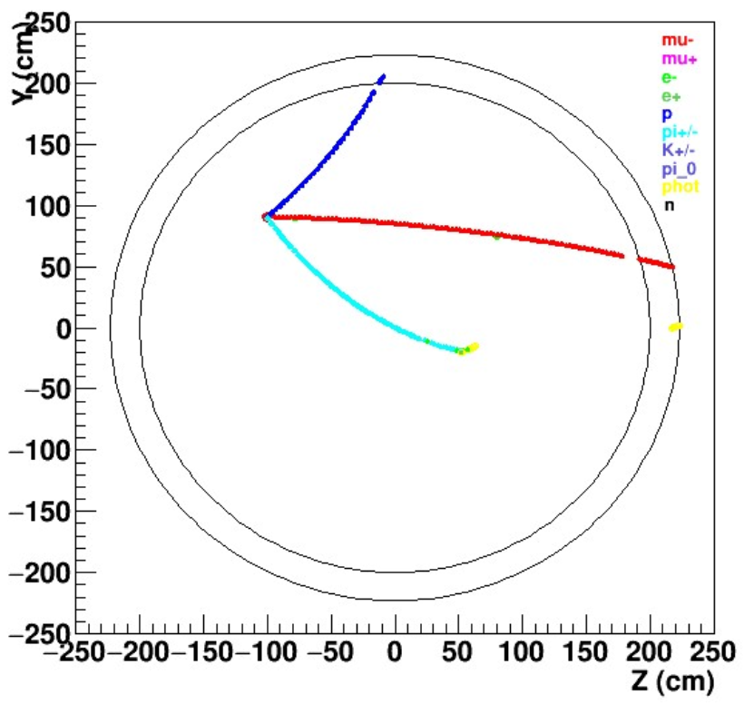
52 pages
Present - single particle reconstruction
e, π⁰, γ, p, n, K⁰, Λ⁰
helix 3D fit in STT and ToF method
- particle ID (e, p, μ, π)
- neutrino energy reconstruction
To write - reconstruction in GRAIN*
Future - identification of neutrino event in the spill
Mainly from the document
DUNE-doc-13262-v7
“A Proposal to Enhance
the DUNE Near-Detector
Complex”
GEANT & FLUKA
Notes:
Document 2021
Matteo Tenti, Antonio Surdo …

Slide 12
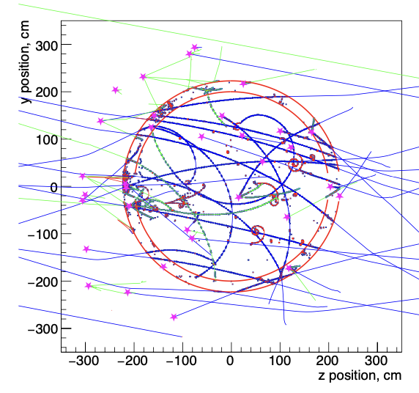
80 pages
Present - selection of CC interactions (ν_{μ}, anti ν_{μ}, ν_{e}, anti ν_{e})
- ν-H interactions - measurement of fluxes
- nuclear smearing in Ar - ν-e scattering - coherent π production - on-axis beam monitoring - ν_{e}/ν_{μ} ratio - external backgrounds
To do - careful reading and corrections (volunteers ?)
- possible new topics
From the document
DUNE-doc-13262-v7
“A Proposal to Enhance
the DUNE Near-Detector
Complex”
Notes:
Autore: Roberto Petti
Antonio Surdo, Matteo Tenti

Slide 13
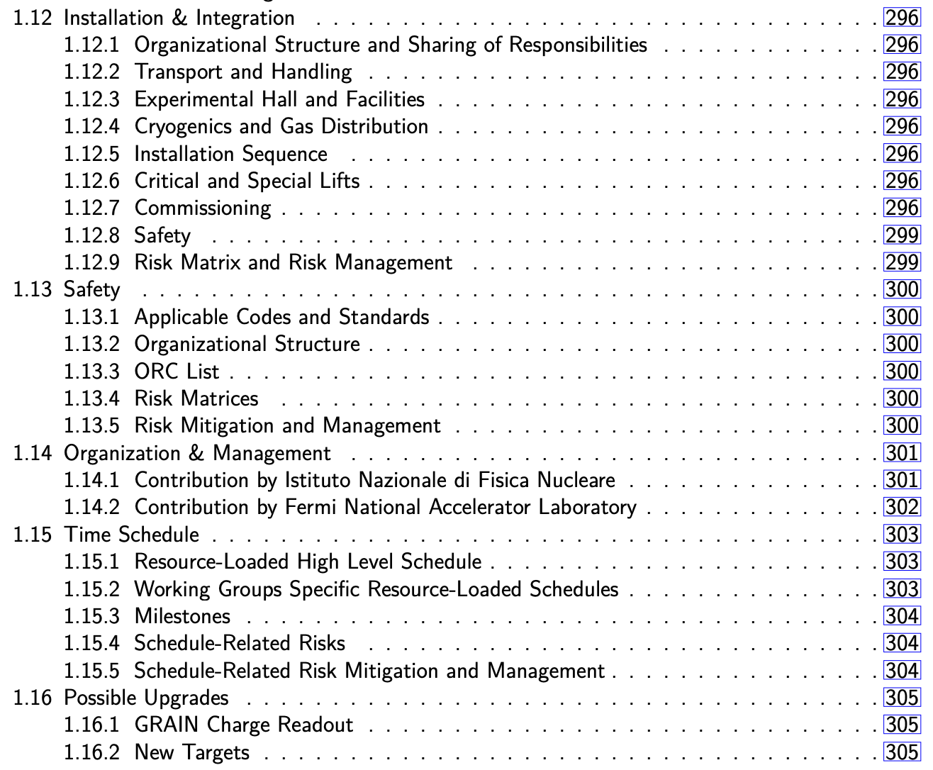
To be written
Present: tables about sizes,
weights and storage @ FNAL
of yoke, coil and calorimeter
Expected: November 31
See talk by C. Montanari
Present: time schedule
from the single sections
Next check: November 30 Complete draft: December 2024
Notes:
Luca Stanco, Claudio Montanari, PB, Laura Patrizii
I&I Gianluigi PIAZZA + Gordon CLINE
Jonathan Lewis <jdl@fnal.gov>

Slide 14
Present:
316 pages
259 figures
65 tables
Overview 7 pages – to be checked
Lead/Scintillating-Fiber Calorimeter (ECAL)
Superconducting Magnet
Liquid Argon Active Target (GRAIN) 28 pages – in progress
Tracker 6 pages – at the beginning
Data Acquisition (DAQ) Architecture
Detector Control (DCS)
Detector Safety System (DSS)
Software & Computing 25 pages – at the beginning
Event Reconstruction
Analysis
Installation & Integration
Safety
Organization & Management
Time Schedule
Possible Upgrades
}
91 pages – to be updated
}
8 pages – to be completed
52 pages – to be completed
80 pages – to be checked
}
At the very beginning (some tables)
1-2 pages for each section
Indexes and keywords are defined

Slide 15
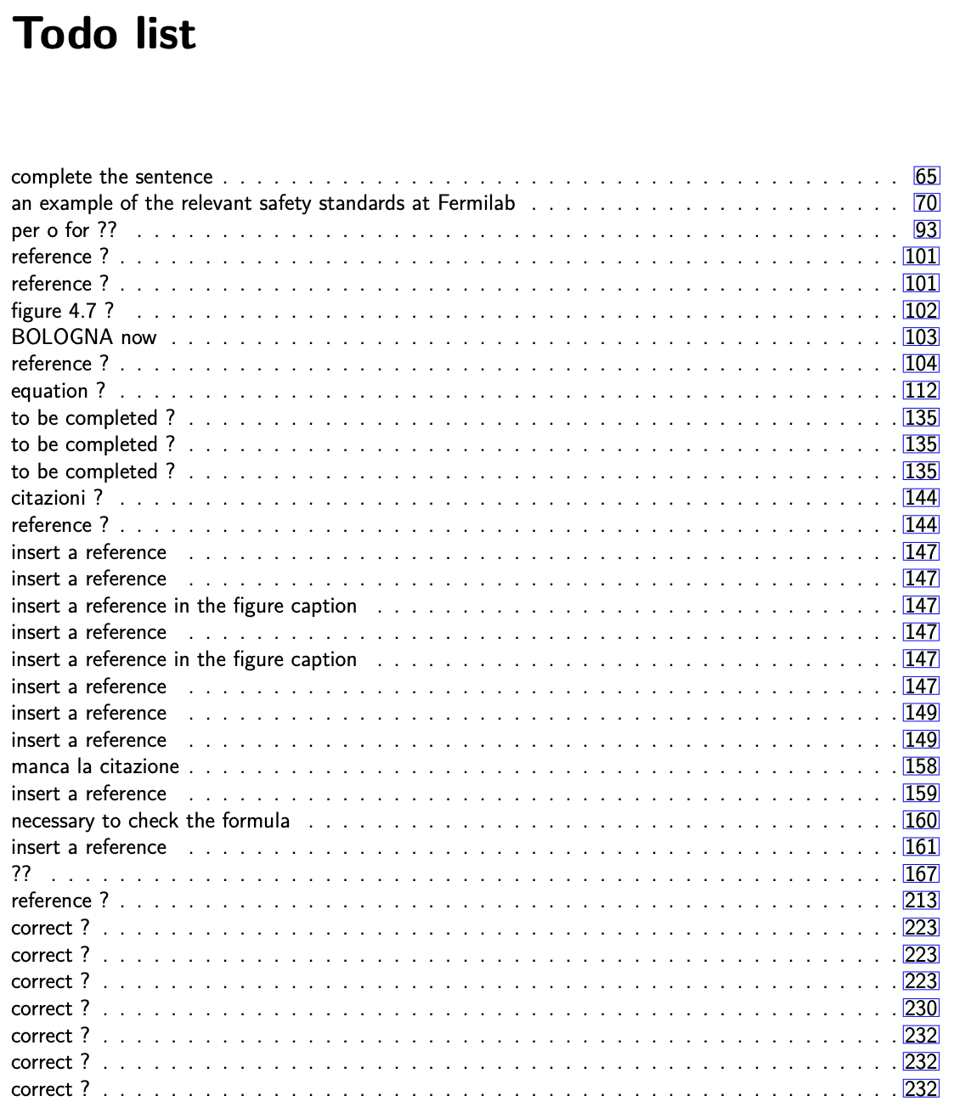
Long todo-list
Essentialy missing or wrong references
Standardize (as possible) quantity names,
reference systems and so on
Each author responsible his/her section
introduces update when necessary
Check priorities
Physics and coherence
English language
Rules of the DUNE documents
but ...
Notes:
Evitare che l’ultimo punto ritardi la pubblicazione

Slide 16
Instructions for the authors
Insert the reference in the bibliography (bibitex format)
Check if some word is present in the glossary and use it
Insert new words in the glossary
Check the reference to equations, figures, tables
Write your name in the text %% author ?
Take into account the DUNE editing rules
https://dune.bnl.gov/docs/guidance.pdf
Notes:
Mia disponibilità a dare una mano

Slide 17
Glossary
Insert new DUNE words and new DUNE abbreviations at the end of this file
Check if the word is already present
Examples
Bibliography
Insert references (bibtex format) at the end of this file
Check if the reference is already present

Slide 18
DUNE Words from the glossary
\dfirst{fnal} first time
\dword{fnal} following times
More informations in the glossary
\dfirst{nd} near detector (ND) with link
\dword{nd} ND with link
\dlong{nd} near detector w/o link
\dshort{nd} ND w/o link
\dword singular \dwords lower case & plural
\Dword capital \Dwords capital & plural
Notes:
Lower case

Slide 19
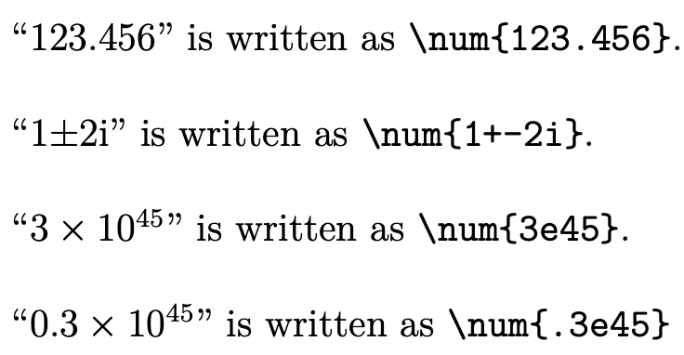
common/units.tex to define commands for units
Examples
bare units
bare numbers
numbers and units
Notes:
Curly brackets

Slide 20
Figures
Please, complete the plots with axis labels and measurement units
English

Slide 21
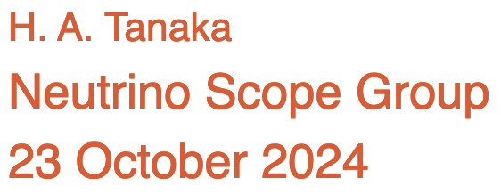

Slide 22
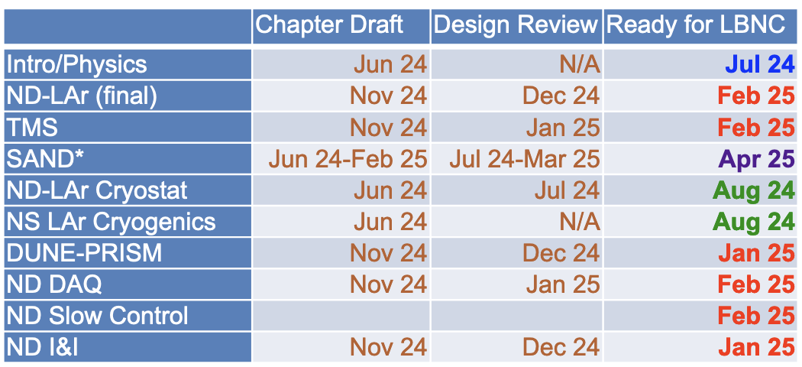
Hiro Tanaka, September 9, 2024
Collaboration Meeting
Notes:
Possibili rinvii
I&I Gennaio 2025
GRAIN Febbraio 2025

Slide 23
Final remarks
Write-up of SAND-TDR has started (February 2024) and is going on
Main part of data are available, it's just a matter of writing
First review about ECAL+magnet in July 2024
2024 end as deadline for a first complete draft
What measurement to evaluate the TDR progress ?
Number of pages: 315 !
Text quality ? Difficult answer
To do:
Some sections to be written and completed
Editing according to DUNE rules
SAND internal reading to “measure” the text quality
When a first draft in DUNE-docdb ? Soon !!!
Notes:
Took place in July

Slide 24
Backup slides

Slide 25
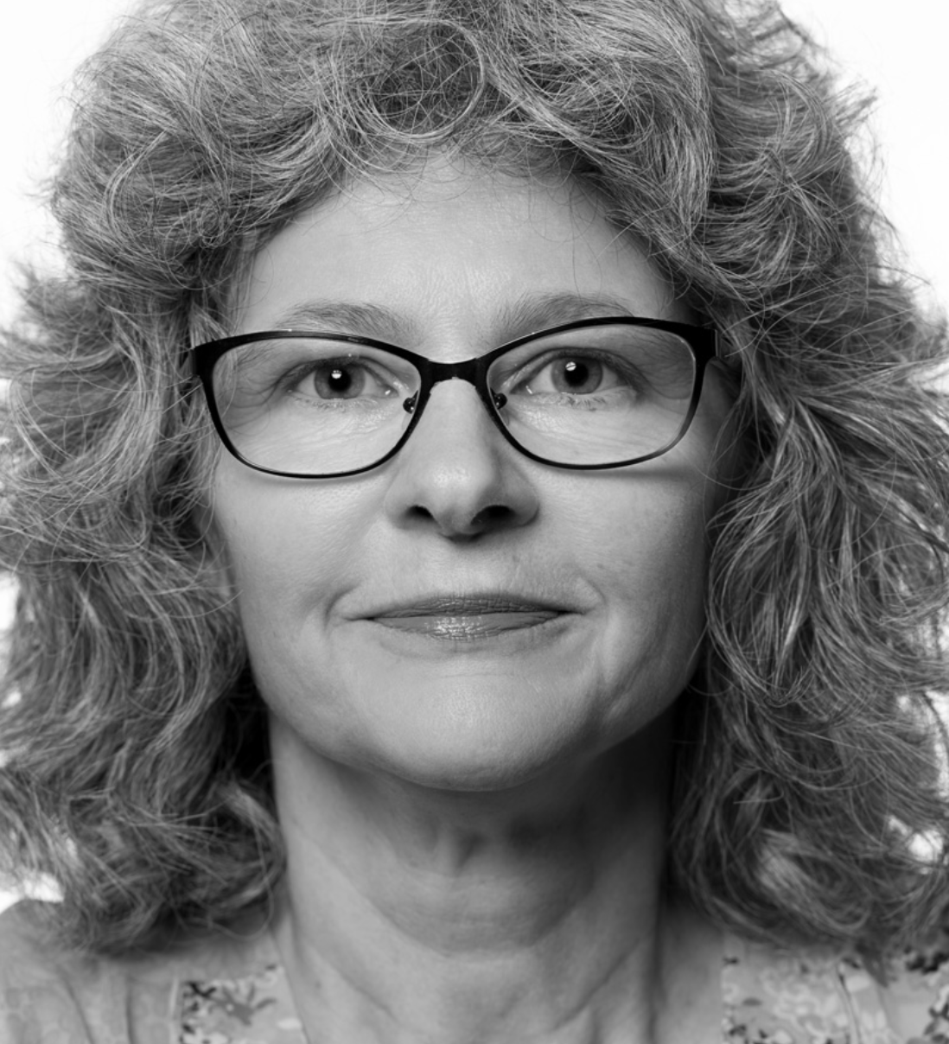
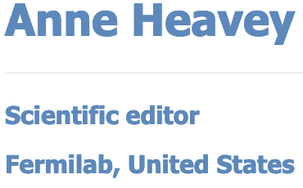
Many many rules/instructions in the writing of DUNE documents :
https://github.com/DUNE/document-guidance/releases/ Latex structure
https://ctan.mirror.garr.it/mirrors/ctan/macros/latex/contrib/siunitx/siunitx.pdf units
https://dune.bnl.gov/docs/technical-proposal/dune-words.pdf DUNE words
https://ctan.mirror.garr.it/mirrors/ctan/macros/latex/contrib/glossaries/glossaries-user.pdf glossary
An almost synthetic guidance (49 pages) https://dune.bnl.gov/docs/guidance.pdf
Help by Anne Heavey, scientific editor at FNAL

Slide 26
Hiro Tanaka, September 9, 2024
Collaboration Meeting
More details for SAND
Preliminary Design Review
topics
Jul 2024 ECAL + magnet
Nov 2024 I & I
Dec 2024/Jan 2025 GRAIN
Mar 2025 Tracker
Review of TDR chapter draft
reviewer
Jan 2025 SAND consortium
Feb 2025 DUNE collaboration
Mar 2025 LBNC
Notes:
Possibili rinvii
I&I Gennaio 2025
GRAIN Febbraio 2025

