Slide 1
A Drift Chamber Tracker for SAND – Mechanical Design
DUNE-Italia Collaboration Meeting, Ferrara
29/10/2024
Marco Guerzoni & Emilie Savin

Slide 2
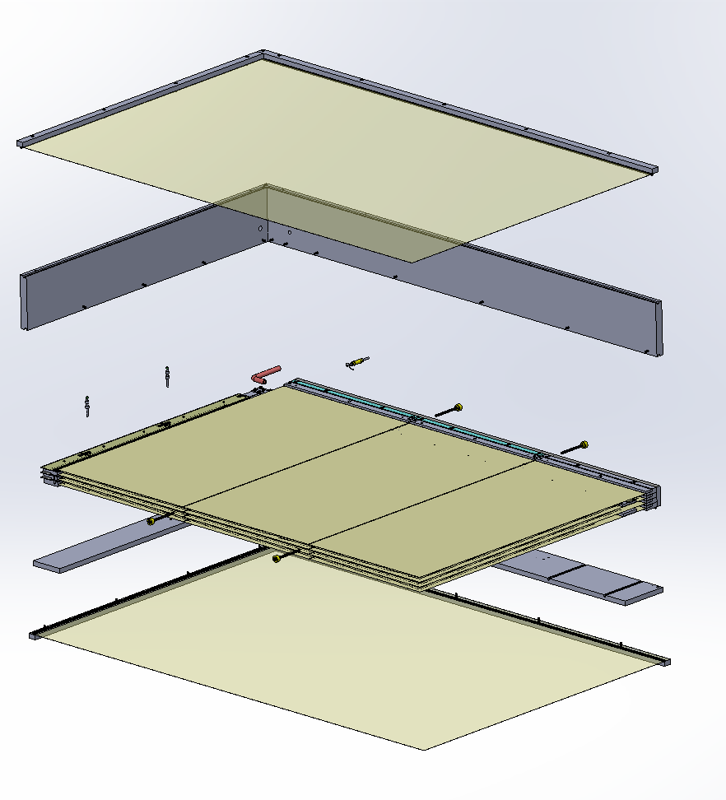
Cross-section of the complete Drift Chamber
Cover
Housing
Gas Input
High Voltage Input
Structural Support
Structural Support
Layer Setup
Base
Cover
Notes:
La Drift Chamber e composta
per irrigidire la struttura.

Slide 3
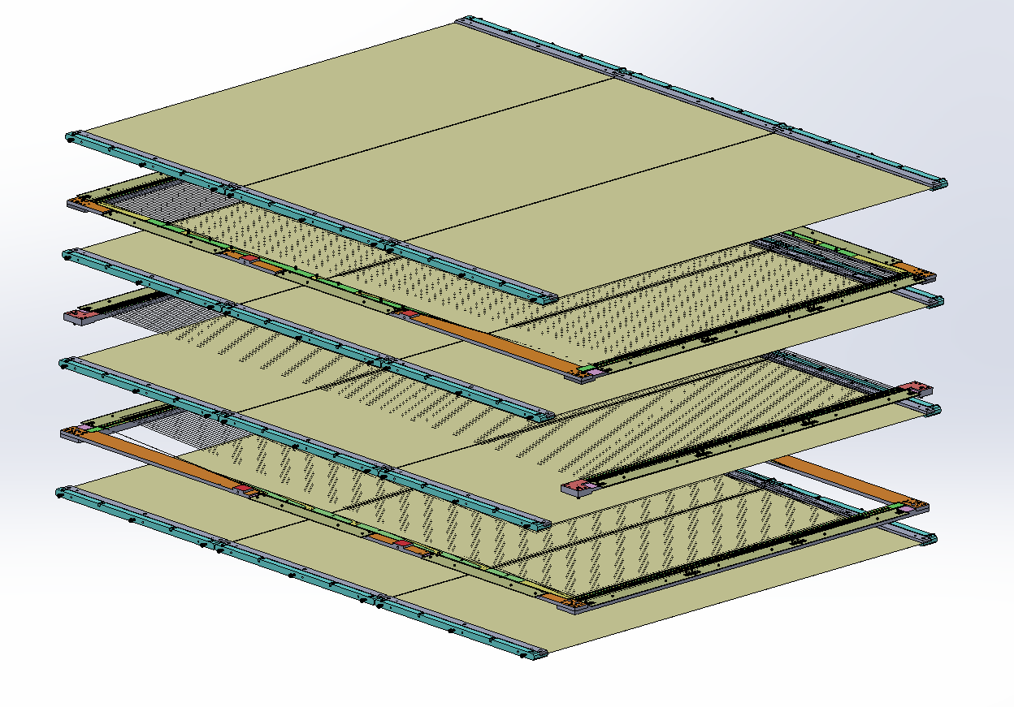
Layer Setup
Effective Measurement Area: 1200 x 800 mm
4 Mylar Layers
Distance between alternating layers: 6 mm
3 Wire Layers
Mylar Layer
Mylar Layer
-5° Wire Layer
Mylar Layer
0° Wire Layer
Mylar Layer
5° Wire Layer
Notes:
Superficie di misura efficace
Distanza tra gli strati alternati

Slide 4
MYLAR LAYER

Slide 5
Mylar Layer – Foil
The Mylar films provided by Fraunhofer are 19 µm thick PET films, coated on both sides with an approximately 70 nm thick layer of aluminum.
Since the roll is about 0.4 meters wide, three films are required to cover the measurement area.
Notes:
Foglio rivestite su entrambi i lati

Slide 6
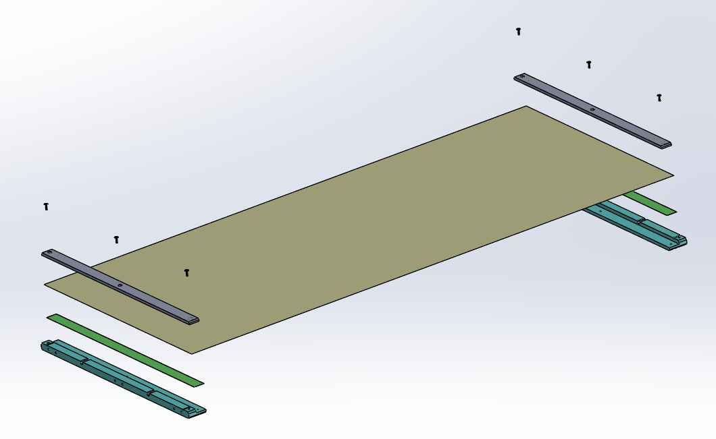
Mylar Layer - Setup
6x Bolts
400 mm - Mylar Foil
Aluminium Alloy Plate
Double-sided Adesive Tape
L-shaped Stesalite Plate

Slide 7
Mylar Layer – Foil
The foil is attached to the lower plate of the clamping device using double-sided tape.
Next, an aluminum alloy plate is screwed in place, through which high voltage is applied.
To apply voltage to both sides of the film, the Mylar is folded over and adhered to the aluminum alloy plate.
Notes:
Il mylar e collegato alla p

Slide 8
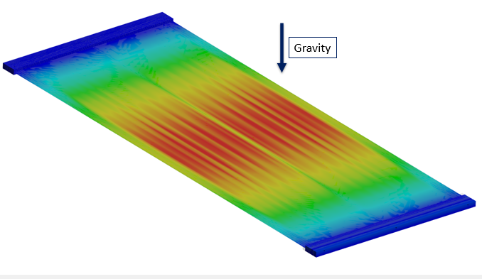
Mylar Layer – Pre-tensioning in horizontal setup
To achieve a plane foil, it must be pre-tensioned.
In the horizontal setup gravitational forces cause bulging at the free edges and in the center.
By stretching these bulges are reduced a few µm in depth .
However, if the Mylar is over-tensioned, the material begins to wrinkle.
Notes:
piatto

Slide 9
Mylar Layer – Horizontal Pretension Test
In a test setup, the assembly process was evaluated.
Additionally, the pretension distance required for foil to achieve flatness was determined.
The results indicated that a pre-tensioning distance of approximately 2 mm was ideal.

Slide 10
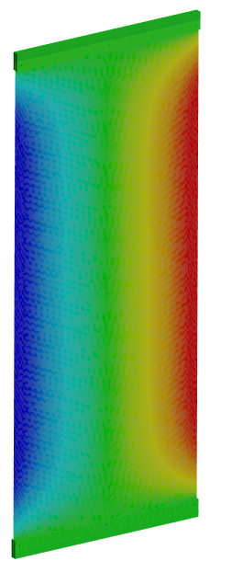
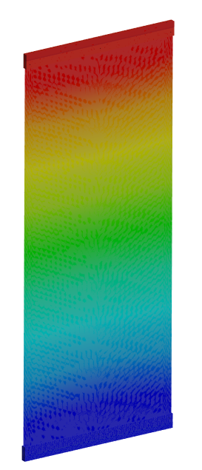
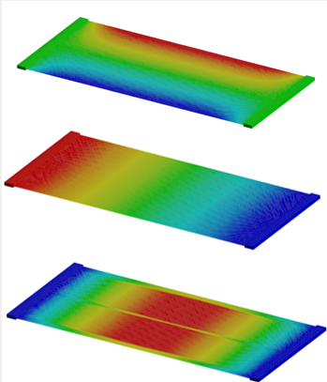
Mylar Layer – Pre-tensioning in vertical setup
When the clamping device is positioned vertically, no bulging occurs in the material, and it. remains flat
Based on this observation, it will be tested whether the pre-tensioning of the Mylar can be achieved solely through gravitational force.
Until then, the prototype should be constructed so that the Mylar is tensioned to a fixed distance.

Slide 11
Mylar Layer – Vertical CreepTest
Since the film is now under constant tension, it will experience creep over time. Creep refers to the permanent deformation of a material.
A creep test will be conducted in the near future.
The clamping device with the film will be hung vertically, and its deformation will be measured at regular intervals.
Notes:
Nella componente trasversale

Slide 12
WIRE LAYER

Slide 13
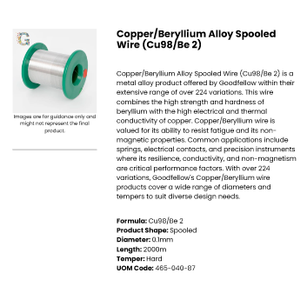
Wires
Ø 100 µm Field Wire (FW) of a Copper Beryllium Alloy
Ø 20 µm Sens Wire (SW) of gold-plated Tungsten

Slide 14
Wires – Pre-tensioning in Horizontal Setup
Vertical deformations of the Field wire:
160-180 µm @ 150g
100-110 µm @ 320 g
Vertical deformations of the Sens wire:
86-88 µm @ 50g
61-63 µm @ 70g
In a future analysis:
necessary pre-tension for the sensor wire to achieve the same deformation as the field wire under vertical loading.

Slide 15
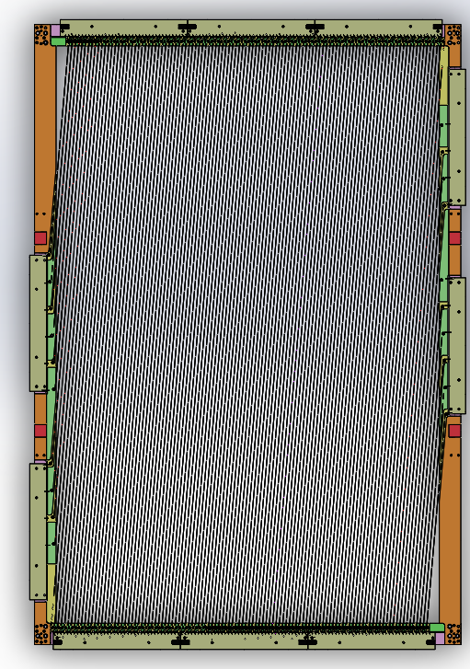
Wire Layers
The horizontal distance between the wires is 7 mm.
Each layer contains 113 wires (57 FW, 56 SW),
There are four different types of PCBs, with two of them being mirrored.

Slide 16
Wire Layers - Positioning
Each wires is positioned using two cylindrical pins each.
Each wire is soldered to the corresponding PCB.

Slide 17
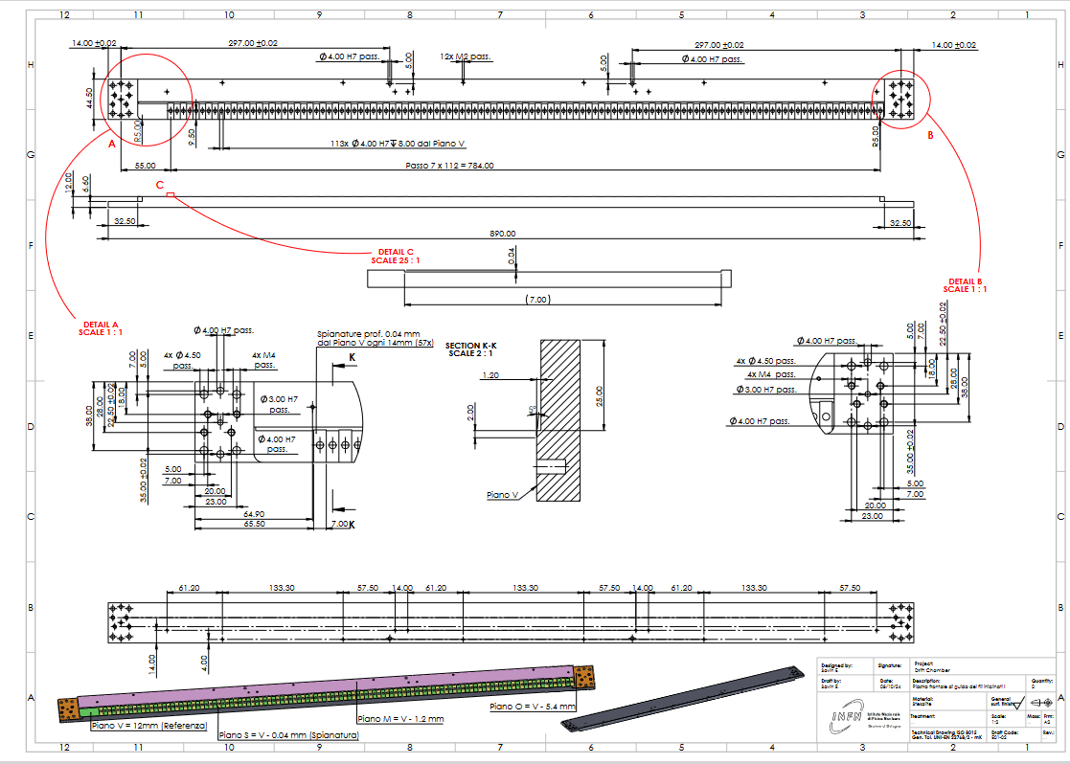
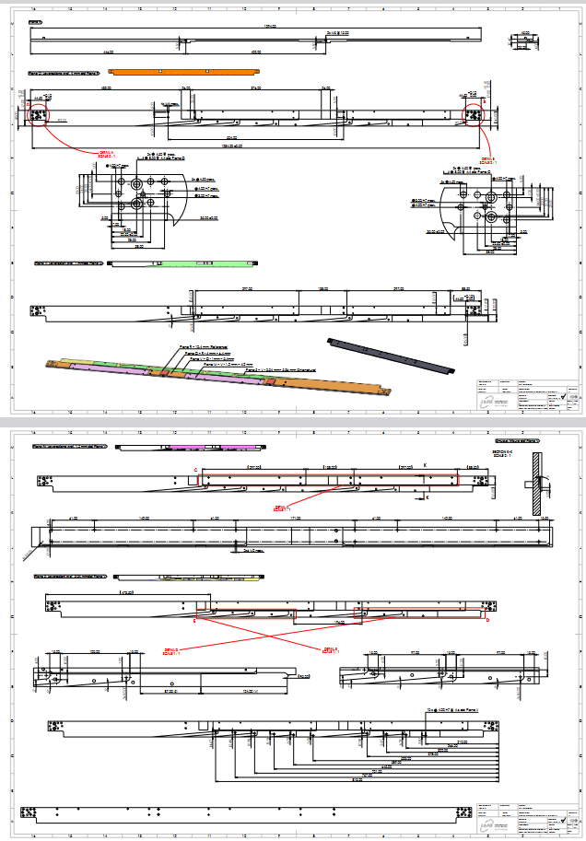
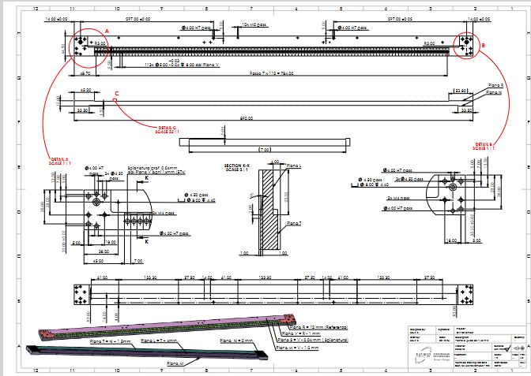
Wire Layers - Frame
The frame consists out of separate Stesalite plates that are screwed together.
There are six different types of Stesalite plates, and a total of 10 plates.

Slide 18
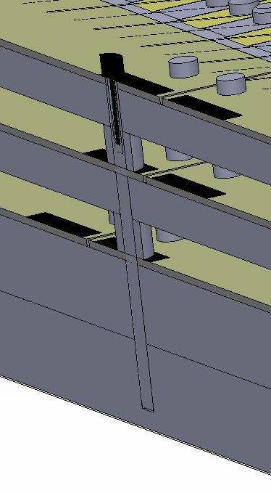
Wire Layers – Structural Support
To prevent deformations structural supports are added.
The longer plates will be held laterally.
The shorter plates will be held vertically.

Slide 19
Wire Layers – Structural Support
In the horizontal setup the vertical deformation could be reduced from 1.35 mm to 0.25 mm

Slide 20
Gas In- and Output, Electronics, and High Voltage

Slide 21
To be defined…
Gas Input
High Voltage
Electronics
Electronics
High Voltage
Gas Output

Slide 22
Mounting and Transport

Slide 23
Wire Layers – Mounting Frame
The frame consists of separate Aluminum alloy plates that are screwed together.
Here the Wire Layers will be mounted completely.

Slide 24
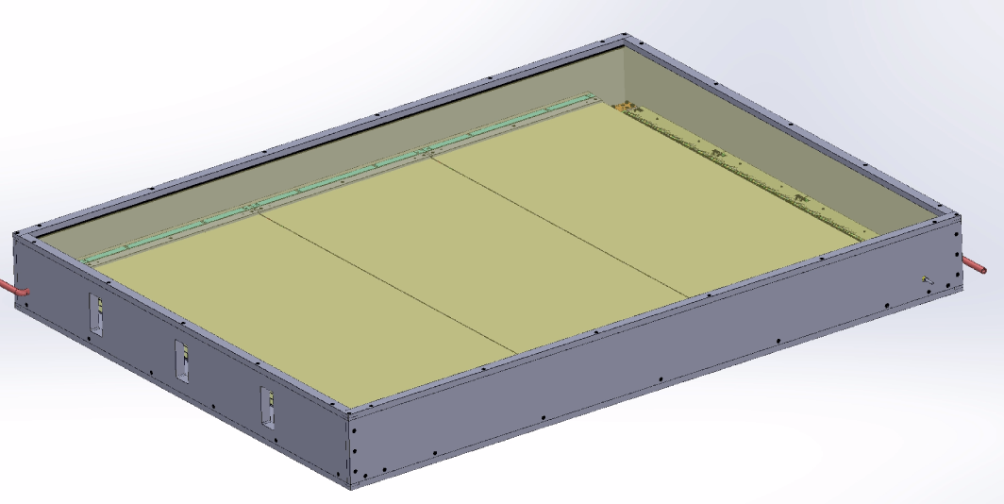
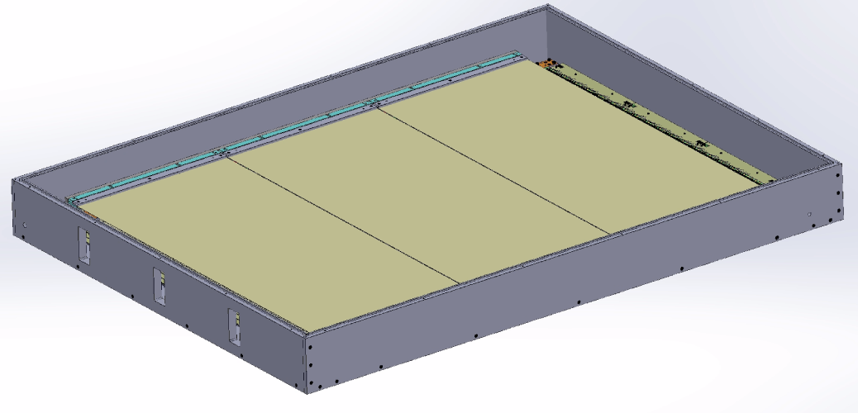
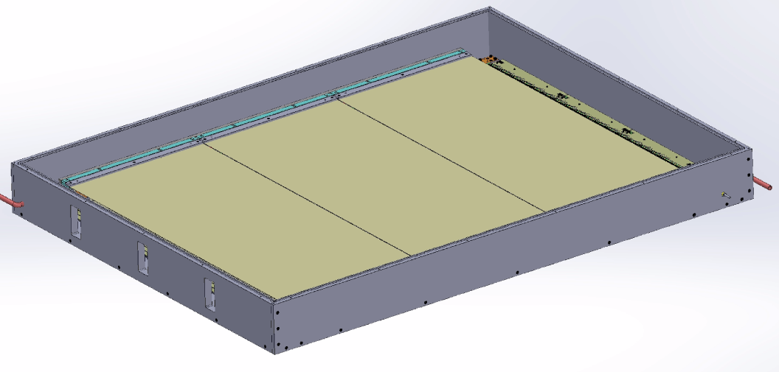
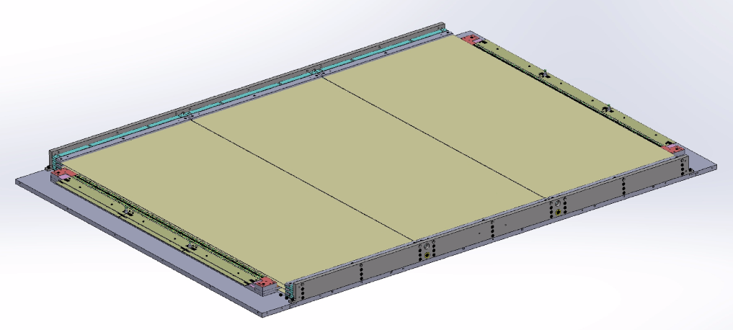
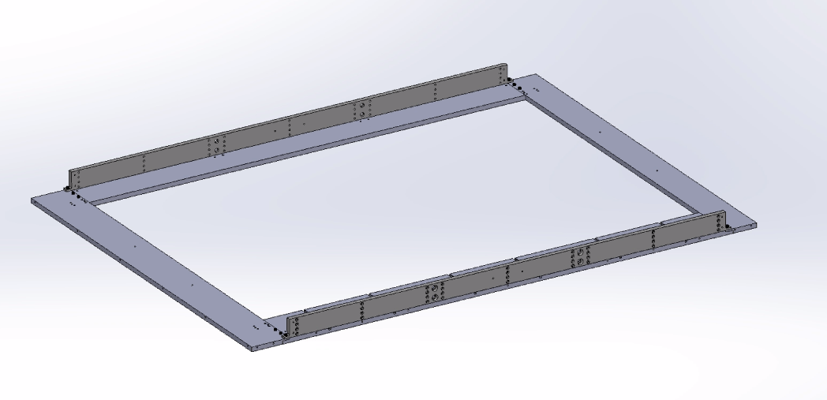
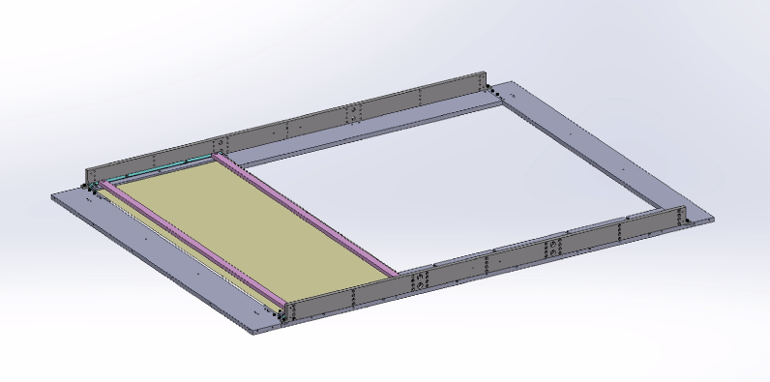
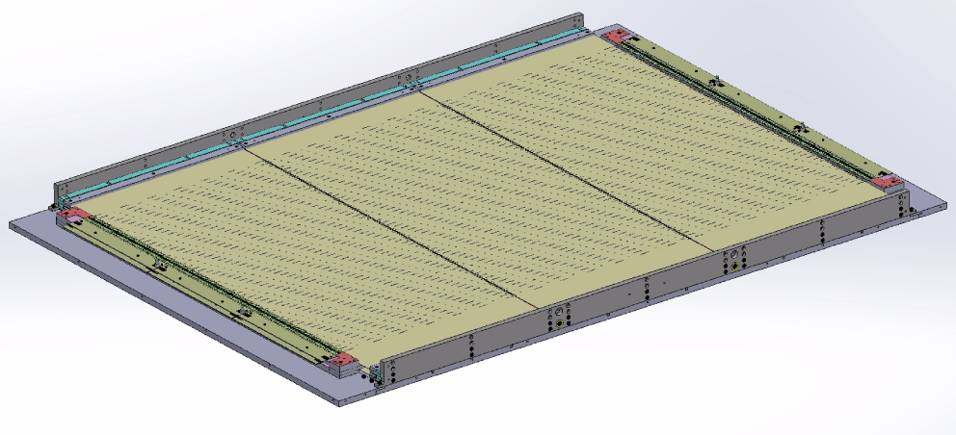
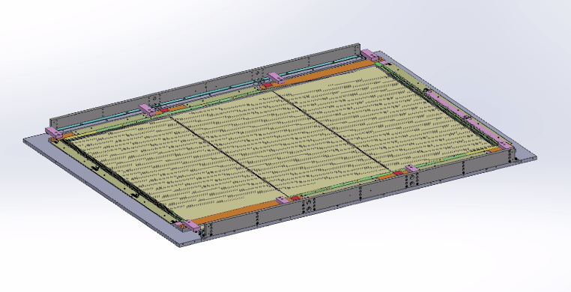
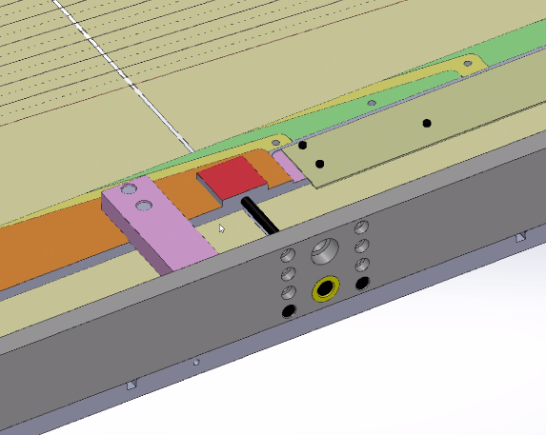
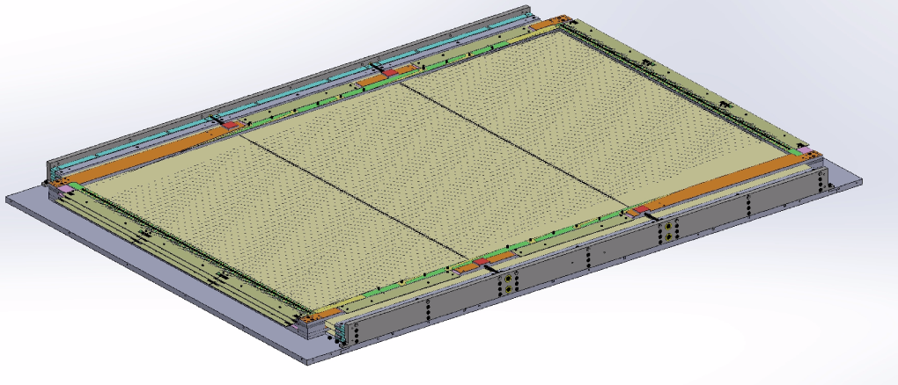
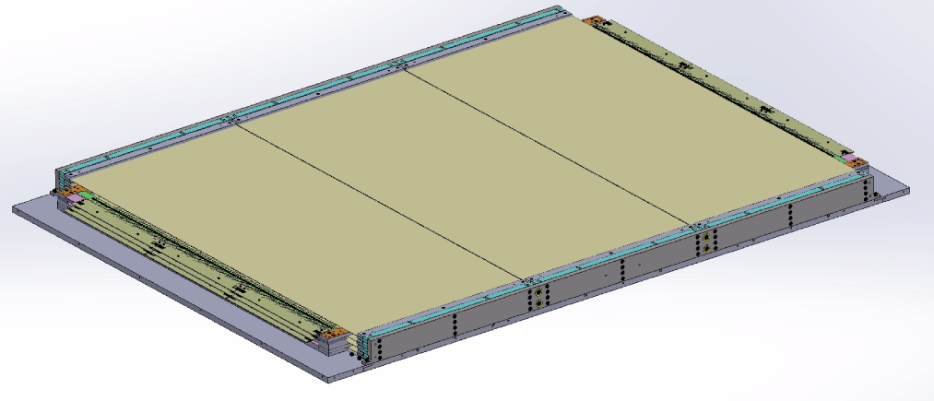
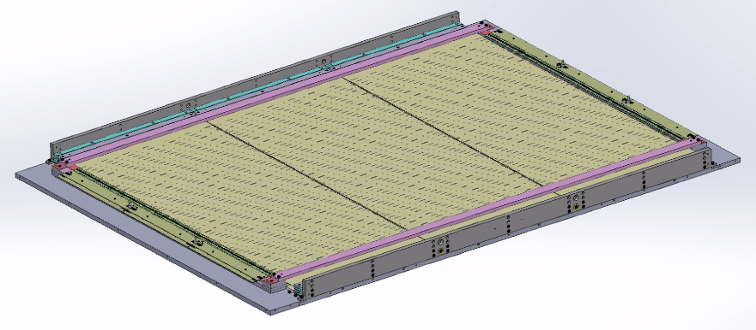
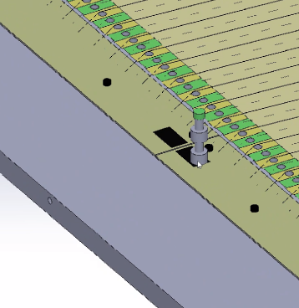
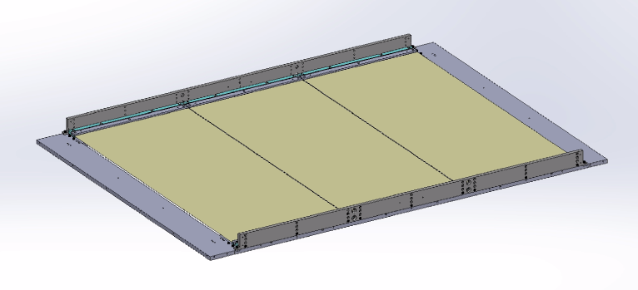
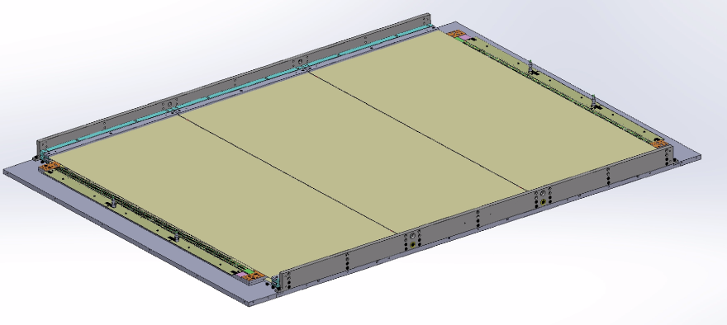
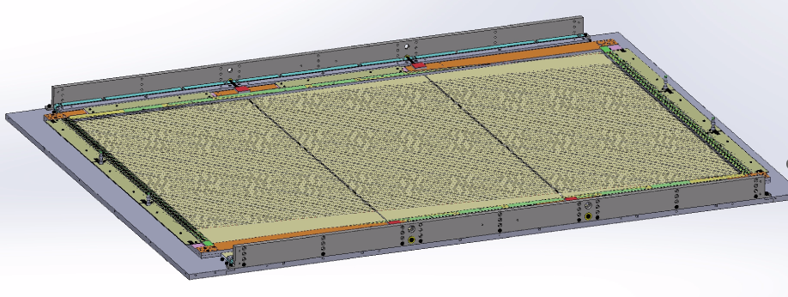
Mounting

Slide 25
Thank you for your attention!

