Slide 1
Summary
Status of STT mechanical Design.
Pisa Prototype 1200x800mm.
Resources for development of STT design.
Conclusions.

Slide 2
Status of STT mechanical Design.
Some STT components have been produced and qualified.
The construction and an assembly method have been study and validated by mechanical analysis.
Mechanical validation of the specifications was done through analytical and FEM analysis. The analysis of the final supporting system of the super module is not yet done.
The necessary tooling for the STT construction are at level of conceptual design.
The mechanical system of handling and insertion in Sand it is at the level of conceptual design.
The design of service integration is not present.
A prototype 1200x800 mm has been completed at CERN a second prototype 1200x800 mm is in construction in Pisa.
The Pisa prototype is going to use some final STT components (spacer, pins, E.P).
A design of a prototype 3800X3200mm module has been completed.

Slide 3
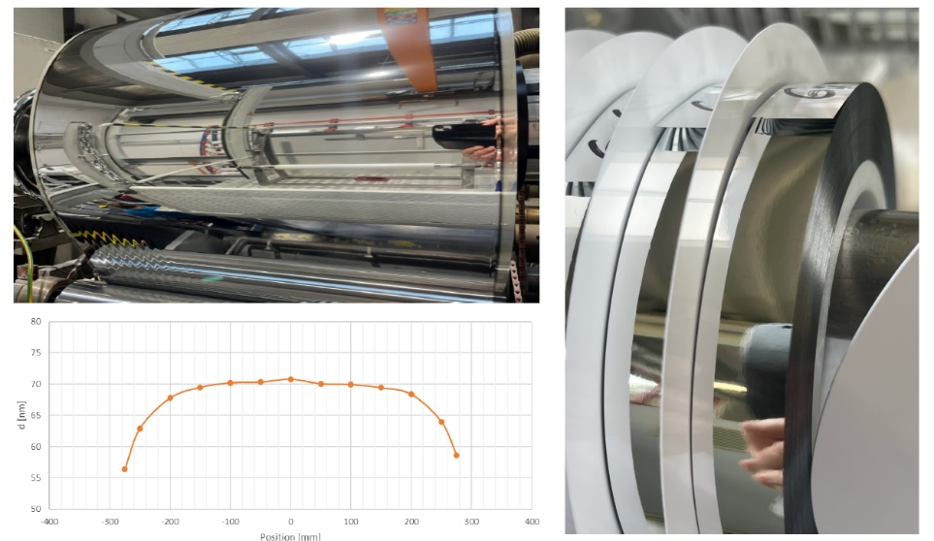
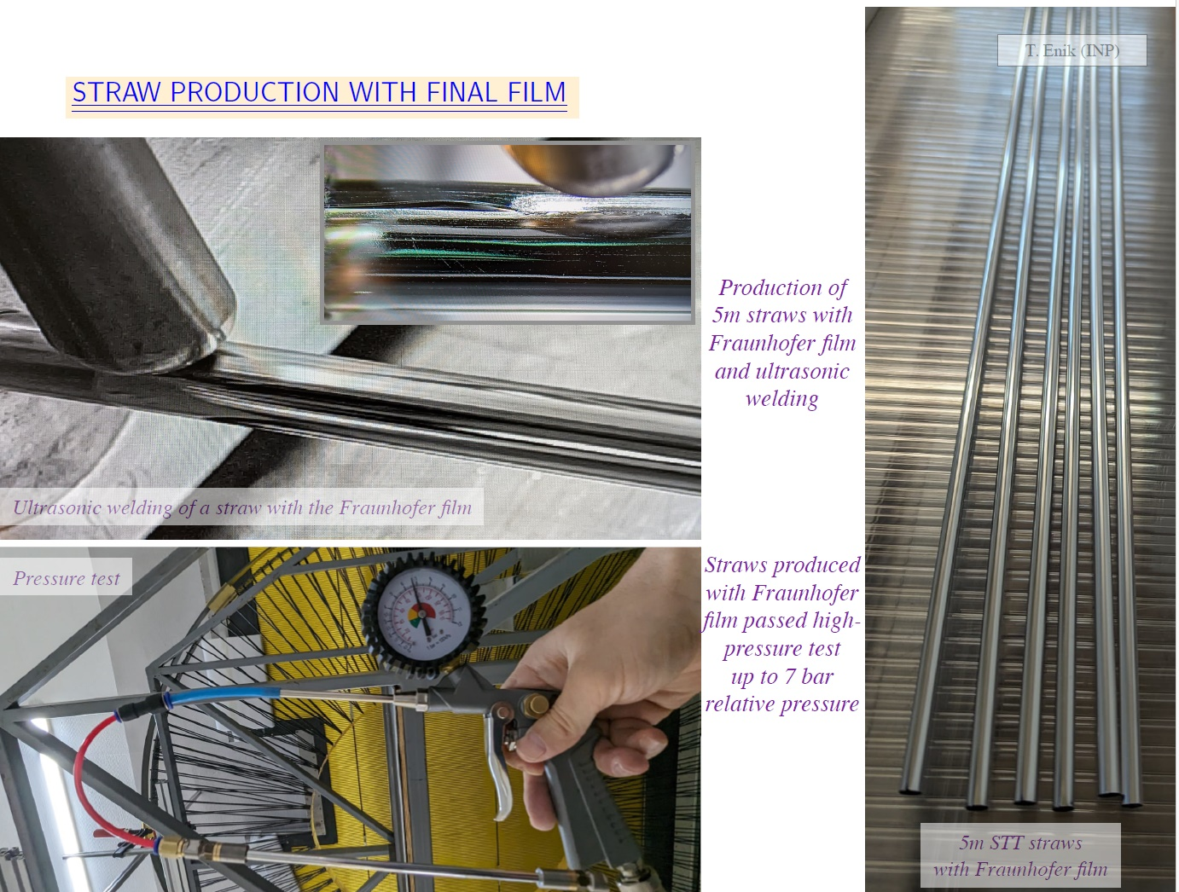
Components Overview of straw tube detectors.
Straw tube are made starting for a film of 19 μm with double side Aluminum of 70 nm (Hostaphan® RNK is a highly transparent, biaxially oriented coextruded film made of polyethylene terephthalate (PET)). An inner wire of gold tungsten rhenium of 20 μm is inserted inside stretched. Straws are filled with a mixture of argon/CO₂ (70/30) at 2 bar maximum absolute pressure.
Welded seam
The double side Aluminum improve the tightness if the straw.
The straw tube are pressurized at 3 bar of absolute pressure to be handle it and glue it to the supporting structure. Mechanical detail analysis has been done and verify by experimental test.

Slide 4
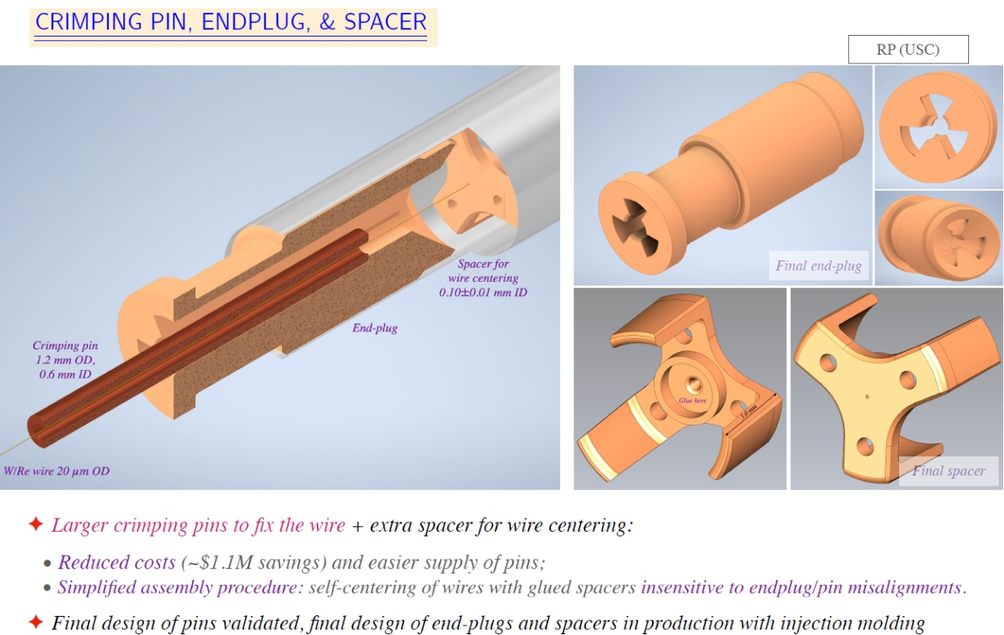
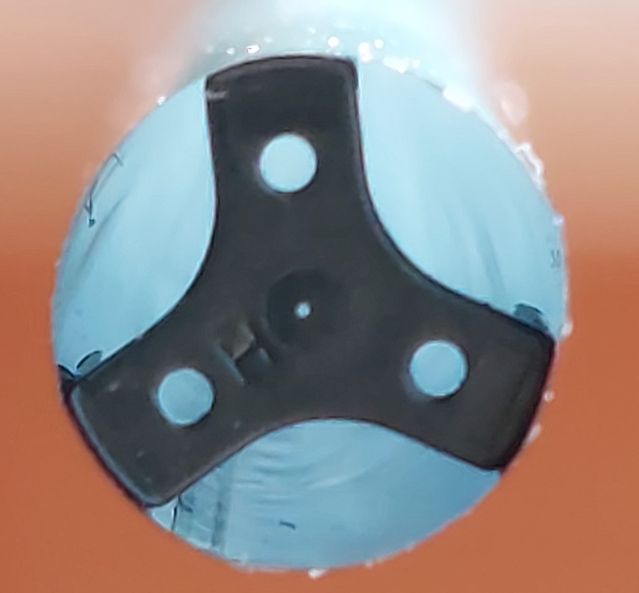
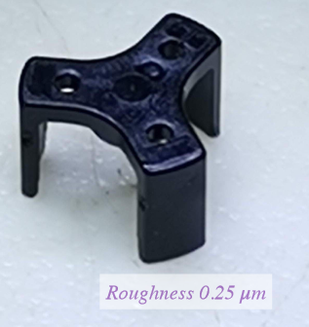
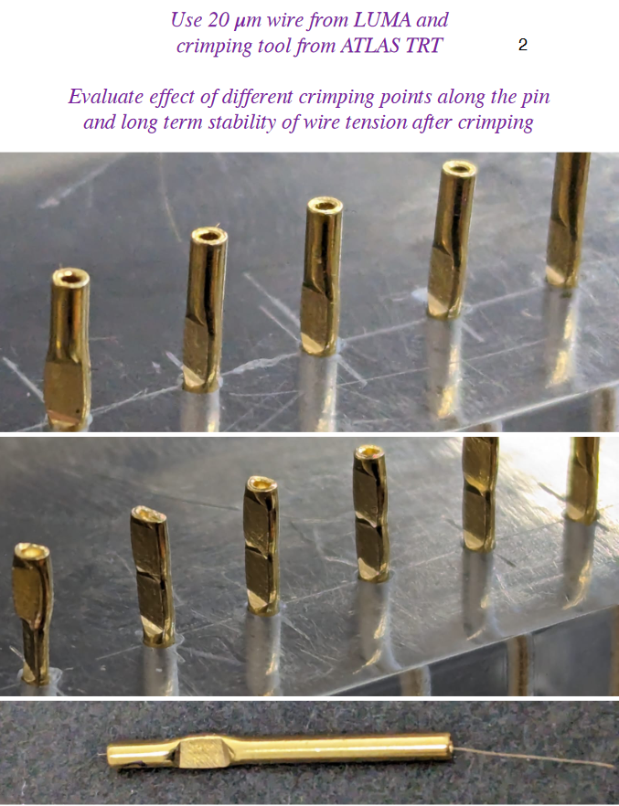
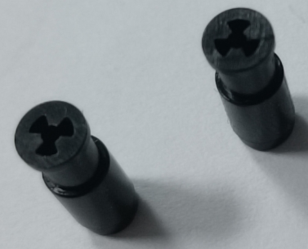
Components of straw tube detectors.
The spacer and end plug are made in polycarbonate with injection mold. This technology allows a production a low cost and large production. The end plug are glue to the straw tube. The wire is stretched and crimped to the gold plated cooper pins.
Holes 70-80 μm
Crimping test

Slide 5
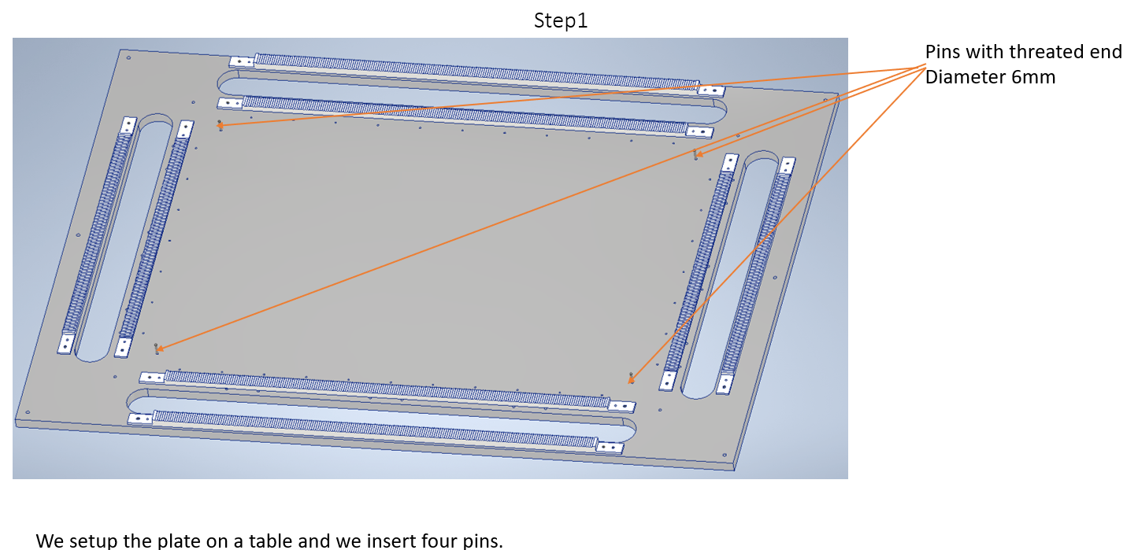
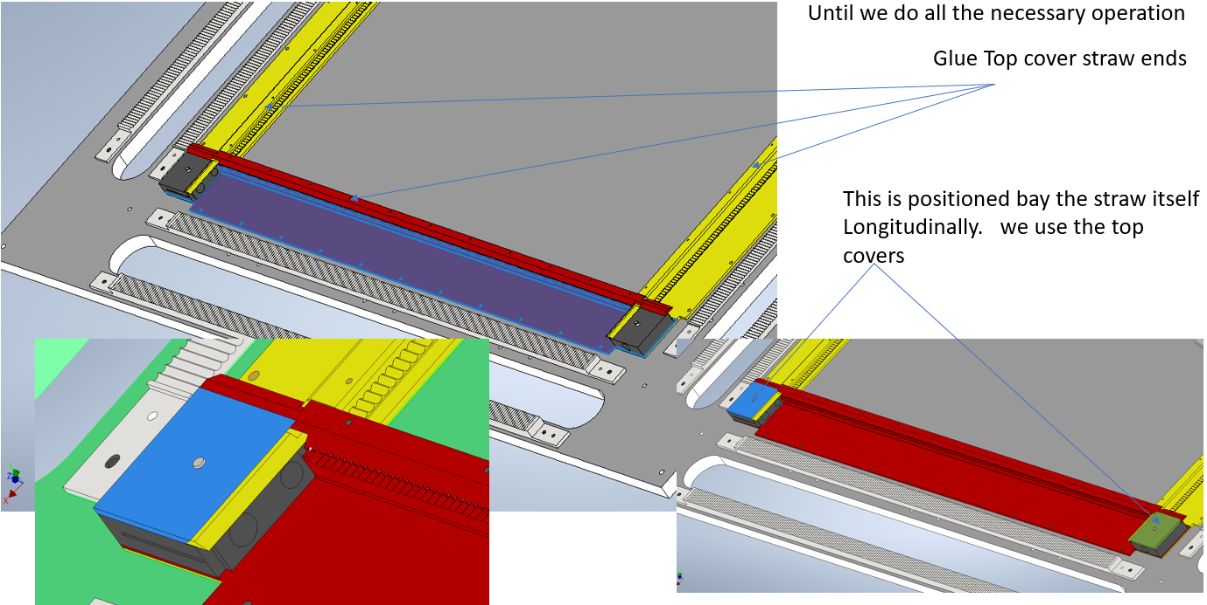
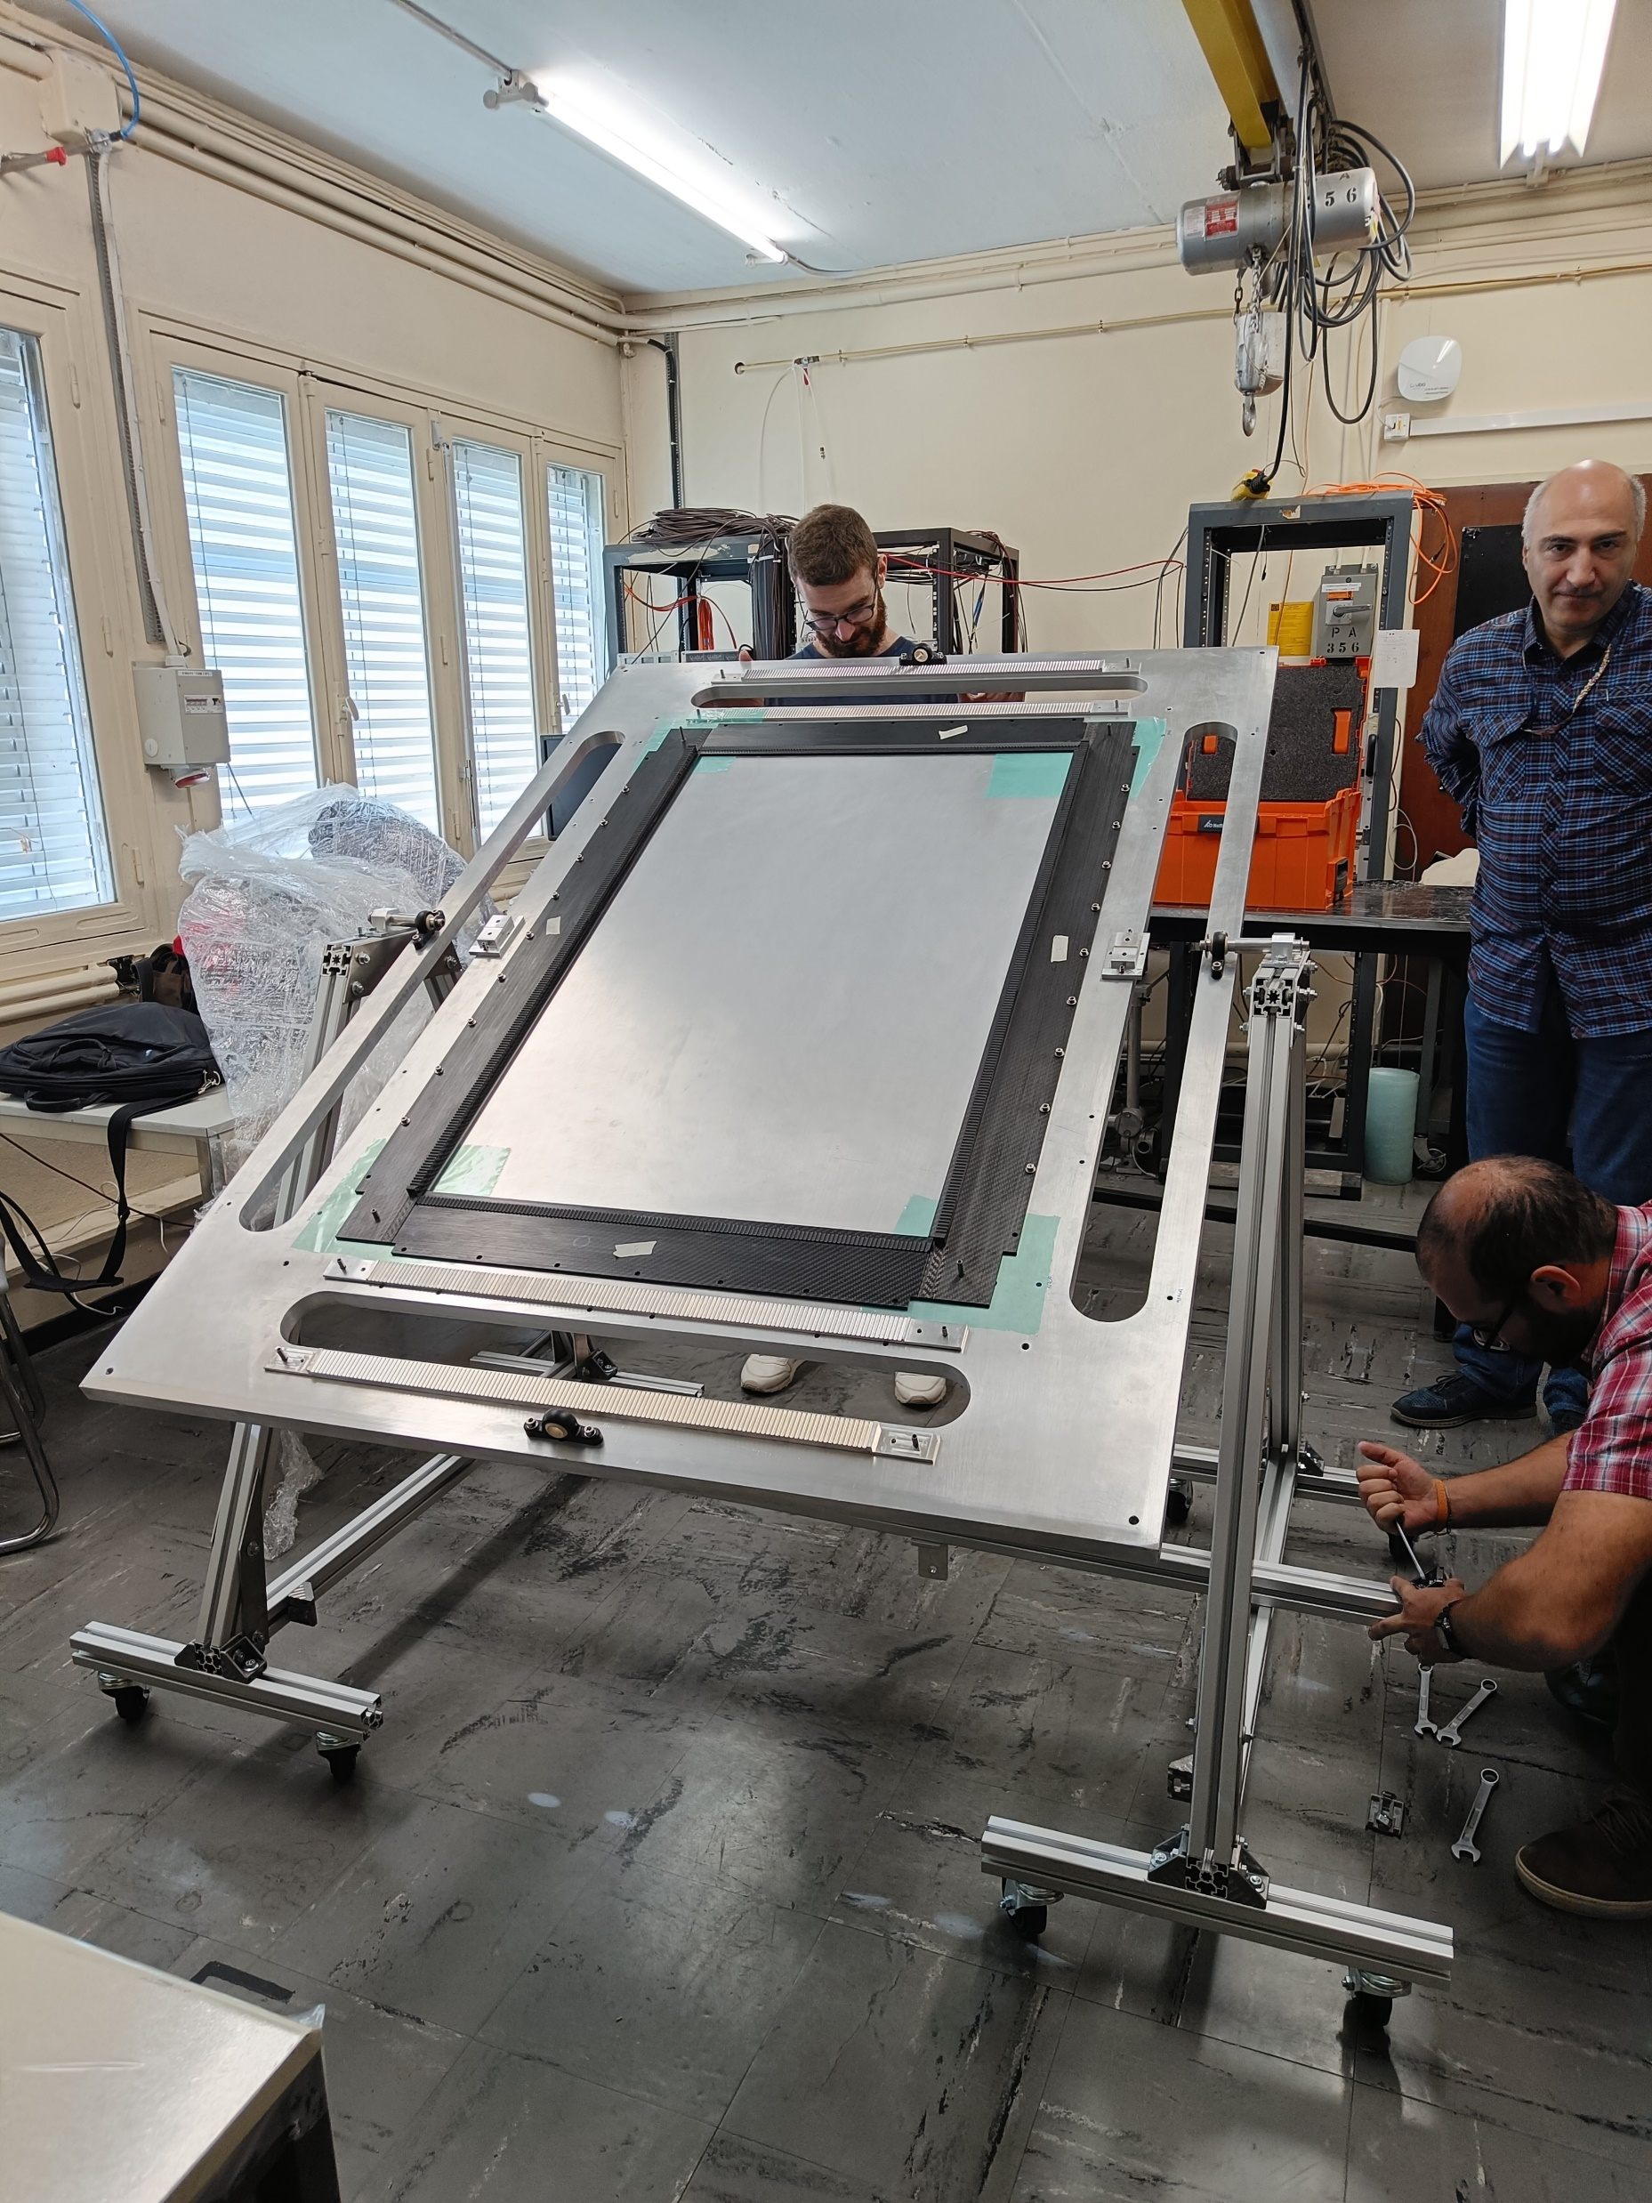
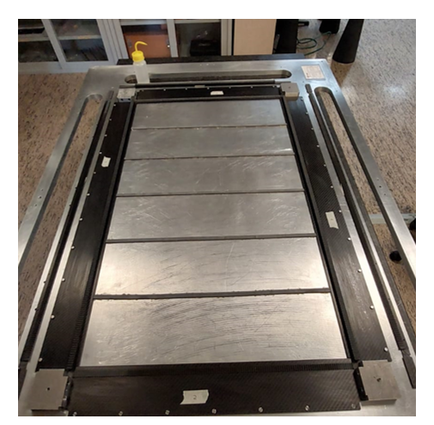
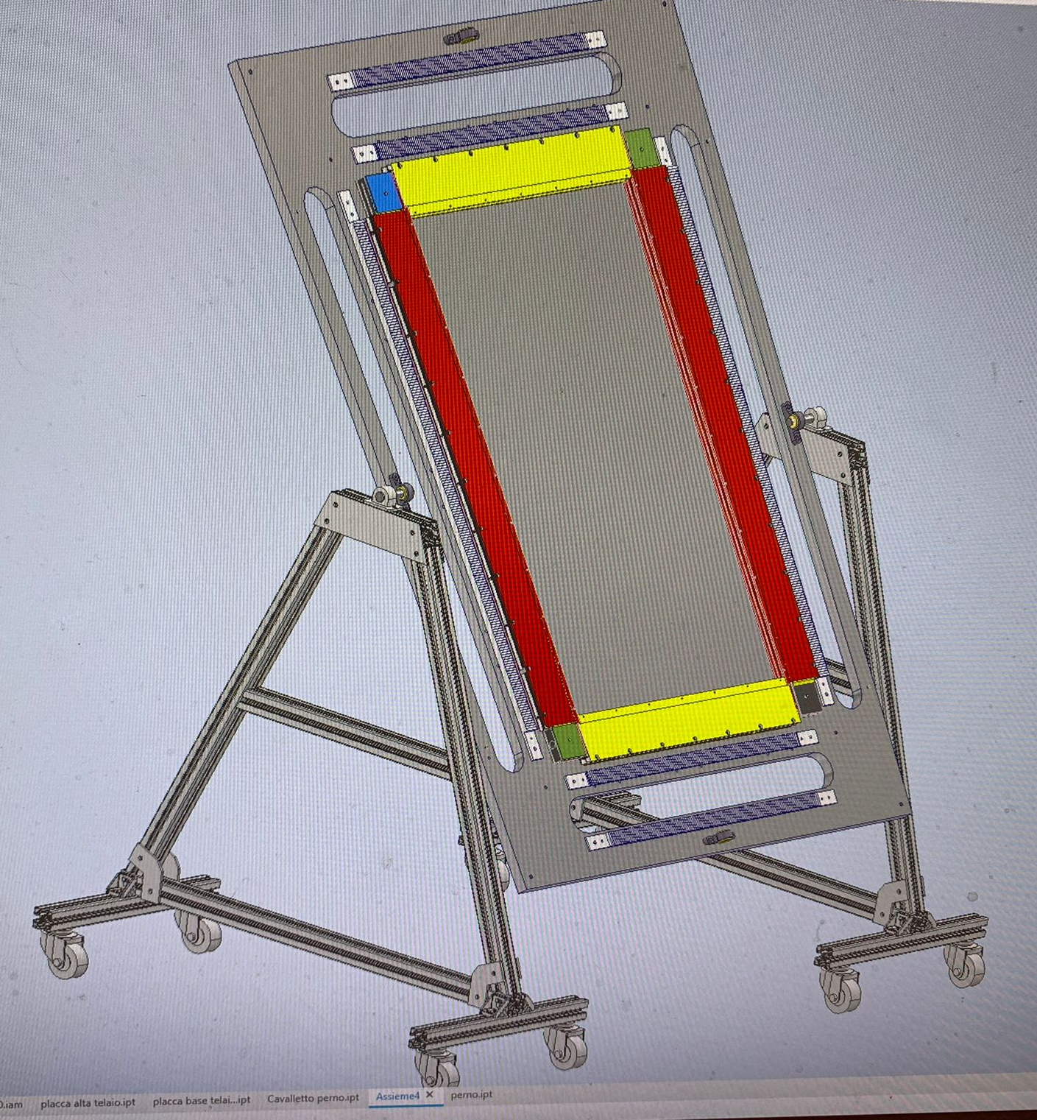
We need to have a mounting table with reference feature to build carbon fiber frame and the straw detector. It is very important to start with first straw layer aligned very well.
Supporting Saddles

Slide 6
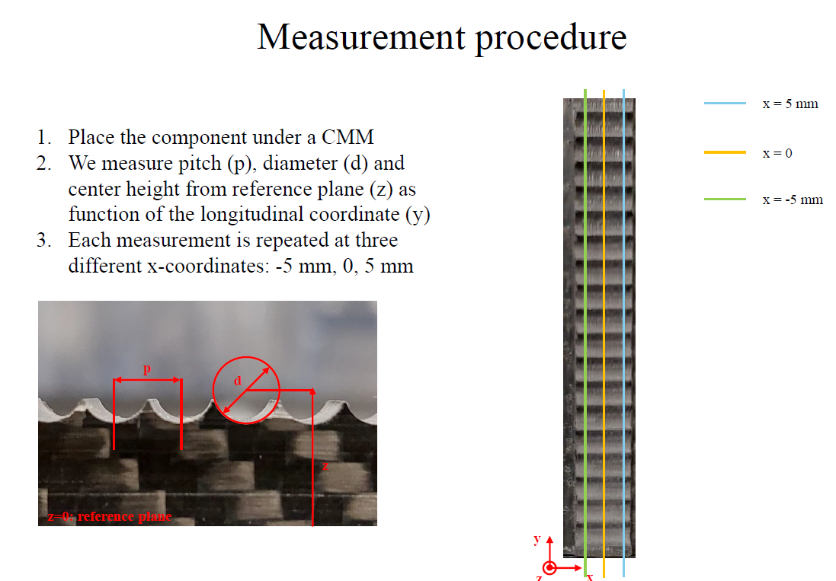
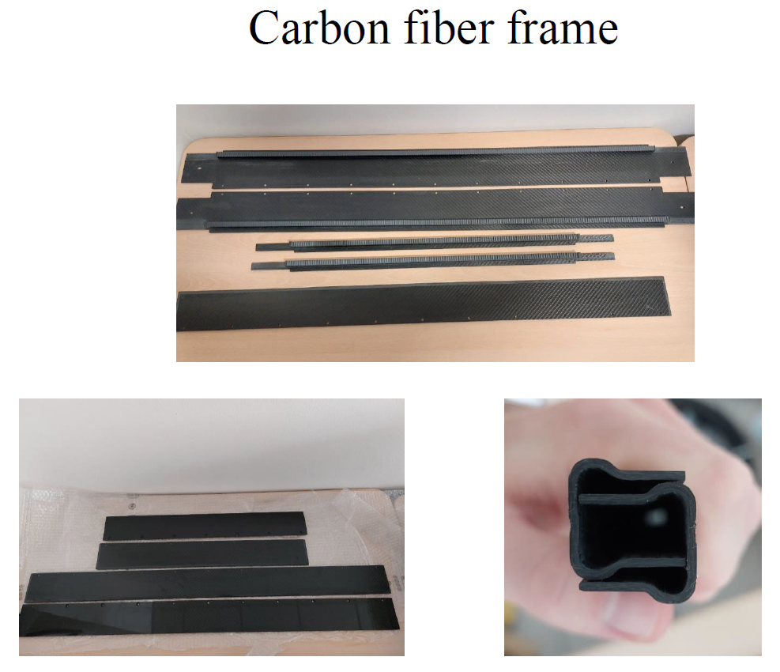
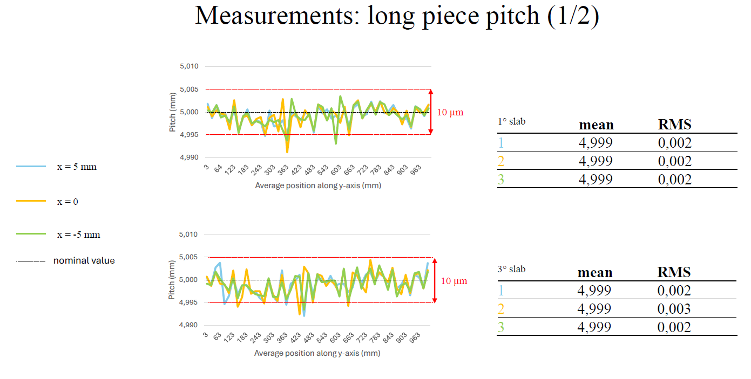
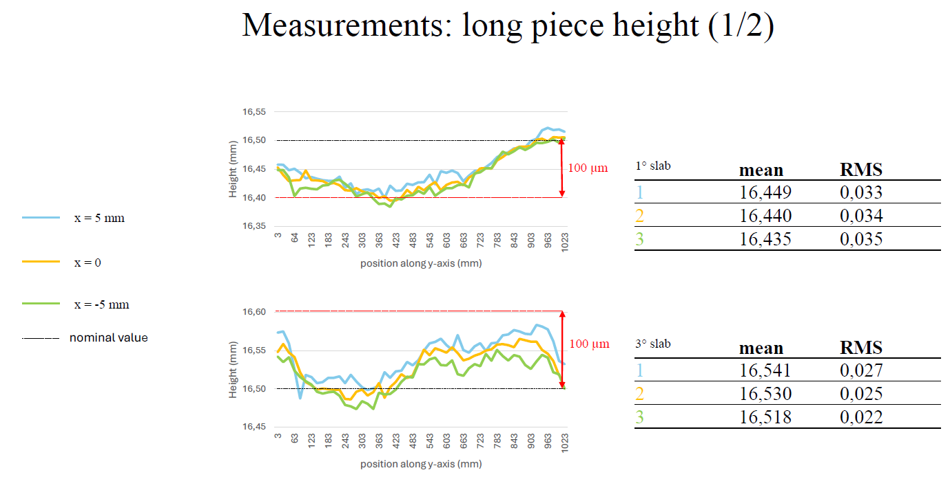
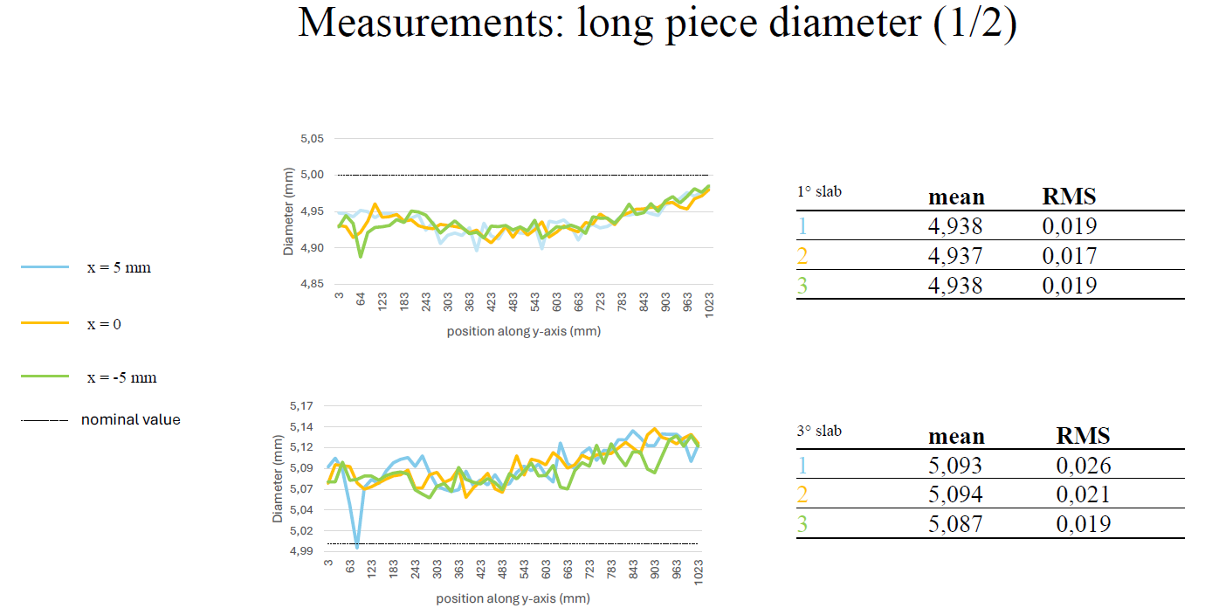
Components of straw tube detectors.
Carbon fiber Frame
Pitch is in the order of CMM accuracy. Diameter RMS 20 μm height 30μm

Slide 7
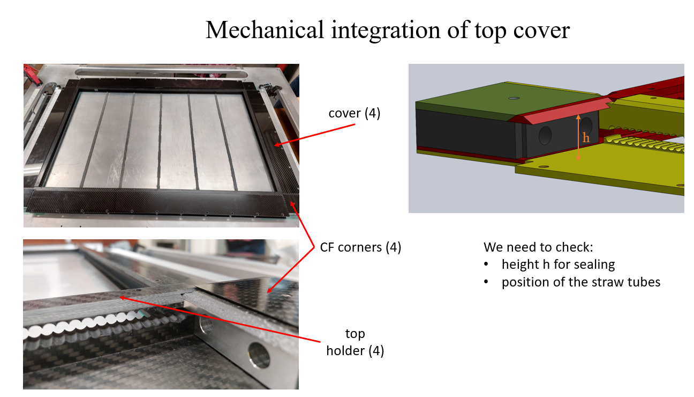
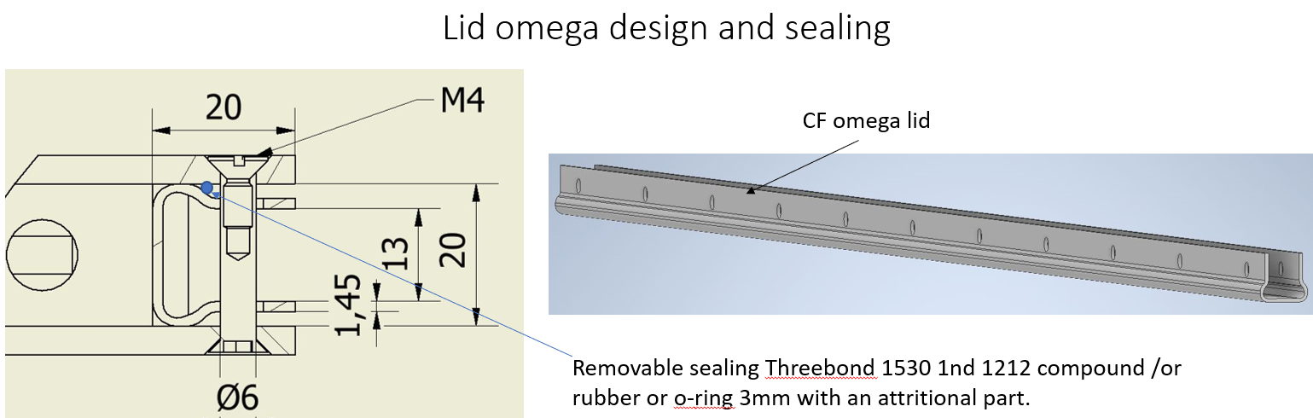
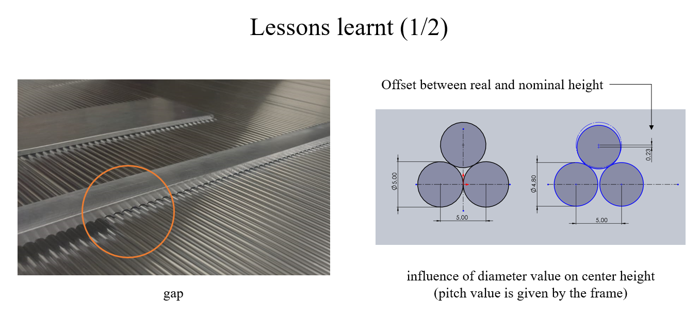
Top holder

Slide 8
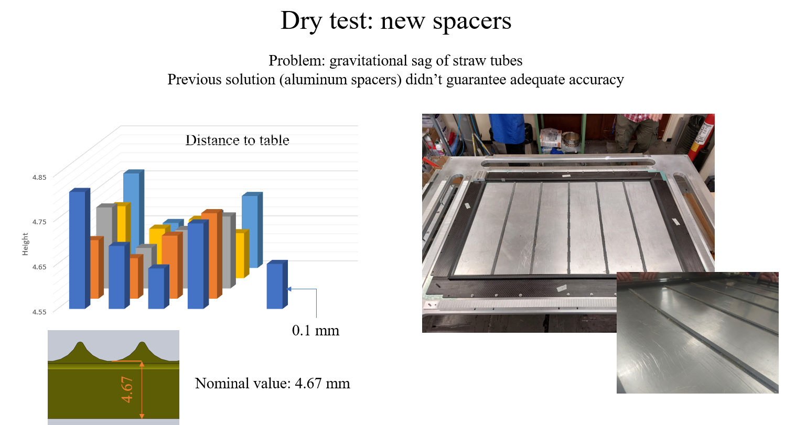
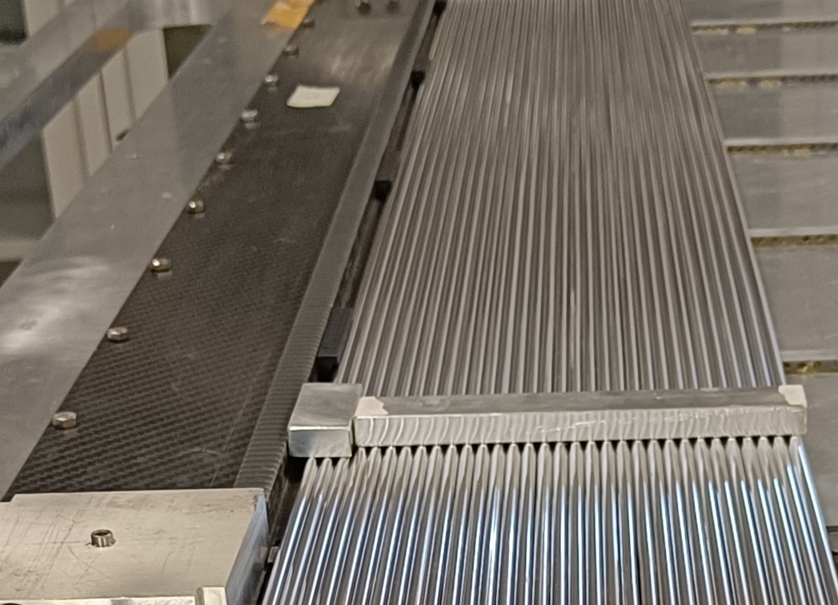
Restrain against the CF frame is necessary

Slide 9
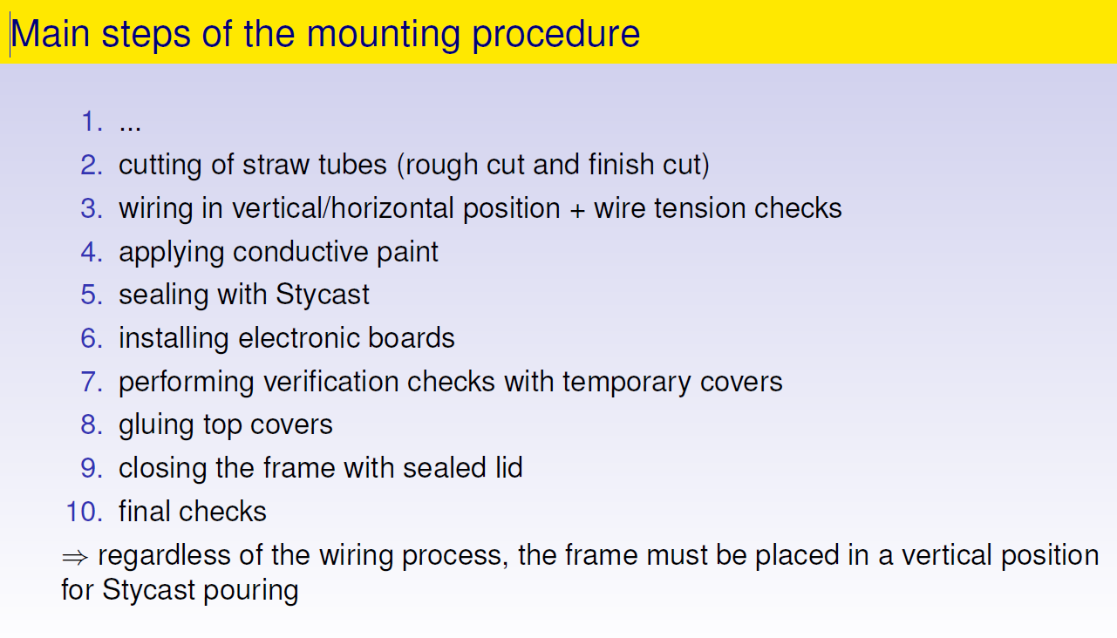

Slide 10
6. Construction phases of a prototype 1200x800mm
3 bar of absolute pressure are used for the straw assembly
End plug are kept temporarily for wire insertion.
Gluing a Supporting frame
Final sealing with stycast
glue poured around the
neck of the end-plugs
with the module in vertical position.
Wiring of the short straws with the table in the vertical position.
Straw are cut at the end of the CF frame
Gluing straws to the frame

Slide 11
The mechanical validation of the CF supporting frame is based on these assumptions:
The CF frame is screwed to a precision mounting table until is the frame is completed. In case we need to remove it from the table, an additional bracing system is envisaged.
The straw are pressurized at 3 bar absolute pressure to be glued to the CF frame.
The straw are kept in position using additional external features. This is due to the fact that the straw are no straight. The necessary forces to realign the straw are minimal.
An external bracing system allows to release a straw tracker unit from the assemble table and glue the covers and connect the lid omegas.
We design several attachment points are built on the perimeter. These are used to build the super module, support the module under gravity and connected the super module to a rolling system in sand.

Slide 12
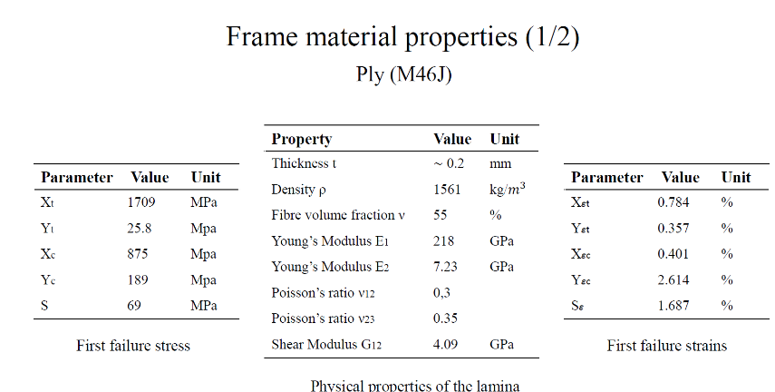
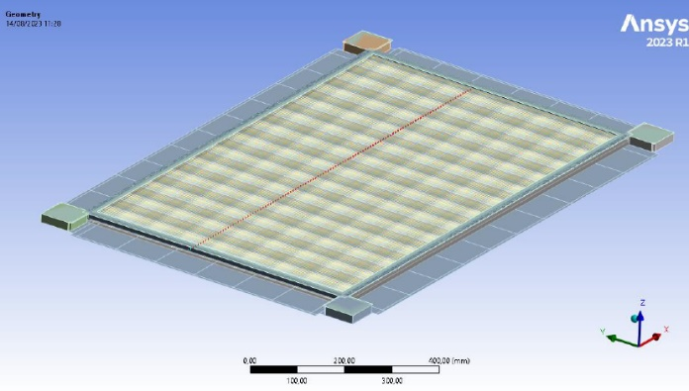
5. Straw supporting structure requirements.
The alignment and stability of the straw tubes is ensured by a rigid frame where the straws are glued. Detailed simulations, together with the insights gained from previous experiments, have been conducted to establish the key requirements for this structure:
the frame must ensure precise alignment of straws with an accuracy of 100 μm;
the frame should possess the capacity to withstand to a maximum absolute pressure of 2 bar while ensuring an appropriate safety factor;
the frame gas tightness must be lower than or comparable to the straw leak rate;
the frame must prevent straw compression throughout all phases, including construction, handling, and transportation;
ensuring the minimum required stress on the electric wire is a crucial aspect of the frame functionality;
structure within the calorimeter; the average density of the tracker, without the target layers, should fall within the range of 0.005 +/- 5% kg/m3
The frame structure is made by 18 plies 0/90.
Internal beam elements
Pre-stressed
The mechanical requirement ahs been analyzed with analytical and FEM analysis.
Analytical, FEM analysis and test on straw has been done before analyzed the CF frame.
Straws are pressurized at 2 bar to be glued and handled. Initially they are stretched when the pressure is released they transfer a force to the supporting frame. The minimum tension on the tungsten wire is 50 gr.
The stiffness of the frame must be guarantee:
that the straw tube never be compressed.
The minimum tungsten wire tension. ( the initial tension of the wire is greater the minimal one)
The frame must withstand to 2 bar of internal pressure.
This requirement that can be removed after a test. The worry that a small compression can damage the weld seal.

Slide 13
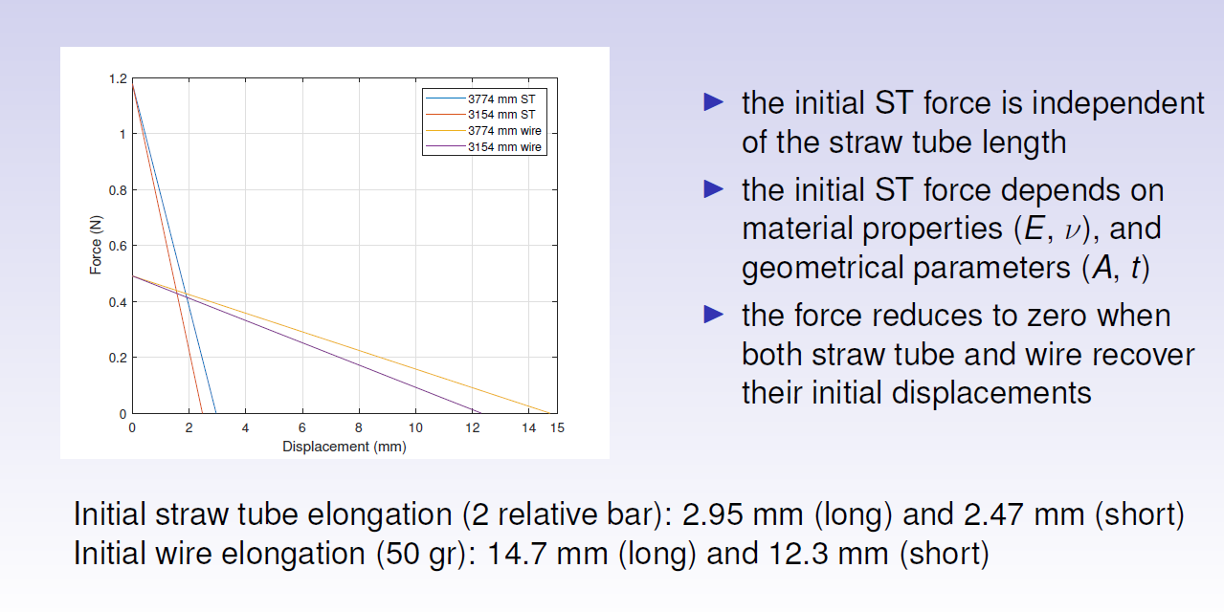
Straw and wire Force and displacements

Slide 14
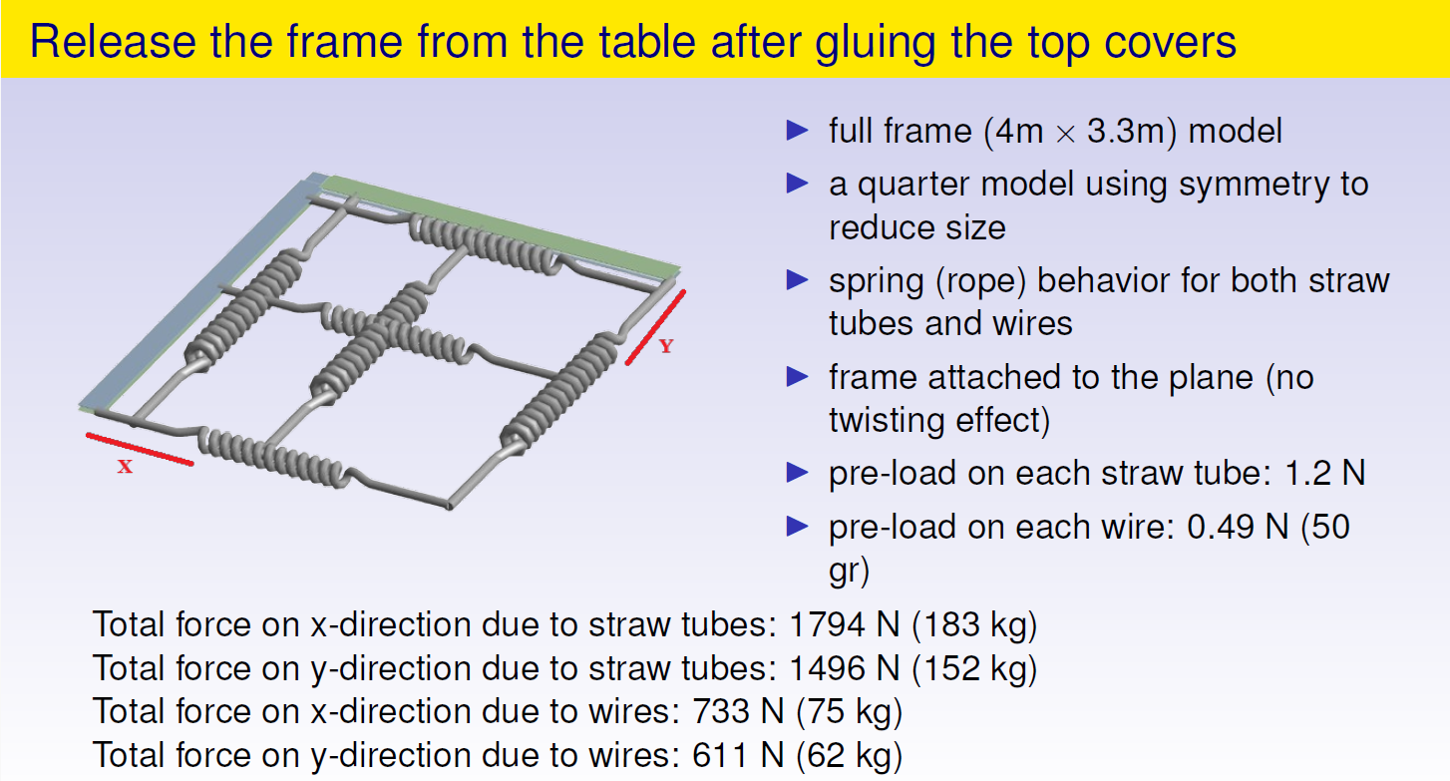

Slide 15
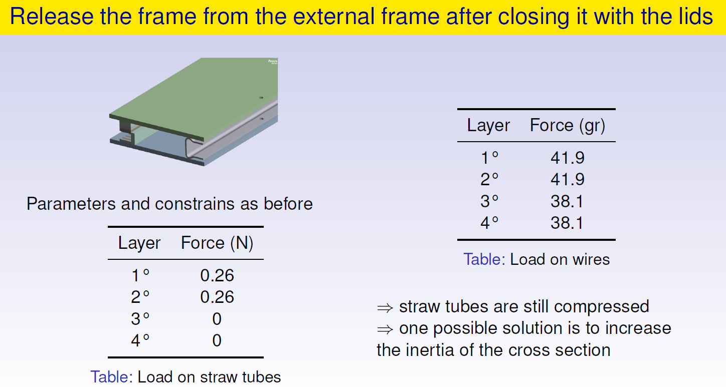
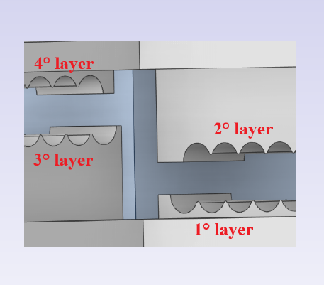

Slide 16
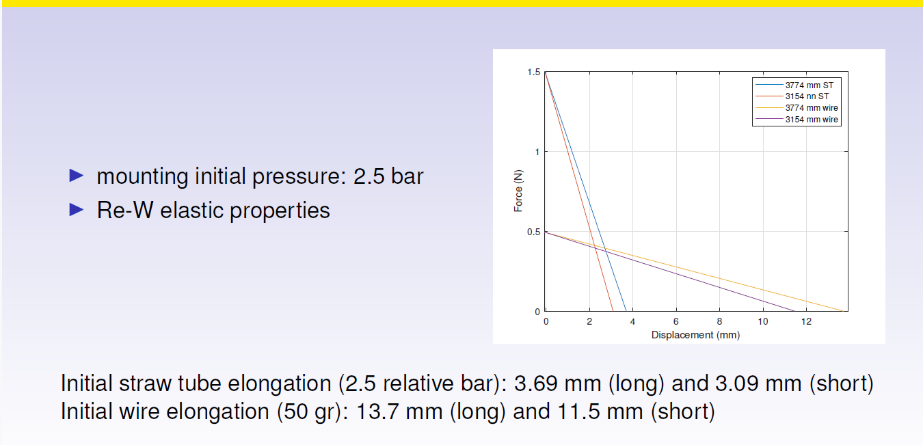
Increasing the mounting pressure to 2.5 bar

Slide 17
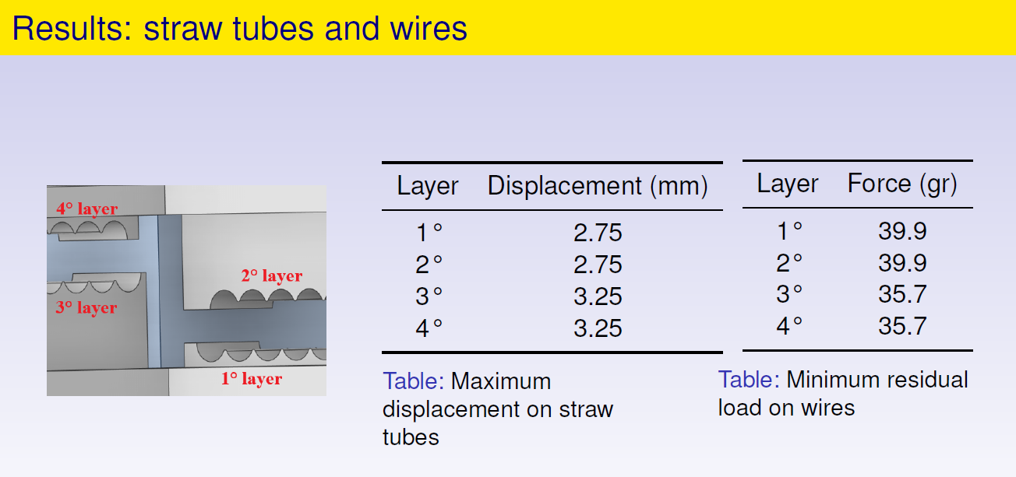
Increasing the mounting pressure to 2.5 bar

Slide 18
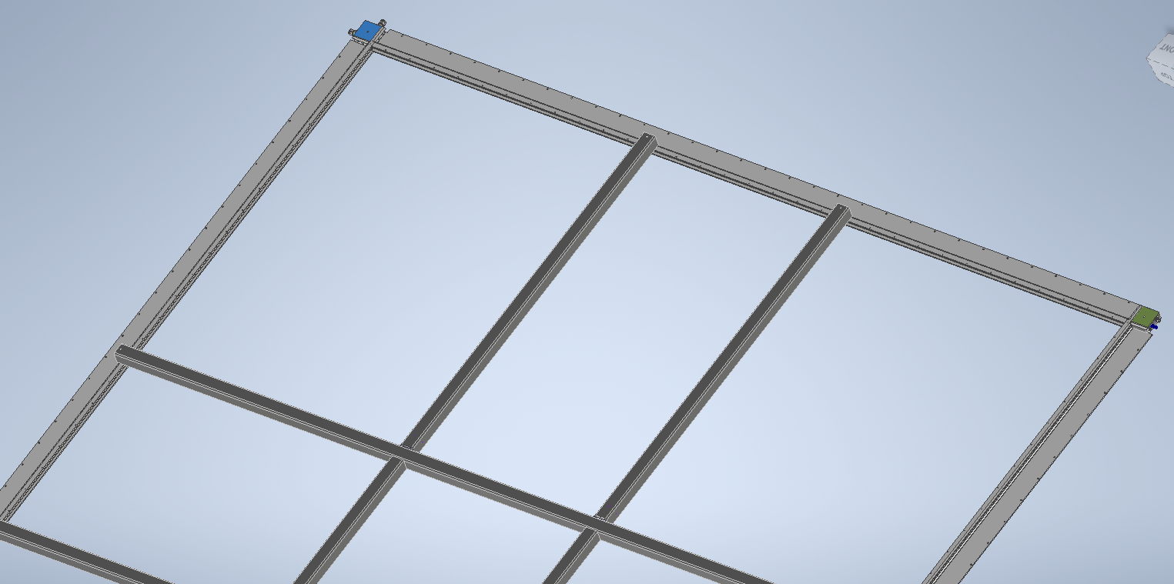
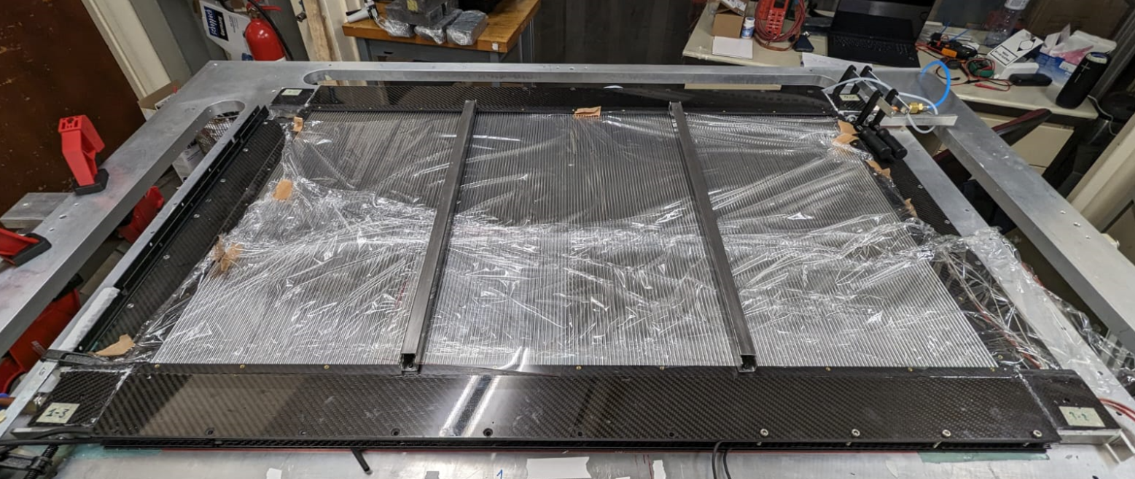
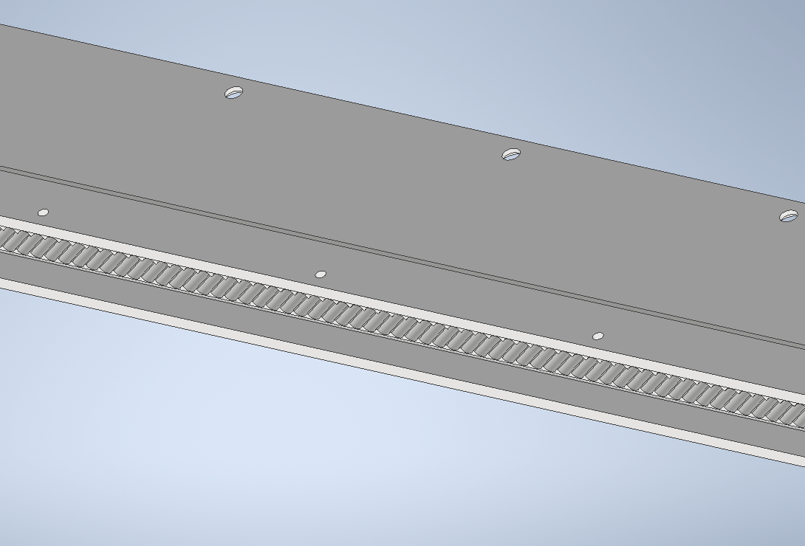
Bracing system to remove the CF from the mounting table.
This is necessary to seal with staycast and/or for the wiring.
We increase the size of the top holder and we set M5 thread inserts.

Slide 19
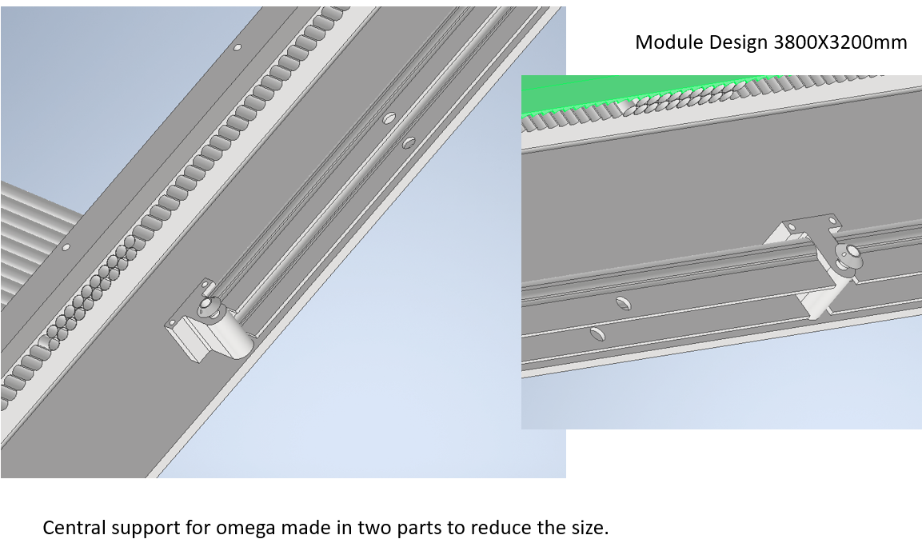
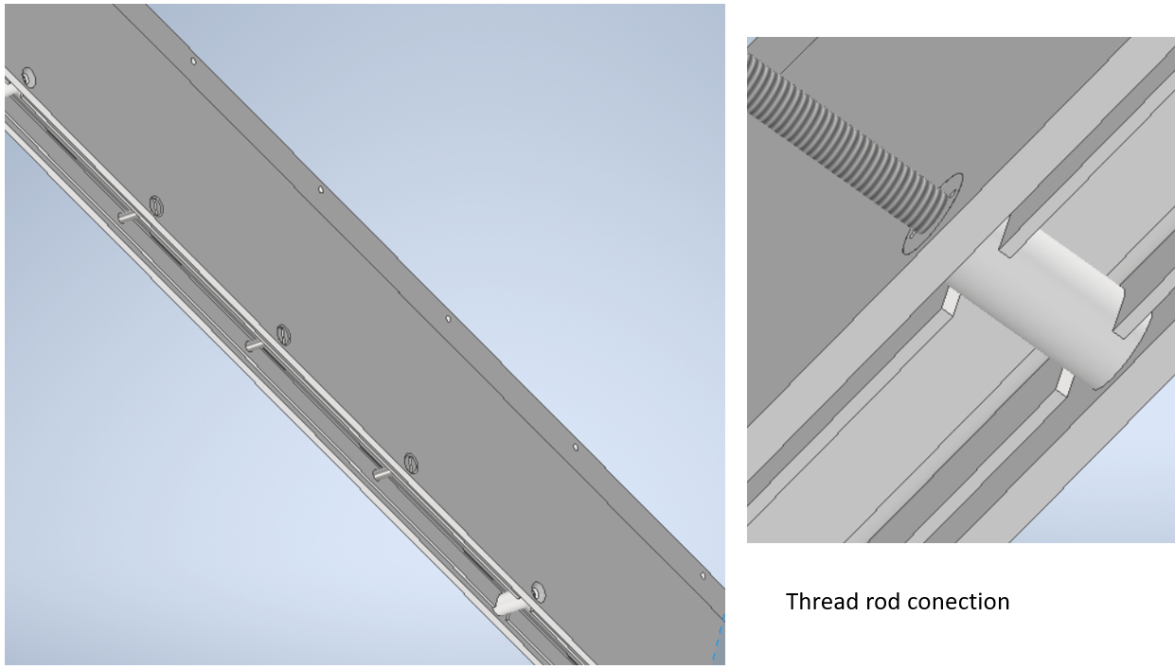
Future design validation.
The full scale prototype (3800X3200mm) is the final step for the straw construction validation. This can allow us to estimate in detail the required time and solve all the technical issues. However this prototype needs an investment in term of man power and tooling much larger that the previous prototype. We started to expand al the level of conceptual design the large prototype and the integration with radiator and graphite sheet. Some examples are reported.

Slide 20
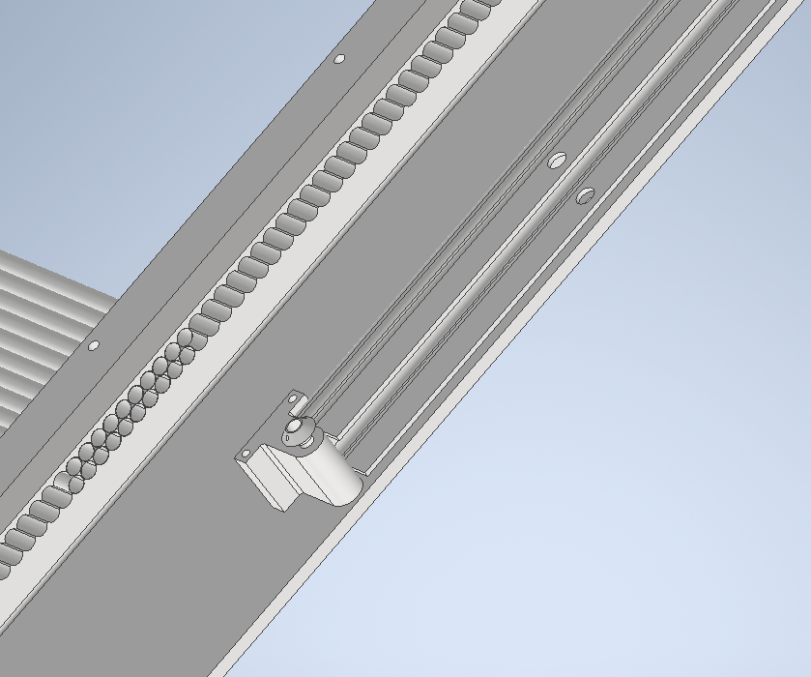
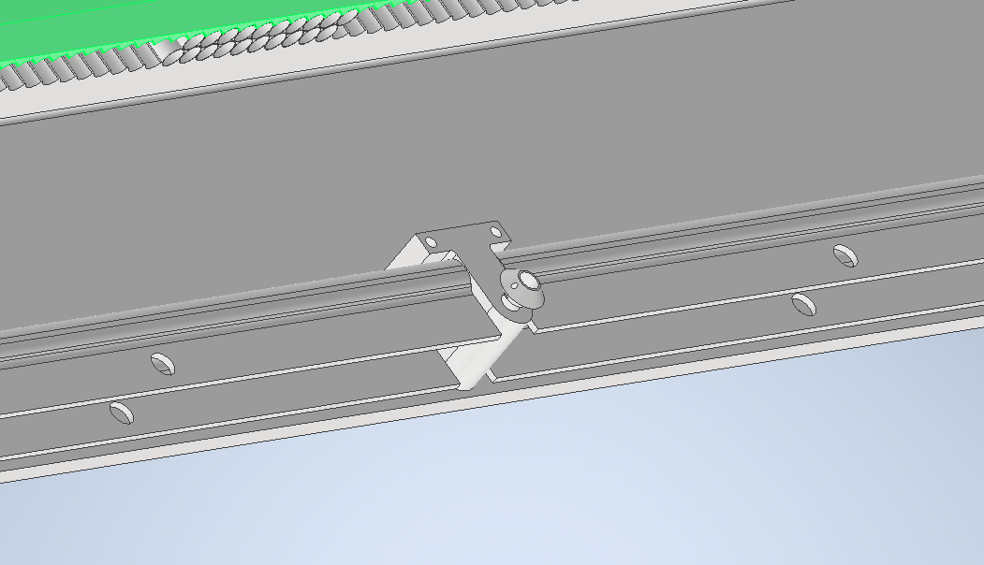
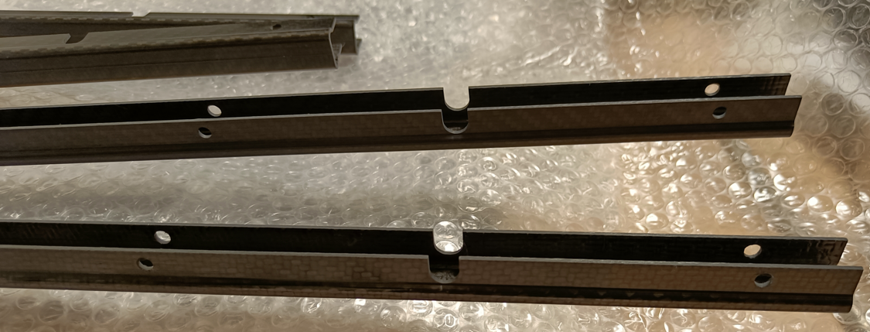
Central support omega
The omega to close the gas volume has been made in three elements per sides.
We can have access inside to the electronic each about 1.2 meter

Slide 21
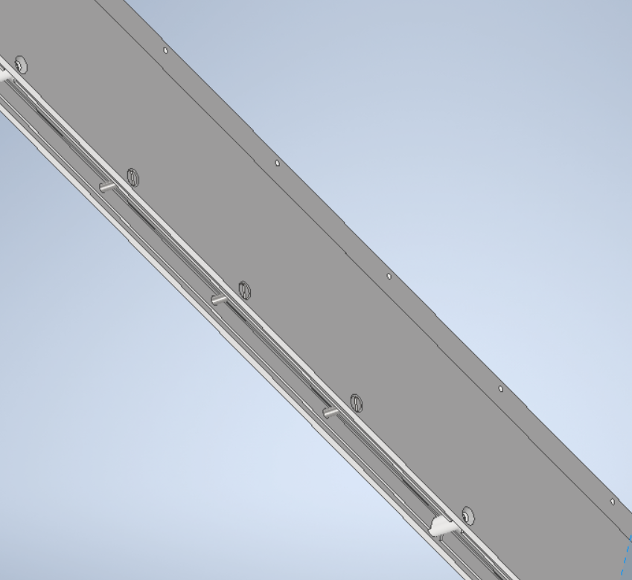
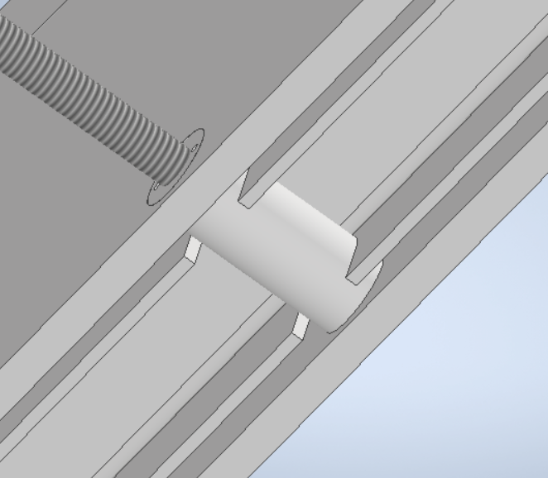

Slide 22
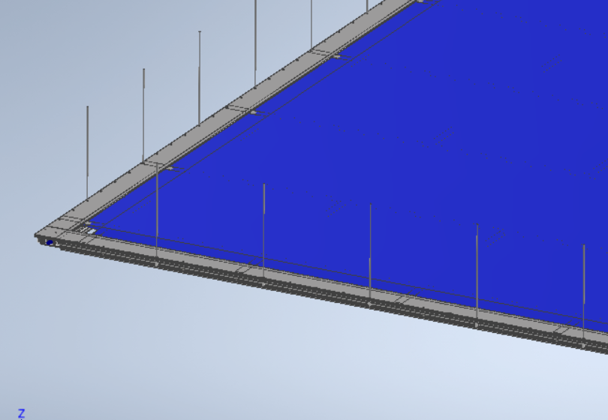
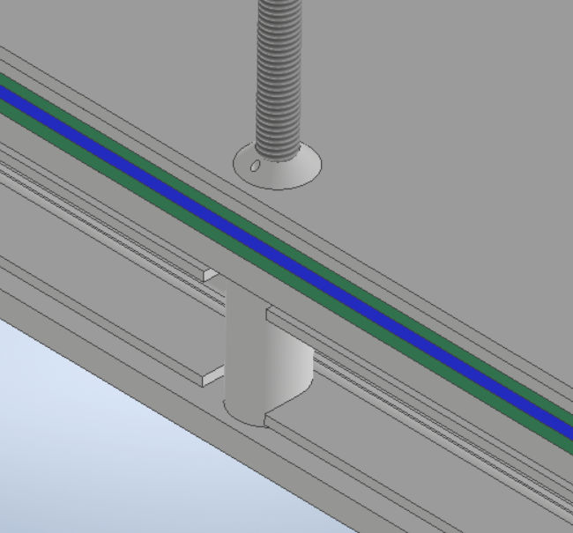
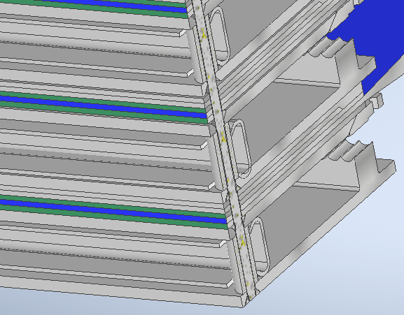
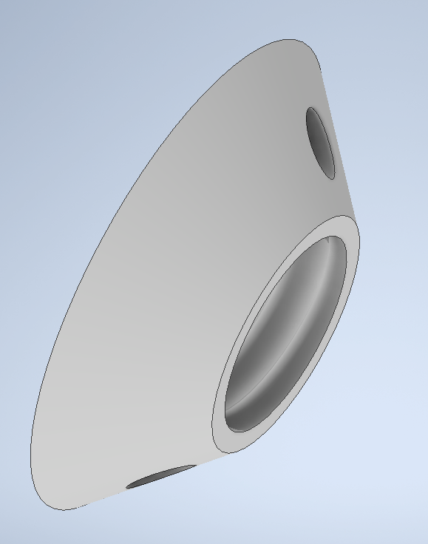
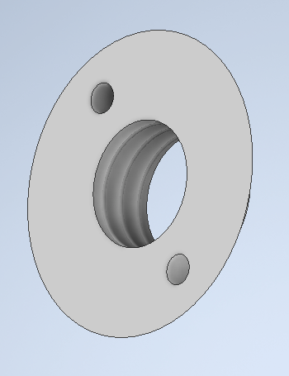
Thread rod
Special Nut

Slide 23
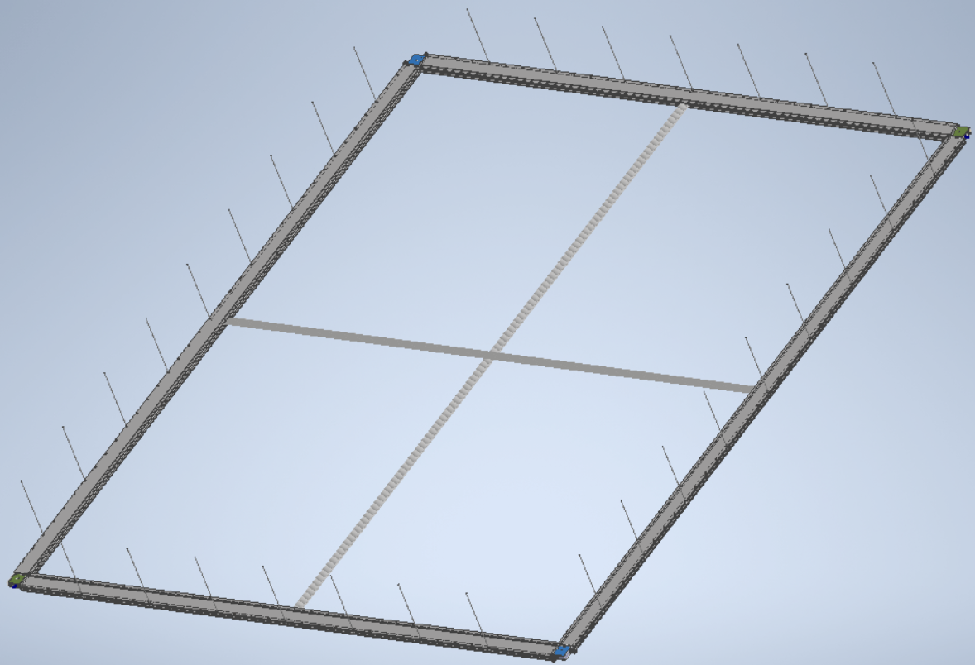
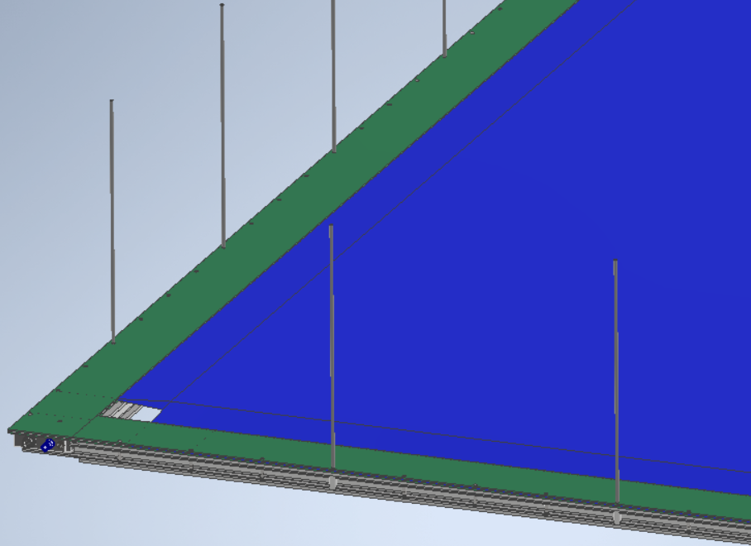
Straw frame with thread rod
Radiator

Slide 24
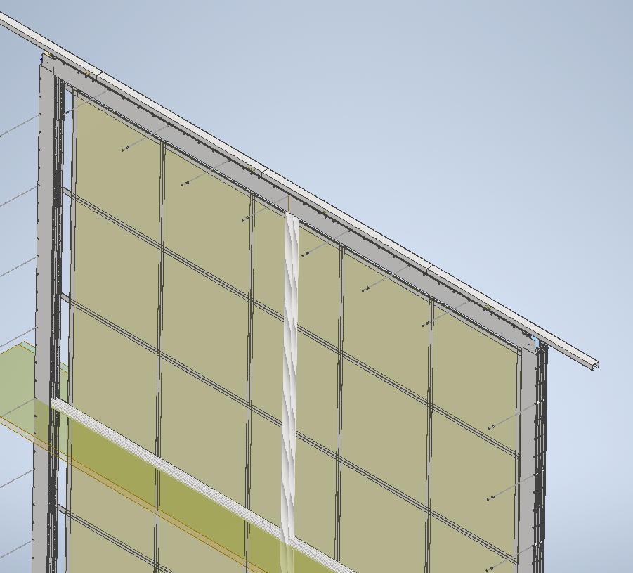
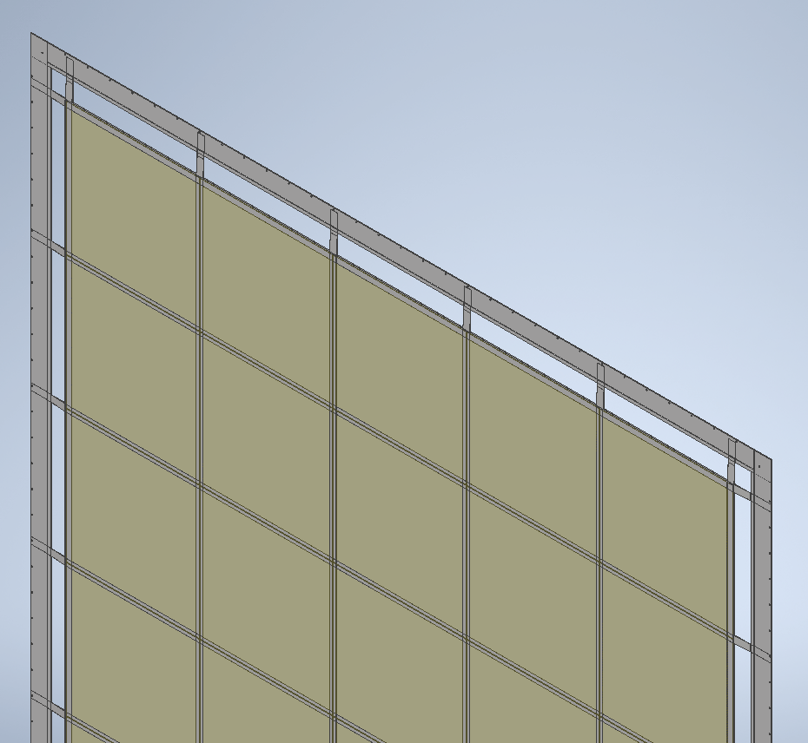
The assembly of the module is made in vertical position supporting the each straw panel from an external frame structure.
The mounting sequence can occur using a cart to bring the panels in position.
Proper clearance must be address in the design to allow the mounting.
Tread insert for holding with strip the panel in vertical position.
External supporting structure

Slide 25


Radiator
Two tracking modules

Slide 26


Thread rod can have a breaks on the
Thread.

Slide 27


Slide 28



Elastic self alignments mount
Vertical elastic
mounting
Elastic pivot mounting

Slide 29


An external frame will hold of the super module in vertical position for mounting transportation and insertion and extraction inside SAND. Number of support need to analyzed with FEA analysis to verify that the deformation are compatible with our requirements.
Simple elastic support self align
Guiding rolling

Slide 30


Pisa Prototype 1200x800mm
In the first prototype made at CERN has a gap of 100 μm between straw. We have to fill the gap with paper foil to control the straw position. The new straw have a larger diameter than the previous one. We increase 50 μm on the diameter to fill the gap. Check the release from the mounting table.
Inner diameter 100 μm,
Outer diameter 600 μm

Slide 31




Slide 32




Straw connecting cable

Slide 33



Slide 34

Straw components inventory.
We expect to have the straw necessary to complete the prototype in January 2025 from Georgia group.

Slide 35
Resources for future development of STT design.
The current situation of the manpower for the development of STT project is:
F. Raffaelli 30% Eng., A. Soldani 20% draftsman.
Saverio Mameli is working on the project unofficially.
We need to identify Tasks and the adequate resources to finalized the STT mechanical design.
The design process that allows to complete the straw tracker is related to the prototype construction. We cannot finalized the mechanical design without participating to the construction process of the prototype. We feel uncomfortable to design a prototype whiteout participate to the construction.

Slide 36
Conclusions.
We consider the second prototype in Pisa very important step to test the STT design. We can test the mechanical design of various “final” components as straw, plugs, spacer, crimping pins, (procured at a reasonable price). This prototype should be ready in the spring 2025.
With this prototype we will test the performance of the detector validating the gas distribution, the cooling of electronic and the physical performance.
The design of the full scale STT module prototype has been done.
A full scale design of super module requires a more engineering efforts and time. We need a lot of work to make a STT design that integrates all components and that have the right features to be compatible with the tooling for its construction handling and mounting.
We need a full scale prototype to test the solutions adopted, this is necessary step to launch the final straw detector production.

