Slide 1

GRAIN: Mechanics and proximity cryogenics
DUNE Italia meeting – Oct 29, 2024
Gianluigi Piazza

Slide 2
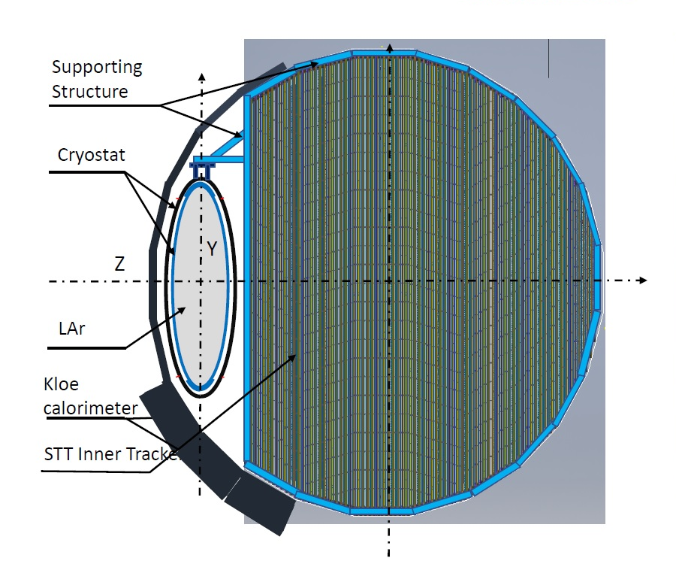
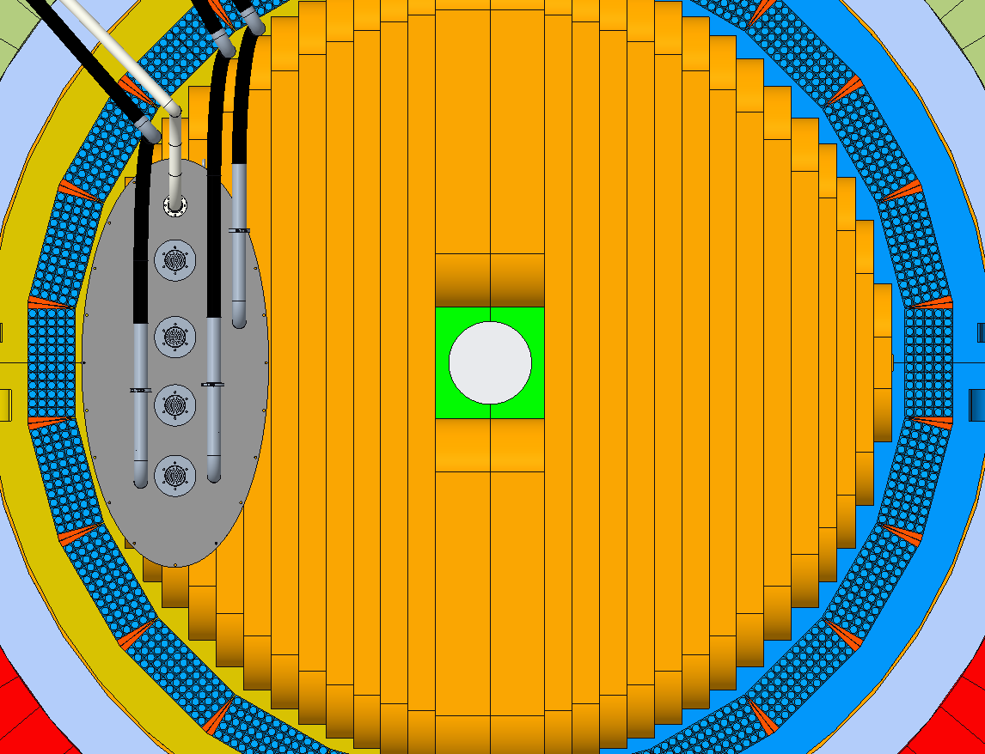
GRAIN inside SAND

Slide 3
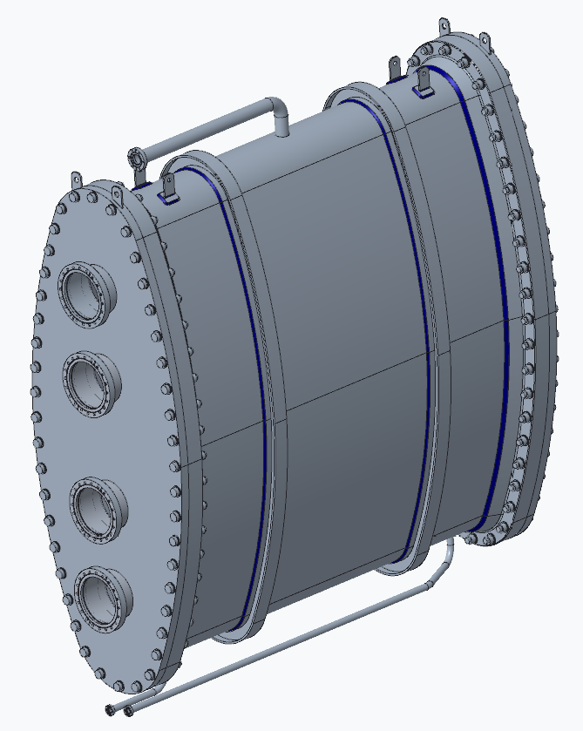
Inner vessel
All AISI 316L stainless steel
Design ready to be certify according to european standard EN 13445 European
body thickness 6 mm
cover thickness 30 mm
4 DN160 CF flanges per cover

Slide 4
Inner vessel
639
1629
1250
1500

Slide 5
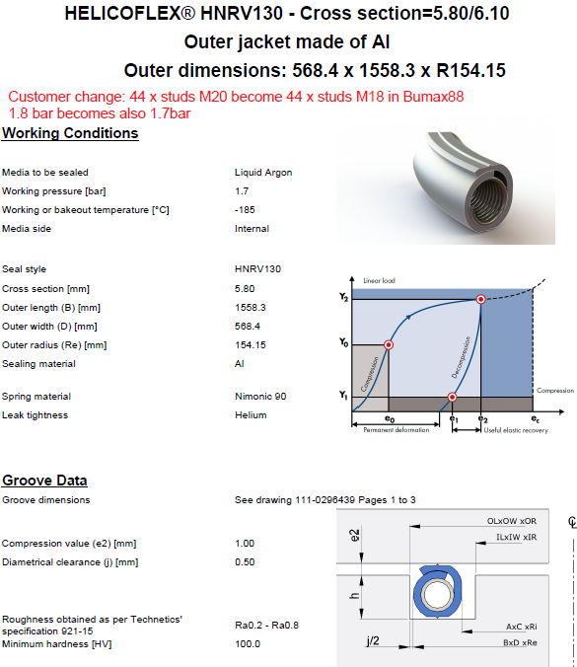
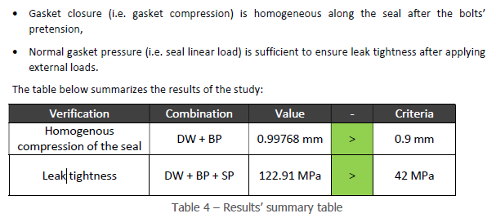
Inner vessel: Helicoflex

Slide 6
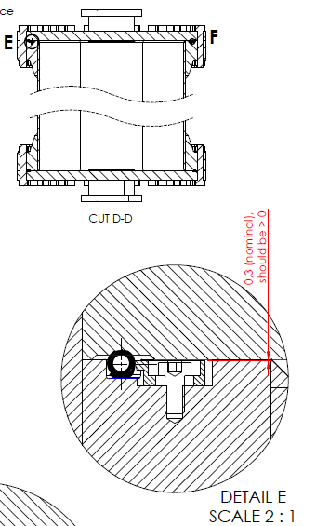
Inner vessel: Helicoflex
4 metallic clips to keep gasket in position during closure
Price of each Helicoflex ca 5000 €

Slide 7
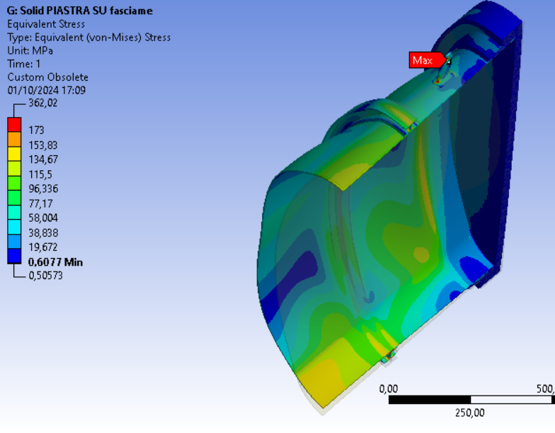
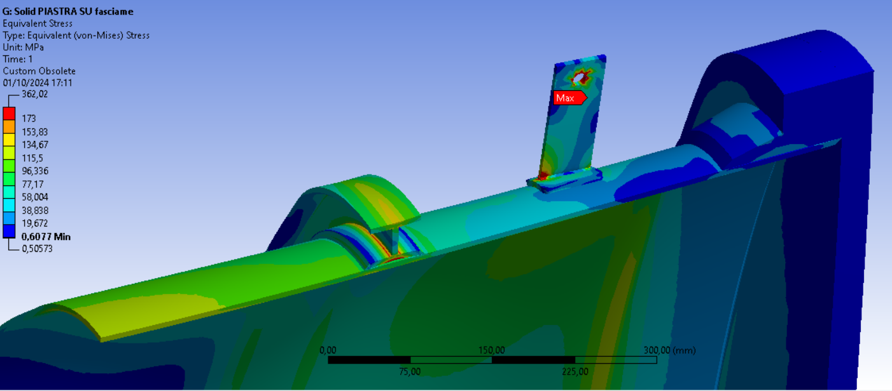
Inner vessel:

Slide 8
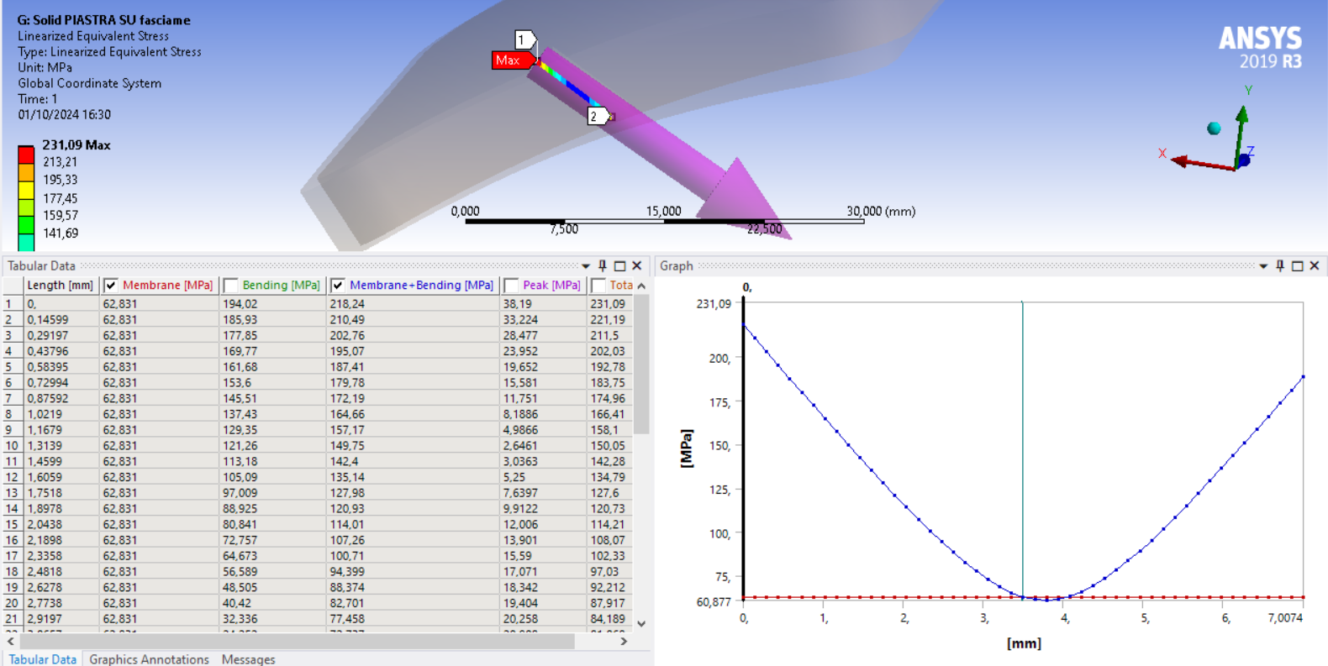
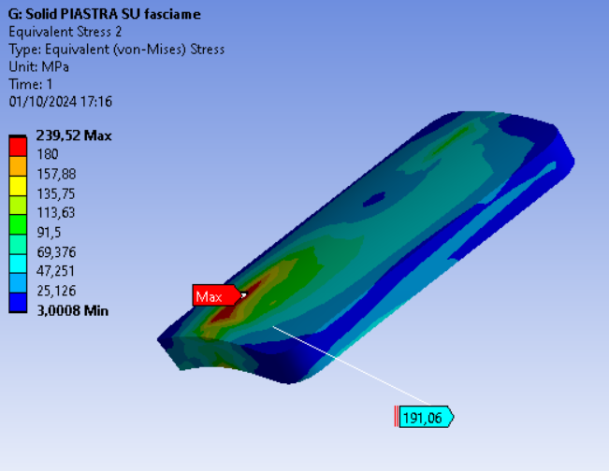
Inner vessel:
Stress linearization for area with stress level exceeded
AISI 316L → Rp1 = 260 MPa , Rm=520 Mpa , f = max (Rp1/1,5 ; Rm/3) = 173 MPa
Local membrane stress: Plmax = 63 MPa < 1,5f = 260 MPa
Membrane stress + bending stress: Qmax = 219 MPa < 3f = 520 Mpa

Slide 9
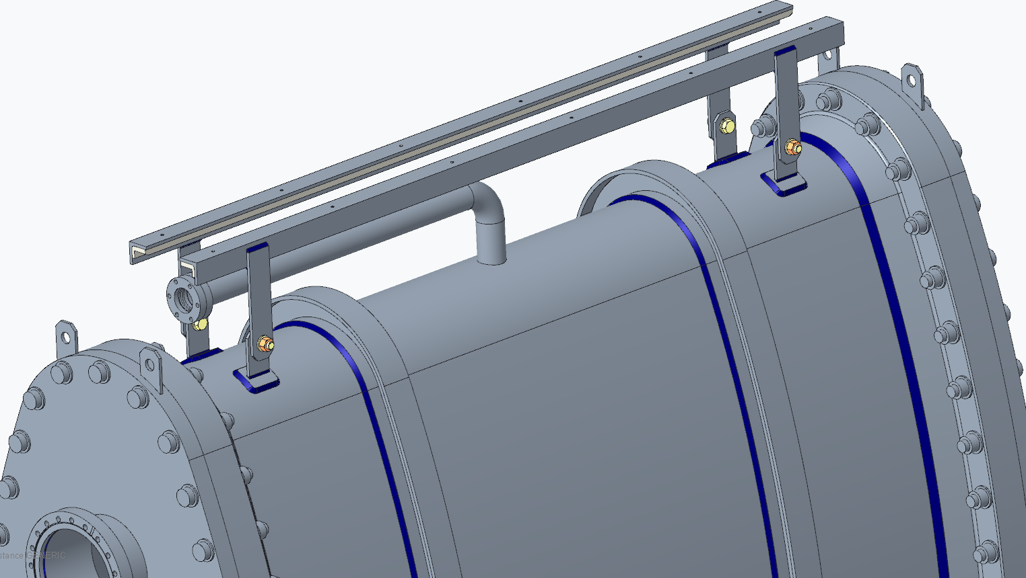
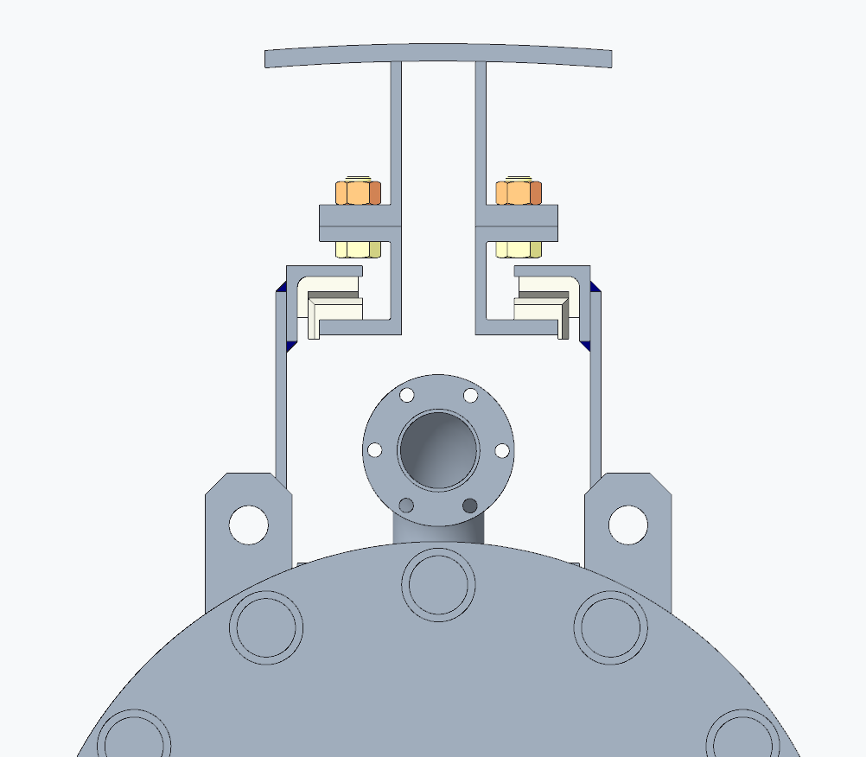
Internal vessel design
New supporting system to avoid oscillations and the critical use of bearings for vacuum and magnetic components

Slide 10
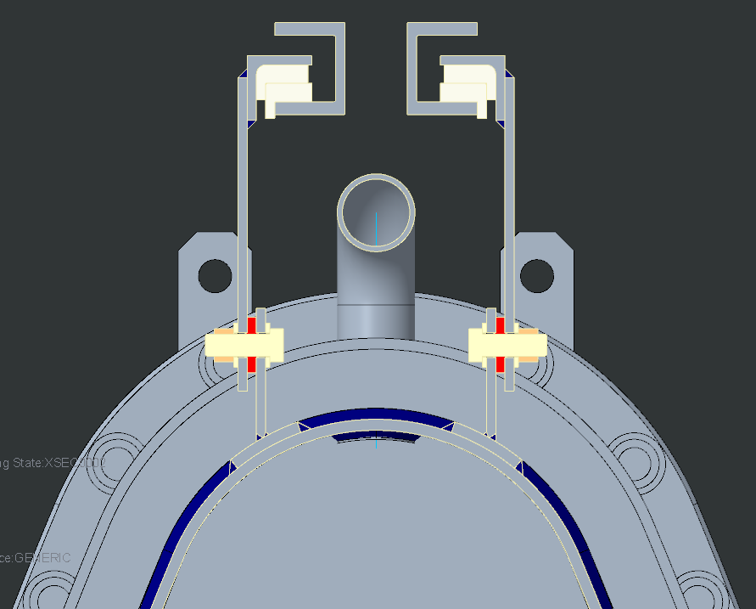
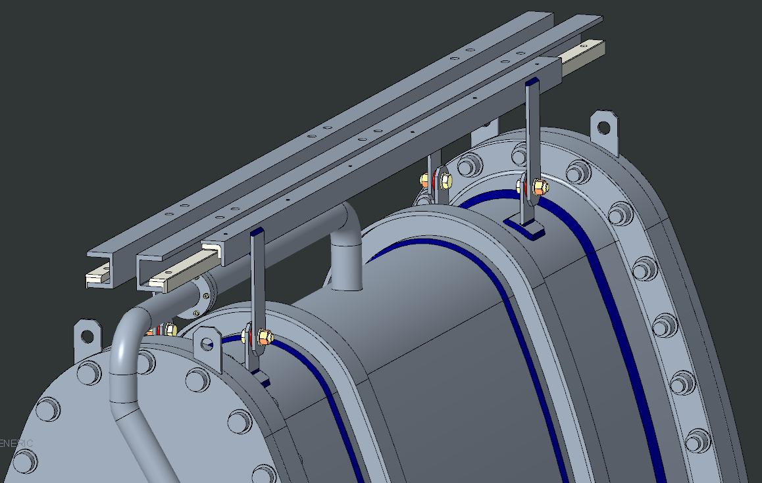
Sliding system
Plastic washer
Teflon sliding element
G10 for thermal brake

Slide 11
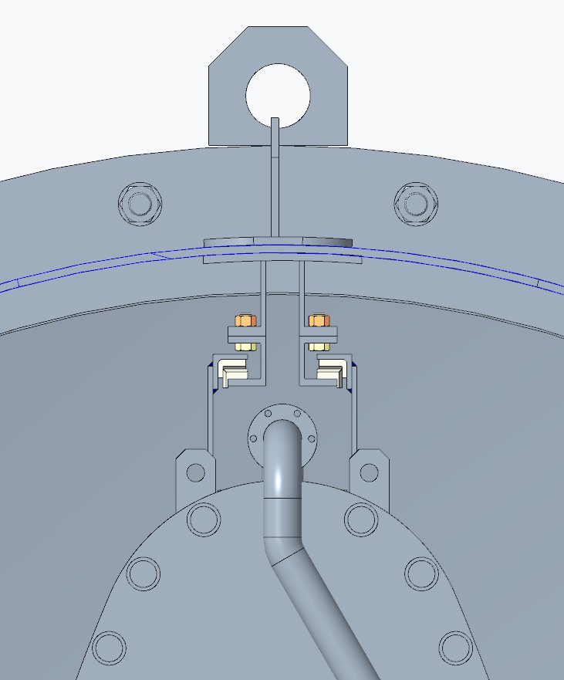
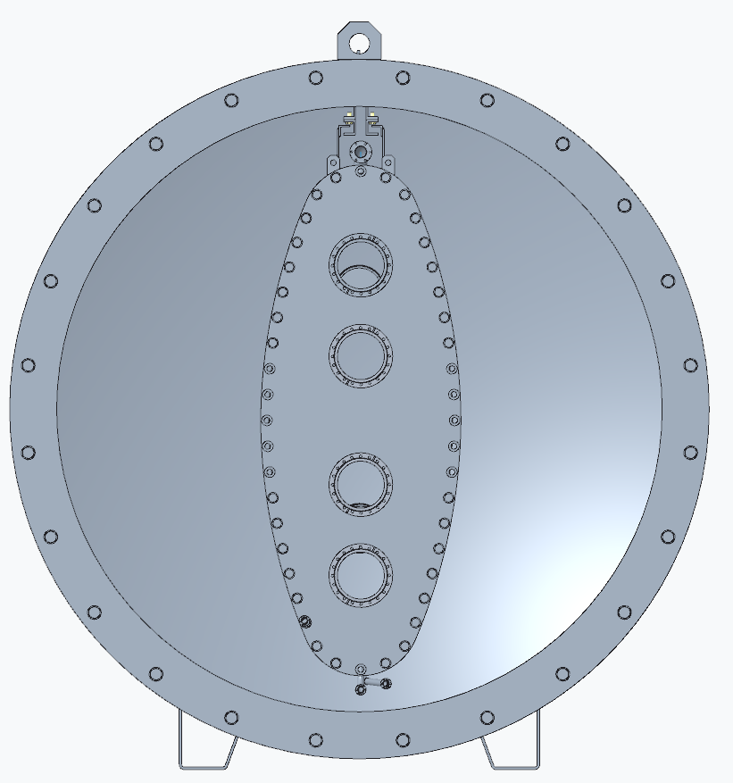
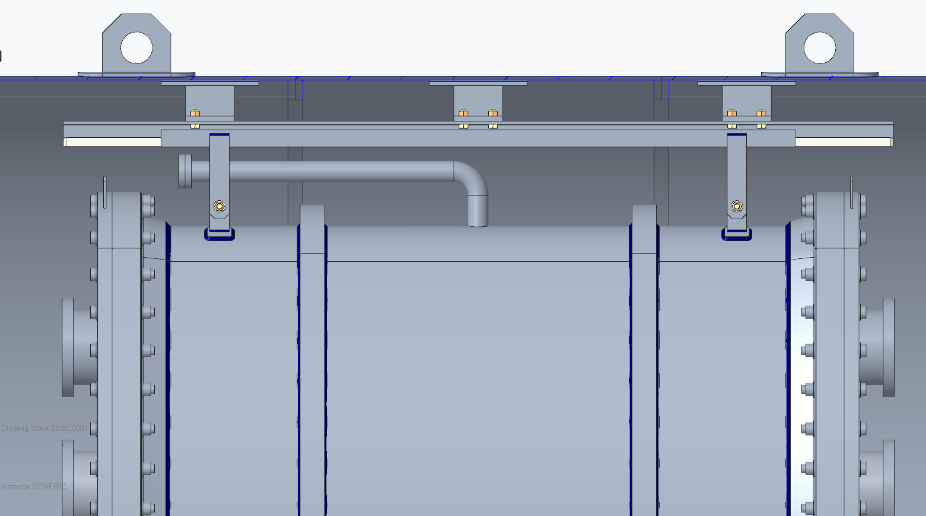
Cryostat for LNL tests

Slide 12
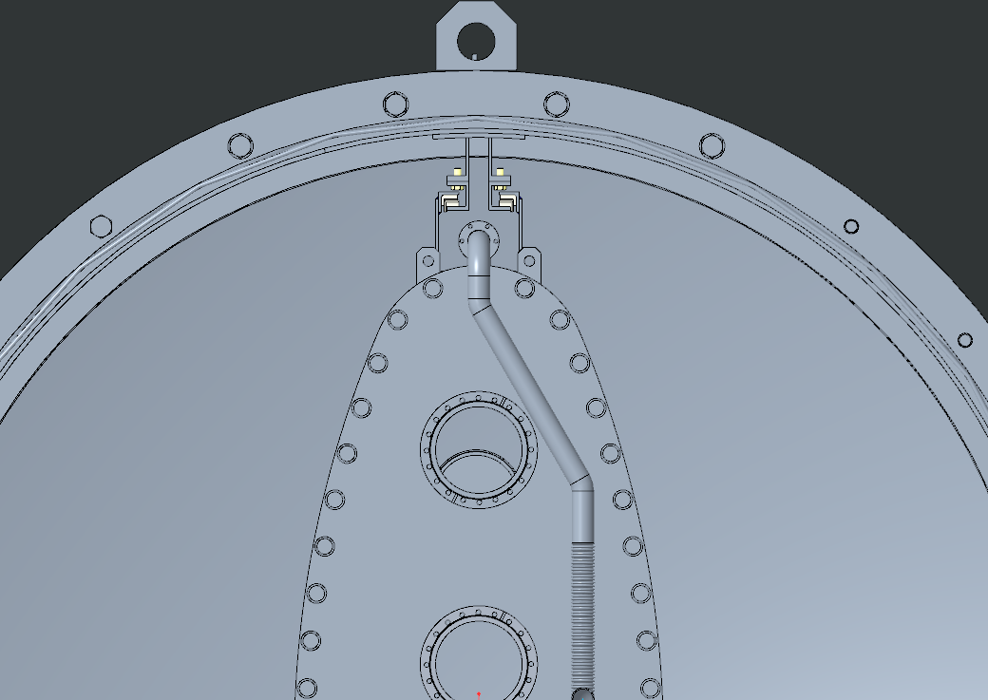
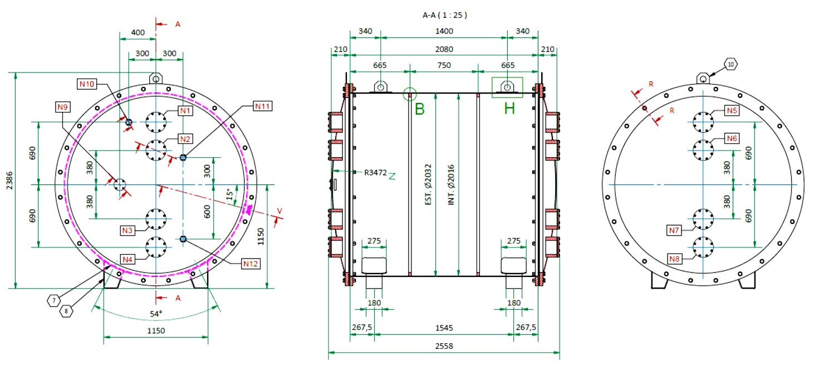
first vacuum tank for LNL facility test
Almost ready for the fabrication, few details remaining for the definition of flexible lines. These are needed in order to open and close the vacuum tank cover

Slide 13
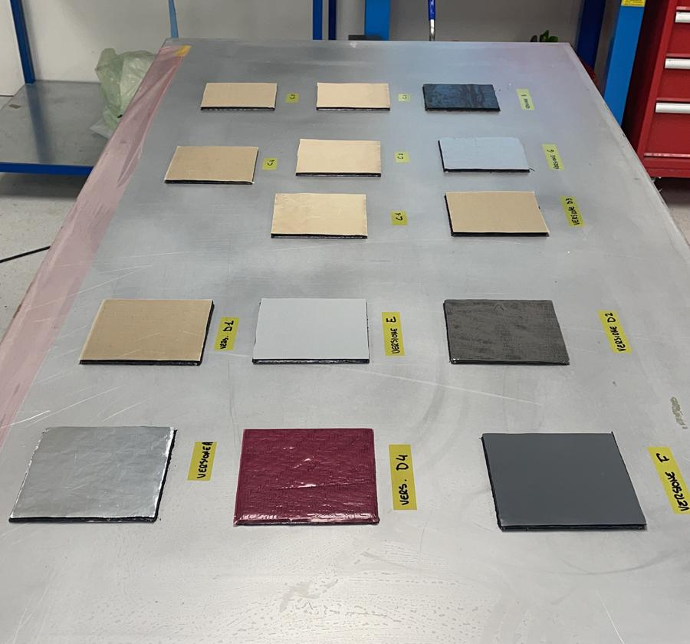
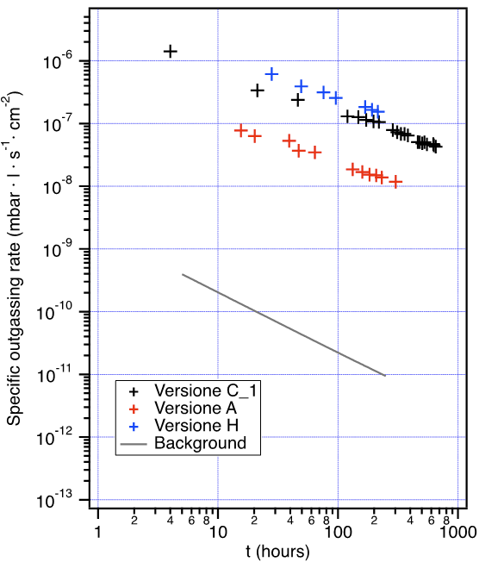
CFRP samples campaign test
The campaign of outgassing test in LNF is almost completed

Slide 14
Proximity cryogenics system

Slide 15
Proximity cryogenics system: P&ID

Slide 16
Proximity cryogenics system
PHASE SEPARATOR
It is a dewar thin and long installed at the available height in order to accomplish the sub-cooling.
A first sizing has been done based on a capacity of ca 200 L:
ø =600 mm ; h=1500 mm → V=400 L of which 200-300 L are useful
The vacuum tank of the phase separator for the thermal insulation will have the following dimensions:
ø =800 mm ; h=2000 mm

Slide 17
Proximity cryogenics system
RE-CONDENSER
This U-tube heat exchanger is
dimensioned for 1500 W.
The boil off is produced by the static heat load, detectors heat load and feedthroughs.
The GAr formed has to be
re-condensed and sent for gravity to the recirculation pump

Slide 18
Proximity cryogenics system
CRYOGENIC RECIRCULATION PUMP

Slide 19
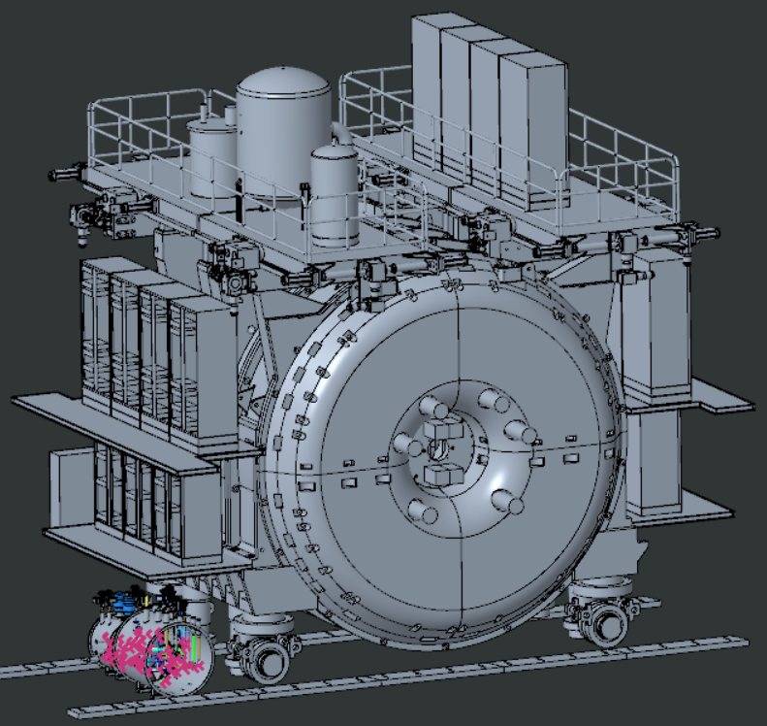
Proximity cryogenics system
Since the different layout available at LNL will be different from the final at FNAL,
the head that the pump must withstand is 4 meters at LNL vs 8 meters at FNAL.
8 m

Slide 20
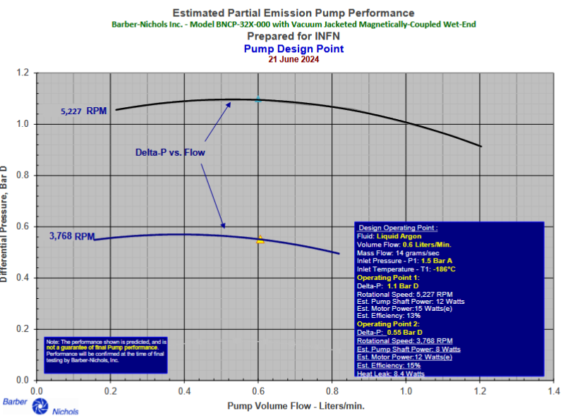
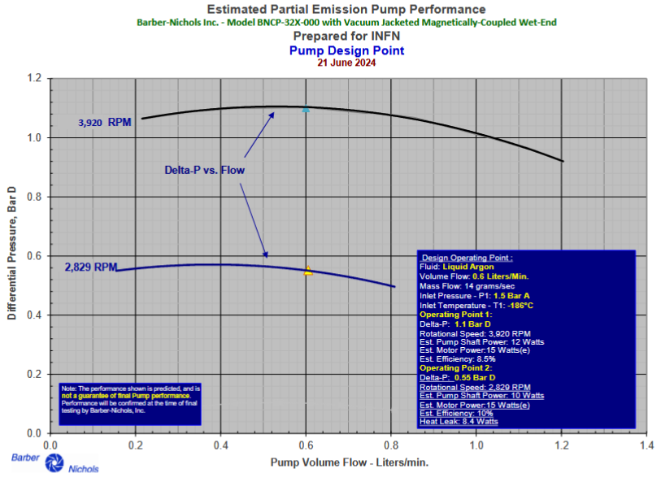
Proximity cryogenics system
An alternative pump was proposed by Barber Nichols:
Higher speed, higher efficiency slower speed, longer bearing life
8 m

Slide 21
Proximity cryogenics system
PURIFICATION FILTERS
Made of molecular sieve (sintered disk) and small spheres of Al2O3 coated with Cu
One purifier for the filling and two in parallel for the recirculation
In order to dismount and regenerate the filters there will be placed a CF flange and a manual shut-off valve on both sides;
in this way the filter can be removed and installed, preventing air from entering.

Slide 22
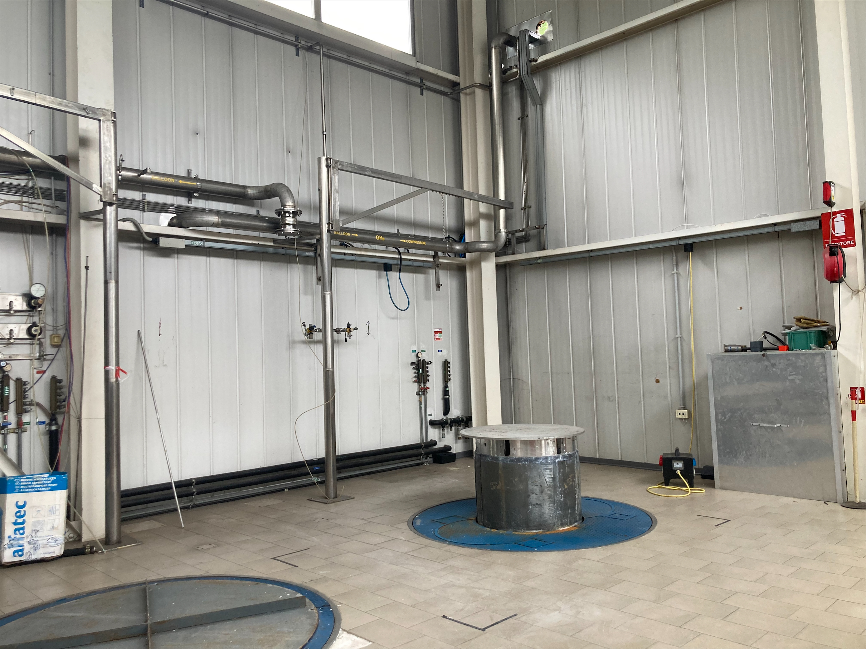
Facility test LNL: lab refurbishment

Slide 23
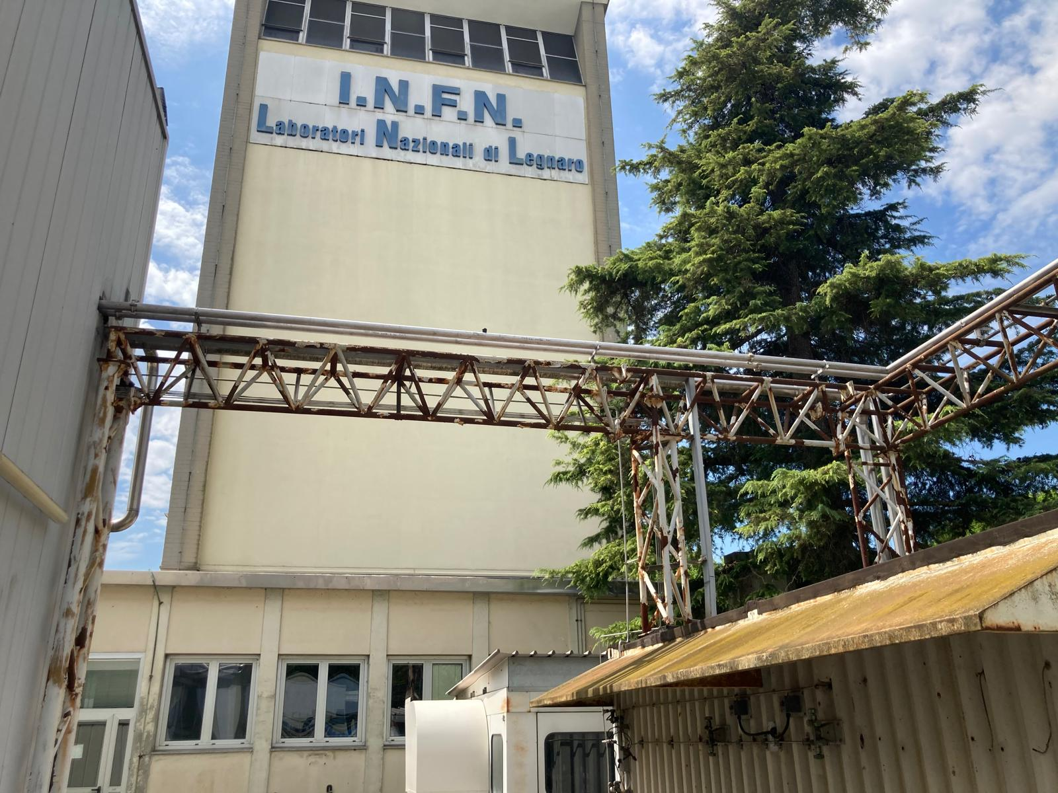
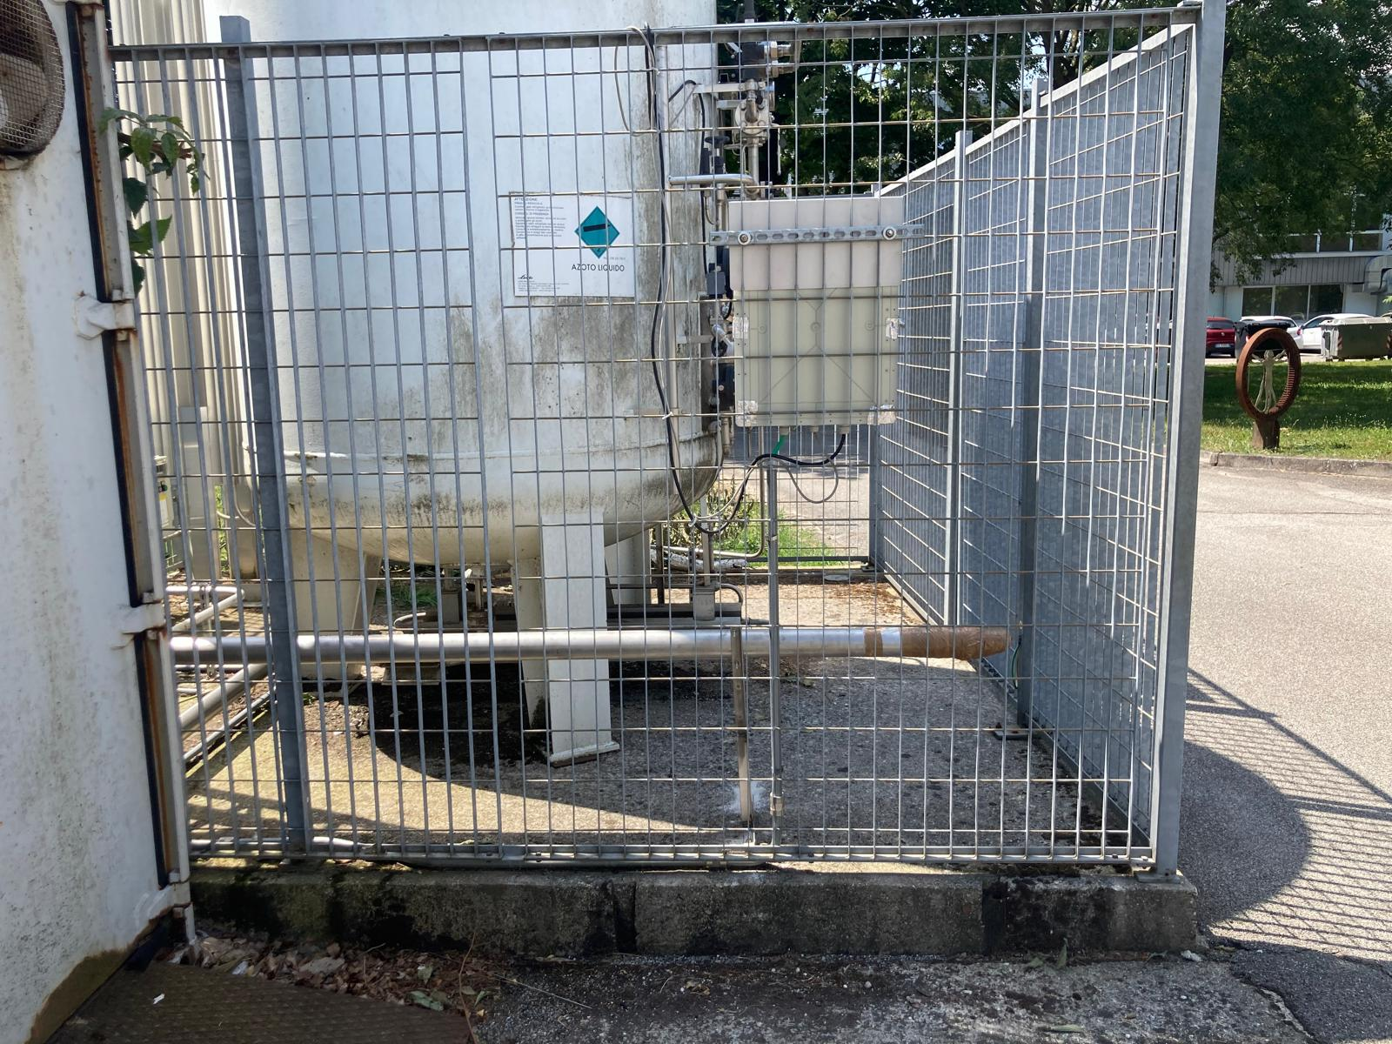
Facility test LNL
Refurbishment of new transfer lines almost completed

Slide 24
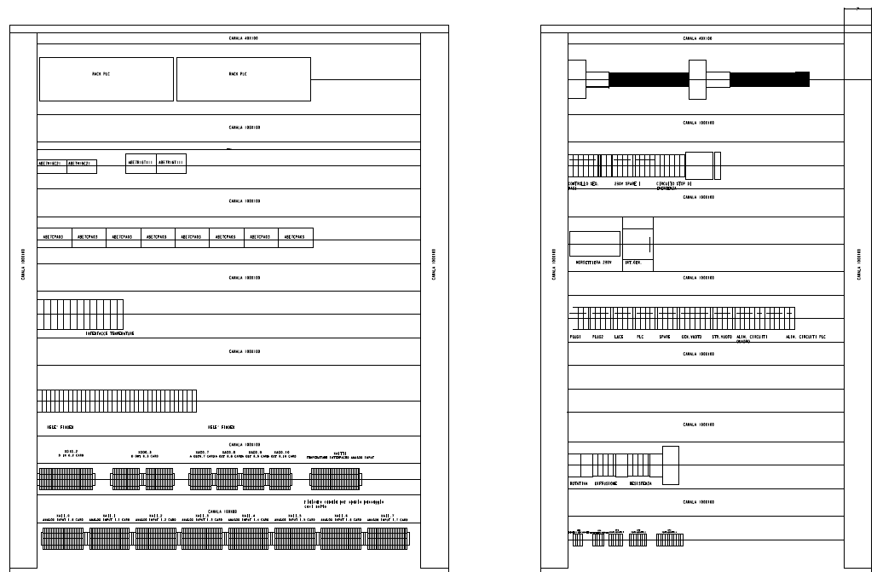
Facility test LNL
The project has been completed with the help of LNL cryogenic division staff, and all the material has been delivered to LNL.
Analog Input: 52
Analog Output: 21
Digital Input: 14
Digital Output: 9
Plus some spares

Slide 25
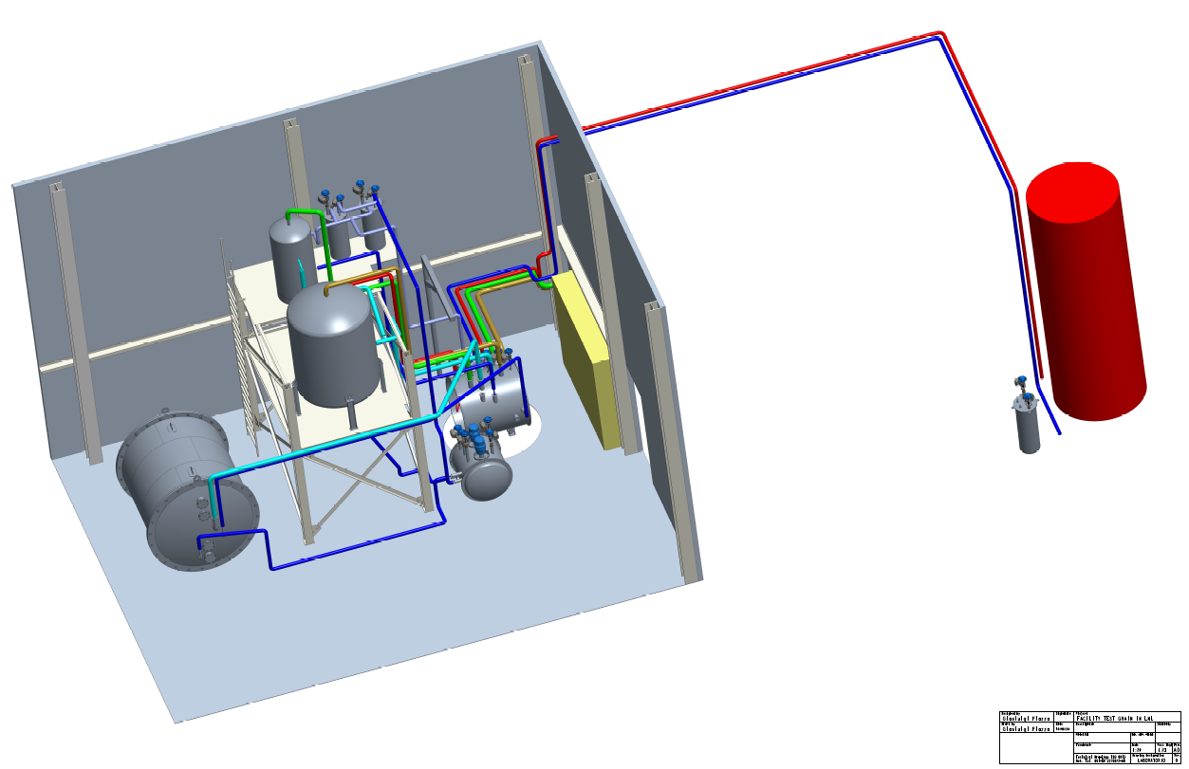
Facility test LNL

Slide 26
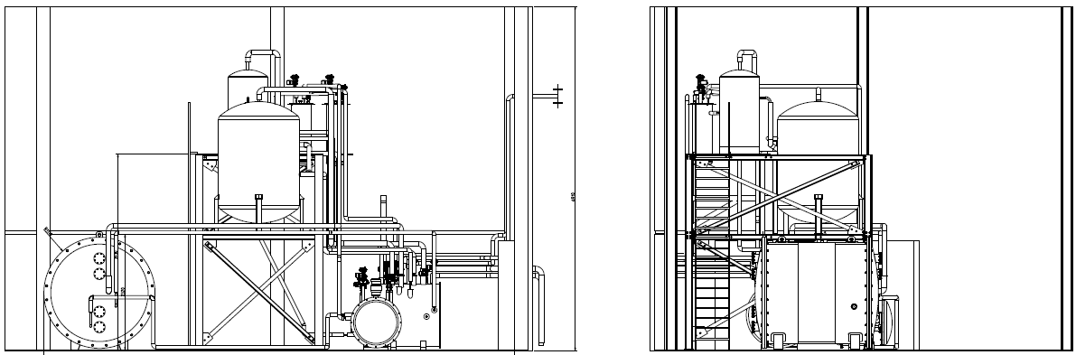
Facility test LNL

Slide 27
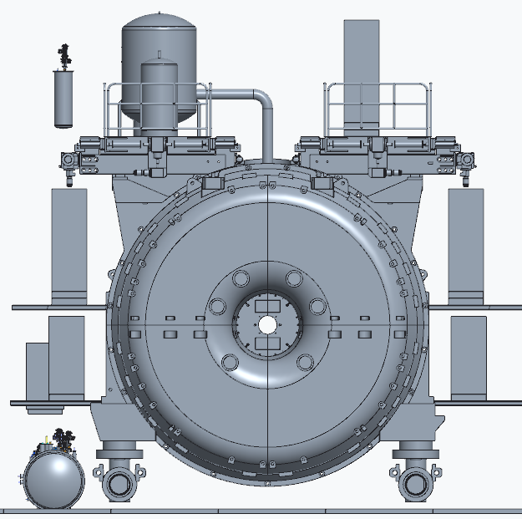
Layout in SAND
Recondenser
Phase separator
Purification
filters
More studies have to be done
Valve box
pumps

Slide 28
In conclusion
Tender for proximity cryogenics to be prepared.
Three companies are interested: Criotec, Demaco and Simic
In November we should receive the quote.
We plan to do the tender in one year and the installation will be completed by the end of 2026.
The tender of the inner vessel postponed to the beginning of 2025

